Slide 1
CSCI-1680
Transport Layer II
Rodrigo Fonseca
Based partly on lecture notes by David Mazières, Phil Levis, John Jannotti

Slide 2
Tuesday: Midterm
TCP Assignment out on Sunday

Slide 3
Last Class
Introduction to TCP
  Header format
  Connection state diagram
Today: sending data

Slide 4
First Goal
We should not send more data than the receiver can take: flow control
Data is sent in MSS-sized segments
  Chosen to avoid fragmentation
Sender can delay sends to get larger segments
When to send data?
How much data to send?

Slide 5
Flow Control
Part of TCP specification (even before 1988)
Goal: not sent more data than the receiver can handle
Sliding window protocol
Receiver uses window header field to tell sender how much space it has

Slide 6
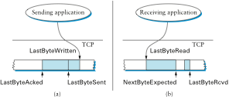
Flow Control
Receiver: AdvertisedWindow
= MaxRcvBuffer – ((NextByteExpected-1) – LastByteRead)
Sender: LastByteSent – LastByteAcked <= AdvertisedWindow
EffectiveWindow = AdvertisedWindow – (BytesInFlight)
LastByteWritten – LastByteAcked <= MaxSendBuffer

Slide 7
Flow Control
Advertised window can fall to 0
  How?
  Sender eventually stops sending, blocks application
Sender keeps sending 1-byte segments until window comes back > 0

Slide 8
When to Transmit?
Nagle’s algorithm
Goal: reduce the overhead of small packets
  If available data and window >= MSS
  Send a MSS segment
  else
  If there is unAcked data in flight
  buffer the new data until ACK arrives
  else
  send all the new data now
Receiver should avoid advertising a window <= MSS after advertising a window of 0

Slide 9
Delayed Acknowledgments
Goal: Piggy-back ACKs on data
  Delay ACK for 200ms in case application sends data
  If more data received, immediately ACK second segment
  Note: never delay duplicate ACKs (if missing a segment)
Warning: can interact very badly with Nagle
  Temporary deadlock
  Can disable Nagle with TCP_NODELAY
  Application can also avoid many small writes

Slide 10
Limitations of Flow Control
Network may be the bottleneck
Signal from receiver not enough!
Sending too fast will cause queue overflows, heavy packet loss
Flow control provides correctness
Need more for performance: congestion control

Slide 11
A Short History of TCP
1974: 3-way handshake
1978: IP and TCP split
1983: January 1st, ARPAnet switches to TCP/IP
1984: Nagle predicts congestion collapses
1986: Internet begins to suffer congestion collapses
  LBL to Berkeley drops from 32Kbps to 40bps
1987/8: Van Jacobson fixes TCP, publishes seminal paper: (TCP Tahoe)
1990: Fast transmit and fast recovery added (TCP Reno)

Slide 12
Second goal
We should not send more data than the network can take: congestion control

Slide 13
TCP Congestion Control
3 Key Challenges
  Determining the available capacity in the first place
  Adjusting to changes in the available capacity
  Sharing capacity between flows
Idea
  Each source determines network capacity for itself
  Rate is determined by window size
  Uses implicit feedback (drops, delay)
  ACKs pace transmission (self-clocking)

Slide 14
Dealing with Congestion
TCP keeps congestion and flow control windows
  Max packets in flight is lesser of two
Sending rate: ~Window/RTT
The key here is how to set the congestion window to respond to congestion signals

Slide 15
Starting Up
Before TCP Tahoe
  On connection, nodes send full (rcv)window of packets
  Retransmit packet immediately after its timer expires
Result: window-sized bursts of packets in network

Slide 16
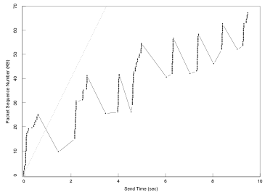
Bursts of Packets
Graph from Van Jacobson and Karels, 1988

Slide 17
Determining Initial Capacity
Question: how do we set w initially?
  Should start at 1MSS (to avoid overloading the network)
  Could increase additively until we hit congestion
  May be too slow on fast network
Start by doubling w each RTT
  Then will dump at most one extra window into network
  This is called slow start
Slow start, this sounds quite fast!
  In contrast to initial algorithm: sender would dump entire flow control window at once

Slide 18
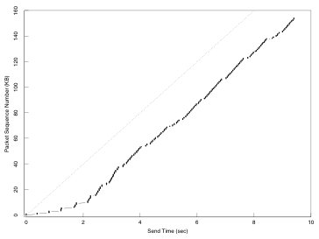
Startup behavior with Slow Start

Slide 19
Slow start implementation
Let w be the size of the window in bytes
  We have w/MSS segments per RTT
We are doubling w after each RTT
  We receive w/MSS ACKs each RTT
  So we can set w = w + MSS on every ack
At some point we hit the network limit.
  Experience loss
  We are at most one window size above the limit
  Remember this: ssthresh and reduce window
Notes:
For each w/MSS ACKs in one RTT, we want to increase w/(w/MSS) = MSS

Slide 20
Dealing with Congestion
Assume losses are due to congestion
After a loss, reduce congestion window
  How much to reduce?
Idea: conservation of packets at equilibrium
  Want to keep roughly the same number of packets network
  Analogy with water in fixed-size pipe
  Put new packet into network when one exits

Slide 21
How much to reduce window?
Crude model of the network
  Let L_{i} be the load (# pkts) in the network at time I
  If network uncongested, roughly constant L_{i} = N
What happens under congestion?
  Some fraction γ of packets can’t exit the network
  Now L_{i} = N + γL_{i-1}, or L_{i} ≈ g^{i}L₀
  Exponential increase in congestion
Sources must decrease offered rate exponentially
  i.e, multiplicative decrease in window size
  TCP chooses to cut window in half

Slide 22
How to use extra capacity?
Network signals congestion, but says nothing of underutilization
  Senders constantly try to send faster, see if it works
  So, increase window if no losses… By how much?
Multiplicative increase?
  Easier to saturate the network than to recover
  Too fast, will lead to saturation, wild fluctuations
Additive increase?
  Won’t saturate the network
  Remember fairness?

Slide 23
Chiu Jain Phase Plots
Fair: A = B
Flow Rate B
Goal: fair and efficient!
Efficient: A+B = C
Flow Rate A

Slide 24
Chiu Jain Phase Plots
Fair: A = B
MI
MD
Flow Rate B
Efficient: A+B = C
Flow Rate A

Slide 25
Chiu Jain Phase Plots
Fair: A = B
AI
AD
Flow Rate B
Efficient: A+B = C
Flow Rate A

Slide 26
Chiu Jain Phase Plots
Fair: A = B
AI
MD
Flow Rate B
Efficient: A+B = C
Flow Rate A

Slide 27
AIMD Implementation
In practice, send MSS-sized segments
  Let window size in bytes be w (a multiple of MSS)
Increase:
  After w bytes ACKed, could set w = w + MSS
  Smoother to increment on each ACK
    w = w + MSS * MSS/w
    (receive w/MSS ACKs per RTT, increase by MSS/(w/MSS) for each)
Decrease:
  After a packet loss, w = w/2
  But don’t want w < MSS
  So react differently to multiple consecutive losses
  Back off exponentially (pause with no packets in flight)

Slide 28
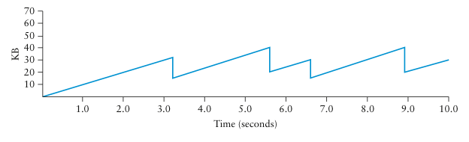
AIMD Trace
AIMD produces sawtooth pattern of window size
  Always probing available bandwidth

Slide 29
Putting it together
TCP has two states: Slow Start (SS) and Congestion Avoidance (CA)
A window size threshold governs the state transition
  Window <= threshold: SS
  Window > threshold: congestion avoidance
States differ in how they respond to ACKs
  Slow start: w = w + MSS
  Congestion Avoidance: w = w + MSS²/w (1 MSS per RTT)
On loss event: set w = 1, slow start

Slide 30
How to Detect Loss
Timeout
Any other way?
  Gap in sequence numbers at receiver
  Receiver uses cumulative ACKs: drops => duplicate ACKs
3 Duplicate ACKs considered loss

Slide 31
Putting it all together
cwnd
Timeout
Timeout
AIMD
AIMD
ssthresh
Slow
Start
Slow
Start
Slow
Start
Time

Slide 32
RTT
We want an estimate of RTT so we can know a packet was likely lost, and not just delayed
Key for correct operation
Challenge: RTT can be highly variable
  Both at long and short time scales!
Both average and variance increase a lot with load
Solution
  Use exponentially weighted moving average (EWMA)
  Estimate deviation as well as expected value
  Assume packet is lost when time is well beyond reasonable deviation

Slide 33
Originally
EstRTT = (1 – α) × EstRTT + α × SampleRTT
Timeout = 2 × EstRTT
Problem 1:
  in case of retransmission, ack corresponds to which send?
  Solution: only sample for segments with no retransmission
Problem 2:
  does not take variance into account: too aggressive when there is more load!

Slide 34
Jacobson/Karels Algorithm (Tahoe)
EstRTT = (1 – α) × EstRTT + α × SampleRTT
  Recommended α is 0.125
DevRTT = (1 – β) × DevRTT + β | SampleRTT – EstRTT |
  Recommended β is 0.25
Timeout = EstRTT + 4 DevRTT
For successive retransmissions: use exponential backoff

Slide 35
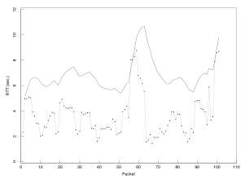
Old RTT Estimation

Slide 36
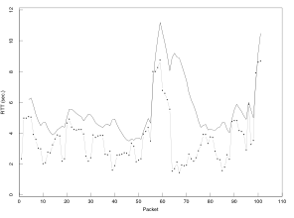
Tahoe RTT Estimation

Slide 37
Slow start every time?!
Losses have large effect on throughput
Fast Recovery (TCP Reno)
  Same as TCP Tahoe on Timeout: w = 1, slow start
  On triple duplicate ACKs: w = w/2
  Retransmit missing segment (fast retransmit)
  Stay in Congestion Avoidance mode

Slide 38
Fast Recovery and Fast Retransmit
cwnd
AI/MD
Slow Start
Fast retransmit
Time

Slide 39
3 Challenges Revisited
Determining the available capacity in the first place
  Exponential increase in congestion window
Adjusting to changes in the available capacity
  Slow probing, AIMD
Sharing capacity between flows
  AIMD
Detecting Congestion
  Timeout based on RTT
  Triple duplicate acknowledgments
Fast retransmit/Fast recovery
  Reduces slow starts, timeouts

Slide 40
Next Thursday
More Congestion Control fun
Cheating on TCP
TCP on extreme conditions
TCP Friendliness
TCP Future
Good luck with the midterm!

