Slide 1
CSCI-1680
Network Layer:
Inter-domain Routing
Rodrigo Fonseca
Based partly on lecture notes by Rob Sherwood, David Mazières, Phil Levis, John Jannotti

Slide 2
Administrivia
Midterm moved up from 3/17 to 3/15
IP due on Friday

Slide 3
Today
Last time: Intra-Domain Routing (IGP)
  RIP distance vector
  OSPF link state
Inter-Domain Routing (EGP)
  Border Gateway Protocol
  Path-vector routing protocol

Slide 4
Why Inter vs. Intra
Why not just use OSPF everywhere?
  E.g., hierarchies of OSPF areas?
  Hint: scaling is not the only limitation
BGP is a policy control and information hiding protocol
  intra == trusted, inter == untrusted
  Different policies by different ASs
  Different costs by different ASs

Slide 5
Types of ASs
Local Traffic – source or destination in local AS
Transit Traffic – passes through an AS
Stub AS
  Connects to only a single other AS
Multihomed AS
  Connects to multiple ASs
  Carries no transit traffic
Transit AS
  Connects to multiple ASs and carries transit traffic

Slide 6
AS Relationships
B
X
A
Z
C
Y
How to prevent X from forwarding transit between B and C?
How to avoid transit between CBA ?
  B: BAZ -> X
  B: BAZ -> C ? (=> Y: CBAZ and Y:CAZ)
Example from Kurose and Ross, 5th Ed

Slide 7
Choice of Routing Algorithm
Constraints
  Scaling
  Autonomy (policy and privacy)
Link-state?
  Requires sharing of complete information
  Information exchange does not scale
  Can’t express policy
Distance Vector?
  Scales and retains privacy
  Can’t implement policy
  Can’t avoid loops if shortest path not taken
  Count-to-infinity

Slide 8
Path Vector Protocol
Distance vector algorithm with extra information
  For each route, store the complete path (ASs)
  No extra computation, just extra storage (and traffic)
Advantages
  Can make policy choices based on set of ASs in path
  Can easily avoid loops

Slide 9
BGP - High Level
Single EGP protocol in use today
Abstract each AS to a single node
Destinations are CIDR prefixes
Exchange prefix reachability with all neighbors
  E.g., “I can reach prefix 128.148.0.0/16 through ASes 44444 3356 14325 11078”
Select a single path by routing policy
Critical: learn many paths, propagate one
  Add your ASN to advertised path

Slide 10
Why study BGP?
Critical protocol: makes the Internet run
  Only widely deployed EGP
Active area of problems!
  Efficiency
  Cogent vs. Level3: Internet Partition
  Spammers use prefix hijacking
  Pakistan accidentally took down YouTube
  Egypt disconnected for 5 days

Slide 11
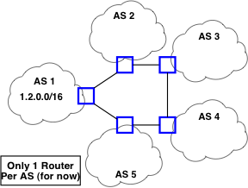
BGP Example

Slide 12
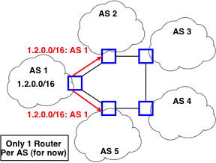
BGP Example

Slide 13
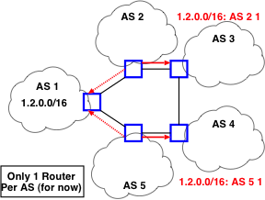
BGP Example

Slide 14
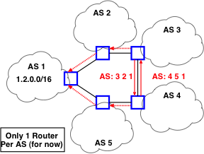
BGP Example

Slide 15
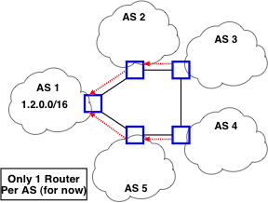
BGP Example

Slide 16
BGP Protocol Details
Separate roles of speakers and gateways
  Speakers talk BGP with other ASs
  Gateways are routes that border other Ass
  Can have more gateways than speakers
  Speakers know how to reach gateways
Speakers connect over TCP on port 179
  Bidirectional exchange over long-lived connection

Slide 17
BGP Implications
Explicit AS Path == Loop free
  Except under churn, IGP/EGP mismatch
Reachability not guaranteed
  Decentralized combination of policies
Not all ASs know all paths
AS abstraction -> loss of efficiency
Scaling
  37K ASs
  350K+ prefixes
  ASs with one prefix: 15664
  Most prefixes by one AS: 3686 (AS6389, BellSouth)

Slide 18
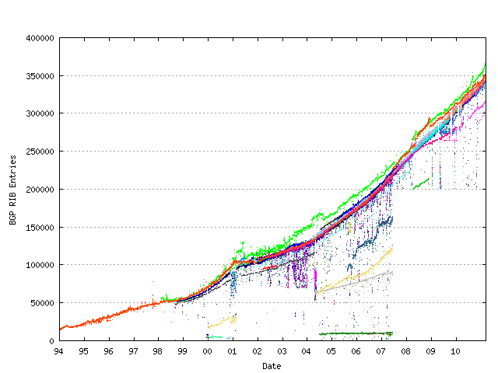
BGP Table Growth
Source: bgp.potaroo.net

Slide 19
Integrating EGP and IGP
Stub ASs
  Border router clear choice for default route
  Inject into IGP: “any unknown route to border router”
Inject specific prefixes in IGP
  E.g., Provider injects routes to customer prefix
Backbone networks
  Too many prefixes for IGP
  Run internal version of BGP, iBGP
  All routers learn mappings: Prefix -> Border Router
  Use IGP to learn: Border Router -> Next Hop

Slide 20
iBGP

Slide 21
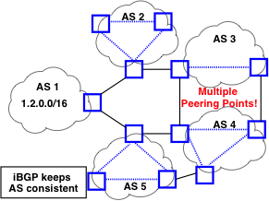
iBGP

Slide 22
BGP Messages
Base protocol has four message types
  OPEN – Initialize connection. Identifies peers and must be first message in each direction
  UPDATE – Announce routing changes (most important message)
  NOTIFICATION – Announce error when closing connection
  KEEPALIVE – Make sure peer is alive
Extensions can define more message types
  E.g., ROUTE-REFRESH [RFC 2918]

Slide 23
Anatomy of an UPDATE
Withdrawn routes: list of withdrawn IP prefixes
Network Layer Reachability Information (NLRI)
  List of prefixes to which path attributes apply
Path attributes
  ORIGIN, AS_PATH, NEXT_HOP, MULTI-EXIT-DISC, LOCAL_PREF, ATOMIC_AGGREGATE, AGGREGATOR, …
  Each attribute has 1-byte type, 1-byte flags, length, content
  Can introduce new types of path attribute – e.g., AS4_PATH for 32-bit AS numbers

Slide 24
Example
NLRI: 128.148.0.0/16
AS Path: ASN 44444 3356 14325 11078
Next Hop IP: same as in RIPv2
Knobs for traffic engineering:
  Metric, weight, LocalPath, MED, Communities
  Lots of voodoo

Slide 25
BGP State
BGP speaker conceptually maintains 3 sets of state
Adj-RIB-In
  “Adjacent Routing Information Base, Incoming”
  Unprocessed routes learned from other BGP speakers
Loc-RIB
  Contains routes from Adj-RIB-In selected by policy
  First hop of route must be reachable by IGP or static route
Adj-RIB-Out
  Subset of Loc-RIB to be advertised to peer speakers

Slide 26
Demo
Route views project: http://www.routeviews.org
  telnet route-views.linx.routeviews.org
  show ip bgp 128.148.0.0/16 longer-prefixes
All path are learned internally (iBGP)
Not a production device

Slide 27
Route Selection
More specific prefix
Next-hop reachable?
Prefer highest weight
  Computed using some AS-specific local policy
Prefer highest local-pref
Prefer locally originated routes
Prefer routes with shortest AS path length
Prefer eBGP over iBGP
Prefer routes with lowest cost to egress point
  Hot-potato routing
Tie-breaking rules
  E.g., oldest route, lowest router-id

Slide 28
Customer/Provider AS relationships
Customer pays for connectivity
  E.g. Brown contracts with OSHEAN
  Customer is stub, provider is a transit
Many customers are multi-homed
  E.g., OSHEAN connects to Level3, Cogent
Typical policy: prefer routes from customers

Slide 29
Peer Relationships
ASs agree to exchange traffic for free
  Penalties/Renegotiate if imbalance
Tier 1 ISPs have no default route: all peer with each other
You are Tier i + 1 if you have a default route to a Tier i

Slide 30
Peering Drama
Cogent vs. Level3 were peers
In 2003, Level3 decided to start charging Cogent
Cogent said no
Internet partition: Cogent’s customers couldn’t get to Level3’s customers and vice-versa
  Other ISPs were affected as well
Took 3 weeks to reach an undisclosed agreement

Slide 31
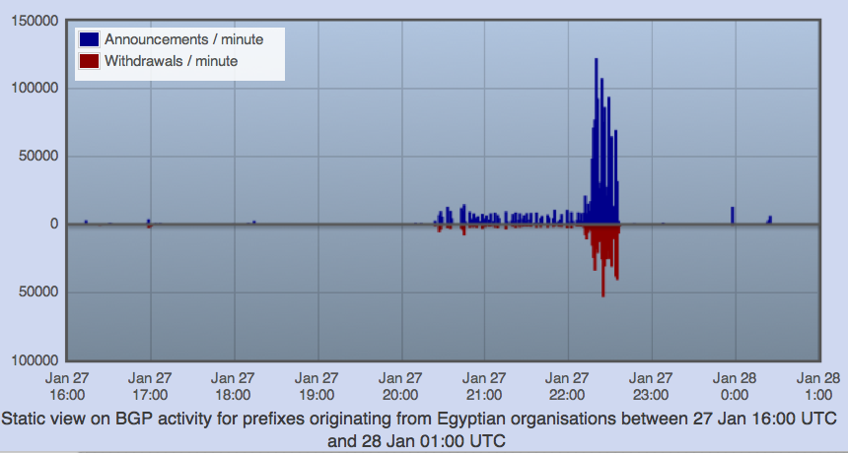
“Shutting off” the Internet
Starting from Jan 27th, 2011, Egypt was disconnected from the Internet
  2769/2903 networks withdrawn from BGP (95%!
Source: RIPEStat - http://stat.ripe.net/egypt/

Slide 32
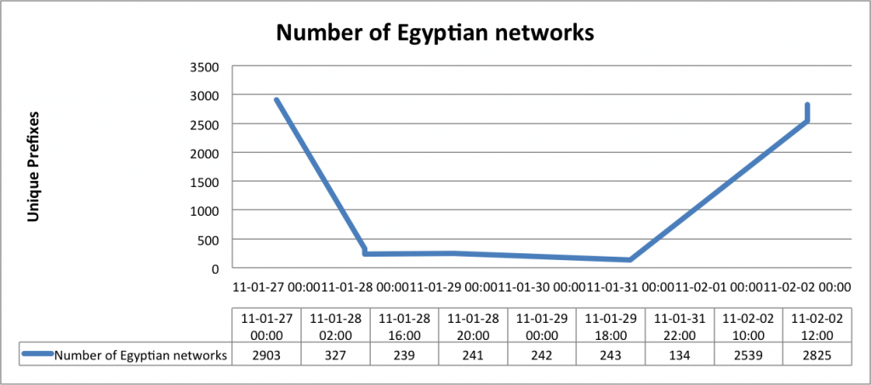
Egypt Incident
Source: BGPMon (http://bgpmon.net/blog/?p=480)

Slide 33
Some BGP Challenges
Convergence
Scaling (route reflectors)
Traffic engineering
  How to assure certain routes are selected
Security

Slide 34
Convergence
Given a change, how long until the network re-stabilizes?
  Depends on change: sometimes never
  Open research problem: “tweak and pray”
  Distributed setting is challenging
Easier: is there a stable configuration?
  Distributed: open research problem
  Centralized: NP-Complete problem!
  Multiple stable solutions given policies (e.g. “Wedgies”, RFC 4264)

Slide 35
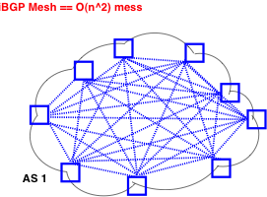
Scaling iBGP: route reflectors

Slide 36
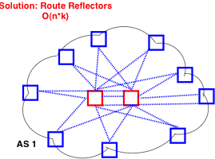
Scaling iBGP: route reflectors

Slide 37
Route Engineering
Route filtering
Setting weights
More specific routes: longest prefix
AS prepending: “477 477 477 477”
More of an art than science

Slide 38
BGP Security
Anyone can source a prefix announcement!
  To say BGP is insecure is an understatement ☺
Pakistan Youtube incident
  Youtube’s has prefix 208.65.152.0/22
  Pakistan’s government order Youtube blocked
  Pakistan Telecom (AS 17557) announces 208.65.153.0/24 in the wrong direction (outwards!)
  Longest prefix match caused worldwide outage
http://www.youtube.com/watch?v=IzLPKuAOe50

Slide 39
Many other incidents
Spammers steal unused IP space to hide
  Announce very short prefixes
  For a short amount of time
China incident, April 8th 2010
  China Telecom’s AS23724 generally announces 40 prefixes
  On April 8th, announced ~37,000 prefixes
  About 10% leaked outside of China
  Suddenly, going to www.dell.com might have you routing through AS23724!
Secure BGP is in the works

Slide 40
BGP Recap
Key protocol that holds Internet routing together
Path Vector Protocol among Autonomous Systems
Policy, feasibility first; non-optimal routes
Important security problems

Slide 41
Next Lecture
Network layer wrap-up
  IPv6
  Multicast
  MPLS
Next Chapter: Transport Layer (UDP, TCP,…)

