Slide 1
CSCI-1680
Link Layer
Rodrigo Fonseca
Based partly on lecture notes by David Mazières, Phil Levis, John Jannotti

Slide 2
Administrivia
Where are the policy forms?
Snowcast due on Friday
Homework I out on Thursday
GitHub
  brown-csci1680 organization
  Private repositories for each group

Slide 3
Today
Previously…
  Physical Layer
    Encoding
    Modulation
  Link Layer
    Framing
Link Layer
  Error Detection
  Reliability
  Media Access
  Ethernet
  Token Ring

Slide 4
Error Detection
Idea: add redundant information to catch errors in packet
Used in multiple layers
Three examples:
  Parity
  Internet Checksum
  CRC

Slide 5
Simplest Schemes
Repeat frame
  High overhead
  Can’t correct error
Parity
  Can detect odd number of bit errors
  No correction

Slide 6

2-D Parity
Add 1 parity bit for each 7 bits
Add 1 parity bit for each bit position across the frame)
  Can correct single-bit errors
  Can detect 2- and 3-bit errors, most 4-bit errors

Slide 7
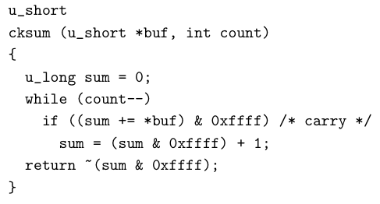
IP Checksum
Fixed-length code
  n-bit code should capture all but 2^{-n} fraction of errors
  But want to make sure that includes all common errors
Example: IP Checksum

Slide 8
How good is it?
16 bits not very long: misses 1/64K errors
Checksum does catch any 1-bit error
But not any 2-bit error
  E.g., increment word ending in 0, decrement one ending in 1
Checksum also optional in UDP
  All 0s means no checksums calculated
  If checksum word gets wiped to 0 as part of error, bad news

Slide 9
CRC – Error Detection with Polynomials
Consider message to be a polynomial in Z₂[x]
  Each bit is one coefficient
  E.g., message 10101001 -> m(x) = x⁷ + x⁵+ x³ + 1
Can reduce one polynomial modulo another
  Let n(x) = m(x)x³. Let C(x) = x³ + x² + 1
  Find q(x) and r(x) s.t. n(x) = q(x)C(x) + r(x) and degree of r(x) < degree of C(x)
  Analogous to taking 11 mod 5 = 1

Slide 10
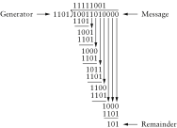
Polynomial Division Example
Just long division, but addition/subtraction is XOR

Slide 11
CRC
Select a divisor polynomial C(x), degree k
  C(x) should be irreducible – not expressible as a product of two lower-degree polynomials in Z₂[x]
Add k bits to message
  Let n(x) = m(x)x^{k} (add k 0’s to m)
  Compute r(x) = n(x) mod C(x)
  Compute n(x) = n(x) – r(x) (will be divisible by C(x)) (subtraction is XOR, just set k lowest bits to r(x)!)
Checking CRC is easy
  Reduce message by C(x), make sure remainder is 0

Slide 12
Why is this good?
Suppose you send m(x), recipient gets m’(x)
  E(x) = m’(x) – m(x) (all the incorrect bits)
  If CRC passes, C(x) divides m’(x)
  Therefore, C(x) must divide E(x)
Choose C(x) that doesn’t divide any common errors!
  All single-bit errors caught if x^{k}, x⁰ coefficients in C(x) are 1
  All 2-bit errors caught if at least 3 terms in C(x)
  Any odd number of errors if last two terms (x + 1)
  Any error burst less than length k caught

Slide 13
Common CRC Polynomials
CRC-8: x⁸ + x² + x¹ + 1
CRC-16: x¹⁶ + x¹⁵ + x² + x¹
CRC-32: x³² + x²⁶ + x²³ + x²² + x¹⁶ + x¹² + x¹¹ + x¹⁰ + x⁸ + x⁷ + x⁵ + x⁴ + x² + x¹ + 1
CRC easily computable in hardware

Slide 14
Reliable Delivery
Error detection can discard bad packets
Problem: if bad packets are lost, how can we ensure reliable delivery?
  Exactly-once semantics = at least once + at most once

Slide 15
At Least Once Semantics
How can the sender know packet arrived at least once?
  Acknowledgments + Timeout
Stop and Wait Protocol
  S: Send packet, wait
  R: Receive packet, send ACK
  S: Receive ACK, send next packet
  S: No ACK, timeout and retransmit

Slide 16
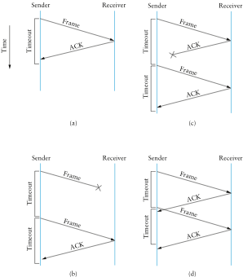

Slide 17
Stop and Wait Problems
Duplicate data
Duplicate acks
Can’t fill pipe (remember bandwitdh-delay product)
Difficult to set the timeout value

Slide 18
At Most Once Semantics
How to avoid duplicates?
  Uniquely identify each packet
  Have receiver and sender remember
Stop and Wait: add 1 bit to the header
  Why is it enough?

Slide 19
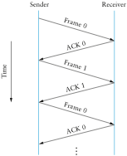

Slide 20
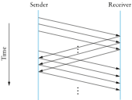
Sliding Window Protocol
Still have the problem of keeping pipe full
  Generalize approach with > 1-bit counter
  Allow multiple outstanding (unACKed) frames
  Upper bound on unACKed frames, called window

Slide 21

Sliding Window Sender
Assign sequence number (SeqNum) to each frame
Maintain three state variables
  send window size (SWS)
  last acknowledgment received (LAR)
  last frame send (LFS)
Maintain invariant: LFS – LAR ≤ SWS
Advance LAR when ACK arrives
Buffer up to SWS frames

Slide 22

Sliding Window Receiver
Maintain three state variables:
  receive window size (RWS)
  largest acceptable frame (LAF)
  last frame received (LFR)
Maintain invariant: LAF – LFR ≤ RWS
Frame SeqNum arrives:
  if LFR < SeqNum ≤ LAF, accept
  if SeqNum ≤ LFR or SeqNum > LAF, discard
Send cumulative ACKs
Notes:
How to set SWS?
How to set RWS?
What is this accomplishing? Reliability, Ordering, Flow Control

Slide 23
Tuning SW
How big should SWS be?
  “Fill the pipe”
How big should RWS be?
  1 ≤ RWS ≤ SWS
How many distinct sequence numbers needed?
  If RWS = 1, need at least SWS+1
  If RWS = SWS, SWS < (#seqs + 1)/2

Slide 24
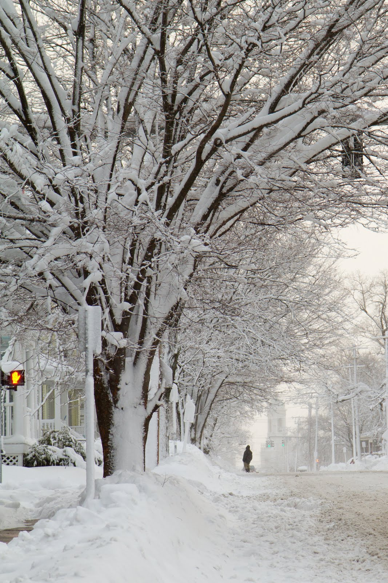

Slide 25

Case Study: Ethernet (802.3)
Dominant wired LAN technology
  10BASE2, 10BASE5 (Vampire Taps)
  10BASET, 100BASE-TX, 1000BASE-T, 10GBASE-T,…
Both Physical and Link Layer specification
CSMA/CD
  Carrier Sense / Multiple Access / Collision Detection
Frame Format (Manchester Encoding):

Slide 26
Ethernet Addressing
Globally unique, 48-bit unicast address per adapter
  Example: 00:1c:43:00:3d:09 (Samsung adapter)
  24 msb: organization
  http://standards.ieee.org/develop/regauth/oui/oui.txt
Broadcast address: all 1s
Multicast address: first bit 1
Adapter can work in promiscuous mode

Slide 27
Media Access Control
Control access to shared physical medium
  E.g., who can talk when?
  If everyone talks at once, no one hears anything
  Job of the Link Layer
Two conflicting goals
  Maximize utilization when one node sending
  Approach 1/N allocation when N nodes sending

Slide 28
Different Approaches
Partitioned Access
  Time Division Multiple Access (TDMA)
  Frequency Division Multiple Access (FDMA)
  Code Division Multiple Access (CDMA)
Random Access
  ALOHA/ Slotted ALOHA
  Carrier Sense Multiple Access / Collision Detection (CSMA/CD)
  Carrier Sense Multiple Access / Collision Avoidance (CSMA/CA)
  RTS/CTS (Request to Send/Clear to Send)
  Token-based

Slide 29
Ethernet MAC
Problem: shared medium
  10Mbps: 2500m, with 4 repeaters at 500m
Transmit algorithm
  If line is idle, transmit immediately
  Upper bound message size of 1500 bytes
  Must wait 9.6μs between back to back frames
  If line is busy: wait until idle and transmit immediately

Slide 30
Handling Collisions
Collision detection (10Base2 Ethernet)
  Uses Manchester encoding
  Constant average voltage unless multiple transmitters
If collision
  Jam for 32 bits, then stop transmitting frame
Collision detection constrains protocol
  Imposes min. packet size (64 bytes or 512 bits)
  Imposes maximum network diameter (2500m)
  Ensure transmission time ≥ 2x propagation delay (why?)

Slide 31
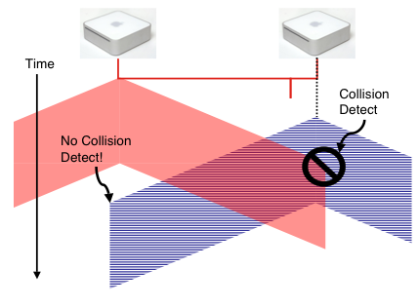
Collision Detection
Without minimum frame length, might not detect collision

Slide 32
When to transmit again?
Delay and try again: exponential backoff
nth time: k × 51.2μs, for k = U{0..2^{min(n,10)}-1}
  1st time: 0 or 51.2μs
  2nd time: 0, 51.2, 102.4, or 153.6μs
Give up after several times (usually 16)

Slide 33
Capture Effect
Exponential backoff leads to self-adaptive use of channel
A and B are trying to transmit, and collide
Both will back off either 0 or 51.2μs
Say A wins.
Next time, collide again.
  A will wait between 0 or 1 slots
  B will wait between 0, 1, 2, or 3 slots
…

Slide 34
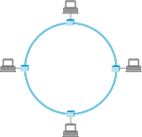
Token Ring
Idea: frames flow around ring
Capture special “token” bit pattern to transmit
Variation used today in Metropolitan Area Networks, with fiber

Slide 35
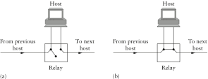
Interface Cards
Problem: if host dies, can break the network
Hardware typically has relays

Slide 36
Token Ring Frames
Frame format (Differential Manchester)
Sender grabs token, sends message(s)
Recipient checks address
Sender removes frame from ring after lap
Maximum holding time: avoid capture
Monitor node reestablishes lost token

Slide 37
Coming Up
Link Layer Switching

