Slide 1
CSCI-1680
Wireless
Rodrigo Fonseca
Based partly on lecture notes by Scott Shenker and John Jannotti

Slide 2
Wireless
Today: wireless networking truly ubiquitous
  802.11, 3G, (4G), WiMAX, Bluetooth, RFID, …
  Sensor networks, Internet of Things
  Some new computers have no wired networking
  4B cellphone subscribers vs. 1B computers
What’s behind the scenes?

Slide 3
Wireless is different
Signals sent by the sender don’t always reach the receiver intact
  Varies with space: attenuation, multipath
  Varies with time: conditions change, interference, mobility
Distributed: sender doesn’t know what happens at receiver
Wireless medium is inherently shared
  No easy way out with switches

Slide 4
Implications
Different mechanisms needed
Physical layer
  Different knobs: antennas, transmission power, encodings
Link Layer
  Distributed medium access protocols
  Topology awareness
Network, Transport Layers
  Routing, forwarding
Most advances do not abstract away the physical and link layers

Slide 5
Physical Layer
Specifies physical medium
  Ethernet: Category 5 cable, 8 wires, twisted pair, R45 jack
  WiFi wireless: 2.4GHz
Specifies the signal
  100BASE-TX: NRZI + MLT-3 encoding
  802.11b: binary and quadrature phase shift keying (BPSK/QPSK)
Specifies the bits
  100BASE-TX: 4B5B encoding
  802.11b @ 1-2Mbps: Barker code (1bit -> 11chips)

Slide 6
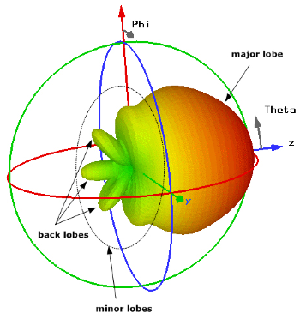
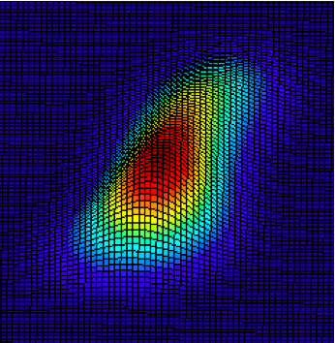
What can happen to signals?
Attenuation
  Signal power attenuates by ~r² factor for omni-directional antennas in free-space
  Exponent depends on type and placement of antennas
    < 2 for directional antennas
    > 2 if antennas are close to the ground

Slide 7
Interference
External sources
  E.g., 2.4GHz unlicensed ISM band
  802.11
  802.15.4 (ZigBee), 802.15.1 (Bluetooth)
  2.4GHz phones
  Microwave ovens
Internal sources
  Nodes in the same network/protocol can (and do) interfere
Multipath
  Self-interference (destructive)

Slide 8
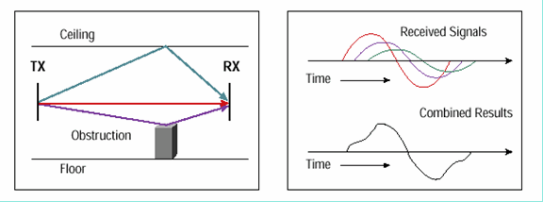
Multipath
May cause attenuation, destructive interference
Picture from Cisco, Inc.

Slide 9
Signal (+ Interference) to Noise Ratio
Remember Shannon?
Shannon-Hartley
C = 2B log₂(M) bits/sec (1)
But noise ruins your party
C = B log₂(1 + S/N) bits/sec (2)
(1) ≤ (2) => M ≤ √1 + S/N
Noise limits your ability to distinguish levels
  For a fixed modulation, increases Bit Error Rate (BER)
Could make signal stronger
  Uses more energy
  Increases interference to other nodes
C – Capacity
B – maximum frequency of signal
M – number of discrete “levels” per symbol

Slide 10
Wireless Modulation/Encoding
More complex than wired
Modulation, Encoding, Frequency
  Frequency: number of symbols per second
  Modulation: number of chips per symbol
    E.g., different phase, frequency, amplitude
  Encoding: number of chips per bit (to counter errors)
Example
  802.11b, 1Msps: 11Mcps, DBPSK, Barker Code
    1 chip per symbol, 11 chips/bit
  802.11b, 2Msps: 22Mcps, DQPSK, Barker Code
    2 chips per symbol, 11 chips/bit
Notes:
DBPSK is differential binary phase shift keying
DQPS

Slide 11
Link Layer
Medium Access Control
  Should give 100% if one user
  Should be efficient and fair if more users
Ethernet uses CSMA/CD
  Can we use CD here?
No! Collision happens at the receiver
Protocols try to avoid collision in the first place

Slide 12
Hidden Terminals
B
A
C
A can hear B and C
B and C can’t hear each other
They both interfere at A
B is a hidden terminal to C, and vice-versa
Carrier sense at sender is useless

Slide 13
Exposed Terminals
B
A
C
D
A transmits to B
C hears the transmission, backs off, even though D would hear C
C is an exposed terminal to A’s transmission
Why is it still useful for C to do CS?

Slide 14
Key points
No global view of collision
  Different receivers hear different senders
  Different senders reach different receivers
Collisions happen at the receiver
Goals of a MAC protocol
  Detect if receiver can hear sender
  Tell senders who might interfere with receiver to shut up

Slide 15
Simple MAC: CSMA/CA
Maintain a waiting counter c
For each time channel is free, c--
Transmit when c = 0
When a collision is inferred, retransmit with exponential backoff
  Use lack of ACK from receiver to infer collision
  Collisions are expensive: only full packet transmissions
How would we get ACKs if we didn’t do carrier sense?

Slide 16
RTS/CTS
Idea: transmitter can check availability of channel at receiver
Before every transmission
  Sender sends an RTS (Request-to-Send)
  Contains length of data (in time units)
  Receiver sends a CTS (Clear-to-Send)
  Sender sends data
  Receiver sends ACK after transmission
If you don’t hear a CTS, assume collision
If you hear a CTS for someone else, shut up

Slide 17
RTS/CTS
RTS
B
A
C

Slide 18
RTS/CTS
CTS
B
A
C

Slide 19
RTS/CTS
Data
B
A
C

Slide 20
Benefits of RTS/CTS
Solves hidden terminal problem
Does it?
  Control frames can still collide
  E.g., can cause CTS to be lost
  In practice: reduces hidden terminal problem on data packets

Slide 21
Drawbacks of RTS/CTS
Overhead is too large for small packets
  3 packets per packet: RTS/CTS/Data (4-22% for 802.11b)
RTS still goes through CSMA: can be lost
CTS loss causes lengthy retries
33% of IP packets are TCP ACKs
In practice, WiFi doesn’t use RTS/CTS

Slide 22
Other MAC Strategies
Time Division Multiplexing (TDMA)
  Central controller allocates a time slot for each sender
  May be inefficient when not everyone sending
Frequency Division
  Multiplexing two networks on same space
  Nodes with two radios (think graph coloring)
  Different frequency for upload and download

Slide 23
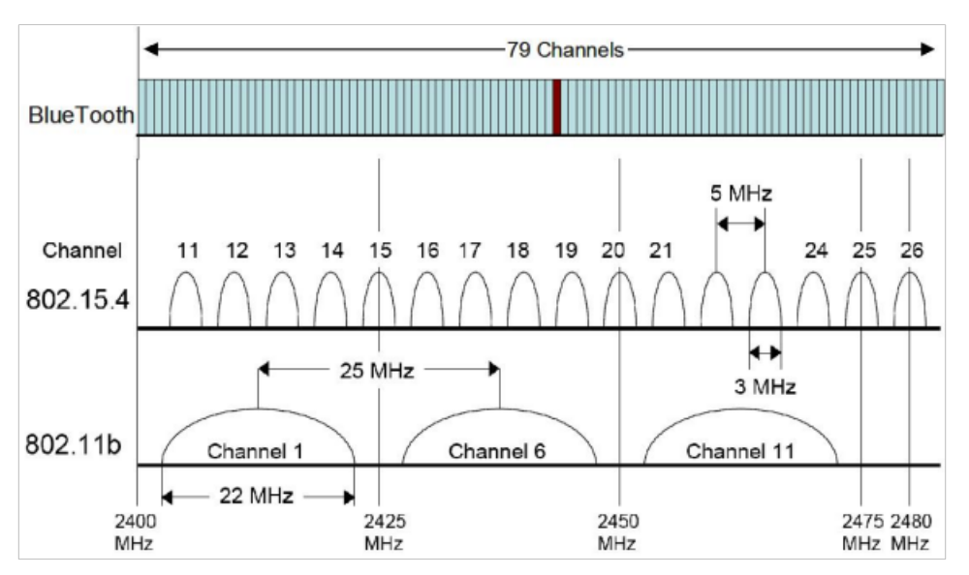
ISM Band Channels

Slide 24
Network Layer
What about the network topology?
Almost everything you use is single hop!
  802.11 in infrastructure mode
  Bluetooth
  Cellular networks
  WiMax (Some 4G networks)
Why?
  Really hard to make multihop wireless efficient

Slide 25
WiFi Distribution System
802.11 typically works in infrastructure mode
  Access points – fixed nodes on wired network
Distribution system connects APs
  Typically connect to the same Ethernet, use learning bridge to route to nodes’ MAC addresses
Association
  Node negotiates with AP to get access
  Security negotiated as well (WEP, WPA, etc)
  Passive or active
Notes:
In passive mode the client waits for periodic beacons, in active mode the client sends probes, which APs respond to.

Slide 26
Wireless Multi-Hop Networks
Some networks are multihop, though!
  Ad-hoc networks for emergency areas
  Vehicular Networks
  Sensor Networks
    E.g., infrastructure (e.g., pipelines) monitoring
  Multihop networking to share Internet access
    E.g. NYC Mesh

Slide 27
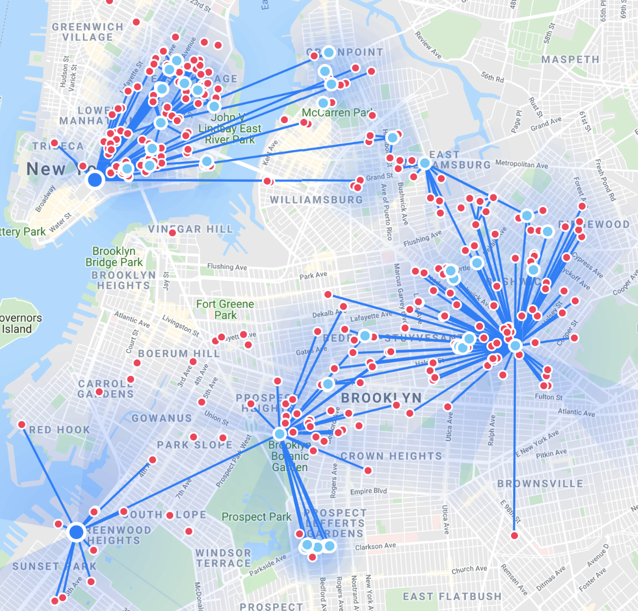
NYC Mesh in 2019 - https://www.nycmesh.net/map/

Slide 28
Many Challenges
Routing
  Link estimation
Multihop throughput dropoff

Slide 29
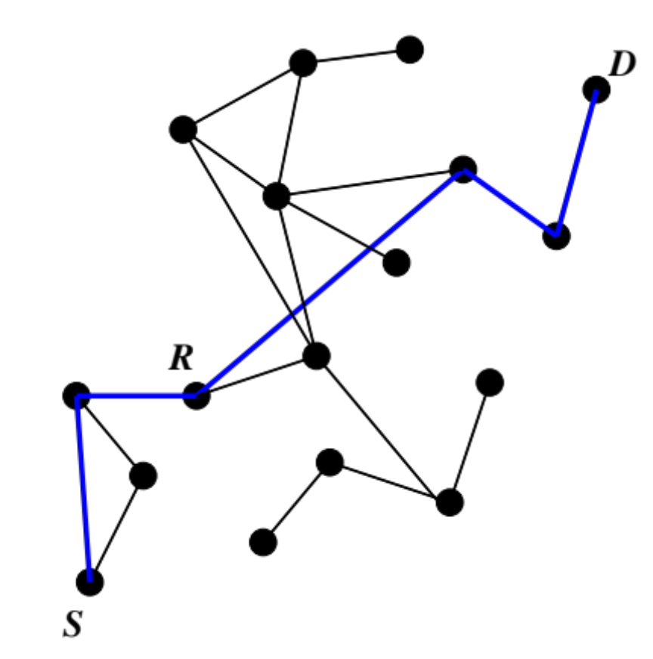
The Routing Problem
Find a route from S to D
Topology can be very dynamic

Slide 30
Routing
Routing in ad-hoc networks has had a lot of research
  General problem: any-to-any routing
  Simplified versions: any-to-one (base station), one-to-any (dissemination)
DV too brittle: inconsistencies can cause loops
DSDV
  Destination Sequenced Distance Vector

Slide 31
DSDV
Charles Perkins (1994)
Avoid loops by using sequence numbers
  Each destination increments own sequence number
    Only use EVEN numbers
  A node selects a new parent if
    Newer sequence number or
    Same sequence number and better route
  If disconnected, a node increments destination sequence number to next ODD number!
  No loops (only transient loops)
  Slow: on some changes, need to wait for root

Slide 32
Many Others
DSR, AODV: on-demand
Geographic routing: use nodes’ physical location and do greedy routing
Virtual coordinates: derive coordinates from topology, use greedy routing
Tree-based routing with on-demand shortcuts
…

Slide 33
Routing Metrics
How to choose between routes?
Hopcount is a poor metric!
  Paths with few hops may use long, marginal links
  Must find a balance
All links do local retransmissions
Idea: use expected transmissions over a link as its cost!
  ETX = 1/(PRR) (Packet Reception Rate)
  Variation: ETT, takes data rate into account

Slide 34
Multihop Throughput
Only every third node can transmit!
  Assuming a node can talk to its immediate neighbors
  (1) Nodes can’t send and receive at the same time
  (2) Third hop transmission prevents second hop from receiving
  (3) Worse if you are doing link-local ACKs
In TCP, problem is worse as data and ACK packets contend for the channel!
Not to mention multiple crossing flows!
Notes:
Draw on the board

Slide 35
Sometimes you can’t (or shouldn’t) hide that you are on wireless!
Three examples of relaxing the layering abstraction

Slide 36
Examples of Breaking Abstractions
TCP over wireless
  Packet losses have a strong impact on TCP performance
  Snoop TCP: hide retransmissions from TCP end-points
  Distinguish congestion from wireless losses

Slide 37
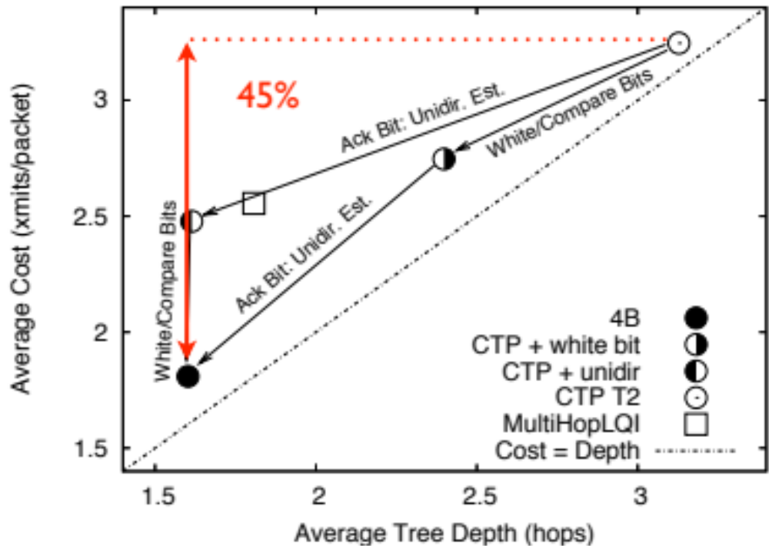
4B Link Estimator
Uses information from Physical, Routing, and Forwarding layers to help estimate link quality
Notes:
The physical layer provides chip recovery data
The routing layer provides link estimation over probes
The forwarding layer provides information from acks and retransmissions

Slide 38
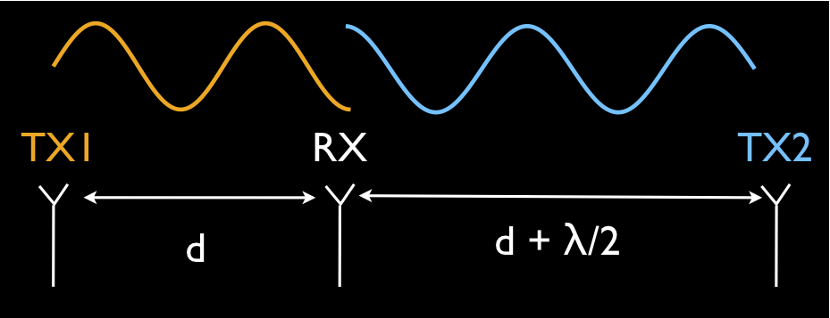
Stanford’s Full Duplex Wireless
Status quo: nodes can’t transmit and receive at the same time
  Why? TX energy much stronger than RX energy
Key insight:
With other tricks, 92% of optimal bandwidth

Slide 39
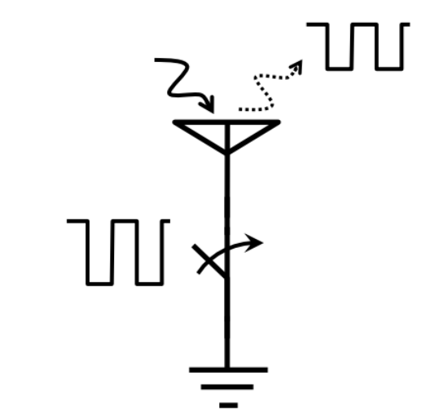
Backscatter
Transmit without generating signals!
  Don’t transmit, reflect!
Flashlight and mirror analogy

Slide 40
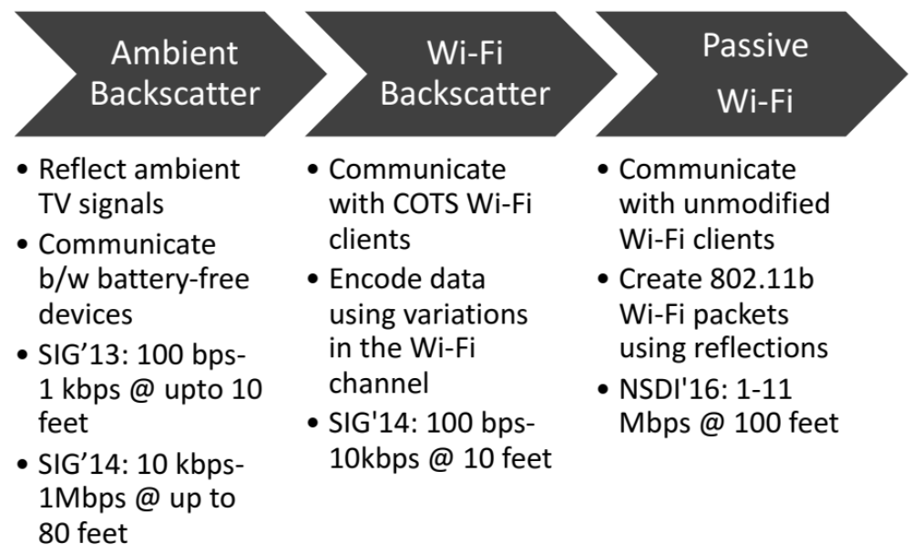
Backscatter
Slide from Vamsi Talla, UW, from Sigcomm Preview Sessions, 2016

Slide 41
Summary
Wireless presents many challenges
  Across all layers
  Encoding/Modulation (we’re doing pretty well here)
  Distributed multiple access problem
  Multihop
Most current protocols sufficient, given over provisioning (good enough syndrome)
Other challenges
  Smooth handoff between technologies (3G, Wifi, 4G…)
  Low-cost, long range wireless for developing regions
  Energy usage

