Slide 1
CSCI-1680
Software-Defined Networking
Rodrigo Fonseca
With content from Scott Shenker, Nick McKeown

Slide 2
SDN
For now: a new paradigm for network management
SDN enables management at cloud scales
  ~1000 engineers at latest Open Networking Summit
  Commercialized, in production use
    Controls Google’s WAN; Microsoft and Google cloud offerings
    VMWare’s main networking product
    Drives many OpenStack network deployments
  Strong acceptance in industry and academia
High level of SDN hype, and backlash…
  Nicira bought by VMWare in 2012 for $1.2B
  SDN doesn’t work miracles, merely makes things easier
If SDN is the solution, what is the problem?

Slide 3
The Problem with Networking
So, what is the problem that justified such excitement?
The management of networks
  Loosely, everything related to the control plane

Slide 4
Building an Artifact, Not a Discipline
Other fields in “systems”: OS, DB, etc.
  Teach basic principles
  Are easily managed
  Continue to evolve
Networking:
  Study of an artifact: the Internet
  Teach (mostly) big bag of protocols
  Notoriously difficult to manage
  Evolves very slowly
Networks are much more primitive and less understood than other computer systems

Slide 5
What is Network Management?
Recall the two “planes”
Data plane: forwarding packets
  Based on local forwarding state
Control plane: computing that forwarding state
  Involves coordination with rest of system
Broad definition of “network management”:
  Everything having to do with the control plane

Slide 6
Original goals for the control plane
Basic connectivity: route packets to destination
  Local state computed by routing protocols
  Globally distributed algorithms
Interdomain policy: find policy-compliant paths
  Done by fully distributed BGP
For long time, these were the only relevant goals!
  What other goals are there in running a network?
Notes:
Security, scalability, quality of service, controlling costs, reliability, predictability, evolvability, ease of management

Slide 7
Also
Isolation
Access Control
Traffic Engineering
…

Slide 8
Isolation
Want multiple LANs on single physical network
Packets on LAN don’t pass through routers
  But routers used to impose various controls (later)
Use VLANs (virtual LANs) tags in L2 headers
  Controls where broadcast packets go
  Gives support for logical L2 networks
  Routers connect these logical L2 networks
No universal method for setting VLAN state

Slide 9
Access Control
Operators want to limit access to various hosts
  Don’t let laptops access backend database machines
This can be imposed by routers using ACLs
  ACL: Access control list
Example entry in ACL: <header template; drop>

Slide 10
Traffic Engineering
Want to avoid persistent overloads on links
Choose routes to spread traffic load across links
Two main methods:
  Setting up MPLS tunnels
  Adjusting weights in OSPF
Often done with centralized computation
  Take snapshot of topology
  Compute appropriate MPLS/OSPF state
  Send to network

Slide 11
Control Plane Mechanisms
Many different control plane mechanisms
Designed from scratch for specific goal
Variety of implementations
  Globally distributed: routing algorithms
  Manual/scripted configuration: ACLs, VLANs
  Centralized computation: Traffic engineering
Network control plane is a complicated mess!

Slide 12
How Have We Managed To Survive?
Net. admins miraculously master this complexity
  Understand all aspects of networks
  Must keep myriad details in mind
This ability to master complexity is both a blessing
  …and a curse!

Slide 13
Mastering Complexity versus
Extracting Simplicity
The ability to master complexity is valuable
  But not the same as the ability to extract simplicity
Each has its role:
  When first getting systems to work, master complexity
  When making system easy to use, extract simplicity
You will never succeed in extracting simplicity
  If you don’t recognize it is a different skill set than mastering complexity

Slide 14



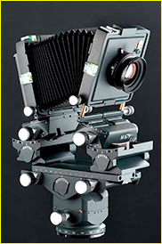
Iphone photo by Sam Alive

Slide 15
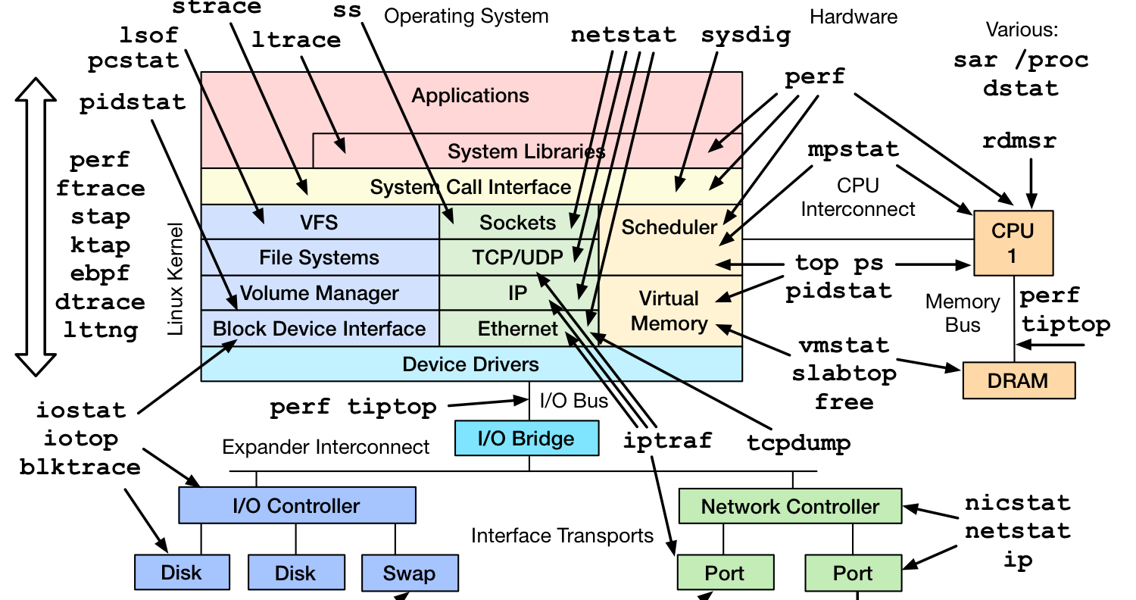
Linux Observability tools by Brendan Gregg, brendangregg.com

Slide 16
Mastering Complexity versus
Extracting Simplicity
Networking has never made the distinction…
  And therefore has never made the transition from mastering complexity to extracting simplicity
Still focused on mastering complexity
  Networking “experts” are those that know all the details
Extracting simplicity lays intellectual foundations
  This is why networking has weak foundation
  We are still building the artifact, not the discipline

Slide 17
Number of published Internet Standards
Graph from Nick McKeown

Slide 18
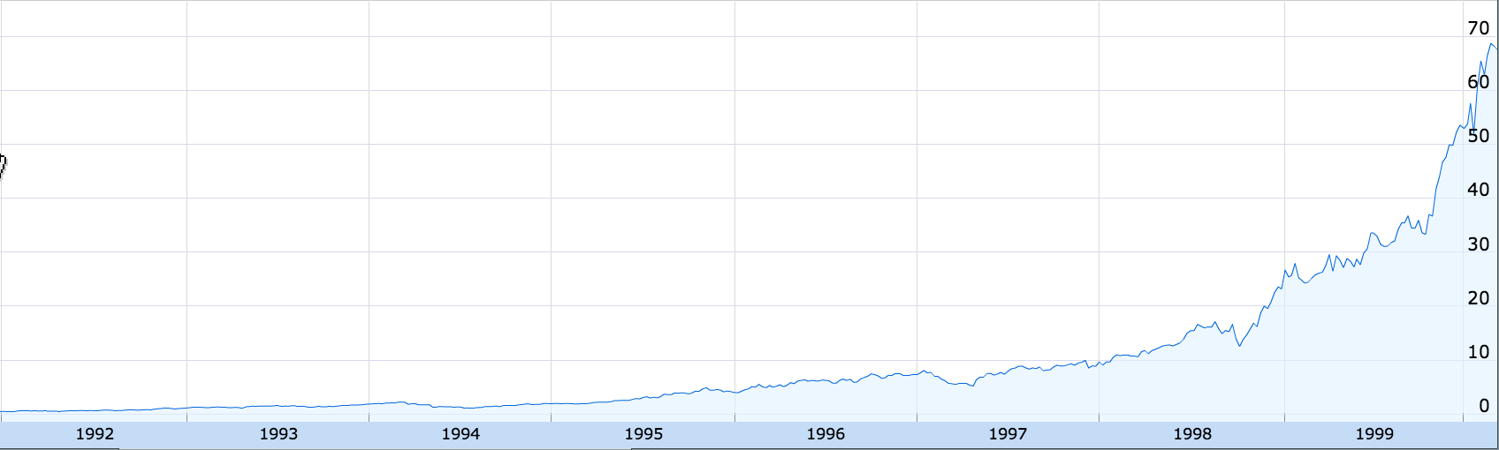
Cisco Stock Price
200x
1991
1999
Google Finance

Slide 19
Why make the transition
Complexity has increased to “unmanageable” levels
Consider datacenters:
  100,000s machines, 10,000s switches
  1000s of customers
    Each with their own logical networks: ACLs, VLANs, etc
Way beyond what we can handle
  Leads to brittle, ossified configurations
  Probably inefficient too

Slide 20
An Example Transition: Programming
Machine languages: no abstractions
  Had to deal with low-level details
  Mastering complexity was crucial
Higher-level languages: OS and other abstractions
  File system, virtual memory, abstract data types, ...
Modern languages: even more abstractions
  Object orientation, garbage collection,...
Abstractions key to extracting simplicity

Slide 21
“The Power of Abstraction”
“Modularity based on abstraction
is the way things get done”
− Barbara Liskov
Abstractions ➔ Interfaces ➔ Modularity

Slide 22
What About Networking Abstractions?
Consider the data and control planes separately
Different tasks, so naturally different abstractions

Slide 23
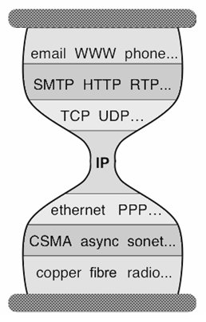
Abstractions for Data Plane: Layers
Applications
…built on…
Reliable (or unreliable) transport
…built on…
Best-effort global packet delivery
…built on…
Best-effort local packet delivery
…built on…
Physical transfer of bits

Slide 24
The Importance of Layering
Decomposed delivery into basic components
Independent, compatible innovation at each layer
  Clean “separation of concerns”
  Leaving each layer to solve a tractable problem
Responsible for the success of the Internet!
  Rich ecosystem of independent innovation

Slide 25
Control Plane Abstractions
?

Slide 26
(Too) Many Control Plane Mechanisms
Control Plane: mechanisms without abstraction
  Too many mechanisms, not enough functionality
Variety of goals, no modularity:
  Routing: distributed routing algorithms
  Isolation: ACLs, VLANs, Firewalls,…
  Traffic engineering: adjusting weights, MPLS,…

Slide 27
Finding Control Plane Abstractions

Slide 28
How do you find abstractions?
You first decompose the problem….
…and define abstractions for each subproblem
So what is the control plane problem?

Slide 29
Task: Compute forwarding state:
Consistent with low-level hardware/software
  Which might depend on particular vendor
Based on entire network topology
  Because many control decisions depend on topology
For all routers/switches in network
  Every router/switch needs forwarding state

Slide 30
Our current approach
Design one-off mechanisms that solve all three
  A sign of how much we love complexity
No other field would deal with such a problem!
They would define abstractions for each subtask
…and so should we!

Slide 31
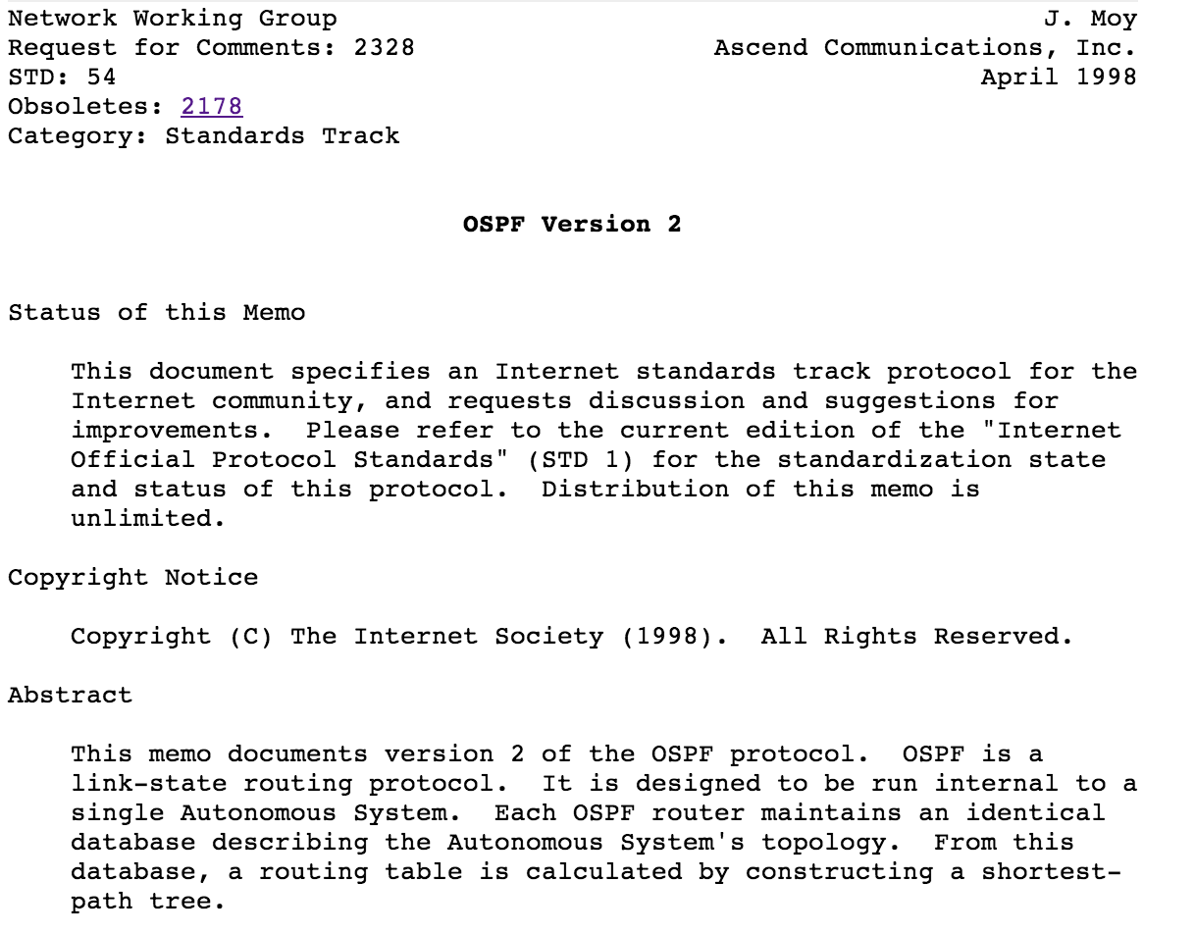
Example
OSPF:
  5% for Djikstra’s algorithm,
  95% to find and maintain the state of the network

Slide 32
Separate Concerns with Abstractions
Be compatible with low-level hardware/software
  Need an abstraction for general forwarding model
Make decisions based on entire network
  Need an abstraction for network state
3. Compute configuration of each physical device
  Need an abstraction that simplifies configuration

Slide 33
Abs#1: Forwarding Abstraction
Express intent independent of implementation
  Don’t want to deal with proprietary HW and SW
OpenFlow is current proposal for forwarding
  Standardized interface to switch
  Configuration in terms of flow entries:
    <header fields, action>
P4 is a much more general language for forwarding
  Programmable switches
Design details concern exact nature of:
  Header matching
  Allowed actions

Slide 34
Two Important Facets to OpenFlow
Switches accept external control messages
  Not closed, proprietary boxes
Standardized flow entry format
  So switches are interchangeable

Slide 35
Abs#2: Network State Abstraction
Abstract away various distributed mechanisms
Abstraction: global network view
  Annotated network graph provided through an API
Implementation: “Network Operating System”
  Runs on servers in network (“controllers”)
  Replicated for reliability
Information flows both ways
  Information from routers/switches to form “view”
  Configurations to routers/switches to control forwarding

Slide 36
Network Operating System
Think of it as a centralized link-state algorithm
Switches send connectivity info to controller
Controller computes forwarding state
  Some control program that uses the topology as input
Controller sends forwarding state to switches
Controller is replicated for resilience
  System is only “logically centralized”

Slide 37
Network of Switches and/or Routers

Slide 38
Traditional Control Mechanisms
Distributed algorithm running between neighbors
Complicated task-specific distributed algorithm

Slide 39
Software Defined Network (SDN)
routing, access control, etc.
Control Program
Global Network View
Network OS
Software
Very simple
hardware

Slide 40
Major Change in Paradigm
Control program:
  Configuration = Function(view)
Control mechanism now program using NOS API
Not a distributed protocol, just a graph algorithm

Slide 41
Abs#3: Specification Abstraction
Control mechanism expresses desired behavior
  Whether it be isolation, access control, or QoS
It should not be responsible for implementing that behavior on physical network infrastructure
  Requires configuring the forwarding tables in each switch
Proposed abstraction: abstract view of network
  Abstract view models only enough detail to specify goals
  Will depend on task semantics

Slide 42
Simple Example: Access Control
A
Abstract Network
View
B
A
Global
Network View
B

Slide 43
Routing
Look at graph of network
Compute routes
Give to SDN platform, which passes on to switches

Slide 44
Access Control
Control program decides who can talk to who
Pass this information to SDN platform
Appropriate ACL flow entries are added to network
  In the right places (based on the topology)

Slide 45
Network Virtualization
Abstract Network View
Virtualization Layer
Control Program
Global Network View
Network OS
Notes:
This is the current killer app for SDNs, main product of VMWare

Slide 46
Clean Separation of Concerns
Control program: express goals on abstract view
  Driven by Operator Requirements
Virtualization Layer: abstract view ⬅➔ global view
  Driven by Specification Abstraction for particular task
NOS: global view ⬅➔ physical switches
  API: driven by Network State Abstraction
  Switch interface: driven by Forwarding Abstraction

Slide 47
SDN: Layers for the Control Plane
Control Program
Abstract Network View
Network Virtualization
Global Network View
Network OS

Slide 48
Abstractions for Control Plane
Expression of Intent
…built on…
Abstract Network View
…built on…
Global Network View
…built on…
Physical Topology

Slide 49
Abstractions Don’t Remove Complexity
NOS, Virtualization are complicated pieces of code
SDN merely localizes the complexity:
  Simplifies interface for control program (user-specific)
  Pushes complexity into reusable code (SDN platform)
This is the big payoff of SDN: modularity!
  The core distribution mechanisms can be reused
  Control programs only deal with their specific function
Note that SDN separates control and data planes
  SDN platform does control plane, switches do data plane

Slide 50
What This Really Means

Slide 51
Separation of Control/Data Plane
Today, routers implement both
  They forward packets
  And run the control plane software
SDN networks
  Data plane implemented by switches
    Switches act on local forwarding state
  Control plane implemented by controllers
    All forwarding state computed by SDN platform
This is a technical change, with broad implications

Slide 52
Changes
Less vendor lock-in
  Can buy HW/SF from different vendors
Changes are easier
  Can test components separately
    HW has to forward
    Can simulate controller
    Can do verification on logical policy
  Can change topology and policy independently
  Can move from private net to cloud and back!
  Greater rate of innovation

Slide 53
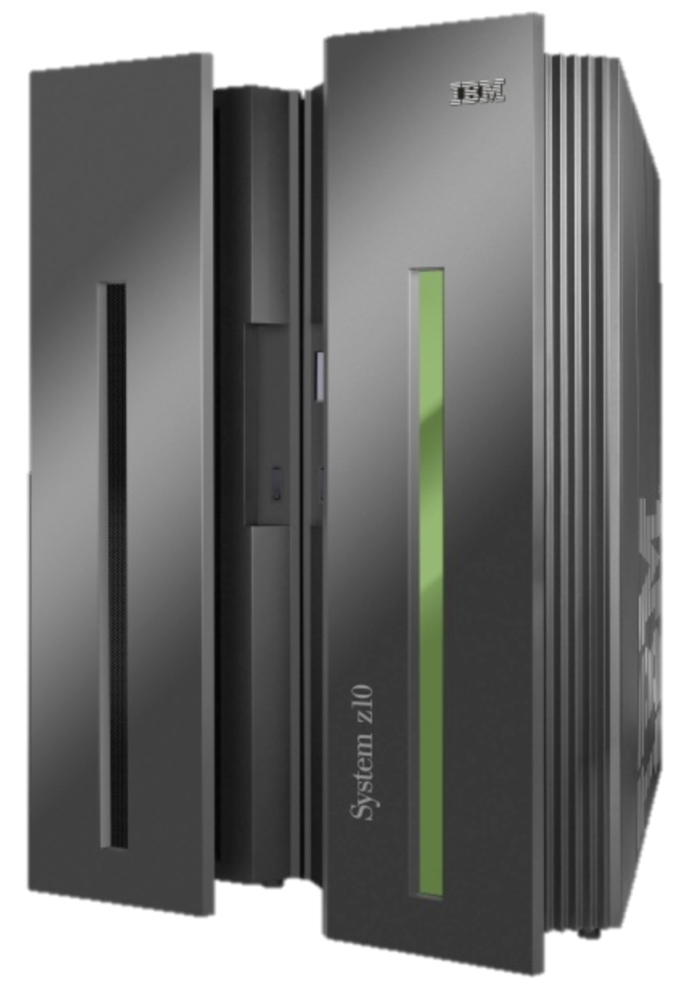
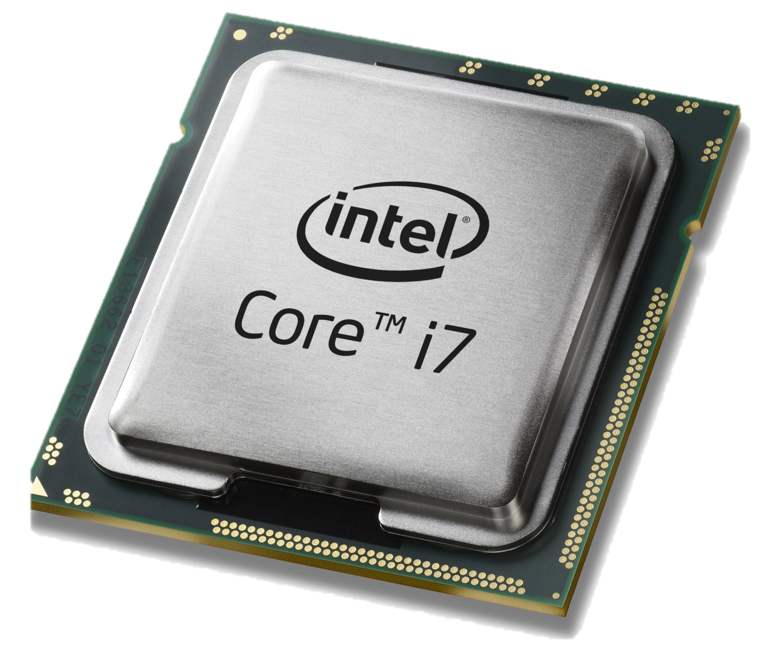
Computer Industry
App
App
App
App
App
App
App
App
App
App
App
Specialized
Applications
Open Interface
Specialized
Operating System
Windows
(OS)
Linux
Mac
OS
or
or
Open Interface
Specialized
Hardware
Microprocessor

Slide 54
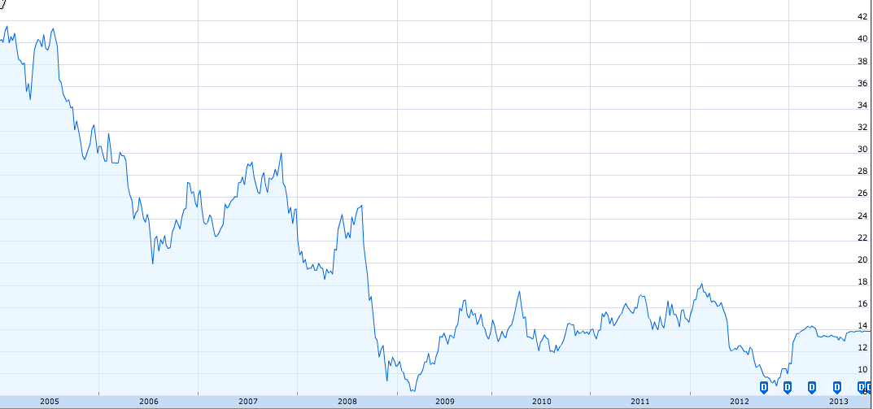
Dell Stock Price
$42
$14
2005
2013
Google Finance
Notes:
Dell stock price from google finance.

Slide 55
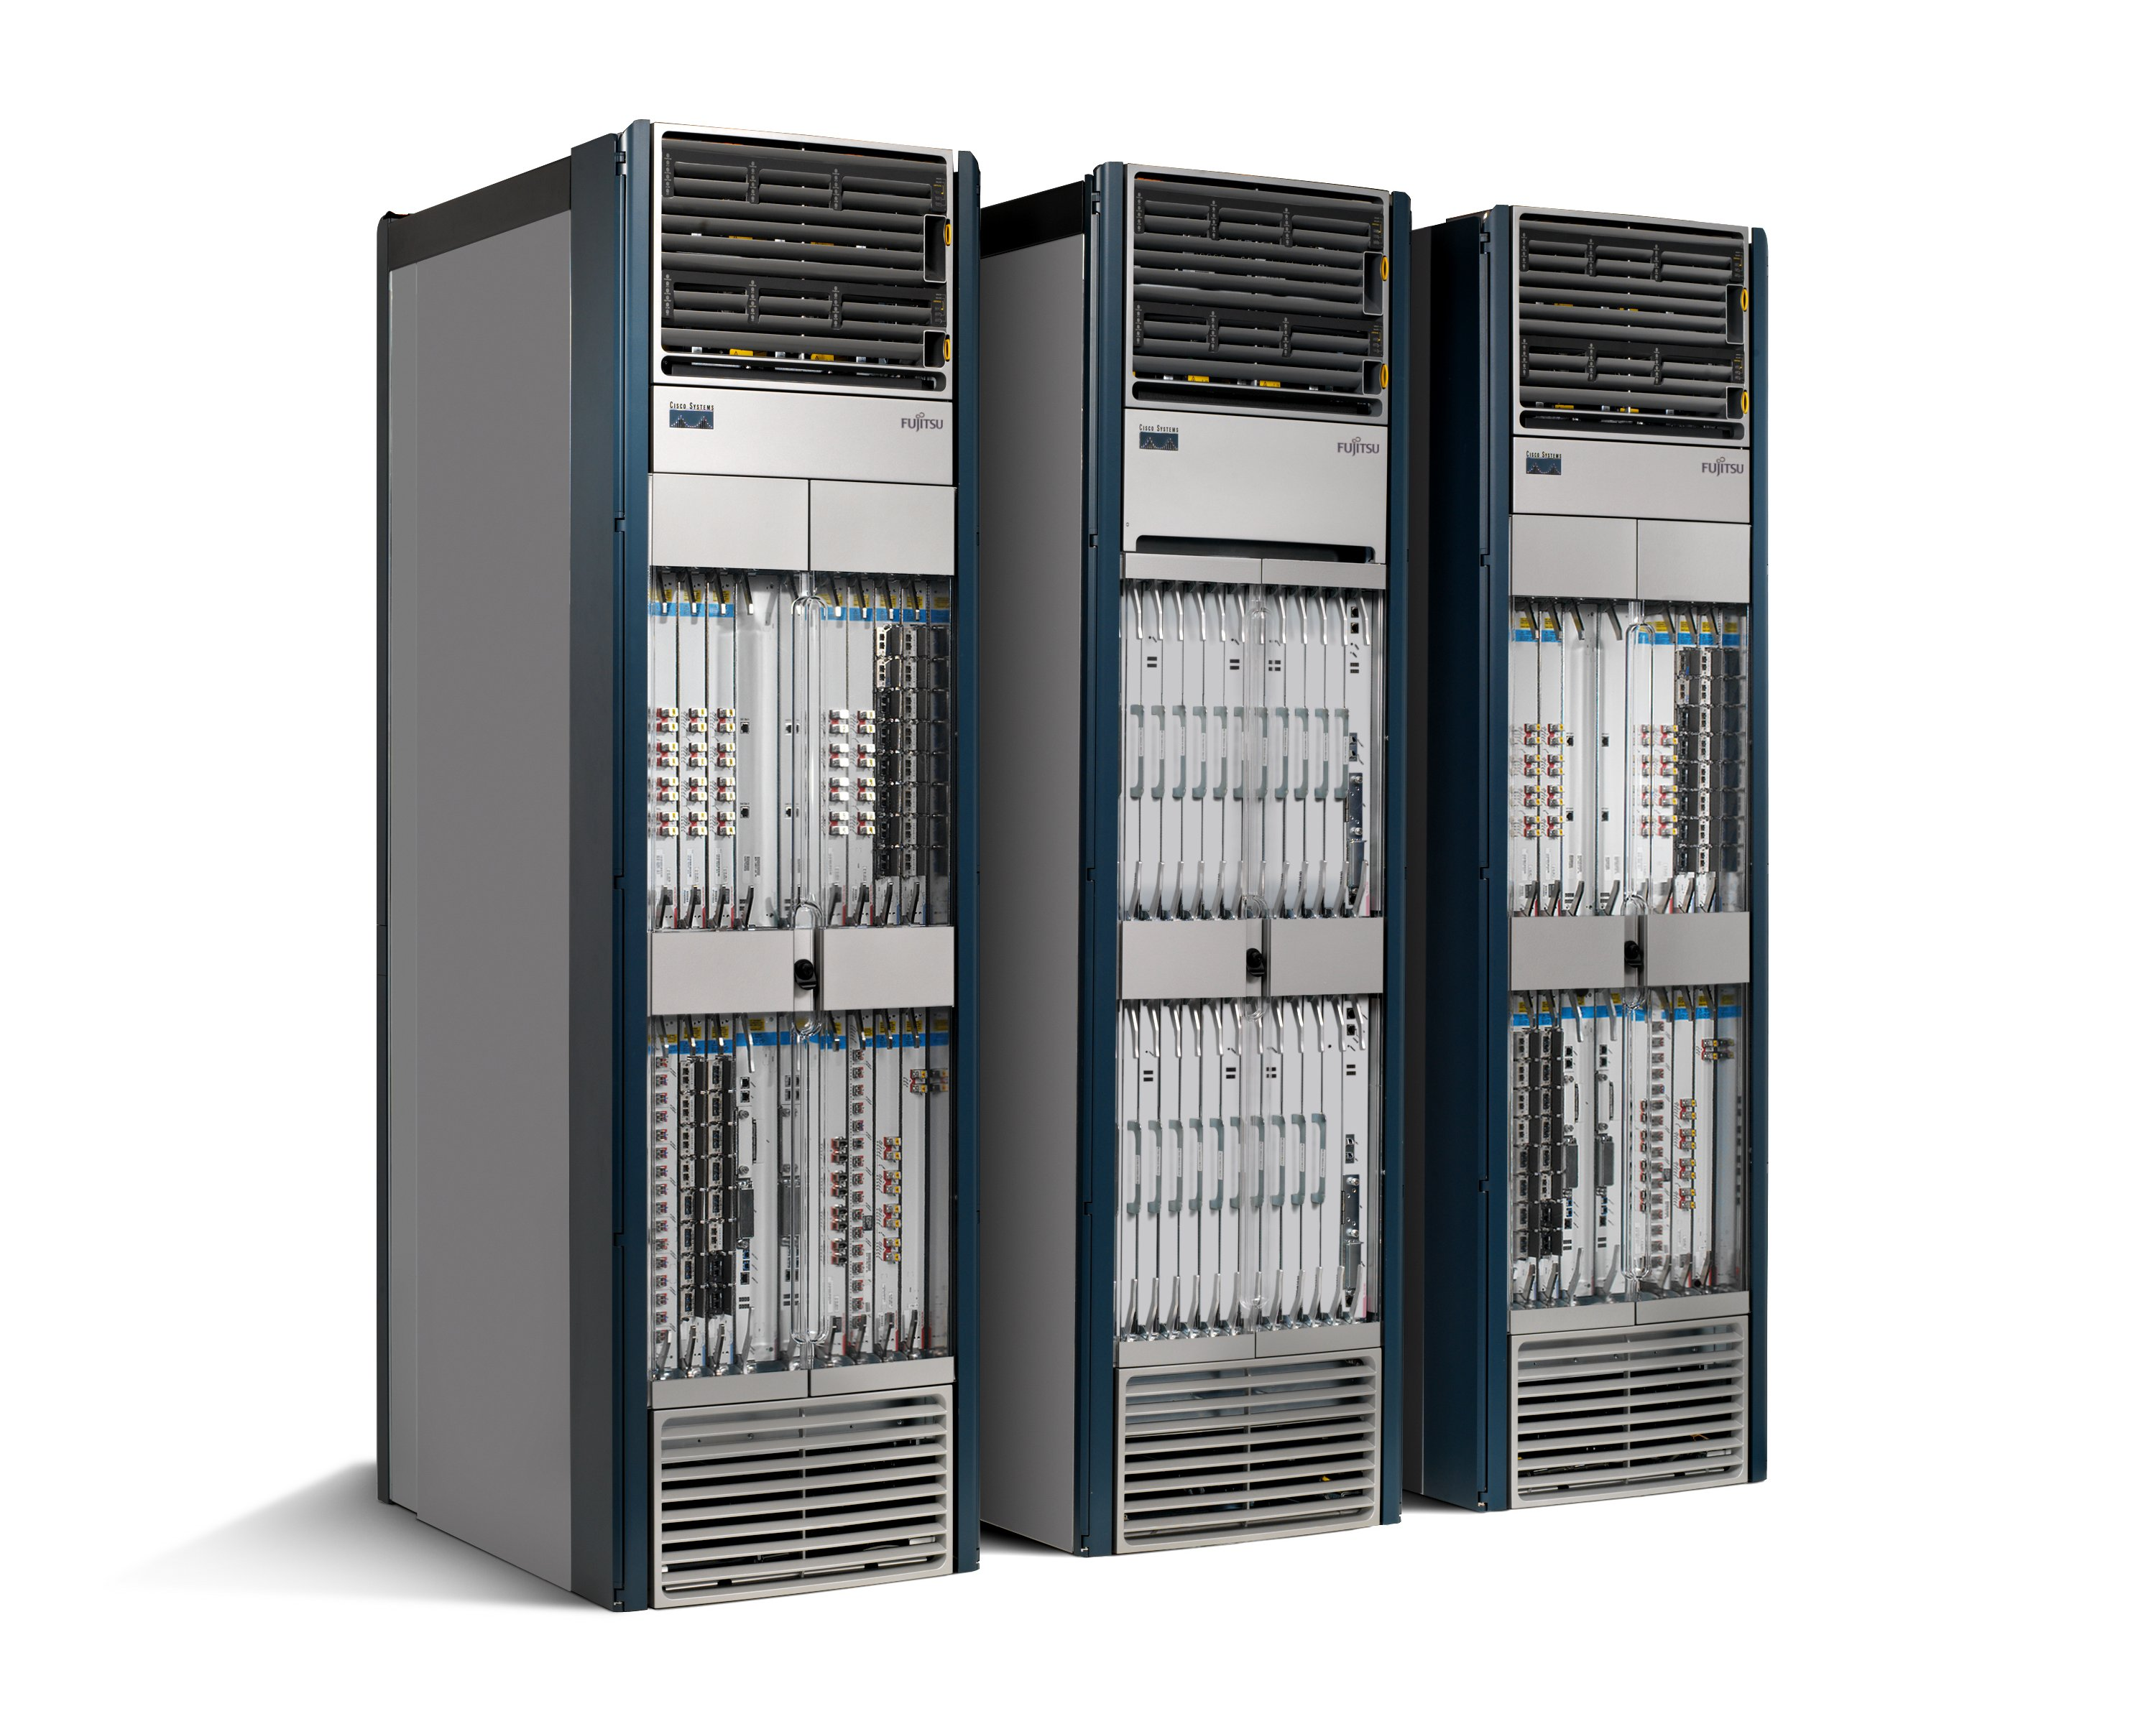
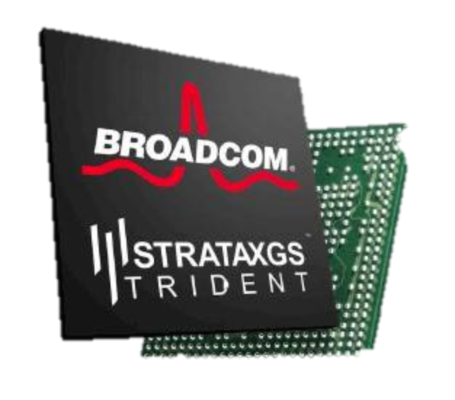
Networking Industry
App
App
App
App
App
App
App
App
App
App
App
Specialized
Features
Open Interface
NOX
Beacon
ONIX
POX
ONOS
Flood
light
Trema
ODL
Ryu
Control
Plane 1
Control
Plane 2
Specialized
Operating System
Open Interface
Switch Chips
Specialized
Hardware

Slide 56
Current Status of SDN
SDN widely accepted as “future of networking”
  Commercial use inter-datacenter (Google), intra-datacenter (Microsoft)
  Network virtualization is current killer app
    VMWare’s NSX, OpenStack network management
A lot of SDN hype, and backlash…
  SDN doesn’t work miracles, merely makes things easier
Open Networking Foundation (100+ members)
  Board: Google, Yahoo, Verizon, DT, Msoft, F’book, NTT
  Members: Cisco, Juniper, HP, Dell, Broadcom, IBM,…
Watch out for upcoming chapters!

Slide 57
To learn more…
Scott Shenker’s talk “The Future of Networking, and the Past of Protocols”
  http://www.youtube.com/watch?v=YHeyuD89n1Y
  Keynote at the 2011 Open Networking Summit
NEC SDN Reading List
  http://www.nec-labs.com/~lume/sdn-reading-list.html
The Road to SDN
  http://queue.acm.org/detail.cfm?id=2560327

Slide 58
OpenFlow
Simple API between switches and centralized controller
Basic abstraction: flow match / action
  E.g., if a packet matches this IP dest, ETH protocol type, forward on port 3
  If a packet matches ARP, send to controller
  It a packet comes from evil IP address, drop

