Slide 1
CSCI-1680
WWW
Rodrigo Fonseca
Based partly on lecture notes by Scott Shenker and John Jannotti

Slide 2
Precursors
1945, Vannevar Bush, Memex:
  “a device in which an individual stores all his books, records, and communications, and which is mechanized so that it may be consulted with exceeding speed and flexibility”
Precursors to hypertext
  “The human mind [...] operates by association. With one item in its grasp, it snaps instantly to the next that is suggested by the association of thoughts, in accordance with some intricate web of trails carried by the cells of the brain”
His essay, “As we may think”, is worth reading!

Slide 3
Tim Berners-Lee
Physicist at CERN, trying to solve real problem
  Distributed access to data
WWW: distributed database of pages linked through the Hypertext Transfer Protocol
  First HTTP implementation: 1990
  HTTP/0.9 – 1991
    Simple GET commant
  HTTP/1.0 – 1992
    Client/server information, simple caching
  HTTP/1.1 – 1996
    Extensive caching support
    Host identification
    Pipelined, persistent connections, …

Slide 4
HTTP/2 – 2015
  True multiplexing of messages
    Multiple streams
    Flow control
    Prioritization
  Binary encoding
  Header compression
  Main goal: reduce latency
http://httpwg.org/specs/rfc7540.html

Slide 5
Why so successful?
Ability to self publish
  Like youtube for video
But…
  Mechanism is easy
  Independent, open
  Free
Current debate
  Is it easy enough? Why is facebook so popular, even though it is not open?

Slide 6
Components
Content
  Objects (may be static or dynamically generated)
Clients
  Send requests / Receive responses
Servers
  Receive requests / Send responses
  Store or generate content
Proxies
  Placed between clients and servers
  Provide extra functions
    Caching, anonymization, logging, transcoding, filtering access
  Explicit or transparent

Slide 7
Ingredients
HTTP
  Hypertext Transfer Protocol
HTML
  Language for description of content
Names (mostly URLs)
  Won’t talk about URIs, URNs

Slide 8
URLs
protocol://[name@]hostname[:port]/directory/resource?k1=v1&k2=v2#tag
URLs are a type of URIs
Name is for possible client identification
Hostname is FQDN or IP address
Port defaults to protocol default (e.g., 80)
Directory is a path to the resource
Resource is the name of the object
?parameters are passed to the server for execution
#tag allows jumps to named tags within document

Slide 9
HTTP
Important properties
  Client-server protocol
  Protocol (but not data) in ASCII (before HTTP/2)
  Stateless
  Extensible (header fields)
Server typically listens on port 80
Server sends response, may close connection (client may ask it to say open)
Currently version 2

Slide 10
Steps in HTTP^{(1.0)} Request
Open TCP connection to server
Send request
Receive response
TCP connection terminates
  How many RTTs for a single request?
You may also need to do a DNS lookup first!

Slide 11
> telnet www.cs.brown.edu 80
Trying 128.148.32.110...
Connected to www.cs.brown.edu.
Escape character is '^]'.
GET / HTTP/1.0
HTTP/1.1 200 OK
Date: Thu, 24 Mar 2011 12:58:46 GMT
Server: Apache/2.2.9 (Debian) mod_ssl/2.2.9 OpenSSL/0.9.8g
Last-Modified: Thu, 24 Mar 2011 12:25:27 GMT
ETag: "840a88b-236c-49f3992853bc0"
Accept-Ranges: bytes
Content-Length: 9068
Vary: Accept-Encoding
Connection: close
Content-Type: text/html
<!DOCTYPE html PUBLIC "-//W3C//DTD XHTML 1.0 Strict//EN"
"http://www.w3.org/TR/xhtml1/DTD/xhtml1-strict.dtd">
<html xmlns="http://www.w3.org/1999/xhtml" xml:lang="en" lang="en”>
...

Slide 12
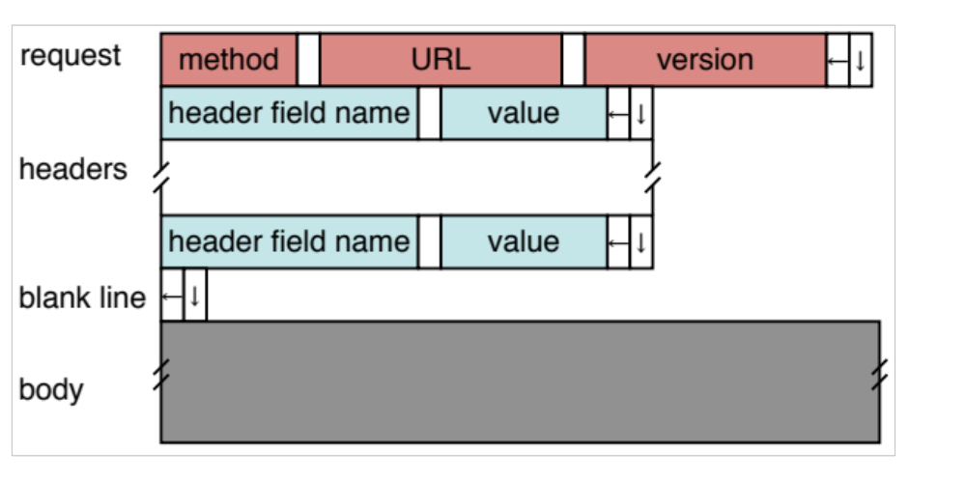
HTTP Request
Method:
  GET: current value of resource, run program
  HEAD: return metadata associated with a resource
  POST: update a resource, provide input for a program
Headers: useful info for proxies or the server
  E.g., desired language

Slide 13
Sample Browser Request
GET / HTTP/1.1
Host: localhost:8000
User-Agent: Mozilla/5.0 (Macinto ...
Accept: text/xml,application/xm ...
Accept-Language: en-us,en;q=0.5
Accept-Encoding: gzip,deflate
Accept-Charset: ISO-8859-1,utf-8;q=0.7,*;q=0.7
(empty line)
Firefox extension LiveHTTPHeaders is a cool way to see this

Slide 14
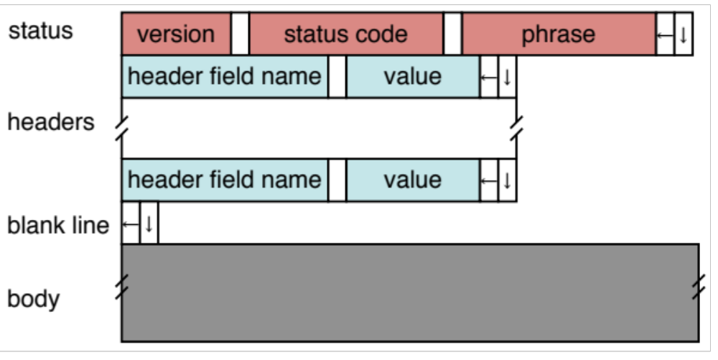
HTTP Response
Status Codes:
  1xx: Information e.g, 100 Continue
  2xx: Success e.g., 200 OK
  3xx: Redirection e.g., 302 Found (elsewhere)
  4xx: Client Error e.g., 404 Not Found
  5xx: Server Error e.g, 503 Service Unavailable

Slide 15
HTTP is Stateless
Each request/response treated independently
Servers not required to maintain state
This is good!
  Improves server scalability
This is also bad…
  Some applications need persistent state
  Need to uniquely identify user to customize content
  E.g., shopping cart, web-mail, usage tracking, (most sites today!)

Slide 16


HTTP Cookies
Client-side state maintenance
  Client stores small state on behalf of server
  Sends request in future requests to the server
  Cookie value is meaningful to the server (e.g., session id)
Can provide authentication
Request
Response
Set-Cookie: XYZ
Request
Cookie: XYZ

Slide 17
Anatomy of a Web Page
HTML content
A number of additional resources
  Images
  Scripts
  Frames
Browser makes one HTTP request for each object
  Course web page: 14 objects
  My facebook page this morning: 100 objects

Slide 18
What about AJAX?
Asynchronous Javascript and XML
Based on XMLHttpRequest object in browsers, which allow code in the page to:
  Issue a new, non-blocking request to the server, without leaving the current page
  Receive the content
  Process the content
Used to add interactivity to web pages
  XML not always used, HTML fragments, JSON, and plain text also popular

Slide 19
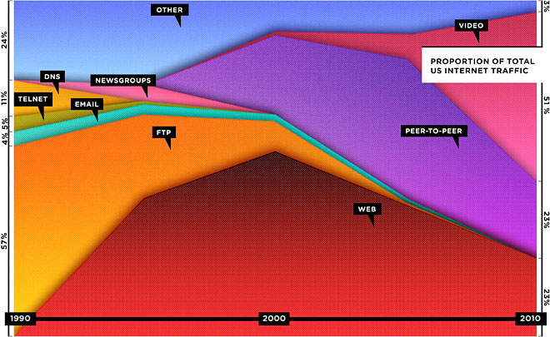
The Web is Dead? (Wired, Aug 2010)
http://www.wired.com/magazine/2010/08/ff_webrip/all/1

Slide 20
The Web is Dead? (Wired, Aug 2010)
“ You wake up and check your email on your bedside iPad — that’s one app. During breakfast you browse Facebook, Twitter, and The New York Times — three more apps. On the way to the office, you listen to a podcast on your smartphone. Another app. At work, you scroll through RSS feeds in a reader and have Skype and IM conversations. More apps. At the end of the day, you come home, make dinner while listening to Pandora, play some games on Xbox Live, and watch a movie on Netflix’s streaming service. You’ve spent the day on the Internet — but not on the Web. And you are not alone.”
Notes:
But most of this traffic goes over HTTP

Slide 21
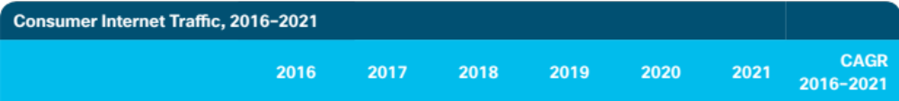
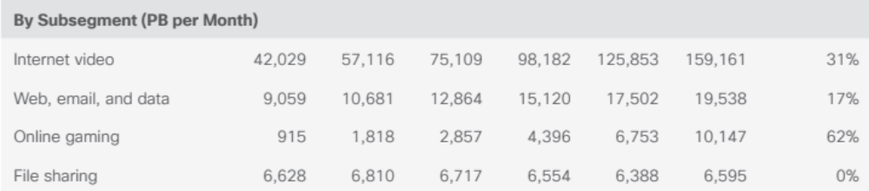
Except that video is also transferred over HTTP!

Slide 22
HTTP Performance
What matters for performance?
Depends on type of request
  Lots of small requests (objects in a page)
  Some big requests (large download or video)

Slide 23
Small Requests
Latency matters
RTT dominates
Two major causes:
  Opening a TCP connection
  Actually sending the request and receiving response
  And a third one: DNS lookup!

Slide 24
How can we reduce the number of connection setups?
Keep the connection open and request all objects serially
  Works for all objects coming from the same server
  Which also means you don’t have to “open” the window each time
Persistent connections (HTTP/1.1)

Slide 25
Browser Request
GET / HTTP/1.1
Host: localhost:8000
User-Agent: Mozilla/5.0 (Macinto ...
Accept: text/xml,application/xm ...
Accept-Language: en-us,en;q=0.5
Accept-Encoding: gzip,deflate
Accept-Charset: ISO-8859-1,utf-8;q=0.7,*;q=0.7
Keep-Alive: 300
Connection: keep-alive

Slide 26
Small Requests (cont)
Second problem is that requests are serialized
  Similar to stop-and-wait protocols!
Two solutions
  Pipelined requests (similar to sliding windows)
  Parallel Connections
    HTTP standard says no more than 2 concurrent connections per host name
    Most browsers use more (up to 8 per host, ~35 total)
      See http://www.browserscope.org/
  How are these two approaches different?

Slide 27
HTTP/2
Adds more options to trade off:
Multiplexed streams on same connection
  Plus stream weights, dependencies
No head of line blocking!
  But what happens if there is packet loss?
https://www.twilio.com/blog/2017/10/http2-issues.html

Slide 28
HTTP/3
Mapping of HTTP semantics onto QUIC
  E.g., QUIC already implements multiple streams, and HTTP doesn’t need to do it
  Still very recent and under development

Slide 29
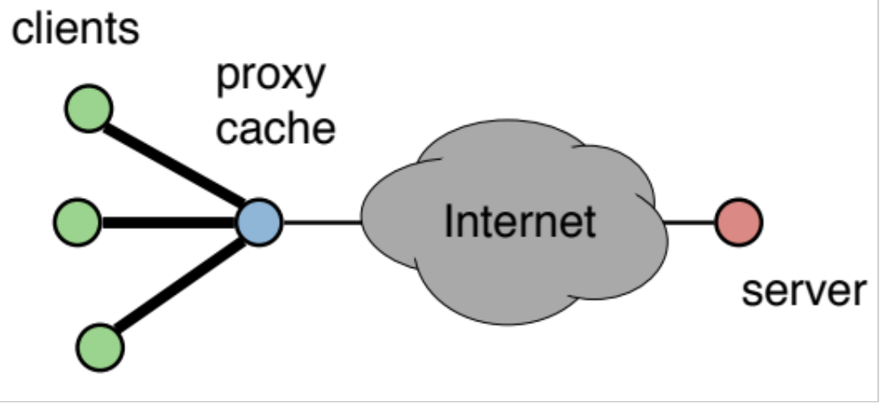
Larger Objects
Problem is throughput in bottleneck link
Solution: HTTP Proxy Caching
  Also improves latency, and reduces server load

Slide 30
How to Control Caching?
Server sets options
  Expires header
  No-Cache header
Client can do a conditional request:
  Header option: if-modified-since
  Server can reply with 304 NOT MODIFIED
More when we talk about Content Distribution

Slide 31
Next Class
Global data distribution
  CDN and P2P
How to create your own application layer protocol!
  Data / RPC

