Slide 1
CSCI-1680
DNS
Rodrigo Fonseca
Based partly on lecture notes by Scott Shenker and John Jannotti

Slide 2
We know how to open TCP connections to a server/port:
  E.g., 128.148.32.110, port 80

Slide 3
Host names and IP Addresses
IP Addresses
  Numerical address appreciated by routers
  Fixed length, binary numbers
  Hierarchical, related to host location (in the network)
  Examples: 128.148.32.110, 212.58.224.138
Host names
  Mnemonics appreciated by humans
  Variable length, ASCII characters
  Provide little (if any) information about location*
  Examples: www.cs.brown.edu, bbc.co.uk

Slide 4
Separating Naming and Addressing
Names are easier to remember
  www.cnn.com vs 157.166.224.26
Addresses can change underneath
  e.g, renumbering when changing providers
Name could map to multiple addresses
  www.cnn.com maps to at least 6 ip addresses
  Enables
    Load balancing
    Latency reduction
    Tailoring request based on requester’s location/device/identity
Multiple names for the same address
  Aliases: www.cs.brown.edu and cs.brown.edu
  Multiple servers in the same node (e.g., apache virtual servers)

Slide 5
Another Change in Layers…
Another mapping
  ARP: maps IP addresses to MAC addresses

Slide 6
Scalable (Address <-> Name) Mappings
Originally kept in a local file, hosts.txt
  Flat namespace
  Central administrator kept master copy (for the Internet)
  To add a host, emailed admin
  Downloaded file regularly

Slide 7
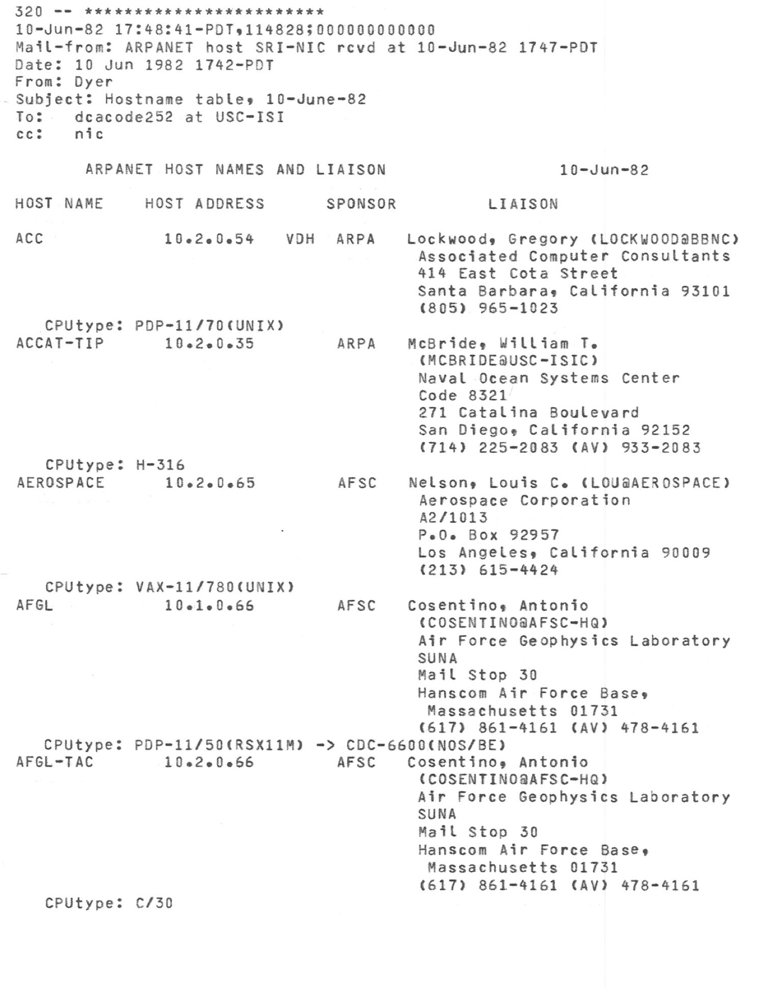

Slide 8
Scalable Address <-> Name Mappings
Originally kept in a local file, hosts.txt
  Flat namespace
  Central administrator kept master copy (for the Internet)
  To add a host, emailed admin
  Downloaded file regularly
Completely impractical today
  File would be huge (gigabytes)
  Traffic implosion (lookups and updates)
    Some names change mappings every few days (dynamic IP)
  Single point of failure
  Impractical politics (security, ownership, etc…)

Slide 9
Goals for an Internet-scale name system
Scalability
  Must handle a huge number of records
    With some software synthesizing names on the fly
  Must sustain update and lookup load
Distributed Control
  Let people control their own names
Fault Tolerance
  Minimize lookup failures in face of other network problems

Slide 10
The good news
Properties that make these goals easier to achieve
  Read-mostly database
    Lookups MUCH more frequent than updates
  Loose consistency
    When adding a machine, not end of the world if it takes minutes or hours to propagate
These suggest aggressive caching
  Once you’ve lookup up a hostname, remember
  Don’t have to look again in the near future

Slide 11
DNS Measurements (Data from MIT, 2000)
What was being looked up?
  60% A, 25% PTR, 5% MX, 6% ANY
Latency
  Median ~100ms (90th percentile ~500ms)
Query packets per lookup: ~2.4
Top 10% of domains → ~70% of lookups
  Great for caching!
9% of lookups are unique
  Caching can’t hit more than 91%
Cache hit rates actually ~75%
http://nms.lcs.mit.edu/papers/dns-ton2002.pdf
Notes:
Lower because of TTL

Slide 12
DNS Measurements (Data from MIT, 2000)
Does DNS give back answers?
  ~23% of queries do not elicit an answer
  ~13% return NXDOMAIN (or similar)
    Mostly reverse lookups
  Only ~64% of queries are successful
~63% of DNS packets in unanswered queries
  Failing queries are frequently retransmitted
  99.9% successful queries have <= 2 retransmissions

Slide 13
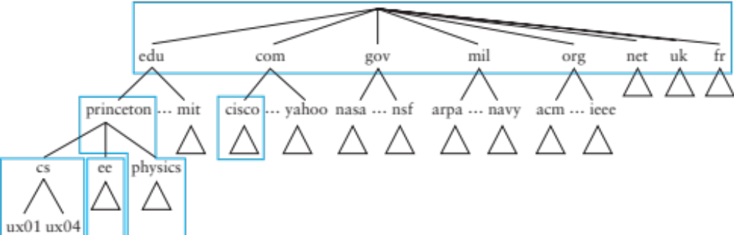
Domain Name System (DNS)
Hierarchical namespace broken into zones
  root (.), edu., brown.edu., cs.brown.edu.,
  Zones separately administered :: delegation
  Parent zone tells you how to find servers for subdomains
Each zone served from multiple replicated servers

Slide 14
DNS Architecture
Hierarchy of DNS servers
  Root servers
  Top-level domain (TLD) servers
  Authoritative DNS servers
Performing the translation
  Local DNS servers
  Resolver software

Slide 15
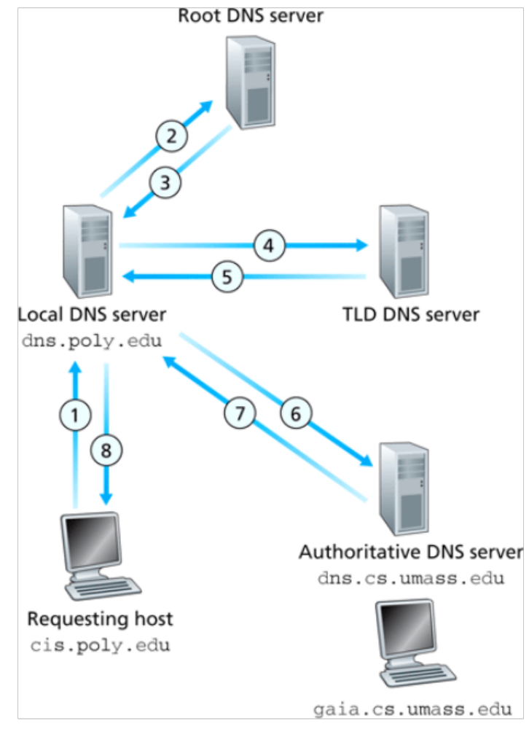
Resolver operation
Apps make recursive queries to local DNS server (1)
  Ask server to get answer for you
Server makes iterative queries to remote servers (2,4,6)
  Ask servers who to ask next
  Cache results aggressively

Slide 16
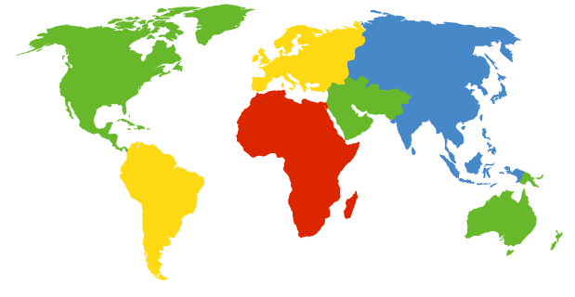
DNS Root Server
Located in New York
How do we make the root scale?
Verisign, New York, NY

Slide 17
DNS Root Servers
13 Root Servers (www.root-servers.org)
  Labeled A through M (e.g, A.ROOT-SERVERS.NET)
Does this scale?
A Verisign, New York, NY
C Cogent, Herndon, VA
D U Maryland College Park, MD
G US DoD Columbus, OH
H ARL Aberdeen, MD
J Verisign
K RIPE London
I Netnod, Stockholm
E NASA Mt View, CA
F Internet Software
Consortium
Palo Alto, CA
M WIDE Tokyo
B USC-ISI Marina del Rey, CA
L ICANN Los Angeles, CA

Slide 18
DNS Root Servers
13 Root Servers (www.root-servers.org)
  Labeled A through M (e.g, A.ROOT-SERVERS.NET)
Replication via anycasting
A Verisign, New York, NY (also Frankfurt, HK, London, LA)
C Cogent, Herndon, VA (also Los Angeles, NY, Chicago, Frankfurt and 3+)
D U Maryland College Park, MD (also in 106 other locations)
G US DoD Columbus, OH (+5)
H ARL Aberdeen, MD (also San Diego)
J Verisign (118 locations)
K RIPE London (plus 41 other locations)
I Netnod, Stockholm
(plus 49 other locations)
E NASA Mt View, CA (+70)
F Internet Software
Consortium,
Palo Alto, CA
(and 57 other locations)
M WIDE Tokyo
plus Seoul, Paris,
San Francisco, Osaka
B USC-ISI Marina del Rey, CA
L ICANN Los Angeles, CA
(plus 157 other locations)

Slide 19
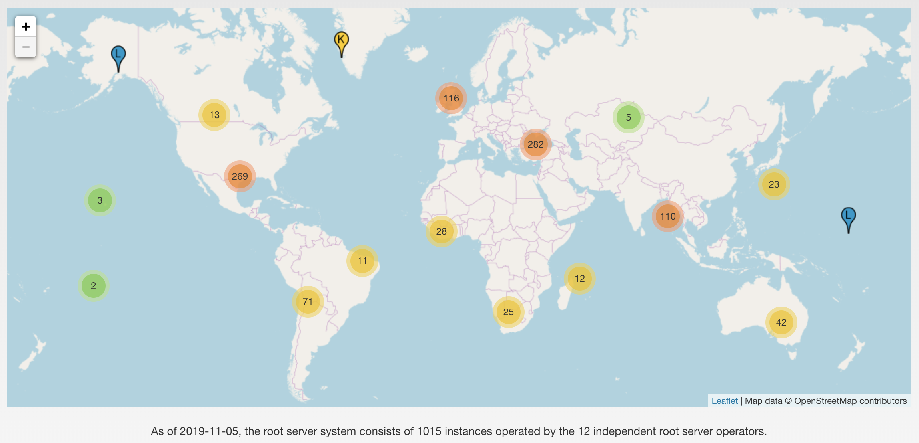
DNS Root Servers
From: www.root-servers.org, as of Nov 2019

Slide 20
TLD and Authoritative DNS Servers
Top Level Domain (TLD) servers
  Generic domains (e.g., com, org, edu)
  Country domains (e.g., uk, br, tv, in, ly)
  Special domains (e.g., arpa)
  Typically managed professionally
Authoritative DNS servers
  Provides public records for hosts at an organization
    e.g, for the organization’s own servers (www, mail, etc)
  Can be maintained locally or by a service provider

Slide 21
DNS Caching
All these queries take a long time!
  And could impose tremendous load on root servers
  This latency happens before any real communication, such as downloading your web page
Caching greatly reduces overhead
  Top level servers very rarely change
  Popular sites visited often
  Local DNS server caches information from many users
How long do you store a cached response?
  Original server tells you: TTL entry
  Server deletes entry after TTL expires

Slide 22
Negative Caching
Remember things that don’t work
  Misspellings like www.cnn.comm, ww.cnn.com
  Is the cost of these two queries the same?
These can take a long time to fail the first time
  Good to cache negative results so it will fail faster next time
But negative caching is optional, and not widely implemented

Slide 23
Reverse Mapping
How do we get the other direction, IP address to name?
Addresses have a natural hierarchy:
  128.148.32.12
But, most significant element comes first
Idea: reverse the numbers: 12.32.148.128 …
  and look that up in DNS
Under what TLD?
  Convention: in-addr.arpa
  Lookup 12.32.148.128.in-addr.arpa
  in6.arpa for IPv6
Notes:
dig -tPTR 12.32.148.128.in-addr.arpa

Slide 24
Example
dig . ns
dig +norec www.cs.brown.edu @a.root-servers.net
dig +norec www.cs.brown.edu @a.edu-servers.net
dig +norec www.cs.brown.edu @bru-ns1.brown.edu
www.cs.brown.edu. 86400 IN A 128.148.32.110

Slide 25
DNS Protocol
TCP/UDP port 53
Most traffic uses UDP
  Lightweight protocol has 512 byte message limit
  Retry using TCP if UDP fails (e.g., reply truncated)
TCP requires messages boundaries
  Prefix all messages with 16-bit length
Bit in query determines if query is recursive

Slide 26
Resource Records
All DNS info represented as resource records (RR)
name [ttl] [class] type rdata
  name: domain name
  TTL: time to live in seconds
  class: for extensibility, normally IN (1) “Internet”
  type: type of the record
  rdata: resource data dependent on the type
Important RR types
  A – Internet Address (IPv4); AAAA – IPv6
  NS – name server;
Example RRs
  www.cs.brown.edu. 86400 IN A 128.148.32.110
  cs.brown.edu. 86400 IN NS dns.cs.brown.edu.
  cs.brown.edu. 86400 IN NS ns1.ucsb.edu.

Slide 27
Some important details
How do local servers find root servers?
  DNS lookup on a.root-servers.net ?
  Servers configured with root cache file
  Contains root name servers and their addresses
  . 3600000 IN NS A.ROOT-SERVERS.NET.
  A.ROOT-SERVERS.NET. 3600000 A 198.41.0.4
  ...
How do you get addresses of other name servers?
  To obtain the address of www.cs.brown.edu, ask a.edu-servers.net, says a.root-servers.net
  How do you find a.edu-servers.net?
  Glue records: A records in parent zone

Slide 28
Other uses of DNS
Local multicast DNS
  Used for service discovery
  Made popular by Apple
  This is how you learn of different Apple TVs in the building
Load balancing
CDNs

Slide 29
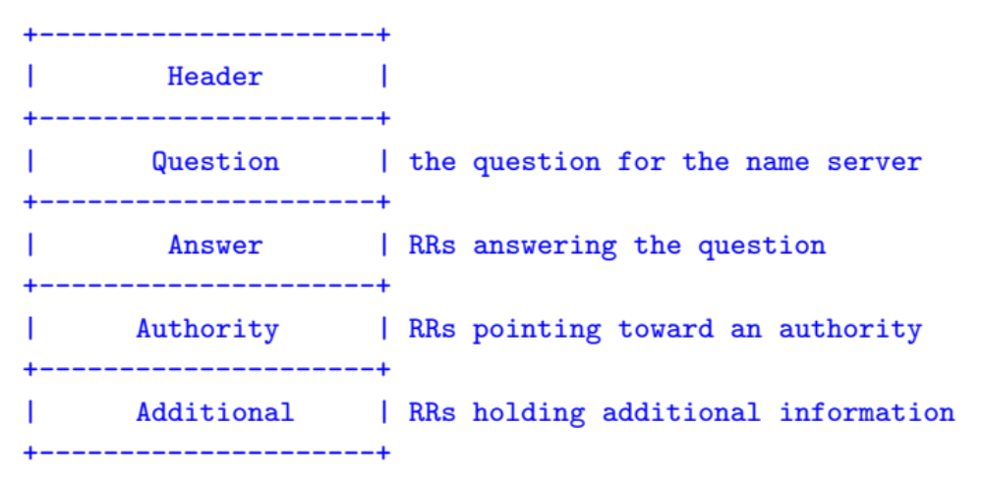
Structure of a DNS Message
Same format for queries and replies
  Query has 0 RRs in Answer/Authority/Additional
  Reply includes question, plus has RRs
Authority allows for delegation
Additional for glue, other RRs client might need

Slide 30
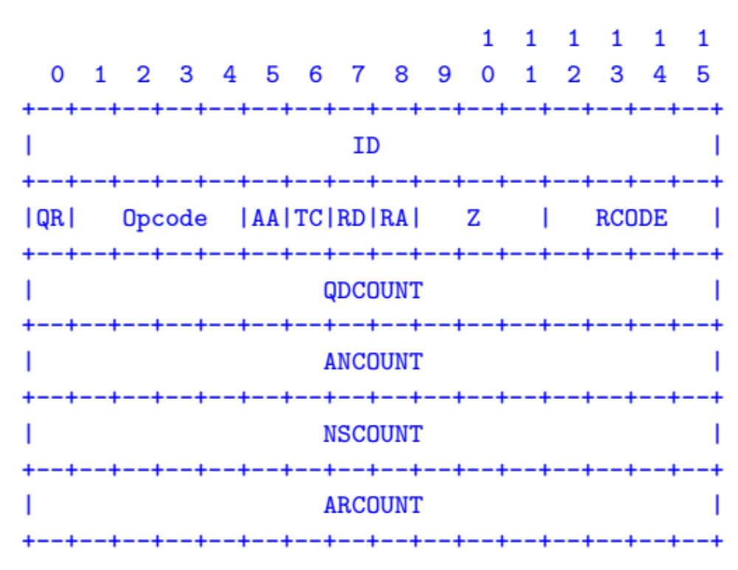
Header format
Id: match response to query; QR: 0 query/1 response
RCODE: error code.
AA: authoritative answer, TC: truncated,
RD: recursion desired, RA: recursion available

Slide 31
Other RR Types
CNAME (canonical name): specifies an alias
www.google.com. 446199 IN CNAME www.l.google.com.
www.l.google.com. 300 IN A 72.14.204.147
MX record: specifies servers to handle mail for a domain (the part after the @ in email addr)
  Different for historical reasons
SOA (start of authority)
  Information about a DNS zone and the server responsible for the zone
PTR (reverse lookup)
7.34.148.128.in-addr.arpa. 86400 IN PTR quanto.cs.brown.edu.

Slide 32
Reliability
Answers may contain several alternate servers
Try alternate servers on timeout
  Exponential backoff when retrying same server
Use same identifier for all queries
  Don’t care which server responds, take first answer

Slide 33
Inserting a Record in DNS
Your new startup helpme.com
Get a block of addresses from ISP
  Say 212.44.9.0/24
Register helpme.com at namecheap.com (for ex.)
  Provide name and address of your authoritative name server (primary and secondary)
  Registrar inserts RR pair into the .com TLD server:
    helpme.com NS dns1.helpme.com
    dns1.helpme.com A 212.44.9.120
Configure your authoritative server (dns1.helpme.com)
  Type A record for www.helpme.com
  Type MX record for helpme.com

Slide 34
Inserting a Record in DNS, cont
Need to provide reverse PTR bindings
  E.g., 212.44.9.120 -> dns1.helpme.com
Configure your dns server to serve the 9.44.212.in-addr.arpa zone
  Need to add a record of this NS into the parent zone (44.212.in-addr.arpa)
Insert the bindings into the 9.44.212.in-addr.arpa zone

Slide 35
DNS Security
You go to starbucks, how does your browser find www.google.com?
  Ask local name server, obtained from DHCP
  You implicitly trust this server
  Can return any answer for google.com, including a malicious IP that poses as a man in the middle
How can you know you are getting correct data?
  Today, you can’t for all sources
  HTTPS can help
  DNSSEC extension allow you to verify

Slide 36
DNS Security 2 – Cache Poisoning
Suppose you control evil.com. You receive a query for www.evil.com and reply:
;; QUESTION SECTION:
;www.evil.com. IN A
;; ANSWER SECTION:
www.evil.com. 300 IN A 212.44.9.144
;; AUTHORITY SECTION:
evil.com. 600 IN NS dns1.evil.com.
evil.com. 600 IN NS google.com.
;; ADDITIONAL SECTION:
google.com. 5 IN A 212.44.9.155
Glue record pointing to your IP, not Google’s
Gets cached!

Slide 37
Cache Poisoning # 2
But how do you get a victim to look up evil.com?
You might connect to their mail server and send
  HELO www.evil.com
  Which their mail server then looks up to see if it corresponds to your IP address (SPAM filtering)
Mitigation (bailiwick checking)
  Only accept glue records from the domain you asked for

Slide 38
Cache Poisoning
Another possibility: bad guy at Starbucks, can sniff or guess the ID field the local server will use
  Not hard if DNS server generates ID numbers sequentially
  Can be done if you force the DNS server to look up something in your name server
  Guessing has 1 in 65535 chance (Or does it?)
Now:
  Ask the local server to lookup google.com
  Spoof the response from google.com using the correct ID
  Bogus response arrives before legit one (maybe)
Local server caches first response it receives
  Attacker can set a long TTL
Notes:
Can send multiple responses almost at the same time.

Slide 39
Countermeasures
Randomize id
  Used to be sequential
Randomize source port number
  Used to be the same for all requests from the server
Offers some protection, but attack still possible
DNS over HTTPS
  Connects you to a trusted resolver
  Encrypts your traffic (no ISP spying / intercepting)
  Does not guarantee correct results

Slide 40
Helpful ISPs
Many ISPs hijack NXDOMAIN responses to “help” by offering search and advertisement related to the domain
E.g., www.bicycleisntadomain.com doesn’t (currently) exist
  Could return a page with search and ads on bicycles (or domain registrations?)

Slide 41
Great Firewall of CIT
If attacker is on the path (say, it is the ISP, or a malicious version of TStaff):
  Can sniff all DNS queries
  Send fake responses back first
  Could do this selectively, to direct facebook.com to cs.brown.edu, for example…

Slide 42
https://blog.thousandeyes.com/monitoring-dns-in-china/

Slide 43
Demo
Find an open resolver that might be giving bad responses…
  https://public-dns.info/
  Let’s try 218.107.55.108

Slide 44
Great Firewall of China
Inject false responses to DNS queries passing through Chinese AS’es!
The Collateral Damage of Internet Censorship by DNS Injection. Sigcomm CCR 42, 3 (June 2012)

Slide 45
Real Solution: Signatures
Signature: cryptographic way to prove a party is who they say they are
Requires a chain of trust
  Mirror the DNS hierarchy
DNSSEC deployment is underway
  Root signed in 2010
  1398 / 1527 TLDs are signed (2019/11/07)

Slide 46
DNSSEC
1. Digitally sign DNS records by authoritative servers
2. Resolvers have to make sure they trust the public key
  Start at the root (have a copy of the root’s key, or fingerprint)
  Verify the public key for the TLD, signed by the root
  Recurse until you get to the public key of the record you got

Slide 47
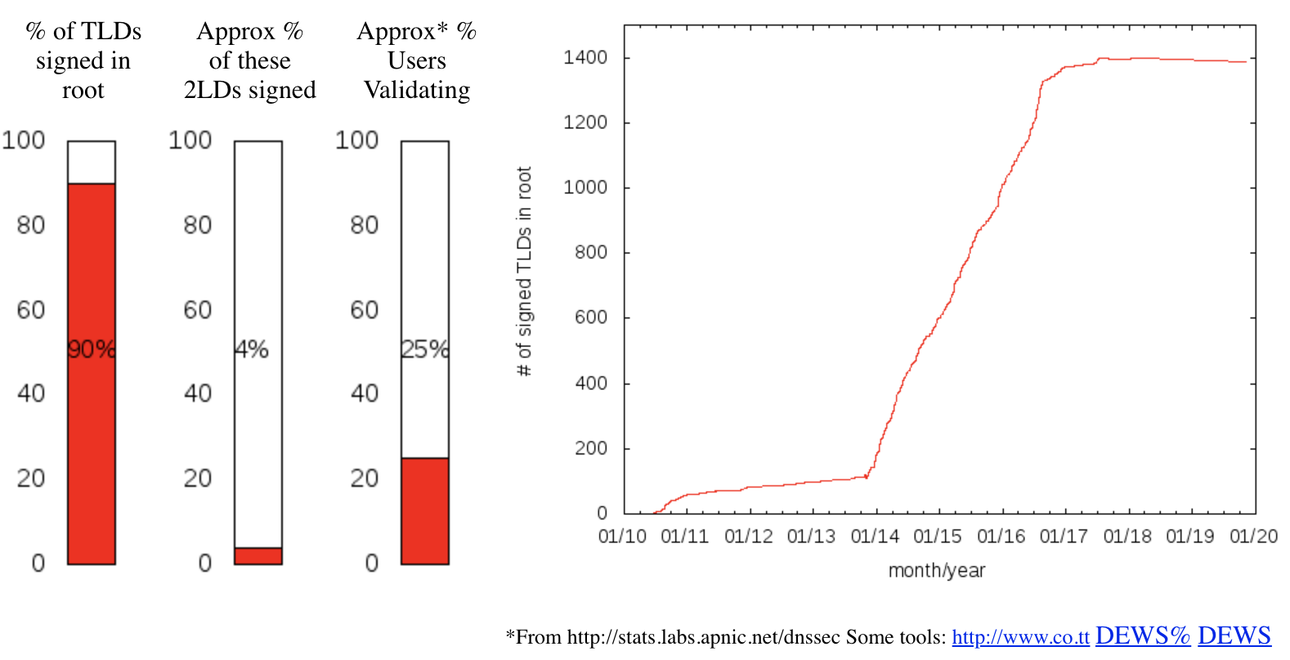
http://rick.eng.br/dnssecstat/

Slide 48
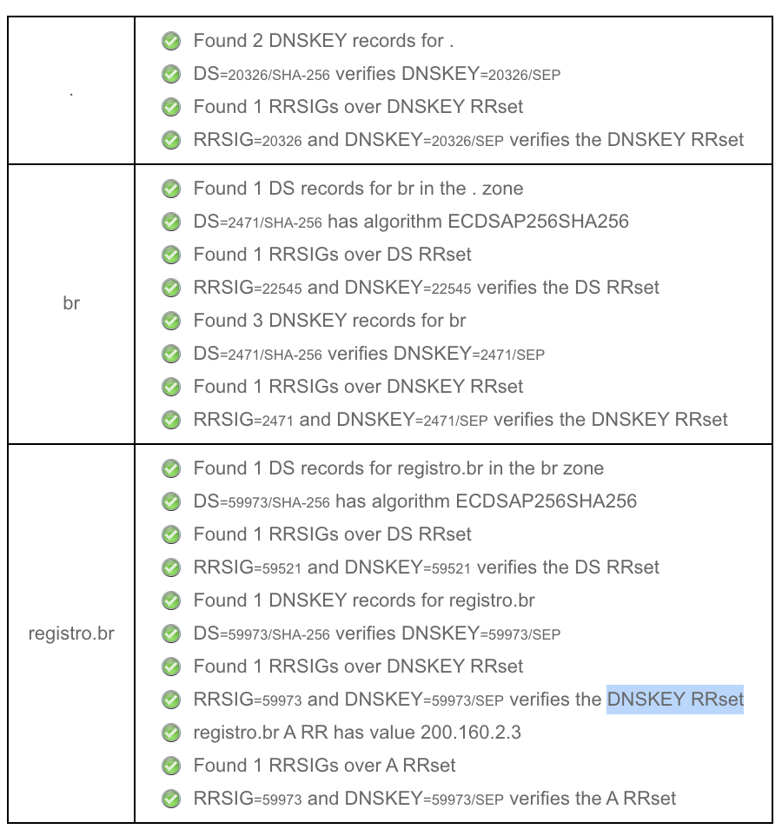
https://dnssec-analyzer.verisignlabs.com/registro.br

Slide 50
Backup Slides
Good information, but not covered in class

Slide 51
Some more DNS fun
You can use DNS to tunnel data!
Steps:
  Start up a Name Server for a domain you control
  Send info encoding data in the domain name part of a query
  Server encodes response in a TXT record
Why? DNS is often not blocked in airports, etc
This has been a final project in this class!

Slide 52
SOPA - H. R. 3261
October 2011
“A BILL To promote prosperity, creativity, entrepreneurship, and innovation by combating the theft of U.S. property, and for other purposes”
…
A service provider shall take technically feasible and reasonable measures designed to prevent access by its subscribers located within the United States to the foreign infringing site (or portion thereof) that is subject to the order, including measures designed to prevent the domain name of the foreign infringing site (or portion thereof) from resolving to that domain name’s Internet Protocol address.
Would this work?
102.c.2

Slide 53
SOPA
Provider filtering would interact badly with DNSSEC
Filtering would be easy to circumvent
  Circumvention could expose users to malicious DNS servers
Could cause collateral damage
  E.g., blog1.blogspot.com vs blog2.blogspot.com
The bill was withdrawn in 2012 after major online outcry, but highlights the importance of understanding technical underpinnings.
See http://www.circleid.com/pdf/PROTECT-IP-Technical-Whitepaper-Final.pdf for details

