Slide 1
CSCI-1680
Transport Layer III
Congestion Control Strikes Back
Rodrigo Fonseca
Based partly on lecture notes by David Mazières, Phil Levis, John Jannotti, Ion Stoica

Slide 2
Last Time
Flow Control
Congestion Control

Slide 3
Today
More TCP Fun!
Congestion Control Continued
  Quick Review
  RTT Estimation
TCP Friendliness
  Equation Based Rate Control
TCP on Lossy Links
Congestion Control versus Avoidance
  Getting help from the network
Cheating TCP

Slide 4
Quick Review
Flow Control:
  Receiver sets Advertised Window
Congestion Control
  Two states: Slow Start (SS) and Congestion Avoidance (CA)
  A window size threshold governs the state transition
    Window <= ssthresh: SS
    Window > ssthresh: Congestion Avoidance
  States differ in how they respond to ACKs
    Slow start: +1 w per RTT (Exponential increase)
    Congestion Avoidance: +1 MSS per RTT (Additive increase)
  On loss event: set ssthresh = w/2, w = 1, slow start

Slide 5
AIMD
Fair: A = B
AI
MD
Flow Rate B
Efficient: A+B = C
Flow Rate A
Notes:
Fair, efficient, distributed

Slide 6
States differ in how they respond to acks
Slow start: double w in one RTT
  There are w/MSS segments (and acks) per RTT
  Increase w per RTT → how much to increase per ack?
    w / (w/MSS) = MSS
AIMD: Add 1 MSS per RTT
  MSS/(w/MSS) = MSS²/w per received ACK

Slide 7
Putting it all together
cwnd
Timeout
Timeout
AIMD
AIMD
ssthresh
Slow
Start
Slow
Start
Slow
Start
Time

Slide 8
Fast Recovery and Fast Retransmit
cwnd
AI/MD
Slow Start
Fast retransmit
Time

Slide 9
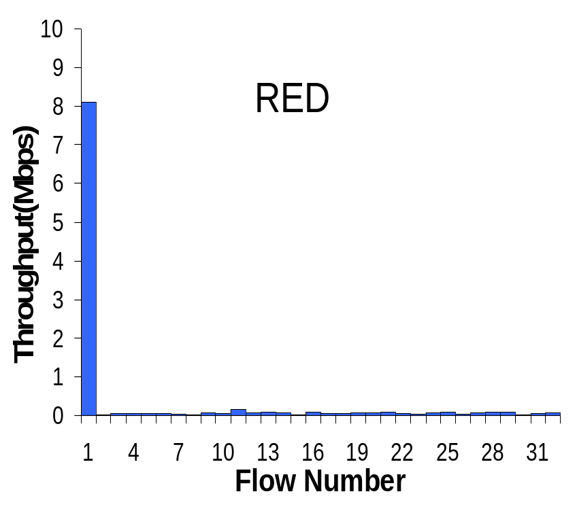
TCP Friendliness
Can other protocols co-exist with TCP?
  E.g., if you want to write a video streaming app using UDP, how to do congestion control?
1 UDP Flow at 10MBps
31 TCP Flows
Sharing a 10MBps link

Slide 10
TCP Friendliness
Can other protocols co-exist with TCP?
  E.g., if you want to write a video streaming app using UDP, how to do congestion control?
Equation-based Congestion Control
  Instead of implementing TCP’s CC, estimate the rate at which TCP would send. Function of what?
  RTT, MSS, Loss
Measure RTT, Loss, send at that rate!

Slide 11
TCP Throughput
Assume a TCP congestion of window W (segments), round-trip time of RTT, segment size MSS
  Sending Rate S = W x MSS / RTT (1)
Drop: W = W/2
  grows by MSS for W/2 RTTs, until another drop at W ≈ W
Average window then 0.75xS
  From (1), S = 0.75 W MSS / RTT (2)
Loss rate is 1 in number of packets between losses:
  Loss = 1 / ( 1 + (W/2 + W/2+1 + W/2 + 2 + … + W)
  = 1 / (3/8 W²) (3)

Slide 12
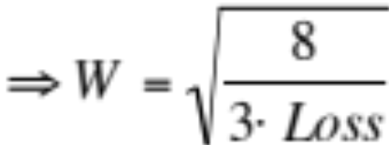
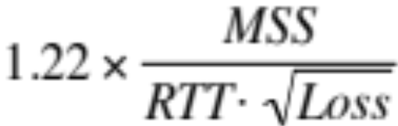
TCP Throughput (cont)
  Loss = 8/(3W²) (4)
  Substituting (4) in (2), S = 0.75 W MSS / RTT ,
  Throughput ≈
Equation-based rate control can be TCP friendly and have better properties, e.g., small jitter, fast ramp-up…

Slide 13
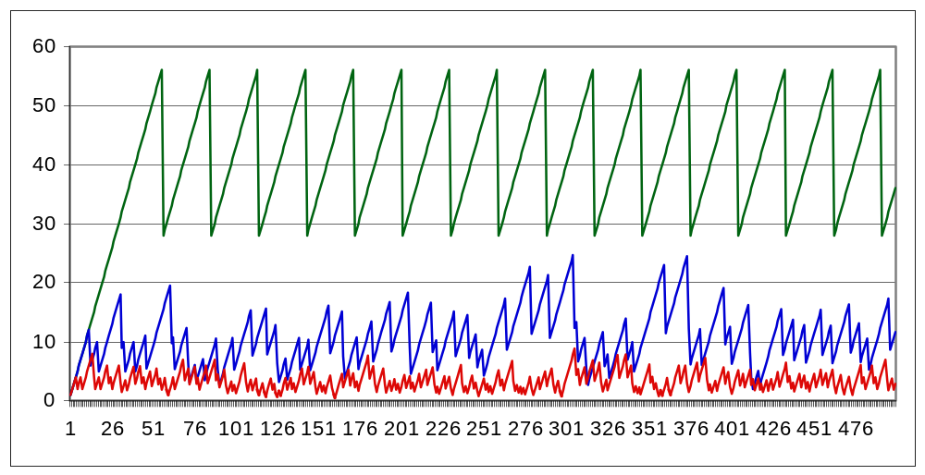
What Happens When Link is Lossy?
Throughput ≈ 1 / sqrt(Loss)
p = 0
p = 1%
p = 10%

Slide 14
What can we do about it?
Two types of losses: congestion and corruption
One option: mask corruption losses from TCP
  Retransmissions at the link layer
  E.g. Snoop TCP: intercept duplicate acknowledgments, retransmit locally, filter them from the sender
Another option:
  Tell the sender about the cause for the drop
  Requires modification to the TCP endpoints

Slide 15
Congestion Avoidance
TCP creates congestion to then back off
  Queues at bottleneck link are often full: increased delay
  Sawtooth pattern: jitter
Alternative strategy
  Predict when congestion is about to happen
  Reduce rate early
Other approaches
  Delay Based: TCP Vegas (not covered)
  Better model of congestion: BBR
  Router-centric: RED, ECN, DECBit, DCTCP

Slide 16
Another view of Congestion Control
Round Trip Time
Bytes in Flight
Throughput
Bytes in Flight
Tput =
InFlight/
RTT_{prop}
Diagrams based on Cardwell et al., BBR: Congestion Based Congestion Control,”
Communications of the ACM, Vol. 60 No. 2, Pages 58-66.

Slide 17
Another view of Congestion Control
Round Trip Time
RTT_{prop}
Bytes in Flight
BDP
Bottleneck BW
Throughput
Slope = 1/RTT_{prop}
Bytes in Flight

Slide 18
Another view of Congestion Control
Slope = 1/BW
Round Trip Time
RTT_{prop}
Bytes in Flight
Bottleneck BW
Throughput
Slope = 1/RTT_{prop}
BDP
Bytes in Flight
BDP+Bottleneck
Queue

Slide 19
Another view of Congestion Control
Ideal
Operating Point
Slope = 1/BW
Round Trip Time
RTT_{prop}
Loss-based CC
Bytes in Flight
Bottleneck BW
Throughput
Slope = 1/RTT_{prop}
BDP
Bytes in Flight
BDP+Bottleneck
Queue
Notes:
Why is the slope the BW? One way to view this is to look at the onset of drops: at this point the queue is full with Q packets, and the extra RTT is the time it takes to send Q extra packets at the bottleneck BW. Slope is then ”time to send Q packets” / Q packets, which is the 1/BW.

Slide 20
BBR
Problem: can’t measure both RTT_{prop} and Bottleneck BW at the same time
BBR:
  Slow start
  Measure throughput when RTT starts to increase
  Measure RTT when throughput is still increasing
  Pace packets at the BDP
  Probe by sending faster for 1RTT, then slower to compensate

Slide 21
BBR
From: https://labs.ripe.net/Members/gih/bbr-tcp

Slide 22
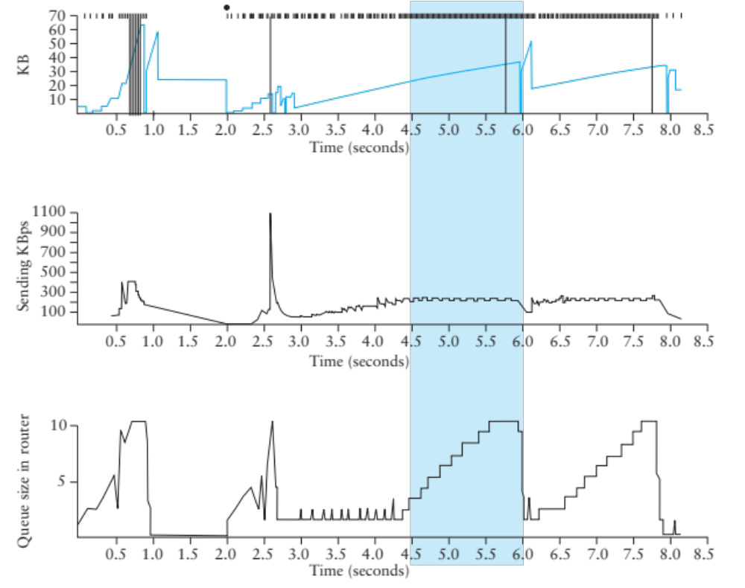
TCP Vegas
Idea: source watches for sign that router’s queue is building up (e.g., sending rate flattens)

Slide 23
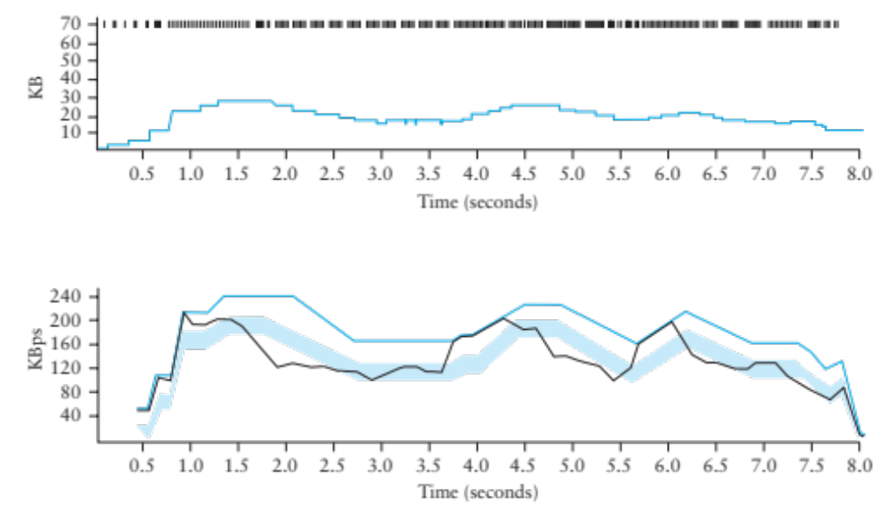
TCP Vegas
Compare Actual Rate (A) with Expected Rate (E)
  If E-A > β, decrease cwnd linearly : A isn’t responding
  If E-A < α, increase cwnd linearly : Room for A to grow

Slide 24
Vegas
Shorter router queues
Lower jitter
Problem:
  Doesn’t compete well with Reno. Why?
  Reacts earlier, Reno is more aggressive, ends up with higher bandwidth…

Slide 25
Help from the network
What if routers could tell TCP that congestion is happening?
  Congestion causes queues to grow: rate mismatch
TCP responds to drops
Idea: Random Early Drop (RED)
  Rather than wait for queue to become full, drop packet with some probability that increases with queue length
  TCP will react by reducing cwnd
  Could also mark instead of dropping: ECN

Slide 26
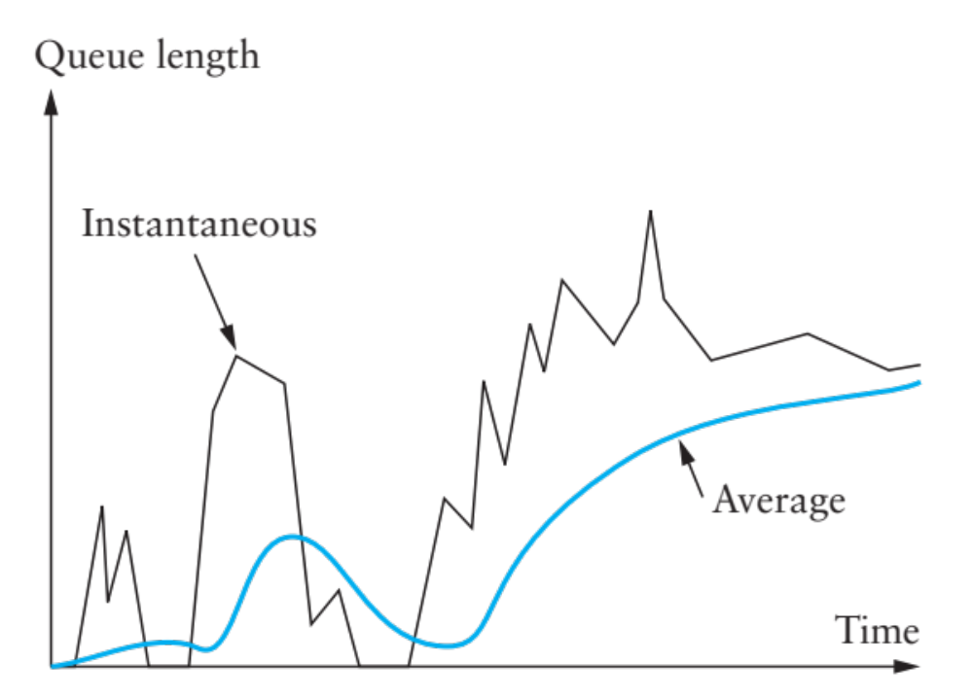
RED Details
Compute average queue length (EWMA)
  Don’t want to react to very quick fluctuations

Slide 27
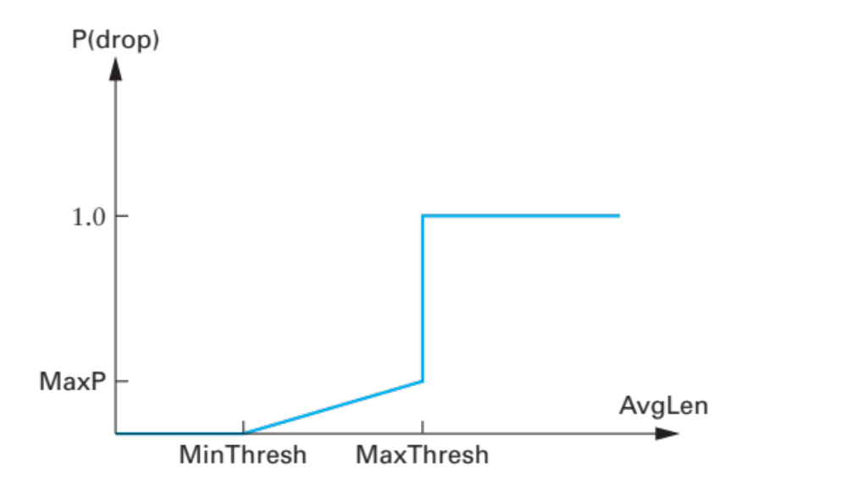
RED Drop Probability
Define two thresholds: MinThresh, MaxThresh
Drop probability:
Improvements to spread drops (see book)

Slide 28
RED Advantages
Probability of dropping a packet of a particular flow is roughly proportional to the share of the bandwidth that flow is currently getting
Higher network utilization with low delays
Average queue length small, but can absorb bursts
ECN
  Similar to RED, but router sets bit in the packet
  Must be supported by both ends
  Avoids retransmissions optionally dropped packets

Slide 29
What happens if not everyone cooperates?
TCP works extremely well when its assumptions are valid
  All flows correctly implement congestion control
  Losses are due to congestion

Slide 30
Cheating TCP
Possible ways to cheat
  Increasing cwnd faster
  Large initial cwnd
  Opening many connections
  Ack Division Attack

Slide 31
Increasing cwnd Faster
y
C
x increases by 2 per RTT
y increases by 1 per RTT
Limit rates:
x = 2y
x
Figure from Walrand, Berkeley EECS 122, 2003

Slide 32
Larger Initial Window
x
A
B
y
D
E
x starts SS with cwnd = 4
y starts SS with cwnd = 1
Figure from Walrand, Berkeley EECS 122, 2003

Slide 33
Open Many Connections
Web Browser: has to download k objects for a page
  Open many connections or download sequentially?
x
A
B
y
D
E
Assume:
  A opens 10 connections to B
  B opens 1 connection to E
TCP is fair among connections
  A gets 10 times more bandwidth than B
Figure from Walrand, Berkeley EECS 122, 2003

Slide 34
Exploiting Implicit Assumptions
Savage, et al., CCR 1999:
  “TCP Congestion Control with a Misbehaving Receiver”
Exploits ambiguity in meaning of ACK
  ACKs can specify any byte range for error control
  Congestion control assumes ACKs cover entire sent segments
What if you send multiple ACKs per segment?

Slide 35
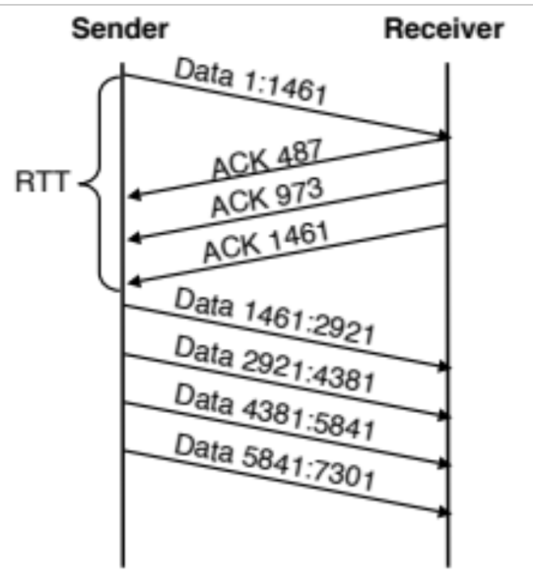
ACK Division Attack
Receiver: “upon receiving a segment with N bytes, divide the bytes in M groups and acknowledge each group separately”
Sender will grow window M times faster
Could cause growth to 4GB in 4 RTTs!
  M = N = 1460

Slide 36
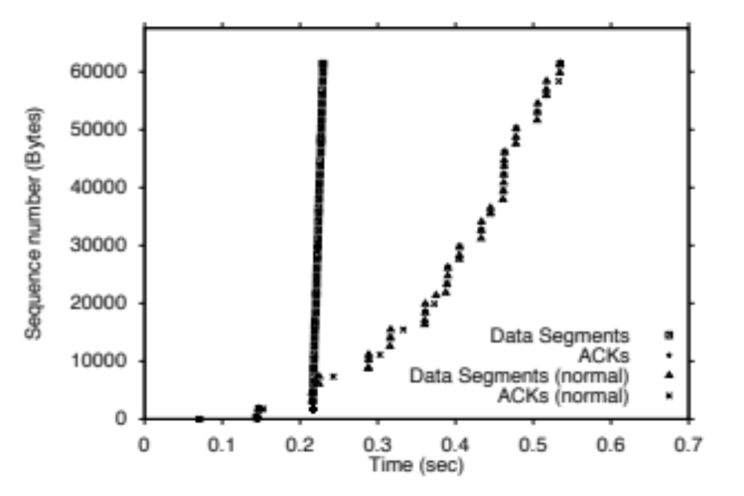
TCP Daytona!

Slide 37
Defense
Appropriate Byte Counting
  [RFC3465 (2003), RFC 5681 (2009)]
  In slow start, cwnd += min (N, MSS)
  where N is the number of newly acknowledged bytes in the received ACK

Slide 38
Cheating TCP and Game Theory
x
A
B
y
D
E
D → Increases by 1 Increases by 5
A
Increases by 1
Increases by 5
(x, y)
22, 22 | 10, 35
35, 10 | 15, 15
Too aggressive
Losses
Throughput falls
Individual incentives: cheating pays
Social incentives: better off without cheating
Classic PD: resolution depends on accountability

Slide 39
An alternative for reliability
Erasure coding
  Assume you can detect errors
  Code is designed to tolerate entire missing packets
    Collisions, noise, drops because of bit errors
  Forward error correction
Examples: Reed-Solomon codes, LT Codes, Raptor Codes
Property:
  From K source frames, produce B > K encoded frames
  Receiver can reconstruct source with any K’ frames, with K’ slightly larger than K
  Some codes can make B as large as needed, on the fly

Slide 40
LT Codes
Luby Transform Codes
  Michael Luby, circa 1998
Encoder: repeat B times
  Pick a degree d (*)
  Randomly select d source blocks. Encoded block t_{n}= XOR or selected blocks
  * The degree is picked from a distribution, robust soliton distribution, that guarantees that the decoding process will succeed with high probability

Slide 41
LT Decoder
Find an encoded block t_{n} with d=1
Set s_{n} = t_{n}
For all other blocks t_{n’} that include s_{n} ,
set t_{n’}=t_{n’} XOR s_{n}
Delete s_{n} from all encoding lists
Finish if
  You decode all source blocks, or
  You run out out blocks of degree 1

Slide 42
Next Time
Move into the application layer
DNS, Web, Security, and more…

Slide 43
Backup slides
We didn’t cover these in lecture: won’t be in the exam, but you might be interested ☺

Slide 44
More help from the network
Problem: still vulnerable to malicious flows!
  RED will drop packets from large flows preferentially, but they don’t have to respond appropriately
Idea: Multiple Queues (one per flow)
  Serve queues in Round-Robin
  Nagle (1987)
  Good: protects against misbehaving flows
  Disadvantage?
  Flows with larger packets get higher bandwidth

Slide 45
Solution
Bit-by-bit round robing
Can we do this?
  No, packets cannot be preempted!
We can only approximate it…

Slide 46
Fair Queueing
Define a fluid flow system as one where flows are served bit-by-bit
Simulate ff, and serve packets in the order in which they would finish in the ff system
Each flow will receive exactly its fair share

Slide 47
Example
Flow 1
(arrival traffic)
1
2
3
4
5
6
time
Flow 2
(arrival traffic)
1
2
3
4
5
time
Service
in fluid flow
system
1
2
1
2
3
4
5
6
3
4
5
time
Packet
system
1
2
1
3
2
3
4
4
5
5
6
time

Slide 48
Implementing FQ
Suppose clock ticks with each bit transmitted
  (RR, among all active flows)
P_{i} is the length of the packet
S_{i} is packet i’s start of transmission time
F_{i} is packet i’s end of transmission time
F_{i} = S_{i} + P_{i}
When does router start transmitting packet i?
  If arrived before F_{i-1}, S_{i} = F_{i-1}
  If no current packet for this flow, start when packet arrives (call this A_{i}): S_{i} = A_{i}
Thus, F_{i} = max(F_{i-1},A_{i}) + P_{i}

Slide 49
Fair Queueing
Across all flows
  Calculate F_{i} for each packet that arrives on each flow
  Next packet to transmit is that with the lowest F_{i}
  Clock rate depends on the number of flows
Advantages
  Achieves max-min fairness, independent of sources
  Work conserving
Disadvantages
  Requires non-trivial support from routers
  Requires reliable identification of flows
  Not perfect: can’t preempt packets
Notes:
Example of max-min fairness: 10: 8, 6, 2 => 10/3 = 3.33; 2 gets 2; 8 remaining: 8/2 = 4, others get 8, 6.

Slide 50
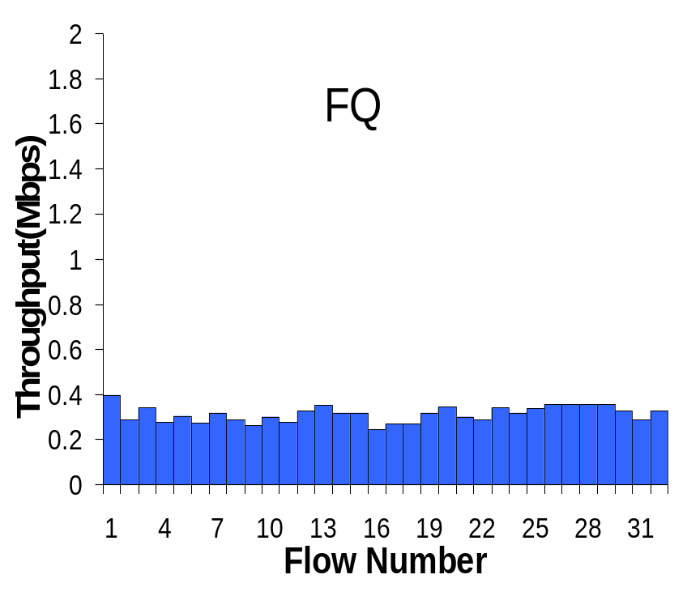
Fair Queueing Example
10Mbps link, 1 10Mbps UDP, 31 TCPs

Slide 51
Big Picture
Fair Queuing doesn’t eliminate congestion: just manages it
You need both, ideally:
  End-host congestion control to adapt
  Router congestion control to provide isolation

