Slide 1
CSCI-1680
Network Layer:
Wrapup
Rodrigo Fonseca
Based partly on lecture notes by Jennifer Rexford, Rob Sherwood, David Mazières, Phil Levis, John Jannotti

Slide 2
Administrivia
HW2 Due tomorrow
  0 late days
  Solutions posted tomorrow at the latest, so you can study ☺
Midterm on Monday, 7pm, CIT368
  Up to what is covered TODAY

Slide 3
Today: IP Wrap-up
IP Service models
  Unicast, Broadcast, Anycast, Multicast
IPv6
  Tunnels

Slide 4
Different IP Service Models
Broadcast: send a packet to all nodes in some subnet. “One to all”
  255.255.255.255 : all hosts within a subnet, never forwarded by a router
  “All ones host part”: broadcast address
    Host address | (255.255.255.255 & ~subnet mask)
    E.g.: 128.148.32.143 mask 255.255.255.128
    ~mask = 0.0.0.127 => Bcast = 128.148.32.255
Example use: DHCP
Not present in IPv6
  Use multicast to link local all nodes group

Slide 5
Anycast
Multiple hosts may share the same IP address
“One to one of many” routing
Example uses: load balancing, nearby servers
  DNS Root Servers (e.g. f.root-servers.net)
  Google Public DNS (8.8.8.8)
  IPv6 6-to-4 Gateway (192.88.99.1)
Notes:
dig +norec @F.ROOT-SERVERS.NET HOSTNAME.BIND CHAOS TXT

Slide 6
Anycast Implementation
Anycast addresses are /32s
At the BGP level
  Multiple ASs can advertise the same prefixes
  Normal BGP rules choose one route
At the Router level
  Router can have multiple entries for the same prefix
  Can choose among many
Each packet can go to a different server
  Best for services that are fine with that (connectionless, stateless)

Slide 7
Multicast
Send messages to many nodes: “one to many”
Why do that?
  Snowcast, Internet Radio, IPTV
  Stock quote information
  Multi-way chat / video conferencing
  Multi-player games
What’s wrong with sending data to each recipient?
  Link stress
  Have to know address of all destinations
Notes:
Wrong: link stress, have to know each recipient

Slide 8
Multicast Service Model
Receivers join a multicast group G
Senders send packets to address G
Network routes and delivers packets to all members of G
Multicast addresses: class D (start 1110)
224.x.x.x to 229.x.x.x
  28 bits left for group address

Slide 9
LAN Multicast
Easy on a shared medium
Ethernet multicast address range:
  01:00:5E:00:00:00 to 01:00:5E:7f:ff:ff
Set low 23 bits of Ethernet address to low bits of IP address
  (Small problem: 28-bit group address -> 23 bits)
  How about on the Internet?
Notes:
The implication of the mismatch is that a node may receive packets destined to another group. The IP layer, however, will drop the extraneous packets.

Slide 10
Wide Area: Distribution Trees
Source-specific trees:
  Spanning tree over recipients, rooted at each source
  Best for each source
Shared trees:
  Single spanning tree among all sources and recipients
  Hard to find one shared tree that’s best for many senders
State in routers much larger for source-specific
How to build these trees is beyond our scope here.

Slide 11
Source vs Shared Trees

Slide 12
Building the Tree: Host to Router
Nodes tell their local routers about groups they want to join
  IGMP, Internet Group Management Protocol (IPv4)
  MLD, Multicast Listener Discovery (IPv6)
Router periodically polls LAN to determine memberships
  Hosts are not required to leave, can stop responding

Slide 13
Building the Tree across networks
Routers maintain multicast routing tables
  Multicast address -> set of interfaces, or
  <Source, Multicast address> -> set of interfaces
Critical: only include interfaces where there are downstream recipients

Slide 14
Practical Considerations
Multicast protocols end up being quite complex
Introduce a lot of router state
Turned off on most routers
Mostly used within domains
  In the department: Ganglia monitoring infrastructure
  IPTV on campus
Alternative: do multicast in higher layers

Slide 15
IPv4 Address Exhaustion
Turns out 2³² addresses was not a lot
  (Hint: 7.6B ~ 1.7 x 2³² people in the world)
How bad is the problem?
What to do?

Slide 16
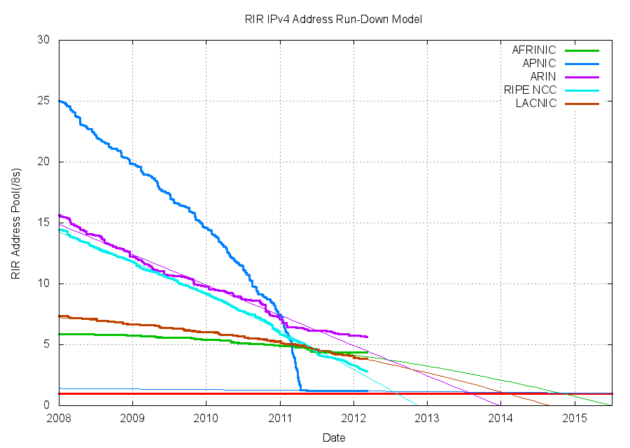
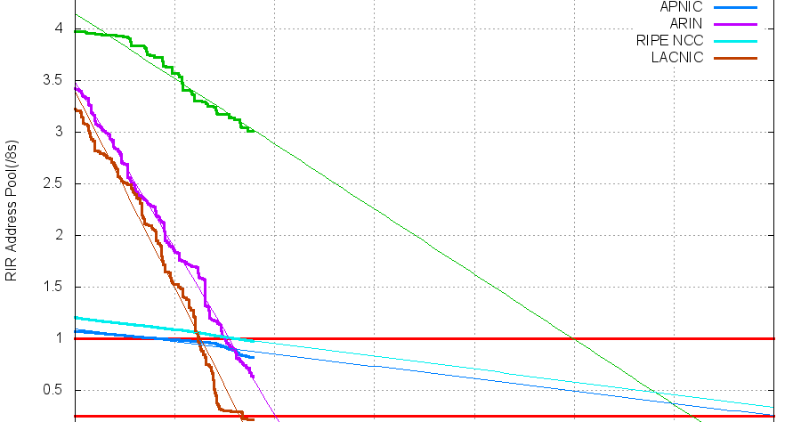
Source: potaroo.net/tools/ipv4

Slide 17
Source: potaroo.net/tools/ipv4

Slide 18
So what happened when we ran out of IPv4 addresses?
Jun 2014
It’s not completely gone just yet, but close
Address block fragmentation
  Secondary market for IPv4
  E.g., in 2011 Microsoft bought >600K US IPv4 addresses for $7.5M
NATs galore
  Home NATs, carrier-grade NATs

Slide 19
Network Address Translation (NAT)
NAT “hides” entire network behind one address
Hosts are given private addresses
  192.168/16; 172.16/12; 10/8
Routers map outgoing packets to a free address/port
Router reverse maps incoming packets
This can happen recursively!
Problems?
Notes:
Incoming flows
Shared ports
Breaks assumptions

Slide 20
IPv6
Main motivation: IPv4 address exhaustion
Initial idea: larger address space
Need new packet format:
  REALLY expensive to upgrade all infrastructure!
  While at it, why don’t we fix a bunch of things in IPv4?
Work started in 1994, basic protocol published in 1998

Slide 21
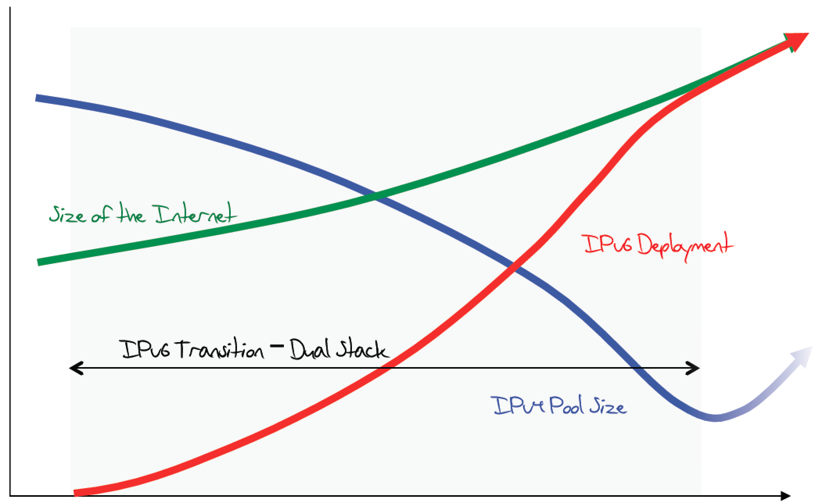
The original expected plan
From: http://www.potaroo.net/ispcol/2012-08/EndPt2.html

Slide 22
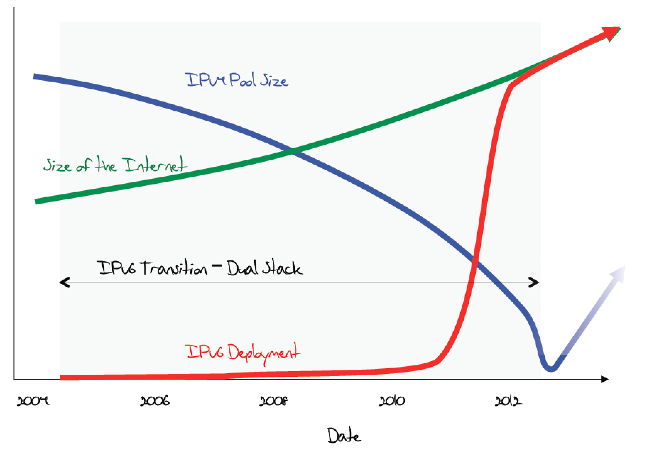
The plan in 2011

Slide 23
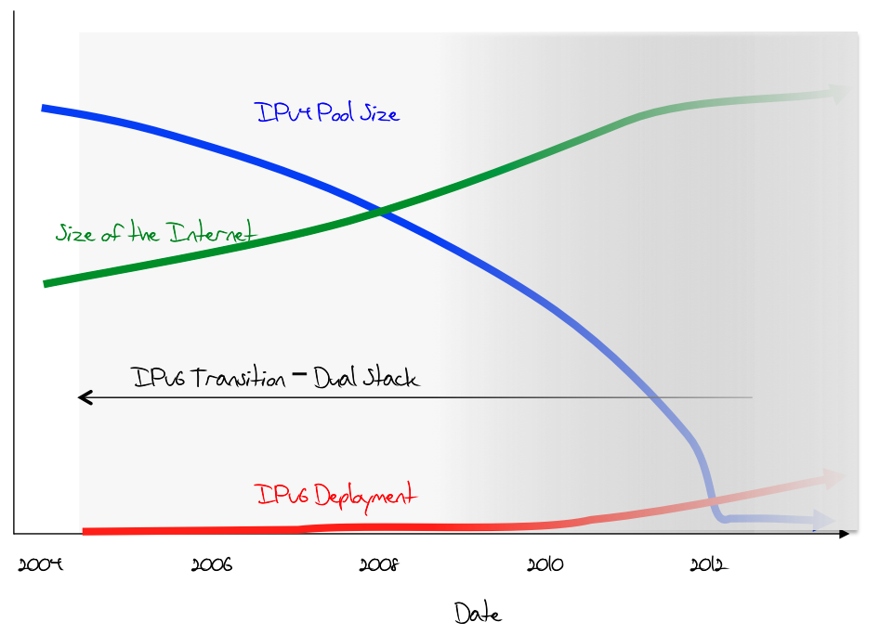
What was happening (late 2012)

Slide 24
June 6th, 2012

Slide 25
In 2014…
From: http://www.worldipv6launch.org/infographic/

Slide 26
In 2014. From: http://www.worldipv6launch.org/infographic/

Slide 27
In 2014. From: http://www.worldipv6launch.org/infographic/

Slide 28
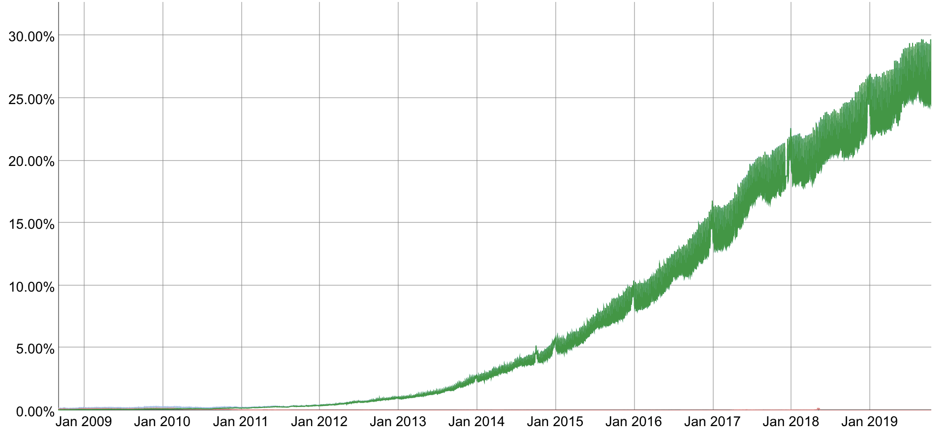
Current Adoption (as seen by Google)
percentage of users that access Google over IPv6
Source: http://www.google.com/ipv6/statistics.html

Slide 29
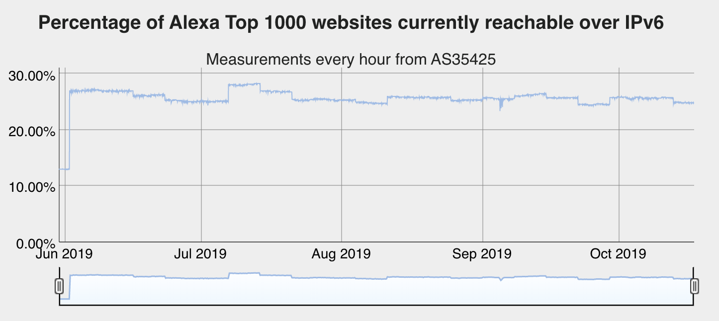
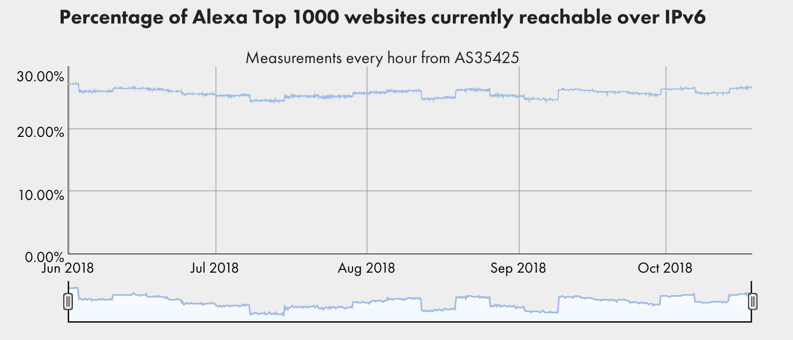
http://www.worldipv6launch.org/measurements/

Slide 30
Transition is not painless
From http://www.internetsociety.org/deploy360/ipv6/ :
Why do each of these parties have to do something?

Slide 31
IPv6 Key Features
128-bit addresses
  Autoconfiguration
Simplifies basic packet format through extension headers
  40-byte base header (fixed)
  Make less common fields optional
Security and Authentication

Slide 32
IPv6 Address Representation
Groups of 16 bits in hex notation
47cd:1244:3422:0000:0000:fef4:43ea:0001
Two rules:
  Leading 0’s in each 16-bit group can be omitted
  47cd:1244:3422:0:0:fef4:43ea:1
  One contiguous group of 0’s can be compacted
  47cd:1244:3422::fef4:43ea:1

Slide 33
IPv6 Addresses
Break 128 bits into 64-bit network and 64-bit interface
  Makes autoconfiguration easy: interface part can be derived from Ethernet address, for example
Types of addresses
  All 0’s: unspecified
  000…1: loopback
  ff/8: multicast
  fe8/10: link local unicast
  fec/10: site local unicast
  All else: global unicast

Slide 34
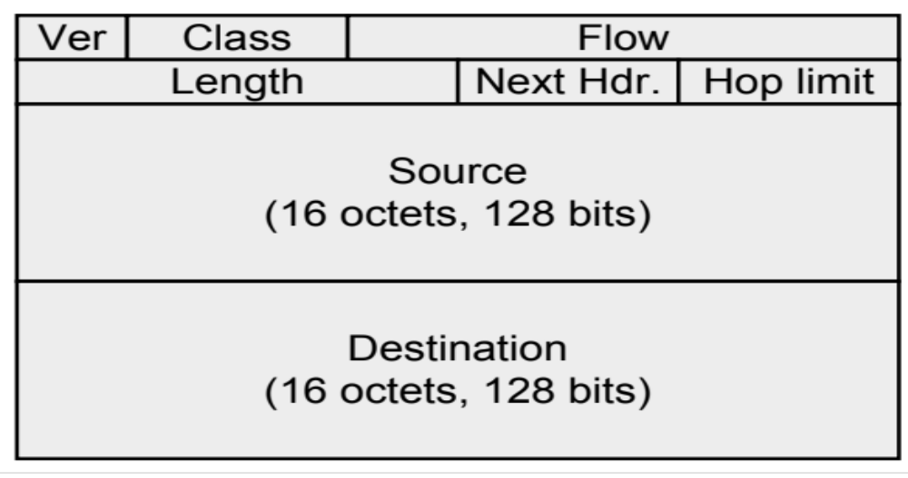
IPv6 Header

Slide 35
IPv6 Header Fields
Version: 4 bits, 6
Class: 8 bits, like TOS in IPv4
Flow: 20 bits, identifies a flow
Length: 16 bits, datagram length
Next Header, 8 bits: …
Hop Limit: 8 bits, like TTL in IPv4
Addresses: 128 bits
What’s missing?
  No options, no fragmentation flags, no checksum

Slide 36
Design Philosophy
Simplify handling
  New option mechanism (fixed size header)
  No more header length field
Do less work at the network (why?)
  No fragmentation
  No checksum
General flow label
  No semantics specified
  Allows for more flexibility
Still no accountability
With some content from Scott Shenker
Notes:
End-to-end principle

Slide 37
Interoperability
RFC 4038
  Every IPv4 address has an associated IPv6 address (mapped)
  Networking stack translates appropriately depending on other end
  Simply prefix 32-bit IPv4 address with 80 bits of 0 and 16 bits of 1:
  E.g., ::FFFF:128.148.32.2
Two IPv6 endpoints must have IPv6 stacks
Transit network:
  v6 – v6 – v6 : ✔
  v4 – v4 – v4 : ✔
  v4 – v6 – v4 : ✔
  v6 – v4 – v6 : ✗!!

Slide 38
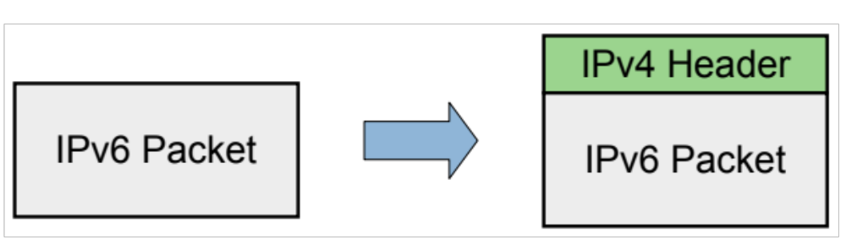
IP Tunneling
Encapsulate an IP packet inside another IP packet
Makes an end-to-end path look like a single IP hop

Slide 39
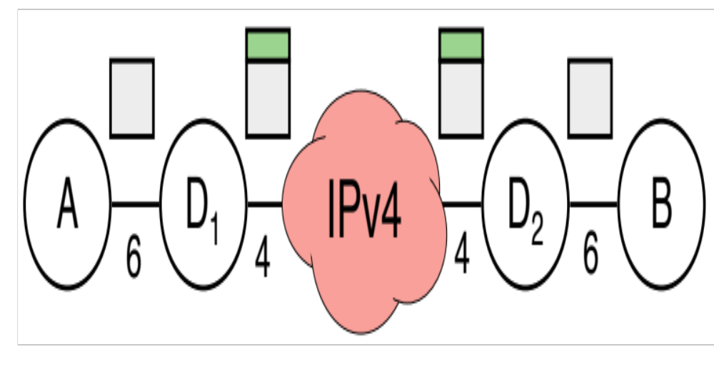
IPv6 in IPv4 Tunneling
Key issues: configuring the tunnels
  Determining addresses
  Determining routes
  Deploying relays to encapsulate/forward/decapsulate
Several proposals, not very successful
  6to4, Teredo, ISATAP, 6rd
  E.g., 6to4
    Deterministic address generation
    Anycast 192.88.99.1 to find gateway into IPv6 network
    Drawbacks: voluntary relays, requires public endpoint address
Notes:
TEREDO: Microsoft protocol for transition, also requires relays
SixXS: public tunnel broker

Slide 40
Other uses for tunneling
Virtual Private Networks
Use case: access CS network from the outside
  Set up an encrypted TCP connection between your computer and Brown’s OpenVPN server
  Configure routes to Brown’s internal addresses to go through this connection
Can connect two remote sites securely

Slide 41
Extension Headers
Two types: hop-by-hop and end-to-end
Both have a next header byte
Last next header also denotes transport protocol
Destination header: intended for IP endpoint
  Fragment header
  Routing header (loose source routing)
Hop-by-hop headers: processed at each hop
  Jumbogram: packet is up to 2³² bytes long!

Slide 42
Example Next Header Values
0: Hop by hop header
1: ICMPv4
4: IPv4
6:TCP
17: UDP
41: IPv6
43: Routing Header
44: Fragmentation Header
58: ICMPv6

Slide 43
Fragmentation and MTU
Fragmentation is supported only on end hosts!
Hosts should do MTU discovery
Routers will not fragment: just send ICMP saying packet was too big
Minimum MTU is 1280-bytes
  If some link layer has smaller MTU, must interpose fragmentation reassembly underneath

Slide 44
Current State
IPv6 Deployment picking up
Most end hosts have dual stacks today (Windows, Mac OSX, Linux, *BSD, Solaris)
Requires all parties to work!
  Servers, Clients, DNS, ISPs, all routers
IPv4 and IPv6 will coexist for a long time

Slide 45
Next time: Transport Layer
  UDP, TCP, Congestion Control
  Application protocols
  …

