Slide 1
CSCI-1680
Network Layer:
Inter-domain Routing – Policy and Security
Rodrigo Fonseca
Based partly on lecture notes by Jennifer Rexford, Rob Sherwood, David Mazières, Phil Levis, John Jannotti

Slide 2
Today
BGP Continued
  Policy routing, instability, vulnerabilities

Slide 3
Route Selection
More specific prefix
Next-hop reachable?
Prefer highest weight
  Computed using some AS-specific local policy
Prefer highest local-pref
Prefer locally originated routes
Prefer routes with shortest AS path length
Prefer eBGP over iBGP
Prefer routes with lowest cost to egress point
  Hot-potato routing
Tie-breaking rules
  E.g., oldest route, lowest router-id

Slide 4
Customer/Provider AS relationships
Customer pays for connectivity
  E.g. Brown contracts with OSHEAN
  Customer is stub, provider is a transit
Many customers are multi-homed
  E.g., OSHEAN connects to Level3, Cogent
Typical policies:
  Provider tells all neighbors how to reach customer
  Provider prefers routes from customers ($$)
  Customer does not provide transit service

Slide 5
Peer Relationships
ASs agree to exchange traffic for free
  Penalties/Renegotiate if imbalance
Tier 1 ISPs have no default route: all peer with each other
You are Tier i + 1 if you have a default route to a Tier I
Typical policies
  AS only exports customer routes to peer
  AS exports a peer’s routes only to its customers
  Goal: avoid being transit when no gain

Slide 6
AS Relationships
B
X
A
Z
C
Y
How to prevent X from forwarding transit between B and C?
How to avoid transit between CBA ?
  B: BAZ -> X
  B: BAZ -> C ? (=> Y: CBAZ and Y:CAZ)
Example from Kurose and Ross, 5th Ed
Notes:
X sends to Y over C, sends to Z over BA. What happens if B sends a packet to X with destination at Y?
X should never advertise any paths to B that include C.
B advertises BAZ to X
B should not advertise BAZ to C

Slide 7
Gao-Rexford Model
(simplified) Two types of relationships: peers and customer/provider
Export rules:
  Customer route may be exported to all neighbors
  Peer or provider route is only exported to customers
Preference rules:
  Prefer routes through customer ($$)
If all ASes follow this, shown to lead to stable network

Slide 8
Peering Drama
Cogent vs. Level3 were peers
In 2003, Level3 decided to start charging Cogent
Cogent said no
Internet partition: Cogent’s customers couldn’t get to Level3’s customers and vice-versa
  Other ISPs were affected as well
Took 3 weeks to reach an undisclosed agreement

Slide 9
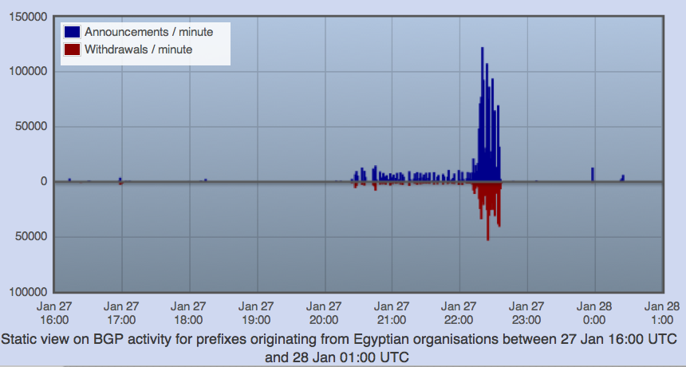
“Shutting off” the Internet
Starting from Jan 27th, 2011, Egypt was disconnected from the Internet
  2769/2903 networks withdrawn from BGP (95%)!
Source: RIPEStat - http://stat.ripe.net/egypt/

Slide 10
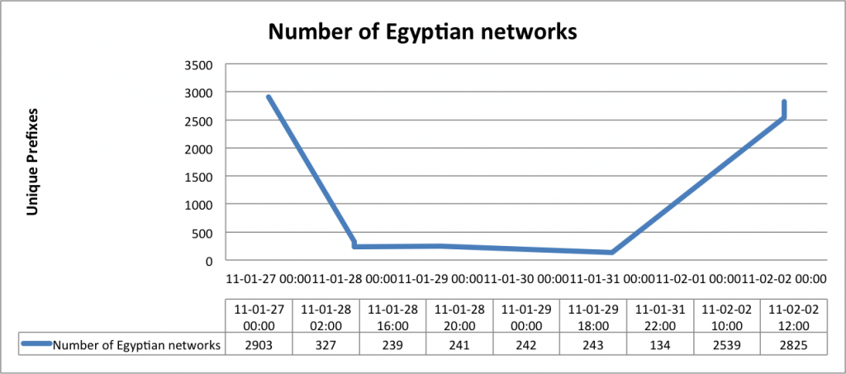
Egypt Incident
Source: BGPMon (http://bgpmon.net/blog/?p=480)

Slide 11
Some BGP Challenges
Convergence
Traffic engineering
  How to assure certain routes are selected
Scaling (route reflectors)
Security

Slide 12
BGP Security Goals
Confidential message exchange between neighbors
Validity of routing information
  Origin, Path, Policy
Correspondence to the data path

Slide 13
Origin: IP Address Ownership and Hijacking
IP address block assignment
  Regional Internet Registries (ARIN, RIPE, APNIC)
  Internet Service Providers
Proper origination of a prefix into BGP
  By the AS who owns the prefix
  … or, by its upstream provider(s) in its behalf
However, what’s to stop someone else?
  Prefix hijacking: another AS originates the prefix
  BGP does not verify that the AS is authorized
  Registries of prefix ownership are inaccurate

Slide 14

Prefix Hijacking
4
3
5
2
7
6
1
12.34.0.0/16
12.34.0.0/16
Consequences for the affected ASes
  Blackhole: data traffic is discarded
  Snooping: data traffic is inspected, and then redirected
  Impersonation: data traffic is sent to bogus destinations

Slide 15
Hijacking is Hard to Debug
Real origin AS doesn’t see the problem
  Picks its own route
  Might not even learn the bogus route
May not cause loss of connectivity
  E.g., if the bogus AS snoops and redirects
  … may only cause performance degradation
Or, loss of connectivity is isolated
  E.g., only for sources in parts of the Internet
Diagnosing prefix hijacking
  Analyzing updates from many vantage points
  Launching traceroute from many vantage points

Slide 16
Sub-Prefix Hijacking
4
3
5
2
7
6
1
12.34.0.0/16
12.34.158.0/24
Originating a more-specific prefix
  Every AS picks the bogus route for that prefix
  Traffic follows the longest matching prefix

Slide 17
How to Hijack a Prefix
The hijacking AS has
  Router with eBGP session(s)
  Configured to originate the prefix
Getting access to the router
  Network operator makes configuration mistake
  Disgruntled operator launches an attack
  Outsider breaks in to the router and reconfigures
Getting other ASes to believe bogus route
  Neighbor ASes not filtering the routes
  … e.g., by allowing only expected prefixes
  But, specifying filters on peering links is hard

Slide 18
Pakistan Youtube incident
Youtube’s has prefix 208.65.152.0/22
Pakistan’s government order Youtube blocked
Pakistan Telecom (AS 17557) announces 208.65.153.0/24 in the wrong direction (outwards!)
Longest prefix match caused worldwide outage
http://www.youtube.com/watch?v=IzLPKuAOe50

Slide 19
Many other incidents
Spammers steal unused IP space to hide
  Announce very short prefixes (e.g., /8). Why?
  For a short amount of time
China incident, April 8th 2010
  China Telecom’s AS23724 generally announces 40 prefixes
  On April 8th, announced ~37,000 prefixes
  About 10% leaked outside of China
  Suddenly, going to www.dell.com might have you routing through AS23724!

Slide 20
Attacks on BGP Paths
Remove an AS from the path
  E.g., 701 3715 88 -> 701 88
Why?
  Attract sources that would normally avoid AS 3715
  Make path through you look more attractive
  Make AS 88 look like it is closer to the core
  Can fool loop detection!
May be hard to tell whether this is a lie
  88 could indeed connect directly to 701!
Notes:
Let’s say you want to make other Ases prefer your routes.

Slide 21
Attacks on BGP Paths
Adding ASes to the path
  E.g., 701 88 -> 701 3715 88
Why?
  Trigger loop detection in AS 3715
    This would block unwanted traffic from AS 3715!
  Make your AS look more connected
Who can tell this is a lie?
  AS 3715 could, if it could see the route
  AS 88 could, but would it really care?

Slide 22
Attacks on BGP Paths
Adding ASes at the end of the path
  E.g., 701 88 into 701 88 3
Why?
  Evade detection for a bogus route (if added AS is legitimate owner of a prefix)
Hard to tell that the path is bogus!
701
3
18.0.0.0/8
88
18.0.0.0/8
Notes:
Let’s say 88 wants to hijack a route to a prefix it does not own

Slide 23
Proposed Solution: S-BGP
Based on a public key infrastructure
Address attestations
  Claims the right to originate a prefix
  Signed and distributed out of band
  Checked through delegation chain from ICANN
Route attestations
  Attribute in BGP update message
  Signed by each AS as route along path
S-BGP can avoid
  Prefix hijacking
  Addition, removal, or reordering of intermediate ASes

Slide 24
S-BGP Deployment
Very challenging
  PKI (RPKI)
  Accurate address registries
  Need to perform cryptographic operations on all path operations
  Flag day almost impossible
  Incremental deployment offers little incentive
But there is hope! [Goldberg et al, 2011]
  Road to incremental deployment
  Change rules to break ties for secure paths
  If a few top Tier-1 ISPs
  Plus their respective stub clients deploy simplified version (just sign, not validate)
  Gains in traffic => $ => adoption!

Slide 25
Data Plane Attacks
Routers/ASes can advertise one route, but not necessarily follow it!
May drop packets
  Or a fraction of packets
  What if you just slow down some traffic?
Can send packets in a different direction
  Impersonation attack
  Snooping attack
How to detect?
  Congestion or an attack?
  Can let ping/traceroute packets go through
  End-to-end checks?
Harder to pull off, as you need control of a router

Slide 26
BGP Recap
Key protocol that holds Internet routing together
Path Vector Protocol among Autonomous Systems
Policy, feasibility first; non-optimal routes
Important security problems

Slide 27
Next Class
Network layer wrap up

Slide 28
Following slides not covered, but interesting

Slide 29
Convergence
Given a change, how long until the network re-stabilizes?
  Depends on change: sometimes never
  Open research problem: “tweak and pray”
  Distributed setting is challenging
Some reasons for change
  Topology changes
  BGP session failures
  Changes in policy
  Conflicts between policies can cause oscillation
Notes:
Why is this a problem? Because of policies, not shortest-path-routing

Slide 30
Routing Change: Before and After
0
0
(1,0)
(2,0)
(2,0)
(1,2,0)
1
2
1
2
(3,1,0)
(3,2,0)
3
3

Slide 31
Routing Change: Path Exploration
AS 1
  Delete the route (1,0)
  Switch to next route (1,2,0)
  Send route (1,2,0) to AS 3
AS 3
  Sees (1,2,0) replace (1,0)
  Compares to route (2,0)
  Switches to using AS 2
0
(2,0)
(1,2,0)
1
2
(3,2,0)
3

Slide 32
Routing Change: Path Exploration
Initial situation
  Destination 0 is alive
  All ASes use direct path
When destination dies
  All ASes lose direct path
  All switch to longer paths
  Eventually withdrawn
E.g., AS 2
  (2,0) → (2,1,0)
  (2,1,0) → (2,3,0)
  (2,3,0) → (2,1,3,0)
  (2,1,3,0) → null
Convergence may be slow!
(2,0)
(2,1,0)
(2,3,0)
(2,1,3,0)
(1,0)
(1,2,0)
(1,3,0)
1
2
0
3
(3,0)
(3,1,0)
(3,2,0)

Slide 33
Route Engineering
Route filtering
Setting weights
More specific routes: longest prefix
AS prepending: “477 477 477 477”
More of an art than science
Notes:
You can break a prefix into two, to get preference
You can make a path longer to avoid selection

Slide 34
Unstable Configurations
Due to policy conflicts (Dispute Wheel)
2 1 0
2 0
2
4
0
3 2 0
3 0
1 3 0
1 0
1
3
3
Notes:
Boxes denote route preferences.
Start with the direct routes, from an announcement from 0.
All nodes choose the direct route and advertise it.
Solution is tricky!

Slide 35
Avoiding BGP Instabilities
Detecting conflicting policies
  Centralized: NP-Complete problem!
  Distributed: open research problem
  Requires too much cooperation
Detecting oscillations
  Monitoring for repetitive BGP messages
Restricted routing policies and topologies
  Some topologies / policies proven to be safe*
* Gao & Rexford, “Stable Internet Routing
without Global Coordination”, IEEE/ACM ToN, 2001

Slide 36
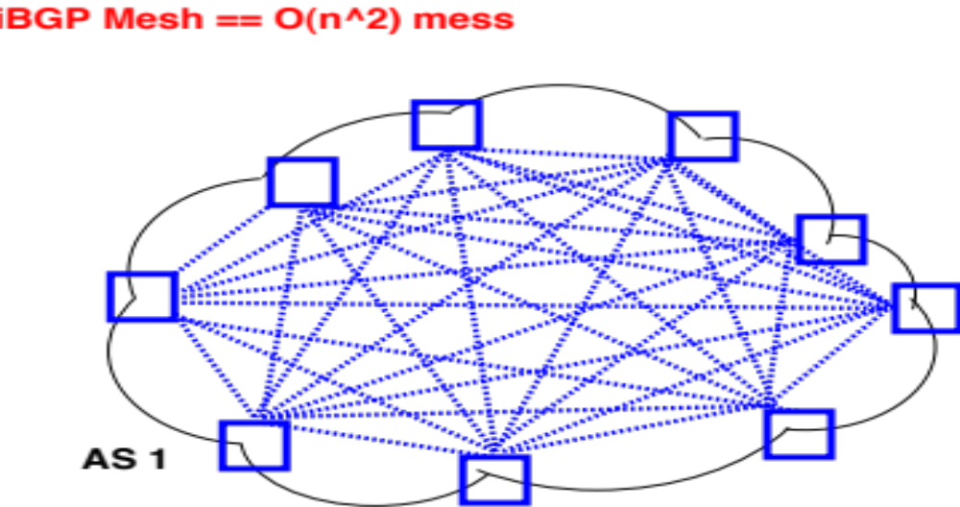
Scaling iBGP: route reflectors

Slide 37
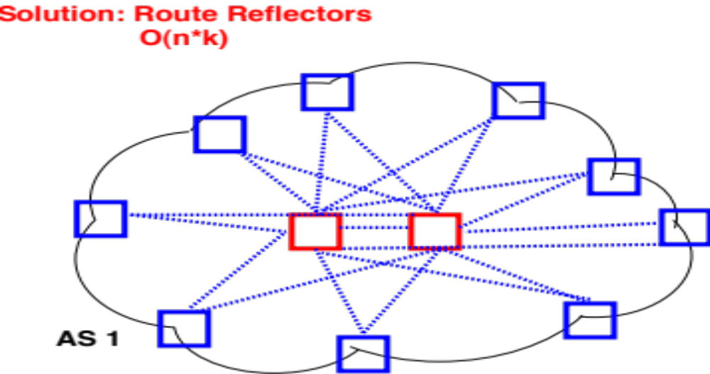
Scaling iBGP: route reflectors

Slide 38
Multiple Stable Configurations
BGP Wedgies [RFC 4264]
Typical policy:
  Prefer routes from customers
  Then prefer shortest paths

Slide 39
BGP Wedgies
3 4 5 1
3
4
4 5 1
2 3 4 5 1
5 1
2
5
1.2.0.0/16: 1 1 1 1
(Backup Path)
1
1.2.0.0/16: 1
Primary Path

Slide 40
BGP Wedgies
3 2 1 1 1 1
3
4
4 3 2 1 1 1 1
2 1 1 1 1
5 4 3 2 1 1 1 1
2
5
1.2.0.0/16: 1 1 1 1
(Backup Path)
1
1.2.0.0/16: 1
Primary Path

Slide 41
BGP Wedgies
3 prefers customer route: stable configuration!
3 2 1 1 1 1
3
4
4 5 1
2 1 1 1 1
5 1
2
5
1.2.0.0/16: 1 1 1 1
(Backup Path)
1
1.2.0.0/16: 1
Primary Path

