Slide 1
CSCI-1680
Network Layer:
Inter-domain Routing
Rodrigo Fonseca
Based partly on lecture notes by Rob Sherwood, David Mazières, Phil Levis, John Jannotti

Slide 2
Today
Last time: Intra-Domain Routing (IGP)
  RIP distance vector
  OSPF link state
Inter-Domain Routing (EGP)
  Border Gateway Protocol
  Path-vector routing protocol

Slide 3
Why Inter vs. Intra
Why not just use OSPF everywhere?
  E.g., hierarchies of OSPF areas?
  Hint: scaling is not the only limitation
BGP is a policy control and information hiding protocol
  intra == trusted, inter == untrusted
  Different policies by different ASs
  Different costs by different ASs

Slide 4
Types of ASs
  Local Traffic – source or destination in local AS
  Transit Traffic – passes through an AS
Stub AS
  Connects to only a single other AS
Multihomed AS
  Connects to multiple ASs
  Carries no transit traffic
Transit AS
  Connects to multiple ASs and carries transit traffic

Slide 5
AS Relationships
B
X
A
Z
C
Y
How to prevent X from forwarding transit between B and C?
How to avoid transit between CBA ?
  B: BAZ -> X (“B advertises BAZ to X”)
  B: BAZ -> C ? (=> Y: CBAZ and Y:CAZ)
Example from Kurose and Ross, 5th Ed
Notes:
X sends to Y over C, sends to Z over BA. What happens if B sends a packet to X with destination at Y?
X should never advertise any paths to B that include C.
B advertises BAZ to X
B should not advertise BAZ to C

Slide 6
Choice of Routing Algorithm
Constraints
  Scaling
  Autonomy (policy and privacy)
Link-state?
  Requires sharing of complete information
  Information exchange does not scale
  Can’t express policy
Distance Vector?
  Scales and retains privacy
  Can’t implement policy
  Can’t avoid loops if shortest path not taken
  Count-to-infinity

Slide 7
Path Vector Protocol
Distance vector algorithm with extra information
  For each route, store the complete path (ASs)
  No extra computation, just extra storage (and traffic)
Advantages
  Can make policy choices based on set of ASs in path
  Can easily avoid loops

Slide 8
BGP - High Level
Single EGP protocol in use today
Abstract each AS to a single node
Destinations are CIDR prefixes
Exchange prefix reachability with neighbors
  E.g., “I can reach prefix 128.148.0.0/16 through ASes 44444 3356 14325 11078”
  May choose to not advertise some paths to some neighbors
Select a single path by routing policy
Critical: learn many paths, propagate one
  Add your ASN to advertised path

Slide 9
BGP Implications
Explicit AS Path == Loop free
  Except under churn, IGP/EGP mismatch
Not all ASs know all paths
Reachability not guaranteed
  Decentralized combination of policies
AS abstraction -> loss of efficiency
Scaling
  55K ASs
  685K+ prefixes
  ASs with one prefix: 21292
  Most prefixes by one AS: 5551 (AS4538 ERX-CERNET-BKB - China Education and Research Network Center)
Source: cidr-report 17Oct2017

Slide 10
Why study BGP?
Critical protocol: makes the Internet run
  Only widely deployed EGP
Active area of problems!
  Efficiency
  Cogent vs. Level3: Internet Partition
  Spammers use prefix hijacking
  Pakistan accidentally took down YouTube
  Egypt disconnected for 5 days

Slide 11
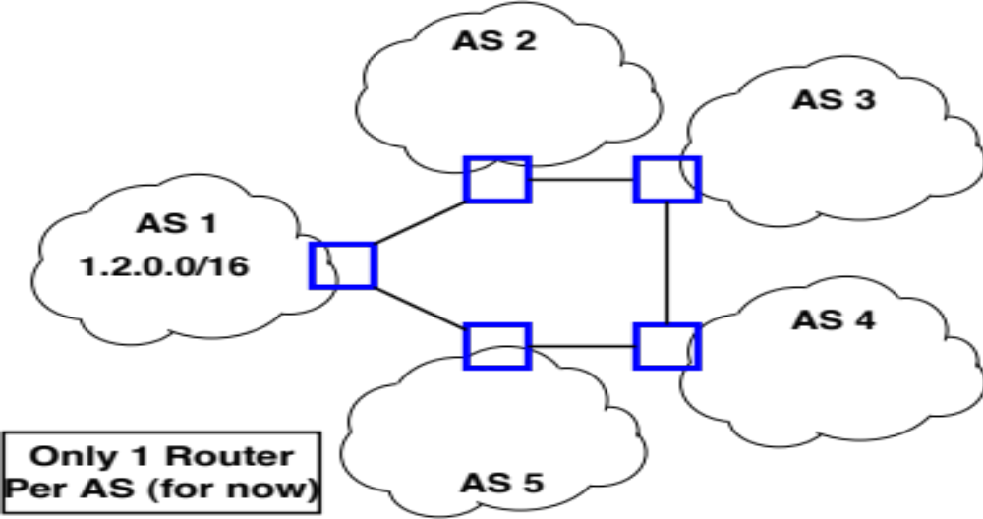
BGP Example

Slide 12
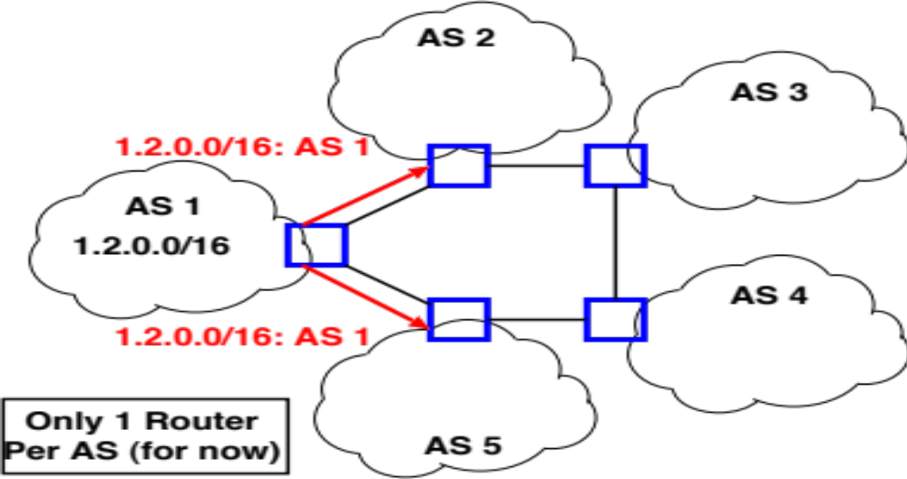
BGP Example

Slide 13
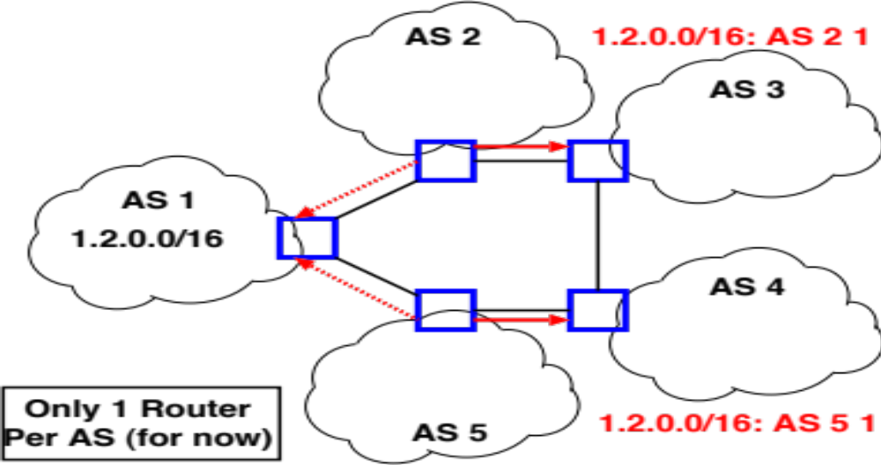
BGP Example

Slide 14
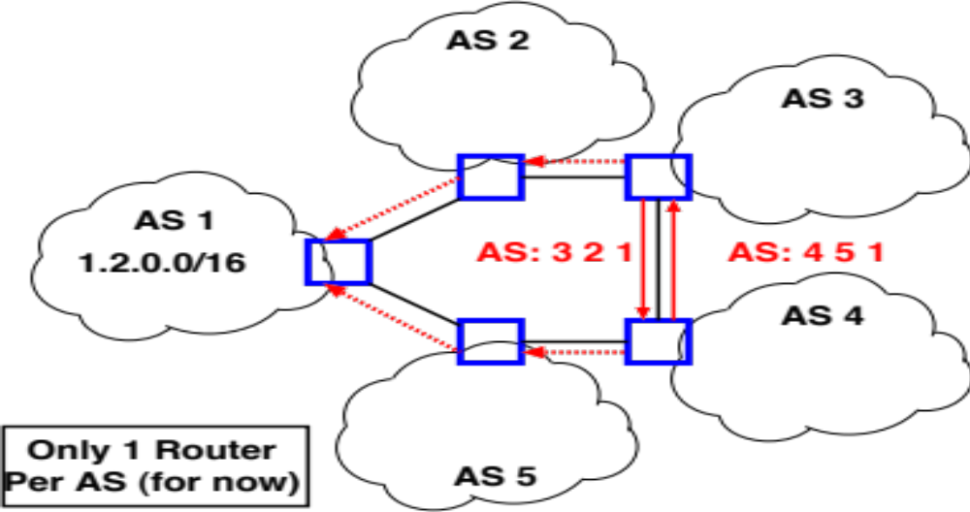
BGP Example

Slide 15
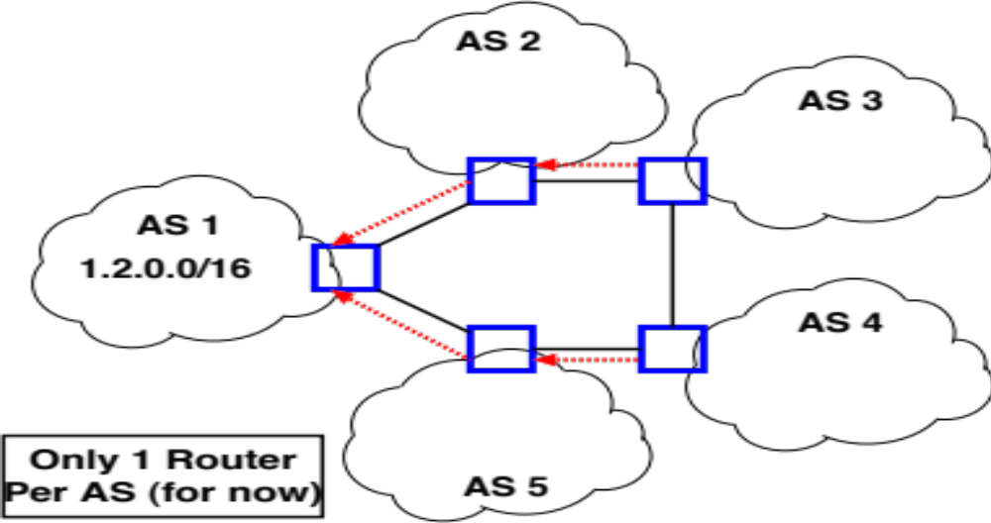
BGP Example

Slide 16
BGP Protocol Details
Separate roles of speakers and gateways
  Speakers talk BGP with other ASes
  Gateways are routes that border other ASes
  Can have more gateways than speakers
  Speakers know how to reach gateways
Speakers connect over TCP on port 179
  Bidirectional exchange over long-lived connection

Slide 17
BGP Messages
Base protocol has four message types
  OPEN – Initialize connection. Identifies peers and must be first message in each direction
  UPDATE – Announce routing changes (most important message)
  NOTIFICATION – Announce error when closing connection
  KEEPALIVE – Make sure peer is alive
Extensions can define more message types
  E.g., ROUTE-REFRESH [RFC 2918]

Slide 18
Anatomy of an UPDATE
Withdrawn routes: list of withdrawn IP prefixes
Network Layer Reachability Information (NLRI)
  List of prefixes to which path attributes apply
Path attributes
  ORIGIN, AS_PATH, NEXT_HOP, MULTI-EXIT-DISC, LOCAL_PREF, ATOMIC_AGGREGATE, AGGREGATOR, …
  Each attribute has 1-byte type, 1-byte flags, length, content
  Can introduce new types of path attribute – e.g., AS4_PATH for 32-bit AS numbers

Slide 19
Example
NLRI: 128.148.0.0/16
AS Path: ASN 44444 3356 14325 11078
Next Hop IP: same as in RIPv2
Knobs for traffic engineering:
  Metric, weight, LocalPath, MED, Communities
  Lots of voodoo
Notes:
MED is multiple exit discriminator
Communities may limit the scope of advertisements

Slide 20
BGP State
BGP speaker conceptually maintains 3 sets of state
Adj-RIB-In
  “Adjacent Routing Information Base, Incoming”
  Unprocessed routes learned from other BGP speakers
Loc-RIB
  Contains routes from Adj-RIB-In selected by policy
  First hop of route must be reachable by IGP or static route
Adj-RIB-Out
  Subset of Loc-RIB to be advertised to peer speakers
  Can be different for each peer

Slide 21
BGP State
RIBIn ⊃ LocRIB ⊃ RIBOut
RIBIn
LocRIB
RIBOut
(for each peer)
Announcements
from peers

Slide 22
Prefixes
Nodes in local network share prefix
  Key to decide whether to send message locally
Prefixes can also aggregate multiple networks
  E.g., 100.20.33.128/25, 100.20.33.0/25 -> 100.20.33.0/24
If networks connected hierarchically, can have significant aggregation
  What happens if not?

Slide 23
BGP Table Growth
Source: bgp.potaroo.net

Slide 24
BGP Table Growth for v6
Source: bgp.potaroo.net

Slide 25
What can lead to table growth?
More addresses being allocated
Fragmentation
  Multihoming
  Change of ISPs
  Address re-selling

Slide 26
Integrating EGP and IGP
How to get internal nodes to route towards external prefixes?
Stub ASs
  Border router clear choice for default route
  Inject into IGP: “any unknown route to border router”
Inject specific prefixes in IGP
  E.g., Provider injects routes to customer prefix
Backbone networks
  Too many prefixes for IGP
  Run internal version of BGP, iBGP
  All routers learn mappings: Prefix -> Border Router
  Use IGP to learn: Border Router -> Next Hop

Slide 27
iBGP

Slide 28
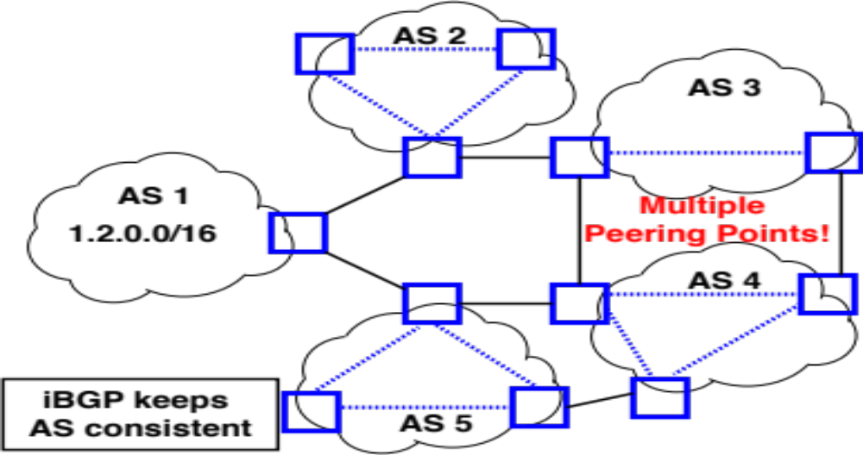
iBGP

Slide 29
Demo
Route views project: http://www.routeviews.org
  telnet route-views.linx.routeviews.org
  show ip bgp 128.148.0.0/16 longer-prefixes
All paths are learned internally (iBGP)
Not a production device

Slide 30
$ telnet route-views.telxatl.routeviews.org
Trying 67.23.60.46...
Connected to route-views.telxatl.routeviews.org.
Escape character is '^]'.
Hello, this is Quagga (version 1.1.0).
Copyright 1996-2005 Kunihiro Ishiguro, et al.
route-views.telxatl.routeviews.org> show ip bgp 128.148.0.0/16 longer-prefixes
BGP table version is 0, local router ID is 198.32.132.3
Status codes: s suppressed, d damped, h history, * valid, > best, = multipath,
i internal, r RIB-failure, S Stale, R Removed
Origin codes: i - IGP, e - EGP, ? - incomplete
Network Next Hop Metric LocPrf Weight Path
* 128.148.0.0 198.32.132.152 0 6082 2914 3257 14325 11078 i
* 198.32.132.160 0 27446 27446 6939 14325 11078 i
* 198.32.132.12 0 0 19151 6939 14325 11078 i
* 198.32.132.75 0 15008 6939 14325 11078 i
* 198.32.132.28 0 4181 6939 14325 11078 i
* 198.32.132.75 0 3491 6939 14325 11078 i
* 198.32.132.75 0 53828 6939 14325 11078 i
*> 198.32.132.75 0 6939 14325 11078 i
11078 is Brown’s ASN
14325 is Brown’s Provider, OSHEAN

Slide 31
Next class
BGP Policy Routing and Security

