Slide 1
CSCI-1680
Link Layer I
Rodrigo Fonseca
Based partly on lecture notes by David Mazières, Phil Levis, John Jannotti

Slide 2
Last time
  Physical layer: encoding, modulation
Today
  Link layer framing
  Getting frames across: reliability, performance

Slide 3
Layers, Services, Protocols
Application
Service: user-facing application.
Application-defined messages
Service: multiplexing applications
Reliable byte stream to other node (TCP),
Unreliable datagram (UDP)
Transport
Network
Service: move packets to any other node in the network
IP: Unreliable, best-effort service model
Link
Service: move frames to other node across link.
May add reliability, medium access control
Physical
Service: move bits to other node across link

Slide 4
Link Layer
Framing

Slide 5
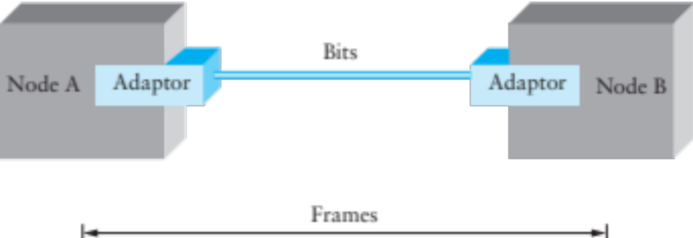
Framing
Given a stream of bits, how can we represent boundaries?
Break sequence of bits into a frame
Typically done by network adaptor

Slide 6
Representing Boundaries
Sentinels
Length counts
Clock-based

Slide 7
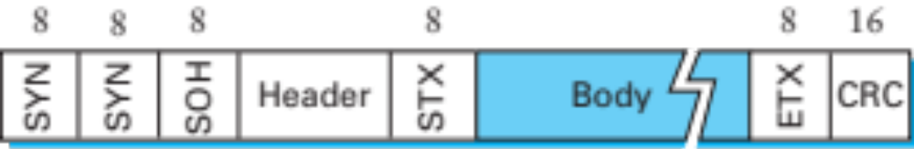
Sentinel-based Framing
Byte-oriented protocols (e.g. BISYNC, PPP)
  Place special bytes (SOH, ETX,…) in the beginning, end of messages
What if ETX appears in the body?
  Escape ETX byte by prefixing DEL byte
  Escape DEL byte by prefixing DEL byte
  Technique known as character stuffing

Slide 8
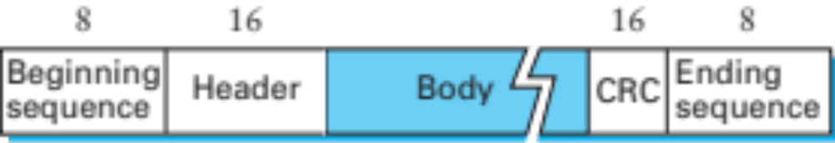
Bit-Oriented Protocols
View message as a stream of bits, not bytes
Can use sentinel approach as well (e.g., HDLC)
  HDLC begin/end sequence 01111110
Use bit stuffing to escape 01111110
  Always append 0 after five consecutive 1s in data
  After five 1s, receiver uses next two bits to decide if stuffed, end of frame, or error.
Notes:
USB uses bit stuffing for a different reason: it uses NRZI with 0:transition, 1:stay => 1’s are a problem. USB stuffs a 0 after every six consecutive 1’s
Go through 4 cases.

Slide 9
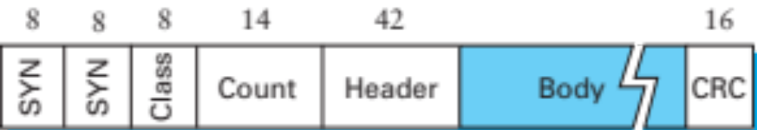
Length-based Framing
Drawback of sentinel techniques
  Length of frame depends on data
Alternative: put length in header (e.g., DDCMP)
Danger: Framing Errors
  What if high bit of counter gets corrupted?
  Adds 8K to length of frame, may lose many frames
  CRC checksum helps detect error
Notes:
DDCMP -> DECNet point-to-point, original VAX, PDP-11

Slide 10
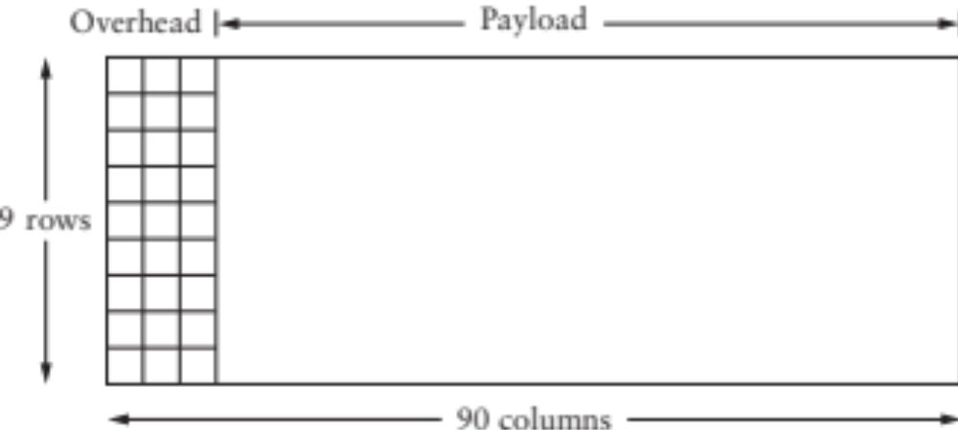
Clock-based Framing
E.g., SONET (Synchronous Optical Network)
  Each frame is 125μs long
  Look for header every 125μs
  Encode with NRZ, but first XOR payload with 127-bit string to ensure lots of transitions

Slide 11
Error Detection
Basic idea: use a checksum
  Compute small checksum value, like a hash of packet
Good checksum algorithms
  Want several properties, e.g., detect any single-bit error
  Details later

Slide 12
Link Layer
Getting Frames Across
Reliability and Performance

Slide 13
Sending Frames Across
Transmission Delay
Latency
Propagation Delay
Notes:
How long does it take to send a frame across?

Slide 14
Sending Frames Across
…
Throughput: bits / s
…
Notes:
How fast can we receive bytes?

Slide 15
Which matters most, bandwidth or delay?
How much data can we send during one RTT?
E.g., send request, receive file
Request
Response
Time
For small transfers, latency more important, for bulk, throughput more important

Slide 16
Performance Metrics
Throughput - Number of bits received/unit of time
  e.g. 10Mbps
Goodput - Useful bits received per unit of time
Latency – How long for message to cross network
  Process + Queue + Transmit + Propagation
Jitter – Variation in latency

Slide 17
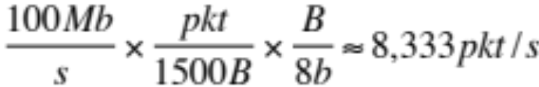
Latency
Processing
  Per message, small, limits throughput
  e.g. or 120μs/pkt
Queue
  Highly variable, offered load vs outgoing b/w
Transmission
  Size/Bandwidth
Propagation
  Distance/Speed of Light

Slide 18
Reliable Delivery
Several sources of errors in transmission
Error detection can discard bad frames
Problem: if bad packets are lost, how can we ensure reliable delivery?
  Exactly-once semantics = at least once + at most once

Slide 19
At Least Once Semantics
How can the sender know packet arrived at least once?
  Acknowledgments + Timeout
Stop and Wait Protocol
  S: Send packet, wait
  R: Receive packet, send ACK
  S: Receive ACK, send next packet
  S: No ACK, timeout and retransmit

Slide 20
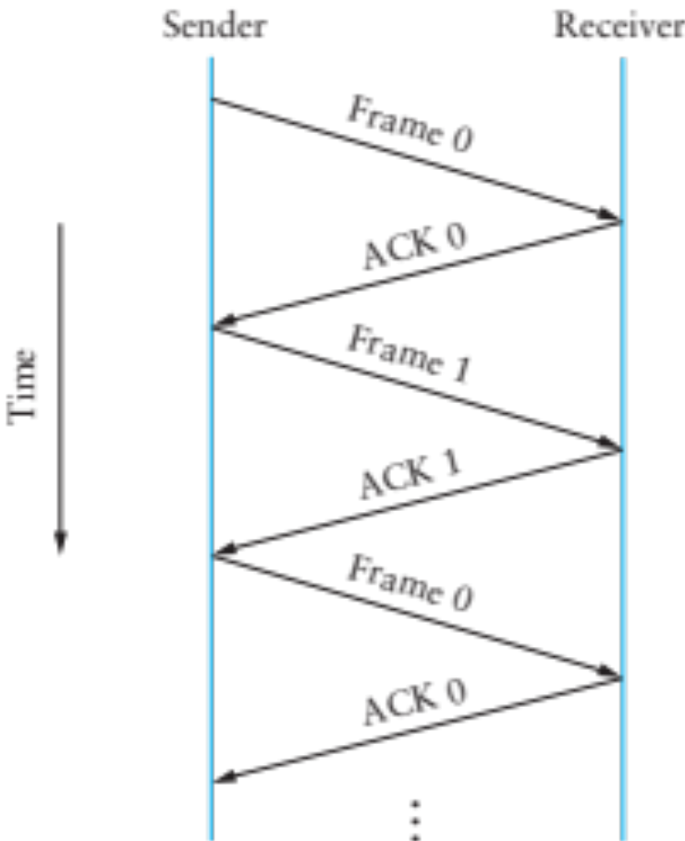

Slide 21
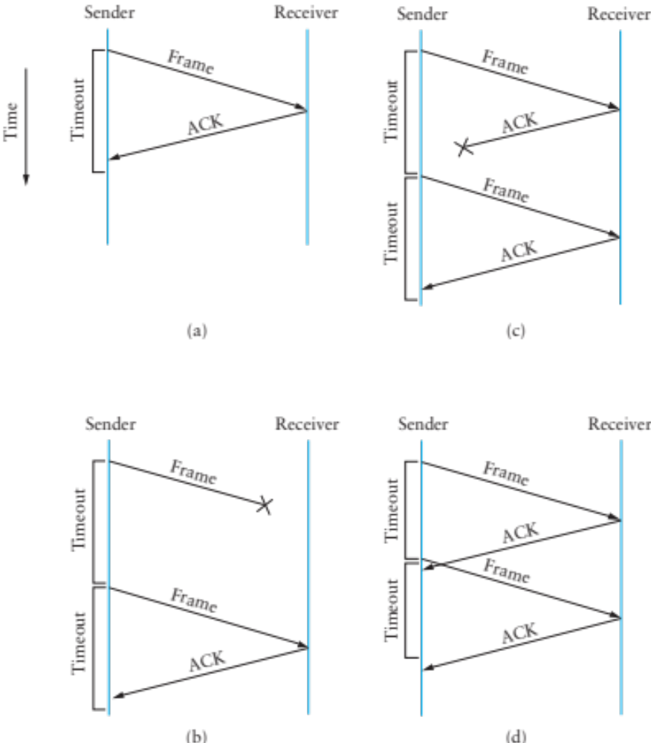
Notes:
Can the sender differentiate between (b) and (c) ?
In (c) and (d), DOES THE RECEIVER KNOW WHETHER THE FRAME IS A NEW FRAME OR A RETRANSMISSION?

Slide 22
Stop and Wait Problems
Duplicate data
Duplicate acks
Slow (channel idle most of the time!)
May be difficult to set the timeout value

Slide 23
Duplicate data: adding sequence numbers

Slide 24
At Most Once Semantics
How to avoid duplicates?
  Uniquely identify each packet
  Have receiver and sender remember
Stop and Wait: add 1 bit to the header
  Why is it enough?

Slide 25
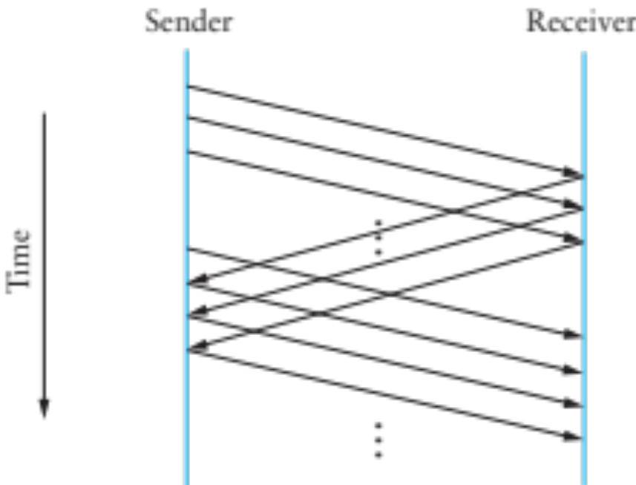
Going faster: sliding window protocol
Still have the problem of keeping pipe full
  Generalize approach with > 1-bit counter
  Allow multiple outstanding (unACKed) frames
  Upper bound on unACKed frames, called window

Slide 26
How big should the window be?
How many bytes can we transmit in one RTT?
  BW B/s x RTT s => “Bandwidth-Delay Product”

Slide 27
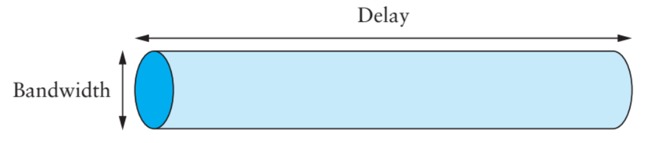
Maximizing Throughput
Can view network as a pipe
  For full utilization want bytes in flight ≥ bandwidth × delay
  But don’t want to overload the network (future lectures)
What if protocol doesn’t involve bulk transfer?
  Get throughput through concurrency – service multiple clients simultaneously

Slide 28
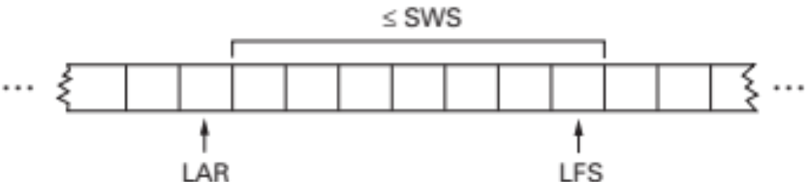
Sliding Window Sender
Assign sequence number (SeqNum) to each frame
Maintain three state variables
  send window size (SWS)
  last acknowledgment received (LAR)
  last frame sent (LFS)
Maintain invariant: LFS – LAR ≤ SWS
Advance LAR when ACK arrives
Buffer up to SWS frames

Slide 29
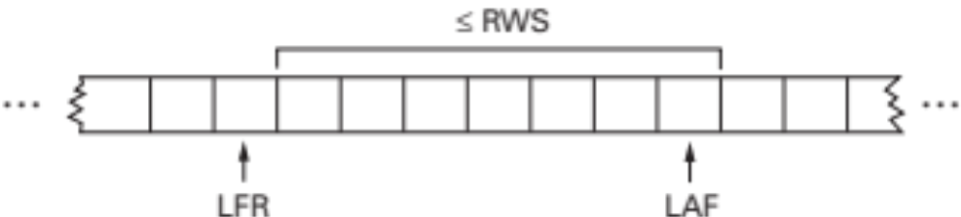
Sliding Window Receiver
Maintain three state variables:
  receive window size (RWS)
  largest acceptable frame (LAF)
  last frame received (LFR)
Maintain invariant: LAF – LFR ≤ RWS
Frame SeqNum arrives:
  if LFR < SeqNum ≤ LAF, accept
  if SeqNum ≤ LFR or SeqNum > LAF, discard
Send cumulative ACKs
Notes:
How to set SWS? -> You want to “fill the pipe”, so look at the BW delay product, or how many frames you can send in one RTT
How to set RWS? -> A RWS > 1 allows for more efficiency, as you can accept packets out of order.
What is this accomplishing? Reliability, Ordering, Flow Control

Slide 30
Tuning Send Window
How big should SWS be?
  “Fill the pipe”
How big should RWS be?
  1 ≤ RWS ≤ SWS
How many distinct sequence numbers needed?

Slide 31
Example
SWS = RWS = 5. Are 6 seq #s enough?
Sender sends 0,1,2,3,4
All acks are lost
Sender sends 0,1,2,3,4 again
…
What are the possible views of the sender and receiver?
Notes:
We would need to make sure that all packets the sender can send in this case can be distinguished!
If the sender advances the whole window, there can’t be any repeated sequence numbers.

Slide 32
Tuning Send Window
How big should SWS be?
  “Fill the pipe”
How big should RWS be?
  1 ≤ RWS ≤ SWS
How many distinct sequence numbers needed?
  SWS can’t be more than half of the space of valid seq#s.

Slide 33
Summary
Want exactly once
  At least once: acks + timeouts + retransmissions
  At most once: sequence numbers
Want efficiency
  Sliding window

Slide 34
Error Detection and Correction

Slide 35
Error Detection
Idea: have some codes be invalid
  Must add bits to catch errors in packet
Sometimes can also correct errors
  If enough redundancy
  Might have to retransmit
Used in multiple layers
Three examples today:
  Parity
  Internet Checksum
  CRC

Slide 36
Simplest Schemes
Repeat frame n times
  Can we detect errors?
  Can we correct errors?
    Voting
  Problem: high redundancy : n
Example: send each bit 3 times
  Valid codes: 000 111
  Invalid codes : 001 010 011 100 101 110
  Corrections : 0 0 1 0 1 1

Slide 37
Parity
Add a parity bit to the end of a word
Example with 2 bits:
  Valid: 000 011 101 110
  Invalid: 001 010 010 111
  Can we correct?
Can detect odd number of bit errors
  No correction
Notes:
Cannot correct because each invalid code is the same distance from 3 valid codes!

Slide 38
In general
Hamming distance: number of bits that are different
  E.g.: HD (00001010, 01000110) = 3
If min HD between valid codewords is d:
  Can detect d-1 bit error
  Can correct ⌊(d-1)/2⌋ bit errors
What is d for parity and 3-voting?
Notes:
Parity: d=2
3-Voting: d=3

Slide 39
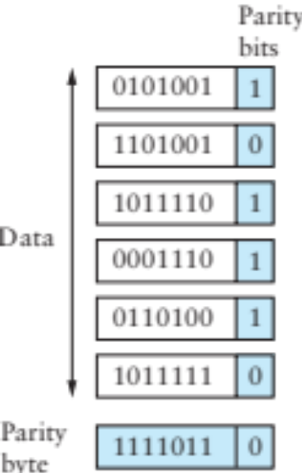
2-D Parity
Add 1 parity bit for each 7 bits
Add 1 parity bit for each bit position across the frame)
  Can correct single-bit errors
  Can detect 2- and 3-bit errors, most 4-bit errors
Find a 4-bit error that can’t be corrected
Notes:
Any corners of a square can’t be corrected

Slide 40
IP Checksum
Fixed-length code
  n-bit code should capture all but 2^{-n} fraction of errors
    Why?
  Trick is to make sure that includes all common errors
IP Checksum is an example
  1’s complement of 1’s complement sum of every 2 bytes
uint16 cksum(uint16 *buf, int count) {
uint32 sum = 0;
while (count--)
if ((sum += *buf++) & 0xffff0000) // carry
sum = (sum & 0xffff) + 1;
return ~(sum & 0xffff);
}
Checking
  Do the sum again, including the checksum. If correct, the sum should be all 1’s (This is super fast to check)
Notes:
Each value maps to one code value. If there are 2^n code values, a fraction of 1/(2^n) values maps to each code value.
Take the values that map to the same code value. If you have an error that goes from one of these to the other, without changing the code value, you won’t detect an error. All others should be detected.

Slide 41
How good is it?
16 bits not very long: misses how many errors?
  1 in 2¹⁶, or 1 in 64K errors
Checksum does catch all 1-bit errors
But not all 2-bit errors
  E.g., increment word ending in 0, decrement one ending in 1
Checksum also optional in UDP
  All 0s means no checksums calculated
  If checksum word gets wiped to 0 as part of error, bad news

Slide 42
From rfc791 (IP)
“This is a simple to compute checksum and experimental evidence indicates it is adequate, but it is provisional and may be replaced by a CRC procedure, depending on further experience.”

Slide 43
CRC – Error Detection with Polynomials
Goal: maximize protection, minimize bits
Consider message to be a polynomial in Z₂[x]
  Each bit is one coefficient
  E.g., message 10101001 -> m(x) = x⁷ + x⁵+ x³ + 1
Can reduce one polynomial modulo another
  Let n(x) = m(x)x³. Let C(x) = x³ + x² + 1.
  n(x) “mod” C(x) : r(x)
  Find q(x) and r(x) s.t. n(x) = q(x)C(x) + r(x) and degree of r(x) < degree of C(x)
  Analogous to taking 11 mod 5 = 1

Slide 44
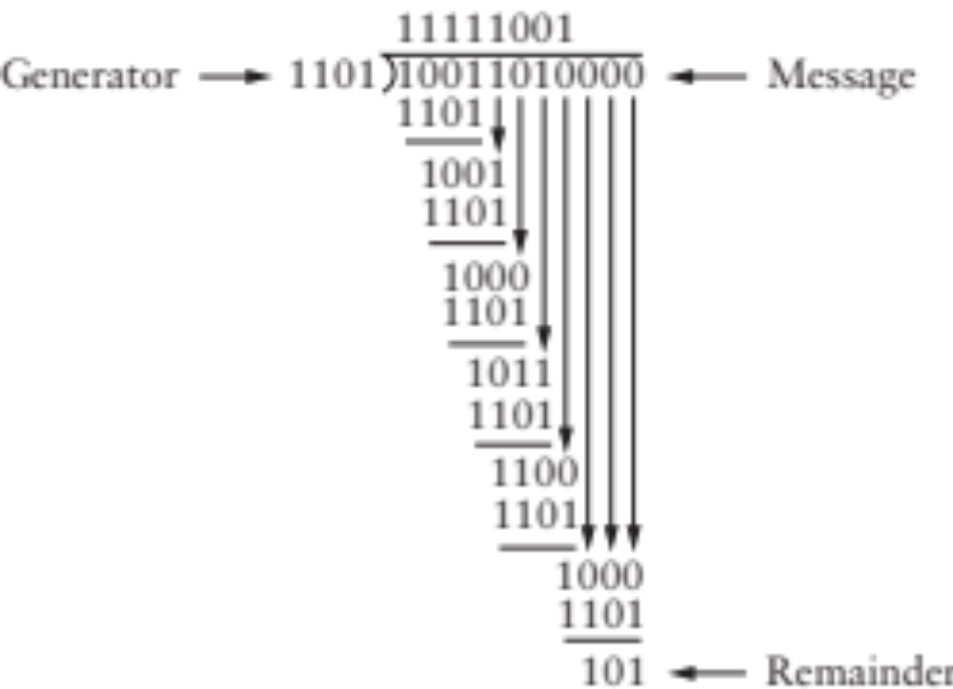
Polynomial Division Example
Just long division, but addition/subtraction is XOR

Slide 45
CRC
Select a divisor polynomial C(x), degree k
  C(x) should be irreducible – not expressible as a product of two lower-degree polynomials in Z₂[x]
Add k bits to message
  Let n(x) = m(x)x^{k} (add k 0’s to m)
  Compute r(x) = n(x) mod C(x)
  Compute n'(x) = n(x) – r(x) (will be divisible by C(x)) (subtraction is XOR, just set k lowest bits to r(x)!)
Checking CRC is easy
  Reduce message by C(x), make sure remainder is 0
Notes:
Irreducible analogous to prime

Slide 46
Why is this good?
Suppose you send m(x), recipient gets m’(x)
  E(x) = m’(x) – m(x) (all the incorrect bits)
  If CRC passes, C(x) divides m’(x)
  Therefore, C(x) must divide E(x)
Choose C(x) that doesn’t divide any common errors!
  All single-bit errors caught if x^{k}, x⁰ coefficients in C(x) are 1
  All 2-bit errors caught if at least 3 terms in C(x)
  Any odd number of errors if last two terms (x + 1)
  Any error burst less than length k caught

Slide 47
Common CRC Polynomials
Polynomials not trivial to find
  Some studies used (almost) exhaustive search
CRC-8: x⁸ + x² + x¹ + 1
CRC-16: x¹⁶ + x¹⁵ + x² + 1
CRC-32: x³² + x²⁶ + x²³ + x²² + x¹⁶ + x¹² + x¹¹ + x¹⁰ + x⁸ + x⁷ + x⁵ + x⁴ + x² + x¹ + 1
CRC easily computable in hardware
Notes:
Not tri

Slide 48
An alternative for reliability
Erasure coding
  Assume you can detect errors
  Code is designed to tolerate entire missing frames
    Collisions, noise, drops because of bit errors
  Forward error correction
Examples: Reed-Solomon codes, LT Codes, Raptor Codes
Property:
  From K source frames, produce B > K encoded frames
  Receiver can reconstruct source with any K’ frames, with K’ slightly larger than K
  Some codes can make B as large as needed, on the fly

Slide 49
LT Codes
Luby Transform Codes
  Michael Luby, circa 1998
Encoder: repeat B times
  Pick a degree d
  Randomly select d source blocks. Encoded block t_{n}= XOR or selected blocks

Slide 50
LT Decoder
Find an encoded block t_{n} with d=1
Set s_{n} = t_{n}
For all other blocks t_{n’} that include s_{n} ,
set t_{n’}=t_{n’} XOR s_{n}
Delete s_{n} from all encoding lists
Finish if
  You decode all source blocks, or
  You run out out blocks of degree 1

Slide 51
Next class
Link Layer II
  Ethernet: dominant link layer technology
    Framing, MAC, Addressing
  Switching

