Slide 1
CSCI-1680
Link Layer Wrap-Up
Rodrigo Fonseca
Based partly on lecture notes by David Mazières, Phil Levis, John Jannotti

Slide 2
Administrivia
Homework I out later today, due next Thursday

Slide 3
Today: Link Layer (cont.)
Framing
Reliability
  Error correction
  Sliding window
Medium Access Control
Case study: Ethernet
Link Layer Switching

Slide 4
Medium Access Control
Control access to shared physical medium
  E.g., who can talk when?
  If everyone talks at once, no one hears anything
  Job of the Link Layer
Two conflicting goals
  Maximize utilization when one node sending
  Approach 1/N allocation when N nodes sending

Slide 5
Different Approaches
Partitioned Access
  Time Division Multiple Access (TDMA)
  Frequency Division Multiple Access (FDMA)
  Code Division Multiple Access (CDMA)
Random Access
  ALOHA/ Slotted ALOHA
  Carrier Sense Multiple Access / Collision Detection (CSMA/CD)
  Carrier Sense Multiple Access / Collision Avoidance (CSMA/CA)
  RTS/CTS (Request to Send/Clear to Send)
  Token-based

Slide 6
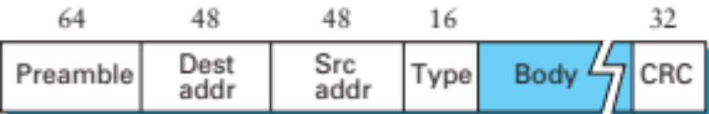
Case Study: Ethernet (802.3)
Dominant wired LAN technology
  10BASE2, 10BASE5 (Vampire Taps)
  10BASET, 100BASE-TX, 1000BASE-T, 10GBASE-T,…
Both Physical and Link Layer specification
CSMA/CD
  Carrier Sense / Multiple Access / Collision Detection
Frame Format (Manchester Encoding):

Slide 7
Ethernet Addressing
Globally unique, 48-bit unicast address per adapter
  Example: 00:1c:43:00:3d:09 (Samsung adapter)
  24 msb: organization
  http://standards.ieee.org/develop/regauth/oui/oui.txt
Broadcast address: all 1s
Multicast address: first bit 1
Adapter can work in promiscuous mode

Slide 8
Ethernet MAC: CSMA/CD
Problem: shared medium
  10Mbps: up to 2500m, with 4 repeaters at 500m
Transmit algorithm
  If line is idle, transmit immediately
  Upper bound message size of 1500 bytes
  If line is busy: wait until idle and transmit immediately

Slide 9
Handling Collisions
Collision detection (10Base2 Ethernet)
  Monitors line voltage level
  Uses Manchester encoding. Why does that help?
    Constant average voltage unless multiple transmitters
If collision
  Jam for 32 bits, then stop transmitting frame
Notes:
51.2 us round-trip time

Slide 10
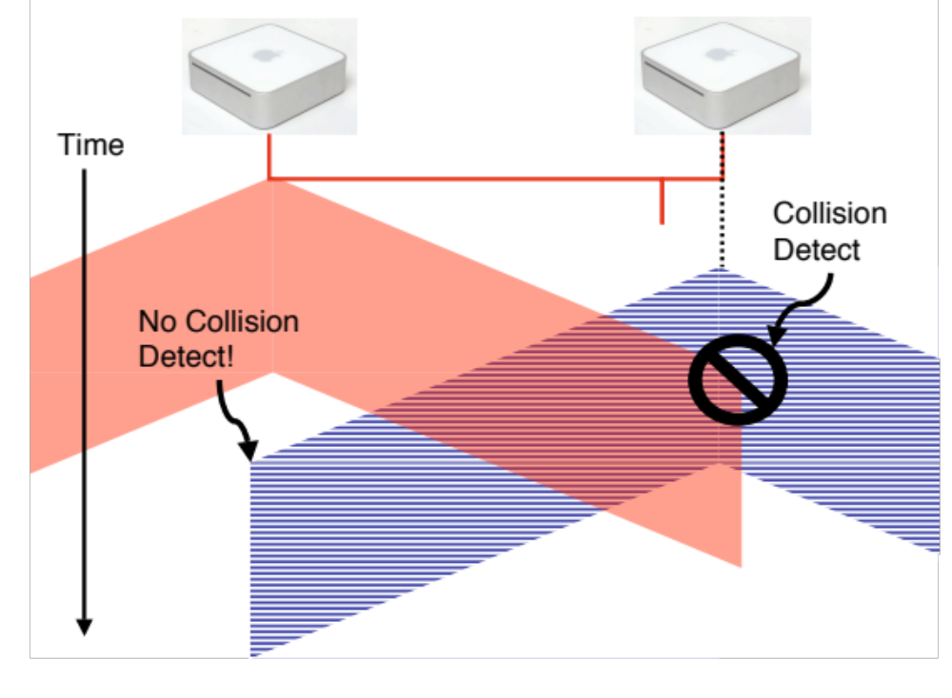
Collision Detection
Without minimum frame length, might not detect collision

Slide 11
Handling Collisions
Collision detection (10Base2 Ethernet)
  Monitors line voltage level
  Uses Manchester encoding. Why does that help?
    Constant average voltage unless multiple transmitters
If collision
  Jam for 32 bits, then stop transmitting frame
Collision detection constrains protocol
  Must ensure transmission time ≥ 2x propagation delay
  Imposes min. packet size (64 bytes or 512 bits)
  Imposes maximum network diameter (2500m)
Notes:
51.2 us round-trip time

Slide 12
When to transmit again?
Delay and try again: exponential backoff
nth time: k × 51.2μs, for k = U{0..(2^{min(n,10)}-1)}
  1st time: 0 or 51.2μs
  2nd time: 0, 51.2, 102.4, or 153.6μs
Give up after several times (usually 16)

Slide 13
Capture Effect
Exponential backoff leads to self-adaptive use of channel
A and B are trying to transmit, and collide
Both will back off either 0 or 51.2μs
Say A wins.
Next time, collide again.
  A will wait between 0 or 1 slots
  B will wait between 0, 1, 2, or 3 slots
…

Slide 14
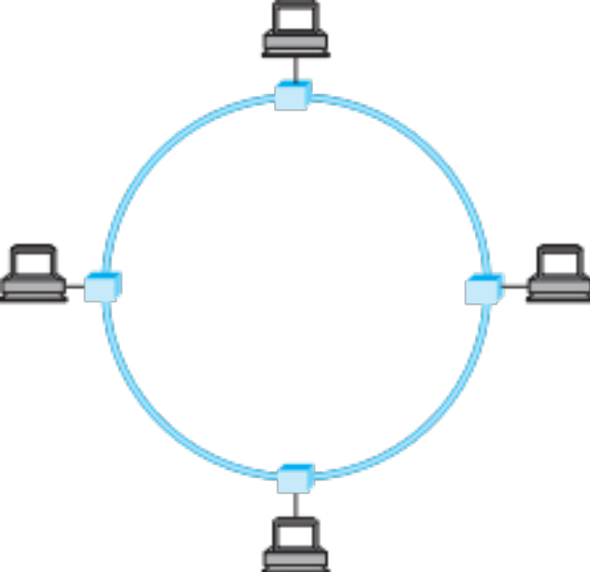
Token Ring
Idea: frames flow around ring
Capture special “token” bit pattern to transmit
Variation used today in Metropolitan Area Networks, with fiber

Slide 15
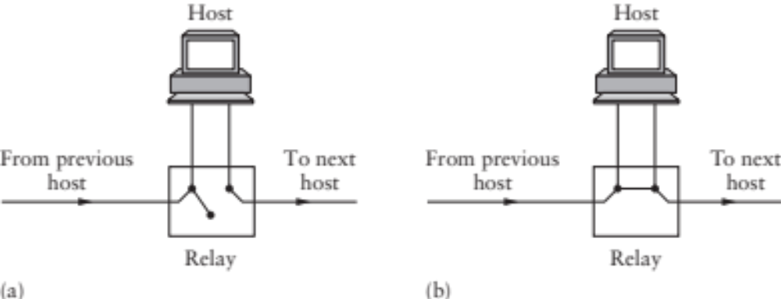
Interface Cards
Problem: if host dies, can break the network
Hardware typically has relays

Slide 16
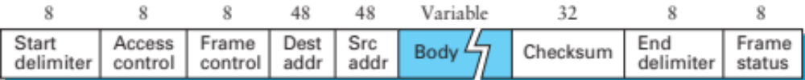
Token Ring Frames
Frame format (Differential Manchester)
Sender grabs token, sends message(s)
Recipient checks address
Sender removes frame from ring after lap
Maximum holding time: avoid capture
Monitor node reestablishes lost token

Slide 17
Bridging

Slide 18
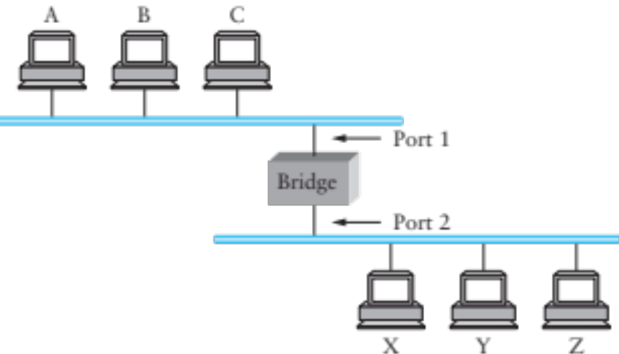
Bridges and Extended LANs
LANs have limitations
  E.g. Ethernet < 1024 hosts, < 2500m
Connect two or more LANs with a bridge
  Operates on Ethernet addresses
  Forwards packets from one LAN to the other(s)
Ethernet switch is just a multi-way bridge

Slide 19
Learning Bridges
Idea: don’t forward a packet where it isn’t needed
  If you know recipient is not on that port
Learn hosts’ locations based on source addresses
  Build a table as you receive packets
  Table is a cache: if full, evict old entries. Why is this fine?
Table says when not to forward a packet
  Doesn’t need to be complete for correctness
Notes:
Never forward to INCOMING port…
What if hosts move? TIMEOUT
What if no space? Still works

Slide 20
Attack on a Learning Switch
Eve: wants to sniff all packets sent to Bob
Same segment: easy (shared medium)
Different segment on a learning bridge: hard
  Once bridge learns Bob’s port, stop broadcasting
How can Eve force the bridge to keep broadcasting?
  Flood the network with frames with spoofed src addr!

Slide 21
Bridges
Unicast: forward with filtering
Broadcast: always forward
Multicast: always forward or learn groups
Difference between bridges and repeaters?
  Bridges: same broadcast domain; copy frames
  Repeaters: same broadcast and collision domain; copy signals

Slide 22
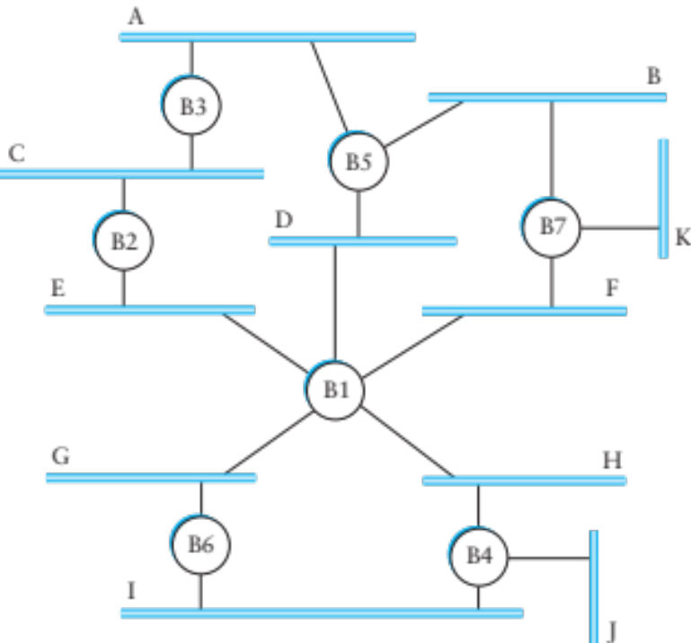
Dealing with Loops
Problem: people may create loops in LAN!
  Accidentally, or to provide redundancy
  Don’t want to forward packets indefinitely

Slide 23
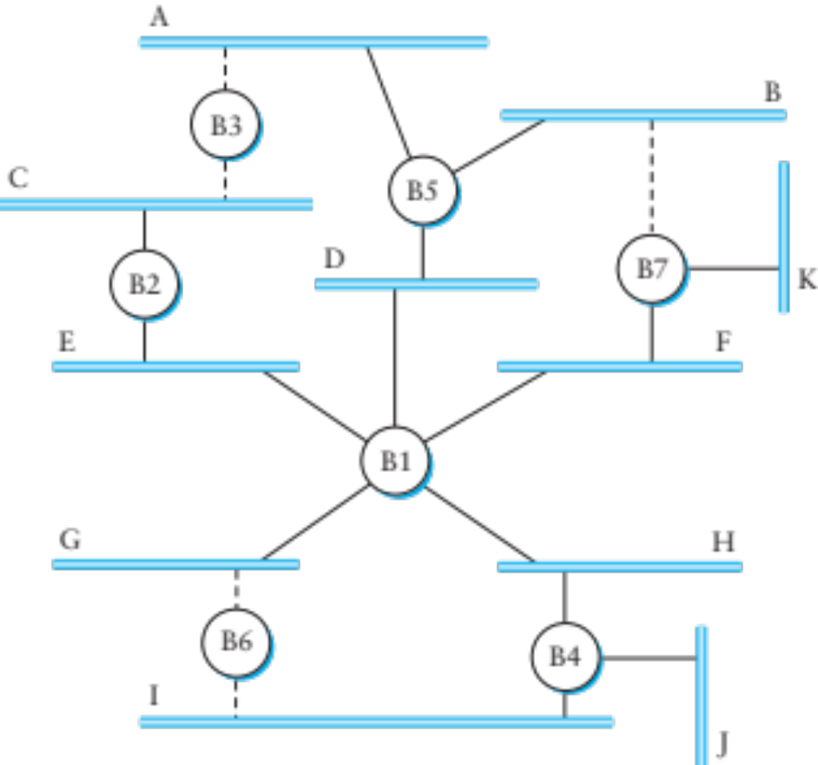
Spanning Tree
Need to disable ports, so that no loops in network
Like creating a spanning tree in a graph
  View switches and networks as nodes, ports as edges

Slide 24
Distributed Spanning Tree Algorithm
Every bridge has a unique ID (Ethernet address)
Goal:
  Bridge with the smallest ID is the root
  Each segment has one designated bridge, responsible for forwarding its packets towards the root
    Bridge closest to root is designated bridge
    If there is a tie, bridge with lowest ID wins

Slide 25
Spanning Tree Protocol
Send message when you think you are the root
Otherwise, forward messages from best known root
  Add one to distance before forwarding
  Don’t forward over discarding ports (see next slide)
Spanning Tree messages contain:
  ID of bridge sending the message
  ID sender believes to be the root
  Distance (in hops) from sender to root
Bridges remember best config msg on each port
In the end, only root is generating messages

Slide 26
Spanning Tree Protocol (cont.)
Forwarding and Broadcasting
Port states*:
  Root port: a port the bridge uses to reach the root
  Designated port: the lowest-cost port attached to a single segment
  If a port is not a root port or a designated port, it is a discarding port.
* In a later protocol RSTP, there can be ports configured as backups and alternates.

Slide 27
Root Port
Designated Port
Discarding Port

Slide 28
Algorhyme
I think that I shall never see
a graph more lovely that a tree.
A tree whose crucial property
is loop-free connectivity.
A tree that must be sure to span
so packet can reach every LAN.
First the root must be selected.
By ID, it is elected.
Least cost paths from root are traced.
In the tree, these paths are placed.
A mesh is made by folks like me,
then bridges find a spanning tree.
Radia Perlman

Slide 29
Limitations of Bridges
Scaling
  Spanning tree algorithm doesn’t scale
  Broadcast does not scale
  No way to route around congested links, even if path exists
May violate assumptions
  Could confuse some applications that assume single segment
    Much more likely to drop packets
    Makes latency between nodes non-uniform
  Beware of transparency

Slide 30
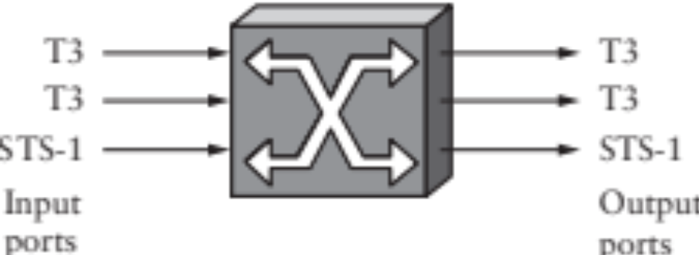
Switching
Switches must be able to, given a packet, determine the outgoing port
3 ways to do this:
  Virtual Circuit Switching
  Datagram Switching
  Source Routing

Slide 31
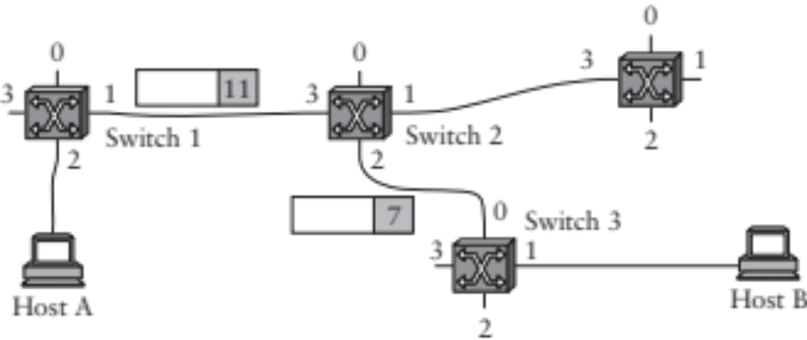
Virtual Circuit Switching
Explicit set-up and tear down phases
  Establishes Virtual Circuit Identifier on each link
  Each switch stores VC table
Subsequent packets follow same path
  Switches map [in-port, in-VCI] : [out-port, out-VCI]
Also called connection-oriented model

Slide 32
Virtual Circuit Model
Requires one RTT before sending first packet
Connection request contain full destination address, subsequent packets only small VCI
Setup phase allows reservation of resources, such as bandwidth or buffer-space
  Any problems here?
If a link or switch fails, must re-establish whole circuit
Example: ATM, MPLS
Notes:
What is the domain of each VCI?
And the address?

Slide 33
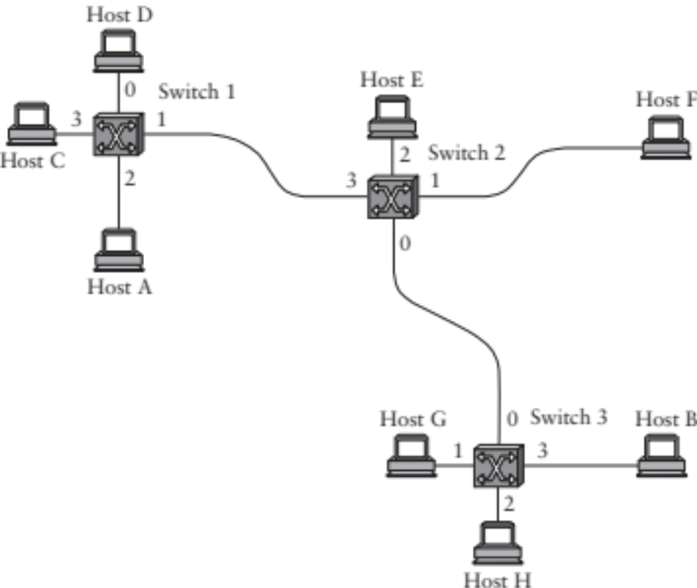
Datagram Switching
Switch 2
Addr | Port
A | 3
B | 0
C | 3
D | 3
E | 2
F | 1
G | 0
H | 0
Each packet carries destination address
Switches maintain address-based tables
  Maps [destination address]:[out-port]
Also called connectionless model

Slide 34
Datagram Switching
No delay for connection setup
Source can’t know if network can deliver a packet
Possible to route around failures
Higher overhead per-packet
Potentially larger tables at switches
Notes:
Why larger tables?

Slide 35
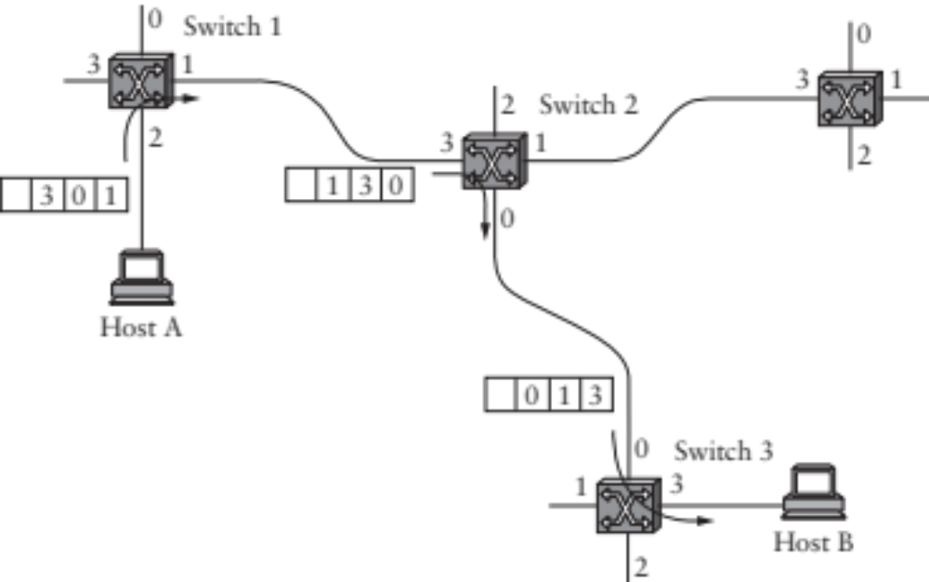
Source Routing
Packets carry entire route: ports
Switches need no tables!
  But end hosts must obtain the path information
Variable packet header
Notes:
May be loose or strict.
Brittle if there are changes host doesn’t know about.

Slide 36
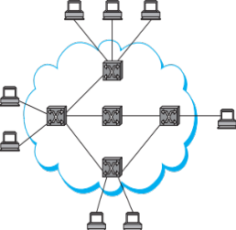
VLANs
b1
a1
b2
a2
Company network, A and B departments
  Broadcast traffic does not scale
  May not want traffic between the two departments
  Topology has to mirror physical locations
  What if employees move between offices?

Slide 37
VLANs
a2
a1
b2
b1
Solution: Virtual LANs
  Assign switch ports to a VLAN ID (color)
  Isolate traffic: only same color
  Trunk links may belong to multiple VLANs
  Encapsulate packets: add 12-bit VLAN ID
Easy to change, no need to rewire

Slide 38
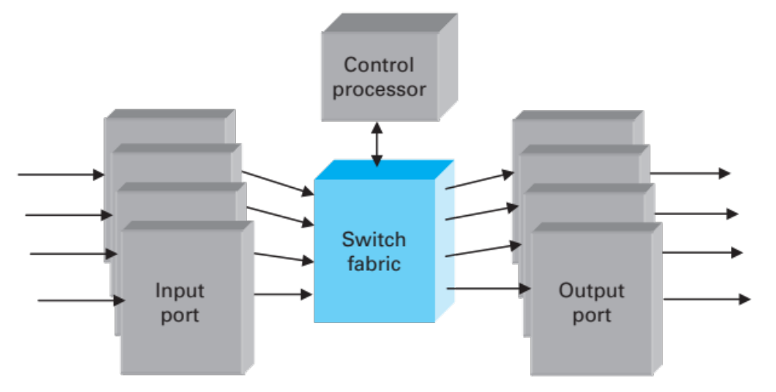
Generic Switch Architecture
Goal: deliver packets from input to output ports
Three potential performance concerns:
  Throughput in bytes/second
  Throughput in packets/second
  Latency
Notes:
Different if packets are variable size

Slide 39
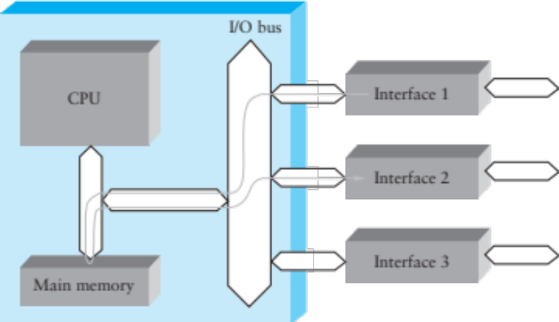
Shared Memory Switch
1st Generation – like a regular PC
  NIC DMAs packet to memory over I/O bus
  CPU examines header, sends to destination NIC
  I/O bus is serious bottleneck
  For small packets, CPU may be limited too
  Typically < 0.5 Gbps

Slide 40
Shared Bus Switch
2st Generation
  NIC has own processor, cache of forwarding table
  Shared bus, doesn’t have to go to main memory
  Typically limited to bus bandwidth
    (Cisco 5600 has a 32Gbps bus)

Slide 41
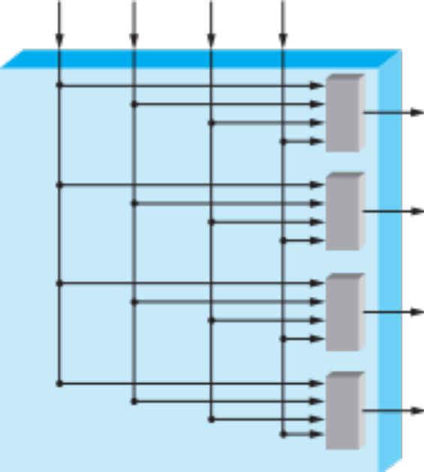
Point to Point Switch
3rd Generation: overcomes single-bus bottleneck
Example: Cross-bar switch
  Any input-output permutation
  Multiple inputs to same output requires trickery
  Cisco 12000 series: 60Gbps
Notes:
Layer 3 routers are similar
Current switching speeds: 6.5Tbps

Slide 42
Cut through vs. Store and Forward
Two approaches to forwarding a packet
  Receive a full packet, then send to output port
  Start retransmitting as soon as you know output port, before full packet
Cut-through routing can greatly decrease latency
Disadvantage
  Can waste transmission (classic optimistic approach)
    CRC may be bad
    If Ethernet collision, may have to send runt packet on output link

Slide 43
Buffering
Buffering of packets can happen at input ports, fabric, and/or output ports
Queuing discipline is very important
Consider FIFO + input port buffering
  Only one packet per output port at any time
  If multiple packets arrive for port 2, they may block packets to other ports that are free
  Head-of-line blocking: can limit throughput to ~ 58% under some reasonable conditions*
2
Port 1
1
2
Port 2
* For independent, uniform traffic, with same-size frames
Notes:
Also allows QoS, Fairness, Prioritization
For independent and uniform traffic

Slide 44
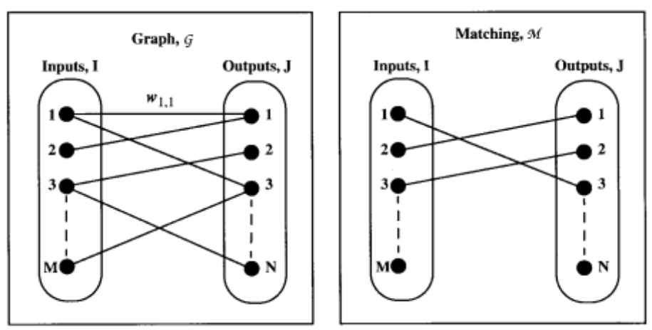
Head-of-Line Blocking
2
Port 1
1
2
Port 2
Solution: Virtual Output Queueing
  Each input port has n FIFO queues, one for each output
  Switch using matching in a bipartite graph
  Shown to achieve 100% throughput*
*MCKEOWN et al.: ACHIEVING 100% THROUGHPUT IN AN INPUT-QUEUED SWITCH, 1999

Slide 45
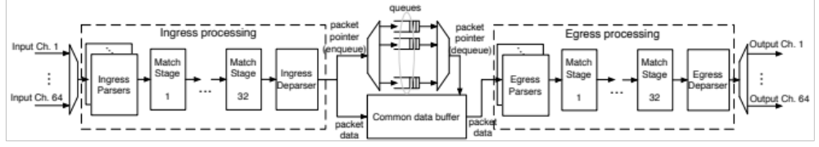
Current Developments
Switches are becoming programmable
  Match-action paradigm
  Custom protocols, encapsulation, metering, monitoring
Current speeds reach 6.5Tbps (65x100Gbps) on a single programmable switching chip

Slide 46
Coming Up
Connecting multiple networks: IP and the Network Layer

