Slide 1
CSCI-1680
Transport Layer I
Rodrigo Fonseca
Based partly on lecture notes by David Mazières, Phil Levis, John Jannotti

Slide 2
Today
Transport Layer
  UDP
  TCP Intro
    Connection Establishment

Slide 3
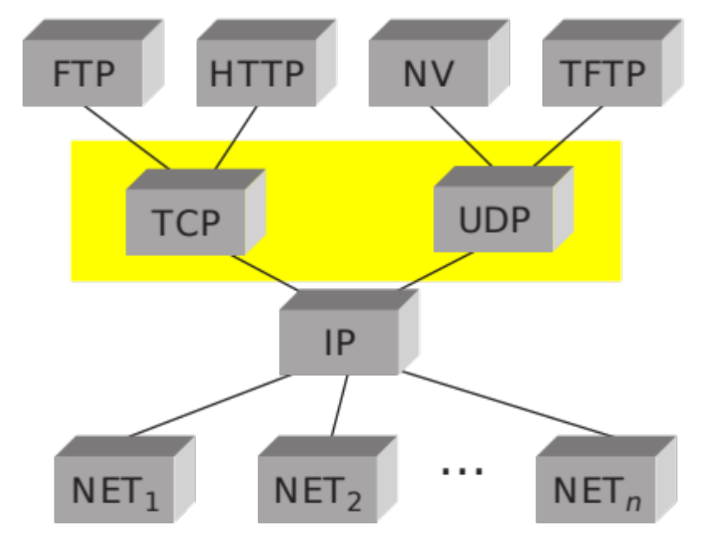
Transport Layer
Transport protocols sit on top of network layer
Problem solved: communication among processes
  Application-level multiplexing (“ports”)
  Error detection, reliability, etc.

Slide 4
UDP – User Datagram Protocol
Unreliable, unordered datagram service
Adds multiplexing, checksum
End points identified by ports
  Scope is an IP address (interface)
Checksum aids in error detection

Slide 5
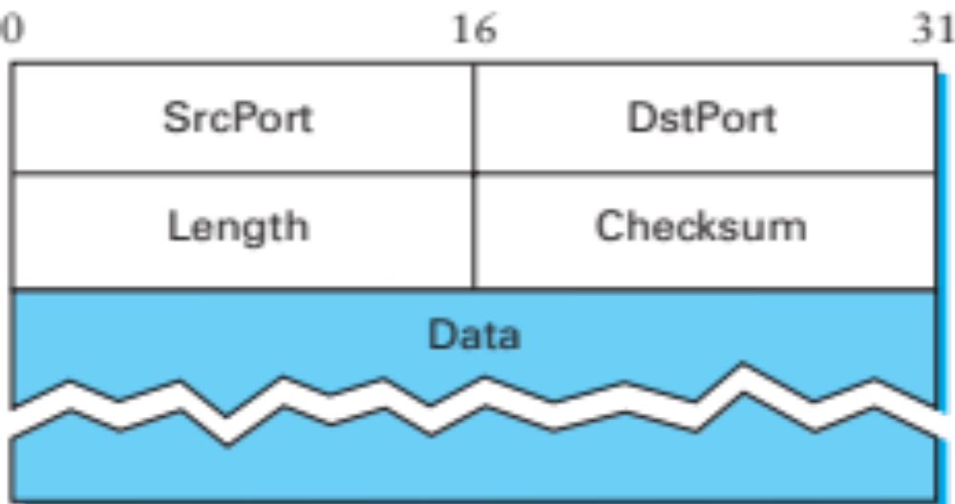
UDP Header

Slide 6
UDP Checksum
Uses the same algorithm as the IP checksum
  Set Checksum field to 0
  Sum all 16-bit words, adding any carry bits to the LSB
  Flip bits to get checksum (except 0xffff->0xffff)
  To check: sum whole packet, including sum, should get 0xffff
How many errors?
  Catches any 1-bit error
  Not all 2-bit errors
Optional in IPv4: not checked if value is 0

Slide 7
Pseudo Header
0 7 8 15 16 23 24 31
+--------+--------+--------+--------+
| source address |
+--------+--------+--------+--------+
| destination address |
+--------+--------+--------+--------+
| zero |protocol| UDP length |
+--------+--------+--------+--------+
UDP Checksum is computer over pseudo-header prepended to the UDP header
  For IPv4: IP Source, IP Dest, Protocol (=17), plus UDP length
What does this give us?
What is a problem with this?
  Is UDP a layer on top of IP?
Notes:
Check that the destination is correct. It’s kind of useless, actually.

Slide 8
Next Problem: Reliability
Review: reliability on the link layer
Problem | Mechanism
Dropped Packets
Acknowledgments + Timeout
Duplicate Packets
Sequence Numbers
Packets out of order
Receiver Window
Keeping the pipe full
Sliding Window (Pipelining)
Single link: things were easy… ☺

Slide 9
Transport Layer Reliability
Extra difficulties
  Multiple hosts
  Multiple hops
  Multiple potential paths
Need for connection establishment, tear down
  Analogy: dialing a number versus a direct line
Varying RTTs
  Both across connections and during a connection
  Why do they vary? What do they influence?
Notes:
RTT influences the potential window size (delay X bandwidth), the values for timeouts.

Slide 10
Extra Difficulties (cont.)
Out of order packets
  Not only because of drops/retransmissions
  Can get very old packets (up to 120s), must not get confused
Unknown resources at other end
  Must be able to discover receiver buffer: flow control
Unknown resources in the network
  Should not overload the network
  But should use as much as safely possible
  Congestion Control (next class)

Slide 11
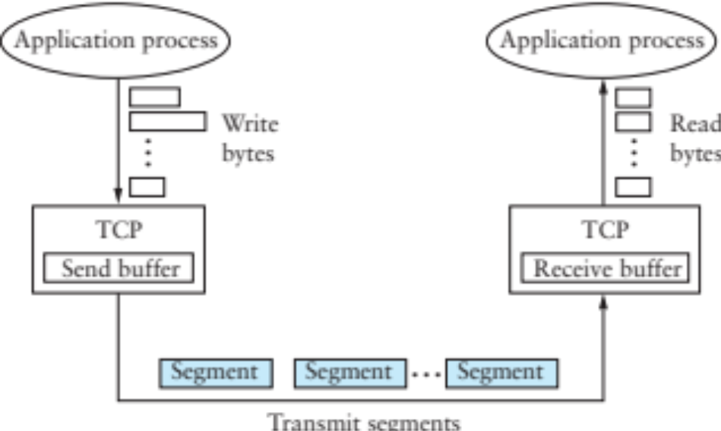
TCP – Transmission Control Protocol
Service model: “reliable, connection oriented, full duplex byte stream”
  Endpoints: <IP Address, Port>
Flow control
  If one end stops reading, writes at other eventually stop/fail
Congestion control
  Keeps sender from overloading the network

Slide 12
TCP
Specification
  RFC 793 (1981), RFC 1222 (1989, some corrections), RFC 5681 (2009, congestion control), …
Was born coupled with IP, later factored out
  We talked about this, don’t always need everything!
End-to-end protocol
  Minimal assumptions on the network
  All mechanisms run on the end points
Alternative idea:
  Provide reliability, flow control, etc, link-by-link
  Does it work?

Slide 13
Why not provide (*) on the network layer?
Cost
  These functionalities are not free: don’t burden those who don’t need them
Conflicting
  Timeliness and in-order delivery, for example
Insufficient
  Example: reliability
* may be security, reliability, ordering guarantees, …

Slide 14
End-to-end argument
Functions placed at lower levels of a system may be redundant or of little value
  They may need to be performed at a higher layer anyway
But they may be justified for performance reasons
  Or just because they provide most of what is needed
  Example: retransmissions
Lesson: weigh the costs and benefits at each layer
  Also: the end also varies from case to case
Notes:
Example: Bit-torrent file transfer
Example performance enhancement
o-----o-----o----o 0.1 chance of drop
End-to-end ack: (0.9^4)^2 = 0.43 (~2.3X)
2 Retransmissions per hop:
Failure: fails two retransmissions = ((1-(0.1+0.1*0.9)^2)^4)^2 = 0.74

Slide 15
TCP Header
0 1 2 3
0 1 2 3 4 5 6 7 8 9 0 1 2 3 4 5 6 7 8 9 0 1 2 3 4 5 6 7 8 9 0 1
+-+-+-+-+-+-+-+-+-+-+-+-+-+-+-+-+-+-+-+-+-+-+-+-+-+-+-+-+-+-+-+-+
| Source Port | Destination Port |
+-+-+-+-+-+-+-+-+-+-+-+-+-+-+-+-+-+-+-+-+-+-+-+-+-+-+-+-+-+-+-+-+
| Sequence Number |
+-+-+-+-+-+-+-+-+-+-+-+-+-+-+-+-+-+-+-+-+-+-+-+-+-+-+-+-+-+-+-+-+
| Acknowledgment Number |
+-+-+-+-+-+-+-+-+-+-+-+-+-+-+-+-+-+-+-+-+-+-+-+-+-+-+-+-+-+-+-+-+
| Data | |U|A|P|R|S|F| |
| Offset| Reserved |R|C|S|S|Y|I| Window |
| | |G|K|H|T|N|N| |
+-+-+-+-+-+-+-+-+-+-+-+-+-+-+-+-+-+-+-+-+-+-+-+-+-+-+-+-+-+-+-+-+
| Checksum | Urgent Pointer |
+-+-+-+-+-+-+-+-+-+-+-+-+-+-+-+-+-+-+-+-+-+-+-+-+-+-+-+-+-+-+-+-+
| Options | Padding |
+-+-+-+-+-+-+-+-+-+-+-+-+-+-+-+-+-+-+-+-+-+-+-+-+-+-+-+-+-+-+-+-+
| data |
+-+-+-+-+-+-+-+-+-+-+-+-+-+-+-+-+-+-+-+-+-+-+-+-+-+-+-+-+-+-+-+-+

Slide 16
Header Fields
Ports: multiplexing
Sequence number
  Correspond to bytes, not packets!
Acknowledgment Number
  Next expected sequence number
Window: willing to receive
  Lets receiver limit SWS (even to 0) for flow control
Data Offset: # of 4 byte (header + option bytes)
Flags, Checksum, Urgent Pointer

Slide 17
Header Flags
URG: whether there is urgent data
ACK: ack no. valid (all but first segment)
PSH: push data to the application immediately
RST: reset connection
SYN: synchronize, establishes connection
FIN: close connection

Slide 18
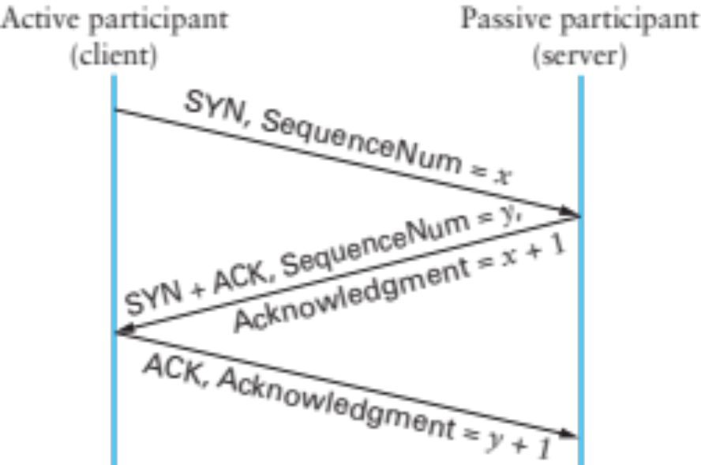
Establishing a Connection
Connect
Listen, Accept…
Accept returns
Three-way handshake
  Two sides agree on respective initial sequence nums
If no one is listening on port: server sends RST
If server is overloaded: ignore SYN
If no SYN-ACK: retry, timeout

Slide 19
Connection Termination
FIN bit says no more data to send
  Caused by close or shutdown
  Both sides must send FIN to close a connection
Typical close
Close
FIN_WAIT_1
FIN
ACK
CLOSE_WAIT
FIN_WAIT_2
…
FIN
Close
LAST_ACK
TIME_WAIT
2MSL
ACK
CLOSED
CLOSED

Slide 20

Summary of TCP States
Unsynchronized
Synchronized
Connection Establishment
Passive close:
Can still send!
Active close:
Can still receive

Slide 21
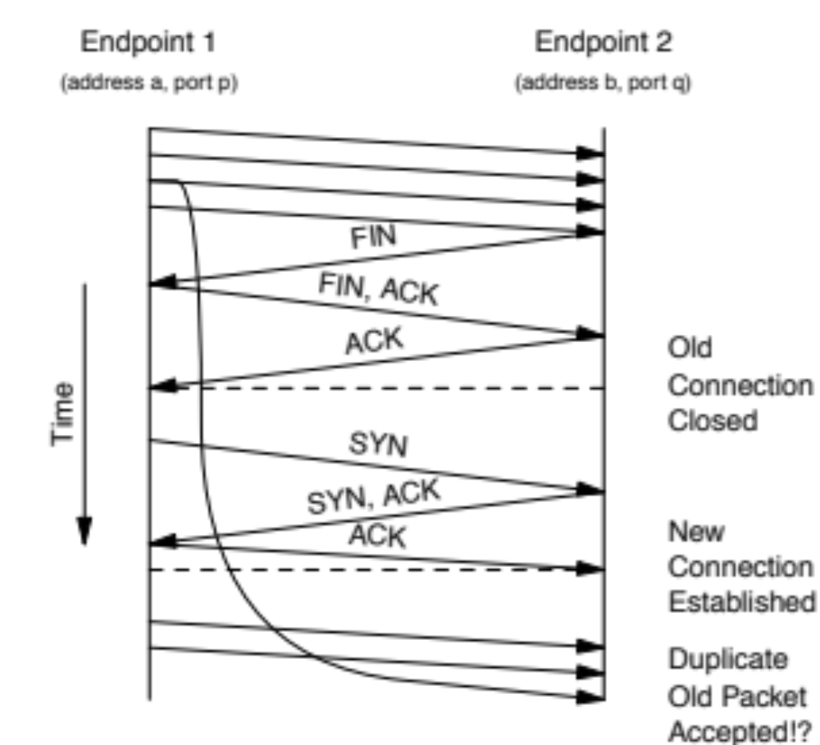
From: The TIME−WAIT state in TCP and Its Effect on Busy Servers, Faber and Touch
Infocom 1999

Slide 22
TIME_WAIT
Why do you have to wait for 2MSL in TIME_WAIT?
  What if last ack is severely delayed, AND
  Same port pair is immediately reused for a new connection?
Solution: active closer goes into TIME_WAIT
  Waits for 2MSL (Maximum Segment Lifetime)
Can be problematic for active servers
  OS has too many sockets in TIME_WAIT, can accept less connections
    Hack: send RST and delete socket, SO_LINGER = 0
  OS won’t let you re-start server because port in use
    SO_REUSEADDR lets you rebind

Slide 23
Next class
Sending data over TCP

