Slide 1


Slide 2
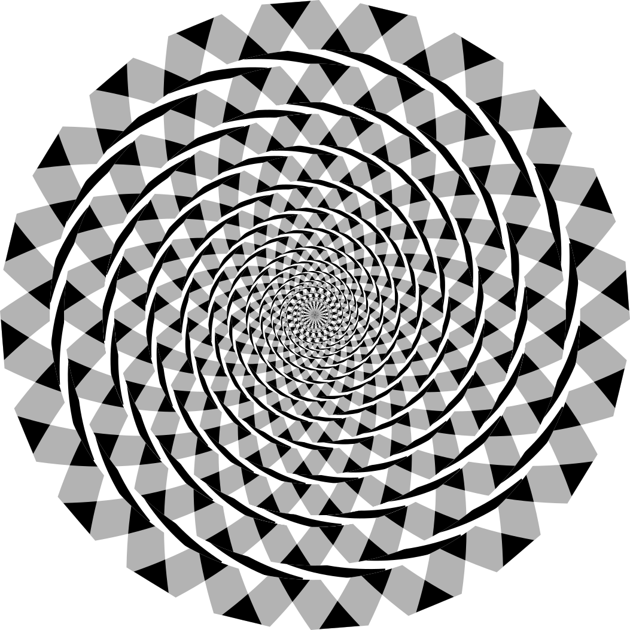
Wikipedia - Mysid

Slide 3
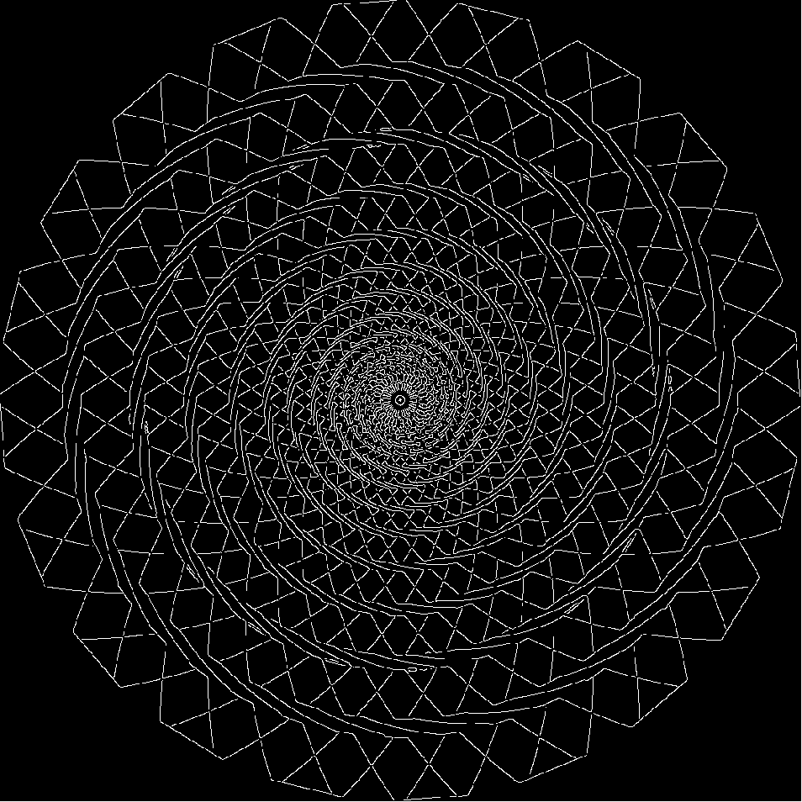
Notes:
Edges (Canny)

Slide 4
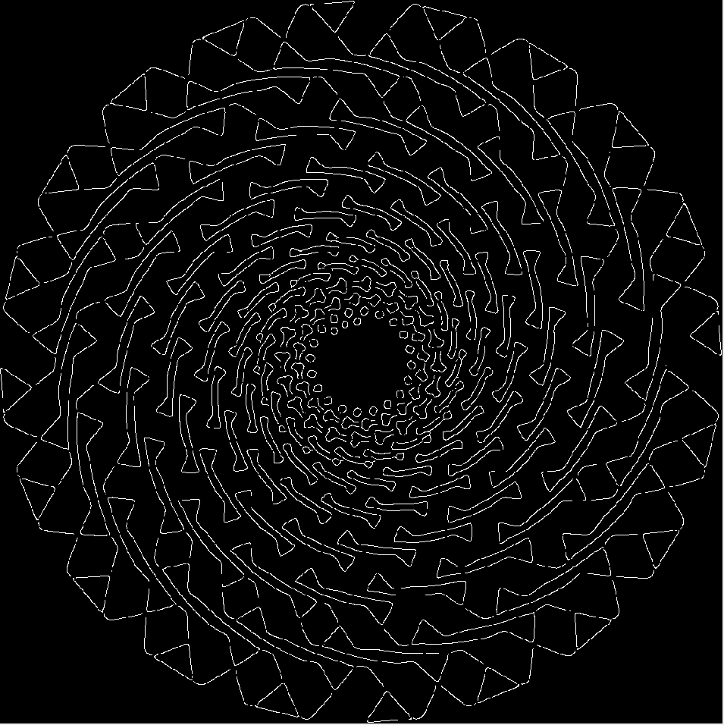
Notes:
Edges (Canny – increasing sigma)

Slide 5
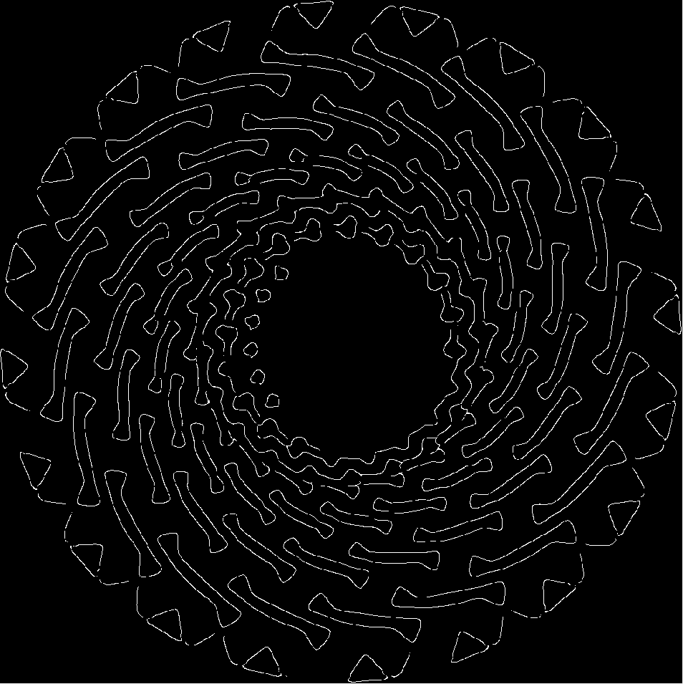
Notes:
Edges (Canny – increasing sigma again)

Slide 6
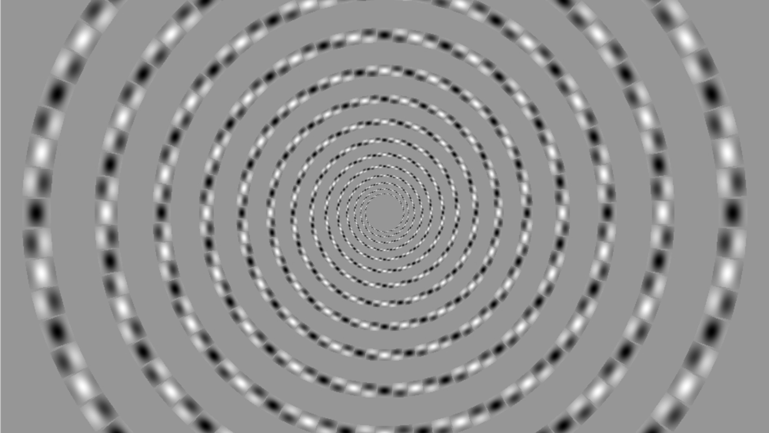

Slide 7
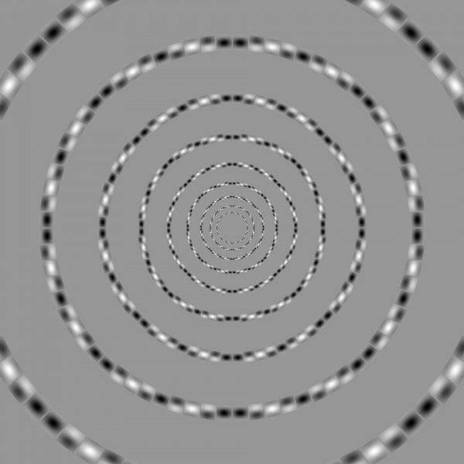
[Akiyoshi Kitaoka, Ritsumeikan University, Kyoto]

Slide 8
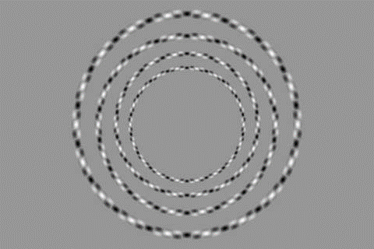

Slide 9
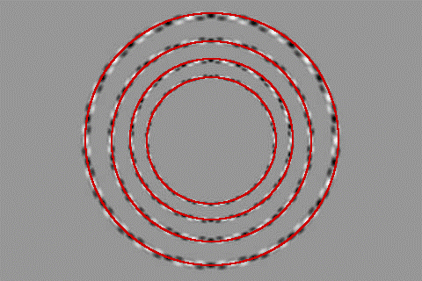

Slide 10

Erik Brynjolfsson, MIT

Slide 11
Project 1 Feedback
Thank you all.
There are no late days on proj0
Numpy gearup beyond proj0 tutorial – OK
Short time frame [my fault]
Axes3D - OK
Improvements to code description – OK

Slide 12
Project 1 Convolution Speeds
 | Convolution speed (seconds)
Jake Chanan | 0.91
Alice Marbach | 0.94
Andrew Cooke | 1.07
Albert Webson | 1.2
Reza Esfandiarpoor | 1.2
Andrew Levy | 1.22
James White | 1.23
Da Huo | 1.24
Troy Moo Penn | 1.27
Michael T Lincoln | 1.29
 | FFT convolution (seconds)
James Wang | 0.45
Matthew Kovoor | 0.75
Isaiah Liu | 0.85

Slide 13
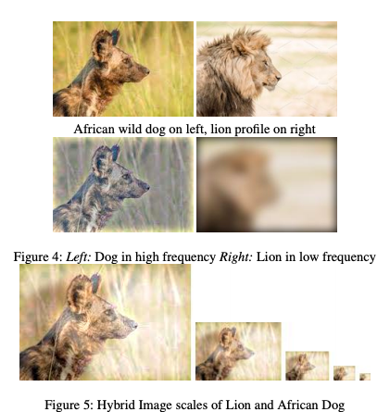
Hybrid images

Slide 14
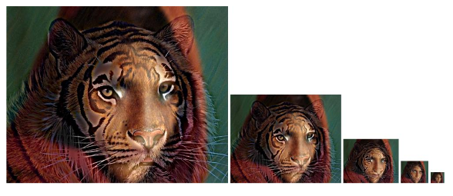
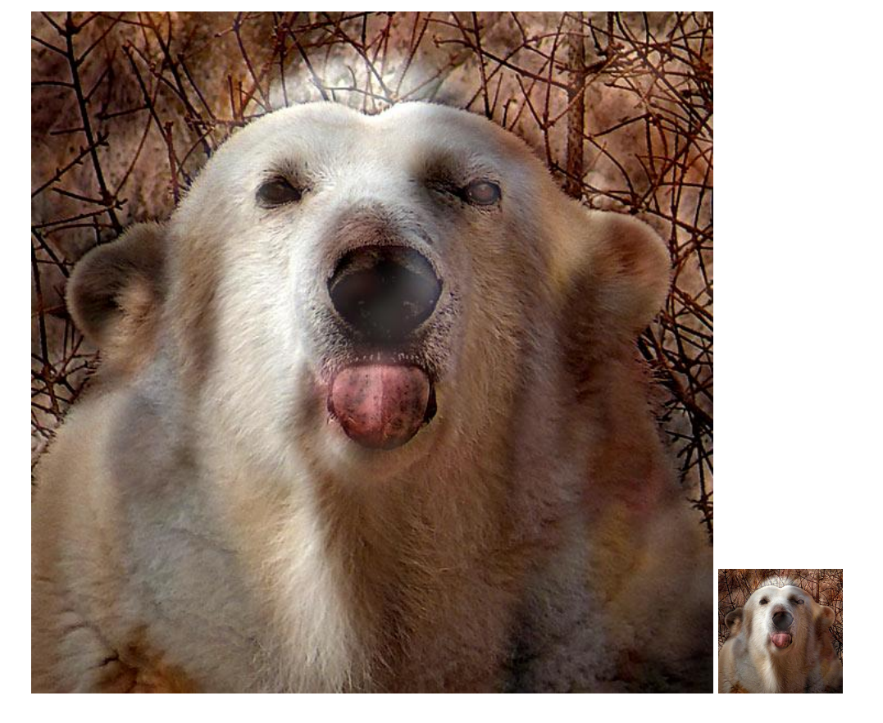

Slide 15
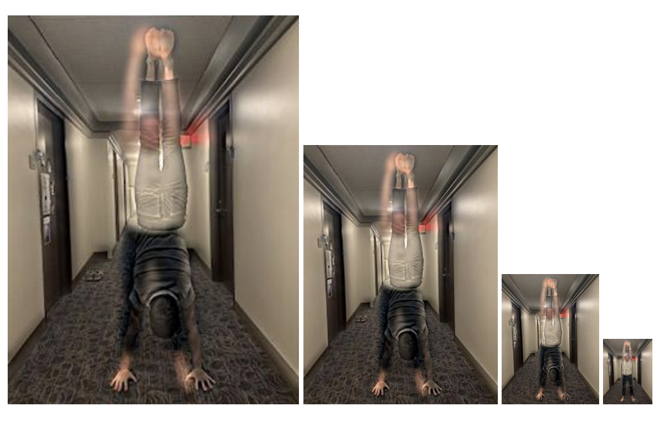

Slide 16
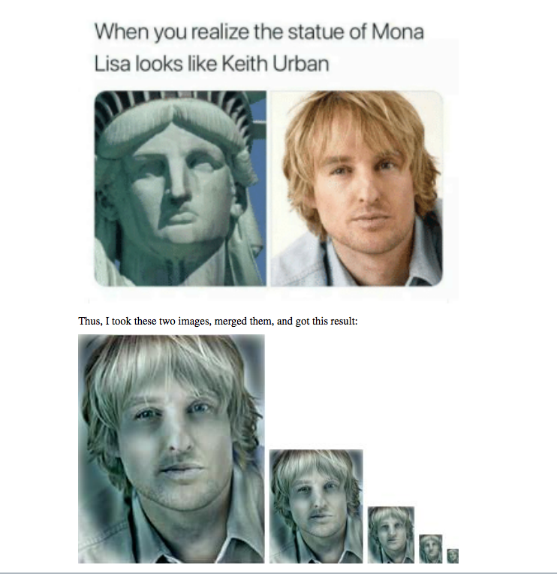

Slide 17
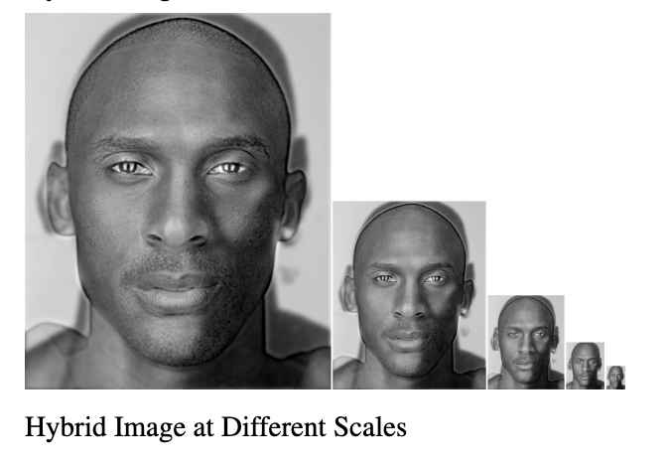

Slide 18
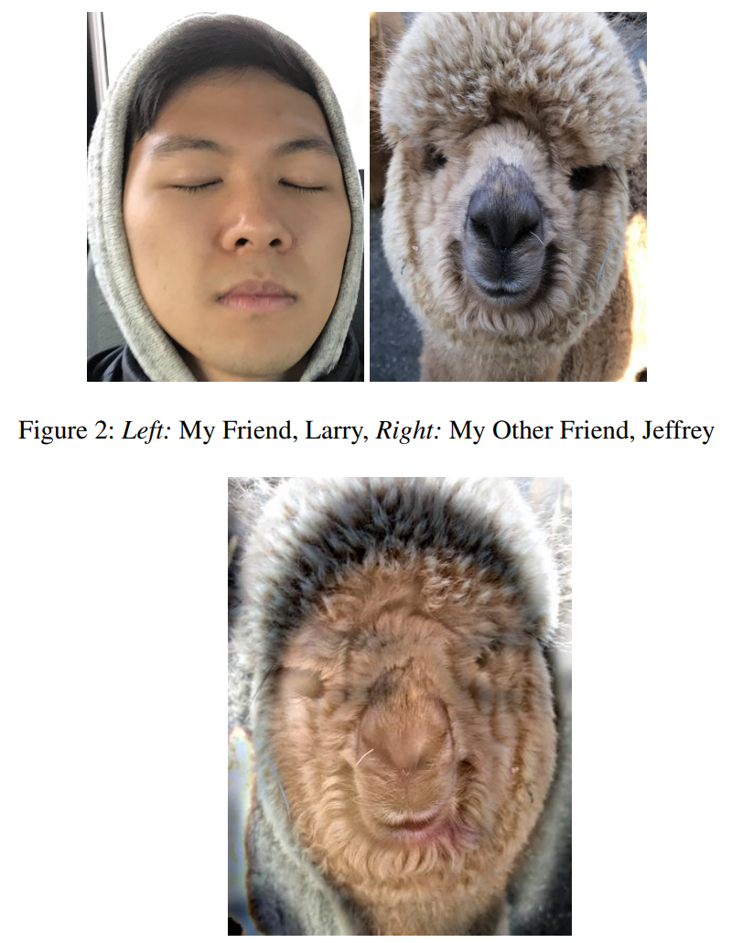

Slide 19
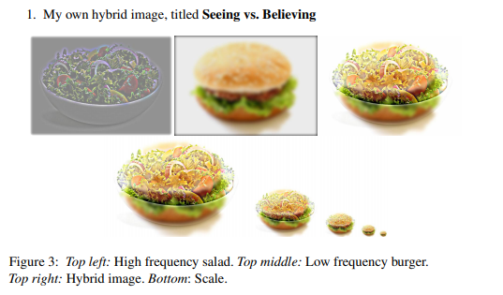
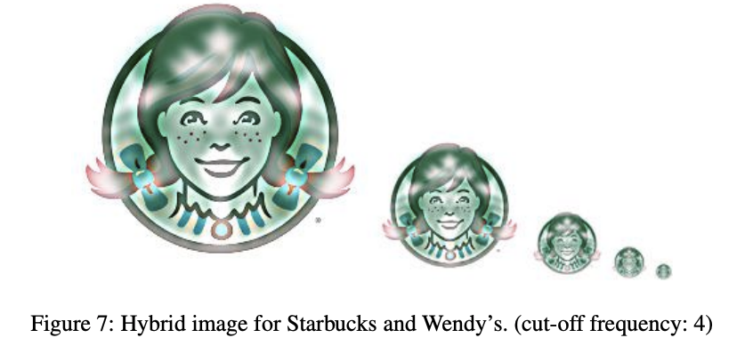

Slide 20
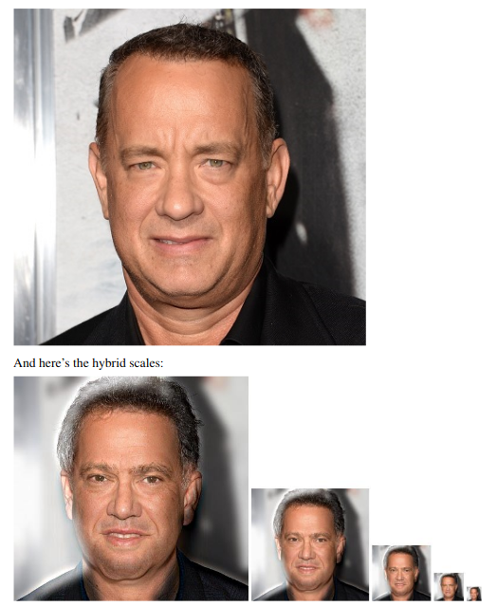

Slide 21
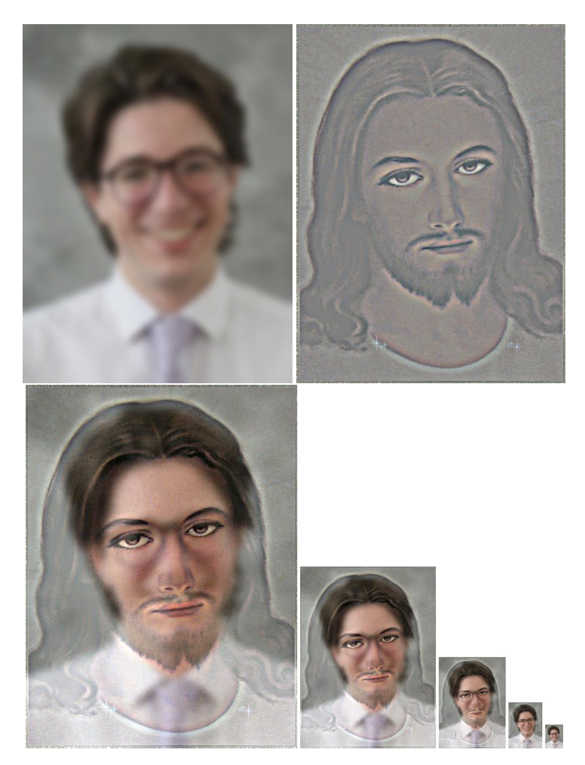

Slide 22
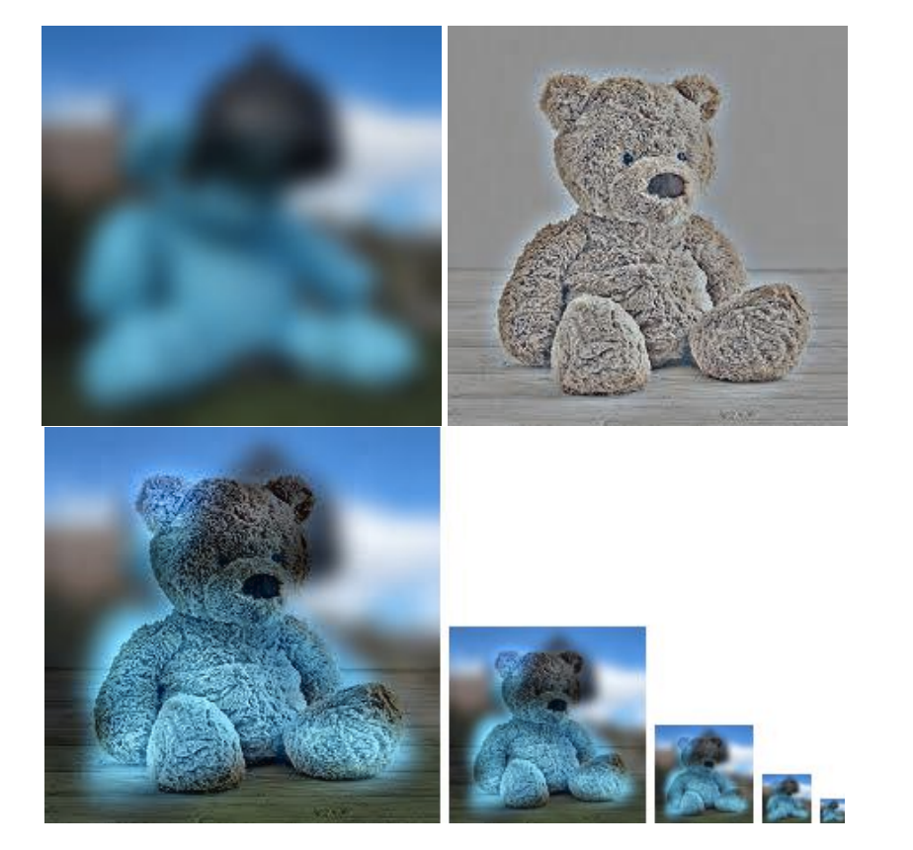

Slide 23
Corners
Filtering
Edges
Feature points
Also called interest points, key points, etc.
Often described as ‘local’ features.
Szeliski 4.1
Slides from Rick Szeliski, Svetlana Lazebnik, Derek Hoiem and Grauman&Leibe 2008 AAAI Tutorial

Slide 24
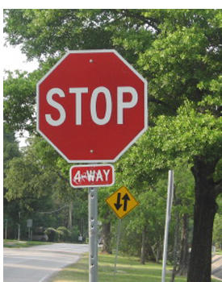


Correspondence across views
Matching points, patches, edges,
or regions across images.
Sparse or local correspondence vs.
dense correspondence (at every pixel).
≈
Hays

Slide 25
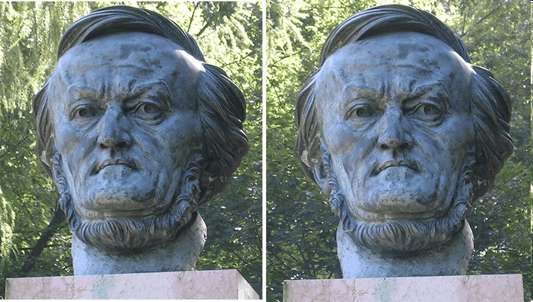
Example: estimate “fundamental matrix” that corresponds two views
Silvio Savarese

Slide 26
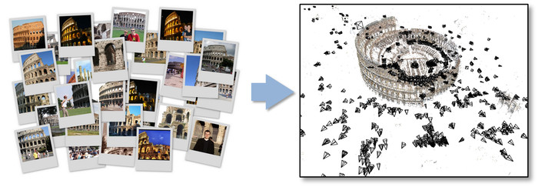
Example: structure from motion

Slide 27
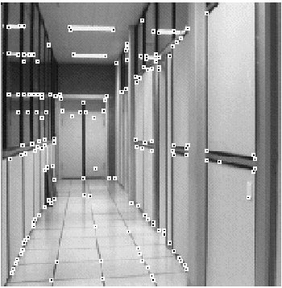
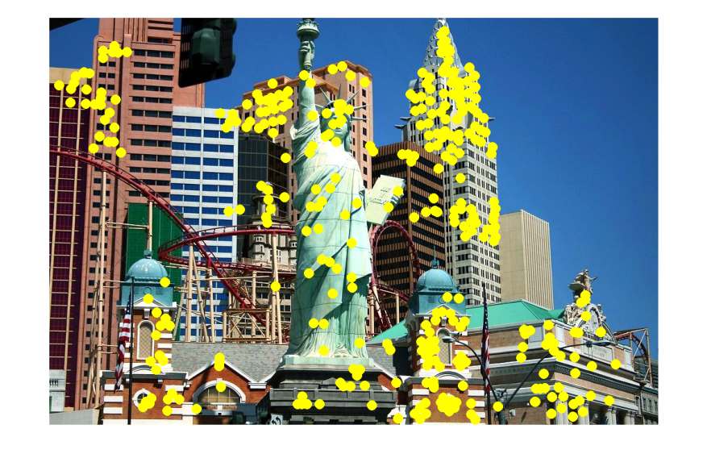
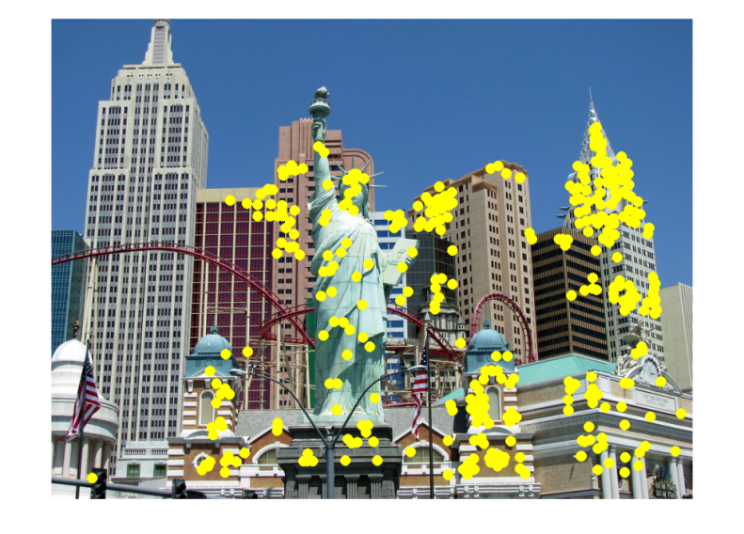
Fundamental to Applications
Image alignment
3D reconstruction
Motion tracking (robots, drones, AR)
Indexing and database retrieval
Object recognition
Hays

Slide 28
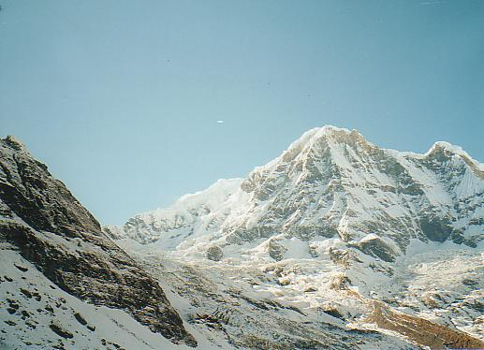
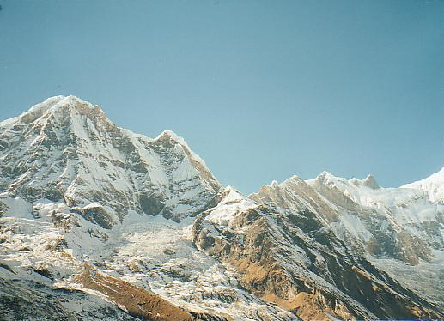
Example application: Panorama stitching
We have two images –
how do we estimate how to overlay them?

Slide 29
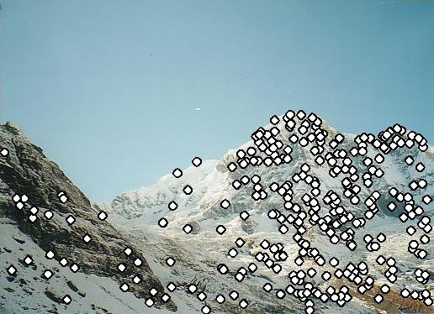
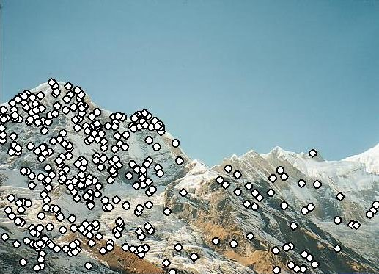

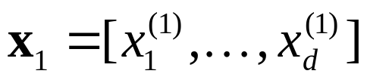

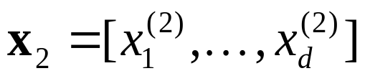
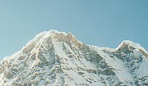

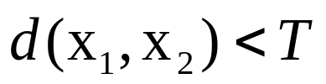
Local features: main components
Detection:
Find a set of distinctive key points.
Description:
Extract feature descriptor around each interest point as vector.
Matching:
Compute distance between feature vectors to find correspondence.

Slide 30
Goal: Distinctiveness
We want to be able to reliably determine which point goes with which.
?
May be difficult in structured environments
with repeated elements
Kristen Grauman

Slide 31
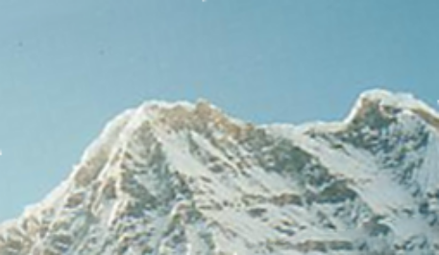

Goal: Repeatability
We want to detect (at least some of)
the same points in both images.
With these points, there’s no chance to find true matches!
Under geometric and photometric variations.
Kristen Grauman
Notes:
31

Slide 32
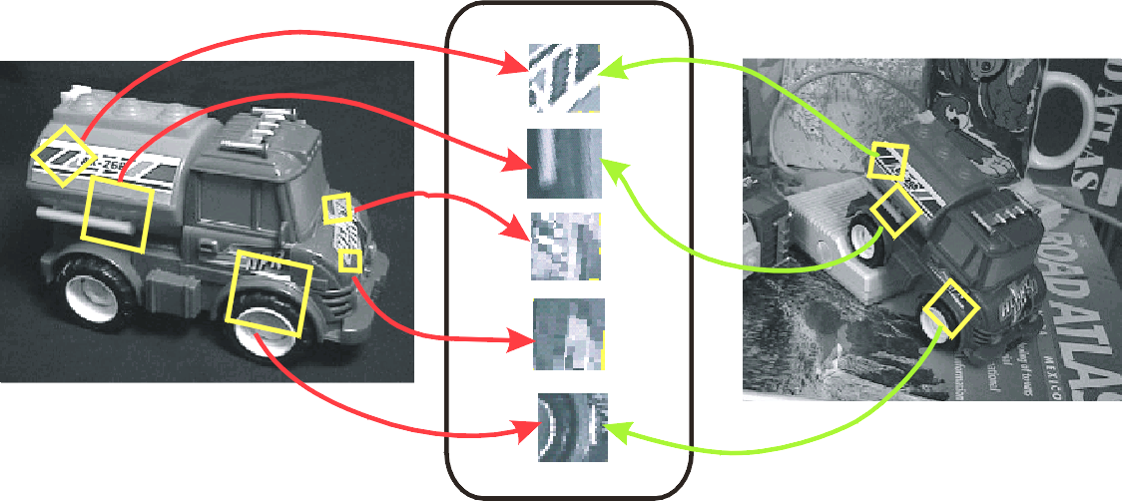
Example: Object Detection
Finding distinctive and repeatable feature points can be difficult when we want our features to be invariant to large transformations:
geometric variation (translation, rotation, scale, perspective)
appearance variation (reflectance, illumination)
Keypoint Descriptors
James Hays

Slide 33
Goal: Compactness and Efficiency
We want the representation to be as small and as fast as possible
  Much smaller than a whole image
We’d like to be able to run the detection procedure independently per image
  Match just the compact descriptors for speed.
  Difficult! We don’t get to see ‘the other image’ at match time, e.g., object detection.
Kristen Grauman

Slide 34
Characteristics of good features
Distinctiveness
  Each feature can be uniquely identified
Repeatability
  The same feature can be found in several images despite differences:
  - geometrically (translation, rotation, scale, perspective)
  - photometrically (reflectance, illumination)
Compactness and efficiency
  Many fewer features than image pixels; run independently per image
Kristen Grauman
Notes:
We might also consider ‘Locality’ – that each point is isolated to a local region of the image, such that it is more robust to effects like occlusions (e.g., seeing only part of an object)

Slide 35
Local features: main components
Detection:
Find a set of distinctive key points.
Description:
Extract feature descriptor around each interest point as vector.
Matching:
Compute distance between feature vectors to find correspondence.

Slide 36
Detection: Basic Idea
We do not know which other image locations the feature will end up being matched against.
But we can compute how stable a location is in appearance with respect to small variations in its position.
Strategy: Compare image patch
against local neighbors.
A. Efros

Slide 37

Corner Detection: Basic Idea
Recognize corners by looking at small window.
We want a window shift in any direction to give a large change in intensity.
“Flat” region:
no change in all directions
“Edge”:
no change along the edge direction
“Corner”:
significant change in all directions
A. Efros

Slide 38
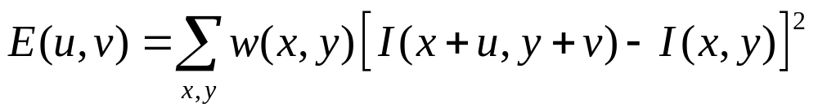
Corner Detection by Auto-correlation
Change in appearance of window w(x,y) for shift [u,v]:
Window function
Shifted intensity
Intensity
Window function w(x,y) =
or
1 in window, 0 outside
Gaussian
Source: R. Szeliski

Slide 39
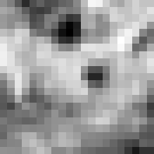

Corner Detection by Auto-correlation
Change in appearance of window w(x,y) for shift [u,v]:
I(x, y)
E(u, v)
E(0,0)
w(x, y)

Slide 40
Corner Detection by Auto-correlation
Change in appearance of window w(x,y) for shift [u,v]:
I(x, y)
E(u, v)
E(3,2)
w(x, y)

Slide 41
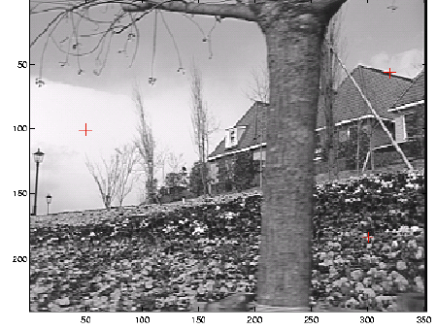
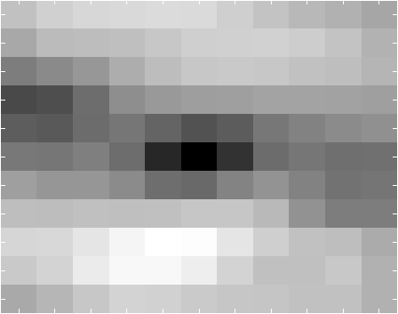
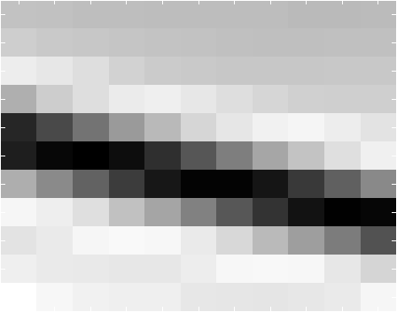
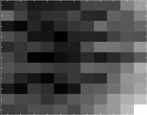
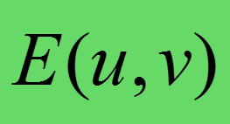
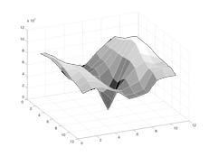
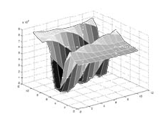
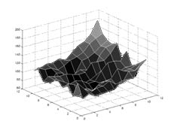
Think-Pair-Share:
Correspond the three red crosses to (b,c,d).
As a surface
Notes:
Figure 4.5 Three auto-correlation surfaces EAC(u) shown as both grayscale images and surface plots:
The original image is marked with three red crosses to denote where the auto-correlation surfaces were computed;
this patch is from the flower bed (good unique minimum);
this patch is from the roof edge (one-dimensional aperture problem); and
this patch is from the cloud (no good peak).
Each grid point in figures b–d is one value of u.

Slide 42
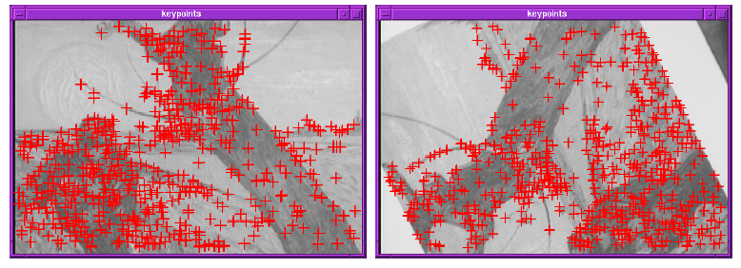
Finding Corners
Key property: in the region around a corner, image gradient has two or more dominant directions
Corners are repeatable and distinctive
C.Harris and M.Stephens. "A Combined Corner and Edge Detector.“ Proceedings of the 4th Alvey Vision Conference: pages 147--151.

Slide 43
Corner Detection by Auto-correlation
Change in appearance of window w(x,y) for shift [u,v]:
We want to discover how E behaves for small shifts
But this is very slow to compute naively.
O(window_width² * shift_range² * image_width²)
O( 11² * 11² * 600² ) = 5.2 billion of these
14.6k ops per image pixel

Slide 44
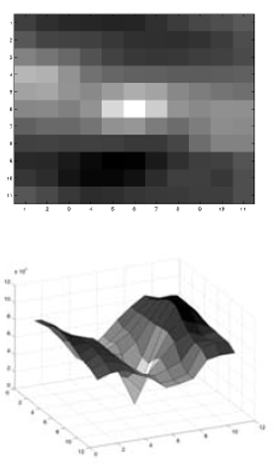
Corner Detection by Auto-correlation
Change in appearance of window w(x,y) for shift [u,v]:
We want to discover how E behaves for small shifts
But we know the response in E that we are looking for – strong peak.

Slide 45
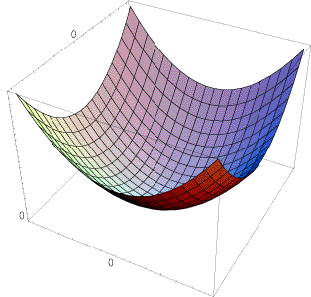
Strategy:
Approximate E(u,v) locally by a quadratic surface, and look for that instead.
≈

Slide 46
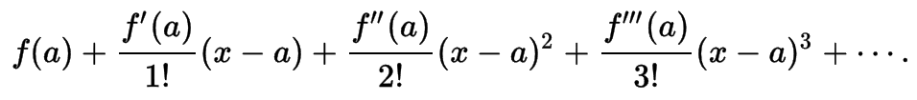

Recall: Taylor series expansion
A function f can be represented by an infinite series of its derivatives at a single point a:
Wikipedia
As we care about window centered, we set a = 0
(MacLaurin series)
Approximation of
f(x) = e^{x}
centered at f(0)

Slide 47

Local quadratic approximation of E(u,v) in the neighborhood of (0,0) is given by the
second-order Taylor expansion:
Notation: partial derivative
Notes:
Technically a Maclaurin expansion, a special case of Taylor expansion centered at 0.
What is the point? Well, now we’re just extrapolating local measurements instead of doing 10s of thousands of computations.

Slide 48
Local quadratic approximation of E(u,v) in the neighborhood of (0,0) is given by the
second-order Taylor expansion:
Ignore function value; set to 0
Ignore first derivative, set to 0
Just look at shape of second derivative
(2D quadratic surface)
Notes:
Technically a Maclaurin expansion, a special case of Taylor expansion centered at 0.
What is the point? Well, now we’re just extrapolating local measurements instead of doing 10s of thousands of computations.

Slide 49

Corner Detection: Mathematics
Second-order Taylor expansion of E(u,v) about (0,0):

Slide 50

Corner Detection: Mathematics
Second-order Taylor expansion of E(u,v) about (0,0):

Slide 51

Corner Detection: Mathematics
Second-order Taylor expansion of E(u,v) about (0,0):

Slide 52



Corner Detection: Mathematics
The quadratic approximation simplifies to
where M is a second moment matrix computed from image derivatives:
M
Notes:
https://en.wikipedia.org/wiki/Image_moment

Slide 53






Corners as distinctive interest points
2 x 2 matrix of image derivatives
(averaged in neighborhood of a point)
Notation:
James Hays

Slide 54

Interpreting the second moment matrix
E(u,v) is locally approximated by a quadratic surface. Let’s try to understand how its shape relates to M.
James Hays

Slide 55


Interpreting the second moment matrix
Let’s take horizontal “slices” of our approximation of E(u, v):
$$[u v] M \left[\begin{matrix}u \\ v\end{matrix}\right]=\text{const}\text{ant}$$
Each coloured line in the diagram below is where
James Hays
Notes:
Try to implement Harris using the technique expressed on slide 5 of the 'Local Image Features' session.
The ellipse construct is useful for understanding what M represents.
In this case, we are saying that each time c is a constant, we define an ellipse over (an idealized) E.
E is a small matrix that contains values for the local auto-correlation of an image. Its axes are u,v (the shifts in x and y) - e.g., slide in the 'Interest Points and Corners' session.
E contains a set of values, from 0 (no difference in the image patches) up to the maximal difference (one all black, one all white patch, which is 255 square).
We can 'cut' E at different values in this set, to produce different shapes. E.G., if we imagine E as a 3D valley or hole shape, the shape at c = 20 will be a contour around the valley at a constant 'altitude'.
Now, when we approximate E using the second-order Taylor approximation, we are idealizing the shape that E takes. This is what we see on slide 59 of the 'Interest Points and Corners' session. Here, our 'idealized' E is a smooth surface which approximates the auto-correlation differences, for which cross sections are ellipses. Each of the isolines on slide 59 represents a different cut at a constant value, or a different ellipse.

Slide 56

Interpreting the second moment matrix
First, consider the axis-aligned case (gradients are either horizontal or vertical)
If either λ is close to 0, then this is not a corner, so look for locations where both are large.

Slide 57


Visualization of second moment matrix
Simple image:
Checkerboard.
1 corner
4 edges
4 flat regions
Note: Edges show ‘wide’ response because image derivatives were blurred by Gaussian $σ=1$ before visualizing.

Slide 58

Visualization of second moment matrices
James Hays

Slide 59

Visualization of second moment matrices
For cornerness,
we only care about the ‘steepness’,
not the rotation.
Can we ignore
this somehow?
James Hays

Slide 60

Linear algebra review
$M$ is symmetric. Symmetric matrices have orthogonal eigenvectors (i.e., a basis).
$M$ is square. Square matrices are diagonalizable if some matrix $P$ exists s.t. $M=P^{−1}AP$, where $A$ has only diagonal entries and $P$ represents a change of basis (in 2D, a rotation).

Slide 61




Interpreting the second moment matrix
Consider a horizontal “slice” of E(u, v):
This defines an ellipse.
$$A$$
Diagonalization of M:
The axis lengths of the ellipse are determined by the eigenvalues,
and the orientation is determined by a rotation matrix $R$.
direction of the fastest change
Note inverse relationship: larger eigenvalue = steeper slope; smaller ellipse in visualization
direction of the slowest change
(λ_{max})^{-1/2}
(λ_{min})^{-1/2}
James Hays
Notes:
This may help some of you:
Haoze (past TA):
“To explain this concept, I proved that the unit eigenvectors maximize the quadratic function, while the local maximum are the eigenvalues (using Lagrangian). It worked well to students who understand linear algebra but did not help those whose who don't (or have forgotten the math). And again, since "M" is symmetric, its eigenvectors should be orthogonal, which is a fact that almost no student have noticed (or understood) and may worth mentioning in class.”

Slide 62
Classification of image points using eigenvalues of M
λ₂
“Edge”
λ₂ >> λ₁
“Corner”
λ₁ and λ₂ are large,
λ₁ ~ λ₂;
E increases in all directions
λ₁ and λ₂ are small;
E is almost constant in all directions
“Edge”
λ₁ >> λ₂
“Flat” region
λ₁

Slide 63

Classification of image points using eigenvalues of M
Cornerness score:
λ₂
“Edge”
C < 0
$$C=λ_{1}λ_{2}−α(λ_{1}+λ_{2})^{2}$$
“Corner”
C > 0
α: some constant (~0.04 to 0.06)
|C| small
“Edge”
C < 0
“Flat” region
λ₁
Notes:
Recommendation: Look at the original paper below, and find the corresponding plot. See how C carves out this green space in the diagram above.
C.Harris and M.Stephens. “A Combined Corner and Edge Detector.” Proceedings of the 4th Alvey Vision Conference: pages 147—151, 1988.

Slide 64

Linear algebra review
Determinant of a diagonal matrix is the product of all eigenvalues. $A$ is diagonal.
Trace of a square matrix is the sum of its diagonal entries; and is the sum of its eigenvalues.
Notes:
https://en.wikipedia.org/wiki/Determinant (geometrically, this is the volume scaling factor of a transformation)
https://en.wikipedia.org/wiki/Determinant#Relation_to_eigenvalues_and_trace
https://en.wikipedia.org/wiki/Trace_%28linear_algebra%29

Slide 65




Classification of image points using eigenvalues of M
Cornerness score:
λ₂
“Edge”
C < 0
$$C=λ_{1}λ_{2}−α(λ_{1}+λ_{2})^{2}$$
“Corner”
C > 0
α: some constant (~0.04 to 0.06)
Remember your linear algebra:
Determinant:
(diagonal matrices)
Trace:
|C| small
“Edge”
C < 0
“Flat” region
Avoids explicit eigenvalue computation!
λ₁
Notes:
Determinant of a diagonal matrix is also the product of its diagonal entries; therefore the determinant of A is a product of its eigenvalues.

Slide 66

This is the Harris corner detector!
Compute M matrix for each window to recover a cornerness score $C$.
  Note: We can find M purely from the per-pixel image derivatives!
Threshold to find pixels which give large corner response ($C$ > threshold).
Find the local maxima pixels,
i.e., non-maximal suppression.
C.Harris and M.Stephens. “A Combined Corner and Edge Detector.” Proceedings of the 4th Alvey Vision Conference: pages 147—151, 1988.
Notes:
66
Note: it took many years to work out each of these pieces and produce an efficient computation for this.

Slide 67


























Harris Corner Detector [Harris88]
James Hays
0. Input image
We want to compute M at each pixel.
$$I$$
1. Compute image derivatives (optionally, blur first).
$$Ix$$
$$Iy$$
2. Compute $M$ components
as squares of derivatives.
$$I_{x}^{2}$$
$$I_{y}^{2}$$
$$Ixy$$
3. Gaussian filter g() with width σ
= $g\left(I_{x}^{2}\right)$, $g\left(I_{y}^{2}\right)$, $g\left(I_{x}∘I_{y}\right)$
Reminder: $a∘b$ is Hadamard product (element-wise multiplication)
$$g(Ix2)$$
$$g(Iy2)$$
$$g(Ix∘Iy)$$
4. Compute cornerness
$$C=\det\left(M\right)−α trace{\left(M\right)}^{2}$$
$$=g\left(I_{x}^{2}\right)∘g\left(I_{y}^{2}\right)−g{\left(I_{x}∘I_{y}\right)}^{2}$$
$−α{\left[g\left(I_{x}^{2}\right)+g\left(I_{y}^{2}\right)\right]}^{2}$
$$R$$
5. Threshold on $C$ to pick high cornerness
6. Non-maximal suppression to pick peaks.
Notes:
$∘$ = https://en.wikipedia.org/wiki/Hadamard_product_(matrices)

Slide 68

Harris Detector: Steps

Slide 69


Harris Detector: Steps
Compute corner response $C$

Slide 70

Harris Detector: Steps
Find points with large corner response: $C$ > threshold

Slide 71


Harris Detector: Steps
Take only the points of local maxima of $C$

Slide 72

Harris Detector: Steps

Slide 73
Live Harris Demo

