Slide 1
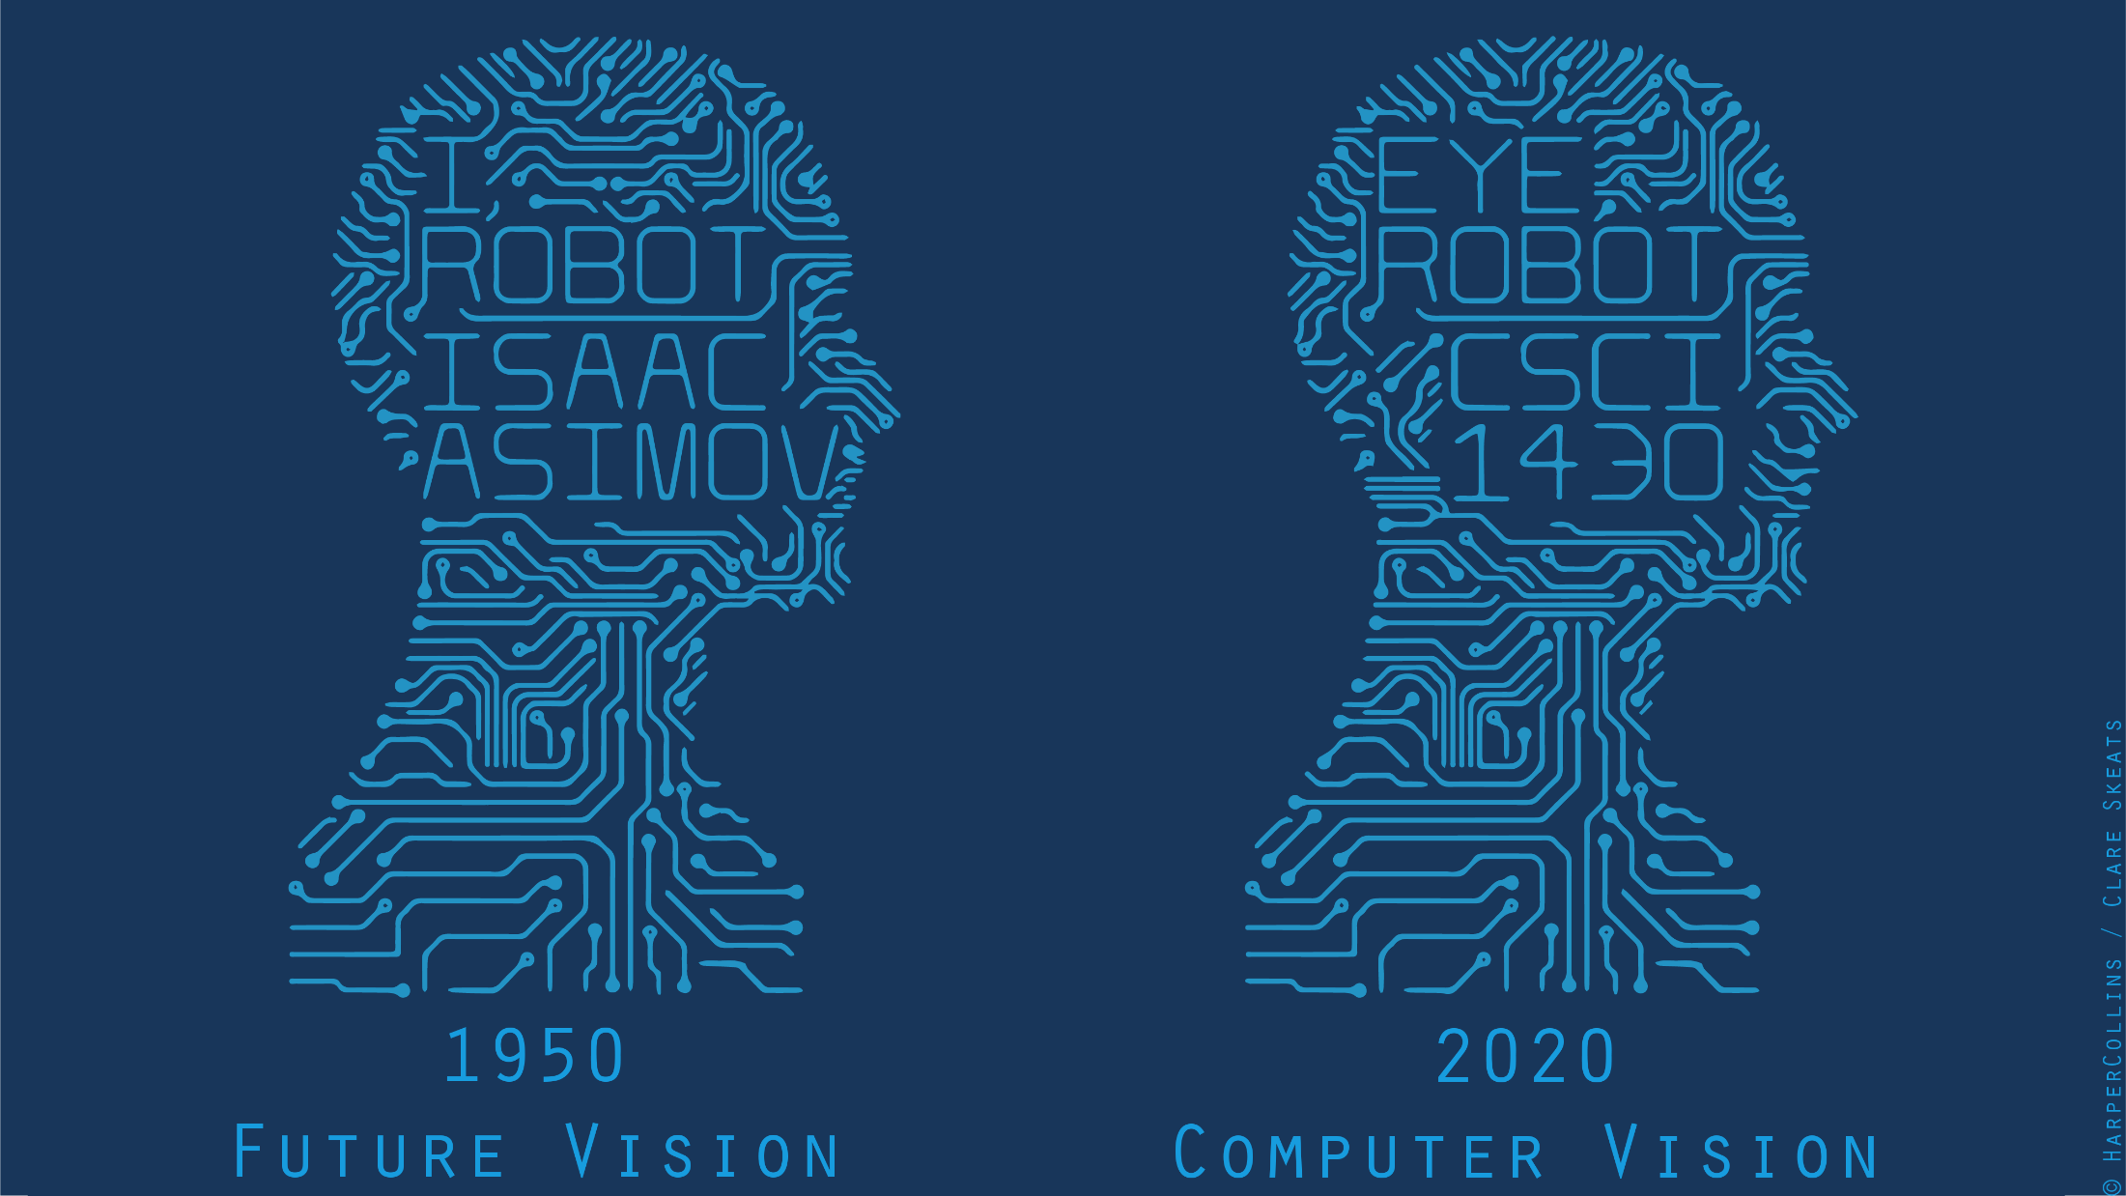

Slide 2
Project 0 Q3 – CV Superpowers
Instantly identify people, objects, places, plant and animal species, …
“I wouldn’t need to have a cheat sheet during exams”
Read people’s minds. Infer thoughts from emotions.
Take a picture of a product and it takes you to a site you can purchase the item, like an Amazon listing.
“Try to get on the Price is Right to become the most dominant Price is Right player ever, and win $10,000s worth of consumer products.”

Slide 3
Project 0 Q3 – CV Food Superpowers
“The ability to tell if a picture of an item is of a hot dog or not…
I’d use it to distinguish things that are hot dogs from things that are not hot dogs.”
Determine the recipe of a food by looking at it.
“Will use it to make food that my mom likes.”
Reliably tell the difference between choco-chip cookies and oatmeal raisin cookies from any distance.
“I would never have my expectations let down from eating an oatmeal raisin cookie expecting it to be a chocolate cookie.” :’ (

Slide 4
Project 0 Q3 – Real Heroes
Overlay myself on objects like a Snapchat filter but in real life.
“Mess around and turn into different famous people to live life in their shoes…
Then master my powers …. use them for good … scare politicians into doing right…
like Batman.”
“Detect a person’s history by scanning their face, having access to any known records of them.
Would use it to travel the world and figure out who to be friends with.
Possibly help find criminals.”
Recognize precise 3D movement of a body and transfer that data to a robot, e.g., for medial tasks.

Slide 5
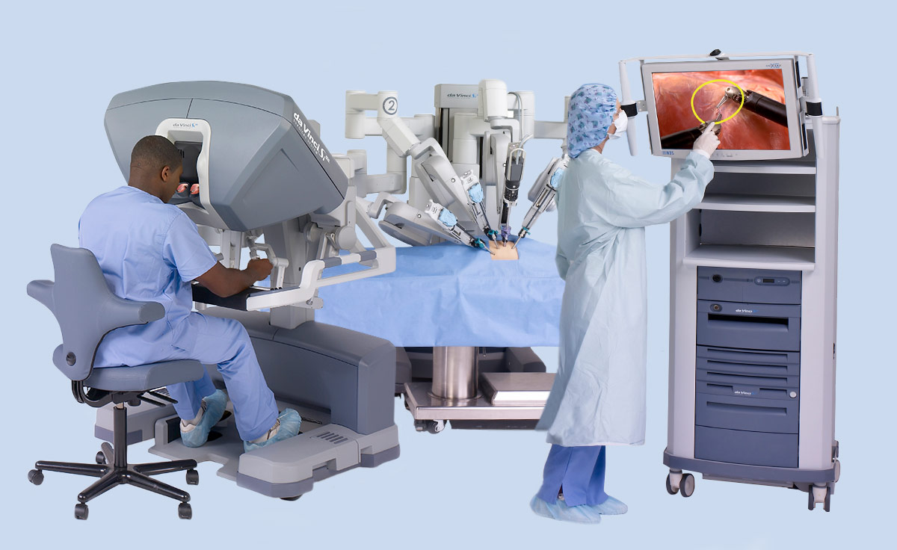
Telesurgery
da Vinci robotic surgery system have been successfully tested remotely
Notes:
https://www.davincisurgery.com/

Slide 6
Project 0 Q3 – Contentious Issues
Hiring for jobs; interview screening
Autonomous vehicle safety
Face reconstruction / recognition.
  Accuracy and bias
  Real-time mass surveillance - in and out of towns, buildings, buying a cellphone, jaywalking
  Face ‘swaps’, editing
Policing; crime prediction
Healthcare; medical imaging; privacy
Industrial automation; jobs
Delivery drones; privacy
Military; autonomous weapons
Notes:
Hiring: HireVue - https://www.washingtonpost.com/technology/2019/10/22/ai-hiring-face-scanning-algorithm-increasingly-decides-whether-you-deserve-job/
Policing: London Metropolitan Police - https://www.bbc.com/news/uk-51237665
Clearview AI

Slide 7
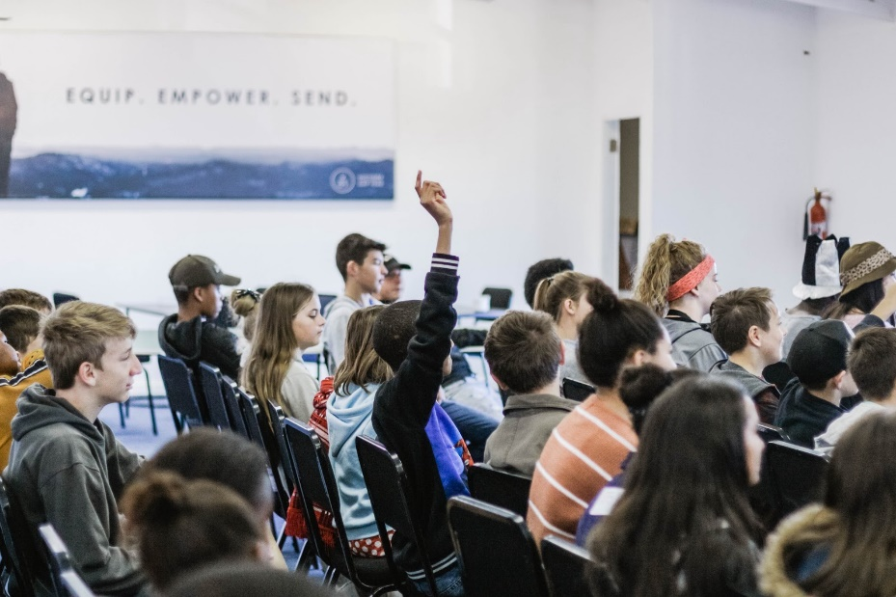
Project 0 Q3 – Contentious Issues
Educators using CV to take attendance, improve campus security, remove from logistic burdens.
Immature --- might give inaccurate or biased results; questions of student privacy
Notes:
https://medium.com/alef-education/computer-vision-in-education-what-can-ai-see-84d679d12a79

Slide 8
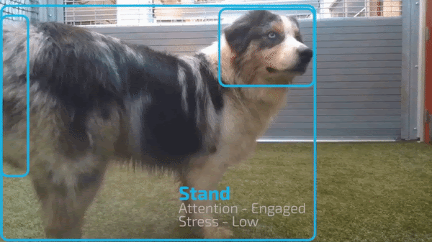
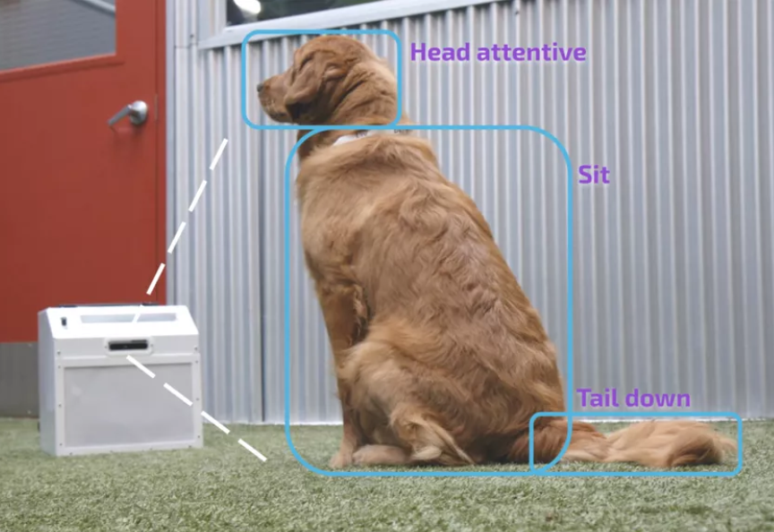
Project 0 Q3 – Contentious Issues
Companion Labs in SF managed to use CV to train dogs and automatically launch treats.
Notes:
https://www.cnet.com/news/new-ai-dog-trainer-uses-computer-vision-and-a-treat-launcher/
Aim is to reduce separation anxiety?

Slide 9
Next Classes
Spatial frequency
Fourier transform and frequency domain
  Frequency view of filtering
  Hybrid images
  Sampling
Reminder: Textbook
  Today’s lecture covers material in
  Klette 1, 2; Szeliski 3.4
Slide: Hoiem

Slide 10
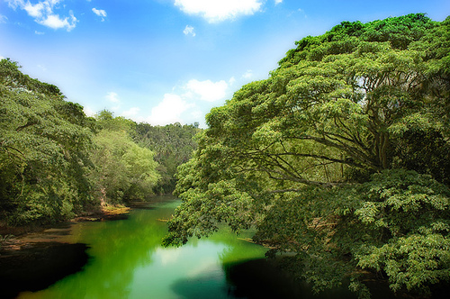
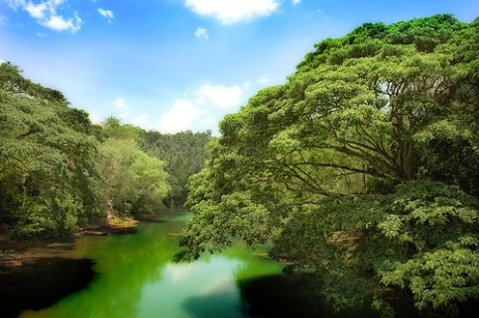
Why does a lower resolution image still make sense to us? What information do we lose?
Image: http://www.flickr.com/photos/igorms/136916757/
Slide: Hoiem

Slide 11
Sampling
Why does a lower resolution image still make sense to us? What do we lose?
Image: http://www.flickr.com/photos/igorms/136916757/

Slide 12
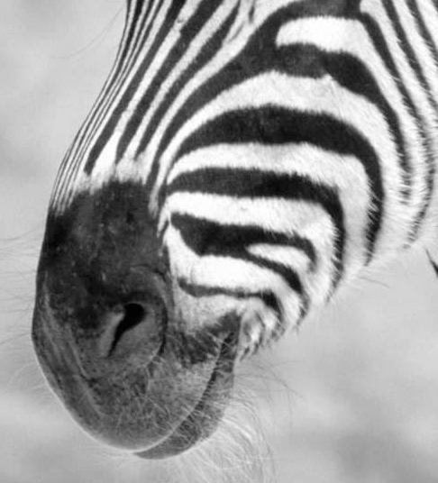
Subsampling by a factor of 2
Throw away every other row and column to create a 1/2 size image

Slide 13
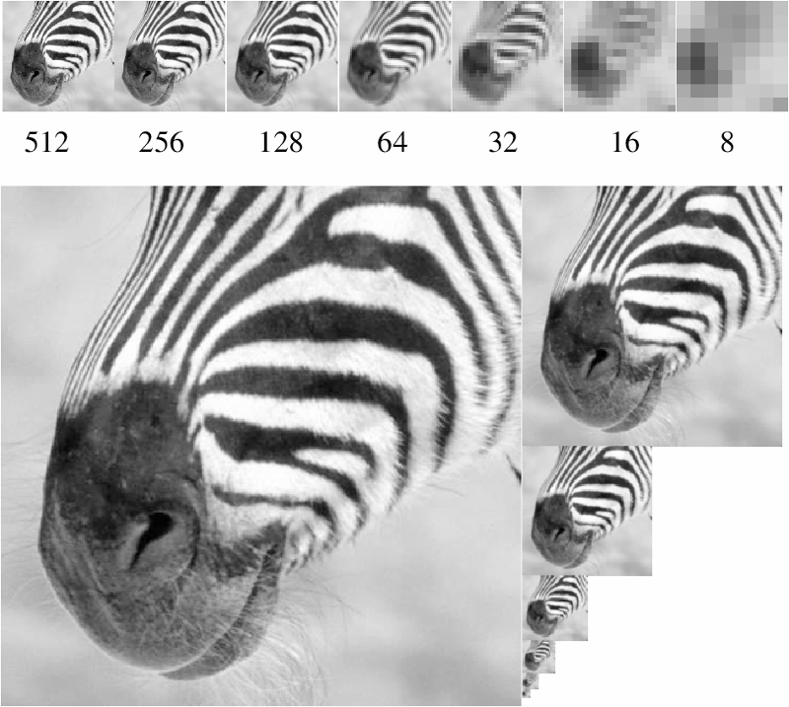
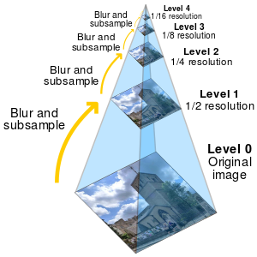
Figure from David Forsyth
A ‘bar’ in the big images is a hair on the zebra’s nose; in smaller images, a stripe; in the smallest, the animal’s nose
Image pyramid

Slide 14
Algorithm for downsampling by factor of 2
Start with image of w x h
Sample every other pixel
  im_small = image[ ::2:, ::2 ]
Repeat until im_small is 1 pixel large.
Numpy syntax:
::2 -> start at 0, end at ‘end’, increase every 2, until the end.
e.g.,
0,2,4,6,…,w
(if w is not even, then this goes to w-1)
Hays

Slide 15
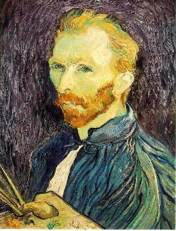
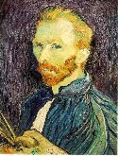

Image sub-sampling
1/8
1/4
Throw away every other row and column to create a 1/2 size image.
Steve Seitz

Slide 16

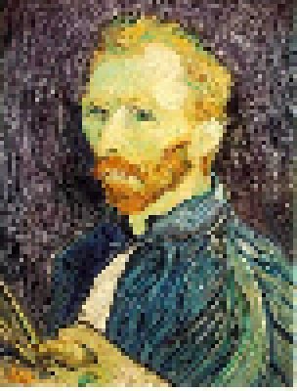
Subsampling without filtering
1/2
1/4 (2x subsample)
1/8 (4x subsample)
Steve Seitz

Slide 17
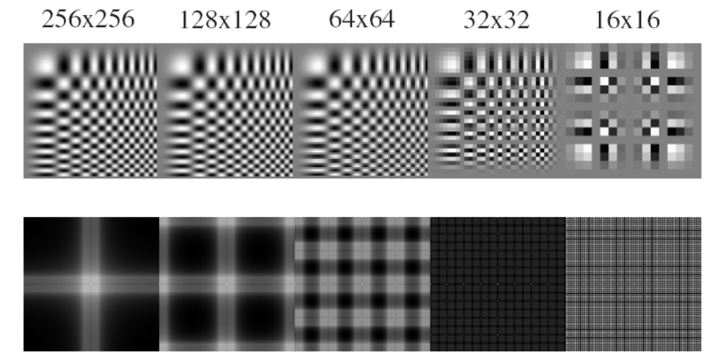
Sampling and aliasing

Slide 18
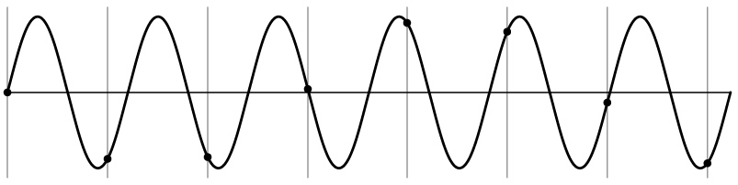
Aliasing problem
1D example (sinewave):
Source: S. Marschner

Slide 19
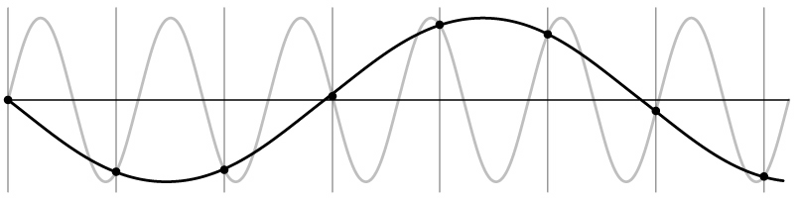
Aliasing problem
1D example (sinewave):
Source: S. Marschner

Slide 20
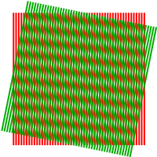
Aliasing problem
Sub-sampling may be dangerous….
Characteristic errors may appear:
  “car wheels rolling the wrong way in movies”
  “checkerboards disintegrate in graphics”
  “striped shirts look funny on color television”
    Moiré patterns
Source: D. Forsyth; Wikipedia

Slide 21
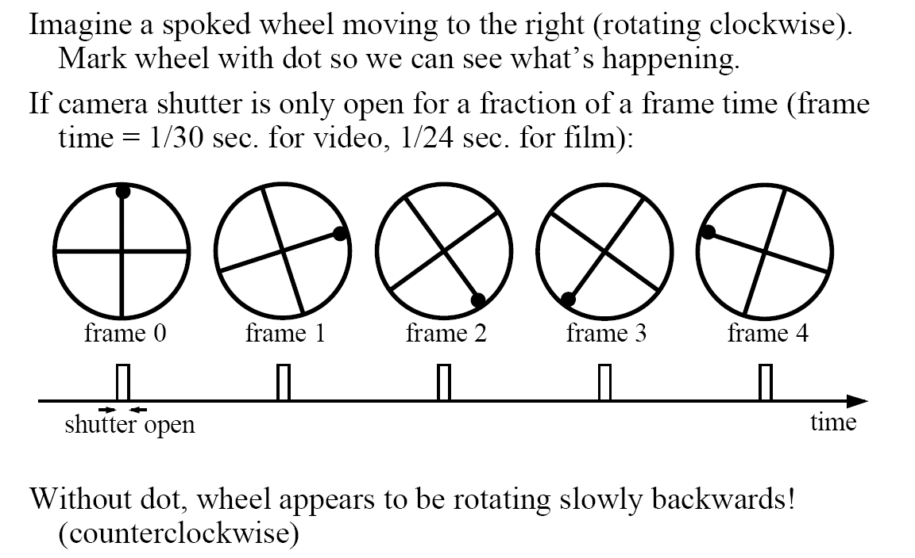
Aliasing in video
Slide by Steve Seitz

Slide 22
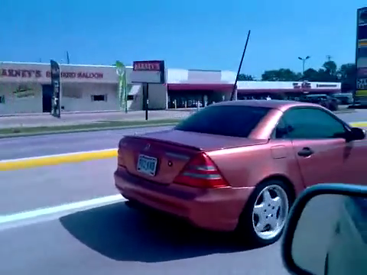
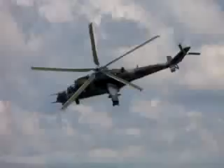
Videos
[YouTube; JoinBuzzirk; phrancque]
Notes:
https://www.youtube.com/watch?v=Y1yHMy0-4TM
https://www.youtube.com/watch?v=jQDjJRYmeWg

Slide 23
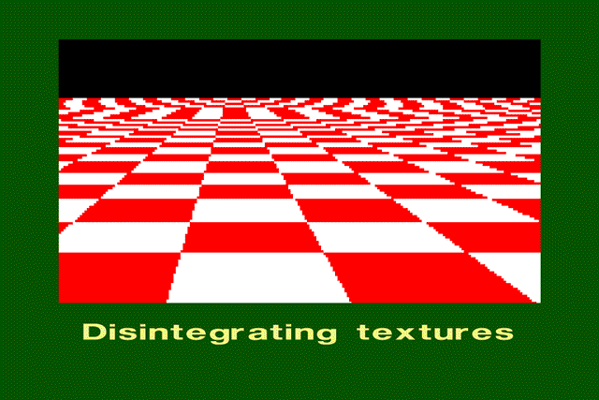
Aliasing in graphics
Source: A. Efros

Slide 24
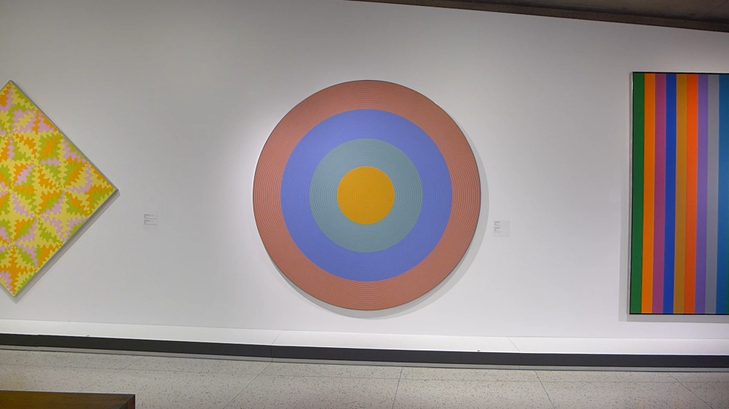
Aliasing and Moiré patterns
Gong 96, 1932, Claude Tousignant, Musée des Beaux-Arts de Montréal

Slide 25


Slide 26
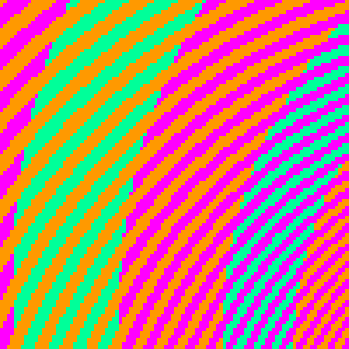
The blue and green colors are actually the same
http://blogs.discovermagazine.com/badastronomy/2009/06/24/the-blue-and-the-green/

Slide 27
Nyquist-Shannon Sampling Theorem
When sampling a signal at discrete intervals, the sampling frequency must be ≥ 2 × f_{max}
f_{max} = max frequency of the input signal
This allows us to reconstruct the original perfectly from the sampled version
v
v
v
good
bad

Slide 28
How to fix aliasing?
Solutions?

Slide 29
Better sensors
Solutions:
Sample more often

Slide 30
Anti-aliasing
Solutions:
Sample more often
Get rid of all frequencies that are greater than half the new sampling frequency
  Will lose information
  But it’s better than aliasing
  Apply a smoothing (low pass) filter
Hays

Slide 31
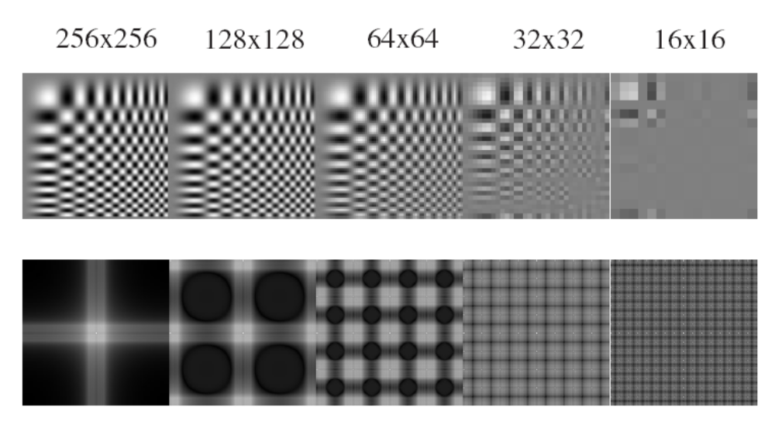
Anti-aliasing
Forsyth and Ponce 2002

Slide 32
Algorithm for downsampling by factor of 2
Start with image(h, w)
Apply low-pass filter
  im_blur = imfilter( image, fspecial(‘gaussian’, 7, 1) )
Sample every other pixel
  im_small = im_blur( 1:2:end, 1:2:end );
Hays

Slide 33
Subsampling without filtering
1/2
1/4 (2x subsample)
1/8 (4x subsample)
Steve Seitz

Slide 34



Subsampling with Gaussian pre-filtering
Gaussian 1/2
G 1/4
G 1/8
Gaussian Pyramid [Burt and Adelson, 1983]
Steve Seitz

Slide 35
Gaussian Pyramid [Burt and Adelson, 1983]

Slide 36
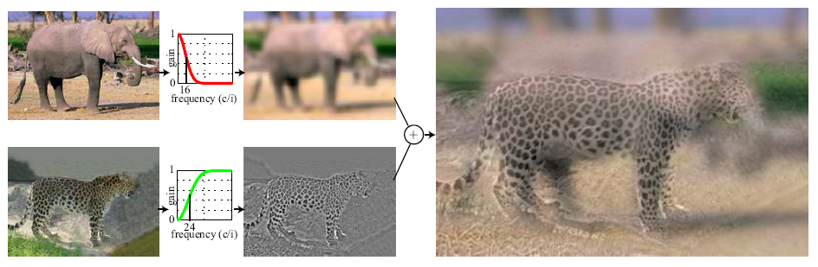
Hybrid Images
Hays
A. Oliva, A. Torralba, P.G. Schyns,
“Hybrid Images,” SIGGRAPH 2006

Slide 37
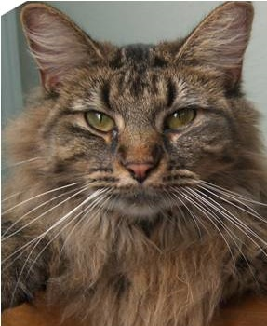
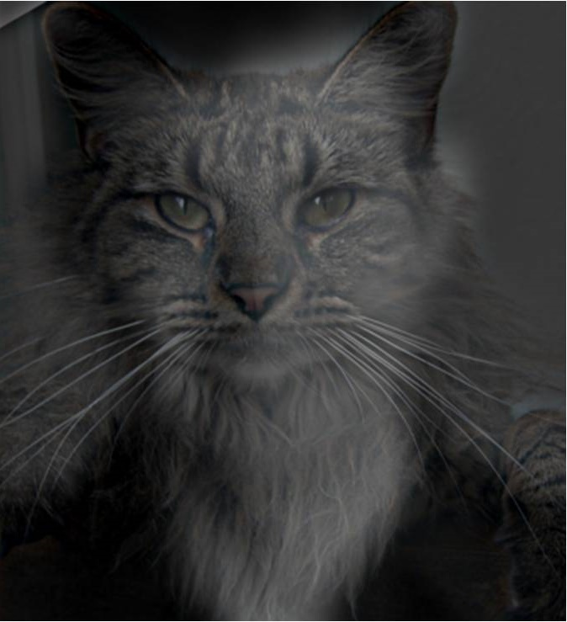
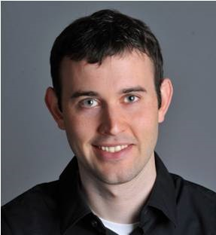
Why do we get different, distance-dependent interpretations of hybrid images?
?
Slide: Hoiem

Slide 38
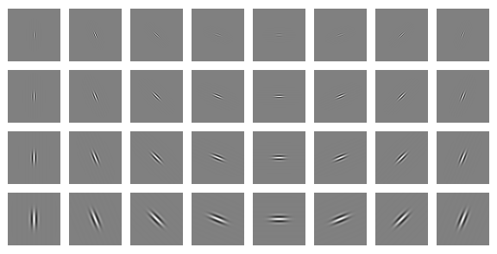
Clues from Human Perception
Early visual processing in human perception
filters for orientations and scales of frequency.
Related to Gabor filters: sinusoids convolved with Gaussians
Notes:
Early Visual Processing: Multi-scale edge and blob filters
https://en.wikipedia.org/wiki/Gabor_filter

Slide 39

Campbell-Robson contrast sensitivity curve
Perceptual cues in the mid-high frequencies dominate perception.
Contrast decrease (log)
Frequency increase (log)
Notes:
Ask students to look at the image and think about where the line of constant response is -

Slide 40
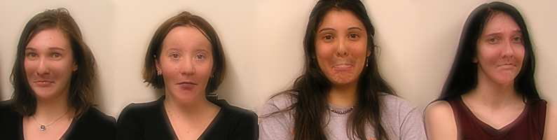

Application: Hybrid Images
When we see an image from far away, we are effectively subsampling it!
A. Oliva, A. Torralba, P.G. Schyns, SIGGRAPH 2006

Slide 41
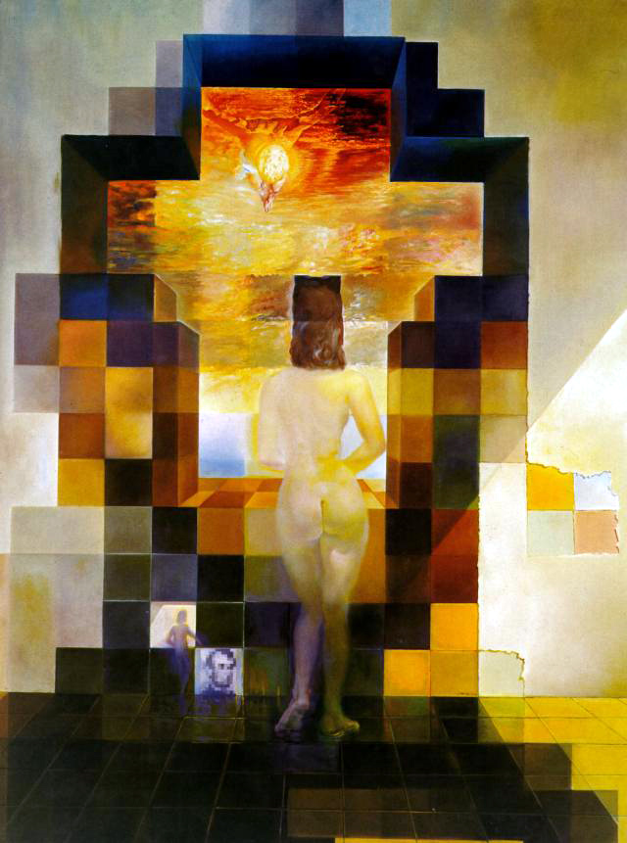
Hays
Salvador Dali
“Gala Contemplating the Mediterranean Sea,
which at 30 meters becomes the portrait
of Abraham Lincoln”, 1976
Notes:
Gala was Dali’s wife.

Slide 42
Salvador Dali invented Hybrid Images?
Salvador Dali
“Gala Contemplating the Mediterranean Sea,
which at 30 meters becomes the portrait
of Abraham Lincoln”, 1976
Notes:
Gala was Dali’s wife.

Slide 43
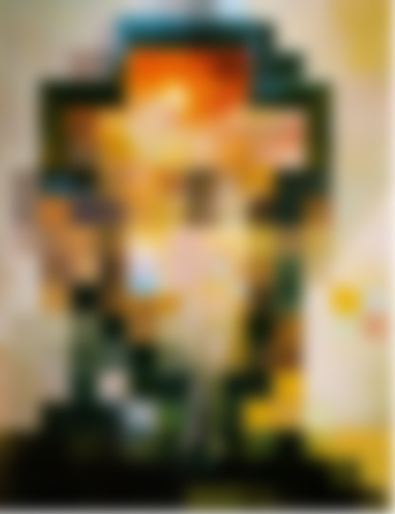

Slide 44
