Slide 1

17 April 2019

Slide 2
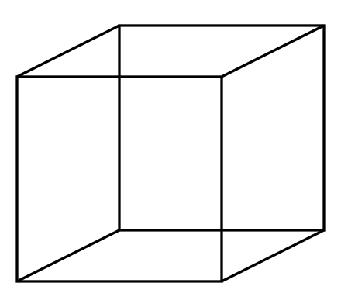
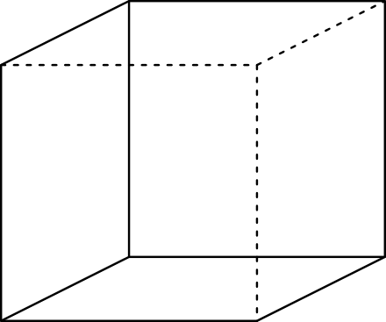
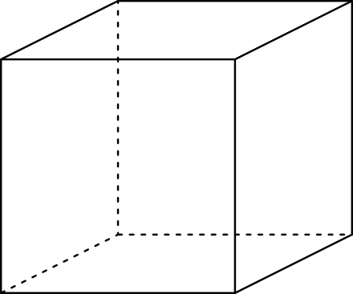
Multi-stable Perception
Necker Cube

Slide 3
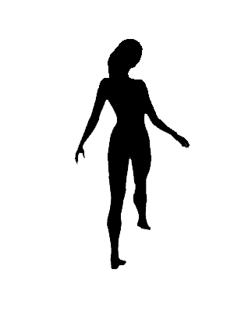
Spinning dancer illusion, Nobuyuki Kayahara

Slide 4
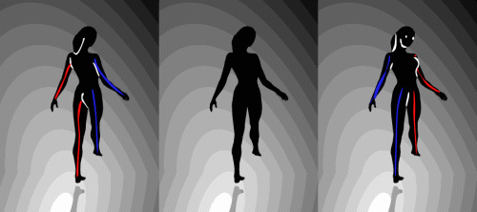

Slide 5
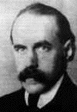
Motion and Gestalt laws of grouping
Gestalt psychology (Max Wertheimer, 1880-1943)
Notes:
Gestalt - means ‘shape, form’ in German
~1900 or so
“…Gestalt psychology is an attempt to understand the laws behind the ability to acquire and maintain meaningful perceptions in an apparently chaotic world…”
[Wikipedia]
Necker cube and dancing lady are examples of multistability – “the tendency of ambiguous perceptual experiences to pop back and forth unstably between two or more alternative interpretations”

Slide 6
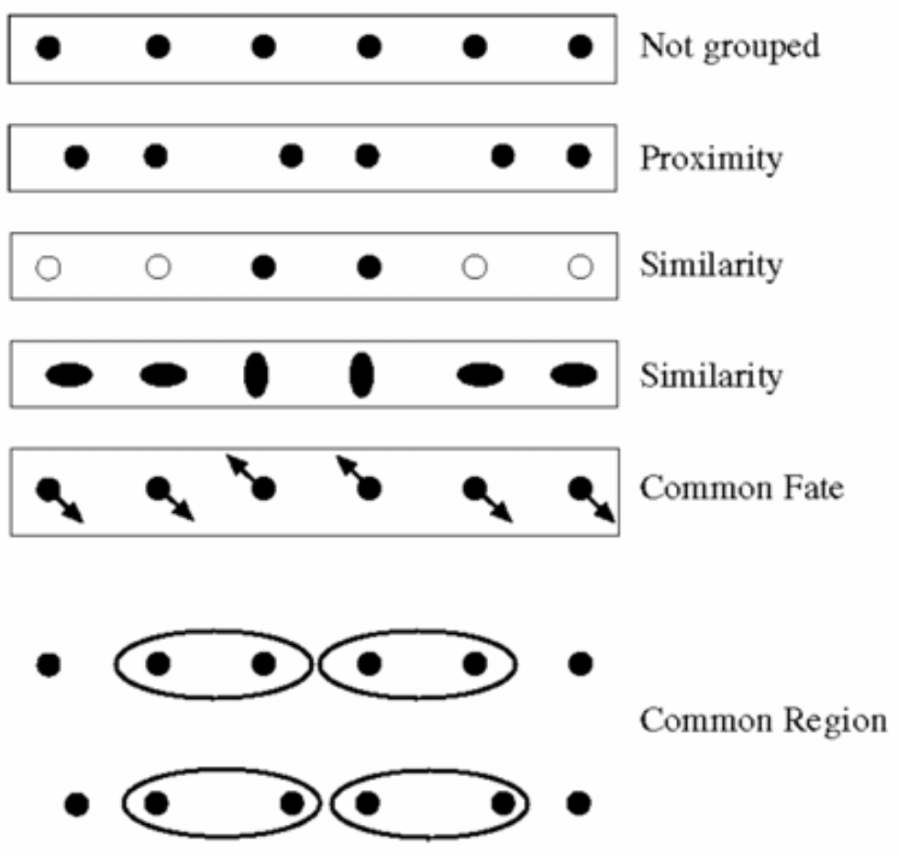
Motion and perceptual organization
Gestalt psychology (Max Wertheimer, 1880-1943)
…plus closure, continuation, ‘good form’

Slide 7
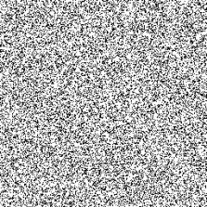
Motion and perceptual organization
Notes:
Now put another one. You probably don’t see anything special.

Slide 8
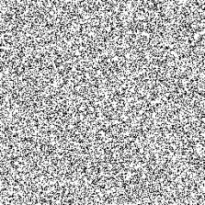
Motion and perceptual organization
Sometimes motion is the only cue…
Notes:
But put them in sequence…. And you see the moving square. The only indication of the square is the common motion.

Slide 9
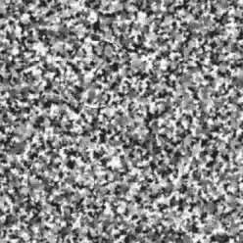
Motion and perceptual organization
http://www.youtube.com/watch?v=aEoxO_RdGhE
Notes:
Motion Stereopsis -> Binocular Depth-from-Motion

Slide 10
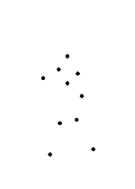
Motion and perceptual organization
Even “impoverished” motion data can evoke a strong percept

Slide 11
Motion and perceptual organization
Even “impoverished” motion data can evoke a strong percept

Slide 12
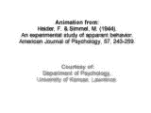
Motion and perceptual organization
Experimental study of apparent behavior.
Fritz Heider & Marianne Simmel. 1944

Slide 13
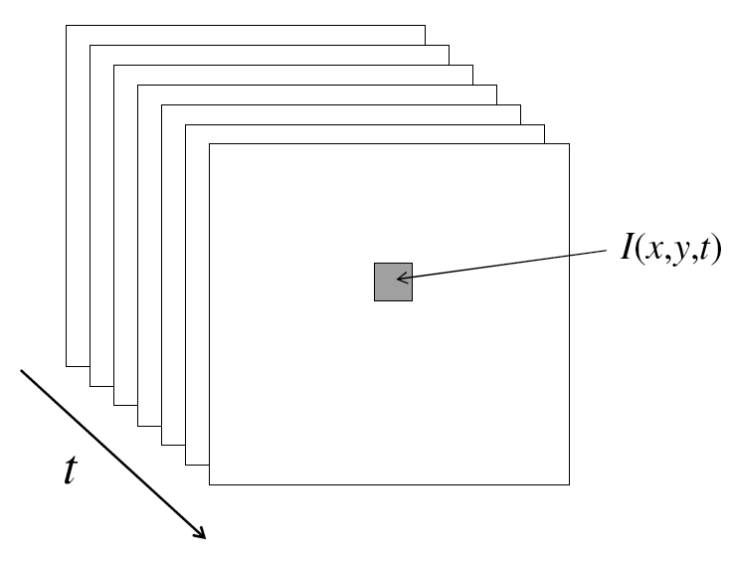
Video
A video is a sequence of frames captured over time
A ‘function’ of space (x, y) and time (t)

Slide 14
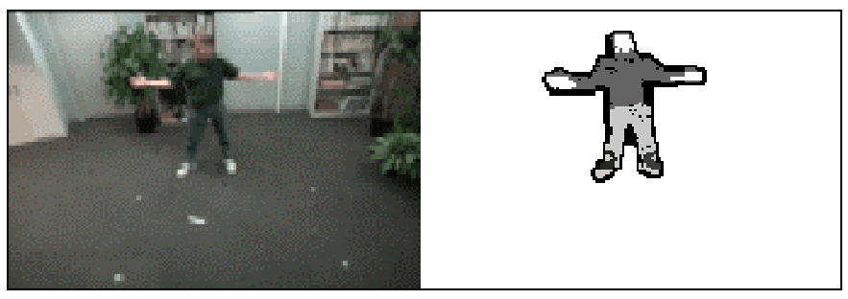
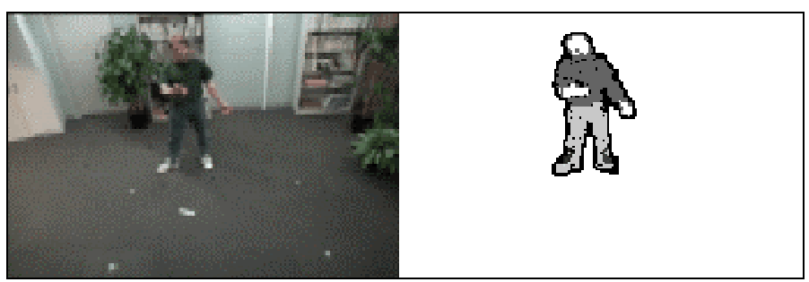
Motion Applications: Segmentation of video
Background subtraction
  A static camera is observing a scene
  Goal: separate the static background from the moving foreground

Slide 15
Applications of segmentation to video
Background subtraction
  Form an initial background estimate
  For each frame:
    Update estimate using a moving average
    Subtract the background estimate from the frame
    Label as foreground each pixel where the magnitude of the difference is greater than some threshold
    Use median filtering to “clean up” the results

Slide 16
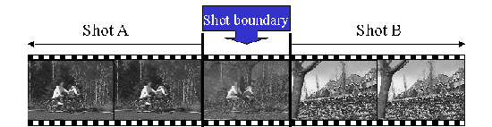
Motion Applications: Segmentation of video
Background subtraction
Shot boundary detection in edited video
  Edited video is usually composed of shots or sequences showing the same objects or scene
  Goal: segment video into shots for summarization and browsing (each shot can be represented by a single keyframe in a user interface)
  Difference from background subtraction: the camera is not necessarily stationary

Slide 17
Applications of segmentation to video
Background subtraction
Shot boundary detection
  For each frame
    Compute the distance between the current frame and the previous one
      Pixel-by-pixel differences
      Differences of color histograms
      Block comparison
    If the distance is greater than some threshold, classify the frame as a shot boundary

Slide 18
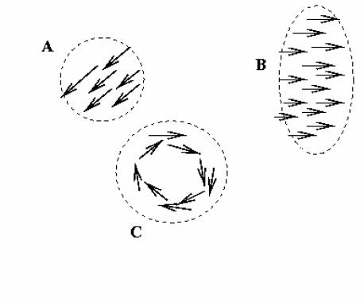
Motion Applications: Segmentation of video
Background subtraction
Shot boundary detection
Motion segmentation
  Segment the video into multiple coherently moving objects

Slide 19
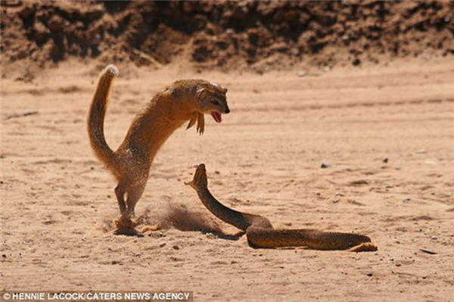
Motion Applications
Background subtraction
Shot boundary detection
Motion segmentation
  Segment the video into multiple coherently moving objects

Slide 20
More applications of motion
Segmentation of objects in space or time
Estimating 3D structure
Learning dynamical models – how things move
Recognizing events and activities
Improving video quality (motion stabilization)

Slide 21
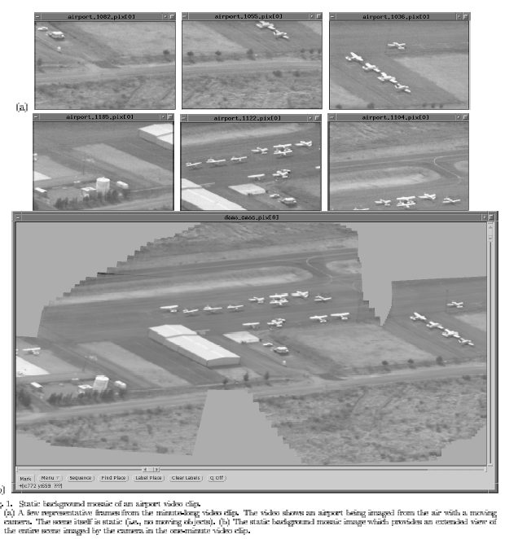
Mosaicing
(Michal Irani, Weizmann)

Slide 22
Mosaicing
(Michal Irani, Weizmann)

Slide 23
Mosaicing for Panoramas on Smartphones
Left to right sweep of video camera
Frame t
t+1
t+3
t+5
Estimate motion frame to frame, but compare small overlap for efficiency.

Slide 24
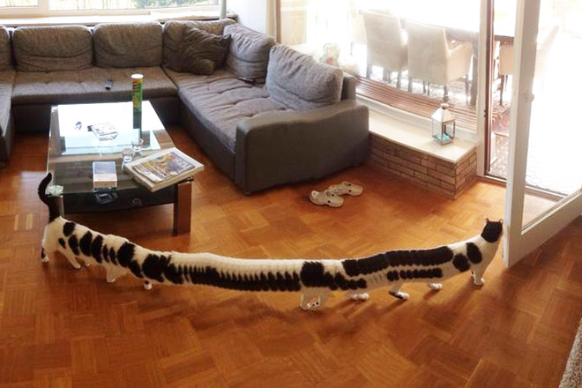
Mosaicing for Panoramas on Smartphones
Notes:
http://www.sadanduseless.com/2017/07/panorama/#uOiuM7ycKM5IX73x.01

Slide 25
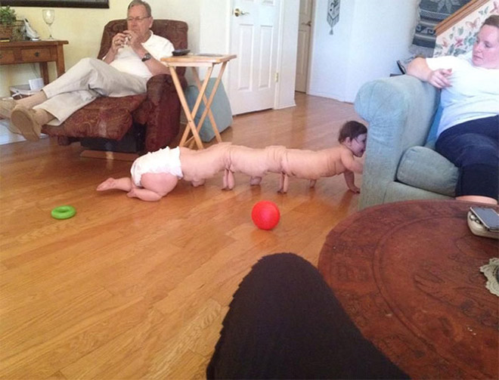
Mosaicing for Panoramas on Smartphones
Notes:
http://www.sadanduseless.com/2017/07/panorama/#uOiuM7ycKM5IX73x.01

Slide 26

Mosaicing for Panoramas on Smartphones
Notes:
http://www.sadanduseless.com/2017/07/panorama/#uOiuM7ycKM5IX73x.01
Unwrap Mosaics (!!) Fitzgibbon et al.

Slide 27
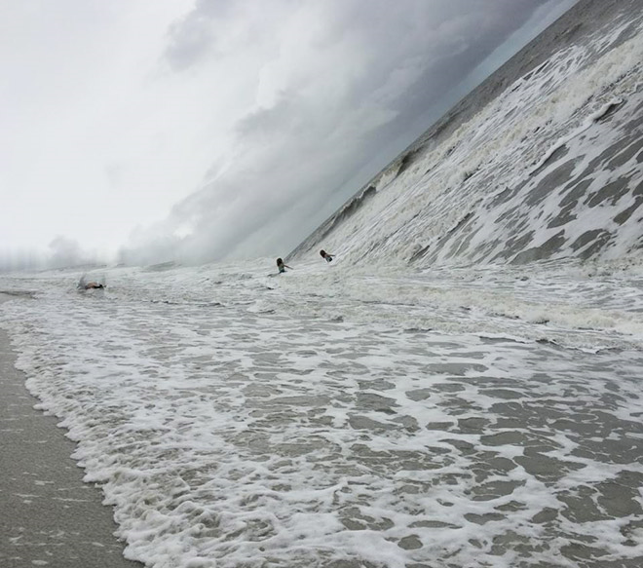
Mosaicing for Panoramas on Smartphones
Notes:
http://www.sadanduseless.com/2017/07/panorama/#uOiuM7ycKM5IX73x.01

Slide 28
Star Trek ‘shakycam’;

Slide 29
Motion estimation techniques
Feature-based methods
  Extract visual features (corners, textured areas) and track them over multiple frames
  Sparse motion fields, but more robust tracking
  Suitable when image motion is large (10s of pixels)
Direct, dense methods
  Directly recover image motion at each pixel from spatio-temporal image brightness variations
  Dense motion fields, but sensitive to appearance variations
  Suitable for video and when image motion is small
    Optical flow!

Slide 30
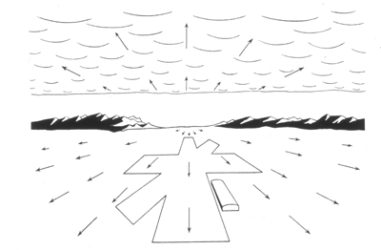
Computer Vision
Motion and Optical Flow
Many slides adapted from J. Hays, S. Seitz, R. Szeliski, M. Pollefeys, K. Grauman and others…
Notes:
Why do we see a runway here?
J.J. Gibson, 1960s? – Navy researcher who investigated how to help pilots land on runways and aircraft carriers. Noted that there was a point in the visual field from which all motion seemed to emanate. Named this point the ‘focus of expansion’, and named the visual field ‘optic flow’.

Slide 31
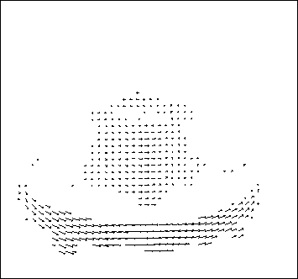
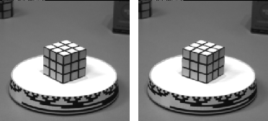
Motion estimation: Optical flow
Optic flow is the apparent motion of objects or surfaces
Will start by estimating motion of each pixel separately
Then will consider motion of entire image

Slide 32


Problem definition: optical flow
How to estimate pixel motion from image I(x,y,t) to I(x,y,t+1) ?
No problem!
for x1 in I(x1,y1,t)
for y1 in I(x1,y1,t)
for x2 in I(x2,y2,t+1)
for y2 in I(x2,y2,t+1)
Patch sum of squared differences
Slow.

Slide 33

Corner Detection: Basic Idea
Back in early lectures…
Recognize corners by looking at small window.
We want a window shift in any direction to give a large change in intensity.
“Flat” region:
no change in all directions
“Edge”:
no change along the edge direction
“Corner”:
significant change in all directions
A. Efros

Slide 34
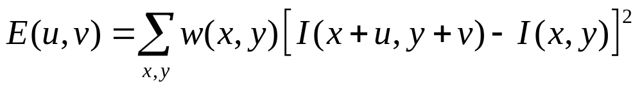
Corner Detection by Auto-correlation
Change in appearance of window w(x,y) for shift [u,v]:
Window function
Shifted intensity
Intensity
Window function w(x,y) =
or
1 in window, 0 outside
Gaussian
Source: R. Szeliski

Slide 35
Corner Detection by Auto-correlation
Change in appearance of window w(x,y) for shift [u,v]:
We want to discover how E behaves for small shifts
But this is very slow to compute naively.
O(window_width² * shift_range² * image_width²)
O( 11² * 11² * 600² ) = 5.2 billion of these
14.6 thousand per pixel in your image

Slide 36
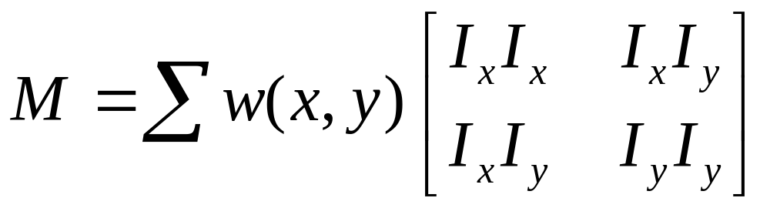
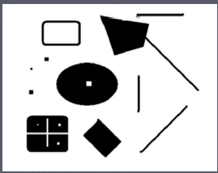
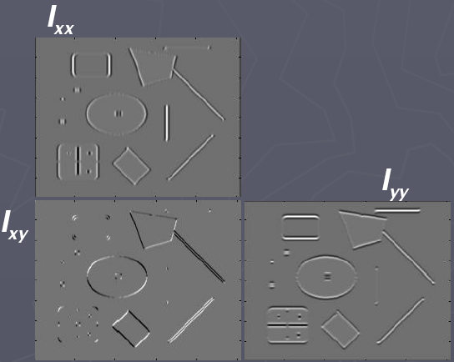
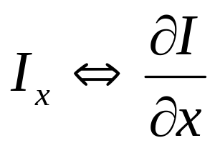
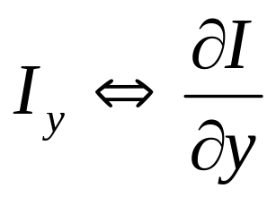
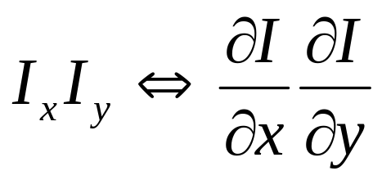
Corners as distinctive interest points
2 x 2 matrix of image derivatives
(averaged in neighborhood of a point)
Notation:
James Hays

Slide 37
Problem definition: optical flow
How to estimate pixel motion from image I(x,y,t) to I(x,y,t+1) ?
Solve pixel correspondence problem
  Given a pixel in I(x,y,t), look for nearby pixels of the same color in I(x,y,t+1)
Key assumptions
  Small motion: Points do not move very far
  Color constancy: A point in I(x,y,t) looks the same in I(x,y,t+1)
    For grayscale images, this is brightness constancy

Slide 38



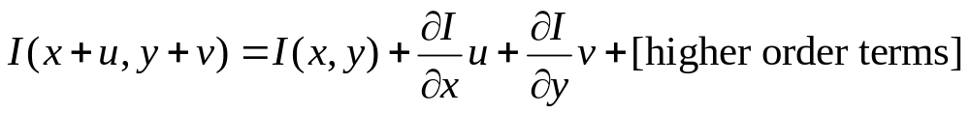
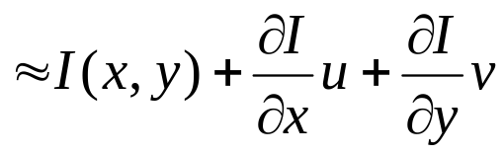
Optical flow constraints (grayscale images)
Let’s look at these constraints more closely
  Brightness constancy constraint (equation)
  Small motion: (u and v are less than 1 pixel, or smoothly varying) Taylor series expansion of I:
Notes:
A: H(x,y) = I(x+u, y+v)

Slide 39
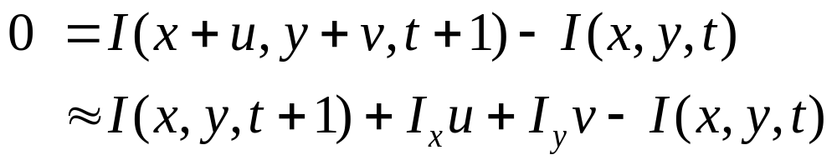
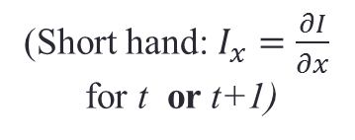
Optical flow equation
Combining these two equations
(Short hand: $I_{x}=\frac{∂I}{∂x}$
for t or t+1)

Slide 40
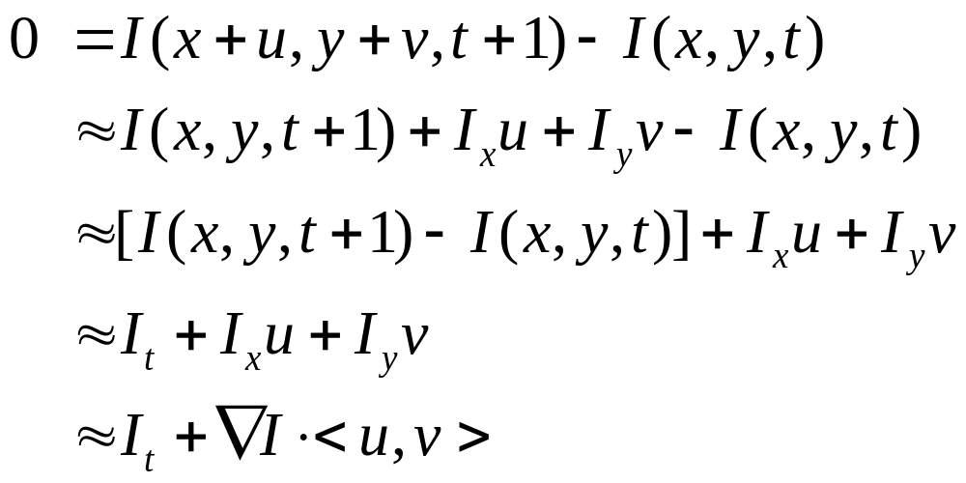
Optical flow equation
Combining these two equations
(Short hand: $I_{x}=\frac{∂I}{∂x}$
for t or t+1)

Slide 41
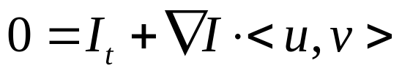
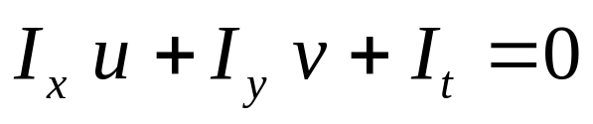
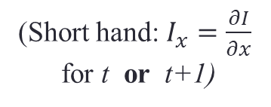
Optical flow equation
Combining these two equations
(Short hand: $I_{x}=\frac{∂I}{∂x}$
for t or t+1)
In the limit as u and v go to zero, this becomes exact
  Brightness constancy constraint equation

Slide 42
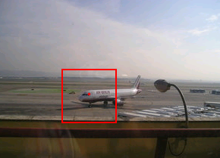
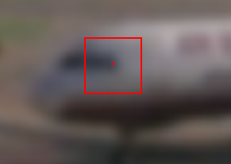
How does this make sense?
  Brightness constancy constraint equation
What do the static image gradients
have to do with motion estimation?

Slide 43
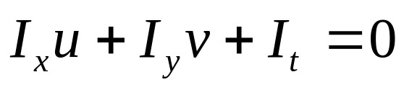
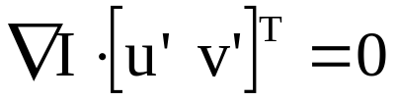
The brightness constancy constraint
Can we use this equation to recover image motion (u,v) at each pixel?
or
How many equations and unknowns per pixel?
  One equation (this is a scalar equation!), two unknowns (u,v)
The component of the motion perpendicular to the gradient (i.e., parallel to the edge) cannot be measured
  If (u, v) satisfies the equation,
  so does (u+u’, v+v’ ) if
gradient
(u,v)
(u’,v’)
(u+u’,v+v’)
edge
Notes:
A: u and v are unknown, 1 equation

Slide 44
Aperture problem

Slide 45
Aperture problem

Slide 46
Aperture problem

Slide 47
Apparently an aperture problem

Slide 48

The barber pole illusion
http://en.wikipedia.org/wiki/Barberpole_illusion

Slide 49


The barber pole illusion
http://en.wikipedia.org/wiki/Barberpole_illusion

Slide 50
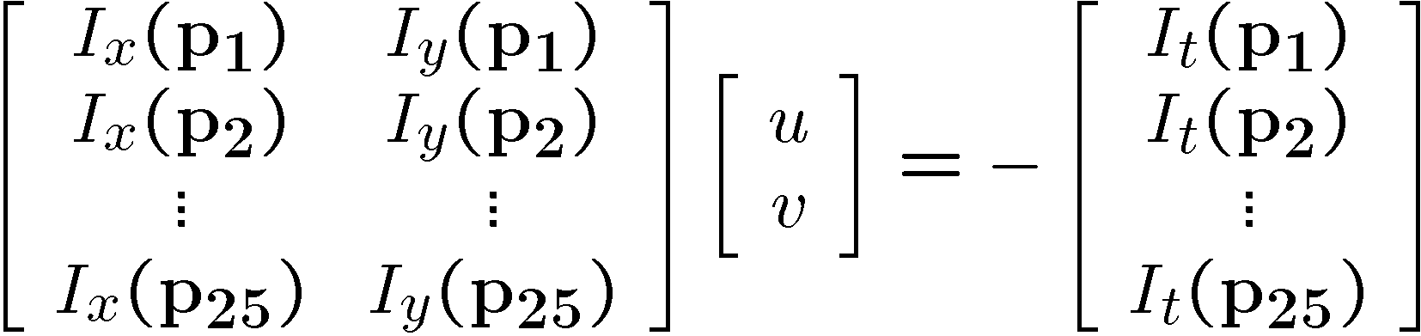
Solving the ambiguity…
B. Lucas and T. Kanade. An iterative image registration technique with an application to stereo vision. In Proceedings of the International Joint Conference on Artificial Intelligence, pp. 674–679, 1981.
How to get more equations for a pixel?
Spatial coherence constraint
Assume the pixel’s neighbors have the same (u,v)
  If we use a 5x5 window, that gives us 25 equations per pixel

Slide 51




Solving the ambiguity…
Least squares problem:

Slide 52

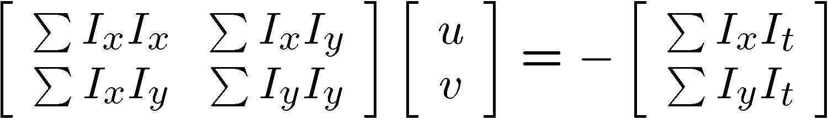


Matching patches across images
Overconstrained linear system
Least squares solution for d given by
  The summations are over all pixels in the K x K window

Slide 53


Conditions for solvability
  Optimal (u, v) satisfies Lucas-Kanade equation
When is this solvable? What are good points to track?
  A^{T}A should be invertible
  A^{T}A should not be too small due to noise
    eigenvalues λ₁ and λ ₂ of A^{T}A should not be too small
  A^{T}A should be well-conditioned
    λ ₁/ λ ₂ should not be too large (λ ₁ = larger eigenvalue)
Does this remind you of anything?
Criteria for Harris corner detector
Notes:
http://en.wikipedia.org/wiki/Invertible_matrix

Slide 54
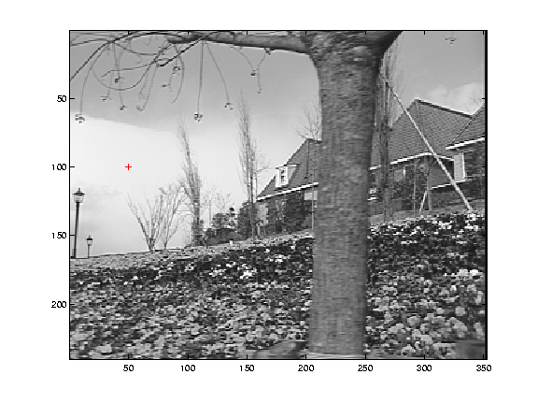
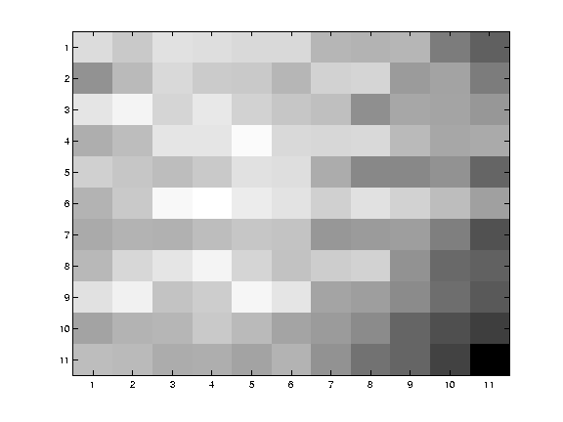
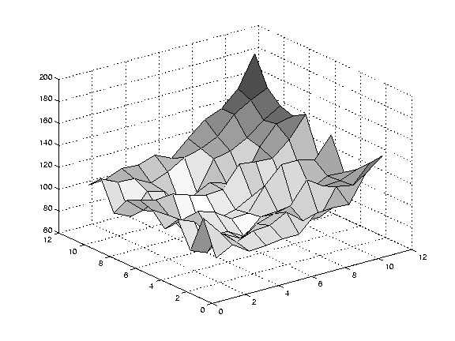
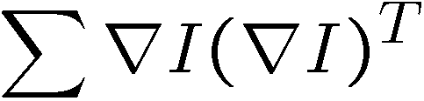
Low texture region
gradients have small magnitude
small λ₁, small λ₂
Notes:
Can’t estimate motion here…nothing you can see moving.

Slide 55



Edge
large gradients, all the same
large λ₁, small λ₂
Notes:
On an edge you can estimate motion perpendicular to the edge but not along it.

Slide 56



High textured region
gradients are different, large magnitudes
large λ₁, large λ₂
Notes:
But on nice textured regions motion is well estimated because the gradient varies over the window.

Slide 57
The aperture problem resolved
Actual motion

Slide 58
The aperture problem resolved
Perceived motion

Slide 59
Errors in assumptions
A point does not move like its neighbors
  Motion segmentation
Brightness constancy does not hold
  Do exhaustive neighborhood search with normalized correlation - tracking features – maybe SIFT – more later….
The motion is large (larger than a pixel)
  Not-linear: Iterative refinement
  Local minima: coarse-to-fine estimation

Slide 60
Not tangent: Iterative Refinement
Iterative Lukas-Kanade Algorithm
  Estimate velocity at each pixel by solving Lucas-Kanade equations
  Warp I_{t} towards I_{t+1} using the estimated flow field
    - use image warping techniques
  Repeat until convergence

Slide 61






Optical Flow: Iterative Estimation
estimate update
Initial guess:
Estimate:
x₀
x
(using d for displacement here instead of u)

Slide 62




Optical Flow: Iterative Estimation
estimate update
Initial guess:
Estimate:
x₀
x

Slide 63




Optical Flow: Iterative Estimation
estimate update
Initial guess:
Estimate:
Initial guess:
Estimate:
x₀
x

Slide 64


Optical Flow: Iterative Estimation
x₀
x

Slide 65
Optical Flow: Iterative Estimation
Some Implementation Issues:
  Warping is not easy (ensure that errors in warping are smaller than the estimate refinement) – but it is in MATLAB!
  Often useful to low-pass filter the images before motion estimation (for better derivative estimation, and linear approximations to image intensity)

Slide 66

Revisiting the small motion assumption
Is this motion small enough?
  Probably not—it’s much larger than one pixel
  How might we solve this problem?

Slide 67




Optical Flow: Aliasing
Temporal aliasing causes ambiguities in optical flow because images can have many pixels with the same intensity.
I.e., how do we know which ‘correspondence’ is correct?
actual shift
estimated shift
nearest match is correct (no aliasing)
nearest match is incorrect (aliasing)
To overcome aliasing: coarse-to-fine estimation.

Slide 68




Reduce the resolution!

Slide 69
Coarse-to-fine optical flow estimation
u=1.25 pixels
u=2.5 pixels
u=5 pixels
image 1
u=10 pixels
image 2
image 1
image 2
Gaussian pyramid of image 1
Gaussian pyramid of image 2

Slide 70
Coarse-to-fine optical flow estimation
run iterative L-K
warp & upsample
run iterative L-K
.
.
.
image J
image I
image 1
image 2
Gaussian pyramid of image 1
Gaussian pyramid of image 2

Slide 71

Optical Flow Results
* From Khurram Hassan-Shafique CAP5415 Computer Vision 2003

Slide 72

Optical Flow Results
* From Khurram Hassan-Shafique CAP5415 Computer Vision 2003

Slide 73
Optical flow
Definition: the apparent motion of brightness patterns in the image
Ideally, the same as the projected motion field
Take care: apparent motion can be caused by lighting changes without any actual motion
  Imagine a uniform rotating sphere under fixed lighting vs. a stationary sphere under moving illumination.

Slide 74


State-of-the-art optical flow, 2009
Start with something similar to Lucas-Kanade
+ gradient constancy
+ energy minimization with smoothing term
+ region matching
+ keypoint matching (long-range)
Region-based
+Pixel-based
+Keypoint-based
Large displacement optical flow, Brox et al., CVPR 2009

Slide 75

State-of-the-art optical flow, 2015
CNN encoder/decoder
Pair of input frames
Upsample estimated flow back to input resolution
Fischer et al. 2015. https://arxiv.org/abs/1504.06852
Notes:
Optical flow as supervised learning

Slide 76

State-of-the-art optical flow, 2015
Synthetic Training data
Fischer et al. 2015. https://arxiv.org/abs/1504.06852

Slide 77

State-of-the-art optical flow, 2015
Results on Sintel
Fischer et al. 2015. https://arxiv.org/abs/1504.06852

Slide 78

State-of-the-art optical flow, 2018 (CVPR)
Notes:
Figure 3. Traditional coarese-to-fine approach vs. PWC-Net. Left: Image pyramid and refinement at one pyramid level by the energy
minimization approach [7, 9, 19, 45]. Right: Feature pyramid and refinement at one pyramid level by PWC-Net. PWC-Net warps features
of the second image using the upsampled flow, computes a cost volume, and process the cost volume using CNNs. Both post-processing
and context network are optional in each system. The arrows indicate the direction of flow estimation and pyramids are constructed in the
opposite direction. Please refer to the text for details about the network.

Slide 79

State-of-the-art optical flow, 2018 (CVPR)

Slide 80
Can we do more? Scene flow
Combine spatial stereo & temporal constraints
Recover 3D vectors of world motion
Stereo view 1
Stereo view 2
t
y
x
t-1
z
Epipolar constraints across space and time!
3D world motion vector per pixel

Slide 81

Scene flow example for human motion
Estimating 3D Scene Flow from Multiple 2D Optical Flows, Ruttle et al., 2009

Slide 82

Scene Flow
https://www.youtube.com/watch?v=RL_TK_Be6_4
https://vision.in.tum.de/research/sceneflow
[Estimation of Dense Depth Maps and 3D Scene Flow from Stereo Sequences, M. Jaimez et al., TU Munchen]

