Slide 1

10 April 2019

Slide 2
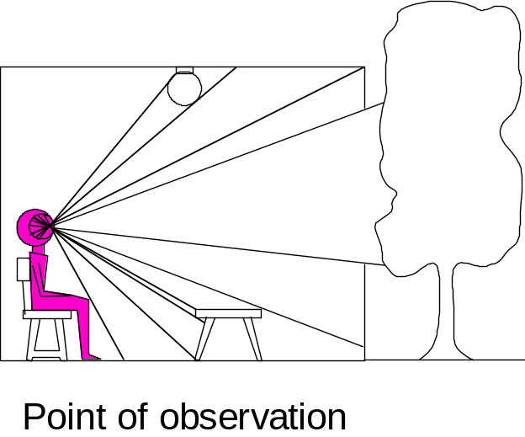
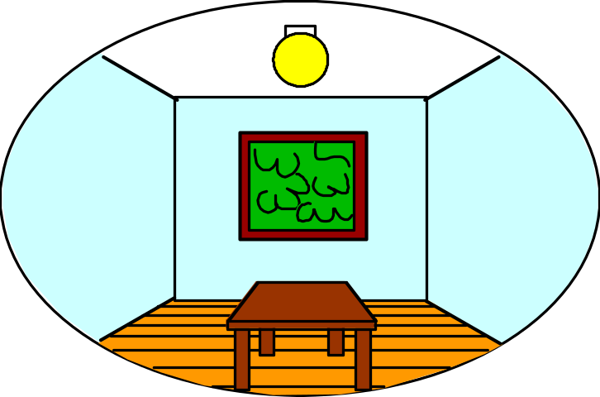
Dimensionality Reduction Machine (3D to 2D)
3D world
2D image
Lengths are lost…
…and so area is lost.
Angle preservation is lost…
…so parallel/perpendicular lines are lost.
How can we recover scene geometry to measure the world?
Figures © Stephen E. Palmer, 2002

Slide 3
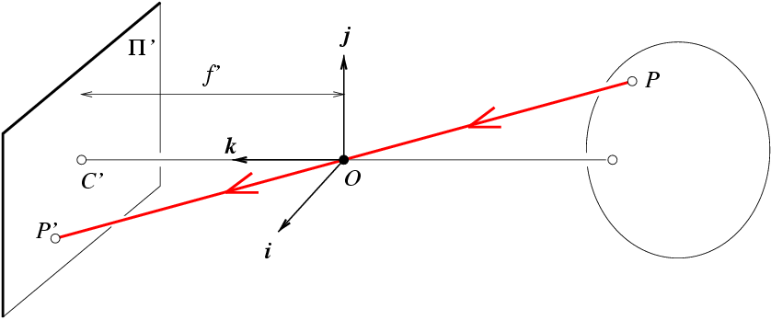
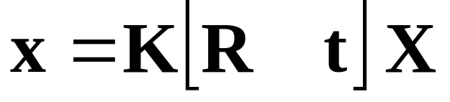
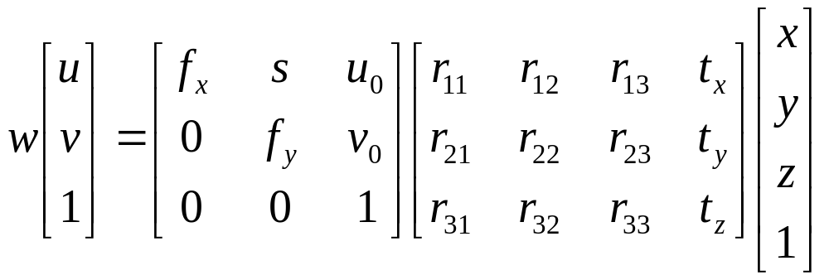
Camera (projection) matrix
Slide Credit: Savarese
R,t
j_{w}
X
k_{w}
O_{w}
x
i_{w}
x: Image Coordinates: (u,v,1)
K: Intrinsic Matrix (3x3)
R: Rotation (3x3)
t: Translation (3x1)
X: World Coordinates: (X,Y,Z,1)
Extrinsic Matrix
Notes:
We can use homogeneous coordinates to write ‘camera matrix’ in linear form.

Slide 4
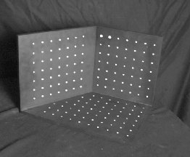
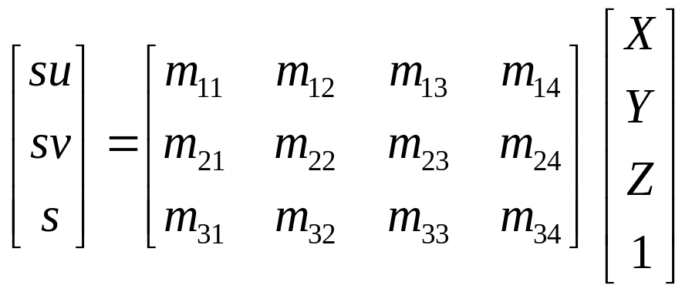
Calibrating the Camera
James Hays
Use an scene with known geometry
  Correspond image points to 3d points
  Get least squares solution (or non-linear solution)
Known 2d image coords
Known 3d
world locations
M
Unknown Camera Parameters

Slide 5
Can we factorize M back to K [R | T]?
Yes!
We can directly solve for the individual entries of K [R | T].
James Hays

Slide 6
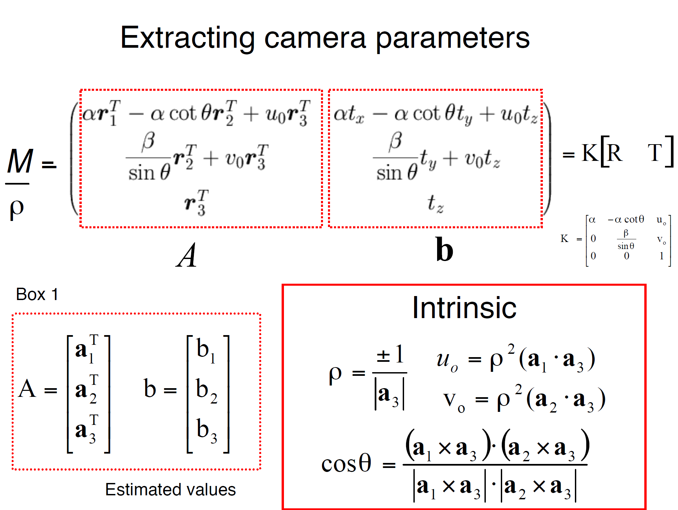
a_{n} = nth column of A
James Hays

Slide 7
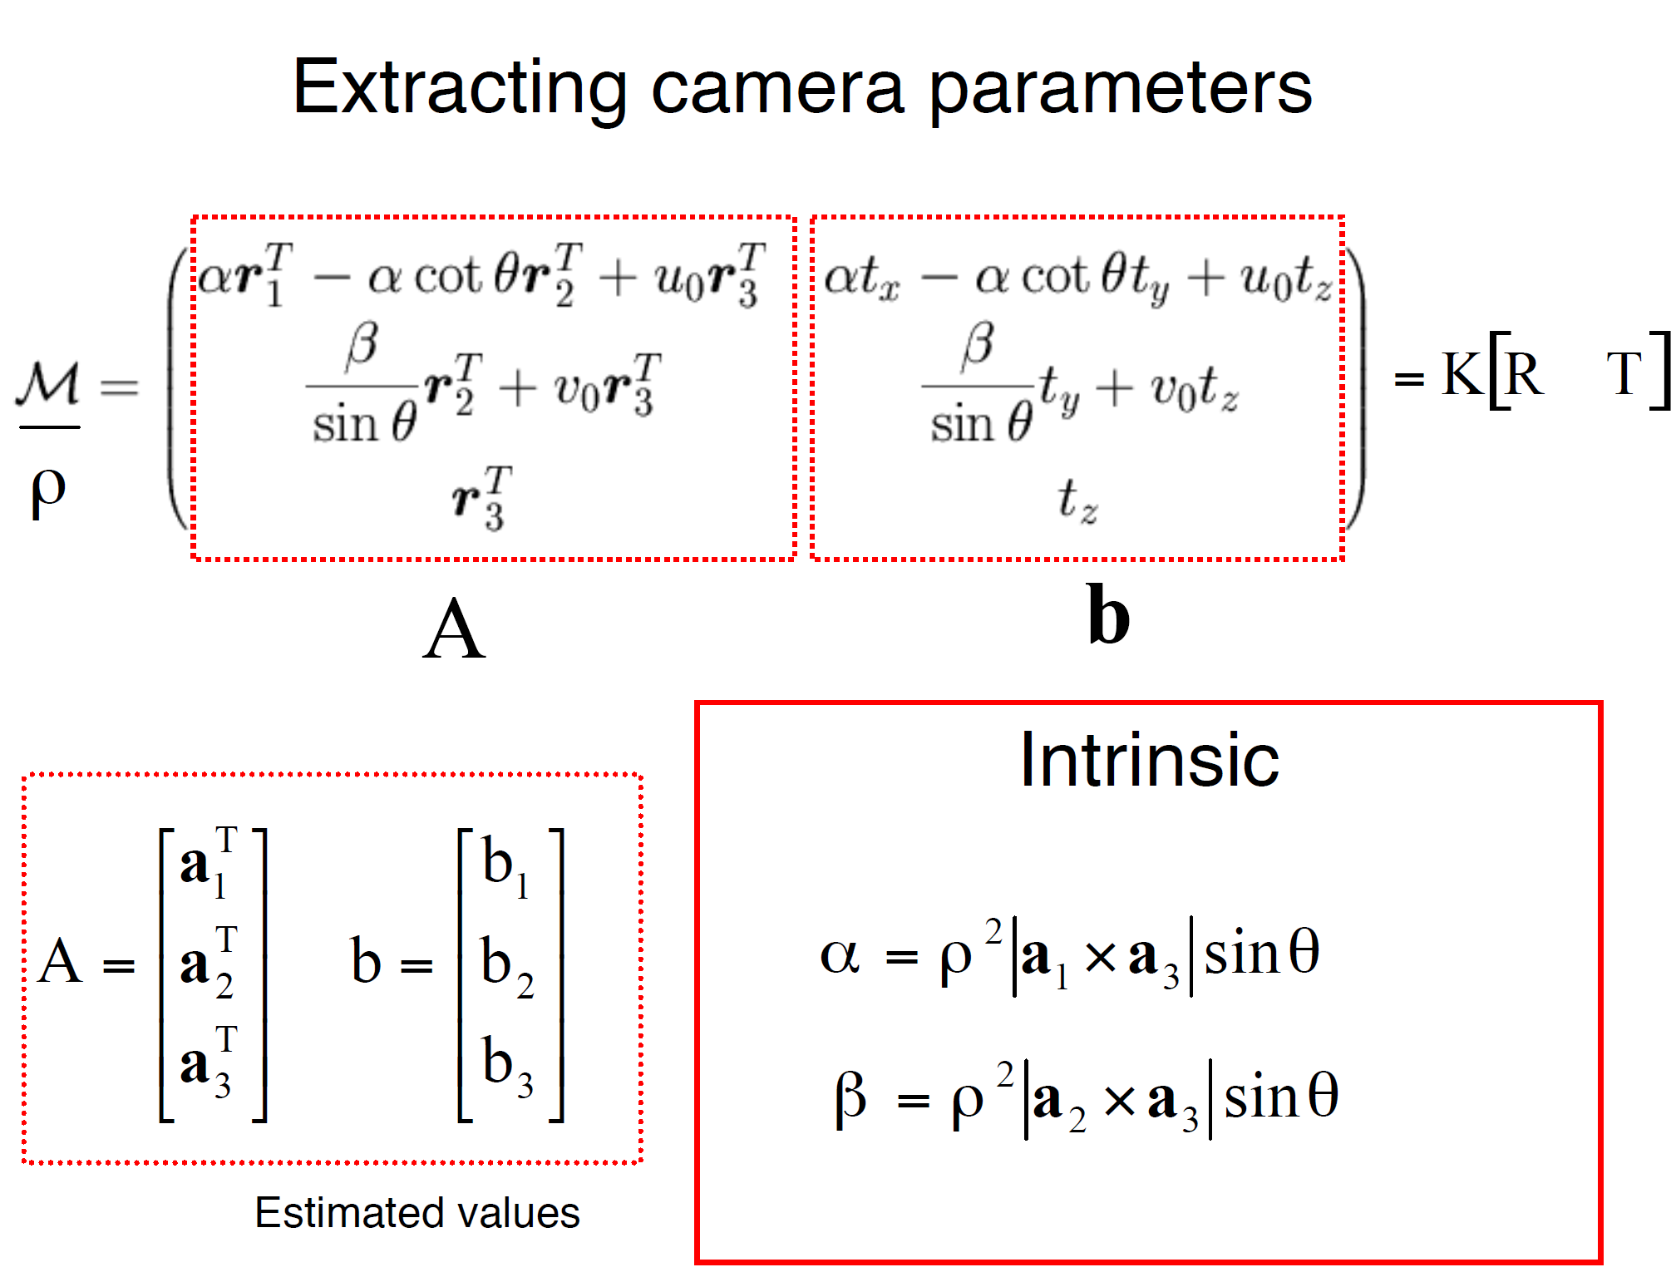
James Hays

Slide 8
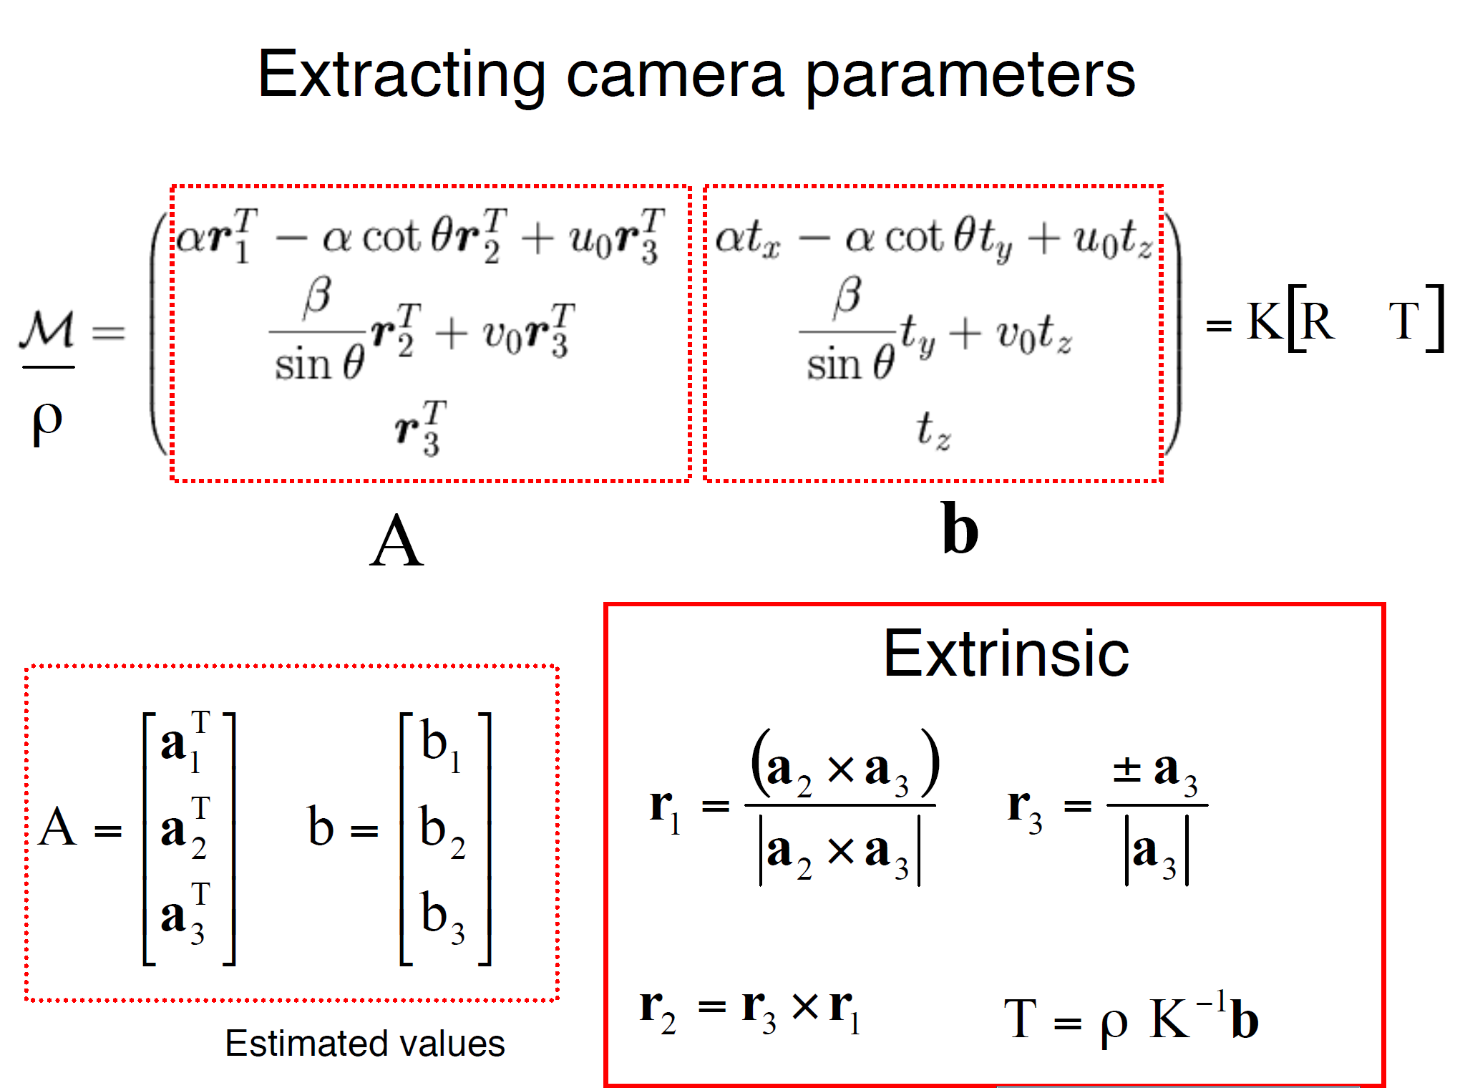
James Hays

Slide 9
Can we factorize M back to K [R | T]?
Yes!
We can also use RQ factorization (not QR)
  R in RQ is not rotation matrix R; crossed names!
R (right diagonal) is K
Q (orthogonal basis) is R the rotation matrix.
T, the last column of [R | T], is inv(K) * last column of M.
  But you need to do a bit of post-processing to make sure that the matrices are valid. See http://ksimek.github.io/2012/08/14/decompose/
James Hays
Notes:
QR decomposition – when I have an orthonormal basis (Q) and a right diagonal matrix (R), I can solve a decomposition of M.
RQ is the other way around.

Slide 10

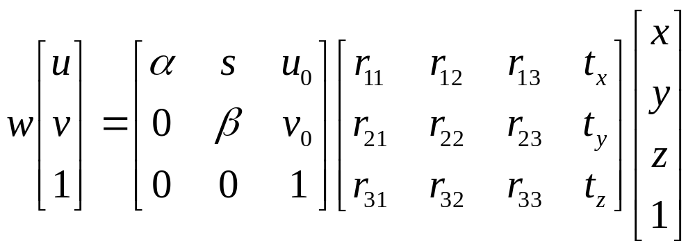
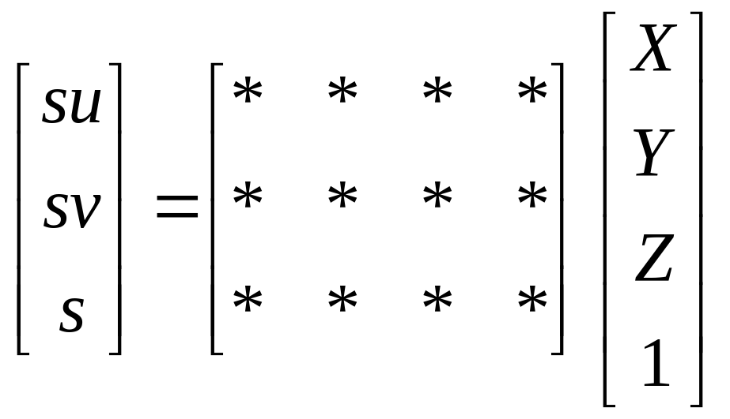
Recovering the camera center
This is not the camera center C.
It is –RC, as the point is rotated before t_{x}, t_{y}, and t_{z} are added
t
So we need
-R⁻¹ K⁻¹ m₄ to get C.
m₄
This is t × K
So K⁻¹ m₄ is t
Q is K × R.
So we just need -Q⁻¹ m₄
Q
James Hays

Slide 11
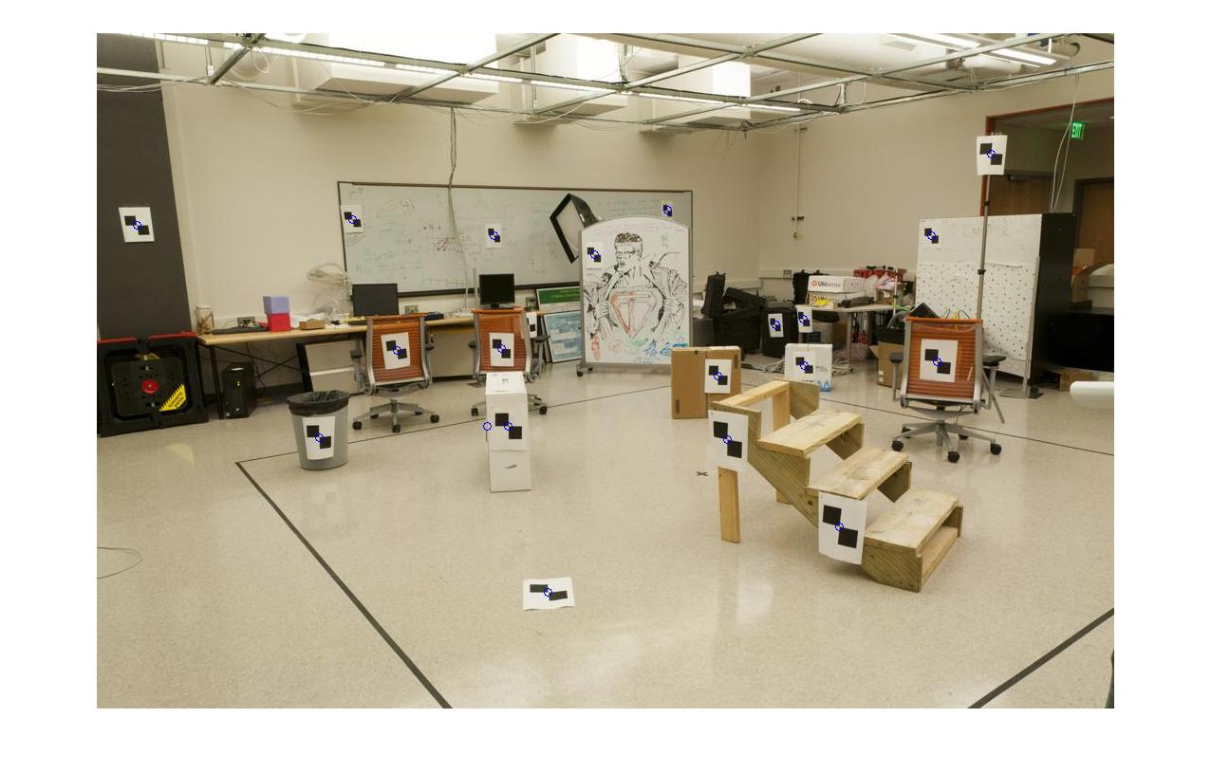
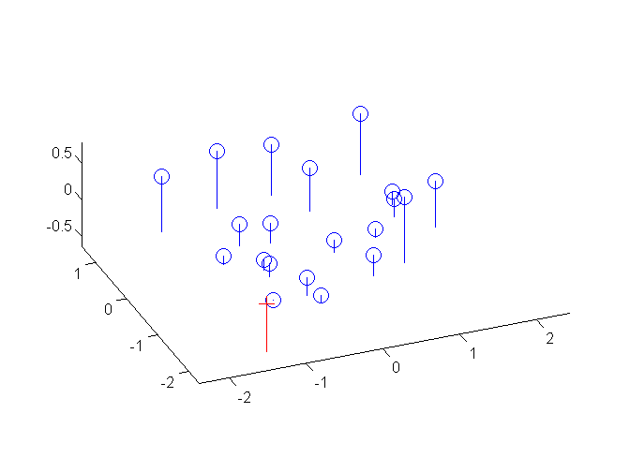
Estimate of camera center
1.0486 -0.3645
-1.6851 -0.4004
-0.9437 -0.4200
1.0682 0.0699
0.6077 -0.0771
1.2543 -0.6454
-0.2709 0.8635
-0.4571 -0.3645
-0.7902 0.0307
0.7318 0.6382
-1.0580 0.3312
0.3464 0.3377
0.3137 0.1189
-0.4310 0.0242
-0.4799 0.2920
0.6109 0.0830
-0.4081 0.2920
-0.1109 -0.2992
0.5129 -0.0575
0.1406 -0.4527
1.5706 -0.1490 0.2598
-1.5282 0.9695 0.3802
-0.6821 1.2856 0.4078
0.4124 -1.0201 -0.0915
1.2095 0.2812 -0.1280
0.8819 -0.8481 0.5255
-0.9442 -1.1583 -0.3759
0.0415 1.3445 0.3240
-0.7975 0.3017 -0.0826
-0.4329 -1.4151 -0.2774
-1.1475 -0.0772 -0.2667
-0.5149 -1.1784 -0.1401
0.1993 -0.2854 -0.2114
-0.4320 0.2143 -0.1053
-0.7481 -0.3840 -0.2408
0.8078 -0.1196 -0.2631
-0.7605 -0.5792 -0.1936
0.3237 0.7970 0.2170
1.3089 0.5786 -0.1887
1.2323 1.4421 0.4506

Slide 12
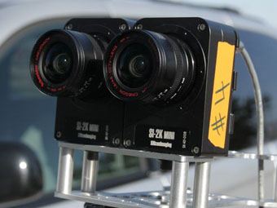
Great! So now I have K and Rt
Well, what is that useful for?
Goal: reconstruct depth.
So far: we have ‘calibrated’ one camera.
Or, potentially two…

Slide 13
Think-Pair-Share
What visual or physiological cues help us to perceive 3D shape and depth?

Slide 14
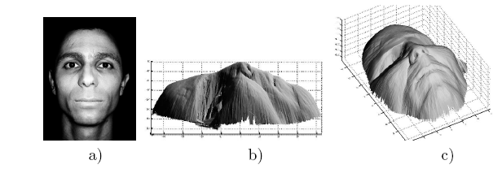
Shading
[Figure from Prados & Faugeras 2006]
Notes:
14

Slide 15
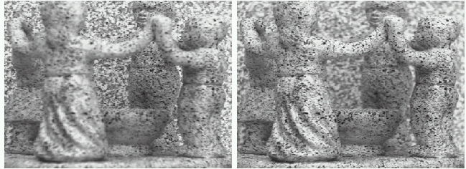
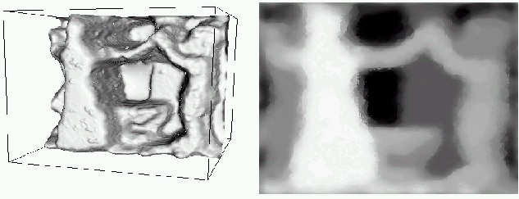
Focus/defocus
Images from same point of view, different camera parameters
3d shape / depth estimates
[figs from H. Jin and P. Favaro, 2002]

Slide 16
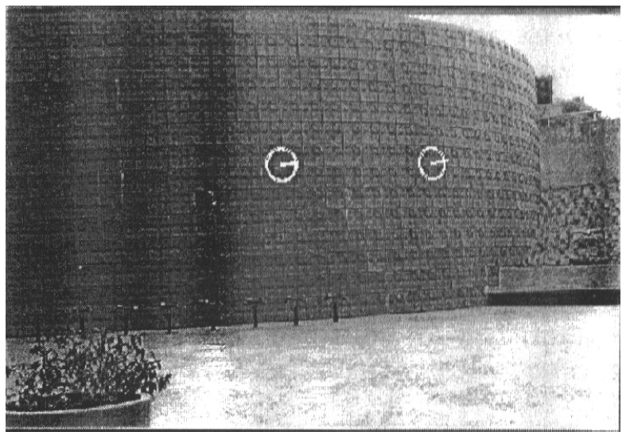
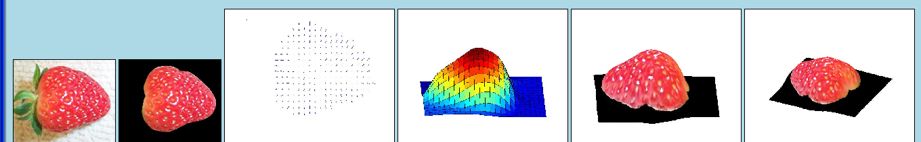
Texture
[From A.M. Loh. The recovery of 3-D structure using visual texture patterns. PhD thesis]
Notes:
16

Slide 17
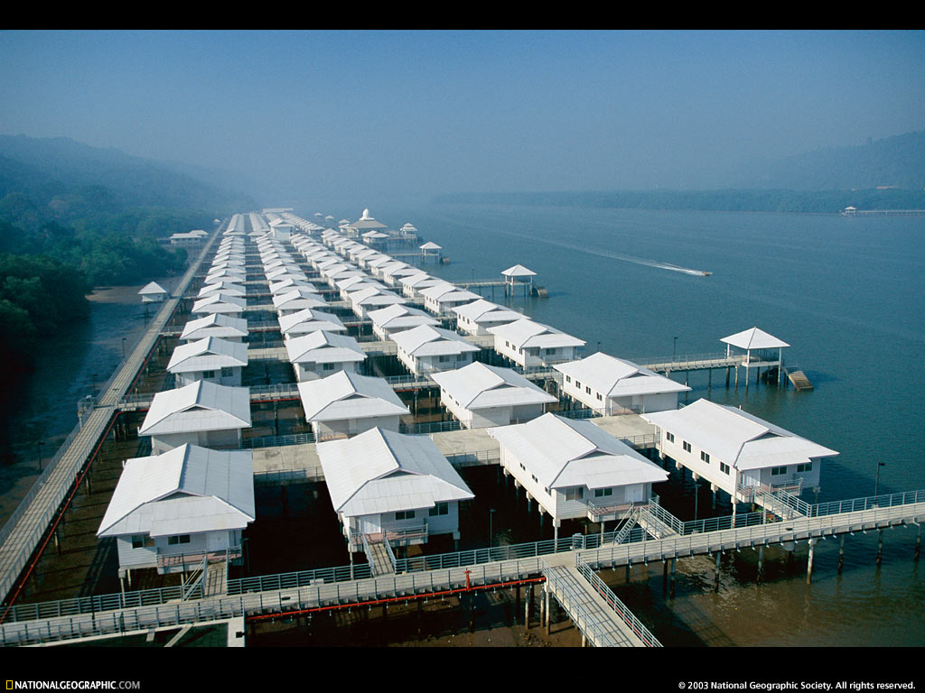
Perspective effects
Image credit: S. Seitz

Slide 18
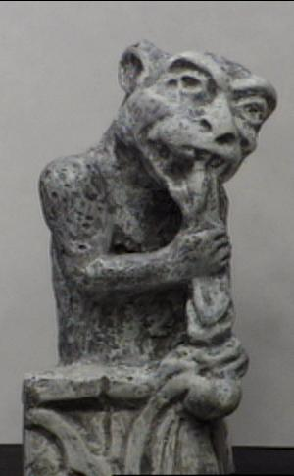
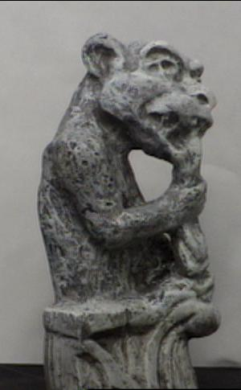
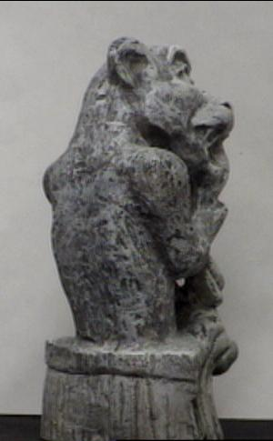
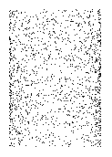
Motion
Figures from L. Zhang
http://www.brainconnection.com/teasers/?main=illusion/motion-shape

Slide 19
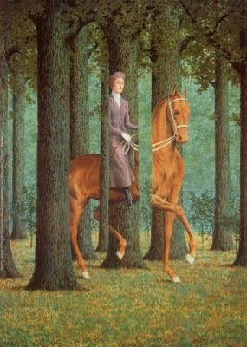
Occlusion
Rene Magritt'e famous painting Le Blanc-Seing (literal translation: "The Blank Signature") roughly translates as "free hand" or "free rein".
Notes:
http://rene-magritte-paintings.blogspot.com/2009/11/le-blanc-seing.html

Slide 20
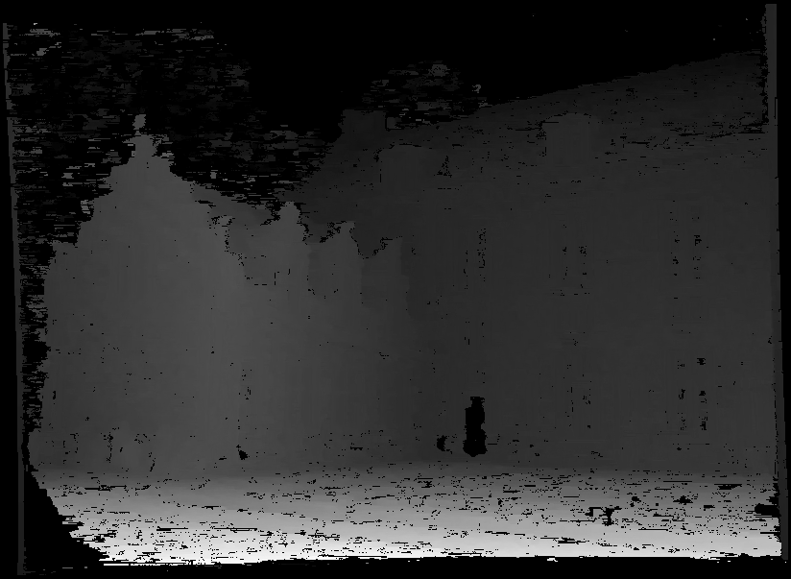
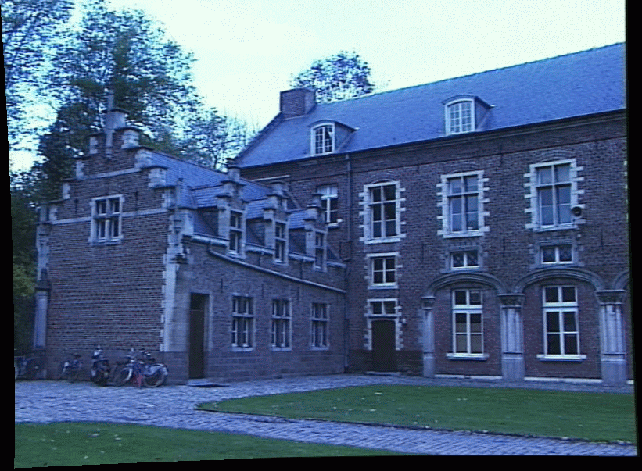
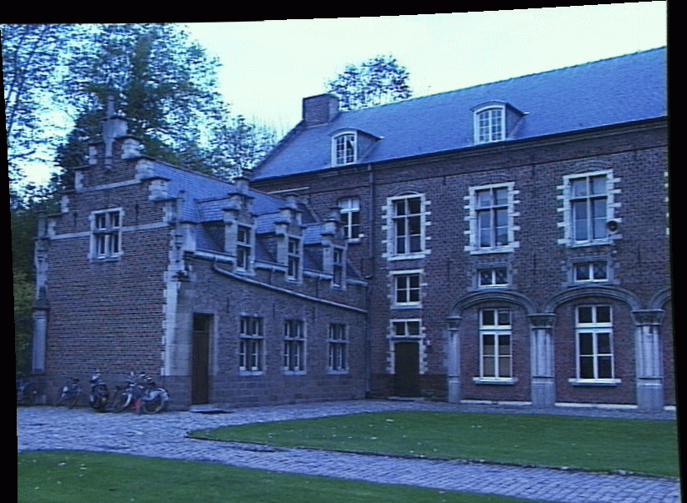
Stereo
Slides: James Hays and Kristen Grauman

Slide 21
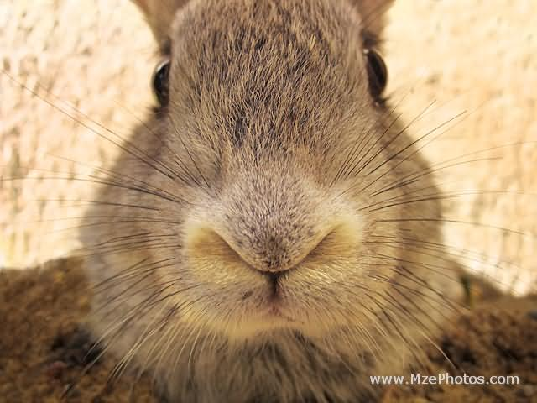
If stereo were critical for depth perception, navigation, recognition, etc., then rabbits would never have evolved.

Slide 22
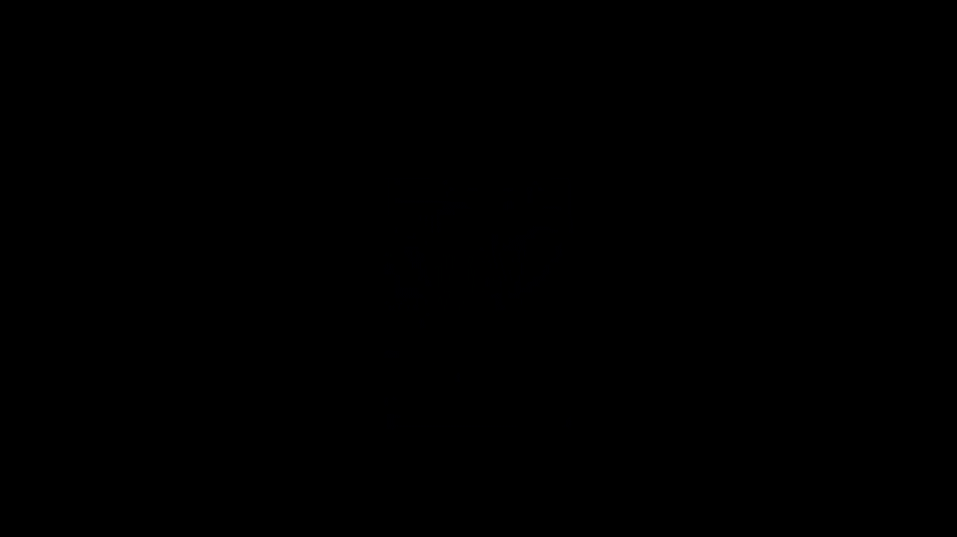
Notes:
http://illusionoftheyear.com/2016/06/ambiguous-cylinder-illusion/
How it works: https://www.youtube.com/watch?v=SKpOKXAVjGo
How it works (academic version): http://www.mdpi.com/2073-8994/8/4/21/htm

Slide 23

Devin Montes
Notes:
http://illusionoftheyear.com/2016/06/ambiguous-cylinder-illusion/
How it works: https://www.youtube.com/watch?v=SKpOKXAVjGo
How it works (academic version): http://www.mdpi.com/2073-8994/8/4/21/htm

Slide 24
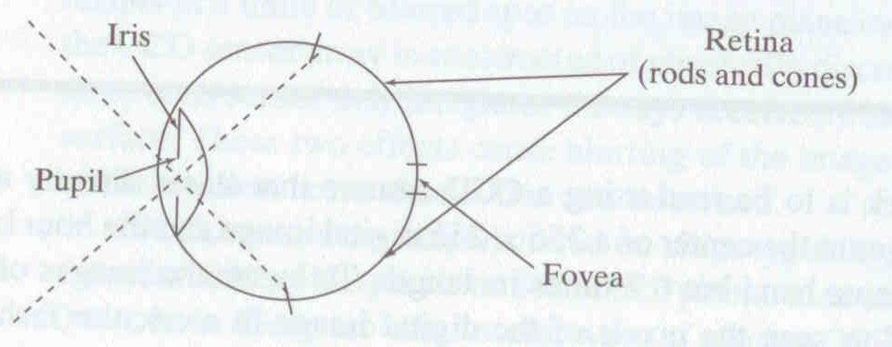
Human eye
Rough analogy with human visual system:
Pupil/Iris – control amount of light passing through lens
Retina - contains sensor cells, where image is formed
Fovea – highest concentration of cones
Fig from Shapiro and Stockman

Slide 25
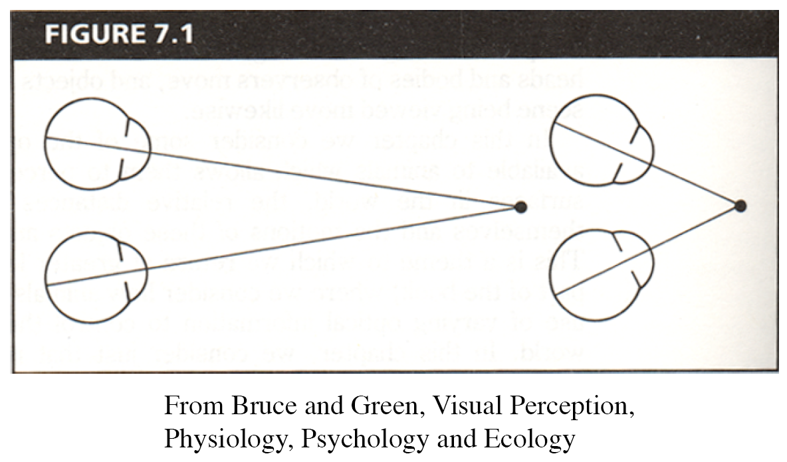
Human eyes fixate on point in space – rotate so that corresponding images form in centers of fovea.
Human stereopsis
Notes:
25

Slide 26
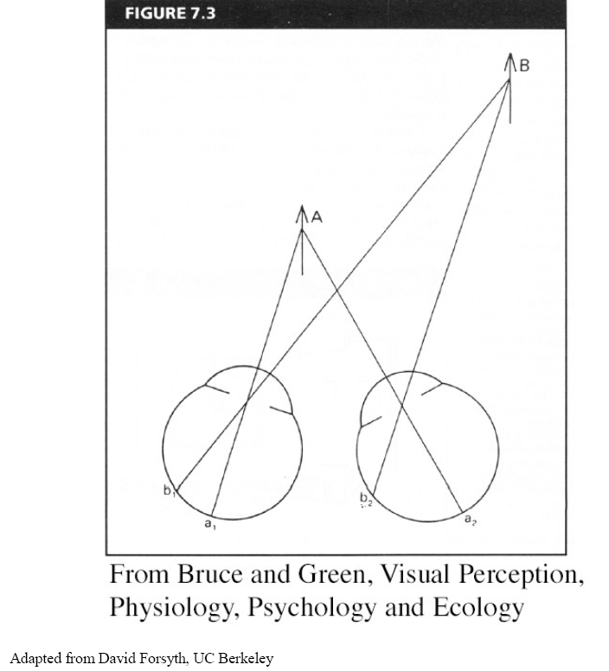
Human stereopsis: disparity
Disparity occurs when eyes fixate on one object; others appear at different visual angles.
Disparity is distance from b1 to b2 along retina.
Notes:
26

Slide 27
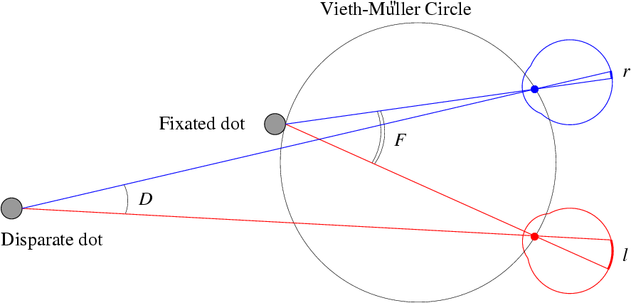
Human stereopsis: disparity
Disparity: d = r-l = D-F.
Forsyth & Ponce
Notes:
27

Slide 28
Yes, you can be stereoblind.
Notes:
Ask audience to put finger tip in line with dot in vision, then ask them to focus on dot -> should see two fingers.
Then, ask them to focus on finger -> should see two dots.
If people only see one finger and one dot, then they might be stereoblind…..
Is this true?

Slide 29
Random dot stereograms
Julesz 1960:
Do we identify local brightness patterns before fusion (monocular process) or after (binocular)?
Think Pair Share – yes / no? how to test?
Notes:
29

Slide 30
Random dot stereograms
Julesz 1960:
Do we identify local brightness patterns before fusion (monocular process) or after (binocular)?
To test: pair of synthetic images obtained by randomly spraying black dots on white objects
Notes:
30

Slide 31
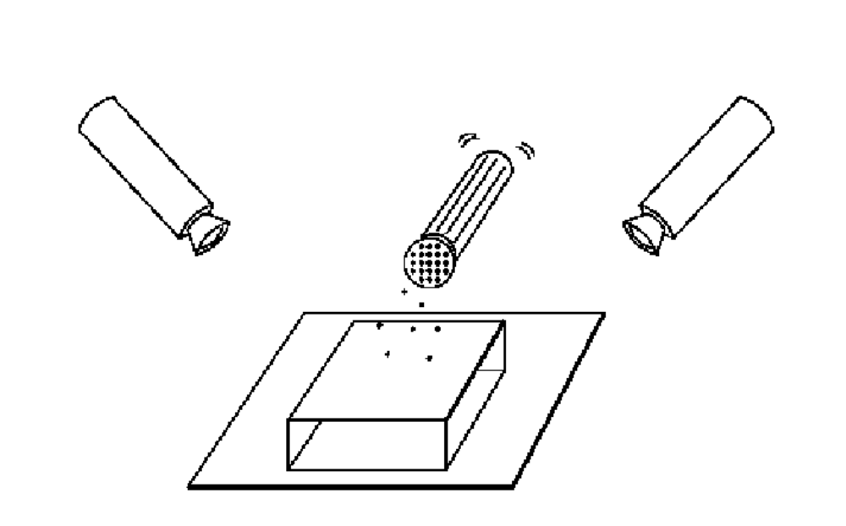
Random dot stereograms
Forsyth & Ponce
Notes:
31

Slide 32
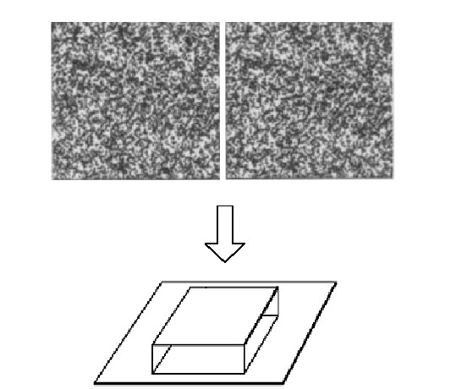
Random dot stereograms
Notes:
32

Slide 33
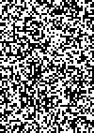
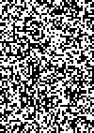
1. Create an image of suitable size. Fill it with random dots. Duplicate the image.
2. Select a region in one image.
3. Shift this region horizontally by a small amount. The stereogram is complete.
CC BY-SA 3.0, https://en.wikipedia.org/wiki/Random_dot_stereogram

Slide 34
CC BY-SA 3.0, https://en.wikipedia.org/wiki/Random_dot_stereogram

Slide 35
Random dot stereograms
When viewed monocularly, they appear random; when viewed stereoscopically, see 3d structure.
Human binocular fusion not directly associated with the physical retinas; must involve the central nervous system (V2, for instance).
Imaginary “cyclopean retina” that combines the left and right image stimuli as a single unit.
High level scene understanding not required for stereo…but, high level scene understanding is arguably better than stereo.
Notes:
35
According to Ralph Siegel, Dr. Bela Julesz had "unambiguously demonstrated that stereoscopic depth could be computed in the absence of any identifiable objects, in the absence of any perspective, in the absence of any cues available to either eye alone."
Artists are more often stereo blind than average people. Being stereo blind may train you to be better at recognizing and thus depicting other monocular depth cues.

Slide 36
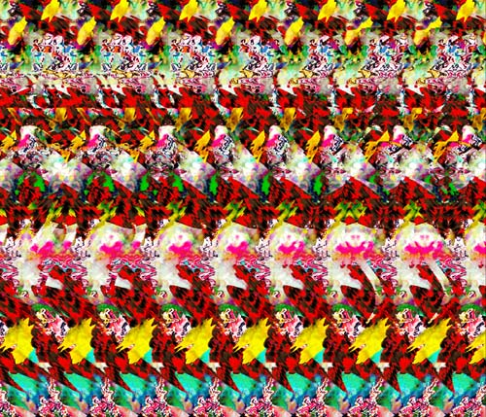
Autostereograms – ‘Magic Eye’
Exploit disparity as depth cue using single image.
(Single image random dot stereogram, Single image stereogram)
Images from magiceye.com
Notes:
36

Slide 37
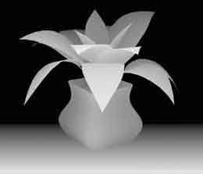
Autostereograms
Images from magiceye.com
Notes:
37

Slide 38
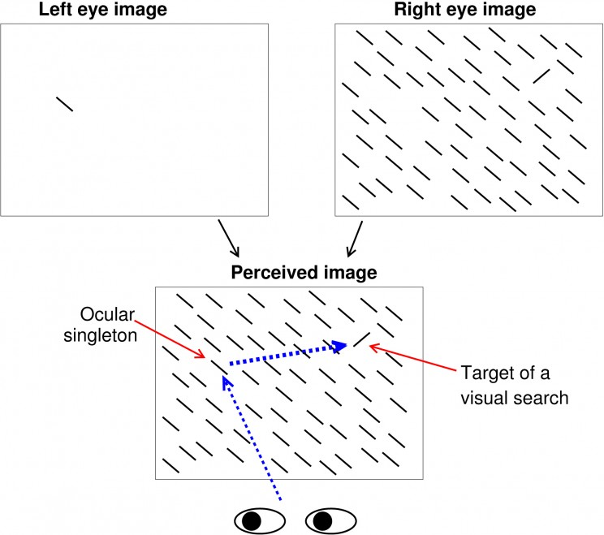
Stereo attention is weird wrt. mind’s eye
[Li Zhaoping, Understanding Vision]
Notes:
- In the following figure, a viewer perceives an image which is a superposition of two images, one shown to each of the two eyes using the equivalent of spectacles for watching 3D movies.
- To the viewer, it is as if the perceived image is shown simultaneously to both eyes --- we see a superposition of the two images, and the left eye image ‘fills the space’ in the right eye image; the ocular singleton appears identical to all the other background bars, i.e. we are blind to its distinctiveness.
The uniquely tilted bar appears most distinctive from the background.
Nevertheless, the ocular singleton often attracts attention more strongly than the orientation singleton (so that the first gaze shift is more frequently directed to the ocular rather than the orientation singleton) even when the viewer is told to find the latter as soon as possible and ignore all distractions.
It is as if the ocular singleton is uniquely coloured and distracting, like the lone-red flower in a green field, except that we are “colour-blind” to it.
Many vision scientists find this hard to believe without experiencing it themselves.
Fig 5.9 from Li Zhaoping, Understanding Vision: Theory Models, and Data

Slide 39
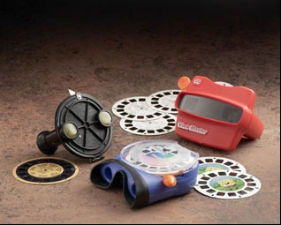
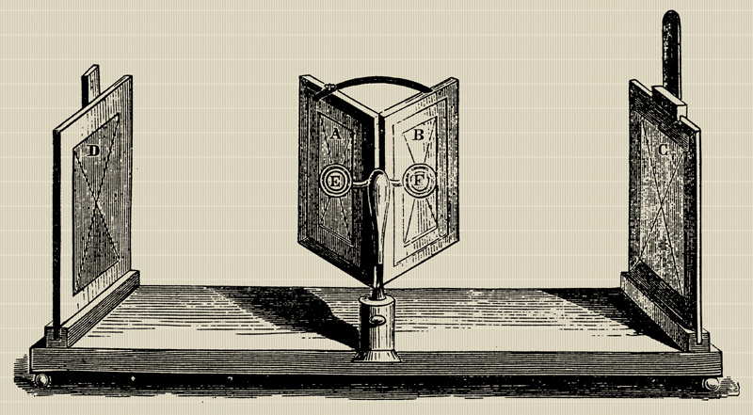
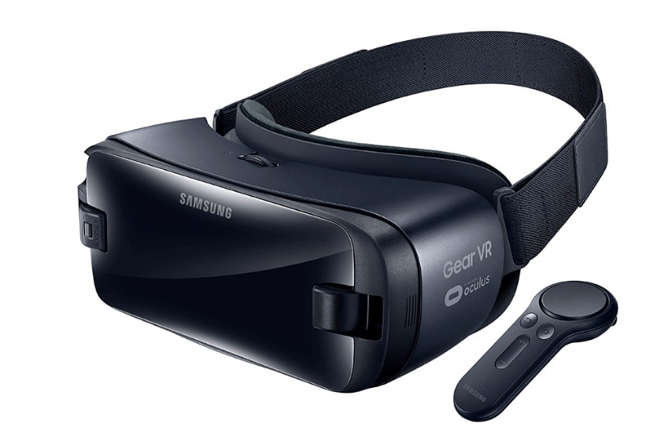
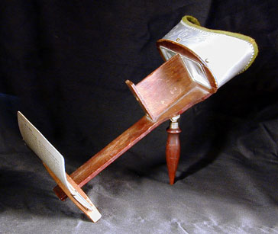
Stereo photography and stereo viewers
Take two pictures of the same subject from two slightly different viewpoints and display so that each eye sees only one of the images.
Image from fisher-price.com
Invented by Sir Charles Wheatstone, 1838

Slide 40
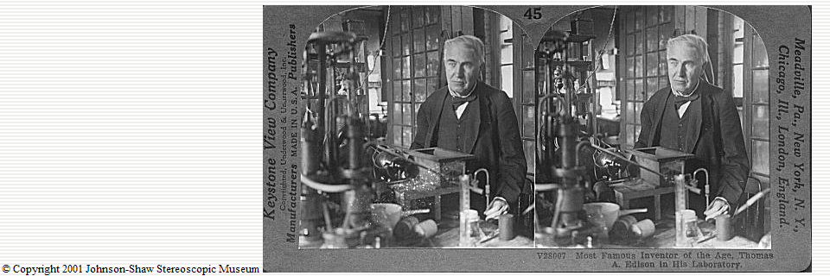
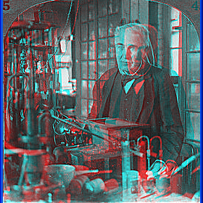
Anaglyph stereo
http://www.johnsonshawmuseum.org
Notes:
40

Slide 41
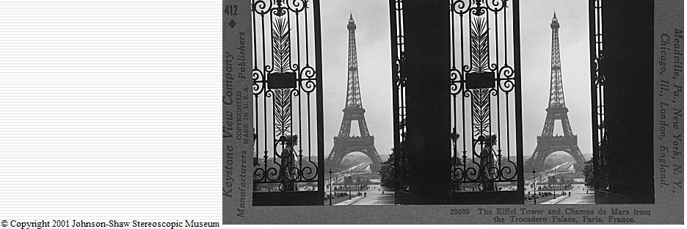
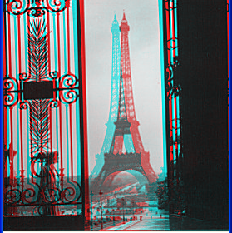
http://www.johnsonshawmuseum.org
Notes:
41

Slide 42


Public Library, Stereoscopic Looking Room, Chicago, by Phillips, 1923
Notes:
42

Slide 43


Wiggle images
http://www.well.com/~jimg/stereo/stereo_list.html
Notes:
43

Slide 44

Notes:
https://en.wikipedia.org/wiki/Leaning_tower_illusion
Pisa

Slide 45
Notes:
https://en.wikipedia.org/wiki/Leaning_tower_illusion
Pisa

Slide 46

Frederick Kingdom
Notes:
https://en.wikipedia.org/wiki/Leaning_tower_illusion
http://www.scholarpedia.org/article/Leaning_tower_illusion
Petronas twin towers in Quala Lumpur
Even though the corresponding outlines of the two towers converge in the image due to perspective, from experience we expect them to be rising at the same angle, and so we perceive the towers to be parallel.

Slide 47

Frederick Kingdom
Notes:
https://en.wikipedia.org/wiki/Leaning_tower_illusion
http://www.scholarpedia.org/article/Leaning_tower_illusion
Petronas twin towers in Quala Lumpur
When the corresponding outlines of two receding towers do not converge but are parallel, the correction for perspective is removed, and the only reasonable interpretation is that the towers must be diverging.

Slide 48
Photo: Georges Jansoon. Illusion: Frederick Kingdom, Ali Yoonessi and Elena Gheorghiu
Notes:
https://en.wikipedia.org/wiki/Leaning_tower_illusion

Slide 49

Frederick Kingdom

Slide 50

Stereo vision
Two cameras, simultaneous views
Single moving camera and static scene

Slide 51


Why multiple views?
Structure and depth can be ambiguous from single views...
Images from Lana Lazebnik

Slide 52

Notes:
Phil Tippett and Jon Berg stop-motion animate a shot with all three walkers (the background walkers are cutouts). Originally the plan had been to photograph the walkers against four-by-five Ektachrome transparencies shot in Norway; when these didn’t work as planned, matte artist Mike Pangrazio copied select Ektachromes onto large scenic backings.

Slide 53
Why multiple views?
Points at different depths along a line project to a single point
P1
P2
P1’=P2’
Optical center

Slide 54


Multiple views
Stereo vision
Structure from motion
Optical flow
Lowe
Hartley and Zisserman

Slide 55
Multi-view geometry problems
Camera ‘Motion’: Given a set of corresponding 2D/3D points in two or more images, compute the camera parameters.
Camera 1
Camera 3
R₁,t₁
?
Camera 2
?
?
R₂,t₂
R₃,t₃
Slide credit: Noah Snavely
Notes:
Structure from motion solves the following problem:
Given a set of images of a static scene with 2D points in correspondence, shown here as color-coded points, find…
a set of 3D points P and
a rotation R and position t of the cameras that explain the observed correspondences. In other words, when we project a point into any of the cameras, the reprojection error between the projected and observed 2D points is low.
This problem can be formulated as an optimization problem where we want to find the rotations R, positions t, and 3D point locations P that minimize sum of squared reprojection errors f. This is a non-linear least squares problem and can be solved with algorithms such as Levenberg-Marquart. However, because the problem is non-linear, it can be susceptible to local minima. Therefore, it’s important to initialize the parameters of the system carefully. In addition, we need to be able to deal with erroneous correspondences.

Slide 56
Multi-view geometry problems
Stereo correspondence: Given known camera parameters and a point in one of the images, where could its corresponding points be in the other images?
Camera 1
Camera 3
R₁,t₁
Camera 2
R₃,t₃
R₂,t₂
Slide credit: Noah Snavely
Notes:
Structure from motion solves the following problem:
Given a set of images of a static scene with 2D points in correspondence, shown here as color-coded points, find…
a set of 3D points P and
a rotation R and position t of the cameras that explain the observed correspondences. In other words, when we project a point into any of the cameras, the reprojection error between the projected and observed 2D points is low.
This problem can be formulated as an optimization problem where we want to find the rotations R, positions t, and 3D point locations P that minimize sum of squared reprojection errors f. This is a non-linear least squares problem and can be solved with algorithms such as Levenberg-Marquart. However, because the problem is non-linear, it can be susceptible to local minima. Therefore, it’s important to initialize the parameters of the system carefully. In addition, we need to be able to deal with erroneous correspondences.

Slide 57
Multi-view geometry problems
Structure from Motion: Given projections of the same 3D point in two or more images, compute the 3D coordinates of that point
?
Camera 1
Camera 3
R₁,t₁
?
Camera 2
?
?
R₂,t₂
R₃,t₃
Slide credit: Noah Snavely
Notes:
Structure from motion solves the following problem:
Given a set of images of a static scene with 2D points in correspondence, shown here as color-coded points, find…
a set of 3D points P and
a rotation R and position t of the cameras that explain the observed correspondences. In other words, when we project a point into any of the cameras, the reprojection error between the projected and observed 2D points is low.
This problem can be formulated as an optimization problem where we want to find the rotations R, positions t, and 3D point locations P that minimize sum of squared reprojection errors f. This is a non-linear least squares problem and can be solved with algorithms such as Levenberg-Marquart. However, because the problem is non-linear, it can be susceptible to local minima. Therefore, it’s important to initialize the parameters of the system carefully. In addition, we need to be able to deal with erroneous correspondences.

Slide 58
Multi-view geometry problems
Optical flow: Given two images, find the location of a world point in a second close-by image with no camera info.
Camera 1
Camera 2
Notes:
Structure from motion solves the following problem:
Given a set of images of a static scene with 2D points in correspondence, shown here as color-coded points, find…
a set of 3D points P and
a rotation R and position t of the cameras that explain the observed correspondences. In other words, when we project a point into any of the cameras, the reprojection error between the projected and observed 2D points is low.
This problem can be formulated as an optimization problem where we want to find the rotations R, positions t, and 3D point locations P that minimize sum of squared reprojection errors f. This is a non-linear least squares problem and can be solved with algorithms such as Levenberg-Marquart. However, because the problem is non-linear, it can be susceptible to local minima. Therefore, it’s important to initialize the parameters of the system carefully. In addition, we need to be able to deal with erroneous correspondences.

Slide 59

Multiple views - Dogception
Notes:
https://a.msn.com/r/2/AAngVMj?m=en-us&ocid=News

Slide 60
Estimating scene shape
“Shape from X”: Shading, Texture, Focus, Motion…
Stereo:
  shape from “motion” between two views
  infer 3d shape of scene from two (multiple) images from different viewpoints
Main idea:
scene point
image plane
optical center
James Hays
Notes:
60

Slide 61

Estimating depth with stereo
Stereo: shape from “motion” between two views
We’ll need to consider:
Info on camera pose (“calibration”)
Image point correspondences
scene point
image plane
optical center
James Hays
Notes:
61

Slide 62
Geometry for a simple stereo system
Assume:
  parallel optical axes,
  known camera parameters
  (i.e., calibrated cameras):
Goal: recover depth of X
by finding image coordinate
x’ that corresponds to x
X
x
x'

Slide 63

World point
Depth of p
image point (left)
image point (right)
Focal length
optical center (right)
optical center (left)
baseline
Notes:
63
The projection of the point p into left camera (p_l) and right camera (p_r) has a coordinate system which is in 'world space' units (the same coordinate space as p). When we sample this space with the camera, our pixels are now in image coordinates. x_l and x_r are in image coordinates. In the next slide, there's some fudging of notation because the units are different; we (also) need to know the size of a pixel in millimetres to translate between the spaces.

Slide 64


Geometry for a simple stereo system
Assume parallel optical axes, known camera parameters (i.e., calibrated cameras). What is expression for Z?
Similar triangles (p_{l}, P, p_{r}) and (O_{l}, P, O_{r}):
disparity
Notes:
64

Slide 65

Depth from disparity
image I(x,y)
Disparity map D(x,y)
image I´(x´,y´)
(x´,y´)=(x+D(x,y), y)
If we could find the corresponding points in two images, we could estimate relative depth…
James Hays

Slide 66
Depth from disparity
Goal: recover depth by finding image coordinate x’ that corresponds to x
Sub-Problems
  Calibration: How do we recover the relation of the cameras (if not already known)?
  Correspondence: How do we search for the matching point x’?
X
x
x'

Slide 67
What do we need to know?
Calibration for the two cameras.
  Intrinsic matrices for both cameras (e.g., f)
  Baseline distance T in parallel camera case
  R, t in non-parallel case
2. Correspondence for every pixel.
Like project 2, but project 2 is “sparse”.
We need “dense” correspondence!

Slide 68


Correspondence for every pixel.
Where do we need to search?

Slide 69
Wouldn’t it be nice to know where matches can live?
Epipolar geometry
Constrains 2D search to 1D

Slide 70

Key idea: Epipolar constraint
X
X
X
x
x’
x’
x’
Potential matches for x’ have to
lie on the corresponding line l.
Potential matches for x have to
lie on the corresponding line l’.

Slide 71

Epipolar geometry: notation
X
x
x’
Baseline – line connecting the two camera centers
Epipoles
= intersections of baseline with image planes
= projections of the other camera center
Epipolar Plane – plane containing baseline (1D family)

Slide 72
Epipolar geometry: notation
X
x
x’
Baseline – line connecting the two camera centers
Epipoles
= intersections of baseline with image planes
= projections of the other camera center
Epipolar Plane – plane containing baseline (1D family)
Epipolar Lines - intersections of epipolar plane with image
planes (always come in corresponding pairs)

Slide 73
Think Pair Share
= camera center
Where are the epipoles?
What do the epipolar lines look like?
X
X
a)
b)
X
X
c)
d)

Slide 74



Example: Converging cameras

Slide 75



Example: Motion parallel to image plane

Slide 76


Example: Forward motion
e’
e
Epipole has same coordinates in both images.
Points move along lines radiating from e: “Focus of expansion”

Slide 77
What is this useful for?
X
x
x’
Reduce search space for stereo disparity estimation.
Help find x’: If I know x, and have calibrated cameras (known intrinsics K,K’ and extrinsic relationship), I can restrict x’ to be along l’.

Slide 78
What is this useful for?
X
x
x’
If we have enough x, x’ correspondences, we can estimate relative position and orientation between the cameras and the 3D position of corresponding image points.

Slide 79
What is this useful for?
X
x
x’
Model fitting: see if candidate x, x’ correspondences fit estimated projection models of cameras 1 and 2.

Slide 80

VLFeat’s 800 most confident matches among 10,000+ local features.

Slide 81


Epipolar lines

Slide 82

Keep only the matches at are “inliers” with respect to the “best” fundamental matrix

Slide 83


Epipolar constraint: Calibrated case
X
x
x’
Given the intrinsic parameters of the cameras:
  Convert to normalized coordinates by pre-multiplying all points with the inverse of the calibration matrix; set first camera’s coordinate system to world coordinates
3D scene point
Homogeneous 2d point (3D ray towards X)
2D pixel coordinate (homogeneous)
3D scene point in 2nd camera’s 3D coordinates

Slide 84


Epipolar constraint: Calibrated case
X
x
x’
Given the intrinsic parameters of the cameras:
  Convert to normalized coordinates by pre-multiplying all points with the inverse of the calibration matrix; set first camera’s coordinate system to world coordinates
  Define some R and t that relate X to X’ as below
for some scale factor

Slide 85





Epipolar constraint: Calibrated case
X
x
x’
$$\hat{x}$$
$${\hat{x}}^{′}$$
(because $\hat{x}, R{\hat{x}}^{′},$ and $t$ are co-planar)
Notes:
X’ is X in the second camera’s coordinate system
We can identify the non-homogeneous 3D vectors X and X’ with the homogeneous coordinate vectors x and x’ of the projections of the two points into the two respective images

Slide 86
Epipolar constraint: Calibrated case
X
x
x’
$$\hat{x}$$
$${\hat{x}}^{′}$$
Intrinsics K’
Intrinsics K
3D scene point
Homogeneous 2d point (3D ray towards X)
2D pixel coordinate (homogeneous)
3D scene point in 2nd camera’s 3D coordinates
Notes:
X’ is X in the second camera’s coordinate system
We can identify the non-homogeneous 3D vectors X and X’ with the homogeneous coordinate vectors x and x’ of the projections of the two points into the two respective images

Slide 87

Epipolar constraint: Calibrated case
X
x
x’
$$\hat{x}$$
$${\hat{x}}^{′}$$
Intrinsics K’
Intrinsics K
3D scene point
Homogeneous 2d point (3D ray towards X)
2D pixel coordinate (homogeneous)
3D scene point in 2nd camera’s 3D coordinates
(because $\hat{x}, R{\hat{x}}^{′},$ and $t$ are co-planar)
Notes:
X’ is X in the second camera’s coordinate system
We can identify the non-homogeneous 3D vectors X and X’ with the homogeneous coordinate vectors x and x’ of the projections of the two points into the two respective images

Slide 88


Essential matrix
X
x
x’
E is a 3x3 matrix which relates corresponding pairs of normalized homogeneous image points across pairs of images – for intrinsic K calibrated cameras.
Estimates relative position/orientation.
Essential Matrix
(Longuet-Higgins, 1981)
Note: [t]× is matrix representation of cross product
Notes:
[t]_{x} is the skew symmetric matrix of t
Skew-symmetric matrix is a square matrix whose transpose is its negation, i.e., -A = A^T

Slide 89

Properties of the Essential matrix
X
x
x’
Drop ^ below to simplify notation
Skew-symmetric matrix
E x’ is the epipolar line associated with x’ (l = E x’)
E^{T}x is the epipolar line associated with x (l’ = E^{T}x)
E e’ = 0 and E^{T}e = 0
E is singular (rank two)
E has five degrees of freedom
  (3 for R, 2 for t because it’s up to a scale)

Slide 90


Epipolar constraint: Uncalibrated case
X
x
x’
If we don’t know intrinsics K and K’, then we can write the epipolar constraint in terms of unknown normalized coordinates:

Slide 91



The Fundamental Matrix
Without knowing K and K’, we can define a similar relation using unknown normalized coordinates
Fundamental Matrix
(Faugeras and Luong, 1992)

Slide 92
Properties of the Fundamental matrix
X
x
x’
F x’ = 0 is the epipolar line l associated with x’
F^{T}x = 0 is the epipolar line l’ associated with x
F is singular (rank two): det(F)=0
F e’ = 0 and F^{T}e = 0 (nullspaces of F = e’; nullspace of F^{T} = e’)
F has seven degrees of freedom: 9 entries but defined up to scale, det(F)=0

Slide 93

F in more detail
F is a 3x3 matrix
Rank 2 -> projection; one column is a linear combination of the other two.
Determined up to scale.
7 degrees of freedom
$\left[\begin{matrix}a & b & αa+ βb \\ c & d & αc+βd \\ e & f & αe+βf\end{matrix}\right]$ where a is scalar; e.g., can normalize out.
Given x projected from X into image 1, F constrains the projection of x’ into image 2 to an epipolar line.

Slide 94
Estimating the Fundamental Matrix
8-point algorithm
  Least squares solution using SVD on equations from 8 pairs of correspondences
  Enforce det(F)=0 constraint using SVD on F
Note: estimation of F (or E) is degenerate for a planar scene.

Slide 95
Estimating the Fundamental Matrix
8-point algorithm
  Least squares solution using SVD on equations from 8 pairs of correspondences
  Enforce det(F)=0 constraint using SVD on F
7-point algorithm
  Use least squares to solve for null space (two vectors) using SVD and 7 pairs of correspondences
  Solve for linear combination of null space vectors that satisfies det(F)=0
Minimize reprojection error
  Non-linear least squares
Note: estimation of F (or E) is degenerate for a planar scene.

Slide 96


8-point algorithm
Solve a system of homogeneous linear equations
  Write down the system of equations
$$uu^{′}f_{11}+uv^{′}f_{12}+uf_{13}+vu^{′}f_{21}+vv^{′}f_{22}+vf_{23}+u^{′}f_{31}+v^{′}f_{32}+f_{33}=0$$
$Af=\left[\begin{matrix}u_{1}u_{1}′ & u_{1}v_{1}′ & \begin{matrix}u_{1} & v_{1}u_{1}′ & \begin{matrix}v_{1}v_{1}′ & v_{1} & \begin{matrix}u_{1}′ & v_{1}′ & 1\end{matrix}\end{matrix}\end{matrix} \\ \begin{matrix}⋮ \\ u_{n}u_{v}^{′}\end{matrix} & \begin{matrix}⋮ \\ u_{n}v_{n}′\end{matrix} & \begin{matrix}\begin{matrix}⋮ \\ u_{n}\end{matrix} & \begin{matrix}⋮ \\ v_{n}u_{n}′\end{matrix} & \begin{matrix}\begin{matrix}⋮ \\ v_{n}v_{n}′\end{matrix} & \begin{matrix}⋮ \\ v_{n}\end{matrix} & \begin{matrix}\begin{matrix}⋮ \\ u_{n}′\end{matrix} & \begin{matrix}⋮ \\ v_{n}′\end{matrix} & \begin{matrix}⋮ \\ 1\end{matrix}\end{matrix}\end{matrix}\end{matrix}\end{matrix}\right]\left[\begin{matrix}f_{11} \\ f_{12} \\ \begin{aligned}f_{13} \\ f_{21} \\ ⋮ \\ f_{33}\end{aligned}\end{matrix}\right]$=0

Slide 97
8-point algorithm
Solve a system of homogeneous linear equations
  Write down the system of equations
  Solve f from Af=0 using SVD
Matlab:
[U, S, V] = svd(A);
f = V(:, end);
F = reshape(f, [3 3])’;
Python Numpy:
U, S, Vh = np.linalg.svd(A)
# V = Vh.T -> note = different from MATLAB
F = Vh[-1,:]
F = np.reshape(F, (3,3))

Slide 98

Need to enforce singularity constraint

Slide 99
8-point algorithm
Solve a system of homogeneous linear equations
  Write down the system of equations
  Solve f from Af=0 using SVD
Resolve det(F) = 0 constraint using SVD
Matlab:
[U, S, V] = svd(A);
f = V(:, end);
F = reshape(f, [3 3])’;
Python Numpy:
U, S, Vh = np.linalg.svd(A)
F = Vh[-1,:]
F = np.reshape(F, (3,3))
Matlab:
[U, S, V] = svd(F);
S(3,3) = 0;
F = U*S*V’;
Python Numpy:
U, S, Vh = np.linalg.svd(F)
S[-1] = 0
F = U @ np.diagflat(S) @ Vh
@ operator = matrix multiplication

Slide 100

Problem with eight-point algorithm

Slide 101


Problem with eight-point algorithm
Poor numerical conditioning
Can be fixed by rescaling the data

Slide 102
The normalized eight-point algorithm
(Hartley, 1995)
Center the image data at the origin, and scale it so the mean squared distance between the origin and the data points is 2 pixels
Use the eight-point algorithm to compute F from the normalized points
Enforce the rank-2 constraint (for example, take SVD of F and throw out the smallest singular value)
Transform fundamental matrix back to original units: if T and T’ are the normalizing transformations in the two images, than the fundamental matrix in original coordinates is T’^{T} F T

Slide 103

7-point algorithm
Faster (need fewer points) and could be more robust (fewer points), but also need to check for degenerate cases

Slide 104

“Gold standard” algorithm
Use 8-point algorithm to get initial value of F
Use F to solve for P and P’ (discussed later)
Jointly solve for 3d points X and F that minimize the squared re-projection error
X
x
x'
See Algorithm 11.2 and Algorithm 11.3 in Hartley-Zisserman (pages 284-285) for details

Slide 105

Comparison of estimation algorithms
 | 8-point | Normalized 8-point | Nonlinear least squares
Av. Dist. 1 | 2.33 pixels | 0.92 pixel | 0.86 pixel
Av. Dist. 2 | 2.18 pixels | 0.85 pixel | 0.80 pixel

Slide 106



We can get projection matrices P and P’ up to a projective ambiguity
MATLAB Code:
function P = vgg_P_from_F(F)
[U,S,V] = svd(F);
e = U(:,3);
P = [-vgg_contreps(e)*F e];
K’*rotation
K’*translation
See Hartley-Zisserman p. 255-256
If we know the intrinsic matrices (K and K’), we can resolve the ambiguity

Slide 107
From epipolar geometry to camera calibration
If we know the calibration matrices of the two cameras, we can estimate the essential matrix: E = K^{T}FK’
The essential matrix gives us the relative rotation and translation between the cameras, or their extrinsic parameters.
Fundamental matrix lets us compute relationship up to scale for cameras with unknown intrinsic calibrations.
Estimating the fundamental matrix is a kind of “weak calibration”

Slide 108
Let’s recap…
Fundamental matrix song
http://danielwedge.com/fmatrix/

Slide 109
Among all my matches, how do I know which ones are good?

Slide 110


Example: solving for translation
A₁
A₂
A₃
(t_{x}, t_{y})
B₁
B₂
B₃
Given matched points in {A} and {B}, estimate the translation of the object

Slide 111
Example: solving for translation
A₁
A₅
B₄
A₂
A₃
(t_{x}, t_{y})
B₁
A₄
B₂
B₃
B₅
Problem: outliers A₄-B₄ and A₅-B₅ which incorrectly correspond

Slide 112

Least squares: Robustness to noise
Least squares fit to the red points:

Slide 113


Least squares line fitting
Data: (x₁, y₁), …, (x_{n}, y_{n})
Line equation: y_{i} = m x_{i} + b
Find (m, b) to minimize
y=mx+b
(x_{i}, y_{i})
Matlab: p = A \ y;
Python: p = np.linalg.lstsq(A,y)[0]
(Closed form solution)
Modified from S. Lazebnik
Notes:
What is p here?

Slide 114

Least squares: Robustness to noise
Least squares fit with an outlier:
Problem: squared error heavily penalizes outliers

Slide 115




Robust least squares (to deal with outliers)
General approach:
minimize
u_{i} (x_{i}, θ) – residual of i^{th} point w.r.t. model parameters ϴ
ρ – robust function with scale parameter σ
Effect of scale parameter σ
The robust function ρ
Favors a configuration
with small residuals
Constant penalty for large residuals
Slide from S. Savarese

Slide 116

Choosing the scale: Just right
The effect of the outlier is minimized
Notes:
Fit to earlier data with an appropriate choice of s

Slide 117

Choosing the scale: Too small
The error value is almost the same for every
point and the fit is very poor

Slide 118

Choosing the scale: Too large
Behaves much the same as least squares

Slide 119
Robust estimation: Details
Robust fitting is a nonlinear optimization problem that must be solved iteratively
Scale of robust function should be chosen adaptively based on median residual
Least squares solution can be used for initialization

Slide 120
Fitting and Alignment: Methods
Global optimization / Search for parameters
  Least squares fit
  Robust least squares
  Iterative closest point (ICP)
Hypothesize and test
  Hough transform
  RANSAC

Slide 121
VLFeat’s 800 most confident matches among 10,000+ local features.
What if I have many outliers?
Episcopal Gaudi image pair

Slide 122
Example: solving for translation
A₁
A₂
A₃
(t_{x}, t_{y})
B₁
B₂
B₃
Given matched points in {A} and {B}, estimate the translation of the object

Slide 123
Example: solving for translation
A₁
A₅
B₄
A₂
A₃
(t_{x}, t_{y})
B₁
A₄
B₂
B₃
B₅
Problem: outliers A₄-B₄ and A₅-B₅ which incorrectly correspond
RANSAC solution
Sample a set of matching points (1 pair)
Solve for transformation parameters
Score parameters with number of inliers
Repeat steps 1-3 N times

Slide 124
RANSAC
_{(RANdom SAmple Consensus) :}
Fischler & Bolles in ‘81.
Notes:
Let me give you an intuition of what is going on. Suppose we have the standard line fitting problem in presence of outliers.
We can formulate this problem as follows: want to find the best partition of points in inlier set and outlier set such that…
The objective consists of adjusting the parameters of a model function so as to best fit a data set.
"best" is defined by a function f that needs to be minimized.
Such that the best parameter of fitting the line give rise to a residual error lower that delta
as when the sum, S, of squared residuals

Slide 125
RANSAC
_{(RANdom SAmple Consensus) :}
Fischler & Bolles in ‘81.
Notes:
Let me give you an intuition of what is going on. Suppose we have the standard line fitting problem in presence of outliers.
We can formulate this problem as follows: want to find the best partition of points in inlier set and outlier set such that…
The objective consists of adjusting the parameters of a model function so as to best fit a data set.
"best" is defined by a function f that needs to be minimized.
Such that the best parameter of fitting the line give rise to a residual error lower that delta
as when the sum, S, of squared residuals

Slide 126
RANSAC
_{(RANdom SAmple Consensus) :}
Fischler & Bolles in ‘81.
This data is noisy, but we expect a good fit to a known model.
Notes:
Let me give you an intuition of what is going on. Suppose we have the standard line fitting problem in presence of outliers.
We can formulate this problem as follows: want to find the best partition of points in inlier set and outlier set such that…
The objective consists of adjusting the parameters of a model function so as to best fit a data set.
"best" is defined by a function f that needs to be minimized.
Such that the best parameter of fitting the line give rise to a residual error lower that delta
as when the sum, S, of squared residuals

Slide 127
RANSAC
_{(RANdom SAmple Consensus) :}
Fischler & Bolles in ‘81.
This data is noisy, but we expect a good fit to a known model.
Here, we expect to see a line, but least-squares fitting will produce the wrong result due to strong outlier presence.
Notes:
Let me give you an intuition of what is going on. Suppose we have the standard line fitting problem in presence of outliers.
We can formulate this problem as follows: want to find the best partition of points in inlier set and outlier set such that…
The objective consists of adjusting the parameters of a model function so as to best fit a data set.
"best" is defined by a function f that needs to be minimized.
Such that the best parameter of fitting the line give rise to a residual error lower that delta
as when the sum, S, of squared residuals

Slide 128
RANSAC
_{(RANdom SAmple Consensus) :}
Fischler & Bolles in ‘81.
Algorithm:
Sample (randomly) the number of points s required to fit the model
Solve for model parameters using samples
Score by the fraction of inliers within a preset threshold of the model
Repeat 1-3 until the best model is found with high confidence
Notes:
Let me give you an intuition of what is going on. Suppose we have the standard line fitting problem in presence of outliers.
We can formulate this problem as follows: want to find the best partition of points in inlier set and outlier set such that…
The objective consists of adjusting the parameters of a model function so as to best fit a data set.
"best" is defined by a function f that needs to be minimized.
Such that the best parameter of fitting the line give rise to a residual error lower that delta
as when the sum, S, of squared residuals

Slide 129
RANSAC
Line fitting example
Algorithm:
Sample (randomly) the number of points required to fit the model (s=2)
Solve for model parameters using samples
Score by the fraction of inliers within a preset threshold of the model
Repeat 1-3 until the best model is found with high confidence
Illustration by Savarese
Notes:
Let me give you an intuition of what is going on. Suppose we have the standard line fitting problem in presence of outliers.
We can formulate this problem as follows: want to find the best partition of points in inlier set and outlier set such that…
The objective consists of adjusting the parameters of a model function so as to best fit a data set.
"best" is defined by a function f that needs to be minimized.
Such that the best parameter of fitting the line give rise to a residual error lower that delta
as when the sum, S, of squared residuals

Slide 130
RANSAC
Line fitting example
Algorithm:
Sample (randomly) the number of points required to fit the model (s=2)
Solve for model parameters using samples
Score by the fraction of inliers within a preset threshold of the model
Repeat 1-3 until the best model is found with high confidence
Notes:
Let me give you an intuition of what is going on. Suppose we have the standard line fitting problem in presence of outliers.
We can formulate this problem as follows: want to find the best partition of points in inlier set and outlier set such that…
The objective consists of adjusting the parameters of a model function so as to best fit a data set.
"best" is defined by a function f that needs to be minimized.
Such that the best parameter of fitting the line give rise to a residual error lower that delta
as when the sum, S, of squared residuals

Slide 131


RANSAC
Line fitting example
Algorithm:
Sample (randomly) the number of points required to fit the model (s=2)
Solve for model parameters using samples
Score by the fraction of inliers within a preset threshold of the model
Repeat 1-3 until the best model is found with high confidence
Notes:
Let me give you an intuition of what is going on. Suppose we have the standard line fitting problem in presence of outliers.
We can formulate this problem as follows: want to find the best partition of points in inlier set and outlier set such that…
The objective consists of adjusting the parameters of a model function so as to best fit a data set.
"best" is defined by a function f that needs to be minimized.
Such that the best parameter of fitting the line give rise to a residual error lower that delta
as when the sum, S, of squared residuals

Slide 132

RANSAC
Algorithm:
Sample (randomly) the number of points required to fit the model (s=2)
Solve for model parameters using samples
Score by the fraction of inliers within a preset threshold of the model
Repeat 1-3 until the best model is found with high confidence
Notes:
Let me give you an intuition of what is going on. Suppose we have the standard line fitting problem in presence of outliers.
We can formulate this problem as follows: want to find the best partition of points in inlier set and outlier set such that…
The objective consists of adjusting the parameters of a model function so as to best fit a data set.
"best" is defined by a function f that needs to be minimized.
Such that the best parameter of fitting the line give rise to a residual error lower that delta
as when the sum, S, of squared residuals

Slide 133




RANSAC
(RANdom SAmple Consensus) :
Learning technique to estimate
parameters of a model by random
sampling of observed data
Fischler & Bolles in ‘81.
Model parameters
such that:
Source: Savarese
Notes:
Let me give you an intuition of what is going on. Suppose we have the standard line fitting problem in presence of outliers.
We can formulate this problem as follows: want to find the best partition of points in inlier set and outlier set such that…
The objective consists of adjusting the parameters of a model function so as to best fit a data set.
"best" is defined by a function f that needs to be minimized.
Such that the best parameter of fitting the line give rise to a residual error lower that delta
as when the sum, S, of squared residuals

Slide 134

How to choose parameters?
Number of algorithm iterations N
  Choose N so that, with probability p, at least one random sample is free from outliers (e.g., p=0.99) (outlier ratio: e)
Number of sampled points s
  Minimum number needed to fit the model
Distance threshold δ
  Choose δ so that a good point with noise is likely (e.g., prob=0.95) within threshold
  Zero-mean Gaussian noise with std. dev. σ: t²=3.84σ²
How many iterations do I need?
 | Proportion of outliers e
s | 5% | 10% | 20% | 25% | 30% | 40% | 50%
2 | 2 | 3 | 5 | 6 | 7 | 11 | 17
3 | 3 | 4 | 7 | 9 | 11 | 19 | 35
4 | 3 | 5 | 9 | 13 | 17 | 34 | 72
5 | 4 | 6 | 12 | 17 | 26 | 57 | 146
6 | 4 | 7 | 16 | 24 | 37 | 97 | 293
7 | 4 | 8 | 20 | 33 | 54 | 163 | 588
8 | 5 | 9 | 26 | 44 | 78 | 272 | 1177
For p = 0.99
modified from M. Pollefeys
Notes:
Table intuition:
s is the number of model parameters
e is the number of outliers in the dataset (data which doesn’t fit model) – 5 to 50 %
Tells us how many iterations of RANSAC we need to run to have a 99% confidence that we will sample has zero outliers in the sampling for the model parameters.
https://en.wikipedia.org/wiki/Random_sample_consensus

Slide 135
VLFeat’s SIFT produces 800 most confident matches among 10,000+ local features.
Notes:
VLFeat is a piece of computer vision software:
http://www.vlfeat.org/

Slide 136
Epipolar lines

Slide 137
Keep only the matches at are “inliers” with respect to the “best” fundamental matrix

Slide 138
RANSAC conclusions
Good
Robust to outliers
Applicable for large number of objective function parameters (than Hough transform)
Optimization parameters are easier to choose (than Hough transform)
Bad
Computational time grows quickly with fraction of outliers and number of parameters
Not good for getting multiple fits
Common applications
Estimating fundamental matrix (relating two views)
Computing a homography (e.g., image stitching)

