Slide 1

13 April 2019
Notes:
Welcome to a class with some curious content!
Today we’re going to be discussing cameras, and how light and color affect image formation.

Slide 2
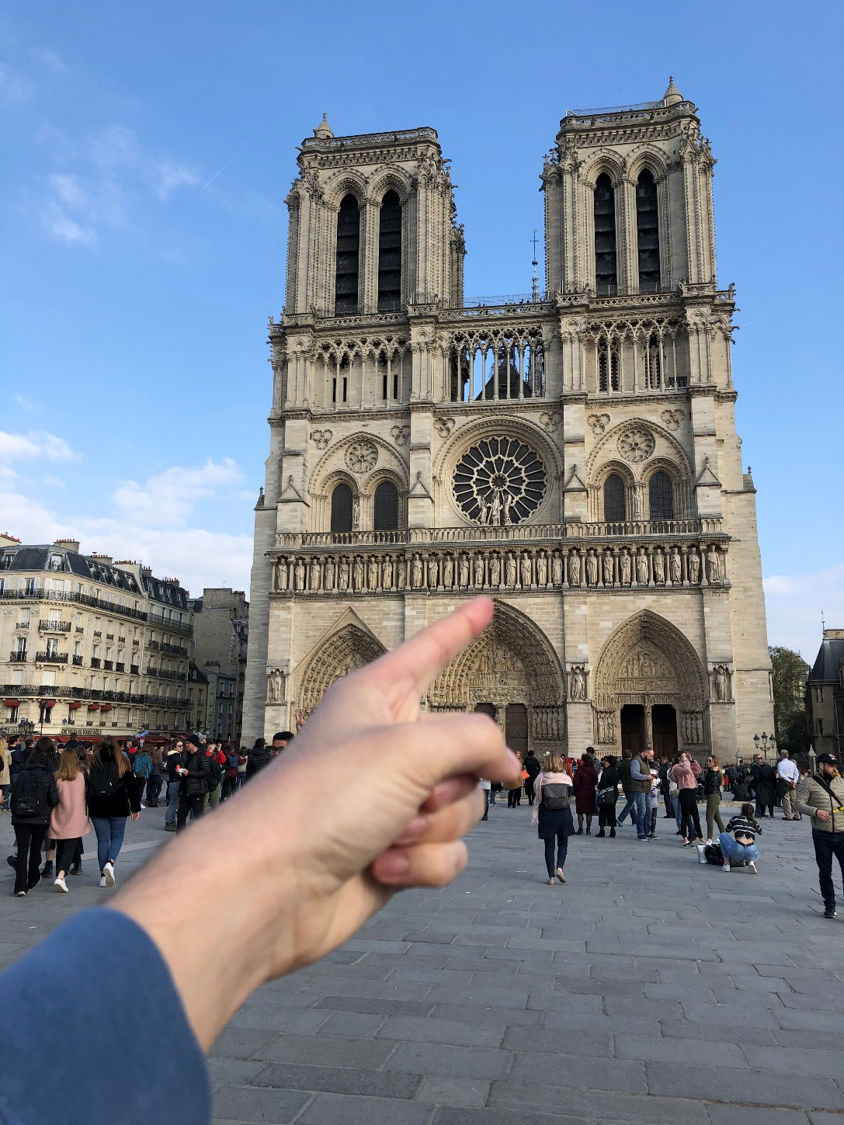
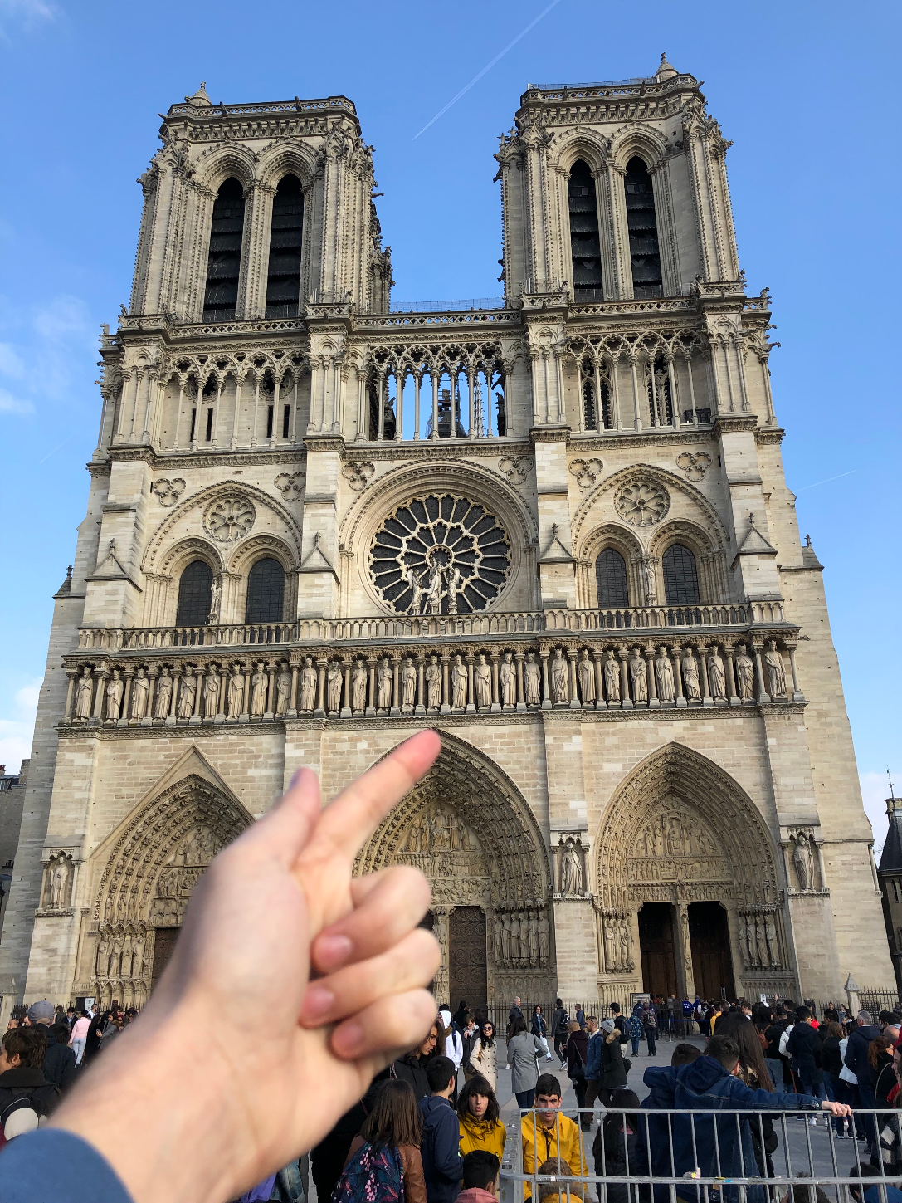
Notes:
SIFT ‘In The Flesh’.
Real-life scale-invariant feature matching
Cathedral de Notre Dame, Paris

Slide 3
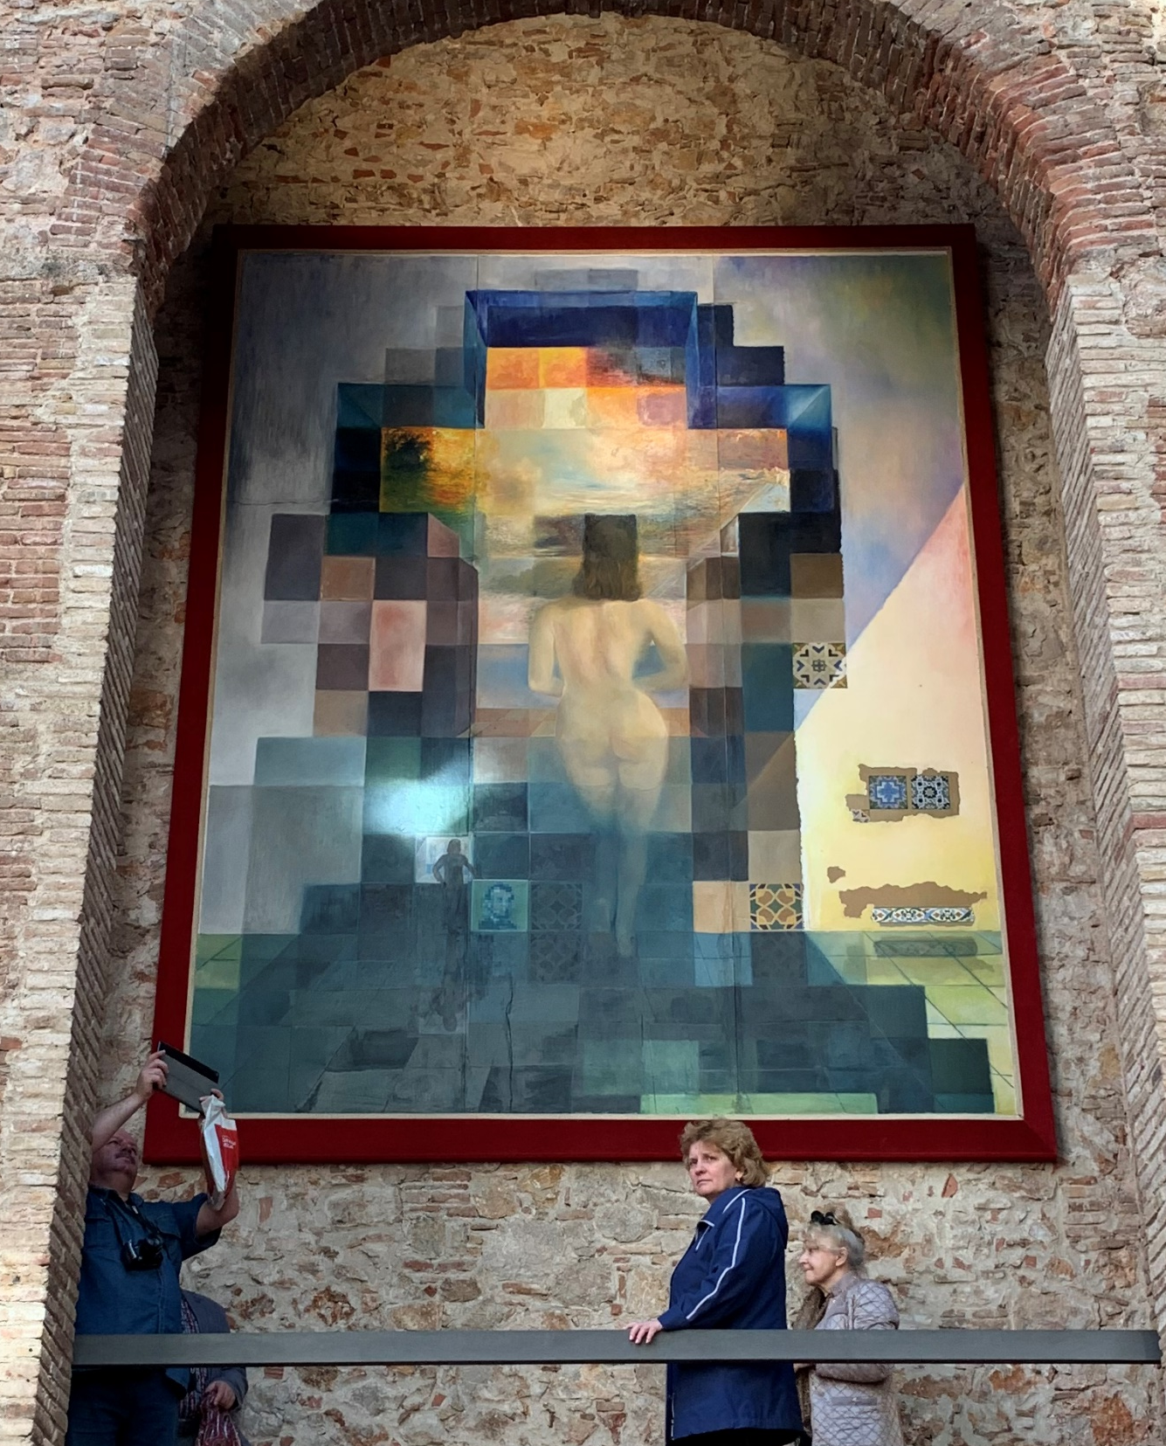

Photo from Madelyn Adams
Notes:
Dali Museum, Figueres, Spain

Slide 4
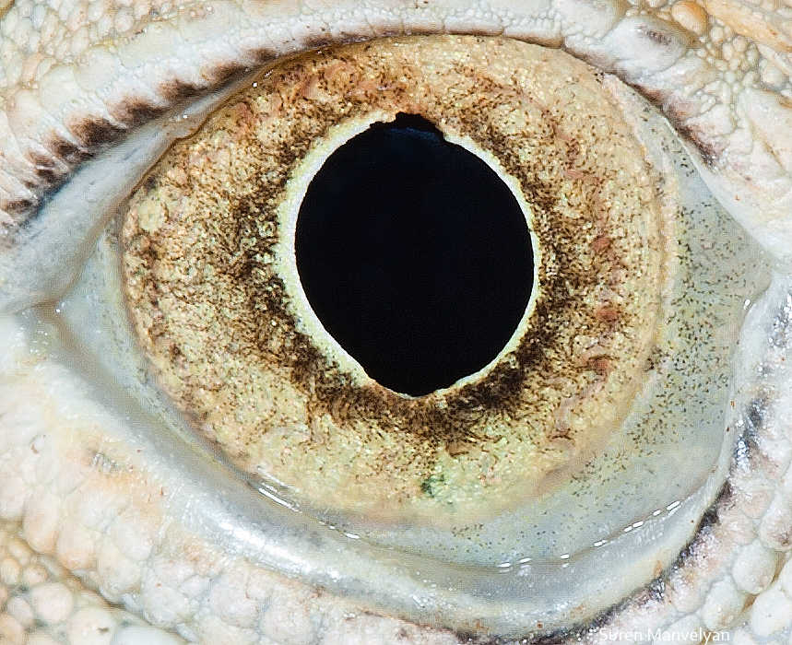
By Suren Manvelyan, http://www.surenmanvelyan.com/gallery/7116
Notes:
http://www.surenmanvelyan.com/gallery/7116
iguana

Slide 5
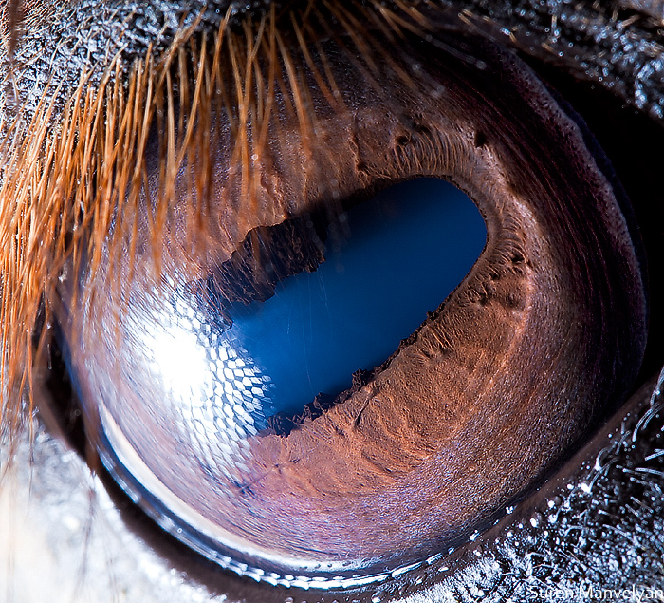
By Suren Manvelyan, http://www.surenmanvelyan.com/gallery/7116
Notes:
http://www.surenmanvelyan.com/gallery/7116
horse

Slide 6
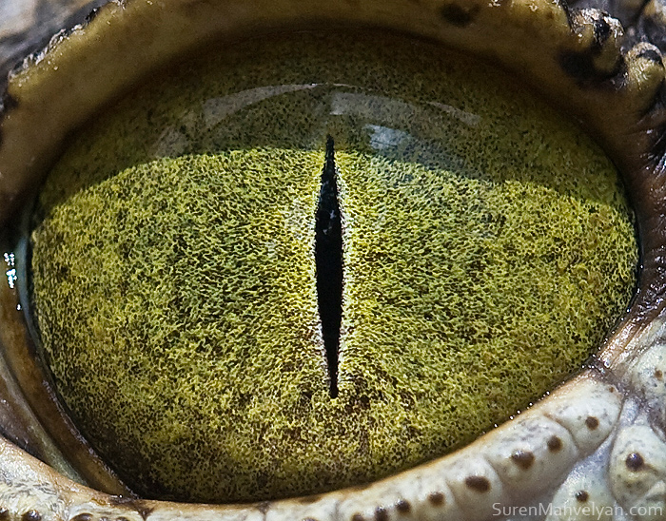
By Suren Manvelyan, http://www.surenmanvelyan.com/gallery/7116
Notes:
http://www.surenmanvelyan.com/gallery/7116
Crocodile (nile crocodile?)

Slide 7
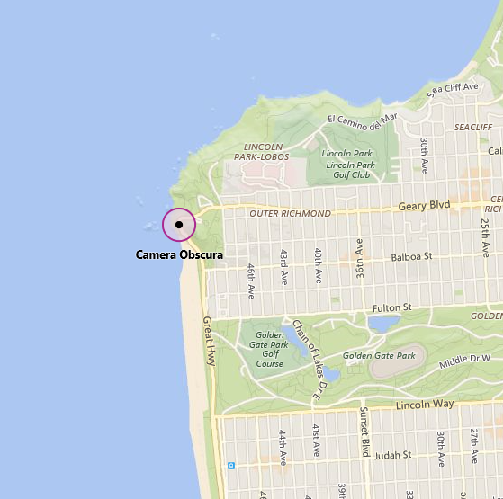
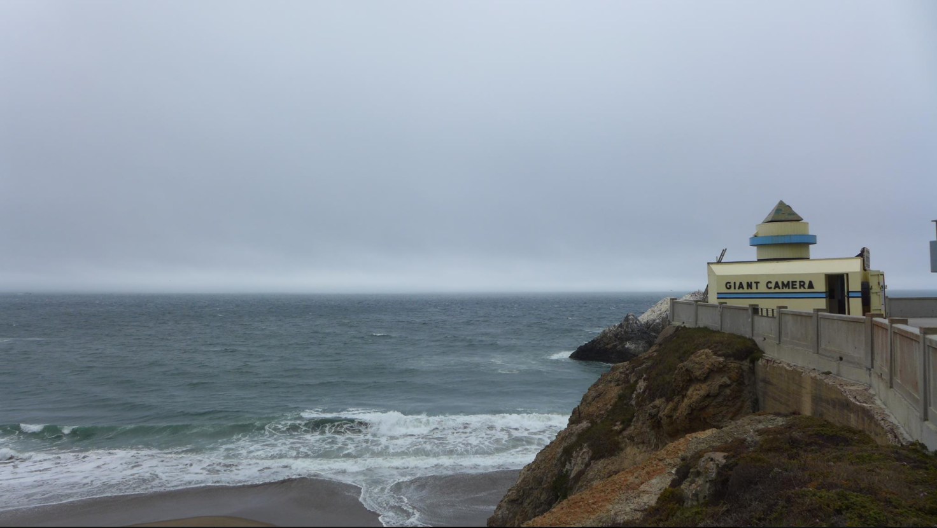
James, San Francisco, Aug. 2017

Slide 8
Cameras, Multiple Views, and Motion

Slide 9
What is a camera?

Slide 10
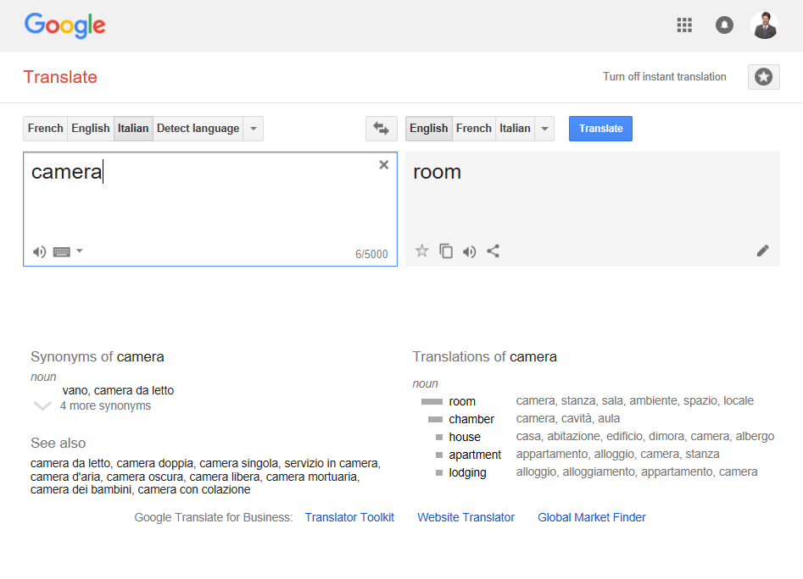

Slide 11
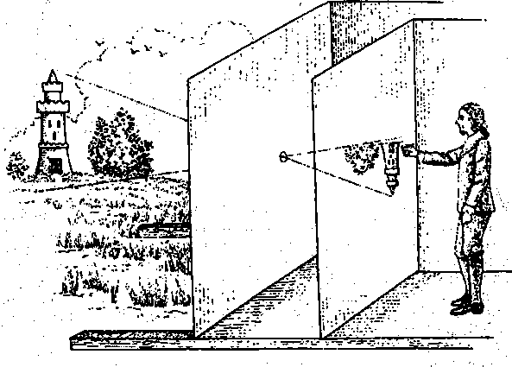
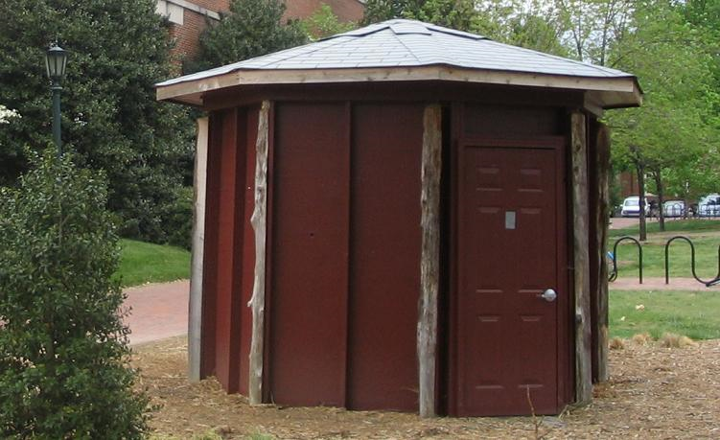
Camera obscura: dark room
Known during classical period in China and Greece (e.g., Mo-Ti, China, 470BC to 390BC)
Illustration of Camera Obscura
Freestanding camera obscura at UNC Chapel Hill
Photo by Seth Ilys
James Hays

Slide 12
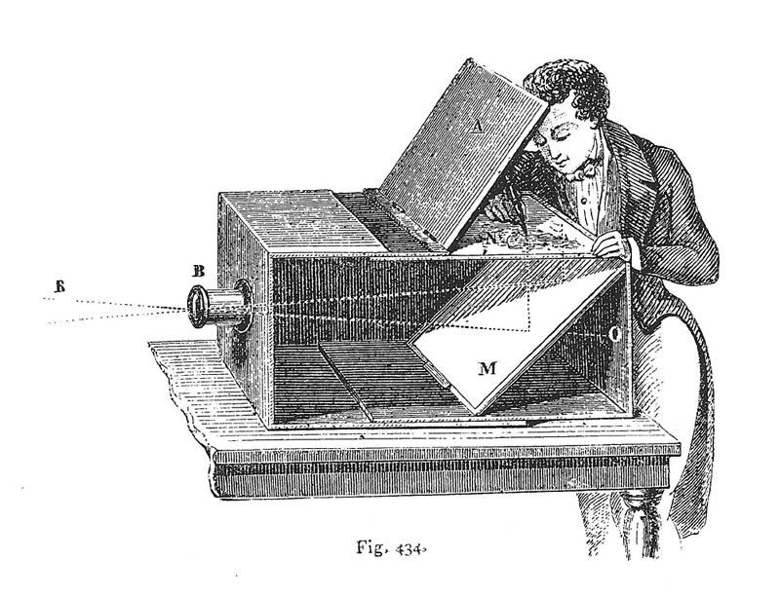
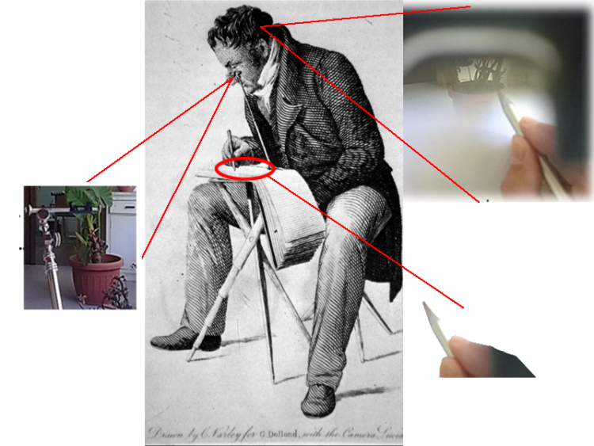
Camera obscura / lucida used for tracing
Lens Based Camera Obscura, 1568
Camera lucida
drawingchamber.wordpress.com
Notes:
https://drawingchamber.wordpress.com/about-me/about/camera-obscura-claude-glass-and-camera-lucida/
Obscura = dark
Lucida = light

Slide 13
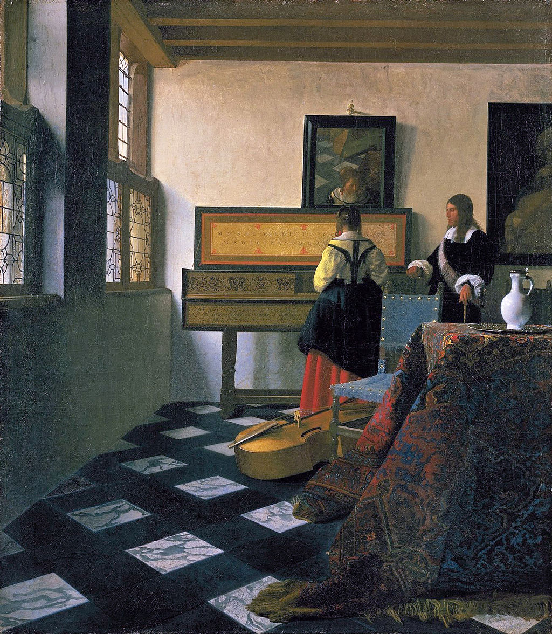
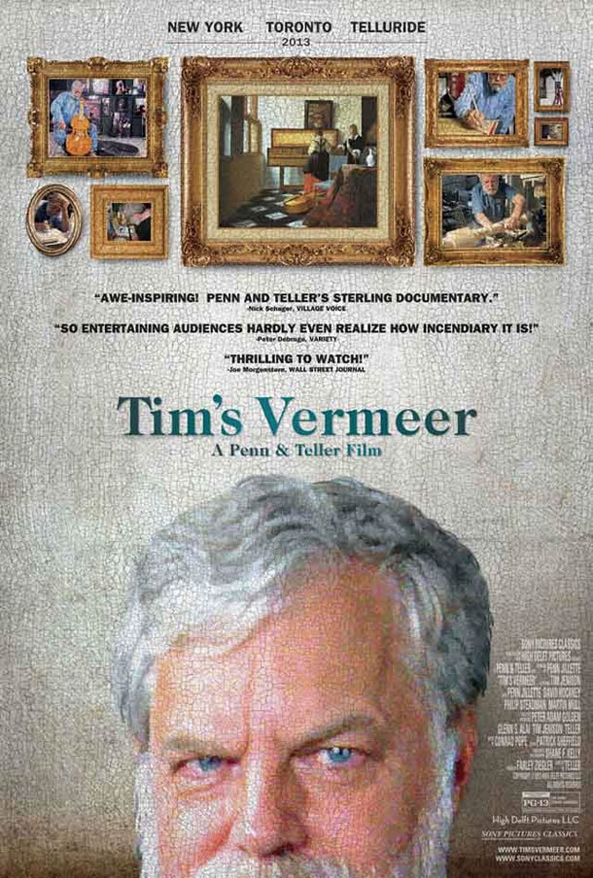
Tim’s Vermeer
Vermeer, The Music Lesson, 1665
Tim Jenison (Lightwave 3D, Video Toaster)
Notes:
Trailer: http://www.imdb.com/title/tt3089388/videoplayer/vi4167804953?ref_=tt_ov_vi
Tim Jenison – NewTek company.
Chromatic aberration, lens curvature distortion visible.
Hockney – 2001 book -

Slide 14
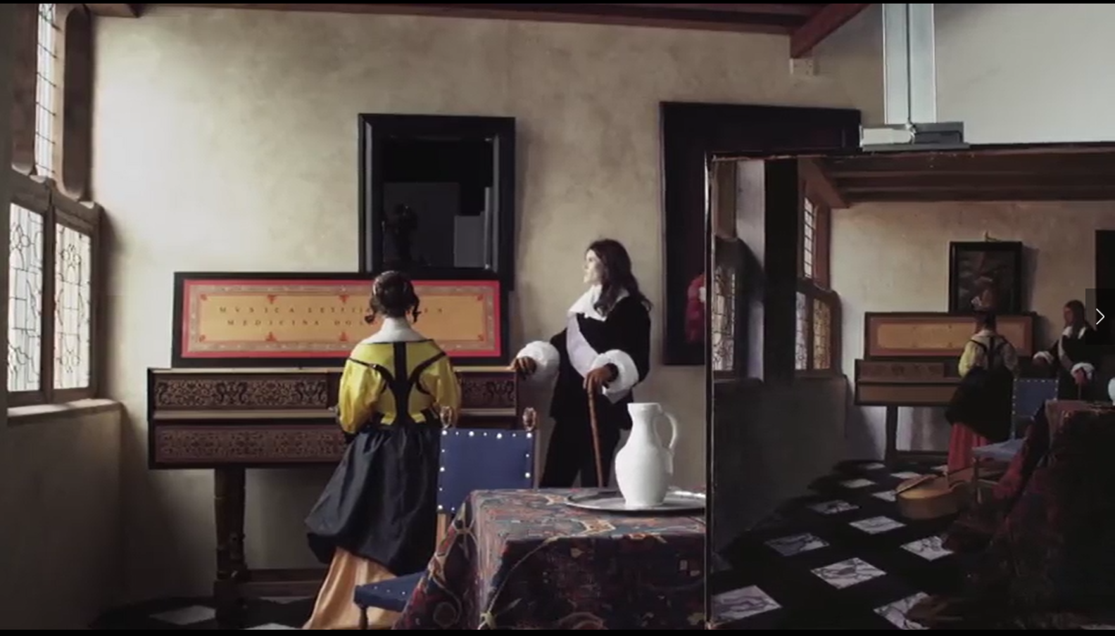
Tim’s Vermeer – video still
Notes:
Tim Jenison built a replica of the room depicted in Vermeer’s painting, then attempted to paint it using the same techniques.
We see (in the background) the replica room, plus in the foreground to the right Tim’s painting.

Slide 15
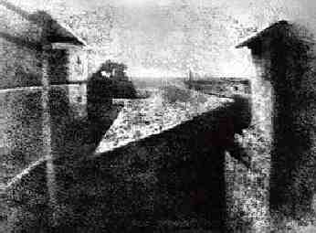
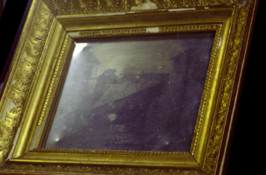
First Photograph
Oldest surviving photograph
  Took 8 hours on pewter plate
Photograph of the first photograph
Joseph Niepce, 1826
Stored at UT Austin
Niepce later teamed up with Daguerre, who eventually created Daguerrotypes

Slide 16
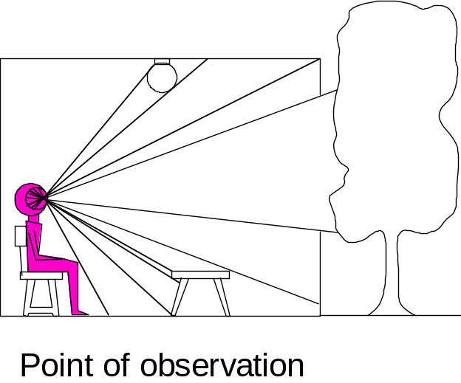

Dimensionality Reduction Machine (3D to 2D)
3D world
2D image
Figures © Stephen E. Palmer, 2002

Slide 17
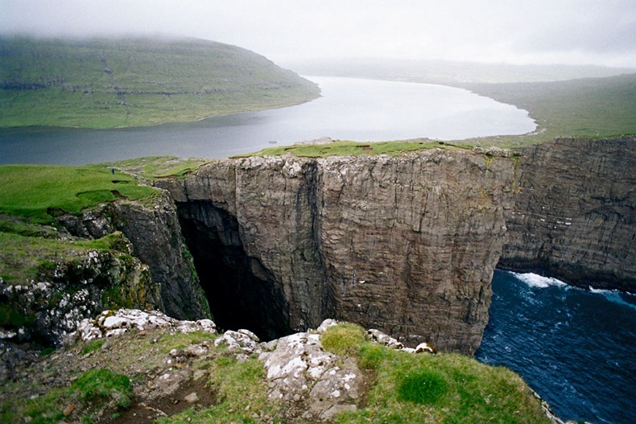
Lake Sørvágsvatn in Faroe Islands
100 metres above sea level

Slide 18
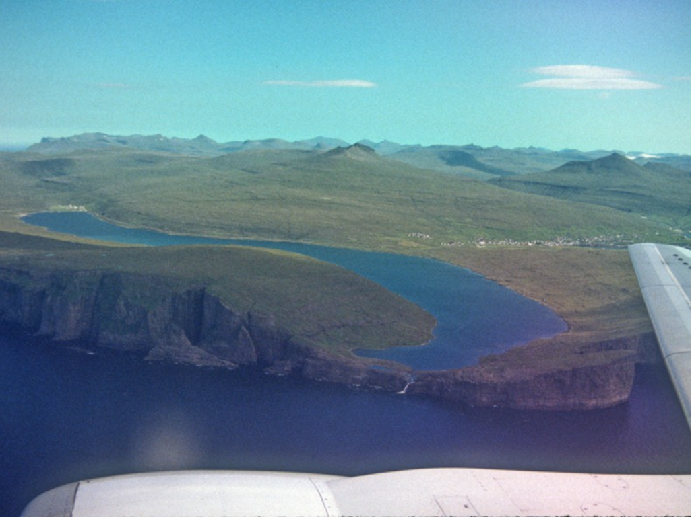
Lake Sørvágsvatn in Faroe Islands
100 30 metres above sea level
amusingplanet.com, thanks to Aaron Gokaslan
Notes:
http://www.amusingplanet.com/2012/04/lake-srvagsvatn-in-faroe-islands.html

Slide 19
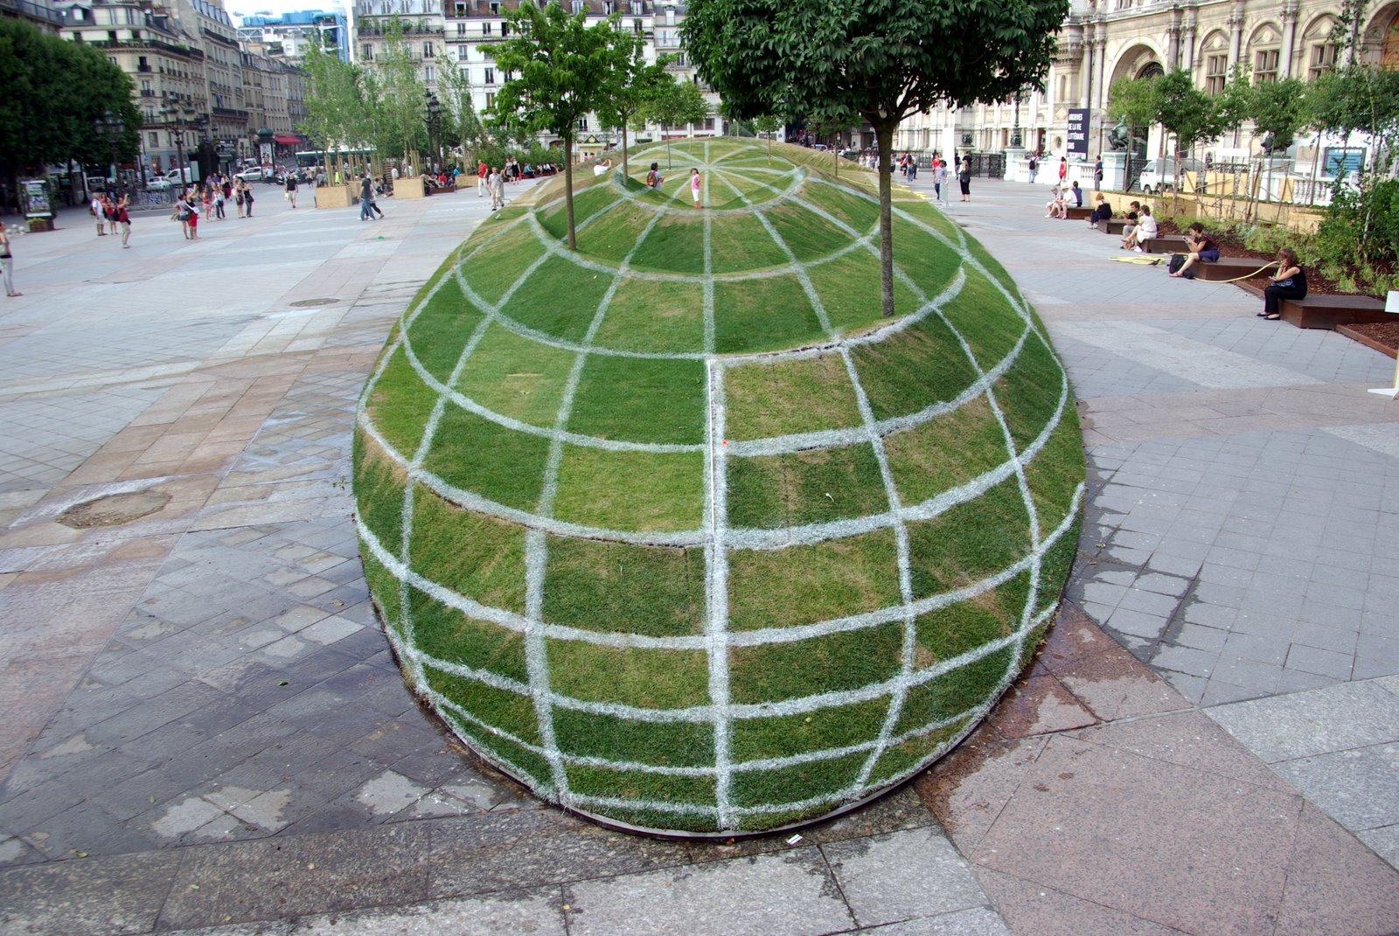
Notes:
Paris town hall
“Anamorphosis” - a distorted projection or perspective requiring the viewer to use special devices or occupy a specific vantage point (or both) to reconstitute the image.

Slide 20
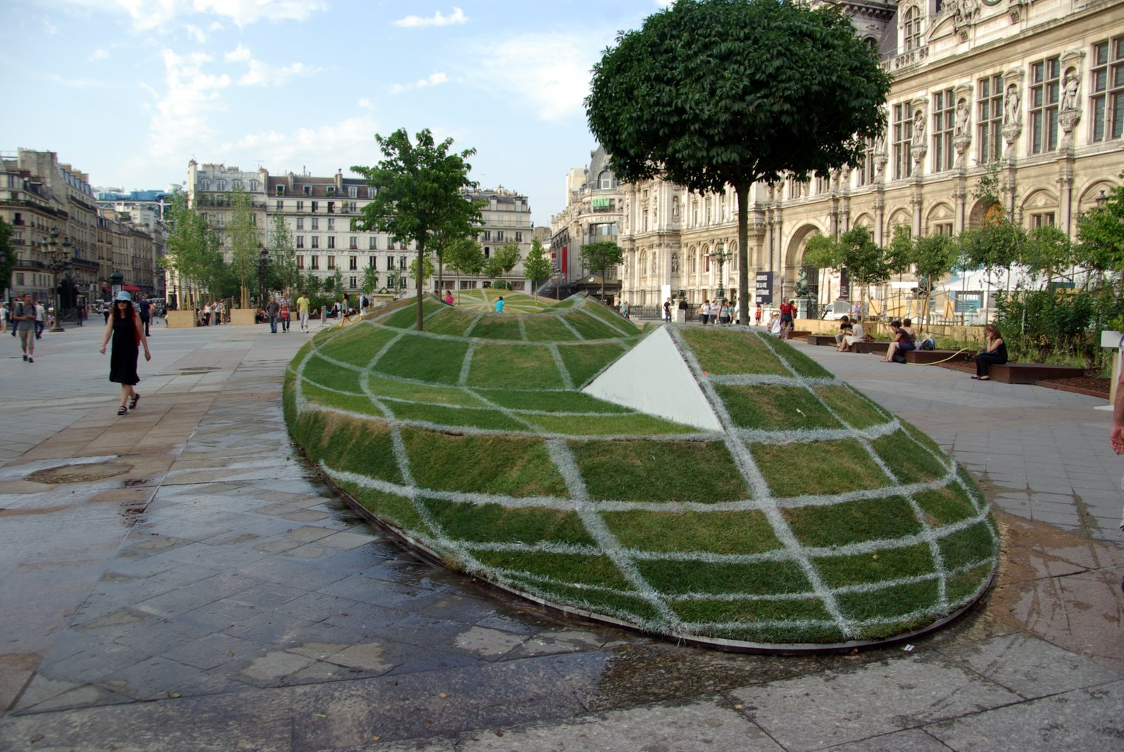

Slide 21
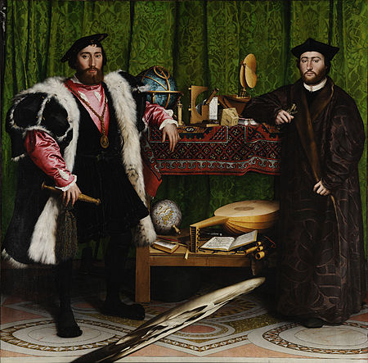
Holbein’s The Ambassadors - 1533
Notes:
Anarmorphosis

Slide 22
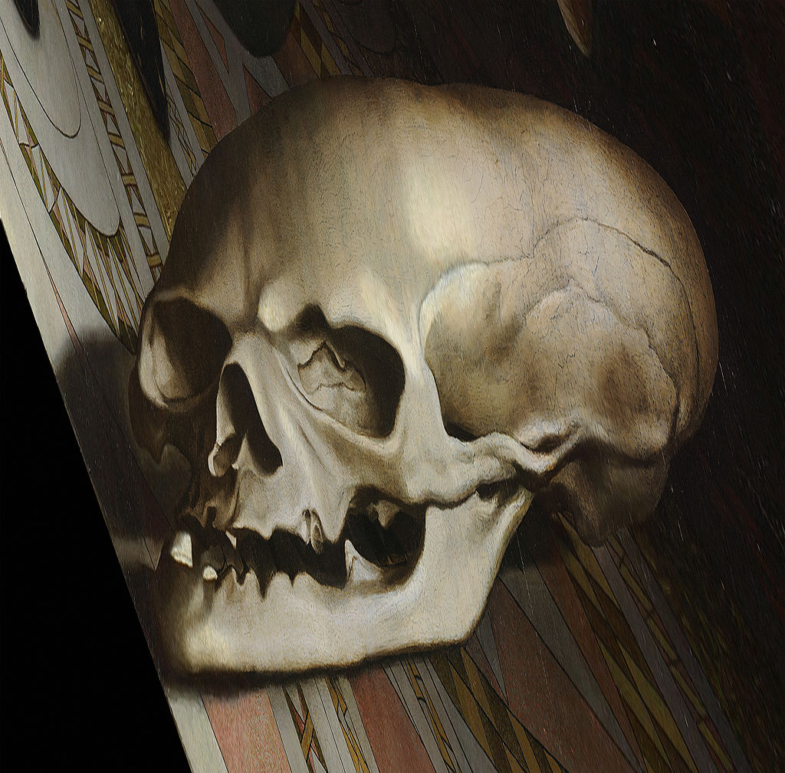
Holbein’s The Ambassadors – Memento Mori

Slide 23
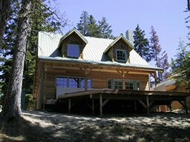
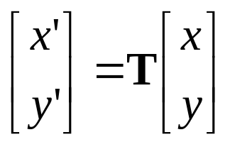
Parametric (global) transformations
T
p = (x,y)
p’ = (x’,y’)
Transformation T is a coordinate-changing machine:
p’ = T(p)
What does it mean that T is global?
  T is the same for any point p
  T can be described by just a few numbers (parameters)
For linear transformations, we can represent T as a matrix
p’ = Tp

Slide 24
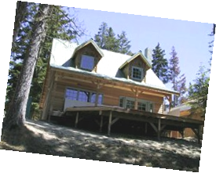
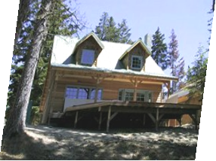
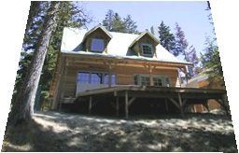
Common transformations
Original
Transformed
Translation
Rotation
Scaling
Affine
Perspective
Slide credit (next few slides): A. Efros and/or S. Seitz

Slide 25
Scaling
Scaling a coordinate means multiplying each of its components by a scalar
Uniform scaling means this scalar is the same for all components:
× 2

Slide 26
Scaling
Non-uniform scaling: different scalars per component:
X × 2,
Y × 0.5

Slide 27
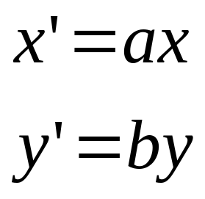
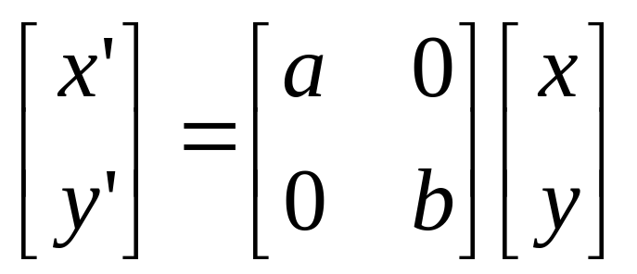
Scaling
Scaling operation:
Or, in matrix form:
scaling matrix S

Slide 28
2-D Rotation
y
(x’, y’)
(x, y)
x’ = x cos(θ) - y sin(θ)
y’ = x sin(θ) + y cos(θ)
θ
x

Slide 29
2-D Rotation
Polar coordinates…
x = r cos (φ)
y = r sin (φ)
x’ = r cos (φ + θ)
y’ = r sin (φ + θ)
Trig Identity…
x’ = r cos(φ) cos(θ) – r sin(φ) sin(θ)
y’ = r sin(φ) cos(θ) + r cos(φ) sin(θ)
Substitute…
x’ = x cos(θ) - y sin(θ)
y’ = x sin(θ) + y cos(θ)
(x’, y’)
(x, y)
θ
φ

Slide 30
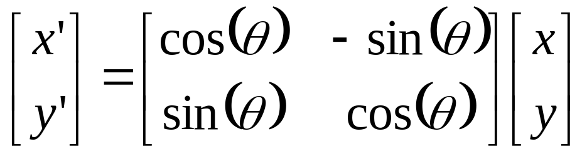

2-D Rotation
This is easy to capture in matrix form:
Even though sin(θ) and cos(θ) are nonlinear functions of θ,
  x’ is a linear combination of x and y
  y’ is a linear combination of x and y
What is the inverse transformation?
  Rotation by –θ
  For rotation matrices
R

Slide 31
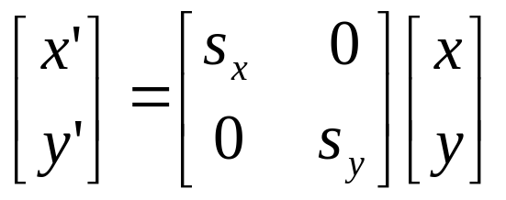
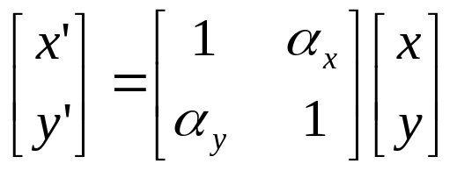
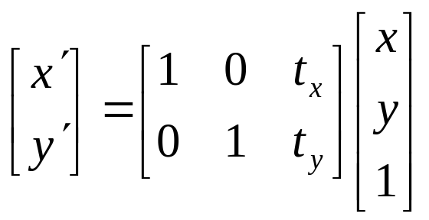
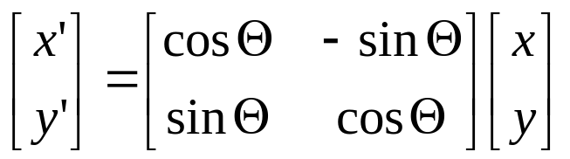
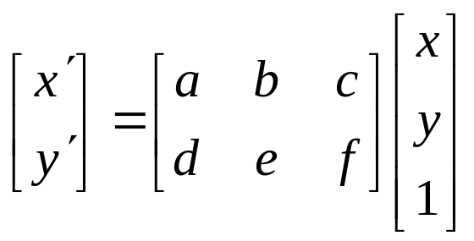
Basic 2D transformations
Scale
Shear
Rotate
Translate
Affine is any combination of translation, scale, rotation, and shear
Affine

Slide 32

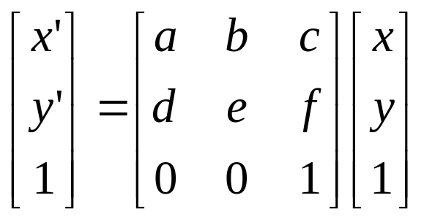
Affine Transformations
Affine transformations are combinations of
  Linear transformations, and
  Translations
Properties of affine transformations:
  Lines map to lines
  Parallel lines remain parallel
  Ratios are preserved
  Closed under composition
or
Notes:
Ratios of distances along straight lines are preserved, e.g. the relative length of two collinear line segments

Slide 33
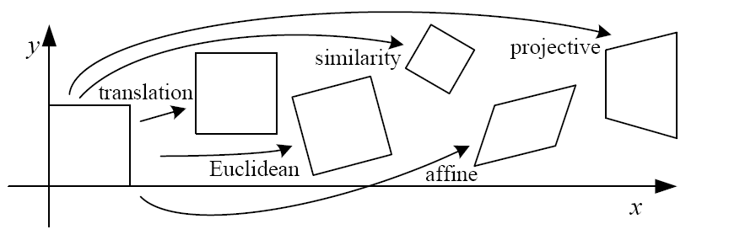
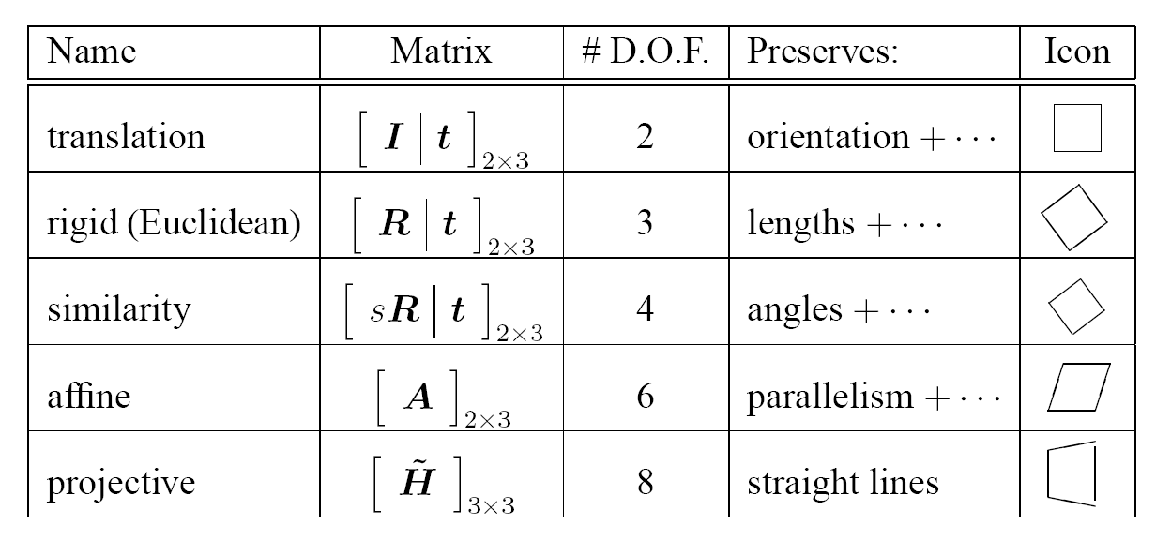
2D image transformations (reference table)
‘Homography’
Szeliski 2.1
Notes:
https://en.wikipedia.org/wiki/Homography_(computer_vision)

Slide 34
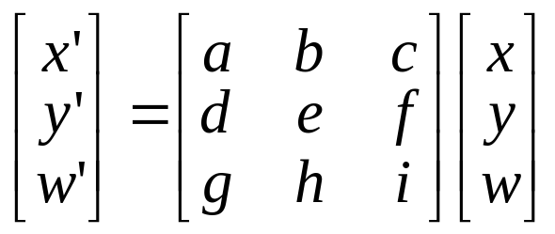
Projective Transformations
Projective transformations are combos of
  Affine transformations, and
  Projective warps
Properties of projective transformations:
  Lines map to lines
  Parallel lines do not necessarily remain parallel
  Ratios are not preserved
  Closed under composition
  Models change of basis
  Projective matrix is defined up to a scale (8 DOF)

Slide 35
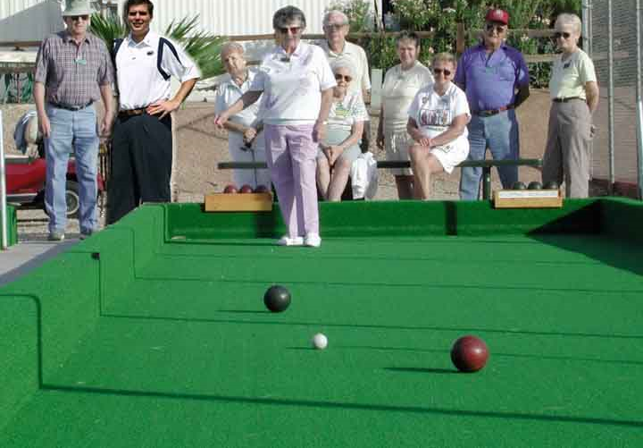
Cameras and World Geometry
How tall is this woman?
How high is the camera?
What is the camera rotation wrt. world?
Which ball is closer?
James Hays

Slide 36


Slide 37
The Geometry of Image Formation
Szeliski 2.1, parts of 2.2
Mapping between image and world coordinates
  Pinhole camera model
  Projective geometry
    Vanishing points and lines
  Projection matrix
Slides from James Hays, Derek Hoiem, Alexei Efros, Steve Seitz, and David Forsyth

Slide 38
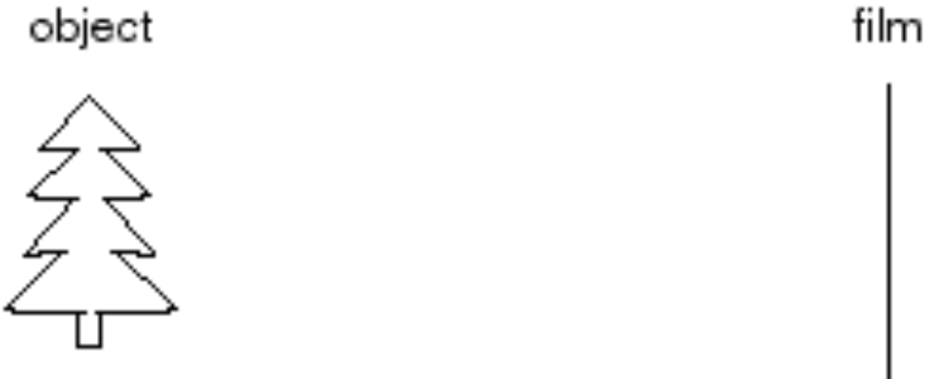
Let’s design a camera
  Idea 1: Put a sensor in front of an object
  Do we get a reasonable image?
sensor
Slide source: Seitz

Slide 39
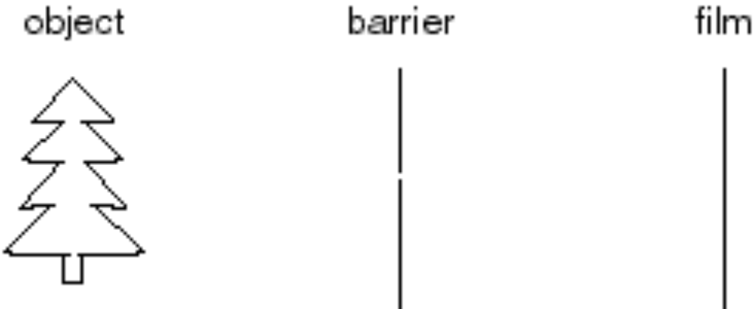
Let’s design a camera
Idea 2: Add a barrier to block most rays
  Pinhole in barrier
  Only sense light from one direction.
    Reduces blurring.
  In most cameras, this aperture can vary in size.
sensor
Slide source: Seitz
Notes:
Q: How does this transform the image? A: It gets inverted

Slide 40
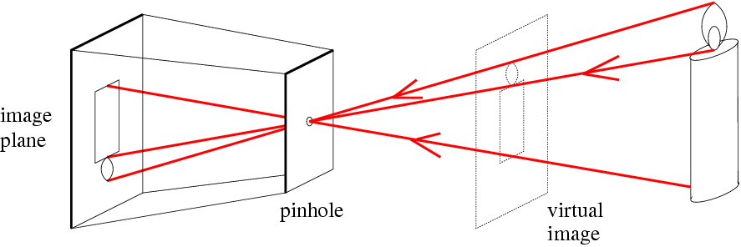
Pinhole camera model
f
c
Real object
f = Focal length
c = Optical center of the camera
Figure from Forsyth

Slide 41
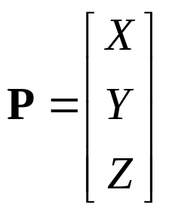
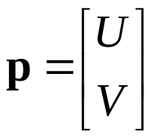
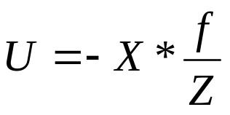
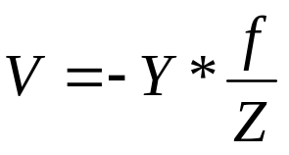
Projection: world coordinates→image coordinates
.
Image center (u₀, v₀)
.
.
f
Z
Y
.
V
Camera Center (0, 0, 0)
U
p = distance from image center
What is the effect if f and Z are equal?

Slide 42
Projective Geometry
Length (and so area) is lost.
Who is taller?
Which is closer?

Slide 43

Length and area are not preserved
A’
C’
B’
Figure by David Forsyth

Slide 44
Projective Geometry
Angles are lost.
Parallel?
Perpendicular?

Slide 45
Projective Geometry
What is preserved?
Straight lines are still straight.

Slide 46

Vanishing points and lines
Parallel lines in the world
intersect in the projected image at a “vanishing point”.
Parallel lines on the same plane in the world converge to vanishing points on a “vanishing line”.
E.G., the horizon.
Vanishing Point
Vanishing Point
Vanishing Line
Notes:
Various properties of vanishing points/lines.
Parallel lines intersect at a point
The intersection of red lines and blue lines form a parallelogram
Sets of parallel lines on the same plane form a vanishing line
Sets of parallel planes form a vanishing line
Not all lines that intersect are parallel

Slide 47

Vanishing points and lines
Vertical vanishing
point
(at infinity)
Vanishing
point
Vanishing
point
Slide from Efros, Photo from Criminisi

Slide 48
Pinhole camera model
f
c
Real object
f = Focal length
c = Optical center of the camera
Forsyth

Slide 49
Projection: world coordinates→image coordinates
.
Image center (u₀, v₀)
.
.
f
Z
Y
.
V
Camera Center (0, 0, 0)
U
p = distance from image center
What is the effect if f and Z are equal?
Notes:
What is the effect if f and Z are equal?
U = -X and V = -Y, so ‘distances’ are preserved and the captured image is undistorted (at the virtual focal plane)

Slide 50

Projective geometry
2D point in cartesian = (x,y) coordinates
2D point in projective = (x,y,w) coordinates
Y
Projector
X
Idea from www.tomdalling.com
Notes:
http://www.tomdalling.com/blog/modern-opengl/explaining-homogenous-coordinates-and-projective-geometry/

Slide 51
Projective geometry
2D point in cartesian = (x,y) coordinates
2D point in projective = (x,y,w) coordinates
Y
Projector
W
X
Idea from www.tomdalling.com
Notes:
http://www.tomdalling.com/blog/modern-opengl/explaining-homogenous-coordinates-and-projective-geometry/

Slide 52


Varying w
w₁
w₂ < w₁
Y
Y
Projector
Projector
X
X
Projected image becomes smaller.

Slide 53
Projective geometry
2D point in projective = (x,y,w) coordinates
  w defines the scale of the projected image.
  Each x,y point becomes a ray!
Y
Projector
W
X

Slide 54
Projective geometry
In 3D, point (x,y,z) becomes (x,y,z,w)
Perspective is w varying with z:
  Objects far away are appear smaller
C’
B’

Slide 55




Homogeneous coordinates
Converting to homogeneous coordinates
2D (image) coordinates
3D (scene) coordinates
Converting from homogeneous coordinates
2D (image) coordinates
3D (scene) coordinates
Notes:
Append coordinate with value 1; proportional coordinate system

Slide 56

Homogeneous coordinates
Scale invariance in projection space
Homogeneous Coordinates
Cartesian Coordinates
E.G., we can uniformly scale the projective space, and it will still produce the same image -> scale ambiguity
Notes:
Q: Suppose we have a point in Cartesian coordinates. What is that in homogeneous coordinates? A: a ray

Slide 57

Homogeneous coordinates
Projective
Point becomes a line
To homogeneous
From homogeneous
Song Ho Ahn
Notes:
http://www.songho.ca/math/homogeneous/homogeneous.html

Slide 58




Basic geometry in homogeneous coordinates
Line equation: ax + by + c = 0
Append 1 to pixel coordinate to get homogeneous coordinate
Line given by cross product of two points
Intersection of two lines given by cross product of the lines

Slide 59
Another problem solved by homogeneous coordinates
Intersection of parallel lines
  Cartesian: (Inf, Inf)
  Homogeneous: (1, 1, 0)
  Cartesian: (Inf, Inf)
Homogeneous: (1, 2, 0)
Notes:
Parallel lines intersect at different infinities

Slide 60

By Suren Manvelyan, http://www.surenmanvelyan.com/gallery/7116
Notes:
http://www.surenmanvelyan.com/gallery/7116
Siam cat

Slide 61

By Suren Manvelyan, http://www.surenmanvelyan.com/gallery/7116
Notes:
http://www.surenmanvelyan.com/gallery/7116
fish

Slide 62

By Suren Manvelyan, http://www.surenmanvelyan.com/gallery/7116
Notes:
http://www.surenmanvelyan.com/gallery/7116
rabbit

Slide 63


Camera (projection) matrix
Slide Credit: Savarese
R,t
j_{w}
X
k_{w}
O_{w}
x
i_{w}
x: Image Coordinates: (u,v,1)
K: Intrinsic Matrix (3x3)
R: Rotation (3x3)
t: Translation (3x1)
X: World Coordinates: (X,Y,Z,1)
Extrinsic Matrix
Notes:
We can use homogeneous coordinates to write ‘camera matrix’ in linear form.

Slide 64


Projection matrix
X
(0,0,0)
x
Intrinsic Assumptions
Unit aspect ratio
Optical center at (0,0)
No skew
Extrinsic Assumptions
No rotation
Camera at (0,0,0)
K
Slide Credit: Savarese
Notes:
Work through equations for u and v on board

Slide 65
Projection: world coordinates→image coordinates
.
Image center (u₀, v₀)
.
.
f
Z
Y
.
V
Camera Center (0, 0, 0)
U
p = distance from image center

Slide 66

Remove assumption: known optical center
Intrinsic Assumptions
Unit aspect ratio
No skew
Extrinsic Assumptions
No rotation
Camera at (0,0,0)
K
James Hays

Slide 67

Remove assumption: equal aspect ratio
Intrinsic Assumptions
No skew
Extrinsic Assumptions
No rotation
Camera at (0,0,0)
James Hays

Slide 68

Remove assumption: non-skewed pixels
Intrinsic Assumptions
Extrinsic Assumptions
No rotation
Camera at (0,0,0)
Note: different books use different notation for parameters
James Hays

Slide 69
Oriented and Translated Camera
R
j_{w}
X
t
k_{w}
O_{w}
x
i_{w}
James Hays

Slide 70


Allow camera translation
Intrinsic Assumptions
Extrinsic Assumptions
No rotation
James Hays

Slide 71

3D Rotation of Points
Slide Credit: Saverese
Rotation around the coordinate axes, counter-clockwise:
p’
γ
y
p
x
z

Slide 72


Allow camera rotation
James Hays

Slide 73
Camera (projection) matrix
Slide Credit: Savarese
R,t
j_{w}
X
k_{w}
O_{w}
x
i_{w}
x: Image Coordinates: (u,v,1)
K: Intrinsic Matrix (3x3)
R: Rotation (3x3)
t: Translation (3x1)
X: World Coordinates: (X,Y,Z,1)
Extrinsic Matrix
Notes:
We can use homogeneous coordinates to write ‘camera matrix’ in linear form.

Slide 74
Demo – Kyle Simek
“Dissecting the Camera Matrix”
Three-part blog series
http://ksimek.github.io/2012/08/14/decompose/
http://ksimek.github.io/2012/08/22/extrinsic/
http://ksimek.github.io/2013/08/13/intrinsic/
“Perspective toy”
http://ksimek.github.io/perspective_camera_toy.html

Slide 75
Degrees of freedom
5
6
James Hays
Notes:
How many known points are needed to estimate this?
11 degrees of freedom
6 points

Slide 76




Vanishing Point = Projection from Infinity
James Hays

Slide 77

Orthographic Projection
Special case of perspective projection
  Distance from the COP to the image plane is infinite
  Also called “parallel projection”
  What’s the projection matrix?
Image
World
Slide by Steve Seitz

Slide 78

Scaled Orthographic Projection
Special case of perspective projection
  Object dimensions are small compared to distance to camera
  Also called “weak perspective”
  What’s the projection matrix?
Image
World
Slide by Steve Seitz

Slide 79

Things to remember
Vertical vanishing
point
(at infinity)
Vanishing points and vanishing lines
Pinhole camera model and camera projection matrix
Homogeneous coordinates
Vanishing
line
Vanishing
point
Vanishing
point
James Hays

Slide 80

By Suren Manvelyan, http://www.surenmanvelyan.com/gallery/7116
Notes:
http://www.surenmanvelyan.com/gallery/7116
Tiger python

Slide 81

By Suren Manvelyan, http://www.surenmanvelyan.com/gallery/7116
Notes:
http://www.surenmanvelyan.com/gallery/7116
Snail
Ommatophore = eye stalk

Slide 82

By Suren Manvelyan, http://www.surenmanvelyan.com/gallery/7116
Notes:
http://www.surenmanvelyan.com/gallery/7116
Husky with heterochromia

Slide 83

Indy
Notes:
http://www.surenmanvelyan.com/gallery/7116
Is this James Hays’ dog?!?!

Slide 84

Indy
Notes:
http://www.surenmanvelyan.com/gallery/7116
Is this James Hays’ dog?!?!

Slide 85


Slide 86



How to calibrate the camera?
(also called “camera resectioning”)
$$x=MX$$
Linear least-squares regression!
James Hays

Slide 87

Simple example: Fitting a line

Slide 88







Least squares line fitting
Data: (x₁, y₁), …, (x_{n}, y_{n})
Line equation: y_{i} = m x_{i} + b
Find (m, b) to minimize
y=mx+b
(x_{i}, y_{i})
Matlab: p = A \ y;
Python:
p = np.linalg.lstsq(A,y)[0]
(Closed form solution)
Modified from S. Lazebnik
Notes:
What is p here? p is [m b]’
The minimum is determined by calculating the partial derivatives of E with respect to p and setting them to zero.

Slide 89


Example: solving for translation
A₁
A₂
A₃
B₁
B₂
B₃
Given matched points in {A} and {B}, estimate the translation of the object

Slide 90

Example: solving for translation
A₁
A₂
A₃
(t_{x}, t_{y})
B₁
B₂
B₃
Least squares setup
Notes:
Solve using pseudo-inverse or eigenvalue decomposition

Slide 91


Example: discovering rot/trans/scale
A₁
B₁
A₂
A₃
B₂
B₃
Given matched points in {A} and {B}, estimate the transformation matrix

Slide 92

Are these transformations enough?

Slide 93
Example: solving for translation
A₁
A₂
A₃
(t_{x}, t_{y})
B₁
B₂
B₃
Least squares solution
Write down objective function
Derived solution
  Compute derivative
  Compute solution
Computational solution
  Write in form Ax=p
  Solve using closed-form solution
Notes:
Solve using pseudo-inverse or eigenvalue decomposition

Slide 94
Problem with “vertical” least squares
Not rotation-invariant
Fails completely for vertical lines
Slide from S. Lazebnik

Slide 95


Total least squares
Slide modified from S. Lazebnik
If (a²+b²=1) then
Distance between point (x_{i}, y_{i}) is
|ax_{i} + by_{i} + c|
ax+by+c=0
Unit normal: N=(a, b)
(x_{i}, y_{i})
proof: http://mathworld.wolfram.com/Point-LineDistance2-Dimensional.html

Slide 96

Total least squares
Slide modified from S. Lazebnik
If (a²+b²=1) then
Distance between point (x_{i}, y_{i}) is
|ax_{i} + by_{i} + c|
Find (a, b, c) to minimize the sum of squared perpendicular distances
ax+by+c=0
Unit normal: N=(a, b)
(x_{i}, y_{i})

Slide 97




Total least squares
Slide modified from S. Lazebnik
Find (a, b, c) to minimize the sum of squared perpendicular distances
ax+by+c=0
Unit normal: N=(a, b)
(x_{i}, y_{i})
Solution is eigenvector corresponding to smallest eigenvalue of A^{T}A
See details on Raleigh Quotient: http://en.wikipedia.org/wiki/Rayleigh_quotient

Slide 98






Recap: Two Common Optimization Problems
Problem statement
Solution
(matlab)
Problem statement
Solution
Notes:
Non-trivial because A != 0

Slide 99
Least squares (global) optimization
Good
Clearly specified objective
Optimization is easy
Bad
Sensitive to outliers
  Bad matches, extra points
Doesn’t allow you to get multiple good fits
  Detecting multiple objects, lines, etc.

Slide 100

World vs Camera coordinates
James Hays

Slide 101


Calibrating the Camera
James Hays
Use an scene with known geometry
  Correspond image points to 3d points
  Get least squares solution (or non-linear solution)
Known 2d image coords
Known 3d
world locations
M
Unknown Camera Parameters

Slide 102

How do we calibrate a camera?
Known 2d image coords
Known 3d world locations
880 214
43 203
270 197
886 347
745 302
943 128
476 590
419 214
317 335
783 521
235 427
665 429
655 362
427 333
412 415
746 351
434 415
525 234
716 308
602 187
312.747 309.140 30.086
305.796 311.649 30.356
307.694 312.358 30.418
310.149 307.186 29.298
311.937 310.105 29.216
311.202 307.572 30.682
307.106 306.876 28.660
309.317 312.490 30.230
307.435 310.151 29.318
308.253 306.300 28.881
306.650 309.301 28.905
308.069 306.831 29.189
309.671 308.834 29.029
308.255 309.955 29.267
307.546 308.613 28.963
311.036 309.206 28.913
307.518 308.175 29.069
309.950 311.262 29.990
312.160 310.772 29.080
311.988 312.709 30.514
James Hays

Slide 103

What is least squares doing?
Given 3D point evidence, find best M which minimizes error between estimate (p’) and known corresponding 2D points (p).
.
Error between M estimate and known projection point
.
.
f
Z
Y
.
.
v
Camera center
p’ under M
u
p = distance from image center

Slide 104
What is least squares doing?
Best M occurs when p’ = p, or when p’ – p = 0
Form these equations from all point evidence
Solve for model via closed-form regression
.
Error between M estimate and known projection point
.
.
f
Z
Y
.
.
v
Camera center
p’ under M
u
p = distance from image center

Slide 105





Unknown Camera Parameters
Known 2d image coords
Known 3d locations
First, work out where X,Y,Z projects to under candidate M.
Two equations per 3D point correspondence
James Hays

Slide 106
Unknown Camera Parameters
Known 2d image coords
Known 3d locations
Next, rearrange into form where all M coefficients are individually stated in terms of X,Y,Z,u,v.
-> Allows us to form lsq matrix.

Slide 107
Unknown Camera Parameters
Known 2d image coords
Known 3d locations
Next, rearrange into form where all M coefficients are individually stated in terms of X,Y,Z,u,v.
-> Allows us to form lsq matrix.

Slide 108

Unknown Camera Parameters
Known 2d image coords
Known 3d locations
Finally, solve for m’s entries using linear least squares
Method 1 –
Ax=b form
x
MATLAB:
M = A\b;
M = [M;1];
M = reshape(M,[],3)';
Python Numpy:
M = np.linalg.lstsq(A,b)[0];
M = np.append(M,1)
M = np.reshape(M, (3,4))
A
b
Note: Must reshape M afterwards!
Hays
Notes:
Method 1 – nonhomogeneous linear system. Not related to homogeneous coordinates!! - https://en.m.wikipedia.org/wiki/System_of_linear_equations

Slide 109

Unknown Camera Parameters
Known 2d image coords
Known 3d locations
Or, solve for m’s entries using total linear least-squares
Method 2 –
  Find non-trivial solution (not A=0)
Ax=0 form
x
MATLAB:
[U, S, V] = svd(A);
M = V(:,end);
M = reshape(M,[],3)’;
Python Numpy:
U, S, Vh = np.linalg.svd(a)
# V = Vh.T
M = Vh[-1,:]
M = np.reshape(M, (3,4))
A
James Hays
Notes:
Method 2 – homogeneous linear system. Not related to homogeneous coordinates!! - https://en.m.wikipedia.org/wiki/System_of_linear_equations
Note: np.linalg.svd returns the transpose of V (Vh), so we take the last row instead of the last column

Slide 110
How do we calibrate a camera?
Known 2d image coords
Known 3d world locations
880 214
43 203
270 197
886 347
745 302
943 128
476 590
419 214
317 335
783 521
235 427
665 429
655 362
427 333
412 415
746 351
434 415
525 234
716 308
602 187
312.747 309.140 30.086
305.796 311.649 30.356
307.694 312.358 30.418
310.149 307.186 29.298
311.937 310.105 29.216
311.202 307.572 30.682
307.106 306.876 28.660
309.317 312.490 30.230
307.435 310.151 29.318
308.253 306.300 28.881
306.650 309.301 28.905
308.069 306.831 29.189
309.671 308.834 29.029
308.255 309.955 29.267
307.546 308.613 28.963
311.036 309.206 28.913
307.518 308.175 29.069
309.950 311.262 29.990
312.160 310.772 29.080
311.988 312.709 30.514
James Hays

Slide 111



Known 2d image coords
Known 3d world locations
1st point
880 214
43 203
270 197
886 347
745 302
943 128
476 590
419 214
335
…
$$(u1,v1)$$
312.747 309.140 30.086
305.796 311.649 30.356
307.694 312.358 30.418
310.149 307.186 29.298
311.937 310.105 29.216
311.202 307.572 30.682
307.106 306.876 28.660
309.317 312.490 30.230
307.435 310.151 29.318
…..
$$(X1,Y1,Z1)$$
Projection error defined by two equations – one for u and one for v

Slide 112



Known 2d image coords
Known 3d world locations
880 214
43 203
270 197
886 347
745 302
943 128
476 590
419 214
335
…
312.747 309.140 30.086
305.796 311.649 30.356
307.694 312.358 30.418
310.149 307.186 29.298
311.937 310.105 29.216
311.202 307.572 30.682
307.106 306.876 28.660
309.317 312.490 30.230
307.435 310.151 29.318
…..
2nd point
$$(u2,v2)$$
$$(X2,Y2,Z2)$$
Projection error defined by two equations – one for u and one for v

Slide 113

How many points do I need to fit the model?
Degrees of freedom?
5
6
Think 3:
Rotation around x
Rotation around y
Rotation around z
Notes:
How many known points are needed to estimate this?
Why 5?
Why 6? Don’t we have 12 parameters here?
But matrix is not full rank -> it’s a projection (we can tell because it isn’t square -> the column space is 4D, but the row space is 3D, so this matrix projects a 4D space to a 3D space)
One of the dimensions is lost – intuitive, dimensionality reduction machine.
Ambiguous scale in the camera projection matrix. This scale is in the null space of the matrix, i.e., there is a line of possible solutions (plane?)

Slide 114
How many points do I need to fit the model?
Degrees of freedom?
5
6
M is 3x4, so 12 unknowns, but projective scale ambiguity – 11 deg. freedom.
One equation per unknown -> 5 1/2 point correspondences determines a solution (e.g., either u or v).
More than 5 1/2 point correspondences -> overdetermined, many solutions to M.
Least squares is finding the solution that best satisfies the overdetermined system.
Why use more than 6? Robustness to error in feature points.
Notes:
How many known points are needed to estimate this?
Why 5?
Why 6? Don’t we have 12 parameters here?
8 equations in 2D -> 16 parameters
But matrix is not full rank -> it’s a projection (we can tell because it isn’t square -> the column space is 4D, but the row space is 3D, so this matrix projects a 4D space to a 3D space)
One of the dimensions is lost – intuitive, dimensionality reduction machine.
Ambiguous scale in the camera projection matrix. This scale is in the null space of the matrix, i.e., there is a line of possible solutions (plane?)
Actually only need 8 points to produce a valid (up to scale) projection matrix.

Slide 115
Solving - why two methods?
Any projection is inherently ambiguous
A space of possible solutions
Under projective model, this is our projective scale ambiguity.
x₁
x
v₁
v₂

Slide 116
Unknown Camera Parameters
Known 2d image coords
Known 3d locations
Method 1 – - p’ = p
To set scale, we artificially set m₃₄ to 1
Ax=b form
Note – you will see this form called ‘inhomogeneous’ linear system -> nothing to do with homogeneous coordinates
M = A\Y;
M = [M;1];
M = reshape(M,[],3)';
James Hays
Notes:
Method 1 – inhomogeneous linear system. Not related to homogeneous coordinates!! - https://en.m.wikipedia.org/wiki/System_of_linear_equations

Slide 117
Unknown Camera Parameters
Known 2d image coords
Known 3d locations
Method 2 – - p’ – p = 0
SVD – singular value decomposition
Computes pseudo-inverse
Ax=0 form
Note – you will see this form called ‘homogeneous’ linear system -> nothing to do with homogeneous coordinates
[U, S, V] = svd(A);
M = V(:,end);
M = reshape(M,[],3)';
James Hays
Notes:
Method 2 – homogeneous linear system. Not related to homogeneous coordinates!! - https://en.m.wikipedia.org/wiki/System_of_linear_equations

Slide 118
Calibration with linear method
Advantages
  Easy to formulate and solve
  Provides initialization for non-linear methods
Disadvantages
  Doesn’t directly give you camera parameters
  Doesn’t model radial distortion
  Can’t impose constraints, such as known focal length
Non-linear methods are preferred
  Define error as difference between projected points and measured points
  Minimize error using Newton’s method or other non-linear optimization
James Hays

Slide 119
Can we factorize M back to K [R | T]?
Yes!
We can directly solve for the individual entries of K [R | T].
James Hays

Slide 120

a_{n} = nth column of A
James Hays

Slide 121

James Hays

Slide 122

James Hays

Slide 123
Can we factorize M back to K [R | T]?
Yes!
We can also use RQ factorization (not QR)
  R in RQ is not rotation matrix R; crossed names!
R (right diagonal) is K
Q (orthogonal basis) is R.
T, the last column of [R | T], is inv(K) * last column of M.
  But you need to do a bit of post-processing to make sure that the matrices are valid. See http://ksimek.github.io/2012/08/14/decompose/
James Hays

Slide 124

Recovering the camera center
This is not the camera center C.
It is –RC, as the point is rotated before t_{x}, t_{y}, and t_{z} are added
t
So we need
-R⁻¹ K⁻¹ m₄ to get C.
m₄
This is t × K
So K⁻¹ m₄ is t
Q is K × R.
So we just need -Q⁻¹ m₄
Q
James Hays

Slide 125

Estimate of camera center
1.0486 -0.3645
-1.6851 -0.4004
-0.9437 -0.4200
1.0682 0.0699
0.6077 -0.0771
1.2543 -0.6454
-0.2709 0.8635
-0.4571 -0.3645
-0.7902 0.0307
0.7318 0.6382
-1.0580 0.3312
0.3464 0.3377
0.3137 0.1189
-0.4310 0.0242
-0.4799 0.2920
0.6109 0.0830
-0.4081 0.2920
-0.1109 -0.2992
0.5129 -0.0575
0.1406 -0.4527
1.5706 -0.1490 0.2598
-1.5282 0.9695 0.3802
-0.6821 1.2856 0.4078
0.4124 -1.0201 -0.0915
1.2095 0.2812 -0.1280
0.8819 -0.8481 0.5255
-0.9442 -1.1583 -0.3759
0.0415 1.3445 0.3240
-0.7975 0.3017 -0.0826
-0.4329 -1.4151 -0.2774
-1.1475 -0.0772 -0.2667
-0.5149 -1.1784 -0.1401
0.1993 -0.2854 -0.2114
-0.4320 0.2143 -0.1053
-0.7481 -0.3840 -0.2408
0.8078 -0.1196 -0.2631
-0.7605 -0.5792 -0.1936
0.3237 0.7970 0.2170
1.3089 0.5786 -0.1887
1.2323 1.4421 0.4506

Slide 126
Oriented and Translated Camera
R
j_{w}
t
k_{w}
O_{w}
i_{w}

Slide 127
One difficult example…

Slide 128

Erik Johansson – The Architect

