Slide 1

17 April 2019
Notes:
Many slides and slide ideas thanks to Marc'Aurelio Ranzato and Michael Nielson.
http://www.cs.toronto.edu/~ranzato/files/ranzato_CNN_stanford2015.pdf
http://neuralnetworksanddeeplearning.com/

Slide 2
Project 4: GCP and such
Quota emails
  We won’t hold this against you
Out of memory
  Anyone still having that?
What other showstoppers?

Slide 3
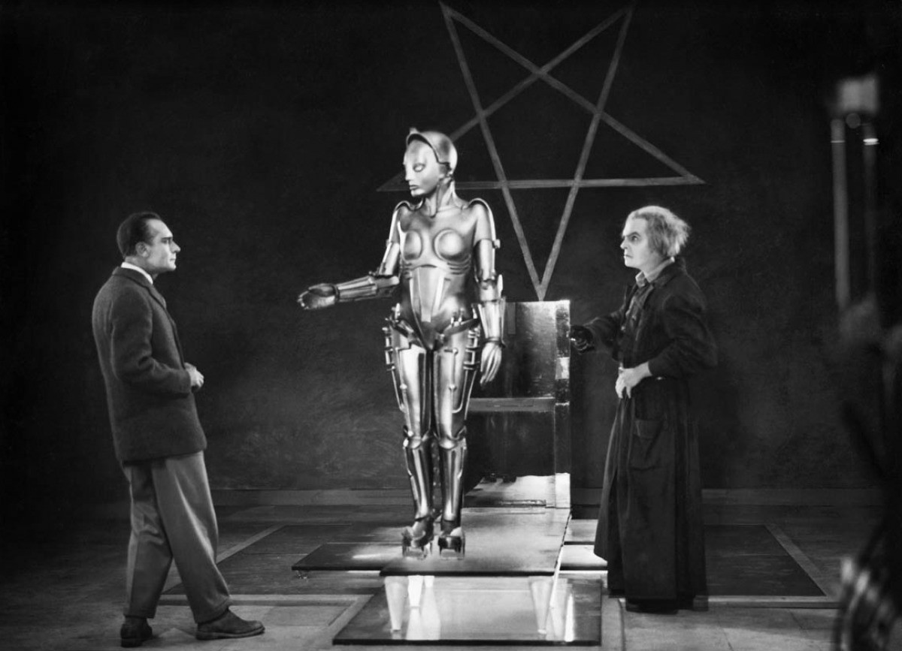
Newsflash: ML Drama
Notes:
Fritz Lang’s Metropolis as viewed. (1927)

Slide 4
NeurIPS (Neural Information Processing Systems) 2017.
Ali Rahimi (Google) just won a ‘test of time’ award for work on applying random functions as a basis for training; gave a speech.
“Artificial Intelligence is the new electricity” – Ng, 2017
“ML has become alchemy” – Rahimi, 2017
Notes:
Alchemy -> protoscience
Turn lead into gold
The medieval forerunner of chemistry, based on the supposed transformation of matter. It was concerned particularly with attempts to convert base metals into gold or to find a universal elixir.
synonyms: chemistry;
“A seemingly magical process of transformation, creation, or combination.
-> "finding the person who's right for you requires a very subtle alchemy"

Slide 5
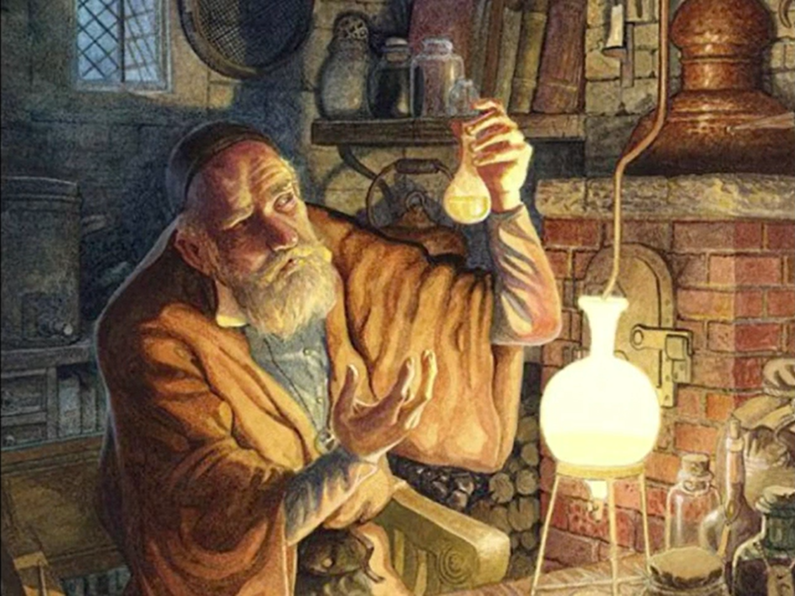
Notes:
https://www.youtube.com/watch?v=ORHFOnaEzPc

Slide 6
Rahimi, NeurIPS 2017 test of time
“If you’re building photo-sharing systems, alchemy is ok, but we’re beyond that now.
We’re building systems that govern healthcare and mediate our civic dialog; we influence elections.
I would like to live in a society whose systems are build on verifiable, rigorous, thorough knowledge, and not on alchemy.”
Notes:
“Now, alchemy is ok, there is a place for alchemy…alchemists invented metallurgy, textile dying, glass making, and making medicine.
…but they also thought you could cure diseases with leeches, and transmute base metals into gold.”
“…scientists had to dismantle 2000 years of alchemic theories.”

Slide 7
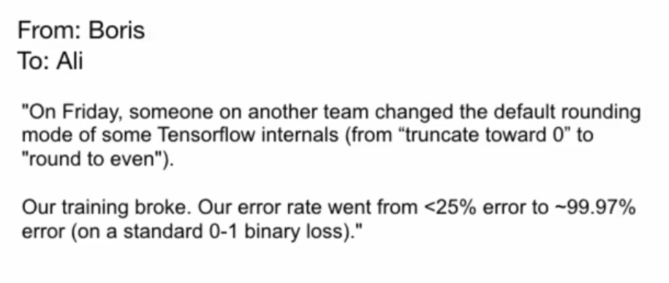
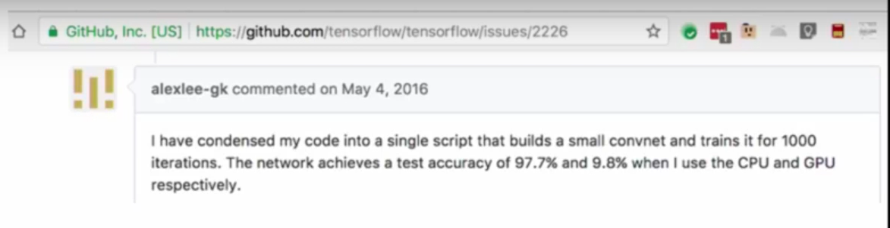
“This is happening because we apply brittle optimization strategies to loss surfaces we don’t understand.”

Slide 8

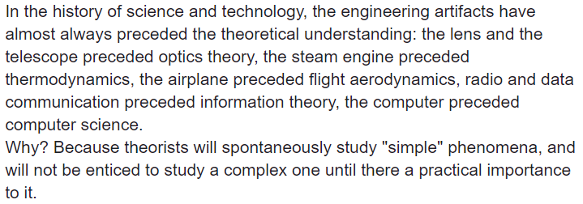

Yann LeCun retorts:
Notes:
https://www.facebook.com/yann.lecun/posts/10154938130592143

Slide 9
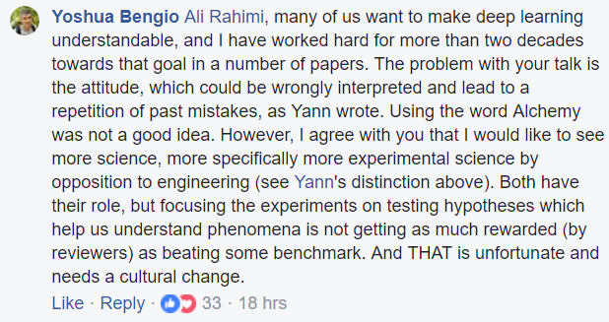
Yoshua Bengio chimes in:
Notes:
https://www.facebook.com/yann.lecun/posts/10154938130592143

Slide 10
Compute cost / human cost
Recent CVPR best paper: 50,000 GPU hours
Google’s commercial object recognizer: continually training for _years_.
“JFT is an internal Google dataset that has 100 million labeled images with 15,000 labels. When we did this work, Google’s baseline model for JFT was a deep convolutional neural network that had been trained for about six months using asynchronous stochastic gradient descent on a large number of cores.”

Slide 11
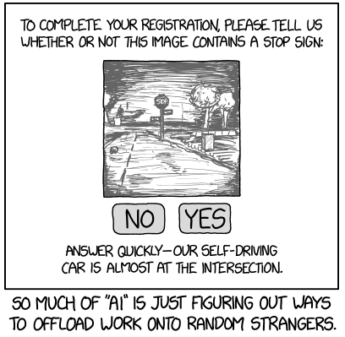
XKCD; thanks to Iuliu Balibanu

Slide 12
Alt-text: “Crowdsourced steering” doesn’t sound quite as appealing as “self driving”.

Slide 13
Fast.ai – Aug 8th 2018
“…managed to train ImageNet to 93% accuracy in just 18 minutes, using 16 machines each with 8 NVIDIA V100 GPUs, running the fastai and PyTorch libraries. This is a new speed record for training Imagenet to this accuracy…”
NVIDIA V100 -> $8500k
16*8*8500 = $$$ a million bucks
“… on publicly available public AWS cloud instances infrastructure, and costs around $40 to run.”
Notes:
http://www.fast.ai/2018/08/10/fastai-diu-imagenet/

Slide 14
Anatomy of an AI System
https://anatomyof.ai/
By Kate Crawford ¹ and Vladan Joler ²
(2018)

Slide 16
Rodney Brooks – The Mistakes We Make
https://rodneybrooks.com/the-seven-deadly-sins-of-predicting-the-future-of-ai/
Quote in notes.
Notes:
Suppose a person tells us that a particular photo is of people playing Frisbee in the park, then we naturally assume that they can answer questions like “what is the shape of a Frisbee?”, “roughly how far can a person throw a Frisbee?”, “can a person eat a Frisbee?”, “roughly how many people play Frisbee at once?”, “can a 3 month old person play Frisbee?”, “is today’s weather suitable for playing Frisbee?”; in contrast we would not expect a person from another culture who says they have no idea what is happening in the picture to be able to answer all those questions. Today’s image labelling systems that routinely give correct labels, like “people playing Frisbee in a park” to online photos, have no chance of answering those questions. Besides the fact that all they can do is label more images and can not answer questions at all, they have no idea what a person is, that parks are usually outside, that people have ages, that weather is anything more than how it makes a photo look, etc., etc.

Slide 17
Rodney Brooks – Artificial General Intelligence Tests
2, 4, 6, 8 year old competency tasks:
object recognition, language understanding, manual dexterity, social understanding.
“A two year old child can know that something is deliberately meant to function as a chair even if it is unlike any chair they have seen before. It can have a different number of legs, it can be made of different material, its legs can be shaped very oddly, it can even be a toy chair meant for dolls. A two year old child is not fazed by this at all. Despite having no visual features in common with any other chair the child has ever seen before the child can declare a new chair to be a chair. This is completely different from how a neural network is able to classify things visually.”
“But wait, there is more! A two year old can do one-shot visual learning from multiple different sources. Suppose a two year old has never been exposed to a giraffe in any way at all. Then seeing just one of a hand drawn picture of a giraffe, a photo of a giraffe, a stuffed toy giraffe, a movie of a giraffe, or seeing one in person for just a few seconds, will forever lock the concept of a giraffe into that two year old’s mind. That child will forever be able to recognize a giraffe as a giraffe, whatever form it is represented in. Most people have never seen a live giraffe, and none have ever seen a live dinosaur, but the are easy for anyone to recognize.”
Notes:
http://rodneybrooks.com/blog/

Slide 18
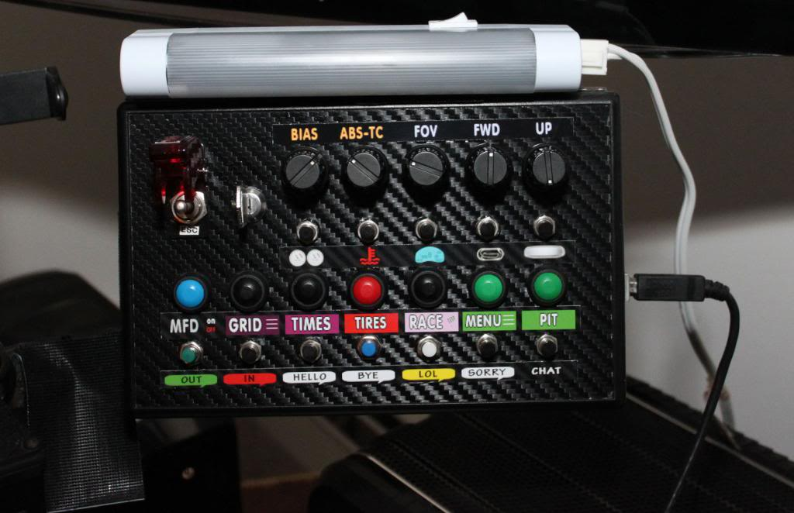
But James…
…I thought we could treat machine learning like a magical black box? I like black boxes.
Deep learning is:
- a black box
- also a black art.
- Grad student
gradient descent : (
Notes:
http://www.isrtv.com/forums/topic/12039-custom-button-box-for-iracing/

Slide 19
CV and society

Slide 20
CV / ML is a tool
Any tool can be used for good or bad.
Definition of good/bad can vary with point of view.
Tools are created and used in the real world.
  Time/money trade-offs
  Different agendas
  Advertent or inadvertent
  With or without awareness
Notes:
I have tried to make this neutral / apolitical.
I do not intend to offend anyone; nor project my personal opinion onto you.

Slide 21
Computer vision domain
Eye
Optics
Dynamic range
Color
Digital processing
Low-level features
Calibration
Geometric
Photometric
Radiometric
Data collection
Labeling
Model fitting
Recognition
Classification
In the beginning, there was light.
Camera
Optics
Dynamic range
Color

Slide 22
Computer vision domain
Eye
Optics
Dynamic range
Color
Digital processing
Low-level features
Calibration
Geometric
Photometric
Radiometric
Data collection
Labeling
Model fitting
Recognition
Classification
In the beginning, there was light.
Camera
Optics
Dynamic range
Color

Slide 23
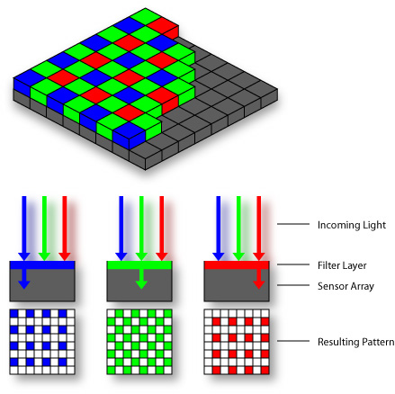
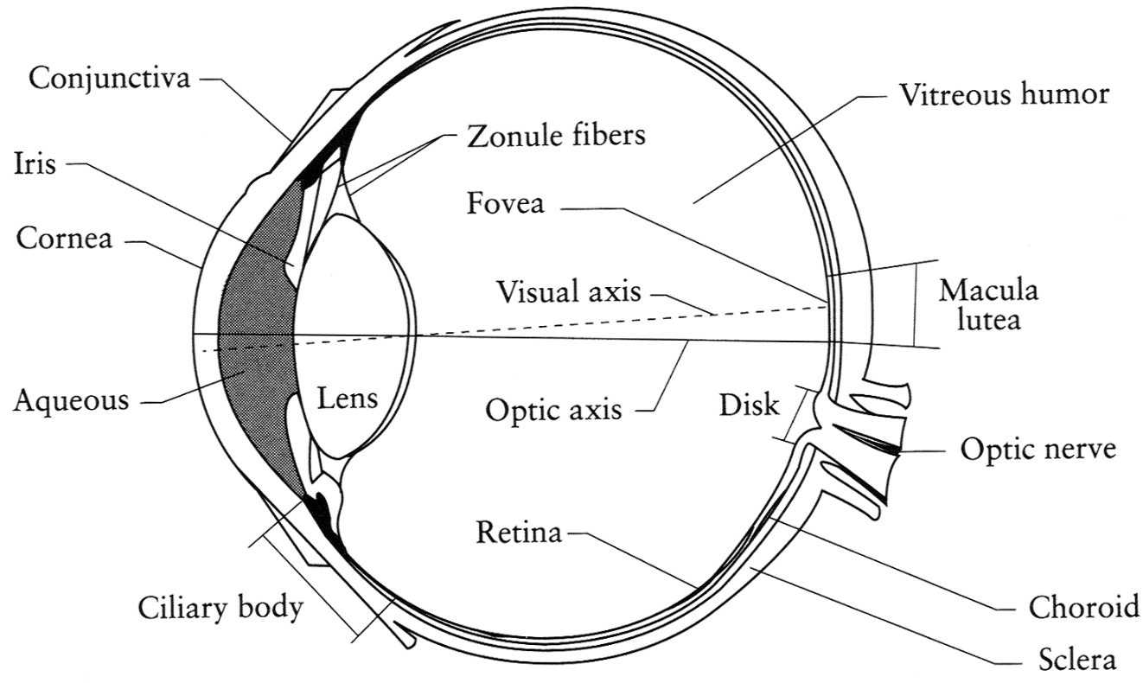
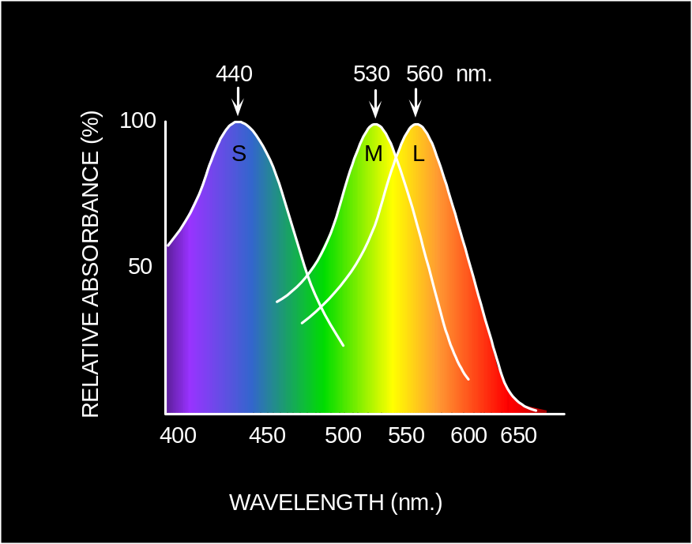
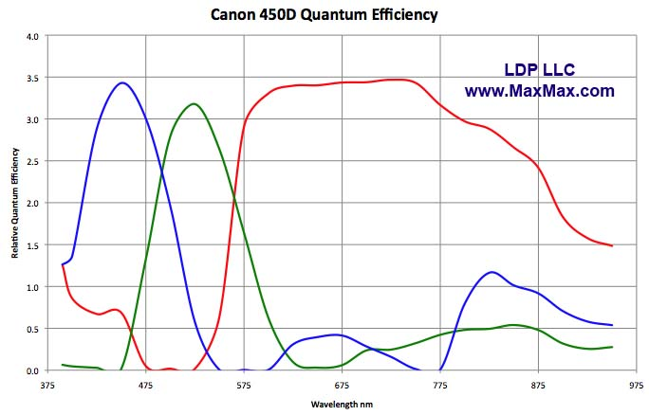
Light response curves
Eye
Sensor:
Camera
Sensor:
© Stephen E. Palmer, 2002
Notes:
http://www.npr.org/2014/11/13/363517842/for-decades-kodak-s-shirley-cards-set-photography-s-skin-tone-standard

Slide 24
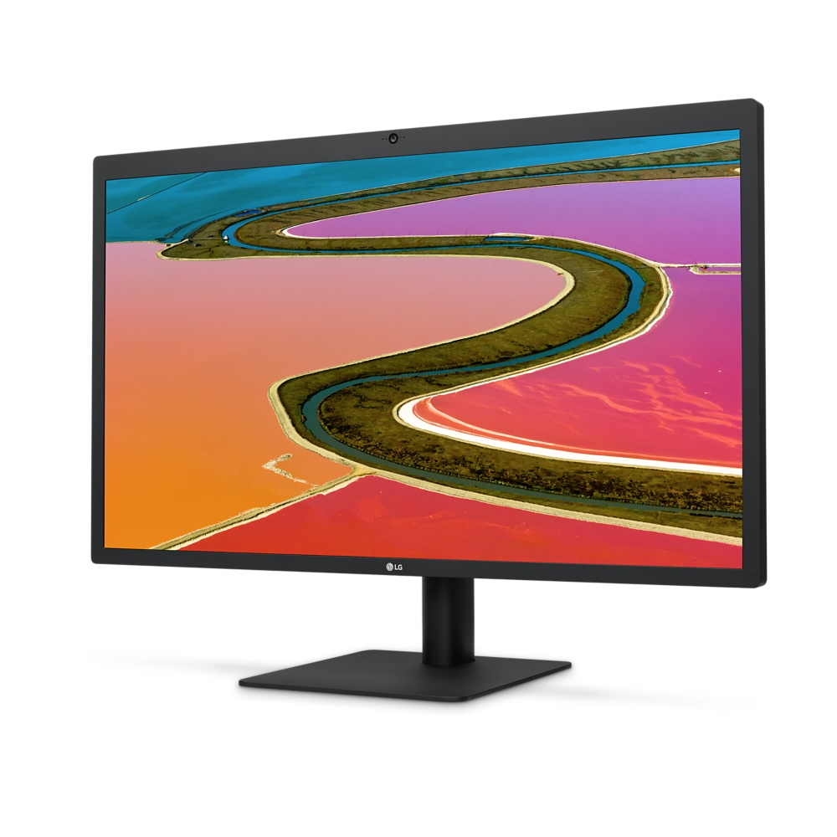
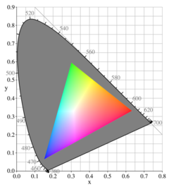
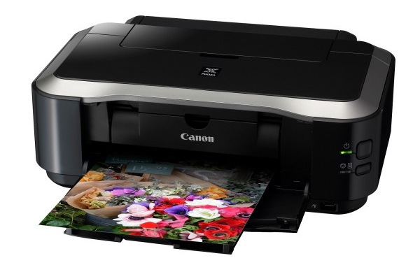
Light/reflectance output curves
250-500:1 contrast ratio (OLED = inf.)
6 / 8 / 10 bit dynamic range
3 / 4 additive primaries (RGB, rarely +yellow)
Defines a gamut
50-150:1 contrast ratio
??? dynamic range
4 subtractive primaries (CYMK)
Defines a gamut
Notes:
Cyan Yellow Magenta Black
Paper contrast ratios:
https://www.dpreview.com/forums/thread/2848210
Typical silver-halide photo lab printers such as Noritsu QSS or Fuji Frontier have a print contrast between 65-85:1.
Inkjets can top 150:1 on the glossiest papers with high-end inks or be well below 50:1 on fine art matte papers. Something, obviously, has to give between screen and print.

Slide 25
How do we calibrate these?
We want:
Colors we see with our eyes in the world
=
Colors we see with our eyes in the reproduction
Notes:
End of slide: so let’s go back in time to before digital cameras – let’s go back to the mid 1950s.

Slide 26
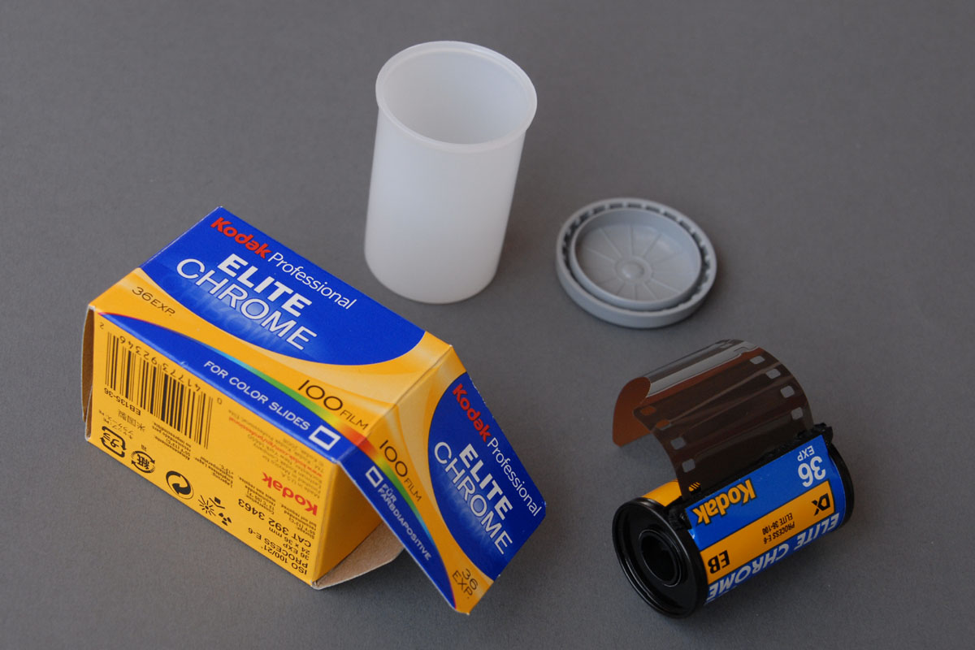
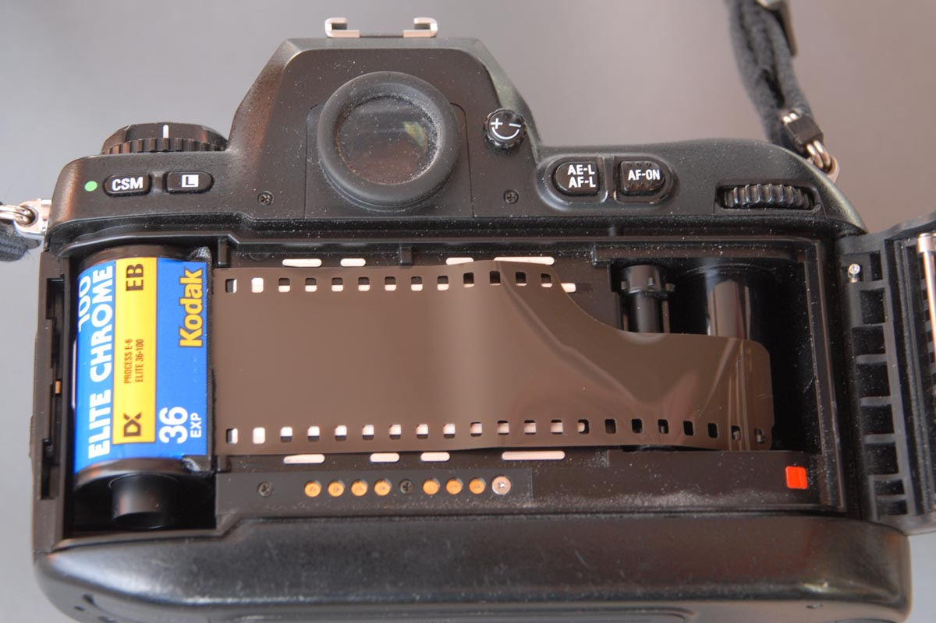
Time Warp:
Photo Film processing
Price of film roll included film development costs.
Actually a monopoly!
1954 – broken up; independent film developers.
http://www.picture-newsletter.com/kodak/
Notes:
https://en.wikipedia.org/wiki/Kodachrome
http://www.picture-newsletter.com/kodak/
Originally, the price of the processing of a roll of film was included in the cost of the film.
Around ~1954, this changed

Slide 27

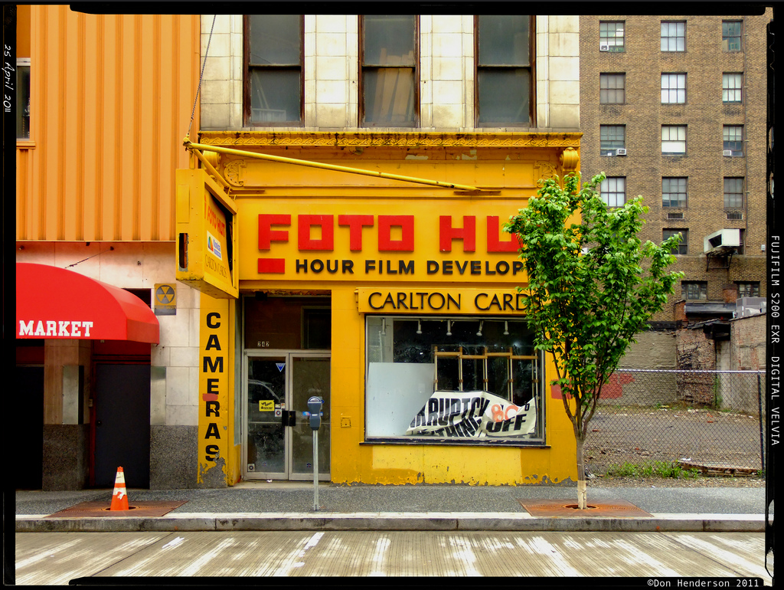
Not actually a Kodak shop…
An independent chain!
New problem:
How to control quality of output across these different developers?
[Don Henderson – Flickr]
Notes:
https://www.flickr.com/photos/yankeedog57/5653210777
Photo - 2011
In downtown Pittsburgh, PA.
https://en.wikipedia.org/wiki/Foto_Hut

Slide 28
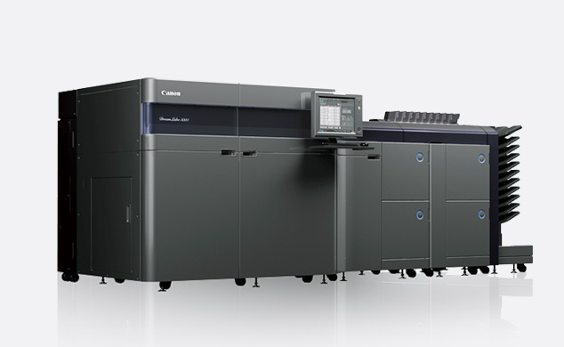
Modern Commercial Photo Printer
Canon DreamLabo 5000
Notes:
https://global.canon/en/technology/interview/dreamlabo/index.html

Slide 29
Here’s the process:
1. Kodak produces a photosensitive chemical film.
  Different compounds gave different spectral responses.
  Kodak calibrates these responses using photometers and using test scenes.
2. You buy Kodak film from the store and put it in your camera.
  Play with your family in the park
  Take photos.
3. You take the film back to the store/lab for development.
  Kodak needs the lab to reproduce the film’s intended spectral response
  Needs to calibrate the chemical development/printer to a target
Solution:
Kodak sends test negatives and test prints to printer technicians to check that their output matches the intended response of the film!
Notes:
Process is finicky; need regular color calibration.

Slide 30
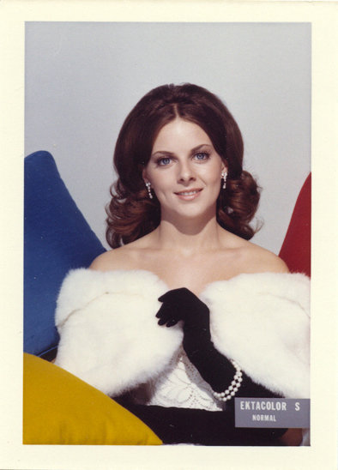
Kodak’s test input + output
‘Shirley cards’ – 1950s/60s
Shirley was photographed hundreds of times by Kodak.
One negative was processed as per Kodak specifications.
A new unexposed negative + processed output was sent to each printer lab.
Colors were calibrated on site to match the target Shirley card.
Circa 1960
Notes:
Anyone see any issues with this approach?
This one is not actually the original Shirley.
From HowToGeek: https://www.howtogeek.com/trivia/photo-lab-printers-are-calibrated-using-a-tool-known-as-a/?answer=1
“Although photo development technology advanced significantly over the course of the 20th century, no amount of automation every proved to be a perfect replacement for the human eye and the viewers acknowledgement that a photo looked balanced and pleasing.
In the 1950s when the Kodak film monopoly was broken up and independent photo labs sprung up across the U.S., Kodak came up with a novel way to help all these independent labs calibrate their equipment properly: Shirley cards. The cards were actually photo negatives that were developed on the local lab equipment to test color density, tone, and contrast. The original Kodak model was named Shirley and the name stuck: for the ensuing decades the test negatives and the resulting 4×6 photos were known was Shirley cards regardless of whether or not Shirley appeared on them.
Although the development process is largely entirely digital at this point (and most photographers no longer even use film), Shirley (and her photographic descendants) can still be found in photo lab calibration software today.”

Slide 31
Kodak’s test input + output
‘Shirley cards’ – 1950s/60s
Any issues with this approach?
Circa 1960
Notes:
Anyone see any issues with this approach?

Slide 32
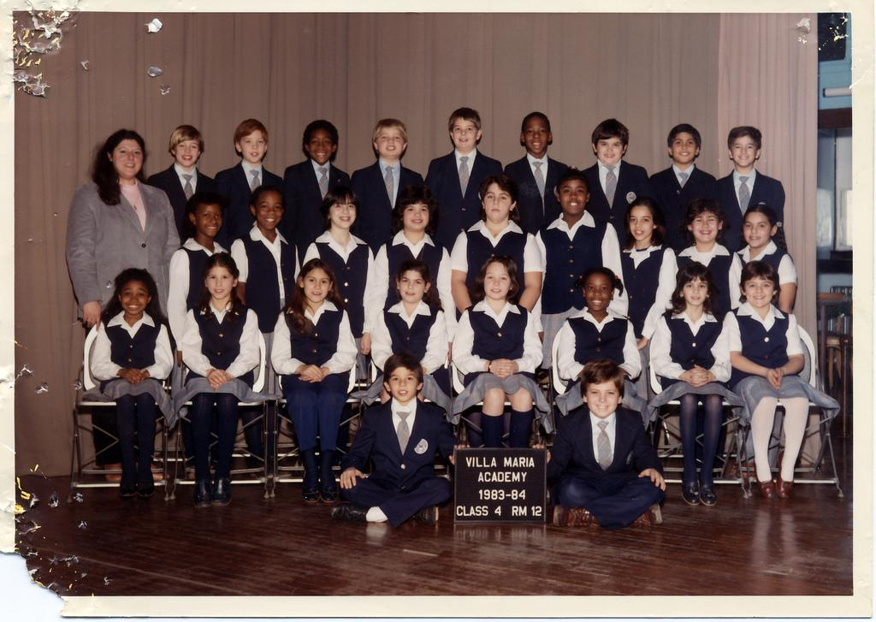

Slide 33
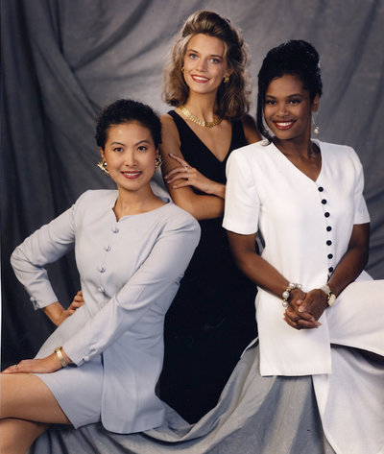
Over time
1978: Filmmaker Jean-Luc Godard refuses to use Kodachrome film in Mozambique.
1980s: Chocolate and furniture manufacturers complain.
1986: Kodacolor VR-G (or Gold) – film for dark browns.
  “Photograph the details of a dark horse in low light.”
Shirley card, 1996

Slide 34
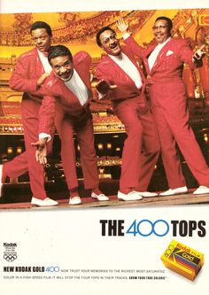
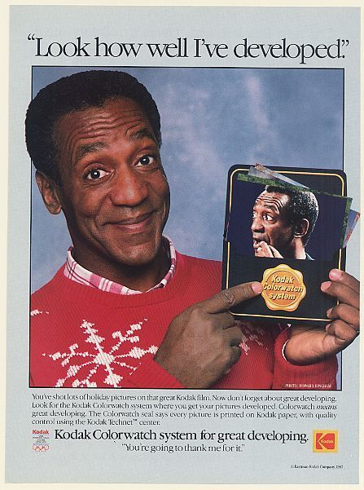
1980s – adverts
The Four Tops!
Bill Cosby!
Some other issues here now too : (
Notes:
Four Tops - Detroit, Michigan band who helped to define the city's Motown sound of the 1960s
Song: Reach out (I’ll be there)

Slide 35
What are the underlying technical problems?
How do they relate to egalitarianism
…and how might we overcome them?
Think-pair-share.

Slide 36
Issues
Dynamic range: not enough!
Color balance:
Notes:
http://imgur.com/aWUHqz6

Slide 37
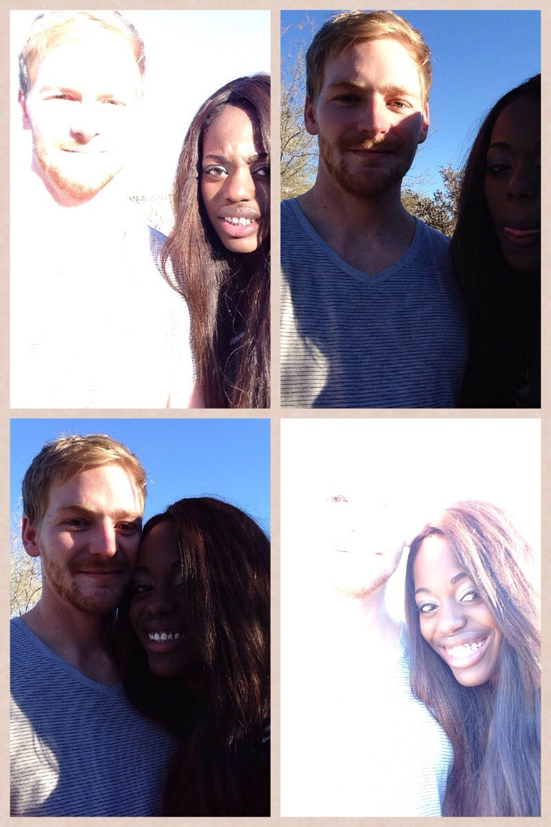
So digital fixes this, right?
Well…
“The hardest part of being in a biracial relationship is taking a picture together.”
whatthecaptcha
Notes:
https://www.reddit.com/r/funny/comments/1tpe5n/the_hardest_part_of_being_in_a_biracial/

Slide 38
So digital fixes this, right?
…it’s a lot better.
14-bit sensors (≈ eye’s static range)
High-dynamic range by combining low-dynamic range
Digital post-processing for color balance
Notes:
http://www.popphoto.com/gear/2014/08/camera-test-nikon-d810

Slide 39
References
Canadian Journal of Communication:
Roth et al., Looking at Shirley, the Ultimate Norm: Colour Balance, Image Technologies, and Cognitive Equity
http://www.cjc-online.ca/index.php/journal/article/view/2196
http://www.npr.org/2014/11/13/363517842/for-decades-kodak-s-shirley-cards-set-photography-s-skin-tone-standard/
https://priceonomics.com/how-photography-was-optimized-for-white-skin/
https://www.buzzfeed.com/syreetamcfadden/teaching-the-camera-to-see-my-skin/

Slide 40
Word of warning
Around 2013/2014 there were a lot of articles about this issue.
Many articles rewrite the same few sources.
Some do not have a technical background, and sometimes technical issues are confused.
‘Internet comments’ warning.
‘Take care.’

Slide 41
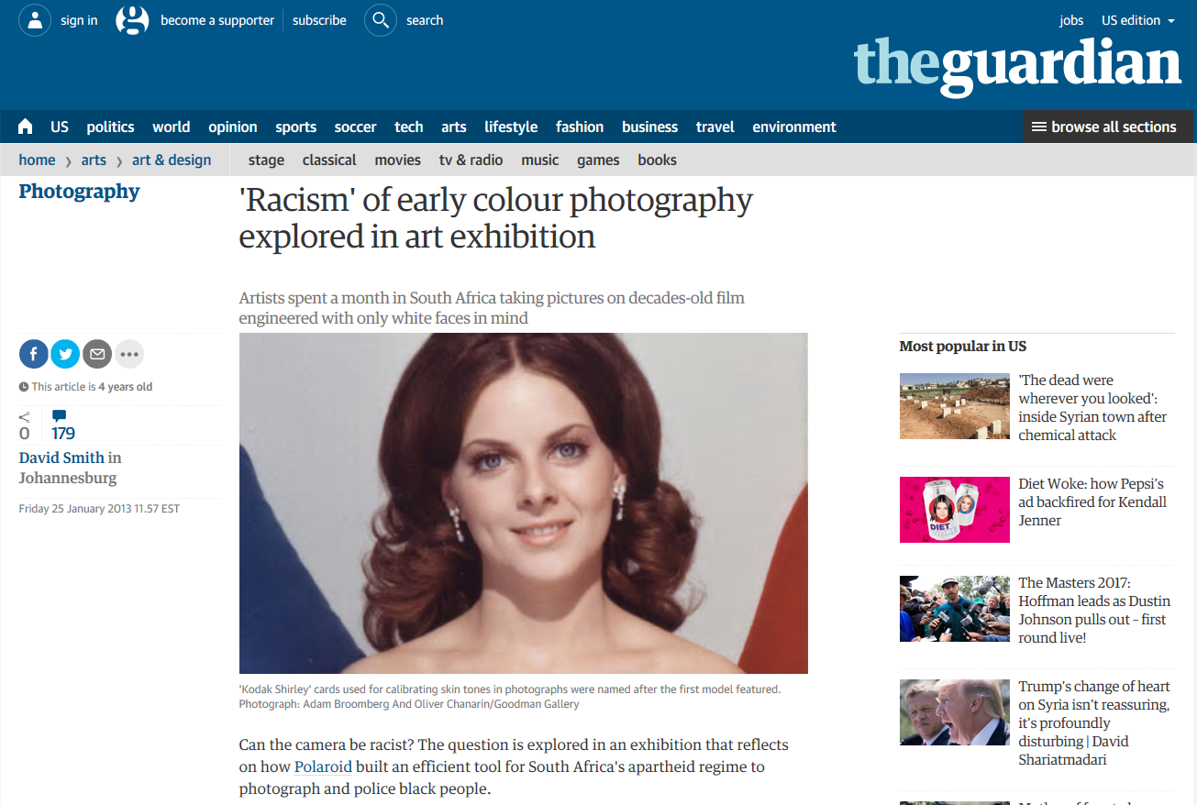

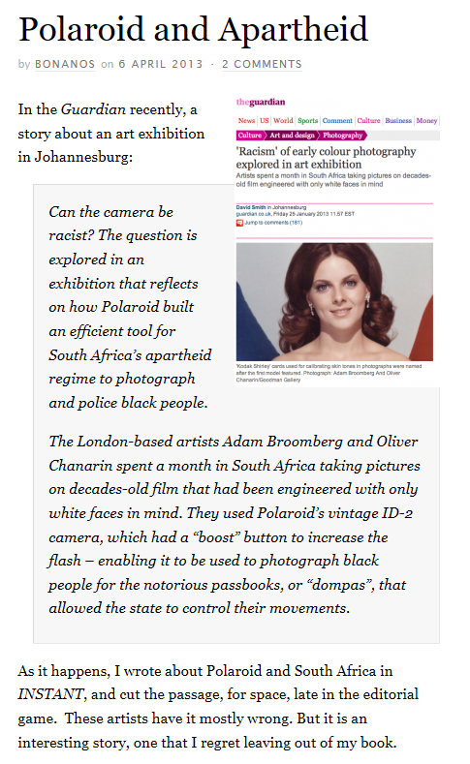
Polaroid and Apartheid
Notes:
https://www.theguardian.com/artanddesign/2013/jan/25/racism-colour-photography-exhibition
http://www.polaroidland.net/2013/04/06/polaroid-and-apartheid/
E.G., these articles on Polaroid and Apartheid are unconvincing as to what is truly going on.

Slide 42
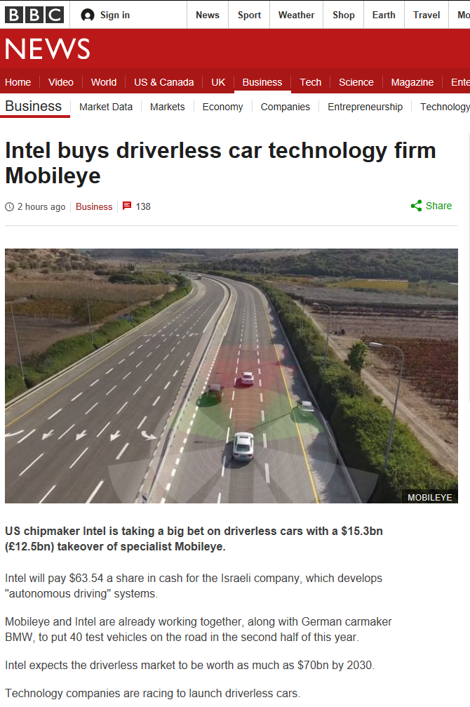
CV as making bank
Intel buys Mobileye!
$15 billion
Mobileye:
  Spin-off from Hebrew University, Israel
  450 engineers
  15 million cars installed
  313 car models
Notes:
As of March 13th 2017 - $15 billion is still less than Snap, Inc. – makers of Snapchat - $25 billion market capitalization
More than Hershey - $23 bil

Slide 43
June 2016 - Tesla left Mobileye
Fatal crash – car ‘autopilot’ ran into a tractor trailer.
“What we know is that the vehicle was on a divided highway with Autopilot engaged when a tractor trailer drove across the highway perpendicular to the Model S. Neither Autopilot nor the driver noticed the white side of the tractor trailer against a brightly lit sky, so the brake was not applied.” – Tesla blog.
What computer vision problems does this sound like?
Notes:
https://www.tesla.com/blog/tragic-loss
http://www.theverge.com/2016/7/1/12085218/tesla-autopilot-crash-investigation-radar-automatic-emergency-braking

Slide 44
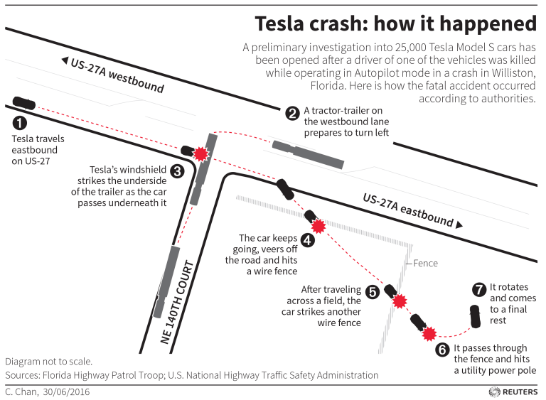

Slide 45
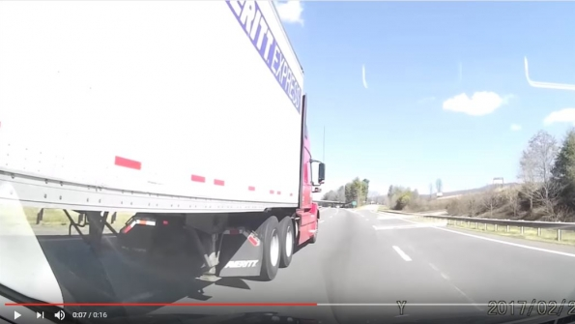
Notes:
http://trucker.com/dashcam/dash-cam-week-blind-spots-bs

Slide 46
June 2016 - Tesla left Mobileye
Fatal crash – car ‘autopilot’ ran into a tractor trailer.
“What we know is that the vehicle was on a divided highway with Autopilot engaged when a tractor trailer drove across the highway perpendicular to the Model S. Neither Autopilot nor the driver noticed the white side of the tractor trailer against a brightly lit sky, so the brake was not applied.” – Tesla blog.
What computer vision problems does this sound like?
What HCI problems does this sound like?
Notes:
https://www.tesla.com/blog/tragic-loss
http://www.theverge.com/2016/7/1/12085218/tesla-autopilot-crash-investigation-radar-automatic-emergency-braking

Slide 47

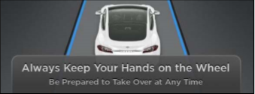
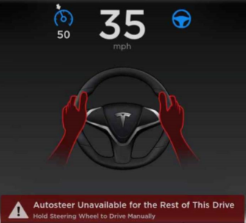
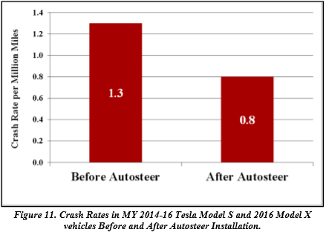
Autosteer
Notes:
https://www.tesla.com/sites/default/files/blog_attachments/tesla_survey_autopilot_awareness.pdf
https://static.nhtsa.gov/odi/inv/2016/INCLA-PE16007-7876.PDF

Slide 48
https://www.bbc.com/news/technology-47468391
Uber 'not liable' for self-driving death
Notes:
https://www.bbc.com/news/technology-47468391
Uber 'not liable' for self-driving death

Slide 49
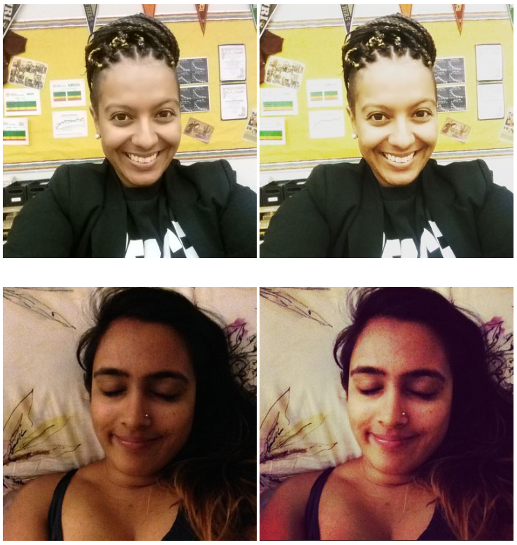
Instagram filters
Filters that brighten
Filters that darken
Filters can do anything!
Notes:
http://www.racked.com/2015/7/7/8906343/instagram-racism

Slide 50
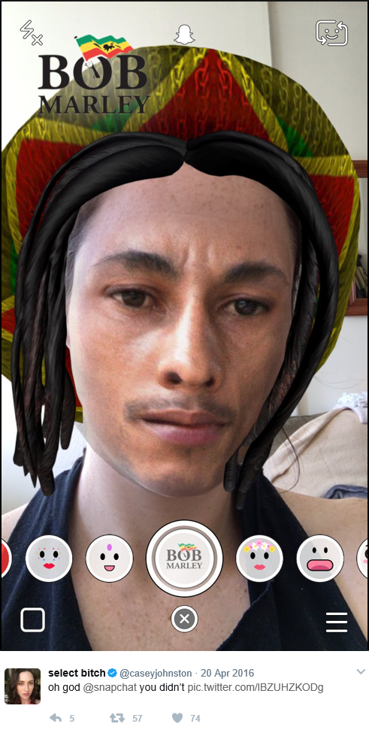
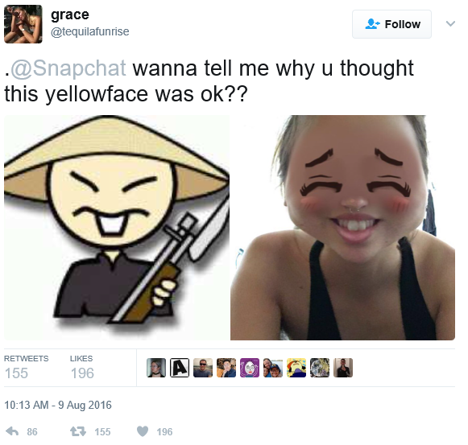
Snapchat
“Anime inspired”
4/20

Slide 51
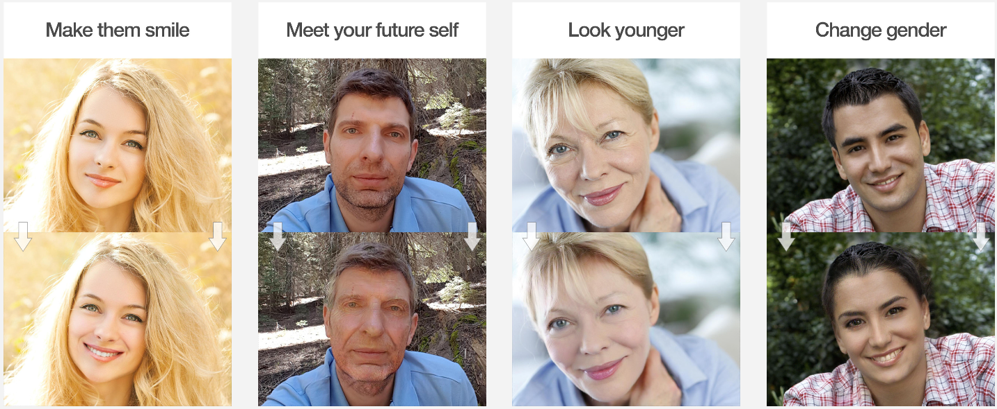
FaceApp
Learning-based face transformations
Notes:
What is FaceApp?
https://www.faceapp.com/

Slide 52
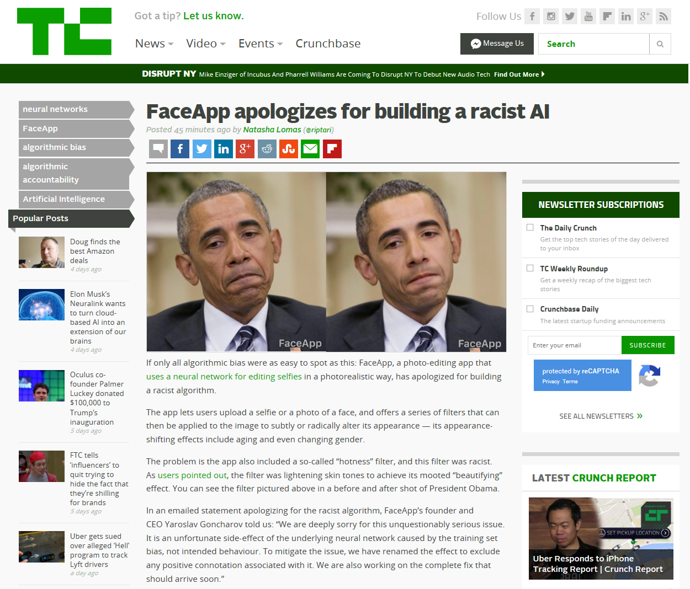
2017/04/25
Notes:
https://techcrunch.com/2017/04/25/faceapp-apologises-for-building-a-racist-ai/
http://www.theverge.com/2017/4/25/15419522/faceapp-hot-filter-racist-apology

Slide 53
Lena and Fabio

Slide 54
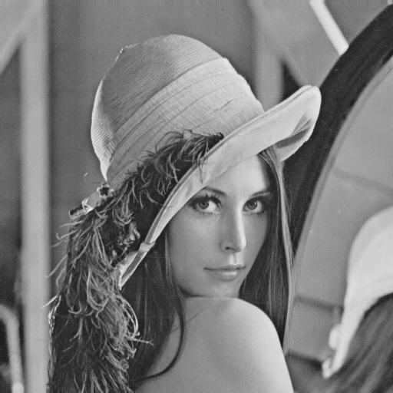
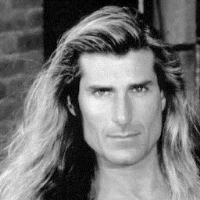
Examples: Controversy and Appropriateness
‘Lena’
‘Fabio’
Alexander Sawchuk @ USC, 1973
Deanna Needell @ Claremont McKenna, 2012
Notes:
Lena Söderberg
November 1972 Playboy
https://en.wikipedia.org/wiki/Lenna
“In 2015, Lena Söderberg was also guest of honor at the banquet of IEEE ICIP 2015.”
“To explain Lena's popularity, David C. Munson, editor-in-chief of IEEE Transactions on Image Processing, noted that it was a good test image because of its detail, flat regions, shading, and texture. However, he also noted that its popularity was largely because an image of an attractive woman appealed to the males in a male-dominated field.”
Fabio Lanzoni
All around 1980’s heartthrob
Deanna Needell introduced him in a 2012 paper.

Slide 55
If it wasn’t clear from class…
Use of Lena is now generally considered inappropriate, as it is not inclusive.
If you wish to include models, then please respect diversity.
We will approach diversity issues in more detail when we start to talk about machine learning and datasets.

Slide 56
Wired article explaining it all
https://www.wired.com/story/finding-lena-the-patron-saint-of-jpegs/

Slide 57
Dataset Bias

Slide 58
Computer vision domain
Eye
Optics
Dynamic range
Color
Digital processing
Low-level features
Calibration
Geometric
Photometric
Radiometric
Data collection
Labeling
Model fitting
Recognition
Classification
In the beginning, there was light.
Camera
Optics
Dynamic range
Color

Slide 59
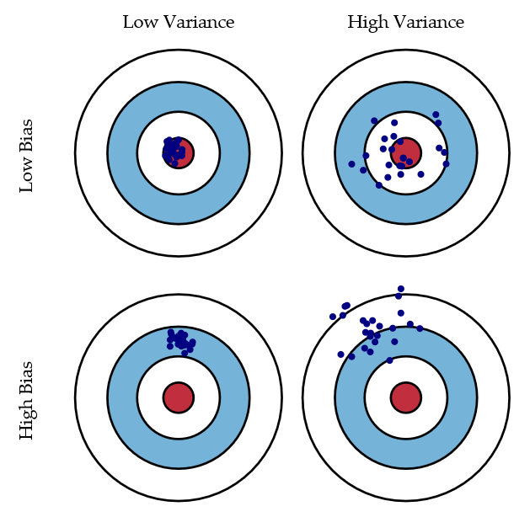
Bias/variance trade-off
Bias = accuracy
Variance = precision
Scott Fortmann-Roe
Notes:
http://scott.fortmann-roe.com/docs/BiasVariance.html
“Bias: The error due to bias is taken as the difference between the expected (or average) prediction of our model and the correct value which we are trying to predict.
Variance: The error due to variance is taken as the variability of a model prediction for a given data point.”

Slide 60
Unbiased Look at Dataset Bias
Torralba and Efros, CVPR 2011
“The authors would like to thank the Eyjafjallajokull volcano as well as the wonderful kirs at the Buvette in Jardin du Luxembourg for the motivation (former) and the inspiration (latter) to write this paper.“
Next few slide contents are from the paper

Slide 61
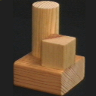
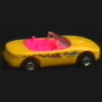
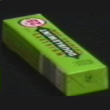
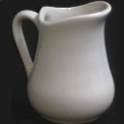
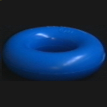
Progression of dataset complexity
COIL-100:
15 scenes: Out of the lab, backgrounds
Caltech-101: Google-mined, single object in middle.
LabelMe: Multiple objects, anywhere
PASCAL VOC: More rigorous testing standards
ImageNet: Internet-scale, real-world

Slide 62
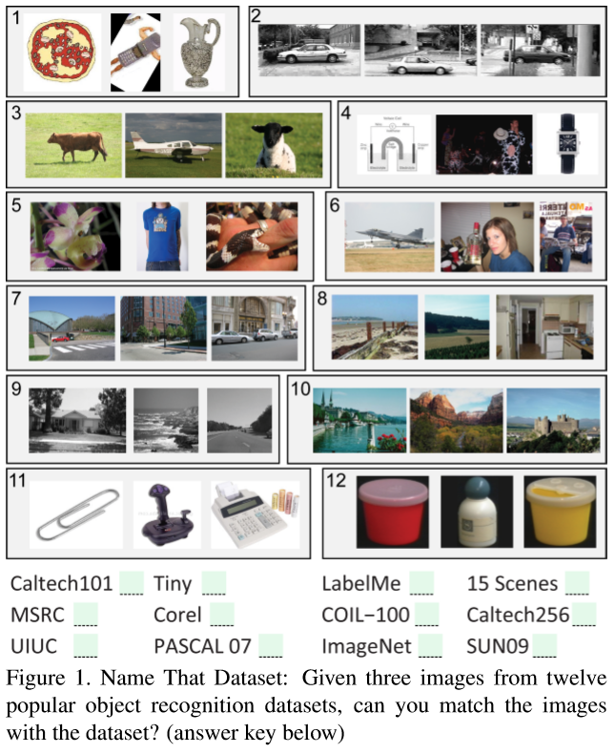
Notes:
Answer key: 1) Caltech-101, 2) UIUC, 3) MSRC, 4) Tiny Images, 5) ImageNet, 6) PASCAL VOC, 7) LabelMe, 8) SUN-09, 9) 15 Scenes, 10) Corel, 11) Caltech-256, 12) COIL-100.
Large-scale datasets are intended to be representative of the world and everything we see in it, but many of them are not.
In a vision-research lab, most people got 75% correct.

Slide 63
Quick reminder of all the ones we have seen so far
Caltech 101
LabelMe
SUN 09
15 Scenes
Tiny Images

Slide 64
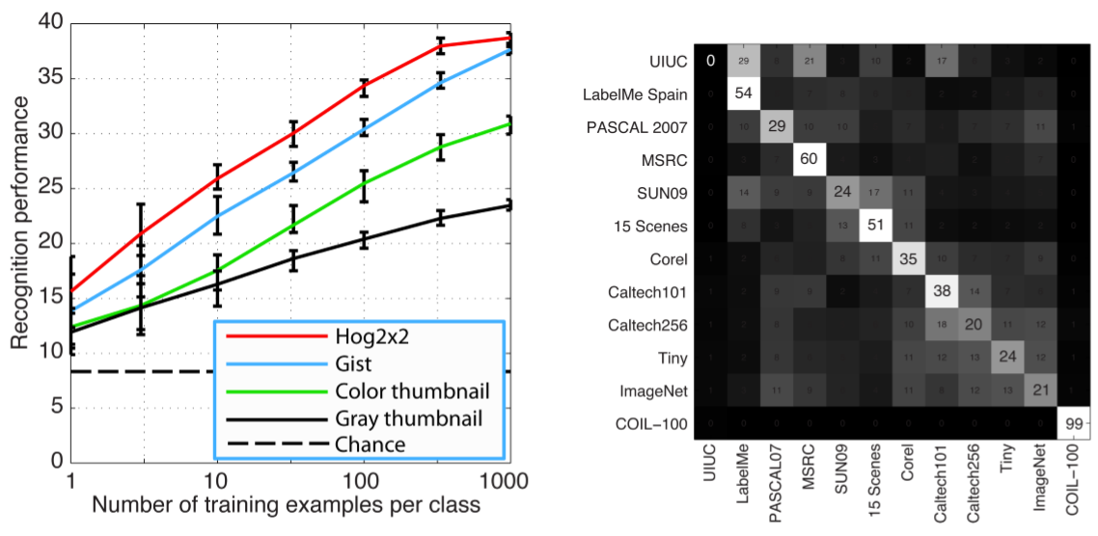
CV plays name that dataset!
Notes:
Of course, much of the bias can be accounted for by the divergent goals of the different datasets: some captured more urban scenes, others more rural landscapes; some collected professional photographs, others the amateur snapshots from the Internet; some focused on entire scenes, others on single objects, etc.
UIUC has poor performance because the test set is nothing like the training set (!)

Slide 65
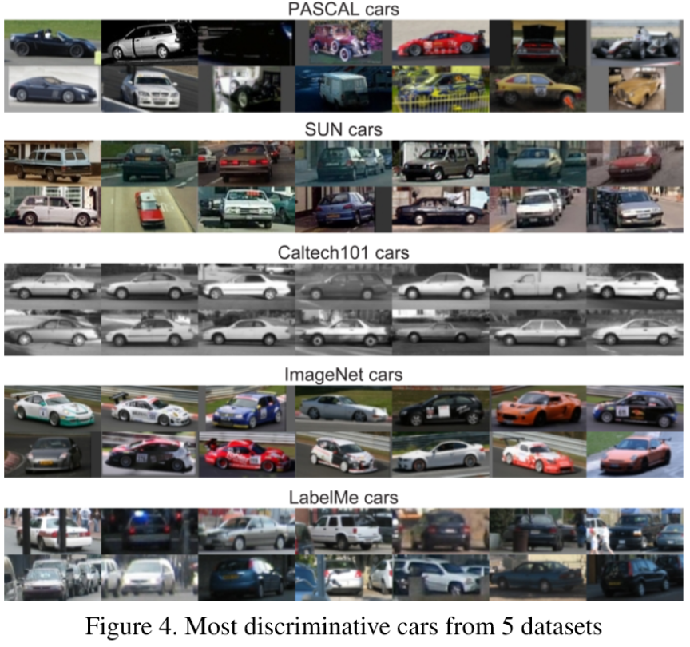
Notes:
What if we just look at one object class across the database?
Yet, even if we try to control for these capture biases by isolating speciﬁc objects of interest, we ﬁnd that the biases are still present in some form.
Classifier still does 61% against a 20% chance.

Slide 66
Measuring Dataset Bias
Idea: cross-dataset generalization
Train an object classifier on one dataset
Test on the same object class on another dataset
Observe performance as measure of bias

Slide 67
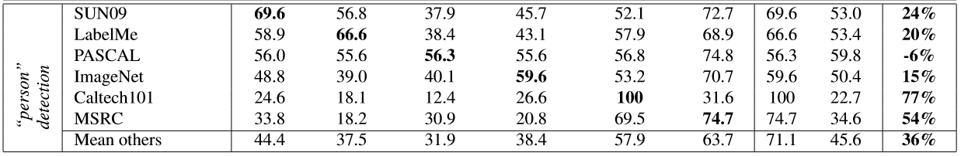


Slide 68
Different kinds of bias
Selection bias
  Retrieve different kinds of images; keywords/search engines can bias.
Capture bias
  Objects photographed in similar ways that do not generalize, e.g., object always in center, race track car vs. street car, mugs.
Notes:
E.G., a low negative set bias for the boat example would include lots of images of rivers and seas without boats.
Capture bias:
Class of ‘mug’
How to resolve selection bias?
“Start with a large collection of unannotated images and label them by crowd-sourcing.”

Slide 69


Notes:
Most handles point to the right.
Only 6 out of 50 point left.

Slide 70
Different kinds of bias
Selection bias
  Retrieve different kinds of images; keywords/search engines can bias.
Capture bias
  Objects photographed in similar ways that do not generalize, e.g., object always in center, race track car vs. street car, mugs.
Category/label bias
  Poorly-defined classes, e.g., painting vs. picture
Negative set bias
  In one vs. all classification, ‘all’ or “the rest of the world” is not well represented.
  “Are features which helps classify ‘boat’ object really the boat, or are they the water it sits on?”
    Low bias negative set would include many boat-free images of rivers and lakes.
Notes:
E.G., a low negative set bias for the boat example would include lots of images of rivers and seas without boats.
Capture bias:
Class of ‘mug’
How to resolve selection bias?
“Start with a large collection of unannotated images and label them by crowd-sourcing.”

Slide 71

Measuring Negative Set Bias
Take negative examples from other datasets and add to superset; train against this.
Drop in performance of ‘all’ suggests negative examples are being misclassified

Slide 72
Overcoming bias at collection time
Selection bias
  Multiple keywords, search engines, countries.
  Collect unknown images and label them by crowd-sourcing.
Capture bias
  Better sampling
  Different transforms: noise, flips, rotations, affine, crops.
Notes:
For noise, go here:
The Unreasonable Effectiveness of Noisy Data for Fine-Grained Recognition
https://link.springer.com/chapter/10.1007/978-3-319-46487-9_19

Slide 73
Overcoming bias at collection time
Category/label bias
  Clear instruction to turkers; unambiguous classes (possible?)
  Pre-label clustering, or multiple acceptable answers.
Negative set bias
  Cross-dataset mining
  Mine for hard negatives from unlabeled set using a reliable algorithm and high threshold.
Notes:
Negative set bias:
Mark Everingham: use a few standard algorithms (e.g. bag of words) to actively mine hard negatives as part of dataset construction from a very large unlabelled set, and then manually going through them to weed out true positives. The down side is that the resulting dataset will be biased against existing algorithms.

Slide 74
Undoing the Damage of Dataset Bias
Khosla et al., ECCV 2012
“While it remains in question whether creating an unbiased dataset is possible given limited resources, we propose a discriminative framework that directly exploits dataset bias during training.”
Notes:
http://link.springer.com/chapter/10.1007/978-3-642-33718-5_12

Slide 75
More info
Kate Crawford @ NIPS 2017
https://www.youtube.com/watch?v=fMym_BKWQzk
The Trouble with Bias

Slide 76
More examples
https://www.quora.com/What-are-examples-of-computer-vision-bugs-related-to-race
http://www.telegraph.co.uk/technology/2016/12/07/robot-passport-checker-rejects-asian-mans-photo-having-eyes/
Thank you Tiffany Chen

Slide 77

Viola-Jones with a bad training database
wzamen01

Slide 78

Google Photos (2015)
Jacky Alciné
Notes:
http://www.slate.com/blogs/future_tense/2015/06/30/google_s_image_recognition_software_returns_some_surprisingly_racist_results.html
Jacky Alciné – Brooklyn computer programmer

Slide 79
Google Photos (2015)
What do you think the problem was?
How could you fix it?
Has it been fixed? Anyone use Google Photos?

Slide 80


Google Photos (2015)
[in]
Notes:
Yonatan Zunger – Chief Architect of Social

Slide 81

Not just a vision problem
Text embeddings also suffer:
https://gist.github.com/rspeer/ef750e7e407e04894cb3b78a82d66aed
‘Sentiment analysis’ ->
Rob Speer
Notes:
Does Anne Hathaway News Drive Berkshire Hathaway's Stock? https://www.theatlantic.com/technology/archive/2011/03/does-anne-hathaway-news-drive-berkshire-hathaways-stock/72661/

Slide 82

Not just a vision problem
Text embeddings also suffer:
https://gist.github.com/rspeer/ef750e7e407e04894cb3b78a82d66aed
‘Sentiment analysis’ ->
Rob Speer
Notes:
Does Anne Hathaway News Drive Berkshire Hathaway's Stock? https://www.theatlantic.com/technology/archive/2011/03/does-anne-hathaway-news-drive-berkshire-hathaways-stock/72661/
Debiasing Word Embeddings: https://arxiv.org/abs/1607.06520

Slide 83


Word embedding trained on Google News – word2vec

Slide 84
AI ‘Safety’
Concrete Problems in AI Safety
https://arxiv.org/abs/1606.06565
In context of robots, but promising ideas
  Regularizer based on expert ‘risk’ of class confusion

Slide 85

Criminality
Wu and Zhang, Automated Inference on Criminality using Face Images, on arXiv 2016
https://arxiv.org/abs/1611.04135
Slide figures from paper

Slide 86
“Unlike a human examiner/judge, a computer vision algorithm or classifier has absolutely no subjective baggages, having no emotions, no biases whatsoever due to past experience, race, religion, political doctrine, gender, age, etc., no mental fatigue, no preconditioning of a bad sleep or meal. The automated inference on criminality eliminates the variable of meta-accuracy (the competence of the human judge/examiner) all together.”

Slide 87

Criminality
1100 non-criminal, 730 criminal Chinese face photos
Tested various features + classifiers

Slide 88

Criminality
K-means, averaging clusters
Notes:
Correlation does not equal causation.
Cited causes:
the curvature of upper lip which is on average 23 percent larger for criminals than for noncriminals;
the distance between two inner corners of the eyes, which is 6 percent shorter;
the angle between two lines drawn from the tip of the nose to the corners of the mouth, which is 20 percent smaller
Criminality

Slide 89
What biases might exist? Discuss!
Selection bias
Capture bias
Category/label bias
Negative set bias

Slide 90
Is this real?
Whatever the case, it needs care! Significant ramifications.
Humans might be able to do this:
  Small but statistically significant ability to tell criminal from non-criminal in photo.
Valla, J., Williams, W., & Ceci, S. J. (2011).
The accuracy of inferences about criminality based on facial appearance.
Journal of Social, Evolutionary, and Cultural Psychology, 5(1), 66-91.
MIT Technology Review has a good overview:
https://www.technologyreview.com/s/602955/neural-network-learns-to-identify-criminals-by-their-faces/
Notes:
PDF for human assessment of criminality trial:
http://emilkirkegaard.dk/en/wp-content/uploads/THE-ACCURACY-OF-INFERENCES-ABOUT-CRIMINALITY-.pdf
Predicting First Impressions with Deep Learning
https://arxiv.org/abs/1610.08119

Slide 91

Valla, J., Williams, W., & Ceci, S. J. (2011)
Notes:
Example test from the Valla study on previous slide.
1 – non-criminal
2 - non-criminal
3- rapist
4 – assault
5 – arson
6 – non-criminal

Slide 92

This one must be an art project…
Faception – “New A.I. Analyzes Facial Structure To See Who's A Terrorist”
  https://www.popsci.com/start-up-is-selling-ai-that-claims-to-identify-terrorists-based-on-their-face

Slide 93


Slide 94

“Guns don't kill people, people kill people!”
“Machine learning doesn’t kill people,
training data kills people!”
- ML community, all the time.
@vielmetti
Notes:
With great power comes great responsibility!
Requiring a license to use ML? To collect a training data set?

Slide 95


Dataset improvement: MS COCO

Slide 96
Help Do Something About It: Upcoming Hackathon
May 11th 2017 @ Microsoft New England in Boston
Organized by New England Machine Learning Day
Hacking Bias in ML
Ex-Brown PhD will be there - Genevieve Patterson
https://www.eventbrite.com/e/new-england-machine-learning-hackathon-hacking-bias-in-ml-tickets-32951771636?aff=NEML

Slide 97

Decent Pew Overview on Big Picture
Rainie and Anderson
Code-Dependent:
Pros and Cons of the
Algorithm Age
http://www.pewinternet.org/2017/02/08/code-dependent-pros-and-cons-of-the-algorithm-age/
Notes:
http://www.slate.com/articles/technology/future_tense/2017/03/the_surprising_creepy_things_algorithms_can_glean_from_photographs.html

Slide 98

Help Do Something About It
Joy Buolamwini
https://www.theguardian.com/technology/2017/may/28/joy-buolamwini-when-algorithms-are-racist-facial-recognition-bias/
Founded ‘Algorithmic Justice League’
https://www.ajlunited.org/

Slide 99

Look at Joy’s paper on face bias in commercial softwares
[New York Times]
Notes:
https://www.nytimes.com/2019/01/24/technology/amazon-facial-technology-study.html

Slide 100
Effect of public shaming on face recognition databases
https://www.engadget.com/2019/01/25/amazon-rekognition-facial-analysis-gender-race-bias-mit/
The paper: http://www.aies-conference.com/wp-content/uploads/2019/01/AIES-19_paper_223.pdf
“However, Amazon has disputed the results of MIT's tests, which took place over the course of 2018. It argued the researchers hadn't used the current version of Rekognition, and said the gender identification test used facial analysis (which picks out faces from images and assigns generic attributes to them), rather than facial recognition, which looks for a match for a specific face. It noted that they are distinct software packages.”
"Using an up-to-date version of Amazon Rekognition with similar data downloaded from parliamentary websites and the Megaface dataset of [1 million] images, we found exactly zero false positive matches with the recommended 99 [percent] confidence threshold," Matt Wood, general manager of deep learning and AI at Amazon Web Services, told VentureBeat.
More info on the technical issues here:
https://itif.org/publications/2019/01/27/note-press-facial-analysis-not-facial-recognition
Notes:
More info on the issues here:
https://itif.org/publications/2019/01/27/note-press-facial-analysis-not-facial-recognition

Slide 101
Microsoft’s face recognition principles
https://blogs.microsoft.com/on-the-issues/2018/12/17/six-principles-to-guide-microsofts-facial-recognition-work/
Fairness. We will work to develop and deploy facial recognition technology in a manner that strives to treat all people fairly.
Transparency. We will document and clearly communicate the capabilities and limitations of facial recognition technology.
Accountability. We will encourage and help our customers to deploy facial recognition technology in a manner that ensures an appropriate level of human control for uses that may affect people in consequential ways.
Non-discrimination. We will prohibit in our terms of service the use of facial recognition technology to engage in unlawful discrimination.
Notice and consent. We will encourage private sector customers to provide notice and secure consent for the deployment of facial recognition technology.
Lawful surveillance. We will advocate for safeguards for people’s democratic freedoms in law enforcement surveillance scenarios and will not deploy facial recognition technology in scenarios that we believe will put these freedoms at risk.

Slide 102

Notes:
https://whitecollar.thenewinquiry.com/static/whitepaper.pdf
Brooklyn-based leftist magazine
cultural and literary criticism
We propose and develop a predictive policing algorithm, the White Collar Crime Early Warning System (WCCEWS), for identifying and assessing the risk of large-scale financial crime at the city block level. Our model achieves an impressive 90.12% accuracy at predicting the activity of white collar crime in a given area.

Slide 103

[https://whitecollar.thenewinquiry.com/]
Notes:
We collected data provided by the Financial Regulatory Authority (FINRA)14 to compile incidents of financial malfeasance dating back to 1964.
Our geographical data started in the form of street addresses, which we converted to latitude/longitude coordinates with a popular geocoding service.
By incorporating public data sources with a random forest classifier, we are able to achieve 90.12% predictive accuracy.

Slide 104



Slide 105


Slide 106

Face detection + facial landmark detection + image warping + averaging/PCA!

Slide 107

[https://whitecollar.thenewinquiry.com/]

Slide 108

[https://whitecollar.thenewinquiry.com/]

Slide 109


Facebook translation (+image)

Slide 110
Dataset openness
Rights on data
Later on could be used in previously inconceivable ways
E.g., Flickr scrape for Creative Commons images is legal
https://www.theinquirer.net/inquirer/news/3072504/ibm-flicker-photos-facial-recognition-privacy-scandal

