Slide 1

13 March 2019
Notes:
Many slides and slide ideas thanks to Marc'Aurelio Ranzato and Michael Nielson.
http://www.cs.toronto.edu/~ranzato/files/ranzato_CNN_stanford2015.pdf
http://neuralnetworksanddeeplearning.com/

Slide 2
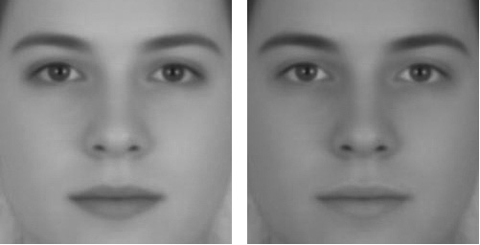
Russell, 2009
Notes:
http://illusionoftheyear.com/2009/05/the-illusion-of-sex/
http://public.gettysburg.edu/~rrussell/Russell_2009.pdf
Left appears female, right appears male.
Eyes and lips have not had their brightness/contrast adjusted, but it looks like the face on the left has darker lips
This is an example of simultaneous contrast adjustment

Slide 3

Simultaneous contrast
Notes:
http://pixgood.com/color-contrast-art-examples.html

Slide 4
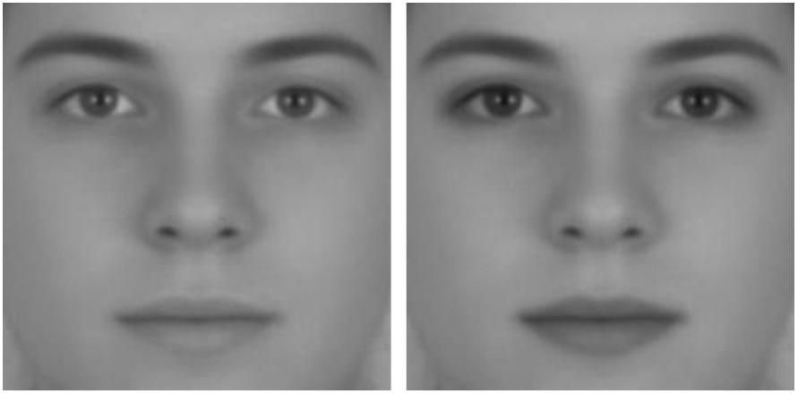
Notes:
In this one, the skin was left unchanged, but the lips and eyes were lightened on the left and darkened on the right.

Slide 5
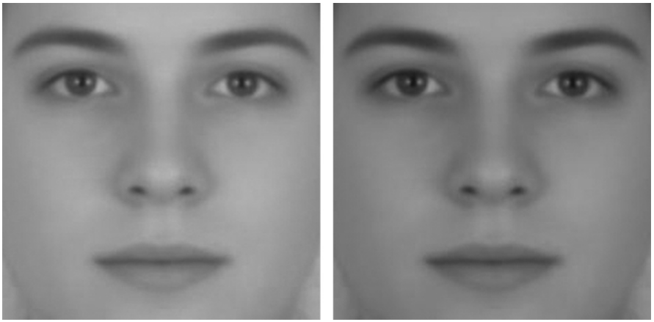
Notes:
No illusion – both faces appear androgenous
“A sex difference in facial contrast and its exaggeration by cosmetics”
Female faces have greater luminance contrast between the eyes, lips, and surrounding skin than do male faces.
This contrast change in some way represents ‘femininity’.
Cosmetics could be seen to increase contrast of these areas, and so increase femininity.

Slide 6
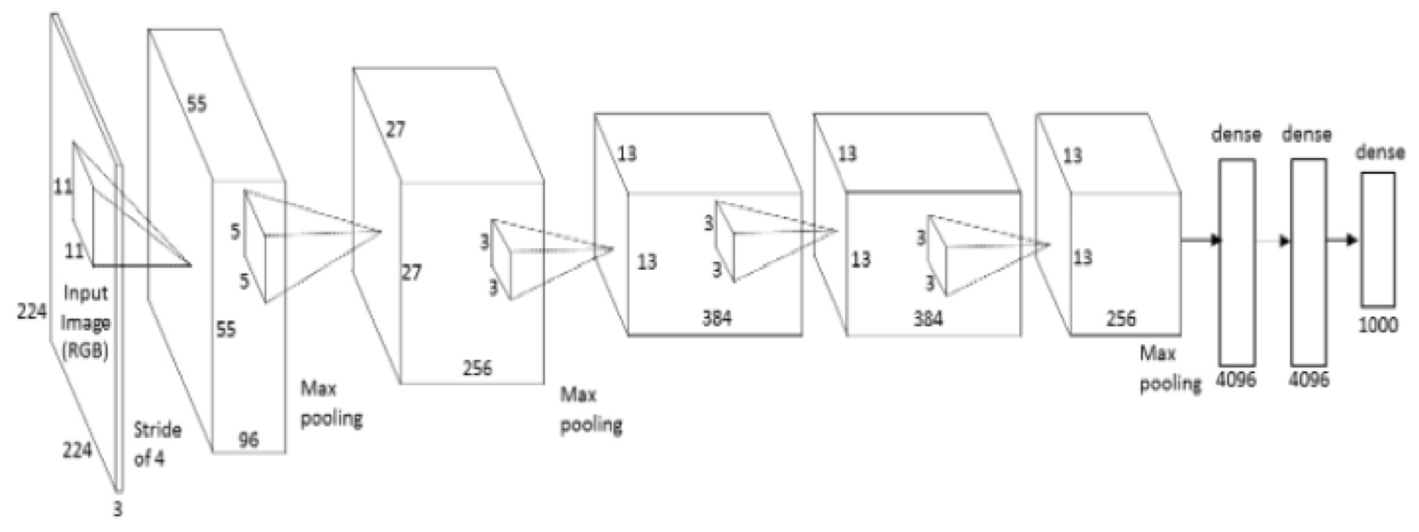
Training Neural Networks
Build network architecture
and define loss function
Pick hyperparameters – learning rate, batch size
Initialize weights + bias in each layer randomly
While loss still decreasing
  Shuffle training data
  For each data point i=1…n (maybe as mini-batch)
    Gradient descent
  Check validation set loss
“Epoch“

Slide 7
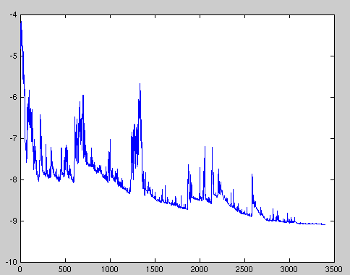
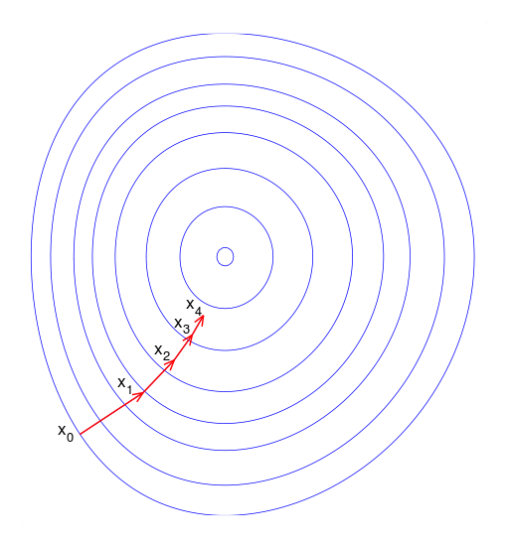
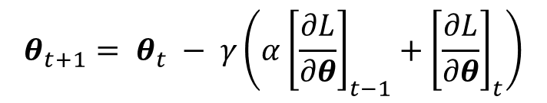
Stochastic Gradient Descent
Try to speed up processing with random training subsets
Loss will not always decrease (locally) as training data point is random, but converges over time.
Momentum
Gradient descent step size is weighted combination over time to dampen ping pong.
$$θ_{t+1}= θ_{t} − γ\left(α{\left[\frac{∂L}{∂θ}\right]}_{t−1}+{\left[\frac{∂L}{∂θ}\right]}_{t}\right)$$
Wikipedia

Slide 8

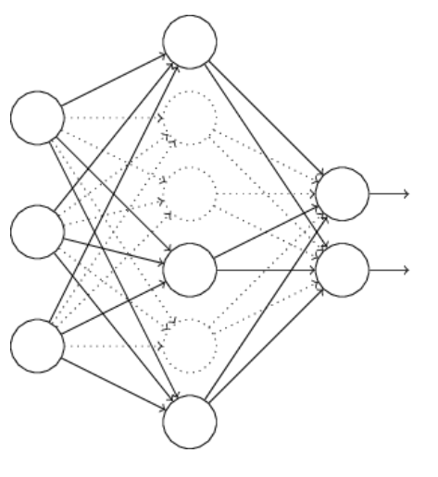

Regularization
Penalize weights for simpler solution
  Occam’s razor
Dropout half of neurons for
each minibatch
  Forces robustness
$$λ$$

Slide 9
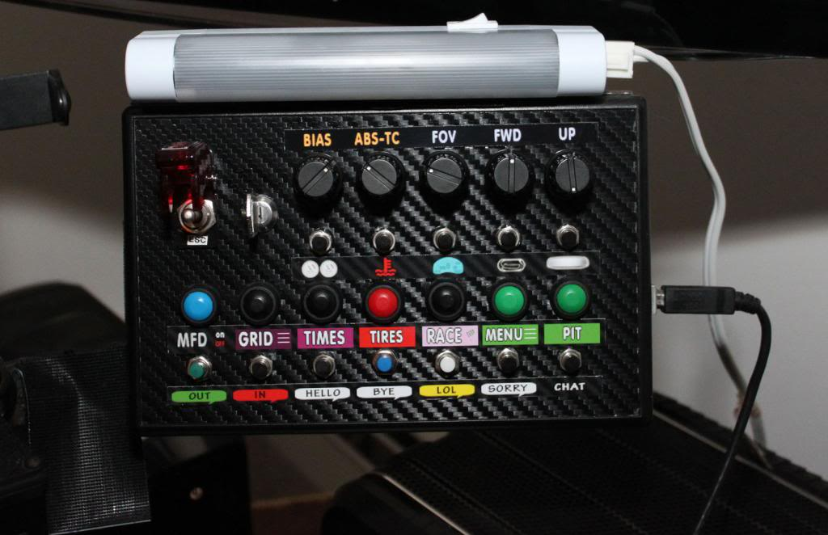
But James…
…I thought we were going to treat machine learning like a black box? I like black boxes.
Deep learning is:
- a black box
- also a black art.
- Grad student
gradient descent : (
http://www.isrtv.com/
Notes:
http://www.isrtv.com/forums/topic/12039-custom-button-box-for-iracing/

Slide 10
Why in Project 4 Q5 do we initialize the weights to zero?
Good question - a mistake on our part.
Setting zero weights makes all neurons equivalent as there is no difference in the gradient computed across neurons. Called “symmetric updates”.
Setting zero bias is OK; often we standardize the data beforehand (subtract mean, divide by std. dev) so a zero bias is a good initialization.
Notes:
More info here about network weight initialization: http://deepdish.io/2015/02/24/network-initialization/

Slide 11
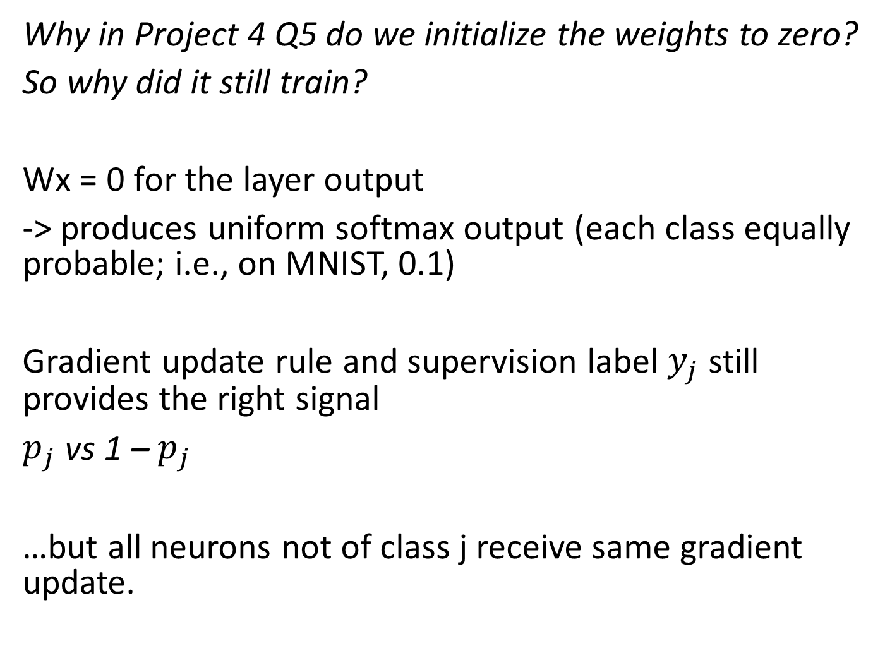
Why in Project 4 Q5 do we initialize the weights to zero?
So why did it still train?
Wx = 0 for the layer output
-> produces uniform softmax output (each class equally probable; i.e., on MNIST, 0.1)
Gradient update rule and supervision label $y_{j}$ still provides the right signal
$p_{j}$ vs 1 – $p_{j}$
…but all neurons not of class j receive same gradient update.
Notes:
More info here about network weight initialization: http://deepdish.io/2015/02/24/network-initialization/

Slide 12
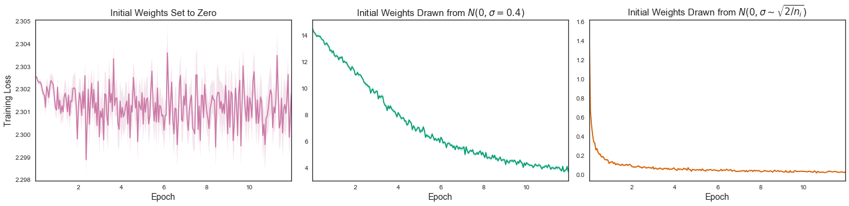
Why in Project 4 Q5 do we initialize the weights to zero?
In general, initialization is very important.
Good strategy: He et al. 2015:
For ReLU, draw random weights from Gaussian distribution with variance = 2 / # inputs to layer
[Image Andre Perunicic]
Notes:
More info here about network weight initialization: https://intoli.com/blog/neural-network-initialization/
He et al. 2015 - https://arxiv.org/pdf/1502.01852.pdf

Slide 13
What is activation function for?
To allow multiple layers; to avoid resulting composition of linear functions collapsing to a single layer.
Difference between CNN and convolution in feature extraction?
No difference! Same operation [correlation/convolution]
Why do we shave off pixels?
We only use the valid region of convolution; typically no padding.
Some recent works special case these edge convolutions.
Why multidimensional kernels?
We wish to convolve over the outputs of many other learned kernels -> ‘integrating’ information via weighted sum of previous layer outputs.

Slide 14
How to know which kernels to use in 2nd+ convolution layers?
Gradient descent + back propagation learns them.
How to set weights on fully connected layers?
Gradient descent + back propagation learns them.
What even is back propagation again?
Project 4 Q5 has some good references.

Slide 15
How do we decide the best parameters for network architecture?
For less complicated situations, we can use ‘guess & check’ [trial and error]. Is there any method?
‘Grid search’ -> trial and error
‘Bayesian optimization’ -> meta-learning; optimize the hyperparameters
General strategy:
Bottleneck -> extract information (kernel) and learn to squeeze representation into a smaller number of parameters.

Slide 16
I’ve heard about many more terms of jargon!
Skip connections
Residual connections
Batch normalization
…we’ll get to these in a little while.
Notes:
In separable problems, perceptron training can also aim at finding the largest separating margin between the classes. The so-called perceptron of optimal stability can be determined by means of iterative training and optimization schemes, such as the Min-Over algorithm (Krauth and Mezard, 1987)^{[11]} or the AdaTron (Anlauf and Biehl, 1989)) .^{[12]} AdaTron uses the fact that the corresponding quadratic optimization problem is convex. The perceptron of optimal stability, together with the kernel trick, are the conceptual foundations of the support vector machine.
https://en.wikipedia.org/wiki/Perceptron
Perceptron of optimal stability can be computed via the Min-Over algorithm (Krauth and Mezard, 1987)^{[11]} or the AdaTron (Anlauf and Biehl, 1989) algorithm.

Slide 17
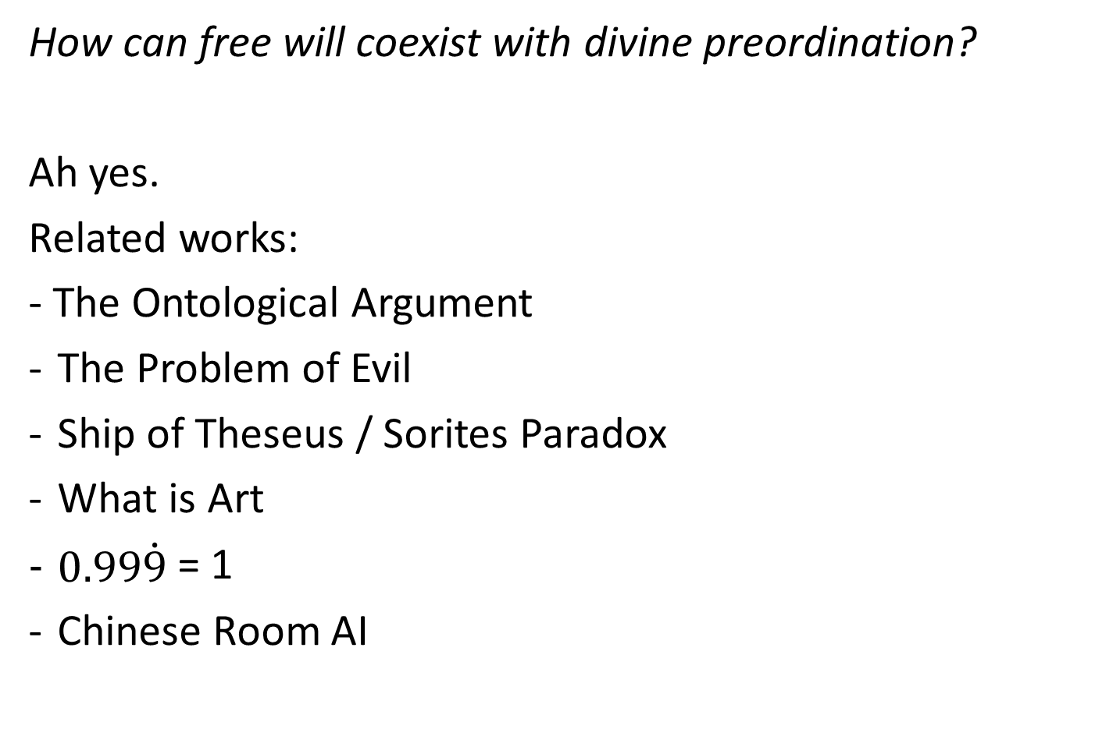
How can free will coexist with divine preordination?
Ah yes.
Related works:
- The Ontological Argument
The Problem of Evil
Ship of Theseus / Sorites Paradox
What is Art
$0.99\dot{9}$ = 1
Chinese Room AI

Slide 18
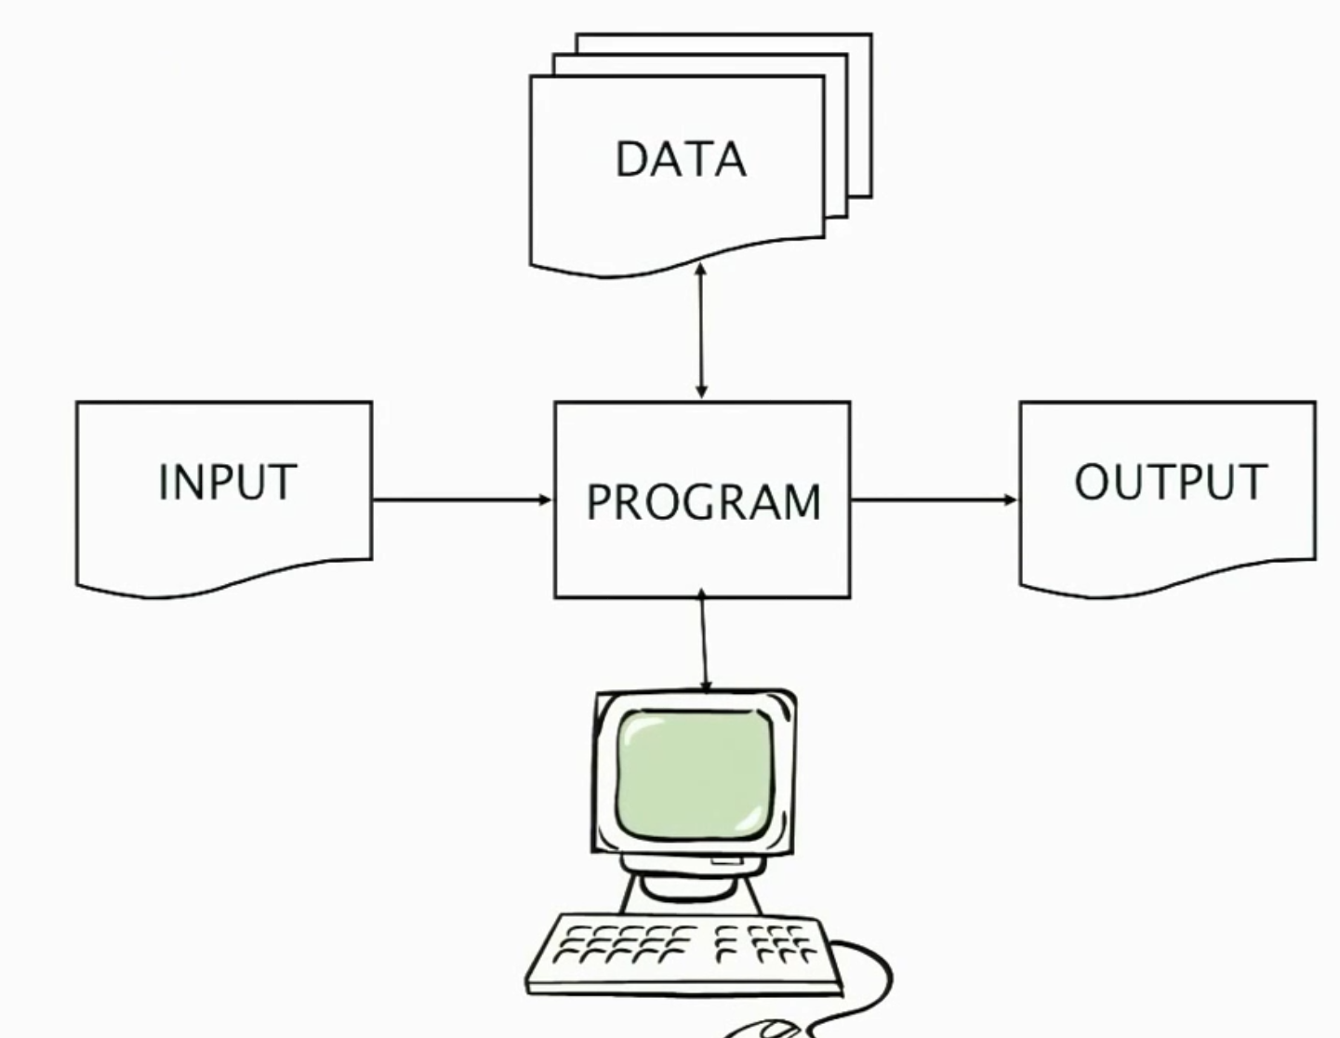

Slide 19
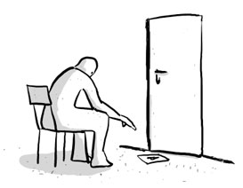
Short cuts to AI
With billions of images on the web, it’s often possible to find a close nearest neighbor.
We can shortcut hard problems by “looking up” the answer, stealing the labels from our nearest neighbor.
Notes:
Wikipedia:
Searle's thought experiment begins with this hypothetical premise: suppose that artificial intelligence research has succeeded in constructing a computer that behaves as if it understands Chinese. It takes Chinese characters as input and, by following the instructions of a computer program, produces other Chinese characters, which it presents as output. Suppose, says Searle, that this computer performs its task so convincingly that it comfortably passes the Turing test: it convinces a human Chinese speaker that the program is itself a live Chinese speaker. To all of the questions that the person asks, it makes appropriate responses, such that any Chinese speaker would be convinced that they are talking to another Chinese-speaking human being.
The question Searle wants to answer is this: does the machine literally "understand" Chinese? Or is it merely simulating the ability to understand Chinese?^{[6][c]} Searle calls the first position "strong AI" and the latter "weak AI".^{[d]}

Slide 20
So what is intelligence?
Weak AI:
The simulation of a ‘mind’ is a model for the ‘mind’.
Strong AI:
The simulation of a ‘mind’ is a ‘mind’.

Slide 21
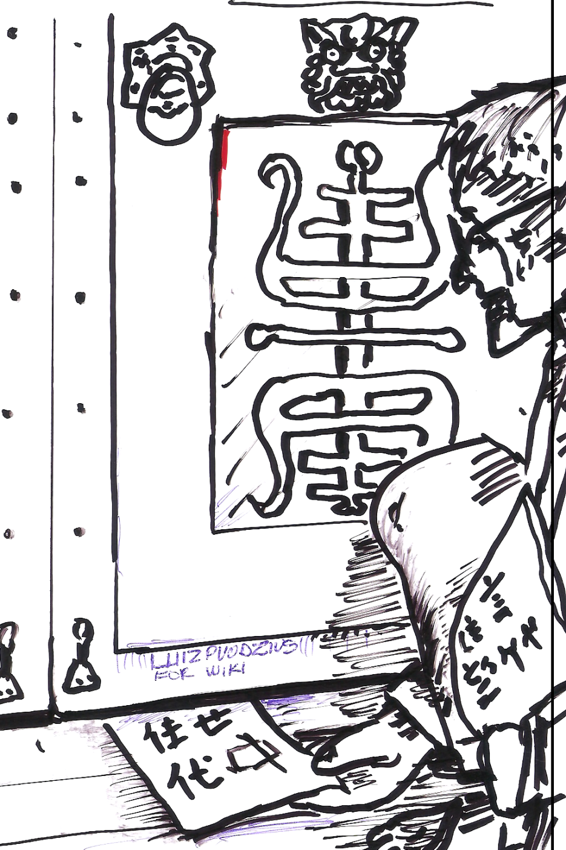
Chinese Room experiment, John Searle (1980)
If a machine can convincingly simulate an intelligent conversation, does it understand?
Notes:
Searle supposes that he is in a closed room and has a book with an English version of the computer program, along with sufficient paper, pencils, erasers, and filing cabinets. Searle could receive Chinese characters through a slot in the door, process them according to the program's instructions, and produce Chinese characters as output. If the computer had passed the Turing test this way, it follows that Searle would do so as well, simply by running the program manually.
Searle asserts that there is no essential difference between the roles of the computer and himself in the experiment. Each simply follows a program, step-by-step, producing a behavior which is then interpreted as demonstrating intelligent conversation. However, Searle would not be able to understand the conversation. ("I don't speak a word of Chinese",^{[9]} he points out.)
Therefore, he argues, it follows that the computer would not be able to understand the conversation either.
Searle argues that, without "understanding" (or "intentionality"), we cannot describe what the machine is doing as "thinking" and, since it does not think, it does not have a "mind" in anything like the normal sense of the word.
Therefore, he concludes that "strong AI" is a false idea; impossible.
Searle, American philosopher, Berkeley

Slide 22
Chinese Room experiment, John Searle (1980)
If a machine can convincingly simulate an intelligent conversation, does it understand?
Searle imagines himself in a room, acting as a computer by manually executing a program that convincingly simulates the behavior of a native Chinese speaker.
Most of the discussion consists of attempts to refute it.
"The overwhelming majority," notes BBS editor Stevan Harnad,“ still think that the Chinese Room Argument is dead wrong.“
The sheer volume of the literature that has grown up around it inspired Pat Hayes to quip that the field of cognitive science ought to be redefined as "the ongoing research program of showing Searle's Chinese Room Argument to be false.”
Notes:
The experiment is the centerpiece of Searle's Chinese Room Argument which holds that a program cannot give a computer a "mind" or "understanding", regardless of how intelligently it may make it behave. He concludes that "programs are neither constitutive of nor sufficient for minds." "I can have any formal program you like, but I still understand nothing."
Searle “according to strong AI, . . . the appropriately programmed computer really is a mind, in the sense that computers given the right programs can be literally said to understand and have other cognitive states.”
https://en.wikipedia.org/wiki/Chinese_room

Slide 23
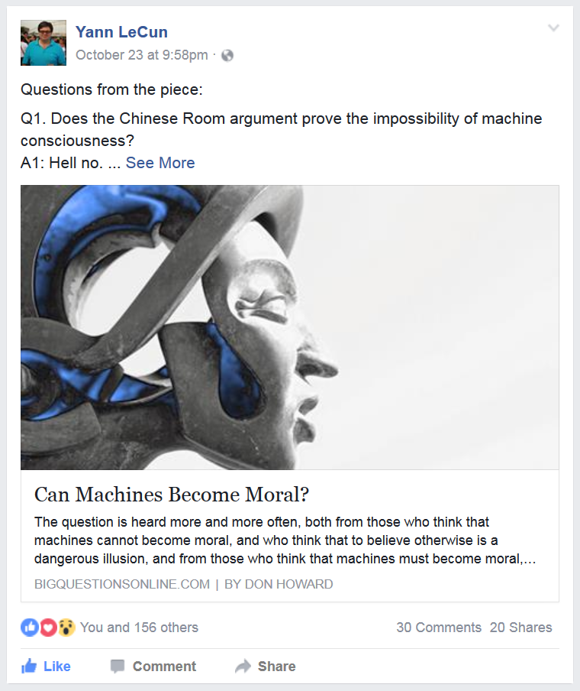
Notes:
Q1. Does the Chinese Room argument prove the impossibility of machine consciousness?
A1: Hell no.
Q2. Do we want to live in a world that we share with ethical robots?
A2: sure beats living in a world with robots that have no sense of ethics and morality, and no sense the notion of common good..
Q3. Some people think that experiments in programming machine morality will help us better to understand human morality. Do you agree?
A3: Yes, absolutely.
Q4. If we succeed in programming machine morality, must it be always and everywhere the same? Or should we allow for the possibility that the moral behavior of robots might vary as widely as does human moral behavior?
A4: probably allow for some variation, as the ideal of morality and ethics varies across cultures.

Slide 24
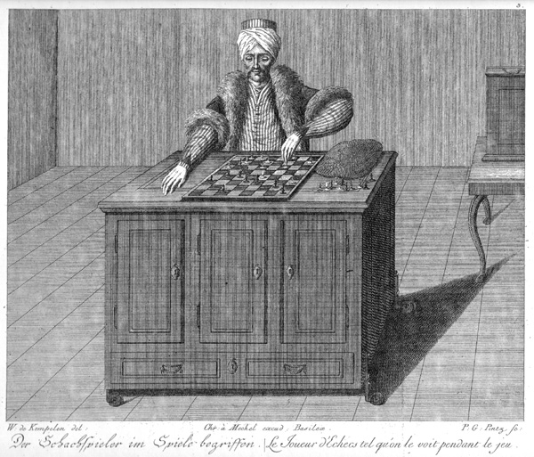
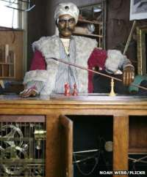
Mechanical Turk
von Kempelen, 1770.
Robotic chess player.
Clockwork routines.
Magnetic induction (not vision)
Toured the world; played
Napoleon Bonaparte
and Benjamin Franklin.
Notes:
Wolfgang von Kempelen
https://ericscrivner.me/2015/04/mechanical-python-guide-1/
Modern reconstruction - John Gaughan

Slide 25
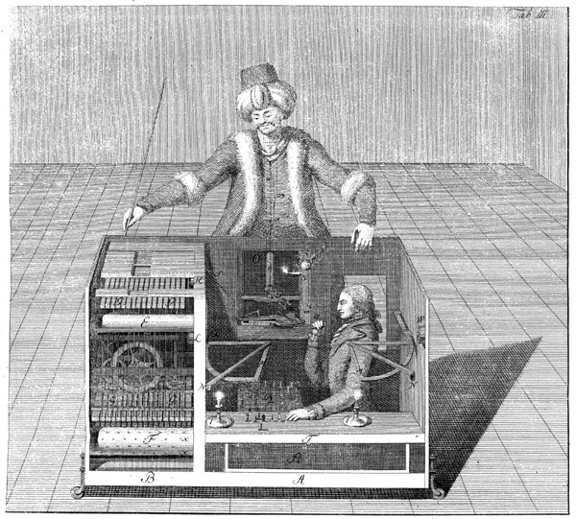
Mechanical Turk
It was all a ruse!
Ho ho ho.
Notes:
Image - Racknitz - Wikipedia

Slide 26
"Can machines fly?"
Yes; aeroplanes exist.
"Can machines fly like a bird?"
No, because aeroplanes don’t flap.
"Can machines perceive?”
“Can machines understand?"
Are these question like the first, or like the second?
[Adapted from Norvig]
Notes:
Norvig – director of research at Google; Brown alumnus (applied math)

Slide 27
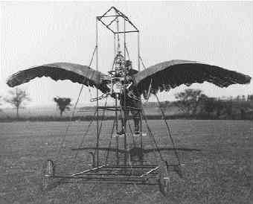
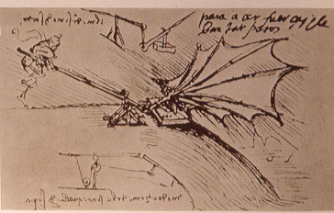
Ornithopters
James Hays

Slide 28
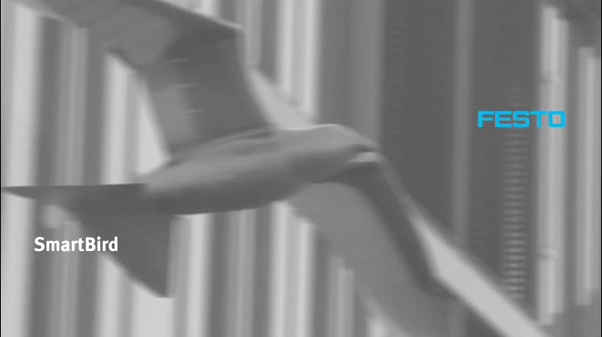
Festo SmartBird [2011]

Slide 29
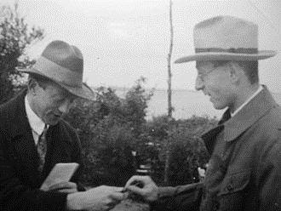
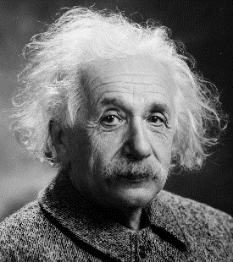
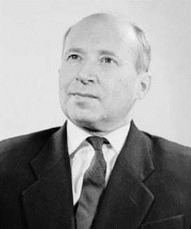
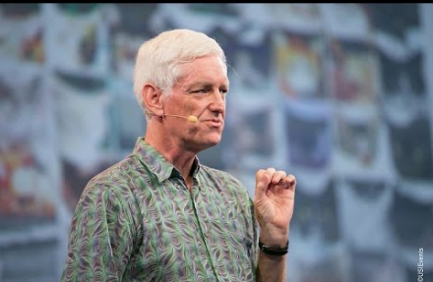
The Unreasonable Effectiveness of Math
“The miracle of the appropriateness of the language of mathematics…”
Eugene Wigner
“The most incomprehensible thing about the universe is that it is comprehensible.”
Albert Einstein
“There is only one thing which is more unreasonable than the unreasonable effectiveness of mathematics in physics, and this is the unreasonable ineffectiveness of mathematics in biology.”
Israel Gelfand
“We should stop acting as if our goal is to author extremely elegant theories, and instead embrace complexity and make use of the best ally we have:
the unreasonable effectiveness of data.”
Peter Norvig

Slide 30
When something is not working…
…how do I know what to do next?

Slide 31
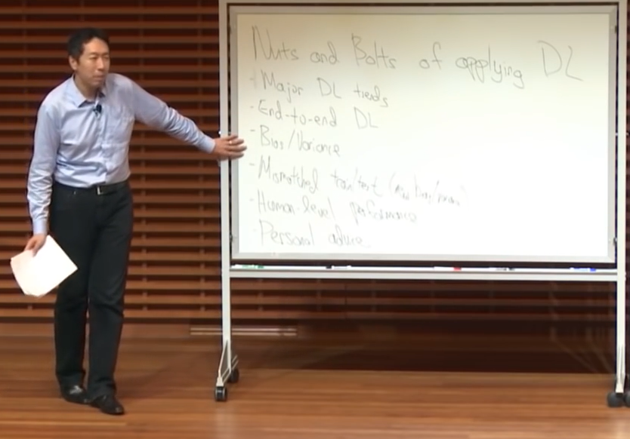
The Nuts and Bolts of Building Applications using Deep Learning
Andrew Ng - NIPS 2016
https://youtu.be/F1ka6a13S9I
Notes:
Andrew Ng leads ~1000 people at Baidu
Was a professor at Stanford

Slide 32
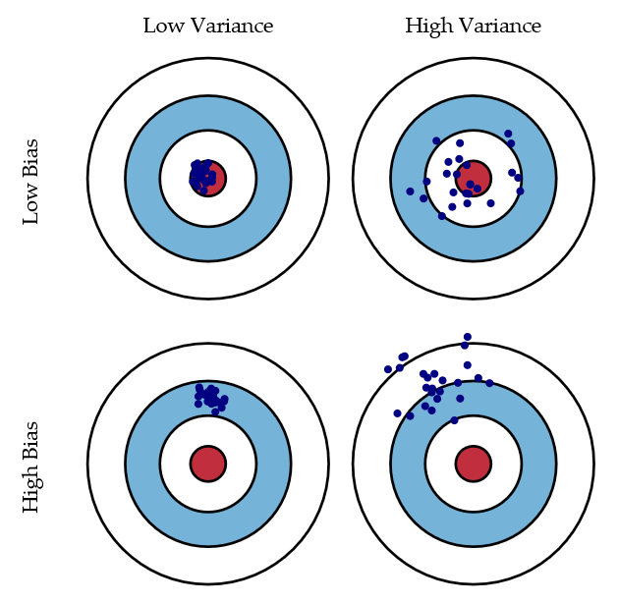
Bias/variance trade-off
"It takes surprisingly long time to grok bias and variance deeply, but
people that understand bias and variance deeply are often able to
drive very rapid progress." --Andrew Ng
Bias = accuracy
Variance = precision
Scott Fortmann-Roe
Notes:
http://scott.fortmann-roe.com/docs/BiasVariance.html
“Bias: The error due to bias is taken as the difference between the expected (or average) prediction of our model and the correct value which we are trying to predict.
Variance: The error due to variance is taken as the variability of a model prediction for a given data point.”

Slide 33
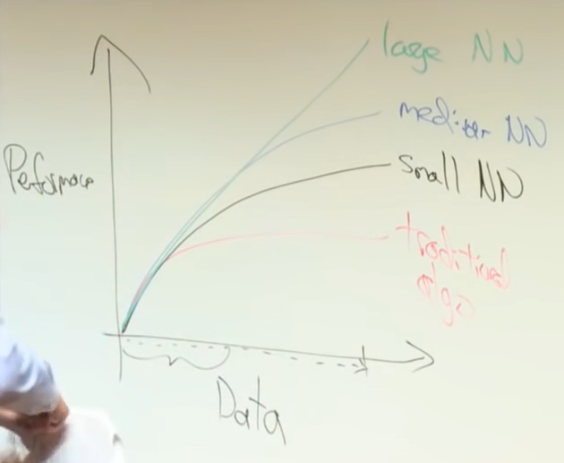

Slide 34
Go collect a dataset
Most important thing:
  Training data must represent target application!
Take all your data
  60% training
  40% testing
    20% testing
    20% validation (or ‘development’)

Slide 35
Properties
Human level error = 1%
Training set error = 10%
Validation error = 10.2%
Test error = 10.4%
“Bias”
“Variance”
Overfitting to validation
Notes:
In this case, I have high bias – my data isn’t right.
High variance = needs regularization

Slide 36
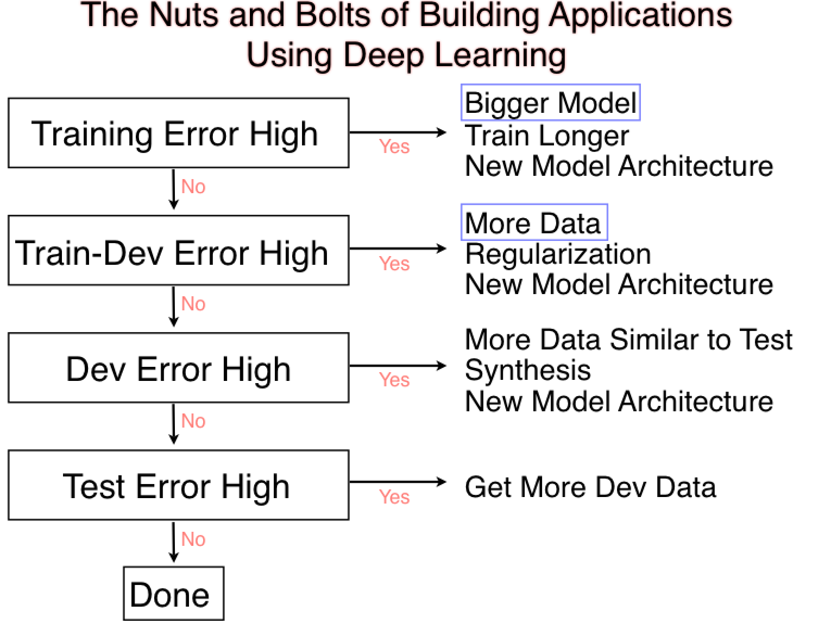
Val
Val
Val
[Andrew Ng]
Notes:
Training error high? High bias problem. Model can’t represent the data.
Bigger model = more parameters
Train longer = make sure my algorithm is correct, e.g., learning rate, so on.
New architecture = complex.
Validation error high? High variance problem

Slide 37
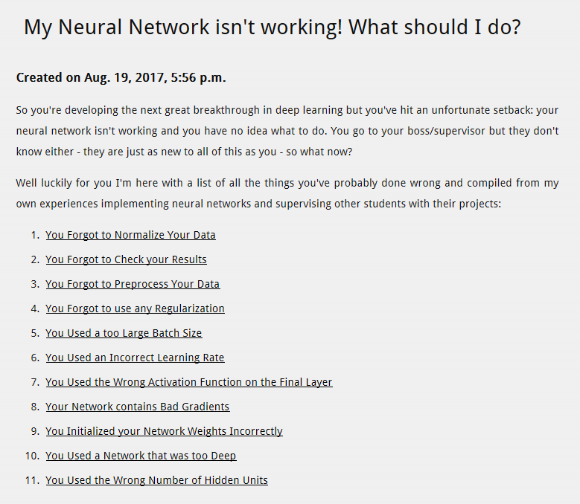
Daniel Holden
http://theorangeduck.com/page/neural-network-not-working

Slide 38
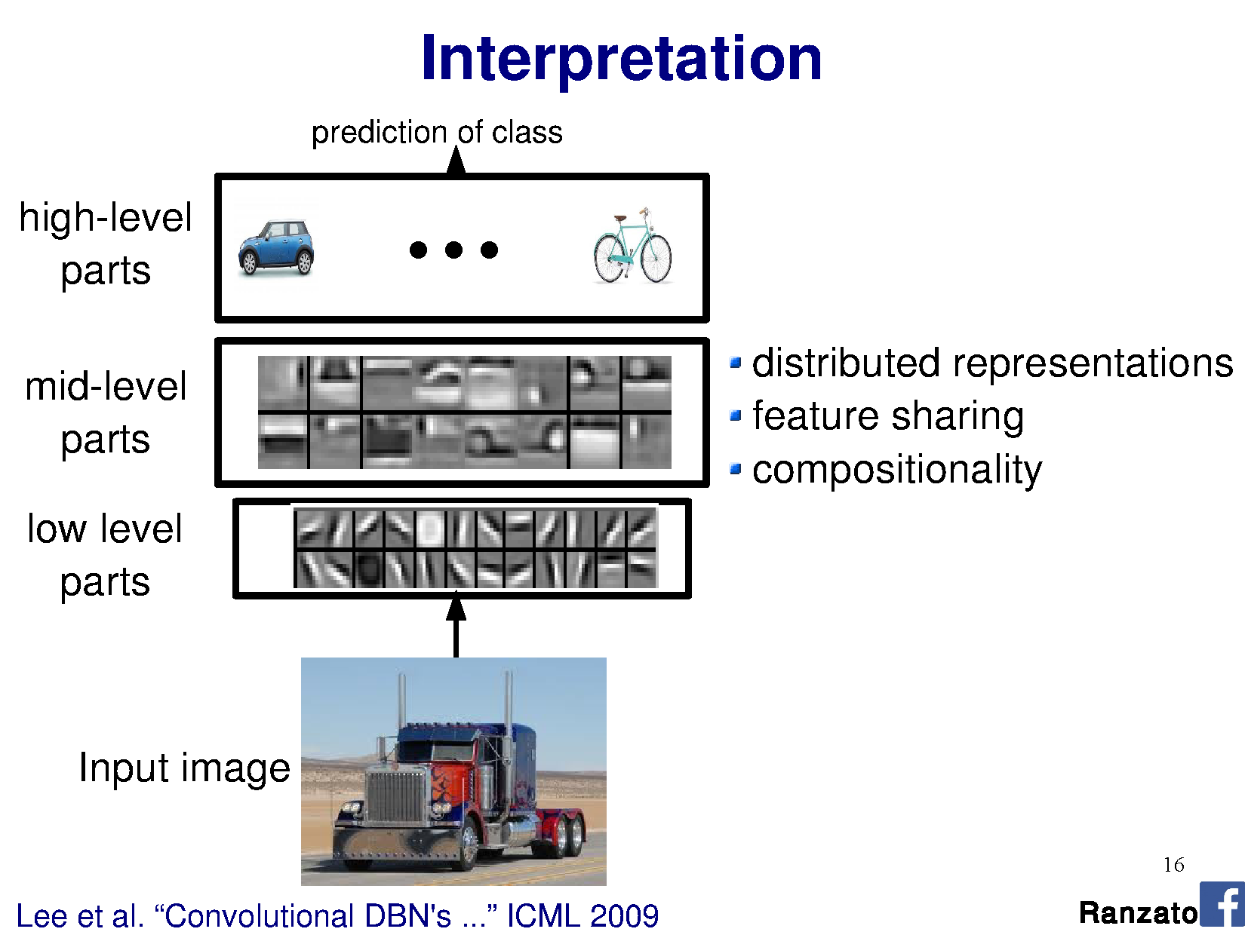

Slide 39
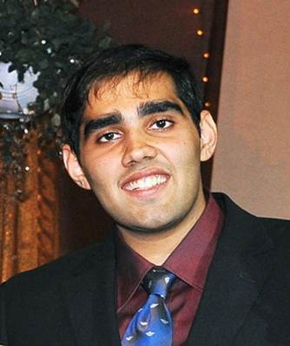
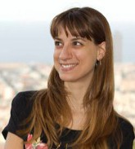


Object Detectors Emerge in Deep Scene CNNs
Bolei Zhou, Aditya Khosla, Agata Lapedriza, Aude Oliva, Antonio Torralba
Massachusetts Institute of Technology
ICLR 2015
Notes:
ICLR = international conference on learning representations

Slide 40
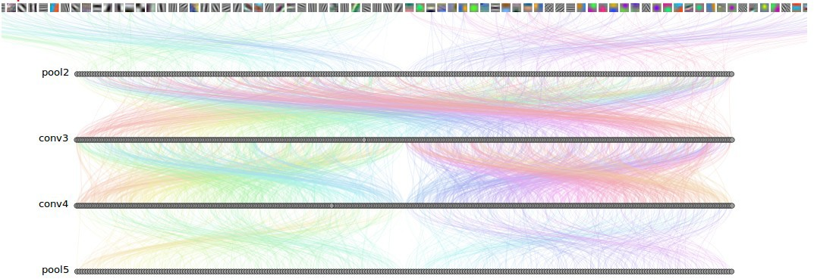
How Objects are Represented in CNN?
CNN uses distributed code to represent objects.
Conv1
Conv2
Conv3
Conv4 Pool5
Agrawal, et al. Analyzing the performance of multilayer neural networks for object recognition. ECCV, 2014 Szegedy, et al. Intriguing properties of neural networks.arXiv preprint arXiv:1312.6199, 2013.
Zeiler, M. et al. Visualizing and Understanding Convolutional Networks, ECCV 2014.

Slide 41
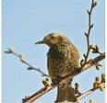
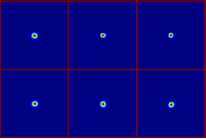
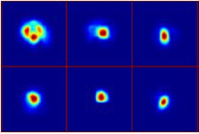
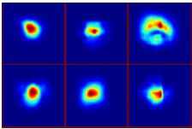
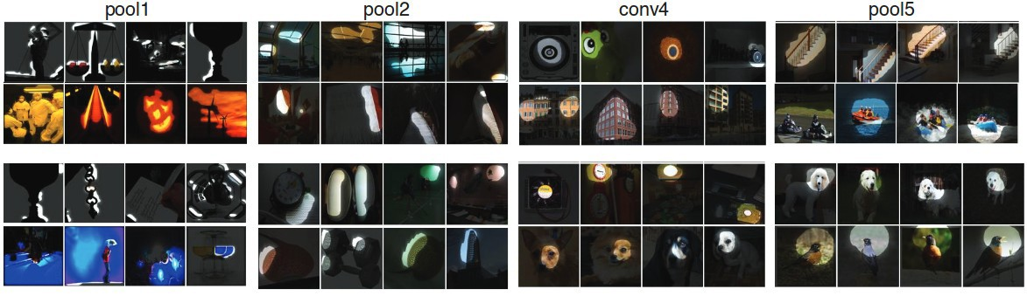
Estimating the Receptive Fields
Estimated receptive fields
pool1
Actual size of RF is much smaller than the theoretic size
conv3 pool5
Segmentation using the RF of Units
More semantically meaningful

Slide 42
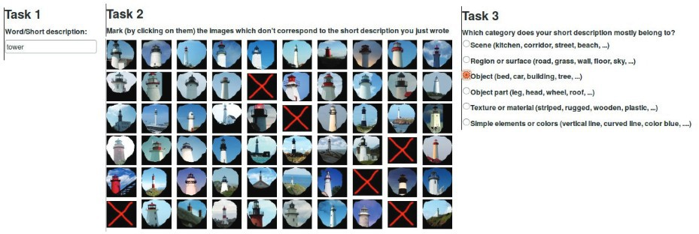
Annotating the Semantics of Units
Top ranked segmented images are cropped and sent to Amazon Turk for annotation.

Slide 43
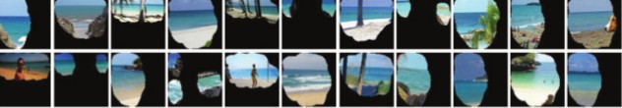
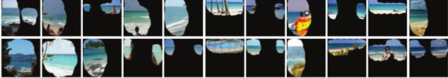

Annotating the Semantics of Units
Pool5, unit 76; Label: ocean; Type: scene; Precision: 93%

Slide 44
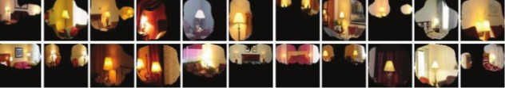
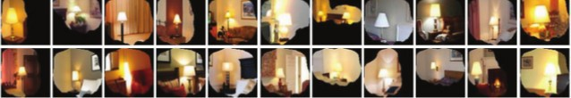
Annotating the Semantics of Units
Pool5, unit 13; Label: Lamps; Type: object; Precision: 84%

Slide 45
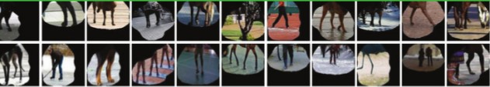
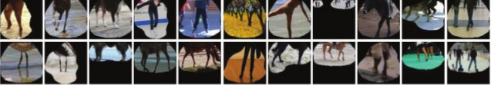

Annotating the Semantics of Units
Pool5, unit 77; Label:legs; Type: object part; Precision: 96%

Slide 46
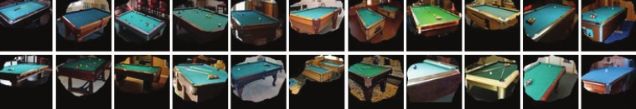
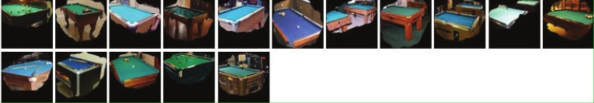

Annotating the Semantics of Units
Pool5, unit 112; Label: pool table; Type: object; Precision: 70%

Slide 47
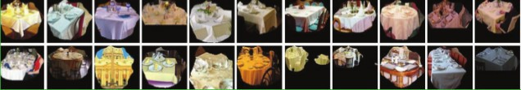
Annotating the Semantics of Units
Pool5, unit 22; Label: dinner table; Type: scene; Precision: 60%

Slide 48

ImageNet vs. PlacesNet
http://places2.csail.mit.edu/demo.html
ImageNet
  ~1 mil object-level images over 1000 classes
PlacesNet
  ~1.8 million images from 365 scene categories
  (at most 5000 images per category).
Notes:
Vs SUN 397, which had at least 100 images in each of 397 classes

Slide 49













Distribution of Semantic Types at Each Layer

Slide 50
Distribution of Semantic Types at Each Layer
Object detectors emerge within CNN trained to classify scenes, without any object supervision!

Slide 51


Slide 52


Slide 53


Slide 54
Interesting CNN properties
…or other ways to measure reception
http://yosinski.com/deepvis

Slide 55


Occlusion experiments
(as a function of the position of the square of zeros in the original image)
[Zeiler & Fergus 2014]
Andrej Karpathy

Slide 56
Occlusion experiments
(as a function of the position of the square of zeros in the original image)
[Zeiler & Fergus 2014]
Andrej Karpathy

Slide 57


What input to a neuron maximizes a class score?
To visualize the function of a specific unit in a neural network, we synthesize an input to that unit which causes high activation.
Neuron of choice i
An image of random noise x.
Repeat:
Forward propagate: compute activation a_{i}(x)
Back propagate: compute gradient at neuron ∂a_{i}(x) / ∂x
Add small amount of gradient back to noisy image.
Andrej Karpathy
Notes:
Activation = result of the convolution
Next, we do a forward pass using this image xx as input to the network to compute the activation ai(x)ai(x) caused by xx at some neuron ii somewhere in the middle of the network. Then we do a backward pass (performing backprop) to compute the gradient of ai(x)ai(x) with respect to earlier activations in the network. At the end of the backward pass we are left with the gradient ∂ai(x)/∂x∂ai(x)/∂x , or how to change the color of each pixel to increase the activation of neuron ii . We do exactly that by adding a little fraction αα of that gradient to the image:
x←x+α⋅∂ai(x)/∂x
We keep doing that repeatedly until we have an image x∗x∗ that causes high activation of the neuron in question.

Slide 58

What image maximizes a class score?
[Understanding Neural Networks Through Deep Visualization, Yosinski et al. , 2015]
http://yosinski.com/deepvis
Andrej Karpathy

Slide 59

What image maximizes a class score?
Andrej Karpathy

Slide 60
Wow!
They just ‘fall out’!
Notes:
https://blog.keras.io/the-limitations-of-deep-learning.html

Slide 61

Francois Chollet - https://blog.keras.io/the-limitations-of-deep-learning.html
Notes:
But no

Slide 62

Breaking CNNs
Intriguing properties of neural networks [Szegedy ICLR 2014]
Andrej Karpathy

Slide 63

Fooling a linear classifier
To fool a linear classifier, add a small multiple of the weight vector to the training example:
x ← x + αw
http://karpathy.github.io/2015/03/30/breaking-convnets/
Jia-bin Huang

Slide 64

Breaking CNNs
Deep Neural Networks are Easily Fooled: High Confidence Predictions for Unrecognizable Images [Nguyen et al. CVPR 2015]
Jia-bin Huang
Notes:
But what types of images does this process produce? As we showed in a previous paper titled Deep networks are easily fooled: high confidence predictions for unrecognizable images, the results when this process is carried out on final-layer output neurons are images that the DNN thinks with near certainty are everyday objects, but that are completely unrecognizable as such.
Synthesizing images without regularization leads to “fooling images”: The DNN is near-certain all of these images are examples of the listed classes (over 99.6% certainty for the class listed under the image), but they are clearly not
http://www.cv-foundation.org/openaccess/content_cvpr_2015/papers/Nguyen_Deep_Neural_Networks_2015_CVPR_paper.pdf

Slide 65

Adversarial Patches
https://www.theverge.com/2018/1/3/16844842/ai-computer-vision-trick-adversarial-patches-google
https://arxiv.org/pdf/1712.09665.pdf
[Brown et al., Google, 2018]

Slide 66

Francois Chollet - https://blog.keras.io/the-limitations-of-deep-learning.html
Notes:
Do not anthropormorphise what is going on! Is not a general intelligence that can abstract.

Slide 67

Francois Chollet - https://blog.keras.io/the-limitations-of-deep-learning.html

Slide 68

For next time: The success of obfuscating gradients
https://github.com/anishathalye/obfuscated-gradients

Slide 69

For next time: human + CV adversarial examples
https://arxiv.org/abs/1802.08195
JT note: does this actually work?

Slide 70
Reconstructing images
Question: Given a CNN code, is it possible to reconstruct the original image?
Andrej Karpathy

Slide 71


Reconstructing images
Find an image such that:
Its code is similar to a given code
It “looks natural”
  Neighboring pixels should look similar
Image
Andrej Karpathy

Slide 72

Reconstructing images
original image
Reconstructions from the 1000 log probabilities for ImageNet (ILSVRC)
classes
Understanding Deep Image Representations by Inverting Them
[Mahendran and Vedaldi, 2014]
Andrej Karpathy

Slide 73

Reconstructing images
Reconstructions from the representation after last last pooling layer
(immediately before the first Fully Connected layer)
Andrej Karpathy

Slide 74




DeepDream
DeepDream https://github.com/google/deepdream
Andrej Karpathy

Slide 75



DeepDream
DeepDream modifies the image in a way that “boosts” all activations, at any layer
This creates a feedback loop: e.g., any slightly detected dog face will be made more and more dog-like over time.
Andrej Karpathy

Slide 76
DeepDream
Deep Dream Grocery Trip
https://www.youtube.com/watch?v=DgPaCWJL7XI
Deep Dreaming Fear & Loathing in Las Vegas: the Great San Francisco Acid Wave https://www.youtube.com/watch?v=oyxSerkkP4o
Andrej Karpathy

Slide 77
Style transfer

Slide 78



Neural Style
[ A Neural Algorithm of Artistic Style by Leon A. Gatys, Alexander S. Ecker, and Matthias Bethge, 2015] good implementation by Justin Johnson in Torch: https://github.com/jcjohnson/neural-style
Andrej Karpathy

Slide 79

Neural Style
Step 1: Extract content targets (ConvNet activations of all layers for the given content image)
content activations
e.g.
at CONV5_1 layer we would have a [14x14x512] array of target activations
Andrej Karpathy

Slide 80
Neural Style
Step 2: Extract style targets (Gram matrices of ConvNet activations of all layers for the given style image)
style gram matrices
e.g.
at CONV1 layer (with [224x224x64] activations) would give a [64x64] Gram matrix of all pairwise activation covariances (summed across spatial locations)
Andrej Karpathy

Slide 81

Neural Style
Step 3: Optimize over image to have:
The content of the content image (activations match content)
The style of the style image (Gram matrices of activations match style)
match content
match style
Adapted from Andrej Karpathy

Slide 82








Neural Style
make your own easily on deepart.io
Andrej Karpathy

Slide 83

Dataset Distillation
https://arxiv.org/pdf/1811.10959.pdf

