Slide 1


Slide 2
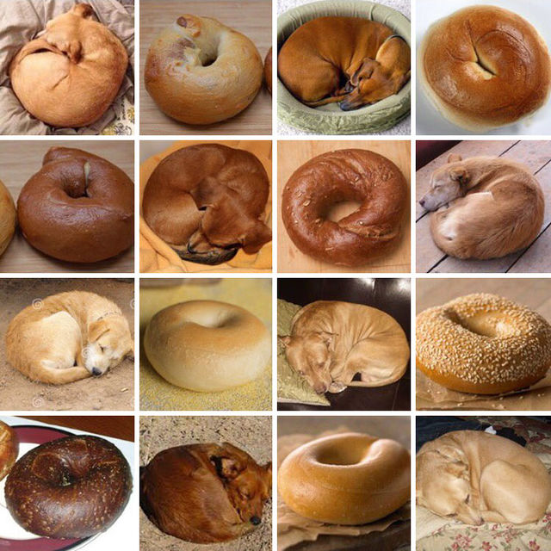

Slide 3


Slide 4
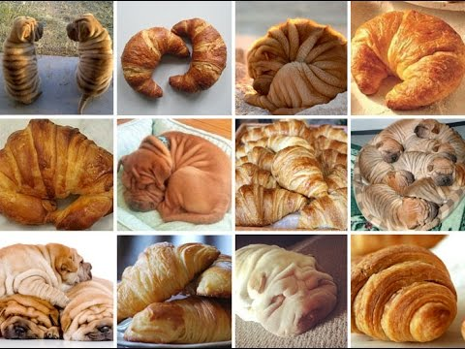

Slide 5
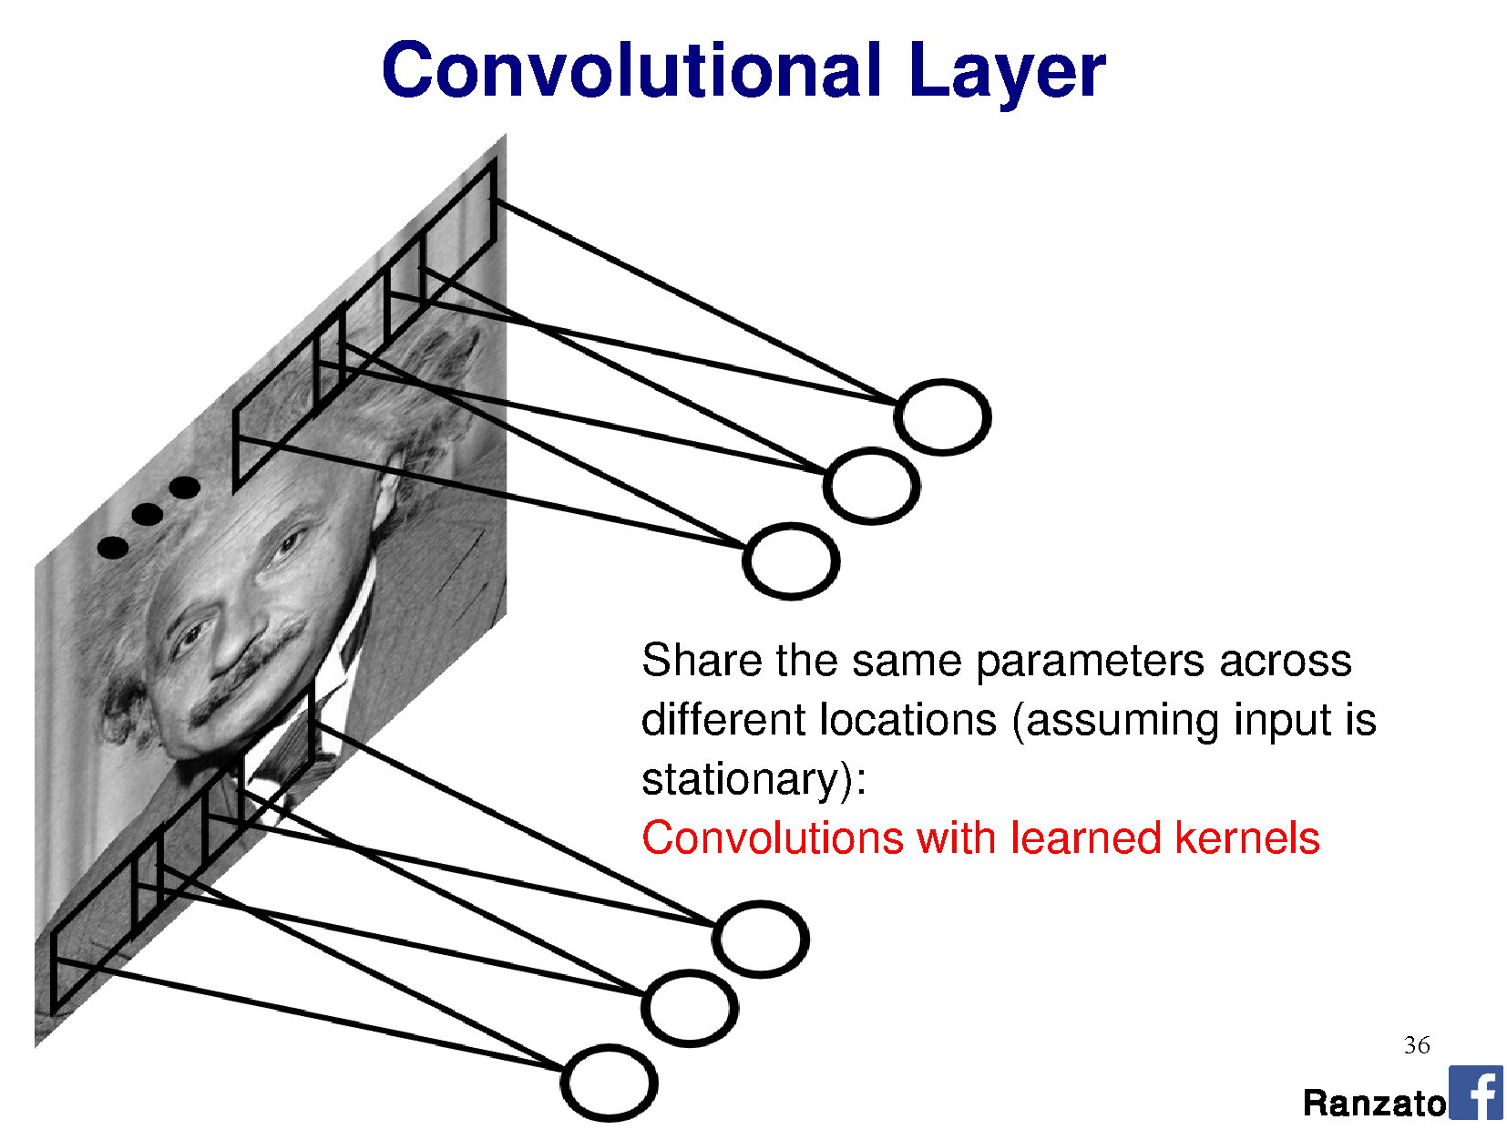


Perceptron:
This is convolution!

Slide 6
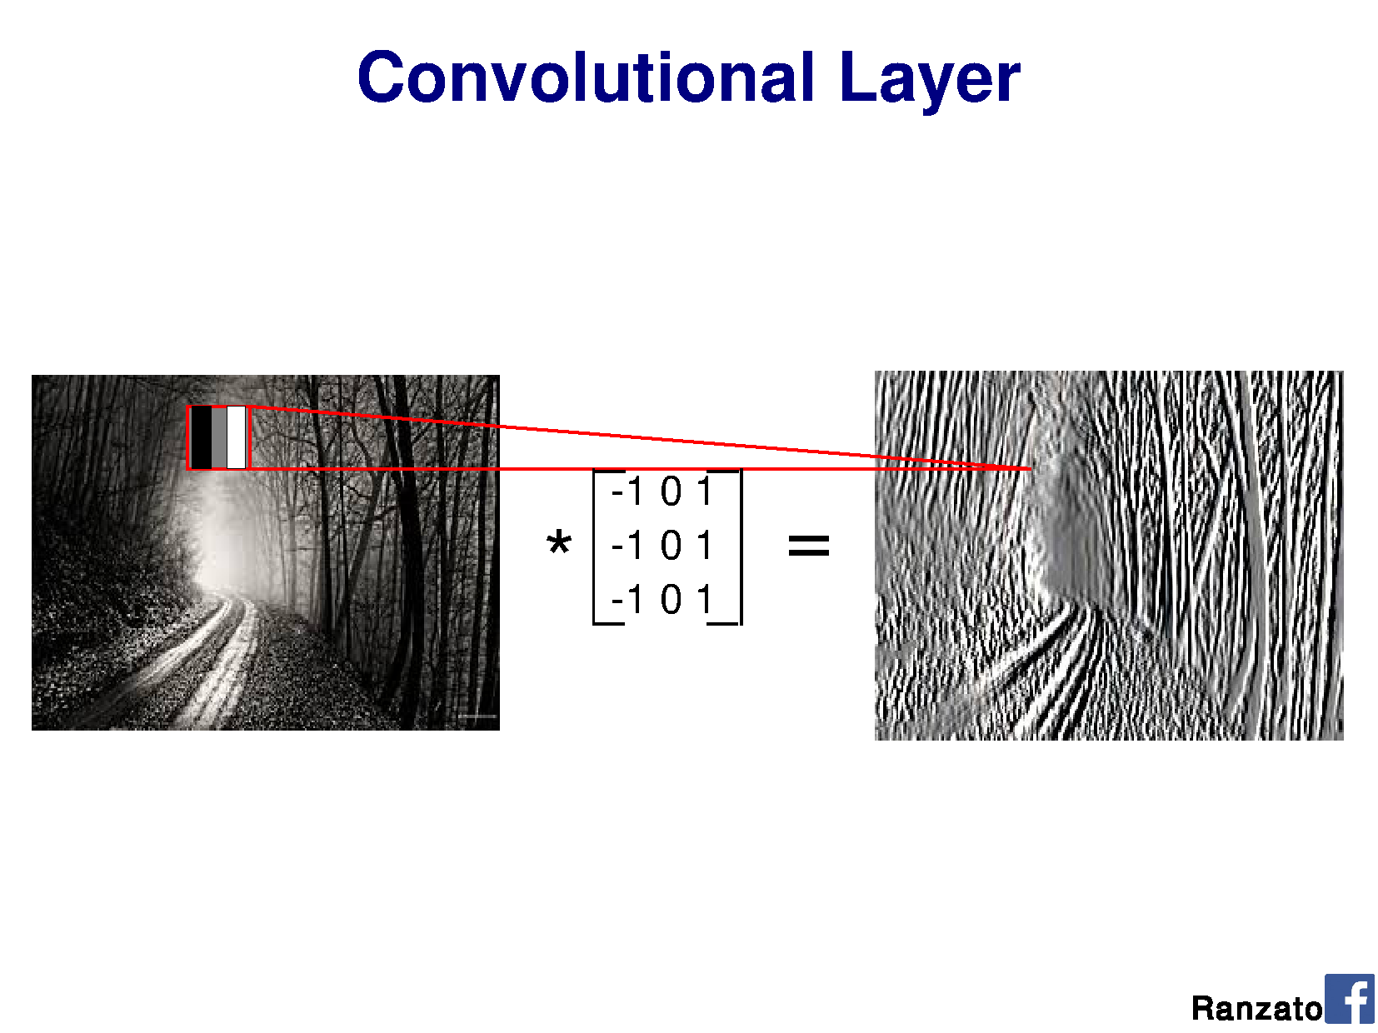
v
v
v
Shared weights
v
Notes:
Output should be a little smaller, as we aren’t padding

Slide 7
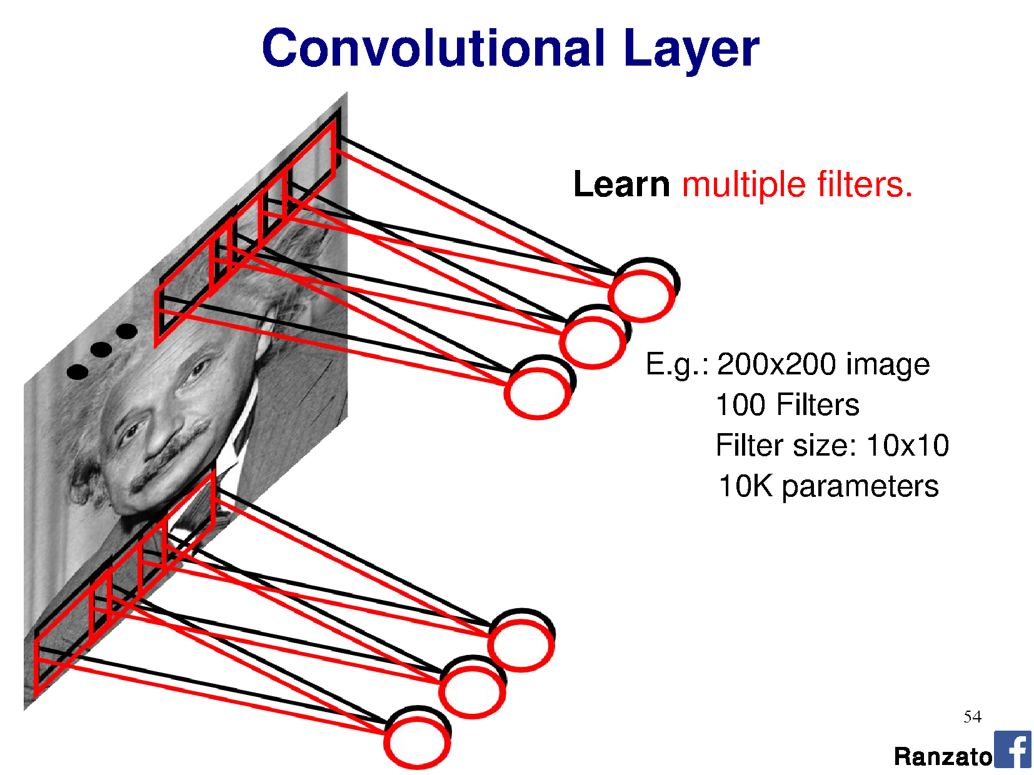
Filter = ‘local’ perceptron.
Also called kernel.
Notes:
This is the major trick.
For each layer of the neural network, we’re going to learn multiple filters.

Slide 8
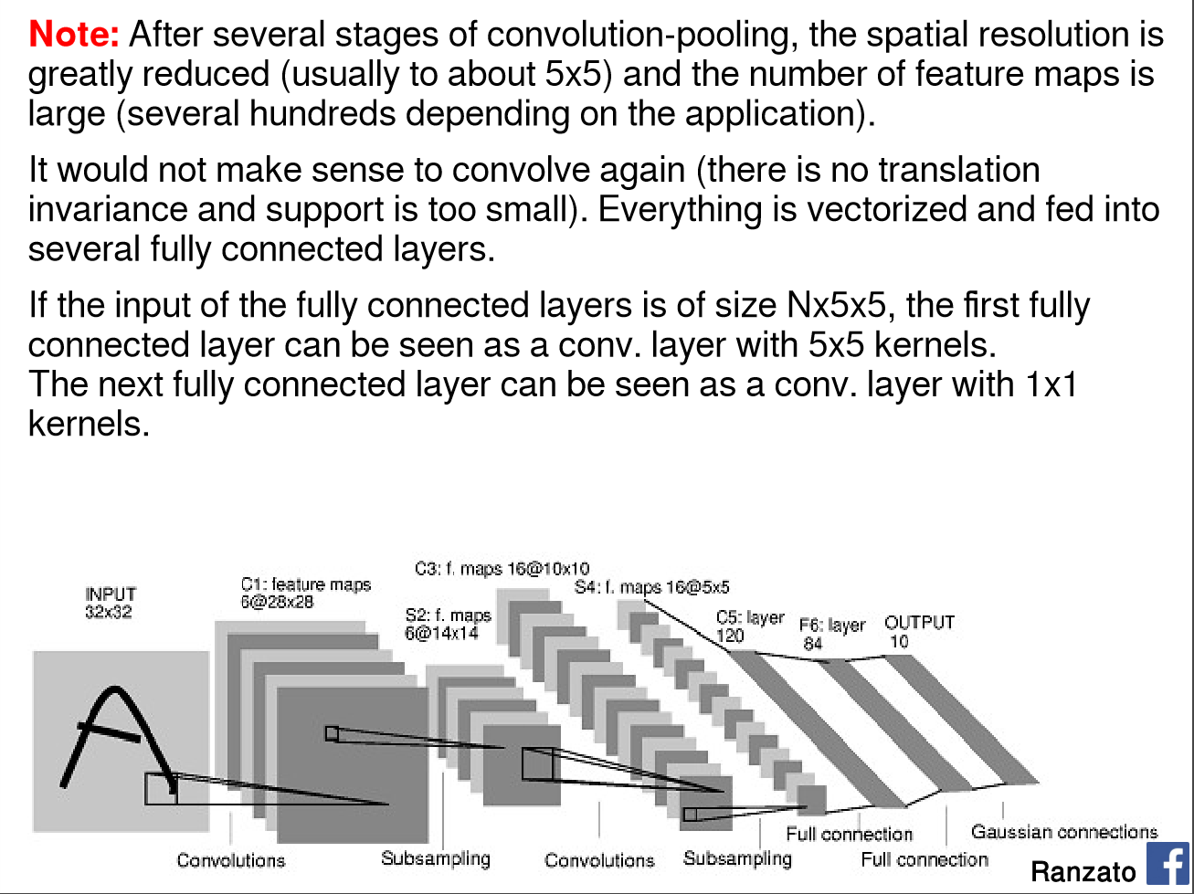
Yann LeCun’s MNIST CNN architecture

Slide 9
DEMO
http://scs.ryerson.ca/~aharley/vis/conv/
Thanks to Adam Harley for making this.
More here: http://scs.ryerson.ca/~aharley/vis

Slide 10
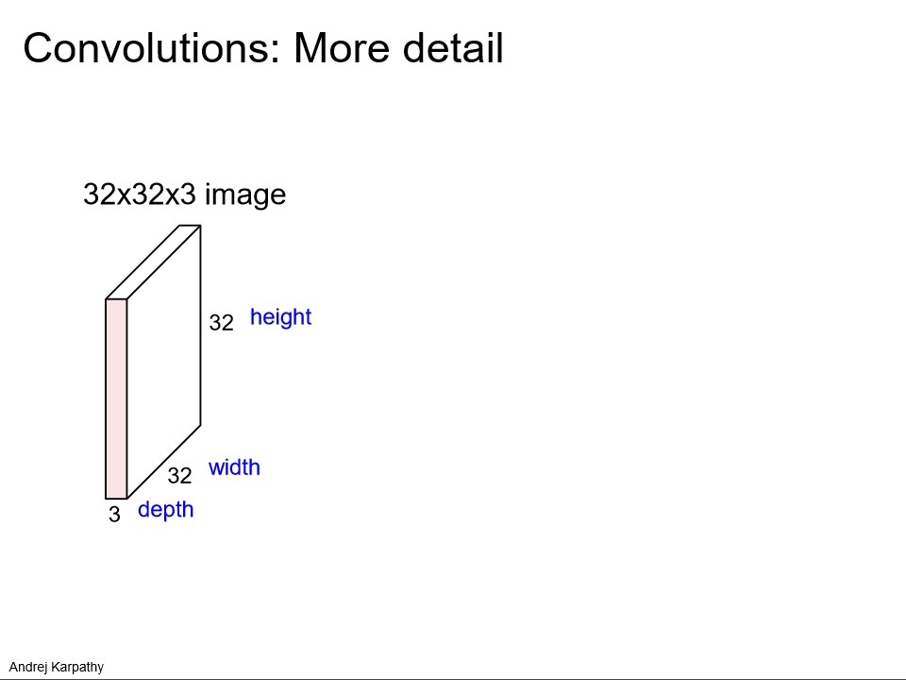

Slide 11
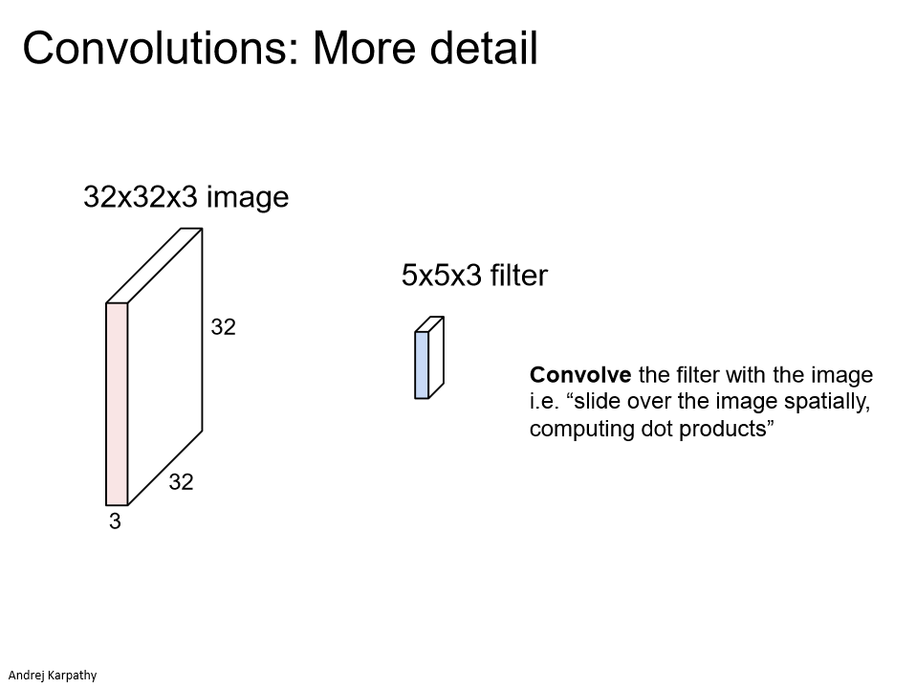

Slide 12
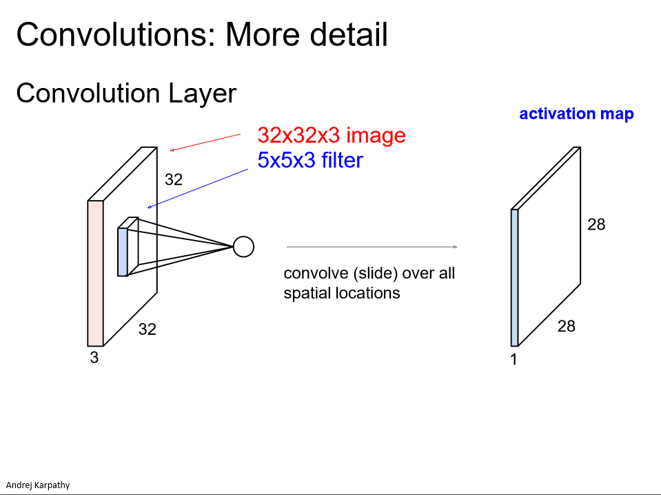

Slide 13
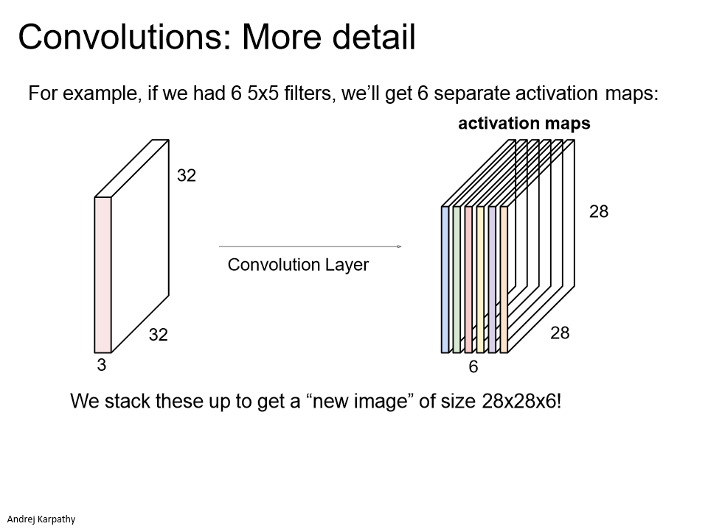

Slide 14
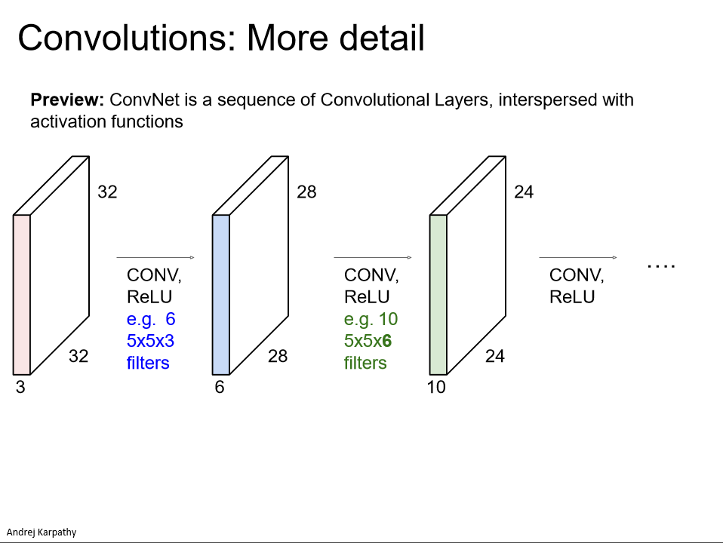

Slide 15
Think-Pair-Share
Input size: 96 x 96 x 3
Kernel size: 5 x 5 x 3
Stride: 1
Max pooling layer: 4 x 4
Output feature map size?
a) 5 x 5
b) 22 x 22
c) 23 x 23
d) 24 x 24
e) 25 x 25
Input size: 96 x 96 x 3
Kernel size: 3 x 3 x 3
Stride: 3
Max pooling layer: 8 x 8
Output feature map size?
a) 2 x 2
b) 3 x 3
c) 4 x 4
d) 5 x 5
e) 12 x 12
Notes:
Answers:
Left: 23 x 23 -> 96 – 2 – 2 from valid region only. Then, 92 x 92 / 4 = 23x23
Right: 4 x 4 -> 94 – 1 – 1 from valid region only. Then,

Slide 16
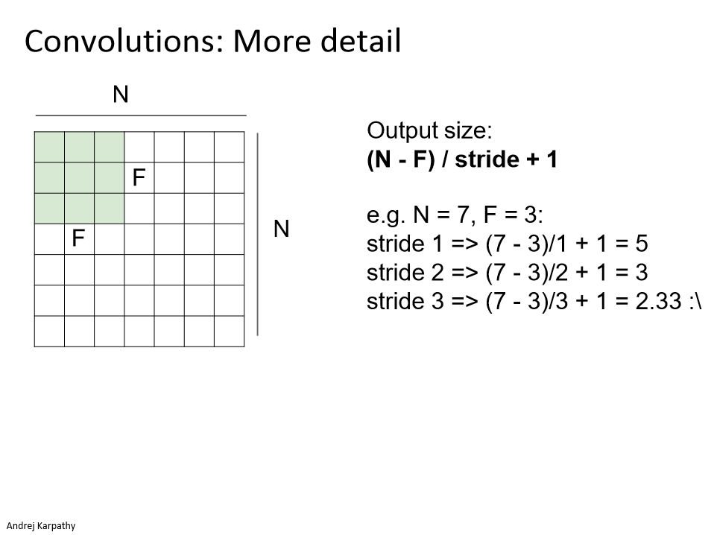
Notes:
Stride 1
Stride 2
Stride 3

Slide 17
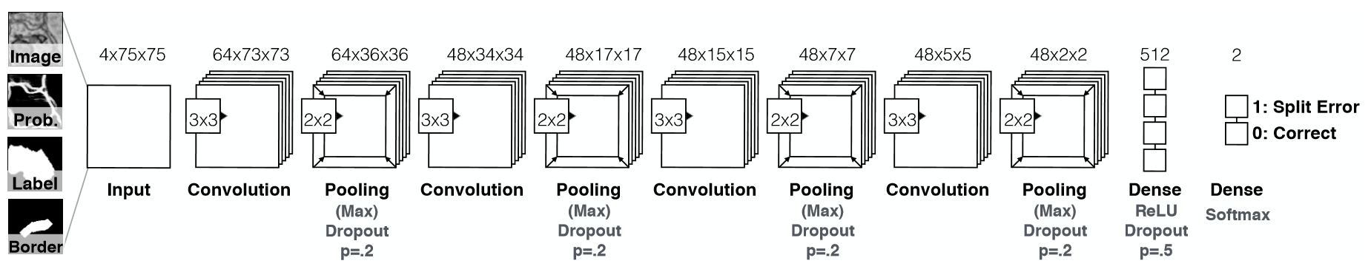
Our connectomics diagram
Auto-generated from network declaration by nolearn (for Lasagne / Theano)
Input
75x75x4
Conv 1
3x3x4
64 filters
Conv 2
3x3x64
48 filters
Conv 3
3x3x48
48 filters
Conv 4
3x3x48
48 filters
Max pooling
2x2 per filter
Max pooling
2x2 per filter
Max pooling
2x2 per filter
Max pooling
2x2 per filter
Notes:
https://github.com/dnouri/nolearn
More details: https://people.cs.pitt.edu/~kovashka/cs2750_sp17/ml_11_cnns.pdf

Slide 18
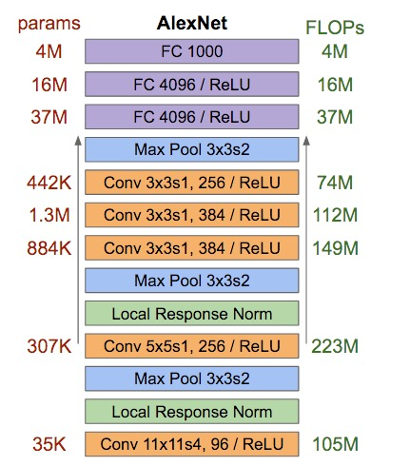
Reading architecture diagrams
Layers
Kernel sizes
Strides
# channels
# kernels
Max pooling

Slide 19
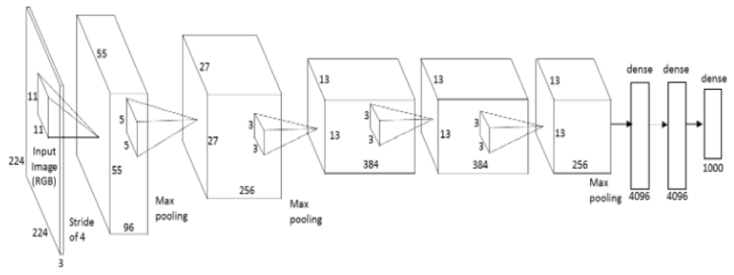
AlexNet diagram (simplified)
[Krizhevsky et al. 2012]
Input size
227 x 227 x 3
227
227
3x3
Stride 2
3x3
Stride 2
Conv 1
11 x 11 x 3
Stride 4
96 filters
Conv 2
5 x 5 x 96
Stride 1
256 filters
Conv 3
3 x 3 x 256
Stride 1
384 filters
Conv 4
3 x 3 x 192
Stride 1
384 filters
Conv 4
3 x 3 x 192
Stride 1
256 filters
Notes:
Input: 227 x 227 x 3 image.
11x11 kernel, stride 4 (AlexNet – 11x11x3 kernels, 96 of them)
5x5 kernel, stride 1, max pool 2x2 (AlexNet – 5x5x48 kernels, 256 of them)
3x3 kernels, (AlexNet – 3x3x256 kernels, 384 of them)
3x3 kernels (AlexNet – 3x3x192 kernels, 384 of them)
3x3 kernels, (AlexNet – 3x3x192 kernels, 256 of them)
FC – 2048 neurons
FC – 2048 neurons
Output – 1000 neurons

Slide 20
AlexNet diagram (simplified)
[Krizhevsky et al. 2012]
Input size
227 x 227 x 3
227
227
3x3
Stride 2
3x3
Stride 2
Eh?
Conv 3
3 x 3 x 256
Stride 1
384 filters
Conv 4
3 x 3 x 192
Stride 1
256 filters
Conv 1
11 x 11 x 3
Stride 4
96 filters
Conv 2
5 x 5 x 48
Stride 1
256 filters
Conv 4
3 x 3 x 192
Stride 1
384 filters
Eh? Shouldn’t these be equal?
Notes:
Input: 227 x 227 x 3 image.
11x11 kernel, stride 4 (AlexNet – 11x11x3 kernels, 96 of them)
5x5 kernel, stride 1, max pool 2x2 (AlexNet – 5x5x48 kernels, 256 of them)
3x3 kernels, (AlexNet – 3x3x256 kernels, 384 of them)
3x3 kernels (AlexNet – 3x3x192 kernels, 384 of them)
3x3 kernels, (AlexNet – 3x3x192 kernels, 256 of them)
FC – 2048 neurons
FC – 2048 neurons
Output – 1000 neurons

Slide 21
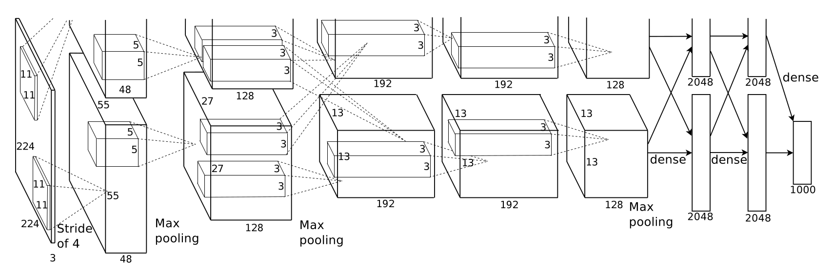
AlexNet diagram (unsimplified)
[Krizhevsky et al. 2012]
Not enough memory for all the weights – use two GPUs!
GPU 1
GPU 2
227
227
Notes:
Input: 227 x 227 x 3 image.
11x11 kernel, stride 4 (AlexNet – 11x11x3 kernels, 96 of them)
5x5 kernel, stride 1, max pool 2x2 (AlexNet – 5x5x48 kernels, 256 of them)
3x3 kernels, (AlexNet – 3x3x256 kernels, 384 of them)
3x3 kernels (AlexNet – 3x3x192 kernels, 384 of them)
3x3 kernels, (AlexNet – 3x3x192 kernels, 256 of them)
FC – 2048 neurons
FC – 2048 neurons
Output – 1000 neurons
3GB memory on each GPU at the time - GTX 580 GPU

Slide 22
Wait, why isn’t it called a correlation neural network?
It could be.
Deep learning libraries actually implement correlation.
Correlation relates to convolution via a 180deg rotation of the kernel. When we learn kernels, we could easily learn them flipped.
Associative property of convolution ends up not being important to our application, so we just ignore it.
[p.323, Goodfellow]
Notes:
Commutative: a * b = b * a
Associative: a * (b * c) = (a * b) * c

Slide 23
What does it mean to convolve over
greater-than-first-layer hidden units?
Notes:
Commutative: a * b = b * a
Associative: a * (b * c) = (a * b) * c

Slide 24
Yann LeCun’s MNIST CNN architecture

Slide 25
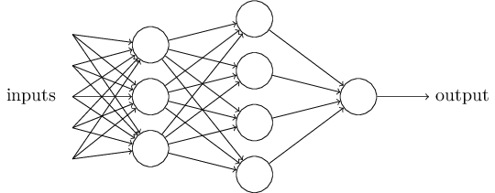
Multi-layer perceptron (MLP)
…is a ‘fully connected’ neural network with non-linear activation functions.
‘Feed-forward’ neural network
Nielson

Slide 26
Does anyone pass along the weight without an activation function?
No – this is linear chaining.
Input
vector
Output vector

Slide 27
Does anyone pass along the weight without an activation function?
No – this is linear chaining.
Input
vector
Output vector

Slide 28
Are there other activation functions?
Yes, many.
As long as:
- Activation function s(z) is well-defined
as z -> -∞ and z -> ∞
- These limits are different
Then we can make a step! [Think visual proof]
It can be shown that it is universal for function approximation.

Slide 29

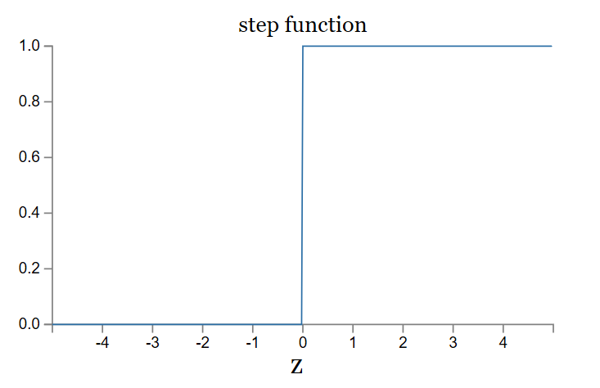
Activation functions:
Rectified Linear Unit
ReLU

Slide 30
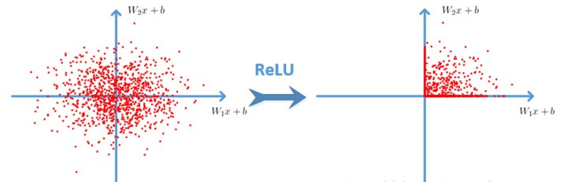
Cyh24 - http://prog3.com/sbdm/blog/cyh_24
Notes:
http://prog3.com/sbdm/blog/cyh_24
http://prog3.com/sbdm/blog/cyh_24/article/details/50593400

Slide 31
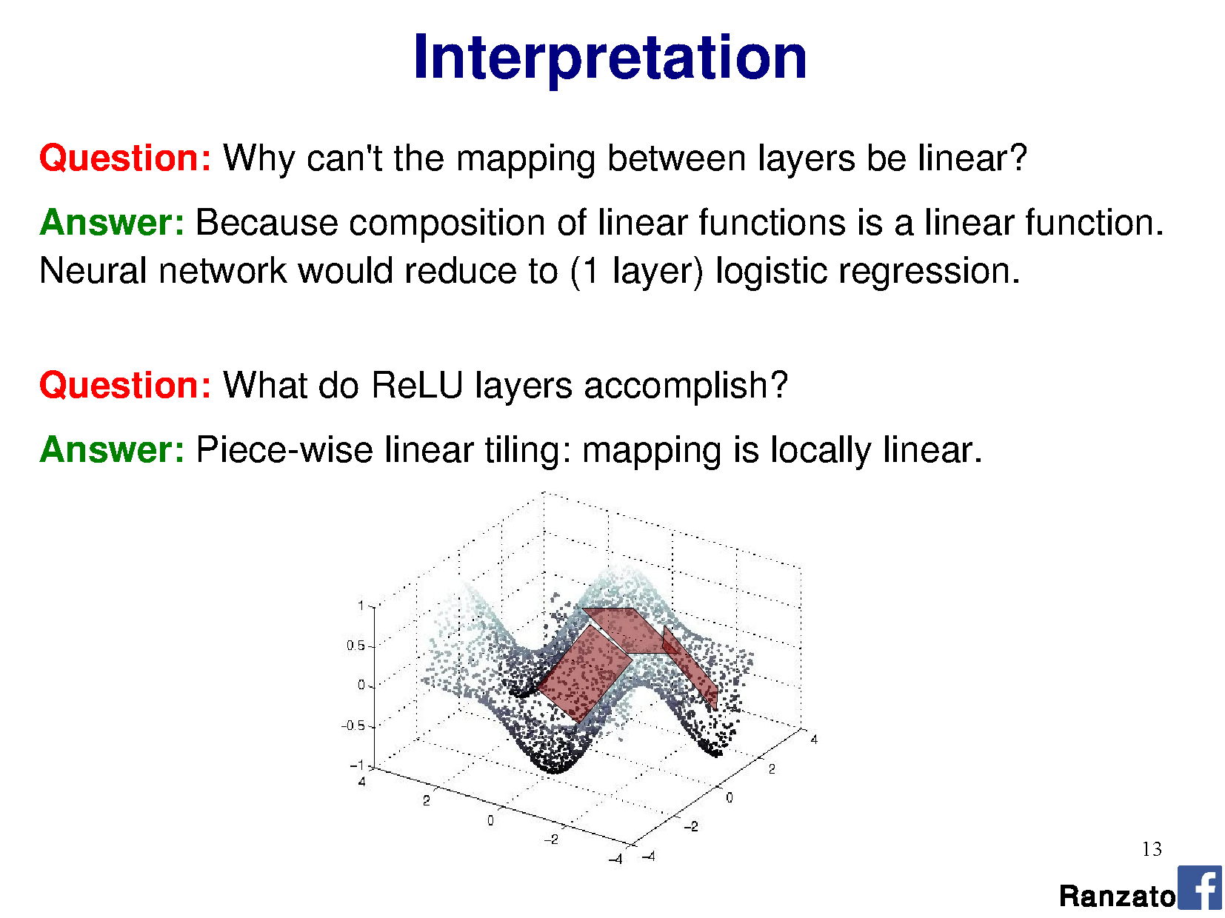
Rectified Linear Unit
Ranzato

Slide 32
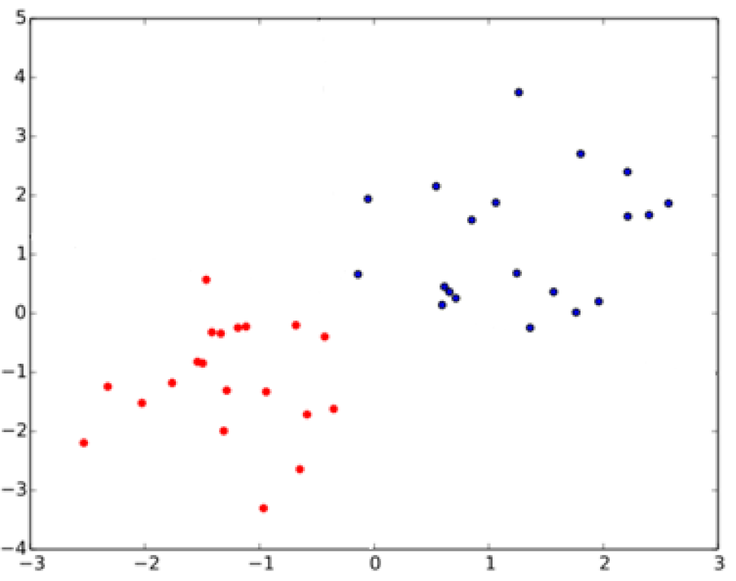
What is the relationship between SVMs
and perceptrons?
SVMs attempt to learn the support vectors which maximize the margin between classes.
Notes:
In separable problems, perceptron training can also aim at finding the largest separating margin between the classes. The so-called perceptron of optimal stability can be determined by means of iterative training and optimization schemes, such as the Min-Over algorithm (Krauth and Mezard, 1987)^{[11]} or the AdaTron (Anlauf and Biehl, 1989)) .^{[12]} AdaTron uses the fact that the corresponding quadratic optimization problem is convex. The perceptron of optimal stability, together with the kernel trick, are the conceptual foundations of the support vector machine.
https://en.wikipedia.org/wiki/Perceptron
Perceptron of optimal stability can be computed via the Min-Over algorithm (Krauth and Mezard, 1987)^{[11]} or the AdaTron (Anlauf and Biehl, 1989) algorithm.

Slide 33
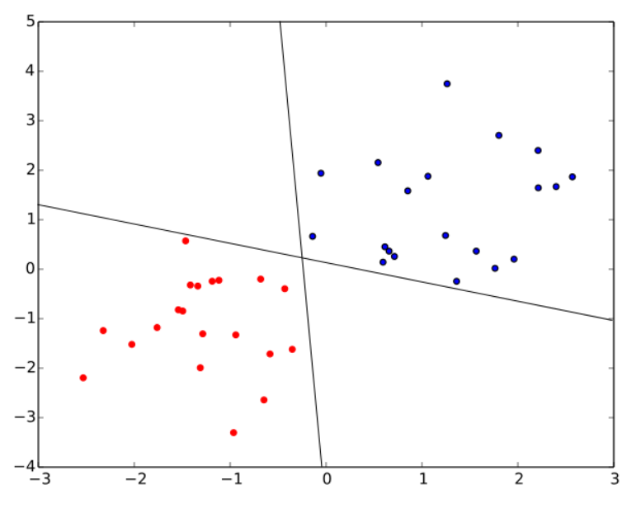
What is the relationship between SVMs
and perceptrons?
SVMs attempt to learn the support vectors which maximize the margin between classes.
A perceptron does not.
Both of these perceptron classifiers are equivalent.
‘Perceptron of optimal
stability’ is used in SVM:
Perceptron
+ optimal stability
+ kernel trick
= foundations of SVM
Notes:
In separable problems, perceptron training can also aim at finding the largest separating margin between the classes. The so-called perceptron of optimal stability can be determined by means of iterative training and optimization schemes, such as the Min-Over algorithm (Krauth and Mezard, 1987)^{[11]} or the AdaTron (Anlauf and Biehl, 1989)) .^{[12]} AdaTron uses the fact that the corresponding quadratic optimization problem is convex. The perceptron of optimal stability, together with the kernel trick, are the conceptual foundations of the support vector machine.
https://en.wikipedia.org/wiki/Perceptron
Perceptron of optimal stability can be computed via the Min-Over algorithm (Krauth and Mezard, 1987)^{[11]} or the AdaTron (Anlauf and Biehl, 1989) algorithm.

Slide 34
Why is pooling useful again?
What kinds of pooling operations might we consider?
Notes:
In separable problems, perceptron training can also aim at finding the largest separating margin between the classes. The so-called perceptron of optimal stability can be determined by means of iterative training and optimization schemes, such as the Min-Over algorithm (Krauth and Mezard, 1987)^{[11]} or the AdaTron (Anlauf and Biehl, 1989)) .^{[12]} AdaTron uses the fact that the corresponding quadratic optimization problem is convex. The perceptron of optimal stability, together with the kernel trick, are the conceptual foundations of the support vector machine.
https://en.wikipedia.org/wiki/Perceptron
Perceptron of optimal stability can be computed via the Min-Over algorithm (Krauth and Mezard, 1987)^{[11]} or the AdaTron (Anlauf and Biehl, 1989) algorithm.

Slide 35
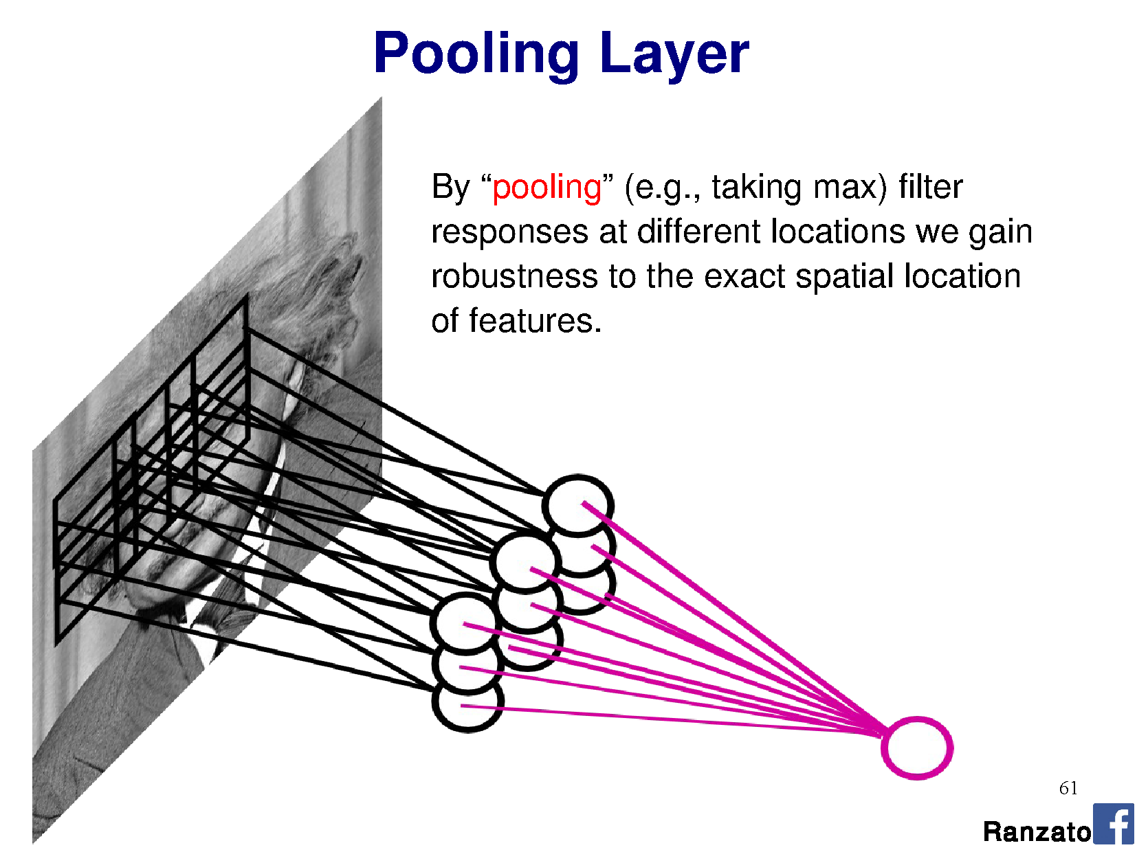
By pooling responses at different locations,
we gain robustness to the exact spatial location of image features.
Useful for classification, when I don’t care about _where_ I ‘see’ a feature!
Pooling layer output
Convolutional layer output

Slide 36
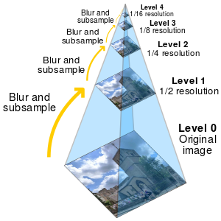
Pooling is similar to downsampling
…but on feature maps, not the input!
…except sometimes we don’t want to blur,
as other functions might be better for classification.

Slide 37
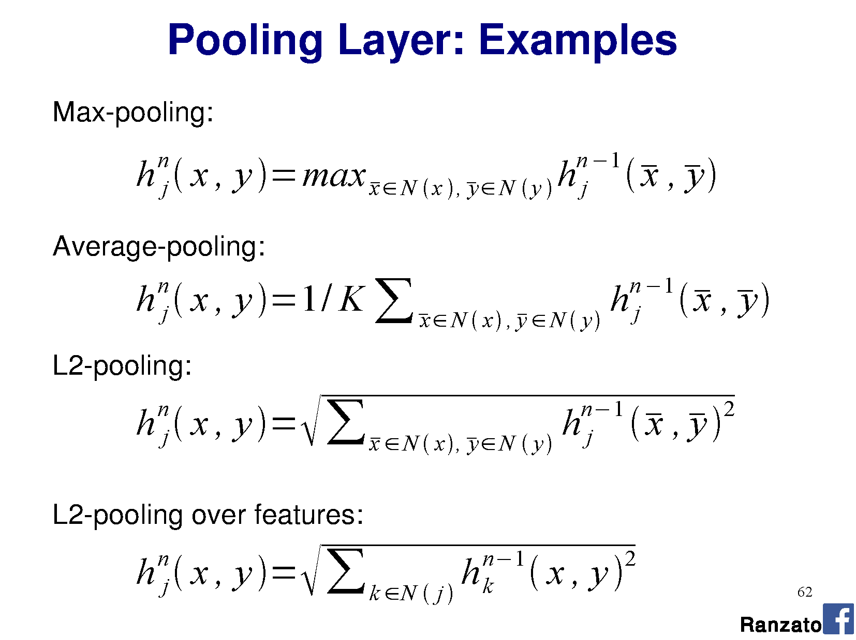

Slide 38
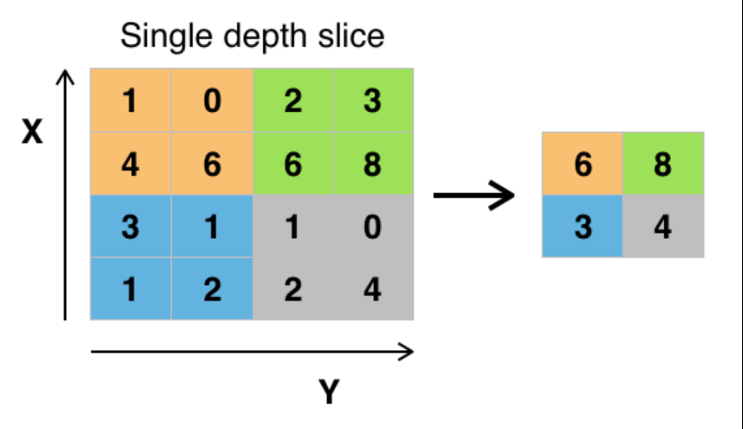
Max pooling
Wikipedia

Slide 39
OK, so does pooling give us rotation invariance?
What about scale invariance?
Convolution is translation invariant (‘shift-invariant’) – we could shift the image and the kernel would give us a corresponding shift in the feature map.
But if we rotated or scaled the input, the same kernel would give a very different response.
Pooling lets us aggregate (avg) or pick from (max) responses, but the kernels themselves must be trained on and so learn to activate on scaled or rotated instances of the object.

Slide 40
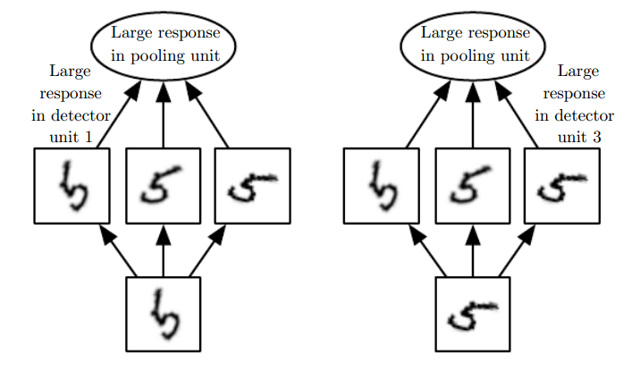
If we max pooled over depth (# kernels)…
Fig 9.9, Goodfellow et al. [the book]

Slide 42
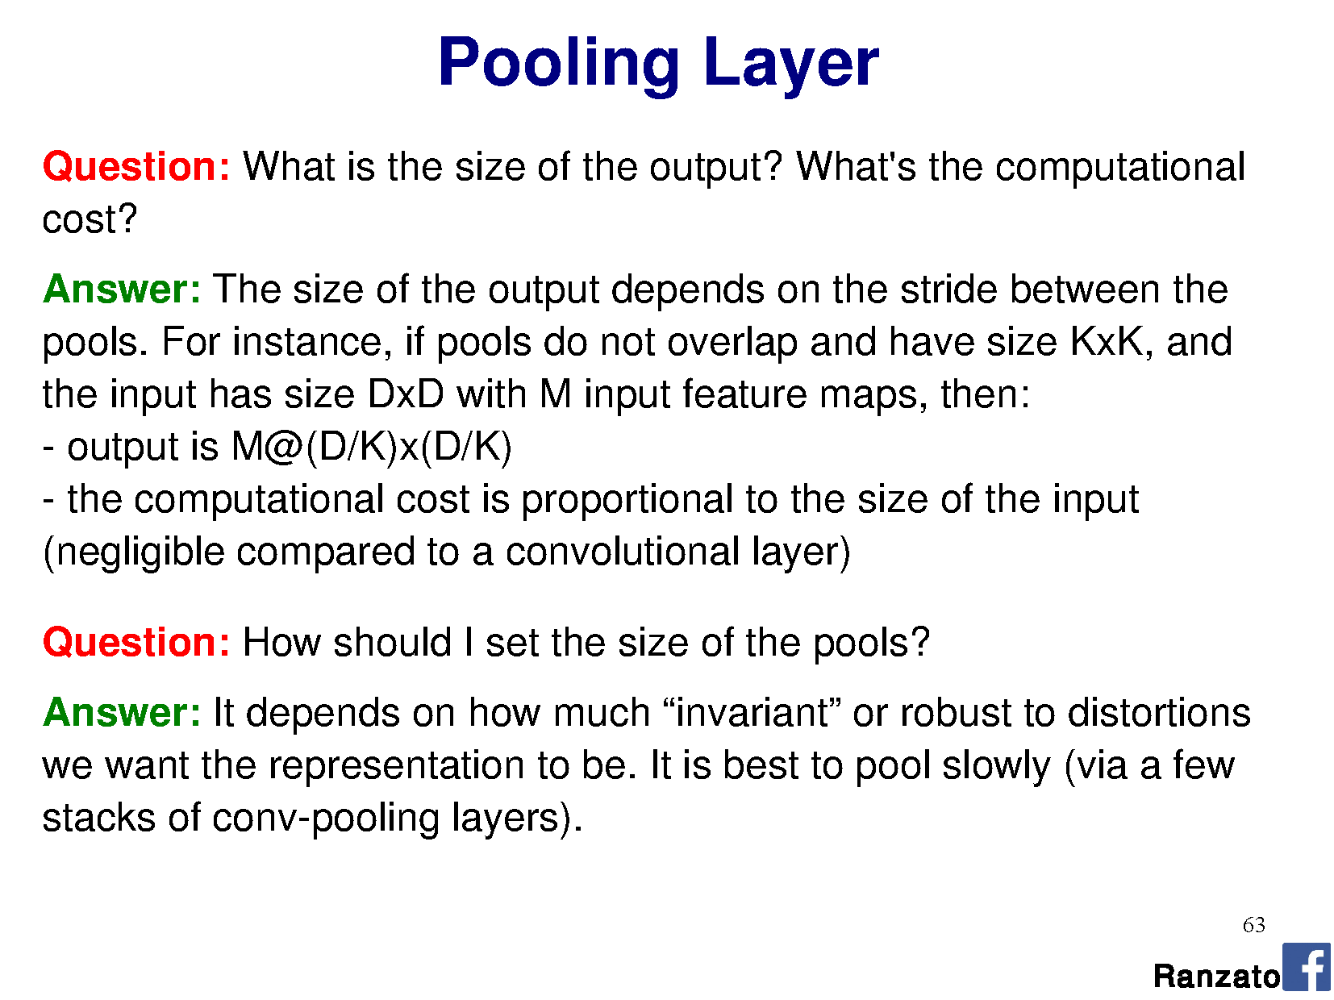

Slide 43
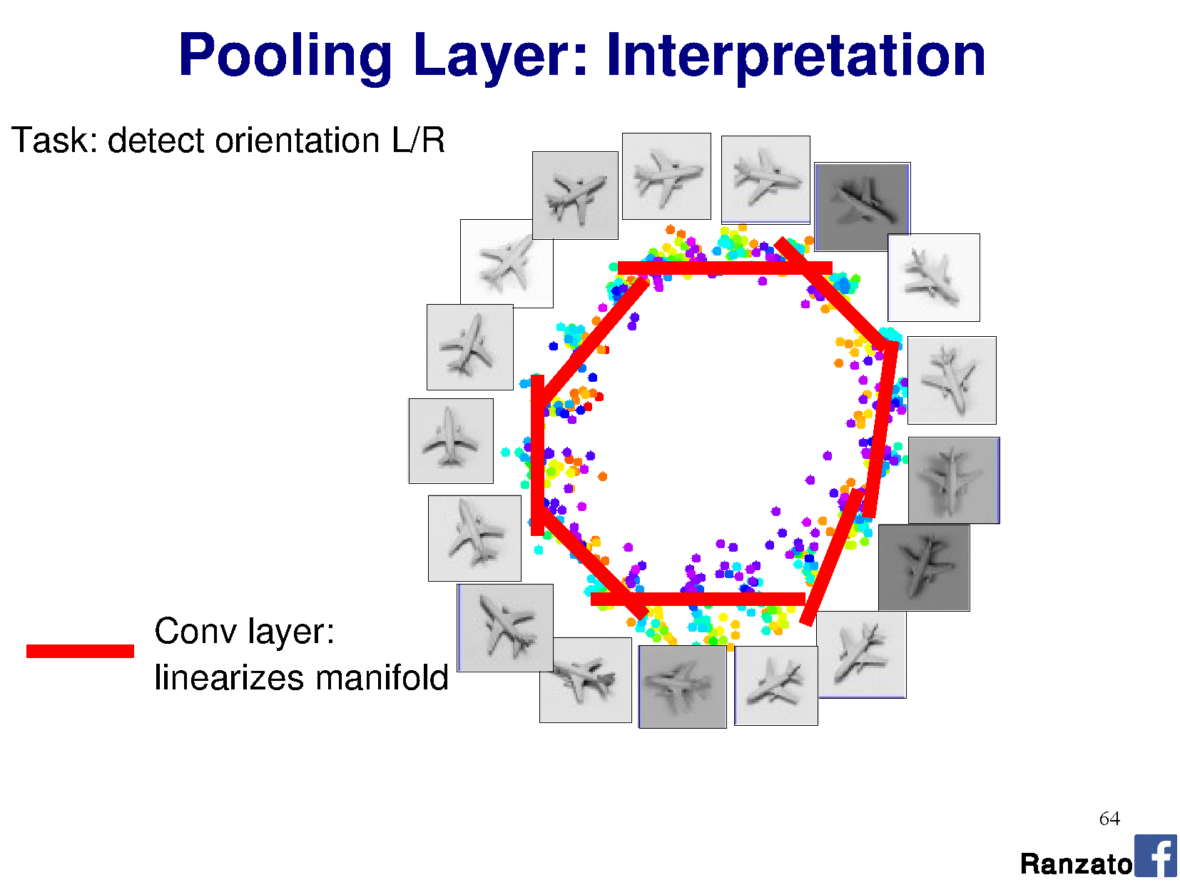

Slide 44
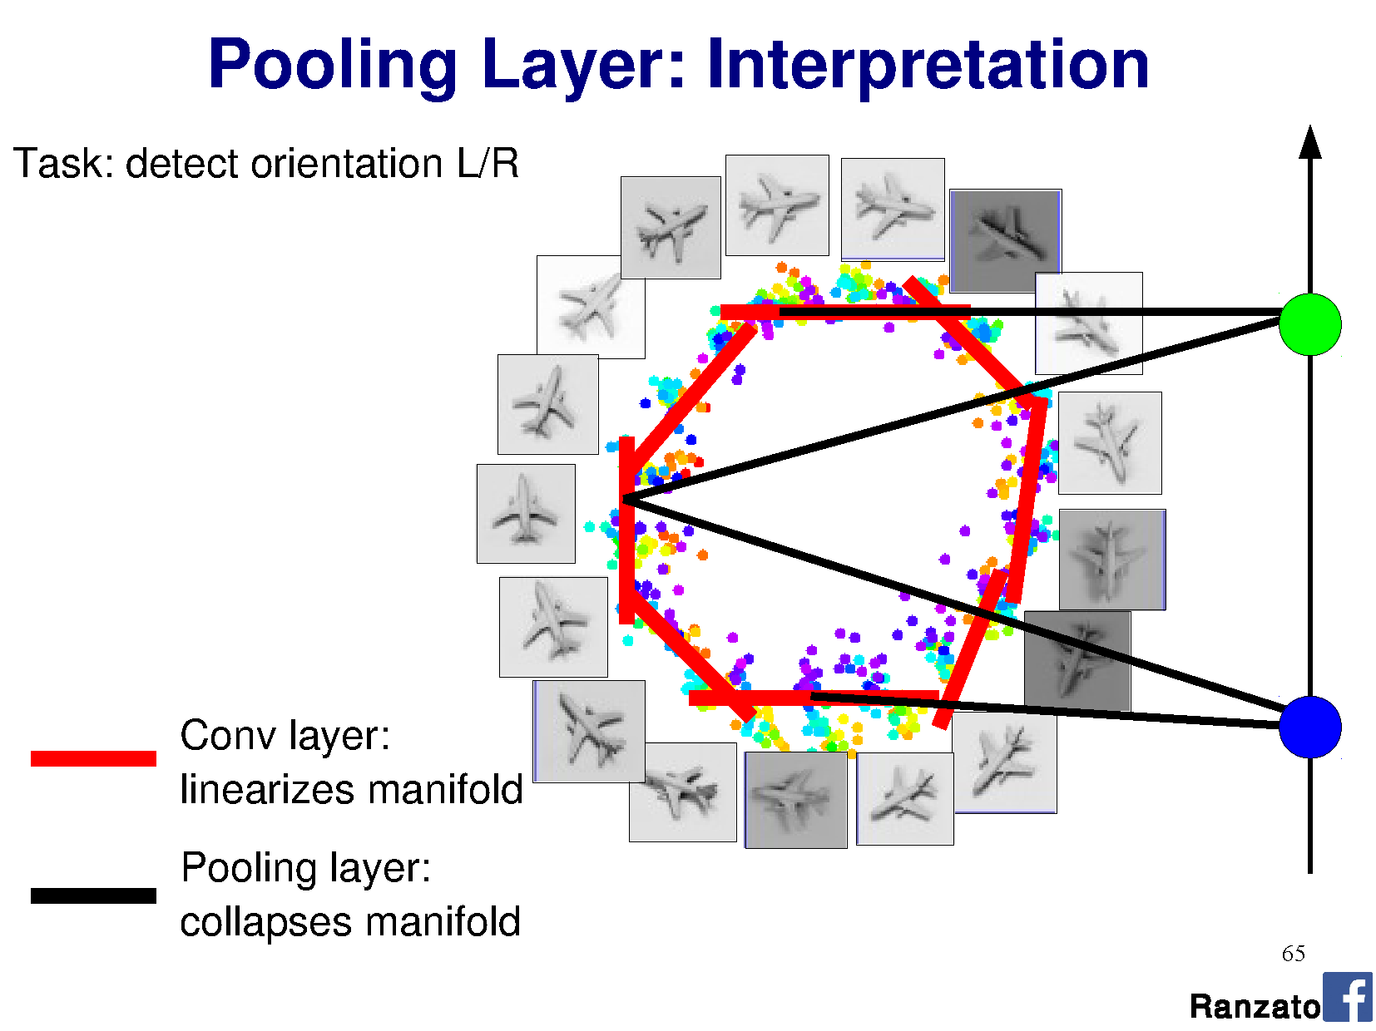

Slide 45
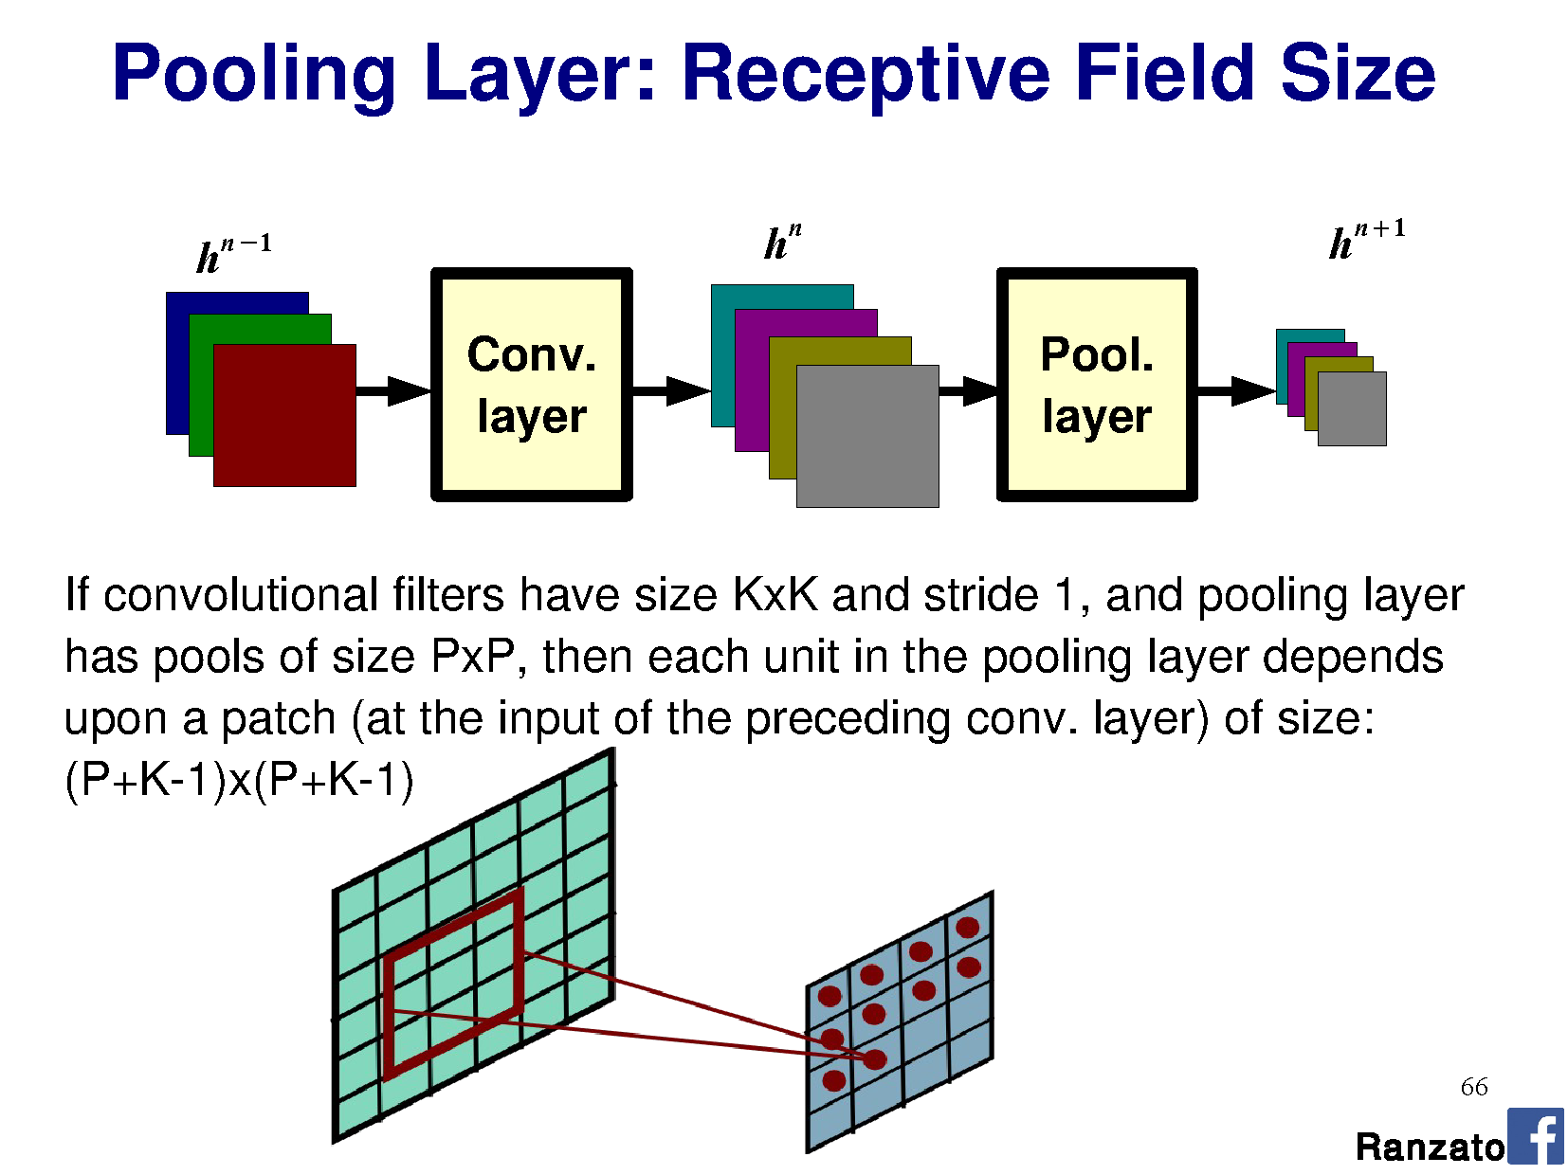

Slide 47
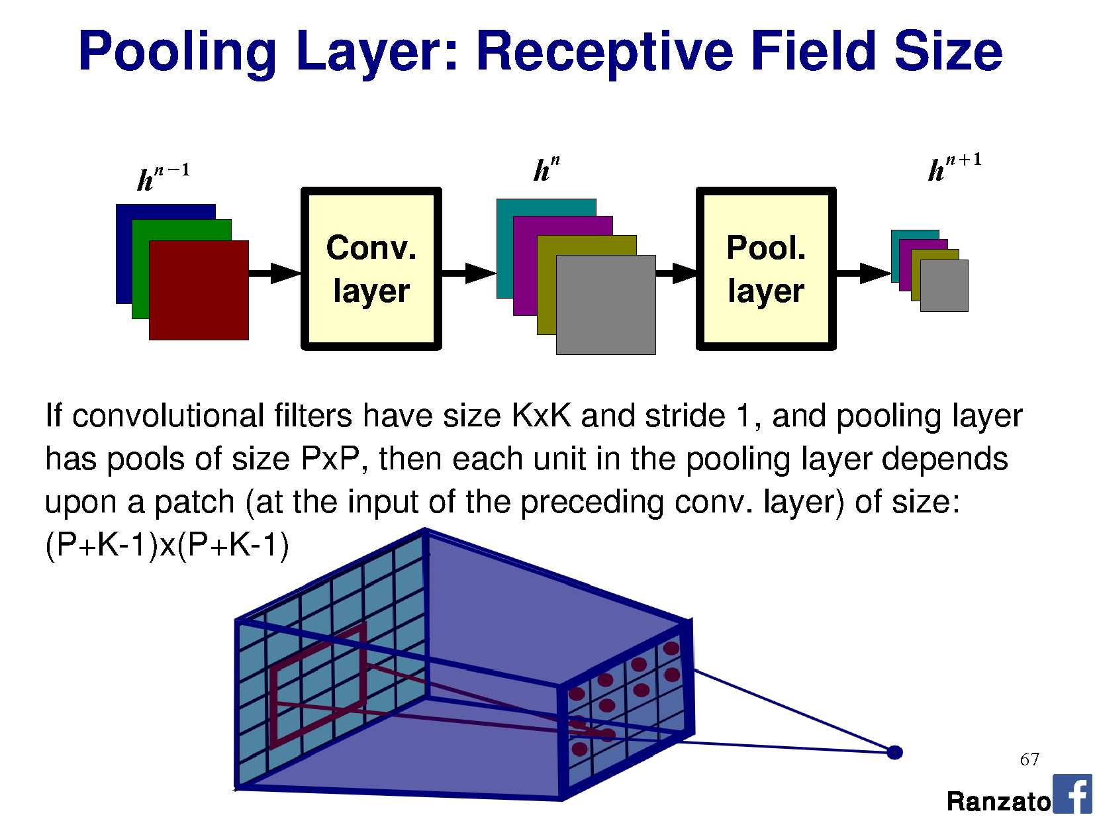

Slide 48
I’ve heard about many more terms of jargon!
Skip connections
Residual connections
Batch normalization
…we’ll get to these in a little while.
Notes:
In separable problems, perceptron training can also aim at finding the largest separating margin between the classes. The so-called perceptron of optimal stability can be determined by means of iterative training and optimization schemes, such as the Min-Over algorithm (Krauth and Mezard, 1987)^{[11]} or the AdaTron (Anlauf and Biehl, 1989)) .^{[12]} AdaTron uses the fact that the corresponding quadratic optimization problem is convex. The perceptron of optimal stability, together with the kernel trick, are the conceptual foundations of the support vector machine.
https://en.wikipedia.org/wiki/Perceptron
Perceptron of optimal stability can be computed via the Min-Over algorithm (Krauth and Mezard, 1987)^{[11]} or the AdaTron (Anlauf and Biehl, 1989) algorithm.

Slide 49
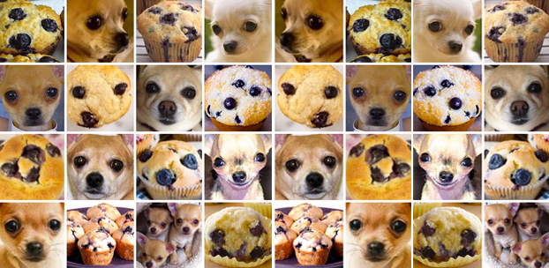

Slide 50
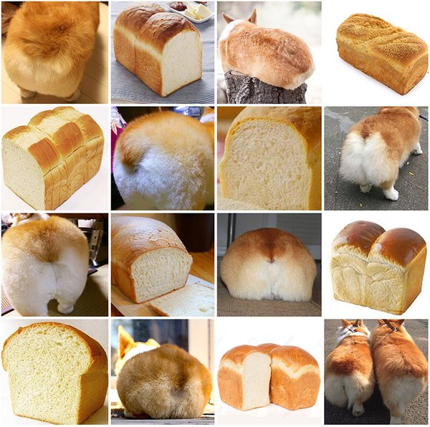
Notes:
Corgi

Slide 51
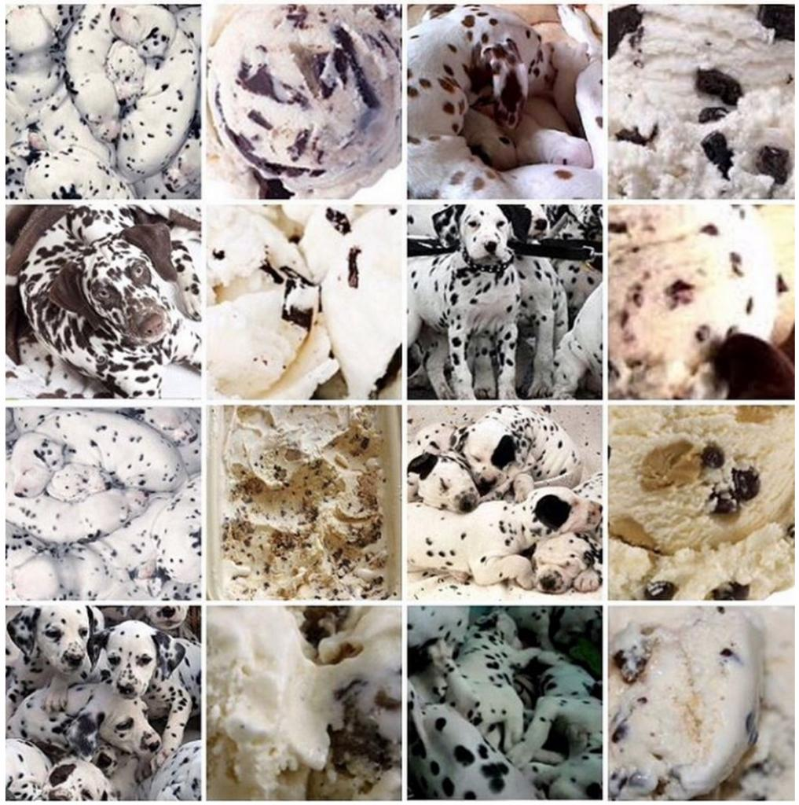
Notes:
Dalmatian

Slide 52
Training Neural Networks
Learning the weight matrices W

Slide 53
Gradient descent
f(x)
x
Notes:
Note: this is not a convex function.

Slide 54

General approach
Pick random starting point.
f(x)
$$a_{1}$$
x

Slide 55

General approach
Compute gradient at point (analytically or by finite differences)
f(x)
$$∇ f(a_{1})$$
$$a_{1}$$
x

Slide 56

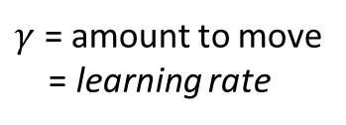

General approach
Move along parameter space in direction of negative gradient
f(x)
$$a_{2}=a_{1}−γ∇ f\left(a_{1}\right)$$
$γ$ = amount to move
= learning rate
$$a_{1}$$
$$a_{2}$$
x

Slide 57


General approach
Move along parameter space in direction of negative gradient.
f(x)
$$a_{3}=a_{2}−γ∇ f\left(a_{2}\right)$$
$γ$ = amount to move
= learning rate
$$a_{1}$$
$$a_{2}$$
$$a_{3}$$
x

Slide 58
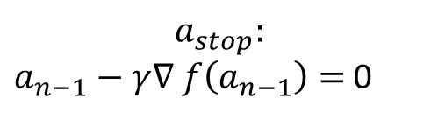

General approach
Stop when we don’t move any more.
f(x)
$$a_{stop}:$$
$a_{n−1}−γ∇ f\left(a_{n−1}\right)=$ 0
$$a_{1}$$
$$a_{2}$$
$$a_{3}$$
$$a_{stop}$$
x

Slide 59
Gradient descent
Optimizer for functions.
Guaranteed to find optimum for convex functions.
  Non-convex = find local optimum.
  Most vision problems aren’t convex.
Works for multi-variate functions.
  Need to compute matrix of partial derivatives (“Jacobian”)
f(x)
x

Slide 60




Why would I use this over Least Squares?
If my function is convex,
why can’t I just use linear least squares?
Analytic solution = normal equations
You can, yes.
$$x={\left(A^{T}A\right)}^{−1}A^{T}b$$
Notes:
https://en.wikipedia.org/wiki/Linear_least_squares_(mathematics)#Derivation_of_the_normal_equations

Slide 61
Why would I use this over Least Squares?
But now imagine that I have 1,000,000 data points.
Matrices are _huge_.
Even for convex functions, gradient descent allows me to iteratively solve the solution without requiring very large matrices.
We’ll see how.
Notes:
https://en.wikipedia.org/wiki/Linear_least_squares_(mathematics)#Derivation_of_the_normal_equations

Slide 62

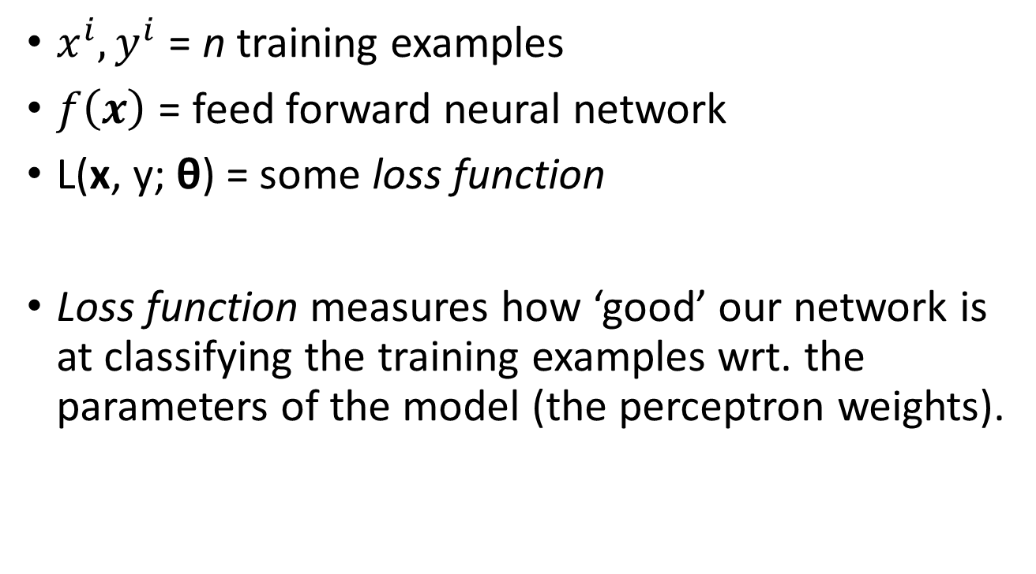
Train NN with Gradient Descent
$x^{i},y^{i}$ = n training examples
$f\left(x\right)$ = feed forward neural network
L(x, y; θ) = some loss function
Loss function measures how ‘good’ our network is at classifying the training examples wrt. the parameters of the model (the perceptron weights).
$$\frac{1}{n}\sum_{i=1}^{n}{{\left\|f\left(x^{i}\right)−y^{i}\right\|}^{2}}$$

Slide 63
Train NN with Gradient Descent
Loss function
(Evaluate NN
on training data)
$$a_{1}$$
$$a_{2}$$
$$a_{3}$$
$$a_{stop}$$
Model parameters
(perceptron weights)

Slide 64
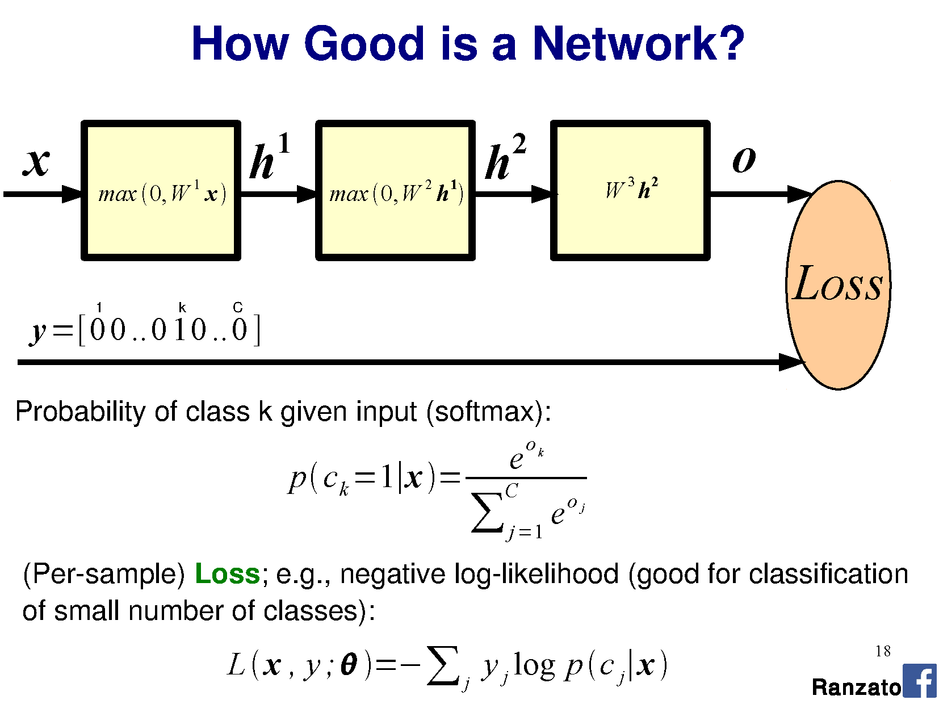
utput

Slide 65

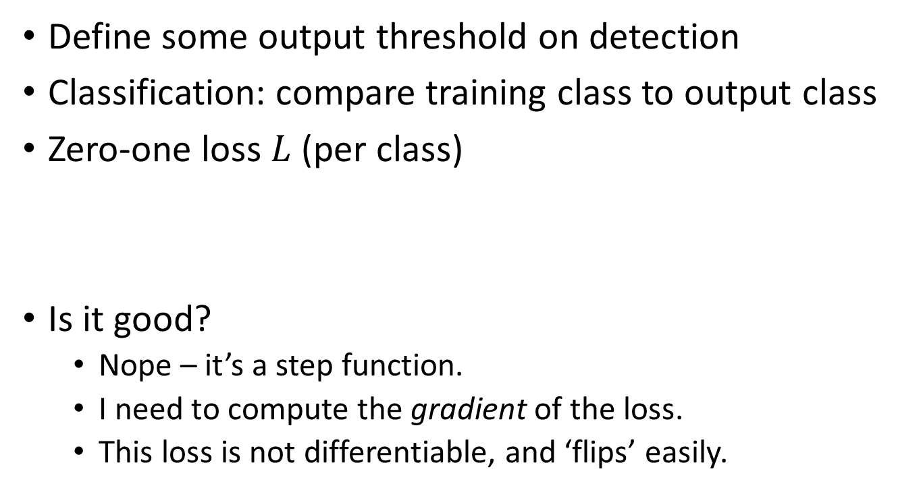
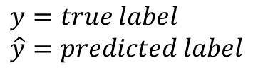
What is an appropriate loss?
Define some output threshold on detection
Classification: compare training class to output class
Zero-one loss $L$(per class)
Is it good?
  Nope – it’s a step function.
  I need to compute the gradient of the loss.
  This loss is not differentiable, and ‘flips’ easily.
$$y=true label \\ \hat{y}=predicted label$$

Slide 66
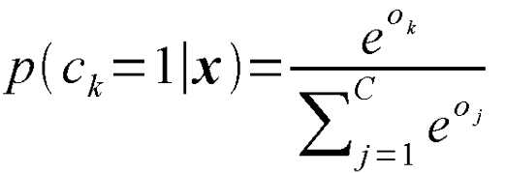
Classification as probability
Special function on last layer - ‘Softmax’:
  “Squashes" a C-dimensional vector O of arbitrary real values to a C-dimensional vector σ(O) of real values in the range (0, 1) that add up to 1.
  Turns the output into a probability distribution on classes.
Notes:
"squashes" a K-dimensional vector z of arbitrary real values to a K-dimensional vector σ ( z ) of real values in the range (0, 1) that add up to 1.
Used as the loss in logistic regression
Add softmax graph
http://dataaspirant.com/2017/03/07/difference-between-softmax-function-and-sigmoid-function/

Slide 67
Softmax
utput
Softmax

Slide 68
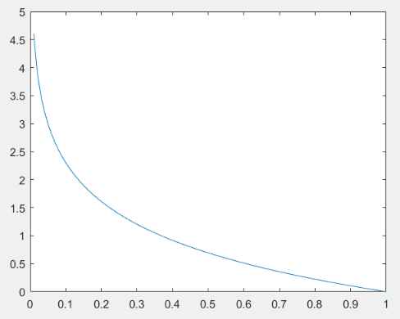
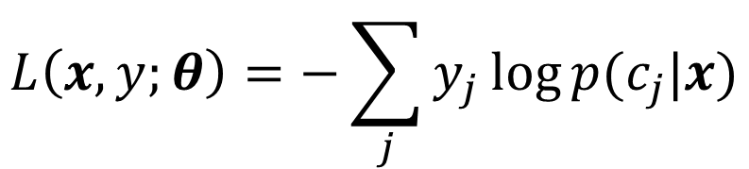
Cross-entropy loss function
Negative log-likelihood
Minimizing this is equivalent
to minimizing KL-divergence
on predicted and target
probability distributions
Is it a good loss?
  Differentiable
  Cost decreases as
  probability increases
$$L\left(x,y;θ\right)=−\sum_{j}{y_{j}\log{p(c_{j}|x)}}$$
L
p(c_{j}|x)
Notes:
https://en.wikipedia.org/wiki/Loss_functions_for_classification
If p(y) is 0.9, and we classify the object as 0.9, then we would wish for a low loss. -log(p) = ~0.1. So, loss = 0.9 * -log(p) = 0.0949. = low.
If p(y) is 0.1, and we classify the object as 0.9, then we would wish for a high loss. –log(p) = ~0.1. So, loss = 0.-1 = higher.

Slide 69
Softmax
utput

Slide 70
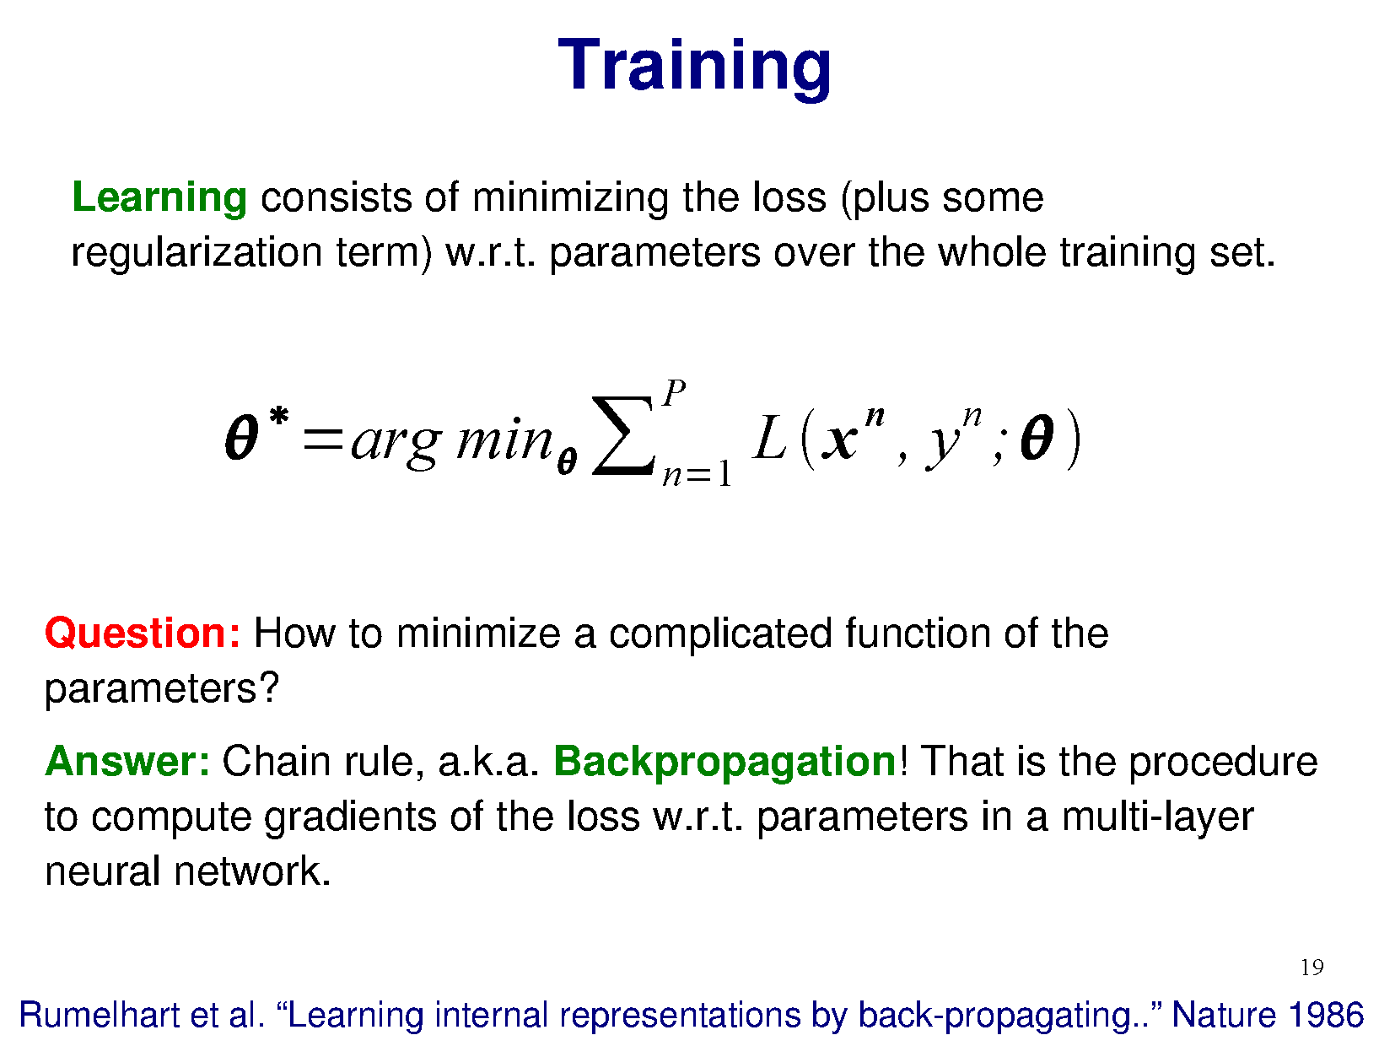

Slide 72
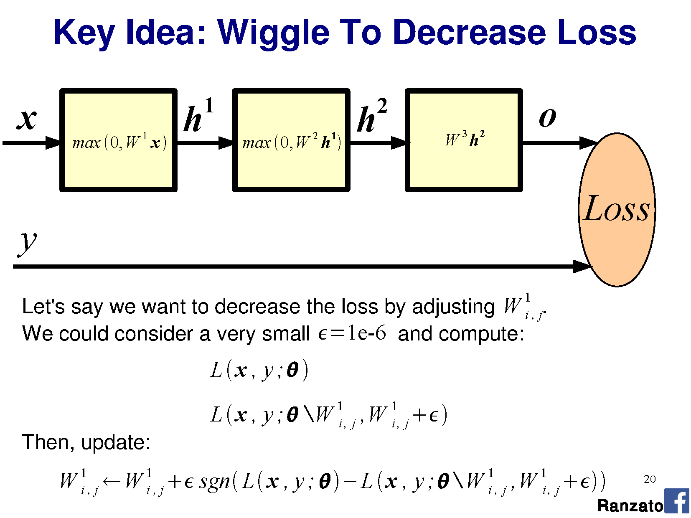

Slide 74
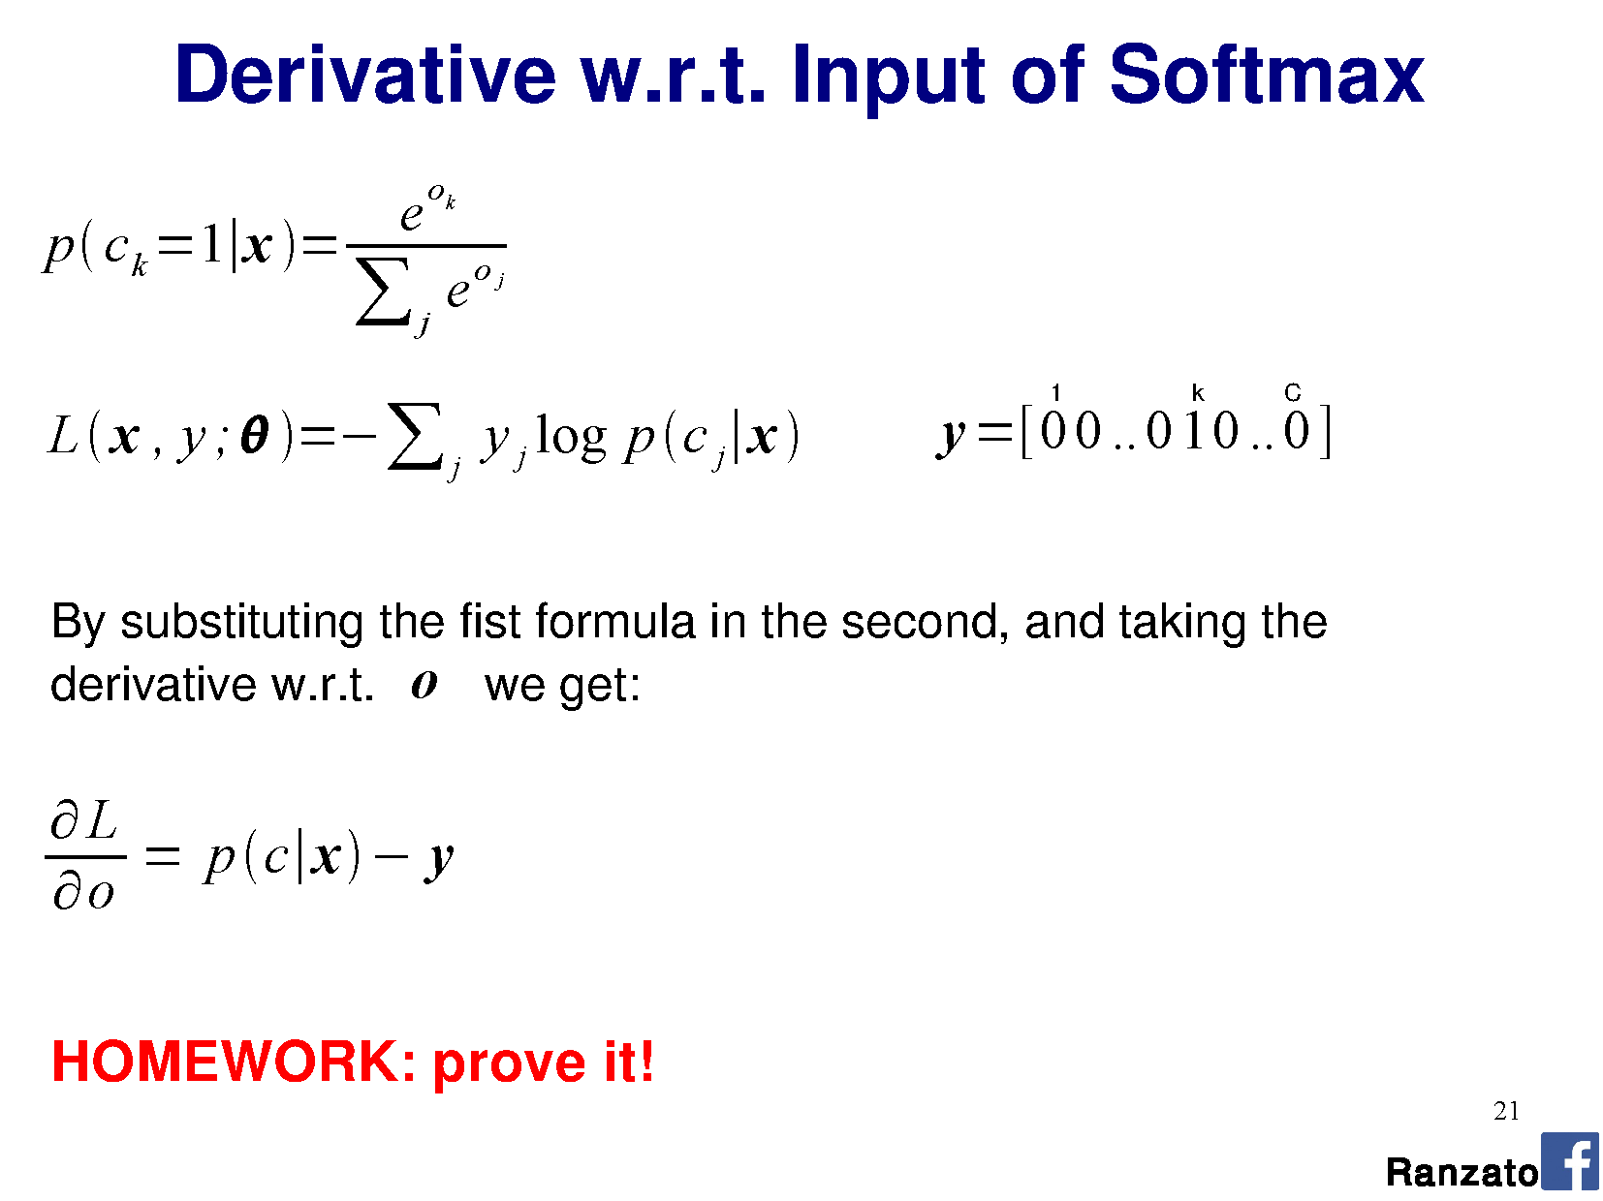

Slide 75
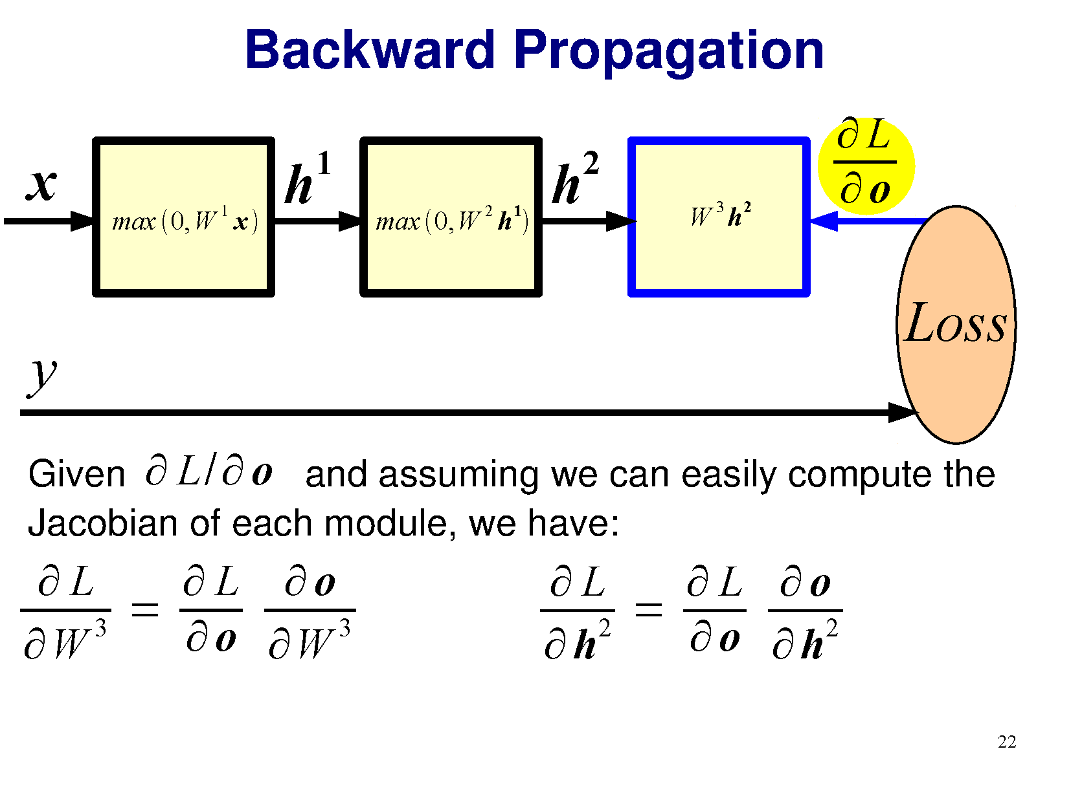
Notes:
Chain rule from calculus on partial derivatives.
Jacobian is matrix of partial derivatives

Slide 76
Notes:
Chain rule from calculus on partial derivatives.

Slide 77
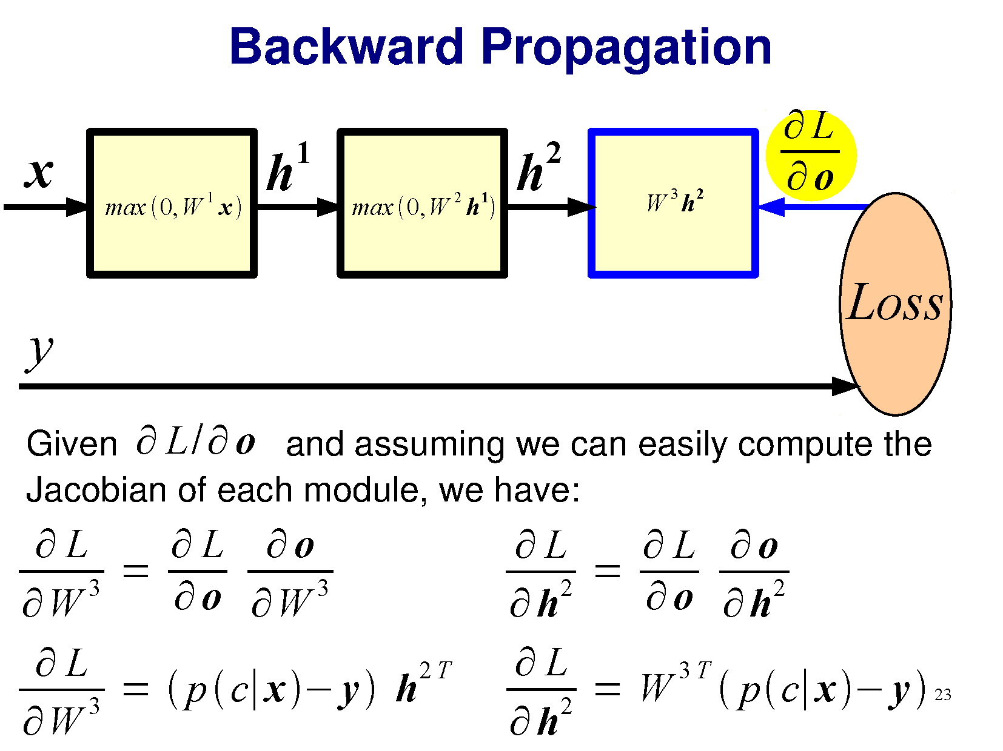

Slide 78
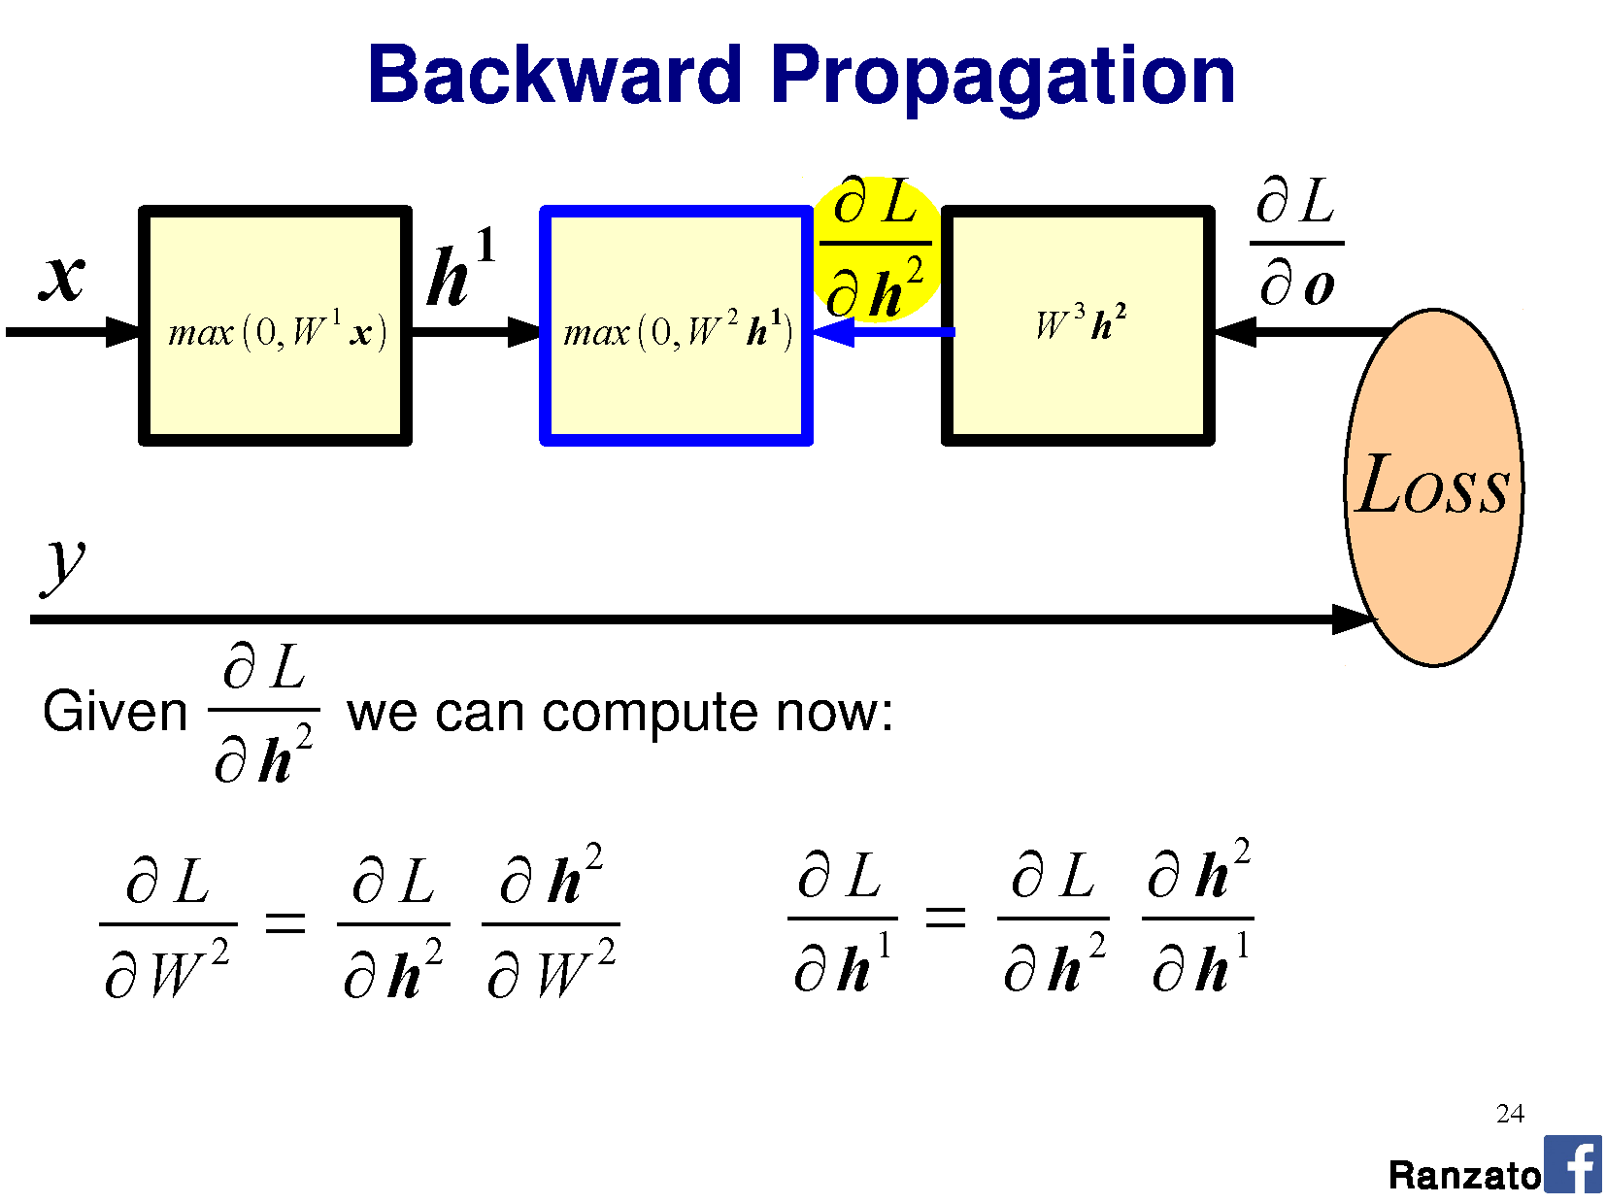

Slide 79


Slide 80

Notes:
a.e. = almost everywhere -> idea from measure theory which states that “a property holds almost everywhere if the set of elements for which the property does not hold is a set of measure zero”
Set of measure zero -> “A set of points capable of being enclosed in intervals whose total length is arbitrarily small.”

Slide 81
But the ReLU is not differentiable at 0!
Right. Fudge!
‘0’ is the best place for this to occur, because we don’t care about the result (it is no activation).
‘Dead’ perceptrons
ReLU has unbounded positive response:
  Potential faster convergence / overstep

Slide 82
Notes:
a.e. = almost everywhere -> idea from measure theory which states that “a property holds almost everywhere if the set of elements for which the property does not hold is a set of measure zero”
Set of measure zero -> “A set of points capable of being enclosed in intervals whose total length is arbitrarily small.”
https://en.wikipedia.org/wiki/Backpropagation

Slide 83


Slide 84

Optimization demo
http://www.emergentmind.com/neural-network
Thank you Matt Mazur
Notes:
https://en.wikipedia.org/wiki/Backpropagation
http://colah.github.io/posts/2015-08-Backprop/

Slide 85


Slide 86


Slide 87


Slide 88


Slide 89

Notes:
Doodle
Poodle cross with …

Slide 90

Wow
false positives
what class
no good filtr
so misclassified
cool kernel
Notes:
Shiba Inu

Slide 91

Stochastic Gradient Descent
Dataset can be too large to strictly apply gradient descent.
Instead, randomly sample a data point, perform gradient descent per point, and iterate.
  True gradient is approximated only
  Picking a subset of points: “mini-batch”
Pick starting $W$ and learning rate $γ$
While not at minimum:
  Shuffle training set
  For each data point i=1…n (maybe as mini-batch)
    Gradient descent
“Epoch“
Notes:
Epoch: running through every training data example and performing SGD
Diagram for different normalizations

Slide 92

Stochastic Gradient Descent
Loss will not always decrease (locally) as training data point is random.
Still converges over time.
Wikipedia

Slide 93

Gradient descent oscillations
Wikipedia

Slide 94
Gradient descent oscillations
Slow to converge to the (local) optimum
Wikipedia

Slide 95

Momentum
Adjust the gradient by a weighted sum of the previous amount plus the current amount.
Without momentum: $θ_{t+1}= θ_{t} − γ\frac{∂L}{∂θ}$
With momentum (new $α$parameter):
$θ_{t+1}= θ_{t} − γ\left(α{\left[\frac{∂L}{∂θ}\right]}_{t−1}+{\left[\frac{∂L}{∂θ}\right]}_{t}\right)$
Notes:
Called momentum because it forces the gradient to change more slowly, and helps prevent oscillations

Slide 96
But James…
…I thought we were going to treat machine learning like a black box? I like black boxes.
Deep learning is:
- a black box
Training data
Classifier

Slide 97

But James…
…I thought we were going to treat machine learning like a black box? I like black boxes.
Deep learning is:
- a black box
- also a black art.
http://www.isrtv.com/
Notes:
http://www.isrtv.com/forums/topic/12039-custom-button-box-for-iracing/

Slide 98
But James…
…I thought we were going to treat machine learning like a black box? I like black boxes.
Many approaches and hyperparameters:
Activation functions, learning rate, mini-batch size,
momentum…
Often these need tweaking, and you need to know what they do to change them intelligently.

Slide 99



Nailing hyperparameters + trade-offs
Notes:
Aaron in March/April 2017

Slide 100
Lowering the learning rate = smaller steps in SGD
-Less ‘ping pong’
-Takes longer to get to the optimum
Wikipedia

Slide 101


Flat regions in energy landscape
Notes:
Also lets us see how different kinds of learning algorithms work.

Slide 102


Slide 103


Slide 104


Slide 105
Problem of fitting
Too many parameters = overfitting
Not enough parameters = underfitting
More data = less chance to overfit
How do we know what is required?

Slide 106
Regularization
Attempt to guide solution to not overfit
But still give freedom with many parameters

Slide 107

Data fitting problem
[Nielson]

Slide 108


Which is better?
Which is better a priori?
9th order polynomial
1st order polynomial
[Nielson]
Notes:
How do we know a priori how many parameters we need?
Cross-validation is one way.

Slide 109
Regularization
Attempt to guide solution to not overfit
But still give freedom with many parameters
Idea:
Penalize the use of parameters to prefer small weights.

Slide 110



Regularization:
Idea: add a cost to having high weights
$λ$ = regularization parameter
$$λ$$
[Nielson]
Notes:
n is size of training data
Intuitively, the effect of regularization is to make it so the network prefers to learn small weights, all other things being equal. Large weights will only be allowed if they considerably improve the first part of the cost function. Put another way, regularization can be viewed as a way of compromising between finding small weights and minimizing the original cost function.

Slide 111
Both can describe the data…
…but one is simpler.
Occam’s razor:
  “Among competing hypotheses, the one with the fewest assumptions should be selected”
  For us:
  Large weights cause large changes in behaviour in response to small changes in the input.
  Simpler models (or smaller changes) are more robust to noise.
Notes:
Why does this help reduce overfitting?

Slide 112


Regularization
Idea: add a cost to having high weights
$λ$ = regularization parameter
$$λ$$
$$λ$$
Normal cross-entropy loss (binary classes)
Regularization term
[Nielson]
Notes:
n is size of training data
Intuitively, the effect of regularization is to make it so the network prefers to learn small weights, all other things being equal. Large weights will only be allowed if they considerably improve the first part of the cost function. Put another way, regularization can be viewed as a way of compromising between finding small weights and minimizing the original cost function.

Slide 113
Regularization: Dropout
Our networks typically start with random weights.
Every time we train = slightly different outcome.
Why random weights?
If weights are all equal,
response across filters
will be equivalent.
  Network doesn’t train.
[Nielson]
Notes:
http://stackoverflow.com/questions/20027598/why-should-weights-of-neural-networks-be-initialized-to-random-numbers

Slide 114
Regularization
Our networks typically start with random weights.
Every time we train = slightly different outcome.
Why not train 5 different networks with random starts and vote on their outcome?
  Works fine!
  Helps generalization because error is averaged.
Notes:
Any problem here?
But, kind of slow?

Slide 115

Regularization: Dropout
[Nielson]

Slide 116

Regularization: Dropout
At each mini-batch:
Randomly select a subset of neurons.
Ignore them.
On test: half weights outgoing to compensate for training on half neurons.
Effect:
Neurons become less dependent on output of connected neurons.
Forces network to learn more robust features that are useful to more subsets of neurons.
Like averaging over many different trained networks with different random initializations.
Except cheaper to train.
[Nielson]

Slide 117
Many forms of ‘regularization’
Adding more data is a kind of regularization
Pooling is a kind of regularization
Data augmentation is a kind of regularization

