Slide 1

27 February 2019

Slide 2
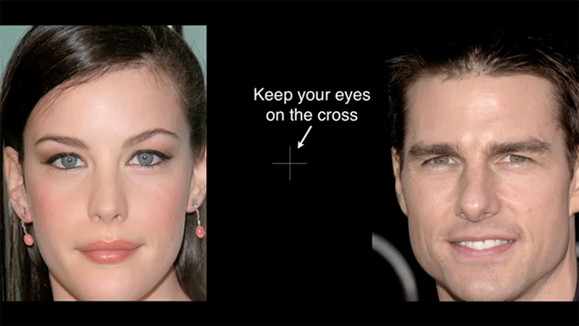
“Flashed Face Distortion”
2nd Place in the 8th Annual Best Illusion of the Year Contest , VSS 2012

Slide 4
Object Detection
Overview
Dalal-Triggs (pedestrian detection)
  Histogram of Oriented Gradients
  Database learning with SVM
Viola-Jones (face detection)
  Boosting for learning
  Decision trees

Slide 5
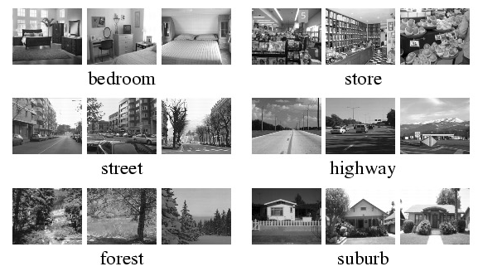
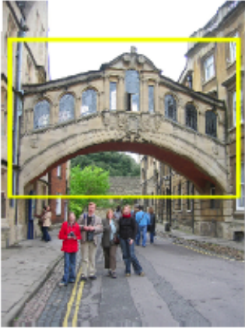
Recognition so far
Category:
  Is this a bedroom?
  What class of scene is this?
  Holistic features/quantization
Instance:
  Find this specific famous building.
  Find this person.
  Local features/precise correspondence
  Often within a database of images
Notes:
Hertford Bridge, often called "the Bridge of Sighs“ - https://en.wikipedia.org/wiki/Bridge_of_Sighs_(Oxford)
Oxford, UK

Slide 6
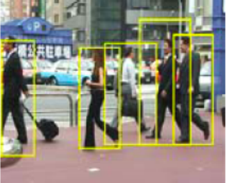
Recognition so far
Object (category) detection:
  Find all the people
  Find all the faces
  Often within a single image
  Often ‘sliding window’
Scenes have “stuff” – distribution of materials and surfaces with arbitrary shape.
- Bag of Words ok!
Objects are “things” with shape, boundaries.
- Bag of Words less ok as spatial layout is lost!
Notes:
Hertford Bridge, often called "the Bridge of Sighs“ - https://en.wikipedia.org/wiki/Bridge_of_Sighs_(Oxford)
Oxford, UK

Slide 7
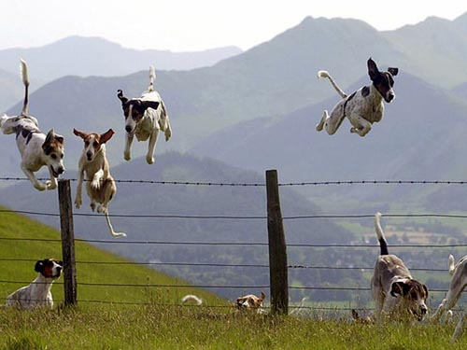
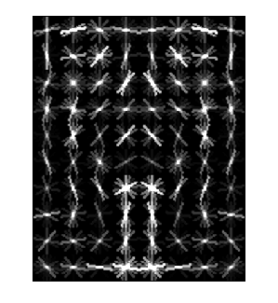
Object Category Detection
Focus on object search: “Where is it?”
Build templates that quickly differentiate object patch from background patch
Dog Model
…
Object or
Non-Object?
James Hays

Slide 8
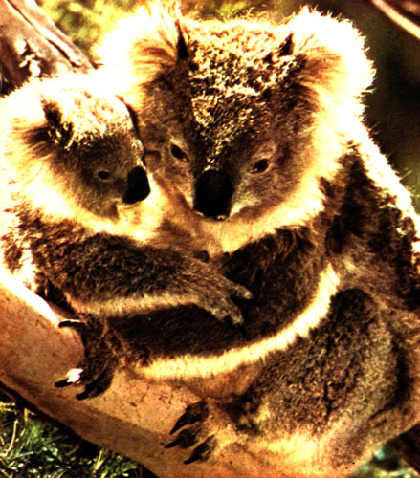
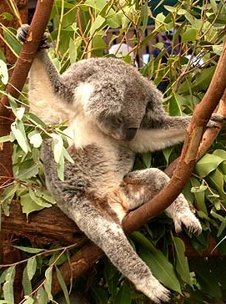

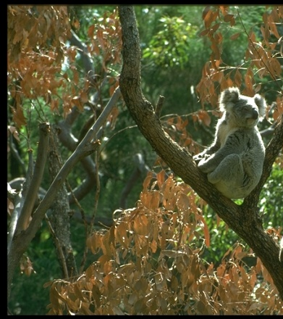
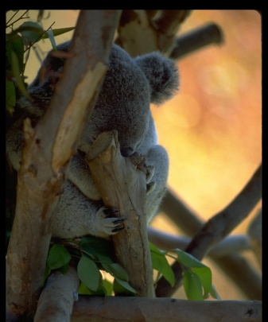
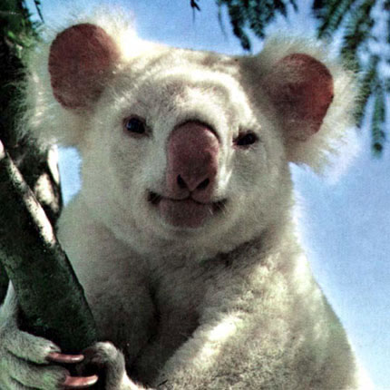
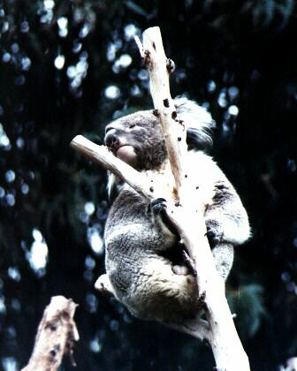
Challenges in modeling the object class
Illumination
Object pose
‘Clutter’
Occlusions
Intra-class appearance
Viewpoint
[K. Grauman, B. Leibe]

Slide 9
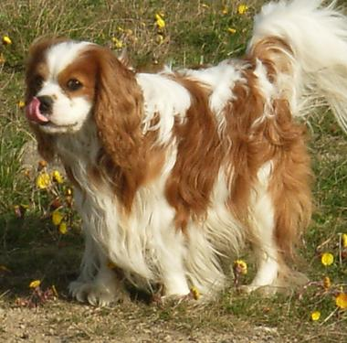
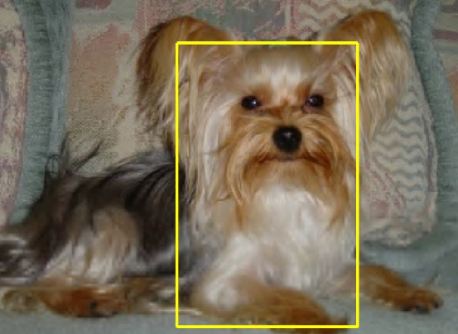
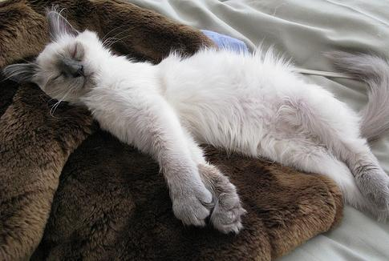
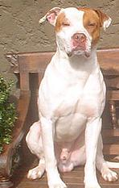
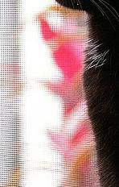

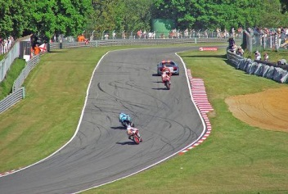

Challenges in modeling the non-object class
True Detections
Bad Localization
Confused with Similar Object
Confused with Dissimilar Objects
Misc. Background
[Hays]

Slide 10
Object Detection Design challenges
How to efficiently search for likely objects
  Even simple models require searching hundreds of thousands of positions and scales.
Feature design and scoring
  How should appearance be modeled?
  What features correspond to the object?
How to deal with different viewpoints?
  Often train different models for a few different viewpoints

Slide 11
General Process of Object Recognition
Specify Object Model
What are the object parameters?
Generate Hypotheses
Score Hypotheses
Resolve Detections
James Hays

Slide 12
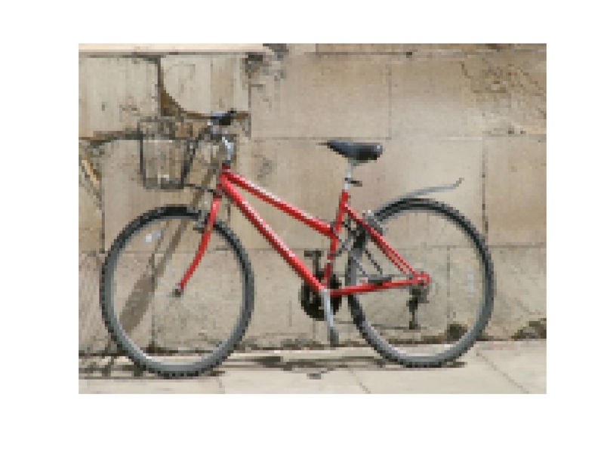
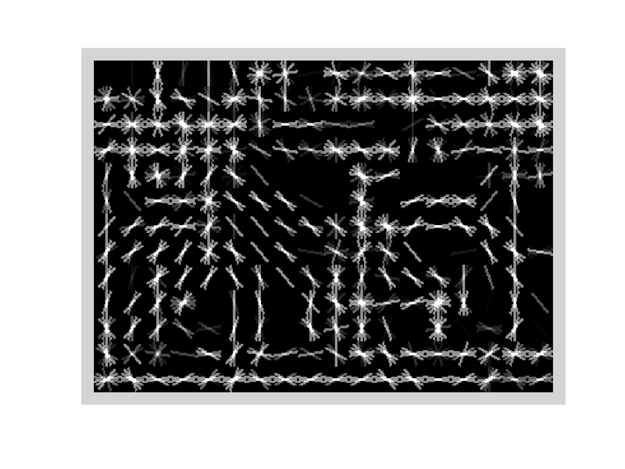
Specifying an object model
Statistical Template in Bounding Box
  Object is some (x,y,w,h) in image
  Features defined wrt bounding box coordinates
Image
Template Visualization
Images from Felzenszwalb

Slide 13
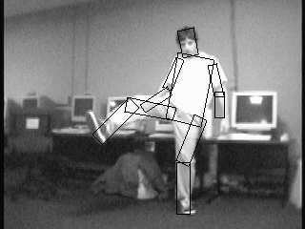
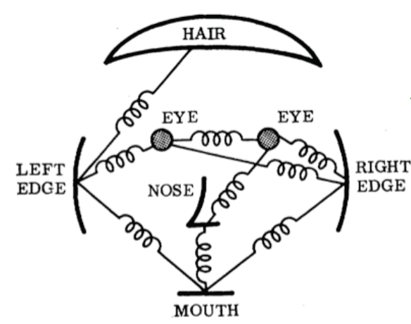
Specifying an object model
2. Articulated parts model
  Object is configuration of parts
  Each part is detectable
Images from Felzenszwalb

Slide 14
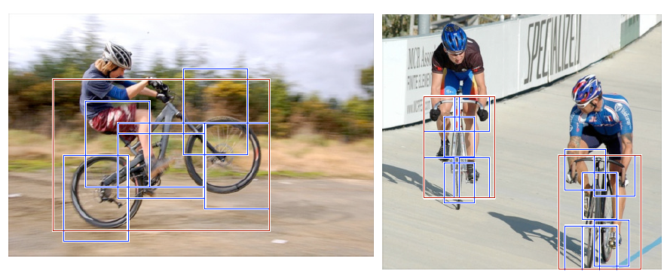
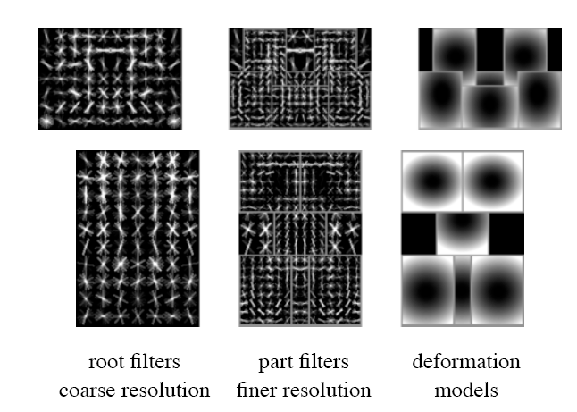
Specifying an object model
3. Hybrid template/parts model
Detections
Template Visualization
Felzenszwalb et al. 2008

Slide 15
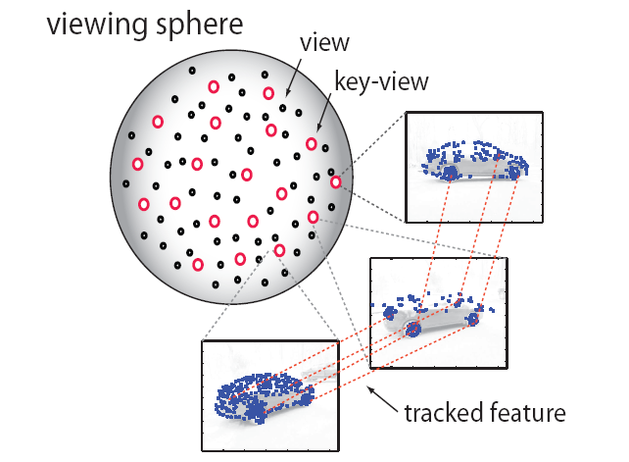
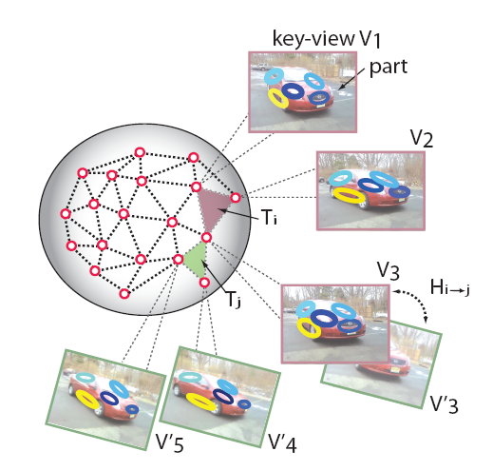
Specifying an object model
3D-ish model
Object is collection of 3D planar patches under affine transformation

Slide 16
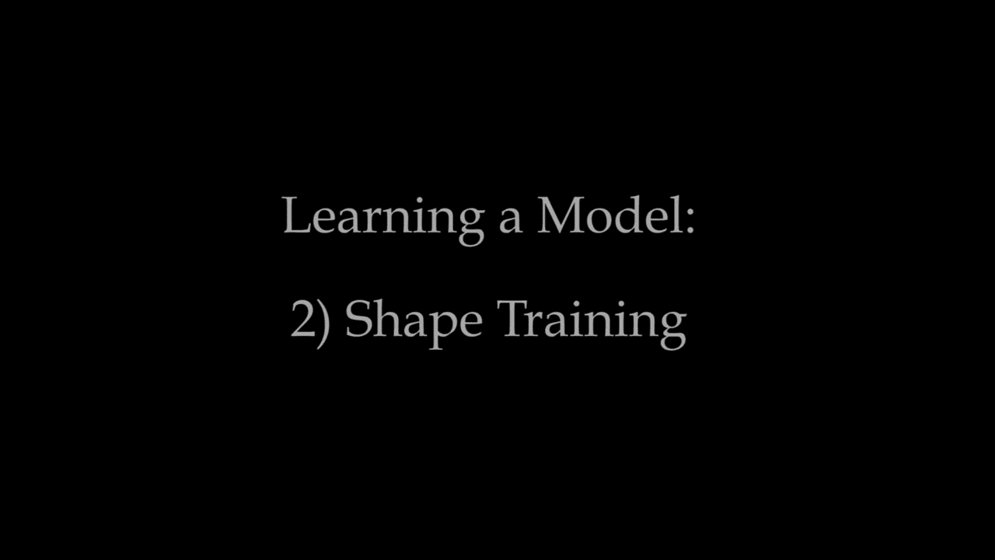
Specifying an object model
Loper et al. 2015
5. Deformable 3D model
Object is a parameterized space of shape/pose/deformation of class of 3D object
Notes:
http://smpl.is.tue.mpg.de/

Slide 17
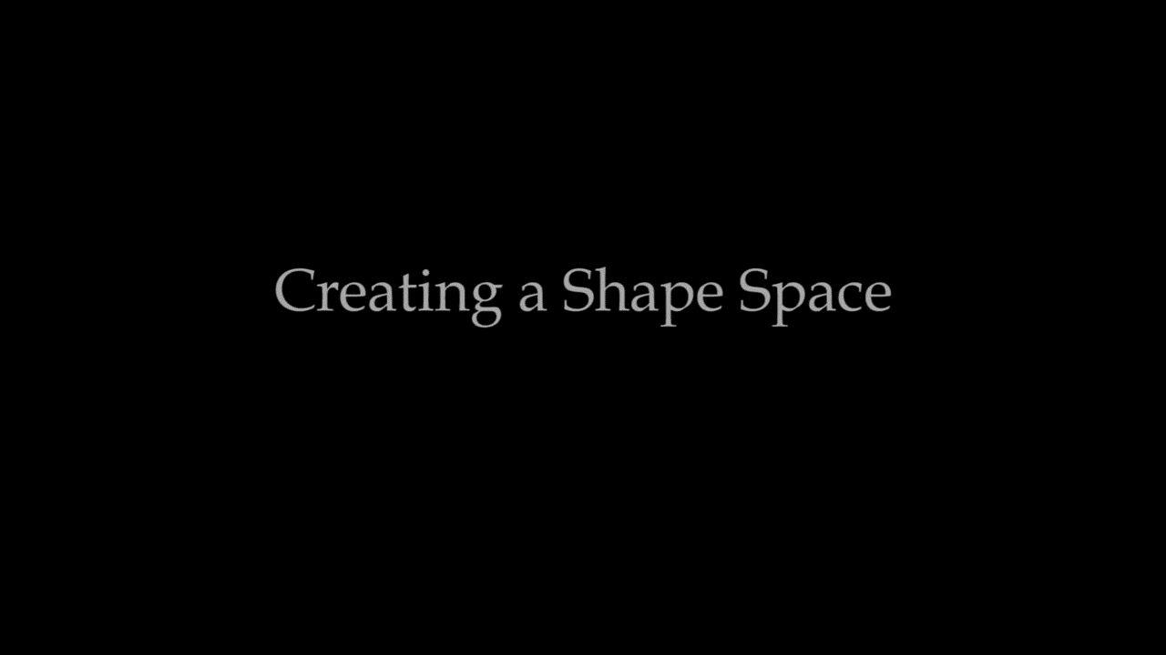
Specifying an object model
Loper et al. 2015
5. Deformable 3D model
Object is a parameterized space of shape/pose/deformation of class of 3D object
Notes:
http://smpl.is.tue.mpg.de/

Slide 18
Why not just pick the most complex model?
Inference is harder
  More parameters
  Harder to ‘fit’ (infer / optimize fit)
  Longer computation

Slide 19
General Process of Object Recognition
Specify Object Model
Generate Hypotheses
Propose an alignment of the model to the image
Score Hypotheses
Resolve Detections
James Hays

Slide 20
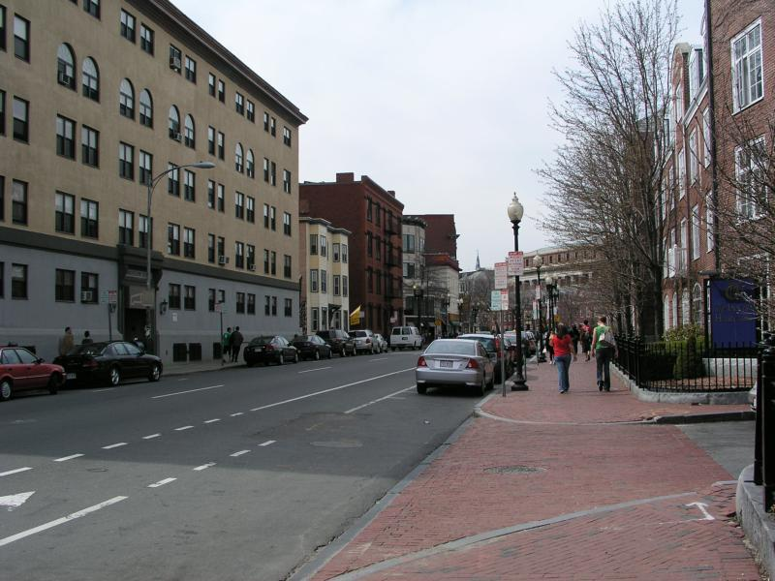
Generating hypotheses
2D template model / sliding window
  Test patch at each location and scale
James Hays

Slide 21
Generating hypotheses
2D template model / sliding window
  Test patch at each location and scale
Note – Template did not change size

Slide 22
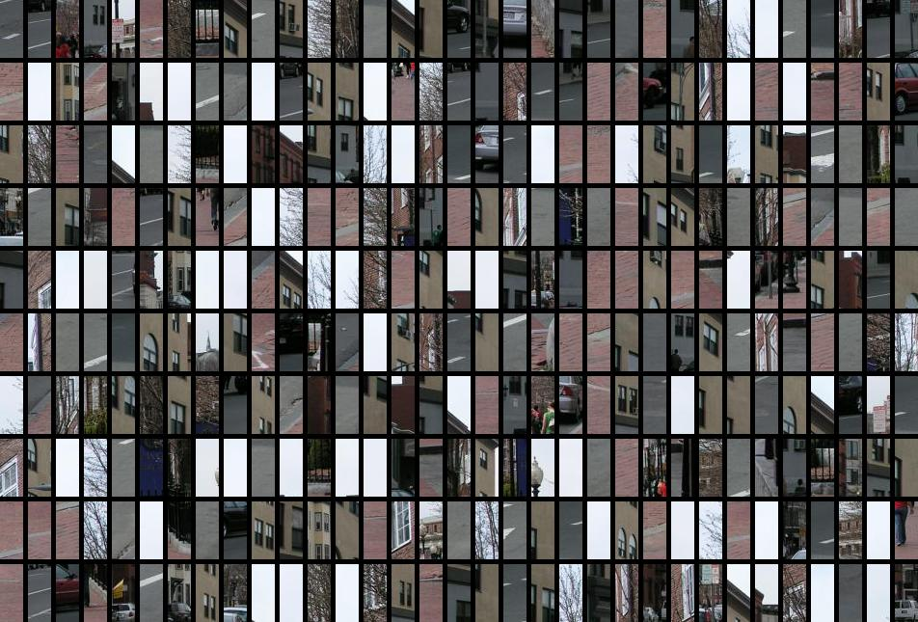
Each window is separately classified

Slide 23
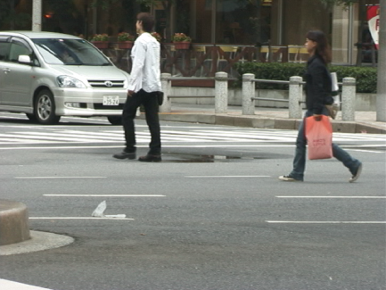
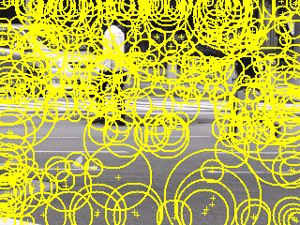
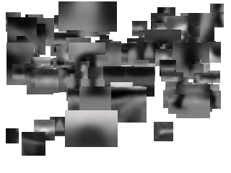
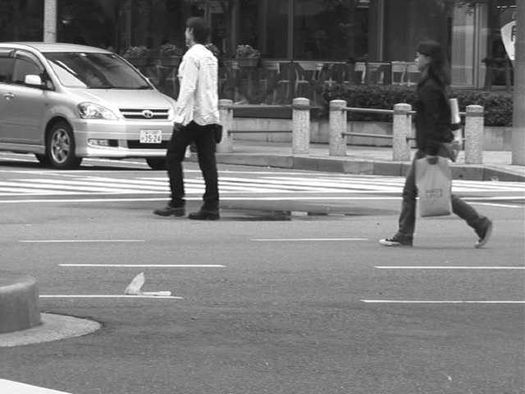
Generating hypotheses
2. Voting from patches/keypoints
Matched Codebook
Entries
Probabilistic
Voting
Interest Points
3D Voting Space
(continuous)
Implicit Shape Model by Leibe et al.
Notes:
http://web.eecs.umich.edu/~silvio/teaching/EECS598/papers/leibe-ism-slcv04.pdf

Slide 24
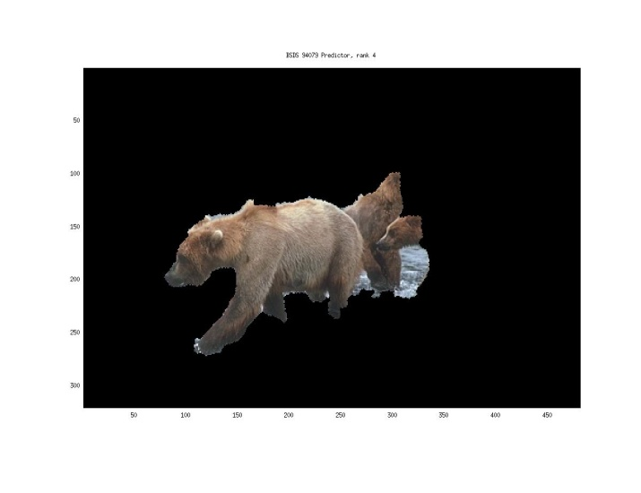
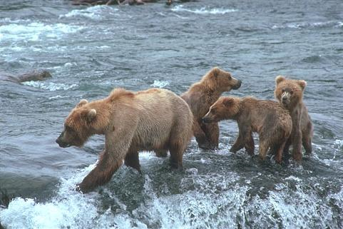
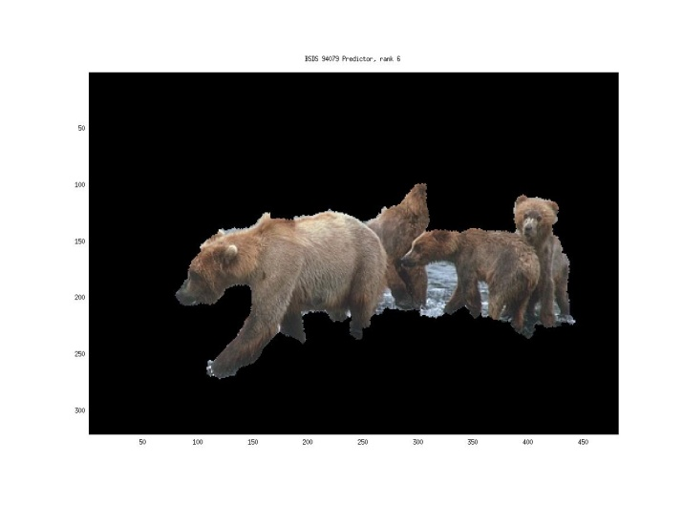
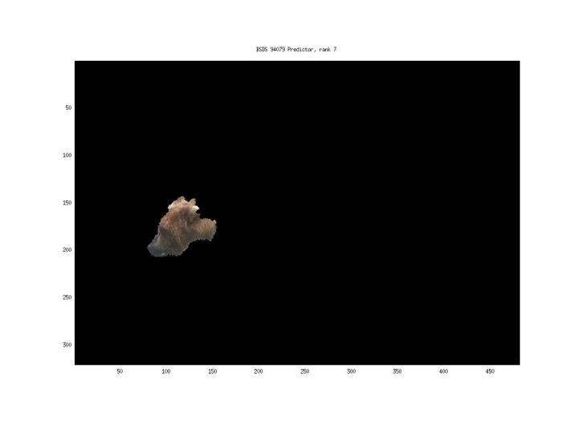
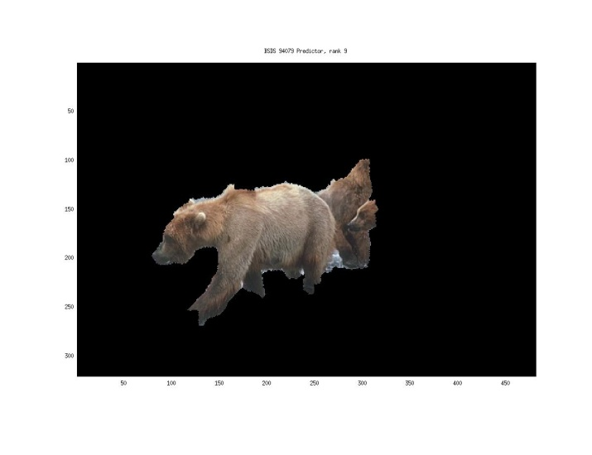
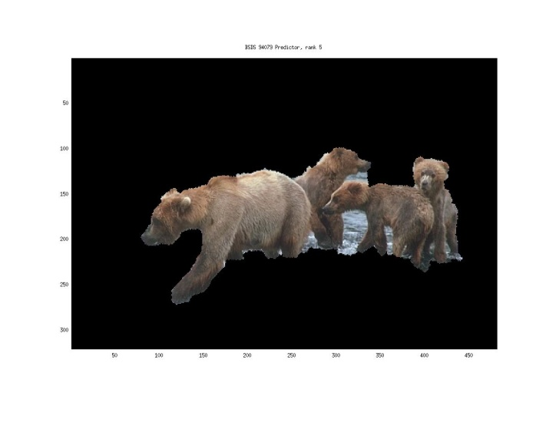
Generating hypotheses
Region-based proposal
  Arbitrary bounding box + image ‘cut’ segmentation
Endres Hoiem 2010

Slide 25
General Process of Object Recognition
Specify Object Model
Generate Hypotheses
Mainly gradient-based features, usually based on summary representation, many classifiers.
Score Hypotheses
Resolve Detections

Slide 26
General Process of Object Recognition
Specify Object Model
Generate Hypotheses
Score Hypotheses
Resolve Detections
Rescore each proposed object based on whole set

Slide 27
Resolving detection scores
Non-max suppression
Score = 0.8
Score = 0.8
Score = 0.1
James Hays

Slide 28
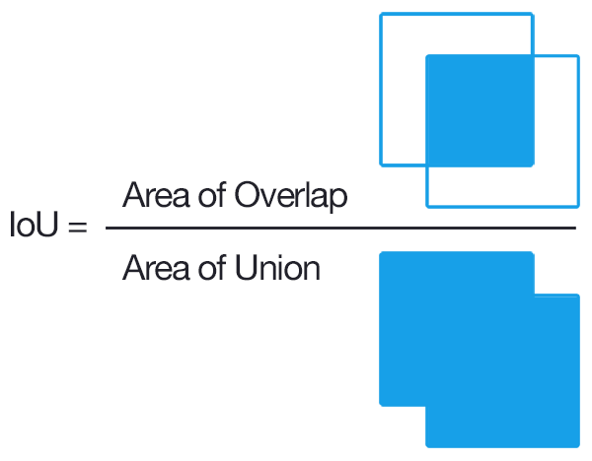
Resolving detection scores
Non-max suppression
Score = 0.8
Score = 0.8
Score = 0.1
Score = 0.1
“Overlap” score is below some threshold
Where overlap = intersection over union (IoU)
often called Jaccard index or similarity
IoU close to 1.0 is good

Slide 29
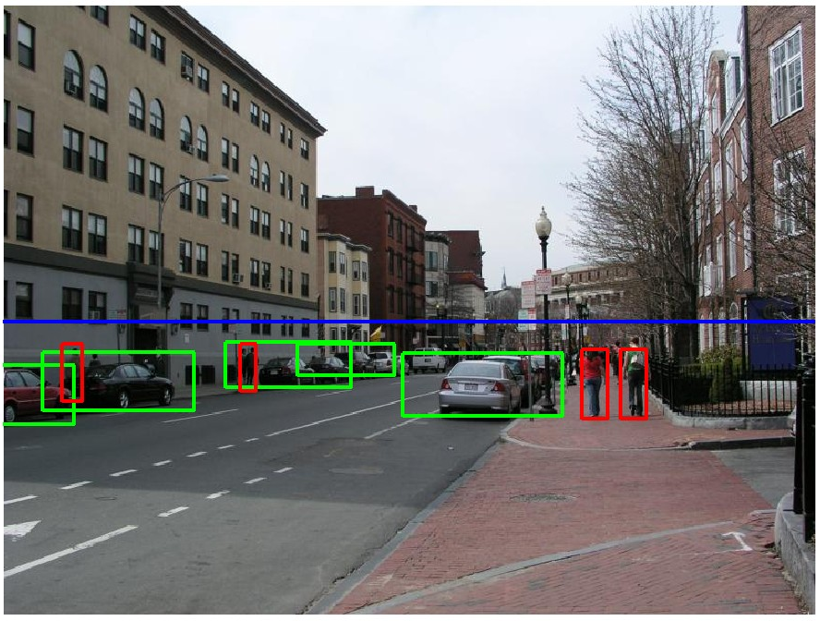
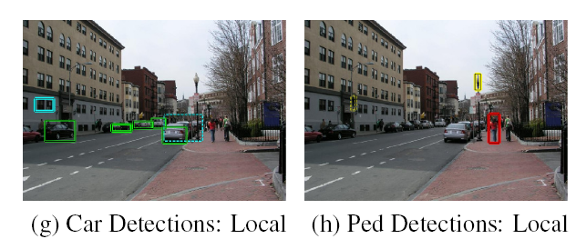
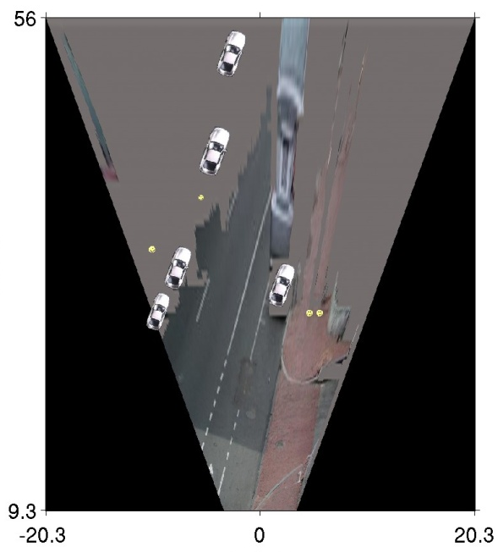
Resolving detection scores
Context/reasoning
  Via geometry
  Via known information
  or prior distributions
meters
Hoiem et al. 2006
meters

Slide 30
Object category detection in computer vision
Goal: detect all pedestrians, cars, monkeys, etc in image

Slide 31
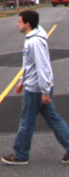
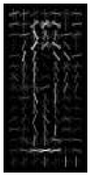
Basic Steps of Category Detection
Align
  E.g., choose position, scale orientation
  How to make this tractable?
Compare
  Compute similarity to an example object or to a summary representation
  Which differences in appearance are important?
Aligned
Possible Objects
Exemplar
Summary

Slide 32
Sliding window: a simple alignment solution
…
…

Slide 33
Influential Works in Detection
Sung-Poggio (1994, 1998) : ~2000 citations
  Basic idea of statistical template detection, bootstrapping to get “face-like” negative examples, multiple whole-face prototypes (in 1994)
Rowley-Baluja-Kanade (1996-1998) : ~3600
  “Parts” at fixed position, non-maxima suppression, simple cascade, rotation, pretty good accuracy, fast
Schneiderman-Kanade (1998-2000,2004) : ~1700
  Careful feature engineering, excellent results, cascade
Viola-Jones (2001, 2004) : ~13,000
  Haar-like features, Adaboost as feature selection, hyper-cascade, very fast
Dalal-Triggs (2005) : ~16,000 citations
  Careful feature engineering, excellent results, HOG feature, online code
Felzenszwalb-McAllester-Ramanan (2008): ~4,600 citations
  Template/parts-based blend
Girshick et al. (2013): ~2000 citations
  R-CNN / Fast R-CNN / Faster R-CNN. Deep learned models on object proposals.
James Hays

Slide 34
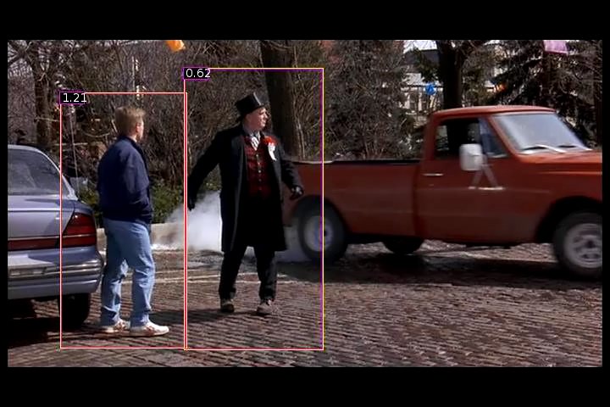
Dalal Triggs: Person detection with HOG & linear SVM
Histograms of Oriented Gradients for Human Detection, Navneet Dalal, Bill Triggs, International Conference on Computer Vision & Pattern Recognition - June 2005
http://lear.inrialpes.fr/pubs/2005/DT05/

Slide 35
Statistical Template
Object model =
sum of scores of features at fixed positions!
?
+3
+2
-2
-1
-2.5
= -0.5
> 7.5
Non-object
?
+4
+1
+0.5
+3
+0.5
= 10.5
> 7.5
Object

Slide 36
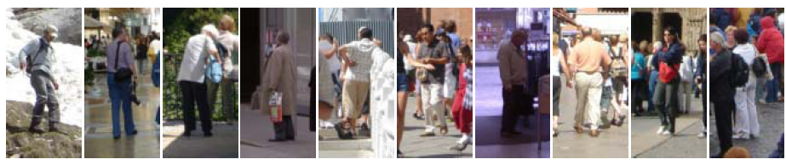
Example: Dalal-Triggs pedestrian detector
Extract fixed-sized (64x128 pixel) window at each position and scale
Compute HOG (histogram of gradient) features within each window
Score the window with a linear SVM classifier
Perform non-maxima suppression to remove overlapping detections with lower scores
Navneet Dalal and Bill Triggs, Histograms of Oriented Gradients for Human Detection, CVPR05
Notes:
6000+ citations, another of the most influential papers in computer vision!

Slide 37

Slides by Pete Barnum
Navneet Dalal and Bill Triggs, Histograms of Oriented Gradients for Human Detection, CVPR05

Slide 38
Tested with
  RGB
  LAB
  Grayscale
Gamma Normalization and Compression
  Square root
  Log
Slightly better performance vs. grayscale
Very slightly better performance vs. no adjustment
Notes:
Gamma normalization -> non-linear effect applied to camera sensor images to make them perceptually uniform vs. linear in light response

Slide 39
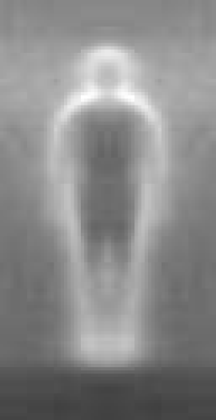

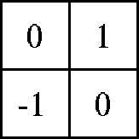



Outperforms
centered
diagonal
uncentered
cubic-corrected
Sobel
Slides by Pete Barnum
Navneet Dalal and Bill Triggs, Histograms of Oriented Gradients for Human Detection, CVPR05

Slide 40



Histogram of Oriented Gradients
  Votes weighted by magnitude
  Bilinear interpolation between cells
Orientation: 9 bins (for unsigned angles 0 -180)
Histograms over
k x k pixel cells
(4 bins shown)
Slides by Pete Barnum
Navneet Dalal and Bill Triggs, Histograms of Oriented Gradients for Human Detection, CVPR05

Slide 41


Normalize with respect to surrounding cells
Rectangular HOG (R-HOG)
How to normalize?
Concatenate all cell responses from block into vector.
Normalize vector.
Extract responses from cell of interest.
Do this 4x for each overlapping block.
e is a small constant
(to remove div. by zero on empty bins)
Slides by Pete Barnum
Navneet Dalal and Bill Triggs, Histograms of Oriented Gradients for Human Detection, CVPR05
Notes:
R-HOG: Rectangular HOG
Also C-HOG exists – Circular HOG

Slide 42
# orientations
# features = 15 x 7 x 9 x 4 = 3780
X=
# cells
# normalizations by neighboring cells
Slides by Pete Barnum
Navneet Dalal and Bill Triggs, Histograms of Oriented Gradients for Human Detection, CVPR05
Notes:
Note – this is not a “bag of features”, these gradient measurements have fixed spatial positions.

Slide 43
Original Formulation
# orientations
# features = 15 x 7 x 9 x 4 = 3780
# cells
# normalizations by neighboring cells
X=
UoCTTI variant
# orientations
# features = 15 x 7 x (3 x 9) + 4 = 3780
# cells
magnitude of neighbor cells
Slides by Pete Barnum
Navneet Dalal and Bill Triggs, Histograms of Oriented Gradients for Human Detection, CVPR05
Notes:
Note – this is not a “bag of features”, these gradient measurements have fixed spatial positions

Slide 44


pos w
neg w
Training data classes
Slides by Pete Barnum
Navneet Dalal and Bill Triggs, Histograms of Oriented Gradients for Human Detection, CVPR05

Slide 45



pedestrian
Slides by Pete Barnum
Navneet Dalal and Bill Triggs, Histograms of Oriented Gradients for Human Detection, CVPR05

Slide 46




Pedestrian detection with HOG
Learn a pedestrian template using a support vector machine
At test time, compare feature map with template over sliding windows.
Find local maxima of response
Multi-scale: repeat over multiple levels of a HOG pyramid
HOG feature map
Template
Detector response map
Can be ‘continuous’ (subpixel) for more sophisticated maxima finding
N. Dalal and B. Triggs, Histograms of Oriented Gradients for Human Detection, CVPR 2005

Slide 47

INRIA pedestrian database
Notes:
http://vislab.isr.ist.utl.pt/wp-content/uploads/2012/12/onPurity.pdf

Slide 48

INRIA pedestrian database issues
Notes:
http://vislab.isr.ist.utl.pt/wp-content/uploads/2012/12/onPurity.pdf

Slide 49

How good is HOG at person detection?
Miss rate =
1 - recall

Slide 50
Something to think about…
Sliding window detectors work
  very well for faces
  fairly well for cars and pedestrians
  badly for cats and dogs
Why are some classes easier than others?

Slide 51
Strengths/Weaknesses of Statistical Template Approach
Strengths
Works very well for non-deformable objects with canonical orientations: faces, cars, pedestrians
Fast detection
Weaknesses
Not so well for highly deformable objects or “stuff”
Not robust to occlusion
Requires lots of training data

Slide 52
Tricks of the trade
Details in feature computation really matter
  E.g., normalization in Dalal-Triggs improves detection rate by 27% at fixed false positive rate
Template size
  Typical choice is size of smallest expected detectable object
“Jittering” or “augmenting” to create synthetic positive examples
  Create slightly rotated, translated, scaled, mirrored versions as extra positive examples.
Bootstrapping to get hard negative examples
  Randomly sample negative examples
  Train detector
  Sample negative examples that score > -1
  Repeat until all high-scoring negative examples fit in memory

Slide 53
Live demo

Slide 54
Dalal-Triggs uses a template with a rigid form – humans are boxed shaped.
But…is there a way to learn the spatial layout more fluidly?
  Might help us capture more appearance variation…
What about faster, too?
Notes:
Note: humans aren’t boxed shape; this is the assumption that the template makes.

Slide 55
Face detection

Slide 56

Consumer application: Apple iPhoto
Things iPhoto thinks are faces

Slide 57

"The Nikon S60 detects up to 12 faces."

Slide 58


Slide 59



Face detection and recognition
Detection
Recognition
“Sally”

Slide 60
Challenges of face detection
Sliding window = tens of thousands of location/scale evaluations
  One megapixel image has ~10⁶ pixels, and a comparable number of candidate face locations
Faces are rare: 0–10 per image
  For computational efficiency, spend as little time as possible on the non-face windows.
  For 1 Mpix, to avoid having a false positive in every image, our false positive rate has to be less than 10⁻⁶
James Hays

Slide 61

Sliding Window Face Detection with Viola-Jones
P. Viola and M. Jones. Rapid object detection using a boosted cascade of simple features. CVPR 2001.
P. Viola and M. Jones. Robust real-time face detection. IJCV 57(2), 2004.
Many Slides from Lana Lazebnik

Slide 62
The Viola/Jones Face Detector
A seminal approach to real-time object detection.
Training is slow, but detection is very fast
Key ideas:
1. Integral images for fast feature evaluation
2. Boosting for feature selection
3. Attentional cascade for fast non-face window rejection

Slide 63

1. Integral images for fast feature evaluation
The integral image computes a value at each pixel (x,y) that is the sum of all pixel values above and to the left of (x,y), inclusive.
This can quickly be computed in one pass through the image.
‘Summed area table’
i(x,y)

Slide 64
Computing the integral image
Image
Region already computed
Current pixel

Slide 65
Computing the integral image
ii(x, y-1)
s(x-1, y)
i(x, y)
Cumulative row sum: s(x, y) = s(x–1, y) + i(x, y)
Integral image: ii(x, y) = ii(x, y−1) + s(x, y)
Python: ii = np.cumsum(i)

Slide 66
Computing sum within a rectangle
Let A,B,C,D be the values of the integral image at the corners of a rectangle
The sum of original image values within the rectangle can be computed as:
  sum = A – B – C + D
D
B
C
A
Only 3 additions are required for any size of rectangle!

Slide 67

Integral Images
ii = cumsum(cumsum(im, 1), 2)
x, y
ii(x,y) = Sum of the values in the grey region
SUM within Rectangle D is
ii(4) - ii(2) - ii(3) + ii(1)

Slide 68

Features that are fast to compute
Haar wavelet
“Haar-like features”
  Differences of sums of intensity
  Computed at different positions and scales
  within sliding window
-1
+1
Two-rectangle features
Three-rectangle features
Etc.
CC BY-SA 3.0, https://commons.wikimedia.org/w/index.php?curid=801361

Slide 69


Image Features
“Rectangle filters”
Value = ∑(pixels in white area)
– ∑(pixels in black area)
Notes:
For real problems results are only as good as the features used...
This is the main piece of ad-hoc (or domain) knowledge
Rather than the pixels, we have selected a very large set of simple functions
Sensitive to edges and other critcal features of the image
** At multiple scales
Since the final classifier is a perceptron it is important that the features be non-linear… otherwise the final classifier will be a simple perceptron.
We introduce a threshold to yield binary features
Image: Sadiq Khan; major of London

Slide 70




Example
Source
Result

Slide 71


Computing a rectangle feature
Integral Image

Slide 72
But these features are rubbish…!
Yes, individually they are ‘weak classifiers’
Jargon: ‘feature’ and ‘classifier’ are used interchangeably here.
Also with ‘learner’.
But, what if we combine thousands of them…
-1
+1
Two-rectangle features
Three-rectangle features
Etc.
CC BY-SA 3.0, https://commons.wikimedia.org/w/index.php?curid=801361

Slide 73

How many features are there?
For a 24x24 detection region, the number of possible rectangle features is ~160,000!
Notes:
So, how many can we get?

Slide 74
How many features are there?
For a 24x24 detection region, the number of possible rectangle features is ~160,000!
At test time, it is impractical to evaluate the entire feature set.
Can we learn a ‘strong classifier’ using just a small subset of all possible features?

Slide 75
2. Boosting for feature selection
Initially, weight each training example equally.
Weight = size of point
Slide credit: Paul Viola

Slide 76
2. Boosting for feature selection
In each boosting round:
Find the weak classifier
that achieves the lowest
weighted training error.
Raise the weights of
training examples
misclassified by
current weak classifier.
Round 1:
Weak
Classifier 1
Slide credit: Paul Viola

Slide 77
Boosting illustration
In each boosting round:
Find the weak classifier
that achieves the lowest
weighted training error.
Raise the weights of
training examples
misclassified by
current weak classifier.
Round 1:
Weights
Increased

Slide 78
Boosting illustration
In each boosting round:
Find the weak classifier
that achieves the lowest
weighted training error.
Raise the weights of
training examples
misclassified by
current weak classifier.
Round 2:
Weak
Classifier 2

Slide 79
Boosting illustration
In each boosting round:
Find the weak classifier
that achieves the lowest
weighted training error.
Raise the weights of
training examples
misclassified by
current weak classifier.
Round 2:
Weights
Increased

Slide 80
Boosting illustration
In each boosting round:
Find the weak classifier
that achieves the lowest
weighted training error.
Raise the weights of
training examples
misclassified by
current weak classifier.
Round 3:
Weak
Classifier 3

Slide 81
Boosting illustration
Round 3:
Compute final classifier as linear combination of all weak classifier.
Weight of each classifier is directly proportional to its accuracy.
Exact formulas for re-weighting and combining weak learners depend on the particular boosting scheme (e.g., AdaBoost).
Y. Freund and R. Schapire, A short introduction to boosting,
Journal of Japanese Society for Artificial Intelligence, 14(5):771-780, September, 1999.

Slide 82

Boosting for face detection
First two features selected by boosting:
This feature combination can yield 100% recall and 50% false positive rate

Slide 83



Feature selection with boosting
Create a large pool of features (180K)
Select discriminative features that work well together
  “Weak learner” = feature + threshold + ‘polarity’
  Choose weak learner that minimizes error on the weighted training set, then reweight
Weak learner
Final strong learner
window
Learner weight
value of rectangle feature
threshold
‘polarity’ = black or white region flip

Slide 84


2. Boosting for feature selection
Boosting is a learning scheme that combines weak learners into a more accurate ensemble classifier
Weak learners based on rectangle filters:
Ensemble classification function:
value of rectangle feature
parity
threshold
window
learned weights
Notes:
What is the point of the parity p if we have alpha weights anyway?

Slide 85

Adaboost pseudocode
Szeliski p665

Slide 86
Boosting vs. SVM
Advantages of boosting
  Integrates classifier training with feature selection
  Complexity of training is linear instead of quadratic in the number of training examples
  Flexibility in the choice of weak learners, boosting scheme
  Testing is fast
Disadvantages
  Needs many training examples
  Training is slow
  Often doesn’t work as well as SVM (especially for many-class problems)

Slide 87
Cascade for Fast Detection
Fast classifiers early in cascade which reject many negative examples but detect almost all positive examples.
Slow classifiers later, but most examples don’t get there.
Stage 1
h₁(x) > t₁?
Yes
Stage 2
h₂(x) > t₂?
Stage N
h_{n}(x) > t_{n}?
Yes
…
Pass
No
No
No
Examples
Reject
Reject
Reject

Slide 88
Attentional cascade
Chain classifiers that are progressively more complex and have lower false positive rates:
Receiver operating characteristic
% False Pos
0
50
vs
false
neg
determined by
0 100
% True positive
T
T
T
IMAGE
SUB-WINDOW
T
FACE
Classifier 1
Classifier 2
Classifier 3
F
F
F
NON-FACE
NON-FACE
NON-FACE
Notes:
In general simple classifiers, while they are more efficient, they are also weaker.
We could define a computational risk hierarchy (in analogy with structural risk minimization)…
A nested set of classifier classes
The training process is reminiscent of boosting…
- previous classifiers reweight the examples used to train subsequent classifiers
The goal of the training process is different
- instead of minimizing errors minimize false positives

Slide 89
Attentional cascade
The detection rate and the false positive rate of the cascade are found by multiplying the respective rates of the individual stages
A detection rate of 0.9 and a false positive rate on the order of 10⁻⁶ can be achieved by a
10-stage cascade if each stage has a detection rate of 0.99 (0.99¹⁰ ≈ 0.9) and a false positive rate of about 0.30 (0.3¹⁰ ≈ 6×10⁻⁶)
T
T
T
IMAGE
SUB-WINDOW
T
FACE
Classifier 1
Classifier 2
Classifier 3
F
F
F
NON-FACE
NON-FACE
NON-FACE

Slide 90
Training the cascade
Set target detection and false positive rates for each stage
Keep adding features to the current stage until its target rates have been met
  Need to lower boosting threshold to maximize detection
  (as opposed to minimizing total classification error)
  Test on a validation set
If the overall false positive rate is not low enough, then add another stage
Use false positives from current stage as the negative training examples for the next stage

Slide 91

The implemented system
Training Data
  5000 faces
    All frontal, rescaled to
    24x24 pixels
  300 million non-faces
    9500 non-face images
  Faces are normalized
    Scale, translation
Many variations
  Across individuals
  Illumination
  Pose
Notes:
This situation with negative examples is actually quite common… where negative examples are free.

Slide 92
Viola-Jones details
38 stages with 1, 10, 25, 50 … features
  6061 total used out of 180K candidates
  10 features evaluated on average
Training Examples
  4916 positive examples
  10000 negative examples collected after each stage
Scanning
  Scale detector rather than image
  Scale steps = 1.25 (factor between two consecutive scales)
  Translation 1*scale (# pixels between two consecutive windows)
Non-max suppression: average coordinates of overlapping boxes
Train 3 classifiers and take vote

Slide 93
System performance
Training time: “weeks” on 466 MHz Sun workstation
38 cascade layers, total of 6061 features
Average of 10 features evaluated per window on test set
“On a 700 Mhz Pentium III processor, the face detector can process a 384 by 288 pixel image in about .067 seconds”
  15 Hz
  15 times faster than previous detector
  of comparable accuracy (Rowley et al., 1998)

Slide 94


Viola Jones Results
Speed = 15 FPS (in 2001)
MIT + CMU face dataset

Slide 95

Boosting for face detection
A 200-feature classifier can yield 95% detection rate and a false positive rate of 1 in 14084
True positive rate
Not good enough!
Receiver operating characteristic (ROC) curve

Slide 96





Output of Face Detector on Test Images
Notes:
Newsroom

Slide 97



Other detection tasks
Facial Feature Localization
Profile Detection
Male vs.
female

Slide 98




Profile Detection

Slide 99

Profile Features

Slide 100
Live demo

Slide 101
Summary: Viola/Jones detector
Rectangle features
Integral images for fast computation
Boosting for feature selection
Attentional cascade for fast rejection of negative windows

Slide 102

Things to remember
Sliding window for search
Features based on differences of intensity (gradient, wavelet, etc.)
  Excellent results = careful feature design
Boosting for feature selection
Integral images, cascade for speed
Bootstrapping to deal with many, many negative examples
Stage 1
H₁(x) > t₁?
Yes
Stage 2
H₂(x) > t₂?
…
Stage N
H_{N}(x) > t_{N}?
Yes
Pass
Examples
No
No
No
Reject
Reject
Reject

