Slide 1

20 February 2019
Notes:
Welcome to a class with some curious content!
Today we’re going to be discussing cameras, and how light and color affect image formation.

Slide 2
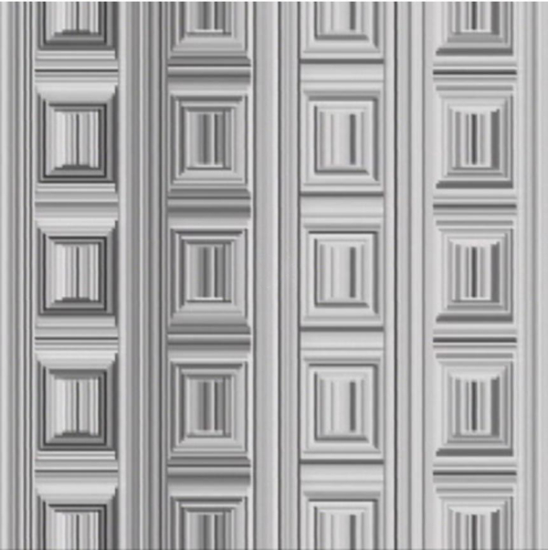
Coffer Illusion
Notes:
Coffer Illusion

Slide 3
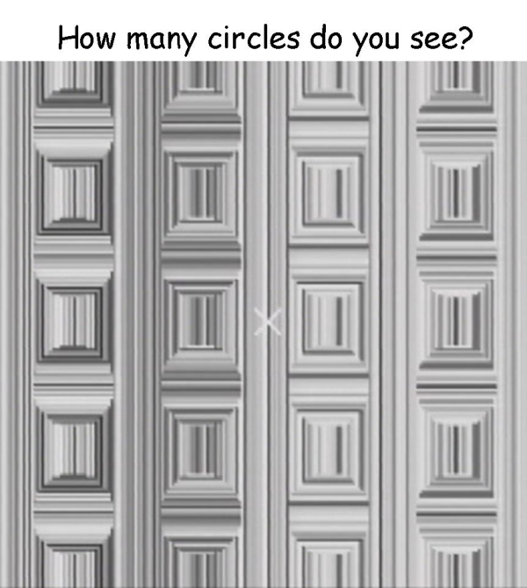
Coffer Illusion
Notes:
Coffer Illusion
16 circles

Slide 4
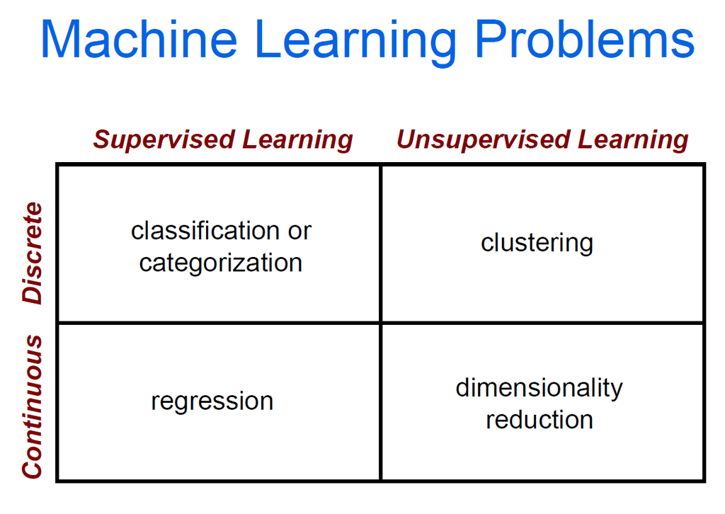

Slide 5
Supervised learning
f(x) = y
Training: Given a training set of labeled examples:
{(x₁,y₁), …, (x_{N},y_{N})}
Estimate the prediction function f by minimizing the prediction error on the training set.
Testing: Apply f to a unseen test example x and output the predicted value y = f(x) to classify x.
Prediction function
Image feature
Output (label)
Slide credit: L. Lazebnik

Slide 6




Image Categorization
Training
Training Labels
Training Images
Image Features
Classifier Training
Trained Classifier

Slide 7
Classifiers
Training
Training Labels
Training Images
Image Features
Classifier Training
Trained Classifier

Slide 8
Learning a classifier
Given a set of features with corresponding labels, learn a function to predict the labels from the features.
+ = Data point from class 1
x2
o = Data point from class 2
+
Each data point has a feature vector (x1,x2).
+
+
+
+
+
o
+
+
o
o
o
o
x1

Slide 9
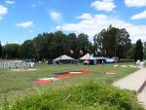
Image Categorization
Training
Training Labels
Training Images
Image Features
Classifier Training
Trained Classifier
Testing
Image Features
Trained Classifier
Prediction
Outdoor
Test Image

Slide 10
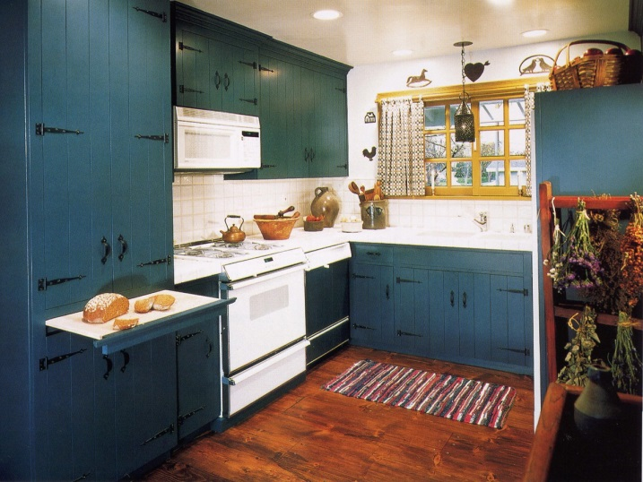
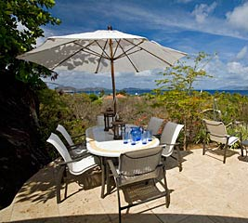
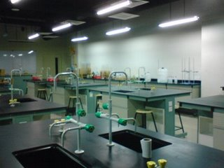
Example: Scene Categorization
Is this a kitchen?

Slide 11
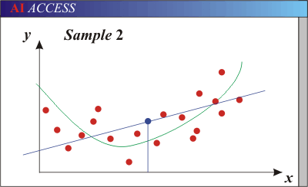
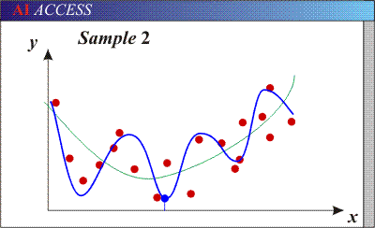
Bias-Variance Trade-off
Bias: error in model assumptions; how much the average model over all training sets differs from the true model.
Variance: how much models estimated from different training sets differ from each other.
Models with too few parameters are inaccurate because of a large bias.
  Not enough flexibility!
Models with too many parameters are inaccurate because of a large variance.
  Too much sensitivity to the sample.
Notes:
http://www.aiaccess.net/English/Glossaries/GlosMod/e_gm_bias_variance.htm

Slide 12
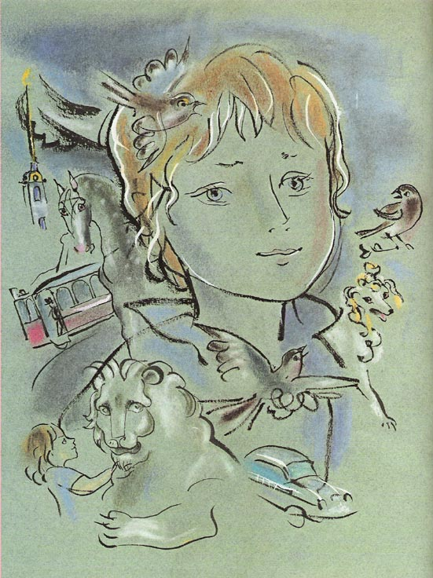
Recognition: Overview and History
Slides from James Hays, Lana Lazebnik, Fei-Fei Li, Rob Fergus, Antonio Torralba, and Jean Ponce

Slide 13
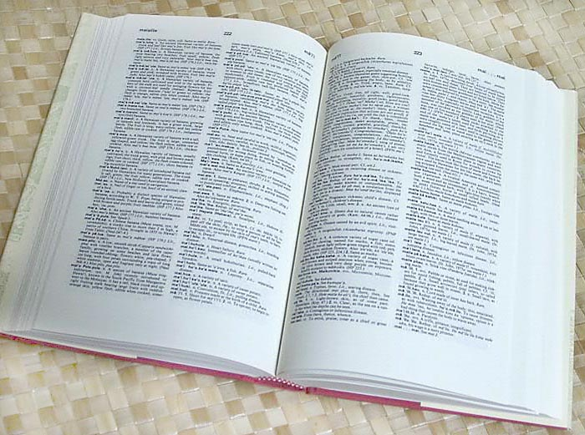

How many visual object categories are there?
~10,000 to 30,000
Biederman 1987
Notes:
1500-3000 basic-level nouns, ~10 types per basic-level category
Alternative explanation (Perona): ~1000 names per domain (broad scene category), 20-30 domains

Slide 14
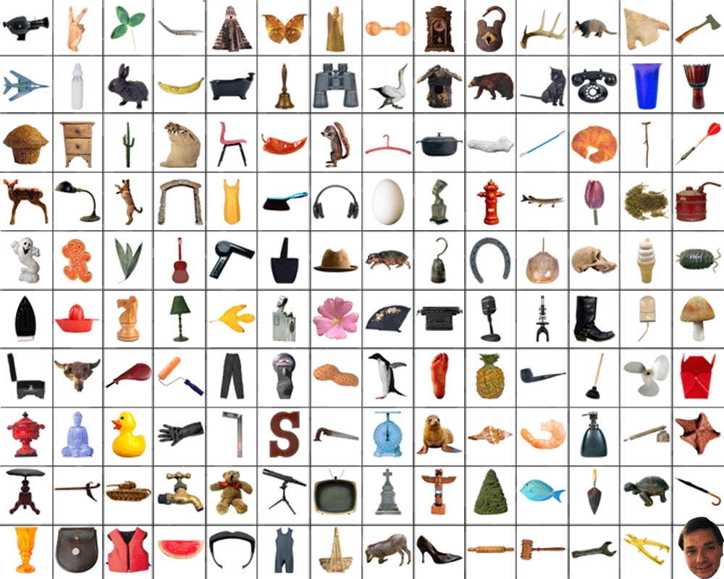
~10,000 to 30,000

Slide 15
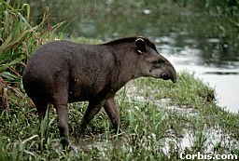
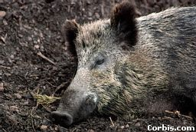
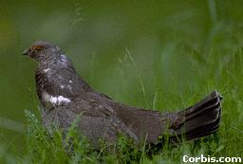
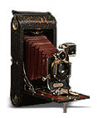
OBJECTS
ANIMALS
PLANTS
INANIMATE
NATURAL
MAN-MADE
…..
VERTEBRATE
MAMMALS
BIRDS
TAPIR
BOAR
GROUSE
CAMERA

Slide 16
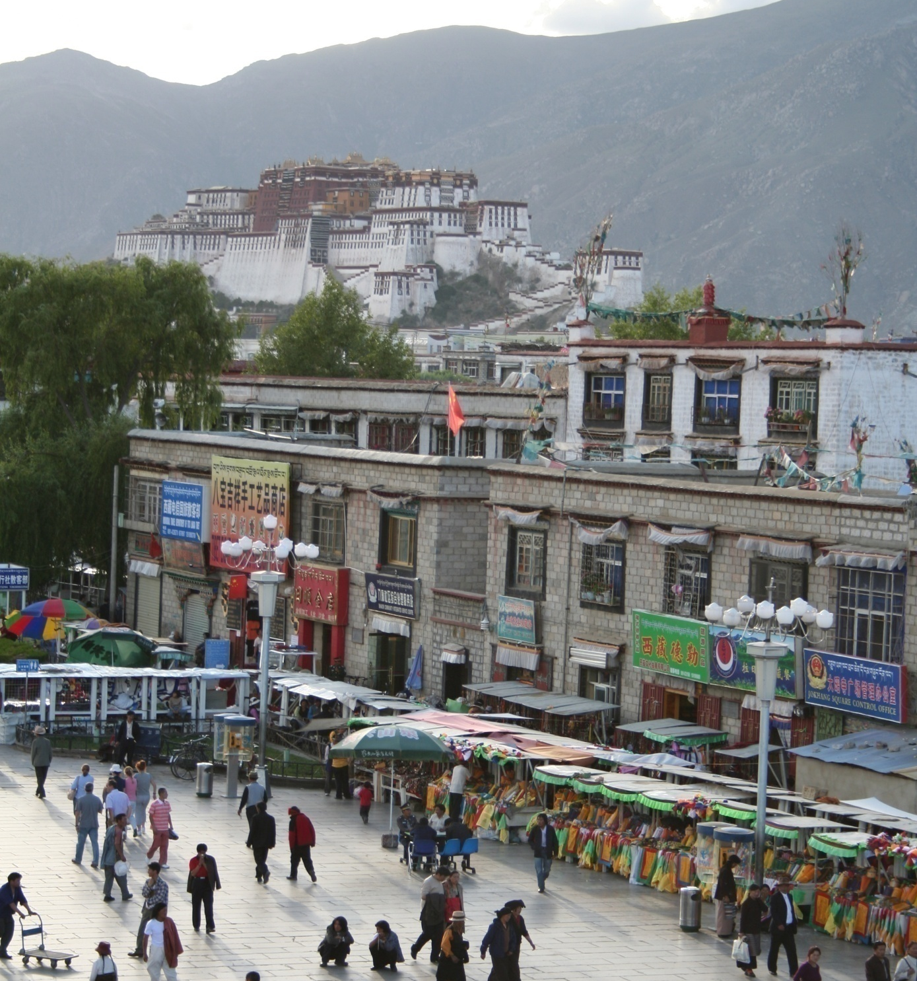
Specific recognition tasks
Svetlana Lazebnik

Slide 17
Scene categorization or classification
outdoor/indoor
city/forest/factory/etc.
Svetlana Lazebnik

Slide 18
Image annotation / tagging / attributes
street
people
building
mountain
tourism
cloudy
brick
…
Svetlana Lazebnik

Slide 19
Image parsing / semantic segmentation
sky
mountain
building
tree
building
banner
street lamp
market
people
Svetlana Lazebnik

Slide 20
Object detection
find pedestrians
Svetlana Lazebnik

Slide 21
Scene understanding?
Svetlana Lazebnik

Slide 22
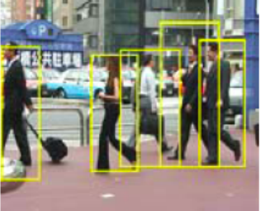
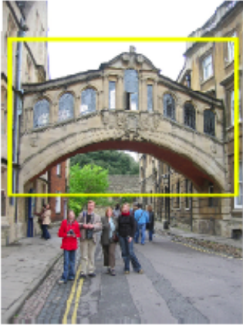
Category vs. instance recognition
Category:
  Find all the people
  Find all the buildings
  Often within a single image
  Often ‘sliding window’
Instance:
  Is this face James?
  Find this specific famous building
  Often within a database of images
Notes:
Hertford Bridge, often called "the Bridge of Sighs“ - https://en.wikipedia.org/wiki/Bridge_of_Sighs_(Oxford)
Oxford, UK

Slide 23
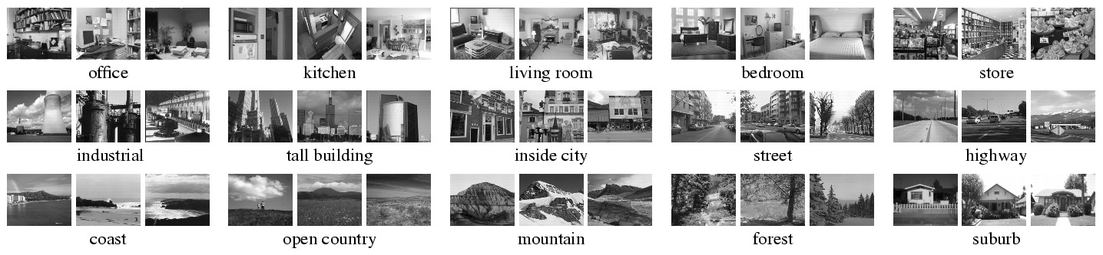
Scene recognition dataset
Instance or category?

Slide 24
Recognition is all about modeling variability
Variability:
Camera position
Svetlana Lazebnik
Notes:
One could argue that invariance is the key challenge to computer vision. But is this still true with big data?

Slide 25
Recognition is all about modeling variability
Variability:
Camera position
Illumination
Svetlana Lazebnik
Notes:
One could argue that invariance is the key challenge to computer vision. But is this still true with big data?

Slide 26
Recognition is all about modeling variability
Variability:
Camera position
Illumination
Pose/shape parameters
Svetlana Lazebnik
Notes:
One could argue that invariance is the key challenge to computer vision. But is this still true with big data?

Slide 27
Recognition is all about modeling variability
Variability:
Camera position
Illumination
Pose/shape parameters
Within-class variations?
Svetlana Lazebnik
Notes:
One could argue that invariance is the key challenge to computer vision. But is this still true with big data?
Manifold of natural images

Slide 28
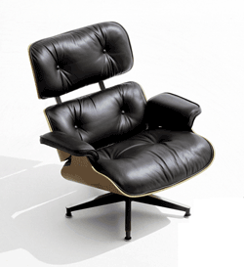
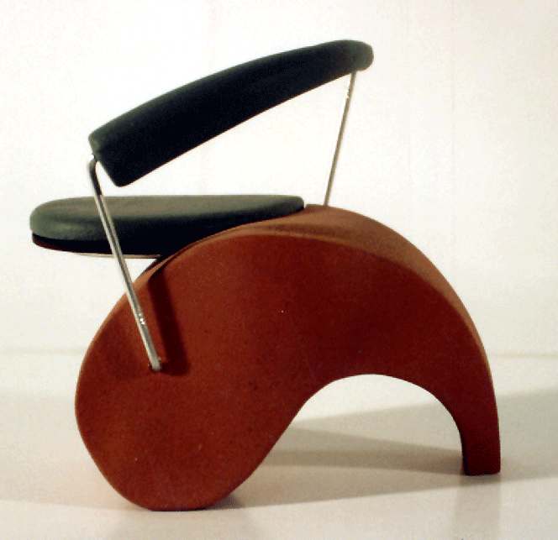
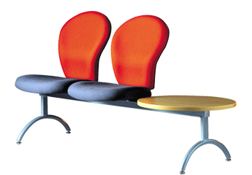
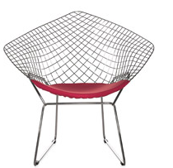
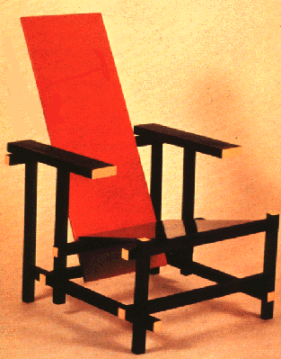
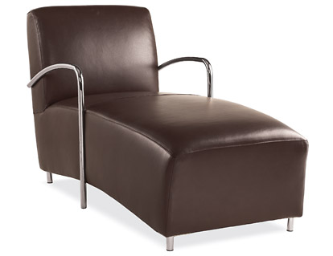
Within-class variations
Svetlana Lazebnik
Notes:
Note English language issues. Try to not let language confound things.

Slide 29
Recognition is all about modeling variability
High-dimensional space
Variability:
Camera position
Illumination
Pose/shape parameters
Within-class variation
Svetlana Lazebnik
Notes:
One could argue that invariance is the key challenge to computer vision. But is this still true with big data?
Manifold of natural images

Slide 30
History of ideas in recognition
1960s – early 1990s: the geometric era
No digital cameras!
Slow compute!
Svetlana Lazebnik

Slide 31
θ
Variability:
Camera position
Illumination
Shape is known
Roberts (1965); Lowe (1987); Faugeras & Hebert (1986); Grimson & Lozano-Perez (1986); Huttenlocher & Ullman (1987)
Svetlana Lazebnik

Slide 32
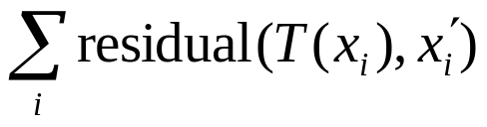
Alignment
Alignment: fitting a model to a transformation between pairs of features (matches) in two images
x_{i}
x_{i}
Find transformation T
that minimizes
'
T
Svetlana Lazebnik

Slide 33
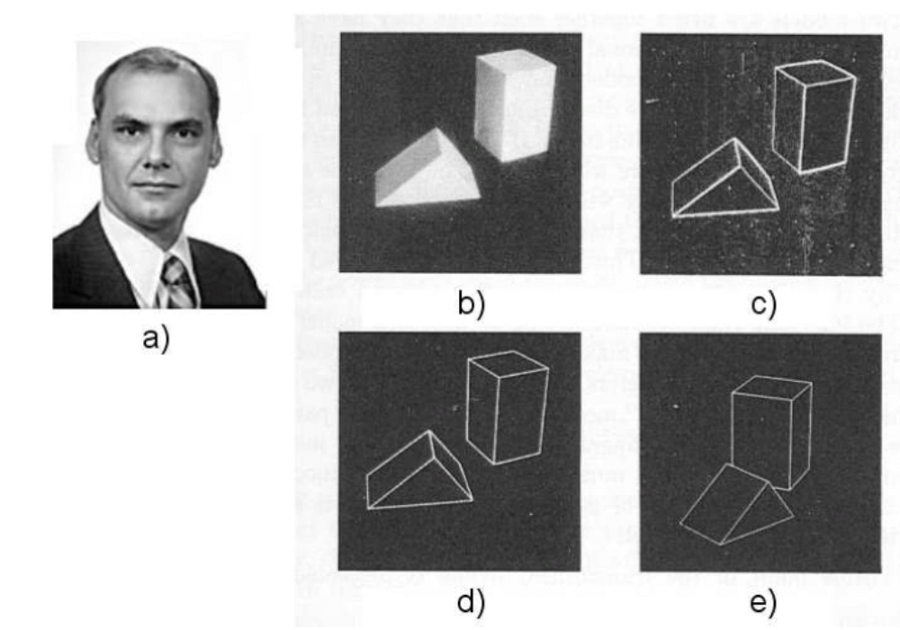
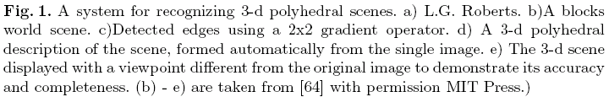
Recognition as an alignment problem:
Block world
L. G. Roberts
Machine Perception of Three Dimensional Solids,
Ph.D. thesis, MIT Department of Electrical Engineering, 1963.
J. Mundy, Object Recognition in the Geometric Era: a Retrospective, 2006

Slide 34
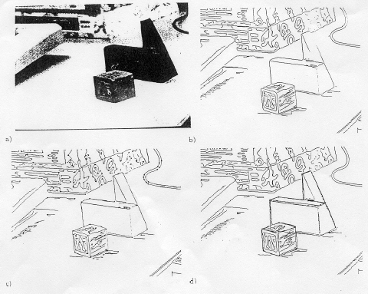
Alignment: Huttenlocher & Ullman (1987)

Slide 35
Variability
Invariance to:
Camera position
Illumination
Internal parameters
Duda & Hart ( 1972); Weiss (1987); Mundy et al. (1992-94);
Rothwell et al. (1992); Burns et al. (1993)
Svetlana Lazebnik

Slide 36
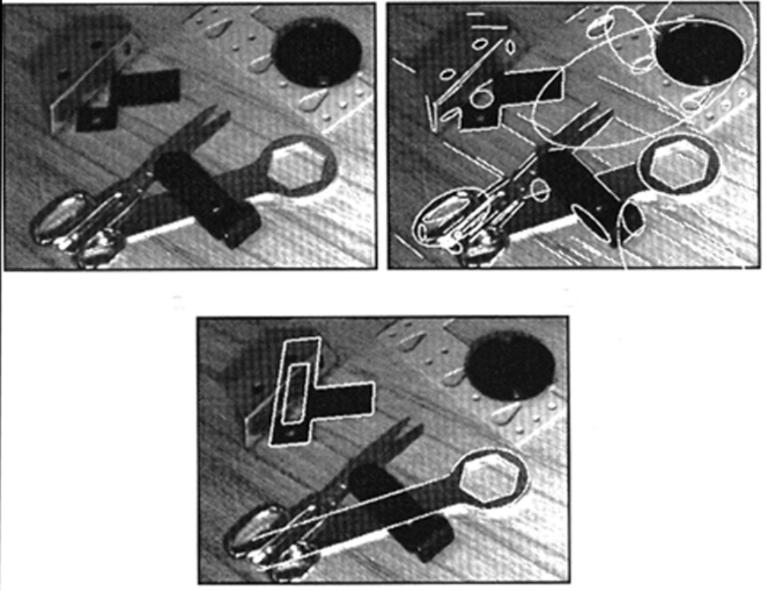
Example: invariant to similarity transformations computed from four points
B
C
D
A
Projective invariants (Rothwell et al., 1992):
General 3D objects do not admit monocular viewpoint
invariants (Burns et al., 1993)

Slide 37






Representing and recognizing object categories is harder...
ACRONYM (Brooks and Binford, 1981)
Binford (1971), Nevatia & Binford (1972), Marr & Nishihara (1978)

Slide 38
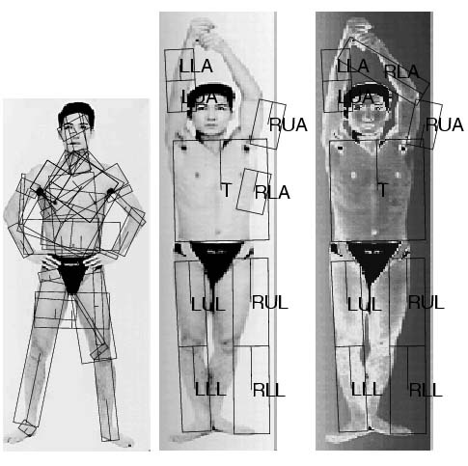
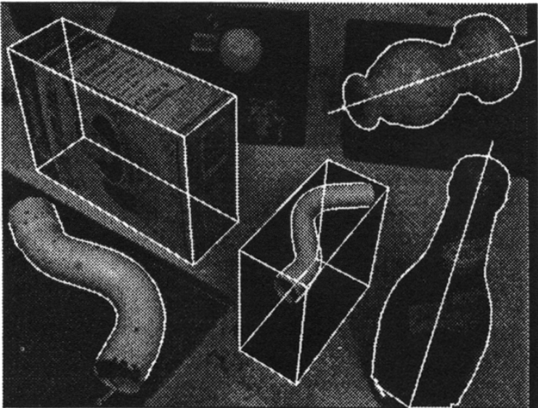
General shape primitives?
Generalized cylinders
Ponce et al. (1989)
Forsyth (2000)
Zisserman et al. (1995)
Svetlana Lazebnik

Slide 39
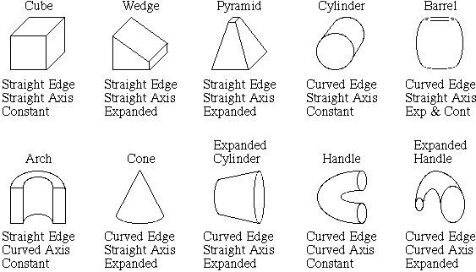
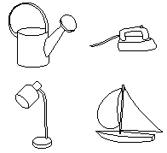
Recognition by components
Biederman (1987)
Primitives (geons)
Objects
http://en.wikipedia.org/wiki/Recognition_by_Components_Theory
Svetlana Lazebnik

Slide 40
History of ideas in recognition
1960s – early 1990s: the geometric era
1990s: appearance-based models
No digital cameras!
Slow compute!
Slow compute!
Svetlana Lazebnik

Slide 41
Known target image
Empirical models of image variability
Appearance-based techniques
Turk & Pentland (1991); Murase & Nayar (1995); etc.
Svetlana Lazebnik

Slide 42
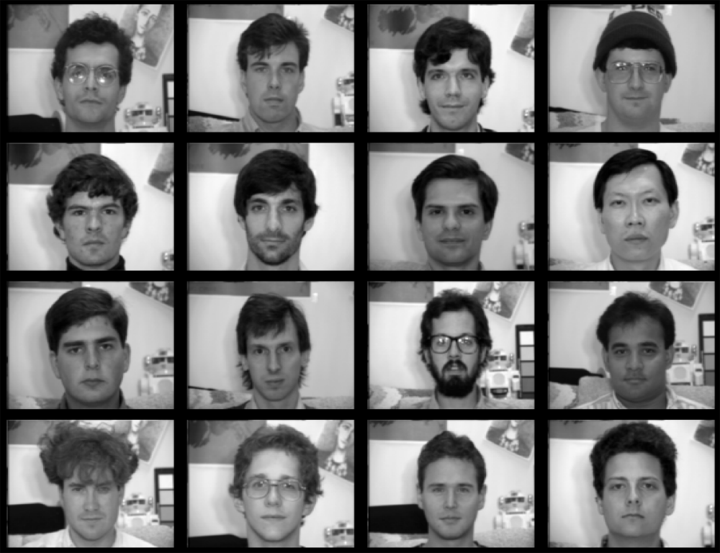
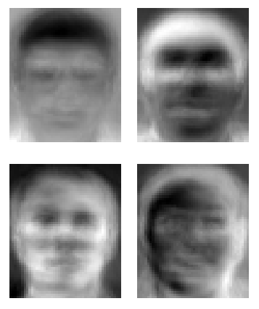
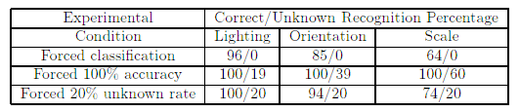
Eigenfaces (Turk & Pentland, 1991)
Svetlana Lazebnik

Slide 43
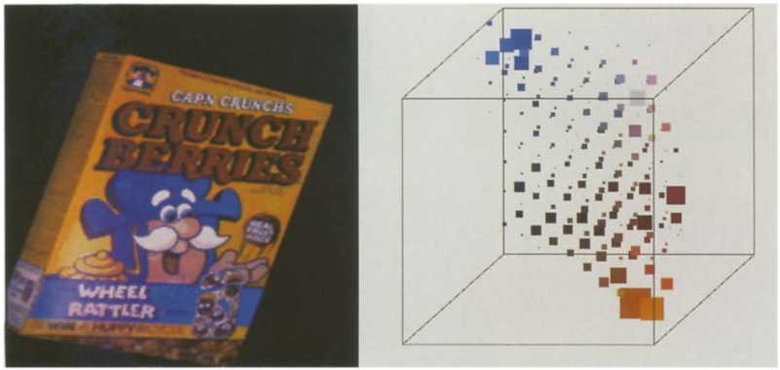
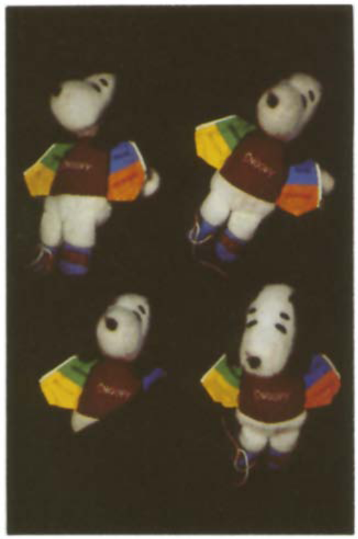
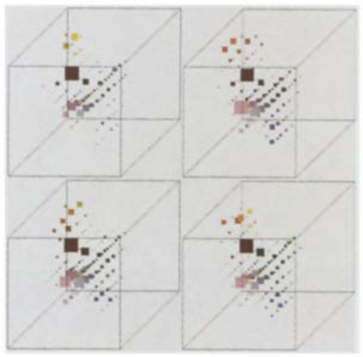
Color Histograms
Swain and Ballard, Color Indexing, IJCV 1991.
Svetlana Lazebnik

Slide 44
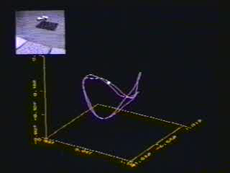
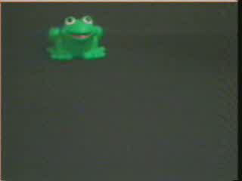
Appearance manifolds
H. Murase and S. Nayar, Visual learning and recognition of 3-d objects from appearance, IJCV 1995

Slide 45
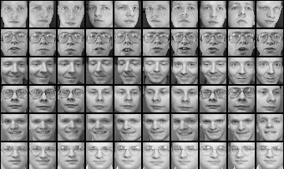
Limitations of global appearance models
Requires global registration of patterns
Not robust to clutter, occlusion, geometric transformations
Svetlana Lazebnik

Slide 46
History of ideas in recognition
1960s – early 1990s: the geometric era
1990s: appearance-based models
1990s – present: sliding window approaches
No digital cameras!
Slow compute!
Slow compute!
Svetlana Lazebnik

Slide 47
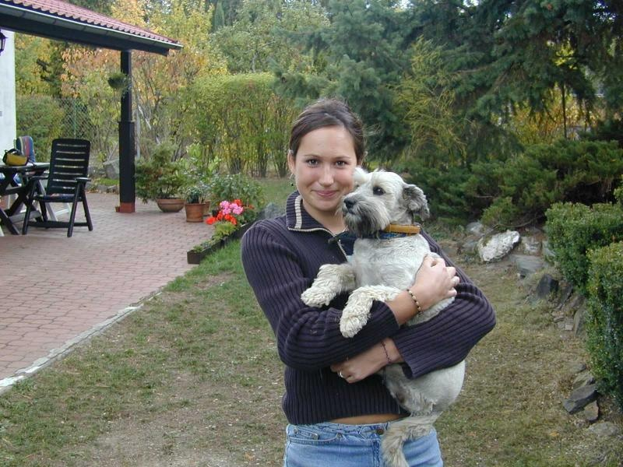
Sliding window approaches

Slide 48
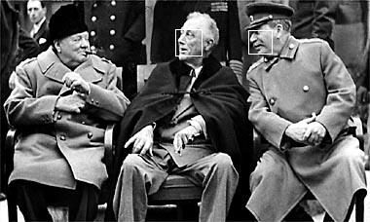
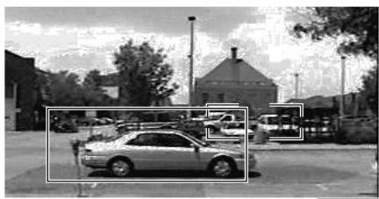
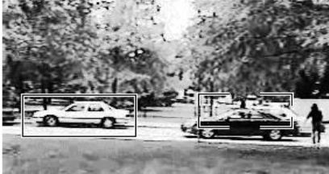
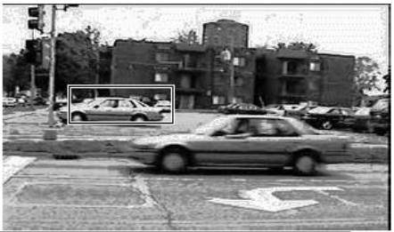
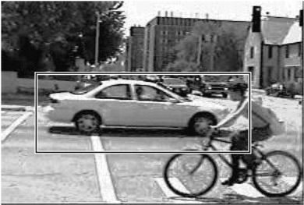
Sliding window approaches
Turk and Pentland, 1991
Belhumeur, Hespanha, & Kriegman, 1997
Schneiderman & Kanade 2004
Viola and Jones, 2000
Schneiderman & Kanade, 2004
Argawal and Roth, 2002
Poggio et al. 1993

Slide 49
History of ideas in recognition
1960s – early 1990s: the geometric era
1990s: appearance-based models
Mid-1990s: sliding window approaches
Late 1990s: local features
No digital cameras!
Slow compute!
Slow compute!
Svetlana Lazebnik

Slide 50
θ
Variability:
Camera position
Illumination
Shape is partially known
Roberts (1965); Lowe (1987); Faugeras & Hebert (1986); Grimson & Lozano-Perez (1986); Huttenlocher & Ullman (1987)
Svetlana Lazebnik

Slide 51






Local features for object instance recognition
D. Lowe (1999, 2004)

Slide 52

Large-scale image search
Combining local features, indexing, and spatial constraints
Philbin et al. ‘07

Slide 53

Large-scale image search
Combining local features, indexing, and spatial constraints
Image credit: K. Grauman and B. Leibe

Slide 54

Large-scale image search
Combining local features, indexing, and spatial constraints
Svetlana Lazebnik

Slide 55
History of ideas in recognition
1960s – early 1990s: the geometric era
1990s: appearance-based models
Mid-1990s: sliding window approaches
Late 1990s: local features
Early 2000s: parts-and-shape models

Slide 56

Parts-and-shape models
Model:
  Object as a set of parts
  Relative locations between parts
  Appearance of part
Figure from [Fischler & Elschlager 73]

Slide 57




Constellation models
Weber, Welling & Perona (2000), Fergus, Perona & Zisserman (2003)
Notes:
Globally different, but have portions in common

Slide 58


Representing people

Slide 59

Discriminatively trained part-based models
P. Felzenszwalb, R. Girshick, D. McAllester, D. Ramanan, PAMI 2009,
“Object Detection with Discriminatively Trained Part-Based Models”

Slide 60
History of ideas in recognition
1960s – early 1990s: the geometric era
1990s: appearance-based models
Mid-1990s: sliding window approaches
Late 1990s: local features
Early 2000s: parts-and-shape models
Mid-2000s: bags of features (next!)
No digital cameras!
Slow compute!
Slow compute!
Early GPU compute.
Svetlana Lazebnik

Slide 61
History of ideas in recognition
1960s – early 1990s: the geometric era
1990s: appearance-based models
Mid-1990s: sliding window approaches
Late 1990s: local features
Early 2000s: parts-and-shape models
Mid-2000s: bags of features (next!)
Present trends:
Combined local and global methods,
context, deep learning
No digital cameras!
Slow compute!
Slow compute!
Early GPU compute.
GPU/cloud compute.
Svetlana Lazebnik

Slide 62
Recognition Issues
How to summarize the content of an entire image? How to gauge overall similarity?
How large should the vocabulary be?
How to perform quantization efficiently?
How to score the retrieval results?
How might we add more spatial verification?
Kristen Grauman

Slide 63
Recognition Issues
How to summarize the content of an entire image?
How to gauge overall similarity?
How large should the vocabulary be?
How to perform quantization efficiently?
How to score the retrieval results?
How might we add more spatial verification?
Kristen Grauman

Slide 64



Bag-of-features models
Bag of ‘words’
Object
Svetlana Lazebnik

Slide 65

Analogy to documents
Of all the sensory impressions proceeding to the brain, the visual experiences are the dominant ones. Our perception of the world around us is based essentially on the messages that reach the brain from our eyes. For a long time it was thought that the retinal image was transmitted point by point to visual centers in the brain; the cerebral cortex was a movie screen, so to speak, upon which the image in the eye was projected. Through the discoveries of Hubel and Wiesel we now know that behind the origin of the visual perception in the brain there is a considerably more complicated course of events. By following the visual impulses along their path to the various cell layers of the optical cortex, Hubel and Wiesel have been able to demonstrate that the message about the image falling on the retina undergoes a step-wise analysis in a system of nerve cells stored in columns. In this system each cell has its specific function and is responsible for a specific detail in the pattern of the retinal image.
China is forecasting a trade surplus of $90bn (£51bn) to $100bn this year, a threefold increase on 2004's $32bn. The Commerce Ministry said the surplus would be created by a predicted 30% jump in exports to $750bn, compared with a 18% rise in imports to $660bn. The figures are likely to further annoy the US, which has long argued that China's exports are unfairly helped by a deliberately undervalued yuan. Beijing agrees the surplus is too high, but says the yuan is only one factor. Bank of China governor Zhou Xiaochuan said the country also needed to do more to boost domestic demand so more goods stayed within the country. China increased the value of the yuan against the dollar by 2.1% in July and permitted it to trade within a narrow band, but the US wants the yuan to be allowed to trade freely. However, Beijing has made it clear that it will take its time and tread carefully before allowing the yuan to rise further in value.
sensory, brain,
visual, perception,
retinal, cerebral cortex,
eye, cell, optical
nerve, image
Hubel, Wiesel
China, trade,
surplus, commerce,
exports, imports, US,
yuan, bank, domestic,
foreign, increase,
trade, value
ICCV 2005 short course, L. Fei-Fei

Slide 66
Origin 1: Bag-of-words models
Orderless document representation: frequencies of words from a dictionary Salton & McGill (1983)

Slide 67

Origin 1: Bag-of-words models
Orderless document representation: frequencies of words from a dictionary Salton & McGill (1983)
US Presidential Speeches Tag Cloud
http://chir.ag/phernalia/preztags/

Slide 68

Origin 1: Bag-of-words models
Orderless document representation: frequencies of words from a dictionary Salton & McGill (1983)
US Presidential Speeches Tag Cloud
http://chir.ag/phernalia/preztags/

Slide 69

Origin 1: Bag-of-words models
Orderless document representation: frequencies of words from a dictionary Salton & McGill (1983)
US Presidential Speeches Tag Cloud
http://chir.ag/phernalia/preztags/

Slide 70






Origin 2: Texture recognition
Characterized by repetition of basic elements or textons
For stochastic textures, the identity of textons matters,
not their spatial arrangement
Julesz, 1981; Cula & Dana, 2001; Leung & Malik 2001; Mori, Belongie & Malik, 2001; Schmid 2001; Varma & Zisserman, 2002, 2003; Lazebnik, Schmid & Ponce, 2003

Slide 71




Origin 2: Texture recognition
histogram
Universal texton dictionary
Julesz, 1981; Cula & Dana, 2001; Leung & Malik 2001; Mori, Belongie & Malik, 2001; Schmid 2001; Varma & Zisserman, 2002, 2003; Lazebnik, Schmid & Ponce, 2003

Slide 72


Bag-of-features models
Svetlana Lazebnik

Slide 73








Objects as texture
All of these are treated as being the same
No distinction between foreground and background: scene recognition?
Svetlana Lazebnik
Notes:
Motivation slide. Clearly location has to help, but bag-of-words doesn’t have it…

Slide 74



Bag-of-features steps
Feature extraction
Learn “visual vocabulary”
Quantize features using visual vocabulary
Represent images by frequencies of “visual words”

Slide 75


1. Feature extraction
Regular grid or interest regions

Slide 76



Sampling strategies
Sparse, at interest points
Dense, uniformly
Randomly
To find specific textured objects, sparse sampling from interest points often more reliable.
Multiple complementary interest operators offer more image coverage.
For object categorization, dense sampling offers better coverage.
[See Nowak, Jurie & Triggs, ECCV 2006]
Multiple interest operators
Image credits: F-F. Li, E. Nowak, J. Sivic

Slide 77


1. Feature extraction
Compute descriptor
Extract patch
Detect patches
Slide credit: Josef Sivic

Slide 78

1. Feature extraction
…
Slide credit: Josef Sivic

Slide 79
2. Learning the visual vocabulary
…
Slide credit: Josef Sivic

Slide 80
2. Learning the visual vocabulary
…
Clustering
Slide credit: Josef Sivic

Slide 81
3. Quantize the visual vocabulary
Visual vocabulary
…
Clustering
Slide credit: Josef Sivic

Slide 82

K-means clustering
Want to minimize sum of squared Euclidean distances between points x_{i} and their nearest cluster centers m_{k} :
Algorithm:
Randomly initialize K cluster centers
Iterate until convergence:
  Assign each data point to the nearest center
  Recompute each cluster center as the mean of all points assigned to it

Slide 83
Clustering and vector quantization
Clustering is a common method for learning a visual vocabulary or codebook
  Unsupervised learning process
  Each cluster center produced by k-means becomes a codevector
  Codebook can be learned on separate training set
  Provided the training set is sufficiently representative, the codebook will be “universal”
The codebook is used for quantizing features
  A vector quantizer takes a feature vector and maps it to the index of the nearest codevector in a codebook
  Codebook = visual vocabulary
  Codevector = visual word

Slide 84
Visual words
Bag of visual words histograms
Notes:
Summarize entire image based on its distribution (histogram) of word occurrences.
Analogous to bag of words representation commonly used for documents.

Slide 85

















Example real codebook
…
Appearance codebook
Source: B. Leibe

Slide 86

Another codebook
…
…
…
…
…
Appearance codebook
Source: B. Leibe

Slide 87


Bags of features for action recognition
Space-time interest points
Juan Carlos Niebles, Hongcheng Wang and Li Fei-Fei, Unsupervised Learning of Human Action Categories Using Spatial-Temporal Words, IJCV 2008.

Slide 88
Visual words/bags of words
+ flexible to geometry / deformations / viewpoint
+ compact summary of image content
+ provides fixed dimensional vector representation for sets
+ very good results in practice
background and foreground mixed when bag covers whole image -> is it really instance recognition?
optimal vocabulary formation remains unclear
basic model ignores geometry – must verify afterwards, or encode via features
Kristen Grauman
Notes:
88

Slide 89




But what about layout?
All of these images have the same color histogram.
How to extend bag of words?

Slide 90

Spatial pyramid
Compute histogram in each spatial bin

Slide 91


Spatial pyramid representation
Extension of a bag of features
Locally orderless representation at several levels of resolution
level 0
Lazebnik, Schmid & Ponce (CVPR 2006)

Slide 92




Spatial pyramid representation
Extension of a bag of features
Locally orderless representation at several levels of resolution
level 0
level 1
Lazebnik, Schmid & Ponce (CVPR 2006)

Slide 93
















Spatial pyramid representation
Extension of a bag of features
Locally orderless representation at several levels of resolution
level 0
level 1
level 2
Lazebnik, Schmid & Ponce (CVPR 2006)

Slide 94

Scene category dataset
Multi-class classification results
(100 training images per class)

Slide 95















Caltech101 dataset
http://www.vision.caltech.edu/Image_Datasets/Caltech101/Caltech101.html
Multi-class classification results (30 training images per class)

Slide 96
Recognition Issues
How to summarize the content of an entire image? How to gauge overall similarity?
How large should the vocabulary be?
How to perform quantization efficiently?
How to score the retrieval results?
How might we add more spatial verification?
Kristen Grauman

Slide 97










Comparing bags of words
Compute cosine similarity (normalized scalar (dot) product) between their occurrence counts, then rank and pick smallest. Nearest neighbor search for similar images.
Database image
Query
×
×
for vocabulary of V words
Kristen Grauman
Notes:
Why do we normalize the bag of words histogram feature vectors?
Allows us to cope with large differences in the number of occurrences in the images, e.g., one bicycle vs a hundred bicycles.

Slide 98
Comparing bags of words
Why might we use cosine similarity here?
What ‘intuitive’ effect does this provide?
Database image
Query
×
×
for vocabulary of V words
Kristen Grauman
Notes:
What do we use cosine similarity?
Why do we normalize the bag of words histogram feature vectors?
Only care about ‘presence’ and not ‘number’.
Allows us to cope with large differences in the number of occurrences in the images, e.g., one bicycle vs. a hundred bicycles.

Slide 99

How can we quickly find images in a large database that match a given image region?
Instance recognition

Slide 100


Simple idea
See how many keypoints are close to keypoints in each other image
Lots of Matches
Few or No Matches
But this will be really, really slow!

Slide 101
Indexing local features
Each patch / region has a descriptor, which is a point in some high-dimensional feature space (e.g., SIFT).
Descriptor feature space
Kristen Grauman
Notes:
101

Slide 102
Indexing local features
When we see close points in feature space, we have similar descriptors, which indicates similar local content.
Query image
Descriptor feature space
Easily can have millions of features to search!
Database images

Slide 103
Visual words
Map high-dimensional descriptors to tokens/words by quantizing the feature space.
Quantize via clustering; cluster centers are the visual “words”
Word #2
Assign word to each image region by finding the closest cluster center.
Descriptor feature space
Kristen Grauman

Slide 104

Visual words
Example: each group of patches belongs to the same visual word
Figure from Sivic & Zisserman, ICCV 2003
Kristen Grauman

Slide 105
Visual vocabulary formation
Issues:
Vocabulary size, number of words
Sampling strategy: where to extract features?
Clustering / quantization algorithm
Unsupervised vs. supervised
What corpus provides features (universal vocabulary?)
Kristen Grauman

Slide 106

Fast lookup: inverted index
For text documents, an efficient way to find all pages on which a word occurs is to use an index…
We want to find all images in which a feature occurs.
Kristen Grauman
Notes:
‘Inverted’ is in contrast to a ‘forward index’, which maps from documents (images) to content (features).

Slide 107

Build Inverted Index from Database
Kristen Grauman

Slide 108

Query Inverted Index
Candidate matches
Kristen Grauman

Slide 109

Query Inverted Index
Candidate matches
w₉₁
Extract words in query
Inverted file index to
find relevant frames
Compare/sort word counts
Kristen Grauman
Notes:
Often we wish to return not just the best matching, but a top k matching images.
What is the critical condition on this index being efficient?

Slide 110
Inverted index
Key requirement: sparsity.
If most images contain most words, then we’re not better off than exhaustive search.
  Exhaustive search would mean comparing the visual word distribution of a query versus every page.

Slide 111
Recognition Issues
How to summarize the content of an entire image? And gauge overall similarity?
How large should the vocabulary be? How to perform quantization (clustering) efficiently?
How to score the retrieval results?
How might we add more spatial verification?
Following slides by David Nister (CVPR 2006)
Kristen Grauman

Slide 112

Visual vocabularies: Issues
How to choose vocabulary size?
  Too small: visual words not representative of all patches
  Too large: quantization artifacts, overfitting
Computational efficiency
  Vocabulary trees
  (Nister & Stewenius, 2006)

Slide 113

Training the vocabulary tree
Notes:
I will now try to describe the approach with an animation.
The first, offline phase, is to train the vocabulary tree.
We use Maximally Stable Extremal Regions by Matas et al. and then we extract SIFT descriptors from the MSER regions.
Regarding the feature extraction, we are not really claiming anything other than down-in-the-trenches nose-to-the-grindstone hard work to get good implementations of the state-of-the-art, and since we are all obsessed with novelty I will not spend any time talking about the feature extraction.
We believe that the vocabulary tree approach will work well on any of your favorite descriptors.

Slide 114

Training the vocabulary tree
Notes:
All the descriptor vectors are thrown into a common space.
This is done for many images, the goal being to acquire enough statistics on how natural images distribute points in the descriptor space.

Slide 115

Training the vocabulary tree

Slide 116

Training the vocabulary tree

Slide 117

Training the vocabulary tree

Slide 118

Training the vocabulary tree

Slide 120
Notes:
We then run k-means on the descriptor space. In this setting, k defines what we call the branch-factor of the tree, which indicates how fast the tree branches.
In this illustration, k is three. We then run k-means again, recursively on each of the resulting quantization cells.
This defines the vocabulary tree, which is essentially a hierarchical set of cluster centers and their corresponding Voronoi regions.
We typically use a branch-factor of 10 and six levels, resulting in a million leaf nodes. We lovingly call this the Mega-Voc.

Slide 130
Vocabulary tree built recursively
Notes:
We now have the vocabulary tree, and the online phase can begin.
In order to add an image to the database, we perform feature extraction. Each descriptor vector is now dropped down from the root of the tree and quantized very efficiently into a path down the tree, encoded by a single integer.
Each node in the vocabulary tree has an associated inverted file index.
Indices back to the new image are then added to the relevant inverted files.
This is a very efficient operation that is carried out whenever we want to add an image.

Slide 131


Each leaf has inverted index

Slide 132



Slide 133



Slide 134


Inverted index built.

Slide 135

Query image
Notes:
When we then wish to query on an input image, we quantize the descriptor vectors of the input image in a similar way, and accumulate scores for the images in the database with so called term frequency inverse document frequency (tf-idf). This is effectively an entropy weighting of the information. The winner is the image in the database with the most common information with the input image.

Slide 136


Vocabulary size
Recognition with 6347 images
Branching factors
Nister & Stewenius, CVPR 2006
Influence on performance, sparsity
Kristen Grauman

Slide 137

Higher branch factor works better (but slower)
Notes:
We also find that performance improves with the branch factor.
This improvement is not dramatic, but it is interesting to note that very low branch factors are somewhat weak, and a branch factor of two results in partitioning the space with planes.

Slide 138
Vocabulary trees: complexity
Number of words given tree parameters: branching_factor^^{number_of_levels}
Word assignment cost vs. flat vocabulary:
O(k) for flat
O(log_{branching_factor}(k) * branching_factor)
Is this like a kd-tree?
Yes, but with better partitioning and defeatist search.
This hierarchical data structure is lossy – you might not find your true nearest cluster.
Notes:
Number of words = (branching_factor)^(number_of_levels)
Assignment cost for flat hierarchy O(k), for tree O(log(base branching_factor)(k) * branching_factor)

Slide 139



(2006) 110,000,000 images in 5.8 Seconds
Slide
David Nister
Notes:
Very recently, we have scaled the system even further.
The system we just demo’d searches a 50 thousand image index in the RAM of this laptop at real-time rates.
We have built and programmed a desktop system at home in which we currently have 12 hard drives. We bypass the operating system and
read and write the disk surfaces directly.
Last week this system clocked in on 110 Million images in 5.8 seconds, so roughly 20Million images per second and machine.
The images consist of around 10 days of four TV channels, so more than a month of TV.
Soon we don’t have to watch TV, because we’ll have machines doing it for us.

Slide 140


Slide
David Nister
Notes:
To continue the analogy, if we printed all these images on paper, and stacked them,

Slide 141

Slide
David Nister
Notes:
The pile would stack, as high as

Slide 142

David Nister
Notes:
Mount Everest.
Another way to put perspective on this is, Google image search not too long ago claimed to index 2 billion images,
although based on meta-data, while we do it based on image content.
So, with about 20 desktop systems like the one I just showed, it seems that it may be possible to build a web-scale content-based image search engine,
and we are sort of hoping that this paper will fuel the race for the first such search engine.
So, that is some motivation.
Let me now move to the contribution of the paper.
As you can guess by now, it is about scalability of recognition and retrieval.

Slide 143































Performance
Notes:
One of the reasons we managed to take the system this far is that we have worked with rigorous performance testing against a database with ground truth.
We now have a benchmark database with over 10000 images grouped in sets of four images of the same object. We query on one of the images in the group and see how many of the other images in the group make it to the top of the query.
In the paper, we have tested this up to a million images, by embedding the ground truth database into a database encompassing all the frames of 10 feature length movies.

Slide 144
Recognition Issues
How to summarize the content of an entire image? And gauge overall similarity?
How large should the vocabulary be? How to perform quantization efficiently?
How to score the retrieval results?
How might we add more spatial verification?
Kristen Grauman

Slide 145


Precision and Recall
True positive (tp) – correct attribution
True negative (tn) – correct rejection
False positive (fp) – incorrect attribution
False negative (fn) – incorrect rejection
Precision = #relevant / #returned
Recall = #relevant / #total relevant
By Walber - Own work, CC BY-SA 4.0,
https://commons.wikimedia.org/w/index.php?curid=36926283

Slide 146











Scoring retrieval quality
Results (ordered):
Database size: 10 images
Relevant (total): 5 images
Query
precision = #relevant / #returned
recall = #relevant / #total relevant
1
0.8
0.6
precision
0.4
0.2
0
0
0.2
0.4
0.6
0.8
1
recall
Slide credit: Ondrej Chum

Slide 147
What else can we borrow from text retrieval?
China is forecasting a trade surplus of $90bn (£51bn) to $100bn this year, a threefold increase on 2004's $32bn. The Commerce Ministry said the surplus would be created by a predicted 30% jump in exports to $750bn, compared with a 18% rise in imports to $660bn. The figures are likely to further annoy the US, which has long argued that China's exports are unfairly helped by a deliberately undervalued yuan. Beijing agrees the surplus is too high, but says the yuan is only one factor. Bank of China governor Zhou Xiaochuan said the country also needed to do more to boost domestic demand so more goods stayed within the country. China increased the value of the yuan against the dollar by 2.1% in July and permitted it to trade within a narrow band, but the US wants the yuan to be allowed to trade freely. However, Beijing has made it clear that it will take its time and tread carefully before allowing the yuan to rise further in value.
China, trade,
surplus, commerce,
exports, imports, US,
yuan, bank, domestic,
foreign, increase,
trade, value

Slide 148

tf-idf weighting
Term frequency – inverse document frequency
Describe image by frequency of each word within it, downweight words that appear often in the database
(Standard weighting for text retrieval)
Number of occurrences of word i in document d
Total number of documents in database
Number of documents word i occurs in, in whole database
Number of words in document d
Kristen Grauman

Slide 149
Query expansion
Query: golf green
Results:
- How can the grass on the greens at a golf course be so perfect?
For example, a skilled golfer expects to reach the green on a par-four hole in ...
- Manufactures and sells synthetic golf putting greens and mats.
Irrelevant result can cause a `topic drift’:
Volkswagen Golf, 1999, Green, 2000cc, petrol, manual, , hatchback, 94000miles, 2.0 GTi, 2 Registered Keepers, HPI Checked, Air-Conditioning, Front and Rear Parking Sensors, ABS, Alarm, Alloy
Slide credit: Ondrej Chum
Notes:
Query expansion is a technique to increase recall, possibly at the expense of precision.

Slide 150















Query expansion
Results
…
Spatial verification
Query image
New results
New query
Chum, Philbin, Sivic, Isard, Zisserman: Total Recall…, ICCV 2007
Ondrej Chum

Slide 151
Recognition Issues
How to summarize the content of an entire image? And gauge overall similarity?
How large should the vocabulary be? How to perform quantization efficiently?
How to score the retrieval results?
How might we add more spatial verification?
Kristen Grauman

Slide 152
Can we be more accurate?
So far, we treat each image as containing a “bag of words”, with no spatial information
Which matches better?
e
h
a
e
z
f
e
a
f
e
h
a
f
e
e
Real objects have
consistent geometry

Slide 153







Multi-view matching
?
vs
…
Matching two given views for depth
Search for a matching view for recognition
Kristen Grauman

Slide 154


Spatial Verification
Query
Query
DB image with high BoW similarity
DB image with high BoW similarity
Both image pairs have many visual words in common.
Slide credit: Ondrej Chum

Slide 155


Spatial Verification
Query
Query
DB image with high BoW similarity
DB image with high BoW similarity
Only some of the matches are mutually consistent
with real-world geometry imaged by a camera.
Ondrej Chum

Slide 156
Spatial Verification: two basic strategies
RANSAC
  Typically sort by BoW similarity as initial filter
  Verify by checking support (inliers) for possible transformations
    e.g., “success” if find a transformation with > N inlier correspondences
Generalized Hough Transform
  Let each matched feature cast a vote on location, scale, orientation of the model object
  Verify parameters with enough votes
Kristen Grauman

Slide 157
RANSAC verification

Slide 158




Recall: Fitting an affine transformation
Approximates viewpoint changes for roughly planar objects and roughly orthographic cameras.

Slide 159
RANSAC verification
No verification
Fails to meet threshold on # inliers! Good!

Slide 160
Recognition via alignment
  Pros:
  Effective for reliable features within clutter
  Great for matching specific instances
  Cons:
  Expensive post-process (how long for proj3?!)
  Not suited for category recognition
Kristen Grauman

Slide 161
Summary
Bag of words: quantize feature space into discrete visual words
  Summarize image by distribution of words
Inverted index: visual word index for faster query time
Evaluation:
Additional spatial verification alignment:
  Robust fitting : RANSAC, Generalized Hough Transform
  We will do this in detail later on in the course
Kristen Grauman

Slide 162
Lessons from a decade later
For Category recognition (project 3)
  Bag of Feature models remained the state of the art until Deep Learning.
  Spatial layout either isn't that important or its too difficult to encode.
  Quantization error is, in fact, the bigger problem. Advanced feature encoding methods address this.
  Bag of feature models are nearly obsolete.
  At best they seem to be inspiring tweaks to deep models e.g., NetVLAD.
James Hays

Slide 163
Lessons from a decade later
For instance retrieval (this lecture):
  deep learning is taking over.
  learn better local features (replace SIFT)
  e.g., MatchNet 2015
  learn better image embeddings (replace visual word histograms)
  e.g., Vo and Hays 2016.
  learn spatial verification
  e.g., DeTone, Malisiewicz, and Rabinovich 2016.
  learn a monolithic deep network to recognition all locations
  e.g., Google’s PlaNet 2016.
James Hays

Slide 164






Things to remember
Object instance recognition
  Find keypoints, compute descriptors
  Match descriptors
  Vote for / fit affine parameters
  Return object if # inliers > T
Keys to efficiency
  Visual words
    Used for many applications
  Inverse document file
    Used for web-scale search

Slide 165










Video Google System
Query region
Collect all words within query region
Inverted file index to find relevant frames
Compare word counts
Spatial verification
Sivic & Zisserman, ICCV 2003
Demo online at : http://www.robots.ox.ac.uk/~vgg/research/vgoogle/index.html
Retrieved frames
Kristen Grauman
Notes:
165

Slide 166


Example Applications
Aachen Cathedral
Mobile tourist guide
Self-localization
Object/building recognition
Photo/video augmentation
[Quack, Leibe, Van Gool, CIVR’08]

Slide 167

Application: Large-Scale Retrieval
Query
Results from 5k Flickr images (demo available for 100k set)
[Philbin CVPR’07]

Slide 168

Web Demo: Movie Poster Recognition
50’000 movie
posters indexed
Query-by-image
from mobile phone
available in Switzer-
land
http://www.kooaba.com/en/products_engine.html#

Slide 169





Application: Image Auto-Annotation
Moulin Rouge
Old Town Square (Prague)
Tour Montparnasse
Colosseum
Viktualienmarkt
Maypole
Left: Wikipedia image
Right: closest match from Flickr
[Quack CIVR’08]

Slide 170


Notes:
http://www.google.com/mobile/goggles

