Slide 1

13 February 2019
Notes:
Welcome to a class with some curious content!
Today we’re going to be discussing cameras, and how light and color affect image formation.

Slide 2
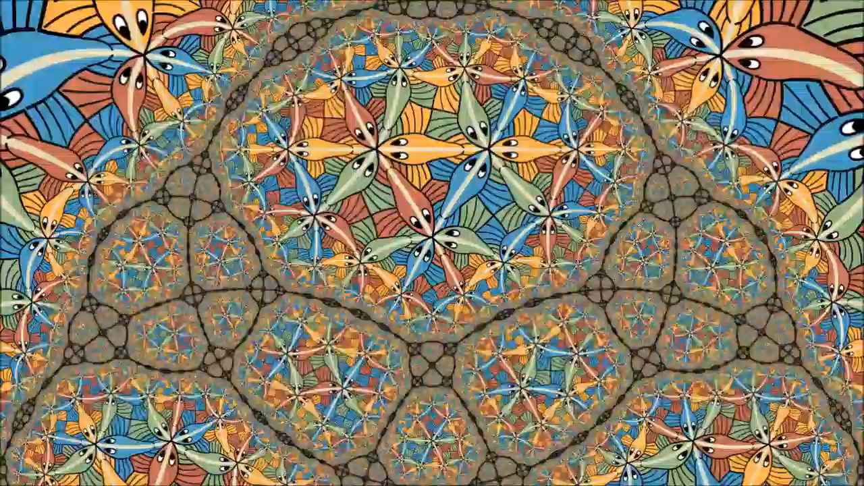
Escher’s Circle Limit III
Notes:
M.C. Escher Circle Limit III
https://en.wikipedia.org/wiki/Circle_Limit_III
Relates to ideas from hyperbolic geometry
https://www.youtube.com/watch?v=AyaxtIShWtM
https://www.d.umn.edu/~ddunham/isamtlk09.pdf

Slide 3
Escher’s Circle Limit III
Notes:
Thanks to Aaron Gokaslan for suggesting this as an illusion.

Slide 4
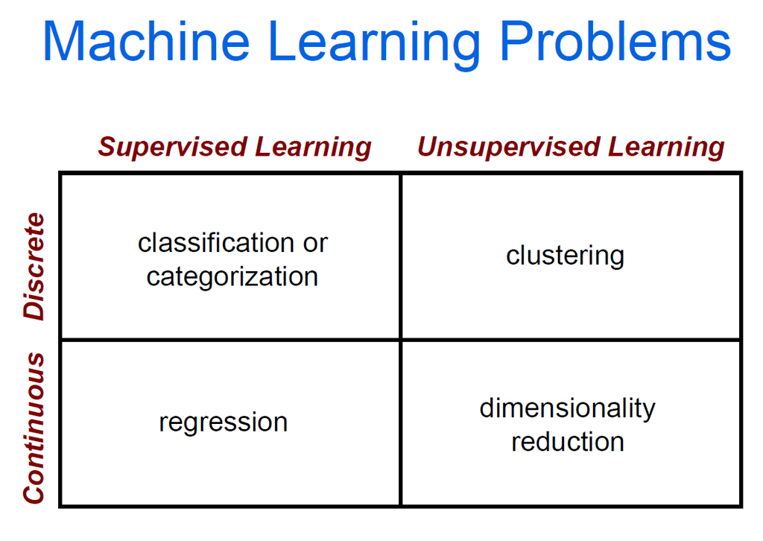

Slide 5
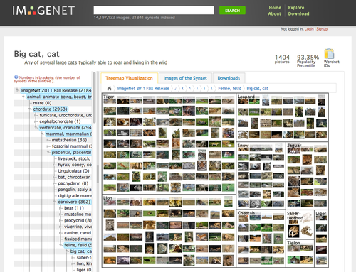
ImageNet
Images for each category of WordNet
1000 classes
1.2mil images
100k test
Top 5 error
Notes:
ImageNet Large Scale Visual Recognition Challenge
https://arxiv.org/pdf/1409.0575.pdf

Slide 6
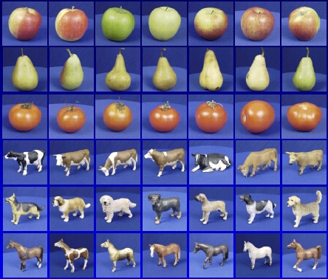
Dataset split
Training Images
Validation Images
Testing Images
- Train classifier
- Measure error
- Tune model hyperparameters
- Secret labels
- Measure error
Random train/validate splits = cross validation

Slide 7

Training
Labels
Images
Image Features
Training
Trained classifier
Testing
Image
not in
training set
Image Features
Apply classifier
Prediction
Slide credit: D. Hoiem and L. Lazebnik

Slide 8
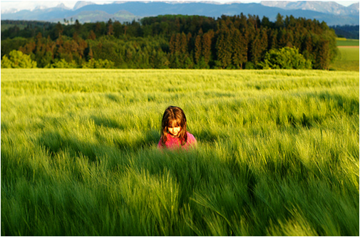
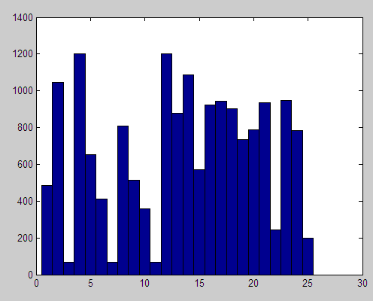
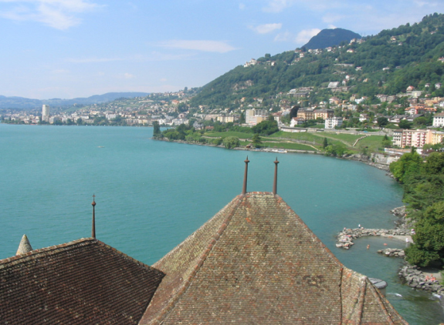
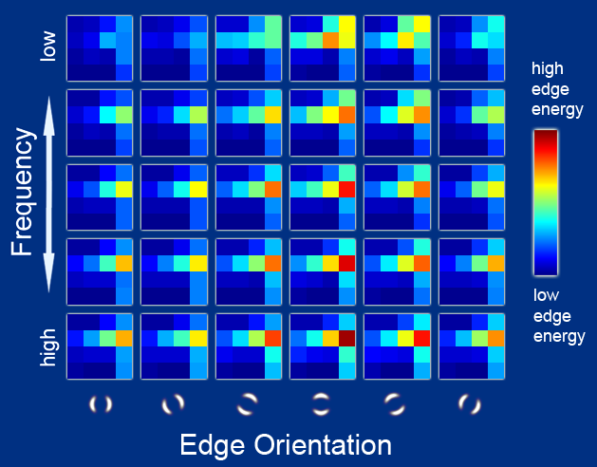
Features
Raw pixels
Histograms
Templates
SIFT descriptors
  GIST
  ORB
  HOG….
L. Lazebnik

Slide 9
General Principles of Representation
Coverage
  Ensure that all relevant info is captured
Concision
  Minimize number of features without sacrificing coverage
Directness
  Ideal features are independently useful for prediction

Slide 10
Training
Labels
Images
Image Features
Training
Trained classifier
Testing
Image
not in
training set
Image Features
Apply classifier
Prediction
Slide credit: D. Hoiem and L. Lazebnik

Slide 11
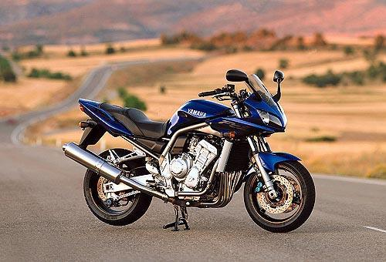
Recognition task and supervision
Think-Pair-Share
What are all the possible supervision (‘label’) types to consider?
L. Lazebnik

Slide 12
Recognition task and supervision
Images in the training set must be annotated with the “correct answer” that the model is expected to produce
Contains a motorbike
L. Lazebnik

Slide 13
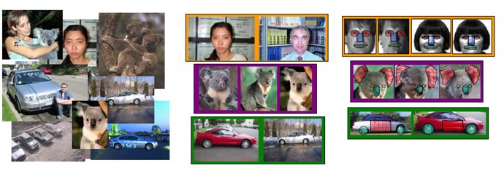
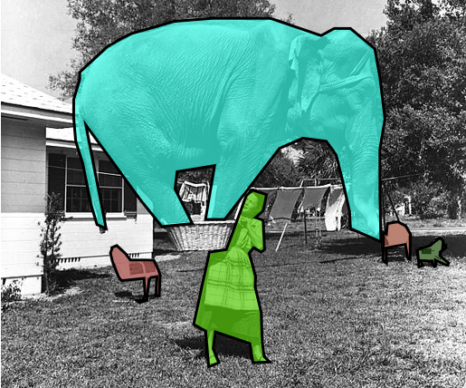
Spectrum of supervision
Less
More
E.G., ImageNet
E.G., MS Coco
Unsupervised
“Weakly” supervised
Fully supervised
Fuzzy; definition depends on task
‘Semi-supervised’: small partial labeling
Lazebnik

Slide 14
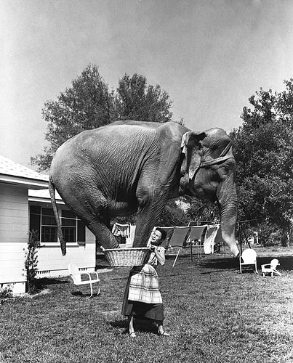
Good training example?

Slide 15
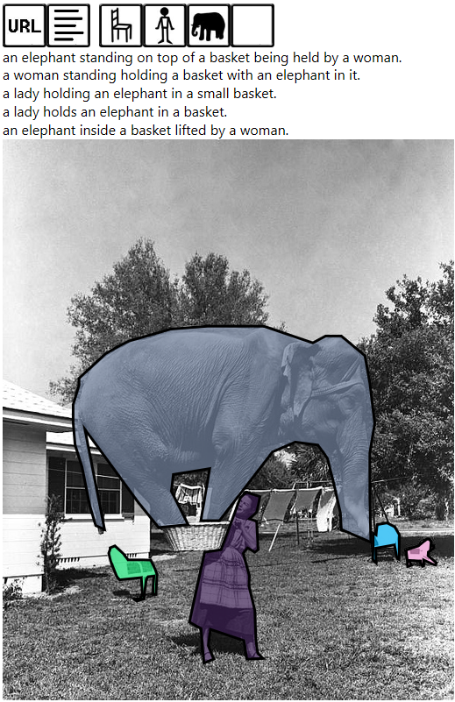
Good labels?
http://mscoco.org/explore/?id=134918

Slide 16
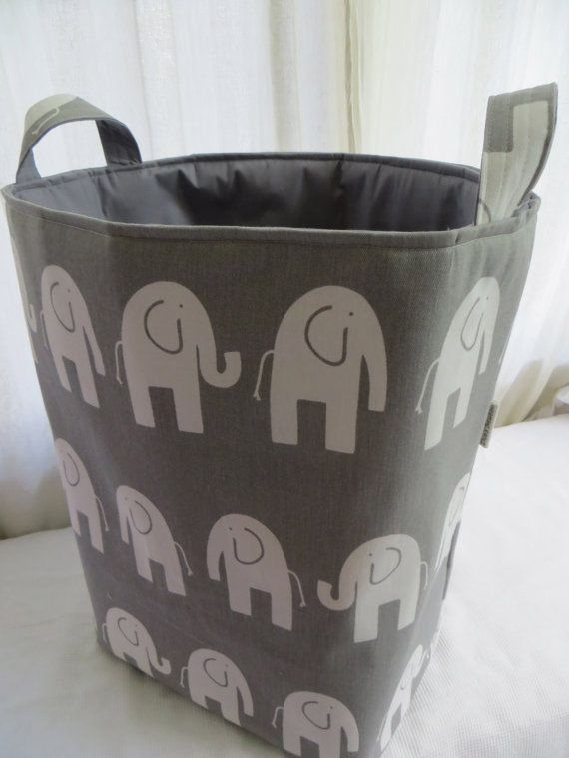
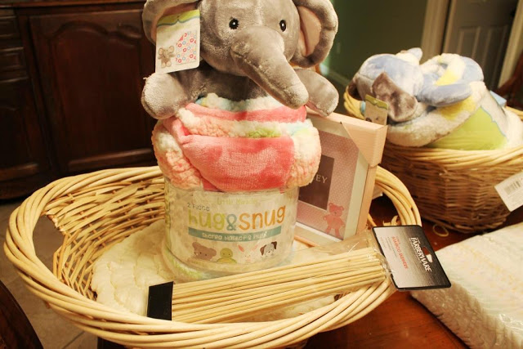

Google guesses from the 1st caption
Notes:
https://www.pinterest.com/explore/toy-basket/
http://misskopykat.blogspot.com/2015/05/tips-for-making-gift-baskets.html
https://www.researchgate.net/publication/307879813_Mapping_Mcfaulds_Lake_%27Ring_of_Fire%27_crystalline_basement_architecture_in_Ontario_Canada_from_airborne_gravity_gradiometry_AGG_data_using_steerable_filter_and_normalized-cut_image_segmentation

Slide 17
Training
Labels
Images
Image Features
Training
Trained classifier
Testing
Image
not in
training set
Image Features
Apply classifier
Prediction
Slide credit: D. Hoiem and L. Lazebnik

Slide 18



The machine learning framework
Apply a prediction function to a feature representation of the image to get the desired output:
f( ) = “apple”
f( ) = “tomato”
f( ) = “cow”
Slide credit: L. Lazebnik

Slide 19
The machine learning framework
f(x) = y
Training: Given a training set of labeled examples:
{(x₁,y₁), …, (x_{N},y_{N})}
Estimate the prediction function f by minimizing the prediction error on the training set.
Testing: Apply f to a unseen test example x_{u} and output the predicted value y_{u} = f(x_{u}) to classify x_{u}.
Prediction function
or classifier
Image feature
Output (label)
Slide credit: L. Lazebnik

Slide 20
Classification
Assign x to one of two (or more) classes.
A decision rule divides input space into decision regions separated by decision boundaries – literally boundaries in the space of the features.
L. Lazebnik

Slide 21
Classifiers: Nearest neighbor
Test example
Training examples from class 2
Training examples from class 1
f(x) = label of the training example nearest to x
All we need is a distance function for our inputs
No training required!
Quickie Think-Pair-Share: What does the decision boundary look like?
Slide credit: L. Lazebnik
Notes:
ASK QUESTION – What does the decision boundary look like in this case?

Slide 22
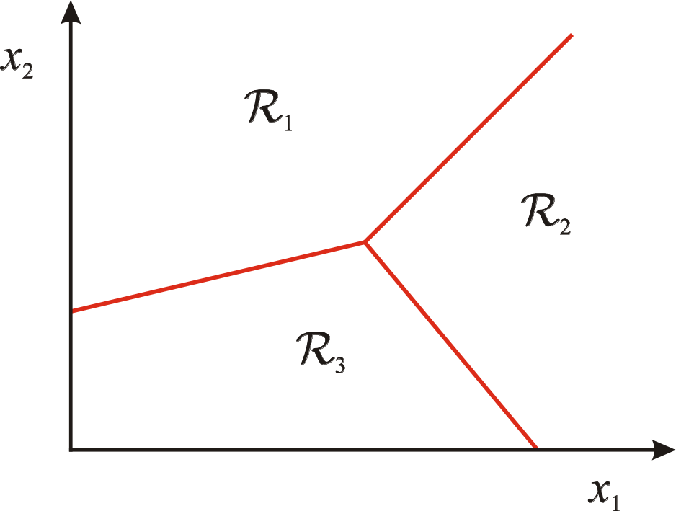
Classification
Assign x to one of two (or more) classes.
A decision rule divides input space into decision regions separated by decision boundaries – literally boundaries in the space of the features.
L. Lazebnik

Slide 23
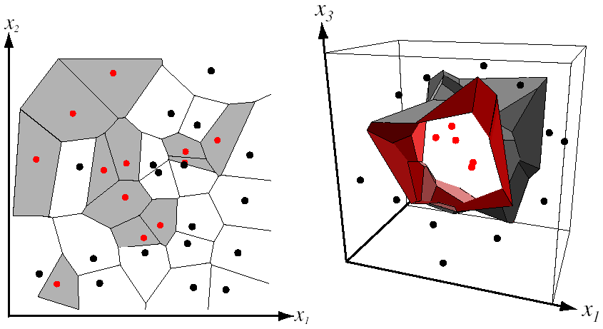
Decision boundary for Nearest Neighbor Classifier
Divides input space into decision regions separated by decision boundaries – Voronoi.
Voronoi partitioning
of feature space
for two-category
2D and 3D data
from Duda et al.
Source: D. Lowe

Slide 24
k-nearest neighbor
1-nearest
x
x
x
x
x
o
x
x
x
o
x
x
x
x
+
o
x
+
o
x
o
x
o
x
o
o
+
o
o
+
o
o
x2
o
x2
o
x1
x1
3-nearest
5-nearest
x
x
x
x
x
o
x
o
x
x
x
x
x
x
+
o
x
+
o
x
o
x
o
x
o
o
+
o
o
+
o
o
x2
o
x2
o
x1
x1
Notes:
Simple, a good one to try first
With infinite examples, 1-NN provably has error that is at most twice Bayes optimal error

Slide 25
Classifiers: Linear
Training examples from class 2
Training examples from class 1
Find a linear function to separate the classes
Slide credit: L. Lazebnik

Slide 26

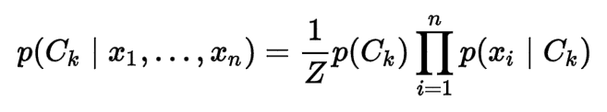
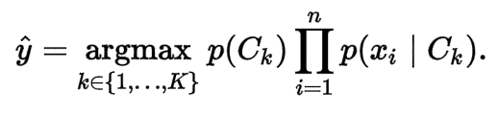
Classifier: Naïve Bayes
Conditional probability model over
y
x₁
x₂
x₃
Classifier:
Notes:
https://en.wikipedia.org/wiki/Naive_Bayes_classifier
Simple thing to try for categorical data
Very fast to train/test

Slide 27
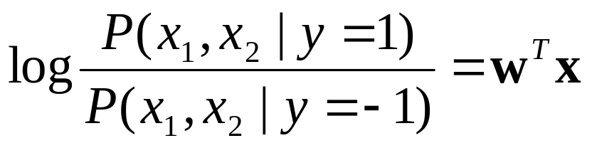

Classifiers: Logistic Regression
Maximize likelihood of label given data, assuming a log-linear model
x
x
x
x
x
x
male
o
x
x
o
o
Height
o
female
o
x2
x1
Pitch of voice

Slide 28
Using Logistic Regression
Quick, simple classifier (try it first)
Outputs a probabilistic label confidence
Use L2 or L1 regularization
  L1 does feature selection and is robust to irrelevant features but slower to train

Slide 29
Classifiers: Linear SVM
Find a linear function
to separate the classes:
f(x) = sgn(w ⋅ x + b)
x
x
x
x
x
x
o
x
x
o
o
o
o
x2
x1

Slide 30
Classifiers: Linear SVM
Find a linear function
to separate the classes:
f(x) = sgn(w ⋅ x + b)
x
x
x
x
x
x
o
x
x
o
o
o
How?
X = all data points
Define hyperplane tX-b = 0, where t is tangent to hyperplane.
Minimize ||t|| s.t. tX-b produces correct label for all X
o
x2
x1
Notes:
Any hyperplane can be written as the set of points {\displaystyle {\vec {x}}} satisfying
{\displaystyle {\vec {w}}\cdot {\vec {x}}-b=0,\,}
Maximum-margin hyperplane and margins for an SVM trained with samples from two classes. Samples on the margin are called the support vectors.
where {\displaystyle {\vec {w}}} is the (not necessarily normalized) normal vector to the hyperplane

Slide 31
Classifiers: Linear SVM
Find a linear function
to separate the classes:
f(x) = sgn(w ⋅ x + b)
x
x
x
o
x
x
x
o
x
x
o
o
o
o
x2
x1
What if my data are not linearly separable?
Introduce flexible ‘hinge’ loss (or ‘soft-margin’)

Slide 32
Nonlinear SVMs
Datasets that are linearly separable work out great:
But what if the dataset is just too hard?
We can map it to a higher-dimensional space:
0
x
0
x
x²
0
x
Andrew Moore

Slide 33
Nonlinear SVMs
Map the original input space to some higher-dimensional feature space where the training set is separable:
Φ: x → φ(x)
Slide credit: Andrew Moore

Slide 34
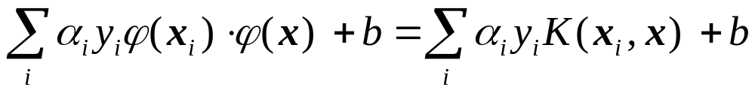
Nonlinear SVMs
[Additional info]
The kernel trick: instead of explicitly computing the lifting transformation φ(x), define a kernel function K such that:
K(x_{i} , x_{j}) = φ(x_{i} ) · φ(x_{j})
This gives a non-linear decision boundary in the original feature space:
But…we only transformed the distance function K!
Common kernel function: Radial basis function kernel
C. Burges, A Tutorial on Support Vector Machines for Pattern Recognition
Data Mining and Knowledge Discovery, 1998
Notes:
To be valid, the kernel function must satisfy Mercer’s condition: that the kernel must be equivalent to a dot product in some space.
https://www.quora.com/Why-should-a-kernel-function-satisfy-Mercers-condition
In practical terms, satisfying Mercer’s condition means the kernel matrix is positive semidefinite, which means that the underlying QP for the SVM in dual form has a unique global optimum. In theory, kernels which fail to satisfy the M. Condition are not legitimate dot products in some higher dimensional space.
RBF Kernel: https://en.wikipedia.org/wiki/Radial_basis_function_kernel

Slide 35
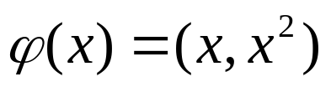
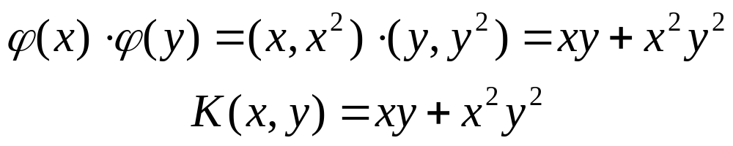
Nonlinear kernel: Example
[Additional info]
Consider the mapping
x²

Slide 36
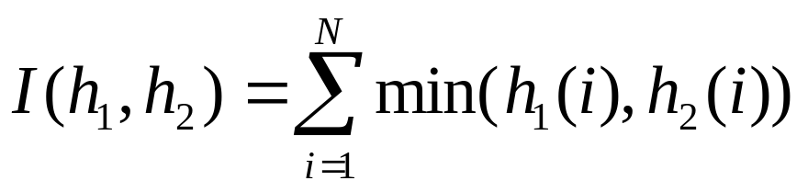
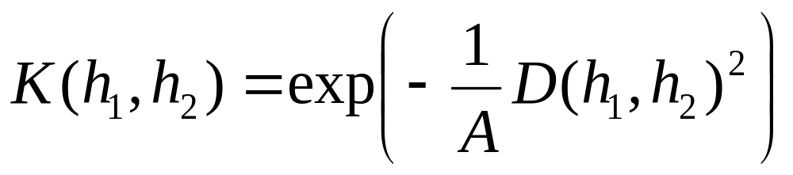
Kernels for bags of features
[Additional info]
Histogram intersection kernel:
Generalized Gaussian kernel:
D can be (inverse) L1 distance, Euclidean distance, χ² distance, etc.
J. Zhang, M. Marszalek, S. Lazebnik, and C. Schmid, IJCV 2007
Local Features and Kernels for Classifcation of Texture and Object Categories: A Comprehensive Study

Slide 37
Summary: SVMs for image classification
Pick an image representation (Proj3: bag of features)
Pick a kernel function for that representation
Compute the matrix of kernel values between every pair of training examples
Feed the kernel matrix into your favorite SVM solver to obtain support vectors and weights
At test time: compute kernel values for your test example and each support vector, and combine them with the learned weights to get the value of the decision function
Slide credit: L. Lazebnik

Slide 38
What about multi-class SVMs?
Unfortunately, there is no “definitive” multi-class SVM.
In practice, we combine multiple two-class SVMs
One vs. others
  Training: learn an SVM for each class vs. the others
  Testing: apply each SVM to test example and assign to it the class of the SVM that returns the highest decision value
One vs. one
  Training: learn an SVM for each pair of classes
  Testing: each learned SVM “votes” for a class to assign to the test example
Slide credit: L. Lazebnik

Slide 39
SVMs: Pros and cons
Pros
  Many publicly available SVM packages:
  http://www.kernel-machines.org/software
  Kernel-based framework is very powerful, flexible
  SVMs work very well in practice, even with very small training sample sizes
Cons
  No “direct” multi-class SVM, must combine two-class SVMs
  Computation, memory
    During training time, must compute matrix of kernel values for every pair of examples
    Learning can take a very long time for large-scale problems

Slide 40
Summary: Classifiers
Nearest-neighbor and k-nearest-neighbor classifiers
  L1 distance, χ² distance, quadratic distance, histogram intersection
Support vector machines
  Linear classifiers
  Margin maximization
  The kernel trick
  Kernel functions: histogram intersection, generalized Gaussian, pyramid match
  Multi-class
Of course, there are many other classifiers out there
  Neural networks, boosting, decision trees, …
Slide credit: L. Lazebnik

Slide 41
Classifiers: Decision Trees
x
x
x
o
x
x
x
o
x
o
x
o
o
o
o
x2
x1

Slide 42
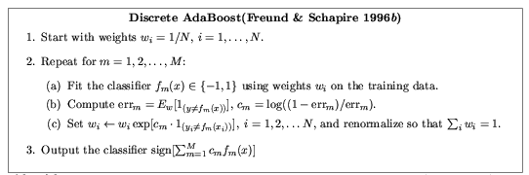
Ensemble Methods: Boosting
figure from Friedman et al. 2000

Slide 43
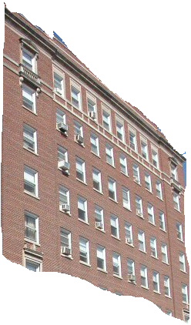
Boosted Decision Trees
High in
Image?
Gray?
Yes
No
Yes
No
Smooth?
Green?
High in
Image?
Many Long
Lines?
…
Yes
No
Yes
No
Yes
No
Yes
No
Blue?
Very High
Vanishing
Point?
Yes
No
Yes
No
Ground Vertical Sky
P(label | good segment, data)
[Collins et al. 2002]

Slide 44
Using Boosted Decision Trees
Flexible: can deal with both continuous and categorical variables
How to control bias/variance trade-off
  Size of trees
  Number of trees
Boosting trees often works best with a small number of well-designed features
Boosting “stubs” can give a fast classifier

Slide 45
Ideals for a classification algorithm
Objective function: encodes the right loss for the problem
Parameterization: takes advantage of the structure of the problem
Regularization: good priors on the parameters
Training algorithm: can find parameters that maximize objective on training set
Inference algorithm: can solve for labels that maximize objective function for a test example

Slide 46
Two ways to think about classifiers
What is the objective?
What are the parameters?
How are the parameters learned?
How is the learning regularized?
How is inference performed?
How is the data modeled?
How is similarity defined?
What is the shape of the boundary?
Slide credit: D. Hoiem

Slide 47
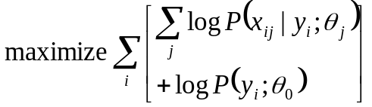
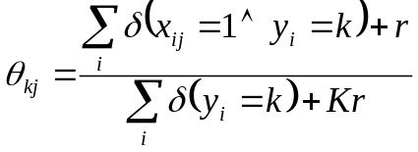
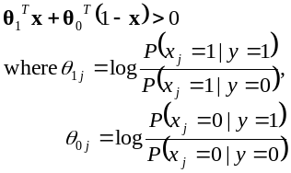
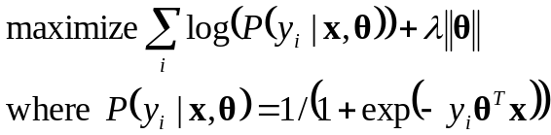

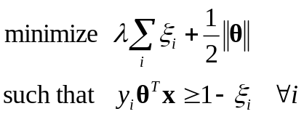
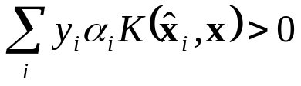
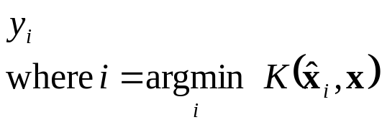
Comparison
assuming x in {0 1}
Learning Objective
Training
Inference
Naïve Bayes
Logistic Regression
Gradient ascent
Linear SVM
Linear programming
Kernelized SVM
complicated to write
Quadratic programming
Nearest Neighbor
most similar features → same label
Record data
Slide credit: D. Hoiem

Slide 48
Training
Training Labels
Training Images
Image Features
Training
Learned classifier
Testing
Image Features
Apply classifier
Prediction
Test Image
Slide credit: D. Hoiem and L. Lazebnik

Slide 49
Features and distance measures
define visual similarity.
Training labels
dictate that examples are the same or different.
Classifiers
learn weights (or parameters) of features and distance measures…
so that visual similarity predicts label similarity.

Slide 50

Generalization
Training set (labels known)
Test set (labels unknown)
How well does a learned model generalize from the data it was trained on to a new test set?
Slide credit: L. Lazebnik

Slide 51
Generalization Error
Bias:
Difference between the expected (or average) prediction of our model and the correct value.
Error due to inaccurate assumptions/simplifications.
Variance:
Amount that the estimate of the target function will change if different training data was used.
Slide credit: L. Lazebnik

Slide 52
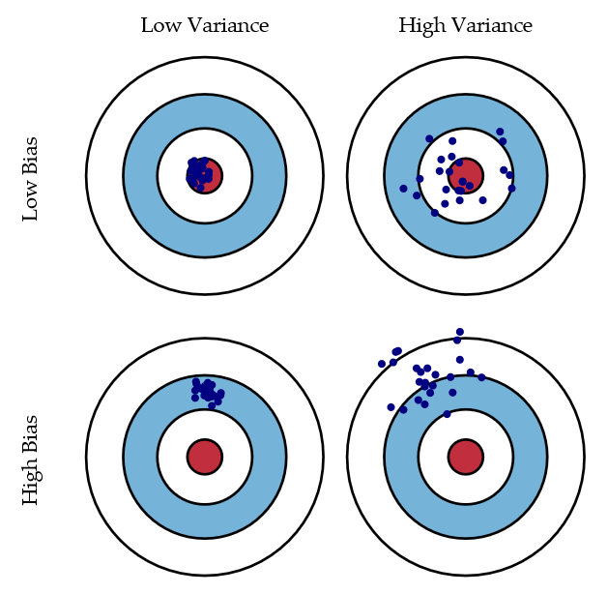
Bias/variance trade-off
Bias = accuracy
Variance = precision
[Scott Fortmann-Roe]
Notes:
http://scott.fortmann-roe.com/docs/BiasVariance.html
“Bias: The error due to bias is taken as the difference between the expected (or average) prediction of our model and the correct value which we are trying to predict.
Variance: The error due to variance is taken as the variability of a model prediction for a given data point.”

Slide 53
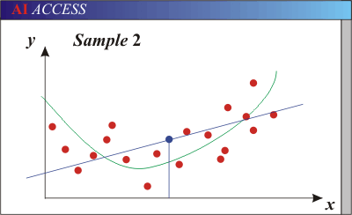
Generalization Error Effects
Underfitting: model is too “simple” to represent all the relevant class characteristics
  High bias (few degrees of freedom) and low variance
  High training error and high test error
Green line = true data-generating function without noise
Blue line = data model which underfits
Slide credit: L. Lazebnik

Slide 54
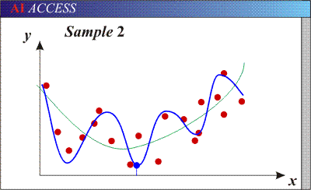
Generalization Error Effects
Overfitting: model is too “complex” and fits irrelevant characteristics (noise) in the data
  Low bias (many degrees of freedom) and high variance
  Low training error and high test error
Green line = true data-generating function without noise
Blue line = data model which overfits
Slide credit: L. Lazebnik

Slide 55
Bias-Variance Trade-off
Models with too few parameters are inaccurate because of a large bias.
  Not enough flexibility!
  Too many assumptions
Models with too many parameters are inaccurate because of a large variance.
  Too much sensitivity to the sample.
  Slightly different data ->
  very different function.
Slide credit: D. Hoiem
Notes:
http://www.aiaccess.net/English/Glossaries/GlosMod/e_gm_bias_variance.htm

Slide 56
Bias-Variance Trade-off
E(MSE) = noise² + bias² + variance
Error due to variance of training samples
Unavoidable error
Error due to incorrect assumptions
For explanations of bias-variance (also Bishop’s “Neural Networks” book):
http://www.inf.ed.ac.uk/teaching/courses/mlsc/Notes/Lecture4/BiasVariance.pdf
Slide credit: D. Hoiem
Notes:
From the link above:
You can only get generalization through assumptions.
Thus, in order to minimize the MSE, we need to minimize both the bias and the variance.
However, this is not trivial to do this.
For instance, just neglecting the input data and predicting the output somehow (e.g., just a constant), would definitely minimize the variance of our predictions: they would be
always the same, thus the variance would be zero—but the bias of our estimate
(i.e., the amount we are off the real function) would be tremendously large. On
the other hand, the neural network could perfectly interpolate the training data,
i.e., it predict y=t for every data point. This will make the bias term vanish entirely, since the E(y)=f (insert this above into the squared bias term to verify this),
but the variance term will become equal to the variance of the noise, which may
be significant (see also Bishop Chapter 9 and the Geman et al. Paper). In general,
finding an optimal bias-variance tradeoff is hard, but acceptable solutions can be
found, e.g., by means of cross validation or regularization.

Slide 57
Bias-variance tradeoff
Fixed number of training examples
Underfitting
Overfitting
Generalization Error
Error
Test error
Training error
High Bias
Low Variance
Model complexity
Low Bias
High Variance
Slide credit: D. Hoiem

Slide 58
Bias-variance tradeoff
Overfitting
Few training examples
Test Error
Underfitting
Many training examples
High Bias
Low Variance
Model complexity
Low Bias
High Variance
Slide credit: D. Hoiem
Notes:
Note: these figures don’t work in pdf

Slide 59
Effect of Training Size
Fixed complexity prediction model
Generalization Error
Error
Testing
Training
Number of Training Examples
Slide credit: D. Hoiem

Slide 60
The perfect classification algorithm
Objective function: encodes the right loss for the problem
Parameterization: makes assumptions that fit the problem
Regularization: right level of regularization for amount of training data
Training algorithm: can find parameters that maximize objective on training set
Inference algorithm: can solve for objective function in evaluation
Slide credit: D. Hoiem

Slide 61
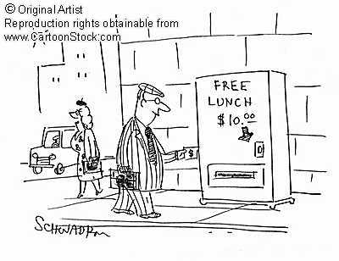
Remember…
No classifier is inherently better than any other: you need to make assumptions to generalize
Three kinds of error
  Inherent: unavoidable
  Bias: due to over-simplifications
  Variance: due to inability to perfectly estimate parameters from limited data
Slide credit: D. Hoiem
Notes:
You can only get generalization through assumptions.

Slide 62
How to reduce variance?
Choose a simpler classifier
Regularize the parameters
Get more training data
Slide credit: D. Hoiem
Notes:
The simpler classifier or regularization could increase bias and lead to more error.

Slide 63
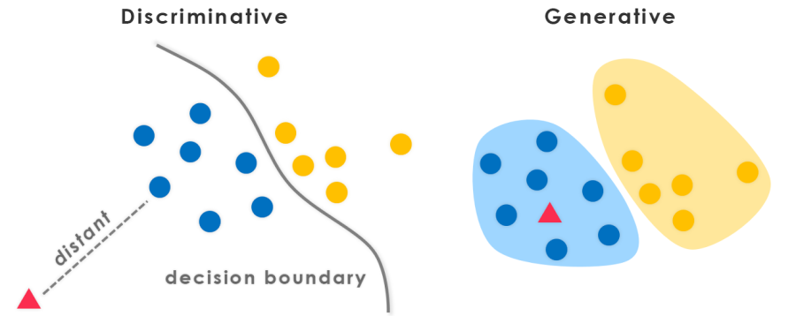
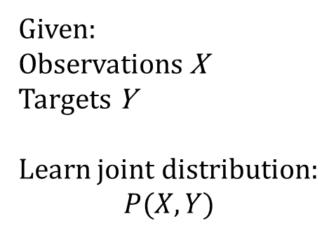
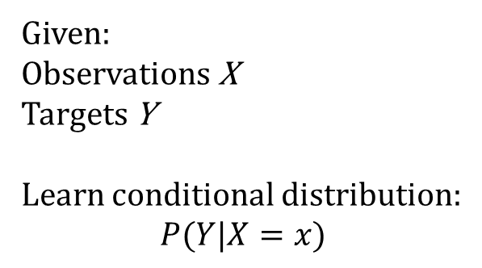
[evolvingai.org]
“Learn the data boundary”
“Represent the data and then
define boundary”
Given:
Observations X
Targets Y
Learn conditional distribution:
$$P(Y|X=x)$$
Given:
Observations X
Targets Y
Learn joint distribution:
$$P(X,Y)$$

Slide 64
Generative vs. Discriminative Classifiers
Discriminative Models
Learn to directly predict the labels from the data
Often, assume a simple boundary (e.g., linear)
Examples
  Logistic regression
  SVM
  Boosted decision trees
Often easier to predict a label from the data than to model the data
Generative Models
Represent both the data and the labels
Often, makes use of conditional independence and priors
Examples
  Naïve Bayes classifier
  Bayesian network
Models of data may apply to future prediction problems
Slide credit: D. Hoiem
Notes:
Generative classifiers try to model the data. Discriminative classifiers try to predict the label.

Slide 65
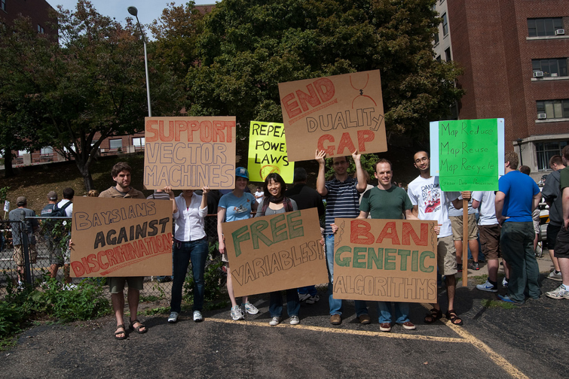
Photo: CMU Machine Learning Department Protests G20
Slides: James Hays, Isabelle Guyon, Erik Sudderth,
Mark Johnson, Derek Hoiem
Notes:
Date for photo?
Bayesian methods:
Condition model on data probabilistically

Slide 66
Making decisions about data
3 important design decisions:
  1) What data do I use?
  2) How do I represent my data (what feature)?
  3) What classifier / regressor / machine learning tool do I use?
These are in decreasing order of importance
Deep learning addresses 2 and 3 simultaneously (and blurs the boundary between them).
You can take the representation from deep learning and use it with any classifier.

Slide 67
Many classifiers to choose from…
K-nearest neighbor
SVM
Naïve Bayes
Bayesian network
Logistic regression
Randomized Forests
Boosted Decision Trees
Restricted Boltzmann Machines
Neural networks
Deep Convolutional Network
…
Which is the best?

Slide 68
Claim:
The decision to use machine learning is more important than the choice of a particular learning method.
*Deep learning seems to be an exception to this, currently, because it learns the feature representation.

Slide 69
Claim:
It is more important to have more or better labeled data than to use a different supervised learning technique.
*Again, deep learning may be an exception here for the same reason, but deep learning _needs_ a lot of labeled data in the first place.
“The Unreasonable Effectiveness of Data” - Norvig

Slide 70
What to remember about classifiers
No free lunch: machine learning algorithms are tools, not dogmas
Try simple classifiers first
Better to have smart features and simple classifiers than simple features and smart classifiers
Use increasingly powerful classifiers with more training data (bias-variance tradeoff)
Slide credit: D. Hoiem

Slide 71
Some Machine Learning References
General
  Tom Mitchell, Machine Learning, McGraw Hill, 1997
  Christopher Bishop, Neural Networks for Pattern Recognition, Oxford University Press, 1995
Adaboost
  Friedman, Hastie, and Tibshirani, “Additive logistic regression: a statistical view of boosting”, Annals of Statistics, 2000
SVMs
  http://www.support-vector.net/icml-tutorial.pdf
Slide credit: D. Hoiem

Slide 72
Why Deep RL is hard
https://www.alexirpan.com/2018/02/14/rl-hard.html
Notes:
https://www.alexirpan.com/2018/02/14/rl-hard.html
Deep Reinforcement Learning That Matters (Henderson et al, AAAI 2018).
Among its conclusions are:
- Multiplying the reward by a constant can cause significant differences in performance.
- Five random seeds (a common reporting metric) may not be enough to argue significant results, since with careful selection you can get non-overlapping confidence intervals.
- Different implementations of the same algorithm have different performance on the same task, even when the same hyperparameters are used.
https://arxiv.org/abs/1709.06560

