Slide 1

13 February 2019
Notes:
Welcome to a class with some curious content!
Today we’re going to be discussing cameras, and how light and color affect image formation.

Slide 2
Where to go from our basic building block?
Image formation
Image frequency
Gradients, edges, corners
Descriptors
Features
Recognition
Scenes, places, objects,
~ 5 weeks (inc. CNNs)
Reconstruction
Geometric understanding
Last topic in class

Slide 3
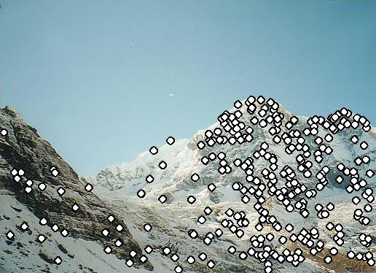
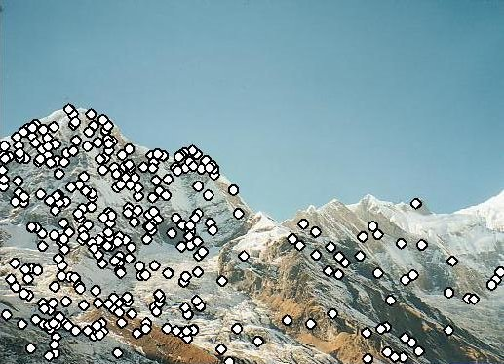
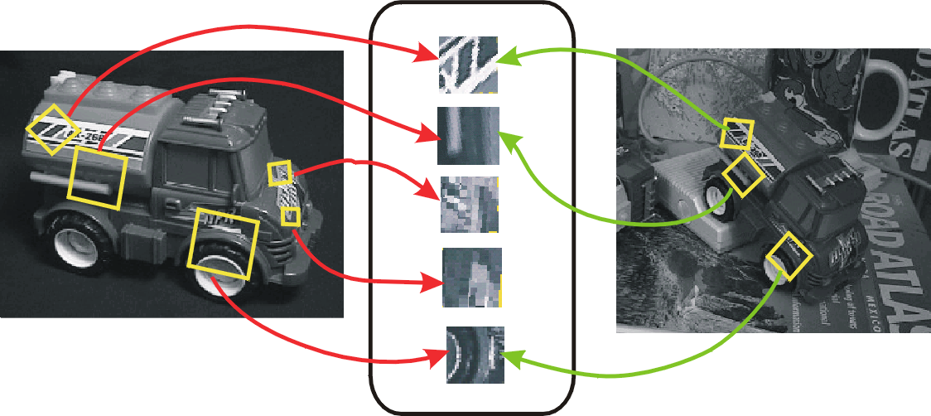
Panorama stitching / instance recognition
Needs more geometric understanding…
…but we’ll see it later on.

Slide 4
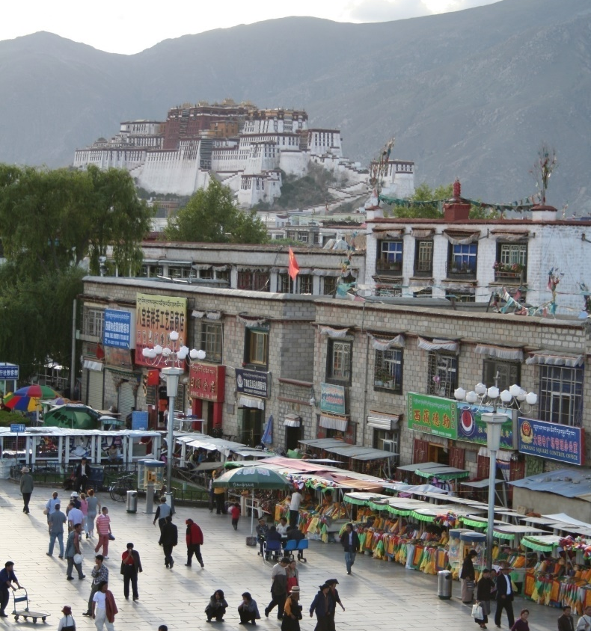

Recognition
Often needs machine learning
for compact descriptions of the visual world.
Scene recognition
- City/forest/factory/…
Find pedestrians

Slide 5
ML Crash course

Slide 6
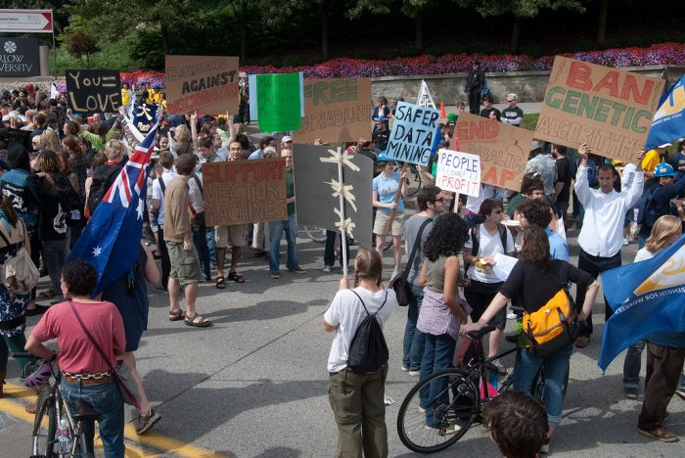
Photo: CMU Machine Learning Department Protests G20
Slides: James Hays, Isabelle Guyon, Erik Sudderth,
Mark Johnson, Derek Hoiem
Notes:
Date for photo?

Slide 7
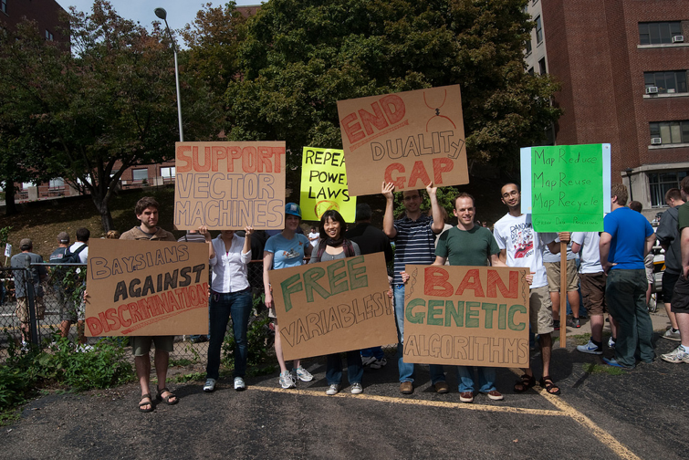
Photo: CMU Machine Learning Department Protests G20
Slides: James Hays, Isabelle Guyon, Erik Sudderth,
Mark Johnson, Derek Hoiem
Notes:
Date for photo?

Slide 8
Our approach
We will look at ML as a tool. We will not detail the underpinnings of each learning method.
Please take a machine learning course if you want to know more!

Slide 9
Machine Learning
Learn from and make predictions on data.
Arguably the greatest export from computing to other scientific fields.
Statisticians might disagree with CompScis on the true origins…

Slide 10
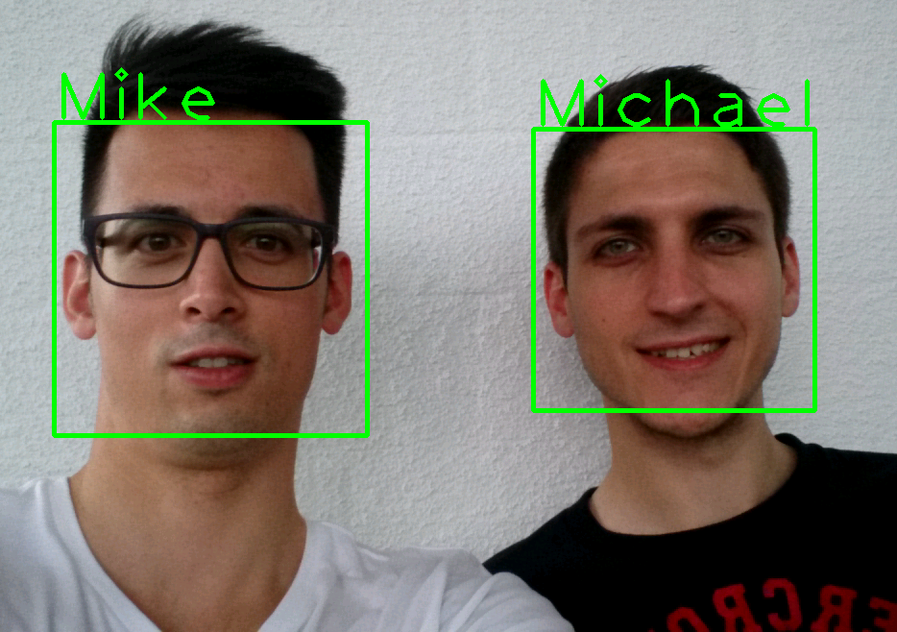
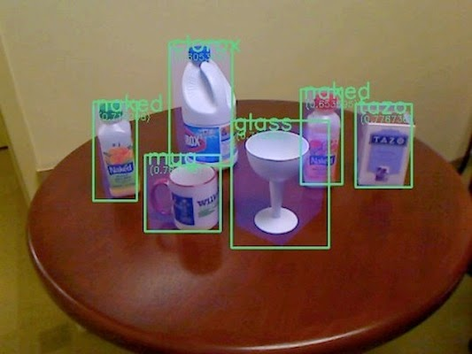
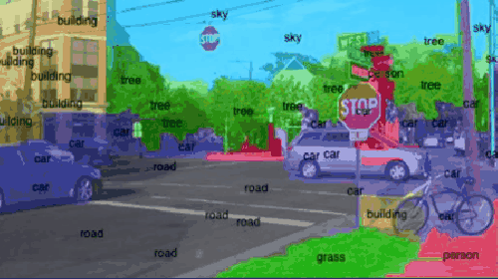
ML for Computer Vision
Face Recognition
Object Classification
Scene Segmentation
Notes:
Faces: https://play.google.com/store/apps/details?id=ch.zhaw.facerecognition – “Face Recognition” Android app
Objects: http://simon-mcav.blogspot.com/2014/09/revision-essay-in-50-minutes-object.html
Street gif: http://www.somatic.io/blog/imagenet-the-original-machine-learning-database

Slide 11
Data, data, data!
Peter Norvig – “The Unreasonable Effectiveness of Data” (IEEE Intelligent Systems, 2009)
  “... invariably, simple models and a lot of data trump more elaborate models based on less data”
[Norvig is Director of Research @ Google, and a Brown APMA alum!]

Slide 12
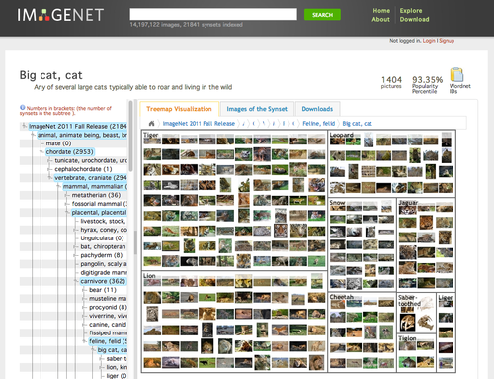
ImageNet
Images for each category of WordNet
1000 classes
1.2mil images
100k test
Top 5 error
Notes:
ImageNet Large Scale Visual Recognition Challenge
https://arxiv.org/pdf/1409.0575.pdf

Slide 13
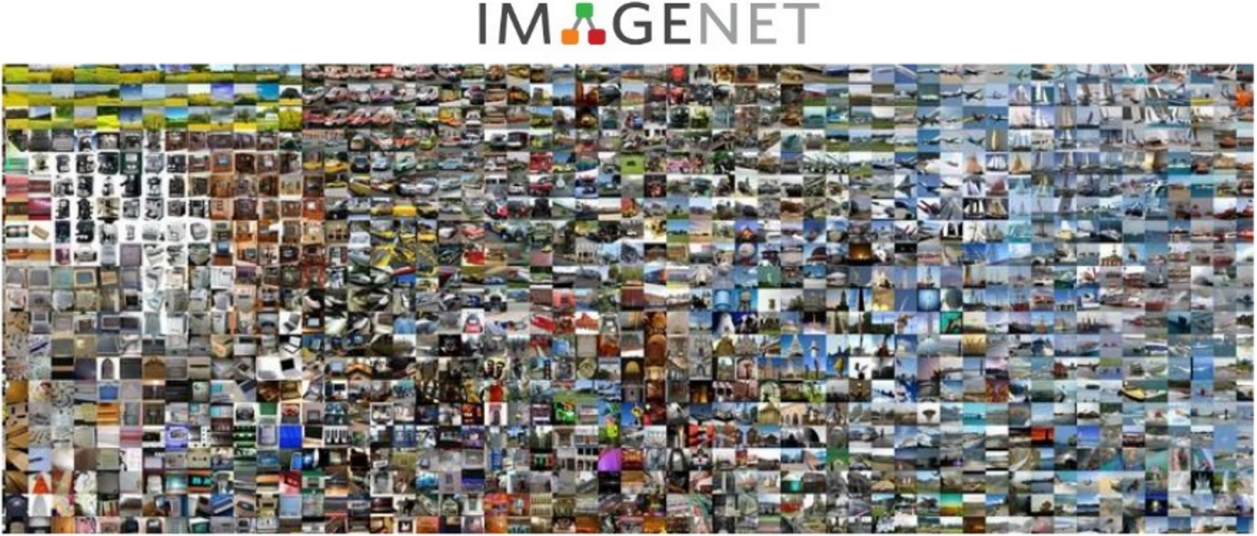
Notes:
ImageNet Large Scale Visual Recognition Challenge
https://arxiv.org/pdf/1409.0575.pdf
Thanks to Xavier Giro, https://www.slideshare.net/xavigiro/deep-learning-for-computer-vision-imagenet-challenge-upc-2016

Slide 14
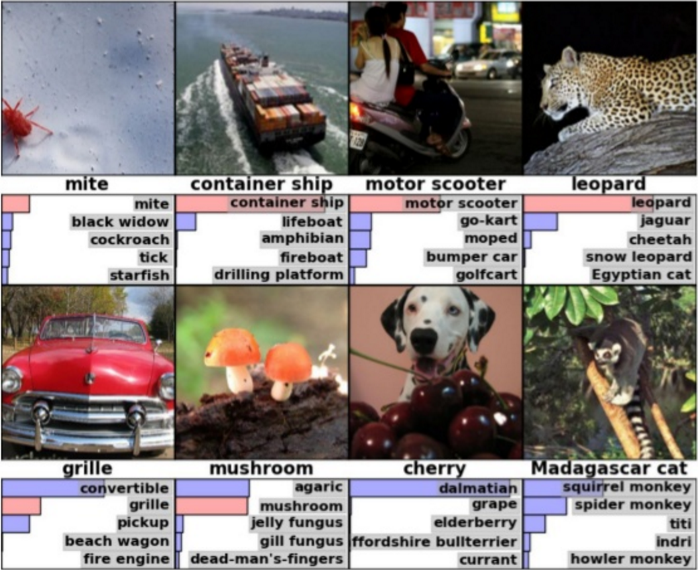

Slide 15
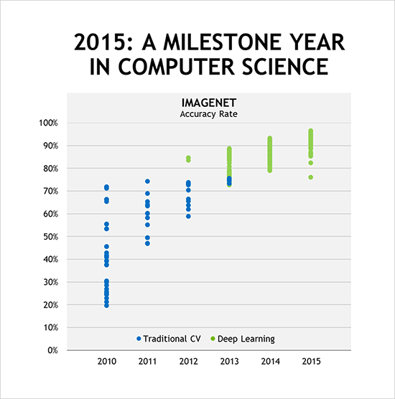
ImageNet Competition
Krizhevsky, 2012
Google, Microsoft 2015
  Beat the best human score in the ImageNet challenge.
NVIDIA
Notes:
https://blogs.nvidia.com/blog/2016/01/12/accelerating-ai-artificial-intelligence-gpus/
Alex Krizhevsky of the University of Toronto won the 2012 ImageNet computer image recognition competition.

Slide 16
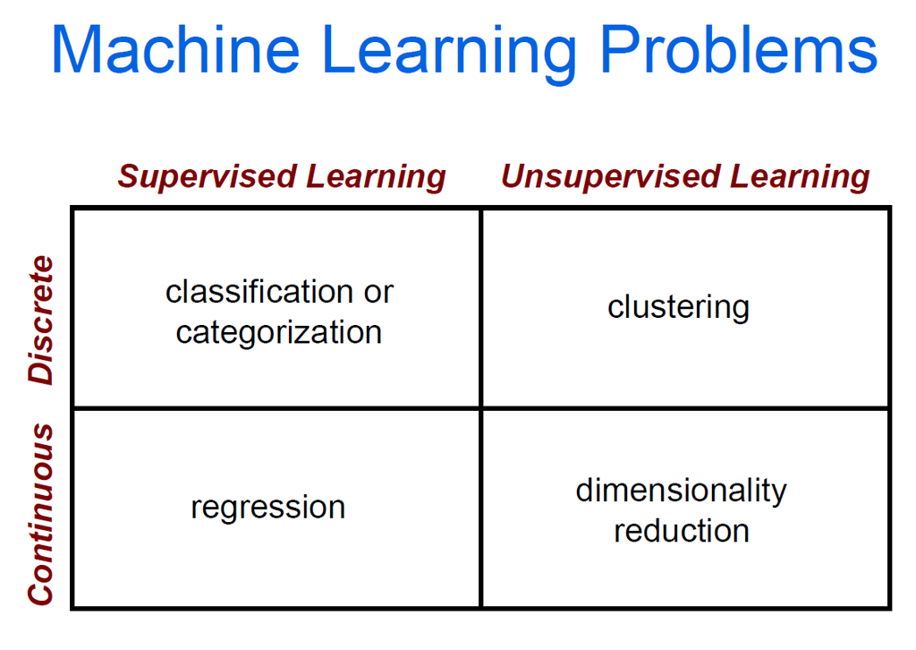

Slide 18
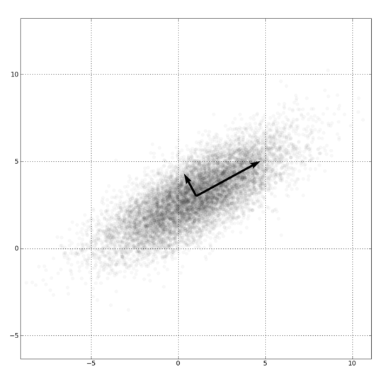
Dimensionality Reduction
PCA, ICA, LLE, Isomap
Principal component analysis
  Creates a basis where the axes represent the dimensions of variance, from high to low.
  Finds correlations in data dimensions to produce best possible lower-dimensional representation based on linear projections.
  Subtract mean of data, compute eigendecomposition.
  Eigenvectors are directions of variance; eigenvalues are magnitudes of variance.

Slide 19
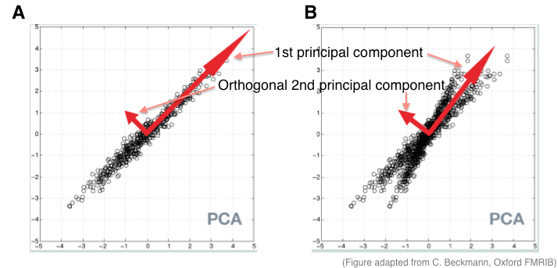

PCA
Notes:
https://www.quora.com/What-is-an-intuitive-explanation-for-PCA

Slide 20
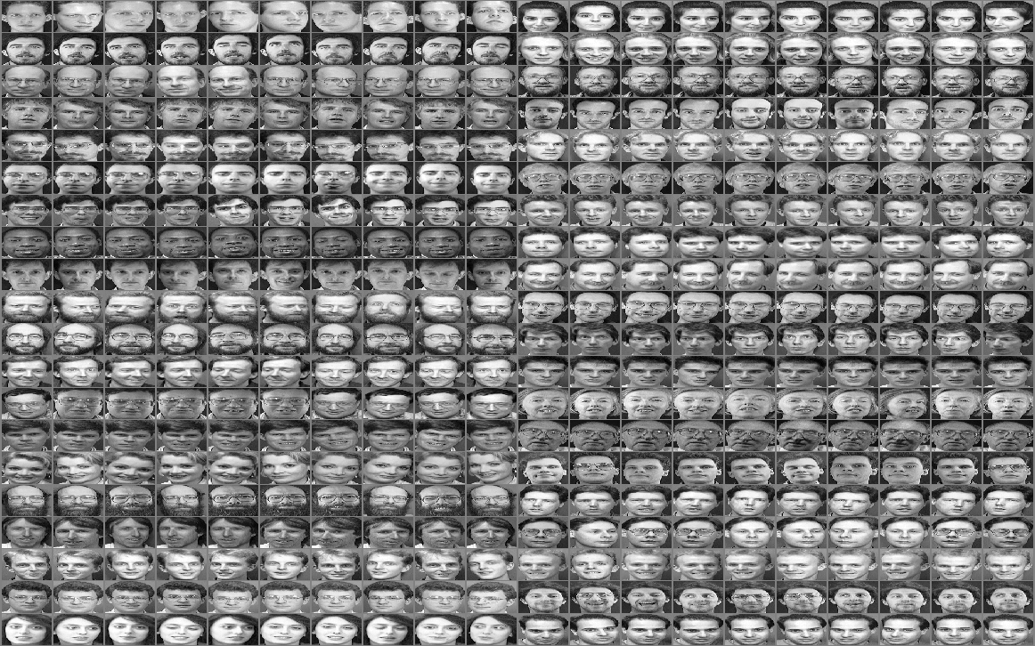
Eigenfaces
The ATT face database (formerly the ORL database), 10 pictures of 40 subjects each
Notes:
ATT Face Database
http://rduin.nl/manual/PRTools_8.html

Slide 21
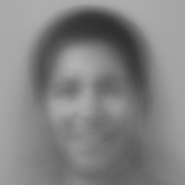
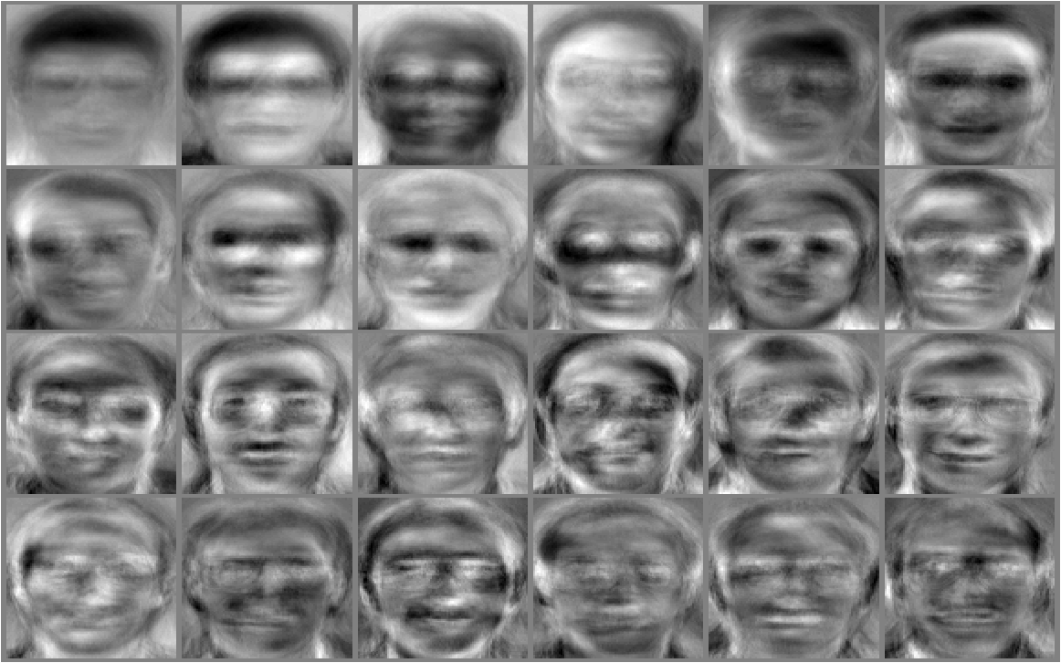
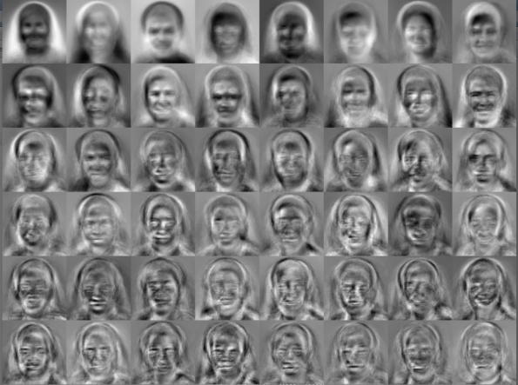
Eigenfaces
Note: the mean face is associated with this set of eigenvectors below, thanks to Kaushiik Baskaran.
Mean face
(not Jack)
Basis of variance (eigenvectors)
M. Turk; A. Pentland (1991). "Face recognition using eigenfaces" (PDF).
Proc. IEEE Conference on Computer Vision and Pattern Recognition. pp. 586–591.
R.P.W. Duin
Notes:
https://kausherald.wordpress.com/category/final-year-project/

Slide 23
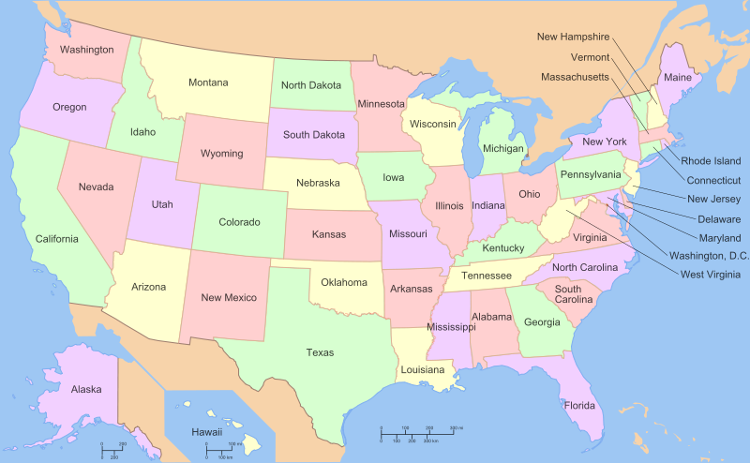

Slide 24
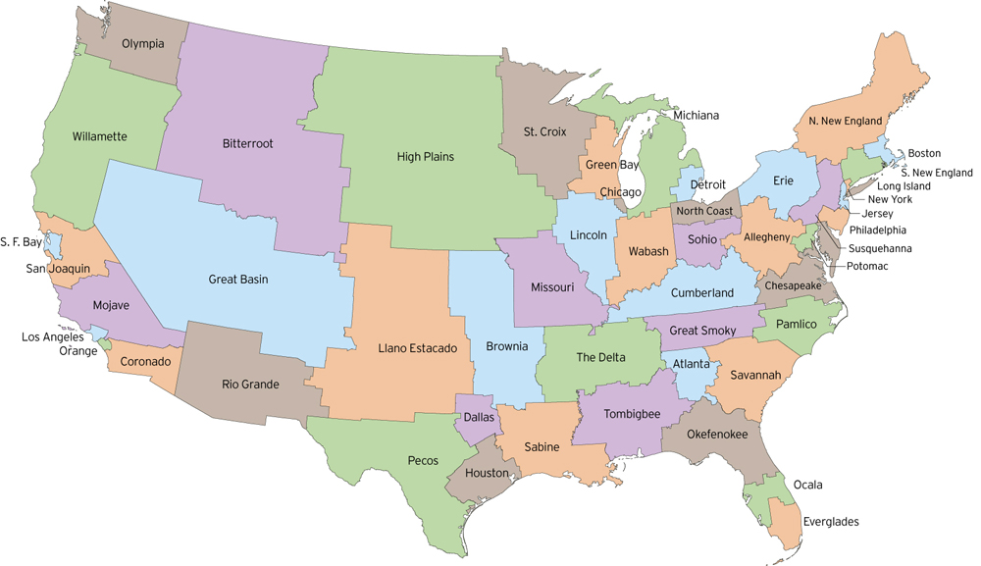
Clustered by similar populations
http://fakeisthenewreal.org/reform/
Notes:
~5,617,000 population in each state

Slide 25
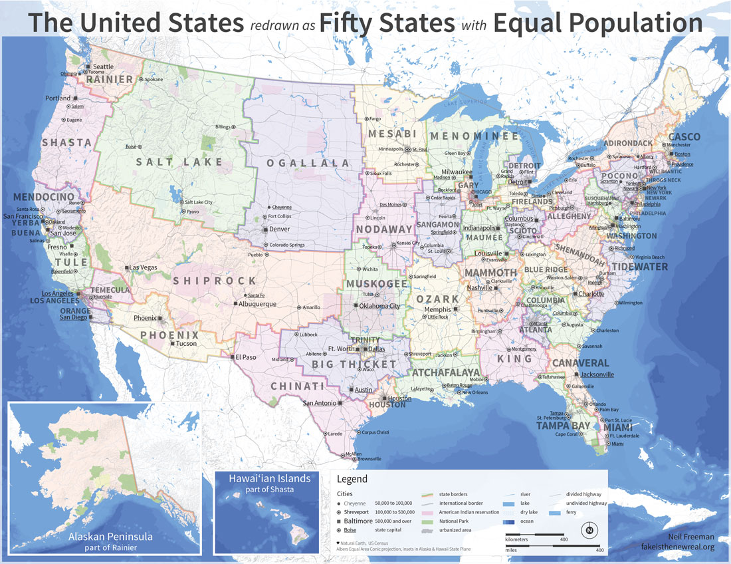
Notes:
~5,617,000 population in each state

Slide 26
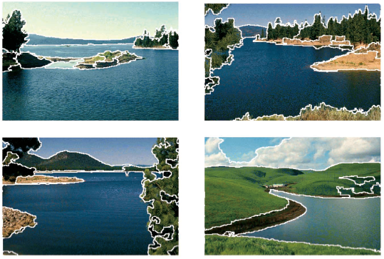
Clustering example: image segmentation
Goal: Break up the image into meaningful or perceptually similar regions

Slide 27
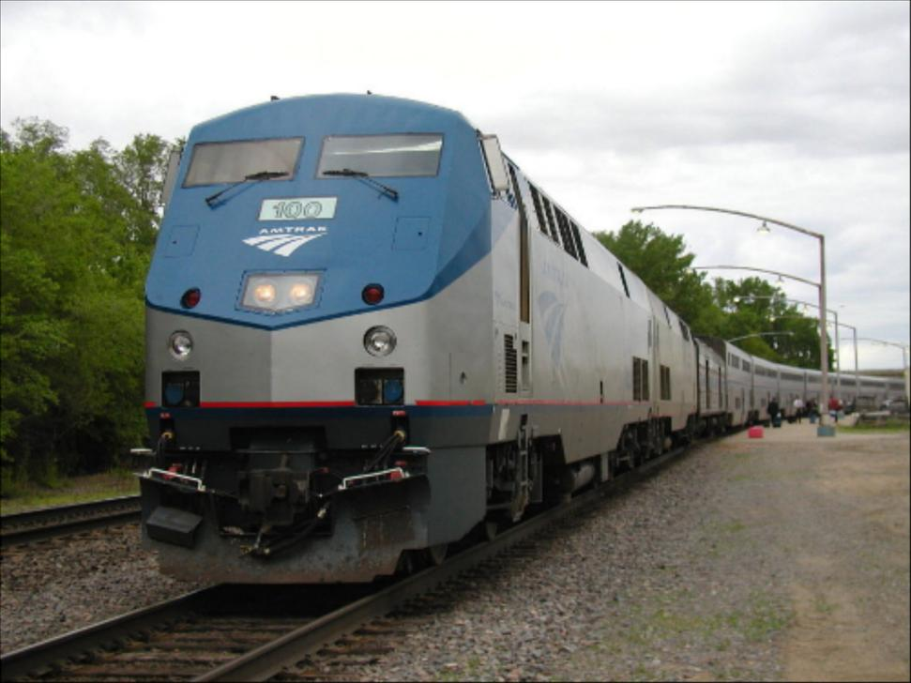
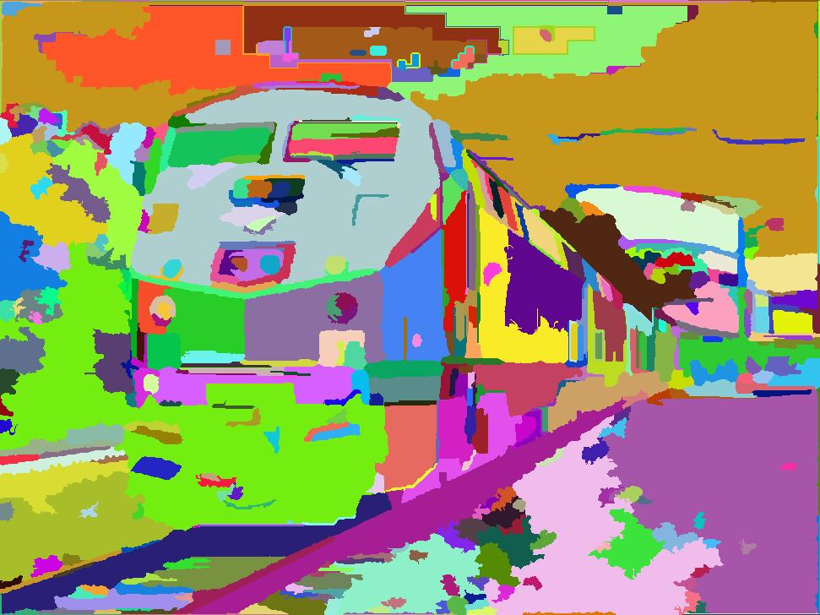

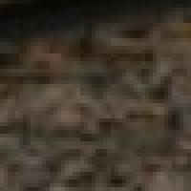
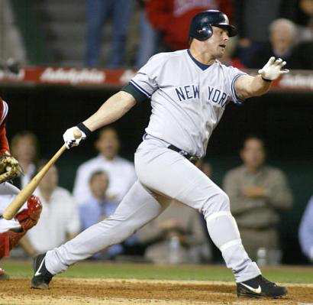
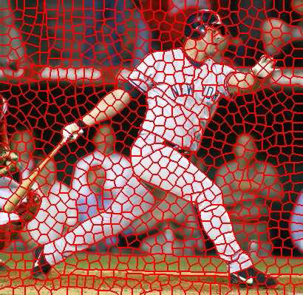
Segmentation for feature support or efficiency
50x50 Patch
50x50 Patch
[Felzenszwalb and Huttenlocher 2004]
Superpixels!
[Shi and Malik 2001]
Derek Hoiem
[Hoiem et al. 2005, Mori 2005]

Slide 28
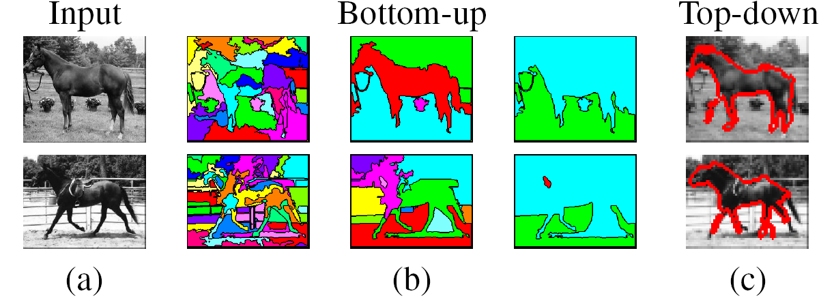
Types of segmentations
Oversegmentation
Undersegmentation
Hierarchical Segmentations

Slide 29
Major processes for segmentation
Bottom-up: group tokens with similar features
Top-down: group tokens that likely belong to the same object
[Levin and Weiss 2006]

Slide 30
Clustering
Group together similar ‘points’ and represent them with a single token.
Key Challenges:
1) What makes two points/images/patches similar?
2) How do we compute an overall grouping from pairwise similarities?
Derek Hoiem

Slide 31
Why do we cluster?
Summarizing data
  Look at large amounts of data
  Patch-based compression or denoising
  Represent a large continuous vector with the cluster number
Counting
  Histograms of texture, color, SIFT vectors
Segmentation
  Separate the image into different regions
Prediction
  Images in the same cluster may have the same labels
Derek Hoiem

Slide 32
How do we cluster?
K-means
  Iteratively re-assign points to the nearest cluster center
Agglomerative clustering
  Start with each point as its own cluster and iteratively merge the closest clusters
Mean-shift clustering
  Estimate modes of pdf
Spectral clustering
  Split the nodes in a graph based on assigned links with similarity weights

Slide 33
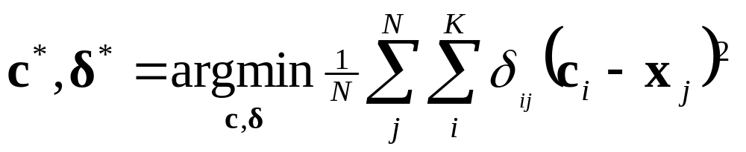
Clustering for Summarization
Goal: cluster to minimize variance in data given clusters
  Preserve information
Cluster center
Data
Whether x_{j} is assigned to c_{i}
Slide: Derek Hoiem

Slide 34
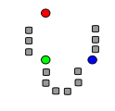
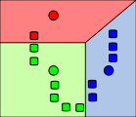
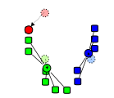
K-means algorithm
1. Randomly select K centers
2. Assign each point to nearest center
3. Compute new center (mean) for each cluster
Illustration: http://en.wikipedia.org/wiki/K-means_clustering

Slide 35
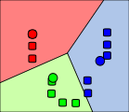
K-means algorithm
1. Randomly select K centers
2. Assign each point to nearest center
Back to 2
3. Compute new center (mean) for each cluster
Illustration: http://en.wikipedia.org/wiki/K-means_clustering

Slide 36
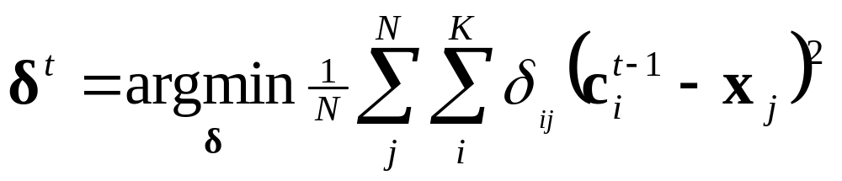
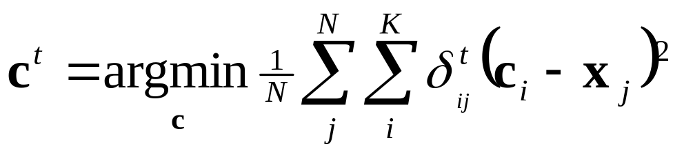
K-means
Initialize cluster centers: c⁰ ; t=0
Assign each point to the closest center
Update cluster centers as the mean of the points
Repeat 2-3 until no points are re-assigned (t=t+1)
Slide: Derek Hoiem

Slide 37
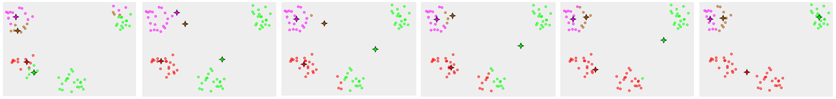
K-means convergence

Slide 38
Think-Pair-Share
What is good about k-means?
What is bad about k-means?
Where could you apply k-means?

Slide 39
K-means: design choices
Initialization
  Randomly select K points as initial cluster center
  Or greedily choose K points to minimize residual
Distance measures
  Traditionally Euclidean, could be others
Optimization
  Will converge to a local minimum
  May want to perform multiple restarts

Slide 40
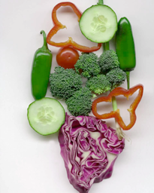
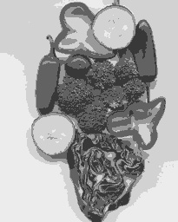
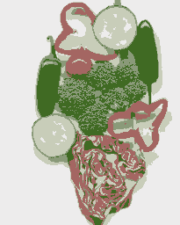
K-means clustering using intensity or color
Image
Clusters on intensity
Clusters on color
Notes:
I gave each pixel the mean intensity or mean color of its cluster --- this is basically just vector quantizing the image intensities/colors. Notice that there is no requirement that clusters be spatially localized and they’re not.

Slide 41
How to choose the number of clusters?
Validation set
  Try different numbers of clusters and look at performance
    When building dictionaries (discussed later), more clusters typically work better.
Slide: Derek Hoiem

Slide 42
How to initialize the clusters?
k-means++ initialization
  Make the initial cluster centers span the space
Choose one center uniformly at random from all data points.
For each point x, compute the distance D(x) between x and the nearest center that has already been chosen.
Choose one new data point at random as a new center, using a weighted probability distribution where a point x is chosen with probability proportional to D(x)².
Repeat Steps 2 and 3 until k centers have been chosen.
Proceed using standard k-means clustering.
Wikipedia / Arthur and Vassilvitskii
Notes:
Arthur, D.; Vassilvitskii, S. (2007). "k-means++: the advantages of careful seeding" (PDF). Proceedings of the eighteenth annual ACM-SIAM symposium on Discrete algorithms. Society for Industrial and Applied Mathematics Philadelphia, PA, USA. pp. 1027–1035.
https://en.wikipedia.org/wiki/K-means%2B%2B

Slide 43
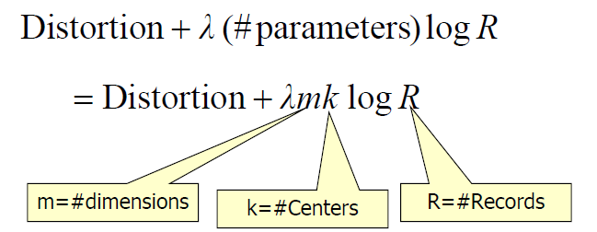
How to choose the number of clusters?
Minimum Description Length (MDL) principal for model comparison
Minimize Schwarz Criterion
  also called Bayes Information Criteria (BIC)

Slide 44
How to evaluate clusters?
Generative
  How well are points reconstructed from the clusters?
Discriminative
  How well do the clusters correspond to labels?
    Purity
  Note: unsupervised clustering does not aim to be discriminative
Slide: Derek Hoiem

Slide 45
K-means demos
General
http://home.dei.polimi.it/matteucc/Clustering/tutorial_html/AppletKM.html
http://www.cs.washington.edu/research/imagedatabase/demo/kmcluster/
Color clustering

Slide 46
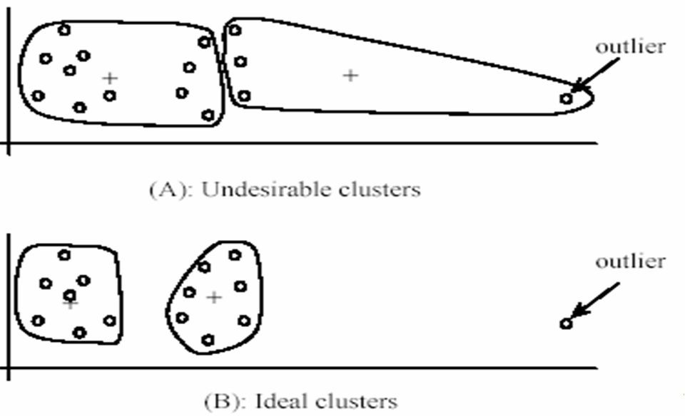
K-Means pros and cons
Pros
  Finds cluster centers that minimize conditional variance (good representation of data)
  Simple and fast*
  Easy to implement
Cons
  Need to choose K
  Sensitive to outliers
  Prone to local minima
  All clusters have the same parameters (e.g., distance measure is non-adaptive)
  *Can be slow: each iteration is O(KNd) for N d-dimensional points
Usage
  Cluster features to build visual dictionaries

Slide 47
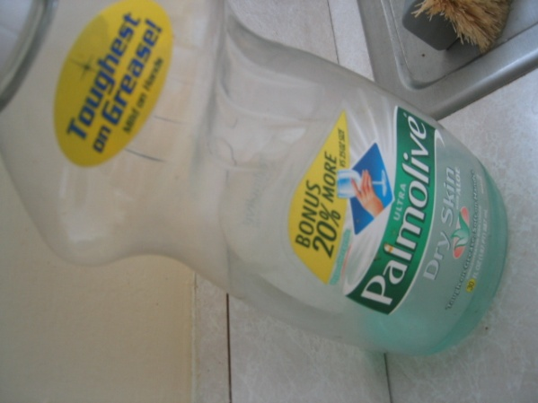
Building Visual Dictionaries
Sample features from a database
  E.g., 128 dimensional SIFT vectors
Cluster to build dictionary
  Cluster centers are the dictionary words
To match new features, assign to the nearest cluster to save rebuilding dictionary

Slide 48
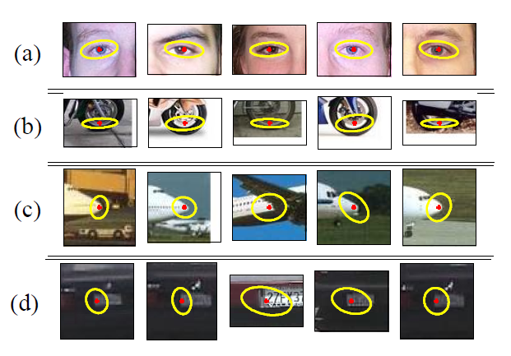
Examples of learned codewords
Most likely codewords for 4 learned “topics”
EM with multinomial (problem 3) to get topics
http://www.robots.ox.ac.uk/~vgg/publications/papers/sivic05b.pdf
Sivic et al. ICCV 2005

Slide 49
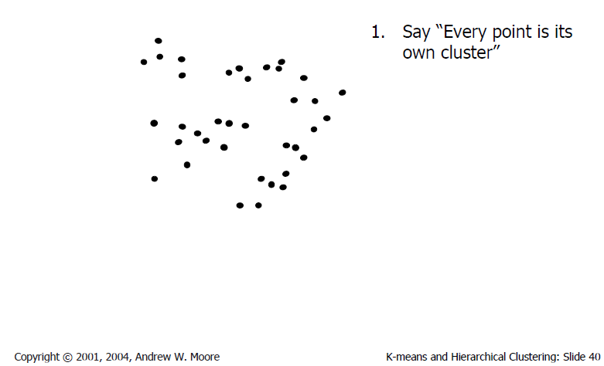
Agglomerative clustering

Slide 50
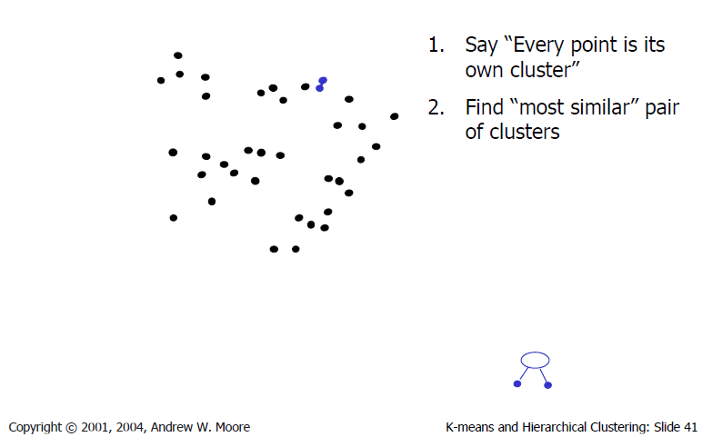
Agglomerative clustering

Slide 51
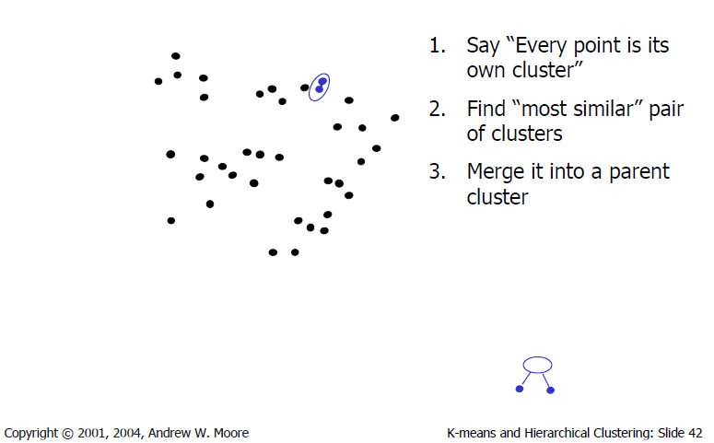
Agglomerative clustering

Slide 52
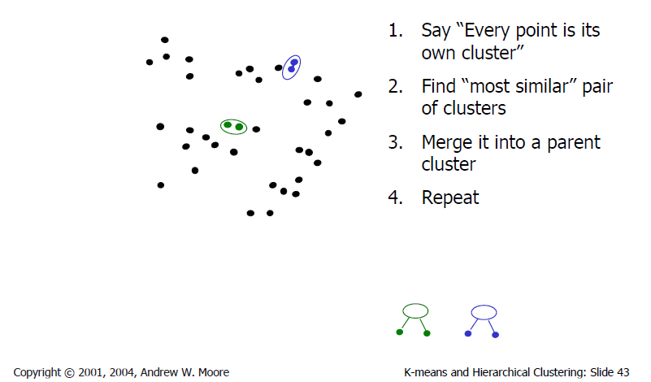
Agglomerative clustering

Slide 53
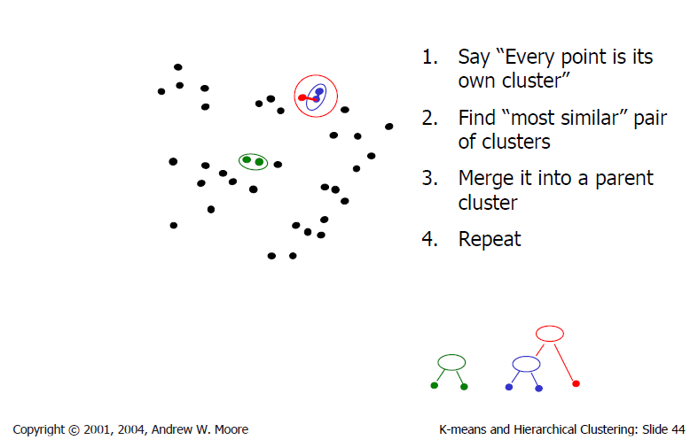
Agglomerative clustering

Slide 54

Agglomerative clustering
How to define cluster similarity?
Average distance between points, maximum distance, minimum distance
Distance between means or medoids
How many clusters?
Clustering creates a dendrogram (a tree)
Threshold based on max number of clusters or based on distance between merges
distance

Slide 55
Agglomerative clustering demo
http://home.dei.polimi.it/matteucc/Clustering/tutorial_html/AppletH.html

Slide 56
Conclusions: Agglomerative Clustering
Good
Simple to implement, widespread application
Clusters have adaptive shapes
Provides a hierarchy of clusters
Bad
May have imbalanced clusters
Still have to choose number of clusters or threshold
Need to use an “ultrametric” to get a meaningful hierarchy
Notes:
Ultrametric – stronger requirement than triangle inequality. Distance between two points must be at least a large as the distance of connecting those two points through any intermediate point.

Slide 57

Mean shift segmentation
D. Comaniciu and P. Meer, Mean Shift: A Robust Approach toward Feature Space Analysis, PAMI 2002.
Versatile technique for clustering-based segmentation

Slide 58



Mean shift algorithm
Try to find modes of a non-parametric density.
Color space
clusters
Color
space

Slide 59

Attraction basin
Attraction basin: the region for which all trajectories lead to the same mode
Cluster: all data points in the attraction basin of a mode
Slide by Y. Ukrainitz & B. Sarel

Slide 60

Attraction basin

Slide 61
Mean shift
Region of
interest
Center of
mass
Mean Shift
vector
Slide by Y. Ukrainitz & B. Sarel

Slide 62
Mean shift
Region of
interest
Center of
mass
Mean Shift
vector
Slide by Y. Ukrainitz & B. Sarel

Slide 63
Mean shift
Region of
interest
Center of
mass
Mean Shift
vector
Slide by Y. Ukrainitz & B. Sarel

Slide 64
Mean shift
Region of
interest
Center of
mass
Mean Shift
vector
Slide by Y. Ukrainitz & B. Sarel

Slide 65
Mean shift
Region of
interest
Center of
mass
Mean Shift
vector
Slide by Y. Ukrainitz & B. Sarel

Slide 66
Mean shift
Region of
interest
Center of
mass
Mean Shift
vector
Slide by Y. Ukrainitz & B. Sarel

Slide 67
Mean shift
Region of
interest
Center of
mass
Slide by Y. Ukrainitz & B. Sarel

Slide 68


Kernel density estimation
Kernel density estimation function
Gaussian kernel

Slide 69


Computing the Mean Shift
Simple Mean Shift procedure:
Compute mean shift vector m(x)
Iteratively translate the kernel window by m(x) until convergence.
Slide by Y. Ukrainitz & B. Sarel

Slide 70
Mean shift clustering
The mean shift algorithm seeks modes of the given set of points
  Choose kernel and bandwidth
  For each point:
    Center a window on that point
    Compute the mean of the data in the search window
    Center the search window at the new mean location
    Repeat (b,c) until convergence
  Assign points that lead to nearby modes to the same cluster

Slide 71

Segmentation by Mean Shift
Compute features for each pixel (color, gradients, texture, etc.).
Set kernel size for features K_{f} and position K_{s}.
Initialize windows at individual pixel locations.
Perform mean shift for each window until convergence.
Merge windows that are within width of K_{f} and K_{s}.

Slide 72




Mean shift segmentation results
Comaniciu and Meer 2002
Notes:
Clustering based on feature (LUV colors), location (x y coordinates), and eliminating small clusters

Slide 73
Comaniciu and Meer 2002

Slide 74
Mean-shift: other issues
Speedups
  Binned estimation
  Fast search of neighbors
  Update each window in each iteration (faster convergence)
Other tricks
  Use kNN to determine window sizes adaptively
Lots of theoretical support
  D. Comaniciu and P. Meer, Mean Shift: A Robust Approach toward Feature Space Analysis, PAMI 2002.

Slide 75
Mean shift pros and cons
Pros
  Good general-practice segmentation
  Flexible in number and shape of regions
  Robust to outliers
Cons
  Have to choose kernel size in advance
  Not suitable for high-dimensional features
When to use it
  Oversegmentation
  Multiple segmentations
  Tracking, clustering, filtering applications

Slide 76

Spectral clustering
Group points based on graph structure & edge costs.
Captures “neighborhood-ness” or local smoothness.
B
A
Image:
Hassan et al.
Notes:
Image: https://www.researchgate.net/publication/307879813_Mapping_Mcfaulds_Lake_%27Ring_of_Fire%27_crystalline_basement_architecture_in_Ontario_Canada_from_airborne_gravity_gradiometry_AGG_data_using_steerable_filter_and_normalized-cut_image_segmentation

Slide 77

Spectral clustering
Group points based on links in a graph
B
A

Slide 78

Cuts in a graph
B
A
Normalized Cut
  a cut penalizes large segments
  fix by normalizing for size of segments
  volume(A) = sum of costs of all edges that touch A
Source: Seitz

Slide 79

Normalized cuts for segmentation

Slide 80
Visual PageRank
Determining importance by random walk
  What’s the probability that you will randomly walk to a given node?
    Create adjacency matrix based on visual similarity
    Edge weights determine probability of transition
Jing Baluja 2008

Slide 81




Segmentation as a result
GrabCut, Rother et al. 2004

Slide 82


Which algorithm to use?
Quantization/Summarization: K-means
  Aims to preserve variance of original data
  Can easily assign new point to a cluster
Summary of 20,000 photos of Rome using “greedy k-means”
http://grail.cs.washington.edu/projects/canonview/
Quantization for computing histograms

Slide 83




Which algorithm to use?
Image segmentation: agglomerative clustering
  More flexible with distance measures (e.g., can be based on boundary prediction)
  Adapts better to specific data
  Hierarchy can be useful
http://www.cs.berkeley.edu/~arbelaez/UCM.html

Slide 84


Things to remember
K-means useful for summarization, building dictionaries of patches, general clustering
Agglomerative clustering useful for segmentation, general clustering
Spectral clustering useful for determining relevance, summarization, segmentation

