Slide 1

9 February 2019
Notes:
Oh, no, wait, sorry, I meant, welcome to the implementation of 20th-century science fiction literature, or a small part of it, where we will learn about computer or machine or robot vision.

Slide 2
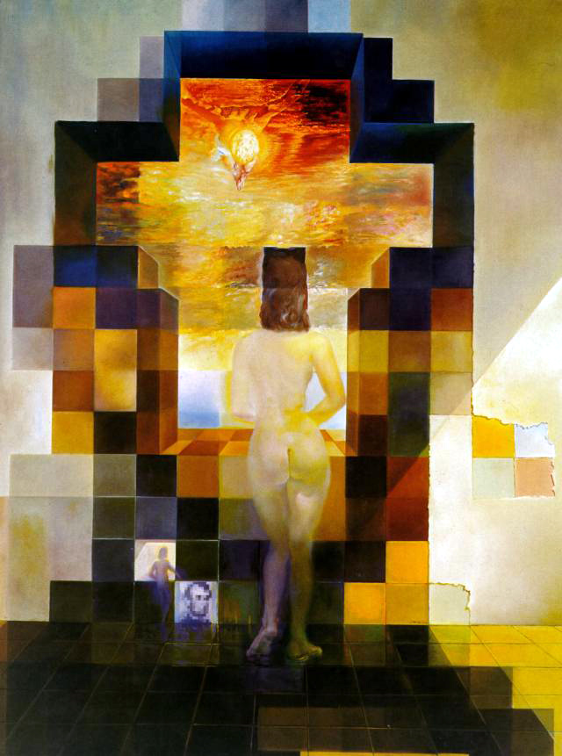
Salvador Dali, 1976

Slide 3
Next Classes
Spatial frequency
Fourier transform and frequency domain
  Frequency view of filtering
  Hybrid images
  Sampling
Reminder: Textbook
  Today’s lecture covers material in 3.4
Slide: Hoiem

Slide 4
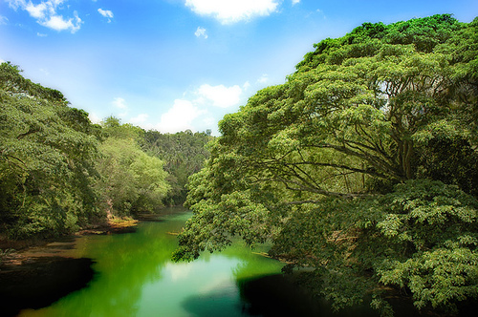
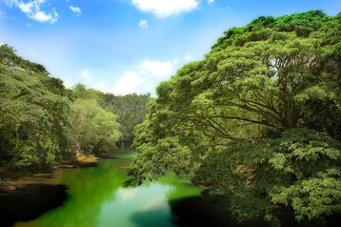
Why does a lower resolution image still make sense to us? What information do we lose?
Image: http://www.flickr.com/photos/igorms/136916757/
Slide: Hoiem

Slide 5
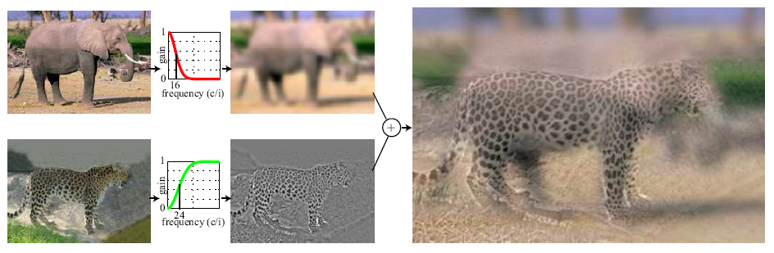
Hybrid Images
Hays
A. Oliva, A. Torralba, P.G. Schyns,
“Hybrid Images,” SIGGRAPH 2006

Slide 6
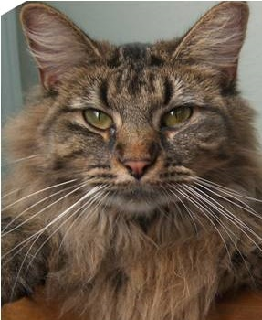
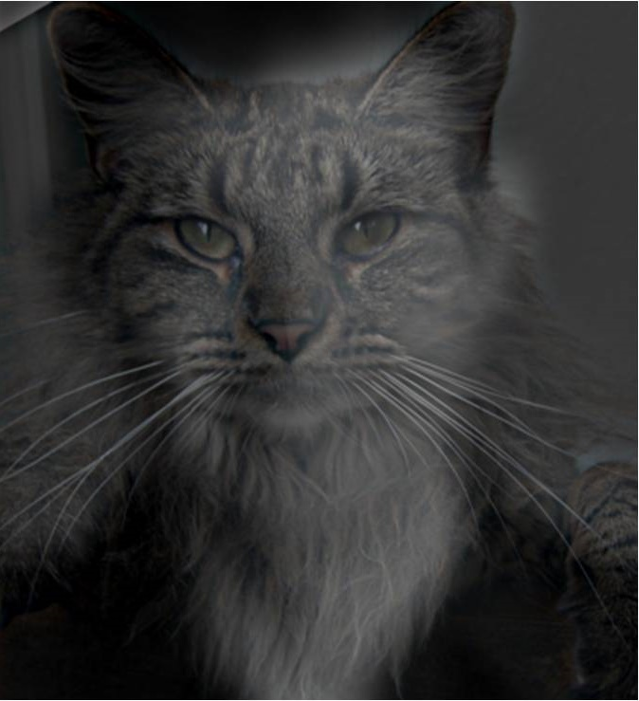
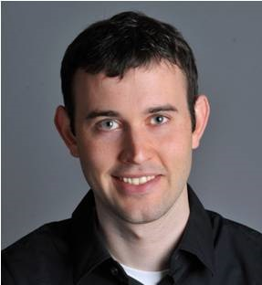
Why do we get different, distance-dependent interpretations of hybrid images?
?
Slide: Hoiem

Slide 7
How is it that a 4MP image can be compressed to a few hundred KB without a noticeable change?

Slide 8
Sampling
Why does a lower resolution image still make sense to us? What do we lose?
Image: http://www.flickr.com/photos/igorms/136916757/

Slide 9
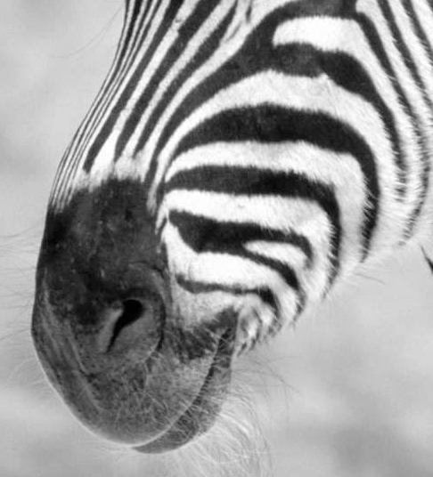
Subsampling by a factor of 2
Throw away every other row and column to create a 1/2 size image

Slide 10
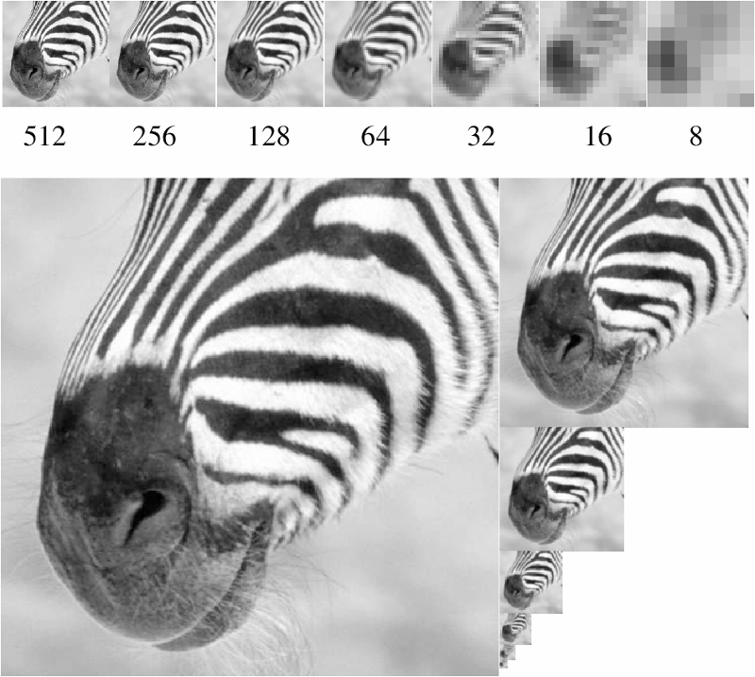
A ‘bar’ in the big images is a hair on the zebra’s nose; in smaller images, a stripe; in the smallest, the animal’s nose
Figure from David Forsyth

Slide 11
Algorithm for downsampling by factor of 2
Start with image of w x h
Sample every other pixel
  im_small = image[ ::2:, ::2 ]
Repeat until im_small is 1 pixel large.
Numpy syntax:
::2 -> start at 0, end at ‘end’, increase every 2, until the end.
e.g.,
0,2,4,6,…,w
(if w is not even, then this goes to w-1)
Hays

Slide 12
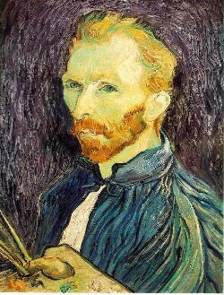
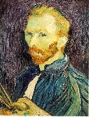

Image sub-sampling
1/8
1/4
Throw away every other row and column to create a 1/2 size image.
Steve Seitz

Slide 13

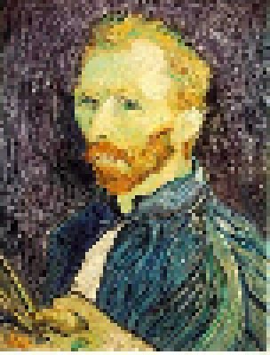
Subsampling without filtering
1/2
1/4 (2x subsample)
1/8 (4x subsample)
Steve Seitz

Slide 14
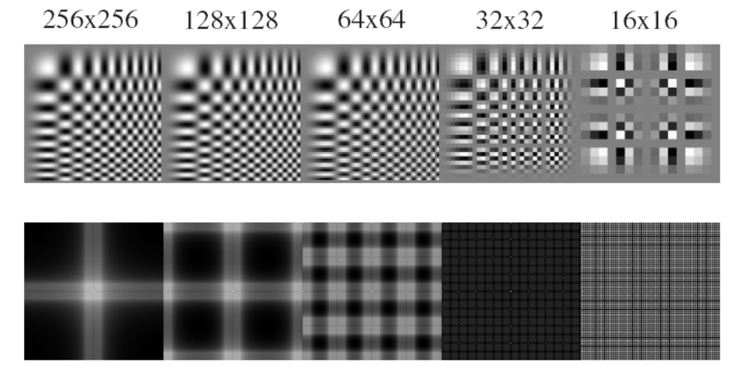
Sampling and aliasing

Slide 15
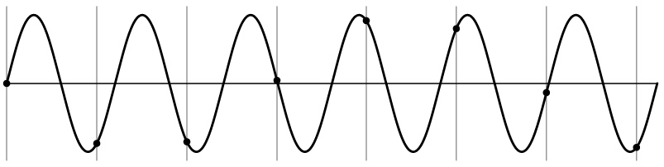
Aliasing problem
1D example (sinewave):
Source: S. Marschner

Slide 16
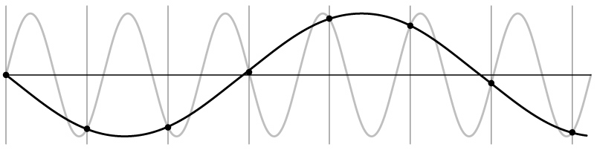
Aliasing problem
1D example (sinewave):
Source: S. Marschner

Slide 17
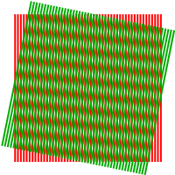
Aliasing problem
Sub-sampling may be dangerous….
Characteristic errors may appear:
  “car wheels rolling the wrong way in movies”
  “checkerboards disintegrate in ray tracing”
  “striped shirts look funny on color television”
    Moiré patterns
Source: D. Forsyth; Wikipedia

Slide 18
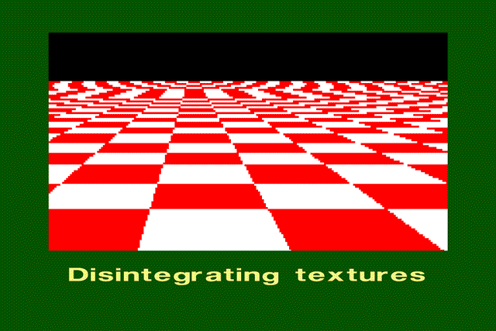
Aliasing in graphics
Source: A. Efros

Slide 19
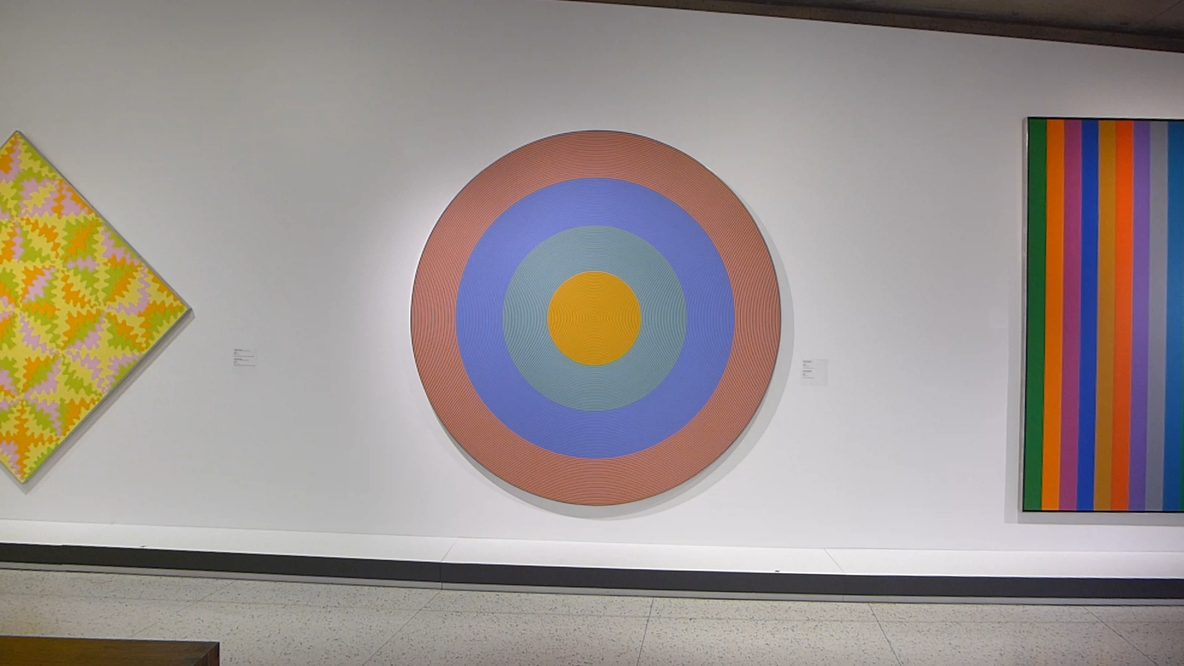
Aliasing and Moiré patterns
Gong 96, 1932, Claude Tousignant, Musée des Beaux-Arts de Montréal

Slide 20
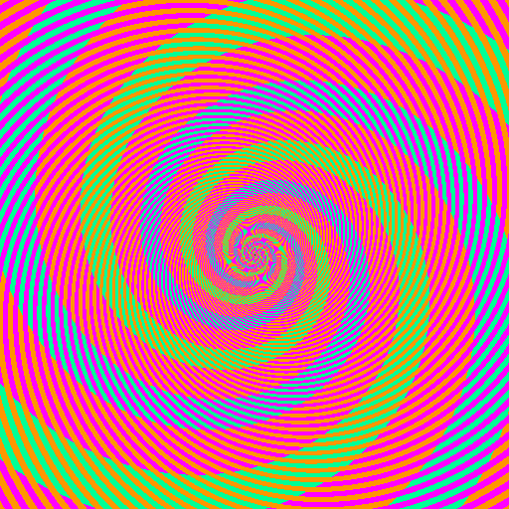

Slide 21
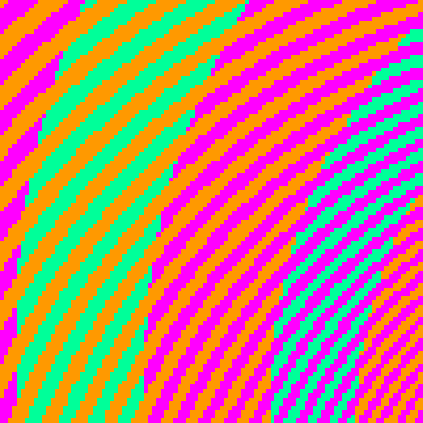
The blue and green colors are actually the same
http://blogs.discovermagazine.com/badastronomy/2009/06/24/the-blue-and-the-green/

Slide 22
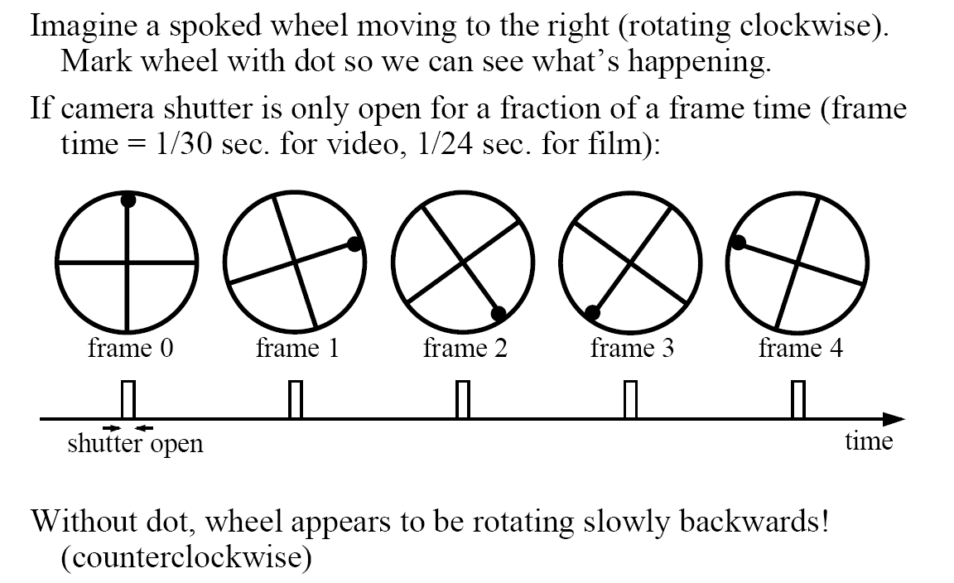
Aliasing in video
Slide by Steve Seitz

Slide 23
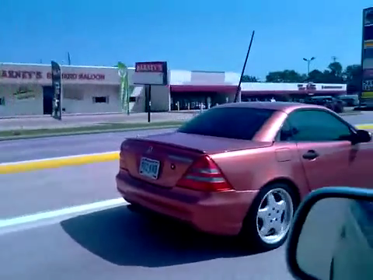
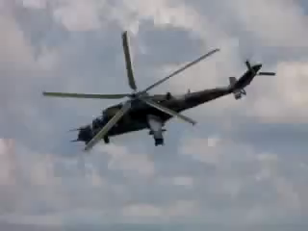
Videos
[YouTube; JoinBuzzirk; phrancque]
Notes:
https://www.youtube.com/watch?v=Y1yHMy0-4TM
https://www.youtube.com/watch?v=jQDjJRYmeWg

Slide 24
Nyquist-Shannon Sampling Theorem
When sampling a signal at discrete intervals, the sampling frequency must be ≥ 2 × f_{max}
f_{max} = max frequency of the input signal
This will allows to reconstruct the original perfectly from the sampled version
v
v
v
good
bad

Slide 25
How to fix aliasing?
Solutions?

Slide 26
Better sensors
Solutions:
Sample more often

Slide 27
Anti-aliasing
Solutions:
Sample more often
Get rid of all frequencies that are greater than half the new sampling frequency
  Will lose information
  But it’s better than aliasing
  Apply a smoothing (low pass) filter
Hays

Slide 28
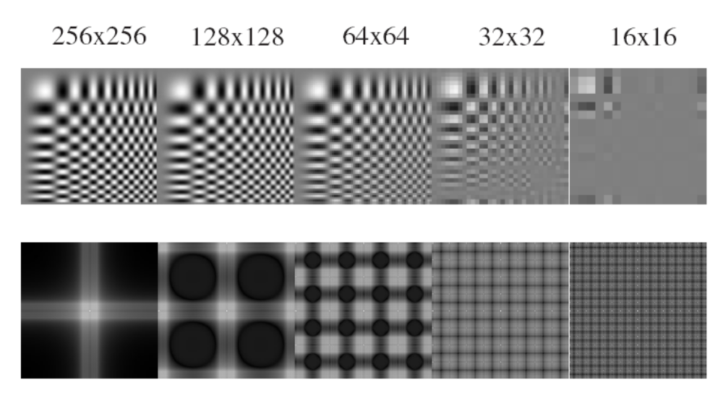
Anti-aliasing
Forsyth and Ponce 2002

Slide 29
Algorithm for downsampling by factor of 2
Start with image(h, w)
Apply low-pass filter
  im_blur = imfilter( image, fspecial(‘gaussian’, 7, 1) )
Sample every other pixel
  im_small = im_blur( 1:2:end, 1:2:end );
Hays

Slide 30
Subsampling without filtering
1/2
1/4 (2x subsample)
1/8 (4x subsample)
Steve Seitz

Slide 31



Subsampling with Gaussian pre-filtering
Gaussian 1/2
G 1/4
G 1/8
Gaussian Pyramid [Burt and Adelson, 1983]
Steve Seitz

Slide 32
Why do we get different, distance-dependent interpretations of hybrid images?
?
Hays

Slide 33
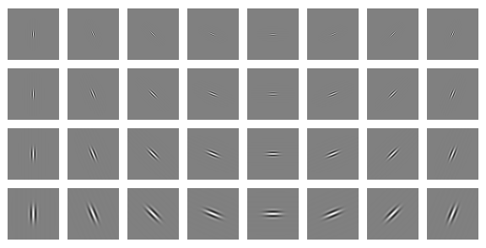
Clues from Human Perception
Early processing in humans filters for orientations and scales of frequency.
Early Visual Processing: Multi-scale edge and blob filters

Slide 34
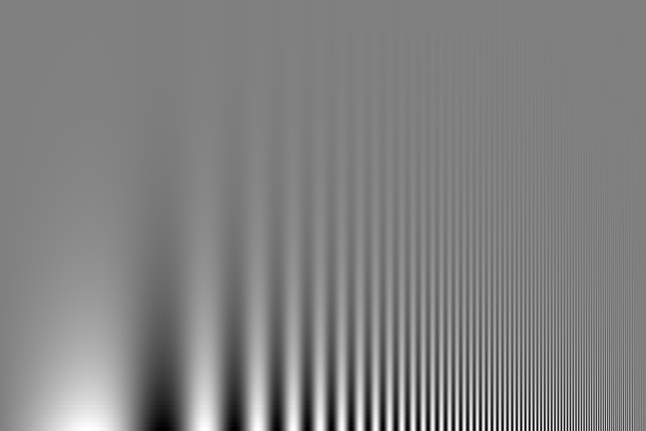
Campbell-Robson contrast sensitivity curve
Perceptual cues in the mid-high frequencies dominate perception.
Contrast decrease (log)
Frequency increase (log)
Notes:
Ask students to look at the image and think about where the line of constant response is -

Slide 35
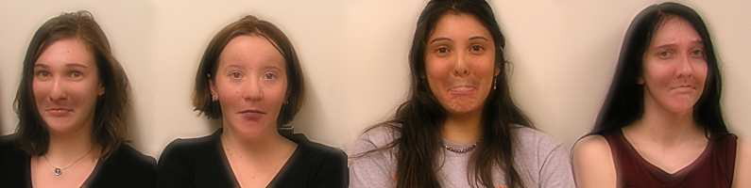

Application: Hybrid Images
When we see an image from far away, we are effectively subsampling it!
A. Oliva, A. Torralba, P.G. Schyns, SIGGRAPH 2006

Slide 36
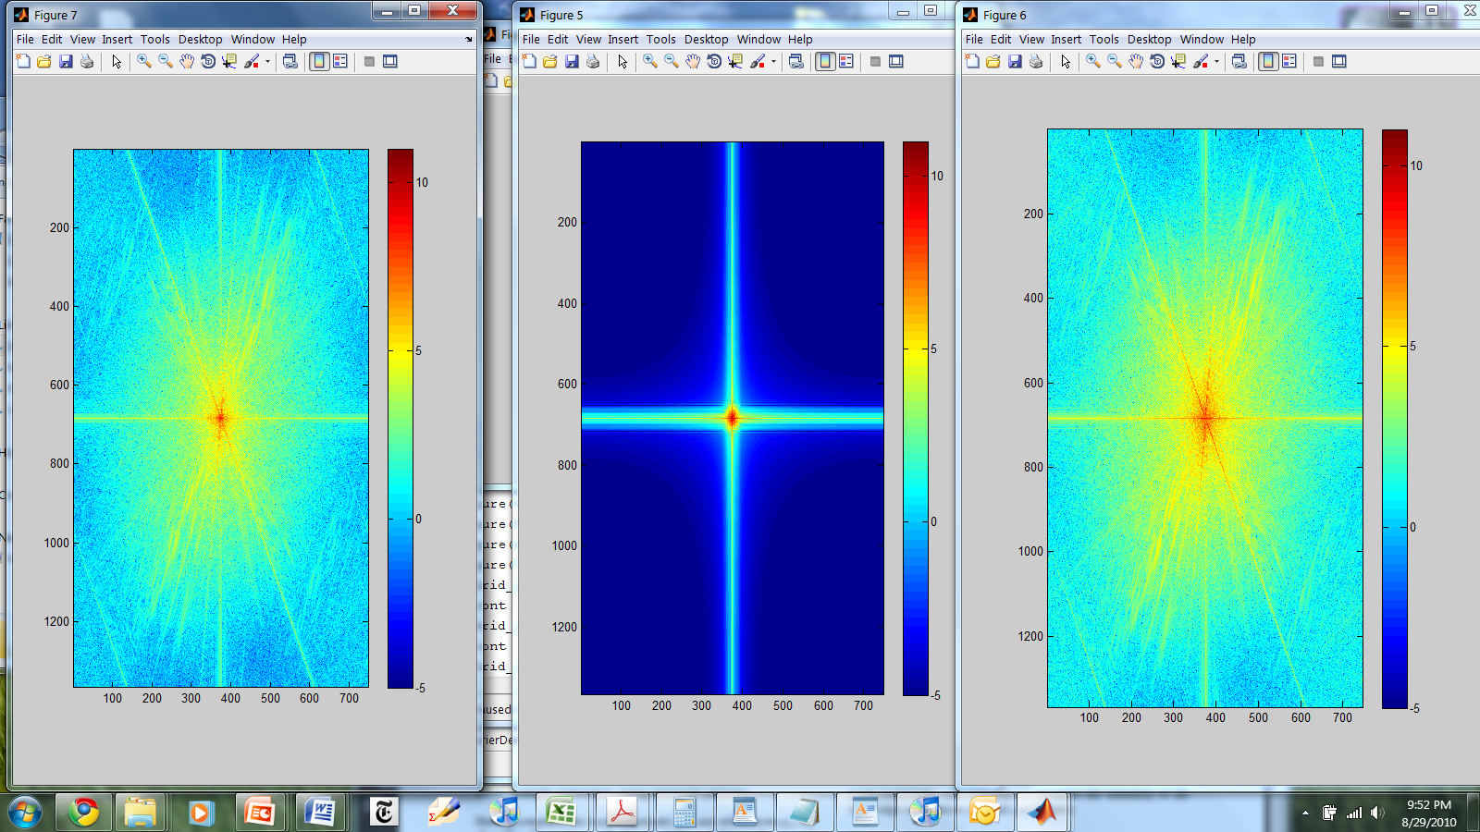
Hybrid Image in FFT
Hybrid Image
Low-passed Image
High-passed Image

Slide 37
Hays
Salvador Dali
“Gala Contemplating the Mediterranean Sea,
which at 30 meters becomes the portrait
of Abraham Lincoln”, 1976
Notes:
Gala was Dali’s wife.

Slide 38
Salvador Dali invented Hybrid Images?
Salvador Dali
“Gala Contemplating the Mediterranean Sea,
which at 30 meters becomes the portrait
of Abraham Lincoln”, 1976
Notes:
Gala was Dali’s wife.

Slide 39
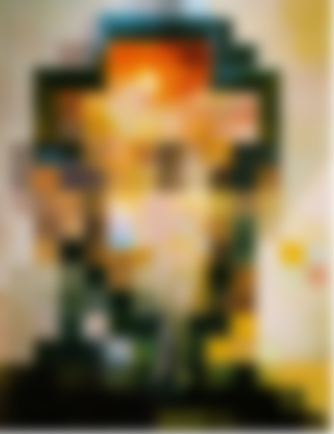

Slide 40
