Slide 1

1 February 2019
Notes:
Oh, no, wait, sorry, I meant, welcome to the implementation of 20th-century science fiction literature, or a small part of it, where we will learn about computer or machine or robot vision.

Slide 2
What Is an Image?

Slide 3
>>> from numpy import random as r
>>> I = r.rand(256,256);
Think-Pair-Share:
What is this? What does it look like?
Which values does it take?
How many values can it take?
Is it an image?

Slide 4
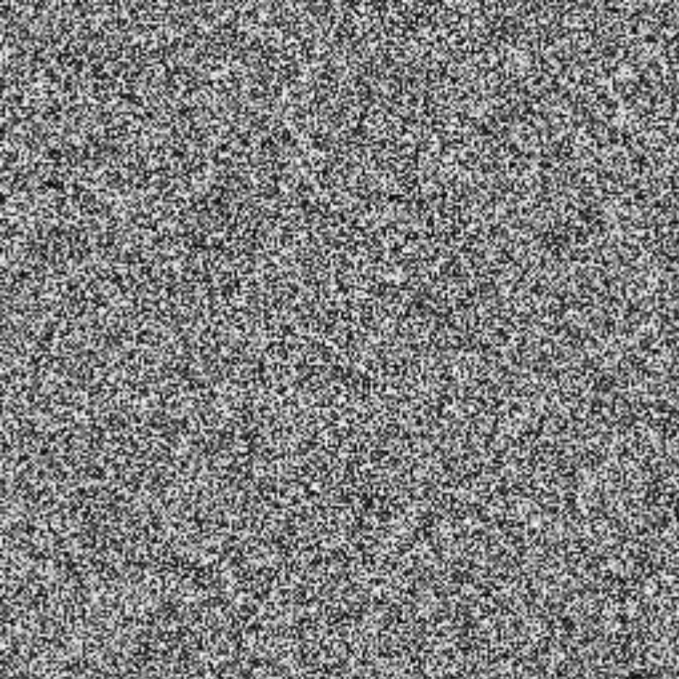
>>> from matplotlib import pyplot as p
>>> I = r.rand(256,256);
>>> p.imshow(I);
>>> p.show();
Danny Alexander

Slide 5
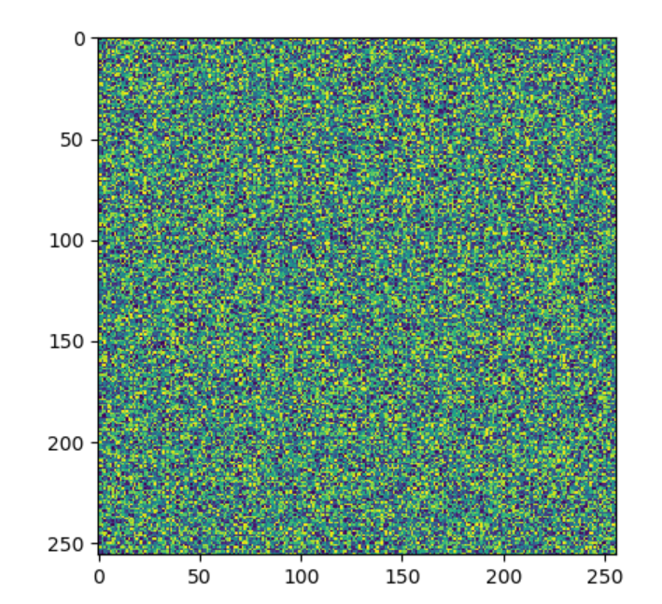
Note: matplotlib and colour maps
>>> from matplotlib import pyplot as p
>>> from numpy import random as r
>>> I = r.rand(256,256);
>>> p.imshow(I);
>>> p.show();
This code will actually
produce an image like this:
matplotlib assumes the data
is ‘scientific’ and
applies a colourmap.
[Additional info]
Notes:
Note: Here’s more info on matplotlib’s display of colormaps - https://matplotlib.org/tutorials/colors/colormaps.html

Slide 6
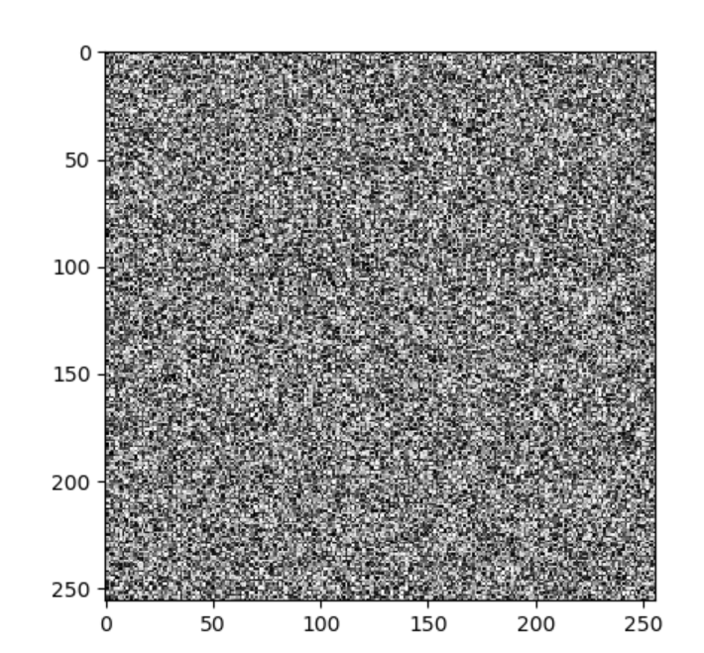
Note: matplotlib and colour maps
>>> from matplotlib import pyplot as p
>>> from numpy import random as r
>>> I = r.rand(256,256);
>>> p.imshow(I,cmap=‘gray’);
>>> p.show();
Better.
[Additional info]

Slide 7
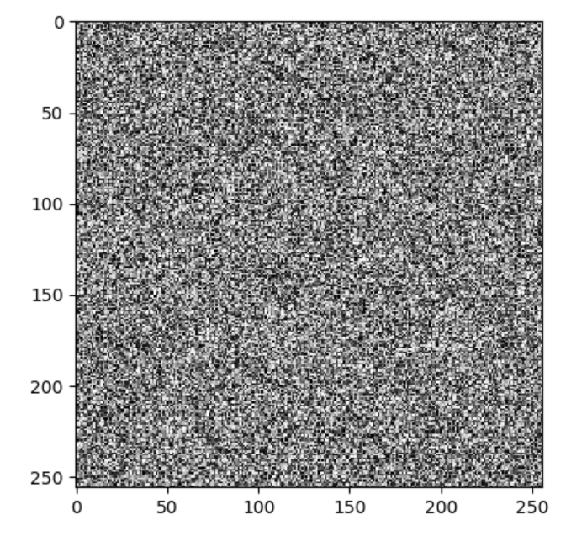
Note: matplotlib and colour maps
>>> from matplotlib import pyplot as p
>>> from numpy import random as r
>>> I = r.rand(256,256) * 0.5;
>>> p.imshow(I,cmap=‘gray’);
>>> p.show();
Next issue:
matplotlib will normalize input
e.g., map the lowest value to 0,
and the highest to 1.
Even though we multiplied by 0.5,
the overall brightness is the same.
[Additional info]

Slide 8
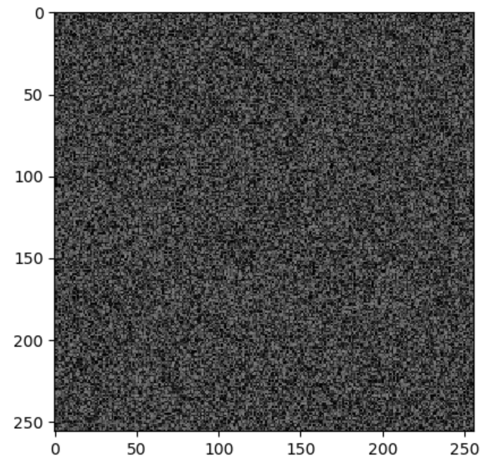
Note: matplotlib and colour maps
>>> from matplotlib import pyplot as p
>>> from numpy import random as r
>>> I = r.rand(256,256) * 0.5;
>>> p.imshow(I,cmap=‘gray’,vmin=0.0,vmax=1.0);
>>> p.show();
Better!
[Additional info]

Slide 9
Dimensionality of an Image
@ 8bit = 256 values ^ 65,536
  Computer says ‘Inf’ combinations.
Some depiction of all possible scenes
would fit into this memory.
Notes:
Zoran and Weiss: “In the context of this work, a natural image would be the result of taking an ordinary digital camera, pointing it somewhere in the world and pressing the shutter button.“

Slide 10
Dimensionality of an Image
@ 8bit = 256 values ^ 65,536
  Computer says ‘Inf’ combinations.
Some depiction of all possible scenes
would fit into this memory.
Computer vision as making sense of an extremely high-dimensional space.
  Subspace of ‘natural’ images.
  Deriving low-dimensional, explainable models.
Notes:
Zoran and Weiss: “In the context of this work, a natural image would be the result of taking an ordinary digital camera, pointing it somewhere in the world and pressing the shutter button.“

Slide 11

What is each part of an image?
y
x
Notes:
What is a pixel?

Slide 12
What is each part of an image?
Pixel -> picture element
‘138’
y
I(x,y)
x
Notes:
What is a pixel?

Slide 13
Image as a 2D sampling of signal
Signal: function depending on some variable with physical meaning.
Image: sampling of that function.
  2 variables: xy coordinates
  3 variables: xy + time (video)
  ‘Brightness’ is the value of the function for visible light
Can be other physical values too: temperature, pressure, depth …
Danny Alexander
Notes:
Danny Alexander, UCL

Slide 14
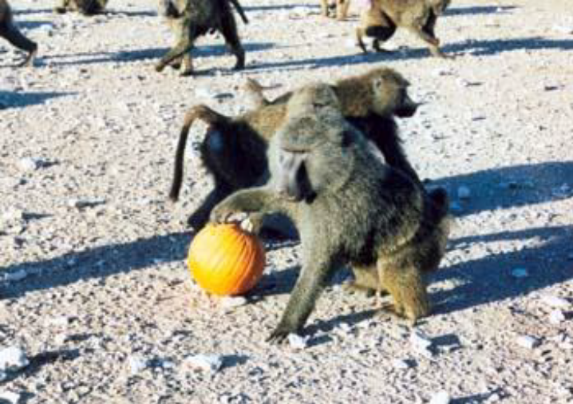
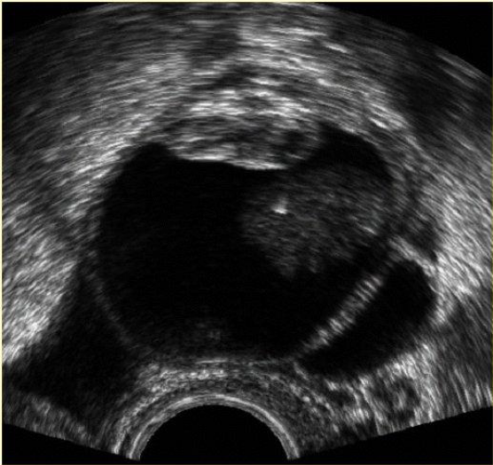
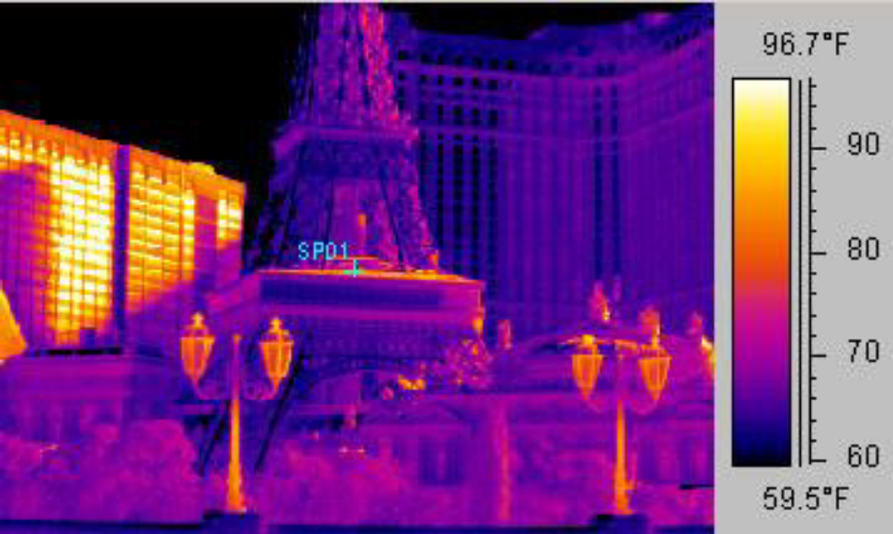
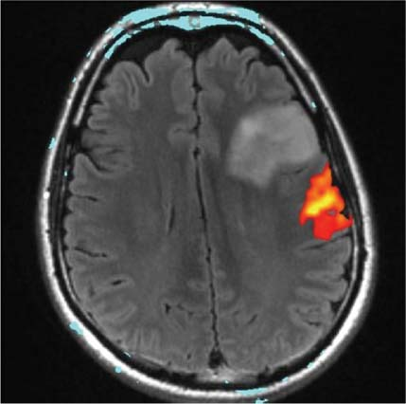
Example 2D Images
Danny Alexander
Notes:
fMRI - changes in blood flow in the brain associated with neural activity
http://radiologykey.com/wp-content/uploads/2016/01/9781604063325_c014_f004.jpg

Slide 15
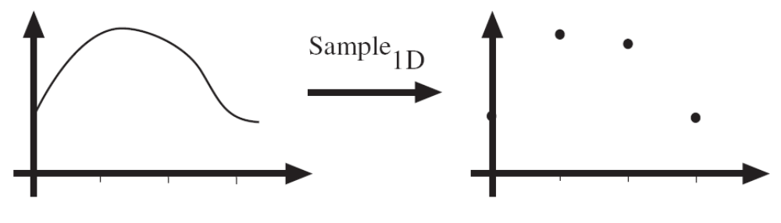
Sampling in 1D
Sampling in 1D takes a function, and returns a vector whose elements are values of that function at the sample points.
Danny Alexander

Slide 16
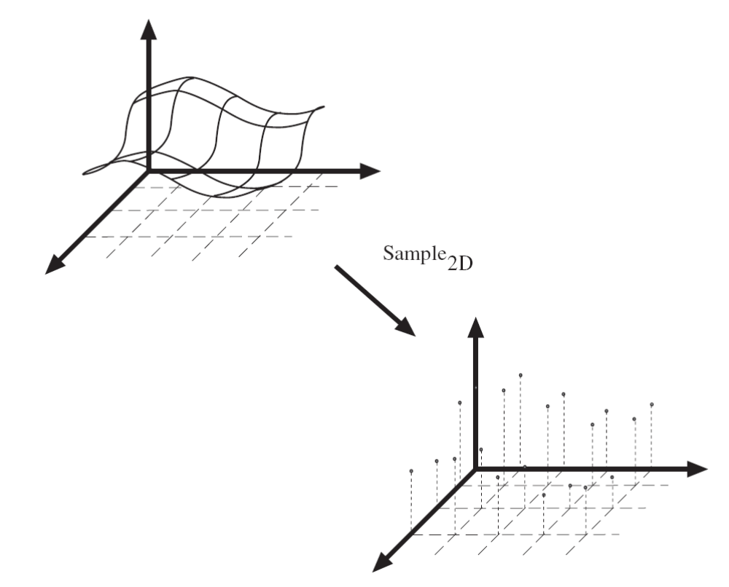
Sampling in 2D
Sampling in 2D takes a function and returns a matrix.
Danny Alexander

Slide 17
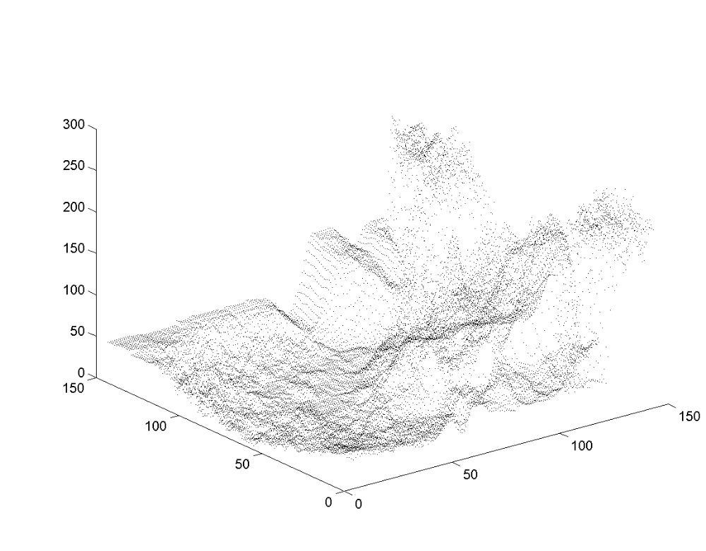
Grayscale Digital Image
Brightness
or intensity
x
y
Danny Alexander

Slide 18
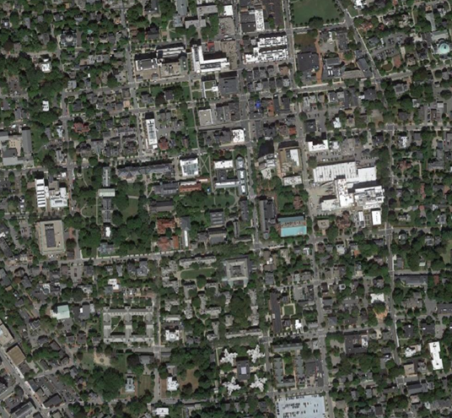
What is each part of a photograph?
Pixel -> picture element
‘127’
y
I(x,y)
x
Notes:
What is a pixel?

Slide 19
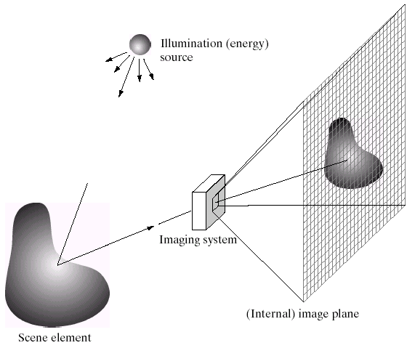
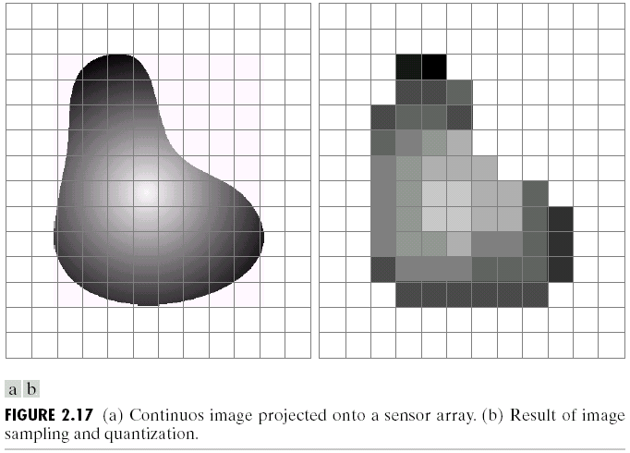
Integrating light over a range of angles.
Output Image
Camera Sensor
James Hays

Slide 20
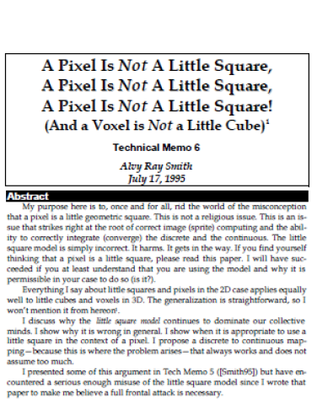
“A Pixel Is Not A Little Square,
A Pixel Is Not A Little Square,
A Pixel Is Not A Little Square!
(And a Voxel is Not a Little Cube)”
Alvy Ray Smith,
MS Tech Memo 6, 1995.
[Additional info]
Notes:
Perhaps a pixel is not a little square?

Slide 21

Resolution – geometric vs. spatial resolution
Both images are ~500x500 pixels
Notes:
What kinds of issues might cause this?
Difference between geometric resolution and spatial resolution.

Slide 22
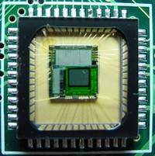
Sensor Array
CMOS sensor
[Additional info]
James Hays

Slide 23
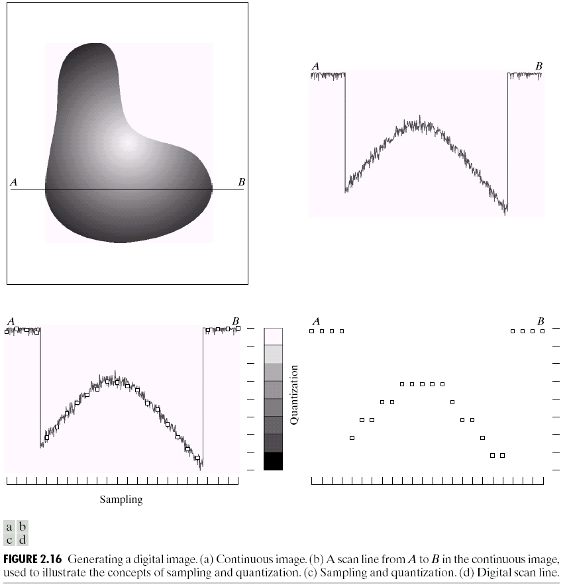
Quantization
Notes:
Real valued function will get digital values – integer values
• Quantization is lossy!!
– After quantization, the original signal cannot be reconstructed anymore
• This is in contrast to sampling, as a sampled but not quantized signal can be reconstructed.
• Simple quantization uses equally spaced levels with k intervals
Figure 2.16 from Szeliski textbook.

Slide 24

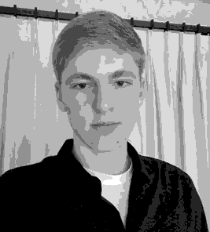

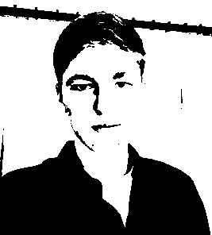
Quantization Effects – Radiometric Resolution
8 bit – 256 levels
4 bit – 16 levels
2 bit – 4 levels
1 bit – 2 levels

Slide 25
Images in Python Numpy
N x M grayscale image “im”
  im[0,0] = top-left pixel value
  im[y, x] = y pixels down, x pixels to right
  im[N-1, M-1] = bottom-right pixel
Column
Row
0.92 | 0.93 | 0.94 | 0.97 | 0.62 | 0.37 | 0.85 | 0.97 | 0.93 | 0.92 | 0.99
0.95 | 0.89 | 0.82 | 0.89 | 0.56 | 0.31 | 0.75 | 0.92 | 0.81 | 0.95 | 0.91
0.89 | 0.72 | 0.51 | 0.55 | 0.51 | 0.42 | 0.57 | 0.41 | 0.49 | 0.91 | 0.92
0.96 | 0.95 | 0.88 | 0.94 | 0.56 | 0.46 | 0.91 | 0.87 | 0.90 | 0.97 | 0.95
0.71 | 0.81 | 0.81 | 0.87 | 0.57 | 0.37 | 0.80 | 0.88 | 0.89 | 0.79 | 0.85
0.49 | 0.62 | 0.60 | 0.58 | 0.50 | 0.60 | 0.58 | 0.50 | 0.61 | 0.45 | 0.33
0.86 | 0.84 | 0.74 | 0.58 | 0.51 | 0.39 | 0.73 | 0.92 | 0.91 | 0.49 | 0.74
0.96 | 0.67 | 0.54 | 0.85 | 0.48 | 0.37 | 0.88 | 0.90 | 0.94 | 0.82 | 0.93
0.69 | 0.49 | 0.56 | 0.66 | 0.43 | 0.42 | 0.77 | 0.73 | 0.71 | 0.90 | 0.99
0.79 | 0.73 | 0.90 | 0.67 | 0.33 | 0.61 | 0.69 | 0.79 | 0.73 | 0.93 | 0.97
0.91 | 0.94 | 0.89 | 0.49 | 0.41 | 0.78 | 0.78 | 0.77 | 0.89 | 0.99 | 0.93
James Hays

Slide 26
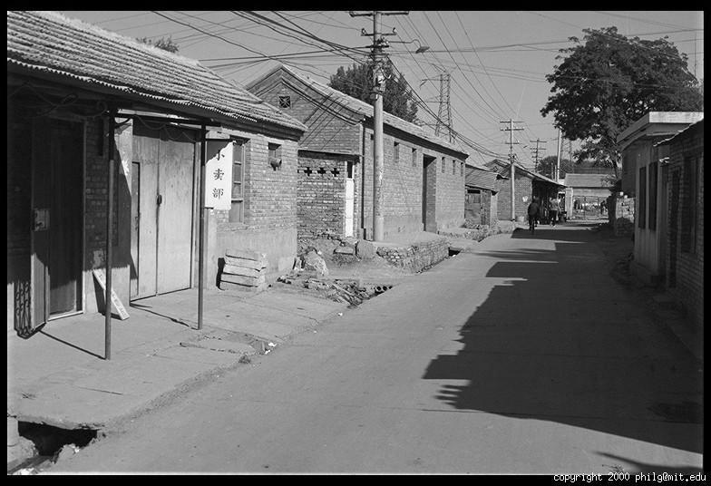
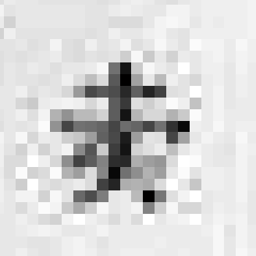
Grayscale intensity
0.92 | 0.93 | 0.94 | 0.97 | 0.62 | 0.37 | 0.85 | 0.97 | 0.93 | 0.92 | 0.99
0.95 | 0.89 | 0.82 | 0.89 | 0.56 | 0.31 | 0.75 | 0.92 | 0.81 | 0.95 | 0.91
0.89 | 0.72 | 0.51 | 0.55 | 0.51 | 0.42 | 0.57 | 0.41 | 0.49 | 0.91 | 0.92
0.96 | 0.95 | 0.88 | 0.94 | 0.56 | 0.46 | 0.91 | 0.87 | 0.90 | 0.97 | 0.95
0.71 | 0.81 | 0.81 | 0.87 | 0.57 | 0.37 | 0.80 | 0.88 | 0.89 | 0.79 | 0.85
0.49 | 0.62 | 0.60 | 0.58 | 0.50 | 0.60 | 0.58 | 0.50 | 0.61 | 0.45 | 0.33
0.86 | 0.84 | 0.74 | 0.58 | 0.51 | 0.39 | 0.73 | 0.92 | 0.91 | 0.49 | 0.74
0.96 | 0.67 | 0.54 | 0.85 | 0.48 | 0.37 | 0.88 | 0.90 | 0.94 | 0.82 | 0.93
0.69 | 0.49 | 0.56 | 0.66 | 0.43 | 0.42 | 0.77 | 0.73 | 0.71 | 0.90 | 0.99
0.79 | 0.73 | 0.90 | 0.67 | 0.33 | 0.61 | 0.69 | 0.79 | 0.73 | 0.93 | 0.97
0.91 | 0.94 | 0.89 | 0.49 | 0.41 | 0.78 | 0.78 | 0.77 | 0.89 | 0.99 | 0.93

Slide 27
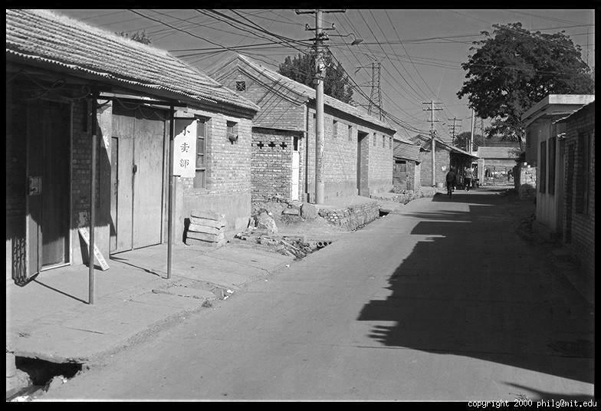
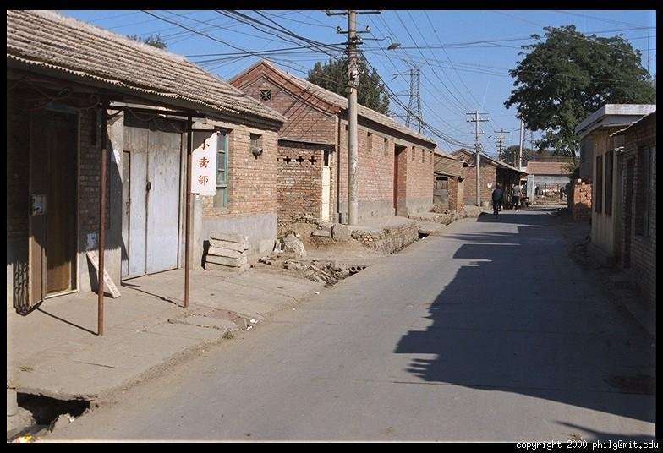
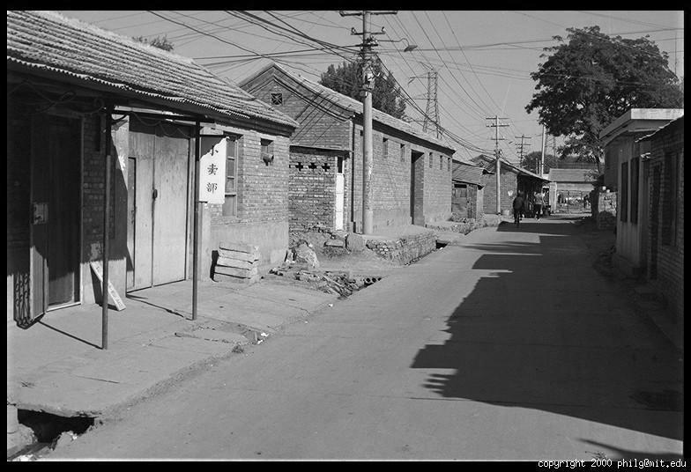
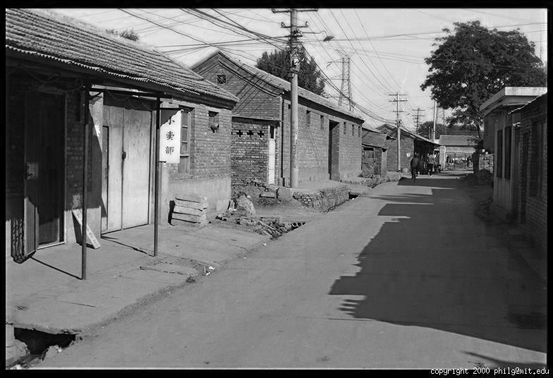
Color
R
G
B
James Hays

Slide 28
Images in Python Numpy
N x M RGB image “im”
  im[0,0,0] = top-left pixel value in R-channel
  Im[x, y, b] = x pixels to right, y pixels down in the b^{th} channel
  Im[N-1, M-1, 3] = bottom-right pixel in B-channel
Column
Row
R
0.92 | 0.93 | 0.94 | 0.97 | 0.62 | 0.37 | 0.85 | 0.97 | 0.93 | 0.92 | 0.99
0.95 | 0.89 | 0.82 | 0.89 | 0.56 | 0.31 | 0.75 | 0.92 | 0.81 | 0.95 | 0.91
0.89 | 0.72 | 0.51 | 0.55 | 0.51 | 0.42 | 0.57 | 0.41 | 0.49 | 0.91 | 0.92
0.96 | 0.95 | 0.88 | 0.94 | 0.56 | 0.46 | 0.91 | 0.87 | 0.90 | 0.97 | 0.95
0.71 | 0.81 | 0.81 | 0.87 | 0.57 | 0.37 | 0.80 | 0.88 | 0.89 | 0.79 | 0.85
0.49 | 0.62 | 0.60 | 0.58 | 0.50 | 0.60 | 0.58 | 0.50 | 0.61 | 0.45 | 0.33
0.86 | 0.84 | 0.74 | 0.58 | 0.51 | 0.39 | 0.73 | 0.92 | 0.91 | 0.49 | 0.74
0.96 | 0.67 | 0.54 | 0.85 | 0.48 | 0.37 | 0.88 | 0.90 | 0.94 | 0.82 | 0.93
0.69 | 0.49 | 0.56 | 0.66 | 0.43 | 0.42 | 0.77 | 0.73 | 0.71 | 0.90 | 0.99
0.79 | 0.73 | 0.90 | 0.67 | 0.33 | 0.61 | 0.69 | 0.79 | 0.73 | 0.93 | 0.97
0.91 | 0.94 | 0.89 | 0.49 | 0.41 | 0.78 | 0.78 | 0.77 | 0.89 | 0.99 | 0.93
G
0.92 | 0.93 | 0.94 | 0.97 | 0.62 | 0.37 | 0.85 | 0.97 | 0.93 | 0.92 | 0.99
0.95 | 0.89 | 0.82 | 0.89 | 0.56 | 0.31 | 0.75 | 0.92 | 0.81 | 0.95 | 0.91
0.89 | 0.72 | 0.51 | 0.55 | 0.51 | 0.42 | 0.57 | 0.41 | 0.49 | 0.91 | 0.92
0.96 | 0.95 | 0.88 | 0.94 | 0.56 | 0.46 | 0.91 | 0.87 | 0.90 | 0.97 | 0.95
0.71 | 0.81 | 0.81 | 0.87 | 0.57 | 0.37 | 0.80 | 0.88 | 0.89 | 0.79 | 0.85
0.49 | 0.62 | 0.60 | 0.58 | 0.50 | 0.60 | 0.58 | 0.50 | 0.61 | 0.45 | 0.33
0.86 | 0.84 | 0.74 | 0.58 | 0.51 | 0.39 | 0.73 | 0.92 | 0.91 | 0.49 | 0.74
0.96 | 0.67 | 0.54 | 0.85 | 0.48 | 0.37 | 0.88 | 0.90 | 0.94 | 0.82 | 0.93
0.69 | 0.49 | 0.56 | 0.66 | 0.43 | 0.42 | 0.77 | 0.73 | 0.71 | 0.90 | 0.99
0.79 | 0.73 | 0.90 | 0.67 | 0.33 | 0.61 | 0.69 | 0.79 | 0.73 | 0.93 | 0.97
0.91 | 0.94 | 0.89 | 0.49 | 0.41 | 0.78 | 0.78 | 0.77 | 0.89 | 0.99 | 0.93
B
0.92 | 0.93 | 0.94 | 0.97 | 0.62 | 0.37 | 0.85 | 0.97 | 0.93 | 0.92 | 0.99
0.95 | 0.89 | 0.82 | 0.89 | 0.56 | 0.31 | 0.75 | 0.92 | 0.81 | 0.95 | 0.91
0.89 | 0.72 | 0.51 | 0.55 | 0.51 | 0.42 | 0.57 | 0.41 | 0.49 | 0.91 | 0.92
0.96 | 0.95 | 0.88 | 0.94 | 0.56 | 0.46 | 0.91 | 0.87 | 0.90 | 0.97 | 0.95
0.71 | 0.81 | 0.81 | 0.87 | 0.57 | 0.37 | 0.80 | 0.88 | 0.89 | 0.79 | 0.85
0.49 | 0.62 | 0.60 | 0.58 | 0.50 | 0.60 | 0.58 | 0.50 | 0.61 | 0.45 | 0.33
0.86 | 0.84 | 0.74 | 0.58 | 0.51 | 0.39 | 0.73 | 0.92 | 0.91 | 0.49 | 0.74
0.96 | 0.67 | 0.54 | 0.85 | 0.48 | 0.37 | 0.88 | 0.90 | 0.94 | 0.82 | 0.93
0.69 | 0.49 | 0.56 | 0.66 | 0.43 | 0.42 | 0.77 | 0.73 | 0.71 | 0.90 | 0.99
0.79 | 0.73 | 0.90 | 0.67 | 0.33 | 0.61 | 0.69 | 0.79 | 0.73 | 0.93 | 0.97
0.91 | 0.94 | 0.89 | 0.49 | 0.41 | 0.78 | 0.78 | 0.77 | 0.89 | 0.99 | 0.93
James Hays

Slide 29
Images in Python Numpy
Take care between types!
- uint8 (values 0 to 255) – io.imread(“file.jpg”)
- float32 (values 0 to 255) – io.imread(“file.jpg”).astype(np.float32)
- float32 (values 0 to 1) – img_as_float32(io.imread(“file.jpg”))
Column
Row
0.92 | 0.93 | 0.94 | 0.97 | 0.62 | 0.37 | 0.85 | 0.97 | 0.93 | 0.92 | 0.99
0.95 | 0.89 | 0.82 | 0.89 | 0.56 | 0.31 | 0.75 | 0.92 | 0.81 | 0.95 | 0.91
0.89 | 0.72 | 0.51 | 0.55 | 0.51 | 0.42 | 0.57 | 0.41 | 0.49 | 0.91 | 0.92
0.96 | 0.95 | 0.88 | 0.94 | 0.56 | 0.46 | 0.91 | 0.87 | 0.90 | 0.97 | 0.95
0.71 | 0.81 | 0.81 | 0.87 | 0.57 | 0.37 | 0.80 | 0.88 | 0.89 | 0.79 | 0.85
0.49 | 0.62 | 0.60 | 0.58 | 0.50 | 0.60 | 0.58 | 0.50 | 0.61 | 0.45 | 0.33
0.86 | 0.84 | 0.74 | 0.58 | 0.51 | 0.39 | 0.73 | 0.92 | 0.91 | 0.49 | 0.74
0.96 | 0.67 | 0.54 | 0.85 | 0.48 | 0.37 | 0.88 | 0.90 | 0.94 | 0.82 | 0.93
0.69 | 0.49 | 0.56 | 0.66 | 0.43 | 0.42 | 0.77 | 0.73 | 0.71 | 0.90 | 0.99
0.79 | 0.73 | 0.90 | 0.67 | 0.33 | 0.61 | 0.69 | 0.79 | 0.73 | 0.93 | 0.97
0.91 | 0.94 | 0.89 | 0.49 | 0.41 | 0.78 | 0.78 | 0.77 | 0.89 | 0.99 | 0.93
James Hays

Slide 30
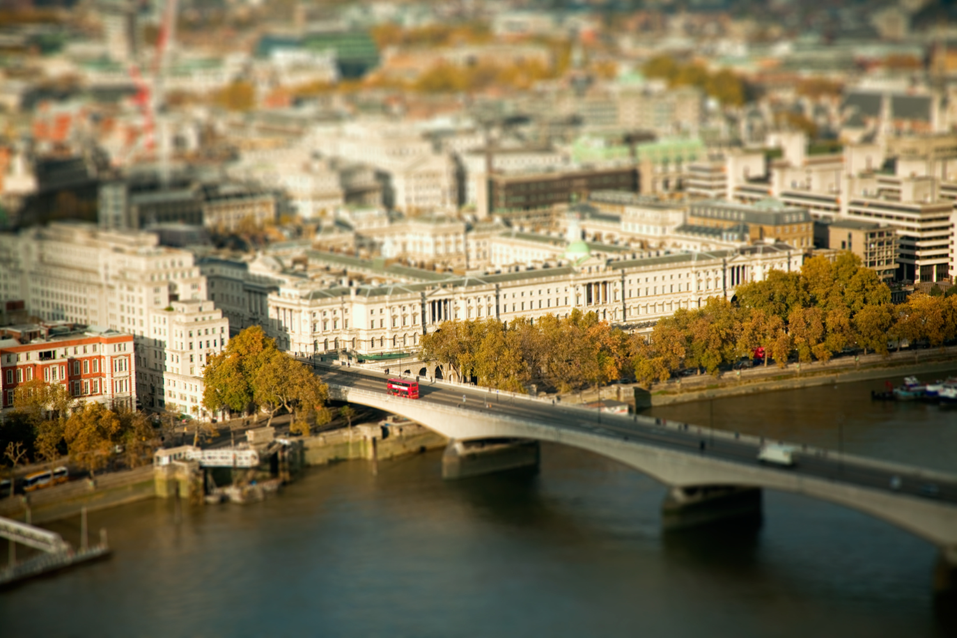
Ben Thomas
Notes:
http://benthomas.net.au/cityshrinker/eilz24txaul9s1hx5prqr0ta5y8nvl

Slide 31
Image filtering

Slide 32
This week: three views of filtering
Image filters in spatial domain
  Filter is a mathematical operation of a grid of numbers
  Smoothing, sharpening, measuring texture
Image filters in the frequency domain
  Filtering is a way to modify the frequencies of images
  Denoising, sampling, image compression
Image pyramids
  Scale-space representation allows coarse-to-fine operations
James Hays

Slide 33
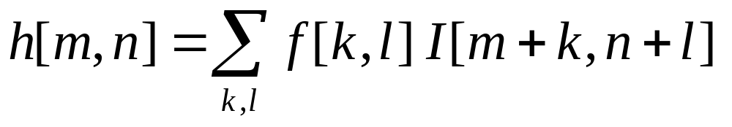
Image filtering
Image filtering:
  Compute function of local neighborhood at each position
James Hays

Slide 34
Image filtering
Image filtering:
  Compute function of local neighborhood at each position
h=output
f=filter
I=image
2d coords=k,l
2d coords=m,n
[ ]
[ ]
[ ]

Slide 35
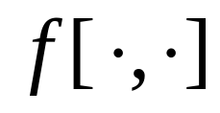

Example: box filter
1
1
1
1
1
1
1
1
1
Slide credit: David Lowe (UBC)

Slide 36
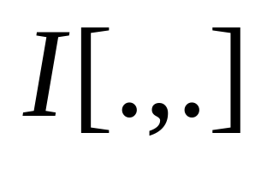
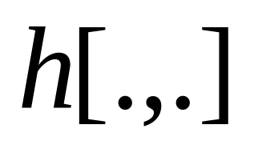
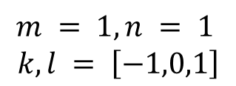
Image filtering
1
1
1
1
1
1
1
1
1
0 | 0 | 0 | 0 | 0 | 0 | 0 | 0 | 0 | 0
0 | 0 | 0 | 0 | 0 | 0 | 0 | 0 | 0 | 0
0 | 0 | 0 | 90 | 90 | 90 | 90 | 90 | 0 | 0
0 | 0 | 0 | 90 | 90 | 90 | 90 | 90 | 0 | 0
0 | 0 | 0 | 90 | 90 | 90 | 90 | 90 | 0 | 0
0 | 0 | 0 | 90 | 0 | 90 | 90 | 90 | 0 | 0
0 | 0 | 0 | 90 | 90 | 90 | 90 | 90 | 0 | 0
0 | 0 | 0 | 0 | 0 | 0 | 0 | 0 | 0 | 0
0 | 0 | 90 | 0 | 0 | 0 | 0 | 0 | 0 | 0
0 | 0 | 0 | 0 | 0 | 0 | 0 | 0 | 0 | 0
 | 0
0 | 0 | 0 | 0 | 0 | 0 | 0 | 0 | 0 | 0
0 | 0 | 0 | 0 | 0 | 0 | 0 | 0 | 0 | 0
0 | 0 | 0 | 90 | 90 | 90 | 90 | 90 | 0 | 0
0 | 0 | 0 | 90 | 90 | 90 | 90 | 90 | 0 | 0
0 | 0 | 0 | 90 | 90 | 90 | 90 | 90 | 0 | 0
0 | 0 | 0 | 90 | 0 | 90 | 90 | 90 | 0 | 0
0 | 0 | 0 | 90 | 90 | 90 | 90 | 90 | 0 | 0
0 | 0 | 0 | 0 | 0 | 0 | 0 | 0 | 0 | 0
0 | 0 | 90 | 0 | 0 | 0 | 0 | 0 | 0 | 0
0 | 0 | 0 | 0 | 0 | 0 | 0 | 0 | 0 | 0
$$m = 1, n = 1$$
$$k,l = \left[−1,0,1\right]$$
Credit: S. Seitz
Notes:
ones, divide by 9

Slide 37
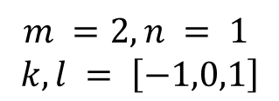
Image filtering
1
1
1
1
1
1
1
1
1
0 | 0 | 0 | 0 | 0 | 0 | 0 | 0 | 0 | 0
0 | 0 | 0 | 0 | 0 | 0 | 0 | 0 | 0 | 0
0 | 0 | 0 | 90 | 90 | 90 | 90 | 90 | 0 | 0
0 | 0 | 0 | 90 | 90 | 90 | 90 | 90 | 0 | 0
0 | 0 | 0 | 90 | 90 | 90 | 90 | 90 | 0 | 0
0 | 0 | 0 | 90 | 0 | 90 | 90 | 90 | 0 | 0
0 | 0 | 0 | 90 | 90 | 90 | 90 | 90 | 0 | 0
0 | 0 | 0 | 0 | 0 | 0 | 0 | 0 | 0 | 0
0 | 0 | 90 | 0 | 0 | 0 | 0 | 0 | 0 | 0
0 | 0 | 0 | 0 | 0 | 0 | 0 | 0 | 0 | 0
 | 0 | 10
0 | 0 | 0 | 0 | 0 | 0 | 0 | 0 | 0 | 0
0 | 0 | 0 | 0 | 0 | 0 | 0 | 0 | 0 | 0
0 | 0 | 0 | 90 | 90 | 90 | 90 | 90 | 0 | 0
0 | 0 | 0 | 90 | 90 | 90 | 90 | 90 | 0 | 0
0 | 0 | 0 | 90 | 90 | 90 | 90 | 90 | 0 | 0
0 | 0 | 0 | 90 | 0 | 90 | 90 | 90 | 0 | 0
0 | 0 | 0 | 90 | 90 | 90 | 90 | 90 | 0 | 0
0 | 0 | 0 | 0 | 0 | 0 | 0 | 0 | 0 | 0
0 | 0 | 90 | 0 | 0 | 0 | 0 | 0 | 0 | 0
0 | 0 | 0 | 0 | 0 | 0 | 0 | 0 | 0 | 0
$$m =2, n = 1$$
$$k,l = \left[−1,0,1\right]$$
Credit: S. Seitz
Notes:
ones, divide by 9

Slide 38
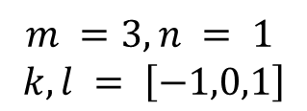
Image filtering
1
1
1
1
1
1
1
1
1
0 | 0 | 0 | 0 | 0 | 0 | 0 | 0 | 0 | 0
0 | 0 | 0 | 0 | 0 | 0 | 0 | 0 | 0 | 0
0 | 0 | 0 | 90 | 90 | 90 | 90 | 90 | 0 | 0
0 | 0 | 0 | 90 | 90 | 90 | 90 | 90 | 0 | 0
0 | 0 | 0 | 90 | 90 | 90 | 90 | 90 | 0 | 0
0 | 0 | 0 | 90 | 0 | 90 | 90 | 90 | 0 | 0
0 | 0 | 0 | 90 | 90 | 90 | 90 | 90 | 0 | 0
0 | 0 | 0 | 0 | 0 | 0 | 0 | 0 | 0 | 0
0 | 0 | 90 | 0 | 0 | 0 | 0 | 0 | 0 | 0
0 | 0 | 0 | 0 | 0 | 0 | 0 | 0 | 0 | 0
 | 0 | 10 | 20
0 | 0 | 0 | 0 | 0 | 0 | 0 | 0 | 0 | 0
0 | 0 | 0 | 0 | 0 | 0 | 0 | 0 | 0 | 0
0 | 0 | 0 | 90 | 90 | 90 | 90 | 90 | 0 | 0
0 | 0 | 0 | 90 | 90 | 90 | 90 | 90 | 0 | 0
0 | 0 | 0 | 90 | 90 | 90 | 90 | 90 | 0 | 0
0 | 0 | 0 | 90 | 0 | 90 | 90 | 90 | 0 | 0
0 | 0 | 0 | 90 | 90 | 90 | 90 | 90 | 0 | 0
0 | 0 | 0 | 0 | 0 | 0 | 0 | 0 | 0 | 0
0 | 0 | 90 | 0 | 0 | 0 | 0 | 0 | 0 | 0
0 | 0 | 0 | 0 | 0 | 0 | 0 | 0 | 0 | 0
$$m =3, n = 1$$
$$k,l = \left[−1,0,1\right]$$
Credit: S. Seitz
Notes:
ones, divide by 9

Slide 39
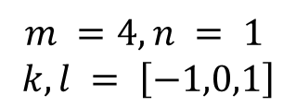
Image filtering
1
1
1
1
1
1
1
1
1
0 | 0 | 0 | 0 | 0 | 0 | 0 | 0 | 0 | 0
0 | 0 | 0 | 0 | 0 | 0 | 0 | 0 | 0 | 0
0 | 0 | 0 | 90 | 90 | 90 | 90 | 90 | 0 | 0
0 | 0 | 0 | 90 | 90 | 90 | 90 | 90 | 0 | 0
0 | 0 | 0 | 90 | 90 | 90 | 90 | 90 | 0 | 0
0 | 0 | 0 | 90 | 0 | 90 | 90 | 90 | 0 | 0
0 | 0 | 0 | 90 | 90 | 90 | 90 | 90 | 0 | 0
0 | 0 | 0 | 0 | 0 | 0 | 0 | 0 | 0 | 0
0 | 0 | 90 | 0 | 0 | 0 | 0 | 0 | 0 | 0
0 | 0 | 0 | 0 | 0 | 0 | 0 | 0 | 0 | 0
 | 0 | 10 | 20 | 30
0 | 0 | 0 | 0 | 0 | 0 | 0 | 0 | 0 | 0
0 | 0 | 0 | 0 | 0 | 0 | 0 | 0 | 0 | 0
0 | 0 | 0 | 90 | 90 | 90 | 90 | 90 | 0 | 0
0 | 0 | 0 | 90 | 90 | 90 | 90 | 90 | 0 | 0
0 | 0 | 0 | 90 | 90 | 90 | 90 | 90 | 0 | 0
0 | 0 | 0 | 90 | 0 | 90 | 90 | 90 | 0 | 0
0 | 0 | 0 | 90 | 90 | 90 | 90 | 90 | 0 | 0
0 | 0 | 0 | 0 | 0 | 0 | 0 | 0 | 0 | 0
0 | 0 | 90 | 0 | 0 | 0 | 0 | 0 | 0 | 0
0 | 0 | 0 | 0 | 0 | 0 | 0 | 0 | 0 | 0
$$m =4, n = 1$$
$$k,l = \left[−1,0,1\right]$$
Credit: S. Seitz
Notes:
ones, divide by 9

Slide 40
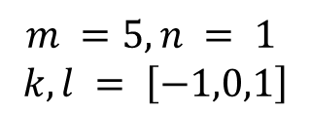
Image filtering
1
1
1
1
1
1
1
1
1
0 | 0 | 0 | 0 | 0 | 0 | 0 | 0 | 0 | 0
0 | 0 | 0 | 0 | 0 | 0 | 0 | 0 | 0 | 0
0 | 0 | 0 | 90 | 90 | 90 | 90 | 90 | 0 | 0
0 | 0 | 0 | 90 | 90 | 90 | 90 | 90 | 0 | 0
0 | 0 | 0 | 90 | 90 | 90 | 90 | 90 | 0 | 0
0 | 0 | 0 | 90 | 0 | 90 | 90 | 90 | 0 | 0
0 | 0 | 0 | 90 | 90 | 90 | 90 | 90 | 0 | 0
0 | 0 | 0 | 0 | 0 | 0 | 0 | 0 | 0 | 0
0 | 0 | 90 | 0 | 0 | 0 | 0 | 0 | 0 | 0
0 | 0 | 0 | 0 | 0 | 0 | 0 | 0 | 0 | 0
 | 0 | 10 | 20 | 30 | 30
$$m =5, n = 1$$
$$k,l = \left[−1,0,1\right]$$
Credit: S. Seitz
Notes:
ones, divide by 9

Slide 41
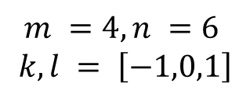
Image filtering
1
1
1
1
1
1
1
1
1
0 | 0 | 0 | 0 | 0 | 0 | 0 | 0 | 0 | 0
0 | 0 | 0 | 0 | 0 | 0 | 0 | 0 | 0 | 0
0 | 0 | 0 | 90 | 90 | 90 | 90 | 90 | 0 | 0
0 | 0 | 0 | 90 | 90 | 90 | 90 | 90 | 0 | 0
0 | 0 | 0 | 90 | 90 | 90 | 90 | 90 | 0 | 0
0 | 0 | 0 | 90 | 0 | 90 | 90 | 90 | 0 | 0
0 | 0 | 0 | 90 | 90 | 90 | 90 | 90 | 0 | 0
0 | 0 | 0 | 0 | 0 | 0 | 0 | 0 | 0 | 0
0 | 0 | 90 | 0 | 0 | 0 | 0 | 0 | 0 | 0
0 | 0 | 0 | 0 | 0 | 0 | 0 | 0 | 0 | 0
 | 0 | 10 | 20 | 30 | 30
?
$$m =4, n =6$$
$$k,l = \left[−1,0,1\right]$$
Credit: S. Seitz
Notes:
ones, divide by 9

Slide 42
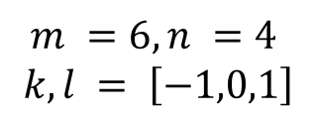
Image filtering
1
1
1
1
1
1
1
1
1
0 | 0 | 0 | 0 | 0 | 0 | 0 | 0 | 0 | 0
0 | 0 | 0 | 0 | 0 | 0 | 0 | 0 | 0 | 0
0 | 0 | 0 | 90 | 90 | 90 | 90 | 90 | 0 | 0
0 | 0 | 0 | 90 | 90 | 90 | 90 | 90 | 0 | 0
0 | 0 | 0 | 90 | 90 | 90 | 90 | 90 | 0 | 0
0 | 0 | 0 | 90 | 0 | 90 | 90 | 90 | 0 | 0
0 | 0 | 0 | 90 | 90 | 90 | 90 | 90 | 0 | 0
0 | 0 | 0 | 0 | 0 | 0 | 0 | 0 | 0 | 0
0 | 0 | 90 | 0 | 0 | 0 | 0 | 0 | 0 | 0
0 | 0 | 0 | 0 | 0 | 0 | 0 | 0 | 0 | 0
 | 0 | 10 | 20 | 30 | 30
 |  |  |  | 50
?
$$m =6, n =4$$
$$k,l = \left[−1,0,1\right]$$
Credit: S. Seitz
Notes:
ones, divide by 9

Slide 43
Image filtering
1
1
1
1
1
1
1
1
1
0 | 0 | 0 | 0 | 0 | 0 | 0 | 0 | 0 | 0
0 | 0 | 0 | 0 | 0 | 0 | 0 | 0 | 0 | 0
0 | 0 | 0 | 90 | 90 | 90 | 90 | 90 | 0 | 0
0 | 0 | 0 | 90 | 90 | 90 | 90 | 90 | 0 | 0
0 | 0 | 0 | 90 | 90 | 90 | 90 | 90 | 0 | 0
0 | 0 | 0 | 90 | 0 | 90 | 90 | 90 | 0 | 0
0 | 0 | 0 | 90 | 90 | 90 | 90 | 90 | 0 | 0
0 | 0 | 0 | 0 | 0 | 0 | 0 | 0 | 0 | 0
0 | 0 | 90 | 0 | 0 | 0 | 0 | 0 | 0 | 0
0 | 0 | 0 | 0 | 0 | 0 | 0 | 0 | 0 | 0
 | 0 | 10 | 20 | 30 | 30 | 30 | 20 | 10
 | 0 | 20 | 40 | 60 | 60 | 60 | 40 | 20
 | 0 | 30 | 60 | 90 | 90 | 90 | 60 | 30
 | 0 | 30 | 50 | 80 | 80 | 90 | 60 | 30
 | 0 | 30 | 50 | 80 | 80 | 90 | 60 | 30
 | 0 | 20 | 30 | 50 | 50 | 60 | 40 | 20
 | 10 | 20 | 30 | 30 | 30 | 30 | 20 | 10
 | 10 | 10 | 10 | 0 | 0 | 0 | 0 | 0
Credit: S. Seitz

Slide 44
Box Filter
What does it do?
Replaces each pixel with an average of its neighborhood
Achieve smoothing effect (remove sharp features)
1
1
1
1
1
1
1
1
1
Slide credit: David Lowe (UBC)

Slide 45
Box Filter
What does it do?
Replaces each pixel with an average of its neighborhood
Achieve smoothing effect (remove sharp features)
Why does it sum to one?
1
1
1
1
1
1
1
1
1
Slide credit: David Lowe (UBC)

Slide 46
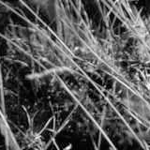
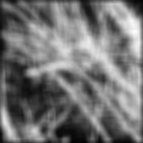
Smoothing with box filter
James Hays
1
1
1
1
1
1
1
1
1

Slide 47
Image filtering
Image filtering:
  Compute function of local neighborhood at each position
Really important!
  Enhance images
    Denoise, resize, increase contrast, etc.
  Extract information from images
    Texture, edges, distinctive points, etc.
  Detect patterns
    Template matching
James Hays

Slide 48
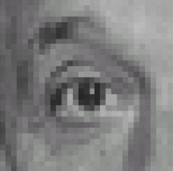

Think-Pair-Share time
0
0
0
1.
0
1
0
0
0
0
0
0
0
2.
0
0
1
0
0
0
1
0
-1
3.
2
0
-2
1
0
-1
0
0
0
-
1
1
1
4.
0
2
0
1
1
1
0
0
0
1
1
1

Slide 49
1. Practice with linear filters
0
0
0
?
0
1
0
0
0
0
Original
Source: D. Lowe

Slide 50
1. Practice with linear filters
0
0
0
0
1
0
0
0
0
Original
Filtered
(no change)
Source: D. Lowe

Slide 51
2. Practice with linear filters
0
0
0
?
0
0
1
0
0
0
Original
Source: D. Lowe

Slide 52
2. Practice with linear filters
0
0
0
0
0
1
0
0
0
Original
Shifted left
By 1 pixel
Source: D. Lowe

Slide 53
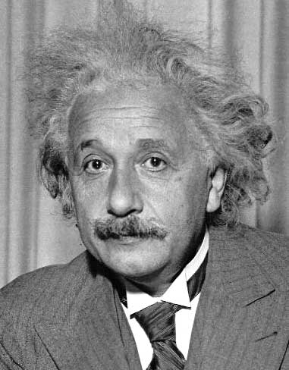
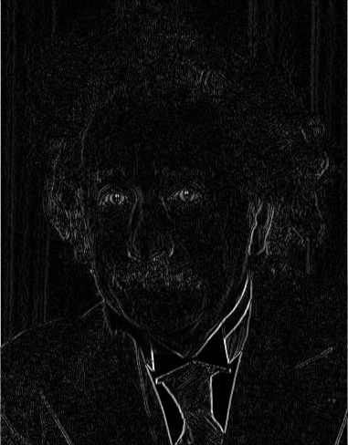
3. Practice with linear filters
1
0
-1
2
0
-2
1
0
-1
Sobel
Vertical Edge
(absolute value)
David Lowe

Slide 54
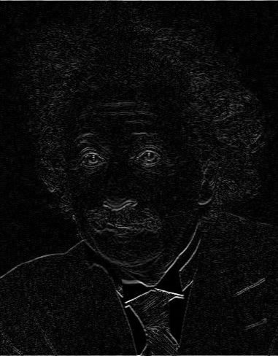
3. Practice with linear filters
1
2
1
0
0
0
-1
-2
-1
Sobel
Horizontal Edge
(absolute value)
David Lowe
Notes:
Questions at this point?

Slide 55
4. Practice with linear filters
0
0
0
-
1
1
1
?
0
2
0
1
1
1
0
0
0
1
1
1
(Note that filter sums to 1)
Original
Source: D. Lowe

Slide 56
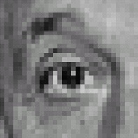
4. Practice with linear filters
0
0
0
-
1
1
1
0
2
0
1
1
1
0
0
0
1
1
1
Original
Sharpening filter
  Accentuates differences with local average
Source: D. Lowe

Slide 57
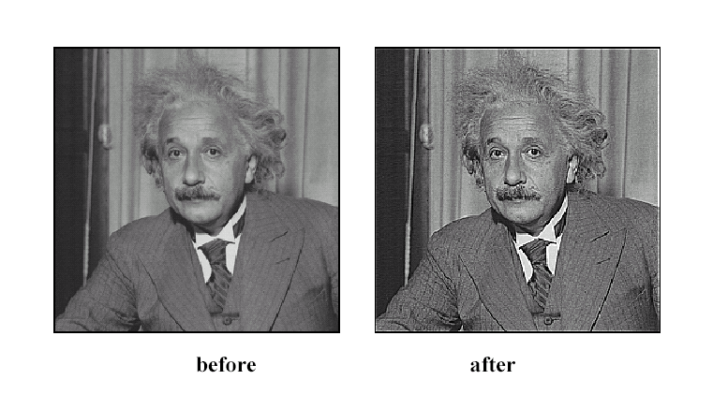
4. Practice with linear filters
Source: D. Lowe

Slide 58

Correlation and Convolution
2d correlation
  e.g., h = scipy.signal.correlate2d(f,I)
James Hays

Slide 59
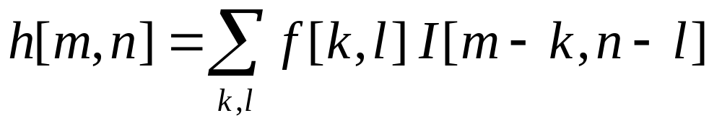
Correlation and Convolution
2d correlation
2d convolution
  e.g., h = scipy.signal.correlate2d(f,I)
  e.g., h = scipy.signal.convolve2d(f,I)
Convolution is the same as correlation with a 180° rotated filter kernel.
Correlation and convolution are identical when the filter kernel is symmetric.
James Hays

Slide 60
Key properties of linear filters
Linearity:
imfilter(I, f₁ + f₂) =
imfilter(I,f₁) + imfilter(I,f₂)
Shift invariance:
Same behavior given intensities regardless of pixel location m,n
imfilter(I,shift(f)) = shift(imfilter(I,f))
Any linear, shift-invariant operator can be represented as a convolution.
S. Lazebnik
Notes:
f is image

Slide 61
Convolution properties
Commutative: a * b = b * a
  Conceptually no difference between filter and signal
  But particular filtering implementations might break this equality, e.g., image edges
Associative: a * (b * c) = (a * b) * c
  Often apply several filters one after another: (((a * b₁) * b₂) * b₃)
  This is equivalent to applying one filter: a * (b₁ * b₂ * b₃)
Source: S. Lazebnik
Notes:
David Jacobs @ UMD http://www.cs.umd.edu/~djacobs/CMSC426/Convolution.pdf
The key difference between the two is that convolution is associative. That is, if F and G are filters, then F*(G*I) = (F*G)*I. If you don’t believe this, try a simple example, using F=G=(-1 0 1), for example. It is very convenient to have convolution be associative. Suppose, for example, we want to smooth an image and then take its derivative. We could do this by convolving the image with a Gaussian filter, and then convolving it with a derivative filter. But we could alternatively convolve the derivative filter with the Gaussian to produce a filter called a Difference of Gaussian (DOG), and then convolve this with our image. The nice thing about this is that the DOG filter can be precomputed, and we only have to convolve one filter with our image.
In general, people use convolution for image processing operations such as smoothing, and they use correlation to match a template to an image. Then, we don’t mind that correlation isn’t associative, because it doesn’t really make sense to combine two templates into one with correlation, whereas we might often want to combine two filter together for convolution. When discussing the Fourier series as a way of understanding filtering, we will use convolution, so that we can introduce the famous convolution theorem.

Slide 62
Convolution properties
Commutative: a * b = b * a
  Conceptually no difference between filter and signal
  But particular filtering implementations might break this equality, e.g., image edges
Associative: a * (b * c) = (a * b) * c
  Often apply several filters one after another: (((a * b₁) * b₂) * b₃)
  This is equivalent to applying one filter: a * (b₁ * b₂ * b₃)
  Correlation is _not_ associative (rotation effect)
  Why important?
Source: S. Lazebnik
Notes:
David Jacobs @ UMD http://www.cs.umd.edu/~djacobs/CMSC426/Convolution.pdf
The key difference between the two is that convolution is associative. That is, if F and G are filters, then F*(G*I) = (F*G)*I. If you don’t believe this, try a simple example, using F=G=(-1 0 1), for example. It is very convenient to have convolution be associative. Suppose, for example, we want to smooth an image and then take its derivative. We could do this by convolving the image with a Gaussian filter, and then convolving it with a derivative filter. But we could alternatively convolve the derivative filter with the Gaussian to produce a filter called a Difference of Gaussian (DOG), and then convolve this with our image. The nice thing about this is that the DOG filter can be precomputed, and we only have to convolve one filter with our image.
In general, people use convolution for image processing operations such as smoothing, and they use correlation to match a template to an image. Then, we don’t mind that correlation isn’t associative, because it doesn’t really make sense to combine two templates into one with correlation, whereas we might often want to combine two filter together for convolution. When discussing the Fourier series as a way of understanding filtering, we will use convolution, so that we can introduce the famous convolution theorem.

Slide 63
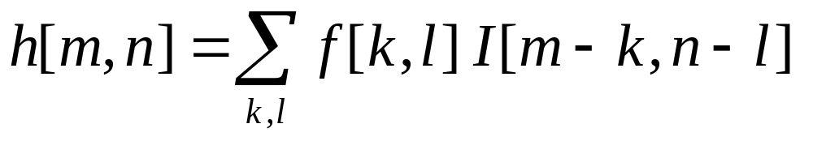
Recap of Monday
Linear filtering (convolution)
  Not a matrix multiplication
  Sum over Hadamard product
  Can smooth, sharpen, translate
  (among many other uses)
1
1
1
1
1
1
1
1
1

Slide 64
Convolution properties
Commutative: a * b = b * a
  Conceptually no difference between filter and signal
  But particular filtering implementations might break this equality,
  e.g., image edges
Associative: a * (b * c) = (a * b) * c
  Often apply several filters one after another: (((a * b₁) * b₂) * b₃)
  This is equivalent to applying one filter: a * (b₁ * b₂ * b₃)
  Correlation is _not_ associative (rotation effect)
  Why important?
Distributes over addition: a * (b + c) = (a * b) + (a * c)
Scalars factor out: ka * b = a * kb = k (a * b)
Identity: unit impulse e = [0, 0, 1, 0, 0], a * e = a
Source: S. Lazebnik
Notes:
David Jacobs @ UMD http://www.cs.umd.edu/~djacobs/CMSC426/Convolution.pdf
The key difference between the two is that convolution is associative. That is, if F and G are filters, then F*(G*I) = (F*G)*I. If you don’t believe this, try a simple example, using F=G=(-1 0 1), for example. It is very convenient to have convolution be associative. Suppose, for example, we want to smooth an image and then take its derivative. We could do this by convolving the image with a Gaussian filter, and then convolving it with a derivative filter. But we could alternatively convolve the derivative filter with the Gaussian to produce a filter called a Difference of Gaussian (DOG), and then convolve this with our image. The nice thing about this is that the DOG filter can be precomputed, and we only have to convolve one filter with our image.
In general, people use convolution for image processing operations such as smoothing, and they use correlation to match a template to an image. Then, we don’t mind that correlation isn’t associative, because it doesn’t really make sense to combine two templates into one with correlation, whereas we might often want to combine two filter together for convolution. When discussing the Fourier series as a way of understanding filtering, we will use convolution, so that we can introduce the famous convolution theorem.

Slide 65
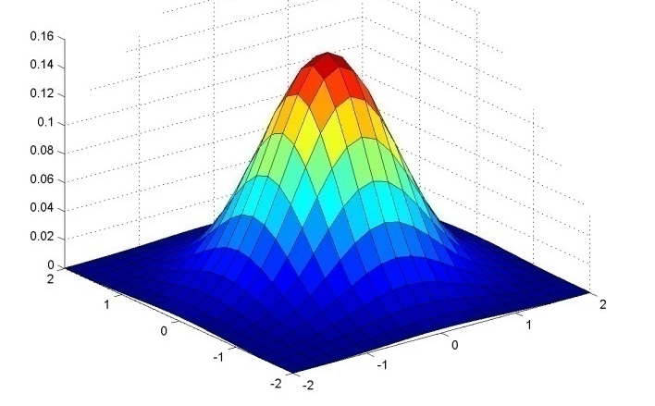
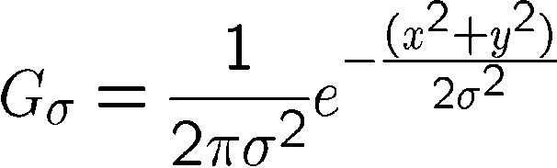
Important filter: Gaussian
Weight contributions of neighboring pixels by nearness
x
0.003 0.013 0.022 0.013 0.003
0.013 0.059 0.097 0.059 0.013
0.022 0.097 0.159 0.097 0.022
0.013 0.059 0.097 0.059 0.013
0.003 0.013 0.022 0.013 0.003
y
x
5 x 5, σ = 1
y
Slide credit: Christopher Rasmussen
Notes:
e^0 = 1, e^-1 = .37, e^-2 = .14, etc.

Slide 66

Smoothing with Gaussian filter
James Hays

Slide 67
Smoothing with box filter
James Hays

Slide 68
Gaussian filters
Remove “high-frequency” components from the image (low-pass filter)
  Images become more smooth
Gaussian convolved with Gaussian…
…is another Gaussian
  So can smooth with small-width kernel, repeat, and get same result as larger-width kernel would have
  Convolving twice with Gaussian kernel of width σ is same as convolving once with kernel of width σ√2
Separable kernel
  Factors into product of two 1D Gaussians
Source: K. Grauman
Notes:
Linear vs. quadratic in mask size

Slide 69

Separability of the Gaussian filter
Source: D. Lowe

Slide 70



Separability example
2D convolution
(center location only)
=
The filter factors
into a product of 1D
filters:
Perform convolution
along rows:
*
=
Followed by convolution
along the remaining column:
*
=
Source: K. Grauman
Notes:
Convolution vs filtering doesn’t matter here because the filter is symmetric
9 multiply-add operations at the top for 2D convolution
~11 multiply-add operations at the bottom for the separable 2D convolution

Slide 71
Separability
Why is separability useful in practice?
MxN image, PxQ filter
2D convolution: ~MNPQ multiply-adds
Separable 2D: ~MN(P+Q) multiply-adds
Speed up = PQ/(P+Q)
9x9 filter = ~4.5x faster
Notes:
https://blogs.mathworks.com/steve/2006/10/04/separable-convolution/

Slide 72
Practical matters
How big should the filter be?
Values at edges should be near zero
Gaussians have infinite extent…
Rule of thumb for Gaussian: set filter half-width to about 3 σ
James Hays

Slide 73













Practical matters
What about near the edge?
  The filter window falls off the edge of the image
  Need to extrapolate
  methods:
    clip filter (black)
    wrap around
    copy edge
    reflect across edge
Source: S. Marschner

Slide 74
Convolution in Convolutional Neural Networks
Convolution is the basic operation in CNNs
Learning convolution kernels allows us to learn which `features’ provide useful information in images.

Slide 75
Sobel filter visualization
What happens to negative numbers?
For visualization:
  Shift image + 0.5
  If gradients are small, scale edge response
Notes:
- Look at a second filter which is an ‘edge detection’ filter
Negative numbers
Oh. Well, let’s take the absolute value (the magnitude)
Add the mean

Slide 76



1
2
1
>> I = img_to_float32( io.imread( ‘luke.jpg’ ) );
>> h = convolve2d( I, sobelKernel );
0
0
0
-1
-2
-1
Sobel
plt.imshow( h );
plt.imshow( h + 0.5 );

Slide 77


h(:,:,1) < 0
h(:,:,1) > 0

Slide 78









Think-Pair-Share
* = Convolution operator
a) _ = D * B
b) A = _ * _
c) F = D * _
d) _ = D * D
D
H
F
I
A
B
C
G
E
Hoiem
Notes:
a) G = D * B
b) A = B * C
c) F = D * E
d) I = D * D

Slide 79
I = D * D
D (275 x 175 pixels)
I (from slide – 275 x 175)
“…something to do with lack of content (black) at edges…”

Slide 80

I = D * D
D (275 x 175 pixels)
I (from slide – 275 x 175)
>> D = img_to_float32( io.imread( ‘convexample.png’ ) )
>> I = convolve2d( D, D )
>> np.max(I)
1.1021e+04
# Normalize for visualization
>> I_norm = (I – np.min(I)) / (np.max(I) – np.min(I))
>> plt.imshow( I_norm )
I_norm

Slide 81

I = D * D
D (275 x 175 pixels)
I (from slide – 275 x 175)
(275-1)/2
(275-1)/2
(549 x 349 pixels)
I_norm
275
For x: 275 + (275-1)/2 + (275-1)/2
= 549

Slide 82

I = D * D
D (275 x 175 pixels)
I (from slide – 275 x 175)
>> I = convolve2d( D, D, mode=‘full’ )
(Default; pad with zeros)
>> I = convolve2d( D, D, mode=‘same’ )
(Return same size as D)
>> I = convolve2d( D, D, mode=‘valid’ )
(No padding)
549 x 349
275 x 175
Value = 10528.3
1x1

Slide 83
A = B * C - “because it kind of looks like it.”
A
B
C
C is a Gaussian filter
(or something close to it it),
and we know that it ‘blurs’.
When the filter ‘looks like’ the image = ‘template matching’
Filtering viewed as comparing an image of
what you want to find against all image regions.
For symmetric filters: use either convolution or correlation.
For nonsymmetric filters: correlation is template matching.

Slide 84
Filtering: Correlation and Convolution
2d correlation
2d convolution
  e.g., h = scipy.signal.correlate2d(f,I)
  e.g., h = scipy.signal.convolve2d(f,I)
Convolution is the same as correlation with a 180° rotated filter kernel.
Correlation and convolution are identical when the filter kernel is symmetric.
James Hays

Slide 85


D (275 x 175 pixels)
OK, so let’s test this idea. Let’s see if we can use correlation to ‘find’ the parts of the image that look like the filter.
>> f = D[ 57:117, 107:167 ]
Expect response ‘peak’ in middle of I
>> I = correlate2d( D, f, ‘same’ )
f
61 x 61
I
Correct location
Hmm…
That didn’t work – why not?
+
Response peak
[Thanks to Robert Collins @ Penn State]

Slide 86
Correlation
  e.g., h = scipy.signal.correlate2d(f,I)
As brightness in I increases, the response in h will increase, as long as f is positive.
Overall brighter regions will give higher correlation response -> not useful!

Slide 87



D2 (275 x 175 pixels)
OK, so let’s subtract the mean
>> f = D[ 57:117, 107:167 ]
>> f2 = f – np.mean(f)
>> D2 = D – np.mean(D)
Now zero centered.
Score is higher only when dark parts
match and when light parts match.
>> I2 = correlate2d( D2, f2, ‘same’ )
f2
61 x 61
I2

Slide 88

D2 (275 x 175 pixels)
Or even
>> I3 = correlate2d( D2, D2, ‘full’ )
I3

Slide 89

D2 (275 x 175 pixels)
What happens with convolution?
>> f = D[ 57:117, 107:167 ]
>> f2 = f – np.mean(f)
>> D2 = D – np.mean(D)
>> I2 = convolve2d( D2, f2, ‘same’ )
f2
61 x 61
I2

Slide 90
Non-linear filters

Slide 91
Median filters
Operates over a window by selecting the median intensity in the window.
‘Rank’ filter as based on ordering of gray levels
  E.G., min, max, range filters
Steve Seitz, Steve Marschner
Notes:
Better at salt’n’pepper noise
Not convolution: try a region with 1’s and a 2, and then 1’s and a 3

Slide 92
Image filtering - mean
1
1
1
1
1
1
1
1
1
0 | 0 | 0 | 0 | 0 | 0 | 0 | 0 | 0 | 0
0 | 0 | 0 | 0 | 0 | 0 | 0 | 0 | 0 | 0
0 | 0 | 0 | 90 | 90 | 90 | 90 | 90 | 0 | 0
0 | 0 | 0 | 90 | 90 | 90 | 90 | 90 | 0 | 0
0 | 0 | 0 | 90 | 90 | 90 | 90 | 90 | 0 | 0
0 | 0 | 0 | 90 | 0 | 90 | 90 | 90 | 0 | 0
0 | 0 | 0 | 90 | 90 | 90 | 90 | 90 | 0 | 0
0 | 0 | 0 | 0 | 0 | 0 | 0 | 0 | 0 | 0
0 | 0 | 90 | 0 | 0 | 0 | 0 | 0 | 0 | 0
0 | 0 | 0 | 0 | 0 | 0 | 0 | 0 | 0 | 0
 | 0 | 10 | 20 | 30 | 30
?
Credit: S. Seitz
Notes:
ones, divide by 9

Slide 93
Image filtering - mean
1
1
1
1
1
1
1
1
1
0 | 0 | 0 | 0 | 0 | 0 | 0 | 0 | 0 | 0
0 | 0 | 0 | 0 | 0 | 0 | 0 | 0 | 0 | 0
0 | 0 | 0 | 90 | 90 | 90 | 90 | 90 | 0 | 0
0 | 0 | 0 | 90 | 90 | 90 | 90 | 90 | 0 | 0
0 | 0 | 0 | 90 | 90 | 90 | 90 | 90 | 0 | 0
0 | 0 | 0 | 90 | 0 | 90 | 90 | 90 | 0 | 0
0 | 0 | 0 | 90 | 90 | 90 | 90 | 90 | 0 | 0
0 | 0 | 0 | 0 | 0 | 0 | 0 | 0 | 0 | 0
0 | 0 | 90 | 0 | 0 | 0 | 0 | 0 | 0 | 0
0 | 0 | 0 | 0 | 0 | 0 | 0 | 0 | 0 | 0
 | 0 | 10 | 20 | 30 | 30
 |  |  |  | 50
Credit: S. Seitz
Notes:
ones, divide by 9

Slide 94
Median filter?
0 | 0 | 0 | 0 | 0 | 0 | 0 | 0 | 0 | 0
0 | 0 | 0 | 0 | 0 | 0 | 0 | 0 | 0 | 0
0 | 0 | 0 | 90 | 90 | 90 | 90 | 90 | 0 | 0
0 | 0 | 0 | 90 | 90 | 90 | 90 | 90 | 0 | 0
0 | 0 | 0 | 90 | 90 | 90 | 90 | 90 | 0 | 0
0 | 0 | 0 | 90 | 0 | 90 | 90 | 90 | 0 | 0
0 | 0 | 0 | 90 | 90 | 90 | 90 | 90 | 0 | 0
0 | 0 | 0 | 0 | 0 | 0 | 0 | 0 | 0 | 0
0 | 0 | 90 | 0 | 0 | 0 | 0 | 0 | 0 | 0
0 | 0 | 0 | 0 | 0 | 0 | 0 | 0 | 0 | 0
 |  |  |  | ?
Credit: S. Seitz
Notes:
Answer is 90.

Slide 95
Median filters
Operates over a window by selecting the median intensity in the window.
What advantage does a median filter have over a mean filter?
Steve Seitz, Steve Marschner
Notes:
Better at salt’n’pepper noise

Slide 96

Noise – Salt and Pepper Jack
Notes:
No, not the latest smash hit from early 90’s hip hop group

Slide 97

Mean Jack – 3 x 3 filter

Slide 98

Very Mean Jack – 11 x 11 filter

Slide 99
Noisy Jack – Salt and Pepper
Notes:
No, not the latest smash hit from early 90’s hip hop group

Slide 100

Median Jack – 3 x 3

Slide 101

Very Median Jack – 11 x 11

Slide 102
Median filters
Operates over a window by selecting the median intensity in the window.
What advantage does a median filter have over a mean filter?
Is a median filter a kind of convolution?
Steve Seitz, Steve Marschner
Notes:
Answer: Not convolution: try a region with 1’s and a 2, and then 1’s and a 3

Slide 103
Review: questions
Write down a 3x3 filter that both:
  Returns a positive value if the average value of the 4-adjacent neighbors is less than the center,
  Returns a negative value otherwise.
Write down a filter that will compute the gradient in the x-direction:
gradx(x,y) = im(x+1,y) - im(x,y) for each x, y
Slide: Hoiem
Notes:
[ 0 -1/4 0;
-1/4 1 -1/4;
0 -1/4 0 ]
[ 0 -1 1 ]

Slide 104
Review: questions
Write down a 3x3 filter that both:
  Returns a positive value if the average value of the 4-adjacent neighbors is less than the center,
  Returns a negative value otherwise.
Write down a filter that will compute the gradient in the x-direction:
gradx(x,y) = im(x+1,y) - im(x,y) for each x, y
[ 0 -1/4 0;
-1/4 1 -1/4;
0 -1/4 0 ]
[ 0 -1 1 ]
Slide: Hoiem
Notes:
[ 0 -1/4 0;
-1/4 1 -1/4;
0 -1/4 0 ]
[ 0 -1 1 ]

Slide 105
Median filters
Operates over a window by selecting the median intensity in the window.
What advantage does a median filter have over a mean filter?
Is a median filter a kind of convolution?
Interpretation: Median filtering is sorting.
Notes:
Answer: Not convolution: try a region with 1’s and a 2, and then 1’s and a 3

Slide 106
Ben Thomas
Notes:
http://benthomas.net.au/cityshrinker/eilz24txaul9s1hx5prqr0ta5y8nvl

Slide 107




Tilt-shift photography
Notes:
http://twistedsifter.com/2009/11/what-is-tilt-shift-photography/
https://www.google.com/url?sa=i&rct=j&q=&esrc=s&source=images&cd=&cad=rja&uact=8&ved=0ahUKEwjh0vHWnOrRAhXHNiYKHU9_C8MQjB0IBg&url=http%3A%2F%2Fwww.tiltshiftphotography.net%2Ftilt-shift-photography-examples%2F&bvm=bv.145822982,d.amc&psig=AFQjCNHwu3AEwcnsTWQDqGS8vA2-H9QSEw&ust=1485877855629030
Fourth one is actually a toy

Slide 108


Tilt shift camera
Sensor
Shift
Tilt
Sensor
Notes:
http://www.bobatkins.com/photography/reviews/macro_tilt_adapter/tilt.jpg

Slide 109

Macro photography
Notes:
http://cow.mooh.org/projects/tiltshift/howdoesitwork.html#miniaturisationeffectfig

Slide 110
Can we fake tilt shift?
We need to blur the image
  OK, now we know how to do that.

Slide 111
Can we fake tilt shift?
We need to blur the image
  OK, now we know how to do that.
We need to blur progressively more away from our ‘fake’ focal point

Slide 112

But can I make it look more like a toy?
Boost saturation – toys are very colorful
We’ll learn how to do this when we discuss color
For now: transform to Hue, Saturation, Value instead of RGB

Slide 113

Next class: Thinking in Frequency

