Slide 1
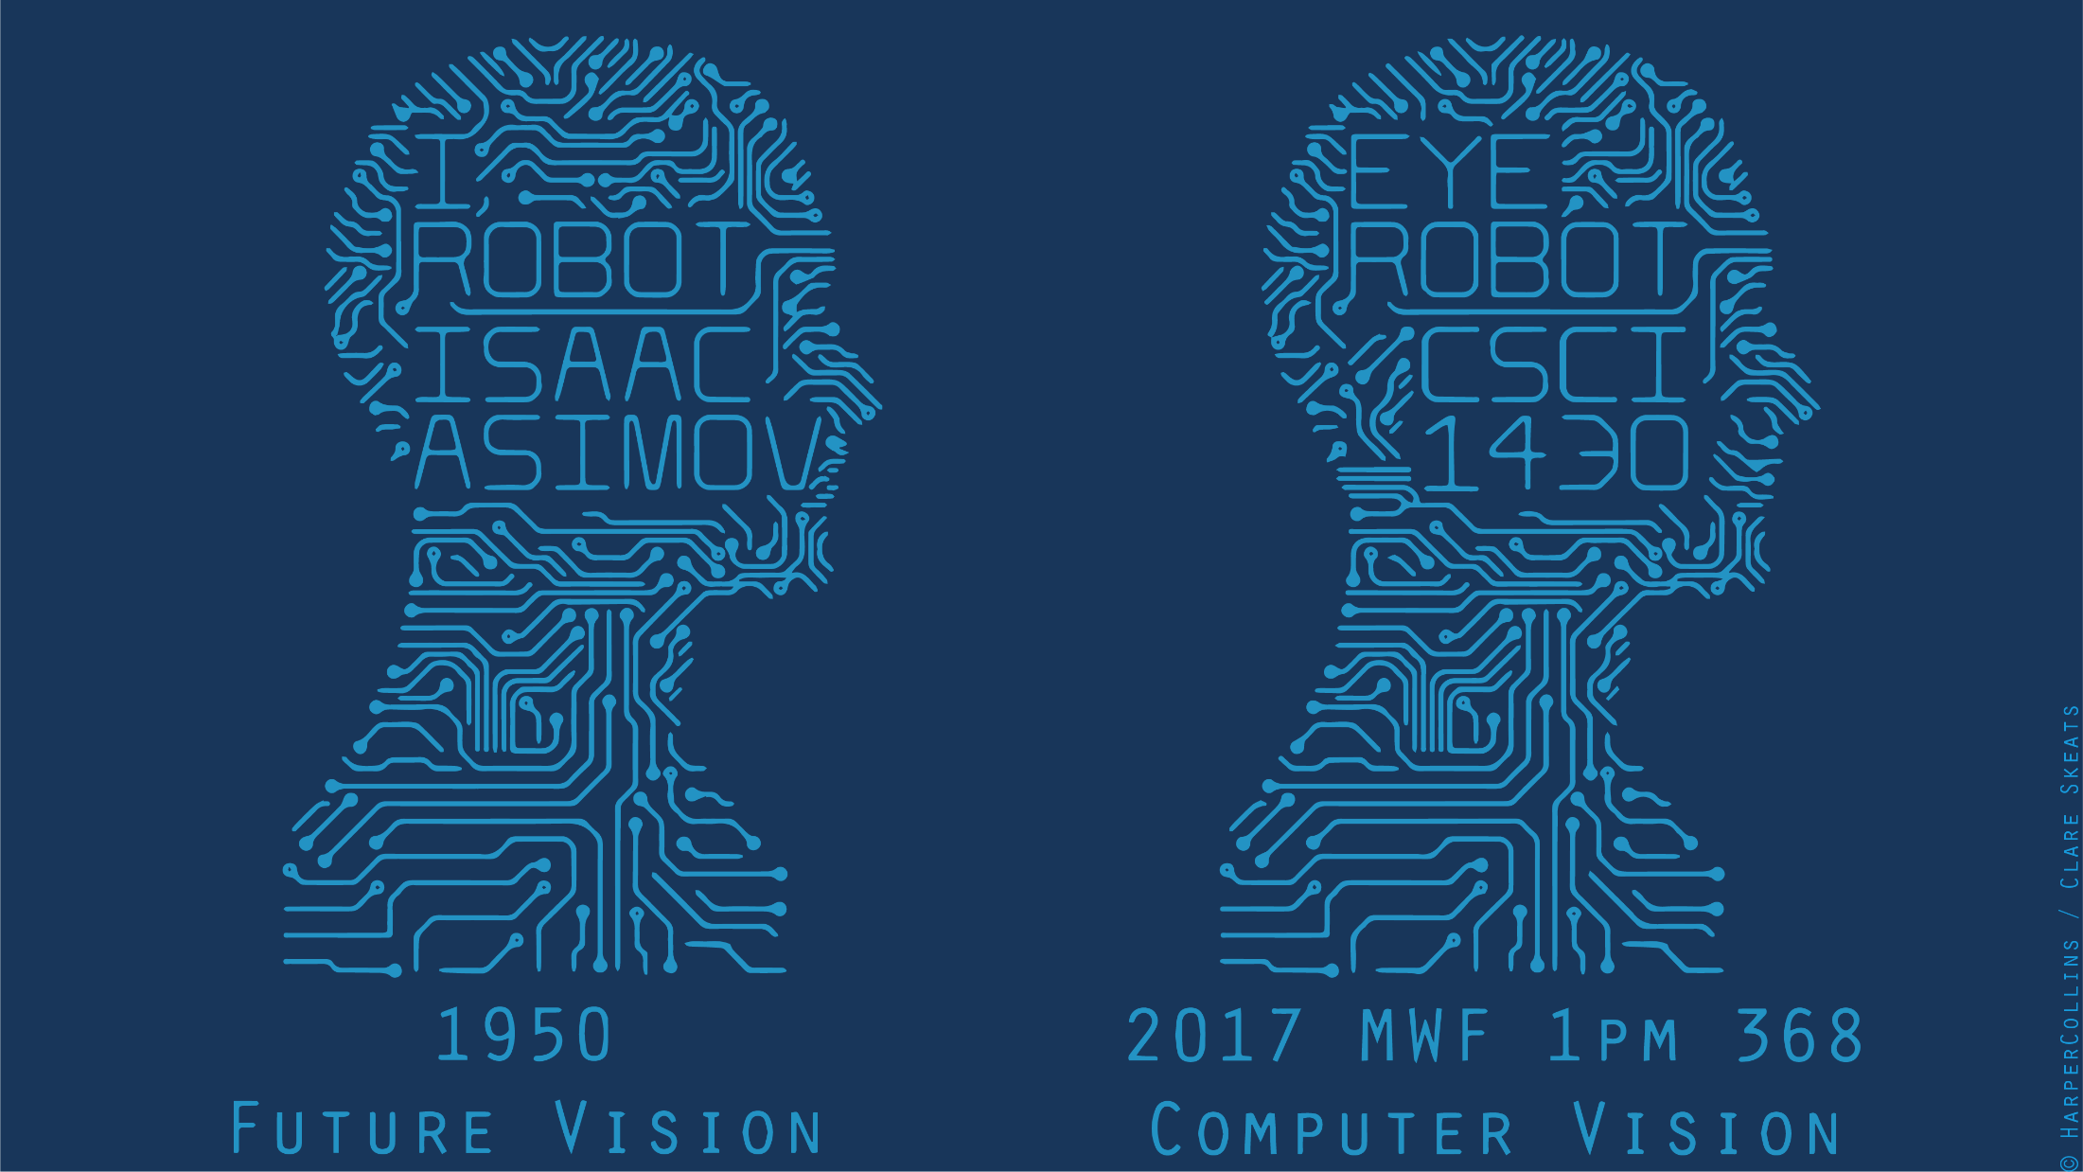

Slide 2
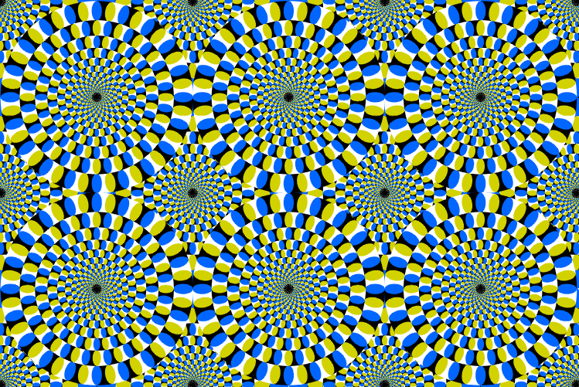
Peripheral drift illusion

Slide 3
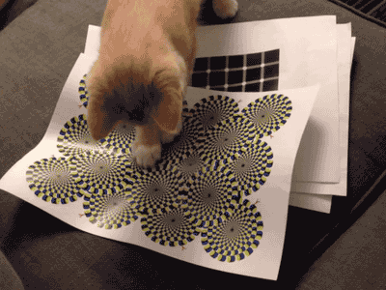
Does it work on other animals?

Slide 4
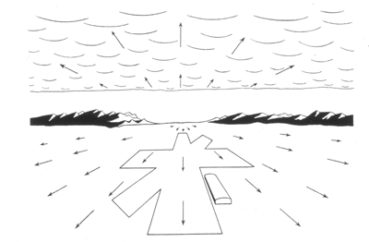
Computer Vision
Motion and Optical Flow
Many slides adapted from J. Hays, S. Seitz, R. Szeliski, M. Pollefeys, K. Grauman and others…

Slide 5
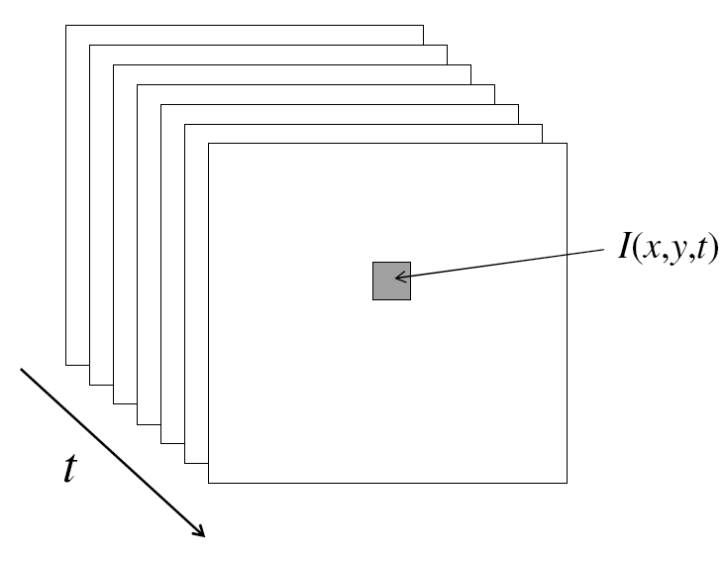
Video
A video is a sequence of frames captured over time
Now our image data is a function of space
(x, y) and time (t)

Slide 6
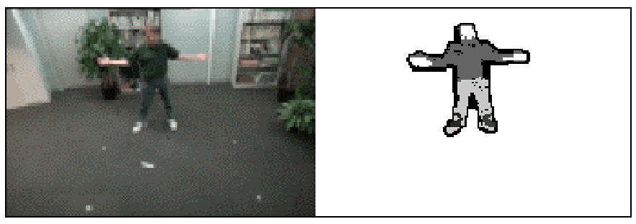
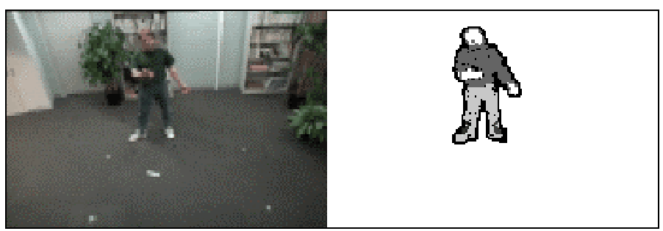
Motion Applications: Segmentation of video
Background subtraction
  A static camera is observing a scene
  Goal: separate the static background from the moving foreground

Slide 7
Applications of segmentation to video
Background subtraction
  Form an initial background estimate
  For each frame:
    Update estimate using a moving average
    Subtract the background estimate from the frame
    Label as foreground each pixel where the magnitude of the difference is greater than some threshold
    Use median filtering to “clean up” the results

Slide 8
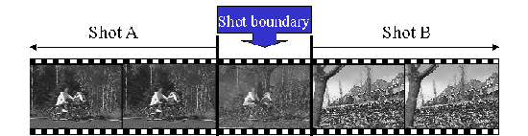
Motion Applications: Segmentation of video
Background subtraction
Shot boundary detection in edited video
  Edited video is usually composed of shots or sequences showing the same objects or scene
  Goal: segment video into shots for summarization and browsing (each shot can be represented by a single keyframe in a user interface)
  Difference from background subtraction: the camera is not necessarily stationary

Slide 9
Applications of segmentation to video
Background subtraction
Shot boundary detection
  For each frame
    Compute the distance between the current frame and the previous one
      Pixel-by-pixel differences
      Differences of color histograms
      Block comparison
    If the distance is greater than some threshold, classify the frame as a shot boundary

Slide 10
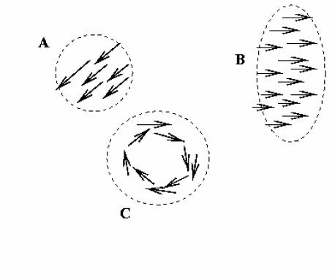
Motion Applications: Segmentation of video
Background subtraction
Shot boundary detection
Motion segmentation
  Segment the video into multiple coherently moving objects

Slide 11
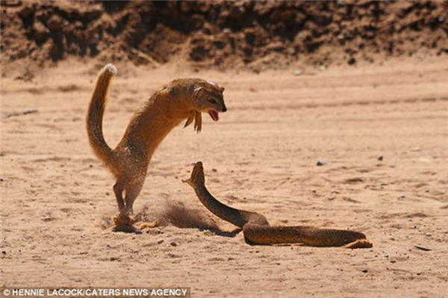
Motion Applications: Segmentation of video
Background subtraction
Shot boundary detection
Motion segmentation
  Segment the video into multiple coherently moving objects

Slide 12
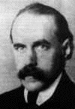
Motion and perceptual organization
Gestalt psychology (Max Wertheimer, 1880-1943)

Slide 13
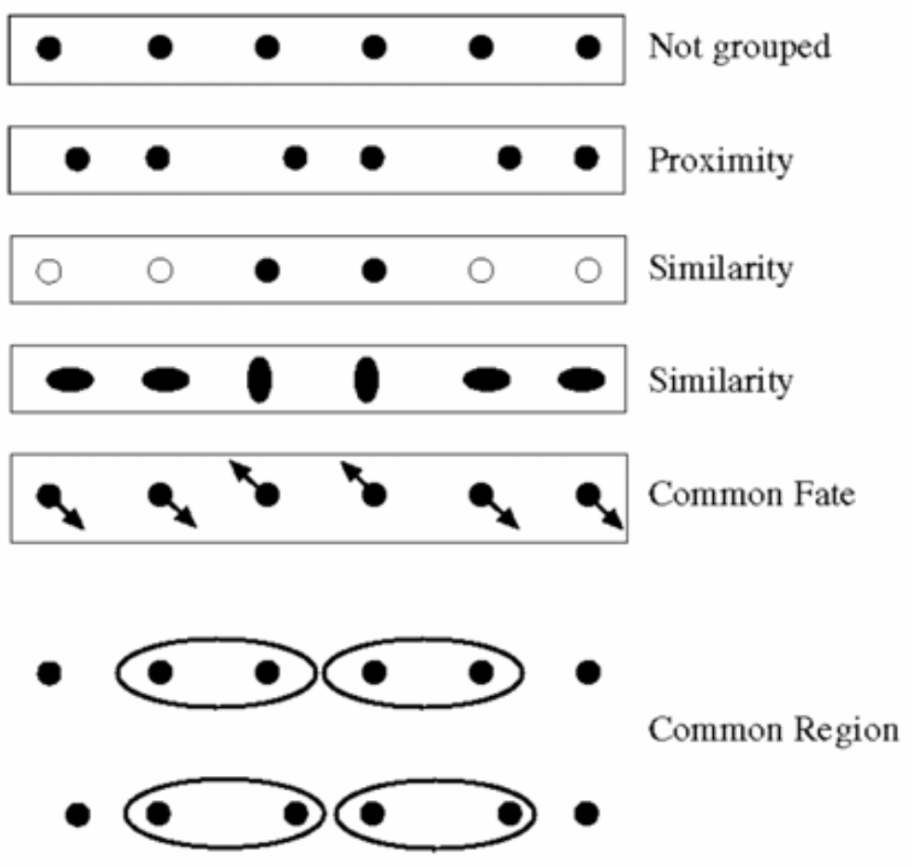
Motion and perceptual organization
Sometimes, motion is the only cue
Gestalt psychology (Max Wertheimer, 1880-1943)

Slide 14
Motion and perceptual organization
Sometimes, motion is the only cue
Notes:
Now take it away. And count to 3…

Slide 15
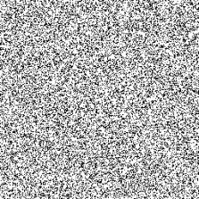
Motion and perceptual organization
Sometimes, motion is the only cue
Notes:
Now put another one. You probably don’t see anything special.

Slide 16
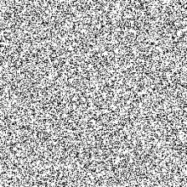
Motion and perceptual organization
Sometimes, motion is the only cue
Notes:
But put them in sequence…. And you see the moving square. The only indication of the square is the common motion.

Slide 17
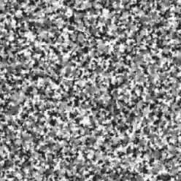
Motion and perceptual organization
Sometimes, motion is the only cue http://www.youtube.com/watch?v=aEoxO_RdGhE

Slide 18
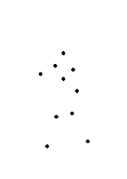
Motion and perceptual organization
Even “impoverished” motion data can evoke a strong percept

Slide 19
Motion and perceptual organization
Even “impoverished” motion data can evoke a strong percept

Slide 20
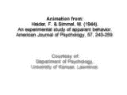
Motion and perceptual organization
Experimental study of apparent behavior.
Fritz Heider & Marianne Simmel. 1944

Slide 21
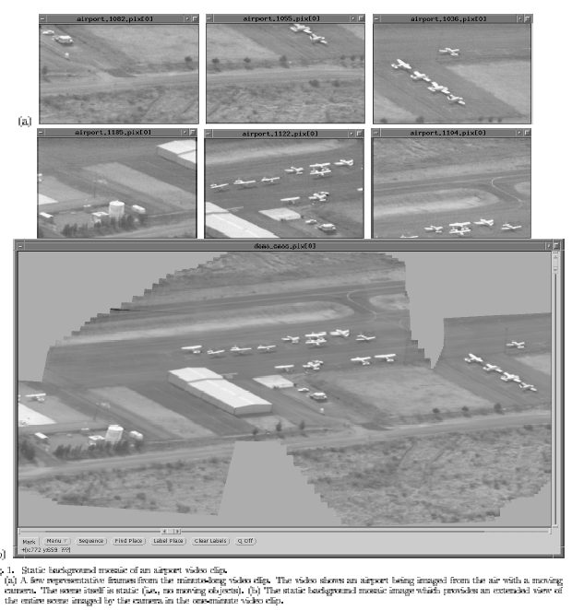
Mosaicing
(Michal Irani, Weizmann)

Slide 22
Mosaicing
(Michal Irani, Weizmann)

Slide 23
More applications of motion
Segmentation of objects in space or time
Estimating 3D structure
Learning dynamical models – how things move
Recognizing events and activities
Improving video quality (motion stabilization)

Slide 24
Motion estimation techniques
Feature-based methods
  Extract visual features (corners, textured areas) and track them over multiple frames
  Sparse motion fields, but more robust tracking
  Suitable when image motion is large (10s of pixels)
Direct, dense methods
  Directly recover image motion at each pixel from spatio-temporal image brightness variations
  Dense motion fields, but sensitive to appearance variations
  Suitable for video and when image motion is small

Slide 25
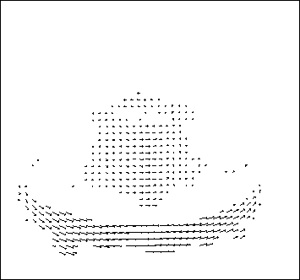
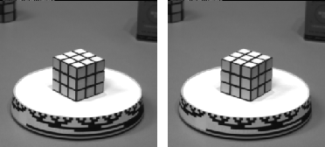
Motion estimation: Optical flow
Optic flow is the apparent motion of objects or surfaces
Will start by estimating motion of each pixel separately
Then will consider motion of entire image

Slide 26


Problem definition: optical flow
How to estimate pixel motion from image I(x,y,t) to I(x,y,t+1) ?
Solve pixel correspondence problem
  Given a pixel in I(x,y,t), look for nearby pixels of the same color in I(x,y,t+1)
Key assumptions
  Small motion: Points do not move very far
  Color constancy: A point in I(x,y,t) looks the same in I(x,y,t+1)
    For grayscale images, this is brightness constancy

Slide 27



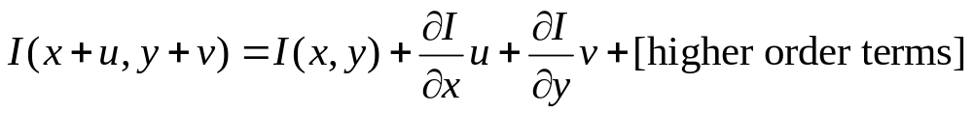
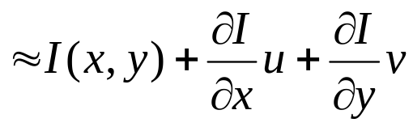
Optical flow constraints (grayscale images)
Let’s look at these constraints more closely
  Brightness constancy constraint (equation)
  Small motion: (u and v are less than 1 pixel, or smooth) Taylor series expansion of I:
Notes:
A: H(x,y) = I(x+u, y+v)

Slide 28
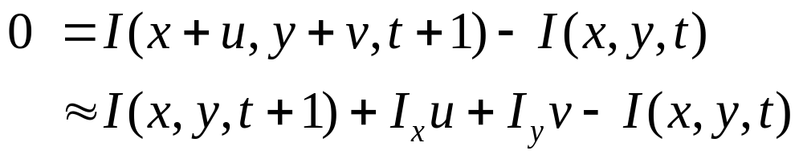
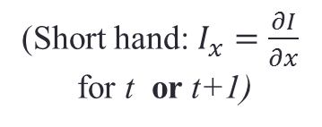
Optical flow equation
Combining these two equations
(Short hand: $I_{x}=\frac{∂I}{∂x}$
for t or t+1)

Slide 29
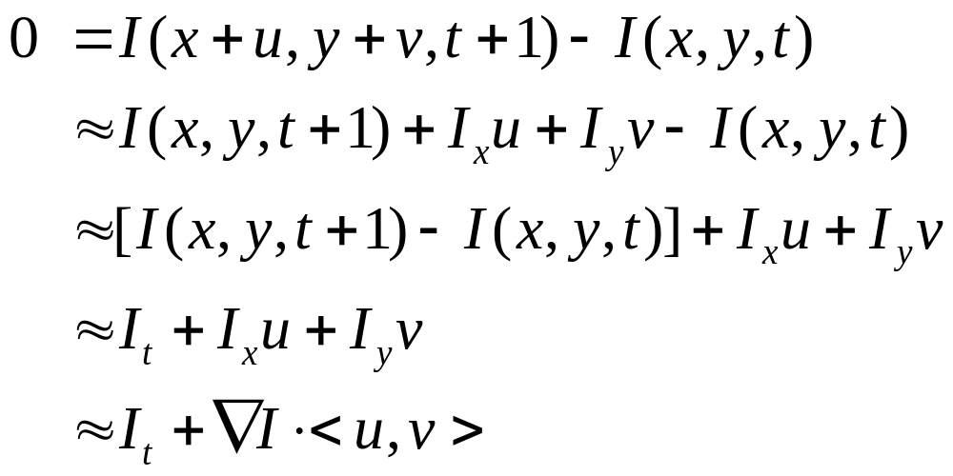
Optical flow equation
Combining these two equations
(Short hand: $I_{x}=\frac{∂I}{∂x}$
for t or t+1)

Slide 30
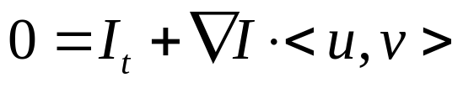
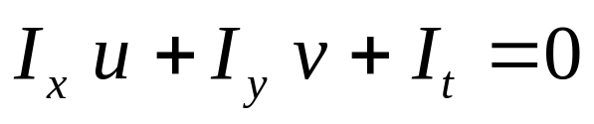
Optical flow equation
Combining these two equations
(Short hand: $I_{x}=\frac{∂I}{∂x}$
for t or t+1)
In the limit as u and v go to zero, this becomes exact
  Brightness constancy constraint equation

Slide 31
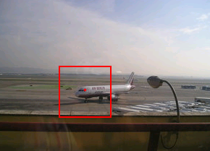
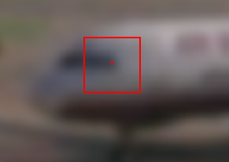
How does this make sense?
  Brightness constancy constraint equation
What do the static image gradients
have to do with motion estimation?

Slide 32
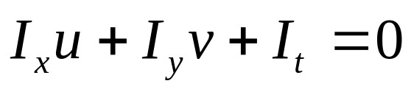
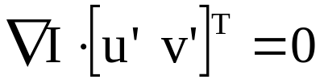
The brightness constancy constraint
Can we use this equation to recover image motion (u,v) at each pixel?
or
How many equations and unknowns per pixel?
  One equation (this is a scalar equation!), two unknowns (u,v)
The component of the motion perpendicular to the gradient (i.e., parallel to the edge) cannot be measured
  If (u, v) satisfies the equation,
  so does (u+u’, v+v’ ) if
gradient
(u,v)
(u’,v’)
(u+u’,v+v’)
edge
Notes:
A: u and v are unknown, 1 equation

Slide 33
Aperture problem

Slide 34
Aperture problem

Slide 35
Aperture problem

Slide 36
Apparently an aperture problem

Slide 37

The barber pole illusion
http://en.wikipedia.org/wiki/Barberpole_illusion

Slide 38


The barber pole illusion
http://en.wikipedia.org/wiki/Barberpole_illusion

Slide 39
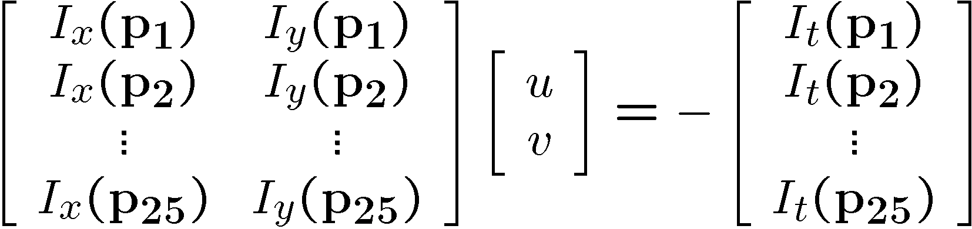
Solving the ambiguity…
B. Lucas and T. Kanade. An iterative image registration technique with an application to stereo vision. In Proceedings of the International Joint Conference on Artificial Intelligence, pp. 674–679, 1981.
How to get more equations for a pixel?
Spatial coherence constraint
Assume the pixel’s neighbors have the same (u,v)
  If we use a 5x5 window, that gives us 25 equations per pixel

Slide 40




Solving the ambiguity…
Least squares problem:

Slide 41

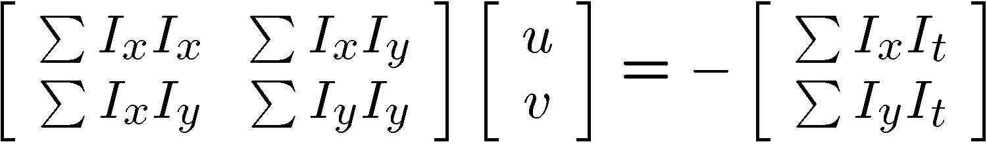


Matching patches across images
Overconstrained linear system
Least squares solution for d given by
  The summations are over all pixels in the K x K window

Slide 42


Conditions for solvability
  Optimal (u, v) satisfies Lucas-Kanade equation
When is this solvable? I.e., what are good points to track?
  A^{T}A should be invertible
  A^{T}A should not be too small due to noise
    eigenvalues λ₁ and λ ₂ of A^{T}A should not be too small
  A^{T}A should be well-conditioned
    λ ₁/ λ ₂ should not be too large (λ ₁ = larger eigenvalue)
Does this remind you of anything?
Criteria for Harris corner detector
Notes:
http://en.wikipedia.org/wiki/Invertible_matrix

Slide 43
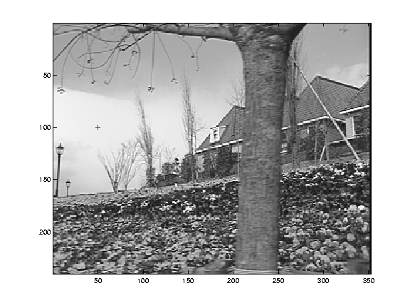
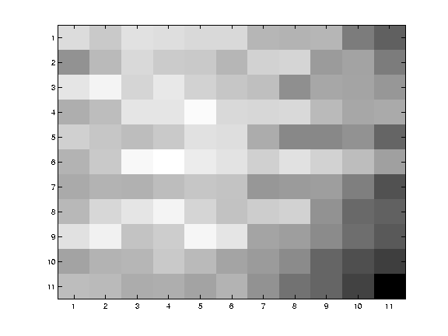
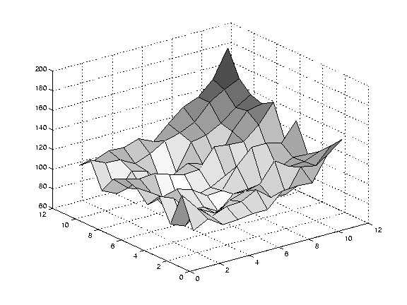
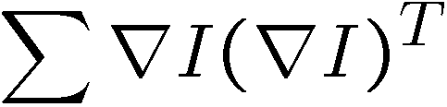
Low texture region
gradients have small magnitude
small λ₁, small λ₂
Notes:
Can’t estimate motion here…nothing you can see moving.

Slide 44
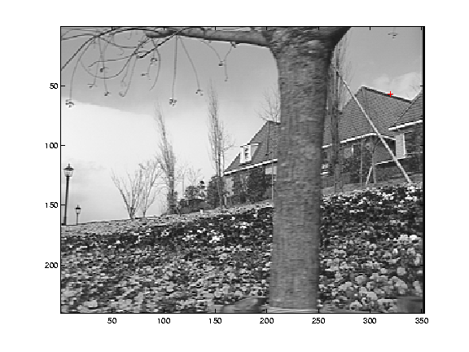
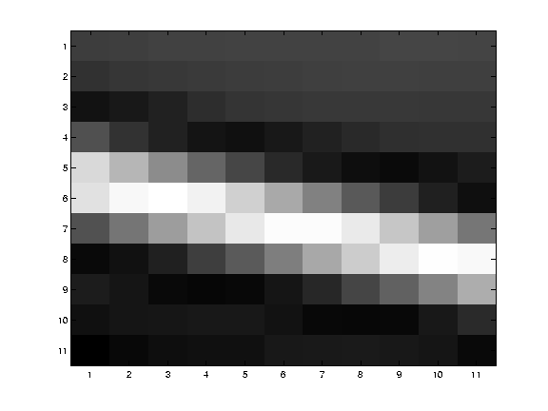
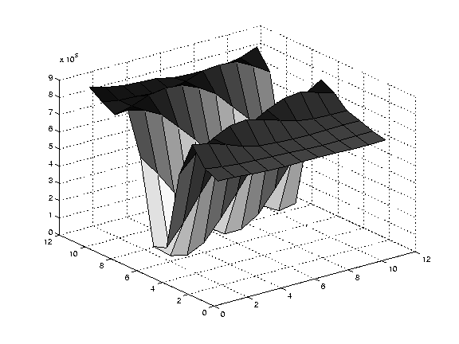
Edge
large gradients, all the same
large λ₁, small λ₂
Notes:
On an edge you can estimate motion perpendicular to the edge but not along it.

Slide 45
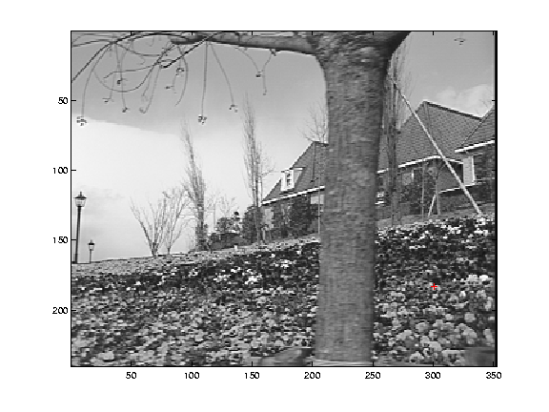
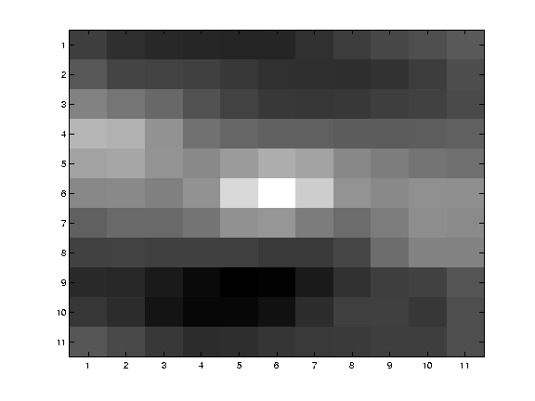
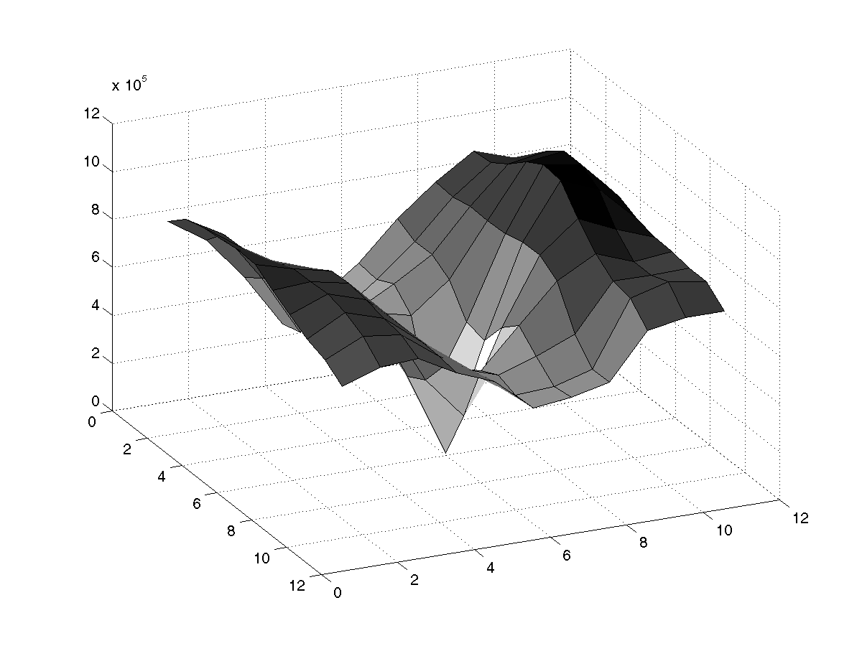
High textured region
gradients are different, large magnitudes
large λ₁, large λ₂
Notes:
But on nice textured regions motion is well estimated because the gradient varies over the window.

Slide 46
The aperture problem resolved
Actual motion

Slide 47
The aperture problem resolved
Perceived motion

Slide 48
Errors in Lucas-Kanade
A point does not move like its neighbors
  Motion segmentation
Brightness constancy does not hold
  Do exhaustive neighborhood search with normalized correlation - tracking features – maybe SIFT – more later….
The motion is large (larger than a pixel)
  Not-linear: Iterative refinement
  Local minima: coarse-to-fine estimation

Slide 49
Not tangent: Iterative Refinement
Iterative Lukas-Kanade Algorithm
  Estimate velocity at each pixel by solving Lucas-Kanade equations
  Warp I_{t} towards I_{t+1} using the estimated flow field
    - use image warping techniques
  Repeat until convergence

Slide 50
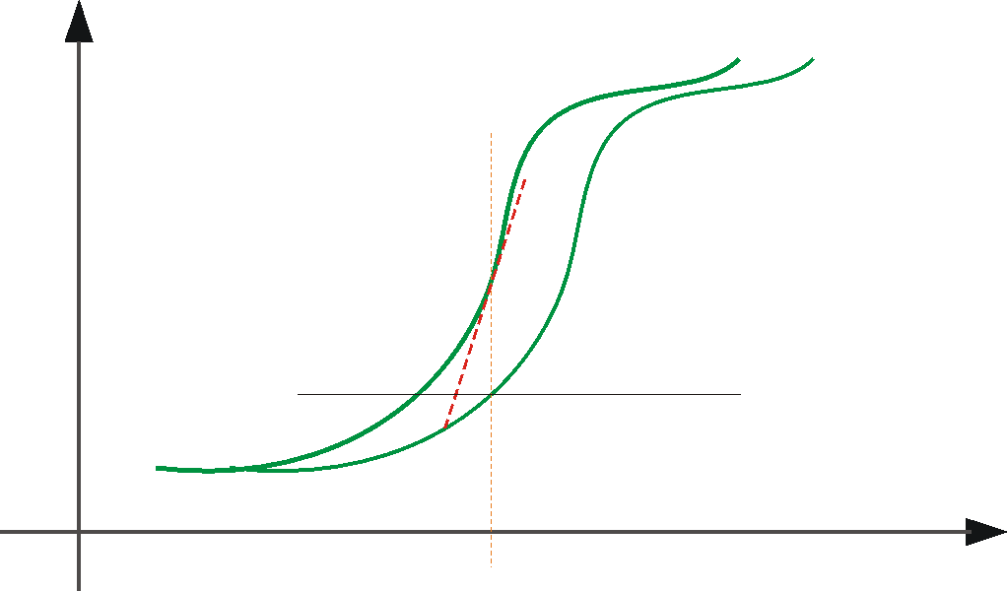





Optical Flow: Iterative Estimation
estimate update
Initial guess:
Estimate:
x₀
x
(using d for displacement here instead of u)

Slide 51
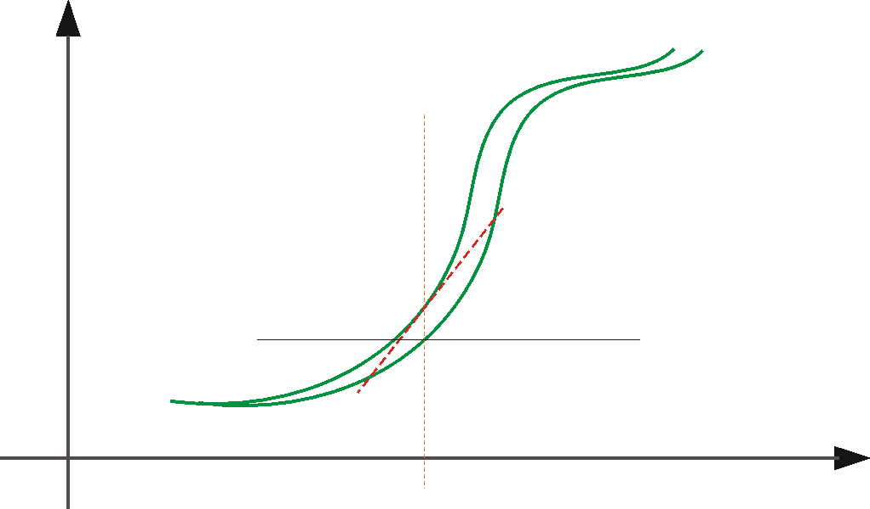



Optical Flow: Iterative Estimation
estimate update
Initial guess:
Estimate:
x₀
x

Slide 52
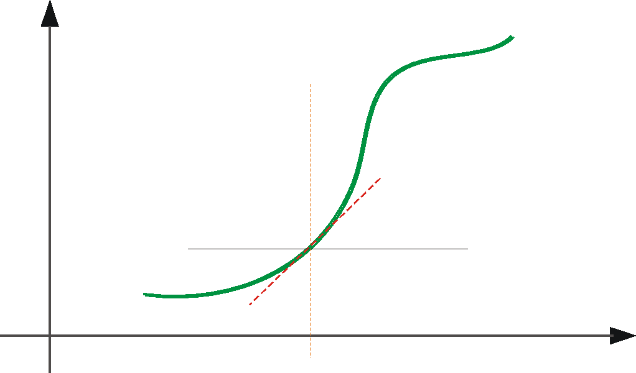



Optical Flow: Iterative Estimation
estimate update
Initial guess:
Estimate:
Initial guess:
Estimate:
x₀
x

Slide 53
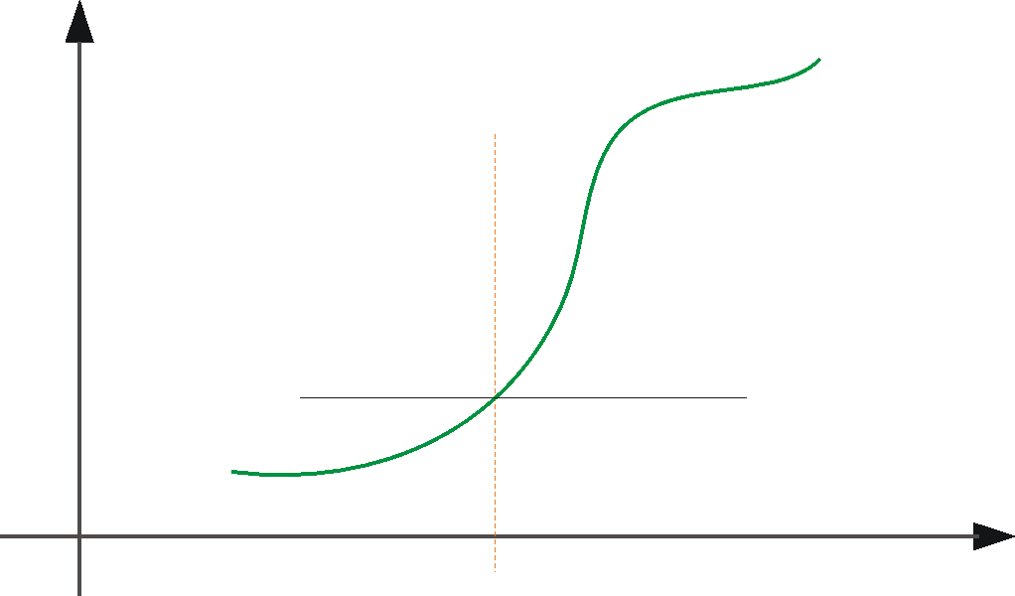

Optical Flow: Iterative Estimation
x₀
x

Slide 54
Optical Flow: Iterative Estimation
Some Implementation Issues:
  Warping is not easy (ensure that errors in warping are smaller than the estimate refinement) – but it is in MATLAB!
  Often useful to low-pass filter the images before motion estimation (for better derivative estimation, and linear approximations to image intensity)

Slide 55
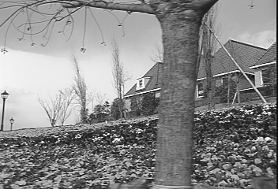
Revisiting the small motion assumption
Is this motion small enough?
  Probably not—it’s much larger than one pixel
  How might we solve this problem?

Slide 56


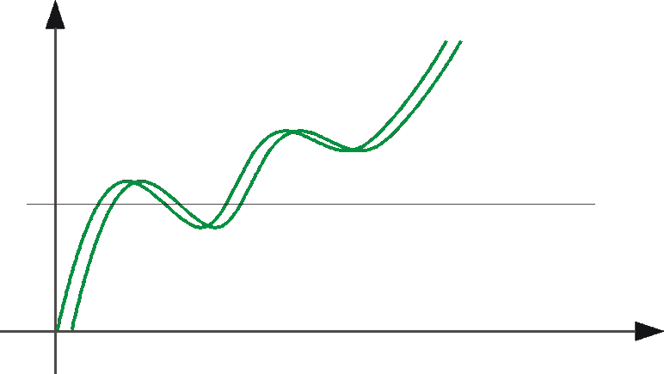
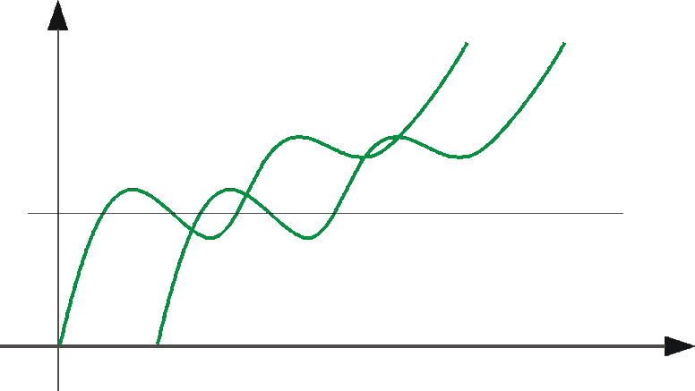
Optical Flow: Aliasing
Temporal aliasing causes ambiguities in optical flow because images can have many pixels with the same intensity.
I.e., how do we know which ‘correspondence’ is correct?
actual shift
estimated shift
nearest match is correct (no aliasing)
nearest match is incorrect (aliasing)
To overcome aliasing: coarse-to-fine estimation.

Slide 57




Reduce the resolution!

Slide 58
Coarse-to-fine optical flow estimation
u=1.25 pixels
u=2.5 pixels
u=5 pixels
image 1
u=10 pixels
image 2
image 1
image 2
Gaussian pyramid of image 1
Gaussian pyramid of image 2

Slide 59
Coarse-to-fine optical flow estimation
run iterative L-K
warp & upsample
run iterative L-K
.
.
.
image J
image I
image 1
image 2
Gaussian pyramid of image 1
Gaussian pyramid of image 2

Slide 60

Optical Flow Results
* From Khurram Hassan-Shafique CAP5415 Computer Vision 2003

Slide 61

Optical Flow Results
* From Khurram Hassan-Shafique CAP5415 Computer Vision 2003

Slide 62


State-of-the-art optical flow, 2009
Start with something similar to Lucas-Kanade
+ gradient constancy
+ energy minimization with smoothing term
+ region matching
+ keypoint matching (long-range)
Region-based
+Pixel-based
+Keypoint-based
Large displacement optical flow, Brox et al., CVPR 2009

Slide 63

State-of-the-art optical flow, 2015
Deep convolutional network which accepts a pair of input frames and upsamples the estimated flow back to input resolution. Very fast because of deep network, near the state-of-the-art in terms of end-point-error.
Fischer et al. 2015. https://arxiv.org/abs/1504.06852
Notes:
Optical flow as supervised learning

Slide 64

State-of-the-art optical flow, 2015
Synthetic Training data
Fischer et al. 2015. https://arxiv.org/abs/1504.06852

Slide 65

State-of-the-art optical flow, 2015
Results on Sintel
Fischer et al. 2015. https://arxiv.org/abs/1504.06852

Slide 66
Optical flow
Definition: optical flow is the apparent motion of brightness patterns in the image
Ideally, optical flow would be the same as the motion field
Have to be careful: apparent motion can be caused by lighting changes without any actual motion
  Think of a uniform rotating sphere under fixed lighting vs. a stationary sphere under moving illumination

