Slide 1
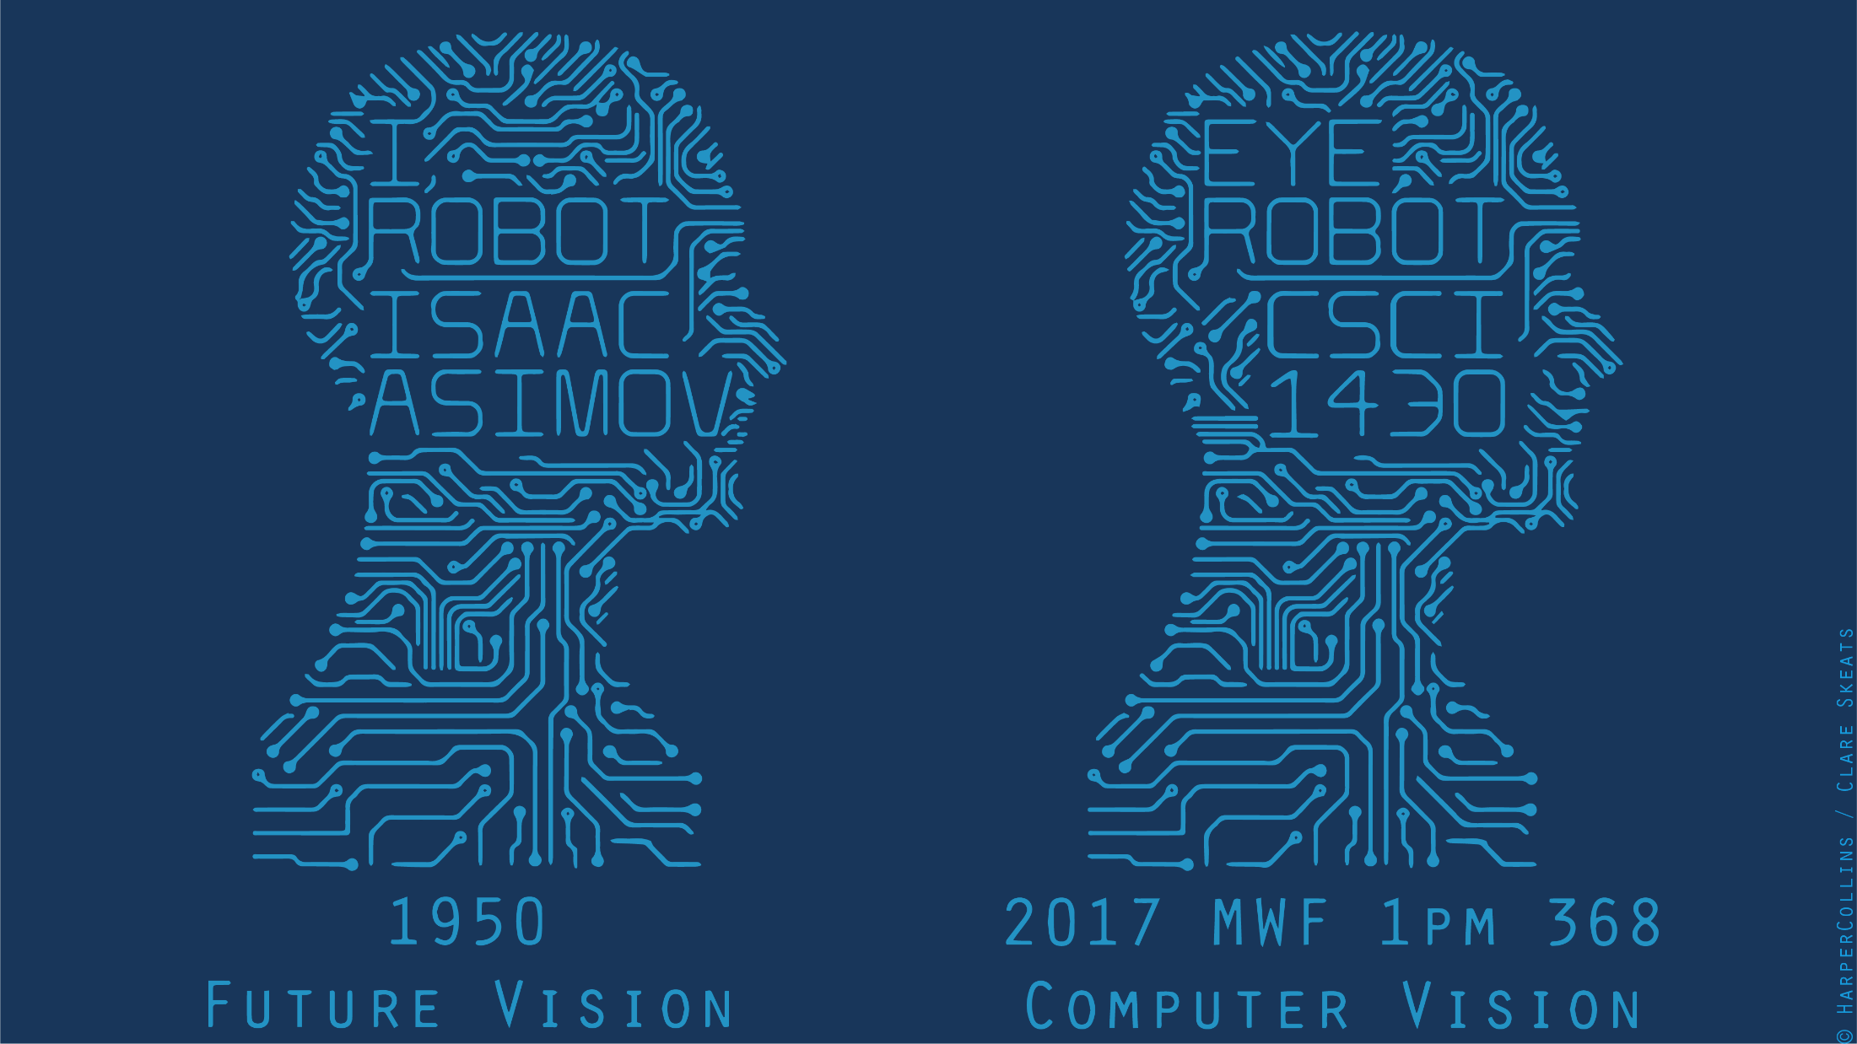

Slide 2
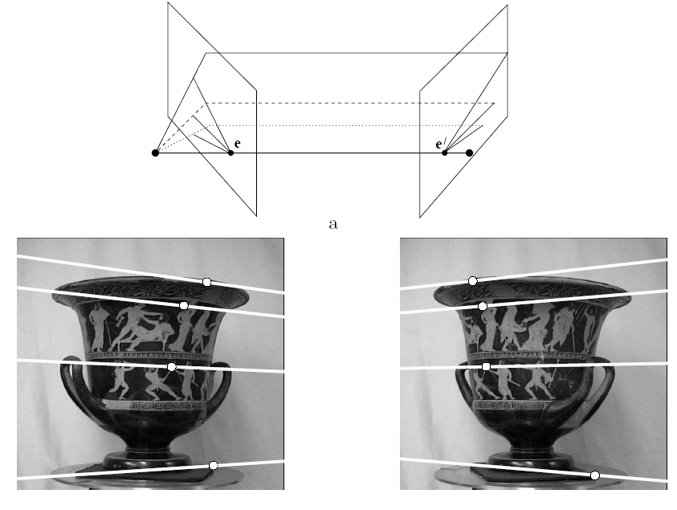
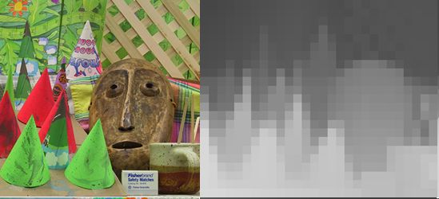
Multiple views
stereo vision
structure from motion
optical flow
Lowe
Hartley and Zisserman
James Hays

Slide 3
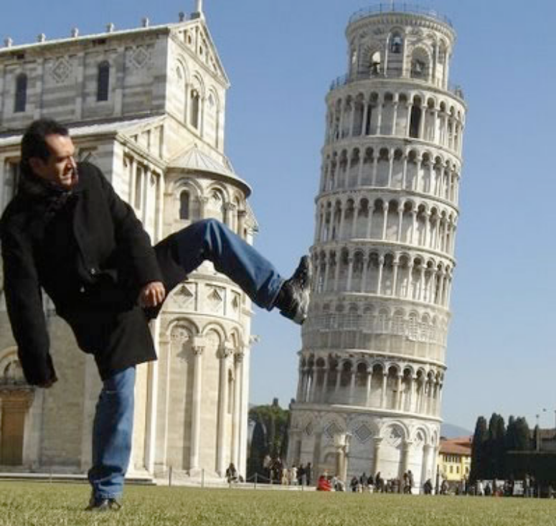
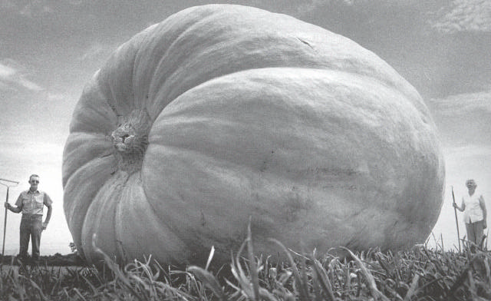
Why multiple views?
Structure and depth are inherently ambiguous from single views.
Images from Lana Lazebnik

Slide 4
Why multiple views?
Structure and depth are inherently ambiguous from single views.
P1
P2
P1’=P2’
Optical center
James Hays

Slide 5
Geometry for a simple stereo system
First, assuming parallel optical axes, known camera parameters (i.e., calibrated cameras):

Slide 6
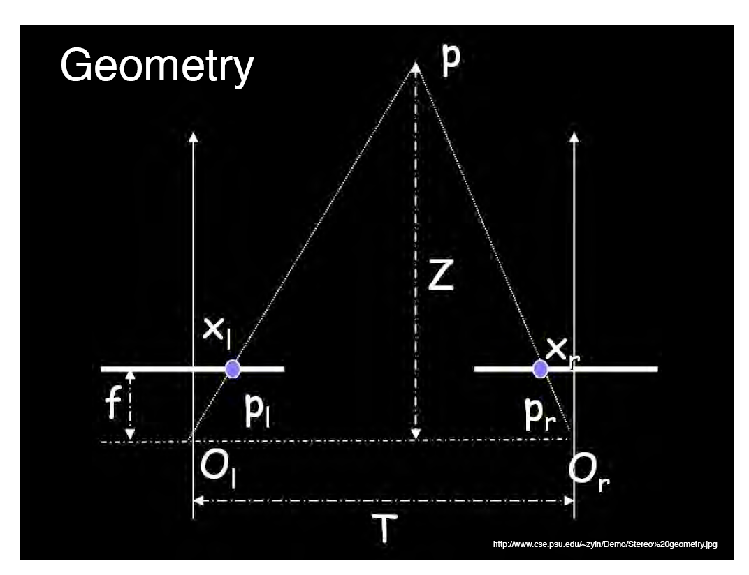
World point
Depth of p
image point (left)
image point (right)
Focal length
optical center (right)
optical center (left)
baseline
Notes:
6

Slide 7
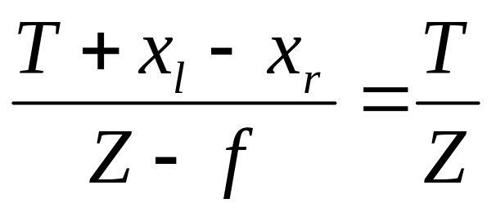
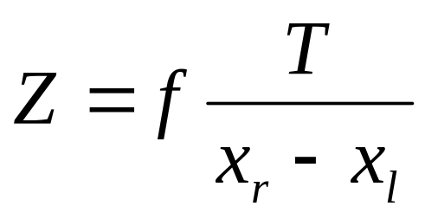
Geometry for a simple stereo system
Assume parallel optical axes, known camera parameters (i.e., calibrated cameras). What is expression for Z?
Similar triangles (p_{l}, P, p_{r}) and (O_{l}, P, O_{r}):
disparity
Notes:
7

Slide 8
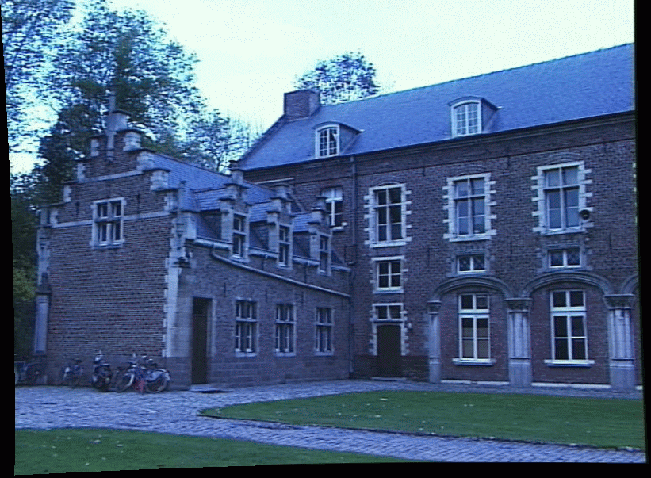
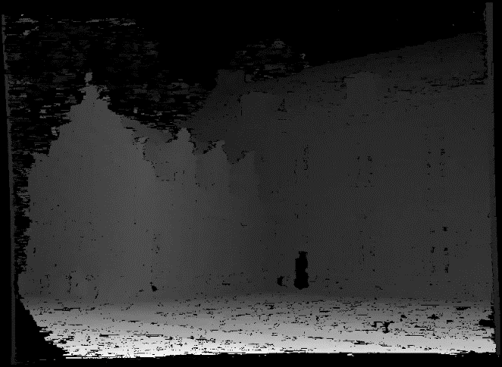
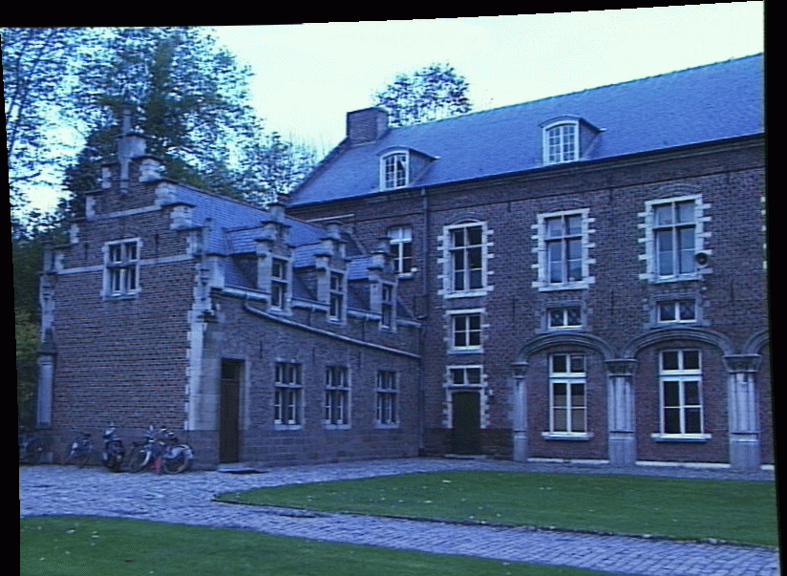
Depth from disparity
image I(x,y)
Disparity map D(x,y)
image I´(x´,y´)
(x´,y´)=(x+D(x,y), y)
If we could find the corresponding points in two images, we could estimate relative depth…
James Hays

Slide 9
What do we need to know?
Calibration for the two cameras.
  Intrinsic matrices for both cameras (e.g., f)
  Baseline distance T in parallel camera case
  R, t in non-parallel case
2. Correspondence for every pixel.
Like project 2, but project 2 is “sparse”.
We need “dense” correspondence!

Slide 10
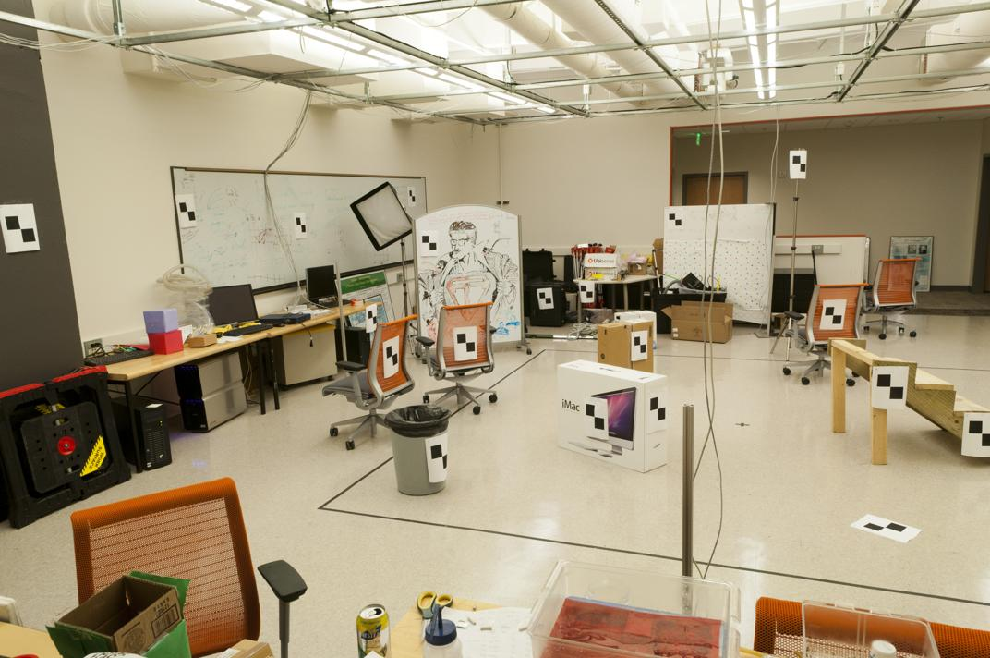
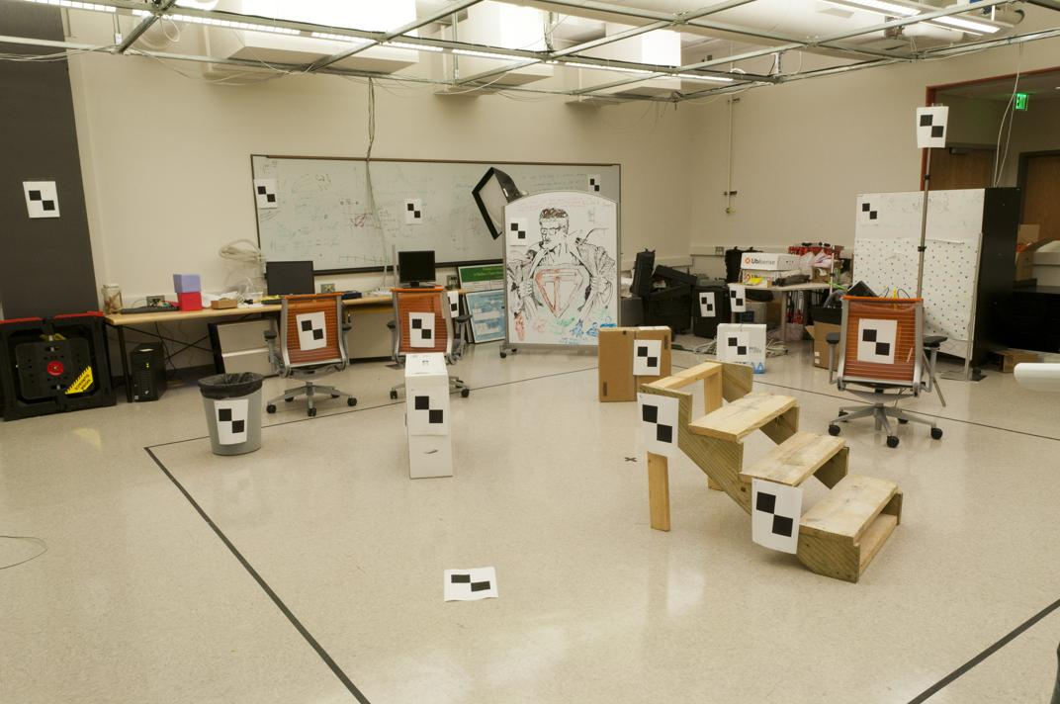
Early Peek:
2. Correspondence for every pixel.
Where do we need to search?

Slide 11
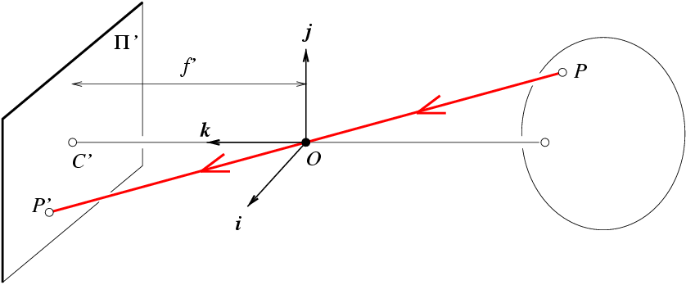
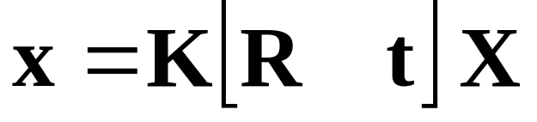
Slide Credit: Savarese
1. Calibration for the two cameras.
R,t
j_{w}
X
k_{w}
O_{w}
x
i_{w}
x: Image Coordinates: (u,v,1)
K: Intrinsic Matrix (3x3)
R: Rotation (3x3)
t: Translation (3x1)
X: World Coordinates: (X,Y,Z,1)
Extrinsic Matrix
Think of [R t] as the transformation from camera 1 to camera 2 in stereo system.
Notes:
We can use homogeneous coordinates to write ‘camera matrix’ in linear form.

Slide 12

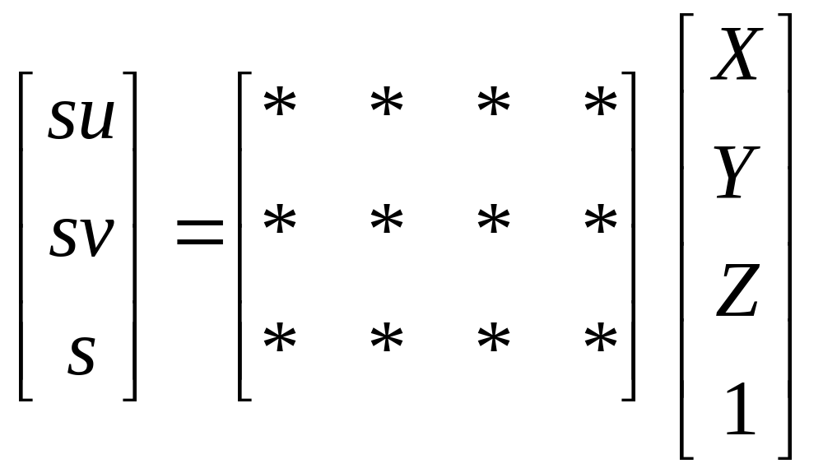
How to calibrate the camera?
(also called “camera resectioning”)
James Hays

Slide 13
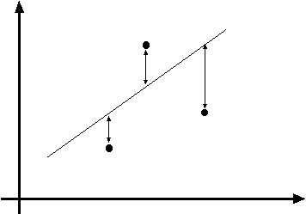
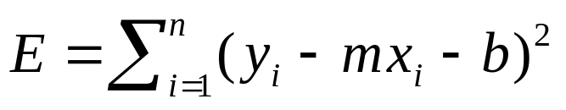
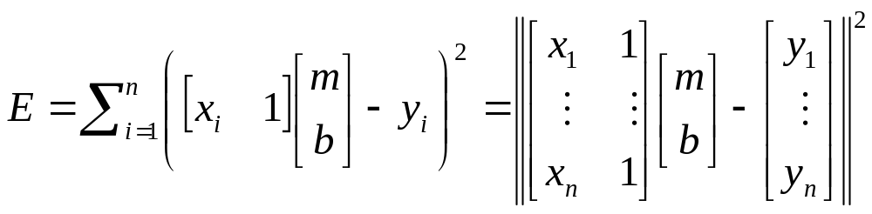
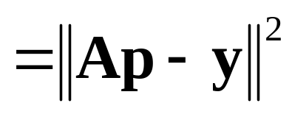

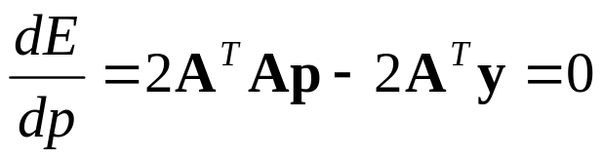
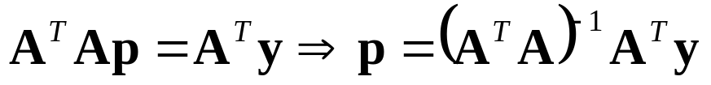
Least squares line fitting
Data: (x₁, y₁), …, (x_{n}, y_{n})
Line equation: y_{i} = m x_{i} + b
Find (m, b) to minimize
y=mx+b
(x_{i}, y_{i})
Matlab: p = A \ y;
(Closed form solution)
Modified from S. Lazebnik
Notes:
What is p here? p is [m b]’
The minimum is determined by calculating the partial derivatives of E with respect to p and setting them to zero.

Slide 14

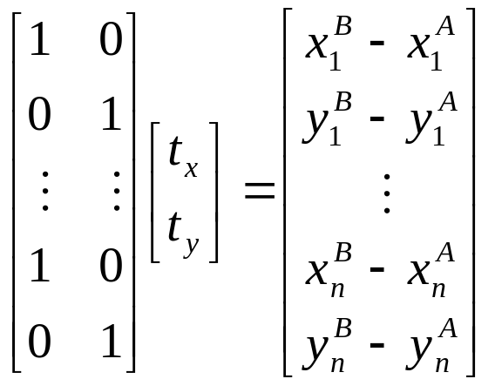
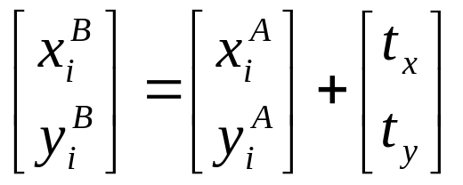
Example: solving for translation
A₁
A₂
A₃
(t_{x}, t_{y})
B₁
B₂
B₃
Least squares setup
Notes:
Solve using pseudo-inverse or eigenvalue decomposition

Slide 15
World vs Camera coordinates
James Hays

Slide 16
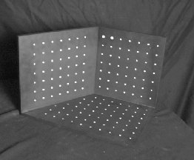
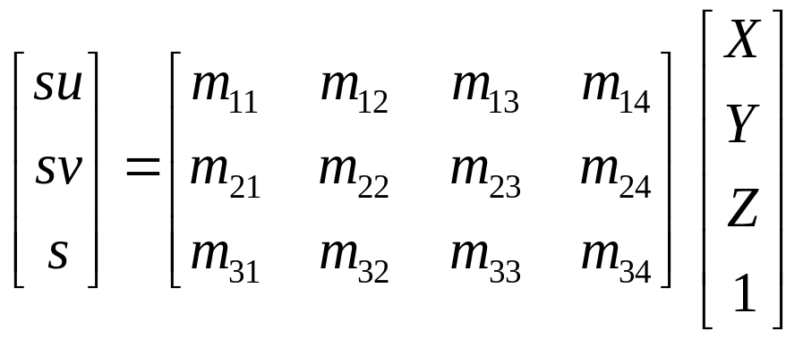
Calibrating the Camera
James Hays
Use an scene with known geometry
  Correspond image points to 3d points
  Get least squares solution (or non-linear solution)
Known 2d image coords
Known 3d
world locations
M
Unknown Camera Parameters

Slide 17
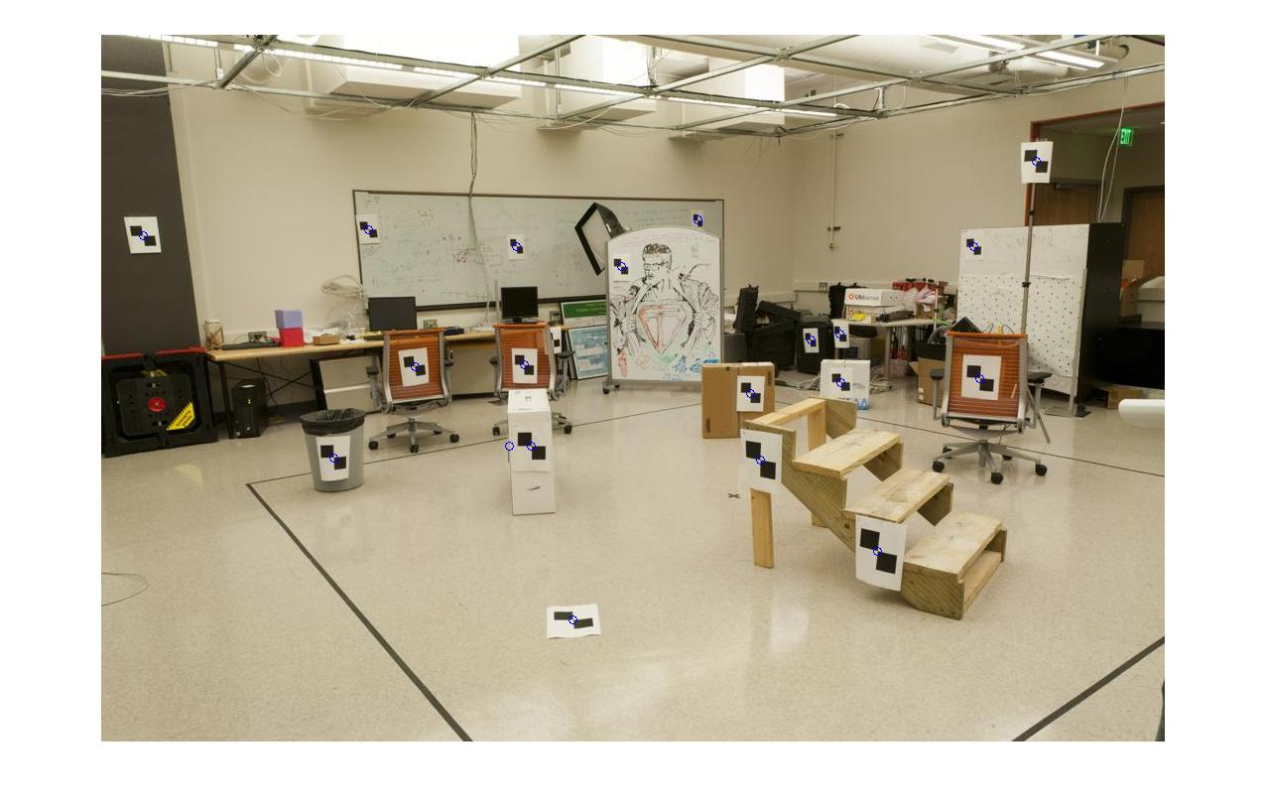
How do we calibrate a camera?
Known 2d image coords
Known 3d world locations
880 214
43 203
270 197
886 347
745 302
943 128
476 590
419 214
317 335
783 521
235 427
665 429
655 362
427 333
412 415
746 351
434 415
525 234
716 308
602 187
312.747 309.140 30.086
305.796 311.649 30.356
307.694 312.358 30.418
310.149 307.186 29.298
311.937 310.105 29.216
311.202 307.572 30.682
307.106 306.876 28.660
309.317 312.490 30.230
307.435 310.151 29.318
308.253 306.300 28.881
306.650 309.301 28.905
308.069 306.831 29.189
309.671 308.834 29.029
308.255 309.955 29.267
307.546 308.613 28.963
311.036 309.206 28.913
307.518 308.175 29.069
309.950 311.262 29.990
312.160 310.772 29.080
311.988 312.709 30.514
James Hays

Slide 18
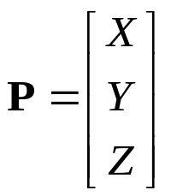
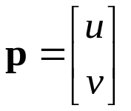
What is least squares doing?
Given 3D point evidence, find best M which minimizes error between estimate (p’) and known corresponding 2D points (p).
.
Error between M estimate and known projection point
.
.
f
Z
Y
.
.
v
Camera center
p’ under M
u
p = distance from image center

Slide 19
What is least squares doing?
Best M occurs when p’ = p, or when p’ – p = 0
Form these equations from all point evidence
Solve for model via closed-form regression
.
Error between M estimate and known projection point
.
.
f
Z
Y
.
.
v
Camera center
p’ under M
u
p = distance from image center

Slide 20



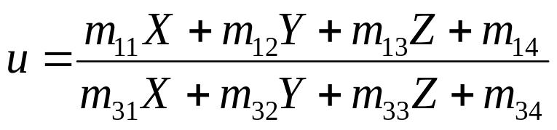
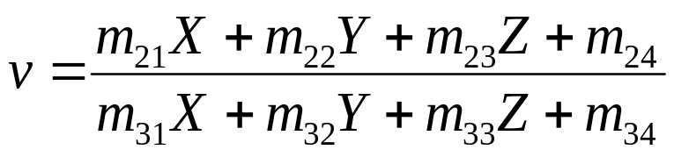
Unknown Camera Parameters
Known 2d image coords
Known 3d locations
First, work out where X,Y,Z projects to under candidate M.
Two equations per 3D point correspondence
James Hays

Slide 21
Unknown Camera Parameters
Known 2d image coords
Known 3d locations
Next, rearrange into form where all M coefficients are individually stated in terms of X,Y,Z,u,v.
-> Allows us to form lsq matrix.

Slide 22
Unknown Camera Parameters
Known 2d image coords
Known 3d locations
Next, rearrange into form where all M coefficients are individually stated in terms of X,Y,Z,u,v.
-> Allows us to form lsq matrix.

Slide 23
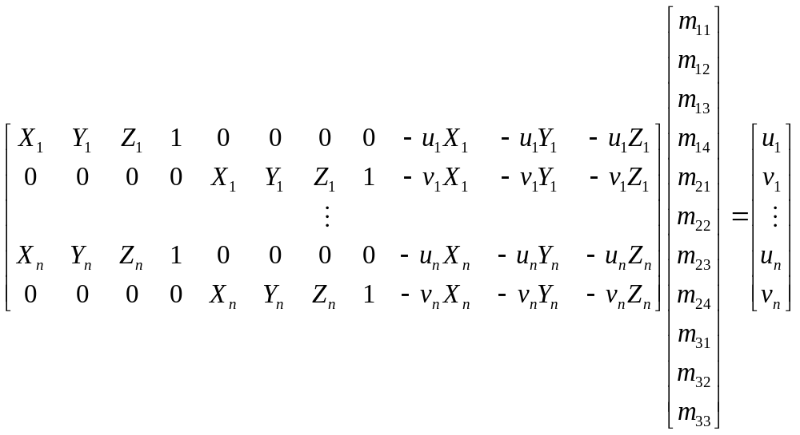
Unknown Camera Parameters
Known 2d image coords
Known 3d locations
Finally, solve for m’s entries using linear least squares
Method 1 –
Ax=b form
M = A\Y;
M = [M;1];
M = reshape(M,[],3)';
James Hays
Notes:
Method 1 – nonhomogeneous linear system. Not related to homogeneous coordinates!! - https://en.m.wikipedia.org/wiki/System_of_linear_equations

Slide 24
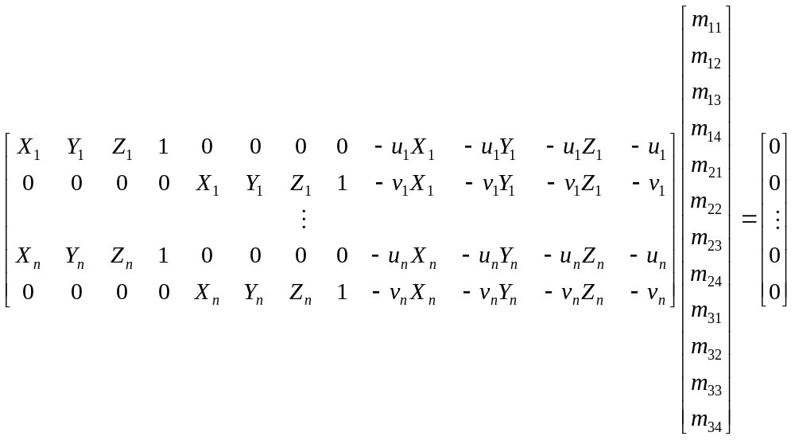
Unknown Camera Parameters
Known 2d image coords
Known 3d locations
Or, solve for m’s entries using total linear least-squares.
Method 2 –
Ax=0 form
[U, S, V] = svd(A);
M = V(:,end);
M = reshape(M,[],3)';
James Hays
Notes:
Method 2 – homogeneous linear system. Not related to homogeneous coordinates!! - https://en.m.wikipedia.org/wiki/System_of_linear_equations

Slide 25
How do we calibrate a camera?
Known 2d image coords
Known 3d world locations
880 214
43 203
270 197
886 347
745 302
943 128
476 590
419 214
317 335
783 521
235 427
665 429
655 362
427 333
412 415
746 351
434 415
525 234
716 308
602 187
312.747 309.140 30.086
305.796 311.649 30.356
307.694 312.358 30.418
310.149 307.186 29.298
311.937 310.105 29.216
311.202 307.572 30.682
307.106 306.876 28.660
309.317 312.490 30.230
307.435 310.151 29.318
308.253 306.300 28.881
306.650 309.301 28.905
308.069 306.831 29.189
309.671 308.834 29.029
308.255 309.955 29.267
307.546 308.613 28.963
311.036 309.206 28.913
307.518 308.175 29.069
309.950 311.262 29.990
312.160 310.772 29.080
311.988 312.709 30.514
James Hays

Slide 26
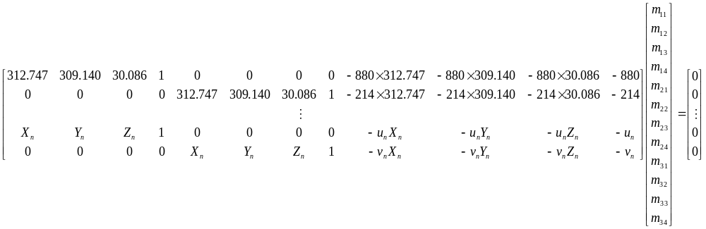


Known 2d image coords
Known 3d world locations
1st point
880 214
43 203
270 197
886 347
745 302
943 128
476 590
419 214
335
…
$$(u1,v1)$$
312.747 309.140 30.086
305.796 311.649 30.356
307.694 312.358 30.418
310.149 307.186 29.298
311.937 310.105 29.216
311.202 307.572 30.682
307.106 306.876 28.660
309.317 312.490 30.230
307.435 310.151 29.318
…..
$$(X1,Y1,Z1)$$
Projection error defined by two equations – one for u and one for v

Slide 27
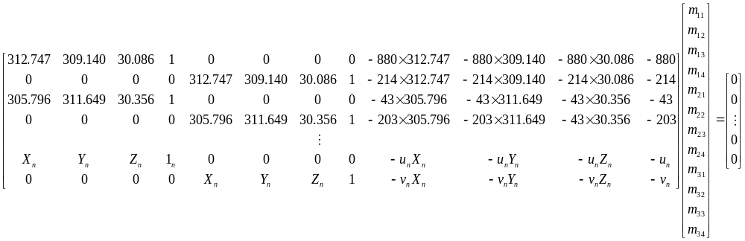


Known 2d image coords
Known 3d world locations
880 214
43 203
270 197
886 347
745 302
943 128
476 590
419 214
335
…
312.747 309.140 30.086
305.796 311.649 30.356
307.694 312.358 30.418
310.149 307.186 29.298
311.937 310.105 29.216
311.202 307.572 30.682
307.106 306.876 28.660
309.317 312.490 30.230
307.435 310.151 29.318
…..
2nd point
$$(u2,v2)$$
$$(X2,Y2,Z2)$$
Projection error defined by two equations – one for u and one for v

Slide 28
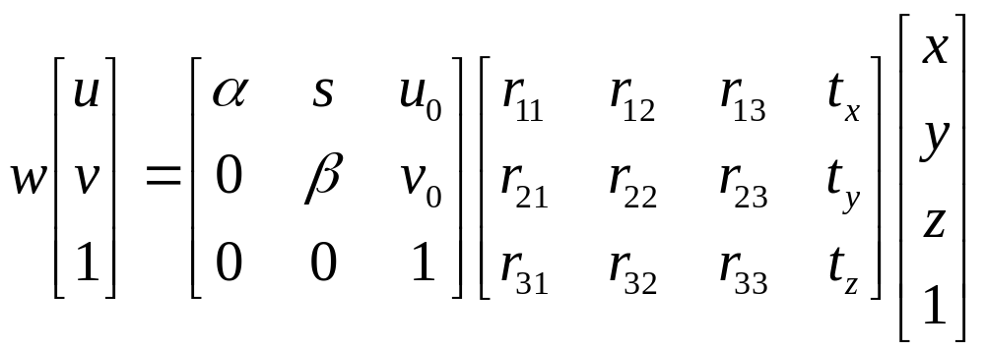
How many points do I need to fit the model?
Degrees of freedom?
5
6
Think 3:
Rotation around x
Rotation around y
Rotation around z
Notes:
How many known points are needed to estimate this?
Why 5?
Why 6? Don’t we have 12 parameters here?
But matrix is not full rank -> it’s a projection (we can tell because it isn’t square -> the column space is 4D, but the row space is 3D, so this matrix projects a 4D space to a 3D space)
One of the dimensions is lost – intuitive, dimensionality reduction machine.
Ambiguous scale in the camera projection matrix. This scale is in the null space of the matrix, i.e., there is a line of possible solutions (plane?)

Slide 29
How many points do I need to fit the model?
Degrees of freedom?
5
6
M is 3x4, so 12 unknowns, but projective scale ambiguity – 11 deg. freedom.
One equation per unknown -> 5 1/2 point correspondences determines a solution (e.g., either u or v).
More than 5 1/2 point correspondences -> overdetermined, many solutions to M.
Least squares is finding the solution that best satisfies the overdetermined system.
Why use more than 6? Robustness to error in feature points.
Notes:
How many known points are needed to estimate this?
Why 5?
Why 6? Don’t we have 12 parameters here?
8 equations in 2D -> 16 parameters
But matrix is not full rank -> it’s a projection (we can tell because it isn’t square -> the column space is 4D, but the row space is 3D, so this matrix projects a 4D space to a 3D space)
One of the dimensions is lost – intuitive, dimensionality reduction machine.
Ambiguous scale in the camera projection matrix. This scale is in the null space of the matrix, i.e., there is a line of possible solutions (plane?)
Actually only need 8 points to produce a valid (up to scale) projection matrix.

Slide 30
Solving - why two methods?
Any projection is inherently ambiguous
A space of possible solutions
Under projective model, this is our projective scale ambiguity.
x₁
x
v₁
v₂

Slide 31
Unknown Camera Parameters
Known 2d image coords
Known 3d locations
Method 1 – - p’ = p
To set scale, we artificially set m₃₄ to 1
Ax=b form
Note – you will see this form called ‘inhomogeneous’ linear system -> nothing to do with homogeneous coordinates
M = A\Y;
M = [M;1];
M = reshape(M,[],3)';
James Hays
Notes:
Method 1 – inhomogeneous linear system. Not related to homogeneous coordinates!! - https://en.m.wikipedia.org/wiki/System_of_linear_equations

Slide 32
Unknown Camera Parameters
Known 2d image coords
Known 3d locations
Method 2 – - p’ – p = 0
SVD – singular value decomposition
Computes pseudo-inverse
Ax=0 form
Note – you will see this form called ‘homogeneous’ linear system -> nothing to do with homogeneous coordinates
[U, S, V] = svd(A);
M = V(:,end);
M = reshape(M,[],3)';
James Hays
Notes:
Method 2 – homogeneous linear system. Not related to homogeneous coordinates!! - https://en.m.wikipedia.org/wiki/System_of_linear_equations

Slide 33
Calibration with linear method
Advantages
  Easy to formulate and solve
  Provides initialization for non-linear methods
Disadvantages
  Doesn’t directly give you camera parameters
  Doesn’t model radial distortion
  Can’t impose constraints, such as known focal length
Non-linear methods are preferred
  Define error as difference between projected points and measured points
  Minimize error using Newton’s method or other non-linear optimization
James Hays

Slide 34
Can we factorize M back to K [R | T]?
Yes!
We can directly solve for the individual entries of K [R | T].
James Hays

Slide 35
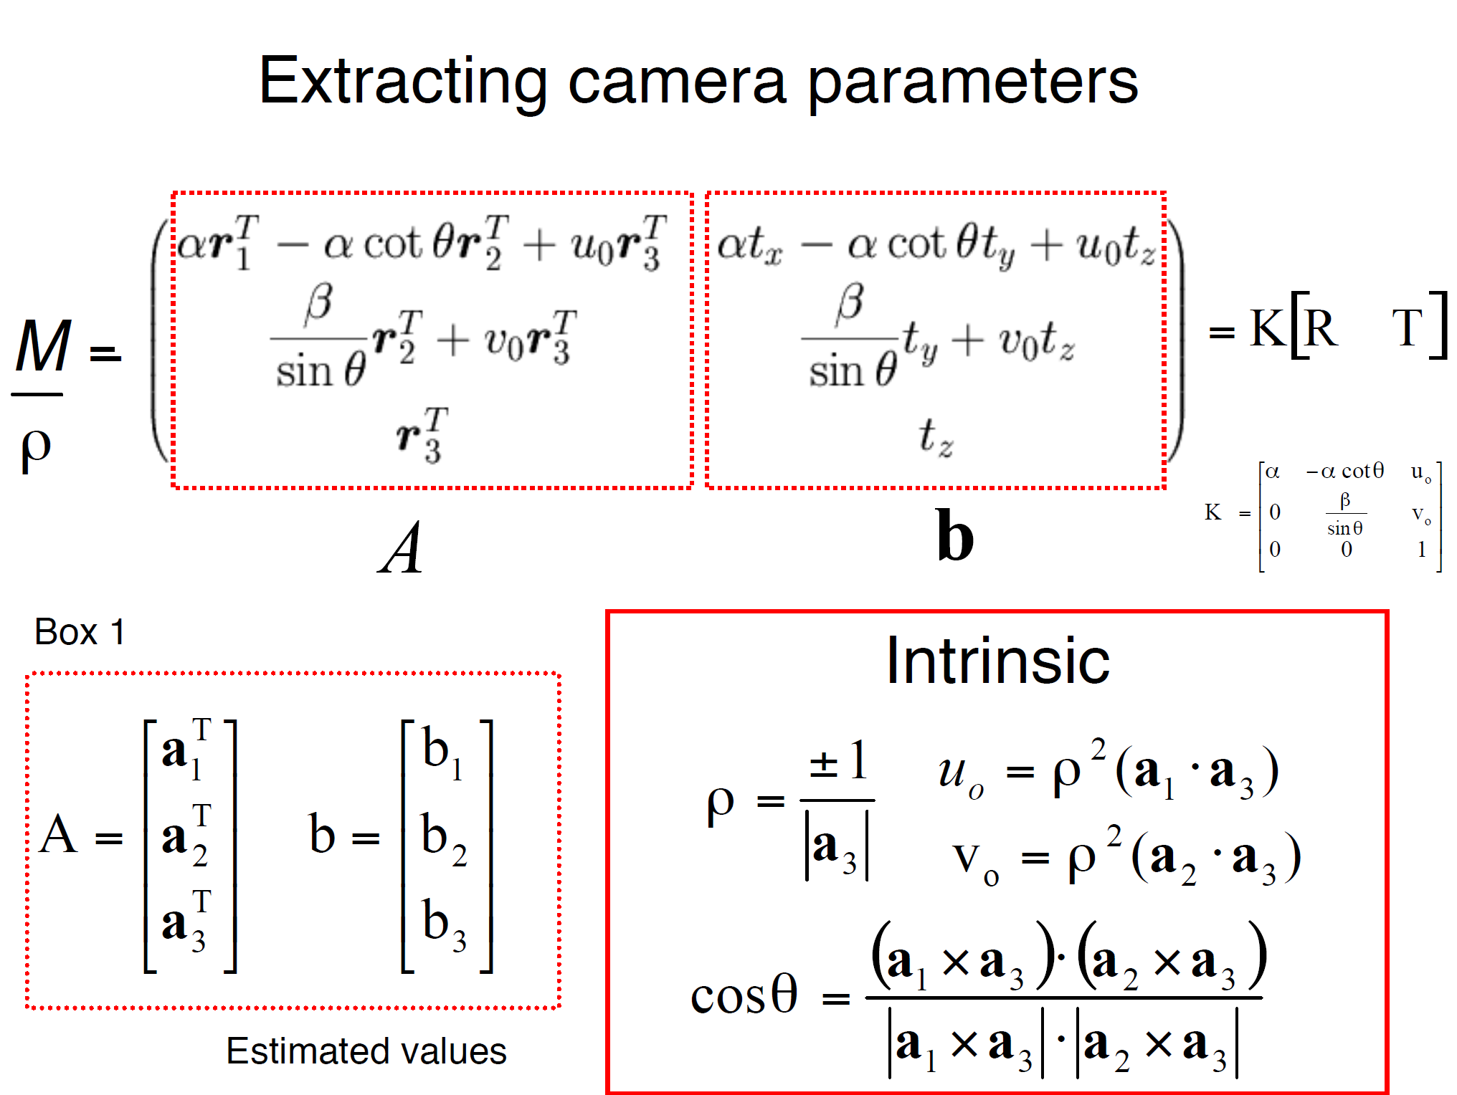
a_{n} = nth column of A
James Hays

Slide 36
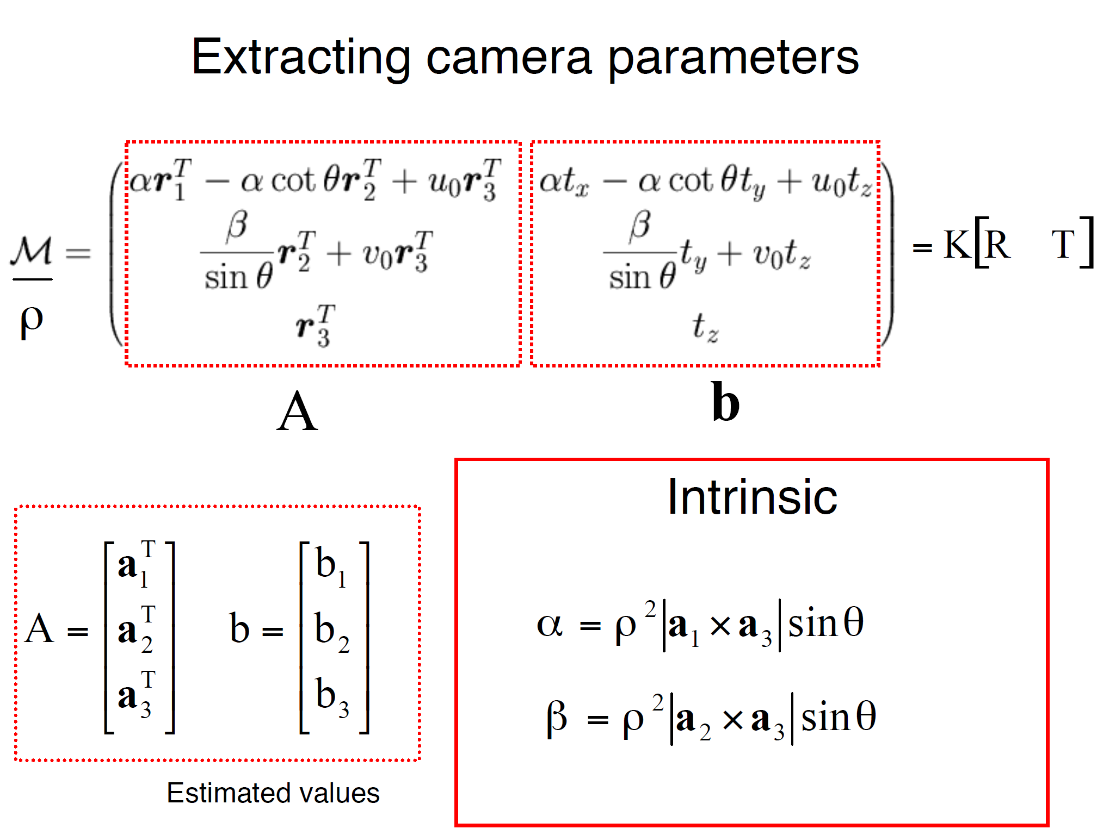
James Hays

Slide 37
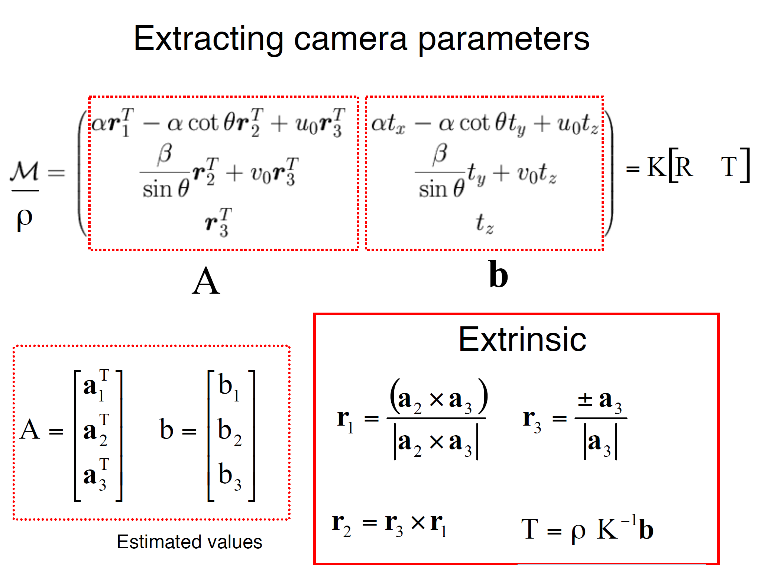
James Hays

Slide 38
Can we factorize M back to K [R | T]?
Yes!
We can also use RQ factorization (not QR)
  R in RQ is not rotation matrix R; crossed names!
R (right diagonal) is K
Q (orthogonal basis) is R.
T, the last column of [R | T], is inv(K) * last column of M.
  But you need to do a bit of post-processing to make sure that the matrices are valid. See http://ksimek.github.io/2012/08/14/decompose/
James Hays

Slide 39
For project 3, we want the camera center

Slide 40
Recovering the camera center
This is not the camera center C.
It is –RC, as the point is rotated before t_{x}, t_{y}, and t_{z} are added
t
So we need
-R⁻¹ K⁻¹ m₄ to get C.
m₄
This is t × K
So K⁻¹ m₄ is t
Q is K × R.
So we just need -Q⁻¹ m₄
Q
James Hays

Slide 41
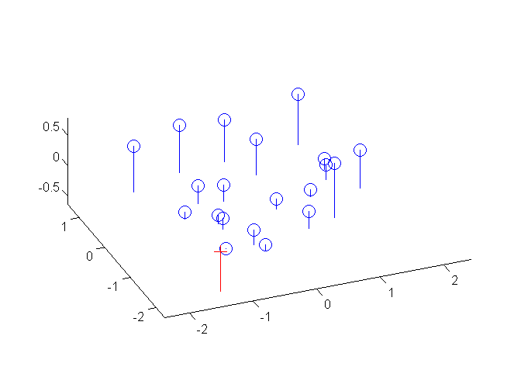
Estimate of camera center
1.0486 -0.3645
-1.6851 -0.4004
-0.9437 -0.4200
1.0682 0.0699
0.6077 -0.0771
1.2543 -0.6454
-0.2709 0.8635
-0.4571 -0.3645
-0.7902 0.0307
0.7318 0.6382
-1.0580 0.3312
0.3464 0.3377
0.3137 0.1189
-0.4310 0.0242
-0.4799 0.2920
0.6109 0.0830
-0.4081 0.2920
-0.1109 -0.2992
0.5129 -0.0575
0.1406 -0.4527
1.5706 -0.1490 0.2598
-1.5282 0.9695 0.3802
-0.6821 1.2856 0.4078
0.4124 -1.0201 -0.0915
1.2095 0.2812 -0.1280
0.8819 -0.8481 0.5255
-0.9442 -1.1583 -0.3759
0.0415 1.3445 0.3240
-0.7975 0.3017 -0.0826
-0.4329 -1.4151 -0.2774
-1.1475 -0.0772 -0.2667
-0.5149 -1.1784 -0.1401
0.1993 -0.2854 -0.2114
-0.4320 0.2143 -0.1053
-0.7481 -0.3840 -0.2408
0.8078 -0.1196 -0.2631
-0.7605 -0.5792 -0.1936
0.3237 0.7970 0.2170
1.3089 0.5786 -0.1887
1.2323 1.4421 0.4506

