Slide 1


Slide 2
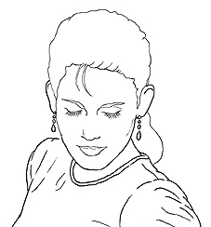
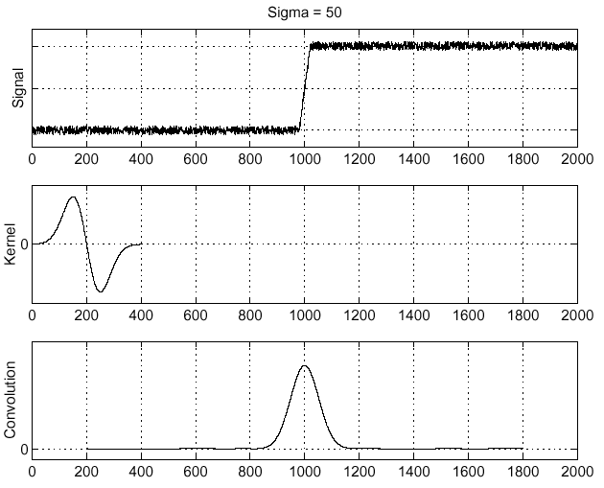


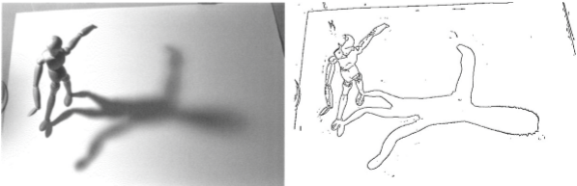
Last lecture: Edges primer
Edge detection to identify
visual change in image
Derivative of Gaussian
and linear combination
of convolutions
What is an edge?
What is a good edge?
f

Slide 3
Canny edge detector
Probably the most widely used edge detector in computer vision.
Theoretical model: step-edges corrupted by additive Gaussian noise.
Canny showed that first derivative of Gaussian closely approximates the operator that optimizes the product of signal-to-noise ratio and localization.
J. Canny, A Computational Approach To Edge Detection, IEEE Trans. Pattern Analysis and Machine Intelligence, 8:679-714, 1986.
22,000 citations!
L. Fei-Fei

Slide 4
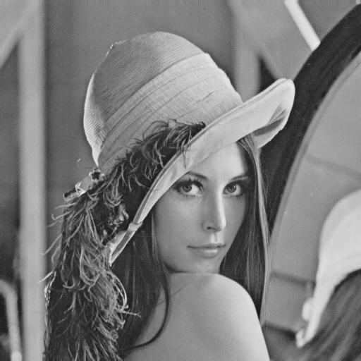
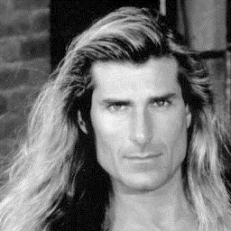
Examples: Controversy and Appropriateness
‘Lena’
‘Fabio’
Alexander Sawchuk @ USC, 1973
Deanna Needell @ Claremont McKenna, 2012
Notes:
Lena Söderberg
November 1972 Playboy
https://en.wikipedia.org/wiki/Lenna
“In 2015, Lena Söderberg was also guest of honor at the banquet of IEEE ICIP 2015.”
“To explain Lena's popularity, David C. Munson, editor-in-chief of IEEE Transactions on Image Processing, noted that it was a good test image because of its detail, flat regions, shading, and texture. However, he also noted that its popularity was largely because an image of an attractive woman appealed to the males in a male-dominated field.”
Fabio Lanzoni
All around 1980’s heartthrob
Deanna Needell introduced him in a 2012 paper.

Slide 5
If it wasn’t clear from class…
Use of Lena is now generally considered inappropriate, as it is not inclusive.
If you wish to include models, then please respect diversity.
We will approach diversity issues in more detail when we start to talk about machine learning and datasets.

Slide 6
Canny edge detector
Filter image with x, y derivatives of Gaussian
Source: D. Lowe, L. Fei-Fei

Slide 7
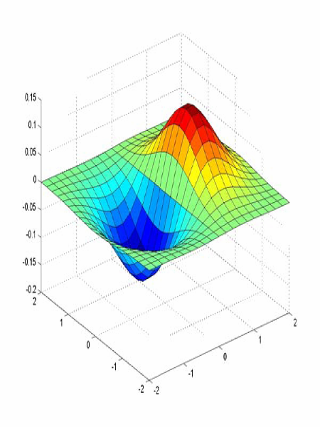
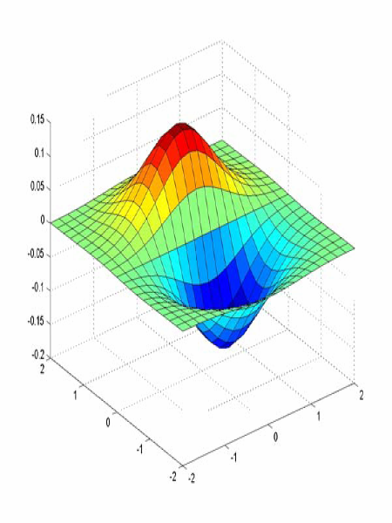
Derivative of Gaussian filter
x-direction
y-direction

Slide 8
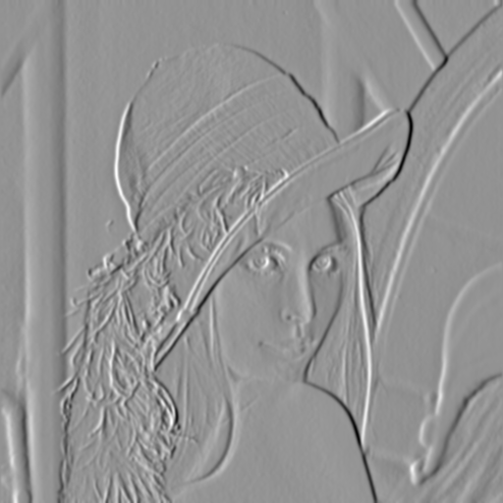
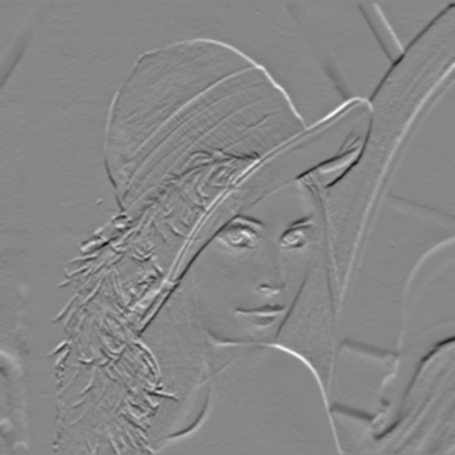
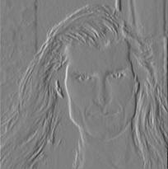
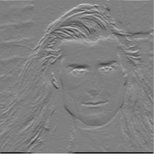
Compute Gradients
X-Derivative of Gaussian
Y-Derivative of Gaussian

Slide 9
Canny edge detector
Filter image with x, y derivatives of Gaussian
Find magnitude and orientation of gradient
Source: D. Lowe, L. Fei-Fei

Slide 10
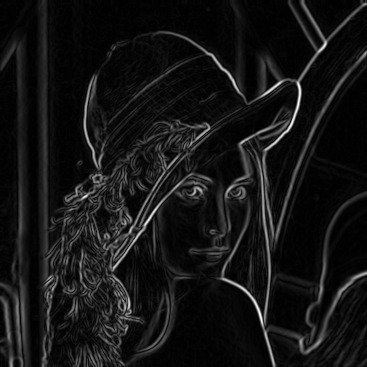
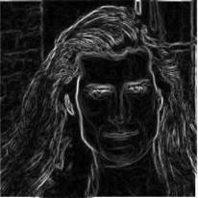
Compute Gradient Magnitude
sqrt( X-Deriv.ofGaussian ^2 + Y-Deriv.ofGaussian ^2 ) = gradient magnitude

Slide 11
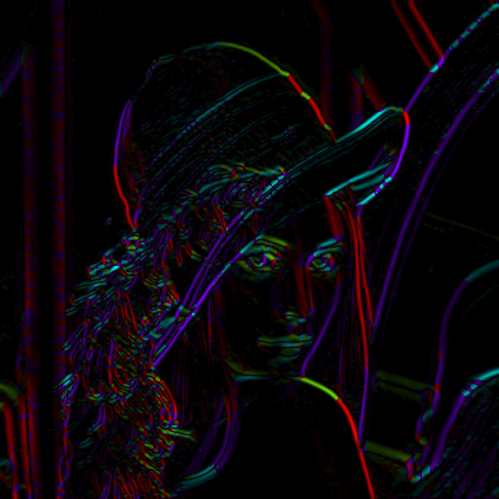
Compute Gradient Orientation
Threshold magnitude at minimum level
Get orientation via
theta = atan2(gy, gx)

Slide 12
Canny edge detector
Filter image with x, y derivatives of Gaussian
Find magnitude and orientation of gradient
Non-maximum suppression:
  Thin multi-pixel wide “ridges” to single pixel width
Source: D. Lowe, L. Fei-Fei

Slide 13


Non-maximum suppression for each orientation
At pixel q:
We have a maximum if the value is larger than those at both p and at r.
Interpolate along gradient direction to get these values.
Source: D. Forsyth

Slide 14
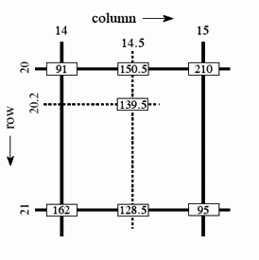
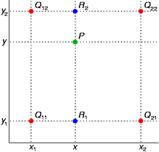

Sidebar: Bilinear Interpolation
http://en.wikipedia.org/wiki/Bilinear_interpolation

Slide 15
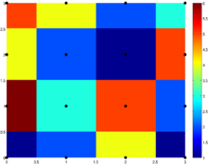
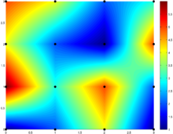
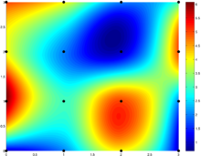
Sidebar: Interpolation options
imx2 = imresize(im, 2, interpolation_type)
‘nearest’
  Copy value from nearest known
  Very fast but creates blocky edges
‘bilinear’
  Weighted average from four nearest known pixels
  Fast and reasonable results
‘bicubic’ (default)
  Non-linear smoothing over larger area (4x4)
  Slower, visually appealing, may create negative pixel values
Examples from http://en.wikipedia.org/wiki/Bicubic_interpolation

Slide 16
Non-maximum suppression for each orientation
At pixel q:
We have a maximum if the value is larger than those at both p and at r.
Interpolate along gradient direction to get these values.
Source: D. Forsyth

Slide 17
Before Non-max Suppression
Gradient magnitude
James Hays

Slide 18
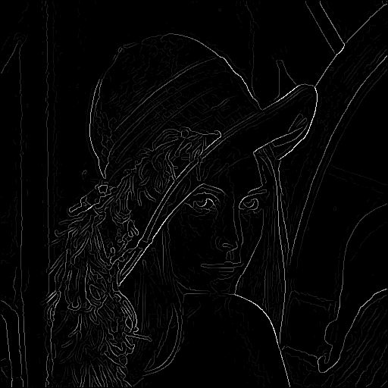
After non-max suppression
Gradient magnitude
James Hays

Slide 19
Canny edge detector
Filter image with x, y derivatives of Gaussian
Find magnitude and orientation of gradient
Non-maximum suppression:
  Thin multi-pixel wide “ridges” to single pixel width
‘Hysteresis’ Thresholding:
  Define two thresholds: low and high
  Use the high threshold to start edge curves and the low threshold to continue them
  ‘Follow’ edges starting from strong edge pixels
    Connected components (Szeliski 3.3.4)
Source: D. Lowe, L. Fei-Fei
Notes:
Hysteresis is the dependence of the state of a system on its history -> bad word to use in this sense (comes from engineering)

Slide 20
Edge linking
Assume the marked point is an edge point. Then we construct the tangent to the edge curve (which is normal to the gradient at that point) and use this to predict the next points (here either r or s).
Source: D. Forsyth

Slide 21
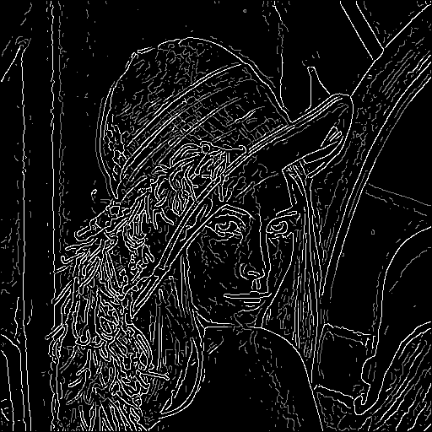
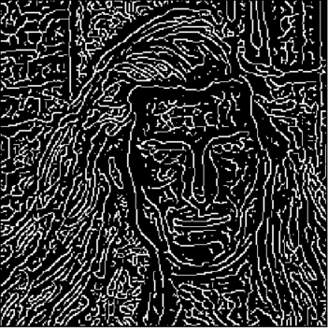
Hysteresis thresholding
Threshold at low/high levels to get weak/strong edge pixels
‘Follow’ edges starting from strong edge pixels
  Connected components

Slide 22
‘Hysteresis’ thresholding
Two thresholds – high and low
Grad. mag. > high threshold? = strong edge
Grad. mag. < low threshold? noise
In between = weak edge
‘Follow’ edges starting from strong edge pixels
Continue them into weak edges
    Connected components (Szeliski 3.3.4)
Source: S. Seitz

Slide 23
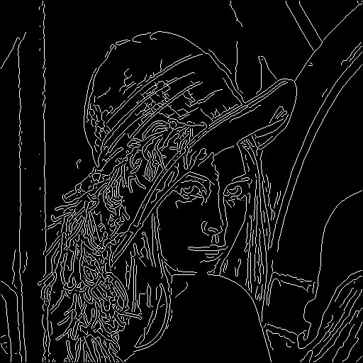
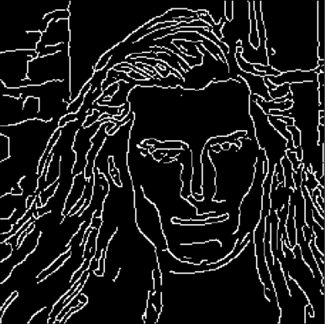
Final Canny Edges

Slide 24
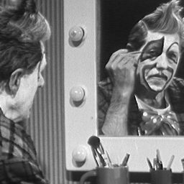
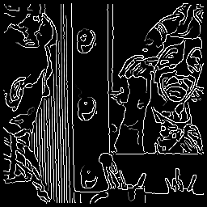
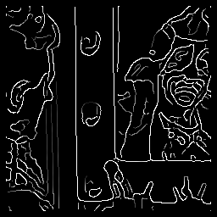


Effect of σ (Gaussian kernel spread/size)
Original
Canny with
Canny with
The choice of σ depends on desired behavior
  large σ detects large scale edges
  small σ detects fine features
Source: S. Seitz

Slide 25
Canny edge detector
Filter image with x, y derivatives of Gaussian
Find magnitude and orientation of gradient
Non-maximum suppression:
  Thin multi-pixel wide “ridges” to single pixel width
‘Hysteresis’ Thresholding:
  Define two thresholds: low and high
  Use the high threshold to start edge curves and the low threshold to continue them
  ‘Follow’ edges starting from strong edge pixels
    Connected components (Szeliski 3.3.4)
MATLAB: edge(image, ‘canny’)
Source: D. Lowe, L. Fei-Fei

Slide 26
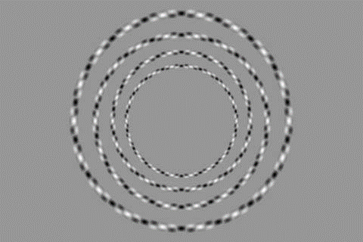
James Hays

Slide 27
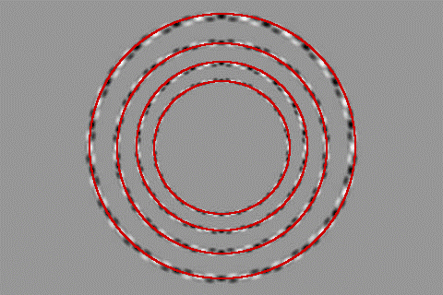
James Hays

Slide 28
Interest Points and Corners
Szeliski 4.1
“Interest points” = “keypoints”
Sometimes called “features”
Slides from Rick Szeliski, Svetlana Lazebnik, Derek Hoiem and Grauman&Leibe 2008 AAAI Tutorial

Slide 29
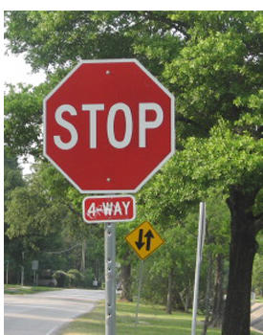
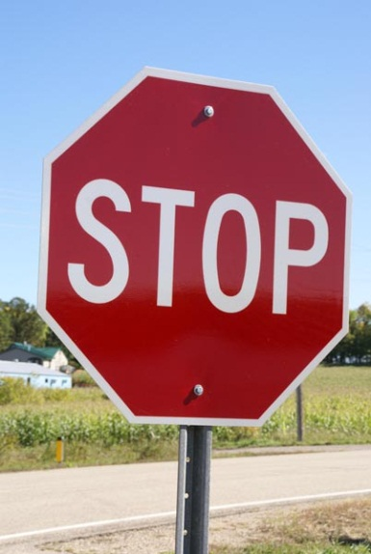
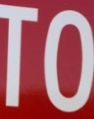
Correspondence across views
Correspondence: matching points, patches, edges, or regions across images.
≈
James Hays

Slide 30
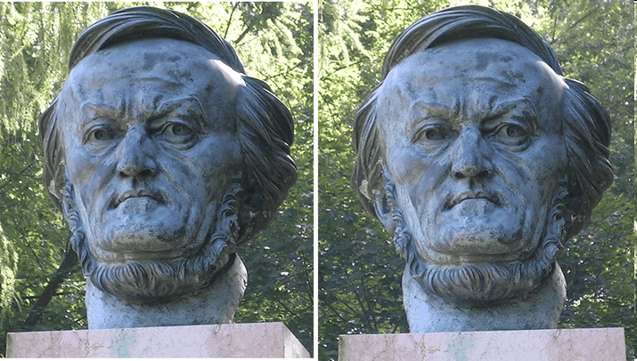
Example: estimate “fundamental matrix” that corresponds two views
Slide from Silvio Savarese

Slide 31
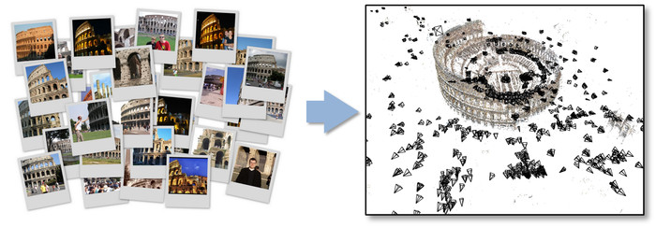
Example: structure from motion

Slide 32
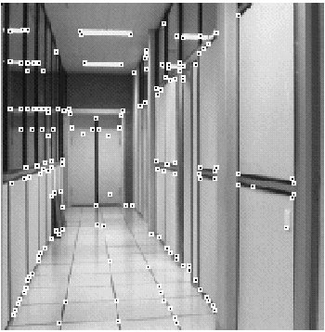
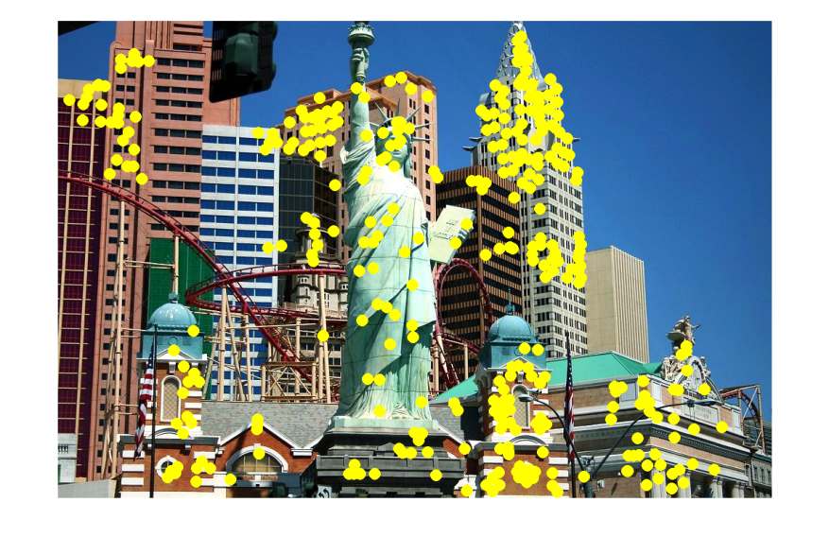
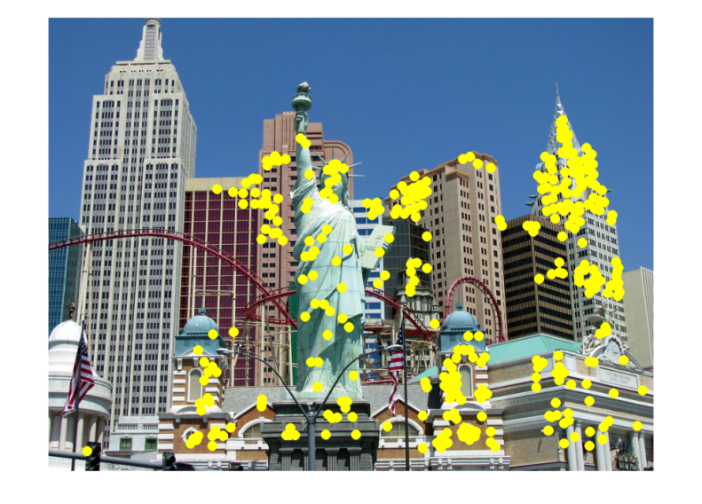
Fundamental to Applications
Feature points are used for:
  Image alignment
  3D reconstruction
  Motion tracking
  Robot navigation
  Indexing and database retrieval
  Object recognition
James Hays

Slide 33
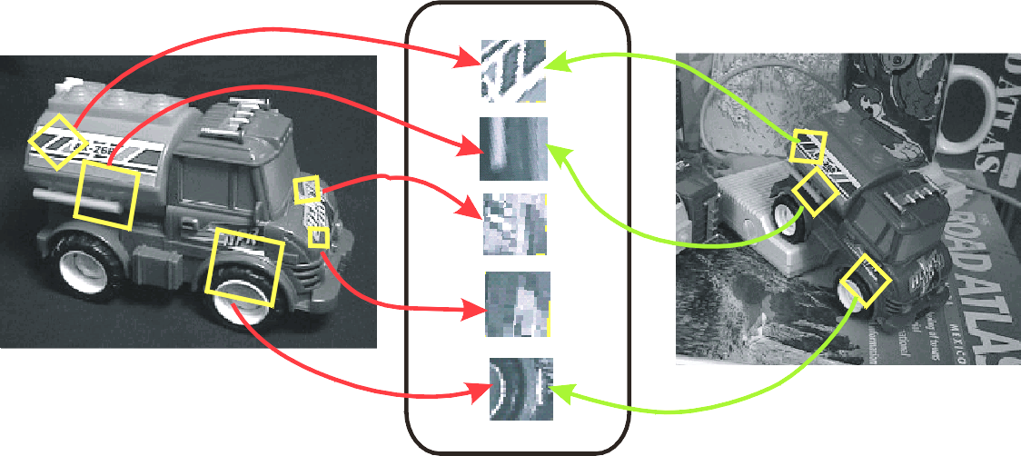
Goal: Invariant Local Features
Detect points that are repeatable and distinctive.
I.E., invariant to image transformations:
appearance variation (brightness, illumination)
geometric variation (translation, rotation, scale).
Keypoint Descriptors
James Hays

Slide 34
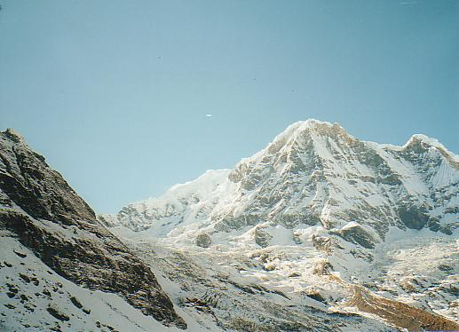
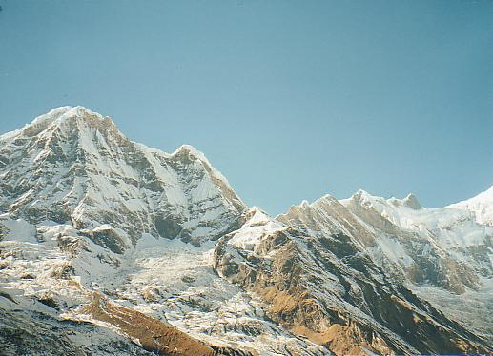
Example application
Panorama stitching
  We have two images – how do we combine them?

Slide 35
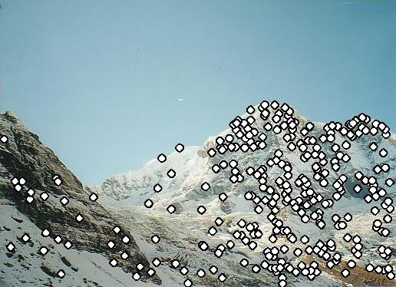
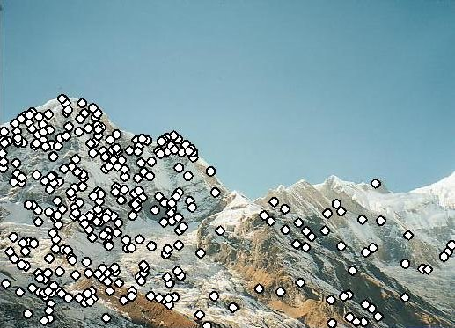

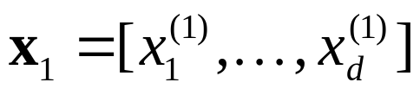

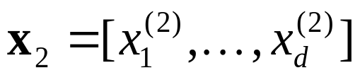
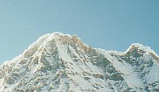

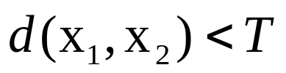
Local features: main components
Detection:
Find a set of distinctive key points.
Description:
Extract feature descriptor around each interest point as vector.
Matching:
Compute distance between feature vectors to find correspondence.

Slide 36
Characteristics of good features
Repeatability
  The same feature can be found in several images despite geometric and photometric transformations
Saliency
  Each feature is distinctive
Compactness and efficiency
  Many fewer features than image pixels
Locality
  A feature occupies a relatively small area of the image; robust to clutter and occlusion
Kristen Grauman

Slide 37
Goal: interest operator repeatability
We want to detect (at least some of) the same points in both images.
Yet we have to be able to run the detection procedure independently per image.
No chance to find true matches!
Kristen Grauman
Notes:
37

Slide 38
Goal: descriptor distinctiveness
We want to be able to reliably determine which point goes with which.
Must provide some invariance to geometric and photometric differences between the two views.
?
Kristen Grauman

Slide 39
Local features: main components
Detection:
Find a set of distinctive key points.
Description:
Extract feature descriptor around each interest point as vector.
Matching:
Compute distance between feature vectors to find correspondence.

Slide 40
Detection: Basic Idea
We do not know which other image locations the feature will end up being matched against.
But we can compute how stable a location is in appearance with respect to small variations in position u.
Compare image patch against
local neighbors.
Source: A. Efros

Slide 41
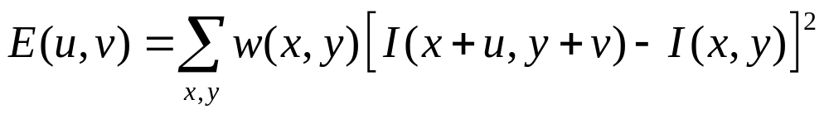
Corner Detection: Mathematics
Change in appearance of window w(x,y) for shift [u,v]:
Window function
Shifted intensity
Intensity
Window function w(x,y) =
or
1 in window, 0 outside
Gaussian
Source: R. Szeliski

Slide 42
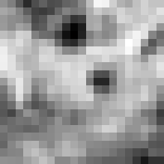

Corner Detection: Mathematics
Change in appearance of window w(x,y)
for the shift [u,v]:
I(x, y)
E(u, v)
E(0,0)
w(x, y)

Slide 43
Corner Detection: Mathematics
Change in appearance of window w(x,y)
for the shift [u,v]:
I(x, y)
E(u, v)
E(3,2)
w(x, y)

Slide 44
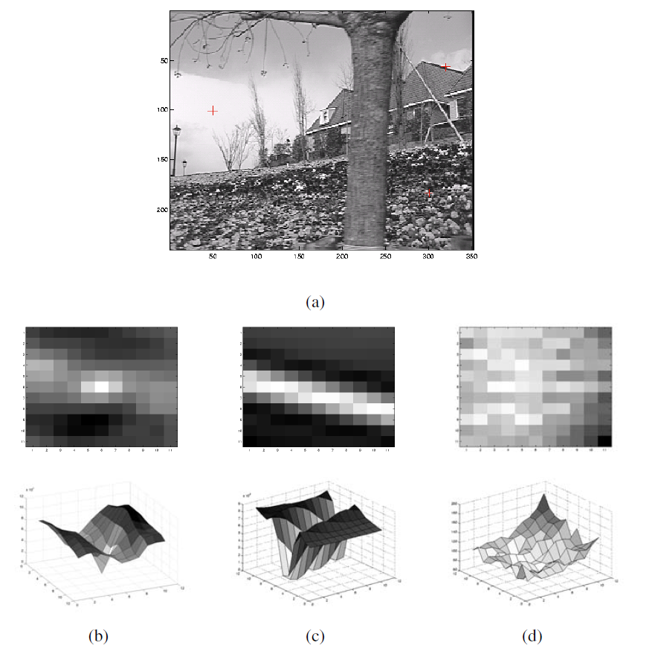
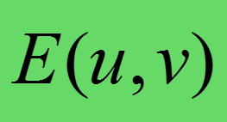
TPS Time
Inverted, and in 3D!
Notes:
Figure 4.5 Three auto-correlation surfaces EAC(u) shown as both grayscale images and surface plots:
The original image is marked with three red crosses to denote where the auto-correlation surfaces were computed;
this patch is from the flower bed (good unique minimum);
this patch is from the roof edge (one-dimensional aperture problem); and
this patch is from the cloud (no good peak).
Each grid point in figures b–d is one value of u.

Slide 45

Finding Corners
Key property: in the region around a corner, image gradient has two or more dominant directions
Corners are repeatable and distinctive
C.Harris and M.Stephens. "A Combined Corner and Edge Detector.“ Proceedings of the 4th Alvey Vision Conference: pages 147--151.

Slide 46

Corner Detection: Basic Idea
We might recognize the point by looking through a small window.
We want a window shift in any direction to give a large change in intensity.
“Flat” region:
no change in all directions
“Edge”:
no change along the edge direction
“Corner”:
significant change in all directions
Source: A. Efros

Slide 47
Corner Detection: Mathematics
Change in appearance of window w(x,y)
for the shift [u,v]:
We want to find out how this function behaves for small shifts
But this is very slow to compute naively.
O(window_width² * shift_range² * image_width²)
O( 11² * 11² * 600² ) = 5.2 billion of these
14.6 thousand per pixel in your image

Slide 48

Corner Detection: Mathematics
Change in appearance of window w(x,y)
for the shift [u,v]:
We want to find out how this function behaves for small shifts.
But we know the response in E that we are looking for – strong peak.

Slide 49
Corner Detection: Mathematics
Change in appearance of window w(x,y)
for the shift [u,v]:
We want to find out how this function behaves for small shifts.
Recall Taylor series expansion. A function f can be approximated at point a as:

Slide 50


Recall: Taylor series expansion
A function f can be represented by an infinite series of its derivatives at a single point a:
Set a = 0
(MacLaurin series) as window centered
Approximation of
f(x) = e^{x}
centered at f(0)
Wikipedia

Slide 51

Taylor expansion in 2D
Local quadratic approximation of E(u,v) in the neighborhood of (0,0) is given by the second-order Taylor expansion:
Notes:
Technically a Maclaurin expansion, a special case of Taylor expansion centered at 0.
What is the point? Well, now we’re just extrapolating local measurements instead of doing 10s of thousands of computations.

Slide 52
Corner Detection: Mathematics
Local quadratic approximation of E(u,v) in the neighborhood of (0,0) is given by the second-order Taylor expansion:
Set to 0
First derivative, set to 0
Notes:
Technically a Maclaurin expansion, a special case of Taylor expansion centered at 0.
What is the point? Well, now we’re just extrapolating local measurements instead of doing 10s of thousands of computations.

Slide 53

Corner Detection: Mathematics
Second-order Taylor expansion of E(u,v) about (0,0):

Slide 54

Corner Detection: Mathematics
Second-order Taylor expansion of E(u,v) about (0,0):

Slide 55

Corner Detection: Mathematics
Second-order Taylor expansion of E(u,v) about (0,0):

Slide 56



Corner Detection: Mathematics
The quadratic approximation simplifies to
where M is a second moment matrix computed from image derivatives:
M
Notes:
https://en.wikipedia.org/wiki/Image_moment

Slide 57






Corners as distinctive interest points
2 x 2 matrix of image derivatives (averaged in neighborhood of a point).
Notation:
James Hays

Slide 58


Interpreting the second moment matrix
The surface E(u,v) is locally approximated by a quadratic form. Let’s try to understand its shape.
James Hays

Slide 59


Interpreting the second moment matrix
Consider a horizontal “slice” of E(u, v):
This is the equation of an ellipse.
James Hays

Slide 60

Interpreting the second moment matrix
First, consider the axis-aligned case (gradients are either horizontal or vertical)
If either λ is close to 0, then this is not a corner, so look for locations where both are large.

Slide 61

Interpreting the second moment matrix
Consider a horizontal “slice” of E(u, v):
This is the equation of an ellipse.
Diagonalization of M:
The axis lengths of the ellipse are determined by the eigenvalues and the orientation is determined by R
direction of the fastest change
direction of the slowest change
(λ_{max})^{-1/2}
(λ_{min})^{-1/2}
James Hays

Slide 62

Visualization of second moment matrices
James Hays

Slide 63

Visualization of second moment matrices
James Hays

Slide 64
Interpreting the eigenvalues
Classification of image points using eigenvalues of M:
λ₂
“Edge”
λ₂ >> λ₁
“Corner”
λ₁ and λ₂ are large,
λ₁ ~ λ₂;
E increases in all directions
λ₁ and λ₂ are small;
E is almost constant in all directions
“Flat” region
“Edge”
λ₁ >> λ₂
λ₁

Slide 65


Corner response function
α: constant (0.04 to 0.06)
λ₂
“Edge”
R < 0
“Corner”
R > 0
Determinant (det(A)):
Trace (trace(A)):
|R| small
“Flat” region
“Edge”
R < 0
λ₁

Slide 66
Harris corner detector
Compute M matrix for each image window to get their cornerness scores.
Find points whose surrounding window gave large corner response (f > threshold)
Take the points of local maxima, i.e., perform non-maximum suppression
C.Harris and M.Stephens. “A Combined Corner and Edge Detector.” Proceedings of the 4th Alvey Vision Conference: pages 147—151, 1988.
Notes:
66

Slide 67












Harris Detector [Harris88]
James Hays
Second moment matrix
1. Image derivatives
I_{x}
I_{y}
(optionally, blur first)
I_{x}²
I_{y}²
I_{x}I_{y}
2. Square of derivatives
3. Gaussian
filter g(σ_{I})
g(I_{x}²)
g(I_{y}²)
g(I_{x}I_{y})
4. Cornerness function – both eigenvalues are strong
5. Non-maxima suppression
har

Slide 68

Harris Detector: Steps

Slide 69

Harris Detector: Steps
Compute corner response R

Slide 70

Harris Detector: Steps
Find points with large corner response: R>threshold

Slide 71

Harris Detector: Steps
Take only the points of local maxima of R

Slide 72

Harris Detector: Steps

Slide 73
Invariance and covariance
We want corner locations to be invariant to photometric transformations and covariant to geometric transformations
  Invariance: image is transformed and corner locations do not change
  Covariance: if we have two transformed versions of the same image, features should be detected in corresponding locations

Slide 74
Affine intensity change
I → a I + b
Only derivatives are used => invariance to intensity shift I → I + b
Intensity scaling: I → a I
R
R
threshold
x (image coordinate)
x (image coordinate)
Partially invariant to affine intensity change

Slide 75
Image translation
Derivatives and window function are shift-invariant
Corner location is covariant w.r.t. translation

Slide 76
Image rotation
Second moment ellipse rotates but its shape (i.e. eigenvalues) remains the same
Corner location is covariant w.r.t. rotation

Slide 77
Scaling
Corner
All points will be classified as edges
Corner location is not covariant to scaling!

Slide 78
Review: Harris corner detector
E(u, v)
Approximate distinctiveness by local auto-correlation.
Approximate local auto-correlation by second moment matrix
Quantify distinctiveness (or cornerness) as function of the eigenvalues of the second moment matrix.
But we don’t actually need to
compute the eigenvalues by
using the determinant and trace
of the second moment matrix.
(λ_{max})^{-1/2}
(λ_{min})^{-1/2}

Slide 79

Proj 2: Local Feature Matching
Implement interest point detector, SIFT-like local feature descriptor, and simple matching algorithm.

Slide 80

So far: can localize in x-y, but not scale

Slide 81



Automatic Scale Selection
How to find corresponding patch sizes?

Slide 82





Automatic Scale Selection
Function responses for increasing scale (scale signature)

Slide 83
Automatic Scale Selection
Function responses for increasing scale (scale signature)

Slide 84
Automatic Scale Selection
Function responses for increasing scale (scale signature)

Slide 85

Automatic Scale Selection
Function responses for increasing scale (scale signature)

Slide 86
Automatic Scale Selection
Function responses for increasing scale (scale signature)

Slide 87

Automatic Scale Selection
Function responses for increasing scale (scale signature)

Slide 88



What Is A Useful Signature Function?
Difference-of-Gaussian = “blob” detector

Slide 89



Difference-of-Gaussian (DoG)
-
=

Slide 90




DoG – Efficient Computation
Computation in Gaussian scale pyramid
Sampling with
step σ⁴ =2
σ
σ
σ
Original image
σ

Slide 91








Find local maxima in position-scale space of Difference-of-Gaussian
σ⁵
σ⁴
σ³
σ²
⇒ List of
(x, y, s)
σ
Notes:
Blob detector is distinct from harris corner detector

Slide 92

Results: Difference-of-Gaussian

Slide 93
Orientation Normalization
Compute orientation histogram
Select dominant orientation
Normalize: rotate to fixed orientation
[Lowe, SIFT, 1999]
0
2
π

Slide 94






Harris-Laplace [Mikolajczyk ‘01]
Initialization: Multiscale Harris corner detection
σ⁴
σ³
σ²
σ
Computing Harris function
Detecting local maxima

Slide 95

Harris-Laplace [Mikolajczyk ‘01]
Initialization: Multiscale Harris corner detection
Scale selection based on Laplacian
(same procedure with Hessian ⇒ Hessian-Laplace)
Harris points
Harris-Laplace points

Slide 96

















Maximally Stable Extremal Regions [Matas ‘02]
Based on Watershed segmentation algorithm
Select regions that stay stable over a large parameter range

Slide 97



Example Results: MSER

Slide 98

Comparison
Hessian
Harris
MSER
LoG

Slide 99
Many Existing Detectors Available
Hessian & Harris [Beaudet ‘78], [Harris ‘88]
Laplacian, DoG [Lindeberg ‘98], [Lowe 1999]
Harris-/Hessian-Laplace [Mikolajczyk & Schmid ‘01]
Harris-/Hessian-Affine [Mikolajczyk & Schmid ‘04]
EBR and IBR [Tuytelaars & Van Gool ‘04]
MSER [Matas ‘02]
Salient Regions [Kadir & Brady ‘01]
Others…

Slide 100
Available at a web site near you…
For most local feature detectors, executables are available online:
  http://www.robots.ox.ac.uk/~vgg/research/affine
  http://www.cs.ubc.ca/~lowe/keypoints/
  http://www.vision.ee.ethz.ch/~surf

