Slide 1
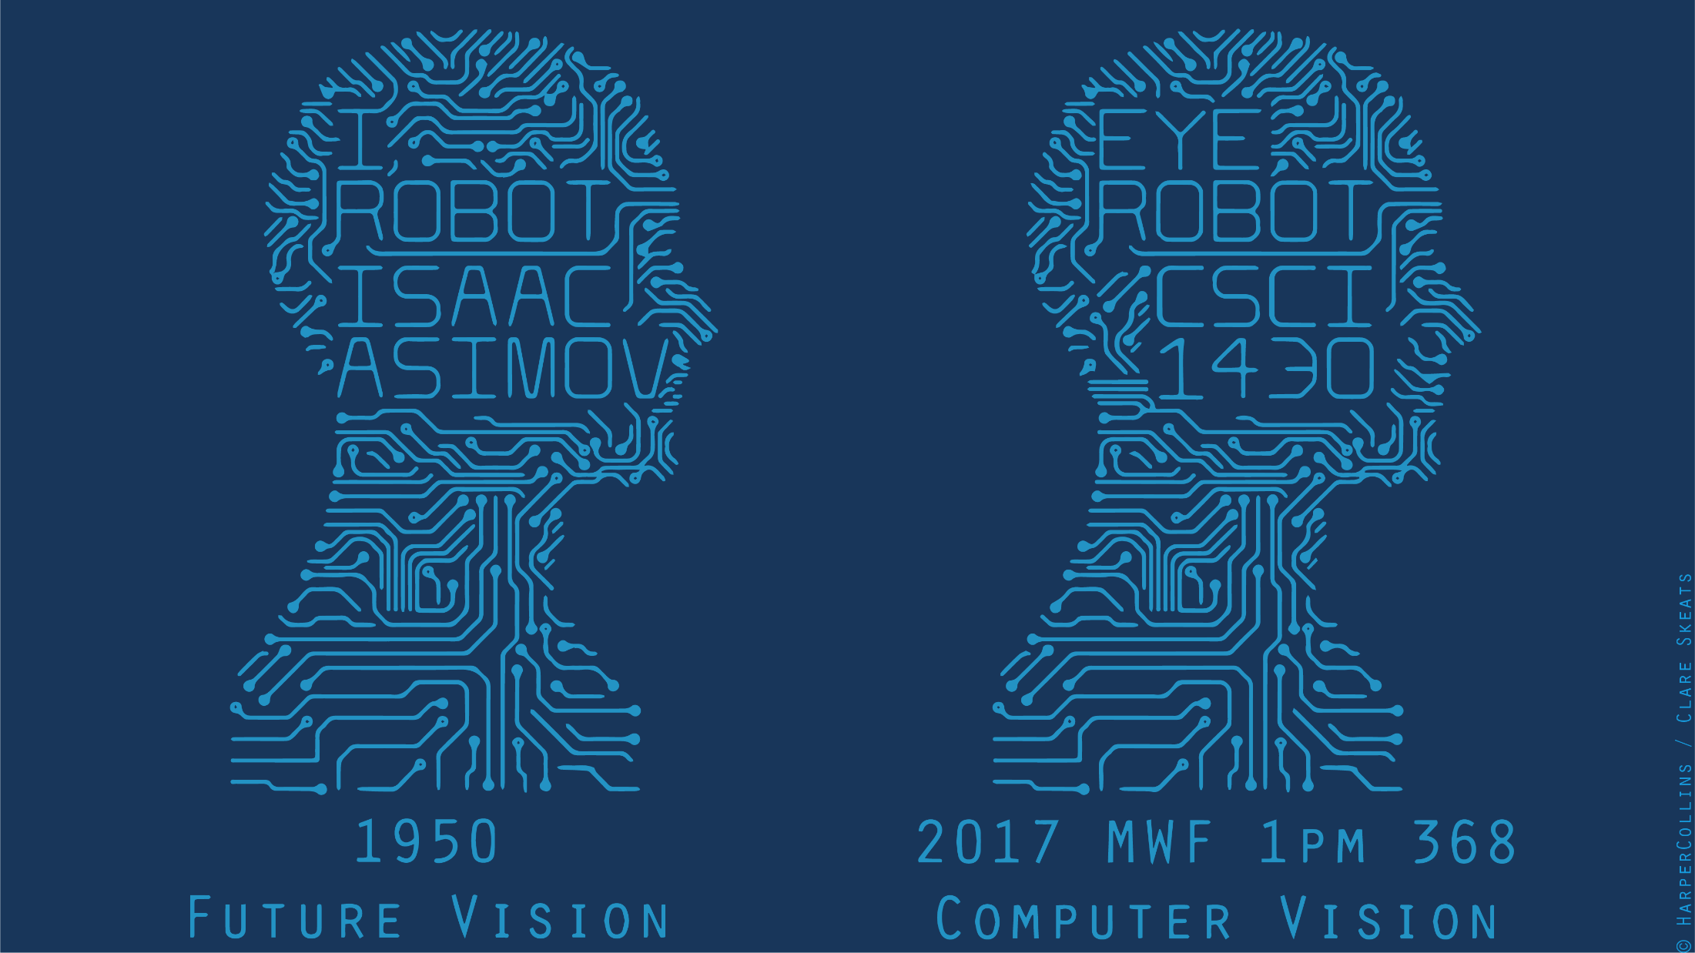

Slide 2
Think-Pair-Share
What visual or physiological cues help us to perceive 3D shape and depth?

Slide 3
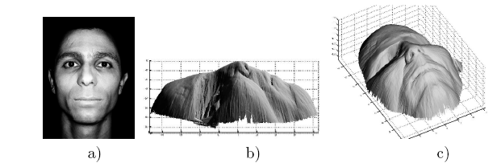
Shading
[Figure from Prados & Faugeras 2006]
Notes:
3

Slide 4
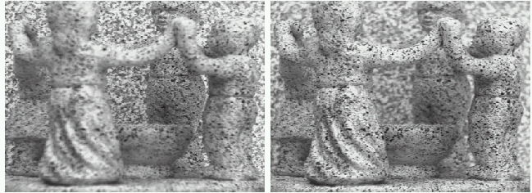
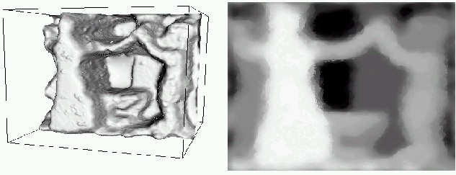
Focus/defocus
Images from same point of view, different camera parameters
3d shape / depth estimates
[figs from H. Jin and P. Favaro, 2002]

Slide 5
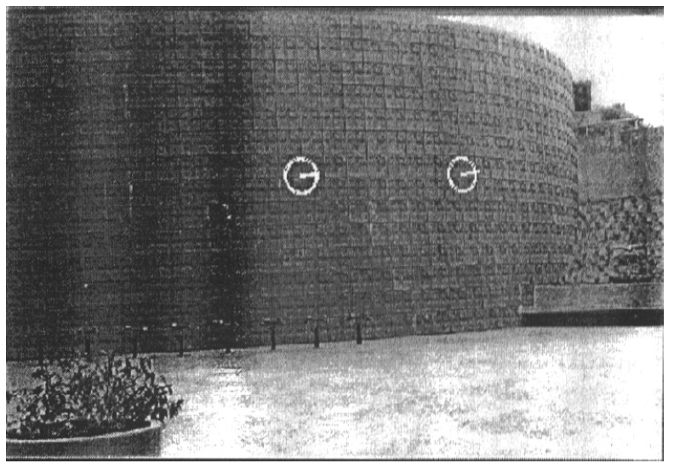
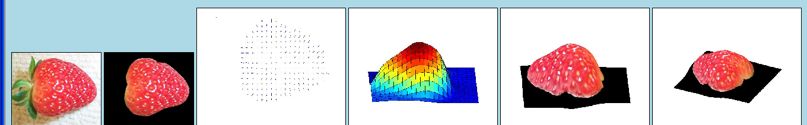
Texture
[From A.M. Loh. The recovery of 3-D structure using visual texture patterns. PhD thesis]
Notes:
5

Slide 6
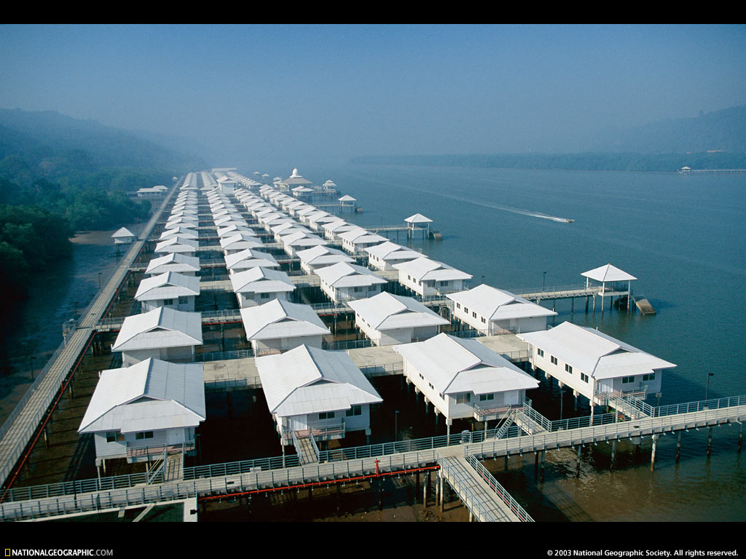
Perspective effects
Image credit: S. Seitz

Slide 7
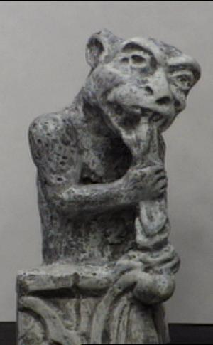
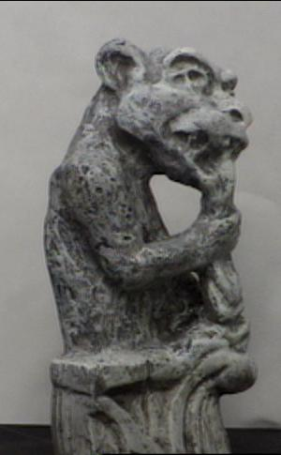
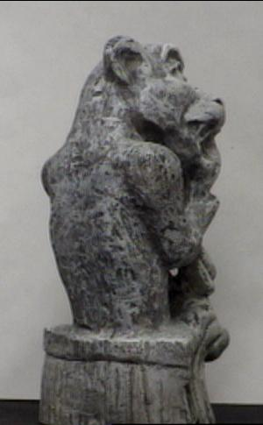
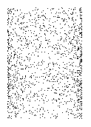
Motion
Figures from L. Zhang
http://www.brainconnection.com/teasers/?main=illusion/motion-shape

Slide 8
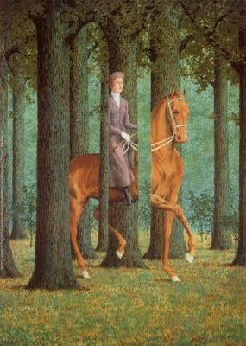
Occlusion
Rene Magritt'e famous painting Le Blanc-Seing (literal translation: "The Blank Signature") roughly translates as "free hand" or "free rein".
Notes:
http://rene-magritte-paintings.blogspot.com/2009/11/le-blanc-seing.html

Slide 9
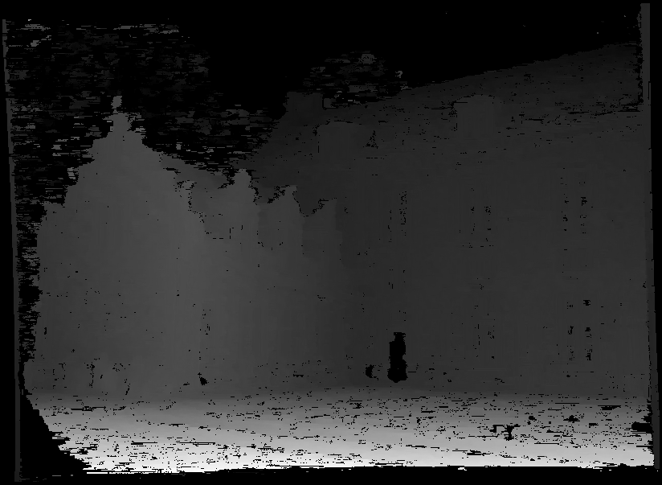
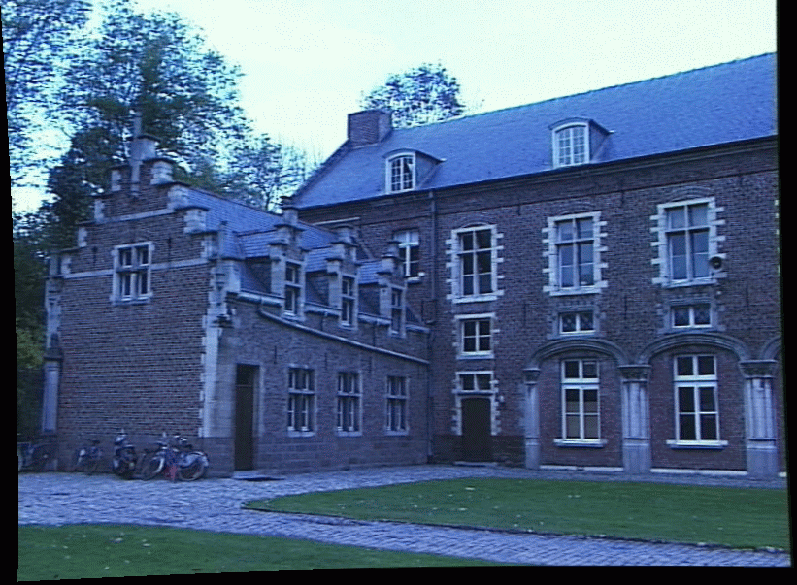
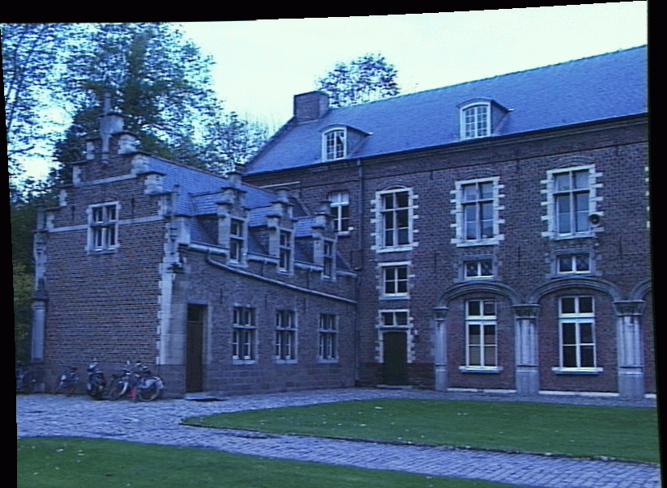
Stereo
Slides: James Hays and Kristen Grauman

Slide 10

If stereo were critical for depth perception, navigation, recognition, etc., then rabbits would never have evolved.

Slide 11
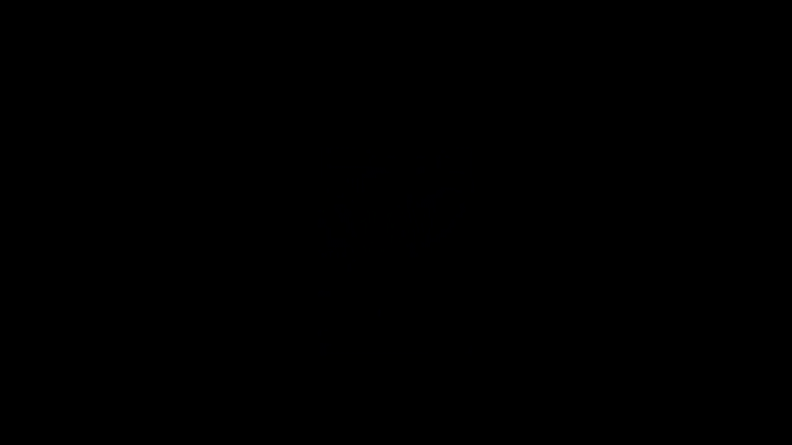
Notes:
http://illusionoftheyear.com/2016/06/ambiguous-cylinder-illusion/
How it works: https://www.youtube.com/watch?v=SKpOKXAVjGo
How it works (academic version): http://www.mdpi.com/2073-8994/8/4/21/htm

Slide 12

Devin Montes
Notes:
http://illusionoftheyear.com/2016/06/ambiguous-cylinder-illusion/
How it works: https://www.youtube.com/watch?v=SKpOKXAVjGo
How it works (academic version): http://www.mdpi.com/2073-8994/8/4/21/htm

Slide 13
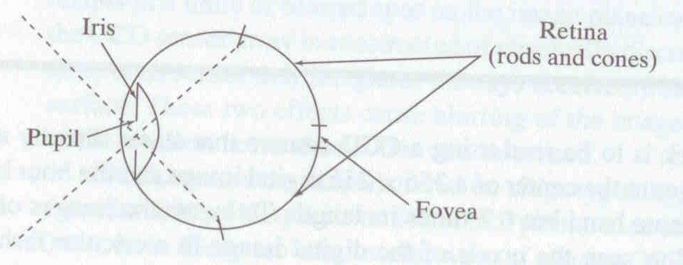
Human eye
Rough analogy with human visual system:
Pupil/Iris – control amount of light passing through lens
Retina - contains sensor cells, where image is formed
Fovea – highest concentration of cones
Fig from Shapiro and Stockman

Slide 14
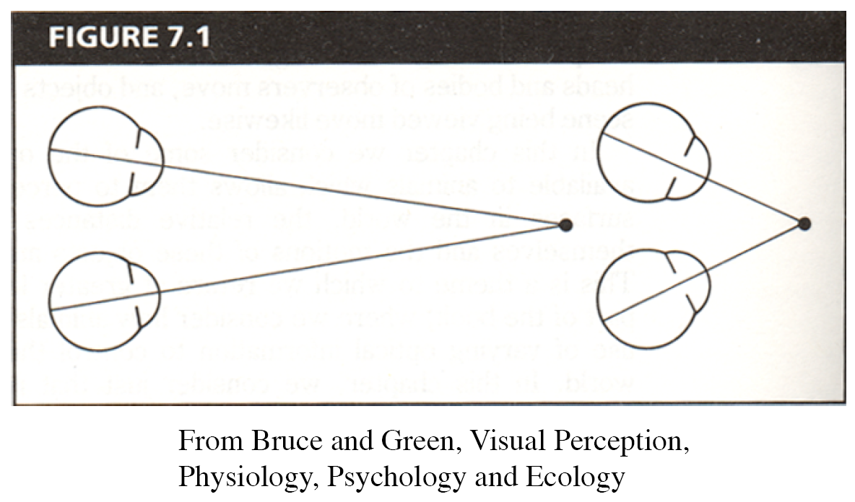
Human eyes fixate on point in space – rotate so that corresponding images form in centers of fovea.
Human stereopsis
Notes:
14

Slide 15
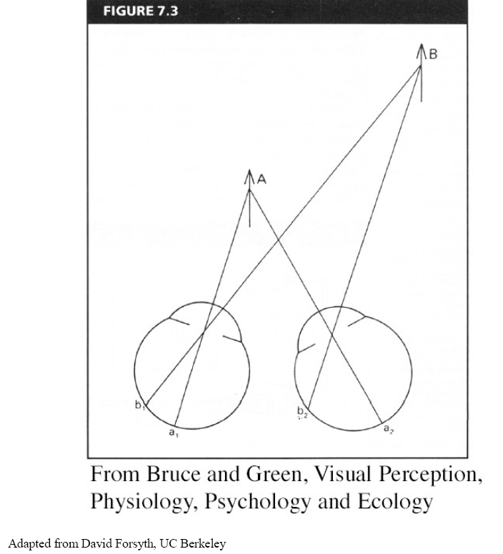
Human stereopsis: disparity
Disparity occurs when eyes fixate on one object; others appear at different visual angles.
Disparity is distance from b1 to b2 along retina.
Notes:
15

Slide 16
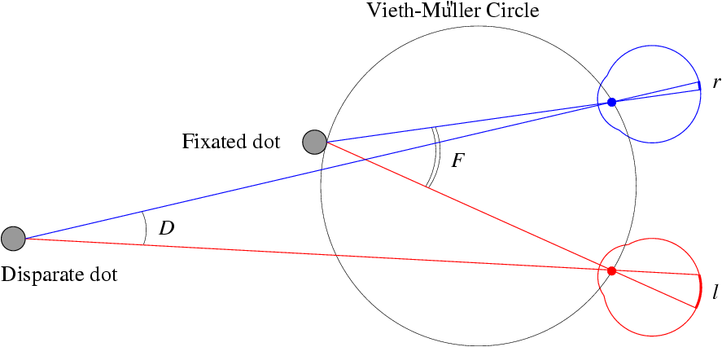
Human stereopsis: disparity
Disparity: d = r-l = D-F.
Forsyth & Ponce
Notes:
16

Slide 17
Yes, you can be stereoblind.
Notes:
Ask audience to put finger tip in line with dot in vision, then ask them to focus on dot -> should see two fingers.
Then, ask them to focus on finger -> should see two dots.
If people only see one finger and one dot, then they might be stereoblind…..
Is this true?

Slide 18
Random dot stereograms
Julesz 1960:
Do we identify local brightness patterns before fusion (monocular process) or after (binocular)?
Think Pair Share – yes / no? how to test?
Notes:
18

Slide 19
Random dot stereograms
Julesz 1960:
Do we identify local brightness patterns before fusion (monocular process) or after (binocular)?
To test: pair of synthetic images obtained by randomly spraying black dots on white objects
Notes:
19

Slide 20
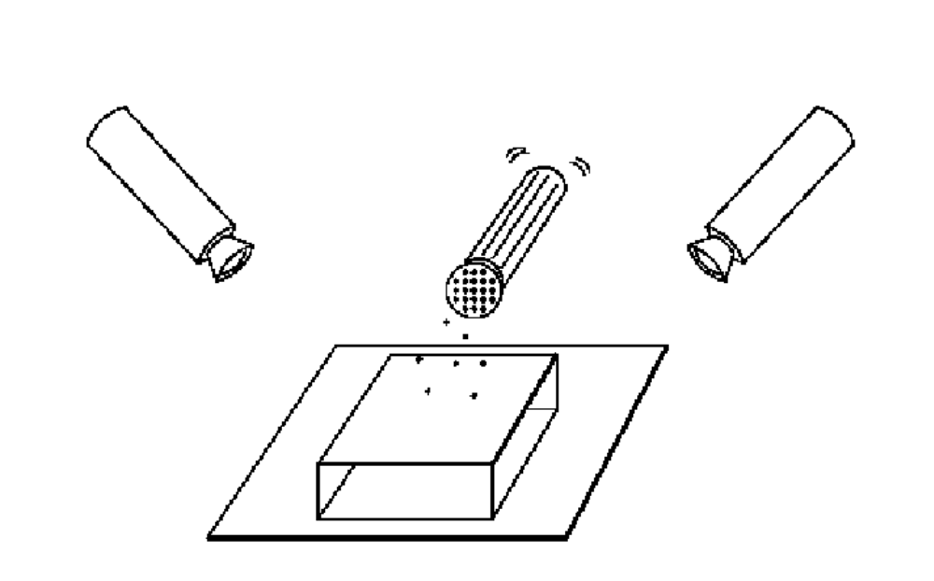
Random dot stereograms
Forsyth & Ponce
Notes:
20

Slide 21
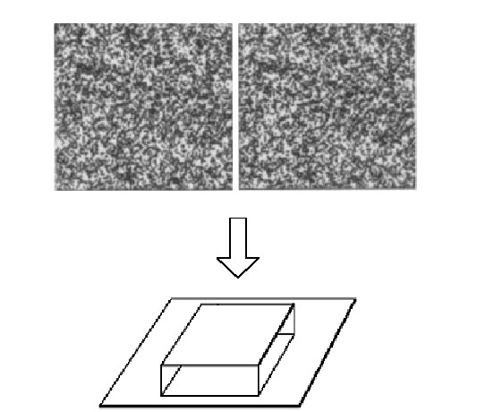
Random dot stereograms
Notes:
21

Slide 22
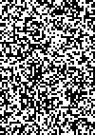
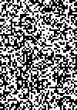
1. Create an image of suitable size. Fill it with random dots. Duplicate the image.
2. Select a region in one image.
3. Shift this region horizontally by a small amount. The stereogram is complete.
CC BY-SA 3.0, https://en.wikipedia.org/wiki/Random_dot_stereogram

Slide 23
Random dot stereograms
When viewed monocularly, they appear random; when viewed stereoscopically, see 3d structure.
Human binocular fusion not directly associated with the physical retinas; must involve the central nervous system (V2, for instance).
Imaginary “cyclopean retina” that combines the left and right image stimuli as a single unit.
High level scene understanding not required for stereo…but, high level scene understanding is arguably better than stereo.
Notes:
23
According to Ralph Siegel, Dr. Bela Julesz had "unambiguously demonstrated that stereoscopic depth could be computed in the absence of any identifiable objects, in the absence of any perspective, in the absence of any cues available to either eye alone."
Artists are more often stereo blind than average people. Being stereo blind may train you to be better at recognizing and thus depicting other monocular depth cues.

Slide 24
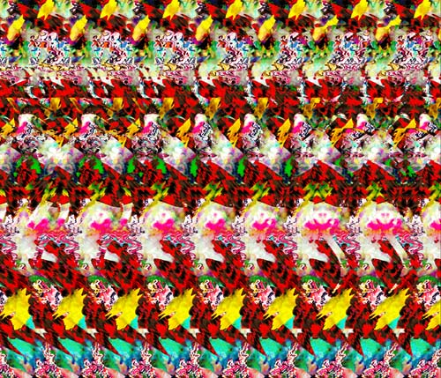
Autostereograms – ‘Magic Eye’
Exploit disparity as depth cue using single image.
(Single image random dot stereogram, Single image stereogram)
Images from magiceye.com
Notes:
24

Slide 25
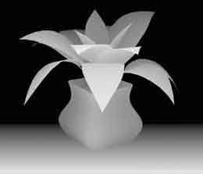
Autostereograms
Images from magiceye.com
Notes:
25

Slide 26
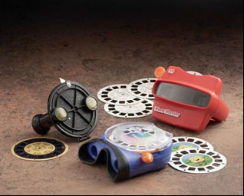
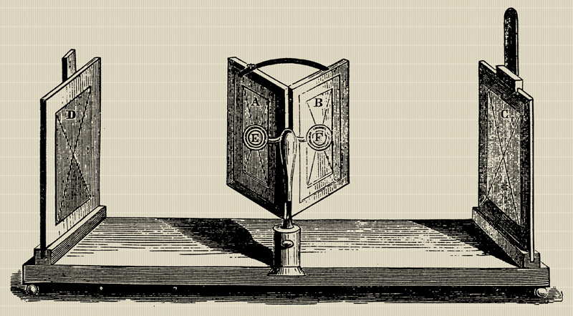
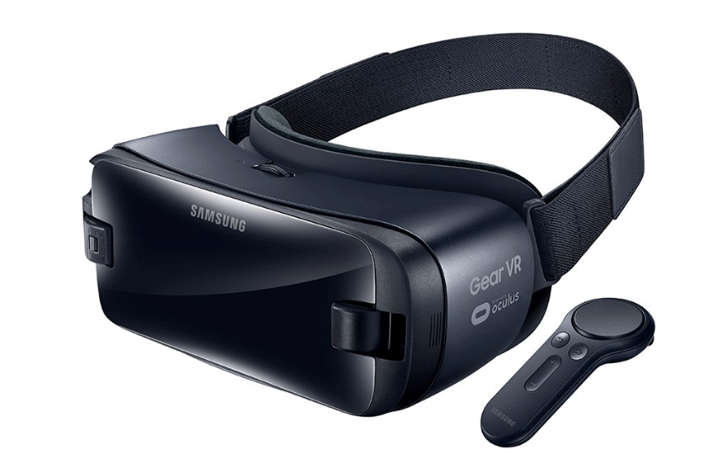
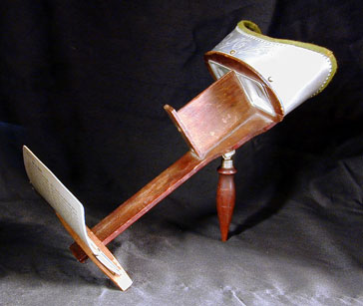
Stereo photography and stereo viewers
Take two pictures of the same subject from two slightly different viewpoints and display so that each eye sees only one of the images.
Image from fisher-price.com
Invented by Sir Charles Wheatstone, 1838

Slide 27
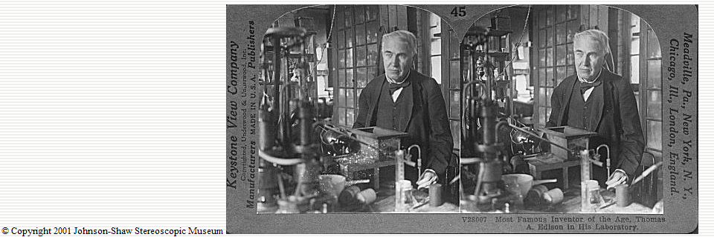
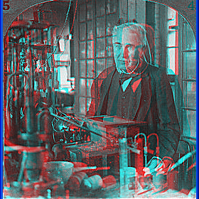
Anaglyph stereo
http://www.johnsonshawmuseum.org
Notes:
27

Slide 28
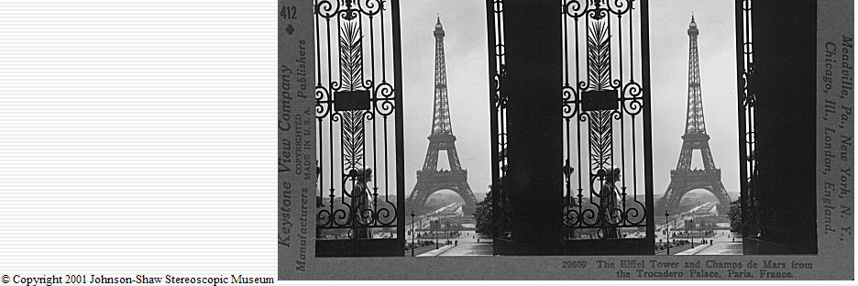
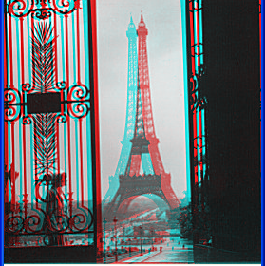
http://www.johnsonshawmuseum.org
Notes:
28

Slide 29
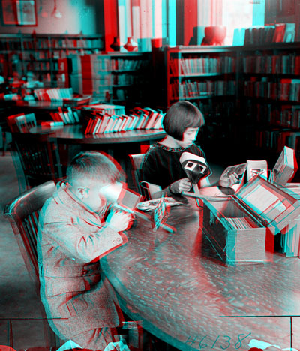

Public Library, Stereoscopic Looking Room, Chicago, by Phillips, 1923
Notes:
29

Slide 30
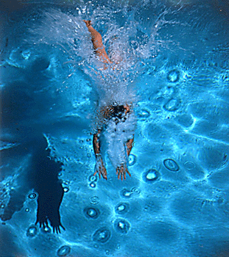
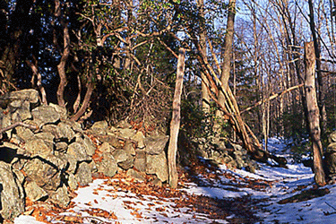
Wiggle images
http://www.well.com/~jimg/stereo/stereo_list.html
Notes:
30

Slide 31
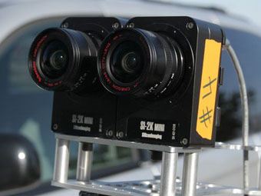
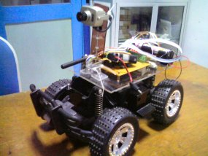
Stereo vision
Two cameras, simultaneous views
Single moving camera and static scene

Slide 32
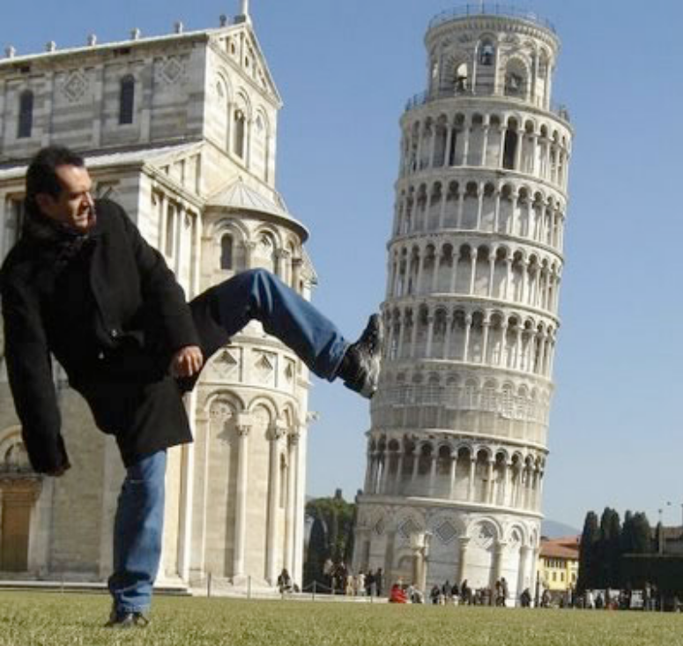
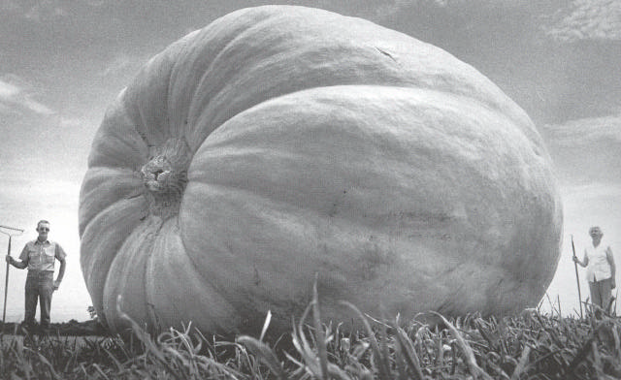
Why multiple views?
Structure and depth can be ambiguous from single views...
Images from Lana Lazebnik

Slide 33
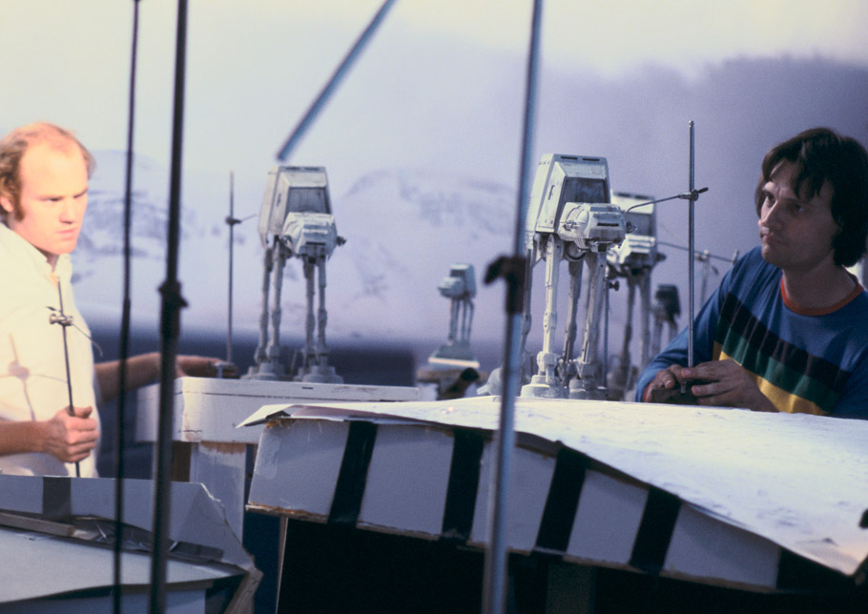
Notes:
Phil Tippett and Jon Berg stop-motion animate a shot with all three walkers (the background walkers are cutouts). Originally the plan had been to photograph the walkers against four-by-five Ektachrome transparencies shot in Norway; when these didn’t work as planned, matte artist Mike Pangrazio copied select Ektachromes onto large scenic backings.

Slide 34
Why multiple views?
Points at different depths along a line project to a single point
P1
P2
P1’=P2’
Optical center

Slide 35
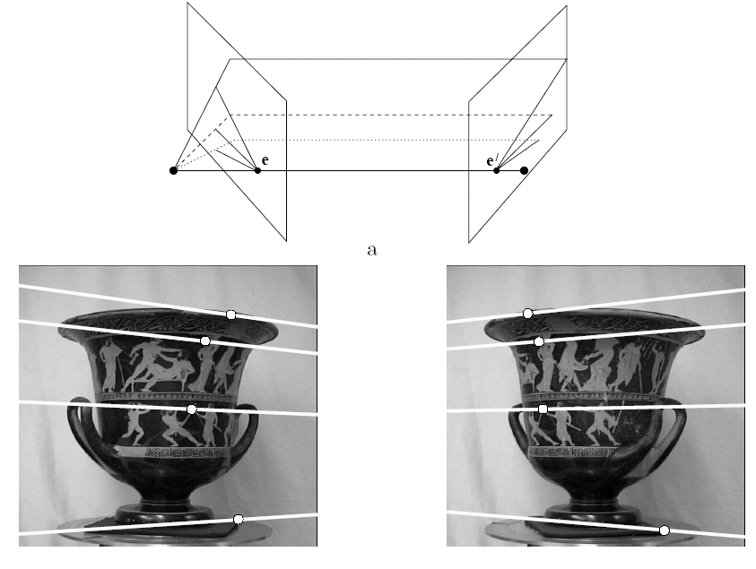
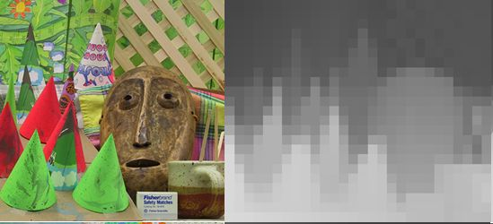
Multiple views
Stereo vision
Structure from motion
Optical flow
Lowe
Hartley and Zisserman

Slide 36
Multi-view geometry problems
Stereo correspondence: Given a point in one of the images, where could its corresponding points be in the other images?
Camera 1
Camera 3
R₁,t₁
Camera 2
R₃,t₃
R₂,t₂
Slide credit: Noah Snavely
Notes:
Structure from motion solves the following problem:
Given a set of images of a static scene with 2D points in correspondence, shown here as color-coded points, find…
a set of 3D points P and
a rotation R and position t of the cameras that explain the observed correspondences. In other words, when we project a point into any of the cameras, the reprojection error between the projected and observed 2D points is low.
This problem can be formulated as an optimization problem where we want to find the rotations R, positions t, and 3D point locations P that minimize sum of squared reprojection errors f. This is a non-linear least squares problem and can be solved with algorithms such as Levenberg-Marquart. However, because the problem is non-linear, it can be susceptible to local minima. Therefore, it’s important to initialize the parameters of the system carefully. In addition, we need to be able to deal with erroneous correspondences.

Slide 37
Multi-view geometry problems
Structure: Given projections of the same 3D point in two or more images, compute the 3D coordinates of that point
?
Camera 1
Camera 3
R₁,t₁
Camera 2
R₃,t₃
R₂,t₂
Slide credit: Noah Snavely
Notes:
Structure from motion solves the following problem:
Given a set of images of a static scene with 2D points in correspondence, shown here as color-coded points, find…
a set of 3D points P and
a rotation R and position t of the cameras that explain the observed correspondences. In other words, when we project a point into any of the cameras, the reprojection error between the projected and observed 2D points is low.
This problem can be formulated as an optimization problem where we want to find the rotations R, positions t, and 3D point locations P that minimize sum of squared reprojection errors f. This is a non-linear least squares problem and can be solved with algorithms such as Levenberg-Marquart. However, because the problem is non-linear, it can be susceptible to local minima. Therefore, it’s important to initialize the parameters of the system carefully. In addition, we need to be able to deal with erroneous correspondences.

Slide 38
Multi-view geometry problems
Motion: Given a set of corresponding points in two or more images, compute the camera parameters
Camera 1
?
Camera 2
?
?
Camera 3
R₁,t₁
R₃,t₃
R₂,t₂
Slide credit: Noah Snavely
Notes:
Structure from motion solves the following problem:
Given a set of images of a static scene with 2D points in correspondence, shown here as color-coded points, find…
a set of 3D points P and
a rotation R and position t of the cameras that explain the observed correspondences. In other words, when we project a point into any of the cameras, the reprojection error between the projected and observed 2D points is low.
This problem can be formulated as an optimization problem where we want to find the rotations R, positions t, and 3D point locations P that minimize sum of squared reprojection errors f. This is a non-linear least squares problem and can be solved with algorithms such as Levenberg-Marquart. However, because the problem is non-linear, it can be susceptible to local minima. Therefore, it’s important to initialize the parameters of the system carefully. In addition, we need to be able to deal with erroneous correspondences.

Slide 39
Multi-view geometry problems
Optical flow: Given two images, find the location of a world point in a second close-by image with no camera info.
Camera 1
Camera 2
Notes:
Structure from motion solves the following problem:
Given a set of images of a static scene with 2D points in correspondence, shown here as color-coded points, find…
a set of 3D points P and
a rotation R and position t of the cameras that explain the observed correspondences. In other words, when we project a point into any of the cameras, the reprojection error between the projected and observed 2D points is low.
This problem can be formulated as an optimization problem where we want to find the rotations R, positions t, and 3D point locations P that minimize sum of squared reprojection errors f. This is a non-linear least squares problem and can be solved with algorithms such as Levenberg-Marquart. However, because the problem is non-linear, it can be susceptible to local minima. Therefore, it’s important to initialize the parameters of the system carefully. In addition, we need to be able to deal with erroneous correspondences.

Slide 40
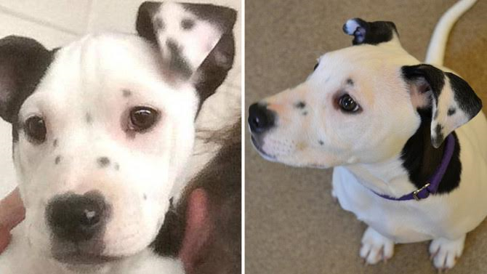
Multiple views - Dogception
Notes:
https://a.msn.com/r/2/AAngVMj?m=en-us&ocid=News

Slide 41
Estimating scene shape
“Shape from X”: Shading, Texture, Focus, Motion…
Stereo:
  shape from “motion” between two views
  infer 3d shape of scene from two (multiple) images from different viewpoints
Main idea:
scene point
image plane
optical center
James Hays
Notes:
41

Slide 42
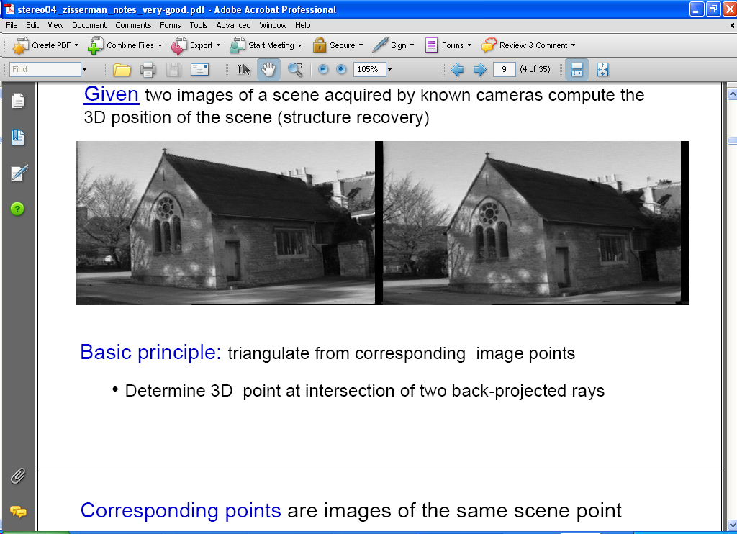
Estimating depth with stereo
Stereo: shape from “motion” between two views
We’ll need to consider:
Info on camera pose (“calibration”)
Image point correspondences
scene point
image plane
optical center
James Hays
Notes:
42

Slide 43
Geometry for a simple stereo system
Let’s look at a simple stereo system first.
Assume:
  parallel optical axes,
  known camera parameters (i.e., calibrated cameras):

Slide 44
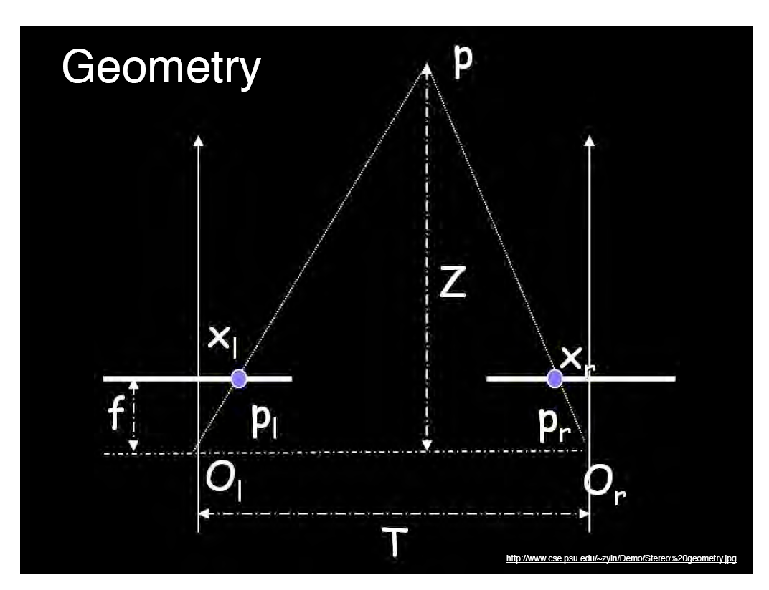
World point
Depth of p
image point (left)
image point (right)
Focal length
optical center (right)
optical center (left)
baseline
Notes:
44

Slide 45
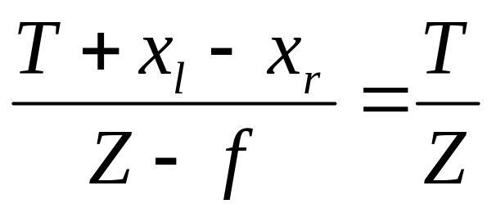
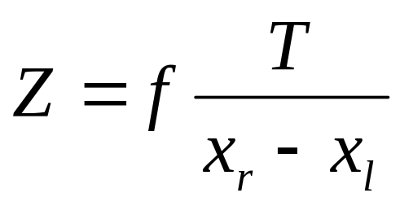
Geometry for a simple stereo system
Assume parallel optical axes, known camera parameters (i.e., calibrated cameras). What is expression for Z?
Similar triangles (p_{l}, P, p_{r}) and (O_{l}, P, O_{r}):
disparity
Notes:
45

Slide 46

Depth from disparity
image I(x,y)
Disparity map D(x,y)
image I´(x´,y´)
(x´,y´)=(x+D(x,y), y)
So if we could find the corresponding points in two images, we could estimate relative depth…

