Slide 1


Slide 2
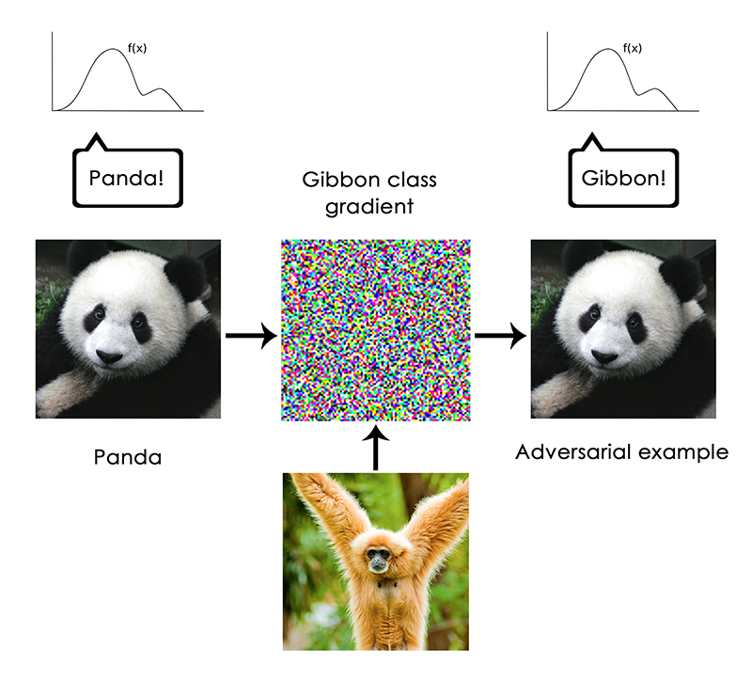
Francois Chollet - https://blog.keras.io/the-limitations-of-deep-learning.html
Notes:
But no

Slide 3
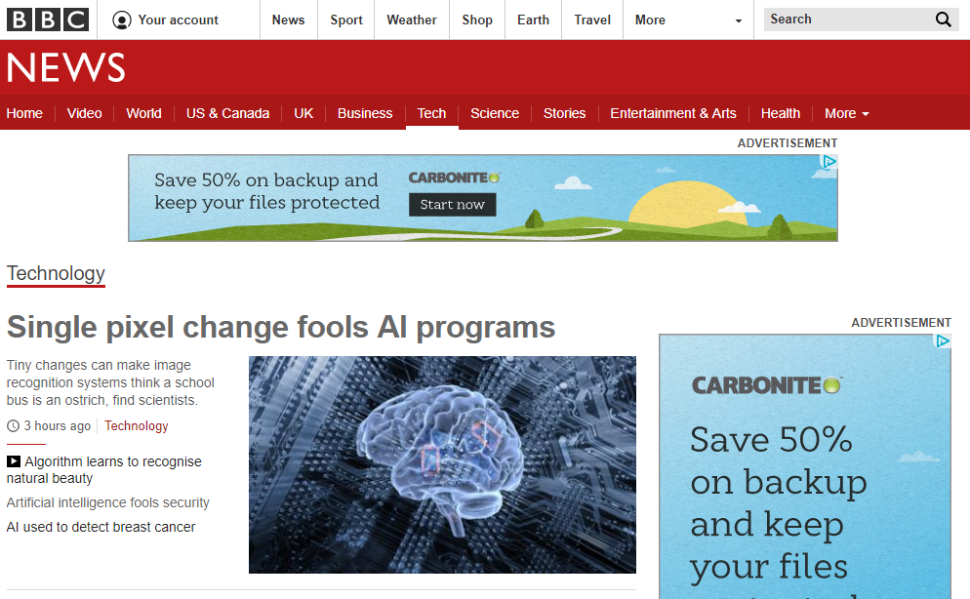
3rd November 2017

Slide 4
Yes, it’s a brain image : (

Slide 5
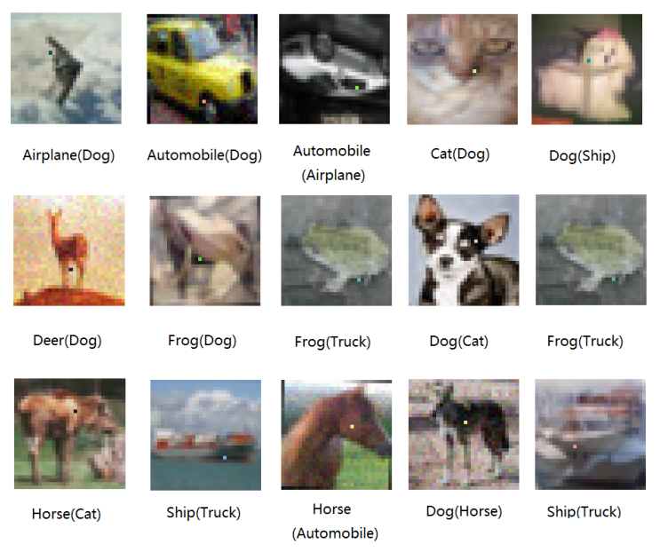
Su et al., One pixel attack for fooling deep neural networks
https://arxiv.org/abs/1710.08864

Slide 6
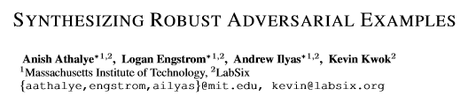
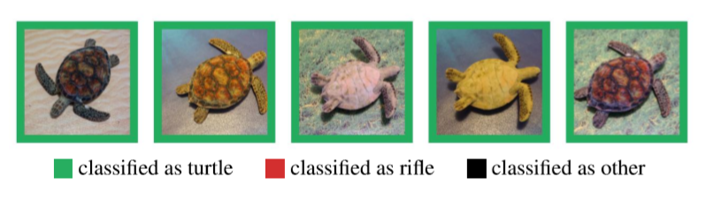
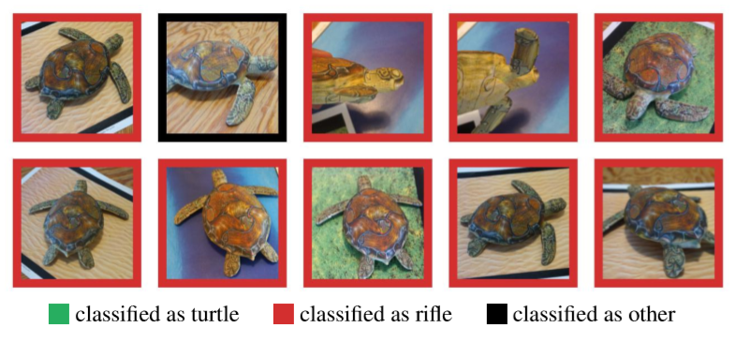
https://arxiv.org/pdf/1707.07397.pdf

Slide 7
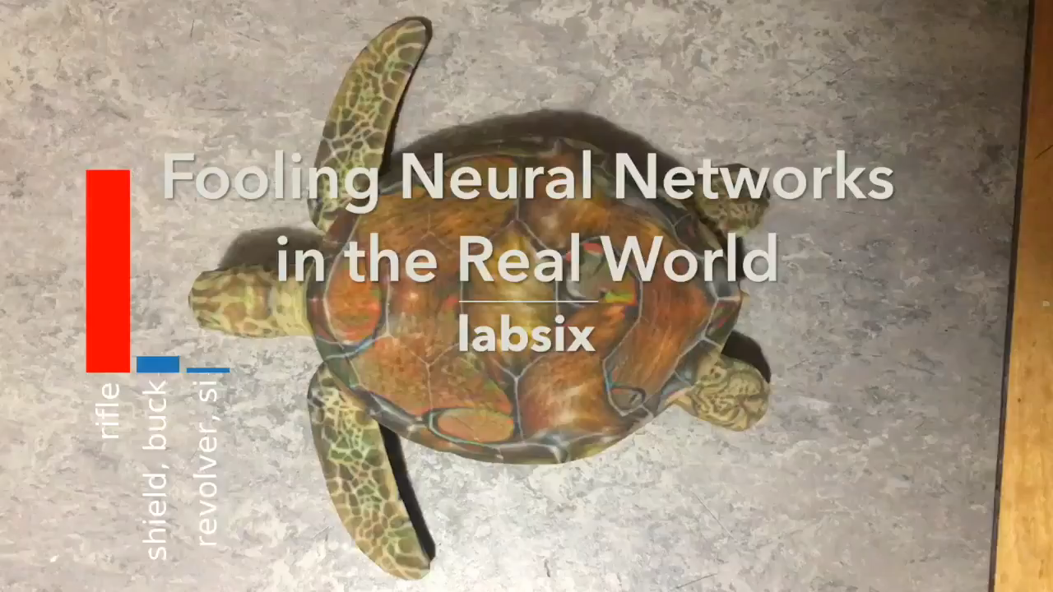

Slide 8
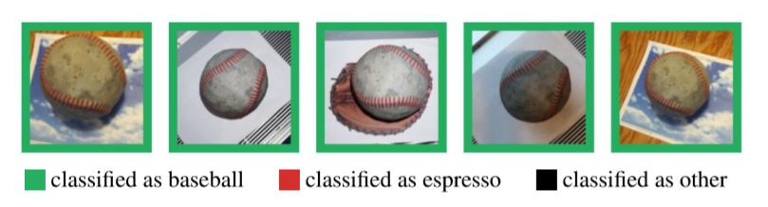
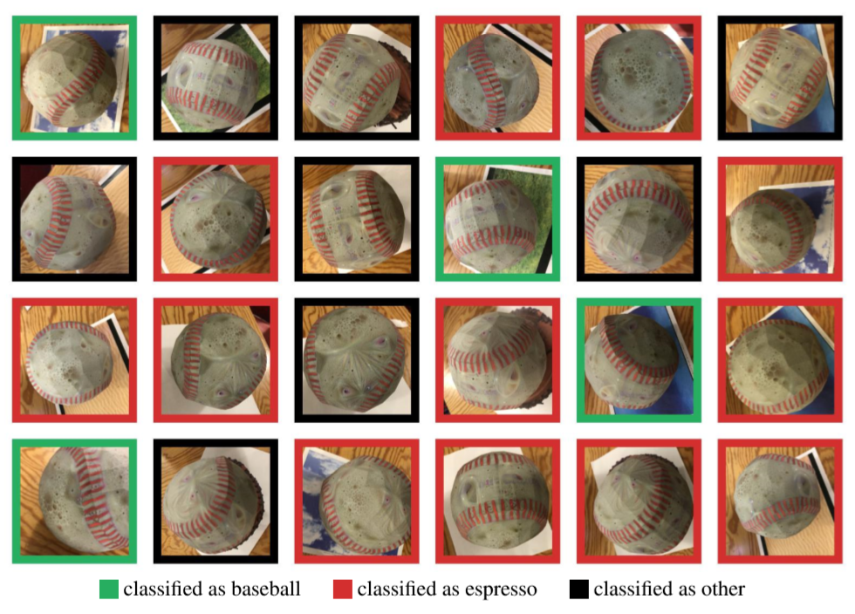

Slide 9
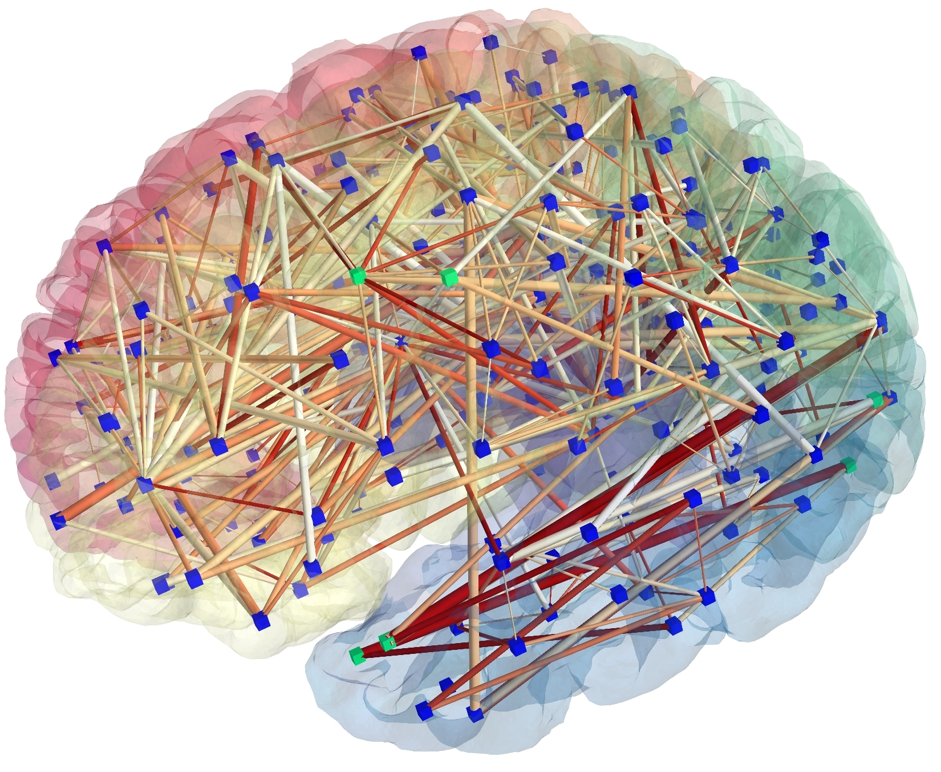
Connectomics:Neural nets for neural nets
[Patric Hagmann]
Notes:
This is some of James’ work with Harvard Brain Science Center.
The brain represented as a network: image obtained from MR connectomics. (Provided by Patric Hagmann, CHUV-UNIL, Lausanne, Switzerland)

Slide 10
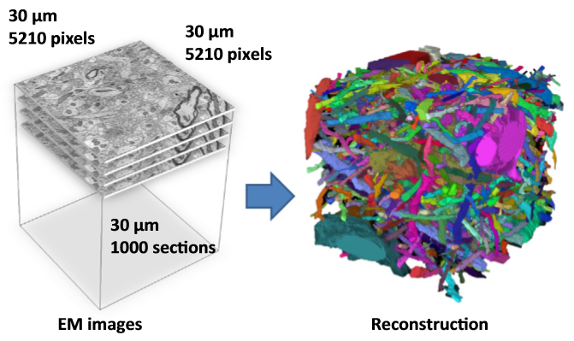
Vision for understanding the brain
1mm cubed of brain
Image at 5-30 nanometers
How much data?
[Kaynig-Fittkau et al.]

Slide 11
Vision for understanding the brain
1mm cubed of brain
Image at 5-30 nanometers
How much data?
1 Petabyte – 1,000,000,000,000,000
~ All photos uploaded to Facebook per day
[Kaynig-Fittkau et al.]

Slide 12
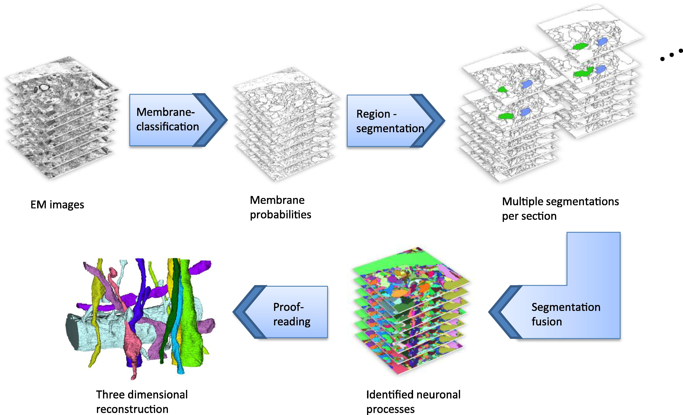
[Kaynig-Fittkau et al.]

Slide 13
[Kaynig-Fittkau et al.]

Slide 14
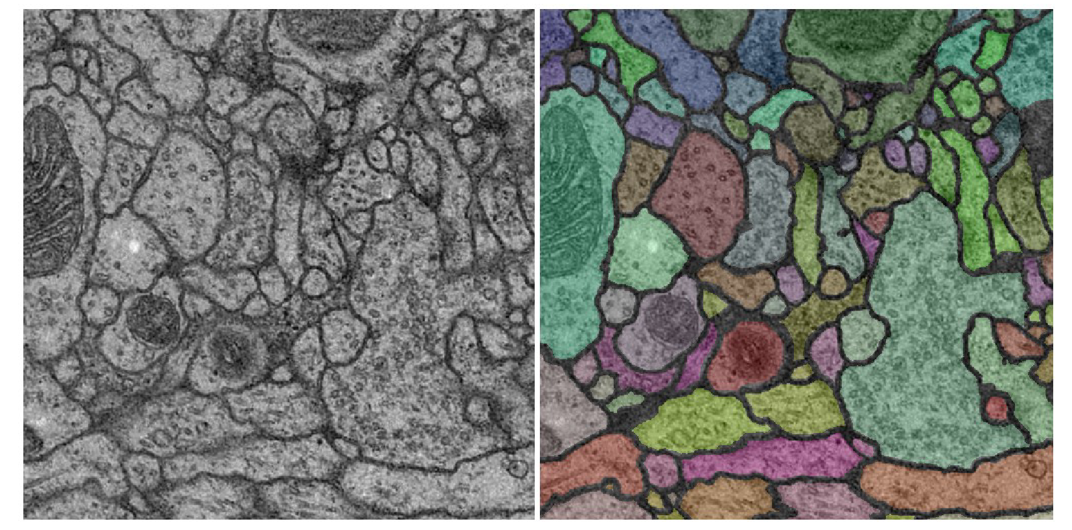

Vision for understanding the brain
Notes:
Use computer vision to classify neurons in the brain.
Attempt to build a connectivity graph of all neurons – ‘connectome’ – so that we can map and simulate brain function.

Slide 15
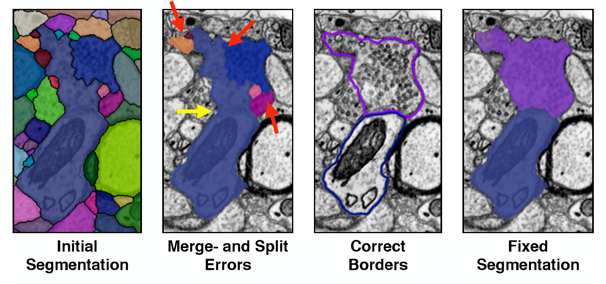
[Haehn et al.]
Notes:
https://arxiv.org/abs/1704.00848

Slide 16
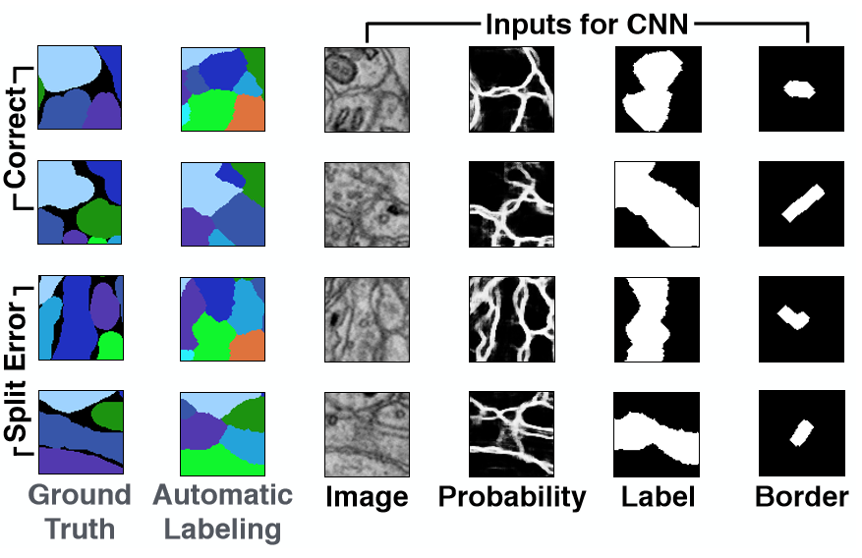
[Haehn et al.]
Notes:
https://arxiv.org/abs/1704.00848

Slide 17
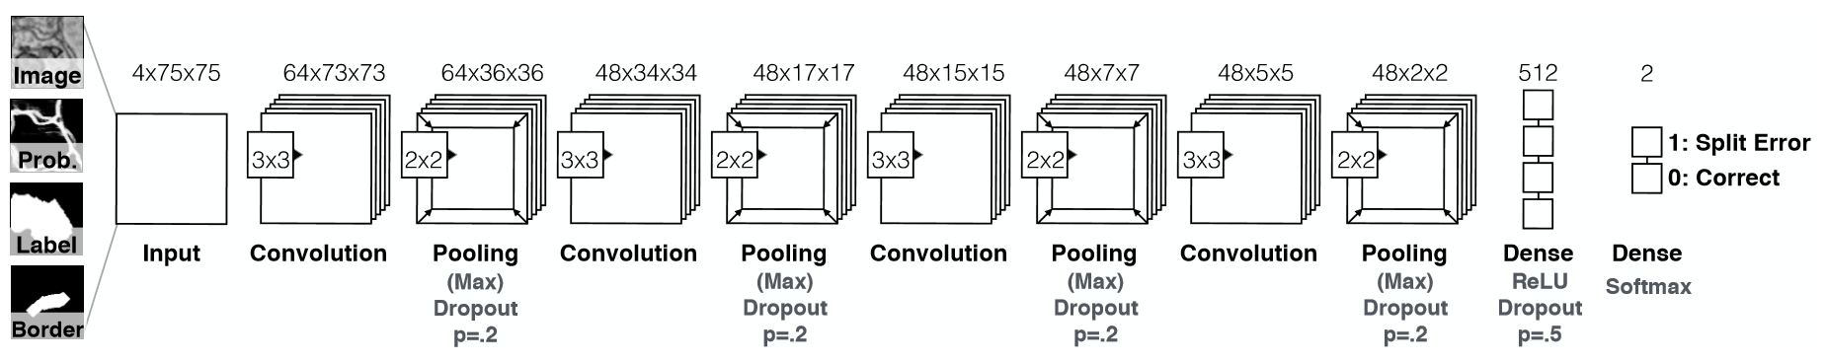
Network Architecture
[Haehn et al.]
Notes:
170,000 parameters
9000 positive / negative example patches
75 x 75
80,000 image patches
https://arxiv.org/abs/1704.00848

Slide 18
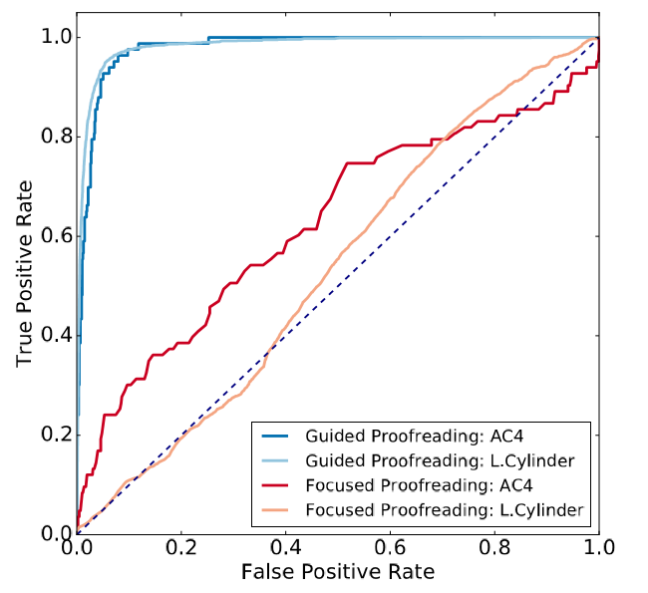
[Haehn et al.]
Notes:
https://arxiv.org/abs/1704.00848

Slide 19
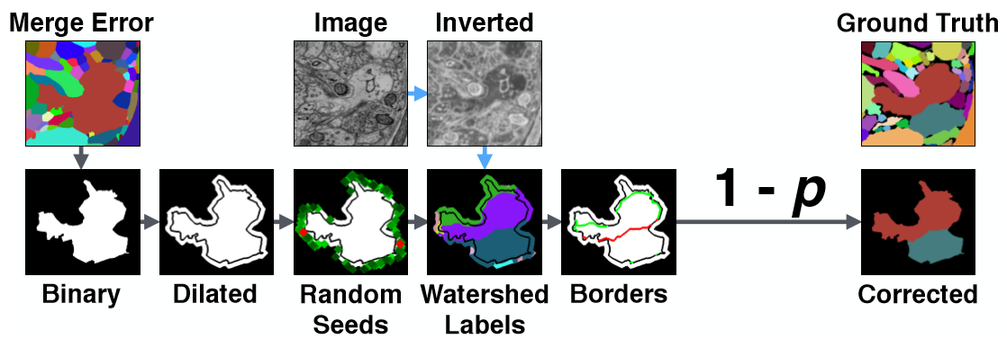
Detecting Merge Errors
Notes:
https://arxiv.org/abs/1704.00848

Slide 20
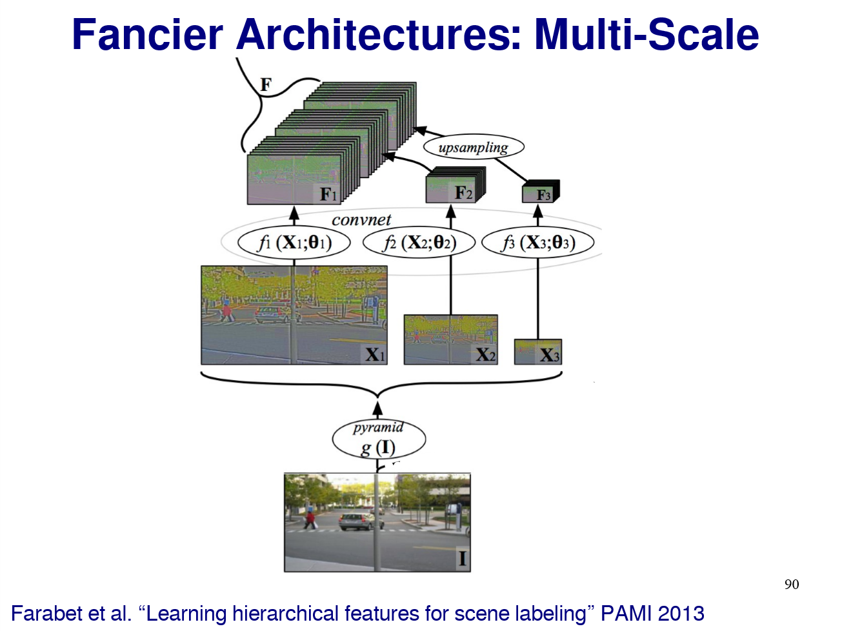

Slide 21
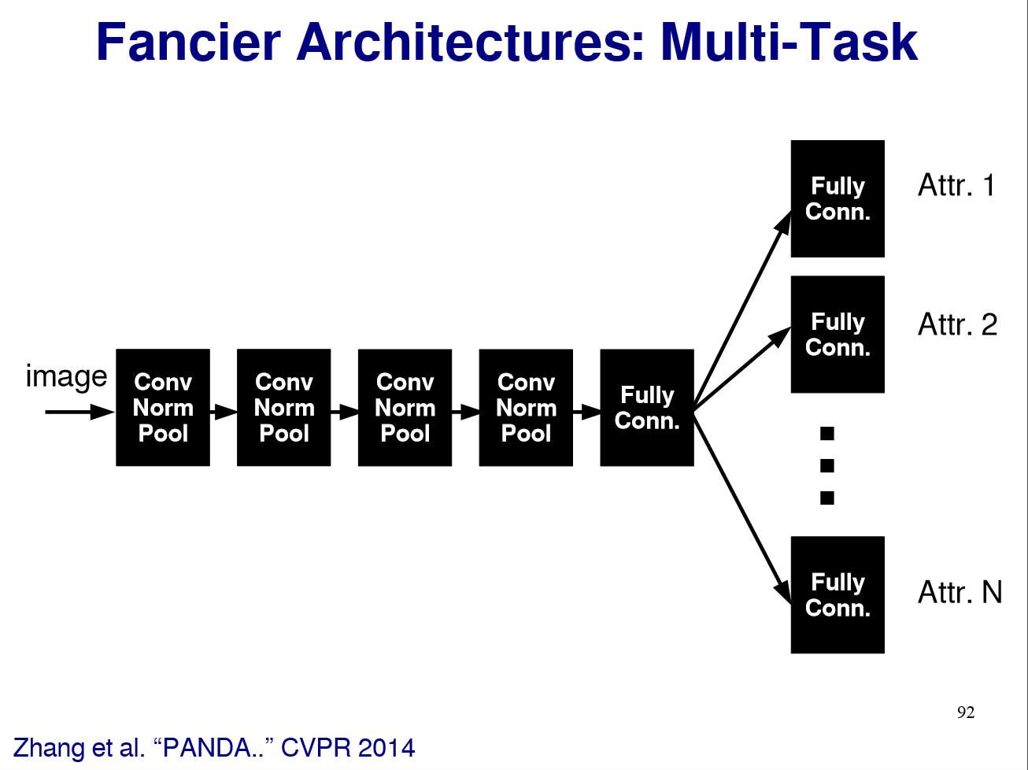

Slide 22
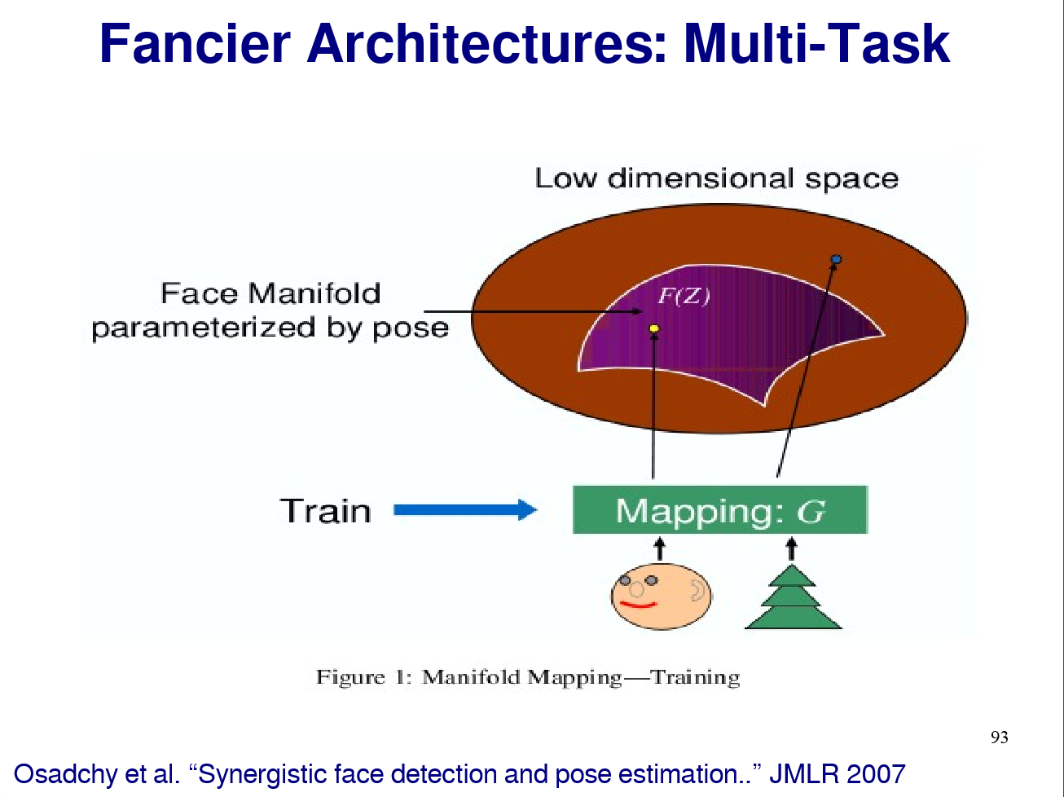

Slide 23
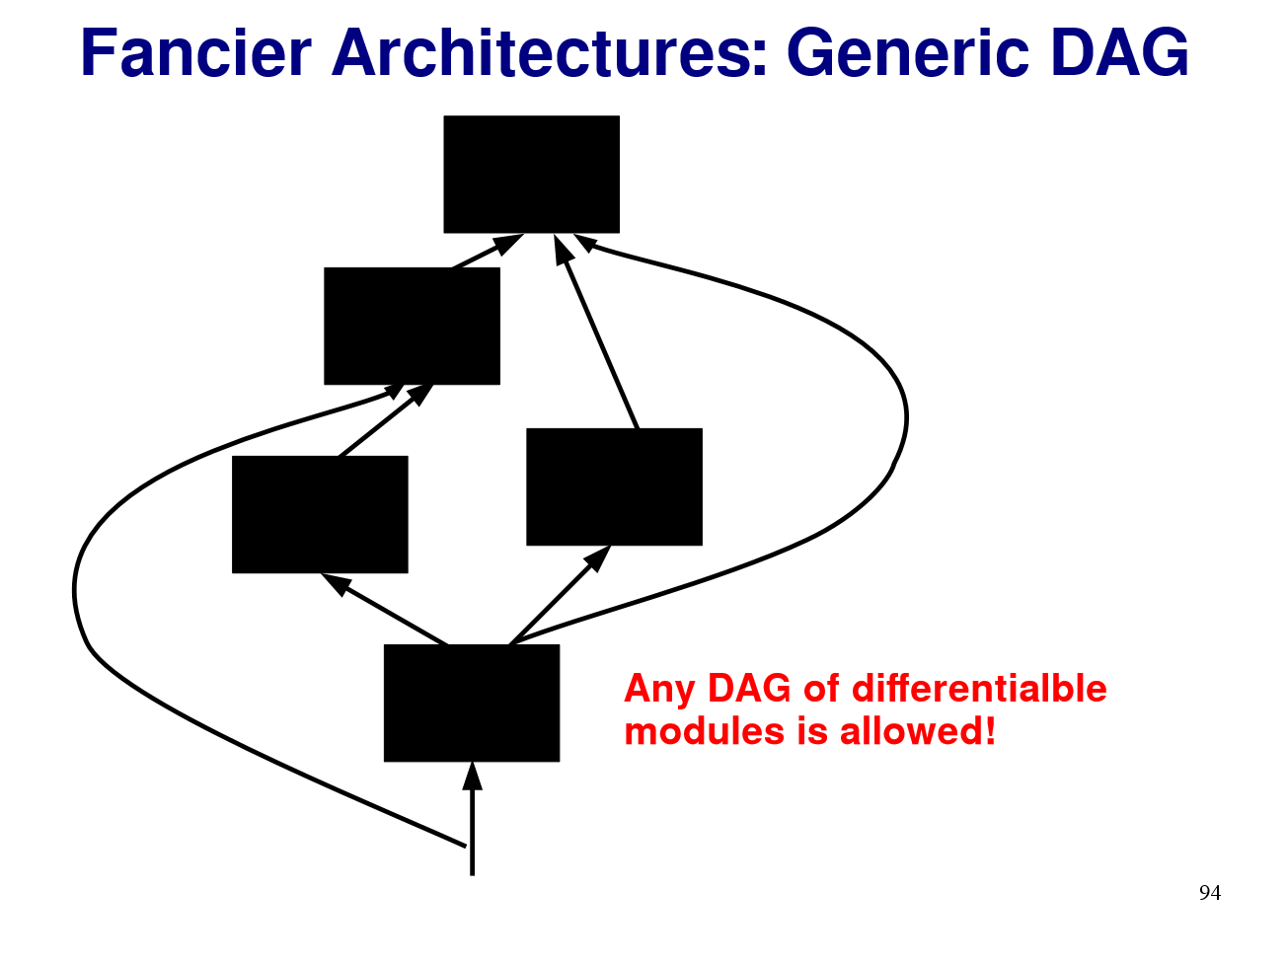
Any directed acyclic graph (DAG) of differentiable modules is allowed.

Slide 24
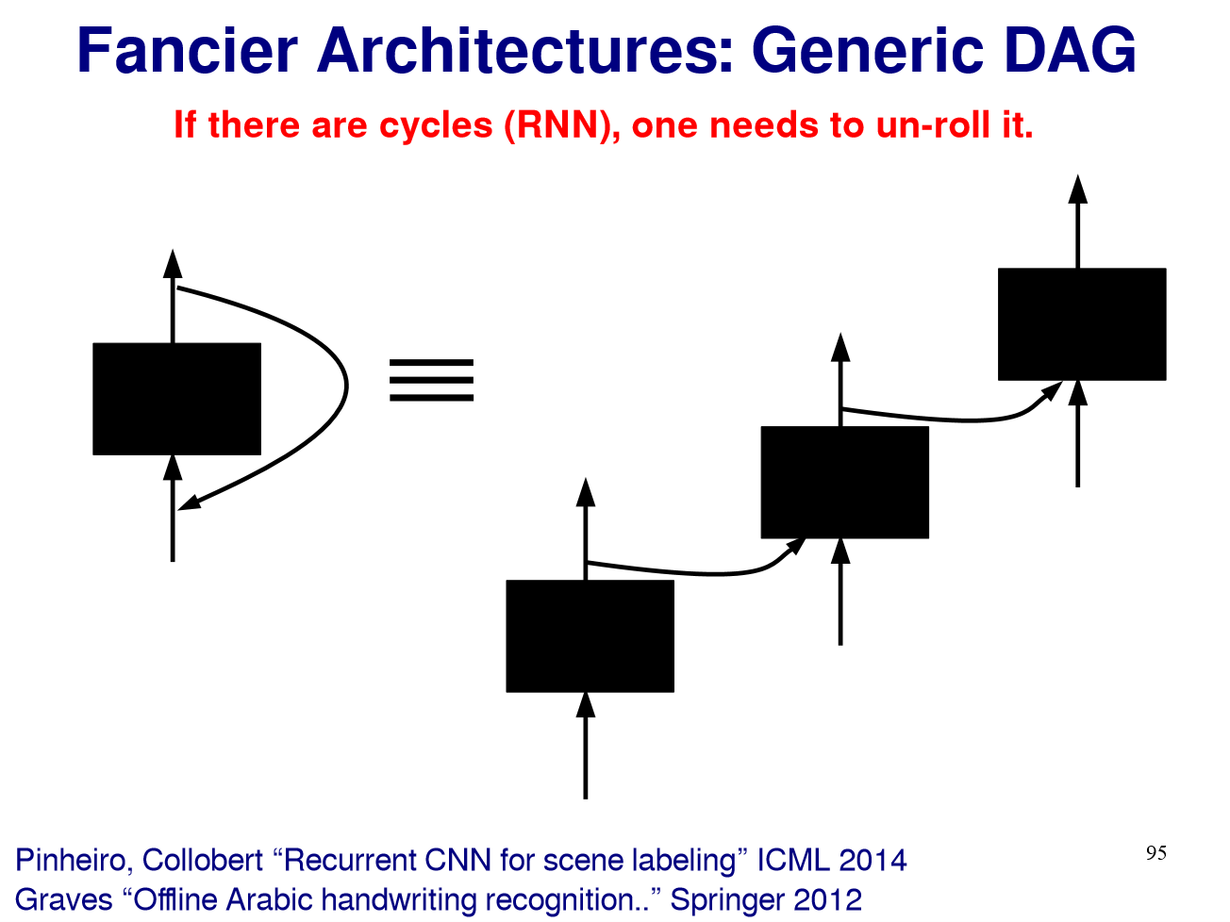

Slide 25
What about learning across ‘domains’?

Slide 26
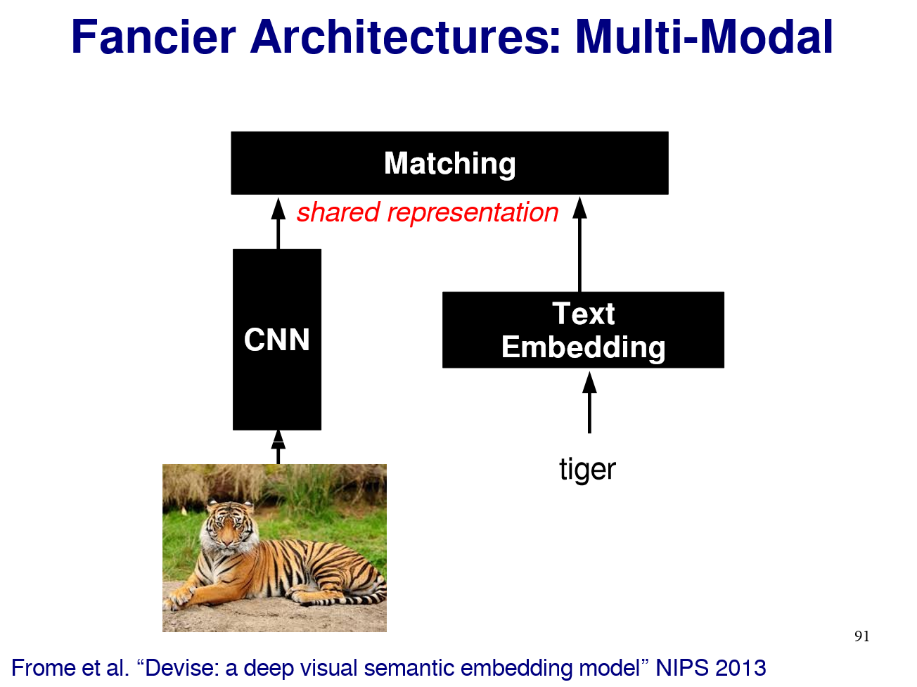

Slide 27
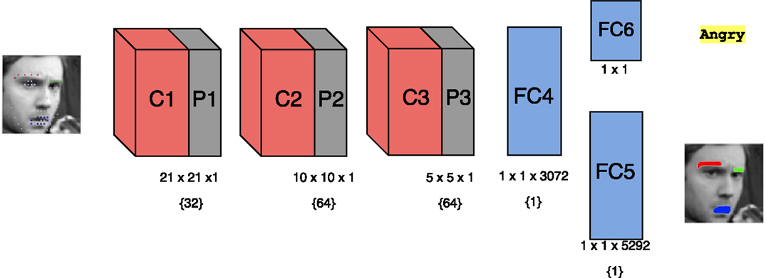
Notes:
http://journal.frontiersin.org/article/10.3389/frobt.2015.00036/full

Slide 28
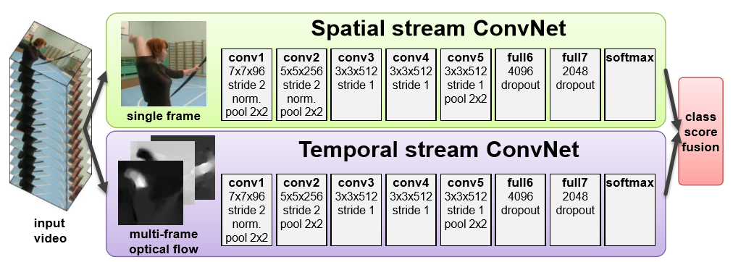
Two-stream networks –
action recognition
[Simonyan et al. 2014]
Notes:
http://journal.frontiersin.org/article/10.3389/frobt.2015.00036/full

Slide 29
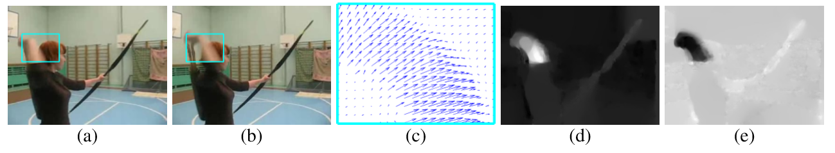
[Simonyan et al. 2014]

Slide 30


Learning Deep Representations For Ground-to-Aerial Geolocalization
Tsung-Yi Lin, Yin Cui, Serge Belongie, James Hays
CVPR 2015

Slide 31
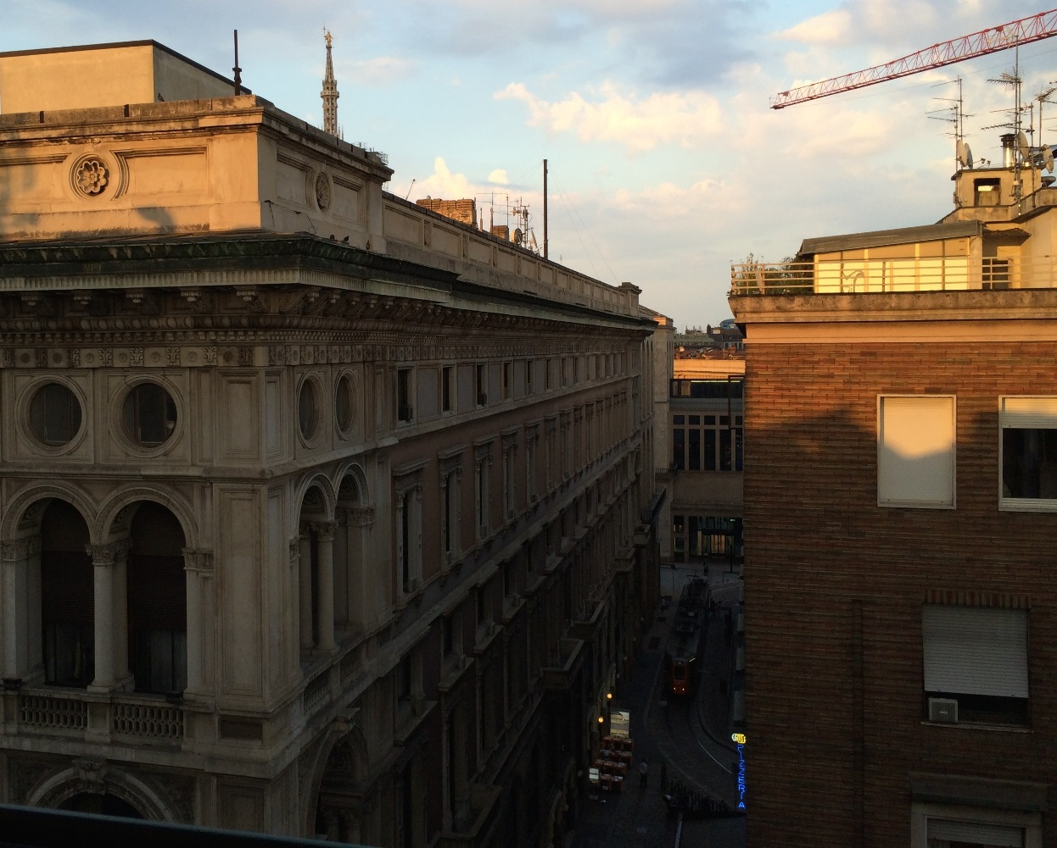
View From Your Window Contest
June 9, 2010 – Feb. 4, 2015
Where was the photo taken?
Notes:
Consider the picture here. Where do you think the picture was taken? (pause, pause, pause)
This photo was from the popular “view from your window” contest. A weekly fun competition that had been running almost for 5 years. In the contest, contenstents were asked to localize where the image was taken. And it can be anywhere on the earth.
You may recognize the building architecture is quite unique. The train running on the street is a clue. Or the blue sign reading “Pizzeria”. All these visual information can be great information to geolocalize the image.

Slide 32
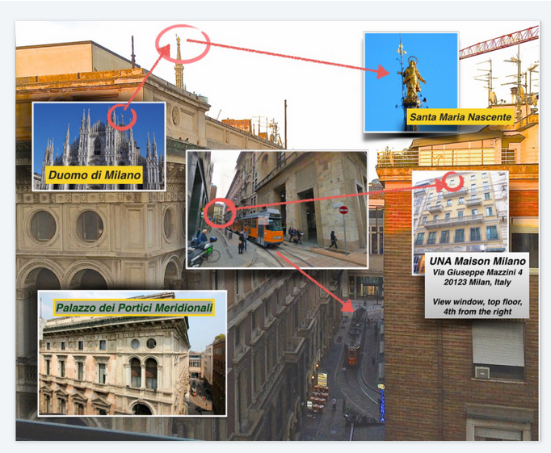
Ans:
Milano, Italy
Notes:
This is someone’s careful response to the contest. A diverse set of publicly available data sources were used to localize the image.
We can see there is a diversity of

Slide 33

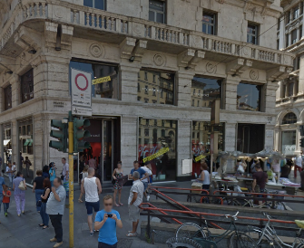
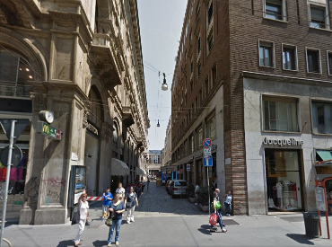
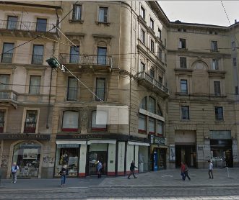
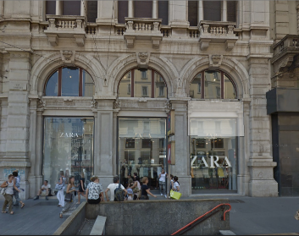
To Geolocalize a Photo
One can capture every corner on the earth
…
Notes:
One popular approach used to geolocalize an image is to match the query image to geo-referenced ground-level images (such as images provided by Google street-view).

Slide 34
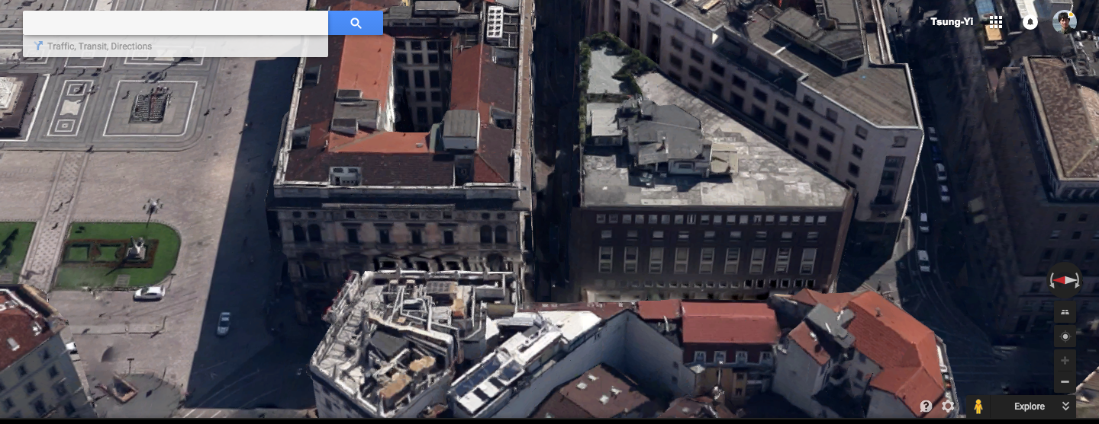

To Geolocalize a Photo
Notes:
As an alternative, another popular approach used in the “view from your window contest” is to localize the query images by matching it to the aerial imagery. Which has the advantage that can densely cover a large region.

Slide 35
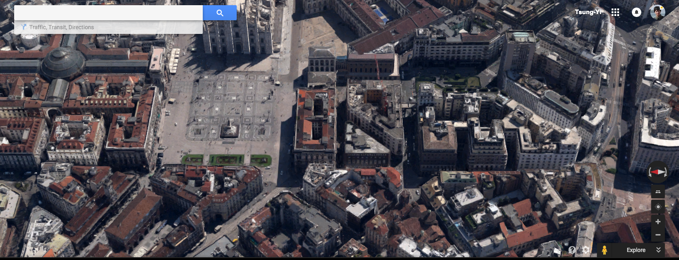

Slide 36
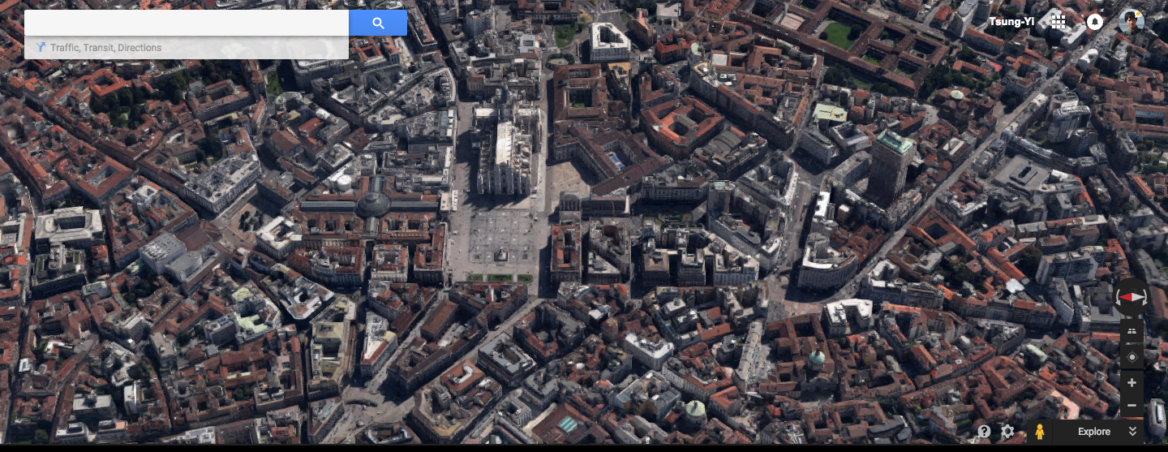

Slide 37
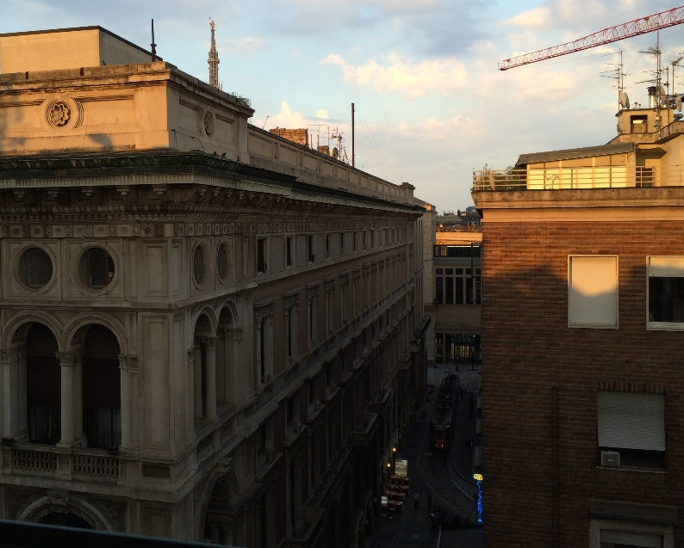
How To Match Ground-to-Aerial?
Shan et al., Accurate Geo-registration by Ground-to-Aerial Image Matching, 3DV’14
Bansal et al., Ultra-wide baseline façade matching for geo-localization, ECCV workshop’12
Notes:
We are particularly interested in matching ground-to-aerial images.
However, the images look quite different because of the illumination, occlusions, imaging device, time of day, moving objects like car, and so on… All these variations make the matching problem challenging.
A couple works from shan, bansal group tried to address that before.

Slide 38
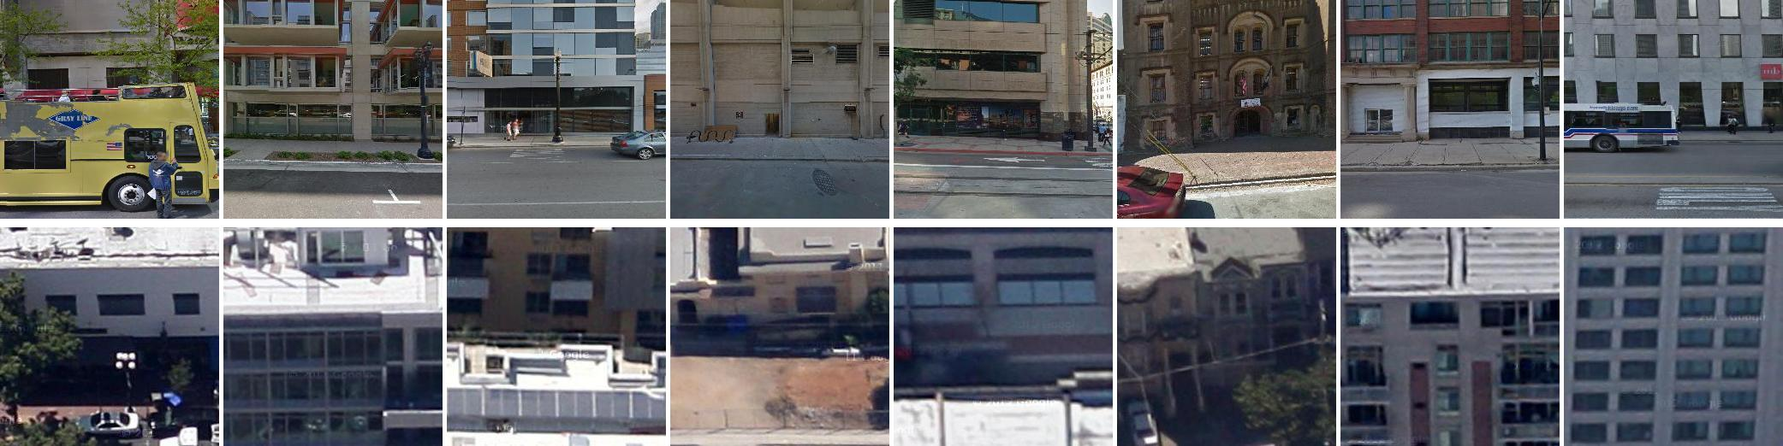
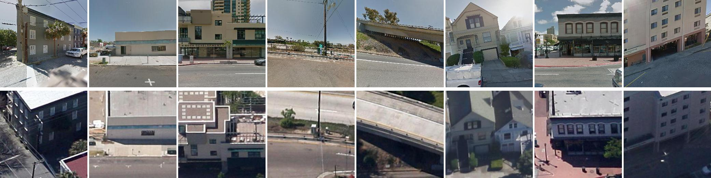
Are these the same location?
Ground
Aerial
Notes:
To demonstrate the level of difficulty of ground-to-aerial geolocalization, we select four cross-view pairs. Some of them are from the same locations, some are not.
The top row shows the ground-level images and the bottom row shows the aerial images.
Guess which pairs are from the same location?

Slide 39
Are these the same location?
Ground
Aerial
Notes:
In this example, only center two pairs are from the same location. Which is quite challenging for human.

Slide 40
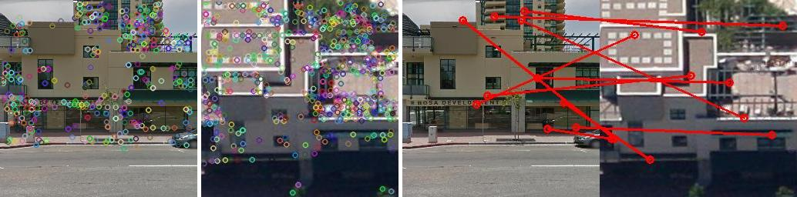
Why Don’t You Just…
Sparse Keypoint Matching + RANSAC
Notes:
Matching ground-to-aerial images is also quite challenging computationally.
The obviously thing to try would be SIFT + RANSAC but due to all variations mentioned in the previous slide. It doesn’t work
And this motivates us to learn a better feature representations with deep learning so that the ground and aerial images can be matched

Slide 41
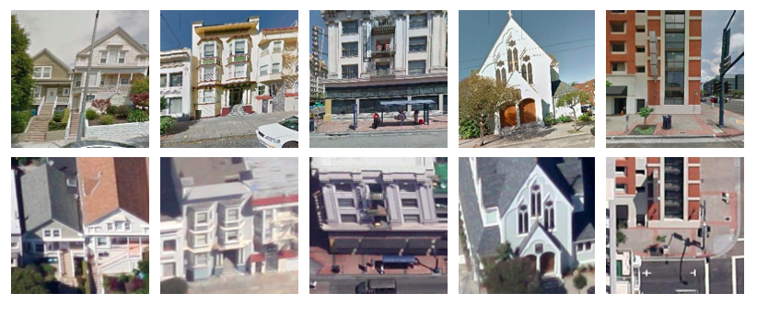
Cross-view Pairs
Ground
Aerial
Notes:
As with any approach using deep learning, we need significant amount of data to learn from.
In our case, we will be learning from corresponding ground-aerial pairs as shown in this slide.

Slide 42
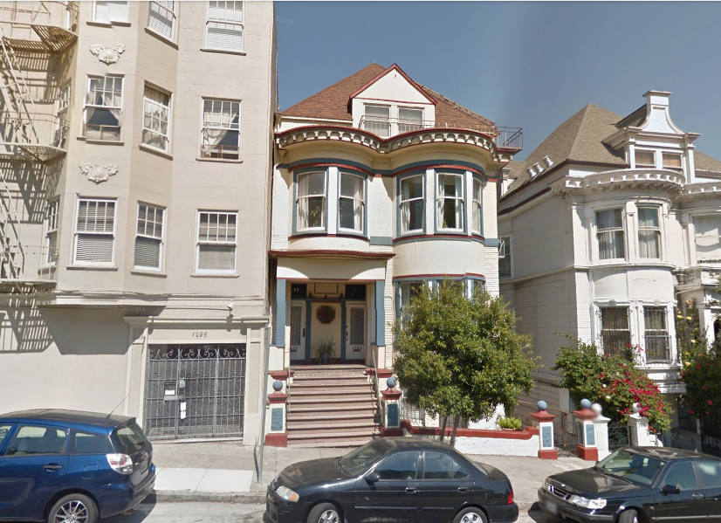

Street view Projection on
depth estimates
Heading Direction
GPS location
0°
Street-view car
Notes:
we collect these pairs by using information captured by google street-view car and aerial imagery.
Google provides the heading direction and gps location so we know the camera pose of each street view panorama image.

Slide 43
Street view Projection on
depth estimates
Heading Direction
GPS location
0°
Street-view car
Notes:
Google also provides rough depth estimates which we use to assign a dominant depth to each street-view crop.

Slide 44

Street view Projection on
depth estimates
45°
Heading Direction
GPS location
0°
Street-view car
Notes:
Together with known camera pose and depth estimates, we compute the homography to align the dominant plane of the street-view crop to aerial image crops.

Slide 45
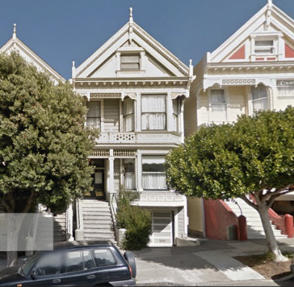
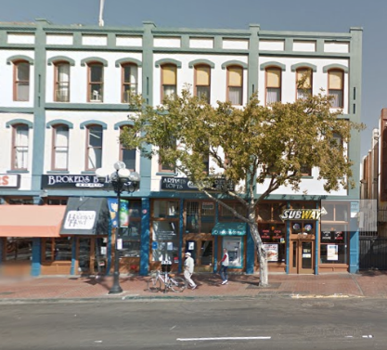
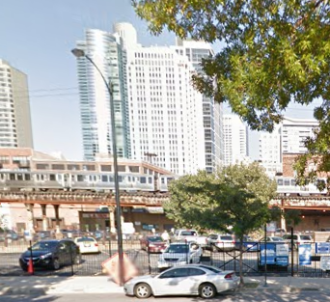
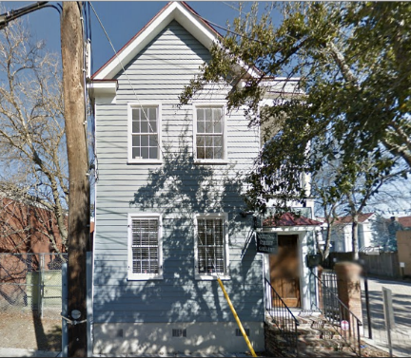
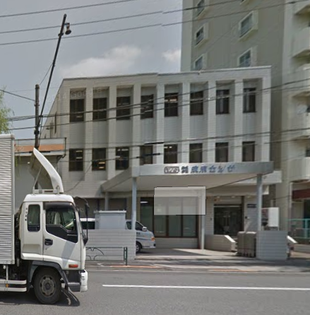
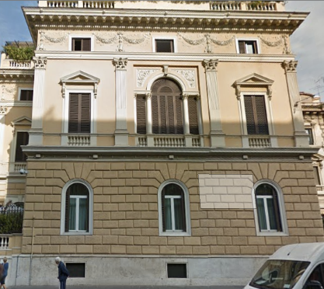
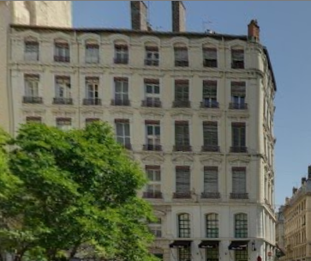
7 Cities: 78k Corresponding Pairs
San Francisco
San Diego
Chicago
Charleston
Tokyo
Rome
Lyon
Notes:
We use the process to generate a city scale cross-view image collection which we will use for training the deep learning model.

Slide 46
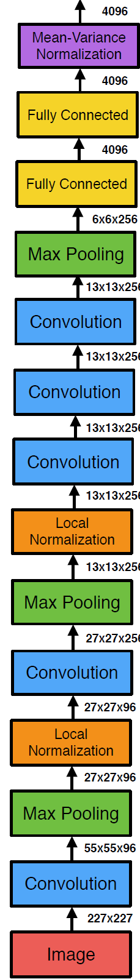





“Siamese” ConvNet for Ground-to-Aerial Matching
Notes:
The siamese network consists of two networks that have identical architecture, here labeled as A and B.
And we use the alex net architecture without fc8 layer..
The network can embed input images onto an embedding space.

Slide 47
“Siamese” ConvNet for Ground-to-Aerial Matching
Notes:
In the training stage, the network takes a pair of data as input.
Given a pair of images form the same location, which we called it a positive pair, the learning process will try to pull the images from the same location together in the embedding space.

Slide 48
“Siamese” ConvNet for Ground-to-Aerial Matching
Notes:
Given a pair of images that are from different location, which we called it negative pairs, the learning process will push the images from different locations away

Slide 49



Contrastive Loss
red: similar pairs
blue: dissimilar pairs
2
2
m = level from which to invert
Hadsell, Chopra, Yann LeCun,
Dimensionality Reduction by Learning an Invariant Mapping,
CVPR06
Notes:
Specifically, we use contrastive loss, which tries to pull positive pairs to have pair distance 0 and push the negative pair away such that it has pair distance larger than margin m.

Slide 50

Pair Distance Distribution
Green: positive pairs
Red: negative pairs
Margin
AlexNet-CNN Model
Where-CNN Model
50k iterations
Distribution of distances between positive/negative pairs.
Notes:
To demonstrate the value of our siamese network, first let’s look at the distribution of distances between positive and negative pairs if we simply use the off the shelf alexnet trained on imagenet. You can see that the positive pairs aren’t really closer together than the negative pairs.
We use the average pair distance from this experiment to set the margin for our siamese network and after 50k learning iterations we have a new embedding with the pair distances on the right.
And now there are many positive pairs that have smaller distance compared to the negative pairs.

Slide 51

Notes:
Let’s take a look at the matching pairs that have small distance in the learned feature embedding. The figure shows the positive pairs that are correctly verified by the network with high confidence.

Slide 52
Notes:
And here shows the negative pairs that are mistaken by the network as matching pairs.

Slide 53
For ground-aerial image pairs, should A, B networks share the same weights?
Notes:
In the face verification literature, A and B share the same network architecture as well as the parameters.
The reason is the input face data is from the same domain.

Slide 54

Quantitative Evaluation
Minor improvement with ‘domain-specific’ weights.
Notes:
We train this domain specific network, and to our surprise, it only gave us 2% AP improvement.

Slide 55
Quantitative Evaluation (AP)
Random: 5% (1:20 pos. to neg. pairs)
HoG2x2 (BoW): 7.9%
Places-CNN: 10.2%
ImageNet-CNN: 11.3%
Where-CNN (ours): 41.9%
Notes:
Here shows the quantitative results measured by average precision on the verification task
If we randomly assign matched and unmatched to the test pairs, the ap is 5%.

Slide 56
Big space of designs!
But we still don’t even know how many layers we need.

Slide 57


Slide 58


Slide 59

Notes:
FLOPS = just to execute, not train.

Slide 60
VERY DEEP CONVOLUTIONAL NETWORKS FOR LARGE-SCALE IMAGE RECOGNITION
Beyond AlexNet
Karen Simonyan & Andrew Zisserman 2015
These are the pre-trained “VGG” networks
that you use in project 5
Notes:
VGG = Visual Geometry Group at Oxford, UK

Slide 61

Notes:
Compared to Alex-Net – Deeper, smaller convolutions, more parameters

Slide 62


Slide 63

Google LeNet (2014)
22 layers
6.67% error
ImageNet top 5

Slide 64

Inception!

Slide 65

Parallel layers

Slide 66

ResNet (He et al., 2015)
ResNet won ILSVRC 2015 with a top-5 error rate of 3.6%
Depending on their skill and expertise, humans generally hover around a 5-10% error.
But the task is arguably
not well defined.
Notes:
They actually have a 152-layer model
http://kaiminghe.com/cvpr16resnet/cvpr2016_deep_residual_learning_kaiminghe.pdf

Slide 67


Slide 68

Notes:
The CIFAR-10 and CIFAR-100 are labeled subsets of the 80 million tiny images dataset. They were collected by Alex Krizhevsky, Vinod Nair, and Geoffrey Hinton. The CIFAR-10 dataset
The CIFAR-10 dataset consists of 60000 32x32 colour images in 10 classes, with 6000 images per class. There are 50000 training images and 10000 test images.

Slide 69

CIFAR-10
60,000 32x32 color images, 10 classes
Notes:
The CIFAR-10 and CIFAR-100 are labeled subsets of the 80 million tiny images dataset. They were collected by Alex Krizhevsky, Vinod Nair, and Geoffrey Hinton.
The CIFAR-10 dataset
The CIFAR-10 dataset consists of 60000 32x32 colour images in 10 classes, with 6000 images per class. There are 50000 training images and 10000 test images.

Slide 70


Slide 71


Slide 72


Slide 73


Regular net

Slide 74

Residual Unit
Notes:
The idea behind a residual block is that you have your input x go through conv-relu-conv series. This will give you some F(x).
That result is then added to the original input x.
Let’s call that H(x) = F(x) + x. In traditional CNNs, your H(x) would just be equal to F(x) right?
So, instead of just computing that transformation (straight from x to F(x)), we’re computing the term that you have to add, F(x), to your input, x.
Basically, the mini module shown below is computing a “delta” or a slight change to the original input x to get a slightly altered representation.
(When we think of traditional CNNs, we go from x to F(x) which is a completely new representation that doesn’t keep any information about the original x). The authors believe that “it is easier to optimize the residual mapping than to optimize the original, unreferenced mapping”.

Slide 75
Residual Unit
The inputs of a lower layer is made available to a node in a higher layer.
Notes:
If identity were the optimal mapping, then we would set all the weight layers to 0 and be done.
If the optimal mapping were close to the identity, then this formulation makes it easier to find small fluctuations.
But, the identity transform is not optimal (duh),

Slide 76


Slide 77

Why so steep?

Slide 78


Flat regions in energy landscape
Notes:
Also lets us see how different kinds of learning algorithms work.

Slide 79

James, do we have to go deeper?
Compute vs. parameters / multiply-adds
Hmm…efficient nets…
might be useful for final project ???
https://www.infoq.com/news/2017/06/google-mobilenets-tensorflow
https://arxiv.org/abs/1704.04861
Notes:
http://theorangeduck.com/page/neural-network-not-working

