Slide 1


Slide 2
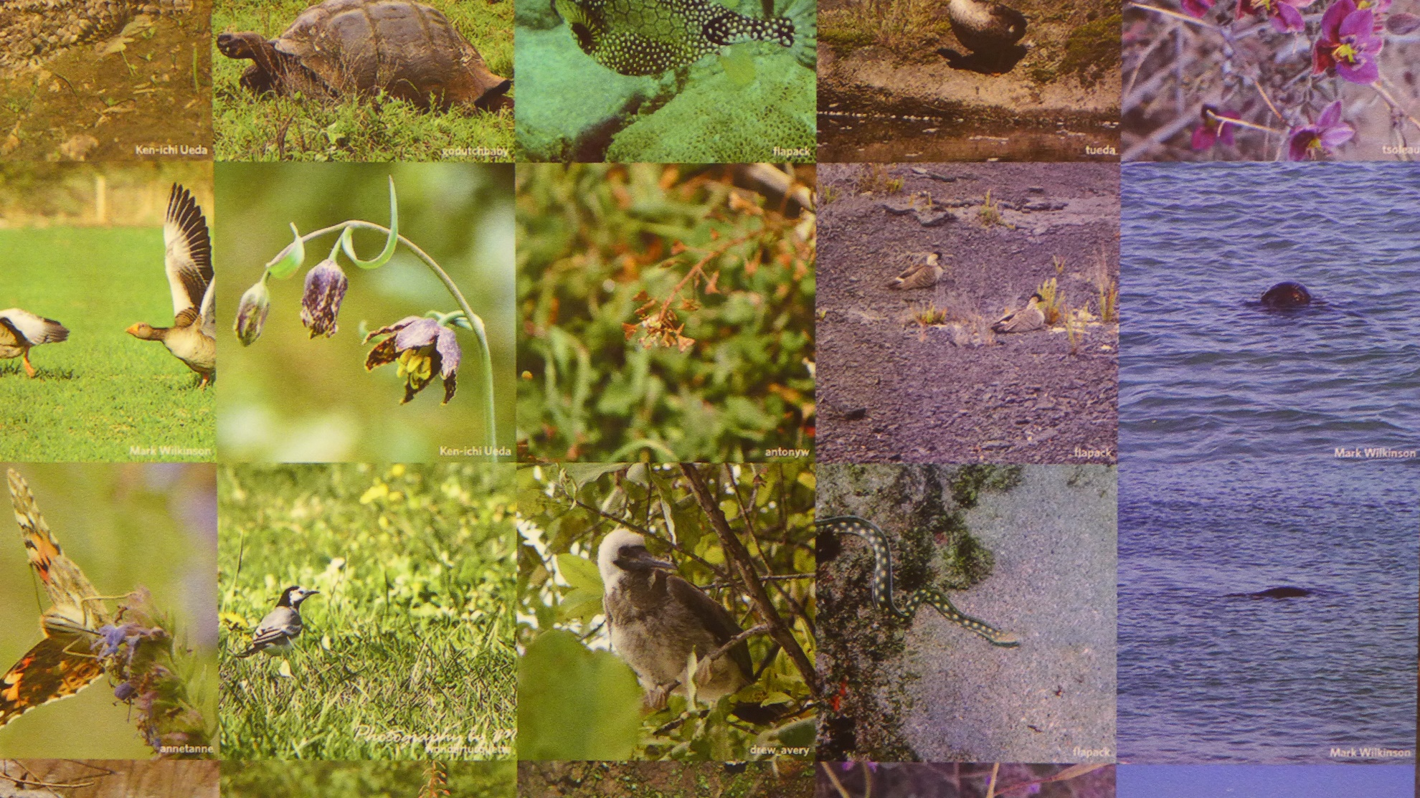

Slide 3
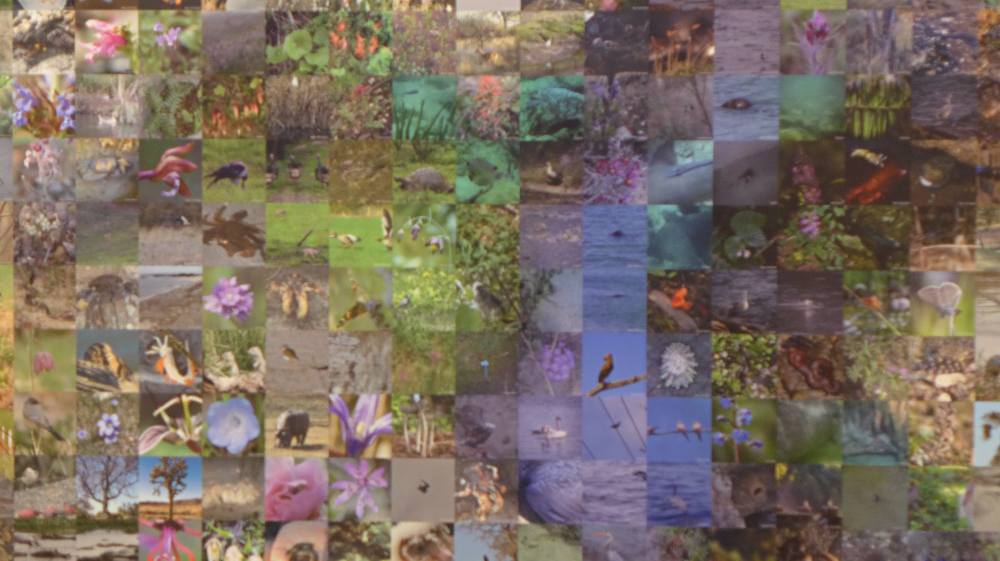

Slide 4
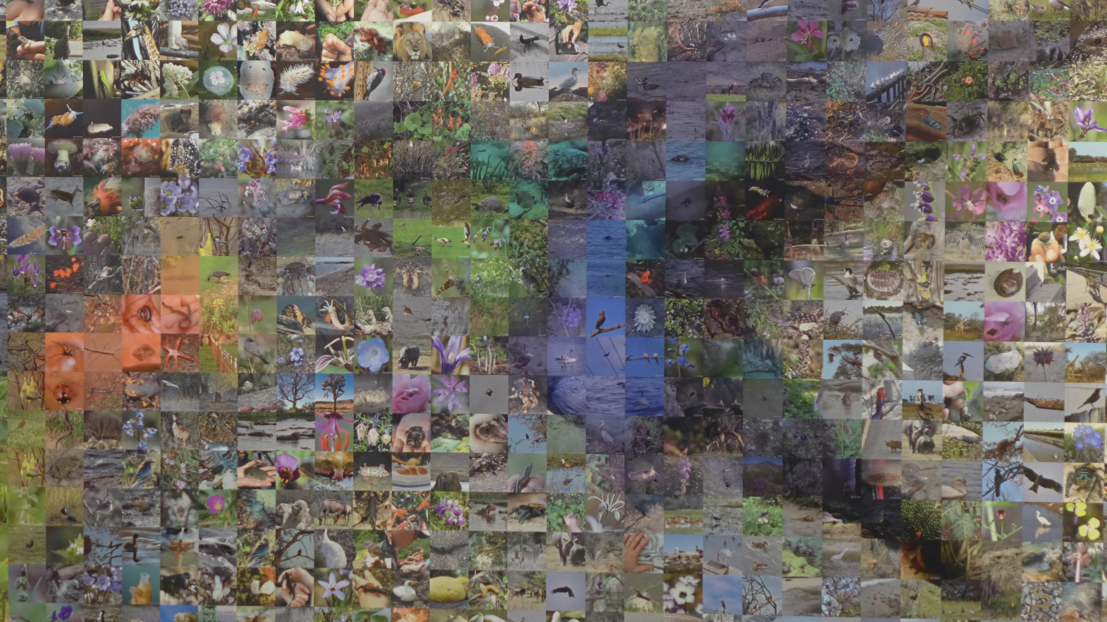

Slide 5
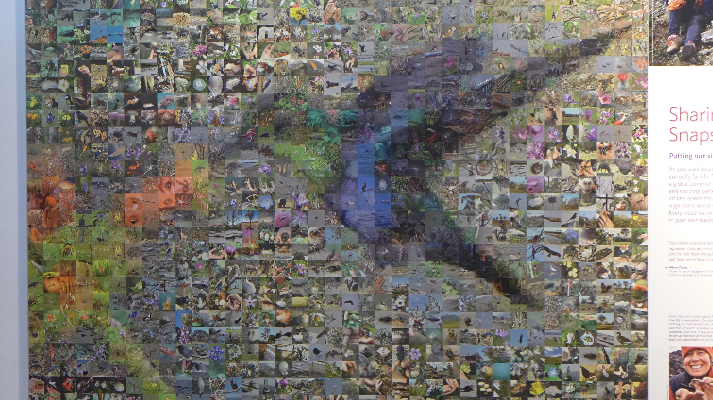

Slide 6
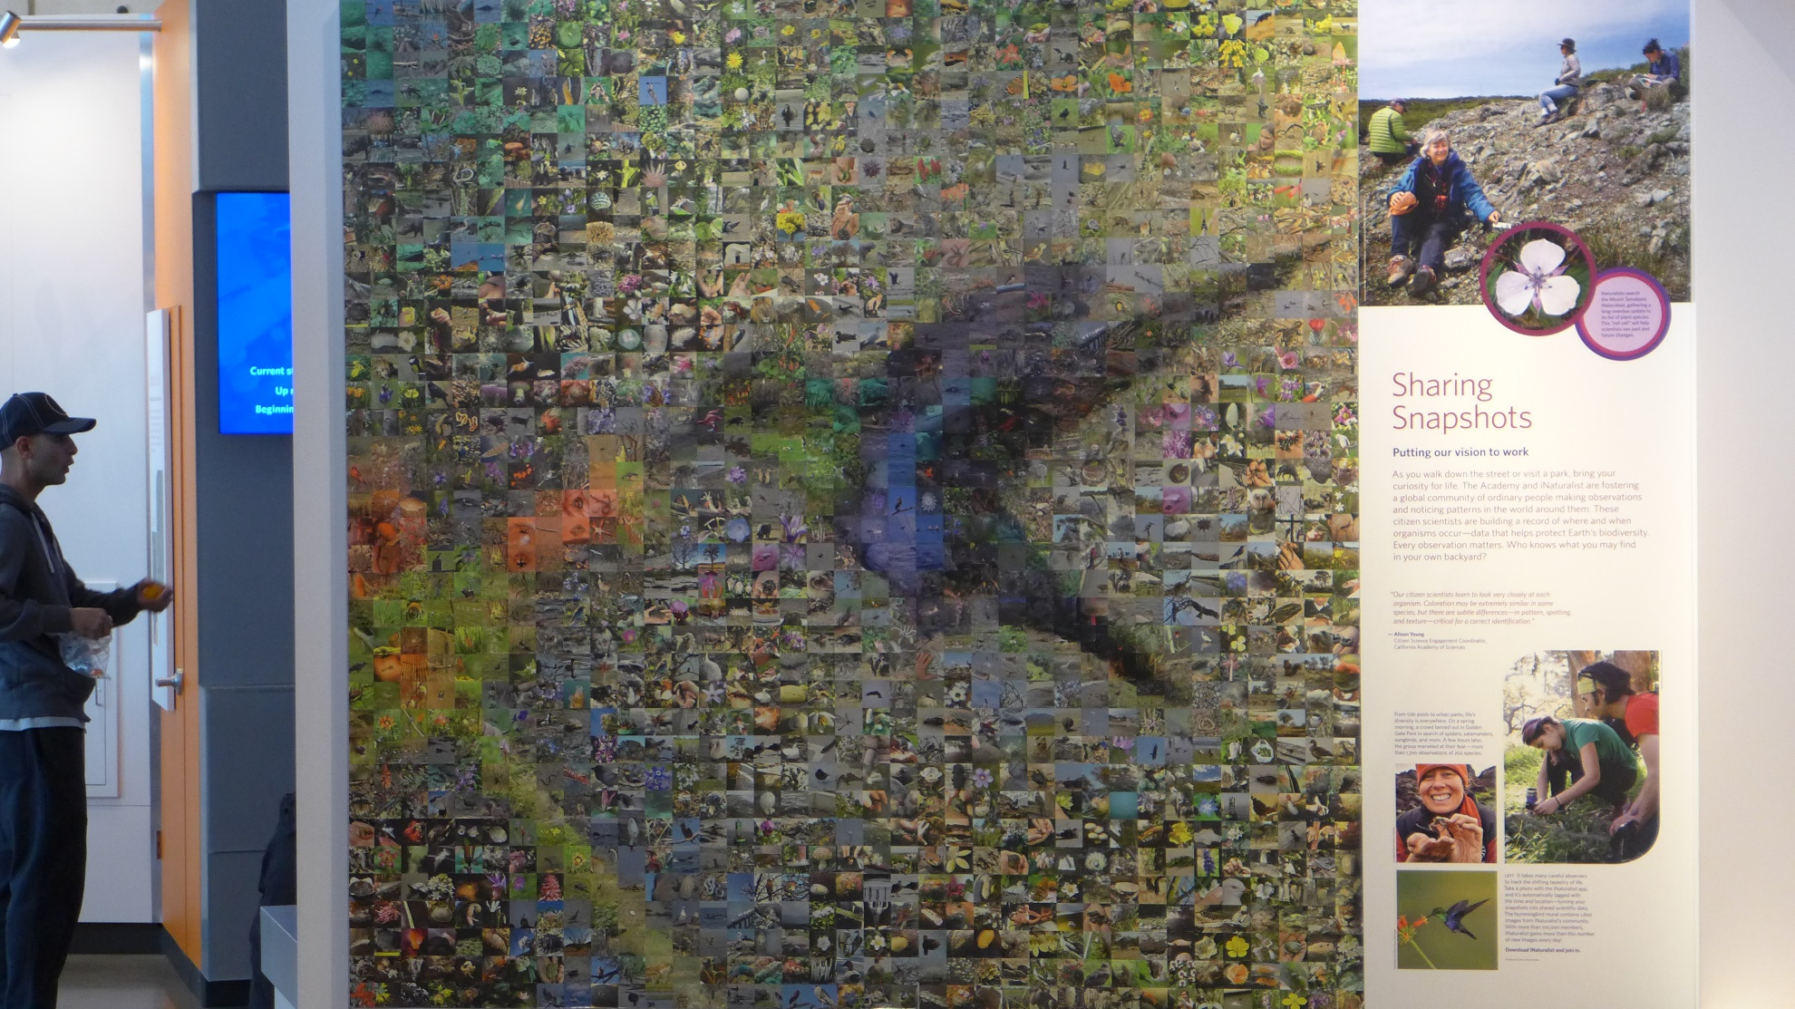

Slide 7
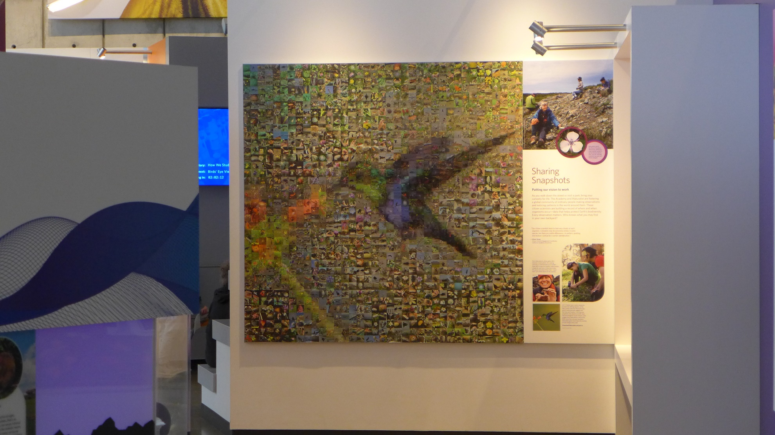

Slide 8
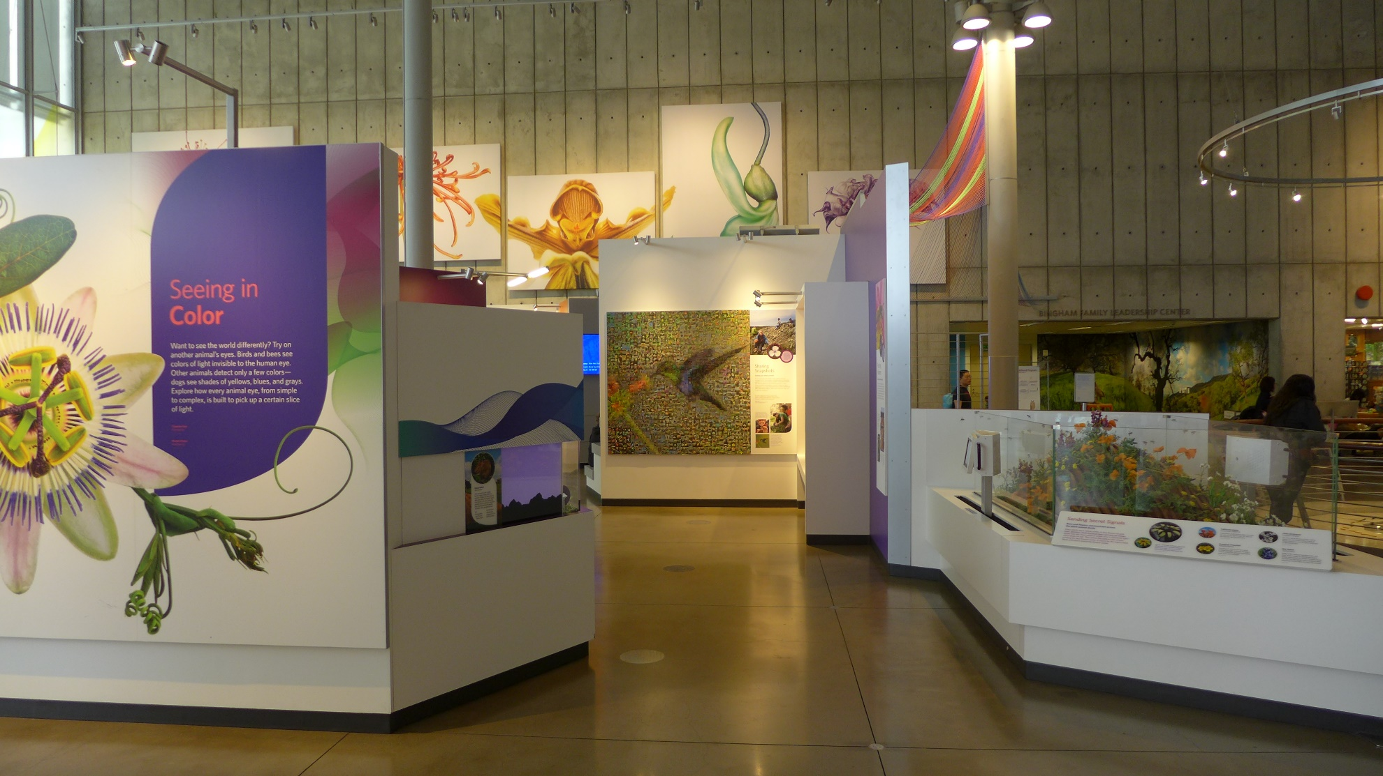
Notes:
California Academy of Sciences
San Francisco’s Golden Gate Park
~ Summer 2017

Slide 9
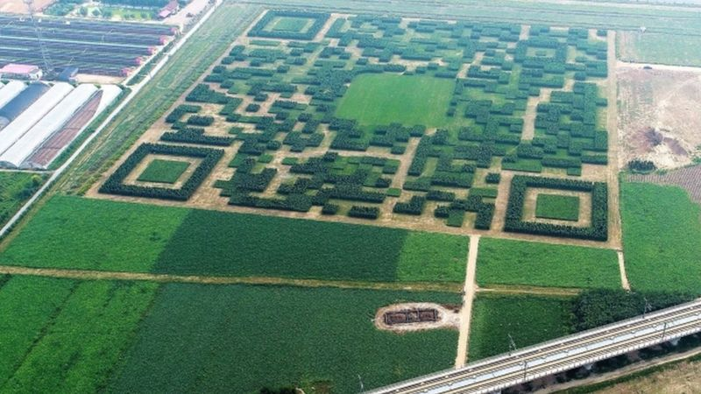
Notes:
http://www.bbc.com/news/world-asia-china-41277549

Slide 10
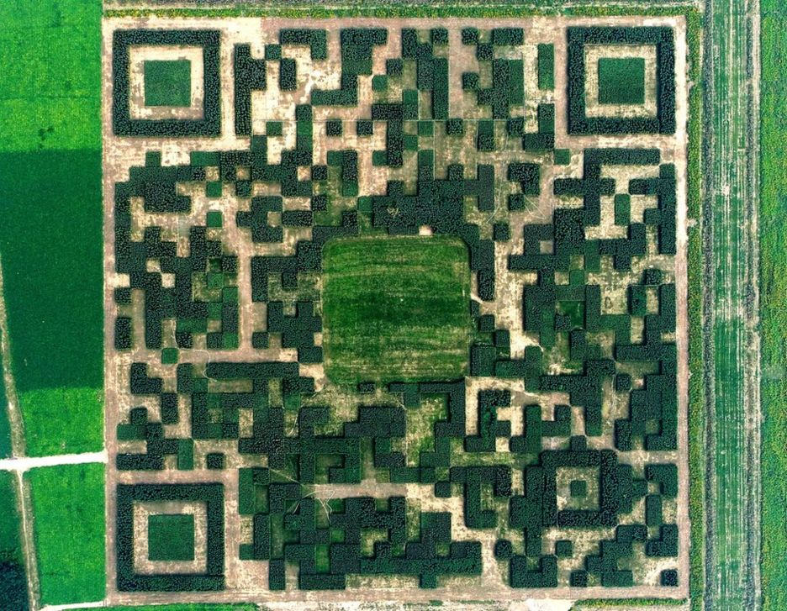
Notes:
Xilinshui village

Slide 11
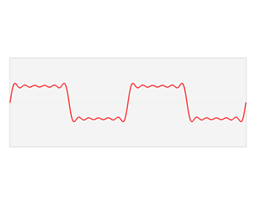
Wikipedia – Fourier transform

Slide 12
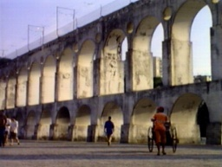
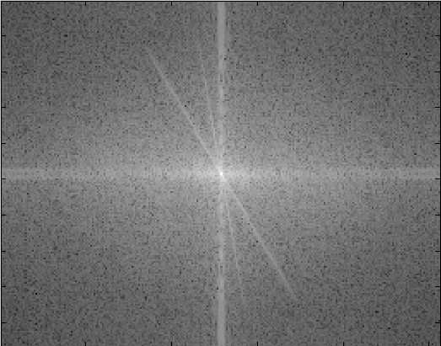
Natural image
Fourier decomposition
Frequency coefficients (amplitude)
Natural image
What does it mean to be at pixel x,y?
What does it mean to be more or less bright in the Fourier decomposition image?

Slide 13
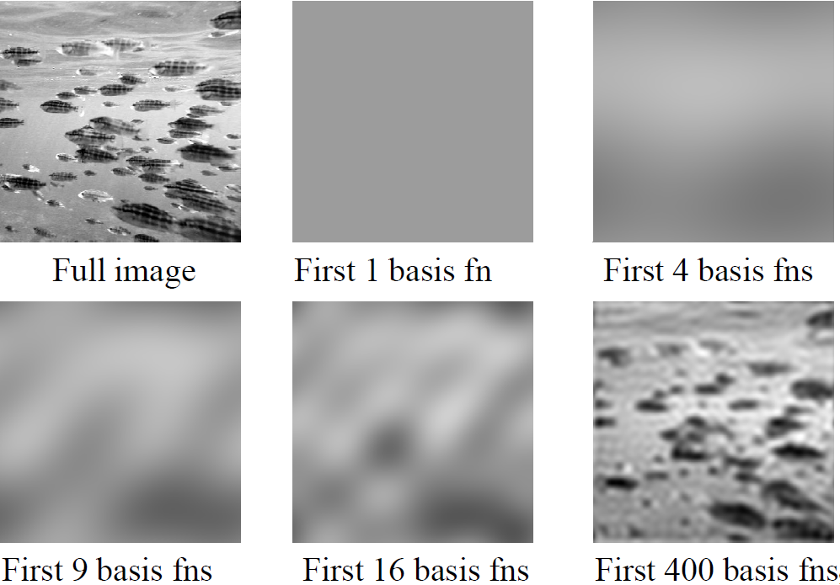
Basis reconstruction
Danny Alexander

Slide 14
Properties of Fourier Transforms
Linearity
Fourier transform of a real signal is symmetric about the origin
The energy of the signal is the same as the energy of its Fourier transform
See Szeliski Book (3.4)

Slide 15
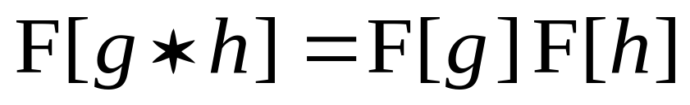
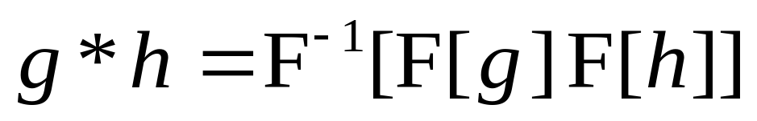
The Convolution Theorem
The Fourier transform of the convolution of two functions is the product of their Fourier transforms
Convolution in spatial domain is equivalent to multiplication in frequency domain!
Hays

Slide 16
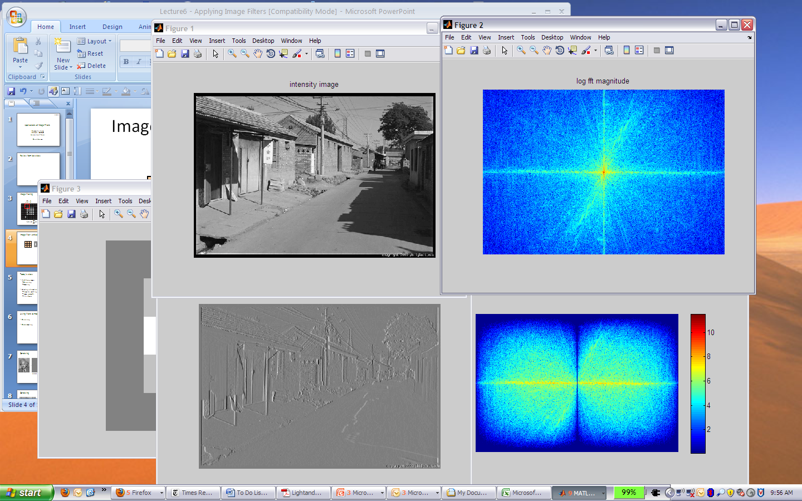
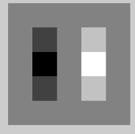
Filtering in spatial domain
1
0
-1
2
0
-2
1
0
-1
*
=
Hays

Slide 17
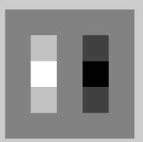

Filtering in frequency domain
FFT
FFT
=
Inverse FFT
Slide: Hoiem

Slide 18
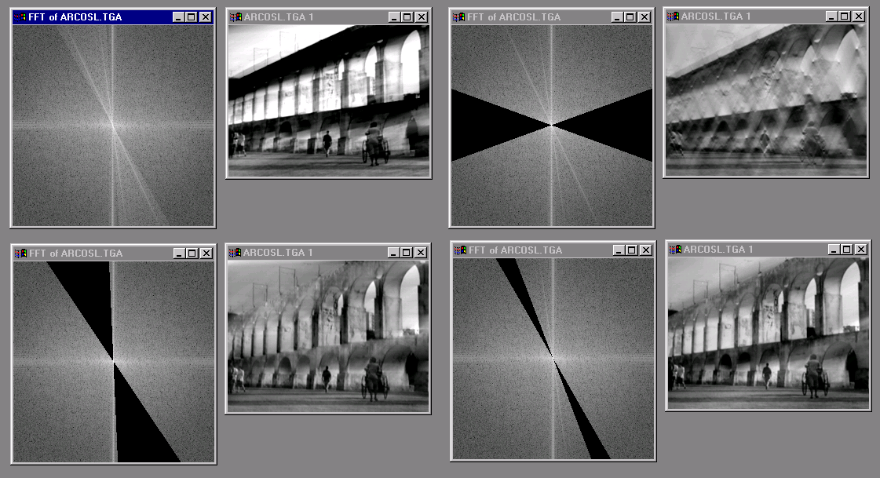
Now we can edit frequencies!

Slide 19
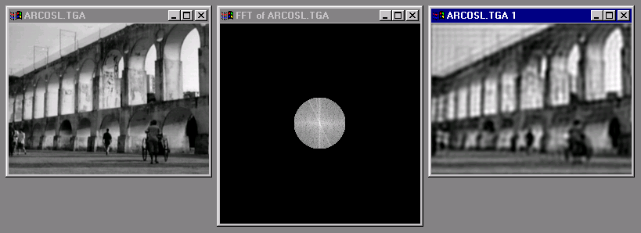
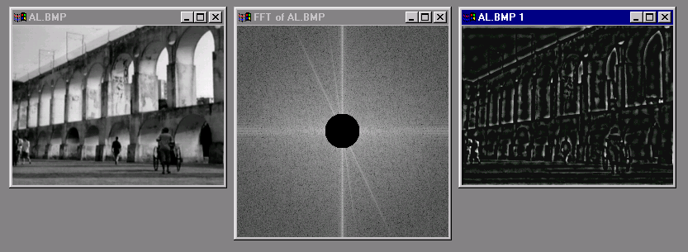
Low and High Pass filtering

Slide 20
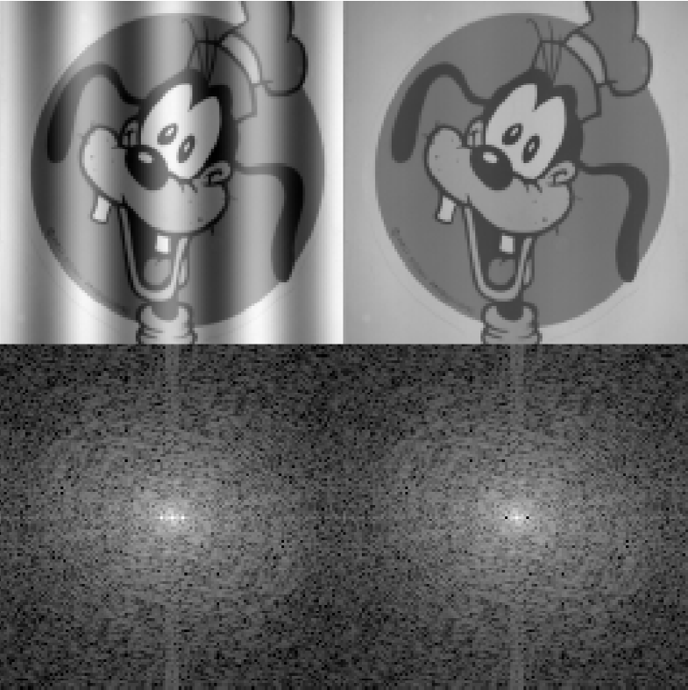
Removing frequency bands
Brayer

Slide 21
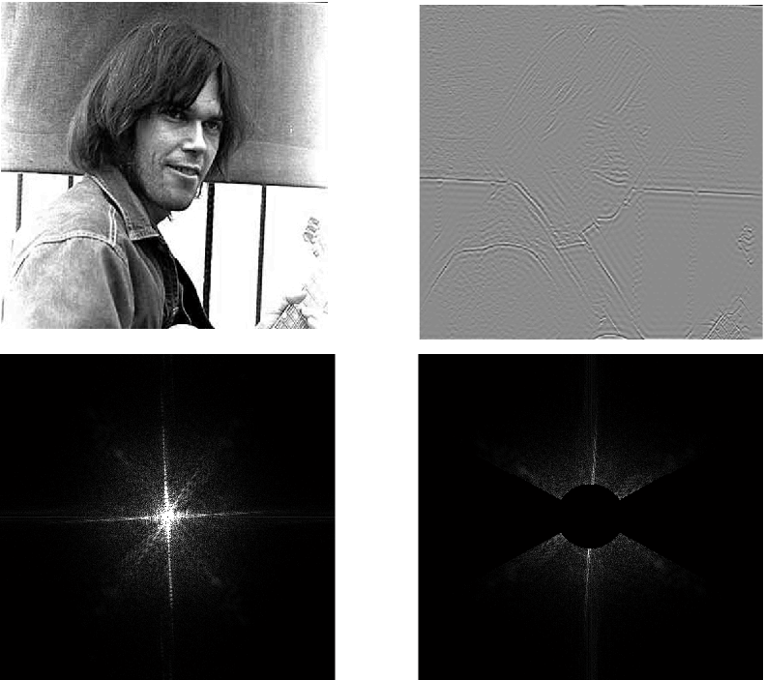
High pass filtering + orientation

Slide 22
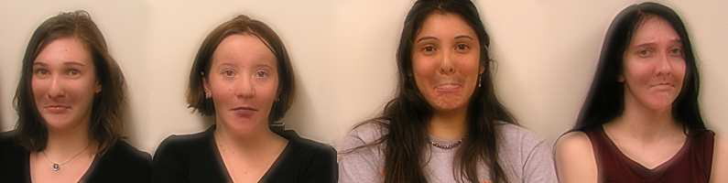

Application: Hybrid Images
When we see an image from far away, we are effectively subsampling it!
A. Oliva, A. Torralba, P.G. Schyns, SIGGRAPH 2006

Slide 23
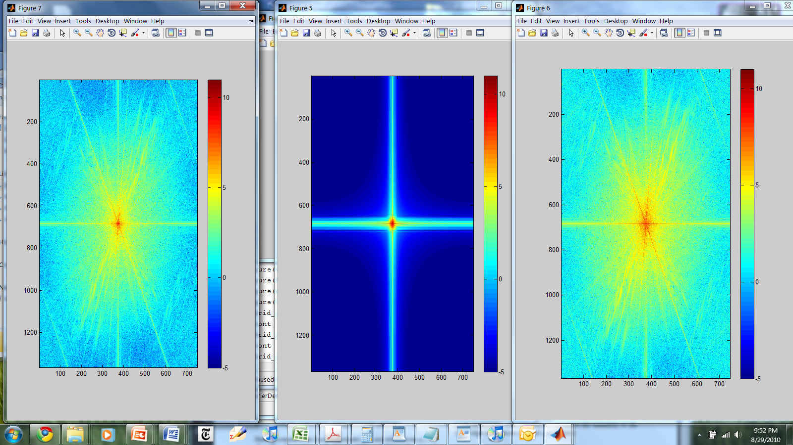
Hybrid Image in FFT
Hybrid Image
Low-passed Image
High-passed Image

Slide 24

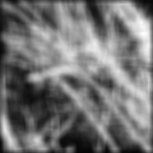
Hays
Why does the Gaussian filter give a nice smooth image, but the square filter give edgy artifacts?
Gaussian
Box filter
Notes:
Things we can’t understand without thinking in frequency

Slide 25
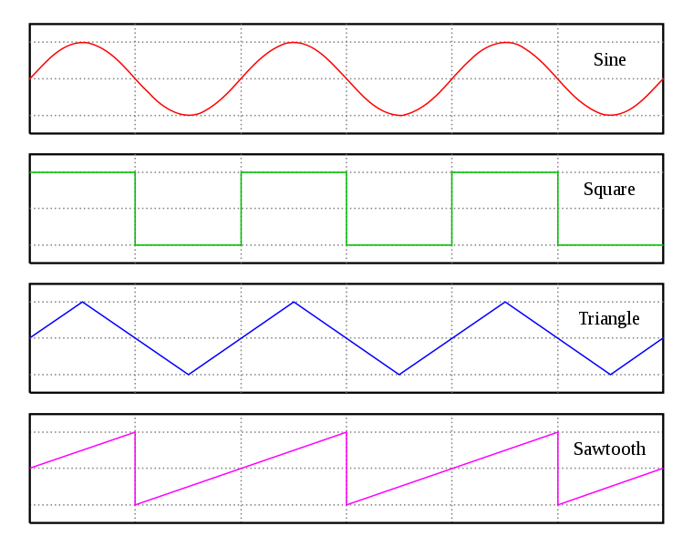
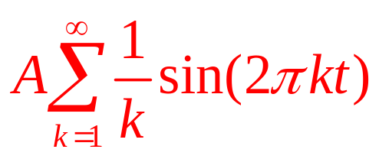
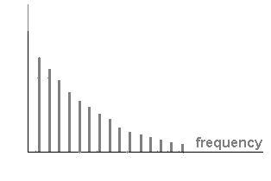
Why do we have those lines in the image?
Sharp edges in the image need _all_ frequencies to represent them.
=
coefficient
Efros

Slide 26
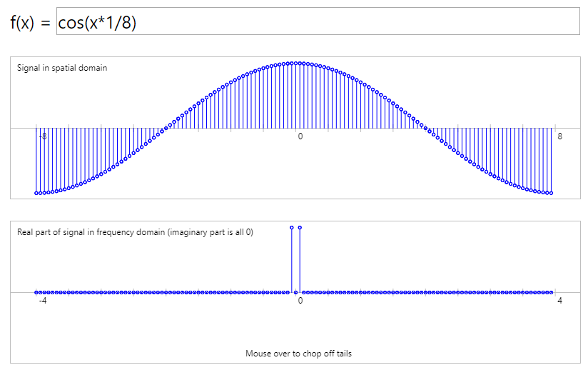
Box filter / sinc filter duality
Hays
What is the spatial representation of the hard cutoff (box) in the frequency domain?
http://madebyevan.com/dft/
Notes:
Dual functions – box(x) and sinc(x)

Slide 27

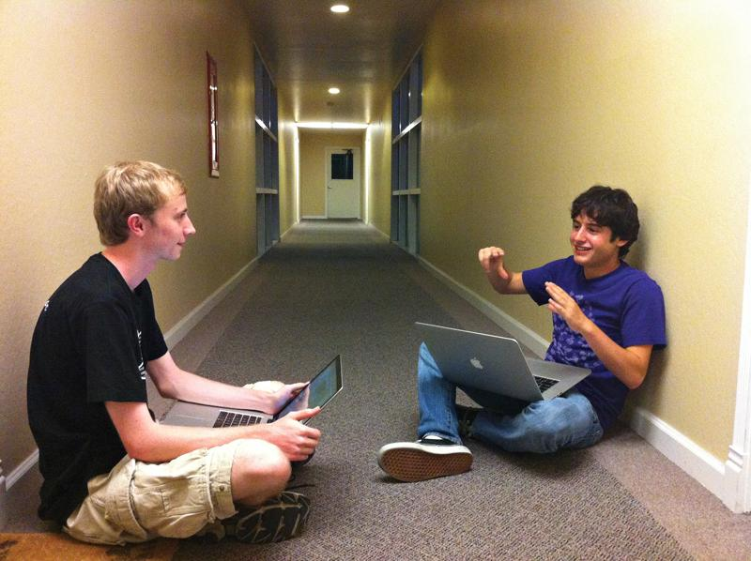
Evan Wallace demo
Made for CS123
1D example
Forbes 30 under 30
  Figma (collaborative design tools)
http://madebyevan.com/dft/
with Dylan Field
Notes:
https://twitter.com/figmadesign/status/816356525748781056
http://www.browndailyherald.com/2012/09/10/cs-undergrad-wins-tech-fellowship/

Slide 28
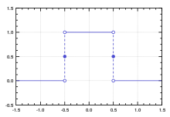
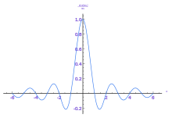
Box filter / sinc filter duality
Hays
What is the spatial representation of the hard cutoff (box) in the frequency domain?
http://madebyevan.com/dft/
Box filter
Sinc filter
sinc(x) = sin(x) / x
Spatial Domain Frequency Domain
Frequency Domain Spatial Domain
Notes:
Dual functions – box(x) and sinc(x)
Sinc function has components out to infinity, has zero crossings (lose signal), and has negative coefficients.

Slide 29

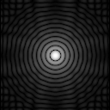
Frequency domain magnitude
Box filter (spatial)

Slide 30

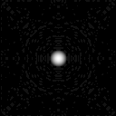
Gaussian filter duality
Fourier transform of one Gaussian…
…is another Gaussian (with inverse variance).
Why is this useful?
  Smooth degradation in frequency components
  No sharp cut-off
  No negative values
  Never zero (infinite extent)
Frequency domain magnitude
Gaussian filter (spatial)
Frequency domain magnitude
Box filter (spatial)
Notes:
http://www.imagemagick.org/Usage/fourier/#blurring
http://www.imagemagick.org/Usage/fourier/#circle_spectrum

Slide 31
Is convolution invertible?
If convolution is just multiplication in the Fourier domain, isn’t deconvolution just division?
Sometimes, it clearly is invertible (e.g. a convolution with an identity filter)
In one case, it clearly isn’t invertible (e.g. convolution with an all zero filter)
What about for common filters like a Gaussian?

Slide 32
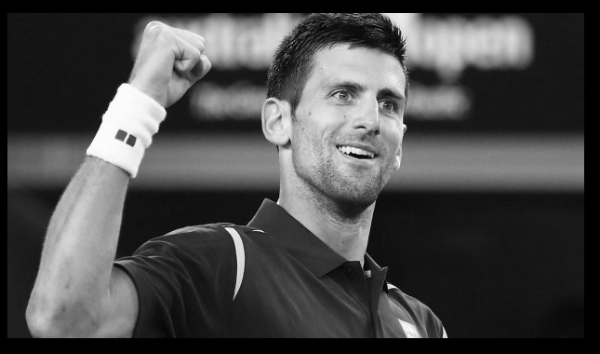
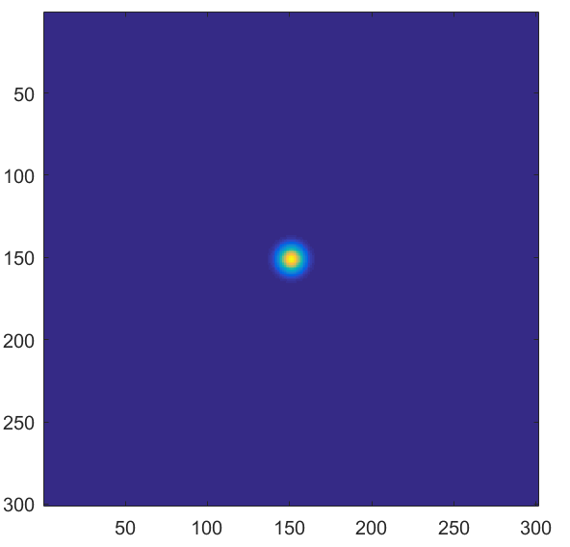
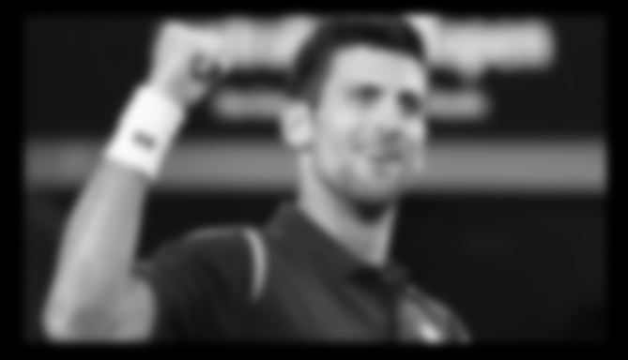
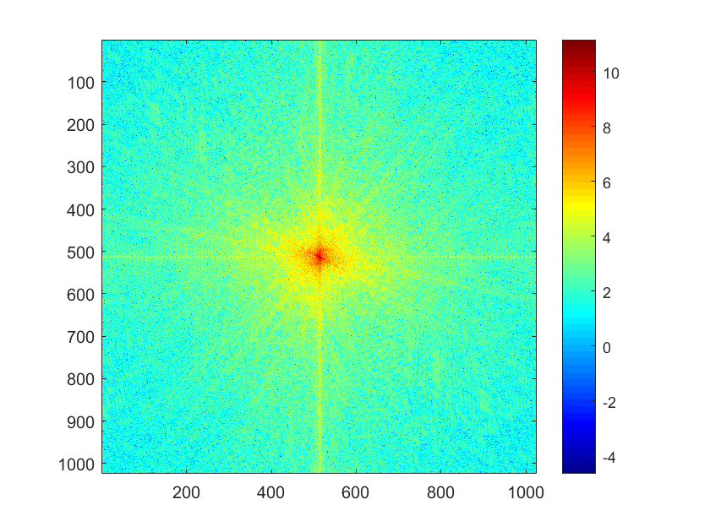
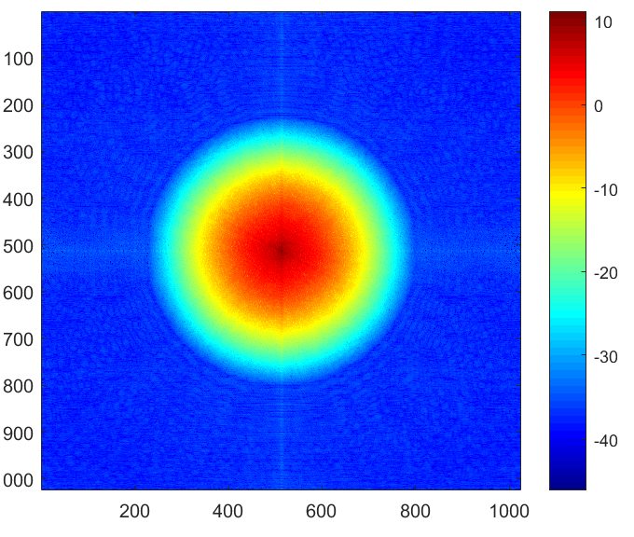
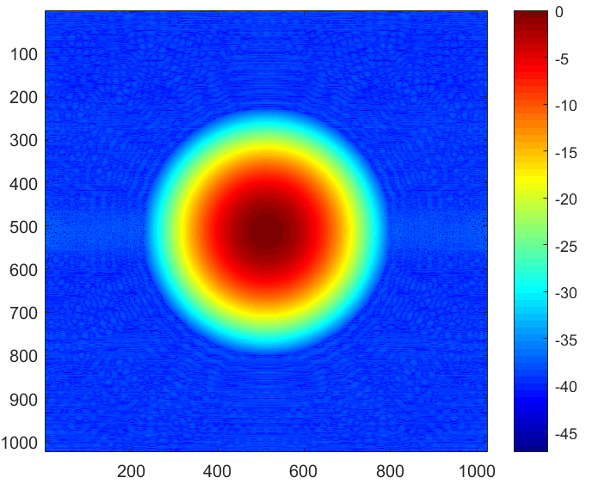
Convolution
*
=
FFT
FFT
iFFT
.x
=
Hays

Slide 33
Deconvolution?
iFFT
FFT
FFT
=
./
Hays
Notes:
It works… if everything is double precision with no noise

Slide 34
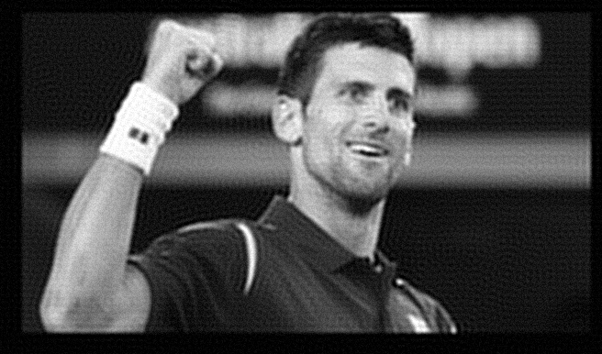
But under more realistic conditions
Random noise, .000001 magnitude
iFFT
FFT
FFT
=
./
Hays

Slide 35

But under more realistic conditions
Random noise, .0001 magnitude
iFFT
FFT
FFT
=
./
Hays

Slide 36
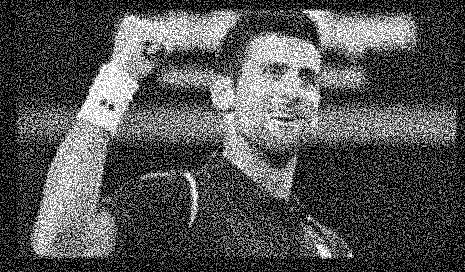
But under more realistic conditions
Random noise, .001 magnitude
iFFT
FFT
FFT
=
./
Hays

Slide 37
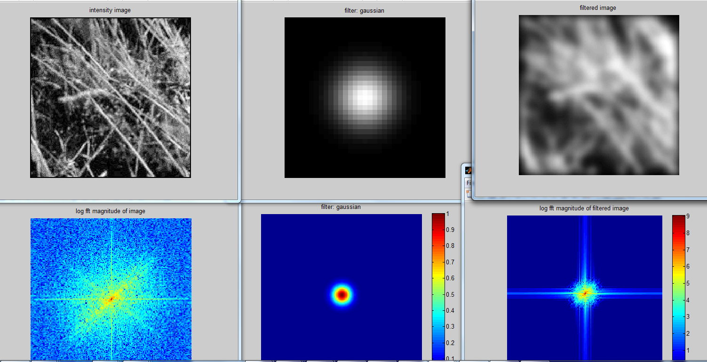
But you can’t invert multiplication by 0!
A Gaussian is only zero at infinity…
Hays

Slide 38


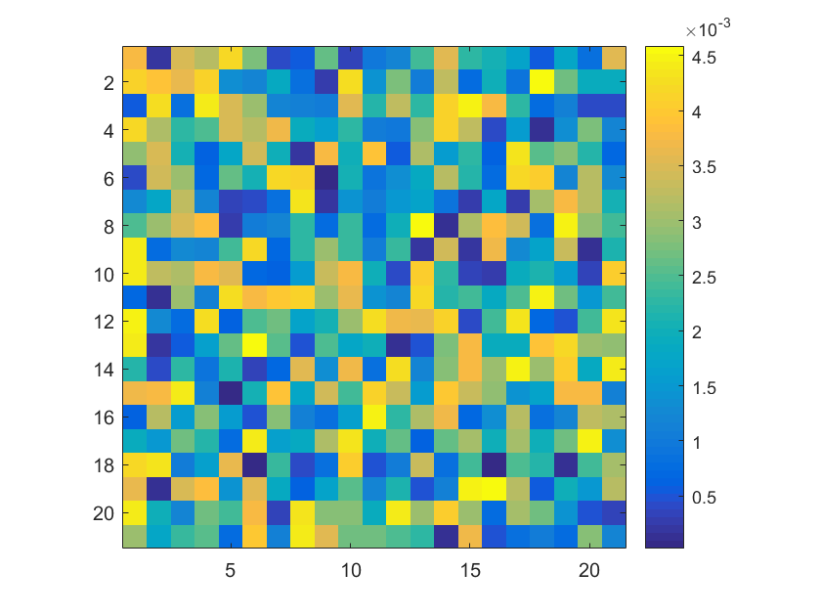
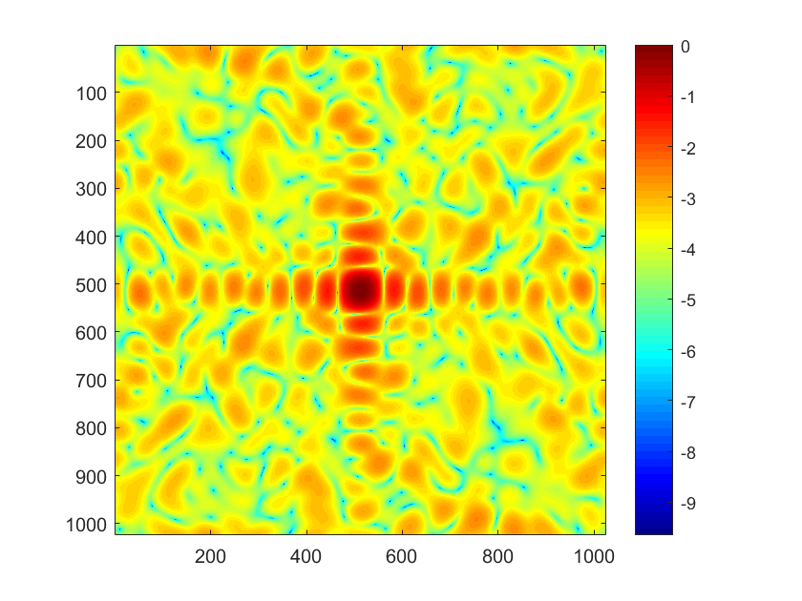
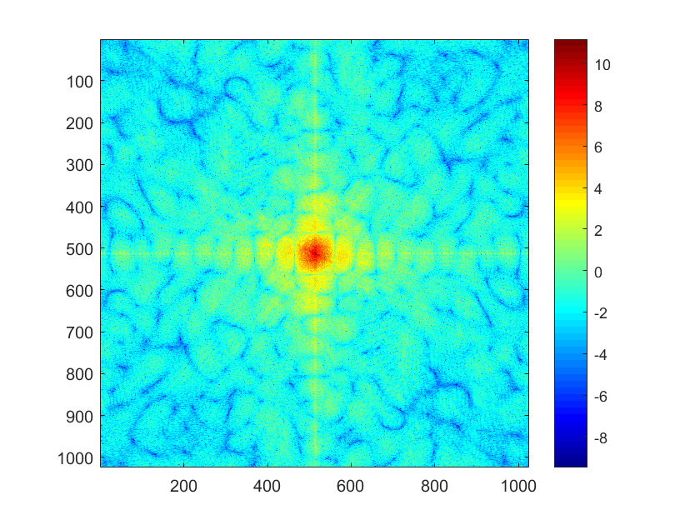
With a random filter…
Random noise, .001 magnitude
iFFT
FFT
FFT
=
./
Notes:
Random filter is easier to invert / deconvolve. The inversion isn’t perfect, still.

Slide 39
Deconvolution is hard.
Active research area.
Even if you know the filter (non-blind deconvolution), it is still hard and requires
strong regularization to counteract noise.
If you don’t know the filter (blind deconvolution),
then it is harder still.

Slide 40
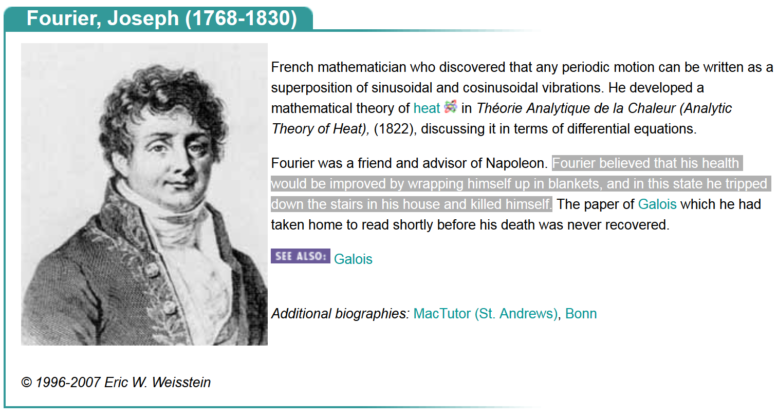
How would math have changed if the onesie had been invented?!?! : (
Hays

Slide 41
A few questions…
If we have infinite frequencies, why does the image end?
  Sampling theory. Frequencies higher than Nyquist frequency end up falling on an existing sample.
    i.e., they are ‘aliases’ for existing samples!
  Nyquist frequency is half the sampling frequency.
  (Nyquist frequency is not Nyquist-Shannon rate, which is sampling required to reconstruct alias-free signal. Both are derived from same theory.)

Slide 42
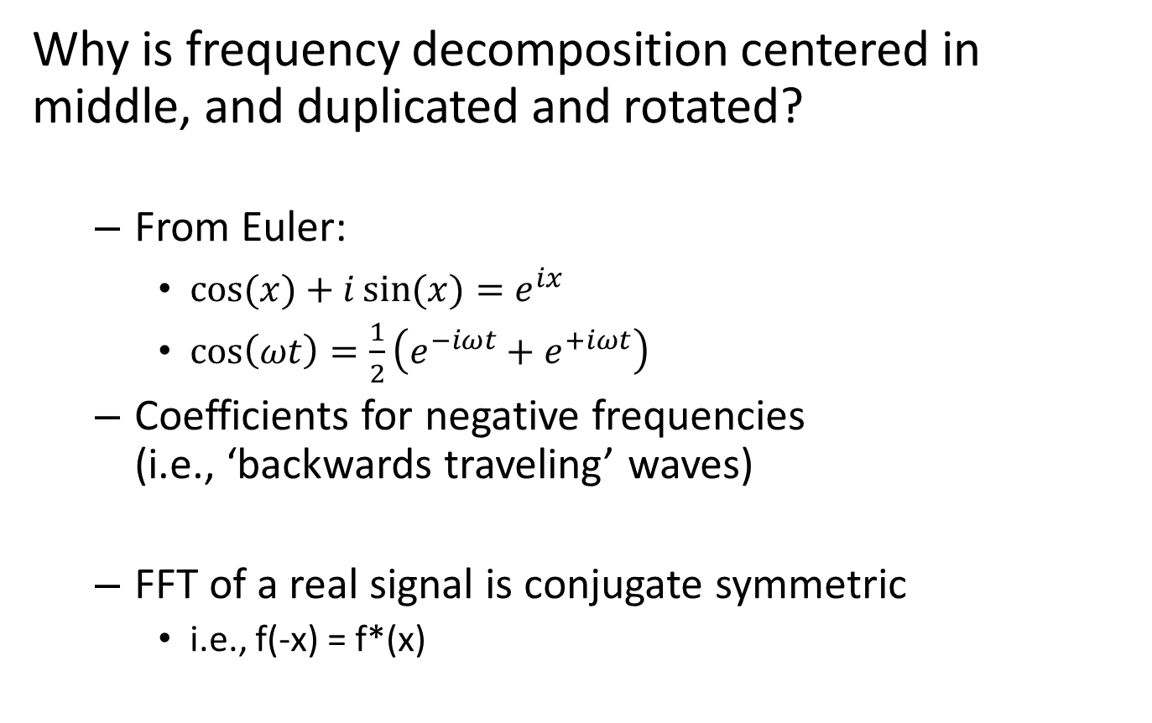
A few questions
Why is frequency decomposition centered in middle, and duplicated and rotated?
  From Euler:
    $\cos{(x)}+i\sin{(x)}=e^{ix}$
    $\cos\left(ωt\right)=\frac{1}{2}\left({e^{−iωt}+e}^{+iωt}\right)$
  Coefficients for negative frequencies
  (i.e., ‘backwards traveling’ waves)
  FFT of a real signal is conjugate symmetric
    i.e., f(-x) = f*(x)
Notes:
https://en.wikipedia.org/wiki/Euler%27s_formula
http://www.bitweenie.com/listings/negative-frequency/

Slide 43
A few questions
How is the Fourier decomposition computed?
Intuitively, by correlating the signal with a set of waves of increasing signal!
Notes in hidden slides.
Plus: http://research.stowers-institute.org/efg/Report/FourierAnalysis.pdf

Slide 44

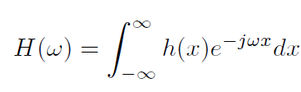

Computing the Fourier Transform
Continuous
Discrete
k = -N/2..N/2
Fast Fourier Transform (FFT): NlogN

Slide 45

Earl F. Glynn
Notes:
http://research.stowers-institute.org/efg/Report/FourierAnalysis.pdf

Slide 46

Earl F. Glynn
Notes:
http://research.stowers-institute.org/efg/Report/FourierAnalysis.pdf

Slide 47


Applications of Fourier analysis
Fast filtering with large kernels
Fourier Optics
  Fraunhofer diffraction is Fourier transform of slit in the ‘far field’.
  Light spectrometry for astronomy
Circular aperture = Airy disc diffraction pattern
Wikipedia for graphics
Notes:
https://en.wikipedia.org/wiki/Diffraction
https://en.wikipedia.org/wiki/Fraunhofer_diffraction
http://hyperphysics.phy-astr.gsu.edu/hbase/phyopt/sinslitd.html
https://en.wikipedia.org/wiki/Airy_disk

Slide 48
Thinking in Frequency - Compression
How is it that a 4MP image can be compressed to a few hundred KB without a noticeable change?

Slide 49





Lossy Image Compression (JPEG)
8x8 blocks
8x8 blocks
The first coefficient B(0,0) is the DC component, the average intensity
The top-left coeffs represent low frequencies, the bottom right represent high frequencies
Block-based Discrete Cosine Transform (DCT)
Slides: Efros

Slide 50

Using DCT in JPEG
The first coefficient B(0,0) is the DC component, the average intensity
The top-left coeffs represent low frequencies, the bottom right – high frequencies

Slide 51



Image compression using DCT
Compute DCT filter responses in each 8x8 block
Quantize to integer (div. by magic number; round)
  More coarsely for high frequencies (which also tend to have smaller values)
  Many quantized high frequency values will be zero
Filter responses
Quantization divisers (element-wise)
Quantized values

Slide 52
JPEG Encoding
Entropy coding (Huffman-variant)
Quantized values
Linearize B like this.
Helps compression:
We throw away the high frequencies (‘0’).
The zig zag pattern increases in frequency space, so long runs of zeros.

Slide 53







Color spaces: YCbCr
Fast to compute, good for compression, used by TV
Y=0
Y=0.5
Y
(Cb=0.5,Cr=0.5)
Cr
Cb
(Y=0.5,Cr=0.5)
Cb
Y=1
Cr
(Y=0.5,Cb=05)
James Hays
Notes:
The colorimetric difference between a given color in a television picture and a standard color of equal luminance.

Slide 54

Most JPEG images & videos subsample chroma
Notes:
http://users.wfu.edu/matthews/misc/jpg_vs_gif/JpgCompTest/

Slide 55
JPEG Compression Summary
Convert image to YCrCb
Subsample color by factor of 2
  People have bad resolution for color
Split into blocks (8x8, typically), subtract 128
For each block
  Compute DCT coefficients
  Coarsely quantize
    Many high frequency components will become zero
  Encode (with run length encoding and then Huffman coding for leftovers)
http://en.wikipedia.org/wiki/YCbCr
http://en.wikipedia.org/wiki/JPEG

