Slide 1
CSCI 1290: Comp Photo
Fall 2020 @ Brown University
James Tompkin
Many slides thanks to James Hays’ old CS 129 course,
along with all of its acknowledgements.

Slide 2
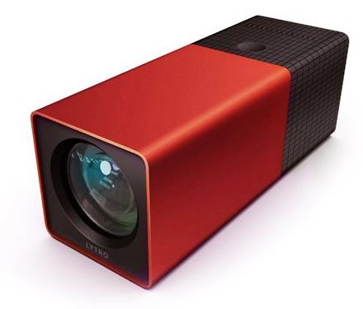
Previous Lecture
The 7D Plenoptic function, indexing all light.
Light fields:
- two-plane 4D parameterization
- captures all outgoing light from a region
- permits reconstruction of arbitrary synthetic viewpoints.
Can be built into a modern camera.
Capturing and recreating visual content
involves a combination of geometric
and image-based methods.
Lytro Camera

Slide 3
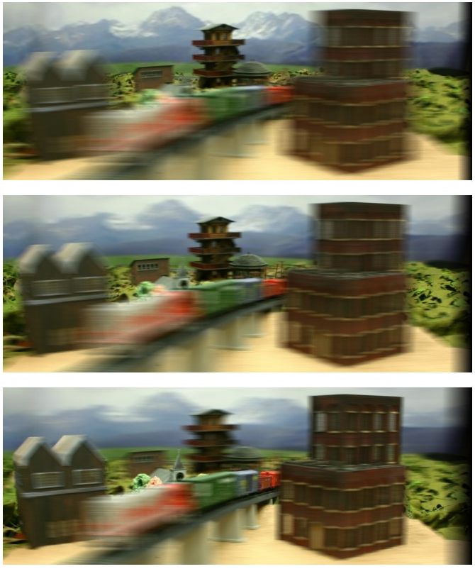
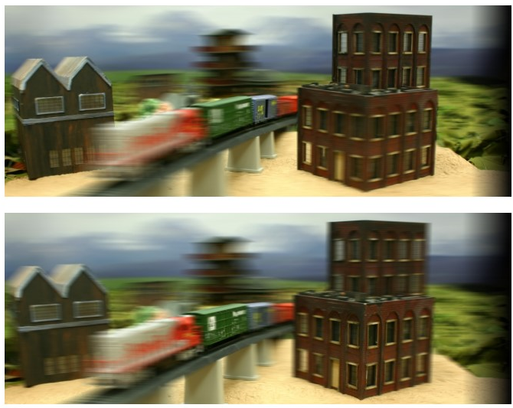
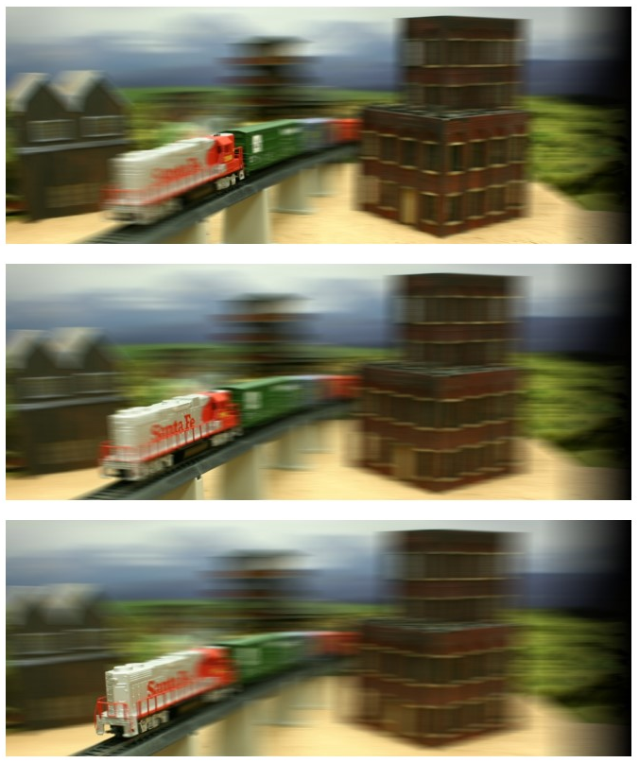
Light field lab

Slide 4
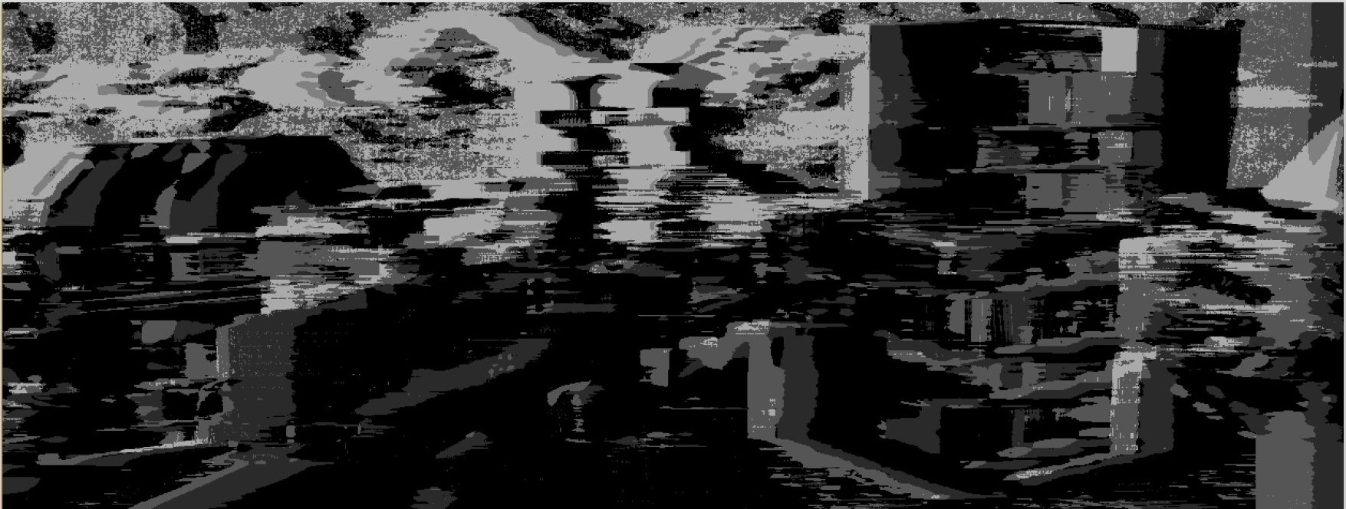
Zachary Hoffman – Stretch goal
Depth?!

Slide 5
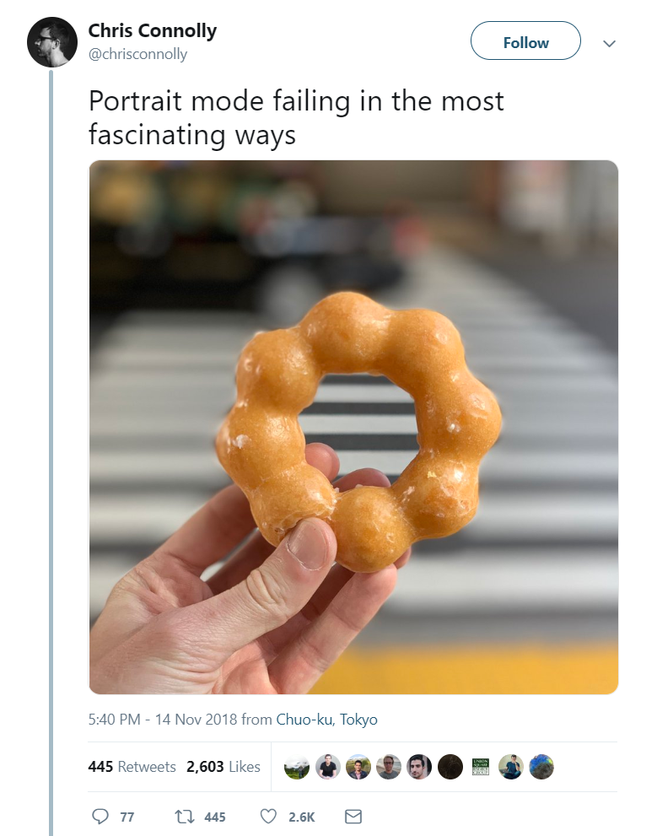

Slide 6
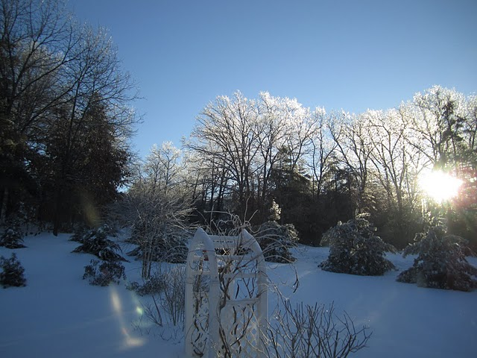
Modeling Light
Slides from Alexei A. Efros, James Hays, and others

Slide 7
A photon’s life choices
Absorption
Diffusion
Reflection
Transparency
Refraction
Fluorescence
Subsurface scattering
Phosphorescence
Interreflection
light source
λ
?
James Hays

Slide 8
A photon’s life choices
Absorption
Diffusion
Reflection
Transparency
Refraction
Fluorescence
Subsurface scattering
Phosphorescence
Interreflection
light source
λ
James Hays

Slide 9
A photon’s life choices
Absorption
Diffuse Reflection
Reflection
Transparency
Refraction
Fluorescence
Subsurface scattering
Phosphorescence
Interreflection
light source
λ
Perfect diffuse
= Lambertian
= Equal in all directions
James Hays

Slide 10
Lambertian Reflectance
Surfaces are often assumed to be ideal diffuse reflectors with no dependence on viewing direction.
This is obviously nonsense, but a useful model!
James Hays

Slide 11
A photon’s life choices
Absorption
Diffusion
Specular Reflection
Transparency
Refraction
Fluorescence
Subsurface scattering
Phosphorescence
Interreflection
light source
λ
Perfect specular
= mirror reflection
= only one direction
James Hays

Slide 12
A photon’s life choices
Absorption
Diffusion
Specular (Glossy) Reflection
Transparency
Refraction
Fluorescence
Subsurface scattering
Phosphorescence
Interreflection
light source
λ
Glossy reflection
= ‘specular lobe’
= amounts vary
across directions
James Hays

Slide 13
A photon’s life choices
Absorption
Diffusion
Reflection
Transparency
Refraction
Fluorescence
Subsurface scattering
Phosphorescence
Interreflection
light source
λ
Transmittance
James Hays

Slide 14
A photon’s life choices
Absorption
Diffusion
Reflection
Transparency
Refraction
Fluorescence
Subsurface scattering
Phosphorescence
Interreflection
light source
λ
James Hays

Slide 15
A photon’s life choices
Absorption
Diffusion
Reflection
Transparency
Refraction
Fluorescence
Subsurface scattering
Phosphorescence
Interreflection
light source
λ₁
λ₂
James Hays

Slide 16
A photon’s life choices
Absorption
Diffusion
Reflection
Transparency
Refraction
Fluorescence
Subsurface scattering
Phosphorescence
Interreflection
light source
λ
James Hays

Slide 17
A photon’s life choices
Absorption
Diffusion
Reflection
Transparency
Refraction
Fluorescence
Subsurface scattering
Phosphorescence
Interreflection
light source
t=1
t=n
James Hays

Slide 18
A photon’s life choices
Absorption
Diffusion
Reflection
Transparency
Refraction
Fluorescence
Subsurface scattering
Phosphorescence
Interreflection
light source
λ
(Specular Interreflection)
James Hays

Slide 19
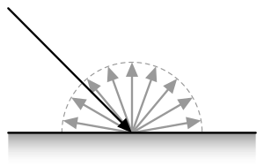
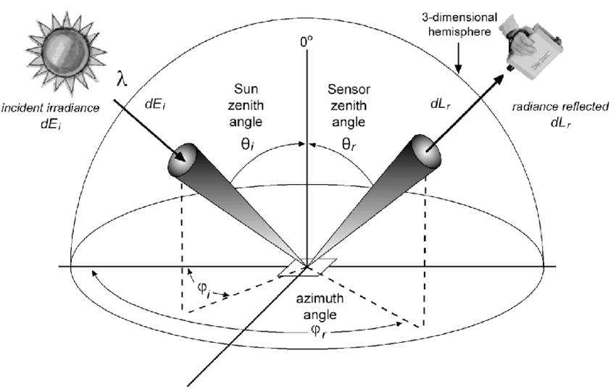
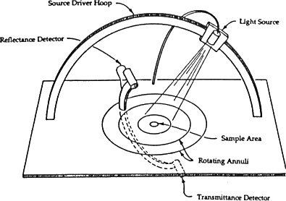
Bidirectional Reflectance Distribution Function
BRDF
Measuring BRDFs: Gonioreflectometer
Gonio – “of angle”
Notes:
https://www.google.com/url?sa=i&url=https%3A%2F%2Fwww.cs.princeton.edu%2F~smr%2Fcs348c-97%2Fsurveypaper.html&psig=AOvVaw1BcaIn7Afsy6qcT330r3cn&ust=1605726500767000&source=images&cd=vfe&ved=0CAIQjRxqFwoTCOCy08Kjiu0CFQAAAAAdAAAAABAK

Slide 20
Fast Separation of Direct and Global Images
Using High Frequency Illumination
Shree K. Nayar
Gurunandan G. Krishnan
Columbia University
Michael D. Grossberg
City College of New York
Ramesh Raskar
MERL
SIGGRAPH Conference
Boston, July 2006
Support: ONR, NSF, MERL

Slide 21
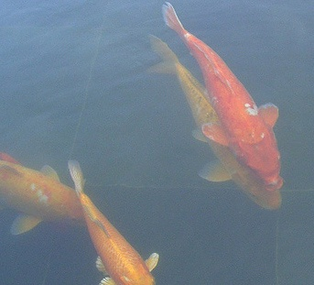
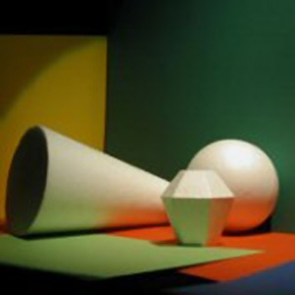
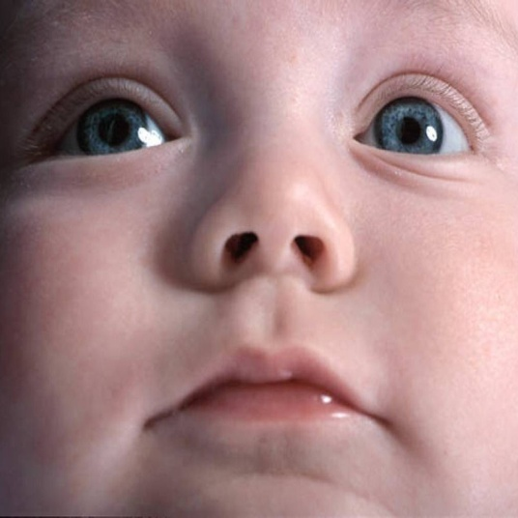
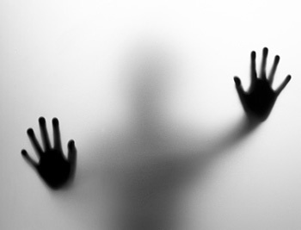
Direct and Global Illumination
participating
medium
surface
source
D
B
A
C
P
A : Direct
E
B : Interreflection
C : Subsurface
camera
translucent
surface
D : Volumetric
E : Diffusion

Slide 22
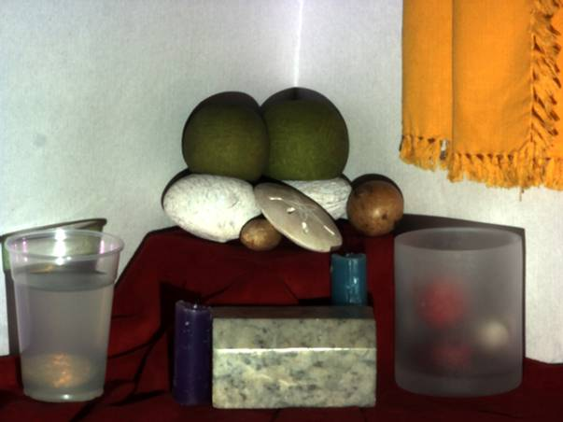
Diffuse
Interreflections
Specular
Interreflections
Diffusion
Volumetric
Scattering
Subsurface
Scattering

Slide 23
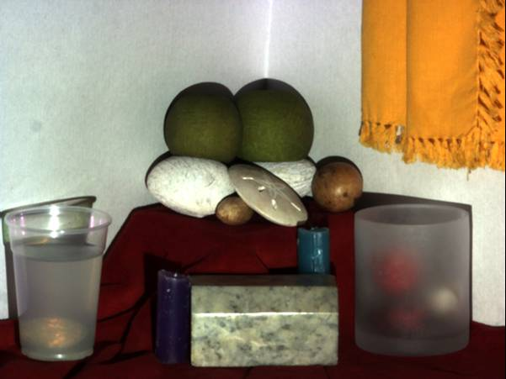
Scene

Slide 24
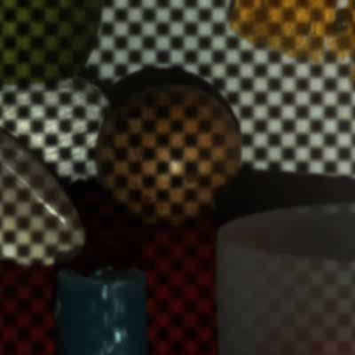
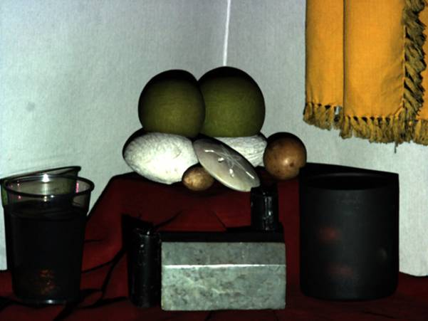
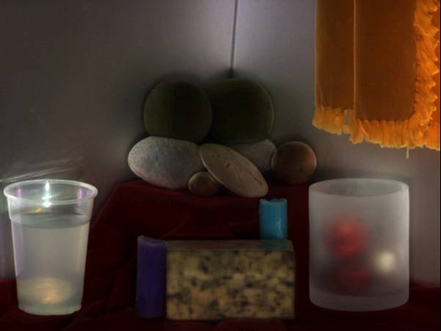
Scene
Direct
Global

Slide 25

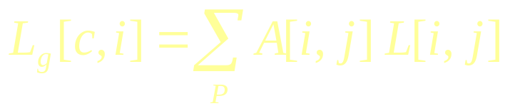
Direct and Global Components: Interreflections
surface
source
j
i
camera
radiance
direct
global
BRDF and geometry

Slide 26


High Frequency Illumination Pattern
surface
source
i
camera
+
fraction of activated source elements
(pixels in the projector)

Slide 27


High Frequency Illumination Pattern
surface
source
i
camera
+
-
fraction of activated source elements
(pixels in the projector)

Slide 28
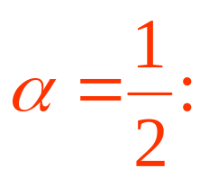
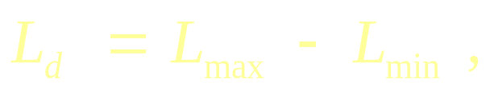

Separation from Two Images
+
-
fraction of activated source elements
(pixels in the projector)
direct
global

Slide 29
Other Global Effects: Subsurface Scattering
translucent
surface
source
j
i
camera

Slide 30
Other Global Effects: Volumetric Scattering
participating medium
surface
source
j
i
camera

Slide 31
Diffuse
Interreflections
Specular
Interreflections
Diffusion
Volumetric
Scattering
Subsurface
Scattering

Slide 32
Scene

Slide 33
Scene
Direct
Global

Slide 34
High Frequency Illumination Pattern
surface
source
i
camera
+
-
fraction of activated source elements

Slide 35
projector
surface
Pipeline
Actually use more unique
chequerboard patterns
Global effects from
local lighting
Pick L_min and L_max
from across all unique patterns
for each pixel
Factor in projector’s light floor
i
camera
Notes:
Implementing the imaging system described above will give a result, but intuitively it won't work perfectly if, for instance, there is global component stemming from very local effects between objects that are lit/unlit together. To rectify this problem, we take 25 images. Instead of simply inverting the checkerboard illumination pattern, we create 25 unique checkerboards to illuminate with. In this case, we used a pattern that was 8x8 pixels on the projector and shifted the pattern by 3 pixels 5 times in each of the X and Y directions. This pattern increases the likelihood of detecting correct global lighting due to highly local effects. To leverage the 25 images, for each pixel we take the pixel from the source with the maximum brightness and the minimum brightness for our values. This means we will probably use information from each of our 25 images. To find maxima and minima, we want to combine all three of the RGB channels into one brightness, so we create a grayscale image and use that as our basis for judgement. Once we know which pixels are brightest and darkest, we index into our color image to get color versions of the maxima and minima. See below for maximum and minimum images for the onion example.

Slide 36
More Real World Examples:

Slide 37
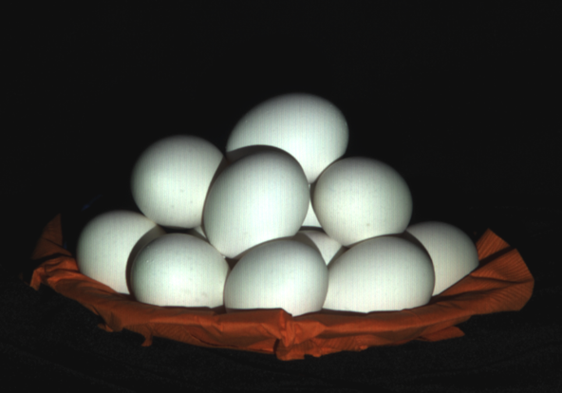
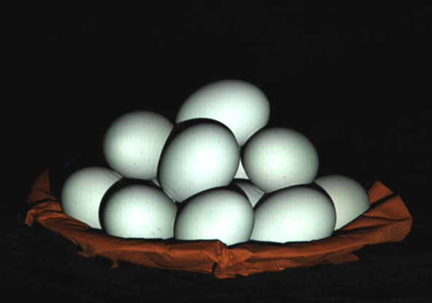
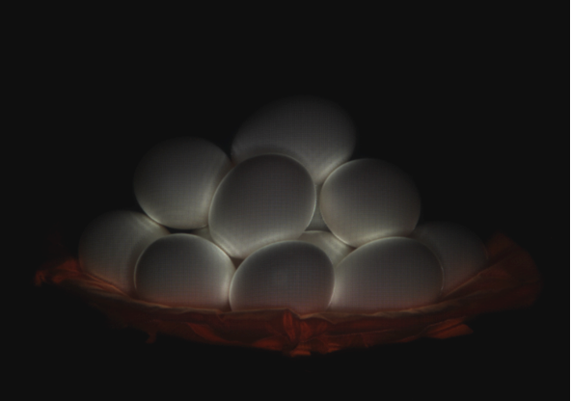
Eggs: Diffuse Interreflections
Direct
Global

Slide 38
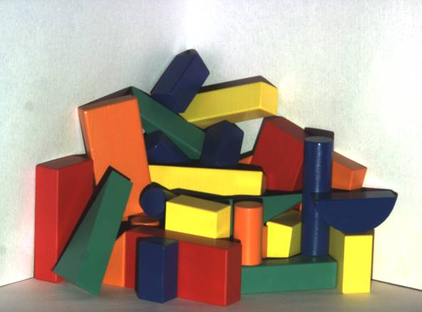
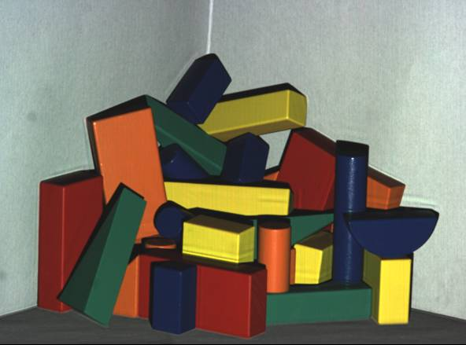
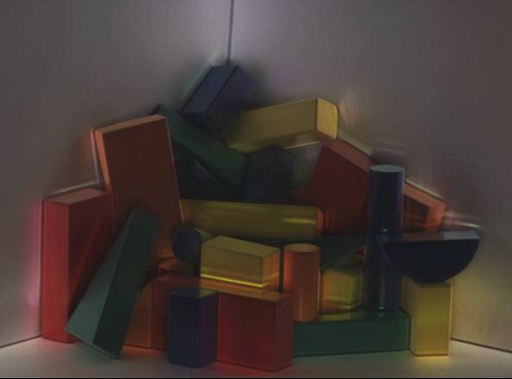
Wooden Blocks: Specular Interreflections
Direct
Global

Slide 39
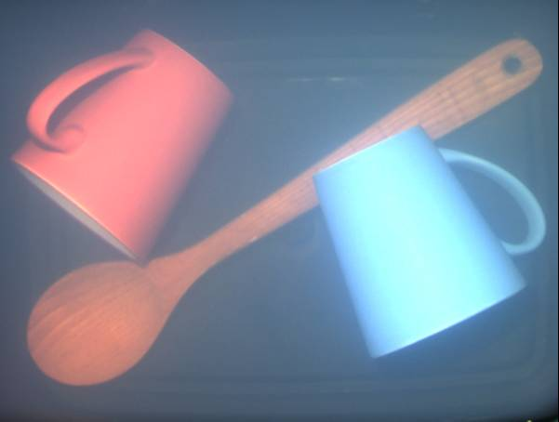
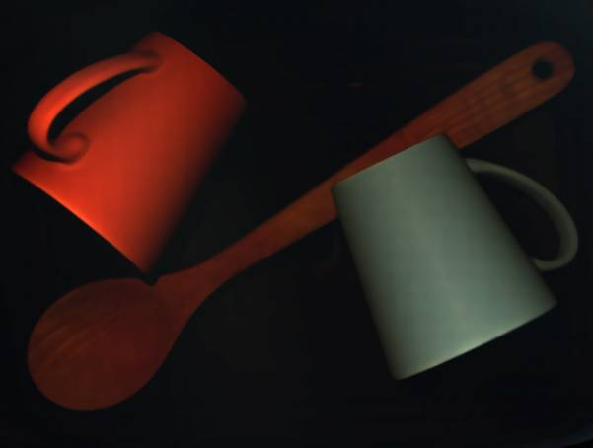
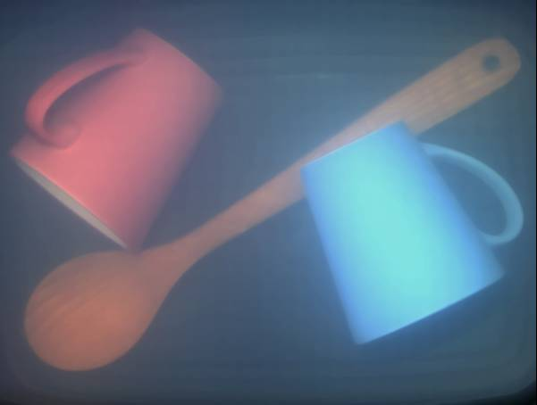
Kitchen Sink: Volumetric Scattering
Volumetric Scattering:
Chandrasekar 50, Ishimaru 78
Direct
Global

Slide 40
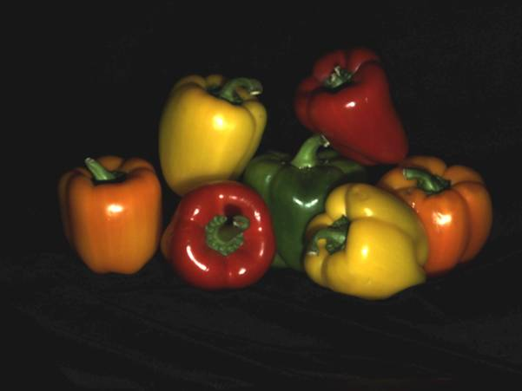
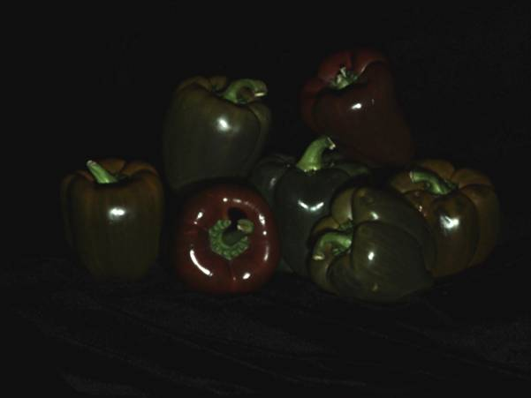
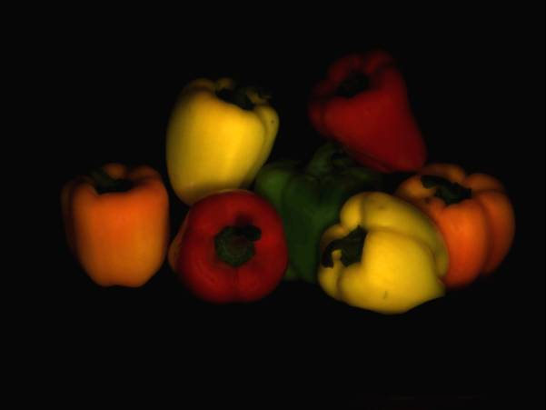
Peppers: Subsurface Scattering
Direct
Global

Slide 41
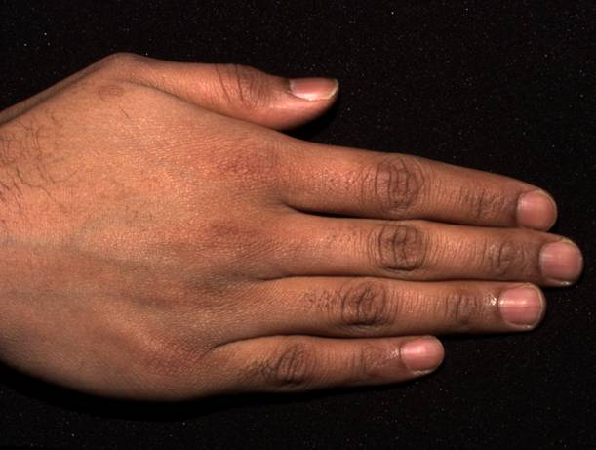
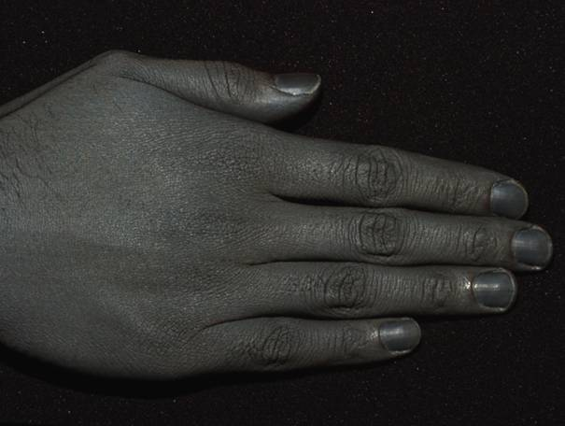
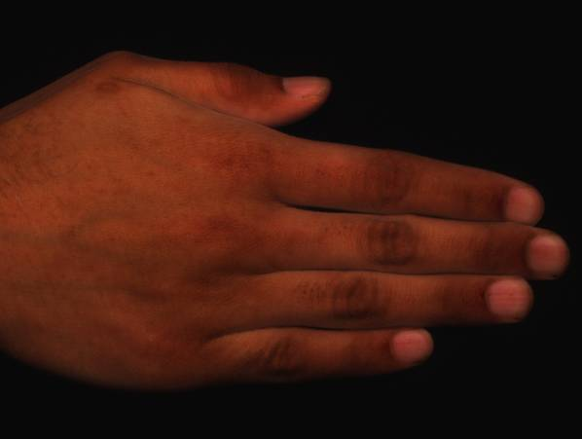
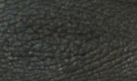
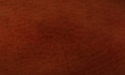
Hand
Skin: Hanrahan and Krueger 93,
Uchida 96, Haro 01, Jensen et al. 01,
Cula and Dana 02, Igarashi et al. 05, Weyrich et al. 05
Direct
Global

Slide 42
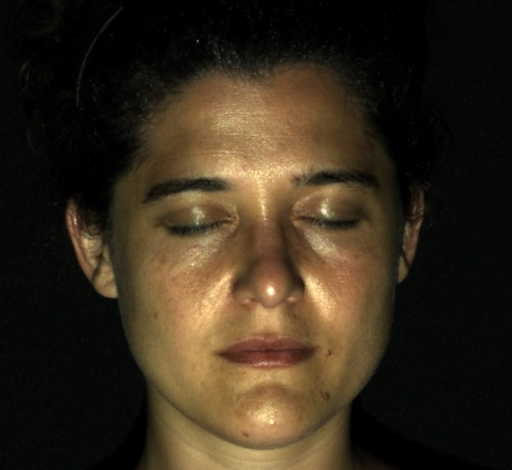
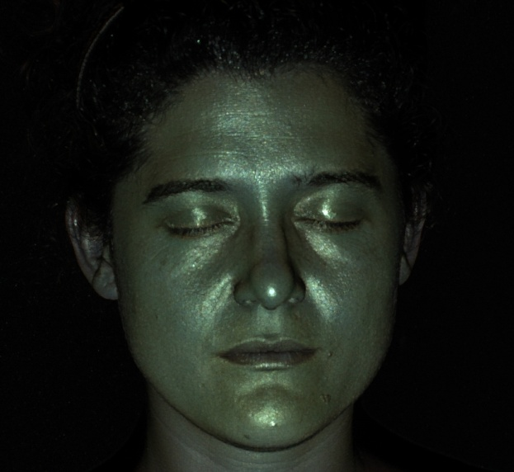
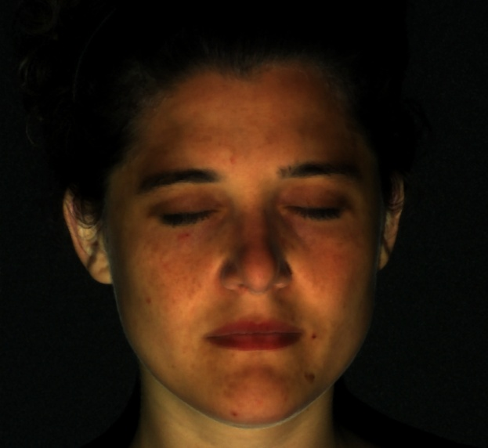
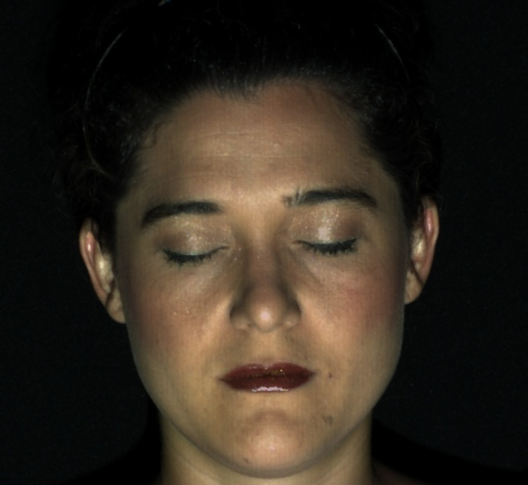
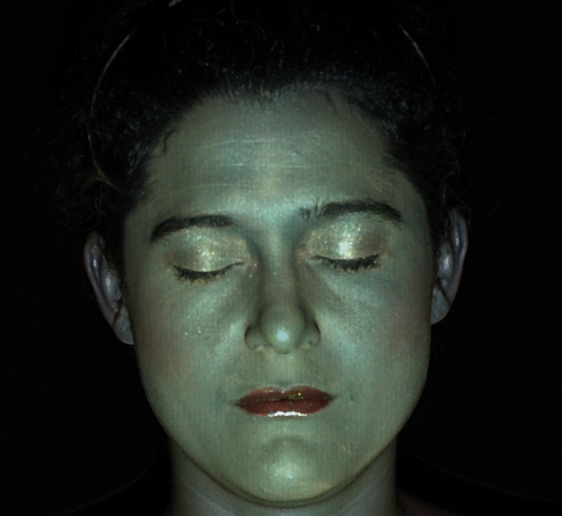
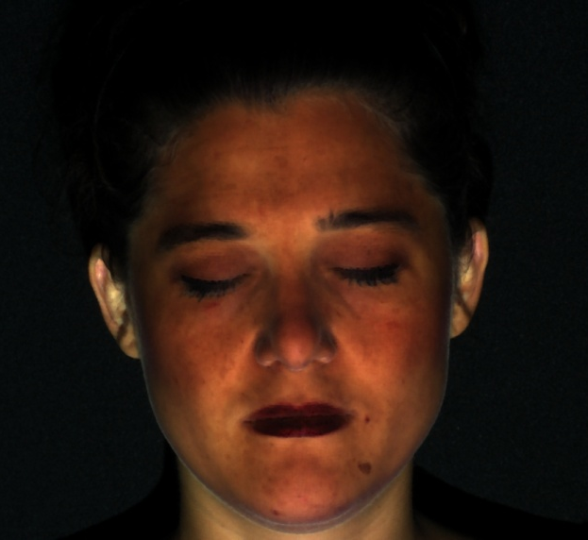
Face: Without and With Makeup
Without Makeup
Direct
Global
With Makeup
Direct
Global

Slide 43

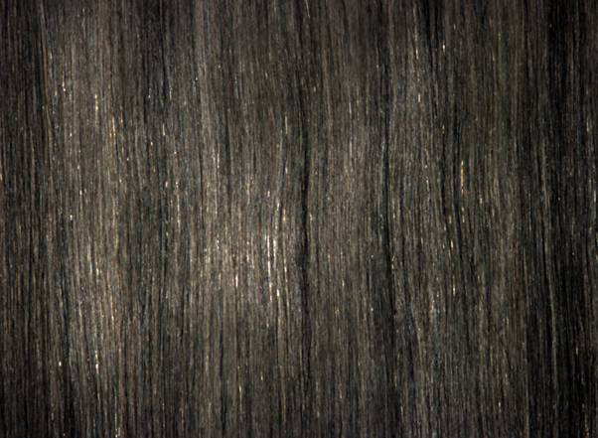

Blonde Hair
Hair Scattering: Stamm et al. 77,
Bustard and Smith 91, Lu et al. 00
Marschner et al. 03
Direct
Global

Slide 44
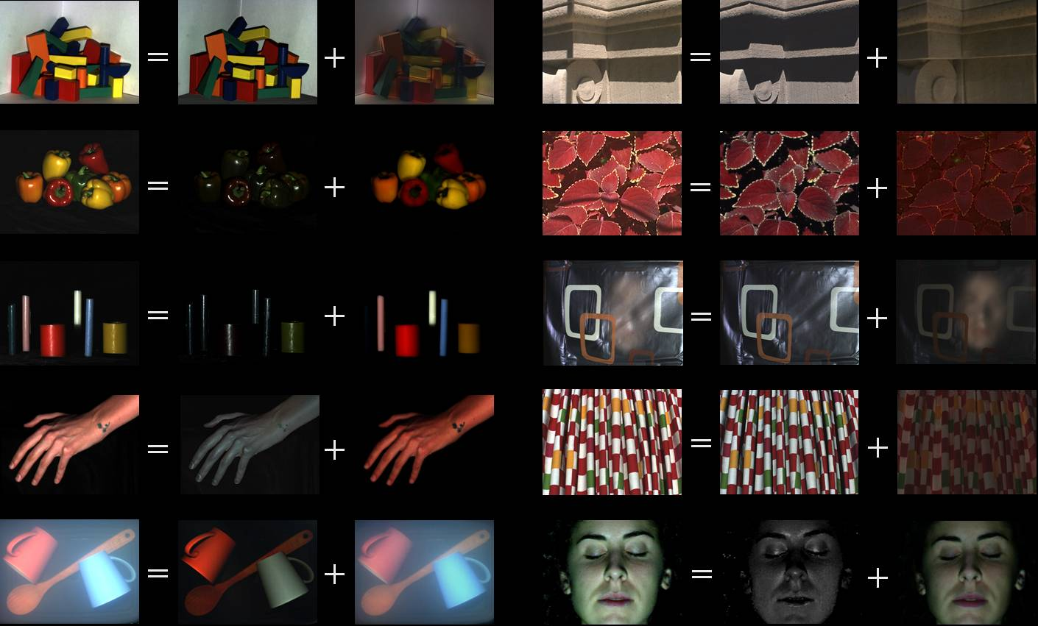
www.cs.columbia.edu/CAVE

Slide 45
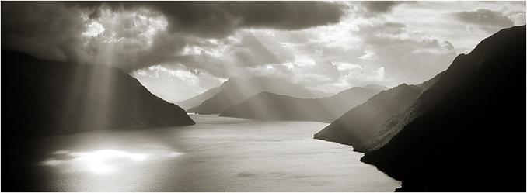
Image-Based Lighting
© Eirik Holmøyvik
Slides from Alexei Efros,
James Hays, and Paul Debevec

Slide 46
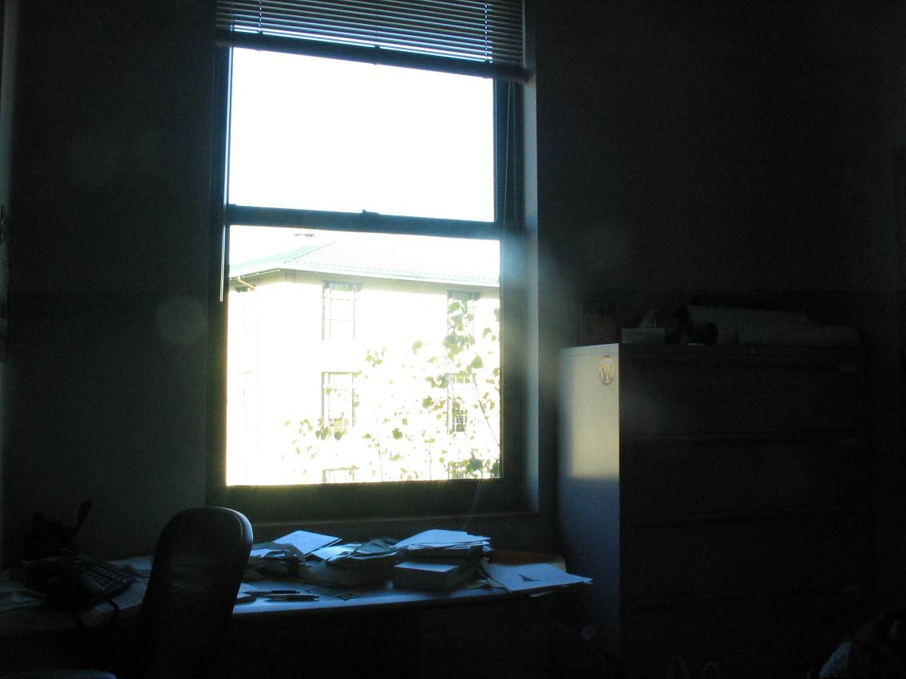
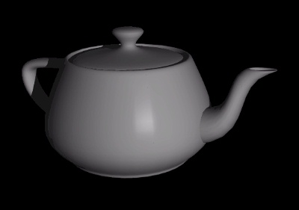
Inserting Synthetic Objects
Why does this look so bad?
  Wrong orientation
  Wrong lighting
  No shadows

Slide 47
Solutions
Wrong Camera Orientation
  Estimate correct camera orientation and render object
    Requires camera calibration to do it right
Lighting & Shadows
  Estimate (eyeball) all the light sources in the scene and simulate it in your virtual rendering
But what happens if lighting is complex?
  Extended light sources, mutual illumination, etc.

Slide 48



What about real scenes?
From Flight of the Navigator (1986)

Slide 49

What about real scenes?
from Terminator 2 (1991)

Slide 50


Environment Maps
Environment map
as spherical panorama
Simple solution for shiny objects
  Models complex lighting as a panoramic image
  i.e. Amount of radiance coming in from each direction
  A sampling of the plenoptic function!

Slide 51
Environment Mapping
Projector function converts reflection vector to texture image pixels (x, y)
Reflected ray: r=2(n·v)n-v
viewer
n
v
r
Cast ray
Reflective
object
Environment lighting map
Texture is transferred in the direction of the reflected ray from the environment map onto the object.

Slide 52
Environment Maps
The environment map may take various forms:
  Cubic mapping
  Spherical mapping (project 5!)
Form describes the shape of the surface
on which the map “resides”
Form determines how the map is generated
and how it is indexed

Slide 53


Example

Slide 54
Sphere Mapping
Map has spherical proxy geometry
To generate the map:
  CompPhoto: Capture it! Panorama construction.
  Graphics: Render a spherical panorama from the designed center point
To use the map:
  Use the orientation of the R ray to index directly into the sphere

Slide 55


Cubic Map Example
Synthetic

Slide 56
Cubic Mapping
The map resides on the surfaces of a cube around the object
  Typically, align the faces of the cube with the coordinate axes
To generate the map:
  For each face of the cube, render the world from the center of the object with the cube face as the image plane
  Rendering can be arbitrarily complex (it’s off-line)
To use the map:
  Index the R ray into the correct cube face
  Compute texture coordinates

Slide 57
What approximations are made?
The map should contain a view of the world with the point of interest on the object as the Center of Projection
  Storing a separate map for each point is possible but more expensive
  Introduces distortions in the reflection, but we usually don’t notice
  Distortions are minimized for a small object in a large room
Limitation: The object will not reflect itself!

Slide 58
Real environment maps
We can use photographs to capture environment maps
Problem: directly capturing light sources (looking ‘at’ one)
Light sources are much brighter than the rest of the environment
Use High Dynamic Range photography, of course!
Several ways to acquire environment maps:
  Scanning cameras
  Stitching mosaics
  Fisheye lens
  Mirrored Balls

Slide 59


Scanning Panoramic Cameras
Pros:
very high res (10K x 7K+)
Full sphere in one scan – no stitching
Good dynamic range, some are HDR
Issues:
More expensive
Scans take a while
Companies: Panoscan, Sphereon

Slide 60

Stitching HDR mosaics
http://www.gregdowning.com/HDRI/stitched/

Slide 61


Fisheye Images

Slide 62


Mirrored Sphere

Slide 63


Slide 64


Image mirror sphere from two directions and stitch together for a complete representation.

Slide 65

Sources of Mirrored Balls
2-inch chrome balls ~ $20 ea.
  e.g. McMaster-Carr Supply Company
  www.mcmaster.com
6-12 inch large gazing balls
Hollow Spheres, 2in – 4in
  e.g. Dube Juggling Equipment
  www.dube.com
FAQ on http://ict.debevec.org/~debevec/HDRShop/main-pages/tutorials.html

Slide 66

0.34
=> 59% Reflective
Calibrating Mirrored Sphere Reflectivity
0.58

Slide 67




Real-World HDR Lighting Environments
Funston
Beach
Eucalyptus
Grove
Uffizi
Gallery
Grace
Cathedral
Lighting Environments from the Light Probe Image Gallery:
http://www.debevec.org/Probes/

Slide 68




Acquiring the Light Probe

Slide 69

Assembling the Light Probe

Slide 70
Not just shiny…
We have captured a true radiance map
We can treat it as an extended (e.g., spherical) light source
Can use Global Illumination to simulate light transport in the scene
  So, all objects (not just shiny) can be lit
  What’s the limitation?

Slide 71

Illumination Results
Rendered with Greg Larson’s RADIANCE
synthetic imaging system
Notes:
HDR is revealed with rough specularities.

Slide 72





Comparison: Radiance map versus single image

Slide 73
Putting it all together
Synthetic Objects
+
Real light!

Slide 74

CG Objects Illuminated by a Traditional CG Light Source

Slide 75
Illuminating Objects using Measurements of Real Light
Light
Environment assigned “glow” material property in
Greg Ward’s RADIANCE system.
Object
http://radsite.lbl.gov/radiance/

Slide 76




Paul Debevec. A Tutorial on Image-Based Lighting. IEEE Computer Graphics and Applications, Jan/Feb 2002.

Slide 77

Rendering with Natural Light
SIGGRAPH 98 Electronic Theater

Slide 78

RNL Environment mapped onto interior of large cube

Slide 79
Rendering with Natural Light
MOVIE!
https://www.youtube.com/watch?v=F8Z3ubriTiY&t=3s

Slide 80

Illuminating a Small Scene

Slide 81


Slide 82
We can now illuminate
synthetic objects with real light.
How do we add synthetic objects to a real scene?

Slide 83

Real Scene Example
Goal: place synthetic objects on table

Slide 84
Light Probe / Calibration Grid

Slide 85
Modeling the Scene
light-based model
real scene

Slide 86

The Light-Based Room Model

Slide 87
Modeling the Scene
light-based model
local scene
synthetic objects
real scene

Slide 88
The Lighting Computation
distant scene (light-based, unknown BRDF)
synthetic objects
(known BRDF)
local scene
(estimated BRDF)

Slide 89
Rendering into the Scene
Background Plate

Slide 90

Rendering into the Scene
Objects and Local Scene matched to Scene

Slide 91

Differential Rendering
Local scene w/o objects, illuminated by model

Slide 92

Differential Rendering (2)
Difference in local scene
-
=

Slide 93

Differential Rendering
Final Result

Slide 94



Slide 95

IMAGE-BASED LIGHTING IN FIAT LUX
Paul Debevec, Tim Hawkins, Westley Sarokin, H. P. Duiker, Christine Cheng, Tal Garfinkel, Jenny Huang
SIGGRAPH 99 Electronic Theater

Slide 96


Slide 97






HDR Image Series
2 sec
1/4 sec
1/30 sec
1/250 sec
1/2000 sec
1/8000 sec

Slide 98










Stp1 Panorama

Slide 99

Assembled Panorama

Slide 100



Light Probe Images

Slide 101














Capturing a Spatially-varying Lighting Environment

Slide 102
The Movie
Fiat Lux, 1999
SIGGRAPH Electronic Theater
Original:
https://www.youtube.com/watch?v=vgJuzml0dIw
Breakdown:
https://www.youtube.com/watch?v=3yO1ybyeOEQ
‘AI’ Remaster:
https://youtu.be/PxJmH8-nIZ4?t=17

Slide 103
Debevec Parthenon movie
The Parthenon, 2004
SIGGRAPH Electronic Theater
https://www.youtube.com/watch?v=G1D5hbxa8CM
Breakdown:
https://www.youtube.com/watch?v=QeWLpTLzZVc

Slide 104

Simulating the Glare in the Human Eye
Greg Spencer, Peter Shirley, Kurt Zimmerman, and Donald Greenberg. Physically-based glare effects for digital images. SIGGRAPH 95.

Slide 105


Scattering in the eye
What’s the scattering model?

Slide 106

HDR Image

Slide 107

Gaussian Blur, LDR information Only

Slide 108

Gaussian Blur, Full HDR Information

Slide 109

Full HDR Disc Blur

Slide 110
Frame Postprocessing in Rendering with Natural Light

