Slide 1
CSCI 1290: Comp Photo
Fall 2020 @ Brown University
James Tompkin
Many slides thanks to James Hays’ old CS 129 course,
along with all of its acknowledgements.

Slide 2
Image Transformations
image filtering: change range of image
g(x) = T(f(x))
f
f
T
x
x
image warping: change domain of image
g(x) = f(T(x))
f
f
T
x
x

Slide 3
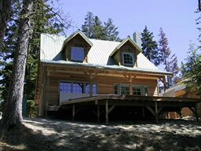
Image Transformations
image filtering: change range of image
g(x) = T(f(x))
f
g
T
image warping: change domain of image
g(x) = f(T(x))
f
g
T

Slide 4
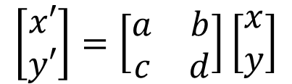
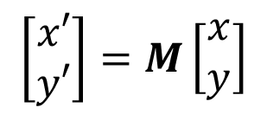
Parametric (global) warping
T
p = (x,y)
p’ = (x’,y’)
Transformation T is a coordinate-changing machine:
p’ = T(p)
What does it mean that T is global and parametric?
  Is the same for any point p
  Can be described by just a few numbers (parameters)
Let’s represent T as a matrix:
p’ = Mp
$$\left[\begin{matrix}x′ \\ y′\end{matrix}\right]=M\left[\begin{matrix}x \\ y\end{matrix}\right]$$
$$\left[\begin{matrix}x′ \\ y′\end{matrix}\right]=\left[\begin{matrix}a & b \\ c & d\end{matrix}\right]\left[\begin{matrix}x \\ y\end{matrix}\right]$$

Slide 5
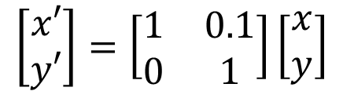
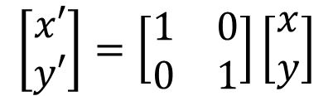
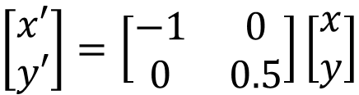
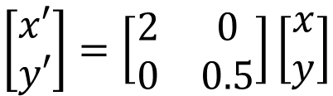
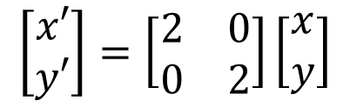
Think-Pair-Share – What happens?
Input image
$$\left[\begin{matrix}x′ \\ y′\end{matrix}\right]=\left[\begin{matrix}1 & 0 \\ 0 & 1\end{matrix}\right]\left[\begin{matrix}x \\ y\end{matrix}\right]$$
1.
$$\left[\begin{matrix}x′ \\ y′\end{matrix}\right]=\left[\begin{matrix}2 & 0 \\ 0 & 2\end{matrix}\right]\left[\begin{matrix}x \\ y\end{matrix}\right]$$
2.
$$\left[\begin{matrix}x′ \\ y′\end{matrix}\right]=\left[\begin{matrix}2 & 0 \\ 0 & 0.5\end{matrix}\right]\left[\begin{matrix}x \\ y\end{matrix}\right]$$
3.
4.
$$\left[\begin{matrix}x′ \\ y′\end{matrix}\right]=\left[\begin{matrix}−1 & 0 \\ 0 & 0.5\end{matrix}\right]\left[\begin{matrix}x \\ y\end{matrix}\right]$$
5.
$$\left[\begin{matrix}x′ \\ y′\end{matrix}\right]=\left[\begin{matrix}1 & 0.1 \\ 0 & 1\end{matrix}\right]\left[\begin{matrix}x \\ y\end{matrix}\right]$$

Slide 6
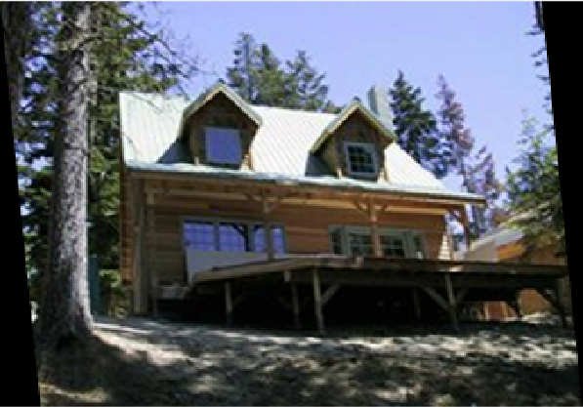
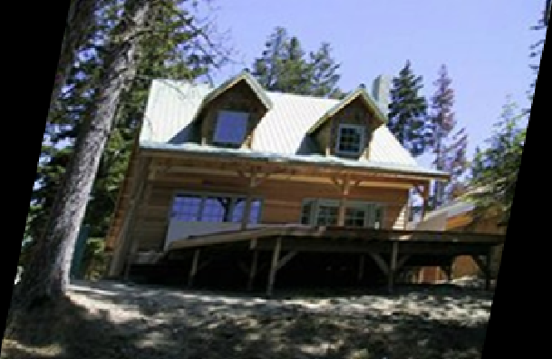


Think-Pair-Share – What happens?
Input image
Output image
2.
1.
$$\left[\begin{matrix}x′ \\ y′\end{matrix}\right]=\left[\begin{matrix}1 & 0 \\ 0 & 1\end{matrix}\right]\left[\begin{matrix}x \\ y\end{matrix}\right]$$
4.
1.
$$\left[\begin{matrix}x′ \\ y′\end{matrix}\right]=\left[\begin{matrix}2 & 0 \\ 0 & 2\end{matrix}\right]\left[\begin{matrix}x \\ y\end{matrix}\right]$$
2.
$$\left[\begin{matrix}x′ \\ y′\end{matrix}\right]=\left[\begin{matrix}2 & 0 \\ 0 & 0.5\end{matrix}\right]\left[\begin{matrix}x \\ y\end{matrix}\right]$$
3.
3.
5.
$$\left[\begin{matrix}x′ \\ y′\end{matrix}\right]=\left[\begin{matrix}1 & 0.1 \\ 0 & 1\end{matrix}\right]\left[\begin{matrix}x \\ y\end{matrix}\right]$$
$$\left[\begin{matrix}x′ \\ y′\end{matrix}\right]\left[\begin{matrix}1 & −0.2 \\ 0 & 1\end{matrix}\right]\left[\begin{matrix}x \\ y\end{matrix}\right]$$
4.
$$\left[\begin{matrix}x′ \\ y′\end{matrix}\right]=\left[\begin{matrix}−1 & 0 \\ 0 & 0.5\end{matrix}\right]\left[\begin{matrix}x \\ y\end{matrix}\right]$$
0,0
0,0
5.
$$\left[\begin{matrix}x′ \\ y′\end{matrix}\right]=\left[\begin{matrix}1 & 0.1 \\ 0 & 1\end{matrix}\right]\left[\begin{matrix}x \\ y\end{matrix}\right]$$

Slide 7
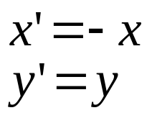
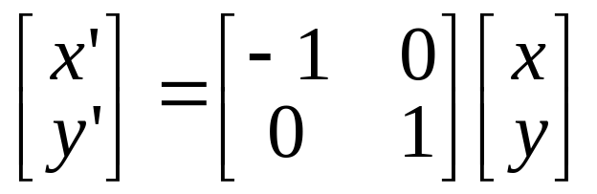
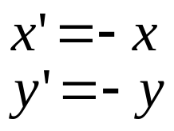
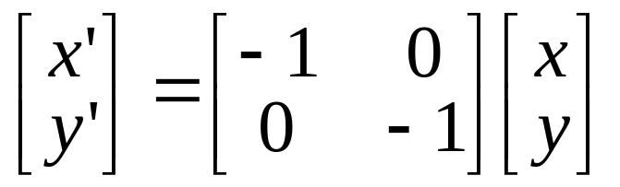
2x2 Matrices
2D Mirror about Y axis
2D Mirror over (0,0)

Slide 8
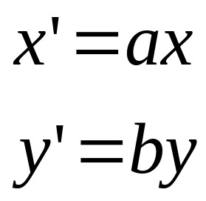
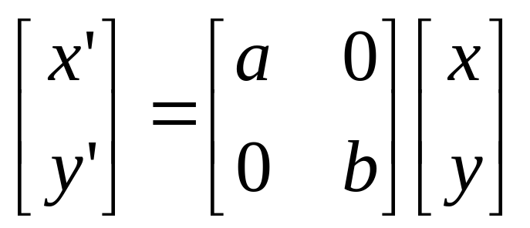
Scaling
Scaling operation:
Or, in matrix form:
× 2
X×2,
Y×0.5
scaling matrix S
Uniform scaling => a = b
What’s the inverse of S?

Slide 9
2-D Rotation
x = r cos (φ)
y = r sin (φ)
x’ = r cos (φ + θ)
y’ = r sin (φ + θ)
Trigonometric identity for angle sum
x’ = r cos(φ) cos(θ) – r sin(φ) sin(θ)
y’ = r sin(φ) cos(θ) + r cos(φ) sin(θ)
Substitute…
x’ = x cos(θ) - y sin(θ)
y’ = x sin(θ) + y cos(θ)
(x’, y’)
(x, y)
r
r
θ
φ
Notes:
https://en.wikipedia.org/wiki/List_of_trigonometric_identities#Angle_sum_and_difference_identities

Slide 10
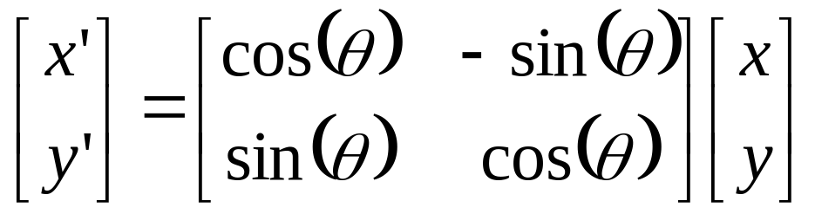

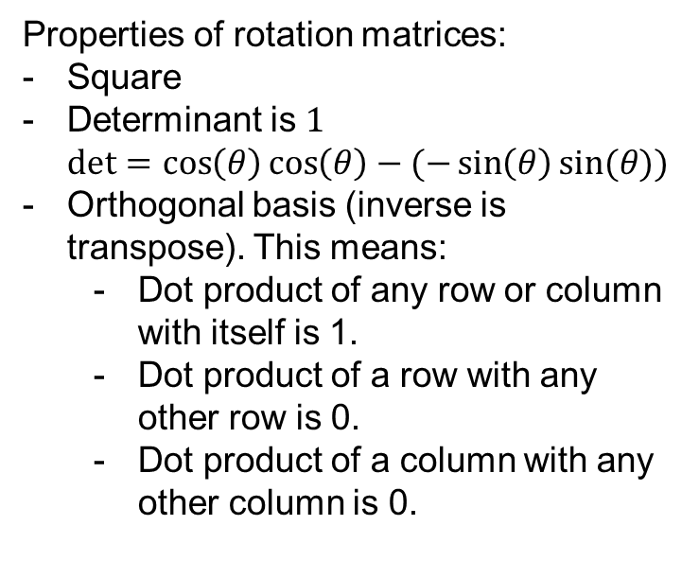
2-D Rotation
This is easy to capture in matrix form:
Even though sin(θ) and cos(θ) are nonlinear functions of θ,
  x’ is a linear combination of x and y
  y’ is a linear combination of x and y
What is the inverse transformation?
  Rotation by –θ
  For rotation matrices
Properties of rotation matrices:
Square
Determinant is $1$
$det=\cos\left(θ\right)\cos\left(θ\right)−(−\sin\left(θ\right)sin⁡(θ))$
Orthogonal basis (inverse is transpose). This means:
  Dot product of any row or column with itself is 1.
  Dot product of a row with any other row is 0.
  Dot product of a column with any other column is 0.
R

Slide 11
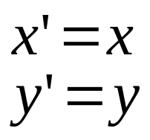
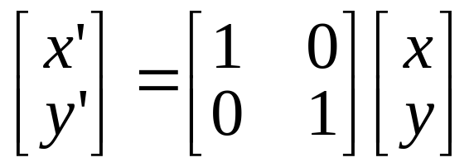
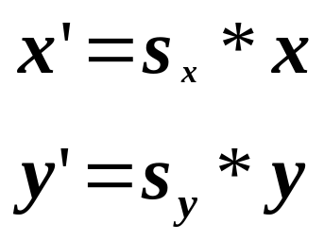
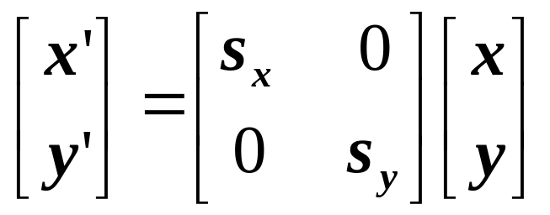
2x2 Matrices
What types of transformations can be
represented with a 2x2 matrix?
2D Identity?
2D Scale around (0,0)?

Slide 12
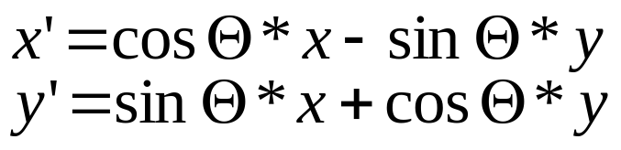
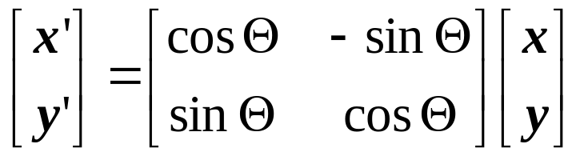
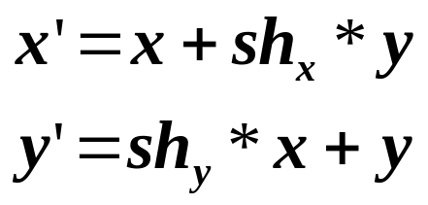
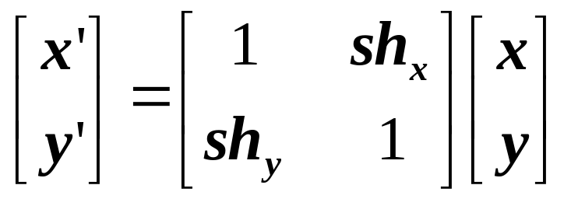
2x2 Matrices
What types of transformations can be
represented with a 2x2 matrix?
2D Rotate around (0,0)?
2D Shear?

Slide 13
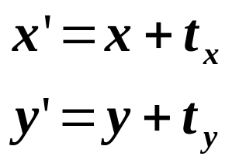
2x2 Matrices
What types of transformations can be
represented with a 2x2 matrix?
2D Translation?
NO!
Only linear 2D transformations
can be represented with a 2x2 matrix

Slide 14
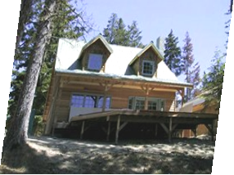
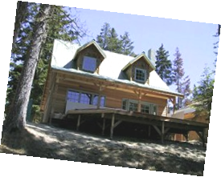
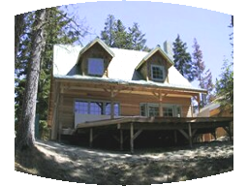
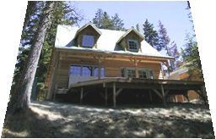
Parametric (global) warping
Examples of parametric warps:
2x2 matrices
Scale / aspect
Rotation
Mirror
Shear
Not 2x2 matrices
perspective
Translation
cylindrical

Slide 15
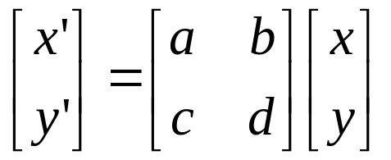
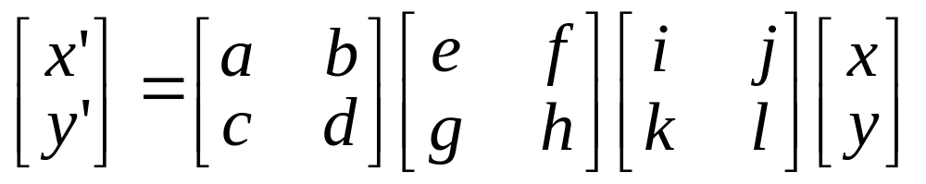
All 2D Linear Transformations
Linear transformations are combinations of …
  Scale,
  Rotation,
  Shear, and
  Mirror
Properties of linear transformations:
  Origin maps to origin
  Lines map to lines
  Parallel lines remain parallel
  Ratios are preserved
  Closed under composition

Slide 16
Consider a different Basis
j =(0,1)
v =(v_{x},v_{y})
p
q
u=(u_{x},u_{y})
i =(1,0)
q=4i+3j = (4,3)
p=4u+3v

Slide 17
Linear Transformations as Change of Basis
v =(v_{x},v_{y})
j =(0,1)
p^{uv}
p^{ij}
u=(u_{x},u_{y})
i =(1,0)
p^{uv} = (4,3)
p^{ij} = 4u+3v
p_{x}=4u_{x}+3v_{x}
p_{y}=4u_{y}+3v_{y}
⎡
u
v
⎤
⎡
4
⎤
⎡
u
v
⎤
p^{ij}
=
⎢
x
x
⎥
=
⎢
x
x
⎥
p^{uv}
⎢
⎥
⎣
u
v
⎦
⎣
3
⎦
⎣
u
v
⎦
y
y
y
y
Any linear transformation is a basis!!!

Slide 18
What’s the inverse transform?
j =(0,1)
v =(v_{x},v_{y})
p^{ij}
p^{uv}
u=(u_{x},u_{y})
i =(1,0)
p^{ij} = (5,4)
= p_{x}u + p_{y}v
p^{uv} = (p_{x},p_{y}) = ?
-1
-1
⎡
u
v
⎤
⎡
5
⎤
⎡
u
v
⎤
p^{uv}
=
⎢
x
x
⎥
=
⎢
x
x
⎥
p^{ij}
⎢
⎥
⎣
u
v
⎦
⎣
4
⎦
⎣
u
v
⎦
y
y
y
y
How can we change from any basis to any basis?
What if the basis are orthogonal?

Slide 19
Projection onto orthogonal basis
j =(0,1)
v =(v_{x},v_{y})
p^{ij}
p^{uv}
u=(u_{x},u_{y})
i =(1,0)
p^{ij} = (5,4)
p^{uv} = (u·p^{ij}, v·p^{ij})
⎡
u
u
⎤
⎡
5
⎤
⎡
u
u
⎤
p^{uv}
=
⎢
x
x
⎥
=
⎢
x
y
⎥
p^{ij}
⎢
⎥
⎣
v
v
⎦
⎣
4
⎦
⎣
v
v
⎦
y
y
x
y

Slide 20
Homogeneous Coordinates
Q: How can we represent translation as a 3x3 matrix?

Slide 21
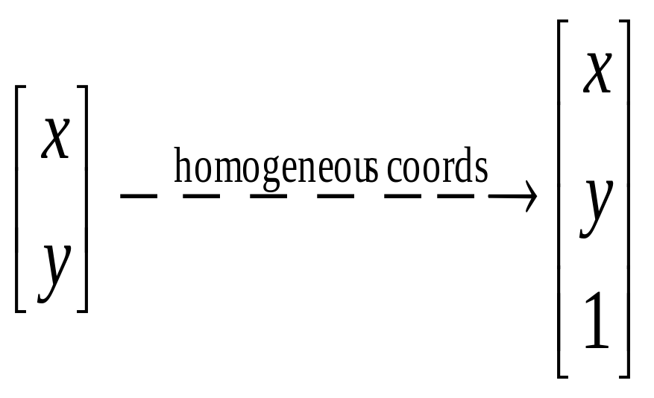
Homogeneous Coordinates
  Represent coordinates in 2 dimensions with a 3-vector
Homogeneous
coords

Slide 22
Homogeneous Coordinates
Add a 3rd coordinate to every 2D point
  (x, y, w) represents a point at location (x/w, y/w)
  (x, y, 0) represents a point at infinity
  (0, 0, 0) is not allowed
y
2
(2,1,1)
or (4,2,2)
or (6,3,3)
Convenient coordinate system to represent many useful transformations
1
1
2
x

Slide 23

Homogeneous Coordinates
Q: How can we represent translation as a 3x3 matrix?
A: Using the rightmost column:

Slide 24
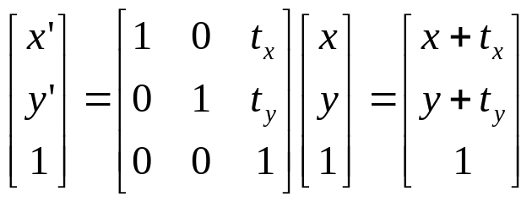
Translation
Example of translation
Homogeneous Coordinates
t_{x} = 2
t_{y} = 1

Slide 25
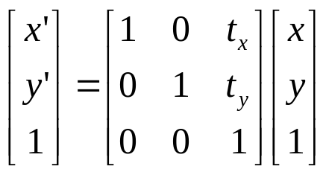
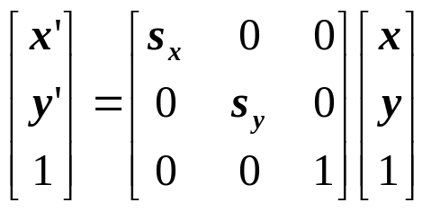
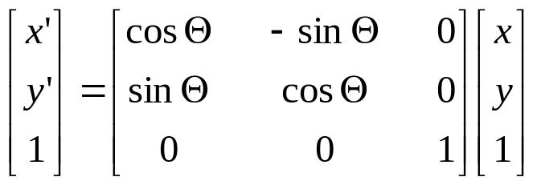
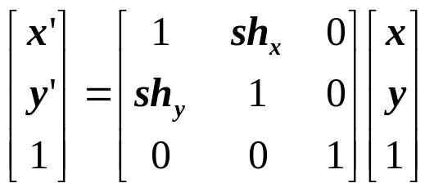
Basic 2D Transformations
Basic 2D transformations as 3x3 matrices
Translate
Scale
Rotate
Shear

Slide 26
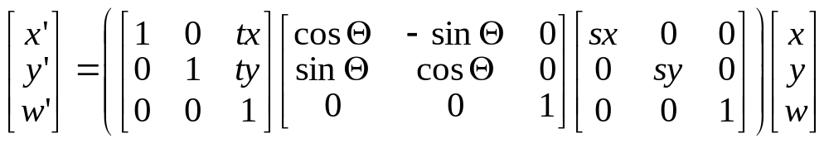
Matrix Composition
Transformations can be combined by matrix multiplication because they are linear!
p’ = T(t_{x},t_{y}) R(Θ) S(s_{x},s_{y}) p

Slide 27
Parametric (global) warping
Examples of parametric warps:
2x2 matrices
Scale / aspect
Rotation
Mirror
Shear
3x3 homogeneous matrices
Translation

Slide 28
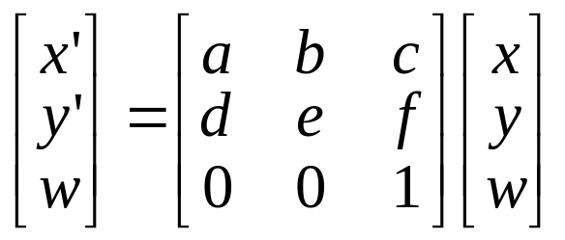
Affine Transformations
Affine transformations are combinations of …
  Linear transformations, and
  Translations
Properties of affine transformations:
  Origin does not necessarily map to origin
  Lines map to lines
  Parallel lines remain parallel
  Ratios are preserved
  Closed under composition
  Models change of basis
Will the last coordinate w always be 1?

Slide 29
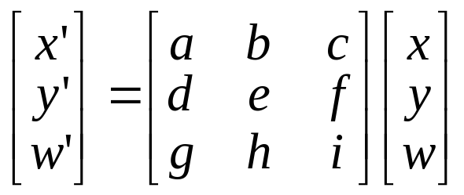
Projective Transformations
Projective transformations …
  Affine transformations, and
  Projective warps
Properties of projective transformations:
  Origin does not necessarily map to origin
  Lines map to lines
  Parallel lines do not necessarily remain parallel
  Ratios are not preserved
  Closed under composition
  Models change of basis

Slide 30
Parametric (global) warping
Examples of parametric warps:
2x2 matrices
Scale / aspect
Rotation
Mirror
Shear
3x3 matrices
Translation
perspective

Slide 31
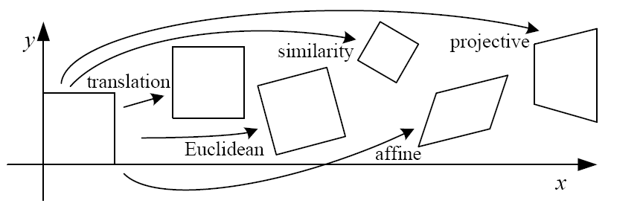
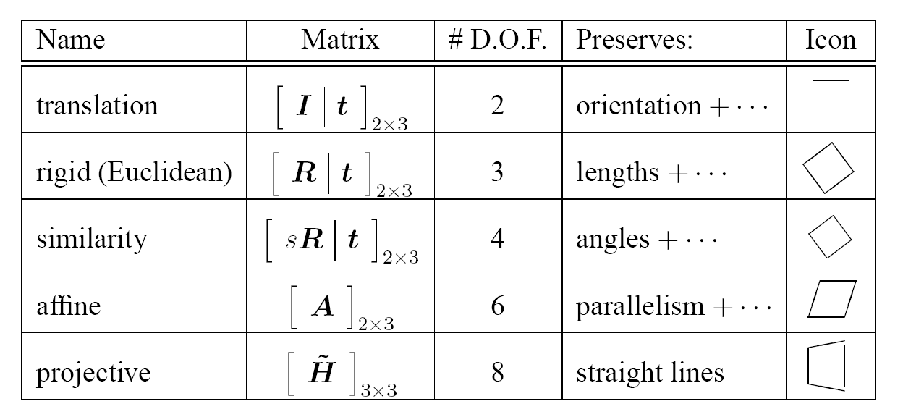
2D image transformations
These transformations are a nested set of groups
  Closed under composition and inverse is a member

Slide 32
Recovering Transformations
?
T(x,y)
y
y’
x
x’
f(x,y)
g(x’,y’)
What if we know f and g and want to recover the transform T?
  e.g. better align images from Project 1
  willing to let user provide correspondences
    How many do we need?

Slide 33
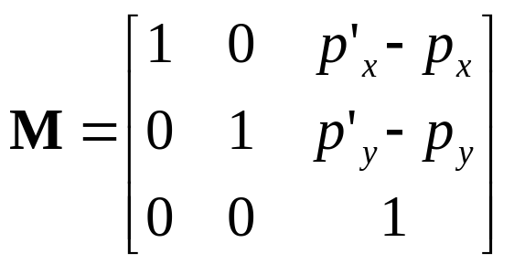
Translation: # correspondences?
?
T(x,y)
y
y’
x
x’
How many correspondences needed for translation?
How many Degrees of Freedom?
What is the transformation matrix?

Slide 34
Euclidian: # correspondences?
?
T(x,y)
y
y’
x
x’
How many correspondences needed for translation+rotation?
How many DOF?

Slide 35
Affine: # correspondences?
?
T(x,y)
y
y’
x
x’
How many correspondences needed for affine?
How many DOF?

Slide 36
Projective: # correspondences?
?
T(x,y)
y
y’
x
x’
How many correspondences needed for projective?
How many DOF?

Slide 37

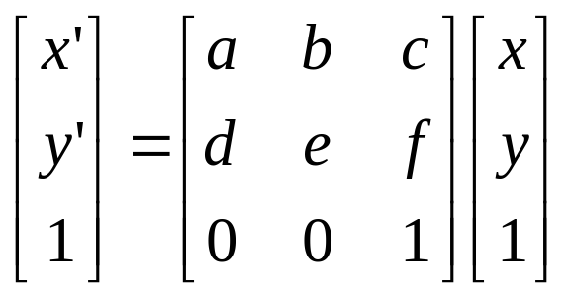
Example: warping triangles
B
B’
?
T(x,y)
C’
A
C
A’
Source
Destination
Given two triangles: ABC and A’B’C’ in 2D (12 numbers)
Need to find transform T to transfer all pixels from one to the other.
What kind of transformation is T?
How can we compute the transformation matrix:

Slide 38
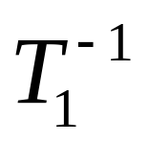
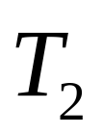
Warping triangles (Barycentric Coordinaes)
(0,1)
(0,0)
(1,0)
B
B’
Inverse
change
of basis
change
of basis
C’
A
C
A’
Source
Destination
Don’t forget to move the origin too!

Slide 39
Image warping
T(x,y)
y
y’
x
x’
f(x,y)
g(x’,y’)
Given a coordinate transform (x’,y’) = T(x,y) and a source image f(x,y), how do we compute a transformed image g(x’,y’) = f(T(x,y))?

Slide 40
Forward warping
T(x,y)
y
y’
x
x’
f(x,y)
g(x’,y’)
Send each pixel f(x,y) to its corresponding location
(x’,y’) = T(x,y) in the second image
Q: What if pixel lands “between” two pixels?

Slide 41
Forward warping
T(x,y)
y
y’
x
x’
f(x,y)
g(x’,y’)
Send each pixel f(x,y) to its corresponding location
(x’,y’) = T(x,y) in the second image
Q: What if pixel lands “between” two pixels?
A: Distribute color among neighboring pixels (x’,y’)
  Known as “splatting”
  Check out griddata in Python scipy.interpolate

Slide 42
Inverse warping
T⁻¹(x,y)
y
y’
x
x
x’
f(x,y)
g(x’,y’)
Get each pixel g(x’,y’) from its corresponding location
(x,y) = T⁻¹(x’,y’) in the first image
Q: What if pixel comes from “between” two pixels?

Slide 43
Inverse warping
T⁻¹(x,y)
y
y’
x
x
x’
f(x,y)
g(x’,y’)
Get each pixel g(x’,y’) from its corresponding location
(x,y) = T⁻¹(x’,y’) in the first image
Q: What if pixel comes from “between” two pixels?
A: Interpolate color value from neighbors
  nearest neighbor, bilinear, Gaussian, bicubic
  Check out interp2 in scipy.interpolate

Slide 44
Forward vs. inverse warping
Q: Which is better?
A: Usually inverse—eliminates holes
  However, it requires an invertible warp function—not always possible...

Slide 45
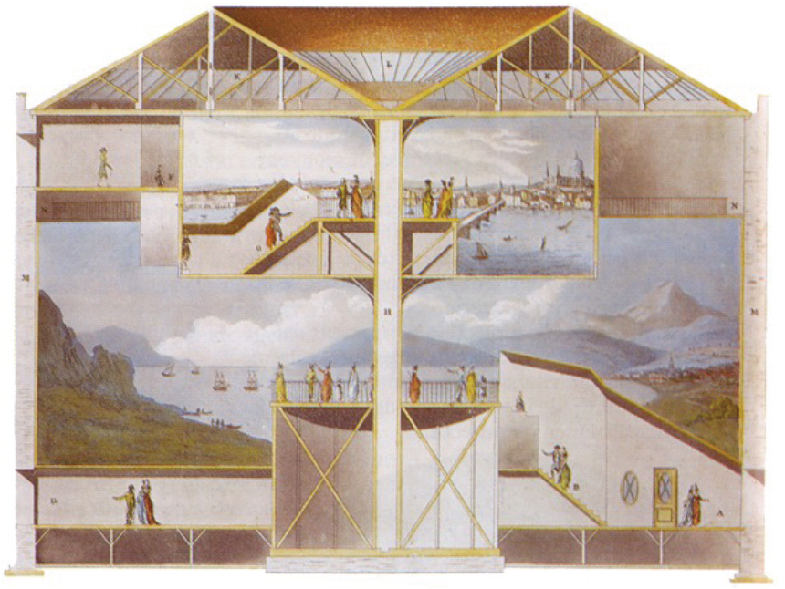
Homographies and Panoramas
Slides from Steve Seitz, Rick Szeliski, Alexei Efros, Fredo Durand, and Kristin Grauman
cs129: Computational Photography
James Hays, Brown, Fall 2012
Notes:
http://en.wikipedia.org/wiki/Cyclorama

Slide 46
Big idea
As with high dynamic range imaging, we are compensating for the shortcomings of traditional cameras by capturing and fusing multiple images.
Today we will assume that correspondence between photos is known and we focus on finding and applying homographies.

Slide 47

Why Mosaic?
Are you getting the whole picture?
  Compact Camera FOV = 50 x 35°
Slide from Brown & Lowe

Slide 48
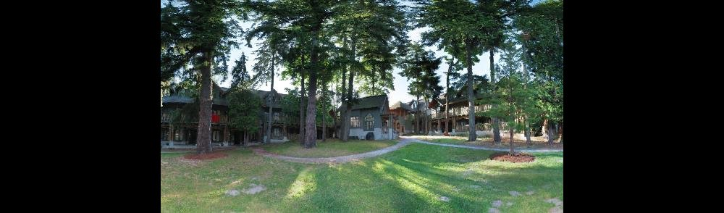
Why Mosaic?
Are you getting the whole picture?
  Compact Camera FOV = 50 x 35°
  Human FOV = 200 x 135°
Slide from Brown & Lowe

Slide 49

Why Mosaic?
Are you getting the whole picture?
  Compact Camera FOV = 50 x 35°
  Human FOV = 200 x 135°
  Panoramic Mosaic = 360 x 180°
Slide from Brown & Lowe

Slide 50


Panoramic Photos are old
Sydney,1875
Beirut, late 1800’s
Notes:
http://en.wikipedia.org/wiki/File:Historic_Sydney_Panorama.jpg

Slide 51


Panorama Capture
Catadioptric lens
(catadioptric means ‘mirror+lens’ – reflection + refraction)
Parabolic mirror
Many telescopes are built like this.

Slide 52









Mosaics: Stitching images together
virtual wide-angle camera

Slide 53
How to do it?
Basic Procedure
  Take a sequence of images from the same position
    Rotate the camera about its optical center
  Compute transformation between second image and first
  Transform the second image to overlap with the first
  Blend the two together to create a mosaic
  If there are more images, repeat
…but wait, why should this work at all?
  What about the 3D geometry of the scene?
  Why aren’t we using it?

Slide 54

Aligning images
left on top
right on top
  Translations are not enough to align the images

Slide 55
A pencil of rays contains all views
Real
camera
Synthetic panoramic camera
Can generate any synthetic camera view
if it has the same center of projection!

Slide 56
Image reprojection
mosaic PP
The mosaic has a natural interpretation in 3D
  The images are reprojected onto a common plane
  The mosaic is formed on this plane
  Mosaic is a synthetic wide-angle camera

Slide 57
Image reprojection
Basic question
  How to relate two images from the same camera center?
    How to map a pixel from PP1 to PP2?
Real-world scene
Answer
  Cast a ray through each pixel in PP1
  Draw the pixel where that ray intersects PP2
PP2
But don’t we need to know the geometry
of the two planes with respect to the eye?
PP1
Observation:
Rather than thinking of this as a 3D reprojection,
think of it as a 2D image warp from one image to another

Slide 58




Back to Image Warping
Which t-form is the right one for warping PP1 into PP2?
    e.g. translation, Euclidean, affine, projective
Translation
Affine
Perspective
2 unknowns
6 unknowns
8 unknowns

Slide 59

Homography
A: Projective – mapping between any two PPs with the same center of projection
  rectangle should map to arbitrary quadrilateral
  parallel lines aren’t maintained
  but must preserve straight lines
  Equal to: project, rotate, reproject
called Homography
PP2
p’
H
p
PP1
To apply a homography H
  Compute p’ = Hp (regular matrix multiply)
  Convert p’ from homogeneous to
  image coordinates

Slide 60



Image warping with homographies
image plane in front
image plane below
black area
where no pixel
maps to

Slide 61
Image rectification
p’
p
To unwarp (rectify) an image
  Find the homography H given a set of p and p’ pairs
  How many correspondences are needed?
  Tricky to write H analytically, but we can solve for it!
    Find such H that “best” transforms points p into p’
    Use least-squares!

Slide 62
Mosaics: main steps
Collect correspondences (manually)
Solve for homography matrix H
  Least squares solution
Warp content from one image frame to the other to combine: say im1 into im2 reference frame
  Determine bounds of the new combined image
    Where will the corners of im1 fall in im2’s coordinate frame?
    We will attempt to lookup colors for any of these positions we can get from im1.
  Compute coordinates in im1’s reference frame (via homography) for all points in that range
  Lookup all colors for all these positions from im1
    Inverse warp : interp2 (watch for nans)
Overlay im2 content onto the warped im1 content.
  Careful about new bounds of the output image: minx, miny

Slide 63




Homography
To apply a given homography H
  Compute p’ = Hp (regular matrix multiply)
  Convert p’ from homogeneous to image coordinates
p’
H
p

Slide 64






Homography
…
…
To compute the homography given pairs of corresponding points in the images, we need to set up an equation where the parameters of H are the unknowns…

Slide 65





Least Squares Example
Say we have a set of data points (X1,X1’), (X2,X2’), (X3,X3’), etc.
(e.g. person’s height vs. weight)
We want a nice compact formula (a line) to predict X’s from Xs: Xa + b = X’
We want to find a and b
How many (X,X’) pairs do we need?
What if the data is noisy?
Ax=B
overconstrained

Slide 66


Solving for homographies
p’ = Hp
Can set scale factor i=1. So, there are 8 unknowns.
Set up a system of linear equations:
Ah = b
where vector of unknowns h = [a,b,c,d,e,f,g,h]^{T}
Need at least 8 eqs, but the more the better…
Solve for h.
If overconstrained, solve using least-squares:

Slide 67

Example system for finding homography
…
Source: Paul Heckbert, Fundamentals of Texture Mapping and Image Warping

Slide 68



Fun with homographies
Original image
St.Petersburg
photo by A. Tikhonov
Virtual camera rotations

Slide 69



Analyzing patterns and shapes
What is the shape of the b/w floor pattern?
Homography
The floor (enlarged)
Automatically
rectified floor
Slide from Criminisi

Slide 70

Analyzing patterns and shapes
Automatic rectification
From Martin Kemp The Science of Art
(manual reconstruction)
2 patterns have been discovered !
Slide from Criminisi

Slide 71


Analyzing patterns and shapes
What is the (complicated)
shape of the floor pattern?
Automatically rectified floor
St. Lucy Altarpiece, D. Veneziano
Slide from Criminisi

Slide 72

Analyzing patterns and shapes
Automatic
rectification
From Martin Kemp, The Science of Art
(manual reconstruction)
Slide from Criminisi

Slide 73

Analyzing patterns and shapes
The Ambassadors by Hans Holbein the Younger, 1533

Slide 74




Julian Beever: Manual Homographies
http://users.skynet.be/J.Beever/pave.htm

Slide 75
Making panoramic images
With planar proxy geometries

Slide 76
Mosaics:
Main steps
Collect correspondences (manually)
Solve for homography matrix H
  Least squares solution
Warp content from one image frame to the other to combine:
Say, warp im1 into im2 reference frame
  Determine bounds of the new combined image
    Where will the corners of im1 fall in im2’s coordinate frame?
    We will attempt to lookup colors for any of these positions we can get from im1. : numpy.meshgrid
  Compute coordinates in im1’s reference frame (via homography) for all points in that range: H⁻¹
  Lookup all colors for all these positions from im1
    Inverse warp : scipy.interpolate.interp2
    (watch for nans : isnan)
Overlay im2 content onto the warped im1 content.
  Careful about new bounds of the output image: minx, miny

Slide 77


im2
im1

Slide 78
Mosaics:
Main steps
Collect correspondences (manually)
Solve for homography matrix H
  Least squares solution
Warp content from one image frame to the other to combine:
Say, warp im1 into im2 reference frame
  Determine bounds of the new combined image
    Where will the corners of im1 fall in im2’s coordinate frame?
    We will attempt to lookup colors for any of these positions we can get from im1. : numpy.meshgrid
  Compute coordinates in im1’s reference frame (via homography) for all points in that range: H⁻¹
  Lookup all colors for all these positions from im1
    Inverse warp : scipy.interpolate.interp2
    (watch for nans : isnan)
Overlay im2 content onto the warped im1 content.
  Careful about new bounds of the output image: minx, miny

Slide 79
im2
im1

Slide 80
Mosaics:
Main steps
Collect correspondences (manually)
Solve for homography matrix H
  Least squares solution
Warp content from one image frame to the other to combine:
Say, warp im1 into im2 reference frame
  Determine bounds of the new combined image
    Where will the corners of im1 fall in im2’s coordinate frame?
    We will attempt to lookup colors for any of these positions we can get from im1. : numpy.meshgrid
  Compute coordinates in im1’s reference frame (via homography) for all points in that range: H⁻¹
  Lookup all colors for all these positions from im1
    Inverse warp : scipy.interpolate.interp2
    (watch for nans : isnan)
Overlay im2 content onto the warped im1 content.
  Careful about new bounds of the output image: minx, miny

Slide 81

im1
im1 warped into reference frame of im2.
im2
Use interp2 to ask for the colors (possibly interpolated) from im1 at all the positions needed in im2’s reference frame.

Slide 82
Mosaics:
Main steps
Collect correspondences (manually)
Solve for homography matrix H
  Least squares solution
Warp content from one image frame to the other to combine:
Say, warp im1 into im2 reference frame
  Determine bounds of the new combined image
    Where will the corners of im1 fall in im2’s coordinate frame?
    We will attempt to lookup colors for any of these positions we can get from im1. : numpy.meshgrid
  Compute coordinates in im1’s reference frame (via homography) for all points in that range: H⁻¹
  Lookup all colors for all these positions from im1
    Inverse warp : scipy.interpolate.interp2
    (watch for nans : isnan)
Overlay im2 content onto the warped im1 content.
  Careful about new bounds of the output image: minx, miny

Slide 83


Slide 84

Panoramas
Pick one image (red)
Warp the other images towards it (usually, one by one)
blend

Slide 85
changing camera center
Does it still work?
synthetic PP
PP1
PP2

Slide 86

Planar scene (or far away)
PP3
PP1
PP2
PP3 is a projection plane of both centers of projection, so we are OK!
This is how big aerial photographs are made

Slide 87


Planar mosaic

Slide 88
Do we have to project onto a plane?
mosaic PP

Slide 89


Slide 90
Full Panoramas
What if you want a 360° field of view?
mosaic Projection Cylinder

Slide 91










Cylindrical projection (Szeliski 9.1)
  Map 3D point (X,Y,Z) onto cylinder
Y
Z
X
  Convert to cylindrical coordinates
$h$ is ‘height’
unit cylinder
  Convert to cylindrical image coordinates
$f$ is the focal length
unwrapped cylinder
cylindrical image

Slide 92


Cylindrical projection
Y
X

Slide 93

Inverse Cylindrical projection
(X,Y,Z)
(sinθ,h,cosθ)
Y
Z
X

Slide 94

Cylindrical panoramas
Steps
  Reproject each image onto a cylinder
  Blend
  Output the resulting mosaic

Slide 95

Cylindrical image stitching
What if you don’t know the camera rotation?
  Solve for the camera rotations
    Note that a rotation of the camera around up vector
    is a translation of the cylinder!

Slide 96
Assembling the panorama
Stitch pairs together, blend, then crop

Slide 97
Problem: Drift
Vertical Error accumulation
  small (vertical) errors accumulate over time
  apply correction so that sum = 0 (for 360° pan.)
Horizontal Error accumulation
  can reuse first/last image to find the right panorama radius

Slide 98

Full-view (360°) panoramas

Slide 99

Other projections are possible
You can stitch on the plane and then warp the resulting panorama
  What’s the limitation here?
Or, you can use these as stitching surfaces
  But there is a catch…

Slide 100







Cylindrical reprojection
top-down view
Focal length – the dirty secret…
Image 384x300
f = 180 (pixels)
f = 280
f = 380
Notes:
Therefore, it is desirable if the global motion model we need to recover is translation, which has only two parameters. It turns out that for a pure panning motion, if we convert two images to their cylindrical maps with known focal length, the relationship between them can be represented by a translation.
Here is an example of how cylindrical maps are constructed with differently with f’s. Note how straight lines are curved.
Similarly, we can map an image to its longitude/latitude spherical coordinates as well if f is given.

Slide 101

What’s your focal length, buddy?
Focal length is (highly!) camera dependant
  Can get a rough estimate by measuring FOV:
  Can use the EXIF data tag (might not give the right thing)
  Can use several images together and try to find f that would make them match
  Can use a known 3D object and its projection to solve for f
  Etc.
There are other camera parameters too:
  Optical center, non-square pixels, lens distortion, etc.

Slide 102


Spherical projection (Szeliski 9.1)
  Map 3D point (X,Y,Z) onto sphere
Y
Z
X
  Convert to spherical coordinates
  Convert to spherical image coordinates
$$\left(\tilde{x},\tilde{y}\right)=\left(fθ,fφ\right)+({\tilde{x}}_{c},{\tilde{y}}_{c})$$
φ
unwrapped sphere
spherical image

Slide 103

Spherical Projection
Y
X

Slide 104

Inverse Spherical projection
φ
(x,y,z)
cos φ
(sinθcosφ,cosθcosφ,sinφ)
sin φ
Y
Z
cos θ cos φ
X

Slide 105
3D rotation
Rotate image before placing on unrolled sphere
φ
(x,y,z)
cos φ
(sinθcosφ,cosθcosφ,sinφ)
sin φ
Y
Z
cos θ cos φ
X
p = R p
_ _
_ _

Slide 106





Full-view Panorama
+
+
+
+

Slide 107


Distortion
No distortion
Pin cushion
Barrel
Radial distortion of the image
  Caused by imperfect lenses
  Deviations are most noticeable for rays that pass through the edge of the lens

Slide 108




Radial distortion
Correct for “bending” in calibrated wide field of view lenses
Use this instead of normal projection
if we know radial distortion coefficients $κ_{1}$and $κ_{2}$

Slide 109



Polar Projection – north pole lies along optical axis
Extreme “bending” in ultra-wide fields of view
Equations become

Slide 110

Project 5: Automatic Panorama Construction

Slide 111

Project 5: Automatic Panorama Construction
Notes:
https://www.nasa.gov/jpl/msl/pia19142
The scene combines dozens of images taken during January 2015 by the Mars Hand Lens Imager (MAHLI) camera at the end of the rover's robotic arm. The pale "Pahrump Hills" outcrop surrounds the rover, and the upper portion of Mount Sharp is visible on the horizon. Darker ground at upper right and lower left holds ripples of wind-blown sand and dust
The view does not include the rover's robotic arm. Wrist motions and turret rotations on the arm allowed MAHLI to acquire the mosaic's component images. The arm was positioned out of the shot in the images, or portions of images, that were used in this mosaic. This process was used previously in acquiring and assembling Curiosity self-portraits taken at sample-collection sites "Rocknest" (http://photojournal.jpl.nasa.gov/catalog/PIA16468), "John Klein" (http://photojournal.jpl.nasa.gov/catalog/PIA16937) and "Windjana" (http://photojournal.jpl.nasa.gov/catalog/PIA18390)..

Slide 112
Camera calibration
Determine camera parameters from known 3D points or calibration object(s)
internal or intrinsic parameters such as focal length, optical center, aspect ratio:
what kind of camera?
external or extrinsic (pose) parameters:
where is the camera in the world coordinates?
  World coordinates make sense for multiple cameras / multiple images
How can we do this?

Slide 113


Approach 1: solve for projection matrix
Place a known object in the scene
  identify correspondence between image and scene
  compute mapping from scene to image

Slide 114
Direct linear calibration
Solve for Projection Matrix Π using least-squares (just like in homework)
Advantages:
  All specifics of the camera summarized in one matrix
  Can predict where any world point will map to in the image
Disadvantages:
  Doesn’t tell us about particular parameters
  Mixes up internal and external parameters
    pose specific: move the camera and everything breaks

Slide 115






Approach 2: solve for parameters
A camera is described by several parameters
  Translation T of the optical center from the origin of world coords
  Rotation R of the image plane
  focal length f, principle point (x’_{c}, y’_{c}), pixel size (s_{x}, s_{y})
  blue parameters are called “extrinsics,” red are “intrinsics”
Projection equation
  The projection matrix models the cumulative effect of all parameters
  Useful to decompose into a series of operations
identity matrix
intrinsics
projection
rotation
translation
  Solve using non-linear optimization

Slide 116

Multi-plane calibration
Images courtesy Jean-Yves Bouguet, Intel Corp.
Advantage
  Only requires a plane
  Don’t have to know positions/orientations
  Good code available online!
    Intel’s OpenCV library: http://www.intel.com/research/mrl/research/opencv/
    Matlab version by Jean-Yves Bouget: http://www.vision.caltech.edu/bouguetj/calib_doc/index.html
    Zhengyou Zhang’s web site: http://research.microsoft.com/~zhang/Calib/

Slide 117





































Optimize over more parameters: Bundle Adjustment
New images initialised with rotation, focal length of best matching image

Slide 118

Optimize over more parameters: Bundle Adjustment
New images initialised with rotation, focal length of best matching image

Slide 119

Multi-band Blending
Burt & Adelson 1983
  Blend frequency bands over range ∝ λ

Slide 120


Project 5: Bells and Whistles
Blending and Compositing
  use homographies to combine images or video and images together in an interesting (fun) way. E.g.
    put fake graffiti on buildings or chalk drawings on the ground
    replace a road sign with your own poster
    project a movie onto a building wall
    etc.

Slide 121
Bells and Whistles
Capture creative/cool/bizzare panoramas
  Example from UW (by Brett Allen):
  Ever wondered what is happening inside your fridge while you are not looking?

Slide 122
Bells and Whistles
Video Panorama
  Capture two (or more) stationary videos (either from the same point, or of a planar/far-away scene). Compute homography and produce a video mosaic. Need to worry about synchronization (not too hard).
  e.g. capturing a football game from the sides of the stadium

Slide 123






More panorama / homography examples
Ben Hollis, 2004
Ben Hollis, 2004
Eunjeong Ryu (E.J), 2004
Matt Pucevich , 2004

Slide 124
RANSAC and projections
© Jeffrey Martin (jeffrey-martin.com)
most slides from Steve Seitz,
Rick Szeliski, and Alexei A. Efros; James Hays

Slide 125

Suppose we have estimated correspondences, but some are bad
What do we do about the “bad” matches?

Slide 126
RANdom SAmple Consensus
Select one match, count inliers

Slide 127
RANdom SAmple Consensus
Select one match, count inliers

Slide 128
Least squares fit
Find “average” translation vector

Slide 129
RANSAC for estimating homography
The key idea is not that there are more inliers than outliers, but that the outliers are wrong in different ways.
RANSAC loop:
Select four feature pairs (at random)
Compute homography H (exact)
Compute inliers where SSD(p_{i}’, H p_{i}) < ε
Keep largest set of inliers
Re-compute least-squares H estimate on all inliers

Slide 130



RANSAC

Slide 131
Example: Recognising Panoramas
M. Brown and D. Lowe,
University of British Columbia

Slide 132
Why “Recognising Panoramas”?

Slide 133
Why “Recognising Panoramas”?
1D Rotations (θ)
  Ordering ⇒ matching images

Slide 134
Why “Recognising Panoramas”?
1D Rotations (θ)
  Ordering ⇒ matching images

Slide 135
Why “Recognising Panoramas”?
1D Rotations (θ)
  Ordering ⇒ matching images

Slide 136
Why “Recognising Panoramas”?
1D Rotations (θ)
  Ordering ⇒ matching images
2D Rotations (θ, φ)
  Ordering ⇒ matching images

Slide 137













Why “Recognising Panoramas”?
1D Rotations (θ)
  Ordering ⇒ matching images
2D Rotations (θ, φ)
  Ordering ⇒ matching images

Slide 138









Why “Recognising Panoramas”?
1D Rotations (θ)
  Ordering ⇒ matching images
2D Rotations (θ, φ)
  Ordering ⇒ matching images

Slide 139




























Why “Recognising Panoramas”?

Slide 140
Overview
Feature Matching
Image Matching
Bundle Adjustment
Multi-band Blending
Results
Conclusions

Slide 141




RANSAC for Homography

Slide 142


RANSAC for Homography

Slide 143

RANSAC for Homography

Slide 144


Probabilistic model for verification

Slide 145
Finding the panoramas

Slide 146
Finding the panoramas

Slide 147
Finding the panoramas

Slide 148
Finding the panoramas

Slide 149



Homography for Rotation
Parameterise each camera by rotation and focal length
This gives pairwise homographies

Slide 150
Bundle Adjustment
New images initialised with rotation, focal length of best matching image

Slide 151
Bundle Adjustment
New images initialised with rotation, focal length of best matching image

Slide 152
Multi-band Blending
Burt & Adelson 1983
  Blend frequency bands over range ∝ λ

Slide 153


























Results

Slide 154

Pinhole camera model
f
c
Real object
f = Focal length
c = Optical center of the camera
Forsyth

Slide 155




Projection: world coordinates→image coordinates
.
Image center (u₀, v₀)
.
.
f
Z
Y
.
V
Camera Center (0, 0, 0)
U
p = distance from image center
What is the effect if f and Z are equal?
Notes:
What is the effect if f and Z are equal?
U = -X and V = -Y, so ‘distances’ are preserved and the captured image is undistorted (at the virtual focal plane)

Slide 156


Camera (projection) matrix
Slide Credit: Savarese
R,t
j_{w}
X
k_{w}
O_{w}
x
i_{w}
x: Image Coordinates: (u,v,1)
K: Intrinsic Matrix (3x3)
R: Rotation (3x3)
t: Translation (3x1)
X: World Coordinates: (X,Y,Z,1)
Extrinsic Matrix
Notes:
We can use homogeneous coordinates to write ‘camera matrix’ in linear form.

Slide 157

Projective geometry
2D point in cartesian = (x,y) coordinates
2D point in projective = (x,y,w) coordinates
Y
Projector
X
Idea from www.tomdalling.com
Notes:
http://www.tomdalling.com/blog/modern-opengl/explaining-homogenous-coordinates-and-projective-geometry/

Slide 158
Projective geometry
2D point in cartesian = (x,y) coordinates
2D point in projective = (x,y,w) coordinates
Y
Projector
W
X
Idea from www.tomdalling.com
Notes:
http://www.tomdalling.com/blog/modern-opengl/explaining-homogenous-coordinates-and-projective-geometry/

Slide 159


Varying w
w₁
w₂ < w₁
Y
Y
Projector
Projector
X
X
Projected image becomes smaller.

Slide 160
Projective geometry
2D point in projective = (x,y,w) coordinates
  w defines the scale of the projected image.
  Each x,y point becomes a ray!
Y
Projector
W
X

Slide 161

Projective geometry
In 3D, point (x,y,z) becomes (x,y,z,w)
Perspective is w varying with z:
  Objects far away are appear smaller
C’
B’

Slide 162




Homogeneous coordinates
Converting to homogeneous coordinates
2D (image) coordinates
3D (scene) coordinates
Converting from homogeneous coordinates
2D (image) coordinates
3D (scene) coordinates
Notes:
Append coordinate with value 1; proportional coordinate system

Slide 163

Homogeneous coordinates
Scale invariance in projection space
Homogeneous Coordinates
Cartesian Coordinates
E.G., we can uniformly scale the projective space, and it will still produce the same image -> scale ambiguity
Notes:
Q: Suppose we have a point in Cartesian coordinates. What is that in homogeneous coordinates? A: a ray

Slide 164




Basic geometry in homogeneous coordinates
Line equation: ax + by + c = 0
Append 1 to pixel coordinate to get homogeneous coordinate
Line given by cross product of two points
Intersection of two lines given by cross product of the lines

Slide 165
Another problem solved by homogeneous coordinates
Intersection of parallel lines
  Cartesian: (Inf, Inf)
  Homogeneous: (1, 1, 0)
  Cartesian: (Inf, Inf)
Homogeneous: (1, 2, 0)
Notes:
Parallel lines intersect at different infinities

Slide 166
Camera (projection) matrix
Slide Credit: Savarese
R,t
j_{w}
X
k_{w}
O_{w}
x
i_{w}
x: Image Coordinates: (u,v,1)
K: Intrinsic Matrix (3x3)
R: Rotation (3x3)
t: Translation (3x1)
X: World Coordinates: (X,Y,Z,1)
Extrinsic Matrix
Notes:
We can use homogeneous coordinates to write ‘camera matrix’ in linear form.

Slide 167


Projection matrix
X
(0,0,0)
x
Intrinsic Assumptions
Unit aspect ratio
Optical center at (0,0)
No skew
Extrinsic Assumptions
No rotation
Camera at (0,0,0)
K
Slide Credit: Savarese
Notes:
Work through equations for u and v on board

Slide 168
Projection: world coordinates→image coordinates
.
Image center (u₀, v₀)
.
.
f
Z
Y
.
V
Camera Center (0, 0, 0)
U
p = distance from image center

Slide 169

Remove assumption: known optical center
Intrinsic Assumptions
Unit aspect ratio
No skew
Extrinsic Assumptions
No rotation
Camera at (0,0,0)
K
James Hays

Slide 170

Remove assumption: equal aspect ratio
Intrinsic Assumptions
No skew
Extrinsic Assumptions
No rotation
Camera at (0,0,0)
James Hays

Slide 171

Remove assumption: non-skewed pixels
Intrinsic Assumptions
Extrinsic Assumptions
No rotation
Camera at (0,0,0)
Note: different books use different notation for parameters
James Hays

Slide 172
Oriented and Translated Camera
R
j_{w}
X
t
k_{w}
O_{w}
x
i_{w}
James Hays

Slide 173


Allow camera translation
Intrinsic Assumptions
Extrinsic Assumptions
No rotation
James Hays

Slide 174

3D Rotation of Points
Slide Credit: Saverese
Rotation around the coordinate axes, counter-clockwise:
p’
γ
y
p
x
z

Slide 175


Allow camera rotation
James Hays

Slide 176
Demo – Kyle Simek
“Dissecting the Camera Matrix”
Three-part blog series
http://ksimek.github.io/2012/08/14/decompose/
http://ksimek.github.io/2012/08/22/extrinsic/
http://ksimek.github.io/2013/08/13/intrinsic/
“Perspective toy”
http://ksimek.github.io/perspective_camera_toy.html

Slide 177
Degrees of freedom
5
6
James Hays
Notes:
How many known points are needed to estimate this?
11 degrees of freedom
6 points

Slide 178




Vanishing Point = Projection from Infinity
James Hays

Slide 179

Orthographic Projection
Special case of perspective projection
  Distance from the COP to the image plane is infinite
  Also called “parallel projection”
  What’s the projection matrix?
Image
World
Slide by Steve Seitz

Slide 180

Scaled Orthographic Projection
Special case of perspective projection
  Object dimensions are small compared to distance to camera
  Also called “weak perspective”
  What’s the projection matrix?
Image
World
Slide by Steve Seitz

Slide 181

Geometry for a simple stereo system
First, assuming parallel optical axes, known camera parameters (i.e., calibrated cameras):
Two cameras, simultaneous views

Slide 182



Geometry for a simple stereo system
Assume parallel optical axes, known camera parameters (i.e., calibrated cameras). What is expression for Z?
Similar triangles (p_{l}, P, p_{r}) and (O_{l}, P, O_{r}):
disparity
Notes:
182

Slide 183

Stereo correspondence constraints
Given p in left image, where can corresponding point p’ be?

Slide 184

Stereo correspondence constraints

Slide 185

Epipolar constraint
Geometry of two views constrains where the corresponding pixel for some image point in the first view must occur in the second view.
  It must be on the line carved out by a plane connecting the world point and optical centers.
Notes:
185

Slide 186

Epipolar geometry
Epipolar Line
Epipolar Plane
Epipole
Baseline
Epipole
http://www.ai.sri.com/~luong/research/Meta3DViewer/EpipolarGeo.html
Notes:
186

Slide 187
Epipolar geometry: terms
Baseline: line joining the camera centers
Epipole: point of intersection of baseline with image plane
Epipolar plane: plane containing baseline and world point
Epipolar line: intersection of epipolar plane with the image plane
All epipolar lines intersect at the epipole
An epipolar plane intersects the left and right image planes in epipolar lines
Why is the epipolar constraint useful?

Slide 188
Fundamental matrix
Let x be a point in left image, x’ in right image
Epipolar relation
  x maps to epipolar line l’
  x’ maps to epipolar line l
Epipolar mapping described by a 3x3 matrix F:
It follows that:
l
l’
x
x’
$$l^{′}=Fx$$
$$l=F^{T}x′$$
$$x^{′}Fx=0$$

Slide 189
Fundamental matrix
This matrix F is called
  the “Essential Matrix”
    when image intrinsic parameters are known
  the “Fundamental Matrix”
    more generally (uncalibrated case)
Can solve for F from point correspondences
  Each (x, x’) pair gives one linear equation in entries of F
  F has 9 entries, but really only 7 degrees of freedom.
  With 8 points it is simple to solve for F, but it is also possible with 7. See Marc Pollefey’s notes for a nice tutorial
$$x^{′}Fx=0$$

Slide 190
Stereo image rectification

Slide 191
Stereo image rectification
Reproject image planes onto a common plane parallel to the line between camera centers
Pixel motion is horizontal after this transformation
Two homographies (3x3 transform), one for each input image reprojection
C. Loop and Z. Zhang. Computing Rectifying Homographies for Stereo Vision. IEEE Conf. Computer Vision and Pattern Recognition, 1999.

Slide 192


Rectification example

Slide 193
Summary: Key idea: Epipolar constraint
X
X
X
x
x’
x’
x’
Potential matches for x have to lie on the corresponding line l’.
Potential matches for x’ have to lie on the corresponding line l.

Slide 194

Automatic Image Alignment
© Mike Nese
cs129: Computational Photography
James Hays, Brown, Fall 2012
Slides from Alexei Efros,
Steve Seitz, and Rick Szeliski

Slide 195
Image Alignment
How do we align two images automatically?
Two broad approaches:
  Feature-based alignment
    Find a few matching features in both images
    compute alignment
  Direct (pixel-based) alignment
    Search for alignment where most pixels agree

Slide 196
Direct Alignment
The simplest approach is a brute force search (project 1)
  Need to define image matching function
    SSD, Normalized Correlation, edge matching, etc.
  Search over all parameters within a reasonable range:
e.g. for translation:
for tx=x0:step:x1,
for ty=y0:step:y1,
compare image1(x,y) to image2(x+tx,y+ty)
end;
end;
Need to pick correct x0,x1 and step
  What happens if step is too large?

Slide 197

Direct Alignment (brute force)
What if we want to search for more complicated transformation, e.g. homography?
for a=a0:astep:a1,
for b=b0:bstep:b1,
for c=c0:cstep:c1,
for d=d0:dstep:d1,
for e=e0:estep:e1,
for f=f0:fstep:f1,
for g=g0:gstep:g1,
for h=h0:hstep:h1,
compare image1 to H(image2)
end; end; end; end; end; end; end; end;

Slide 198
Problems with brute force
Not realistic
  Search in O(N⁸) is problematic
  Not clear how to set starting/stopping value and step
What can we do?
  Use pyramid search to limit starting/stopping/step values
  For special cases (rotational panoramas), can reduce search slightly to O(N⁴):
    H = K₁R₁R₂⁻¹K₂⁻¹ (4 DOF: f and rotation)
Alternative: gradient descent on the error function
  i.e. how do I tweak my current estimate to make the SSD error go down?
  Can do sub-pixel accuracy
  BIG assumption?
    Images are already almost aligned (<2 pixels difference!)
    Can improve with pyramid
  Same tool as in motion estimation

Slide 199

Slide credit Fei Fei Li

Slide 200

Slide credit Fei Fei Li

Slide 201

Slide credit Fei Fei Li

Slide 202


Image alignment

Slide 203
Feature-based alignment (project 6)
Find a few important features (aka Interest Points)
Match them across two images
Compute image transformation
How do we choose good features?
  They must prominent in both images
  Easy to localize
  Think how you would do it by hand
  Corners!

Slide 204


Feature Detection

Slide 205
Feature Matching
How do we match the features between the images?
  Need a way to describe a region around each feature
    e.g. image patch around each feature
  Use successful matches to estimate homography
    Need to do something to get rid of outliers
Issues:
  What if the image patches for several interest points look similar?
    Make patch size bigger
  What if the image patches for the same feature look different due to scale, rotation, exposure etc.
    Need an invariant descriptor

Slide 206




Invariant Feature Descriptors
Schmid & Mohr 1997, Lowe 1999, Baumberg 2000, Tuytelaars & Van Gool 2000, Mikolajczyk & Schmid 2001, Brown & Lowe 2002, Matas et. al. 2002, Schaffalitzky & Zisserman 2002

Slide 207

Invariant Local Features
Image content is transformed into local feature coordinates that are invariant to translation, rotation, scale, and other imaging parameters
Features Descriptors

Slide 208
Applications
Feature points are used for:
  Image alignment (homography, fundamental matrix)
  3D reconstruction
  Motion tracking
  Object recognition
  Scene categorization
  Indexing and database retrieval
  Robot navigation
  … other

Slide 209
Today’s lecture
1 Feature detector
  scale invariant Harris corners
1 Feature descriptor
  patches, oriented patches
Reading:
Brown, Szeliski, and Winder. Multi-image Matching using Multi-scale image patches, CVPR 2005
(linked from Project 6)

Slide 210
Harris corner detector
C.Harris, M.Stephens. “A Combined Corner and Edge Detector”. 1988

Slide 211
The Basic Idea
We should easily recognize the point by looking through a small window
Shifting a window in any direction should give a large change in intensity

Slide 212
Harris Detector: Basic Idea
“flat” region:
no change in all directions
“edge”:
no change along the edge direction
“corner”:
significant change in all directions

Slide 213

Harris Detector: Mathematics
Change of intensity for the shift [u,v]:
Window function
Shifted intensity
Intensity
Window function w(x,y) =
or
1 in window, 0 outside
Gaussian

Slide 214


Harris Detector: Mathematics
For small shifts [u,v] we have a bilinear approximation:
where M is a 2×2 matrix computed from image derivatives:
Notes:
the structure tensor, also referred to as the second-moment matrix, is a matrix derived from the gradient of a function

Slide 215
Harris Detector: Mathematics
Classification of image points using eigenvalues of M:
λ₂
“Edge”
λ₂ >> λ₁
“Corner”
λ₁ and λ₂ are large,
λ₁ ~ λ₂;
E increases in all directions
λ₁ and λ₂ are small;
E is almost constant in all directions
“Flat” region
“Edge”
λ₁ >> λ₂
λ₁
But eigenvalues are expensive to compute

Slide 216


Harris Detector: Mathematics
Measure of corner response:

Slide 217
Harris Detector
The Algorithm:
  Find points with large corner response function R (R > threshold)
  Take the points of local maxima of R

Slide 218

Harris Detector: Workflow

Slide 219

Harris Detector: Workflow
Compute corner response R

Slide 220

Harris Detector: Workflow
Find points with large corner response: R>threshold

Slide 221

Harris Detector: Workflow
Take only the points of local maxima of R

Slide 222

Harris Detector: Workflow

Slide 223
Harris Detector: Some Properties
Rotation invariance
Ellipse rotates but its shape (i.e. eigenvalues) remains the same
Corner response R is invariant to image rotation

Slide 224
Harris Detector: Some Properties
Partial invariance to affine intensity change
Only derivatives are used => invariance to intensity shift I → I + b
Intensity scale: I → a I
R
R
threshold
x (image coordinate)
x (image coordinate)

Slide 225
Harris Detector: Some Properties
But: non-invariant to image scale!
All points will be classified as edges
Corner !

Slide 226
Scale Invariant Detection
Consider regions (e.g. circles) of different sizes around a point
Regions of corresponding sizes will look the same in both images

Slide 227
Scale Invariant Detection
The problem: how do we choose corresponding circles independently in each image?
Choose the scale of the “best” corner

Slide 228





Feature selection
Distribute points evenly over the image

Slide 229

Adaptive Non-maximal Suppression
Desired: Fixed # of features per image
  Want evenly distributed spatially…
  Sort points by non-maximal suppression radius
  [Brown, Szeliski, Winder, CVPR’05]

Slide 230
Feature descriptors
We know how to detect points
Next question: How to match them?
?
Point descriptor should be:
  Invariant 2. Distinctive

Slide 231
Descriptors Invariant to Rotation
Find local orientation
Dominant direction of gradient
Extract image patches relative to this orientation

Slide 232
Multi-Scale Oriented Patches
Interest points
  Multi-scale Harris corners
  Orientation from blurred gradient
  Geometrically invariant to rotation
Descriptor vector
  Bias/gain normalized sampling of local patch (8x8)
  Photometrically invariant to affine changes in intensity
[Brown, Szeliski, Winder, CVPR’2005]

Slide 233

Descriptor Vector
Orientation = blurred gradient
Rotation Invariant Frame
  Scale-space position (x, y, s) + orientation (θ)

Slide 234

Detections at multiple scales

Slide 235

MOPS descriptor vector
8x8 oriented patch
  Sampled at 5 x scale
Bias/gain normalisation: I’ = (I – μ)/σ
40 pixels
8 pixels

Slide 236




Feature matching
?

Slide 237
Feature matching
Exhaustive search
  for each feature in one image, look at all the other features in the other image(s)
Hashing
  compute a short descriptor from each feature vector, or hash longer descriptors (randomly)
Nearest neighbor techniques
  kd-trees and their variants

Slide 238
What about outliers?
?

Slide 239

Feature-space outlier rejection
Let’s not match all features, but only these that have “similar enough” matches?
How can we do it?
  SSD(patch1,patch2) < threshold
  How to set threshold?

Slide 240

Feature-space outlier rejection
A better way [Lowe, 1999]:
  1-NN: SSD of the closest match
  2-NN: SSD of the second-closest match
  Look at how much better 1-NN is than 2-NN, e.g. 1-NN/2-NN
  That is, is our best match so much better than the rest?

Slide 241


Feature-space outliner rejection
Can we now compute H from the blue points?
  No! Still too many outliers…
  What can we do?

