Slide 1
CSCI 1290: Comp Photo
Fall 2020 @ Brown University
James Tompkin
Many slides thanks to James Hays’ old CS 129 course,
along with all of its acknowledgements.

Slide 2
Canny edge detector
Filter image with x, y derivatives of Gaussian
Find magnitude and orientation of gradient
Non-maximum suppression:
  Thin multi-pixel wide “ridges” to single pixel width
‘Hysteresis’ Thresholding:
  Define two thresholds: low and high
  Use the high threshold to start edge curves and the low threshold to continue them
  ‘Follow’ edges starting from strong edge pixels
    Connected components (Szeliski 3.3.4)
MATLAB: edge(image, ‘canny’)
Source: D. Lowe, L. Fei-Fei

Slide 3
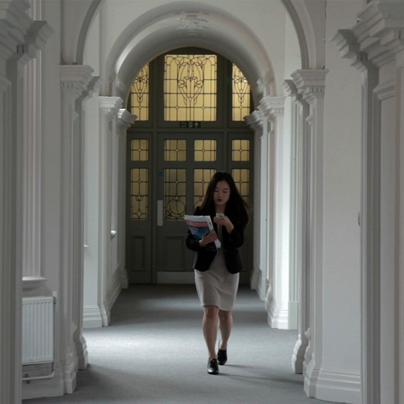
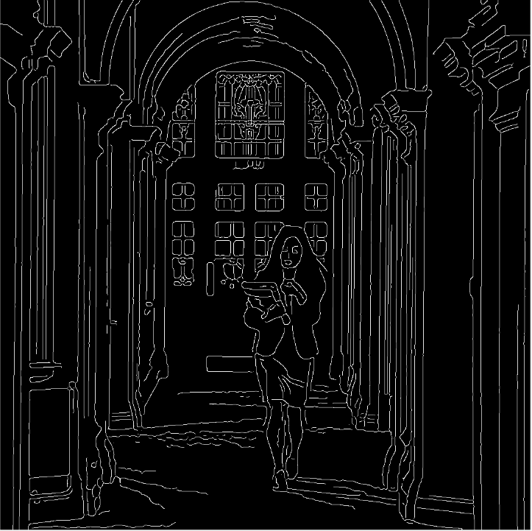
Final Canny Edges
$$σ=\sqrt{2}, t_{low}=0.05,t_{high}=0.1$$

Slide 4
Live Canny edge detector

Slide 5
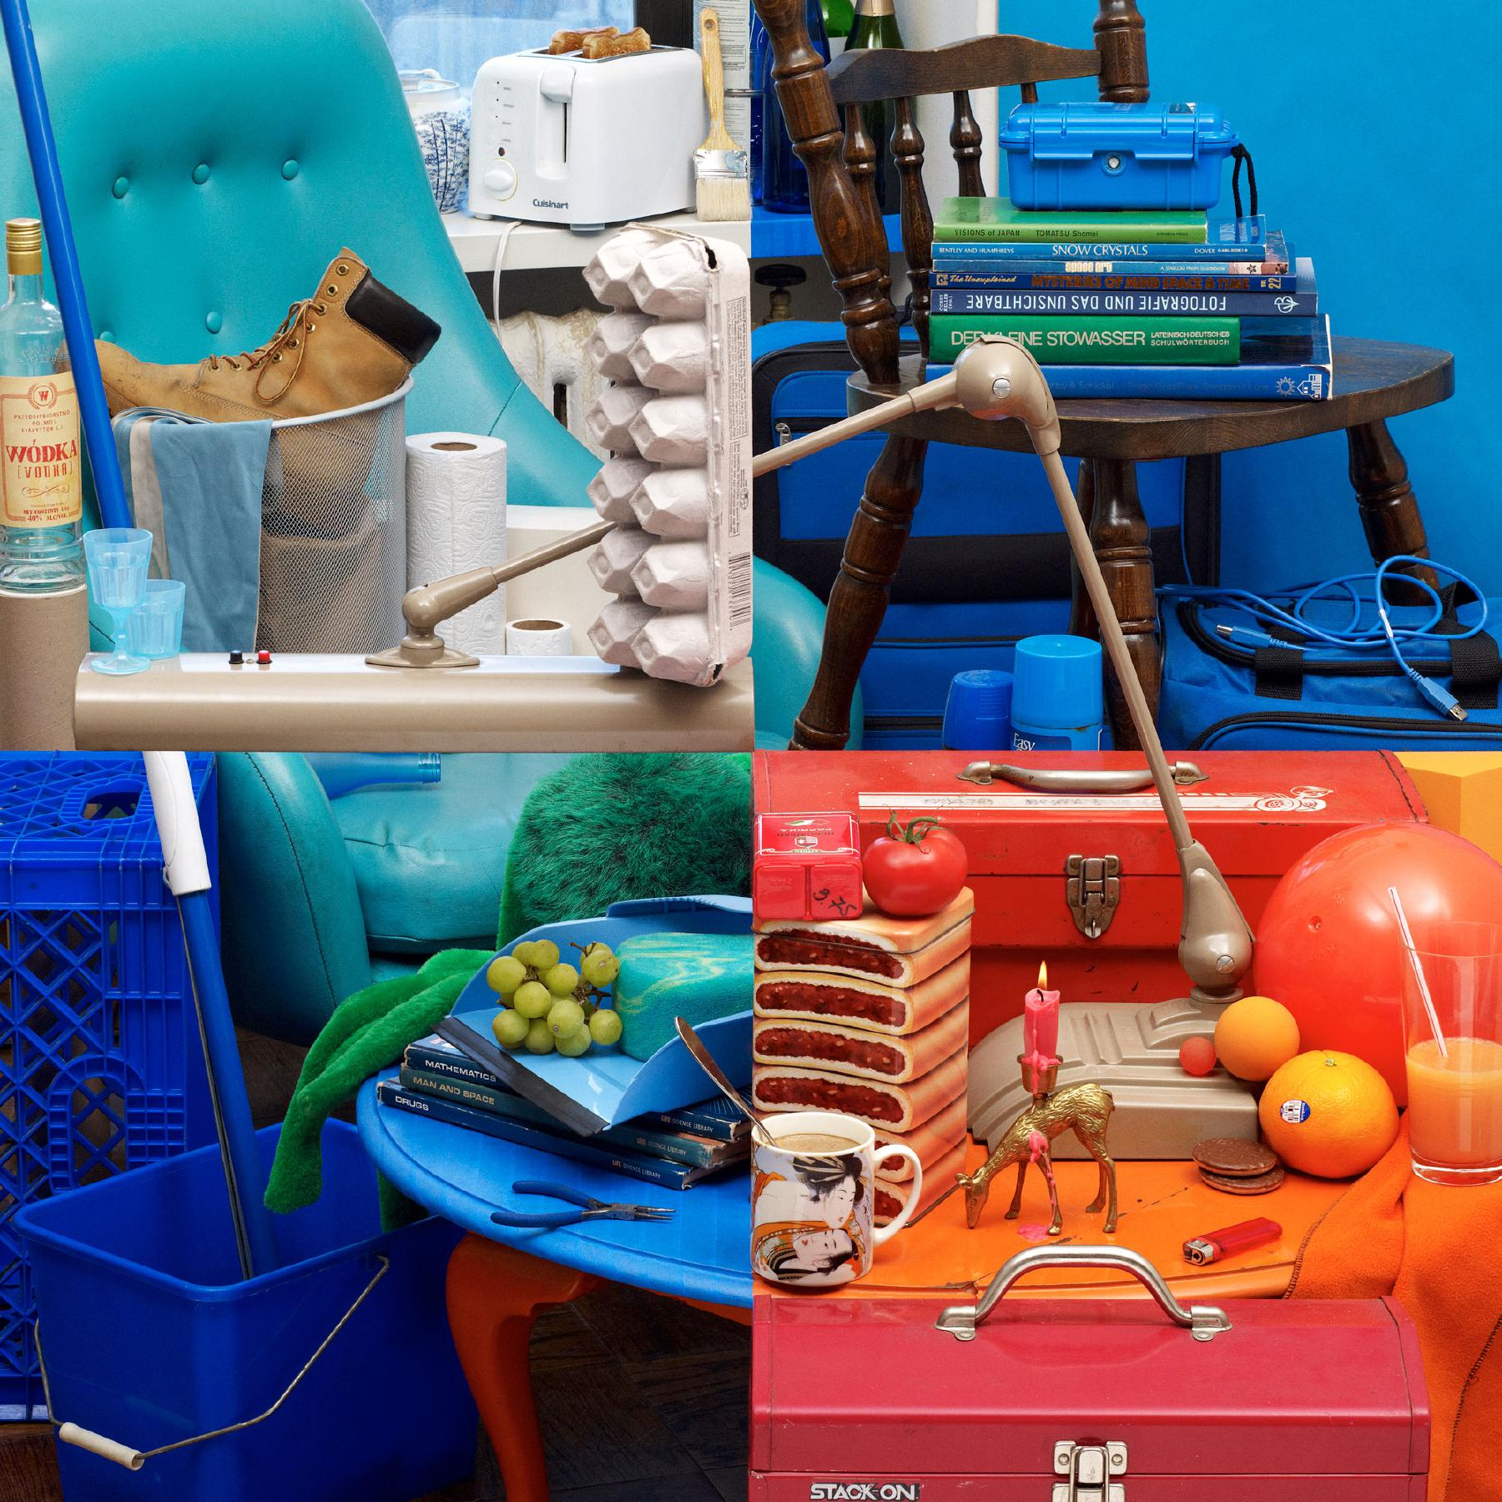
Bela Borsodi
Notes:
To start us off, let’s look at these four colorful images.
Think for a minute - what can you tell me about the differences between these images?
http://www.belaborsodi.com/

Slide 6
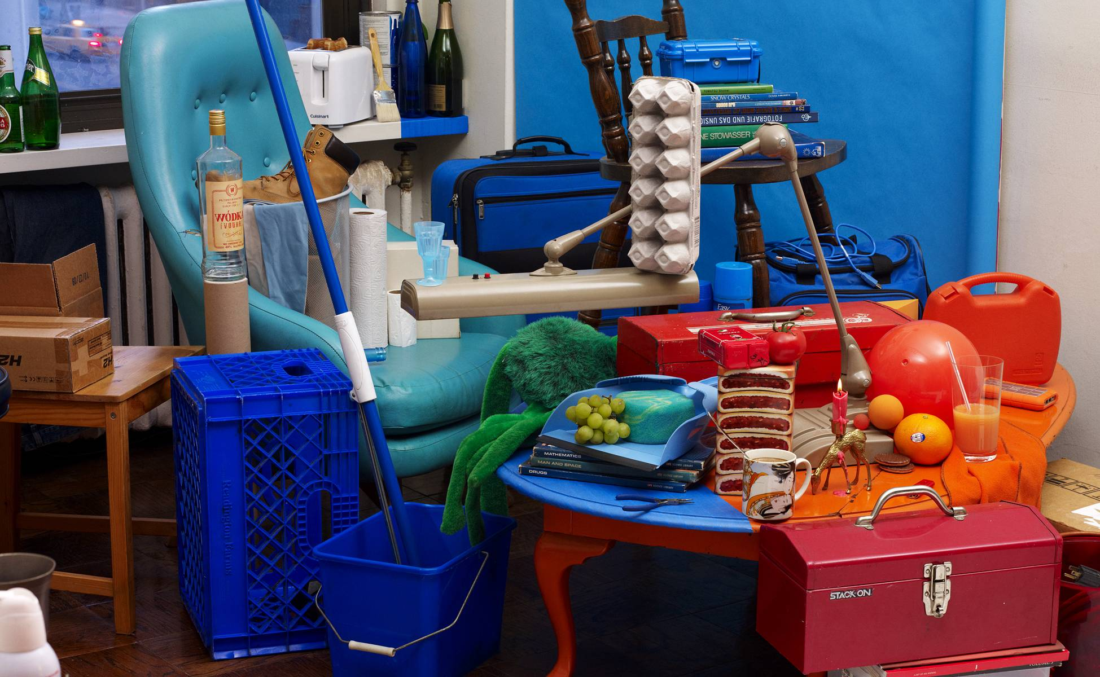
Bela Borsodi
Notes:
Major trick. The scene was arranged by looking through the viewfinder of the camera, which, as like the image, offers a fixed perspective which makes this possible.
http://youtube.com/watch?v=oJGN6sX5Ekg
Later on, we’re going to

Slide 7
Anatomy
But what is color?

Slide 8
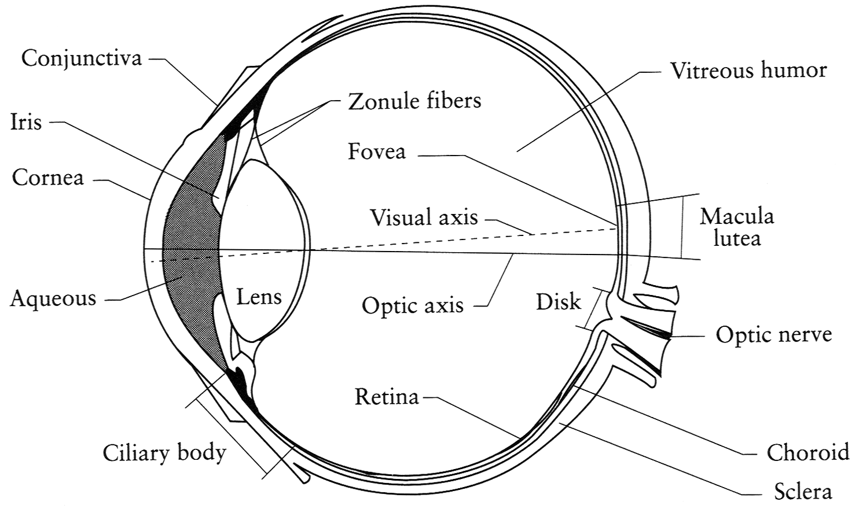
The Eye
The human eye is a camera!
  Iris - colored annulus with radial muscles
  Pupil - the hole (aperture) whose size is controlled by the iris
  What’s the “film”?
    photoreceptor cells (rods and cones) in the retina
Slide by Steve Seitz

Slide 9
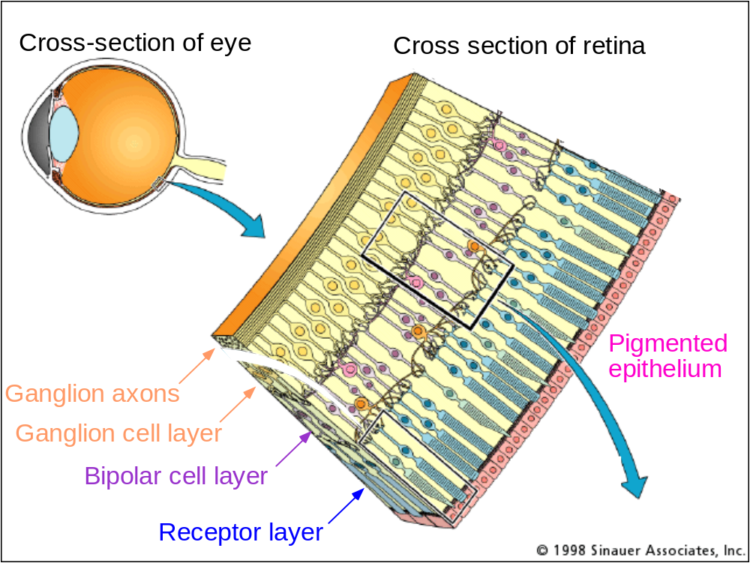
The Retina

Slide 10
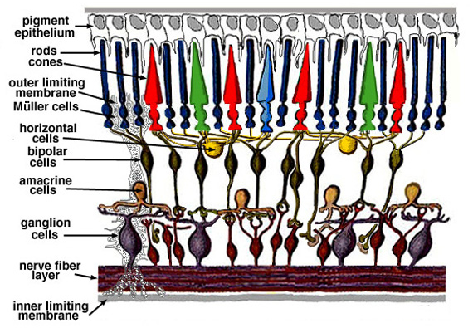
Retina up-close
Light
Notes:
Tapetum lucidum

Slide 11
Wait, the blood vessels are in front of the photoreceptors??
https://www.youtube.com/watch?v=L_W-IXqoxHA
Notes:
Yes, and you can see them!

Slide 12
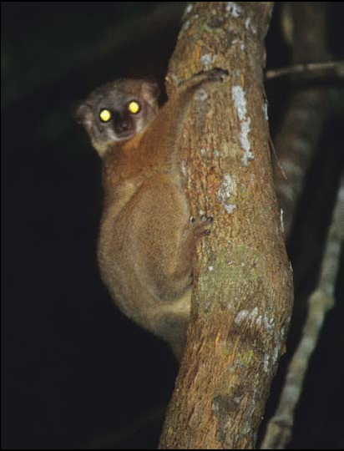
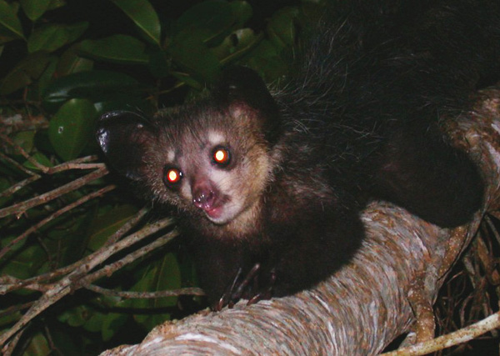
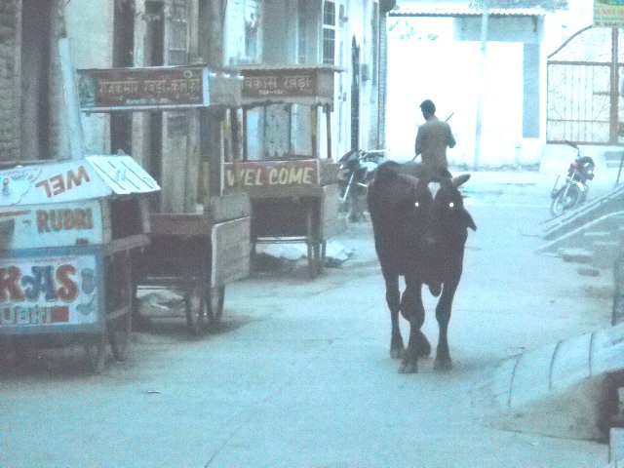
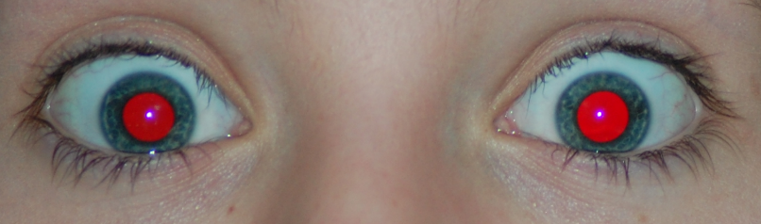
What humans don’t have: tapetum lucidum
Human eyes can reflect a tiny bit and blood in the retina makes this reflection red.
James Hays
Notes:
Animals with Tapetum Lucidum also have RPE, just not in the same part of the eye.
The tapetum lucidum /təˈpiːtəm/ (Latin: "bright tapestry; coverlet", plural tapeta lucida)^{[1]} is a layer of tissue in the eye of many vertebrates.^{[2]} Lying immediately behind the retina, it reflects visible light back through the retina, increasing the light available to the photoreceptors, though blurring the initial image of the light on focus. The tapetum lucidum contributes to the superior night vision of some animals. Many of these animals are nocturnal, especially carnivores that hunt their prey at night, while others are deep sea animals.

Slide 13
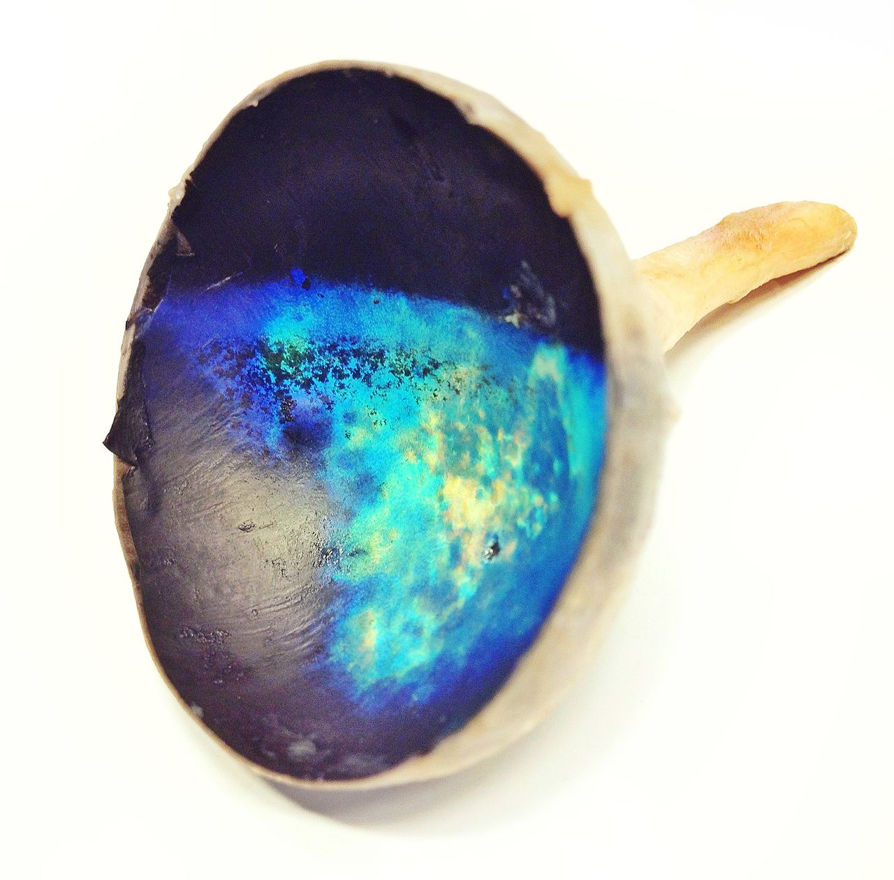
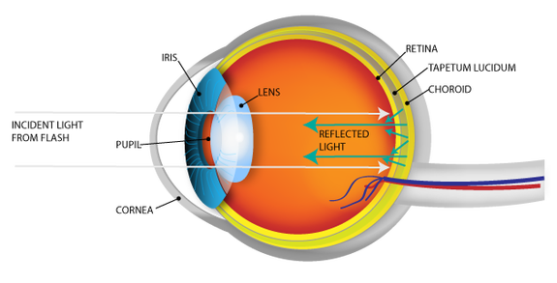
Tapetum lucidum exposed (cow eye)
Notes:
Image on the right is a photo of a tapetum lucidum from a cow.

Slide 14
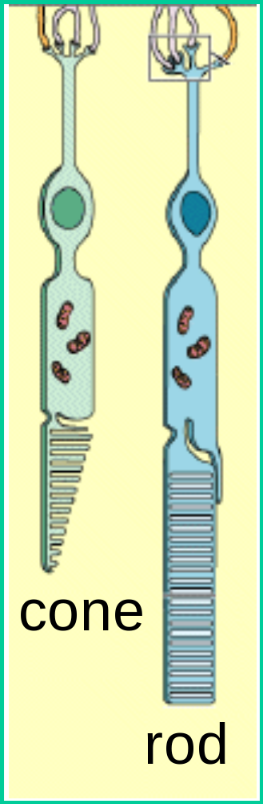
Two types of light-sensitive receptors
Cones
cone-shaped
less sensitive
operate in high light
color vision
Rods
rod-shaped
highly sensitive
operate at night
gray-scale vision
© Stephen E. Palmer, 2002

Slide 15
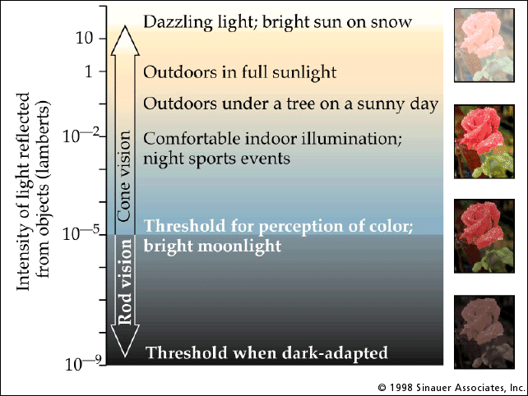
Rod / Cone sensitivity

Slide 16
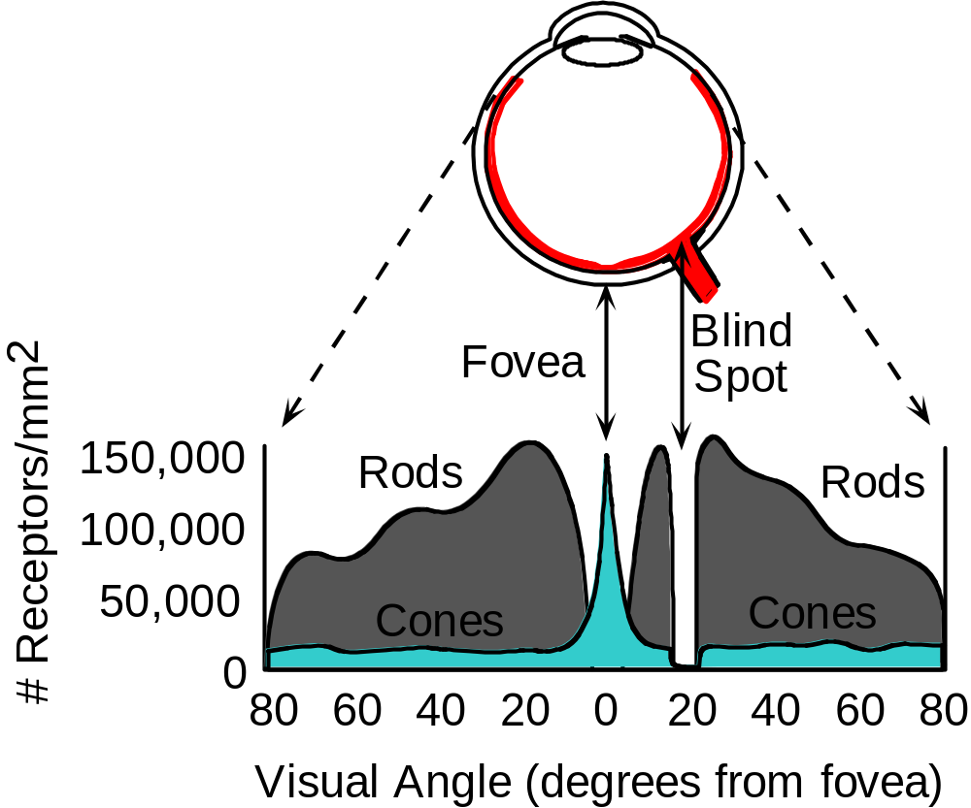
Distribution of Rods and Cones
Night Sky: why are there more stars off-center?
Averted vision: http://en.wikipedia.org/wiki/Averted_vision
© Stephen E. Palmer, 2002

Slide 17
Eye Movements
Saccades
Can be consciously controlled. Related to perceptual attention.
200ms to initiation, 20 to 200ms to carry out. Large amplitude.
Microsaccades
Involuntary. Smaller amplitude. Especially evident during prolonged fixation. Function debated.
Ocular microtremor (OMT)
Involuntary. High frequency (up to 80Hz), small amplitude.
Smooth pursuit – tracking an object

Slide 18
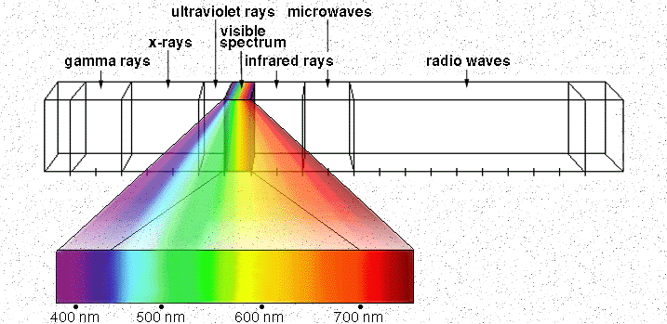
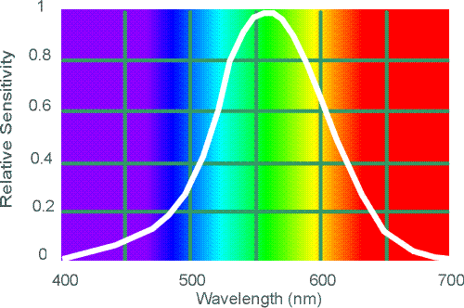
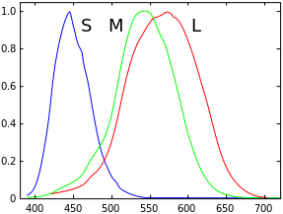
Electromagnetic Spectrum
Relative sensitivity
Human Luminance Sensitivity Function
http://www.yorku.ca/eye/photopik.htm
Wavelength (nm)
Notes:
At least 3 spectral bands required (e.g. R,G,B)

Slide 19
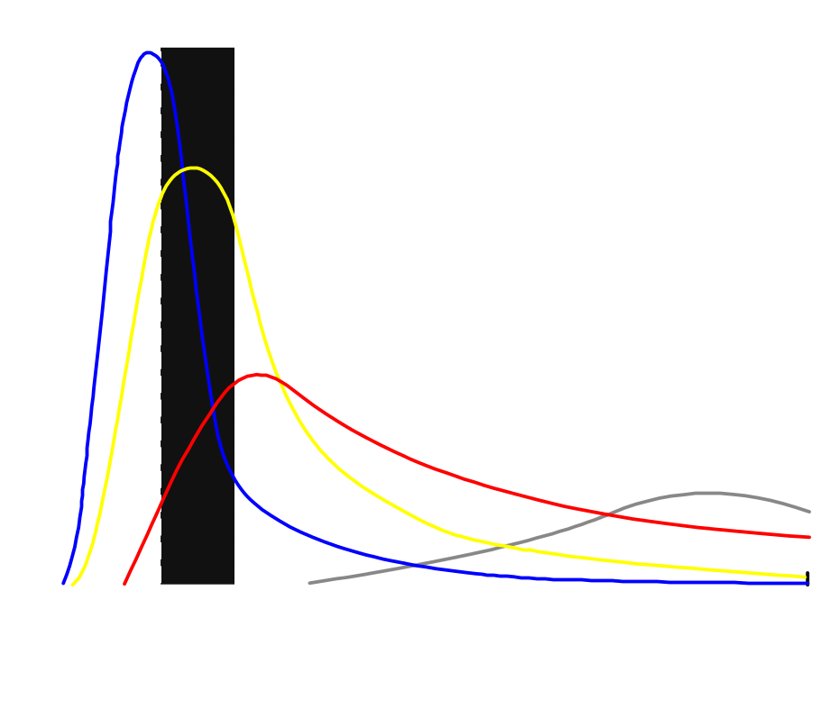
Visible Light
Why do we see light of these wavelengths?
…because that’s where the
Sun radiates EM energy
© Stephen E. Palmer, 2002

Slide 20
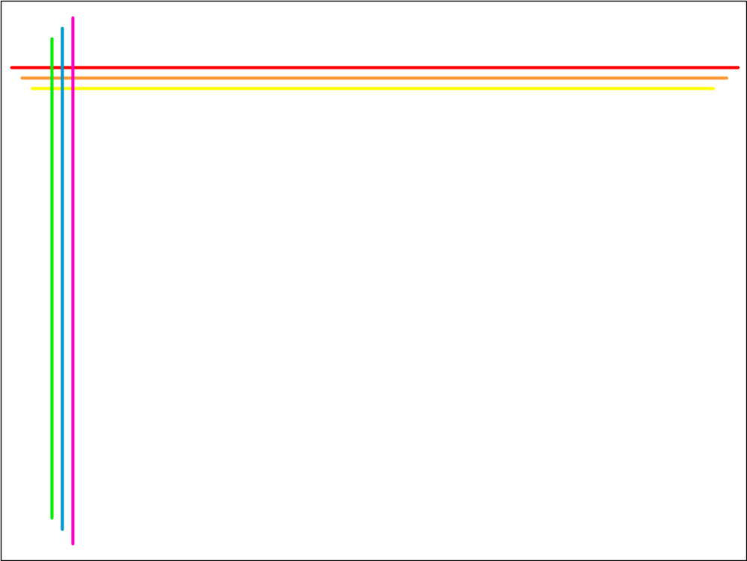
The Physics of Light
Any patch of light can be completely described
physically by its spectrum: the number of photons
(per time unit) at each wavelength 400 - 700 nm.
© Stephen E. Palmer, 2002

Slide 21
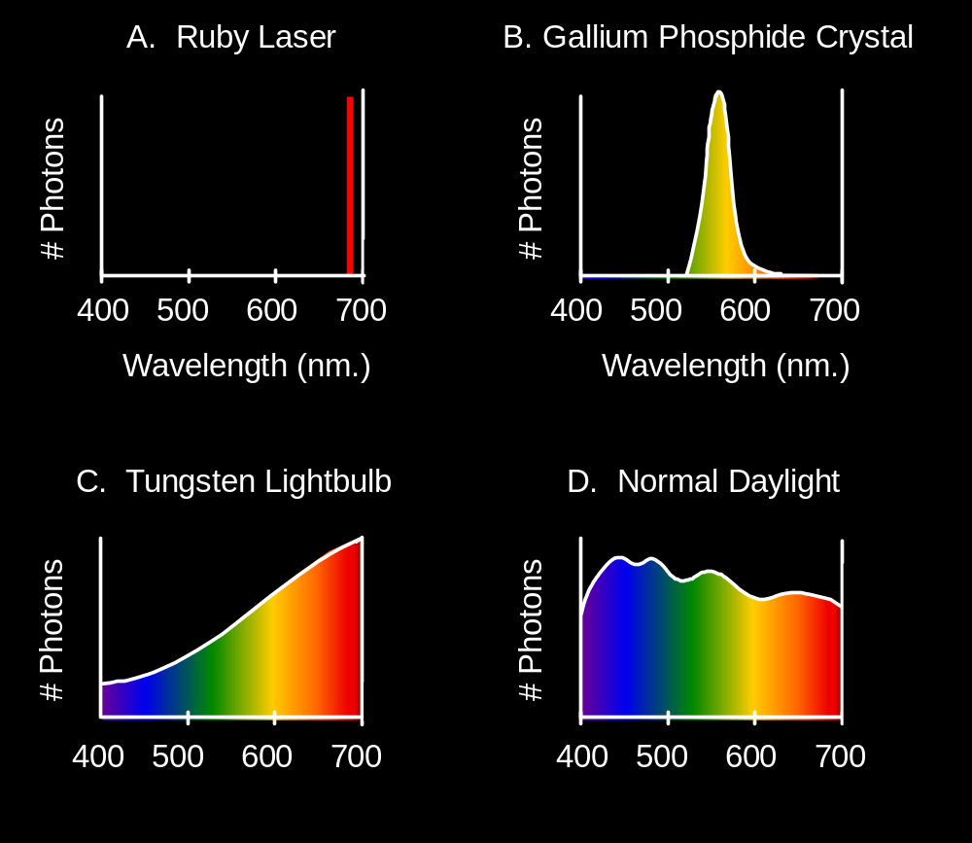
The Physics of Light
Some examples of the spectra of light sources
© Stephen E. Palmer, 2002

Slide 22
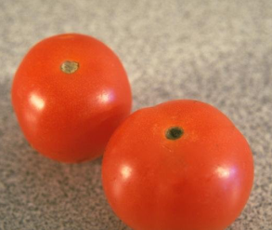
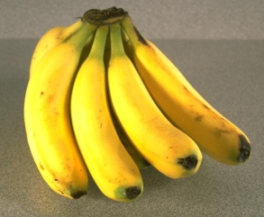
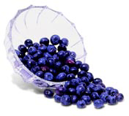
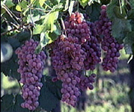
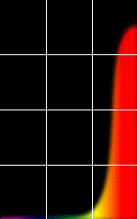
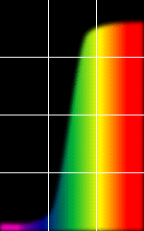
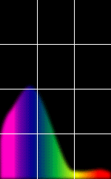
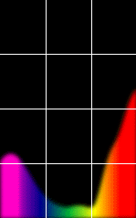
The Physics of Light
Some examples of the reflectance spectra of surfaces
Red
Yellow
Blue
Purple
% Photons Reflected
400 700
400 700
400 700
400 700
Wavelength (nm)
© Stephen E. Palmer, 2002

Slide 23

The Psychophysical Correspondence
There is no simple functional description for the perceived
color of all lights under all viewing conditions, but …...
A helpful constraint:
Consider only physical spectra with normal distributions
mean
area
variance
© Stephen E. Palmer, 2002
Notes:
Psychophysics -> the branch of psychology that deals with the relationships between physical stimuli and mental phenomena.

Slide 24
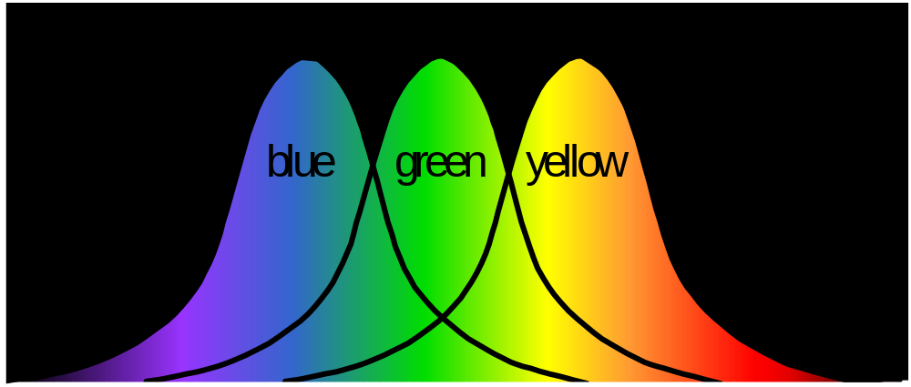
The Psychophysical Correspondence
Mean
Hue
# Photons
Wavelength
© Stephen E. Palmer, 2002

Slide 25

The Psychophysical Correspondence
Variance
Saturation
# Photons
Wavelength
© Stephen E. Palmer, 2002

Slide 26
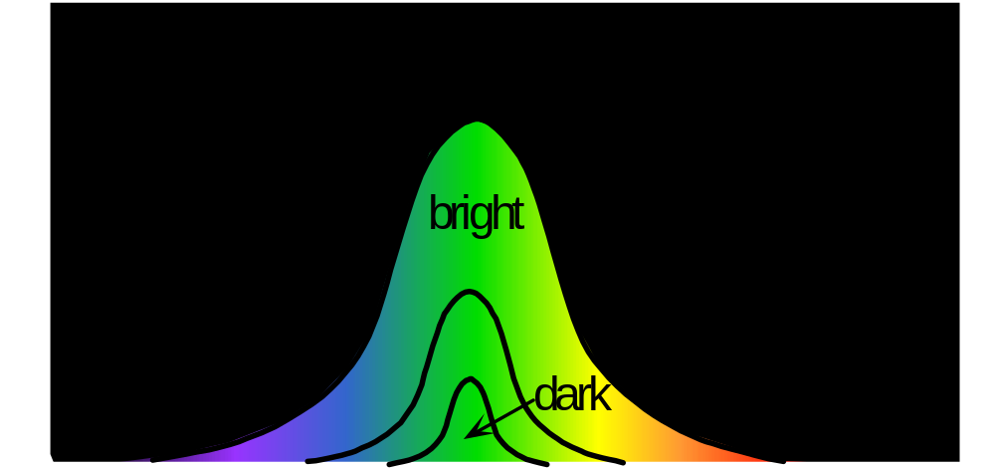
The Psychophysical Correspondence
Area
Brightness
# Photons
Wavelength
© Stephen E. Palmer, 2002

Slide 27
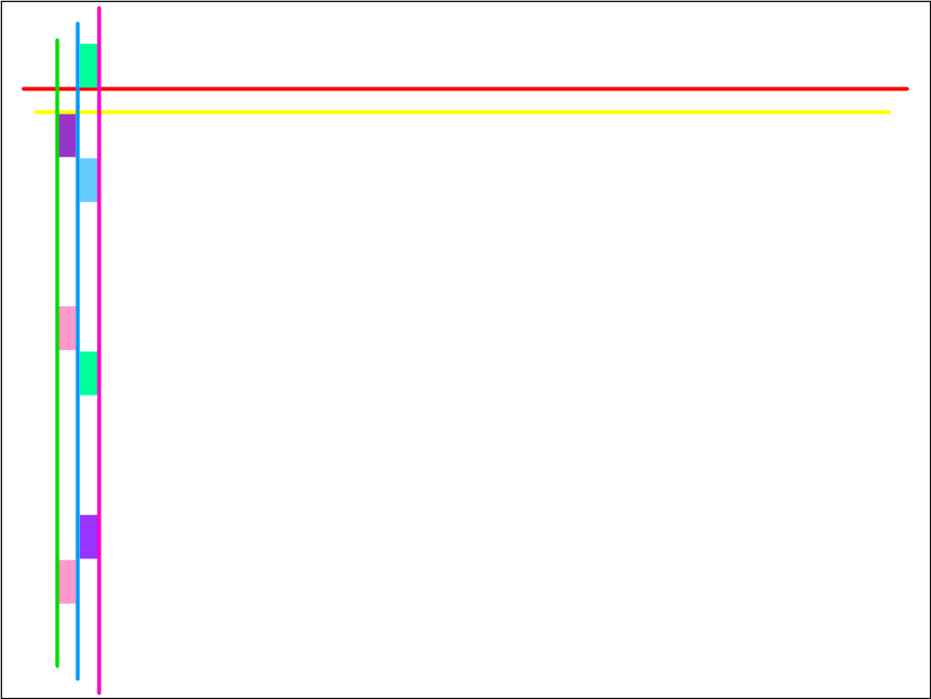
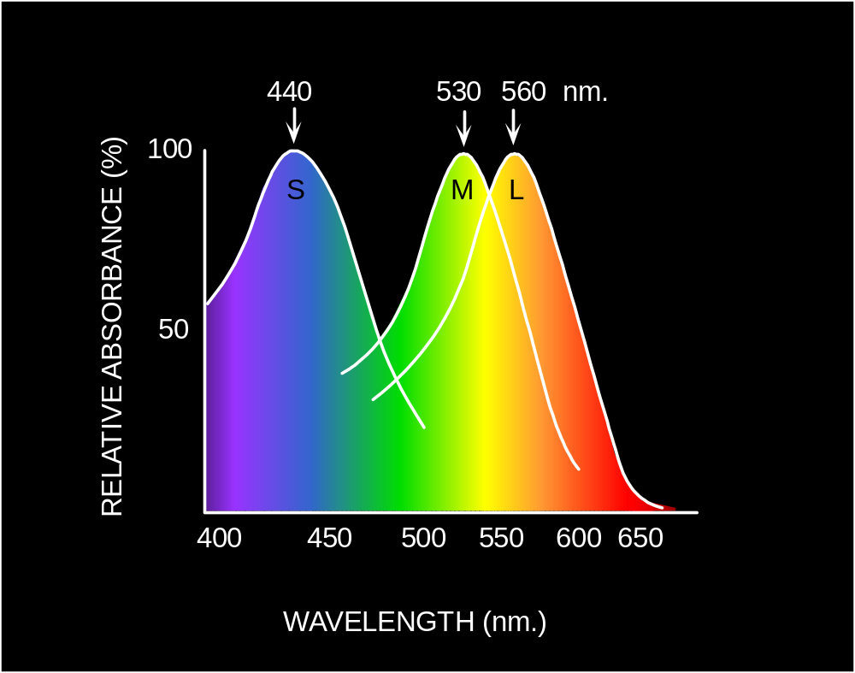
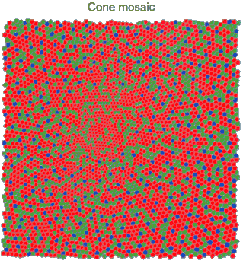
Physiology of Color Vision
Three kinds of cones:
Why are M and L cones so close?
Why are there 3?
© Stephen E. Palmer, 2002

Slide 28
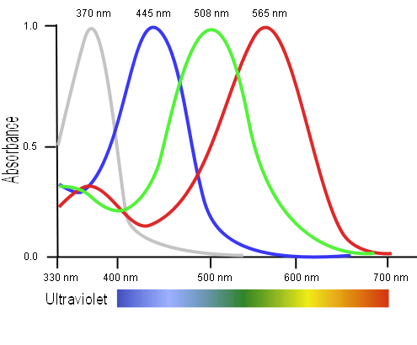
Tetrachromatism
Bird cone responses
Most birds, and many other animals, have cones for ultraviolet light.
Some humans, mostly female, seem to have slight tetrachromatism.

Slide 29
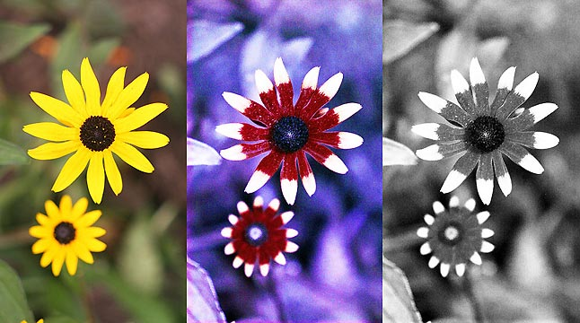
Bee vision
Notes:
Does color exist?
http://www.askamathematician.com/2012/06/q-do-colors-exist/
http://www.radiolab.org/story/211178-rip-rainbow/

Slide 30
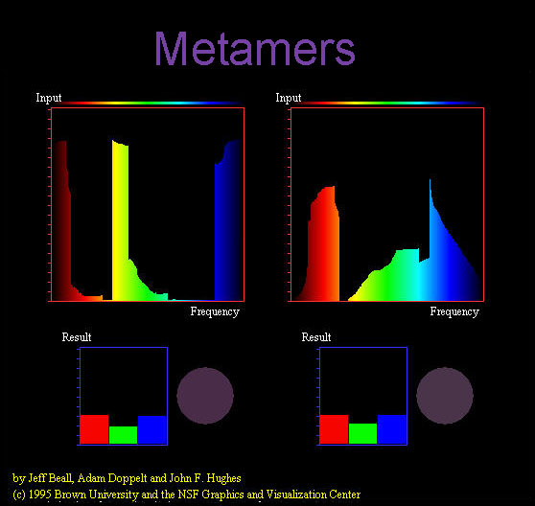
Notes:
Does color exist?

Slide 31
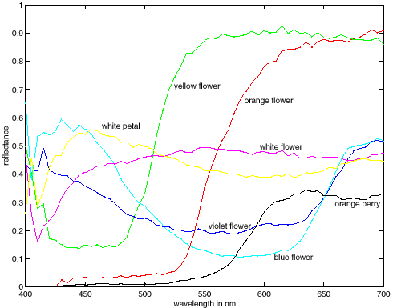
More Spectra
metamers
Notes:
Metamerism can be illuminant based or observer based. Color blindness produced well known instances of metamerism.

Slide 32
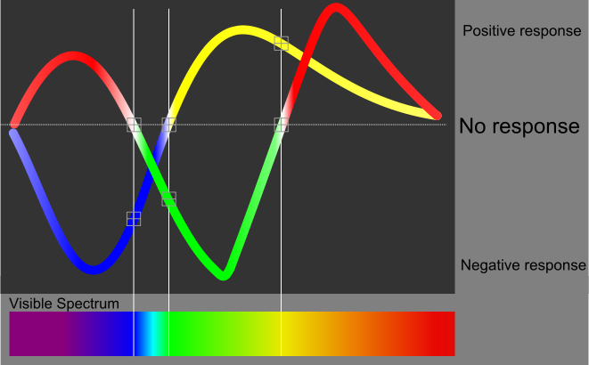
Impossible Colors
Can we make the cones respond in ways that typical light spectra never would?
http://en.wikipedia.org/wiki/Impossible_colors
Relative sensitivity
Wavelength (nm)
Notes:
The human eye's red-to-green and blue-to-yellow values of each one-wavelength visible color

Slide 33

Impossible Colors
Can we make the cones respond in ways that typical light spectra never would?
http://en.wikipedia.org/wiki/Impossible_colors
James Hays

Slide 34
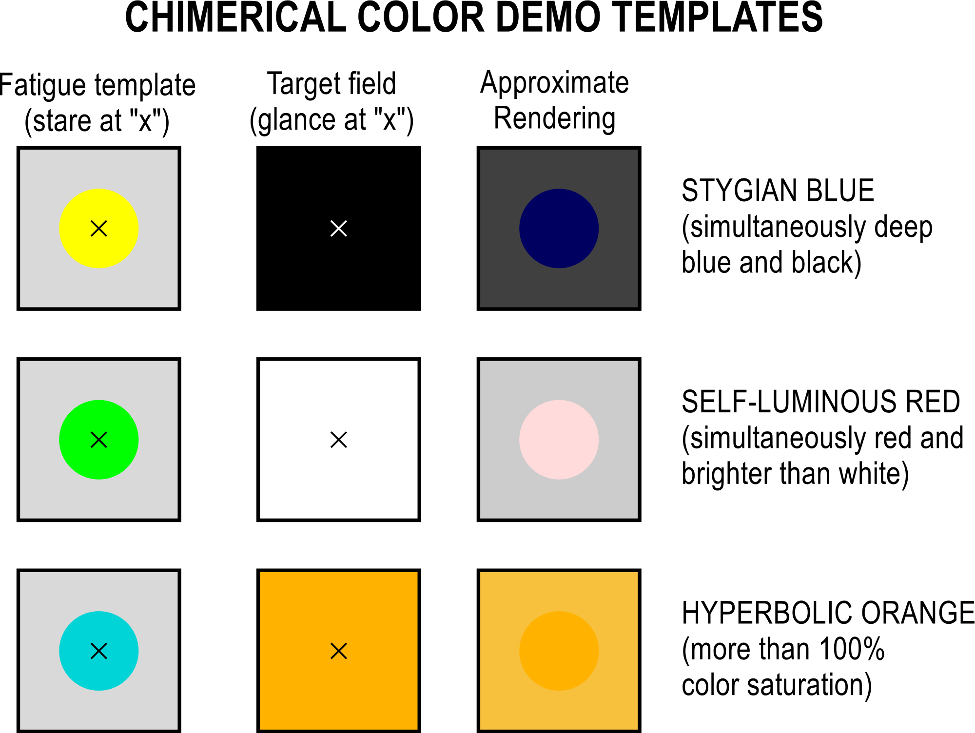
Notes:
By staring at a "fatigue template" for 20-60 seconds, then switching to a neutral target, it is possible to view "impossible" colors.

Slide 35
What is color?
Why do we even care about human vision in this class?
Notes:
Does color exist?

Slide 36
Why do we care about human vision?
We don’t, necessarily.
But biological vision informs how we might efficiently represent images computationally.
James Hays

Slide 37
Why do we care about human vision?
We don’t, necessarily.
But biological vision informs how we might efficiently represent images computationally.
It’s a human world -> cameras imitate the frequency response of the human eye to try to see as we see.

Slide 38
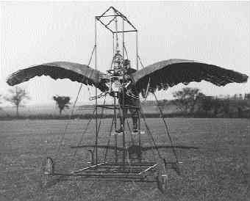
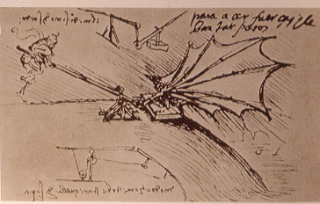
Ornithopters
James Hays

Slide 39
"Can machines fly like a bird?"
No, because airplanes don’t flap.
"Can machines fly?"
Yes, but airplanes use a different mechanism.
"Can machines perceive?"
Is this question like the first, or like the second?
Adapted from Peter Norvig
Notes:
Norvig – director of research at Google; Brown alumnus (applied math)

Slide 40
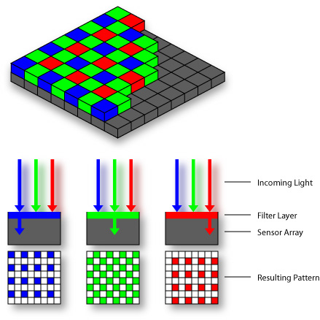

Practical Color Sensing: Bayer Grid
Estimate RGB
at ‘G’ cells from neighboring values
Slide by Steve Seitz

Slide 41
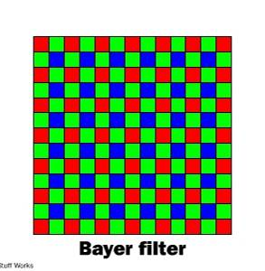
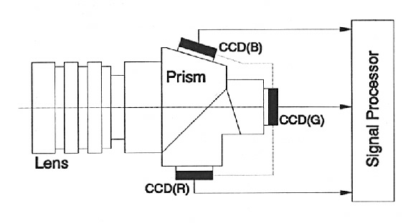
Color Sensing in Camera (RGB)
3-chip vs. 1-chip: quality vs. cost
Why more green?
Why 3 colors?
http://www.cooldictionary.com/words/Bayer-filter.wikipedia
Slide by Steve Seitz

Slide 42
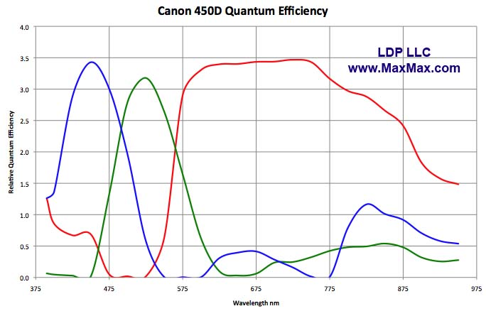
Example Camera Color Response
MaxMax.com
Notes:
https://www.quora.com/Why-is-there-a-significant-difference-between-image-sensors-and-human-eyes-Spectral-response
http://www.maxmax.com/ndvi_camera_technical.htm
http://www.maxmax.com/faq/camera-tech/spectral-response
NOTE the strong response into long wavelengths (near IR). Many camera sensors can see into infrared range, but the lens system includes an IR low-pass filter which blocks incoming IR light.

Slide 43
Human sensitivity
Human tri-stimulus sensitivity functions
Relative sensitivity
Wavelength (nm)

Slide 44
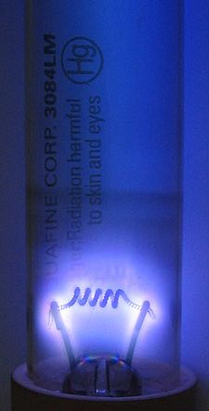
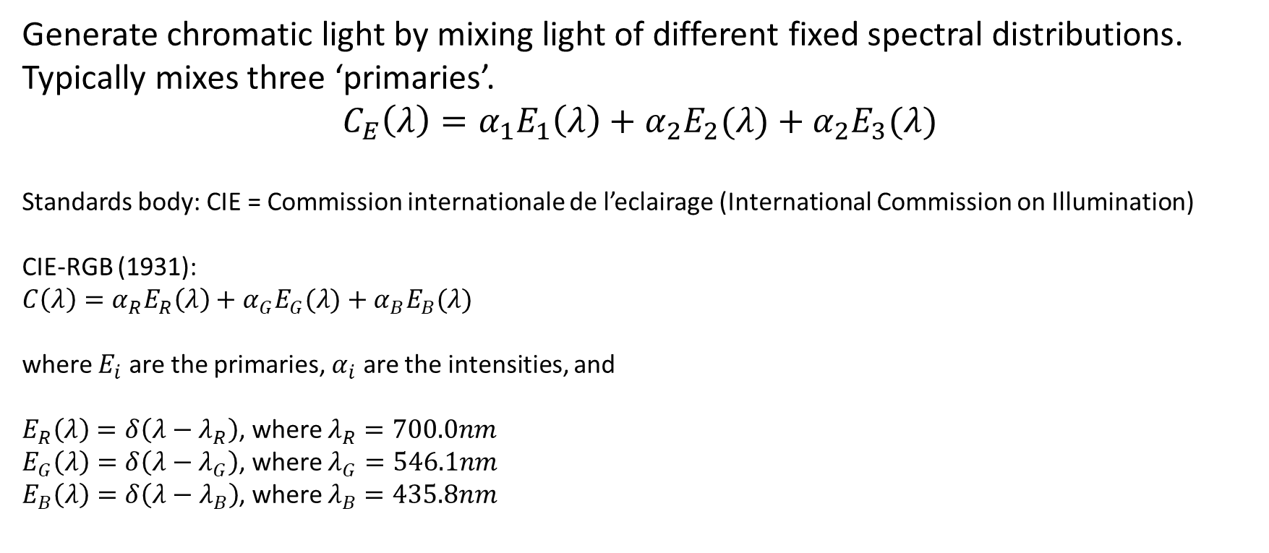
Primaries (basis) for a camera or display
Generate chromatic light by mixing light of different fixed spectral distributions. Typically mixes three ‘primaries’.
$$C_{E}\left(λ\right)=α_{1}E_{1}\left(λ\right)+α_{2}E_{2}(λ)+α_{2}E_{3}(λ)$$
Standards body: CIE = Commission internationale de l’eclairage (International Commission on Illumination)
CIE-RGB (1931):
$$C\left(λ\right)=α_{R}E_{R}\left(λ\right)+α_{G}E_{G}(λ)+α_{B}E_{B}(λ)$$
where $E_{i}$ are the primaries, $α_{i}$ are the intensities, and
$E_{R}\left(λ\right)=δ\left(λ−λ_{R}\right)$, where $λ_{R}=700.0nm$
$E_{G}\left(λ\right)=δ\left(λ−λ_{G}\right)$, where $λ_{G}=546.1nm$
$E_{B}\left(λ\right)=δ\left(λ−λ_{B}\right)$, where $λ_{B}=435.8nm$
Why 700nm?
Eye response is consistent around this wavelength, e.g., robust to display noise in nm output
Why these?
Easily reproduced accurately by mercury vapor gas-discharge lamp
[UCL CS APMA 2010; Wikipedia]

Slide 45
CIE XYZ (1931)
All color sensations that are visible to a human with average eyesight.
  Derived from experimentation.
Y is luminance -> brightness
X,Z plane contains all possible chromaticities for a given Y luminance.
Cannot represent how objects look, or paints
- Purely how the eye will perceive light.
[UCL CS APMA 2010; Wikipedia]

Slide 46
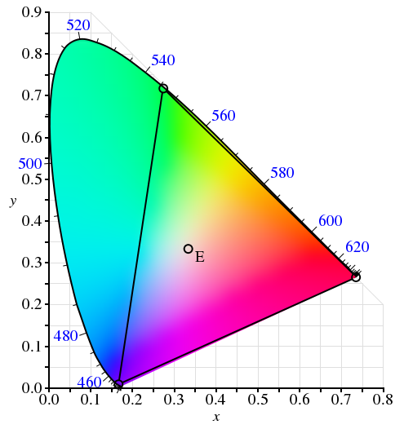

Gamut
The range of colors possible given a primary basis.
Here, CIE RGB gamut is embedded as a color triangle within the CIE XYZ gamut of the human eye.
Where in diagram:
$$x=\frac{X}{X+Y+Z}$$
$$y=\frac{Y}{X+Y+Z}$$
[UCL CS APMA 2010; Wikipedia]
Notes:
This gamut is for a given (arbitrary) luminance, the Y of CIE XYZ, as it only represents color and not brightness/intensity or saturation.
NOTICE how much of the visible spectrum is not represented by CIE-RGB!!
Dot in middle is D65 white point (what is D65? A ‘color temperature’, e.g., a color which is said to be white.)

Slide 47

Another example
The gamut of sRGB.
- Common standard for images if no profile is known.
Around the outer curve are the light wavelengths in nanometers – 380 to 700 nm.
[UCL CS APMA 2010; Wikipedia]
Notes:
How was XYZ measured?
“The observer would alter the brightness of each of the three primary beams until a match to the test color was observed. Not all test colors could be matched using this technique. When this was the case, a variable amount of one of the primaries could be added to the test color, and a match with the remaining two primaries was carried out with the variable color spot. For these cases, the amount of the primary added to the test color was considered to be a negative value. In this way, the entire range of human color perception could be covered. When the test colors were monochromatic, a plot could be made of the amount of each primary used as a function of the wavelength of the test color. These three functions are called the color matching functions for that particular experiment. “
[Wikipedia]

Slide 48

But this CIE RGB basis has some problems…
The color matching functions are the amounts of primaries needed to match the monochromatic test color at the wavelength shown on the horizontal scale.
The CIE 1931 RGB color matching functions.
NOTE – we need _negative_ amounts of red! This means that it is impossible to display certain perceptual colors using CIE RGB emissive displays, hence why the gamut cannot show all colors.
What does this say about human perception?
Relative power
[UCL CS APMA 2010; Wikipedia]

Slide 49




Color Image
R
G
B

Slide 50
Images in Matlab
Images represented as a matrix
Suppose we have a NxM RGB image called “im”
  im(1,1,1) = top-left pixel value in R-channel
  im(y, x, b) = y pixels down, x pixels to right in the b^{th} channel
  im(N, M, 3) = bottom-right pixel in B-channel
imread(filename) returns a uint8 image (values 0 to 255)
  Convert to double format (values 0 to 1) with im2double
column
row
R
0.92 | 0.93 | 0.94 | 0.97 | 0.62 | 0.37 | 0.85 | 0.97 | 0.93 | 0.92 | 0.99
0.95 | 0.89 | 0.82 | 0.89 | 0.56 | 0.31 | 0.75 | 0.92 | 0.81 | 0.95 | 0.91
0.89 | 0.72 | 0.51 | 0.55 | 0.51 | 0.42 | 0.57 | 0.41 | 0.49 | 0.91 | 0.92
0.96 | 0.95 | 0.88 | 0.94 | 0.56 | 0.46 | 0.91 | 0.87 | 0.90 | 0.97 | 0.95
0.71 | 0.81 | 0.81 | 0.87 | 0.57 | 0.37 | 0.80 | 0.88 | 0.89 | 0.79 | 0.85
0.49 | 0.62 | 0.60 | 0.58 | 0.50 | 0.60 | 0.58 | 0.50 | 0.61 | 0.45 | 0.33
0.86 | 0.84 | 0.74 | 0.58 | 0.51 | 0.39 | 0.73 | 0.92 | 0.91 | 0.49 | 0.74
0.96 | 0.67 | 0.54 | 0.85 | 0.48 | 0.37 | 0.88 | 0.90 | 0.94 | 0.82 | 0.93
0.69 | 0.49 | 0.56 | 0.66 | 0.43 | 0.42 | 0.77 | 0.73 | 0.71 | 0.90 | 0.99
0.79 | 0.73 | 0.90 | 0.67 | 0.33 | 0.61 | 0.69 | 0.79 | 0.73 | 0.93 | 0.97
0.91 | 0.94 | 0.89 | 0.49 | 0.41 | 0.78 | 0.78 | 0.77 | 0.89 | 0.99 | 0.93
G
0.92 | 0.93 | 0.94 | 0.97 | 0.62 | 0.37 | 0.85 | 0.97 | 0.93 | 0.92 | 0.99
0.95 | 0.89 | 0.82 | 0.89 | 0.56 | 0.31 | 0.75 | 0.92 | 0.81 | 0.95 | 0.91
0.89 | 0.72 | 0.51 | 0.55 | 0.51 | 0.42 | 0.57 | 0.41 | 0.49 | 0.91 | 0.92
0.96 | 0.95 | 0.88 | 0.94 | 0.56 | 0.46 | 0.91 | 0.87 | 0.90 | 0.97 | 0.95
0.71 | 0.81 | 0.81 | 0.87 | 0.57 | 0.37 | 0.80 | 0.88 | 0.89 | 0.79 | 0.85
0.49 | 0.62 | 0.60 | 0.58 | 0.50 | 0.60 | 0.58 | 0.50 | 0.61 | 0.45 | 0.33
0.86 | 0.84 | 0.74 | 0.58 | 0.51 | 0.39 | 0.73 | 0.92 | 0.91 | 0.49 | 0.74
0.96 | 0.67 | 0.54 | 0.85 | 0.48 | 0.37 | 0.88 | 0.90 | 0.94 | 0.82 | 0.93
0.69 | 0.49 | 0.56 | 0.66 | 0.43 | 0.42 | 0.77 | 0.73 | 0.71 | 0.90 | 0.99
0.79 | 0.73 | 0.90 | 0.67 | 0.33 | 0.61 | 0.69 | 0.79 | 0.73 | 0.93 | 0.97
0.91 | 0.94 | 0.89 | 0.49 | 0.41 | 0.78 | 0.78 | 0.77 | 0.89 | 0.99 | 0.93
B
0.92 | 0.93 | 0.94 | 0.97 | 0.62 | 0.37 | 0.85 | 0.97 | 0.93 | 0.92 | 0.99
0.95 | 0.89 | 0.82 | 0.89 | 0.56 | 0.31 | 0.75 | 0.92 | 0.81 | 0.95 | 0.91
0.89 | 0.72 | 0.51 | 0.55 | 0.51 | 0.42 | 0.57 | 0.41 | 0.49 | 0.91 | 0.92
0.96 | 0.95 | 0.88 | 0.94 | 0.56 | 0.46 | 0.91 | 0.87 | 0.90 | 0.97 | 0.95
0.71 | 0.81 | 0.81 | 0.87 | 0.57 | 0.37 | 0.80 | 0.88 | 0.89 | 0.79 | 0.85
0.49 | 0.62 | 0.60 | 0.58 | 0.50 | 0.60 | 0.58 | 0.50 | 0.61 | 0.45 | 0.33
0.86 | 0.84 | 0.74 | 0.58 | 0.51 | 0.39 | 0.73 | 0.92 | 0.91 | 0.49 | 0.74
0.96 | 0.67 | 0.54 | 0.85 | 0.48 | 0.37 | 0.88 | 0.90 | 0.94 | 0.82 | 0.93
0.69 | 0.49 | 0.56 | 0.66 | 0.43 | 0.42 | 0.77 | 0.73 | 0.71 | 0.90 | 0.99
0.79 | 0.73 | 0.90 | 0.67 | 0.33 | 0.61 | 0.69 | 0.79 | 0.73 | 0.93 | 0.97
0.91 | 0.94 | 0.89 | 0.49 | 0.41 | 0.78 | 0.78 | 0.77 | 0.89 | 0.99 | 0.93

Slide 51

Color spaces
How can we represent color?
http://en.wikipedia.org/wiki/File:RGB_illumination.jpg

Slide 52





Color spaces: RGB
Default color space
0,1,0
R
(G=0,B=0)
1,0,0
G
(R=0,B=0)
0,0,1
B
(R=0,G=0)
Some drawbacks
Strongly correlated channels
Non-perceptual
Image from: http://en.wikipedia.org/wiki/File:RGB_color_solid_cube.png

Slide 53
Is color a vector space?
Think-Pair-Share
Got it. C = r*R + g*G + b*B
Notes:
https://arcsecond.wordpress.com/2008/10/06/calculoergosum/
Has certain properties of vector spaces, e.g., we can make a new basis from a different set of colors, like cyan, magenta, and yellow for instance.
But, it’s clamped at 1, and it doesn’t have negative values.

Slide 54




Color spaces: HSV
Intuitive color space
H
(S=1,V=1)
S
(H=1,V=1)
V
(H=1,S=0)

Slide 55
Is color a vector space?
Think-Pair-Share
Got it. C = r*R + g*G + b*B
Notes:
https://arcsecond.wordpress.com/2008/10/06/calculoergosum/
Has certain properties of vector spaces, e.g., we can make a new basis from a different set of colors, like cyan, magenta, and yellow for instance.
But, it’s clamped at 1, and it doesn’t have negative values.

Slide 56
Color spaces: HSV
Intuitive color space

Slide 57
If you had to choose, would you rather have:
- intensity (‘value’), or
- hue + saturation (‘chroma’)?
Think-Pair-Share
James Hays
Notes:
Think Pair Share

Slide 58
If you had to choose, would you rather go without luminance or chrominance?

Slide 59

Most information in intensity
Only color shown – constant intensity
James Hays

Slide 60

Most information in intensity
Only intensity shown – constant color
James Hays

Slide 61
Most information in intensity
Original image
James Hays

Slide 62
Color spaces: HSV
Intuitive color space
H
(S=1,V=1)
S
(H=1,V=1)
V
(H=1,S=0)
James Hays

Slide 63






Color spaces: YCbCr (YUV)
Fast to compute, good for compression, used by TV
Y=0
Y=0.5
Y
(Cb=0.5,Cr=0.5)
Cr
Cb
(Y=0.5,Cr=0.5)
Cb
Y=1
Cr
(Y=0.5,Cb=05)

Slide 64

Most JPEG images & videos subsample chroma
Notes:
http://users.wfu.edu/matthews/misc/jpg_vs_gif/JpgCompTest/

Slide 65


Slide 66

Notes:
Mapping linear scales to hue does not produce smooth perceptual changes.
It looks like there are sharp changes across these ranges, e.g., red, yellow, green, cyan, blue, purple.
Rainbow Color Map (Still) Considered Harmful
http://people.renci.org/~borland/pdfs/RainbowColorMap_VisViewpoints.pdf

Slide 67
Rainbow color map considered harmful
Borland and Taylor
Notes:
In actual fact, these are smooth uniformly increasing functions (gradients), with no such boundaries.
Rainbow Color Map (Still) Considered Harmful
http://people.renci.org/~borland/pdfs/RainbowColorMap_VisViewpoints.pdf

Slide 68
Is color perception a vector space?

Slide 69




Color spaces: L*a*b*
“Perceptually uniform”* color space
L
(a=0,b=0)
a
(L=65,b=0)
b
(L=65,a=0)

Slide 70
Why Does color look like it
Maps smoothly to a circle?
“Intuitive” color space?
Wait a minute…

Slide 71
‘Color’ != position on EM spectrum
Our cells induce color perception
by interpreting spectra.
Most mammals are dichromats:
Lack ‘L’ cone; cannot distinguish green-red
1% of men (protanopia color blindness)
Trichromaticity evolved.
No implicit reason for effect of
extra cone to be linear.
Thanks to Cam Allen-Lloyd
Notes:
https://www.reddit.com/r/askscience/comments/1u735d/why_is_the_color_spectrum_cyclical/?st=iz4h40gv&sh=11370a3d
https://www.reddit.com/r/askscience/comments/1qjdbr/why_does_red_look_like_violet_the_color_spectrum/cddyd6t/?st=iz4h5jad&sh=6baffb3d
https://en.wikipedia.org/wiki/Trichromacy
https://en.wikipedia.org/wiki/Evolution_of_color_vision
https://en.wikipedia.org/wiki/Evolution_of_color_vision_in_primates
Cam Allen-Lloyd is a PhD student at Brown.

Slide 72
‘Color’ != position on EM spectrum
Many different ways to parameterize color.
Go ask Prof. Thomas Serre for a qualified answer.
Or…
“When some primates started growing a third cone in their retinas, the old bipolar system remained, with the third cone adding a 2nd dimension of color encoding: red versus green. since color is now encoded in a 2d space, you find that you can draw a circle of colors in that space, which when you think about the fact that wavelength is 1d is really weird.”
- aggasalk, Reddit.
Thanks to Alexander Nibley
Notes:
https://www.reddit.com/r/askscience/comments/1u735d/why_is_the_color_spectrum_cyclical/?st=iz4h40gv&sh=11370a3d
https://www.reddit.com/r/askscience/comments/1qjdbr/why_does_red_look_like_violet_the_color_spectrum/cddyd6t/?st=iz4h5jad&sh=6baffb3d
https://en.wikipedia.org/wiki/Evolution_of_color_vision
https://en.wikipedia.org/wiki/Evolution_of_color_vision_in_primates
aggasalk is a self-described
Cam Allen-Lloyd is a PhD student at Brown.

Slide 73

XKCD

Slide 74
More references
https://www.colorsystem.com/
A description of many different color systems developed through history.
Navigate from the right-hand links.
Thanks to Alex Nibley!

Slide 75

Ted Adelson’s checkerboard illusion

Slide 76

Motion illusion, rotating snakes

Slide 77

Gamma correction for perceptually uniform

Slide 78

Campbell-Robson contrast sensitivity curve
Perceptual cues in the mid-high frequencies dominate perception.
Contrast decrease (log)
Frequency increase (log)
Notes:
Ask students to look at the image and think about where the line of constant response is -

Slide 79

Clues from Human Perception
Early processing in humans filters for orientations and scales of frequency.
Early Visual Processing: Multi-scale edge and blob filters

Slide 80


Application: Hybrid Images
When we see an image from far away, we are effectively subsampling it!
A. Oliva, A. Torralba, P.G. Schyns, SIGGRAPH 2006

Slide 81

Hybrid Images
Implement image filtering to separate high and low frequencies.
Combine high frequencies and low frequencies from different images to create a scale-dependent image.
James Hays

Slide 82



Why do we get different, distance-dependent interpretations of hybrid images?
?
Hays

Slide 83

Held and Hein (1963)
Notes:
https://marom.net.technion.ac.il/files/2016/07/Held-1963.pdf
https://youtu.be/okKuKsHbKt0?t=1021

Slide 84

Notes:
http://en.wikipedia.org/wiki/Troxler%27s_fading

Slide 85

Notes:
http://en.wikipedia.org/wiki/Troxler%27s_fading

Slide 86


Slide 87

Coffer Illusion
Notes:
Coffer Illusion

Slide 88

Coffer Illusion
Notes:
Coffer Illusion
16 circles

