Slide 1
CSCI 1290: Comp Photo
Fall 2020 @ Brown University
James Tompkin
Many slides thanks to James Hays’ old CS 129 course,
along with all its acknowledgements.

Slide 2
Image filtering

Slide 3
Linear filtering: a key idea
Transformations on signals; e.g.:
  bass/treble controls on stereo
  blurring/sharpening operations in image editing
  smoothing/noise reduction in tracking
Key properties
  linearity: filter(f + g) = filter(f) + filter(g)
  shift invariance: behavior invariant to shifting the input
    delaying an audio signal
    sliding an image around
Can be modeled mathematically by convolution

Slide 4
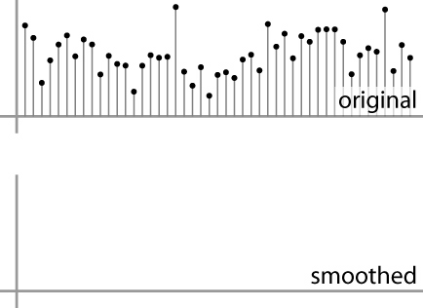
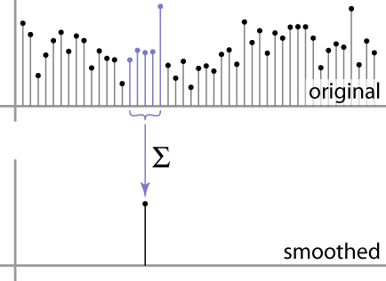
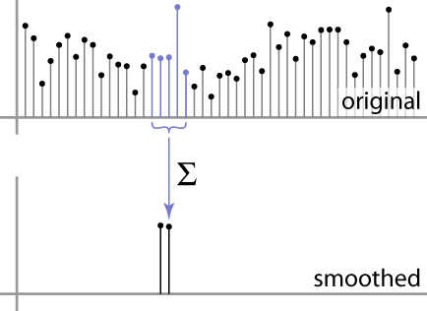
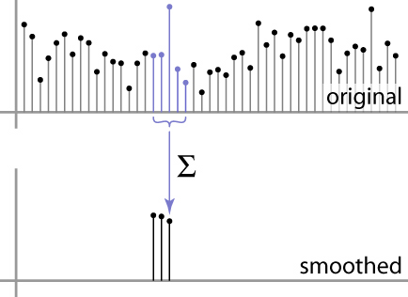
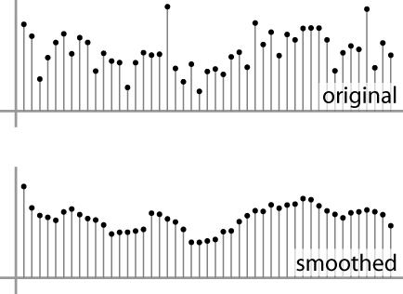
Moving Average
basic idea: define a new function by averaging over a sliding window
a simple example to start off: smoothing

Slide 5
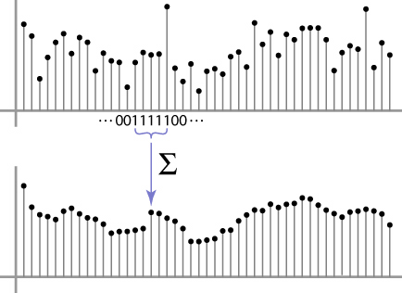
Weighted Moving Average
Can add weights to our moving average
Weights […, 0, 1, 1, 1, 1, 1, 0, …] / 5

Slide 6

Weighted Moving Average
bell curve (gaussian-like) weights […, 1, 4, 6, 4, 1, …]

Slide 7
This week: three views of filtering
Image filters in spatial domain
  Filter is a mathematical operation of a grid of numbers
  Smoothing, sharpening, measuring texture
Image filters in the frequency domain
  Filtering is a way to modify the frequencies of images
  Denoising, sampling, image compression
Image pyramids
  Scale-space representation allows coarse-to-fine operations
James Hays

Slide 8
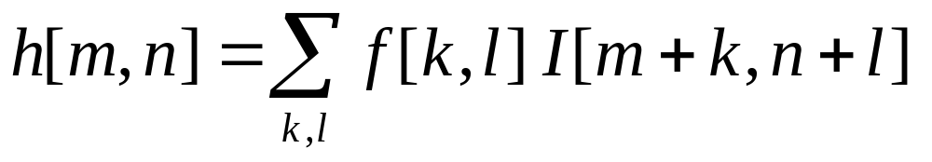
Image filtering
Image filtering:
  Compute function of local neighborhood at each position
James Hays

Slide 9
Image filtering
Image filtering:
  Compute function of local neighborhood at each position
h=output
f=filter
I=image
2d coords=k,l
2d coords=m,n
[ ]
[ ]
[ ]

Slide 10
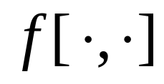

Example: box filter
1
1
1
1
1
1
1
1
1
Slide credit: David Lowe (UBC)

Slide 11
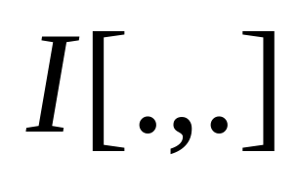
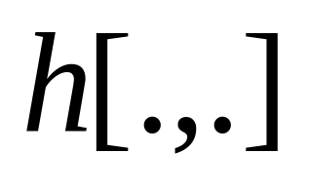
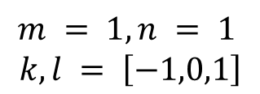
Image filtering
1
1
1
1
1
1
1
1
1
0 | 0 | 0 | 0 | 0 | 0 | 0 | 0 | 0 | 0
0 | 0 | 0 | 0 | 0 | 0 | 0 | 0 | 0 | 0
0 | 0 | 0 | 90 | 90 | 90 | 90 | 90 | 0 | 0
0 | 0 | 0 | 90 | 90 | 90 | 90 | 90 | 0 | 0
0 | 0 | 0 | 90 | 90 | 90 | 90 | 90 | 0 | 0
0 | 0 | 0 | 90 | 0 | 90 | 90 | 90 | 0 | 0
0 | 0 | 0 | 90 | 90 | 90 | 90 | 90 | 0 | 0
0 | 0 | 0 | 0 | 0 | 0 | 0 | 0 | 0 | 0
0 | 0 | 90 | 0 | 0 | 0 | 0 | 0 | 0 | 0
0 | 0 | 0 | 0 | 0 | 0 | 0 | 0 | 0 | 0
 | 0
0 | 0 | 0 | 0 | 0 | 0 | 0 | 0 | 0 | 0
0 | 0 | 0 | 0 | 0 | 0 | 0 | 0 | 0 | 0
0 | 0 | 0 | 90 | 90 | 90 | 90 | 90 | 0 | 0
0 | 0 | 0 | 90 | 90 | 90 | 90 | 90 | 0 | 0
0 | 0 | 0 | 90 | 90 | 90 | 90 | 90 | 0 | 0
0 | 0 | 0 | 90 | 0 | 90 | 90 | 90 | 0 | 0
0 | 0 | 0 | 90 | 90 | 90 | 90 | 90 | 0 | 0
0 | 0 | 0 | 0 | 0 | 0 | 0 | 0 | 0 | 0
0 | 0 | 90 | 0 | 0 | 0 | 0 | 0 | 0 | 0
0 | 0 | 0 | 0 | 0 | 0 | 0 | 0 | 0 | 0
Credit: S. Seitz

Slide 12
Image filtering
1
1
1
1
1
1
1
1
1
0 | 0 | 0 | 0 | 0 | 0 | 0 | 0 | 0 | 0
0 | 0 | 0 | 0 | 0 | 0 | 0 | 0 | 0 | 0
0 | 0 | 0 | 90 | 90 | 90 | 90 | 90 | 0 | 0
0 | 0 | 0 | 90 | 90 | 90 | 90 | 90 | 0 | 0
0 | 0 | 0 | 90 | 90 | 90 | 90 | 90 | 0 | 0
0 | 0 | 0 | 90 | 0 | 90 | 90 | 90 | 0 | 0
0 | 0 | 0 | 90 | 90 | 90 | 90 | 90 | 0 | 0
0 | 0 | 0 | 0 | 0 | 0 | 0 | 0 | 0 | 0
0 | 0 | 90 | 0 | 0 | 0 | 0 | 0 | 0 | 0
0 | 0 | 0 | 0 | 0 | 0 | 0 | 0 | 0 | 0
 | 0 | 10
0 | 0 | 0 | 0 | 0 | 0 | 0 | 0 | 0 | 0
0 | 0 | 0 | 0 | 0 | 0 | 0 | 0 | 0 | 0
0 | 0 | 0 | 90 | 90 | 90 | 90 | 90 | 0 | 0
0 | 0 | 0 | 90 | 90 | 90 | 90 | 90 | 0 | 0
0 | 0 | 0 | 90 | 90 | 90 | 90 | 90 | 0 | 0
0 | 0 | 0 | 90 | 0 | 90 | 90 | 90 | 0 | 0
0 | 0 | 0 | 90 | 90 | 90 | 90 | 90 | 0 | 0
0 | 0 | 0 | 0 | 0 | 0 | 0 | 0 | 0 | 0
0 | 0 | 90 | 0 | 0 | 0 | 0 | 0 | 0 | 0
0 | 0 | 0 | 0 | 0 | 0 | 0 | 0 | 0 | 0
Credit: S. Seitz

Slide 13
Image filtering
1
1
1
1
1
1
1
1
1
0 | 0 | 0 | 0 | 0 | 0 | 0 | 0 | 0 | 0
0 | 0 | 0 | 0 | 0 | 0 | 0 | 0 | 0 | 0
0 | 0 | 0 | 90 | 90 | 90 | 90 | 90 | 0 | 0
0 | 0 | 0 | 90 | 90 | 90 | 90 | 90 | 0 | 0
0 | 0 | 0 | 90 | 90 | 90 | 90 | 90 | 0 | 0
0 | 0 | 0 | 90 | 0 | 90 | 90 | 90 | 0 | 0
0 | 0 | 0 | 90 | 90 | 90 | 90 | 90 | 0 | 0
0 | 0 | 0 | 0 | 0 | 0 | 0 | 0 | 0 | 0
0 | 0 | 90 | 0 | 0 | 0 | 0 | 0 | 0 | 0
0 | 0 | 0 | 0 | 0 | 0 | 0 | 0 | 0 | 0
 | 0 | 10 | 20
0 | 0 | 0 | 0 | 0 | 0 | 0 | 0 | 0 | 0
0 | 0 | 0 | 0 | 0 | 0 | 0 | 0 | 0 | 0
0 | 0 | 0 | 90 | 90 | 90 | 90 | 90 | 0 | 0
0 | 0 | 0 | 90 | 90 | 90 | 90 | 90 | 0 | 0
0 | 0 | 0 | 90 | 90 | 90 | 90 | 90 | 0 | 0
0 | 0 | 0 | 90 | 0 | 90 | 90 | 90 | 0 | 0
0 | 0 | 0 | 90 | 90 | 90 | 90 | 90 | 0 | 0
0 | 0 | 0 | 0 | 0 | 0 | 0 | 0 | 0 | 0
0 | 0 | 90 | 0 | 0 | 0 | 0 | 0 | 0 | 0
0 | 0 | 0 | 0 | 0 | 0 | 0 | 0 | 0 | 0
Credit: S. Seitz

Slide 14
Image filtering
1
1
1
1
1
1
1
1
1
0 | 0 | 0 | 0 | 0 | 0 | 0 | 0 | 0 | 0
0 | 0 | 0 | 0 | 0 | 0 | 0 | 0 | 0 | 0
0 | 0 | 0 | 90 | 90 | 90 | 90 | 90 | 0 | 0
0 | 0 | 0 | 90 | 90 | 90 | 90 | 90 | 0 | 0
0 | 0 | 0 | 90 | 90 | 90 | 90 | 90 | 0 | 0
0 | 0 | 0 | 90 | 0 | 90 | 90 | 90 | 0 | 0
0 | 0 | 0 | 90 | 90 | 90 | 90 | 90 | 0 | 0
0 | 0 | 0 | 0 | 0 | 0 | 0 | 0 | 0 | 0
0 | 0 | 90 | 0 | 0 | 0 | 0 | 0 | 0 | 0
0 | 0 | 0 | 0 | 0 | 0 | 0 | 0 | 0 | 0
 | 0 | 10 | 20 | 30
0 | 0 | 0 | 0 | 0 | 0 | 0 | 0 | 0 | 0
0 | 0 | 0 | 0 | 0 | 0 | 0 | 0 | 0 | 0
0 | 0 | 0 | 90 | 90 | 90 | 90 | 90 | 0 | 0
0 | 0 | 0 | 90 | 90 | 90 | 90 | 90 | 0 | 0
0 | 0 | 0 | 90 | 90 | 90 | 90 | 90 | 0 | 0
0 | 0 | 0 | 90 | 0 | 90 | 90 | 90 | 0 | 0
0 | 0 | 0 | 90 | 90 | 90 | 90 | 90 | 0 | 0
0 | 0 | 0 | 0 | 0 | 0 | 0 | 0 | 0 | 0
0 | 0 | 90 | 0 | 0 | 0 | 0 | 0 | 0 | 0
0 | 0 | 0 | 0 | 0 | 0 | 0 | 0 | 0 | 0
Credit: S. Seitz

Slide 15
Image filtering
1
1
1
1
1
1
1
1
1
0 | 0 | 0 | 0 | 0 | 0 | 0 | 0 | 0 | 0
0 | 0 | 0 | 0 | 0 | 0 | 0 | 0 | 0 | 0
0 | 0 | 0 | 90 | 90 | 90 | 90 | 90 | 0 | 0
0 | 0 | 0 | 90 | 90 | 90 | 90 | 90 | 0 | 0
0 | 0 | 0 | 90 | 90 | 90 | 90 | 90 | 0 | 0
0 | 0 | 0 | 90 | 0 | 90 | 90 | 90 | 0 | 0
0 | 0 | 0 | 90 | 90 | 90 | 90 | 90 | 0 | 0
0 | 0 | 0 | 0 | 0 | 0 | 0 | 0 | 0 | 0
0 | 0 | 90 | 0 | 0 | 0 | 0 | 0 | 0 | 0
0 | 0 | 0 | 0 | 0 | 0 | 0 | 0 | 0 | 0
 | 0 | 10 | 20 | 30 | 30
Credit: S. Seitz

Slide 16
Image filtering
1
1
1
1
1
1
1
1
1
0 | 0 | 0 | 0 | 0 | 0 | 0 | 0 | 0 | 0
0 | 0 | 0 | 0 | 0 | 0 | 0 | 0 | 0 | 0
0 | 0 | 0 | 90 | 90 | 90 | 90 | 90 | 0 | 0
0 | 0 | 0 | 90 | 90 | 90 | 90 | 90 | 0 | 0
0 | 0 | 0 | 90 | 90 | 90 | 90 | 90 | 0 | 0
0 | 0 | 0 | 90 | 0 | 90 | 90 | 90 | 0 | 0
0 | 0 | 0 | 90 | 90 | 90 | 90 | 90 | 0 | 0
0 | 0 | 0 | 0 | 0 | 0 | 0 | 0 | 0 | 0
0 | 0 | 90 | 0 | 0 | 0 | 0 | 0 | 0 | 0
0 | 0 | 0 | 0 | 0 | 0 | 0 | 0 | 0 | 0
 | 0 | 10 | 20 | 30 | 30
?
Credit: S. Seitz

Slide 17
Image filtering
1
1
1
1
1
1
1
1
1
0 | 0 | 0 | 0 | 0 | 0 | 0 | 0 | 0 | 0
0 | 0 | 0 | 0 | 0 | 0 | 0 | 0 | 0 | 0
0 | 0 | 0 | 90 | 90 | 90 | 90 | 90 | 0 | 0
0 | 0 | 0 | 90 | 90 | 90 | 90 | 90 | 0 | 0
0 | 0 | 0 | 90 | 90 | 90 | 90 | 90 | 0 | 0
0 | 0 | 0 | 90 | 0 | 90 | 90 | 90 | 0 | 0
0 | 0 | 0 | 90 | 90 | 90 | 90 | 90 | 0 | 0
0 | 0 | 0 | 0 | 0 | 0 | 0 | 0 | 0 | 0
0 | 0 | 90 | 0 | 0 | 0 | 0 | 0 | 0 | 0
0 | 0 | 0 | 0 | 0 | 0 | 0 | 0 | 0 | 0
 | 0 | 10 | 20 | 30 | 30
 |  |  |  | 50
?
Credit: S. Seitz

Slide 18
Image filtering
1
1
1
1
1
1
1
1
1
0 | 0 | 0 | 0 | 0 | 0 | 0 | 0 | 0 | 0
0 | 0 | 0 | 0 | 0 | 0 | 0 | 0 | 0 | 0
0 | 0 | 0 | 90 | 90 | 90 | 90 | 90 | 0 | 0
0 | 0 | 0 | 90 | 90 | 90 | 90 | 90 | 0 | 0
0 | 0 | 0 | 90 | 90 | 90 | 90 | 90 | 0 | 0
0 | 0 | 0 | 90 | 0 | 90 | 90 | 90 | 0 | 0
0 | 0 | 0 | 90 | 90 | 90 | 90 | 90 | 0 | 0
0 | 0 | 0 | 0 | 0 | 0 | 0 | 0 | 0 | 0
0 | 0 | 90 | 0 | 0 | 0 | 0 | 0 | 0 | 0
0 | 0 | 0 | 0 | 0 | 0 | 0 | 0 | 0 | 0
 | 0 | 10 | 20 | 30 | 30 | 30 | 20 | 10
 | 0 | 20 | 40 | 60 | 60 | 60 | 40 | 20
 | 0 | 30 | 60 | 90 | 90 | 90 | 60 | 30
 | 0 | 30 | 50 | 80 | 80 | 90 | 60 | 30
 | 0 | 30 | 50 | 80 | 80 | 90 | 60 | 30
 | 0 | 20 | 30 | 50 | 50 | 60 | 40 | 20
 | 10 | 20 | 30 | 30 | 30 | 30 | 20 | 10
 | 10 | 10 | 10 | 0 | 0 | 0 | 0 | 0
Credit: S. Seitz

Slide 19
Box Filter
What does it do?
Replaces each pixel with an average of its neighborhood
Achieve smoothing effect (remove sharp features)
1
1
1
1
1
1
1
1
1
Slide credit: David Lowe (UBC)

Slide 20
Box Filter
What does it do?
Replaces each pixel with an average of its neighborhood
Achieve smoothing effect (remove sharp features)
Why does it sum to one?
1
1
1
1
1
1
1
1
1
Slide credit: David Lowe (UBC)

Slide 21
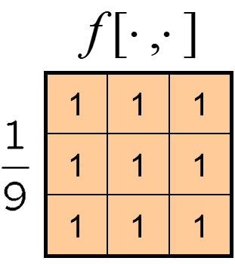
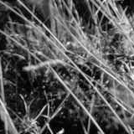
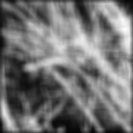
Smoothing with box filter
James Hays

Slide 22
Image filtering
Image filtering:
  Compute function of local neighborhood at each position
Really important!
  Enhance images
    Denoise, resize, increase contrast, etc.
  Extract information from images
    Texture, edges, distinctive points, etc.
  Detect patterns
    Template matching
James Hays

Slide 23
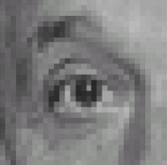

Think-Pair-Share time
0
0
0
1.
0
1
0
0
0
0
0
0
0
2.
0
0
1
0
0
0
1
0
-1
3.
2
0
-2
1
0
-1
0
0
0
-
1
1
1
4.
0
2
0
1
1
1
0
0
0
1
1
1

Slide 24
1. Practice with linear filters
0
0
0
?
0
1
0
0
0
0
Original
Source: D. Lowe

Slide 25
1. Practice with linear filters
0
0
0
0
1
0
0
0
0
Original
Filtered
(no change)
Source: D. Lowe

Slide 26
2. Practice with linear filters
0
0
0
?
0
0
1
0
0
0
Original
Source: D. Lowe

Slide 27
2. Practice with linear filters
0
0
0
0
0
1
0
0
0
Original
Shifted left
By 1 pixel
Source: D. Lowe

Slide 28
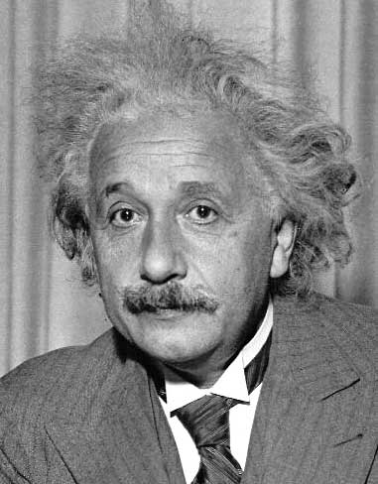
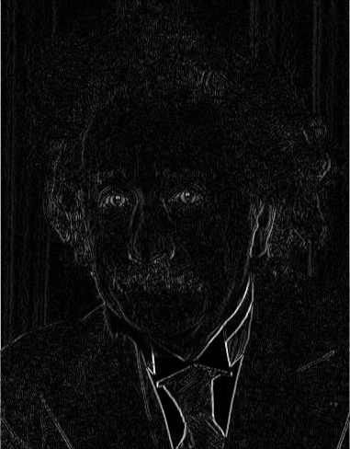
3. Practice with linear filters
1
0
-1
2
0
-2
1
0
-1
Sobel
Vertical Edge
(absolute value)
David Lowe

Slide 29
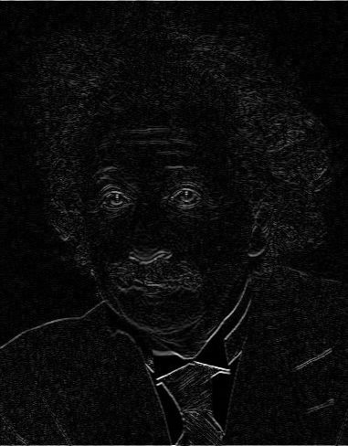
3. Practice with linear filters
1
2
1
0
0
0
-1
-2
-1
Sobel
Horizontal Edge
(absolute value)
David Lowe

Slide 30
4. Practice with linear filters
0
0
0
-
1
1
1
?
0
2
0
1
1
1
0
0
0
1
1
1
(Note that filter sums to 1)
Original
Source: D. Lowe

Slide 31
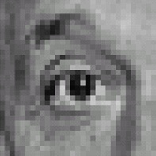
4. Practice with linear filters
0
0
0
-
1
1
1
0
2
0
1
1
1
0
0
0
1
1
1
Original
Sharpening filter
  Accentuates differences with local average
Source: D. Lowe

Slide 32
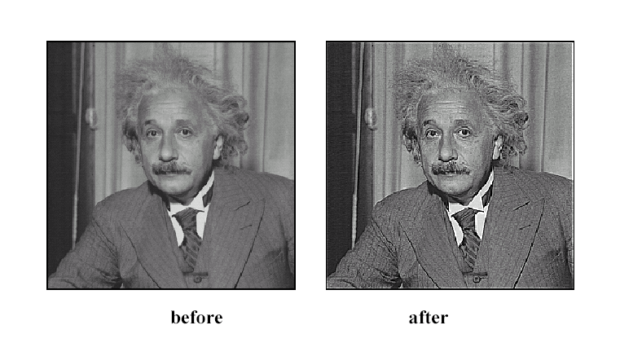
4. Practice with linear filters
Source: D. Lowe

Slide 33
How could we synthesize motion blur?
theta = 30; len = 20;
fil = imrotate(ones(1, len), theta, 'bilinear');
fil = fil / sum(fil(:));
figure(2), imshow(imfilter(im, fil));

Slide 34

Correlation and Convolution
2D correlation
  e.g., h = scipy.signal.correlate2d(f,I)
James Hays

Slide 35
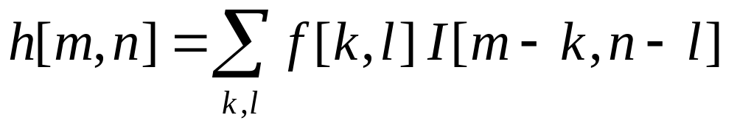
Correlation and Convolution
2D correlation
2D convolution
  e.g., h = scipy.signal.correlate2d(f,I)
  e.g., h = scipy.signal.convolve2d(f,I)
Convolution is the same as correlation with a 180° rotated filter kernel.
Correlation and convolution are identical when the filter kernel is symmetric.
* Symmetric in the geometric sense, not in the matrix linear algebra sense.
Hays

Slide 36
Key properties of linear filters
Linearity:
filter(I, f₁ + f₂) =
filter(I,f₁) + filter(I,f₂)
Shift invariance:
Same behavior regardless of pixel location
filter(I,shift(f)) = shift(filter(I,f))
Any linear, shift-invariant operator can be represented as a convolution.
Source: S. Lazebnik

Slide 37
Convolution properties
Commutative: a * b = b * a
  Conceptually no difference between filter and signal
  But particular filtering implementations might break this equality, e.g., image edges
Associative: a * (b * c) = (a * b) * c
  Often apply several filters one after another: (((a * b₁) * b₂) * b₃)
  This is equivalent to applying one filter: a * (b₁ * b₂ * b₃)
Source: S. Lazebnik
Notes:
David Jacobs @ UMD http://www.cs.umd.edu/~djacobs/CMSC426/Convolution.pdf
The key difference between the two is that convolution is associative. That is, if F and G are filters, then F*(G*I) = (F*G)*I. If you don’t believe this, try a simple example, using F=G=(-1 0 1), for example. It is very convenient to have convolution be associative. Suppose, for example, we want to smooth an image and then take its derivative. We could do this by convolving the image with a Gaussian filter, and then convolving it with a derivative filter. But we could alternatively convolve the derivative filter with the Gaussian to produce a filter called a Difference of Gaussian (DOG), and then convolve this with our image. The nice thing about this is that the DOG filter can be precomputed, and we only have to convolve one filter with our image.
In general, people use convolution for image processing operations such as smoothing, and they use correlation to match a template to an image. Then, we don’t mind that correlation isn’t associative, because it doesn’t really make sense to combine two templates into one with correlation, whereas we might often want to combine two filter together for convolution. When discussing the Fourier series as a way of understanding filtering, we will use convolution, so that we can introduce the famous convolution theorem.

Slide 38
Convolution properties
Commutative: a * b = b * a
  Conceptually no difference between filter and signal
  But particular filtering implementations might break this equality, e.g., image edges
Associative: a * (b * c) = (a * b) * c
  Often apply several filters one after another: (((a * b₁) * b₂) * b₃)
  This is equivalent to applying one filter: a * (b₁ * b₂ * b₃)
  Correlation is _not_ associative (rotation effect)
  Why important?
Source: S. Lazebnik
Notes:
David Jacobs @ UMD http://www.cs.umd.edu/~djacobs/CMSC426/Convolution.pdf
The key difference between the two is that convolution is associative. That is, if F and G are filters, then F*(G*I) = (F*G)*I. If you don’t believe this, try a simple example, using F=G=(-1 0 1), for example. It is very convenient to have convolution be associative. Suppose, for example, we want to smooth an image and then take its derivative. We could do this by convolving the image with a Gaussian filter, and then convolving it with a derivative filter. But we could alternatively convolve the derivative filter with the Gaussian to produce a filter called a Difference of Gaussian (DOG), and then convolve this with our image. The nice thing about this is that the DOG filter can be precomputed, and we only have to convolve one filter with our image.
In general, people use convolution for image processing operations such as smoothing, and they use correlation to match a template to an image. Then, we don’t mind that correlation isn’t associative, because it doesn’t really make sense to combine two templates into one with correlation, whereas we might often want to combine two filter together for convolution. When discussing the Fourier series as a way of understanding filtering, we will use convolution, so that we can introduce the famous convolution theorem.

Slide 39
Convolution properties
Commutative: a * b = b * a
  Conceptually no difference between filter and signal
  But particular filtering implementations might break this equality,
  e.g., image edges
Associative: a * (b * c) = (a * b) * c
  Often apply several filters one after another: (((a * b₁) * b₂) * b₃)
  This is equivalent to applying one filter: a * (b₁ * b₂ * b₃)
  Correlation is _not_ associative (rotation effect)
  Why important?
Distributes over addition: a * (b + c) = (a * b) + (a * c)
Scalars factor out: ka * b = a * kb = k (a * b)
Identity: unit impulse e = [0, 0, 1, 0, 0], a * e = a
Source: S. Lazebnik
Notes:
David Jacobs @ UMD http://www.cs.umd.edu/~djacobs/CMSC426/Convolution.pdf
The key difference between the two is that convolution is associative. That is, if F and G are filters, then F*(G*I) = (F*G)*I. If you don’t believe this, try a simple example, using F=G=(-1 0 1), for example. It is very convenient to have convolution be associative. Suppose, for example, we want to smooth an image and then take its derivative. We could do this by convolving the image with a Gaussian filter, and then convolving it with a derivative filter. But we could alternatively convolve the derivative filter with the Gaussian to produce a filter called a Difference of Gaussian (DOG), and then convolve this with our image. The nice thing about this is that the DOG filter can be precomputed, and we only have to convolve one filter with our image.
In general, people use convolution for image processing operations such as smoothing, and they use correlation to match a template to an image. Then, we don’t mind that correlation isn’t associative, because it doesn’t really make sense to combine two templates into one with correlation, whereas we might often want to combine two filter together for convolution. When discussing the Fourier series as a way of understanding filtering, we will use convolution, so that we can introduce the famous convolution theorem.

Slide 40
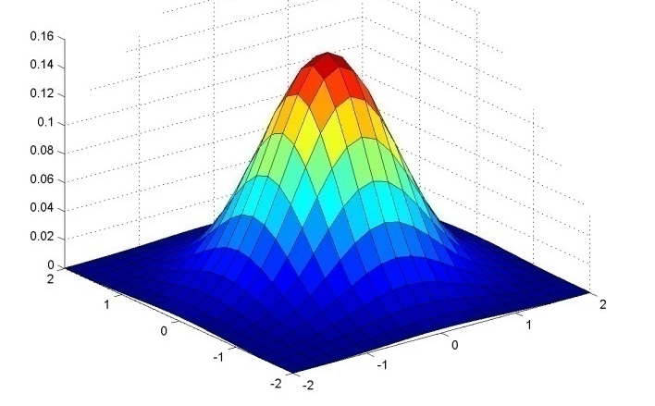
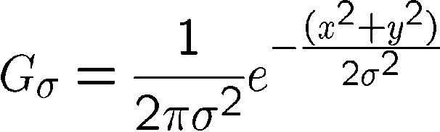
Important filter: Gaussian
Weight contributions of neighboring pixels by nearness
x
0.003 0.013 0.022 0.013 0.003
0.013 0.059 0.097 0.059 0.013
0.022 0.097 0.159 0.097 0.022
0.013 0.059 0.097 0.059 0.013
0.003 0.013 0.022 0.013 0.003
y
x
5 x 5, σ = 1
y
Viewed from top
as intensity
Slide credit: Christopher Rasmussen

Slide 41
Smoothing with box filter
James Hays
1
1
1
1
1
1
1
1
1

Slide 42

Smoothing with Gaussian filter
James Hays

Slide 43
Gaussian filters
Remove “high-frequency” components from the image
(low-pass filter)
  Images become more smooth
Gaussian convolved with Gaussian…
…is another Gaussian
  So can smooth with small-width kernel, repeat, and get same result as larger-width kernel would have
  Convolving two times with Gaussian kernel of width σ is same as convolving once with kernel of width σ√2
Separable kernel
  Factors into product of two 1D Gaussians
Source: K. Grauman

Slide 44
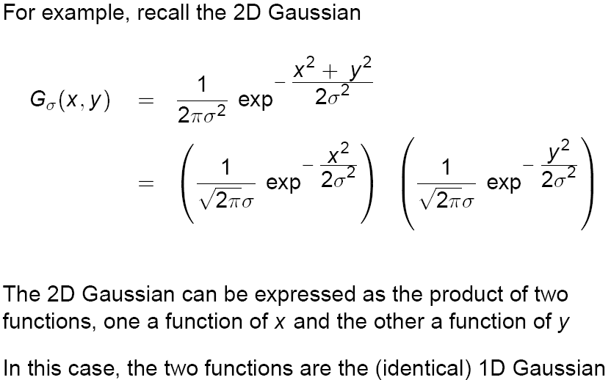
Separability of the Gaussian filter
Source: D. Lowe

Slide 45
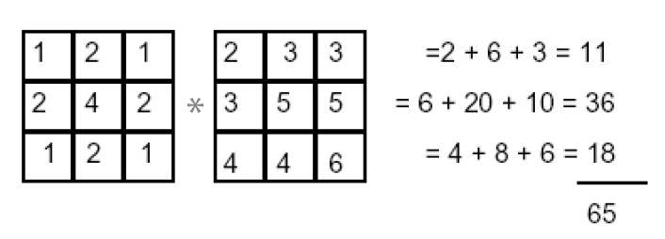
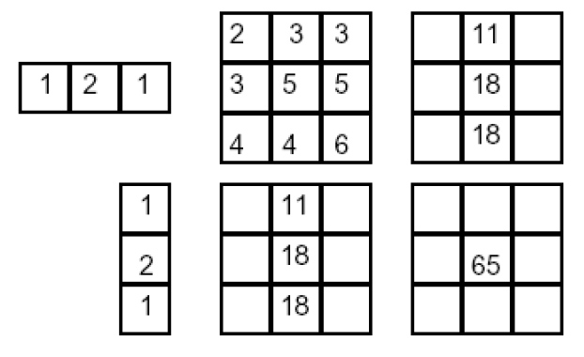
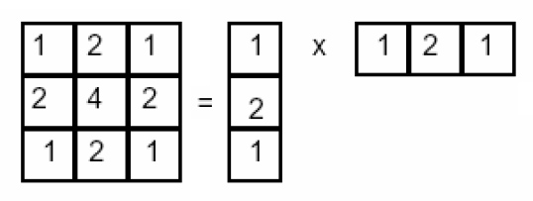
Separability example
2D convolution
(center location only)
=
The filter factors
into a product of 1D
filters:
Perform convolution
along rows:
*
=
Followed by convolution
along the remaining column:
*
=
Source: K. Grauman

Slide 46
Separability
Why is separability useful in practice?

Slide 47
Separability
Why is separability useful in practice?
MxN image, PxQ filter
2D convolution: ~MNPQ multiply-adds
Separable 2D: ~MN(P+Q) multiply-adds
Speed up = PQ/(P+Q)
9x9 filter = ~4.5x faster

Slide 48
Practical matters
How big should the filter be?
Values at edges should be near zero
Gaussians have infinite extent…
Rule of thumb for Gaussian: set filter half-width to about 3 σ
James Hays

Slide 49













Practical matters
What about near the edge?
  the filter window falls off the edge of the image
  need to extrapolate
  methods:
    clip filter (black)
    wrap around
    copy edge
    reflect across edge
Source: S. Marschner

Slide 50
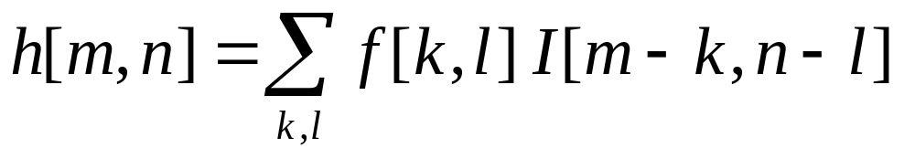

Recap
Linear filtering (convolution)
  Not a matrix multiplication
  Sum over Hadamard product
  Can smooth, sharpen, translate (among many other uses)
Be aware of details for filter size, extrapolation, cropping
1
1
1
1
1
1
1
1
1
James Hays

Slide 51
Practice with linear filters
1
2
1
0
0
0
-1
-2
-1
Sobel
Horizontal Edge
(absolute value)
David Lowe
Notes:
Questions at this point?

Slide 52
Sobel filter visualization
What happens to negative numbers?
For visualization:
  Shift image + 0.5
  If gradients are small, scale edge response
Notes:
- Look at a second filter which is an ‘edge detection’ filter
Negative numbers
Oh. Well, let’s take the absolute value (the magnitude)
Add the mean

Slide 53

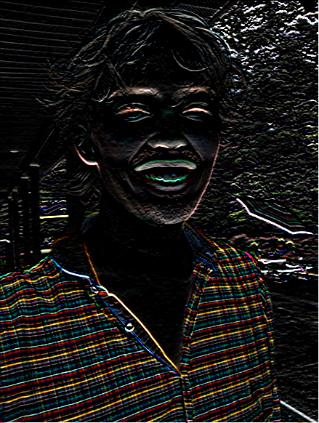
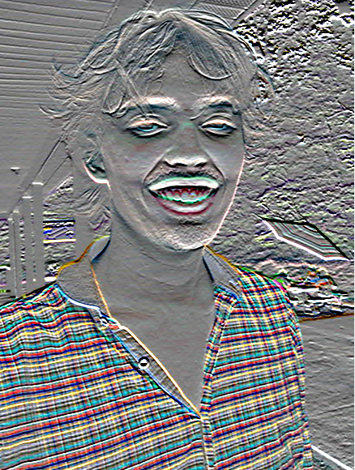
>> I = im2double( imread( ‘luke.jpg’ ) );
>> h = imfilter( I, fspecial(‘sobel’) );
imshow( h );
imshow( h + 0.5 );

Slide 54
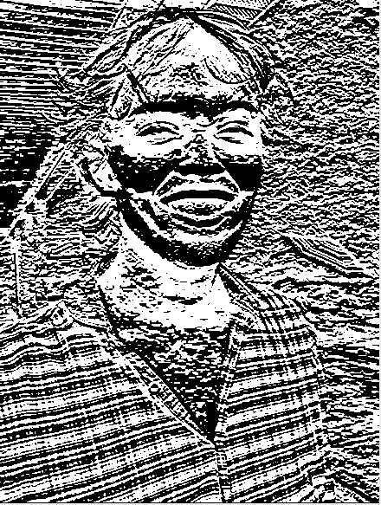
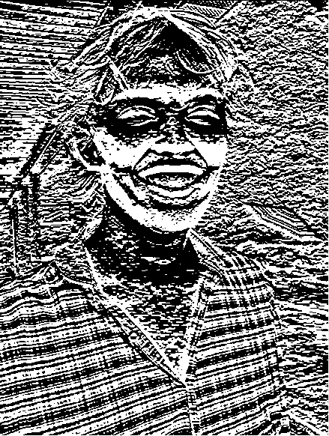
h(:,:,1) < 0
h(:,:,1) > 0

Slide 55
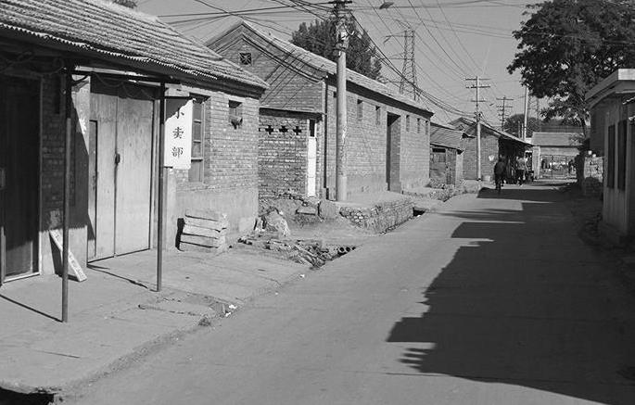

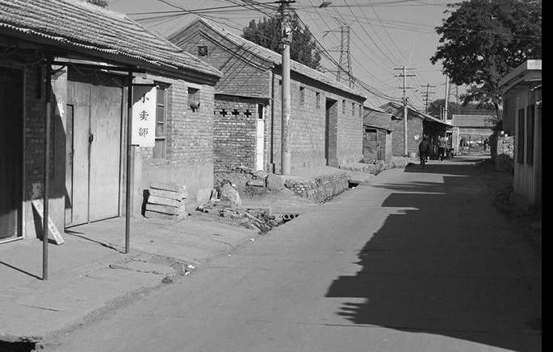
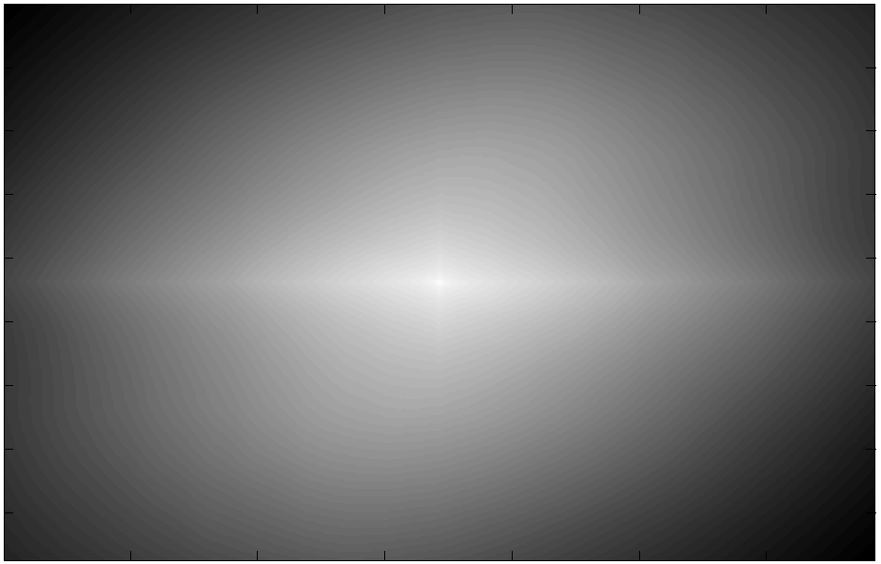
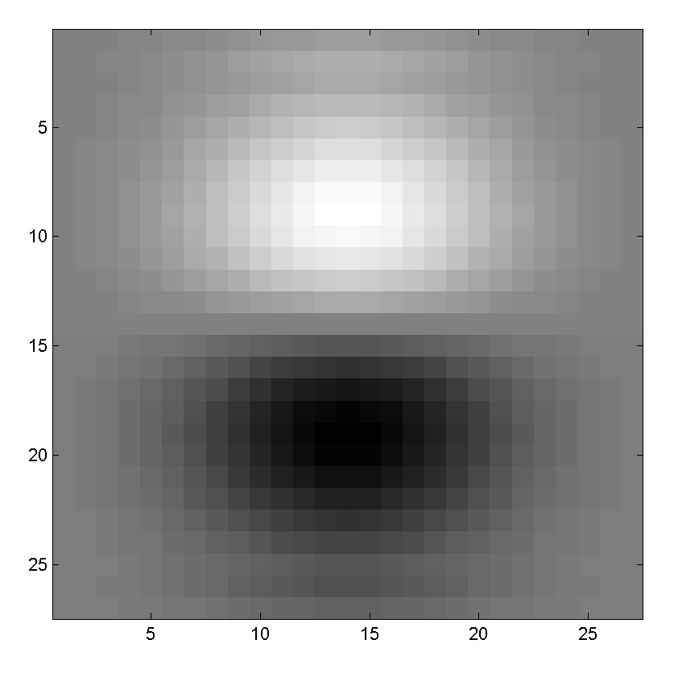
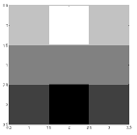
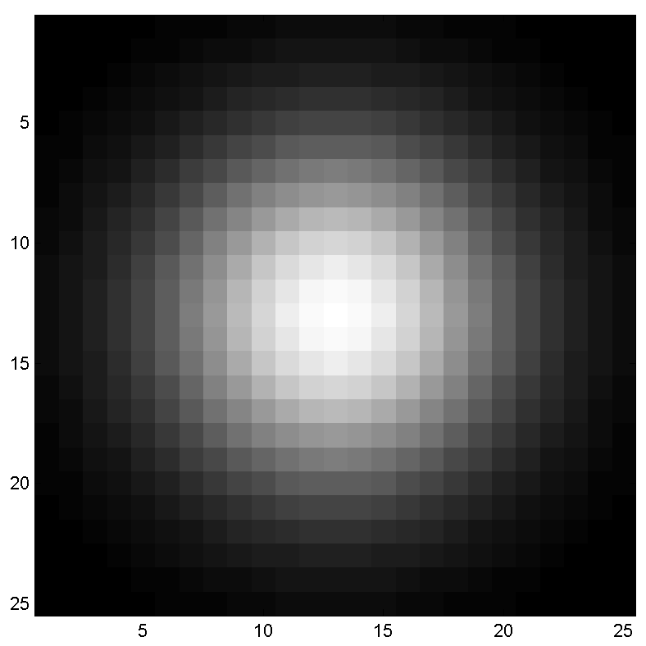
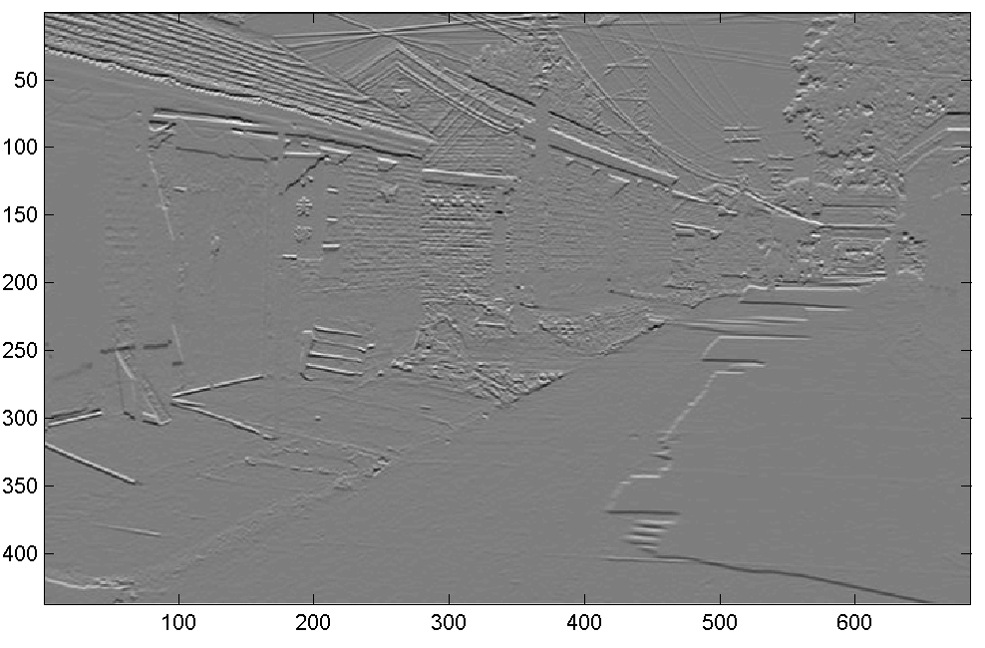
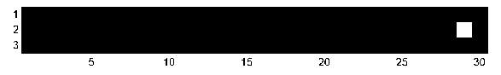
Think-Pair-Share
* = Convolution operator
1) _ = D * B
2) A = _ * _
3) F = D * _
4) _ = D * D
D
H
F
I
A
B
C
G
E
Hoiem
Notes:
1) G = D * B
2) A = B * C
3) F = D * E
4) I = D * D

Slide 56
I = D * D
D (275 x 175 pixels)
I (from slide – 275 x 175)
“…something to do with lack of content (black) at edges…”

Slide 57

I = D * D
D (275 x 175 pixels)
I (from slide – 275 x 175)
>> D = img_to_float32( io.imread( ‘convexample.png’ ) )
>> I = convolve2d( D, D )
>> np.max(I)
1.1021e+04
# Normalize for visualization
>> I_norm = (I – np.min(I)) /
(np.max(I) – np.min(I))
>> plt.imshow( I_norm )
I_norm

Slide 58

I = D * D
D (275 x 175 pixels)
I (from slide – 275 x 175)
(275-1)/2
(275-1)/2
(549 x 349 pixels)
I_norm
275
For x: 275 + (275-1)/2 + (275-1)/2
= 549

Slide 59

I = D * D
D (275 x 175 pixels)
I (from slide – 275 x 175)
>> I = convolve2d( D, D, mode=‘full’ )
(Default; pad with zeros)
>> I = convolve2d( D, D, mode=‘same’ )
(Return same size as D)
>> I = convolve2d( D, D, mode=‘valid’ )
(No padding)
549 x 349
275 x 175
Value = 10528.3
1x1

Slide 60
A = B * C - “because it kind of looks like it.”
A
B
C
C is a Gaussian filter
(or something close to it it),
and we know that it ‘blurs’.
When the filter ‘looks like’ the image = ‘template matching’
Filtering viewed as comparing an image of
what you want to find against all image regions.
For symmetric filters: use either convolution or correlation.
For nonsymmetric filters: correlation is template matching.

Slide 61
Filtering: Correlation and Convolution
2d correlation
2d convolution
  e.g., h = scipy.signal.correlate2d(f,I)
  e.g., h = scipy.signal.convolve2d(f,I)
Convolution is the same as correlation with a 180° rotated filter kernel.
Correlation and convolution are identical when the filter kernel is symmetric.
James Hays

Slide 62
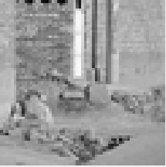

D (275 x 175 pixels)
OK, so let’s test this idea. Let’s see if we can use correlation to ‘find’ the parts of the image that look like the filter.
>> f = D[ 57:117, 107:167 ]
Expect response ‘peak’ in middle of I
>> I = correlate2d( D, f, ‘same’ )
f
61 x 61
I
Correct location
Hmm…
That didn’t work – why not?
+
Response peak
[Thanks to Robert Collins @ Penn State]

Slide 63
Correlation
  e.g., h = scipy.signal.correlate2d(f,I)
As brightness in I increases, the response in h will increase, as long as f is positive.
Overall brighter regions will give higher correlation response -> not useful!

Slide 64
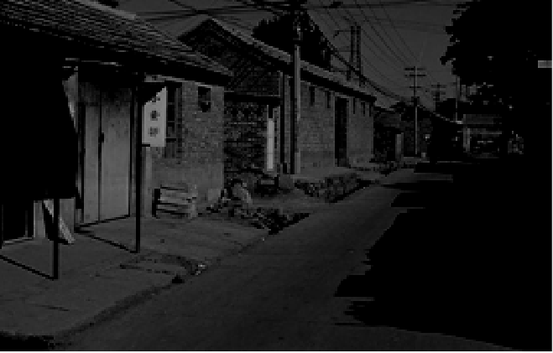
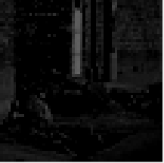
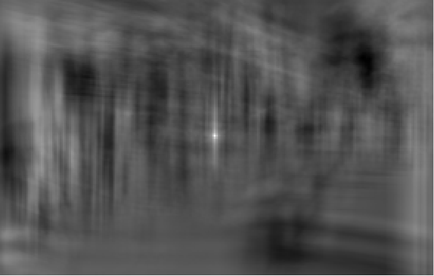
D2 (275 x 175 pixels)
OK, so let’s subtract the mean
>> f = D[ 57:117, 107:167 ]
>> f2 = f – np.mean(f)
>> D2 = D – np.mean(D)
Now zero centered.
Score is higher only when dark parts
match and when light parts match.
>> I2 = correlate2d( D2, f2, ‘same’ )
f2
61 x 61
I2

Slide 65
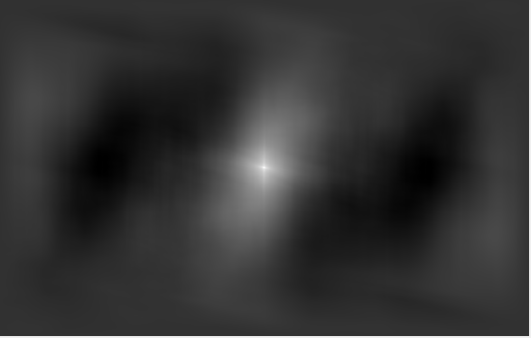
D2 (275 x 175 pixels)
Or even for our original example
>> I3 = correlate2d( D2, D2, ‘full’ )
I3

Slide 66
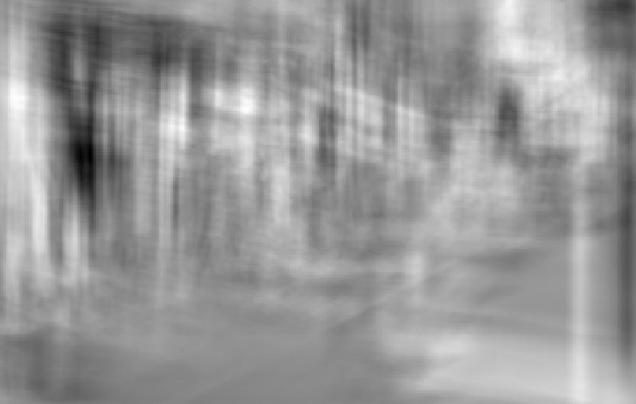
D2 (275 x 175 pixels)
What happens with convolution?
>> f = D[ 57:117, 107:167 ]
>> f2 = f – np.mean(f)
>> D2 = D – np.mean(D)
>> I2 = convolve2d( D2, f2, ‘same’ )
f2
61 x 61
I2

Slide 67
Non-linear filters

Slide 68
Median filters
Operates over a window by selecting the median intensity in the window.
‘Rank’ filter as based on ordering of gray levels
  E.G., min, max, range filters
Steve Seitz, Steve Marschner
Notes:
Better at salt’n’pepper noise
Not convolution: try a region with 1’s and a 2, and then 1’s and a 3

Slide 69
Image filtering - mean
1
1
1
1
1
1
1
1
1
0 | 0 | 0 | 0 | 0 | 0 | 0 | 0 | 0 | 0
0 | 0 | 0 | 0 | 0 | 0 | 0 | 0 | 0 | 0
0 | 0 | 0 | 90 | 90 | 90 | 90 | 90 | 0 | 0
0 | 0 | 0 | 90 | 90 | 90 | 90 | 90 | 0 | 0
0 | 0 | 0 | 90 | 90 | 90 | 90 | 90 | 0 | 0
0 | 0 | 0 | 90 | 0 | 90 | 90 | 90 | 0 | 0
0 | 0 | 0 | 90 | 90 | 90 | 90 | 90 | 0 | 0
0 | 0 | 0 | 0 | 0 | 0 | 0 | 0 | 0 | 0
0 | 0 | 90 | 0 | 0 | 0 | 0 | 0 | 0 | 0
0 | 0 | 0 | 0 | 0 | 0 | 0 | 0 | 0 | 0
 | 0 | 10 | 20 | 30 | 30
?
Credit: S. Seitz
Notes:
ones, divide by 9

Slide 70
Image filtering - mean
1
1
1
1
1
1
1
1
1
0 | 0 | 0 | 0 | 0 | 0 | 0 | 0 | 0 | 0
0 | 0 | 0 | 0 | 0 | 0 | 0 | 0 | 0 | 0
0 | 0 | 0 | 90 | 90 | 90 | 90 | 90 | 0 | 0
0 | 0 | 0 | 90 | 90 | 90 | 90 | 90 | 0 | 0
0 | 0 | 0 | 90 | 90 | 90 | 90 | 90 | 0 | 0
0 | 0 | 0 | 90 | 0 | 90 | 90 | 90 | 0 | 0
0 | 0 | 0 | 90 | 90 | 90 | 90 | 90 | 0 | 0
0 | 0 | 0 | 0 | 0 | 0 | 0 | 0 | 0 | 0
0 | 0 | 90 | 0 | 0 | 0 | 0 | 0 | 0 | 0
0 | 0 | 0 | 0 | 0 | 0 | 0 | 0 | 0 | 0
 | 0 | 10 | 20 | 30 | 30
 |  |  |  | 50
Credit: S. Seitz
Notes:
ones, divide by 9

Slide 71
Median filter?
0 | 0 | 0 | 0 | 0 | 0 | 0 | 0 | 0 | 0
0 | 0 | 0 | 0 | 0 | 0 | 0 | 0 | 0 | 0
0 | 0 | 0 | 90 | 90 | 90 | 90 | 90 | 0 | 0
0 | 0 | 0 | 90 | 90 | 90 | 90 | 90 | 0 | 0
0 | 0 | 0 | 90 | 90 | 90 | 90 | 90 | 0 | 0
0 | 0 | 0 | 90 | 0 | 90 | 90 | 90 | 0 | 0
0 | 0 | 0 | 90 | 90 | 90 | 90 | 90 | 0 | 0
0 | 0 | 0 | 0 | 0 | 0 | 0 | 0 | 0 | 0
0 | 0 | 90 | 0 | 0 | 0 | 0 | 0 | 0 | 0
0 | 0 | 0 | 0 | 0 | 0 | 0 | 0 | 0 | 0
 |  |  |  | ?
Credit: S. Seitz
Notes:
Answer is 90.

Slide 72
Median filters
Operates over a window by selecting the median intensity in the window.
What advantage does a median filter have over a mean filter?
Steve Seitz, Steve Marschner
Notes:
Better at salt’n’pepper noise

Slide 73
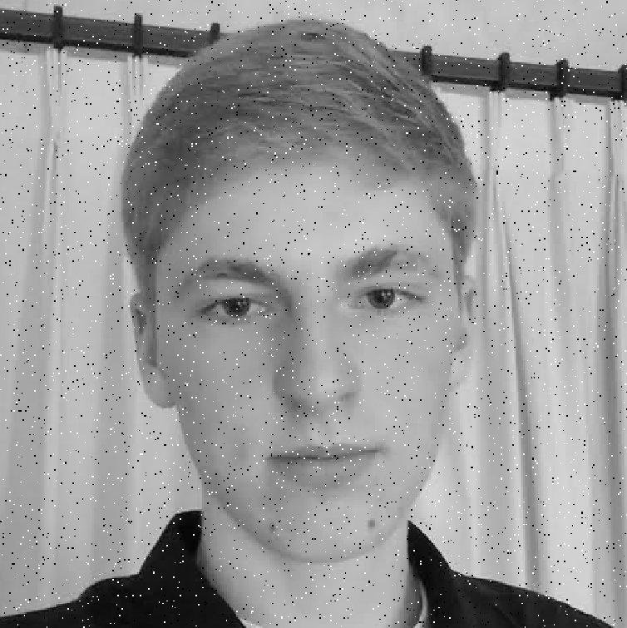
Noisy Jack – Salt and Pepper
Notes:
No, not the latest smash hit from early 90’s hip hop group

Slide 74

Mean Jack – 3 x 3 filter

Slide 75

Very Mean Jack – 11 x 11 filter

Slide 76
Noisy Jack – Salt and Pepper
Notes:
No, not the latest smash hit from early 90’s hip hop group

Slide 77

Median Jack – 3 x 3

Slide 78

Very Median Jack – 11 x 11

Slide 79
Median filters
Operates over a window by selecting the median intensity in the window.
What advantage does a median filter have over a mean filter?
Is a median filter a kind of convolution?
Steve Seitz, Steve Marschner
Notes:
Answer: Not convolution: try a region with 1’s and a 2, and then 1’s and a 3

Slide 80
Median filters
Operates over a window by selecting the median intensity in the window.
What advantage does a median filter have over a mean filter?
Is a median filter a kind of convolution?
Secret: Median filtering is sorting.
Notes:
Answer: Not convolution: try a region with 1’s and a 2, and then 1’s and a 3

Slide 81
Review: questions
Write down a 3x3 filter that both:
  Returns a positive value if the average value of the 4-adjacent neighbors is less than the center,
  Returns a negative value otherwise.
Write down a filter that will compute the gradient in the x-direction:
gradx(x,y) = im(x+1,y) - im(x,y) for each x, y
Slide: Hoiem
Notes:
[ 0 -1/4 0;
-1/4 1 -1/4;
0 -1/4 0 ]
[ 0 -1 1 ]

Slide 82
Review: questions
Write down a 3x3 filter that both:
  Returns a positive value if the average value of the 4-adjacent neighbors is less than the center,
  Returns a negative value otherwise.
Write down a filter that will compute the gradient in the x-direction:
gradx(x,y) = im(x+1,y) - im(x,y) for each x, y
[ 0 -1/4 0;
-1/4 1 -1/4;
0 -1/4 0 ]
[ 0 -1 1 ]
Slide: Hoiem
Notes:
[ 0 -1/4 0;
-1/4 1 -1/4;
0 -1/4 0 ]
[ 0 -1 1 ]

