Slide 1
CSCI 1290: Comp Photo
Fall 2020 @ Brown University
James Tompkin
Many slides thanks to James Hays’ old CS 129 course,
along with all its acknowledgements.

Slide 2
What is an image?

Slide 3
>>> from numpy import random as r
>>> I = r.rand(256,256);
Think-Pair-Share:
What is this? What does it look like?
Which values does it take?
How many values can it take?
Is it an image?

Slide 4
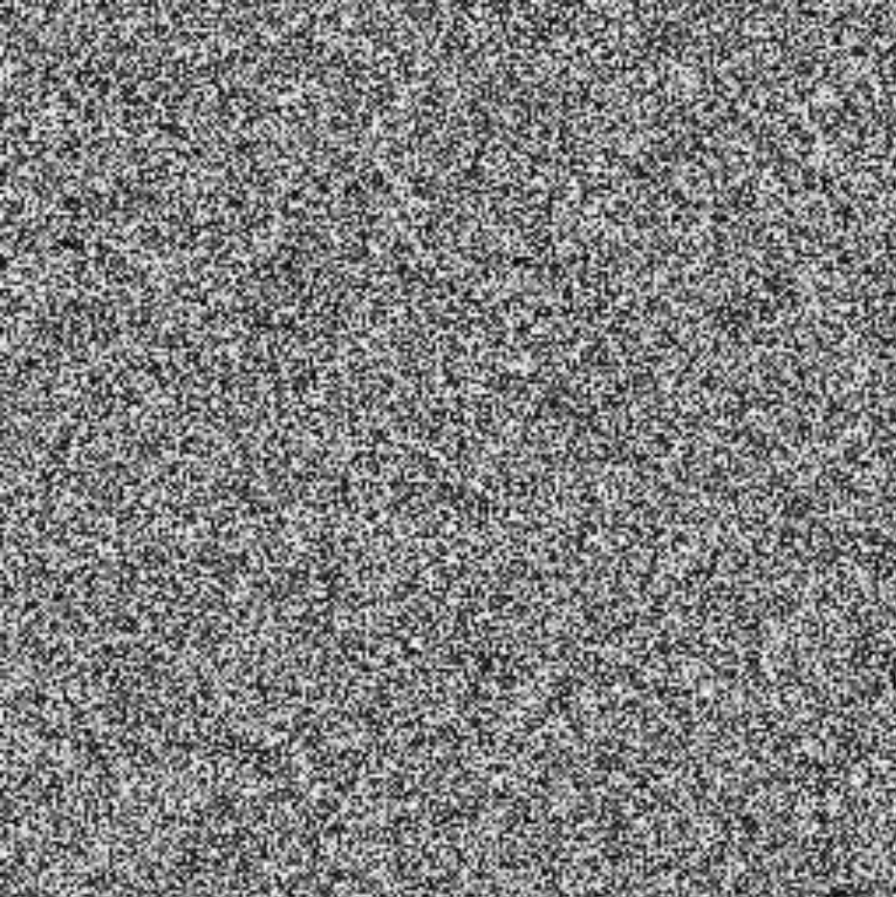
>>> from matplotlib import pyplot as p
>>> I = r.rand(256,256);
>>> p.imshow(I);
>>> p.show();
Danny Alexander

Slide 5
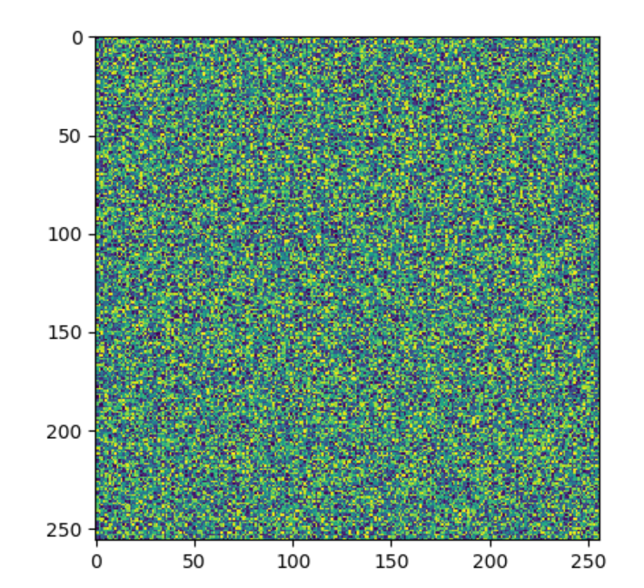
Note: matplotlib and colour maps
>>> from matplotlib import pyplot as p
>>> from numpy import random as r
>>> I = r.rand(256,256);
>>> p.imshow(I);
>>> p.show();
This code will actually
produce an image like this:
matplotlib assumes the data
is ‘scientific’ and
applies a colourmap.
[Additional info]
Notes:
Note: Here’s more info on matplotlib’s display of colormaps - https://matplotlib.org/tutorials/colors/colormaps.html

Slide 6
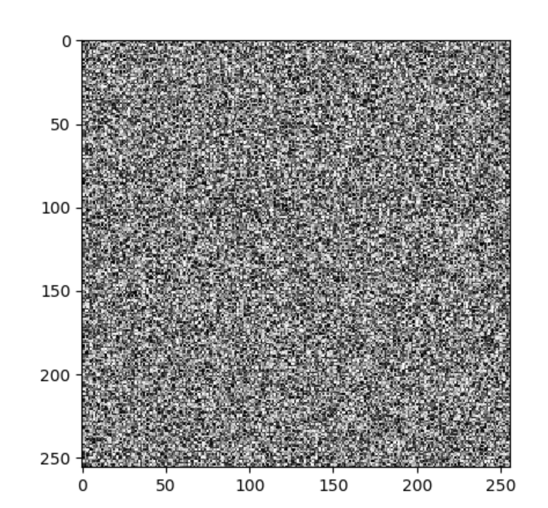
Note: matplotlib and colour maps
>>> from matplotlib import pyplot as p
>>> from numpy import random as r
>>> I = r.rand(256,256);
>>> p.imshow(I,cmap=‘gray’);
>>> p.show();
Better.
[Additional info]

Slide 7
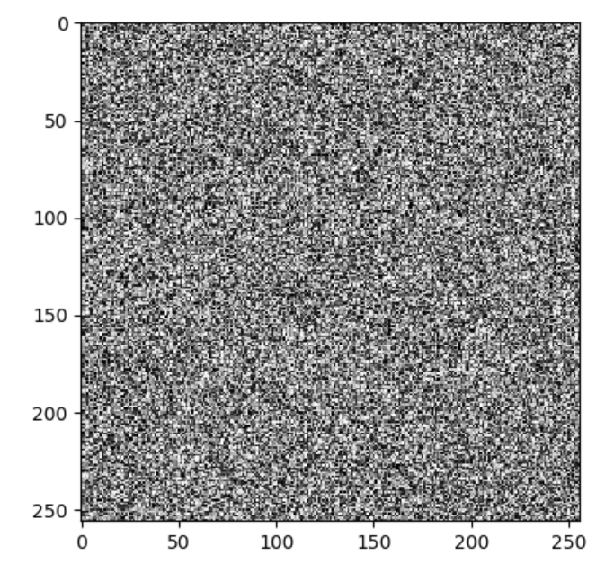
Note: matplotlib and colour maps
>>> from matplotlib import pyplot as p
>>> from numpy import random as r
>>> I = r.rand(256,256) * 0.5;
>>> p.imshow(I,cmap=‘gray’);
>>> p.show();
Next issue:
matplotlib will normalize input
e.g., map the lowest value to 0,
and the highest to 1.
Even though we multiplied by 0.5,
the overall brightness is the same.
[Additional info]

Slide 8
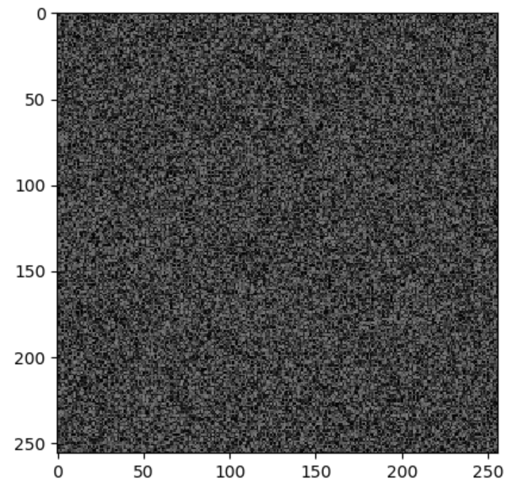
Note: matplotlib and colour maps
>>> from matplotlib import pyplot as p
>>> from numpy import random as r
>>> I = r.rand(256,256) * 0.5;
>>> p.imshow(I,cmap=‘gray’,vmin=0.0,vmax=1.0);
>>> p.show();
Better!
[Additional info]

Slide 9
Dimensionality of an Image
@ 8bit = 256 values ^ 65,536
  Computer says ‘Inf’ combinations.
Some depiction of all possible scenes
would fit into this memory.
Notes:
Zoran and Weiss: “In the context of this work, a natural image would be the result of taking an ordinary digital camera, pointing it somewhere in the world and pressing the shutter button.“

Slide 10
Dimensionality of an Image
@ 8bit = 256 values ^ 65,536
  Computer says ‘Inf’ combinations.
Some depiction of all possible scenes
would fit into this memory.
We must operate or reason over this
extremely high-dimensional space.
  Subspace of ‘natural’ images.
  Deriving low-dimensional, explainable, physically-meaningful models.
Notes:
Zoran and Weiss: “In the context of this work, a natural image would be the result of taking an ordinary digital camera, pointing it somewhere in the world and pressing the shutter button.“

Slide 11
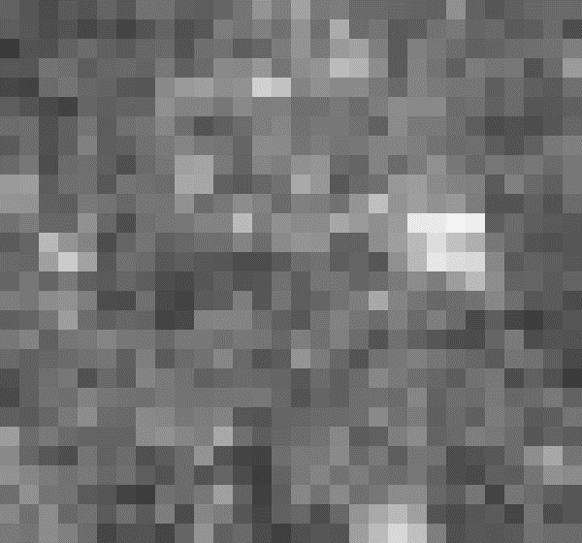
Each part of an image is a pixel
y
x
Notes:
What is a pixel?

Slide 12
Each part of an image is a pixel
Pixel -> picture element
‘138’
y
I(x,y)
x
Notes:
What is a pixel?

Slide 13
Image as a 2D sampling of signal
Signal: function depending on some variable with physical meaning.
Image: sampling of that function.
  2 variables: xy coordinates
  3 variables: xy + time (video)
  ‘Brightness’ is the value of the function for visible light
Can be other physical values too: temperature, pressure, depth …
Danny Alexander
Notes:
Danny Alexander, UCL

Slide 14
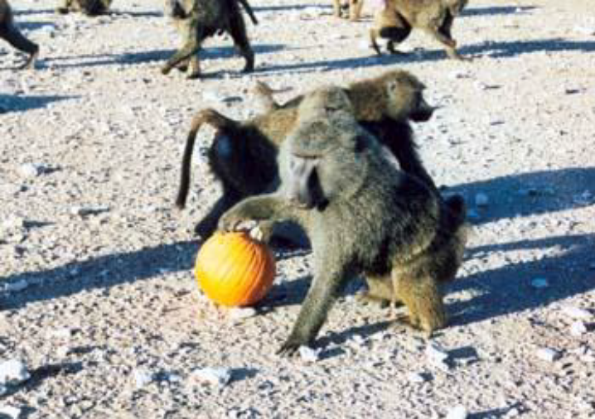
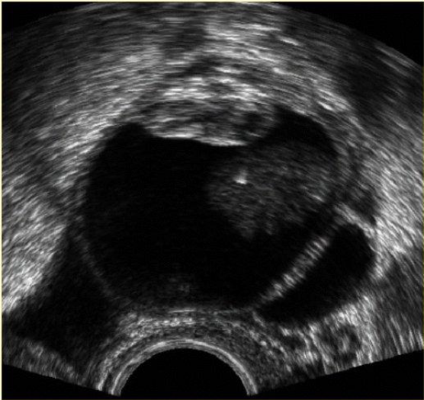
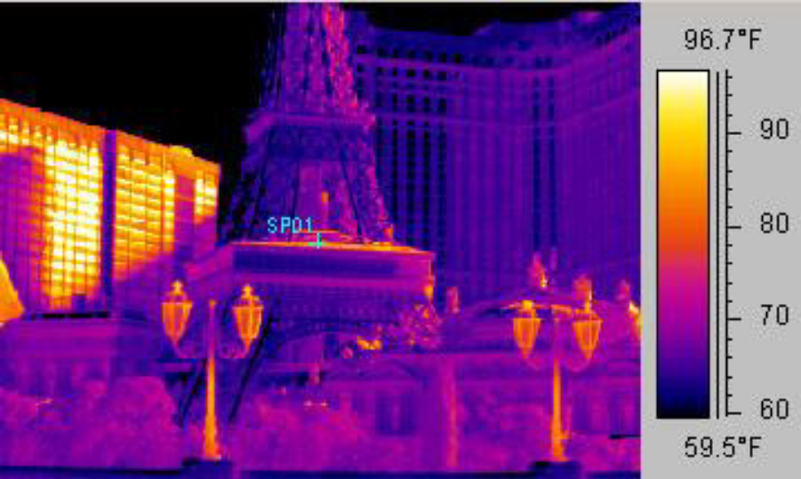
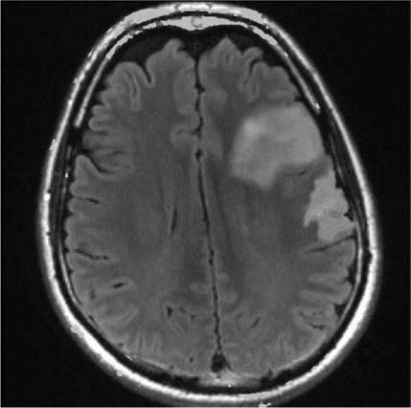
Example 2D Images
Danny Alexander
Notes:
fMRI - changes in blood flow in the brain associated with neural activity
http://radiologykey.com/wp-content/uploads/2016/01/9781604063325_c014_f004.jpg

Slide 15
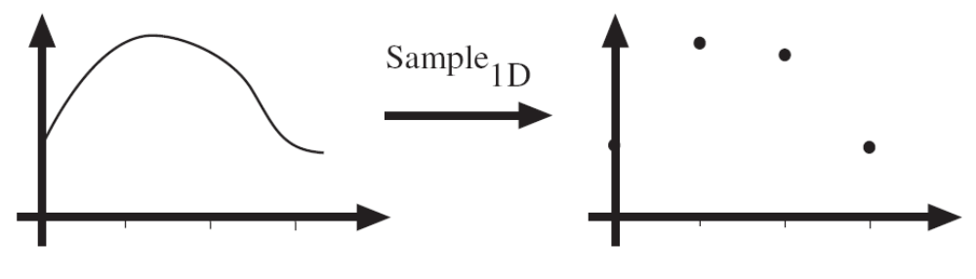
Sampling in 1D
f(x)
[2,6,5,2]
x
x
Sampling in 1D takes a ‘function’, and returns a vector whose elements are values of that function at the sample points.
Danny Alexander

Slide 16
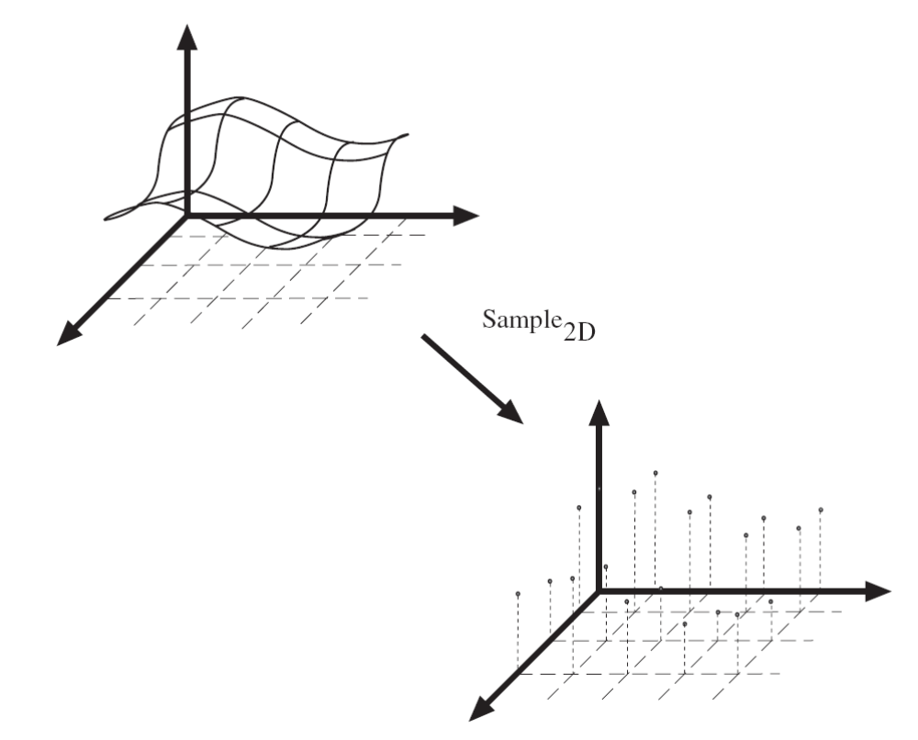
Sampling in 2D
f(x)
x
y
Sampling in 2D takes a
function and returns a matrix.
Danny Alexander

Slide 17
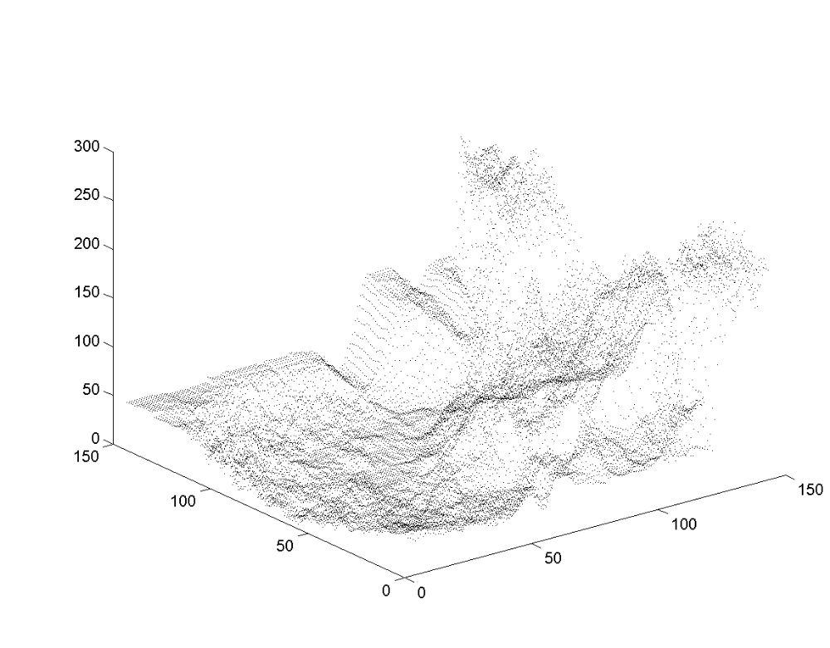
Grayscale Digital Image as ‘Height Map’
Brightness
or intensity
x
y
Danny Alexander

Slide 18
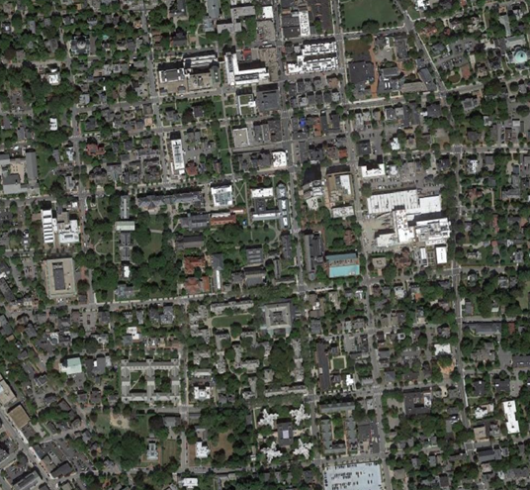
What is each part of a photograph?
Pixel -> picture element
‘127’
y
I(x,y)
x

Slide 19
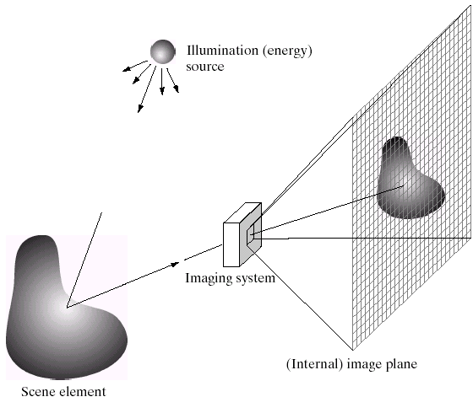
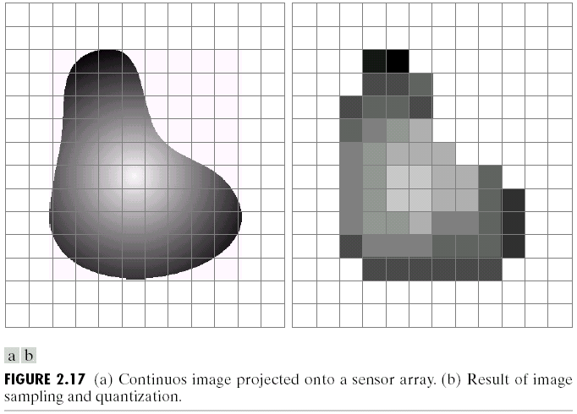
Integrating light over a range of angles.
Output Image
Camera Sensor
James Hays

Slide 20
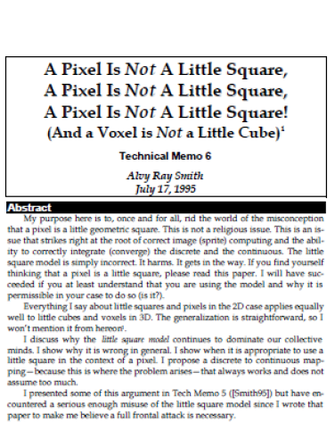
“A Pixel Is Not A Little Square,
A Pixel Is Not A Little Square,
A Pixel Is Not A Little Square!
(And a Voxel is Not a Little Cube)”
Alvy Ray Smith,
MS Tech Memo 6, 1995.

Slide 21
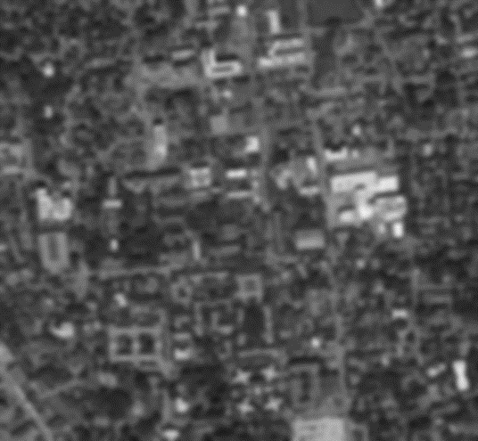

Resolution – geometric vs. spatial resolution
Both images are ~500x500 pixels
Notes:
What kinds of issues might cause this?
Difference between geometric resolution and spatial resolution.

Slide 22
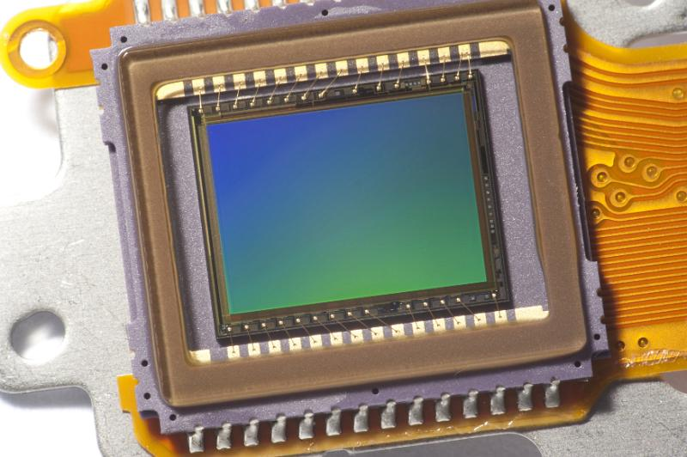
Sensor Array
CMOS sensor
James Hays
Notes:
https://www.freeimages.co.uk/galleries/transtech/audiovideo/slides/CMOS_sensor.htm
Why does it have this blue/green tint on the sensor?

Slide 23
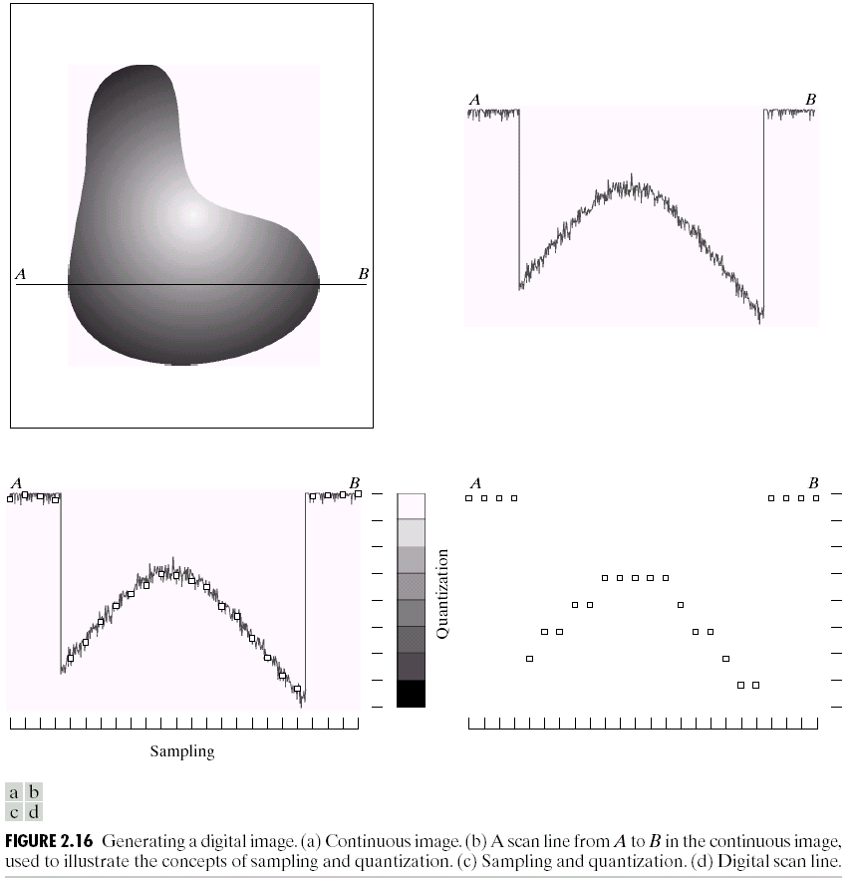
Quantization
Notes:
Real valued function will get digital values – integer values
• Quantization is lossy!!
– After quantization, the original signal cannot be reconstructed anymore
• This contrasts with sampling, as a sampled but not quantized signal can be reconstructed.
• Simple quantization uses equally spaced levels with k intervals

Slide 24
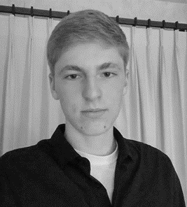
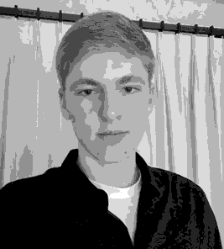
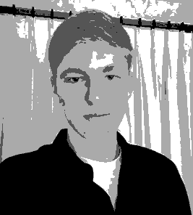
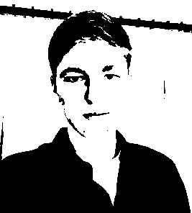
Quantization Effects – Radiometric Resolution
8 bit – 256 levels
4 bit – 16 levels
2 bit – 4 levels
1 bit – 2 levels
We often call this bit depth.
For photography, this is also related to dynamic range.
Notes:
Dynamic range: The minimum and maximum

Slide 25
Images in Python Numpy
N x M grayscale image “im”
  im[0,0] = top-left pixel value
  im[y, x] = y pixels down, x pixels to right
  im[N-1, M-1] = bottom-right pixel
column
row
0.92 | 0.93 | 0.94 | 0.97 | 0.62 | 0.37 | 0.85 | 0.97 | 0.93 | 0.92 | 0.99
0.95 | 0.89 | 0.82 | 0.89 | 0.56 | 0.31 | 0.75 | 0.92 | 0.81 | 0.95 | 0.91
0.89 | 0.72 | 0.51 | 0.55 | 0.51 | 0.42 | 0.57 | 0.41 | 0.49 | 0.91 | 0.92
0.96 | 0.95 | 0.88 | 0.94 | 0.56 | 0.46 | 0.91 | 0.87 | 0.90 | 0.97 | 0.95
0.71 | 0.81 | 0.81 | 0.87 | 0.57 | 0.37 | 0.80 | 0.88 | 0.89 | 0.79 | 0.85
0.49 | 0.62 | 0.60 | 0.58 | 0.50 | 0.60 | 0.58 | 0.50 | 0.61 | 0.45 | 0.33
0.86 | 0.84 | 0.74 | 0.58 | 0.51 | 0.39 | 0.73 | 0.92 | 0.91 | 0.49 | 0.74
0.96 | 0.67 | 0.54 | 0.85 | 0.48 | 0.37 | 0.88 | 0.90 | 0.94 | 0.82 | 0.93
0.69 | 0.49 | 0.56 | 0.66 | 0.43 | 0.42 | 0.77 | 0.73 | 0.71 | 0.90 | 0.99
0.79 | 0.73 | 0.90 | 0.67 | 0.33 | 0.61 | 0.69 | 0.79 | 0.73 | 0.93 | 0.97
0.91 | 0.94 | 0.89 | 0.49 | 0.41 | 0.78 | 0.78 | 0.77 | 0.89 | 0.99 | 0.93
James Hays

Slide 26
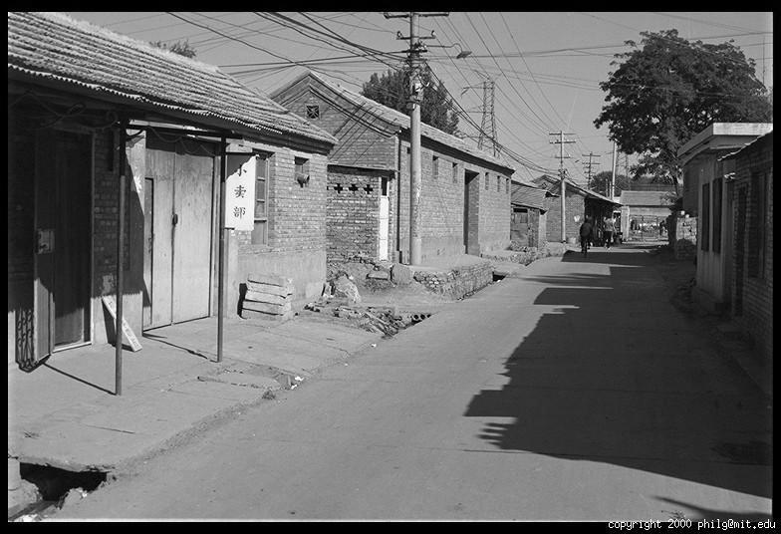
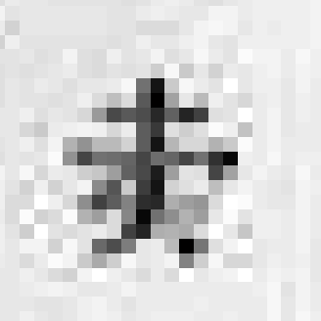
Grayscale intensity
0.92 | 0.93 | 0.94 | 0.97 | 0.62 | 0.37 | 0.85 | 0.97 | 0.93 | 0.92 | 0.99
0.95 | 0.89 | 0.82 | 0.89 | 0.56 | 0.31 | 0.75 | 0.92 | 0.81 | 0.95 | 0.91
0.89 | 0.72 | 0.51 | 0.55 | 0.51 | 0.42 | 0.57 | 0.41 | 0.49 | 0.91 | 0.92
0.96 | 0.95 | 0.88 | 0.94 | 0.56 | 0.46 | 0.91 | 0.87 | 0.90 | 0.97 | 0.95
0.71 | 0.81 | 0.81 | 0.87 | 0.57 | 0.37 | 0.80 | 0.88 | 0.89 | 0.79 | 0.85
0.49 | 0.62 | 0.60 | 0.58 | 0.50 | 0.60 | 0.58 | 0.50 | 0.61 | 0.45 | 0.33
0.86 | 0.84 | 0.74 | 0.58 | 0.51 | 0.39 | 0.73 | 0.92 | 0.91 | 0.49 | 0.74
0.96 | 0.67 | 0.54 | 0.85 | 0.48 | 0.37 | 0.88 | 0.90 | 0.94 | 0.82 | 0.93
0.69 | 0.49 | 0.56 | 0.66 | 0.43 | 0.42 | 0.77 | 0.73 | 0.71 | 0.90 | 0.99
0.79 | 0.73 | 0.90 | 0.67 | 0.33 | 0.61 | 0.69 | 0.79 | 0.73 | 0.93 | 0.97
0.91 | 0.94 | 0.89 | 0.49 | 0.41 | 0.78 | 0.78 | 0.77 | 0.89 | 0.99 | 0.93

Slide 27
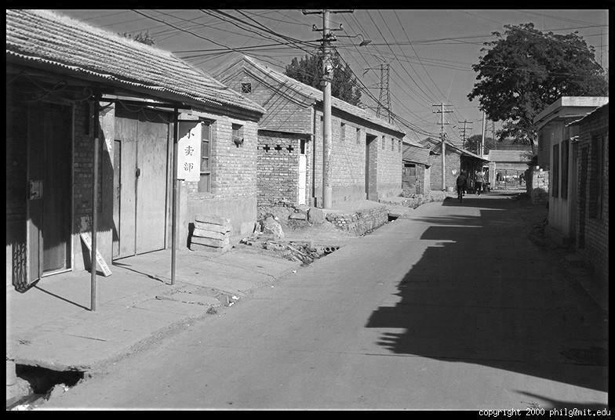
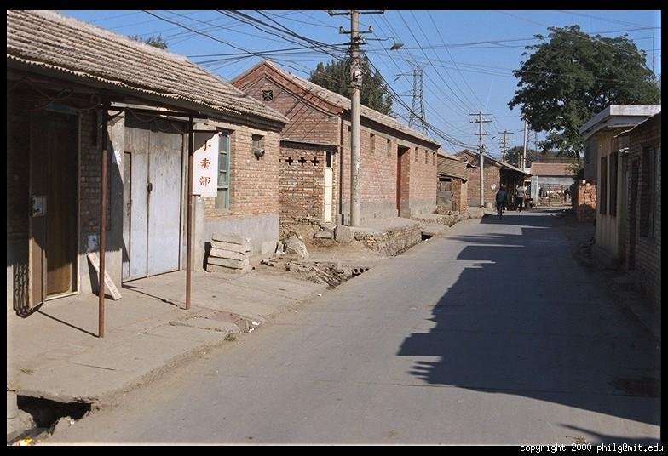
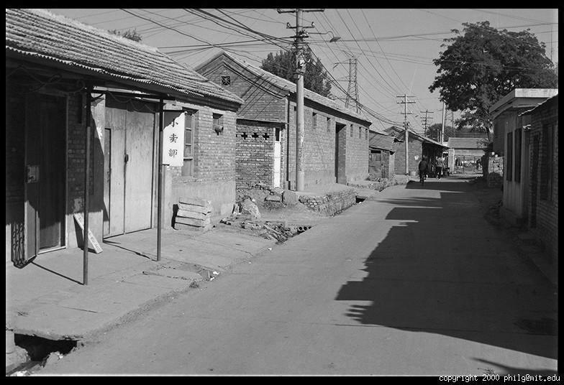
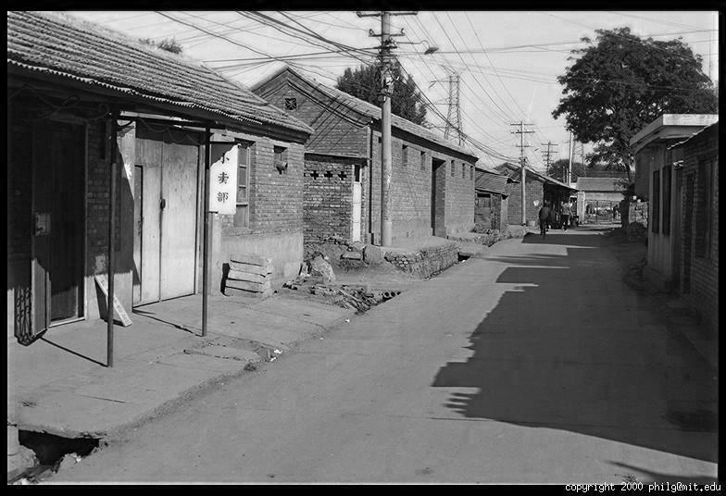
Color
R
G
B
James Hays

Slide 28
Images in Python Numpy
N x M RGB image “im”
im[0,0,0] = top-left pixel value in R-channel
im[x, y, b] = x pixels to right, y pixels down in the bth channel
im[N-1, M-1, 3] = bottom-right pixel in B-channel
column
row
0.92 | 0.93 | 0.94 | 0.97 | 0.62 | 0.37 | 0.85 | 0.97 | 0.93 | 0.92 | 0.99
0.95 | 0.89 | 0.82 | 0.89 | 0.56 | 0.31 | 0.75 | 0.92 | 0.81 | 0.95 | 0.91
0.89 | 0.72 | 0.51 | 0.55 | 0.51 | 0.42 | 0.57 | 0.41 | 0.49 | 0.91 | 0.92
0.96 | 0.95 | 0.88 | 0.94 | 0.56 | 0.46 | 0.91 | 0.87 | 0.90 | 0.97 | 0.95
0.71 | 0.81 | 0.81 | 0.87 | 0.57 | 0.37 | 0.80 | 0.88 | 0.89 | 0.79 | 0.85
0.49 | 0.62 | 0.60 | 0.58 | 0.50 | 0.60 | 0.58 | 0.50 | 0.61 | 0.45 | 0.33
0.86 | 0.84 | 0.74 | 0.58 | 0.51 | 0.39 | 0.73 | 0.92 | 0.91 | 0.49 | 0.74
0.96 | 0.67 | 0.54 | 0.85 | 0.48 | 0.37 | 0.88 | 0.90 | 0.94 | 0.82 | 0.93
0.69 | 0.49 | 0.56 | 0.66 | 0.43 | 0.42 | 0.77 | 0.73 | 0.71 | 0.90 | 0.99
0.79 | 0.73 | 0.90 | 0.67 | 0.33 | 0.61 | 0.69 | 0.79 | 0.73 | 0.93 | 0.97
0.91 | 0.94 | 0.89 | 0.49 | 0.41 | 0.78 | 0.78 | 0.77 | 0.89 | 0.99 | 0.93
R
0.92 | 0.93 | 0.94 | 0.97 | 0.62 | 0.37 | 0.85 | 0.97 | 0.93 | 0.92 | 0.99
0.95 | 0.89 | 0.82 | 0.89 | 0.56 | 0.31 | 0.75 | 0.92 | 0.81 | 0.95 | 0.91
0.89 | 0.72 | 0.51 | 0.55 | 0.51 | 0.42 | 0.57 | 0.41 | 0.49 | 0.91 | 0.92
0.96 | 0.95 | 0.88 | 0.94 | 0.56 | 0.46 | 0.91 | 0.87 | 0.90 | 0.97 | 0.95
0.71 | 0.81 | 0.81 | 0.87 | 0.57 | 0.37 | 0.80 | 0.88 | 0.89 | 0.79 | 0.85
0.49 | 0.62 | 0.60 | 0.58 | 0.50 | 0.60 | 0.58 | 0.50 | 0.61 | 0.45 | 0.33
0.86 | 0.84 | 0.74 | 0.58 | 0.51 | 0.39 | 0.73 | 0.92 | 0.91 | 0.49 | 0.74
0.96 | 0.67 | 0.54 | 0.85 | 0.48 | 0.37 | 0.88 | 0.90 | 0.94 | 0.82 | 0.93
0.69 | 0.49 | 0.56 | 0.66 | 0.43 | 0.42 | 0.77 | 0.73 | 0.71 | 0.90 | 0.99
0.79 | 0.73 | 0.90 | 0.67 | 0.33 | 0.61 | 0.69 | 0.79 | 0.73 | 0.93 | 0.97
0.91 | 0.94 | 0.89 | 0.49 | 0.41 | 0.78 | 0.78 | 0.77 | 0.89 | 0.99 | 0.93
G
0.92 | 0.93 | 0.94 | 0.97 | 0.62 | 0.37 | 0.85 | 0.97 | 0.93 | 0.92 | 0.99
0.95 | 0.89 | 0.82 | 0.89 | 0.56 | 0.31 | 0.75 | 0.92 | 0.81 | 0.95 | 0.91
0.89 | 0.72 | 0.51 | 0.55 | 0.51 | 0.42 | 0.57 | 0.41 | 0.49 | 0.91 | 0.92
0.96 | 0.95 | 0.88 | 0.94 | 0.56 | 0.46 | 0.91 | 0.87 | 0.90 | 0.97 | 0.95
0.71 | 0.81 | 0.81 | 0.87 | 0.57 | 0.37 | 0.80 | 0.88 | 0.89 | 0.79 | 0.85
0.49 | 0.62 | 0.60 | 0.58 | 0.50 | 0.60 | 0.58 | 0.50 | 0.61 | 0.45 | 0.33
0.86 | 0.84 | 0.74 | 0.58 | 0.51 | 0.39 | 0.73 | 0.92 | 0.91 | 0.49 | 0.74
0.96 | 0.67 | 0.54 | 0.85 | 0.48 | 0.37 | 0.88 | 0.90 | 0.94 | 0.82 | 0.93
0.69 | 0.49 | 0.56 | 0.66 | 0.43 | 0.42 | 0.77 | 0.73 | 0.71 | 0.90 | 0.99
0.79 | 0.73 | 0.90 | 0.67 | 0.33 | 0.61 | 0.69 | 0.79 | 0.73 | 0.93 | 0.97
0.91 | 0.94 | 0.89 | 0.49 | 0.41 | 0.78 | 0.78 | 0.77 | 0.89 | 0.99 | 0.93
B
James Hays

Slide 29
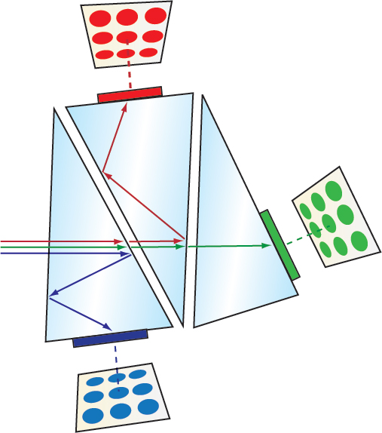
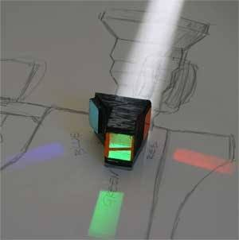
Cameras with Three Sensors
Lens
[Edmund Optics; Adam Wilt]
Notes:
https://www.edmundoptics.eu/resources/application-notes/imaging/understanding-camera-sensors-for-machine-vision-applications/
https://www.adamwilt.com/TechDiffs/CCDColor.html

Slide 30
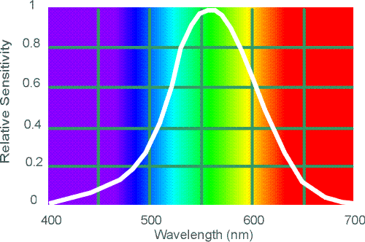
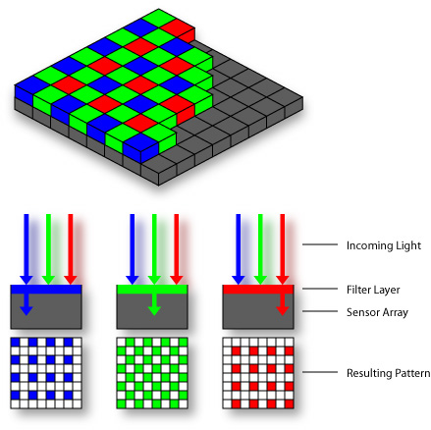

Cheaper/More Compact Color Sensing: Bayer Filter
Estimate RGB
at ‘G’ cells from neighboring values
Steve Seitz

Slide 31
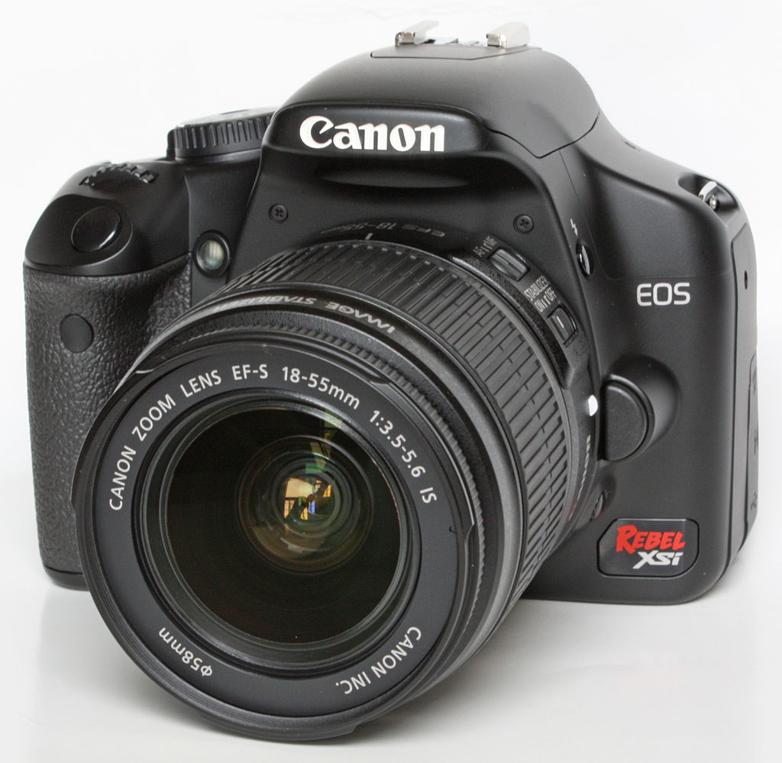
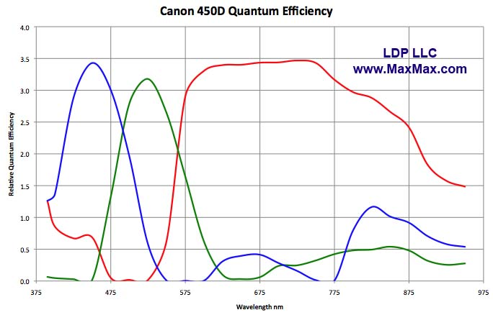
Camera Color Response
Canon 450D
What’s going on over here?
MaxMax.com
Notes:
https://en.wikipedia.org/wiki/Quantum_efficiency
Literally “the percentage of photons hitting the device's photoreactive surface that produce charge carrying electrons. It is measured in electrons per photon or amps per watt.”

Slide 32
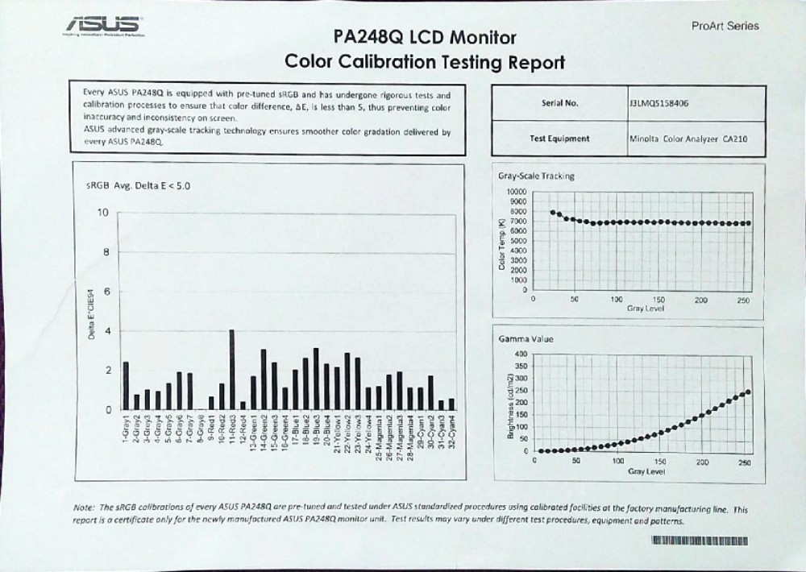
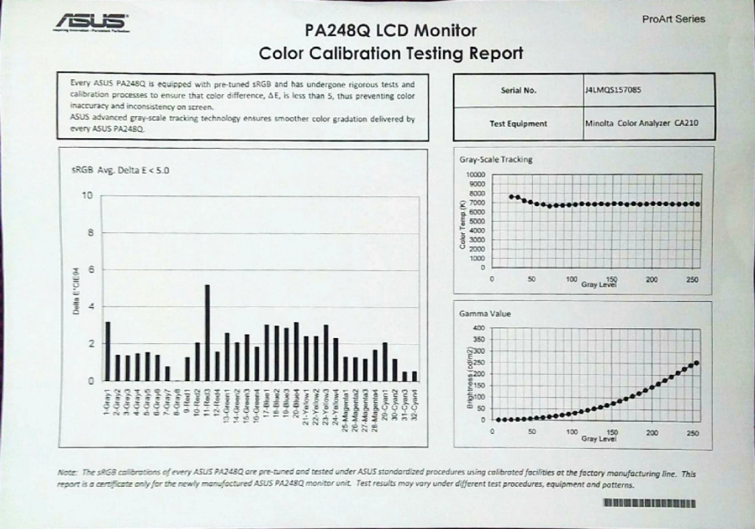
Display Color Response

Slide 33
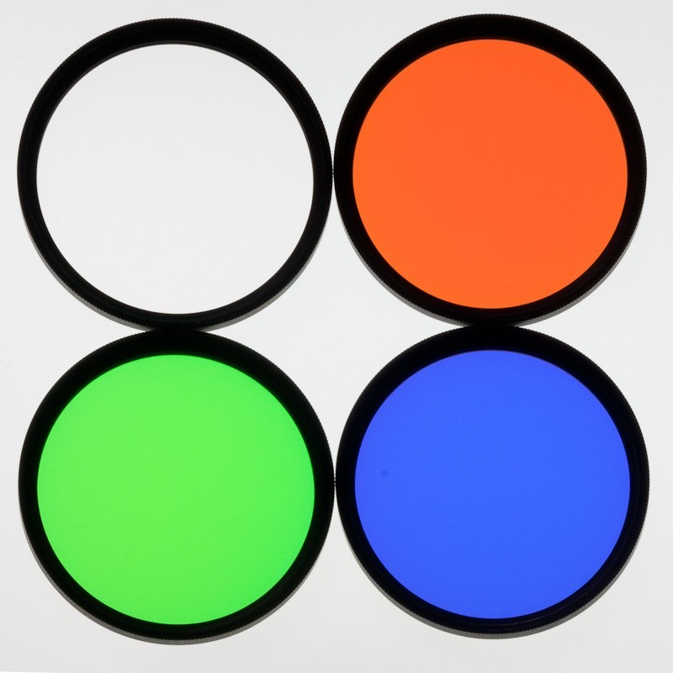
How to capture color?
Back in the old days…
Take three photographs each with a different color filter
How to display?
Light is additive (linear), so just
project three photographs on
top of each other!
[High Point Scientific]
Notes:
https://www.highpointscientific.com/astronomik-lrgb-filter-set-2-round-mounted-lrgb-2?utm_source=google&utm_medium=cse&utm_term=ASF-LRGB-2&gclid=EAIaIQobChMI-5KtlK-z3QIVyJ6zCh1l2gnuEAQYBSABEgJRQ_D_BwE

Slide 34
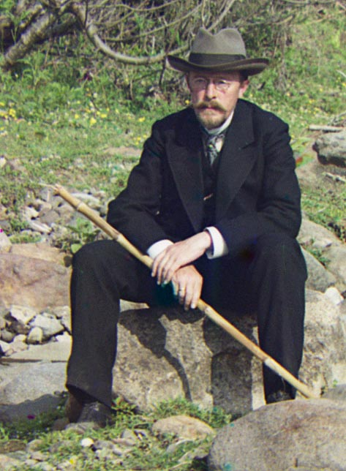
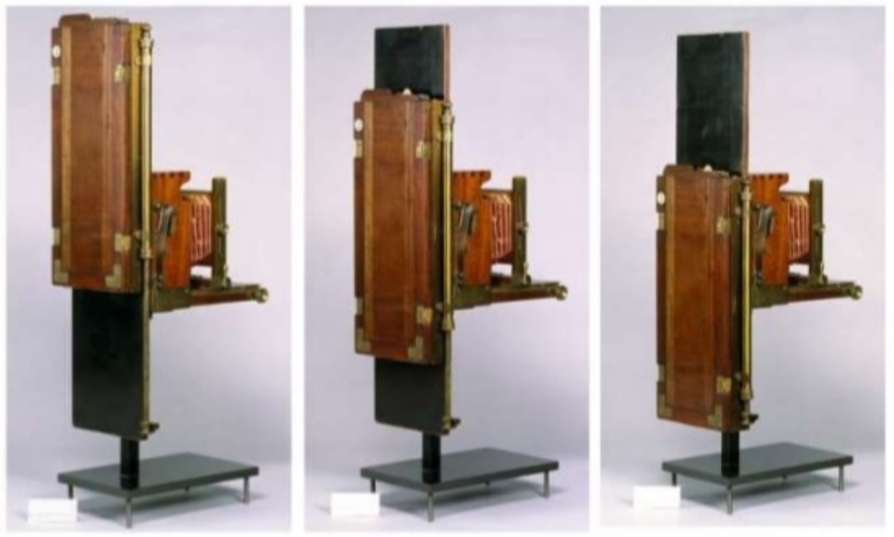
The Prokudin-Gorsky Photo Collection
Prokudin-Gorsky (1863-1944)
Similar design camera of
Adolf Miethe
[Nadezhda Stanulevich, Russian Academy of Fine Arts]
Notes:
Prokudin-Gorsky visit Adolf Miethe in Charlottenberg around ~1902.
Info from:
Nadezhda Stanulevich
Russian Academy of Fine Arts Museum
https://www.slideshare.net/NadezhdaStanulevich/emigrant-age-colour-photographs-and-films-by-prokudingorskii-sons

Slide 35
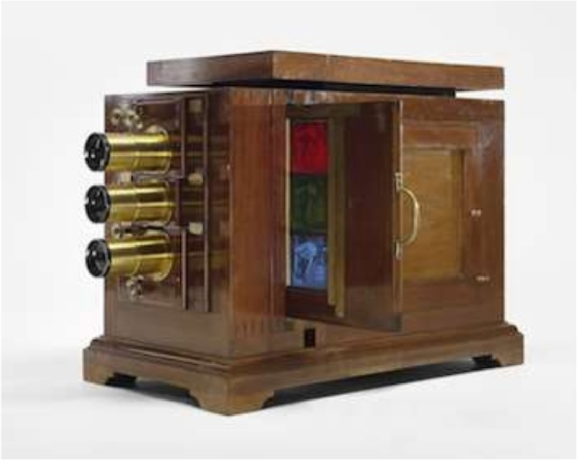
The Prokudin-Gorsky Photo Collection
Prokudin-Gorsky (1863-1944)
Similar design viewing projector of Adolf Miethe
[Nadezhda Stanulevich, Russian Academy of Fine Arts]
Notes:
Prokudin-Gorsky visit Adolf Miethe in Charlottenberg around ~1902.
Info from:
Nadezhda Stanulevich
Russian Academy of Fine Arts Museum
https://www.slideshare.net/NadezhdaStanulevich/emigrant-age-colour-photographs-and-films-by-prokudingorskii-sons

Slide 36
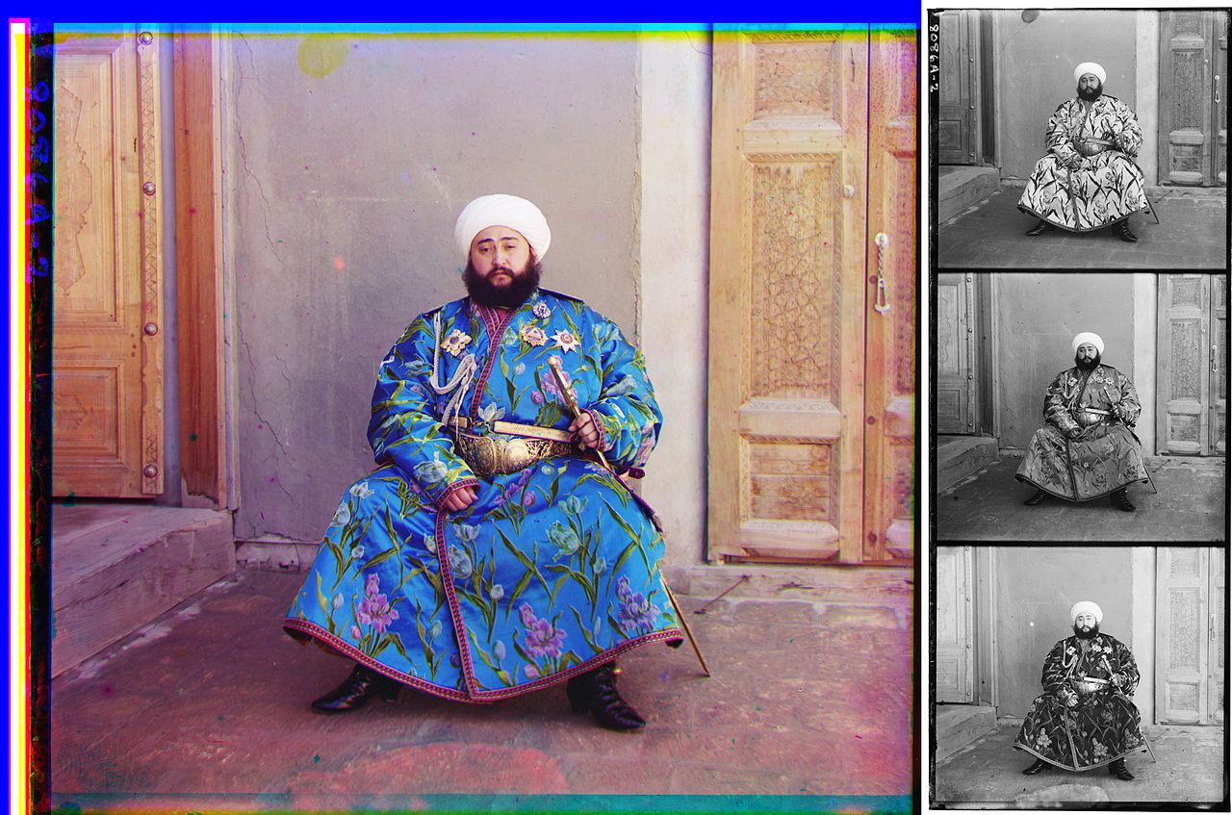
Alim Khan,
emir of Bukhara,
1911.
[Wikipedia]
Notes:
Simple, unretouched color composite of Alim Khan, emir of Bukhara, 1911. At right, the original triple negative on glass, shown here in positive form. Prokudin-Gorsky photographed the upper, middle and lower images through blue, green and red filters.
https://upload.wikimedia.org/wikipedia/commons/3/33/Prokudin-Gorskii-19.jpg

Slide 37
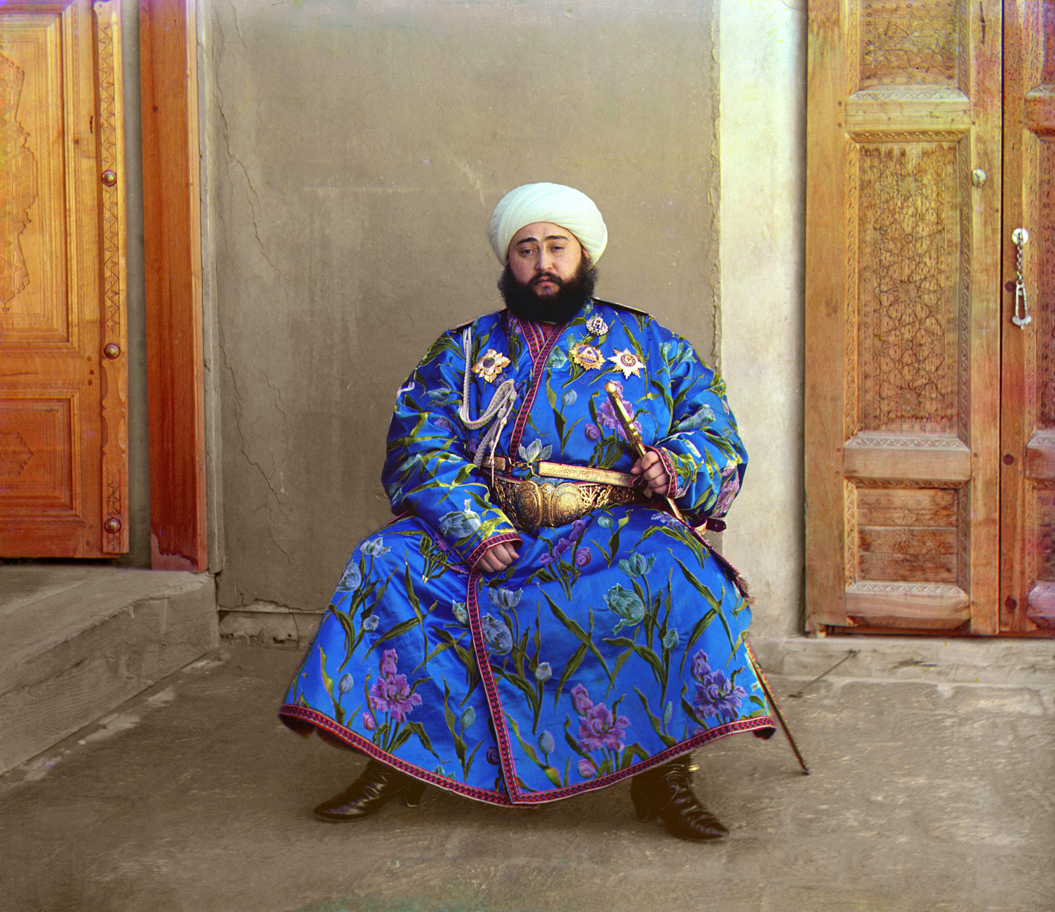
‘Good result’
Six or seven hours
of manual work…
Geometric correction
Radiometric (color) correction
Blemish removal
Too much!
Let’s go computational!
[Wikipedia]

Slide 38
Project 1: Image Alignment to Recombine the Prokudin-Gorsky Photo Collection
How to align R,G,B channels?
Think-pair-share!

Slide 39
Project 1: Image Alignment to Recombine the Prokudin-Gorsky Photo Collection
Approach we will take: sliding window.

Slide 40
Project 1: Image Alignment to Recombine the Prokudin-Gorsky Photo Collection
Approach we will take: sliding window.
Compute metric for similarity at each position.

Slide 41
Project 1: Image Alignment to Recombine the Prokudin-Gorsky Photo Collection
Approach we will take: sliding window.
Compute metric for similarity at each position.
What is a good metric?
(open research problem)

Slide 42
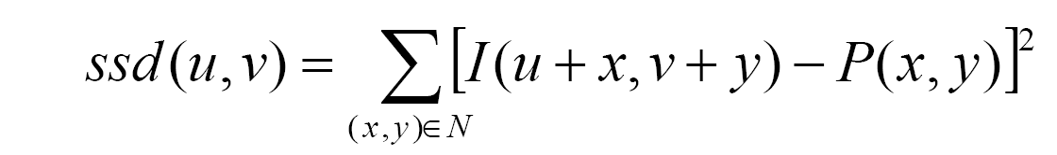
Project 1: Image Alignment to Recombine the Prokudin-Gorsky Photo Collection
Approach we will take: sliding window.
Compute metric for similarity at each position.
Candidate metrics:
  Sum of Squared Differences (SSD):
I = Image to align
P = Image to compare
x,y = Pixel coordinates
u,v = Alignment offset coordinates
N = ‘Neighbourhood’ of pixels to compare (e.g., whole image)

Slide 43
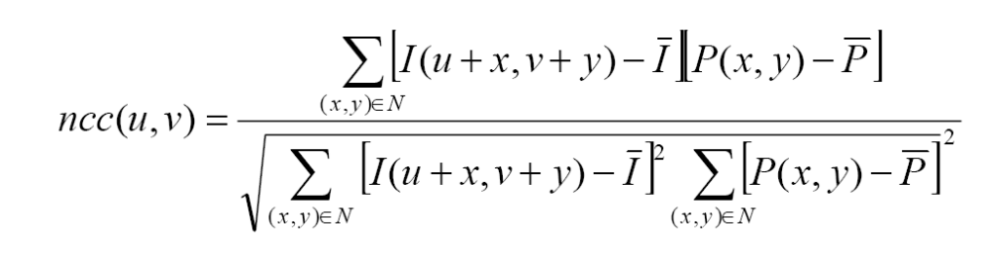
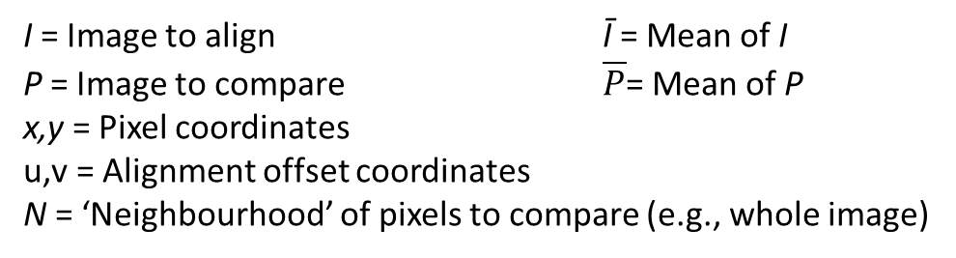
Project 1: Image Alignment to Recombine the Prokudin-Gorsky Photo Collection
Approach we will take: sliding window.
Compute metric for similarity at each position.
Candidate metrics:
  Normalized Cross Correlation (NCC):
I = Image to align Ī = Mean of I
P = Image to compare $\overline{P}$= Mean of P
x,y = Pixel coordinates
u,v = Alignment offset coordinates
N = ‘Neighbourhood’ of pixels to compare (e.g., whole image)

Slide 44
Project 1: Image Alignment to Recombine the Prokudin-Gorsky Photo Collection
Next problem: It’s expensive!
Especially for high-resolution images.
Coarse-to-fine strategy:
1. Compare at low resolution; find alignment
2. At higher resolution, search around this alignment
3. Repeat

Slide 45
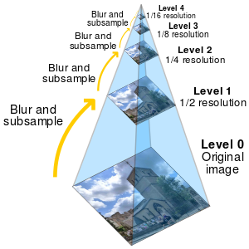
Multi-resolution Image Pyramids
  Good for:
  Search over translations
    Like project 1
    Classic coarse-to-fine strategy
  Search over scale
    Template matching
    E.g. find a face at different scales
    Pre-computation
    Real-time graphics (texture mapping via ‘mip map’)
    Compositing
    In a couple of lectures…
Graphic: Wikipedia – Image Pyramids
Notes:
A mip map [Williams, 1983] helps us solve aliasing issues in computer graphics.
Also called a ‘Gaussian pyramid’ if the pyramid is constructed through convolution.
Other connections:
- Image pyramid is a precursor to the wavelet transform
- Convolution Pyramids, Farbman et al., SIGGRAPH Asia 2011 - http://www.cs.huji.ac.il/labs/cglab/projects/convpyr/
Allow large-support kernels to be approximated by pyramids of smaller kernels -> more efficient

Slide 46
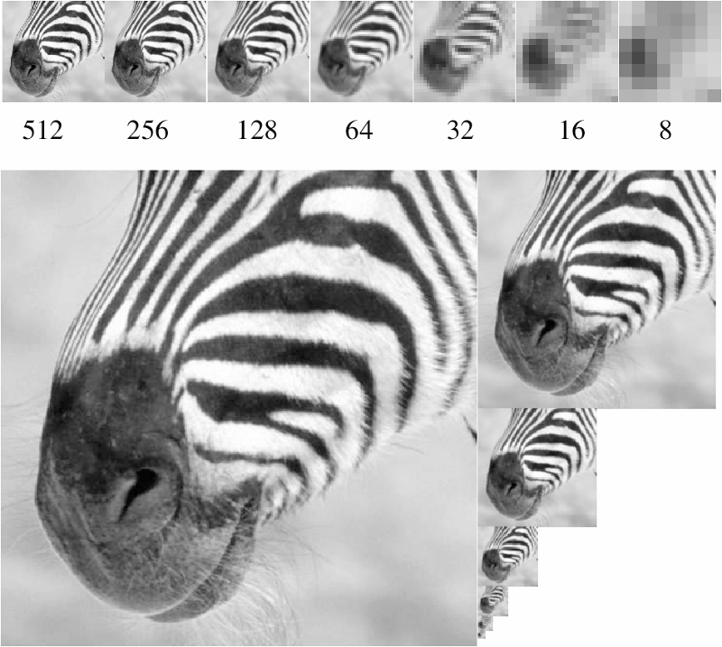
A bar in the big images is a hair on the zebra’s nose; in smaller images, a stripe; in the smallest, the animal’s nose
Figure from David Forsyth

Slide 47
Algorithm for downsampling by factor of 2
Start with image(h, w)
Sample every other pixel
  im_small = image( 1:2:end, 1:2:end );
Repeat until im_small is 1 pixel large.
Hays

Slide 48
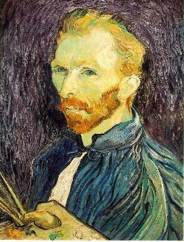


Image sub-sampling
1/8
1/4
Throw away every other row and column to create a 1/2 size image.
Steve Seitz

Slide 49


Subsampling without filtering
1/2
1/4 (2x subsample)
1/8 (4x subsample)
Steve Seitz

Slide 50

Sampling and Reconstruction
Most slides from
Alexei Efros and Steve Marschner
CS 129: Computational Photography

Slide 51

Subsampling and aliasing

Slide 52

Sampled representations
How to store and compute with continuous functions?
Common scheme for representation: samples
  Write down the function’s values at many points
[FvDFH fig.14.14b / Wolberg]

Slide 53
Reconstruction
Making samples back into a continuous function
  For output (need realizable method)
  For analysis or processing (need mathematical method)
  Amounts to “guessing” what the function did in between
[FvDFH fig.14.14b / Wolberg]

Slide 54

Sampling in digital audio
Recording: sound to analog to samples to disc
Playback: disc to samples to analog to sound again
  How can we be sure we are filling in the gaps correctly?

Slide 55

1D Example: Audio
Input signal:
Low
High
Frequency

Slide 56

Aliasing problem
1D example (sinewave):
Source: S. Marschner

Slide 57

Aliasing problem
1D example (sinewave):
Source: S. Marschner

Slide 58

What’s happening?
Input signal:
Plot as image:
x = 0:.05:5; imagesc(sin((2.^x).*x))
Aliasing!
Not enough samples

Slide 59

Aliasing problem
Sub-sampling may be dangerous….
Characteristic errors may appear:
  “Car wheels rolling the wrong way in movies”
  “Striped shirts look funny on color television”
  “Checkerboards disintegrate in ray tracing”
    Moiré patterns!
Source: D. Forsyth; Wikipedia

Slide 60

Aliasing in graphics
Source: A. Efros

Slide 61

Gong 96, 1932, Claude Tousignant, Musée des Beaux-Arts de Montréal
Notes:
Aliasing and Moiré patterns

Slide 62

Aliasing in video
Slide by Steve Seitz

Slide 63



Videos
[YouTube; JoinBuzzirk; phrancque]
Notes:
https://www.youtube.com/watch?v=Y1yHMy0-4TM
https://www.youtube.com/watch?v=jQDjJRYmeWg

Slide 64
Nyquist-Shannon Sampling Theorem
When sampling a signal at discrete intervals, the sampling frequency must be ≥ 2 × f_{max}
f_{max} = max frequency of the input signal
This allows to reconstruct the original perfectly from the sampled version
good
bad

Slide 65
How to fix aliasing?
Solutions?

Slide 66
Better sensors
Solutions:
Sample more often ; )

Slide 67
Anti-aliasing
Solutions:
Sample more often ; )
Remove all frequencies that are greater than
half the new sampling frequency (often called ‘high frequencies’)
  Will lose information
  But it’s better than aliasing
  How? Apply a smoothing filter to the input signal
    Often called ‘low pass’ filter because it lets through low frequencies.
    Could also be called a ‘high cut’ filter (but nobody does)
Hays

Slide 68

Preventing aliasing
Introduce lowpass filters:
  Remove high frequencies leaving only safe, low frequencies
  Choose lowest frequency in reconstruction (disambiguate)

Slide 69

Anti-aliasing
Forsyth and Ponce 2002

Slide 70
Subsampling without filtering
1/2
1/4 (2x subsample)
1/8 (4x subsample)
Steve Seitz

Slide 71



Subsampling with Gaussian pre-filtering
Gaussian 1/2
G 1/4
G 1/8
Gaussian Pyramid [Burt and Adelson, 1983]
Steve Seitz

Slide 72
Gaussian pyramid construction
filter mask
Repeat
  Filter
  Subsample
Until minimum resolution reached
  can specify desired number of levels (e.g., 3-level pyramid)
The whole pyramid is only 4/3 the size of the original image!
Slide by Steve Seitz

Slide 73
Project 1: Image Alignment to Recombine the Prokudin-Gorsky Photo Collection
Make alignment operation fast using image pyramid.
Remove aliasing from pyramid by filtering.
Coarse-to-fine strategy:
0. Build Gaussian Pyramid
1. Compare at low resolution; find alignment
2. At higher resolution, search around this alignment
3. Repeat

Slide 74
Break time question
Does the eye alias? Why or why not?
Notes:
Spatially, apparently not. The retina (sensor) has high resolution, but the optics of the eye cannot meet that resolution, and so the image is blurred optically before being sampled (removes high-frequency content!)
https://extellireader.wordpress.com/2009/03/03/aliasing-in-sensory-and-neurobiological-systems/

Slide 75

Notes:
Signal frequency, aliasing, and color!

Slide 76

The blue and green colors are actually the same
http://blogs.discovermagazine.com/badastronomy/2009/06/24/the-blue-and-the-green/

Slide 77
Shouldn’t my camera alias everywhere?

Slide 78
Why it doesn’t: Optical low-pass filters (OLPF)
Most cameras have an optical low-pass filter just before the sensor.
Removes frequencies above that which sensor can image.
Some cameras do not have OLPF
- Maximizes sharpness
- Assume that any aliasing will be removed by the author with digital post processing
- More common in special purpose professional commercial cameras
Notes:
Many camera sensors include an optical low-pass filter just above the sensor:
- http://www.strollswithmydog.com/resolution-model-digital-cameras-aa/#footnote
- http://mtfmapper.blogspot.com/2012/06/nikon-d40-and-d7000-aa-filter-mtf.html
But you can buy cameras without it!
https://www.outdoorphotographer.com/photography-gear/cameras/can-you-go-no-low-pass/
This is especially true of ‘Medium format’ cameras, which have _very large_ sensors and are used commonly for professional commercial photography (portraiture, product shots, etc.)
The assumption there is that any artifacts due to aliasing will be _post processed out_ (typically using computation and human work).

Slide 79


What is an optical low-pass filter (OLPF)?
Typically made from two one-way birefringent filters
Birefringence: “the optical property of a material having a refractive index that depends on the polarization and propagation direction of light.”
Birefringent material
Camera ‘prefilter’ over sensor:
Notes:
Birefringence:
https://en.wikipedia.org/wiki/Birefringence
“the optical property of a material having a refractive index that depends on the polarization and propagation direction of light.”
https://www.outdoorphotographer.com/photography-gear/cameras/can-you-go-no-low-pass/
Wave plate: changes polarization of light going through it.

