Slide 1
Comparing Brand Rivalries
Download from course website:
data (then extract it)
3-4Starter.py

Slide 2
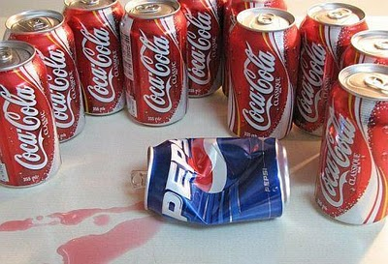


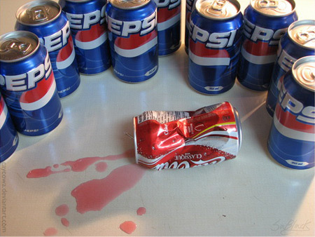
Which one of them is the most heated competition?

Slide 3
Idea
Look at tweets that talk about them
See which pair is mentioned together most frequently
Belligerence score = # of times mentioned together / # of times either is mentioned
Attention score = # of times mentioned together / # of hours during which they are mentioned

Slide 4
Look at 3-4Starter.py
Mark (using comments) places where you do not understand / haven't seen before
We'll discuss them in a minute

Slide 5
while loop
We've seen for-loop
Here's another way of looping:
  while (some condition that evaluates to Boolean) :
  do something
The 'do something' part will be executed again and again until the condition becomes false.

Slide 6
Using while-loop to iterate structured data
myList = [1,4,6,3,8,4,0]
index = 0
while (index != len(myList)):
print(myList[index])
index += 1
How do you rewrite it using a for-loop? (two ways)

Slide 7
Now you have a way of breaking your computer
import random
myList = []
while True:
myList += [random.random()]
What does it do?

Slide 8
Print meaningful things in your program
Helps debugging
Helps showing progress
Print indicating texts along with values you are interested in.

Slide 9
Finding out Belligerence Score
Belligerence score = # of times mentioned together / # of times either is mentioned
Algorithm
Set a count (# of times mentioned together), 0 intially
For each tweet:
  text ← look up its text
  cokeMentioned ← True if 'coke' is in text, False otherwise
  pepsiMentioned ← True if 'pepsi' is in text, False otherwise
  if both cokeMentioned and pepsiMentioned are True
    increase count by 1
Divide count by total number of tweets, print answer

Slide 10
How to find out
if 'coke' appears in some text?
Regular expression!
re.findall(pattern, string)
What the pattern should be?

Slide 11
Finding out Attention Score
Attention score = # of times mentioned together / # of hours during which they are mentioned
How to find out the denominator?

Slide 12
Repeat this
for the personal computer war
for the smartphone war

