Slide 1


Jockey
Guaranteed Job Latency in
Data Parallel Clusters
Andrew Ferguson, Peter Bodik, Srikanth Kandula, Eric Boutin, and Rodrigo Fonseca
Notes:
Hi! As George mentioned, I’m Andrew Ferguson from Brown University, and this afternoon, I’m going to present Jockey, which provides guaranteed job latency in data parallel clusters. This was developed during my internship at Microsoft Research.
(Pause) (click)
For several years now, …

Slide 2

Data parallel clusters
Notes:
… major websites have used….

Slide 3
Data parallel clusters
Notes:
… data parallel clusters as an important part of the backend. At Bing, they’re used for inverting web indices, analyzing clickstreams, aggregating server logs, and other large tasks.
(Pause) (click)
Users of data parallel clusters

Slide 4
Predictability
Data parallel clusters
Notes:
… now demand predictable latency. They want to know how long their jobs will take.

Slide 5
Deadline
Data parallel clusters
Notes:
Predictability can be provided by enforcing deadlines …

Slide 6

Deadline
Data parallel clusters
Notes:
… which can also be specified in contracts with business partners.
In a modern data parallel cluster, many deadlines exist for business purposes.
Missing these deadlines has negative financial consequences for the business, which we’d like to avoid.
Previous work on scheduling in data parallel clusters sought to maximize fairness.
However, our jobs need to execute with a predictable latency target set by the user.

Slide 7
Variable latency
Notes:
Providing deadlines would be easy if data parallel computations had deterministic latency.
Unfortunately, if we look at the runtime distributions for even a few recurring data parallel jobs, we see this is not the case.

Slide 8
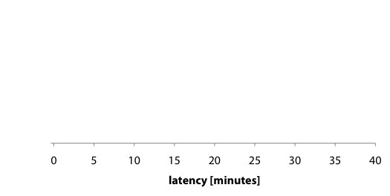
Variable latency
Notes:
Along the X axis, we plot the execution latency.

Slide 9
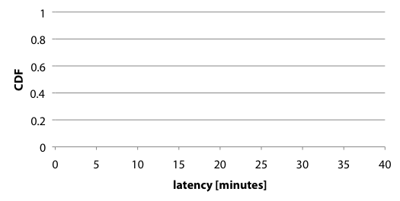
Variable latency
Notes:
And along the Y axis, we plot the percentage of runs which finished by the specified time.
A deterministic job would appear as a vertical line on this graph.

Slide 10
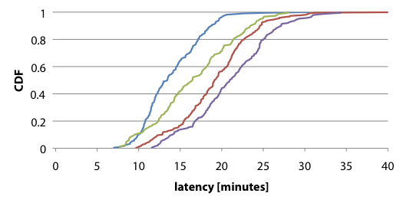
Variable latency
Notes:
These four example jobs, each with more than 100 executions in a production cluster, are clearly not vertical.

Slide 11
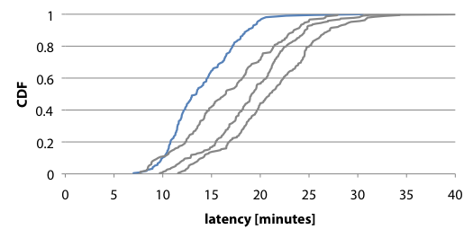
Variable latency
Notes:
Even for the job with the most narrow distribution…

Slide 12
Variable latency
Notes:
the ratio of longest runtime

Slide 13
Variable latency
Notes:
To shortest

Slide 14
4.3x
Variable latency
Notes:
Is 4.3 times.
(PAUSE)

Slide 15
Why does latency vary?
Pipeline complexity
Noisy execution environment
Notes:
So, why does latency vary in data parallel clusters?
(pipeline complexity)
Today’s data parallel jobs are sophisticated multi-stage programs.
(noisy execution environment)
Many jobs
running concurrently
sharing resources which are highly utilized
And of course, equipment failures at this scale

Slide 16

Cosmos
Microsoft’s data parallel clusters
Notes:
We found these answers by looking at Cosmos, which is Microsoft’s environment for data parallel batch processing.
Cosmos runs across many clusters, and primarily supports the Online Services Division, which includes Bing web search, Microsoft AdCenter, MSN and other properties.
Cosmos consists of three main components:

Slide 17
Cosmos
CosmosStore
Microsoft’s data parallel clusters
Notes:
CosmosStore - a distributed filesystem similar to Hadoop’s HDFS or the Google File System

Slide 18
Cosmos
CosmosStore
Dryad
Microsoft’s data parallel clusters
Notes:
Dryad - a data parallel execution engine introduced at EuroSys five years ago.

Slide 19
Cosmos
CosmosStore
Dryad
SCOPE
Microsoft’s data parallel clusters
Notes:
SCOPE - a SQL-like query language which is compiled to Dryad plans
(PAUSE)
This work focuses…

Slide 20
Cosmos
CosmosStore
Dryad
SCOPE
Microsoft’s data parallel clusters
Notes:
… on allocating resources for Dryad.
(Pause) (click for slide)
Cosmos clusters have…

Slide 21
Cosmos Cluster
Dryad’s dag workflow
Notes:
…. multiple processing pipelines running simultaneously.
(click for slide)
Some pipelines are even run …

Slide 22
Cosmos Cluster
Dryad’s dag workflow
Notes:
…. on behalf of external (non-Microsoft) customers.

Slide 23
Pipeline
Job
Dryad’s dag workflow
Notes:
Each pipeline consists of multiple dependent jobs. The outputs of earlier jobs become the inputs of later jobs.

Slide 24
Deadline
Deadline
Deadline
Deadline
Deadline
Dryad’s dag workflow
Notes:
These dependences mean that deadlines on a complete pipeline will create deadlines on the constituent jobs.

Slide 25
Deadline
Deadline
Deadline
Deadline
Deadline
Dryad’s dag workflow
Notes:
As pipelines can contain jobs managed by multiple teams, the coordination of these deadlines can be challenging.
Looking at Cosmos jobs with dependencies, we see that the median job’s output is used by more than ten other jobs.
And for the top 10% of these jobs, there are over one hundred dependent jobs.

Slide 26
Job
Stage
Dryad’s dag workflow
Notes:
Diving deeper, in Dryad, each job is built from a directed acyclic graph of stages.
Big production jobs have 10s – 100s of stages.

Slide 27
Tasks
Job
Stage
Dryad’s dag workflow
Notes:
And each stage consists of multiple independent tasks executing the same program on different input.
(Pause)

Slide 28

Notes:
So, in this noisy execution environment with complicated jobs and multistage pipelines, how can our users express their performance targets?

Slide 29
Priorities?
Expressing performance targets
Notes:
We first consider priority classes as a simple approach. However, they are not expressive enough.
When the cluster is overloaded and too many jobs have the highest priority, which job should be run first?
Or perhaps, it might actually be better for the business to predictably complete several lower-priority jobs rather than a single high-priority job.
Furthermore, in any shared environment, providing predictability though a special class of high-priority jobs can be detrimental to other jobs because lower priority jobs might be evicted by higher priority ones.
We need an approach which does not potentially harm other jobs.

Slide 30

Priorities? Not expressive enough
Weights?
Expressing performance targets
Notes:
Weights are an excellent mechanism for allocating resources in a shared cluster.
Hadoop’s FairScheduler and CapacityScheduler are popular weight-based approaches to sharing Hadoop clusters.
However, we found that our users have trouble setting these weights.
They find it challenging to map the desired runtime to the appropriate weight.
Again, because the jobs are complicated and the cluster is noisy, the effect of adjusting the weight is hard to predict.
If we wanted to provide predictable performance using weights and admission control, these poorly-sized requests from our users would make it difficult to be successful.

Slide 31
Priorities? Not expressive enough
Weights? Difficult for users to set
Utility curves?
Expressing performance targets
Notes:
Finally, we consider utility curves in which the user specifies the benefit that comes from finishing the job by a certain time.
This benefit can directly map to any contractually-specified financial penalties which might be incurred for missing a deadline.

Slide 32

Priorities? Not expressive enough
Weights? Difficult for users to set
Utility curves? Capture deadline & penalty
Expressing performance targets
Notes:
For these reasons, we found utility curves to be the best method of expressing performance targets.
The curves submitted by our users are piece-wise linear, and a simple text format describes their starting point, end point and inflection points.
We can then map these utility curves onto weights automatically, removing the configuration burden from the users.

Slide 33
Our goal
Notes:
Now that we understand our users’ performance targets, we can formalize our goal.

Slide 34
Maximize utility
Our goal
Notes:
For each job, we want to maximize the value of the user-provided utility curve…

Slide 35
Maximize utility
while minimizing resources
Our goal
Notes:
… while minimizing resources.
This is important because we want to run as many jobs as possible while still providing predictable performance for our users.

Slide 36
Maximize utility
while minimizing resources
by dynamically adjusting the allocation
Our goal
Notes:
To accomplish our goal, we will dynamically adjust the weight used for allocating resources.
In Cosmos, these weights provide a fixed slice of CPU and memory, but do not guarantee disk or network bandwidth.
If this were Hadoop, our goal might be to maximize utility while minimizing resources by dynamically adjusting the weights in the Fair Scheduler.
Our experiments show that this simple mechanism of adjusting the weight is sufficient for providing predictable performance.
We can overcome most variance in the cluster simply by running a job with an appropriately greater weight.
(Pause)
I want to pause here for a moment and say that while this goal only maximizes the utility of a single job, we can provide predictable performance for multiple jobs as long as their cumulative resource requirements are satisfiable. This condition can be enforced by doing admission control using the resource models we develop as part of the solution. In the future, we could rebalance across multiple jobs in order to maximize global utility.

Slide 37
Jockey
Notes:
Jockey is the system we developed to meet this goal.

Slide 38
Jockey
Large clusters
Notes:
Jockey is designed for large shared clusters…

Slide 39
Jockey
Large clusters
Many users
Notes:
… with many simultaneous users…

Slide 40
Jockey
Large clusters
Many users
Prior execution
Notes:
… and jobs with A prior execution.
In our environment, there are always many jobs running and several tasks executing on each of the 1000s of machines.
Jockey requires at least one previous execution to build a model of the job’s performance.
This is not a problem for the jobs we focused on because more than 40% of jobs in Cosmos are recurring, including the majority of those with service-level objectives.

Slide 41
f(job state, allocation) -> remaining run time
Jockey – model
Notes:
At it’s core, Jockey has two components.
The first is a model of the job, which we can think of as a function from

Slide 42
f(job state, allocation) -> remaining run time
Jockey – Model
Notes:
The state of the job

Slide 43
f(job state, allocation) -> remaining run time
Jockey – Model
Notes:
And the current allocation of resources

Slide 44
f(job state, allocation) -> remaining run time
Jockey – Model
Notes:
To the remaining run time

Slide 45
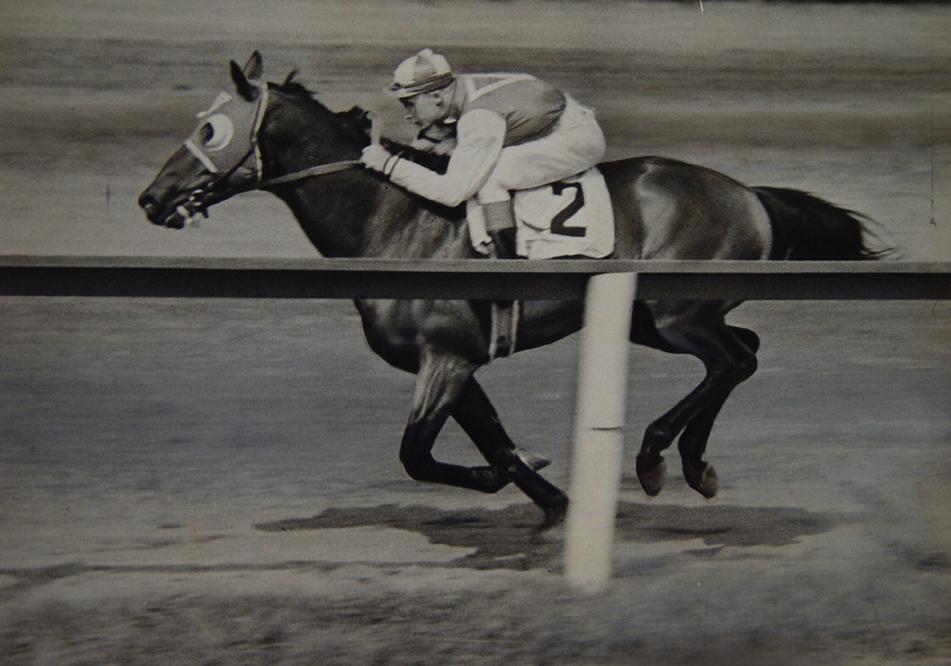
Jockey – Control loop
Notes:
And the second is a feedback loop, which like a Jockey on a racehorse,

Slide 46

Jockey – control loop
Notes:
Encourages the job’s progress by providing more resources when it might miss the deadline

Slide 47

Jockey – control loop
Notes:
And decreasing the allocation when it might be running ahead.
This control loop works to minimize the resources while still driving the job to the maximum utility.

Slide 48
f(job state, allocation) -> remaining run time
Jockey – model
Notes:
To simplify the model, we map the state of the job

Slide 49
f(job state, allocation) -> remaining run time
f(progress, allocation) -> remaining run time
Jockey – model
Notes:
to a discrete value from 0 to 100 using a progress indicator.

Slide 50

Jockey – Progress indicator
Notes:
The job indicator should faithfully reflect the work that has happened.

Slide 51

Jockey – Progress indicator
Notes:
And ultimately, it must be useful for estimating the future run time.
Our indicator must account for parallel stages whose tasks can finish in any order, widely varying individual task latencies, and the need to recompute results due to failures.

Slide 52
Jockey – Progress indicator
Notes:
We considered several progress indicators while developing Jockey, and present and evaluate six of them in our paper.

Slide 53
total running
Jockey – Progress indicator
Notes:
Jockey’s indicator uses previous executions to determine the average total running time, plus the..

Slide 54
total running
+
total queuing
Jockey – Progress indicator
Notes:
…average total queuing time

Slide 55
stage
total running
+
total queuing
Jockey – Progress indicator
Notes:
of each stage.
(Pause)
During runtime, we estimate progress

Slide 56
Stage 1
total running
+
+
total queuing
Stage 2
total running
+
+
total queuing
Stage 3
total running
+
total queuing
Jockey – Progress indicator
Notes:
as the sum of each of these per-stage times

Slide 57
Stage 1
total running
+
# complete
+
total tasks
total queuing
Stage 2
total running
+
# complete
+
total tasks
total queuing
Stage 3
total running
# complete
+
total tasks
total queuing
Jockey – Progress indicator
Notes:
multiplied by the fraction of completed tasks in each stage. That is, for completed stages, we add the total time, and for a stage in which half the tasks have finished, we add half the total time.

Slide 58
Jockey – Progress indicator
Notes:
To see how our indicator performs,

Slide 59
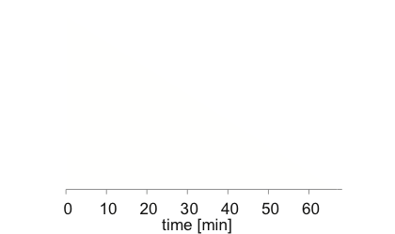
Jockey – Progress indicator
Notes:
We plot the time during the job on the X axis

Slide 60
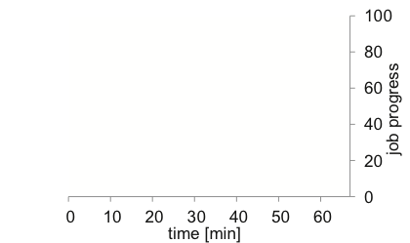
Jockey – Progress indicator
Notes:
And the indicated progress on the right Y axis.

Slide 61
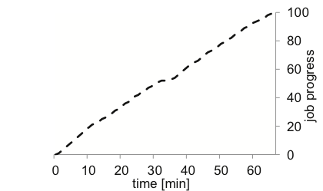
Jockey – Progress indicator
Notes:
These are the values computed by Jockey’s progress indicator.

Slide 62
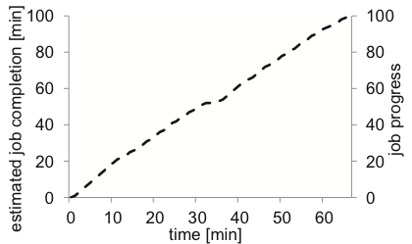
Jockey – Progress indicator
Notes:
To see why we chose this indicator, we look at the estimated completion time on the left Y axis.

Slide 63
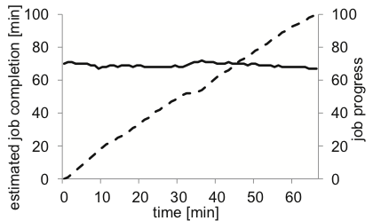
Jockey – Progress indicator
Notes:
This indicator leads to stable estimates of the completion time, making it a good input to the control loop.

Slide 64
Jockey – Control loop
Notes:
The control loop runs periodically during run time. Each iteration, it considers the model of remaining run time, and adjusts the allocation if necessary to meet the deadline.
We will now step through an example of this decision.

Slide 65
Job model
1% complete
2% complete
3% complete
4% complete
5% complete
Jockey – Control loop
Notes:
The model can be thought of as a table which relates the job progress on the left,

Slide 66
Job model
 | 10 nodes | 20 nodes | 30 nodes
1% complete
2% complete
3% complete
4% complete
5% complete
Jockey – Control loop
Notes:
to a resource allocation on the top.

Slide 67
Job model
 | 10 nodes | 20 nodes | 30 nodes
1% complete | 60 minutes | 40 minutes | 25 minutes
2% complete | 59 minutes | 39 minutes | 24 minutes
3% complete | 58 minutes | 37 minutes | 22 minutes
4% complete | 56 minutes | 36 minutes | 21 minutes
5% complete | 54 minutes | 34 minutes | 20 minutes
Jockey – Control loop
Notes:
Each cell corresponds to the estimated run time remaining, given the percent complete and allocation.

Slide 68
Job model
 | 10 nodes | 20 nodes | 30 nodes
1% complete | 60 minutes | 40 minutes | 25 minutes
2% complete | 59 minutes | 39 minutes | 24 minutes
3% complete | 58 minutes | 37 minutes | 22 minutes
4% complete | 56 minutes | 36 minutes | 21 minutes
5% complete | 54 minutes | 34 minutes | 20 minutes
Completion:
1%
Deadline:
50 min.
Jockey – Control loop
Notes:
During the first iteration, Jockey calculates that the job is 1% complete and the deadline is in 50 minutes.

Slide 69
Job model
 | 10 nodes | 20 nodes | 30 nodes
1% complete | 60 minutes | 40 minutes | 25 minutes
2% complete | 59 minutes | 39 minutes | 24 minutes
3% complete | 58 minutes | 37 minutes | 22 minutes
4% complete | 56 minutes | 36 minutes | 21 minutes
5% complete | 54 minutes | 34 minutes | 20 minutes
Completion:
1%
Deadline:
50 min.
Jockey – Control loop
Notes:
The control loop then chooses the minimum allocation which still meets the deadline.
Here, an allocation corresponding to 20 nodes is the minimum required to meet the deadline.

Slide 70
Job model
 | 10 nodes | 20 nodes | 30 nodes
1% complete | 60 minutes | 40 minutes | 25 minutes
2% complete | 59 minutes | 39 minutes | 24 minutes
3% complete | 58 minutes | 37 minutes | 22 minutes
4% complete | 56 minutes | 36 minutes | 21 minutes
5% complete | 54 minutes | 34 minutes | 20 minutes
Completion:
3%
Deadline:
40 min.
Jockey – Control loop
Notes:
This process repeats on successive iterations.

Slide 71
Job model
 | 10 nodes | 20 nodes | 30 nodes
1% complete | 60 minutes | 40 minutes | 25 minutes
2% complete | 59 minutes | 39 minutes | 24 minutes
3% complete | 58 minutes | 37 minutes | 22 minutes
4% complete | 56 minutes | 36 minutes | 21 minutes
5% complete | 54 minutes | 34 minutes | 20 minutes
Completion:
5%
Deadline:
30 min.
Jockey – Control loop
Notes:
In this case, the cluster appears to be running slowly, and the control loop increases the allocation of resources.
Delay in ramping up the allocation and the cost of killing running tasks means we want to smooth the control loop’s decisions before implementing them. Jockey uses three techniques from control-theory to achieve this, including hysteresis or exponential smooth as an earlier questioner asked. Our paper contains complete details of how we use each technique.
(Pause)

Slide 72
f(progress, allocation) -> remaining run time
Jockey – Model
Notes:
The model I presented could be built using several methods.

Slide 73
f(progress, allocation) -> remaining run time
analytic model?
Jockey – Model
Notes:
One approach would be to use an analytic model, which we compare in our evaluation.
We found that job complexity makes it hard to develop a closed-form solution for our multi-stage pipelines.
And noise in the cluster due to failures, multiplexed resources, and the fluctuating availability of spare capacity amplifies this problem.

Slide 74
f(progress, allocation) -> remaining run time
analytic model?
machine learning?
Jockey – MODEL
Notes:
A second approach would be to use machine learning and develop a statistical model of the workload.

Slide 75
f(progress, allocation) -> remaining run time
analytic model?
machine learning?
simulator
Jockey – Model
Notes:
But since this is a systems paper … we built a simulator which captures the salient features of task execution, scheduling, and failure.
Our simulator is fast, and can simulate many Cosmos jobs in milliseconds. Despite this, to make decisions using thousands of simulations, we run the simulator off-line and build the table I previously showed you in advance. With this table, the control loop can rapidly determine how to minimize the resource allocation while maximizing utility.

Slide 76
Problem | Solution
jockey
Notes:
To summarize, Jockey is designed to overcome the two problems found in today’s data-parallel clusters.

Slide 77
Problem | Solution
Pipeline complexity
jockey
Notes:
The complexity of pipelines and individual jobs

Slide 78
Problem | Solution
Pipeline complexity | Use a simulator
jockey
Notes:
Is solved by using a fast and relatively simple simulator which can accurately predict the latency.

Slide 79
Problem | Solution
Pipeline complexity | Use a simulator
Noisy environment
jockey
Notes:
And the noisy environment with resource contention and hardware failures

Slide 80
Problem | Solution
Pipeline complexity | Use a simulator
Noisy environment | Dynamic control
jockey
Notes:
Is overcome by a dynamic control-loop which allocates resources based on the changing conditions.
(PAUSE)

Slide 81
Jockey in Action
Notes:
So how does Jockey perform?

Slide 82
Jockey in Action
Real job
Notes:
We’ll start with a detailed look at a real job running

Slide 83
Jockey in Action
Real job
Production cluster
Notes:
on a production cluster.
(Pause)

Slide 84
Jockey in Action
Real job
Production cluster
CPU load: ~80%
Notes:
The average CPU load on the cluster was around 80% during this experiment and throughout others performed for the evaluation.
This constantly high utilization – as well as the deadlines – unfortunately makes our clusters ineligible for the energy-efficient Map Reduce system we heard about this morning.

Slide 85
Jockey in Action
Notes:
To see Jockey in action, we will look at how the task execution varies over time.

Slide 86
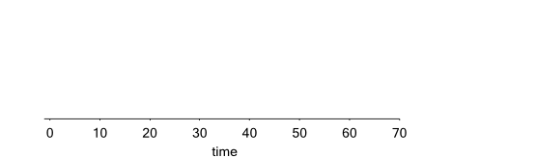
Jockey in Action
Notes:
Along the X axis, we have the time during the job.

Slide 87
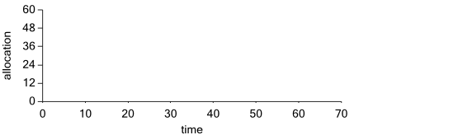
Jockey in Action
Notes:
And along the Y axis we have the allocation of resources.

Slide 88
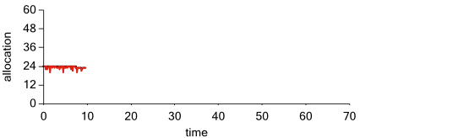

Jockey in Action
Initial deadline:
140 minutes
Notes:
The allocation determined by Jockey is shown as a black line, while
The red line plots the job’s current resource consumption.
We started the job with an initial deadline of 140 minutes.
One of Jockey’s design goals was the ability to adjust the deadline after the job begins.
In this experiment, we decreased the deadline to 70 minutes by submitting a new utility curve 10 minutes into the job.

Slide 89
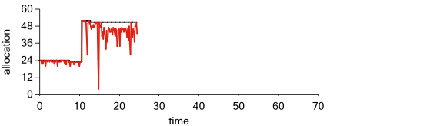
Jockey in Action
New deadline:
70 minutes
Notes:
As you can see, Jockey responded to the new deadline by increasing the resource allocation.
Here we can see how the red line, which is the number of running tasks, fluctuates below the provided allocation due to stragglers and the job structure.

Slide 90
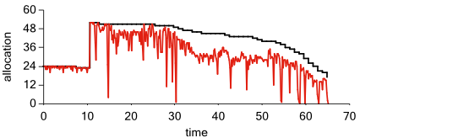
Jockey in Action
Release resources due to excess pessimism
New deadline:
70 minutes
Notes:
In this run, we also see a general behavior of Jockey, which is to over-allocate resources at the start.
This increases the likelihood that there will be sufficient time to recover from any failures and still meet the deadline.
In this case, that initial pessimism was unwarranted, and Jockey decreased the allocation during the remaining runtime.
Finally, the job finishes before the new deadline.

Slide 91
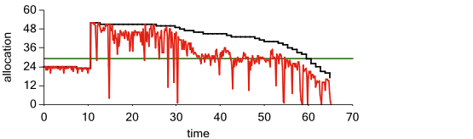

Jockey in Action
“Oracle” allocation:
Total allocation-hours
Deadline
Notes:
To help us evaluate Jockey’s behavior, we consider the “Oracle Allocation” which can be calculated after the job completes.
The Oracle Allocation is how many resources we would have allocated if:
We knew the total required at the start, including any necessary resources to recover from failures
The job could run with full parallelism at all times – that is, fully consuming all allocated resources.

Slide 92
Jockey in Action
Available parallelism
less than allocation
“Oracle” allocation:
Total allocation-hours
Deadline
Notes:
As you can see, this is not always possible in practice.
Starting around minute 30, this job is not able to fully use its allocation as shown by the red line’s consistent gap below the black line.
One reason this can happen is because of barrier or synchronization stages, which require data from all input tasks before beginning.

Slide 93
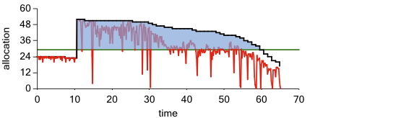
Jockey in Action
Allocation above oracle
“Oracle” allocation:
Total allocation-hours
Deadline
Notes:
By calculating the fraction of resources allocated above the oracle (which I’ve shaded here in blue), we can measure the unnecessary impact of this job on other jobs in the same cluster.
Although this is an overestimate of that impact, it gives us a metric with which to compare different allocation schemes. Better allocation schemes will result in smaller allocations above the oracle.

Slide 94

Evaluation
Notes:
This brings us to our evaluation of Jockey.
Today, I will focus on Jockey’s performance relative to other allocation schemes.
Our paper includes a fuller evaluation of Jockey, including the importance of each design element, and the sensitivity of the configuration parameters in the control-loop.

Slide 95
Evaluation
Production cluster
Notes:
This evaluation is based on more than 800 executions in our slice of A large production cluster.

Slide 96
Evaluation
Production cluster
21 jobs
Notes:
The 21 jobs we used in the evaluation were all of the recurring, production jobs from a single business group which were neither too big for our slice nor too small to study.
We usually set the deadline to one hour as a default, and for seven jobs we tested Jockey with additional deadlines.

Slide 97
Evaluation
Production cluster
21 jobs
SLO met?
Notes:
We are interested in two performance measures.
The first is whether Jockey simply met the deadline expressed in the SLO.

Slide 98
Evaluation
Production cluster
21 jobs
SLO met?
Cluster impact?
Notes:
And the second is the impact on the rest of the cluster while trying to meet the deadline.
(Pause)

Slide 99
Evaluation
Notes:
Turning to the most important objective, how many experiments finished before their deadline?

Slide 100
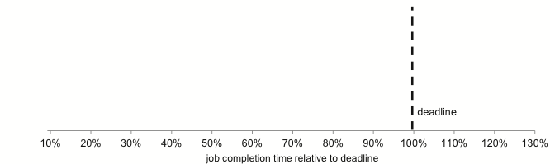
Evaluation
Jobs which met the SLO
Notes:
Along the X axis, we have the time at which the job completed, relative to the deadline. Points to the right of 100% are for jobs which missed their deadline.

Slide 101
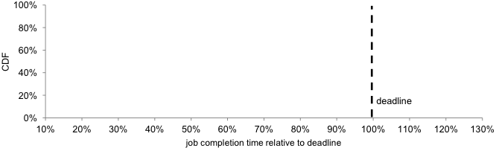
Evaluation
Jobs which met the SLO
Notes:
Along the Y axis, we have the percentage of jobs which finished before the relative deadline.

Slide 102
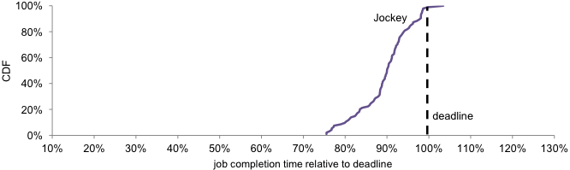
Evaluation
Missed 1 of
94 deadlines
Jobs which met the SLO
Notes:
This is Jockey’s performance. It only missed a single deadline in 94 experiments.
During that run, the cluster was more than twice as heavily loaded as during any previous time.
Our paper includes a detailed look at this case, and how Jockey handled it, finishing the job only 3% late.
Furthermore, if we take a look at the ratio of

Slide 103
Evaluation
Jobs which met the SLO
Notes:
Longest relative run-time

Slide 104
Evaluation
Jobs which met the SLO
Notes:
To shortest

Slide 105
Evaluation
1.4x
Jobs which met the SLO
Notes:
It is only 1.4 times, which is a significant decrease from the 4.3x ratio of the single job we looked at in the beginning.

Slide 106
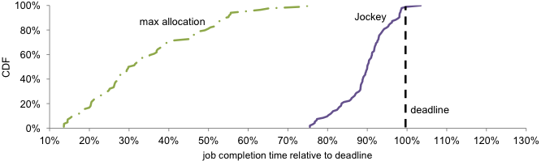
Evaluation
Missed 1 of
94 deadlines
Allocated too many
resources
Jobs which met the SLO
Notes:
Next, we compare with a naïve approach in which we allocated our entire slice to each job. While this was NOT THE WHOLE CLUSTER, it was all of the resources available to our research.
When using this allocation scheme, the median job completion time was about 70% early. Whereas when Jockey adjusted the allocations, the jobs finished much closer to the specified deadline -- Jockey can provide predictable performance for our users.
We clearly could have allocated fewer resources than the maximum when starting each job, but how could we set this amount and continue to meet the deadlines?

Slide 107
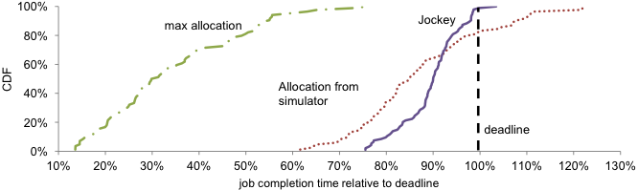
Evaluation
Missed 1 of
94 deadlines
Simulator made good predictions:
80% finish before deadline
Allocated too many
resources
Jobs which met the SLO
Notes:
We could use the simulator on its own to estimate a static resource allocation.
This is equivalent to running Jockey with the dynamic control loop disabled.
From the results, we see that the simulator can make pretty good predictions: 80% of jobs finished before their deadline while consuming fewer resources than the maximum allocation.
But what about those 20% of jobs which missed their deadline? Clearly the dynamic control loop was working to prevent that.

Slide 108
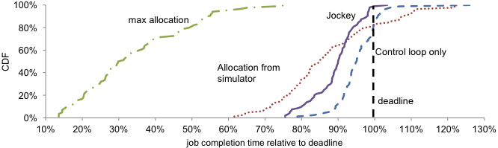
Evaluation
Missed 1 of
94 deadlines
Simulator made good predictions:
80% finish before deadline
Control loop is
stable
and successful
Allocated too many
resources
Jobs which met the SLO
Notes:
So, we now ask whether the control loop would be adequate without the simulator.
The control loop still requires an estimate of remaining runtime, so we developed a basic analytic model using Amdahl’s Law.
We can see that the control loop lowers the variance in completion times -- the jobs finished close to the specified deadline. However, by using the analytic model to estimate the runtime, we miss more deadlines than when we used the simulator.
Jockey’s success is clearly due to the combination of both techniques:
a simulator which considers failure probabilities and distributions of task runtimes to estimate the job latency,
and a control loop which dynamically adjusts the resources during execution.

Slide 109
Evaluation
Notes:
Finally, we compare all four approaches using both evaluation metrics at once.

Slide 110
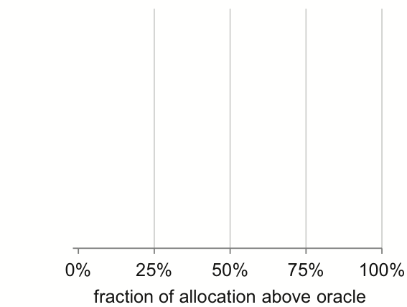
Evaluation
Notes:
Along the X axis, we plot the average consumption of resources above the oracle allocation.
Higher numbers correspond to having a greater impact on the rest of the cluster, while lower numbers permit more SLO-bound jobs to be run simultaneously.

Slide 111
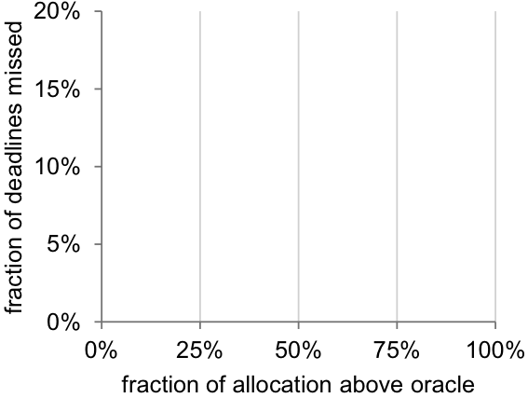
Evaluation
Notes:
Along the Y axis, we plot the fraction of deadlines missed by each approach.
Ideally, we would not miss any deadlines.

Slide 112
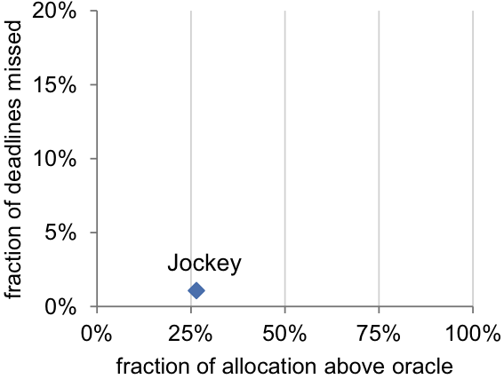
Evaluation
Notes:
Jockey is our first candidate. As mentioned, it missed only a single deadline in 94 experiments, and has a low impact on the rest of the cluster.

Slide 113
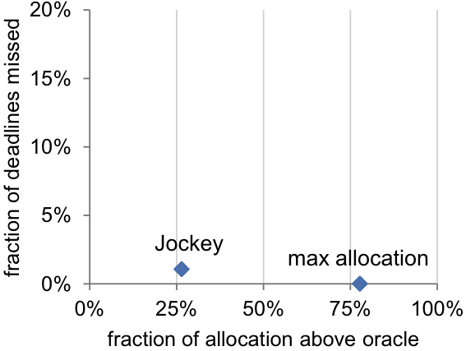
Evaluation
Notes:
The other approaches faired worse.
Naively allocating all available resources allowed us to meet all deadlines, but this strategy had a much larger impact on the rest of the cluster

Slide 114
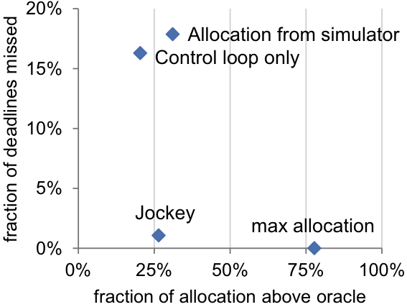
Evaluation
Notes:
Using either of Jockey’s two components independently led to low resource consumption, but both approaches missed more deadlines than their combined use in Jockey.

Slide 115
Conclusion

Slide 116
Data parallel jobs are complex,

Slide 117
Data parallel jobs are complex,
yet users demand deadlines.

Slide 118
Data parallel jobs are complex,
yet users demand deadlines.
Jobs run in shared, noisy clusters,

Slide 119
Data parallel jobs are complex,
yet users demand deadlines.
Jobs run in shared, noisy clusters,
making simple models inaccurate.
Notes:
Making simple models inaccurate.
This motivates the development of

Slide 120
Jockey
Notes:
Jockey, which combines

Slide 121
simulator
Notes:
a detailed simulator

Slide 122
control-loop
Notes:
with a robust control-loop

Slide 123
Deadline
Deadline
Deadline
Deadline
Deadline
Notes:
to provide guaranteed latency

Slide 124
Notes:
in a data-parallel cluster.
(PAUSE)

Slide 125
Questions?
Andrew Ferguson
adf@cs.brown.edu
Notes:
I am happy to take your questions at this time…

Slide 126

Co-authors
Peter Bodík (Microsoft Research)
Srikanth Kandula (Microsoft Research)
Eric Boutín (Microsoft)
Rodrigo Fonseca (Brown)
Questions?
Andrew Ferguson
adf@cs.brown.edu
Notes:
… or you can direct them to my collaborators in the audience.
Thank you!

Slide 127
Backup Slides

Slide 128
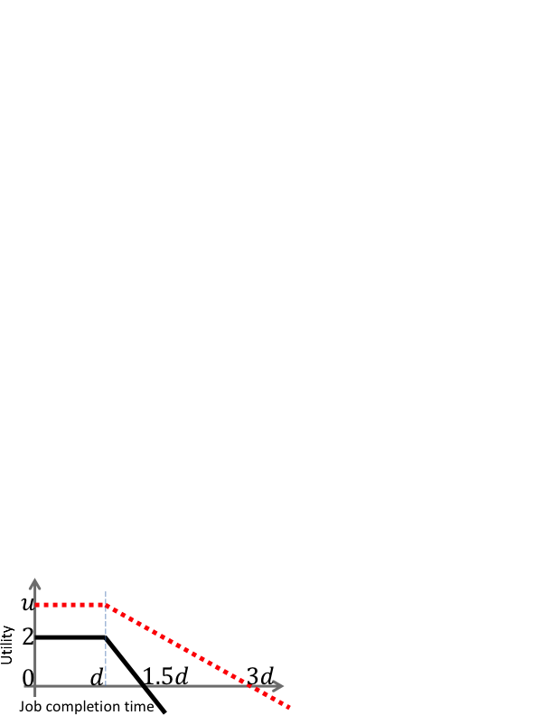
Utility Curves
For single jobs,
scale doesn’t matter
Deadline
For multiple jobs,
use financial penalties

Slide 129


Jockey
Resource allocation control loop
Utility
Run Time
Prediction
1. Slack
2. Hysteresis
3. Dead Zone
Notes:
U_a = U(t_r + C(p, a))
Slack = add X%
Hysteresis = exponential smoothing … A^s_t = A^s_{t-1} + alpha * (A^r - A^s_{t-1})
Dead zone
These are needed to prevent aggressive under- or over-allocation as well as oscillation in resource demands

Slide 130
Cosmos
Resource sharing in Cosmos
Resources are allocated with a form of fair sharing across business groups and their jobs. (Like Hadoop FairScheduler or CapacityScheduler)
Each job is guaranteed a number of tokens as dictated by cluster policy; each running or initializing task uses one token. Token released on task completion.
A token is a guaranteed share of CPU and memory
To increase efficiency, unused tokens are re-allocated to jobs with available work

Slide 131

Jockey
Progress indicator
Can use many features of the job to build a progress indicator
Earlier work (ParaTimer) concentrated on fraction of tasks completed
Our indicator is very simple, but we found it performs best for Jockey’s needs
Fraction of completed vertices
Total vertex initialization time
Total vertex run time
Notes:
Must faithfully reflect the work completed … should NOT GET STUCK … many parallel tasks can finish in any order, stages with different numbers of tasks … lastly, tasks sometimes fail
Fraction of completed tasks, aggregate CPU time spent executing, relative time when a particular stage started or completed, length of remaining critical path

Slide 132
Comparison with ARIA
ARIA uses analytic models
Designed for 3 stages: Map, Shuffle, Reduce
Jockey’s control loop is robust due to control-theory improvements
ARIA tested on small (66-node) cluster without a network bottleneck
We believe Jockey is a better match for production DAG frameworks such as Hive, Pig, etc.

Slide 133
Jockey
Latency prediction: C(p, a)
Event-based simulator
  Same scheduling logic as actual Job Manager
  Captures important features of job progress
  Does not model input size variation or speculative re-execution of stragglers
  Inputs: job algebra, distributions of task timings, probabilities of failures, allocation
Analytic model
  Inspired by Amdahl’s Law: T = S + P/N
  S is remaining work on critical path, P is all remaining work, N is number of machines
Notes:
Simulator captures outliers and barriers -- discuss the inputs to the simulator, etc
A third approach would be to use machine learning techniques

Slide 134
Jockey
Resource allocation control loop
Executes in Dryad’s Job Manager
Inputs: fraction of completed tasks in each stage, time job has spent running, utility function, precomputed values (for speedup)
Output: Number of tokens to allocate
Improved with techniques from control-theory
Notes:
These are needed to prevent aggressive under- or over-allocation as well as oscillation in resource demands

Slide 135
Jockey
offline
during job runtime
job profile
Notes:
Jockey requires a profile of at least one prior execution to start out. In our clusters, over 40% of jobs are recurring, which includes most SLO-bound jobs.

Slide 136
Jockey
offline
during job runtime
job profile
simulator
Notes:
Latency prediction looked-up from table computed during offline phase
- Event-based simulator
- Analytic model

Slide 137
Jockey
offline
during job runtime
job profile
simulator
job stats
Notes:
Progress indicator is important part of this work because we need good predictions from within running job, not only end-to-end latency
Progress indicator:
- Tested six, picked one which performed best

Slide 138
Jockey
offline
during job runtime
job profile
simulator
latency
predictions
job stats
Notes:
A simple lookup from the tables pre-computed by the simulator, using the progress calculated by the progress indicator

Slide 139
Jockey
offline
during job runtime
job profile
simulator
latency
predictions
job stats
utility
function
Notes:
Utility function provided by the user

Slide 140
Jockey
offline
during job runtime
job profile
simulator
latency
predictions
job stats
utility
function
resource allocation control loop
running
job
Notes:
Resource allocation loop
- Executed periodically during run time
- Made successful using techniques from control-theory: slack, hysteresis (exponential smoothing), and dead zone
Discuss role of offline phase: use historical distributions to calibrate the latency predictions (job stats) and to estimate the latency. Simulator could be launched during each control loop to produce new latency predictions, but we optimize this away with precomputed probability surfaces (details in paper)

